Slide 1

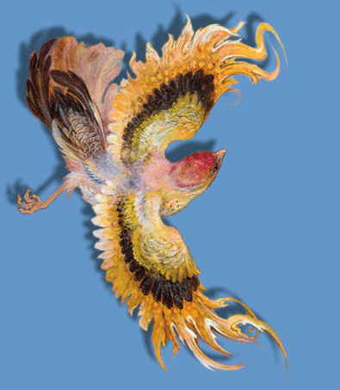

Abbas Katouzian
http://www.authorstream.com/Presentation/michaelasanda-1431406-abbas-katouzian/

Slide 2
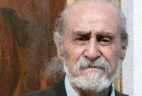
Abbas Katouzian (1923 - April 12, 2008) was an Iranian painter and artist.
Born in Tehran, Katouzian studied art history during his childhood and chose his mentor as Kamalolmolk. He followed the latter in developing the realistic movement in Iran.
He died on April 12, 2008 in Tehran, aged 86.
An international prize on painting dubbed as ''Abbas Katouzian Prize'' will be awarded to the best portrait painter from 2009. Ms. Shohreh Katouzian, daughter of late Abbas Katouzian, announced the event on a commemoration ceremony for her father, one of the best-known portrait painters in contemporary Iran who passed away in 2008. She expressed hope that such an action would revive and promote the art of painting portrait in Iran and the world.
Mr. Katouzian has gained national recognition as a master artist. With more than 26 exhibitions in Tehran and 9 in Abadan. Mr. Katouzian has had 6 exhibitions in the United States and once in Great Britain in the Lytton House library.
In 1973 Mr. Katouzian participated in a joint exhibition at the National Consultative Assembly with the works of the late Kamal-ul Mulk. Katouzians paintings have graced the covers of more than 200 magazines.

Slide 3
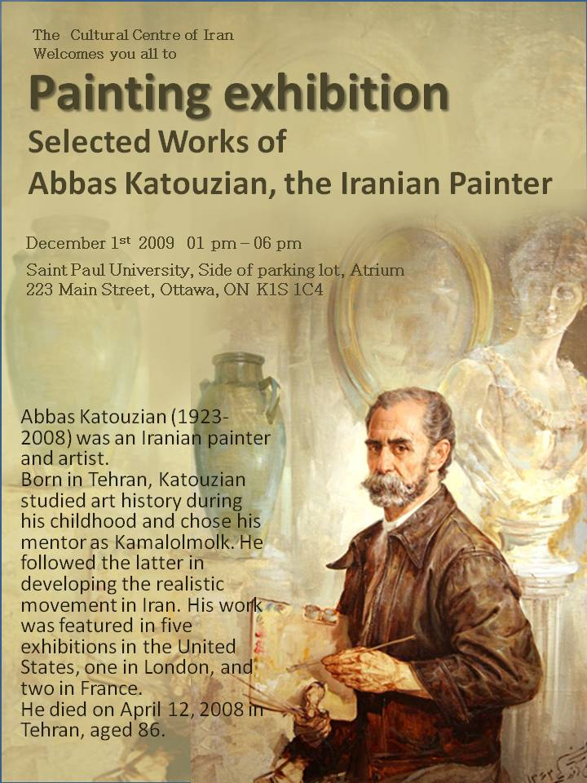
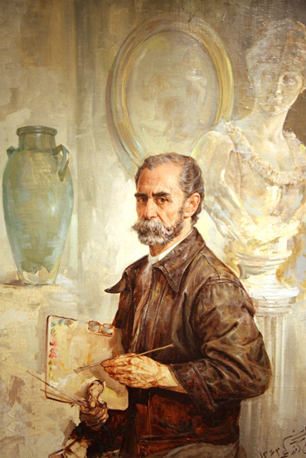

Slide 4
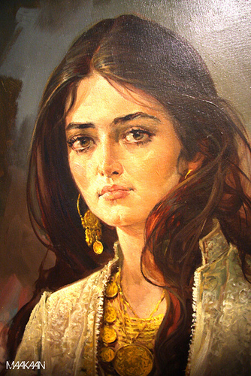
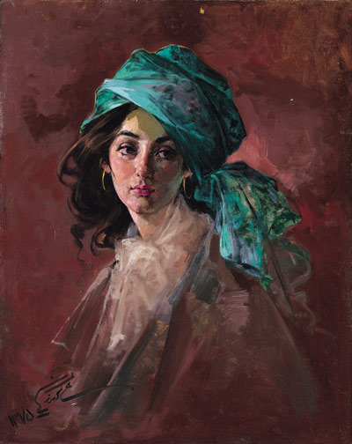

Slide 5
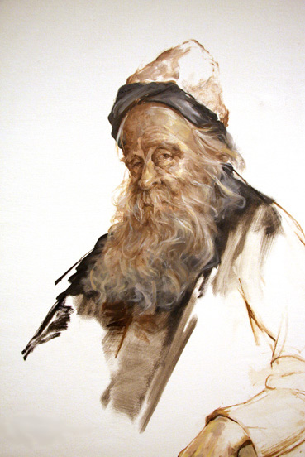
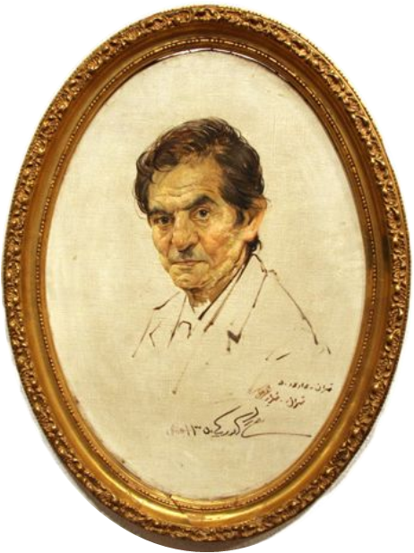

Slide 6
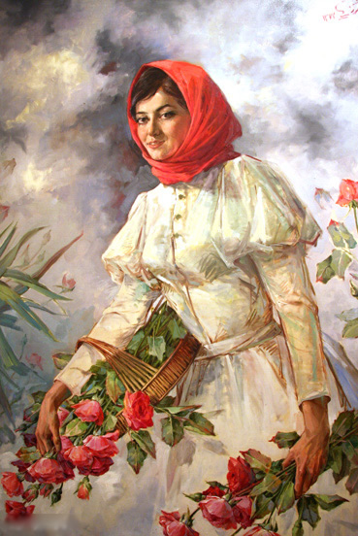
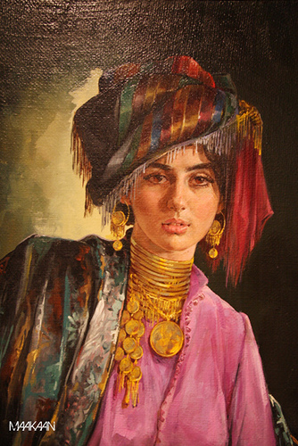

Slide 7
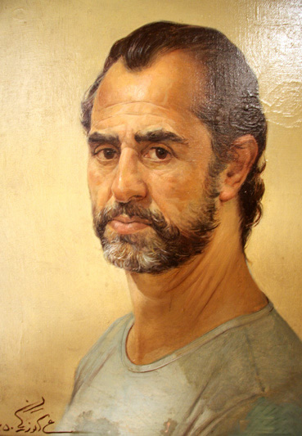

Slide 8
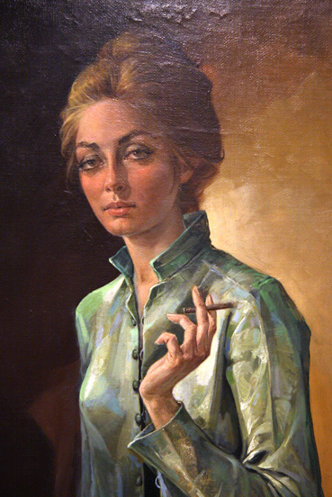
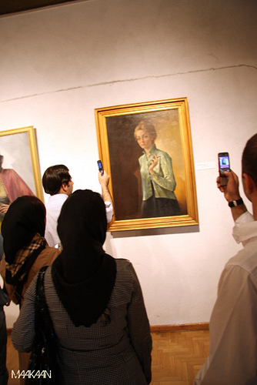

Slide 9
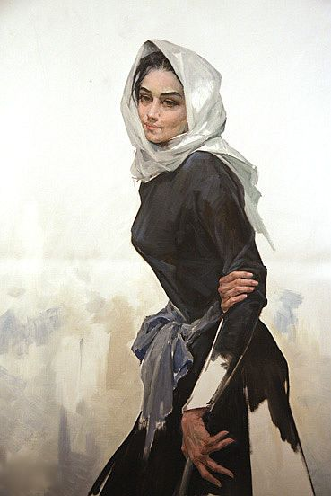

Slide 10
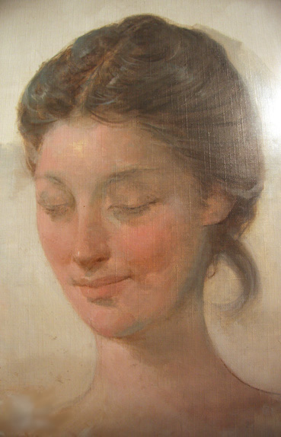
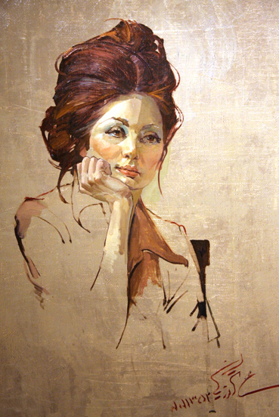

Slide 11
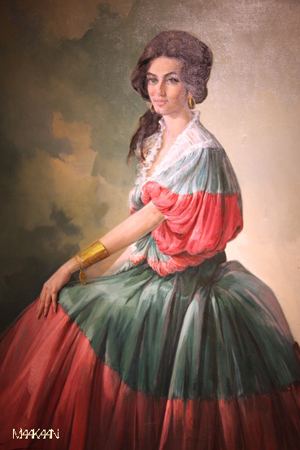

Slide 12
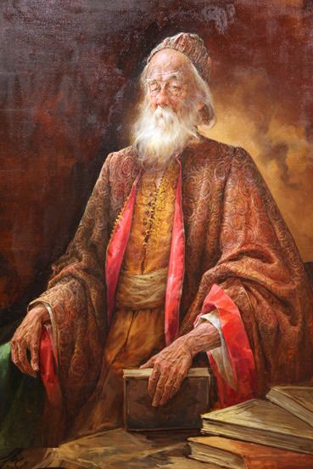
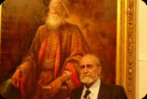
Katouzian poses in front of Hakim Omar-e Khayyam at his exhibit

Slide 13
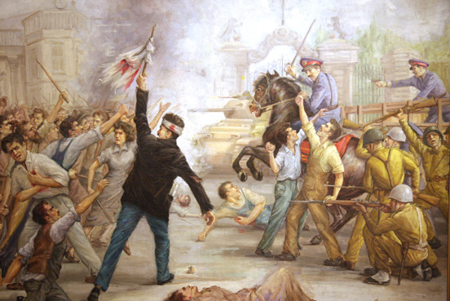

Slide 14
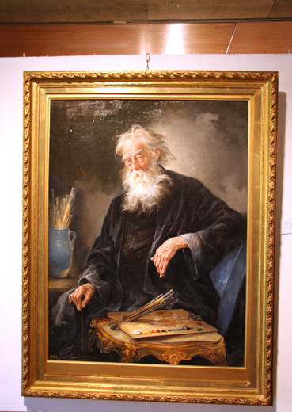
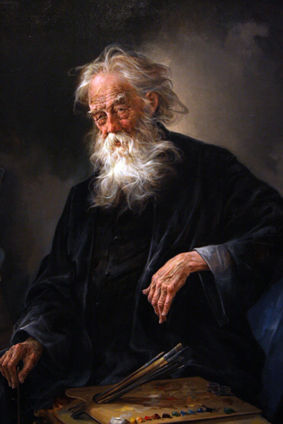

Slide 15
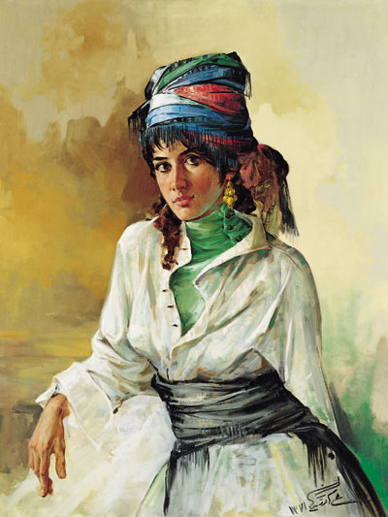
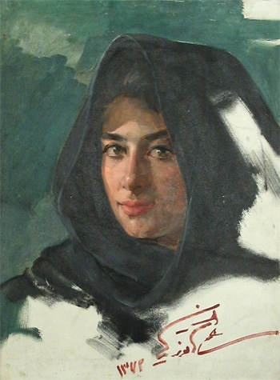

Slide 16
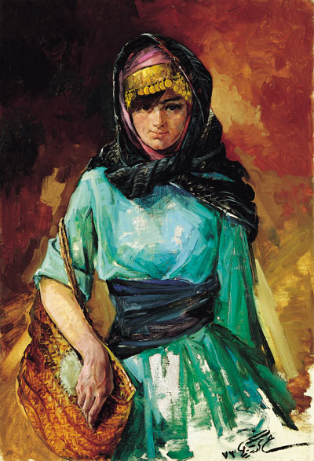
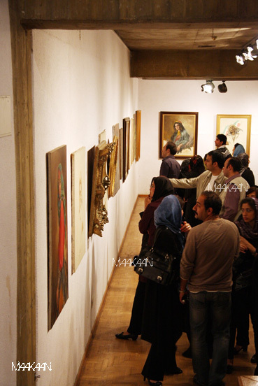

Slide 17
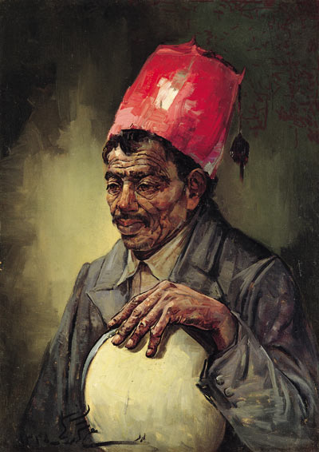

Slide 18
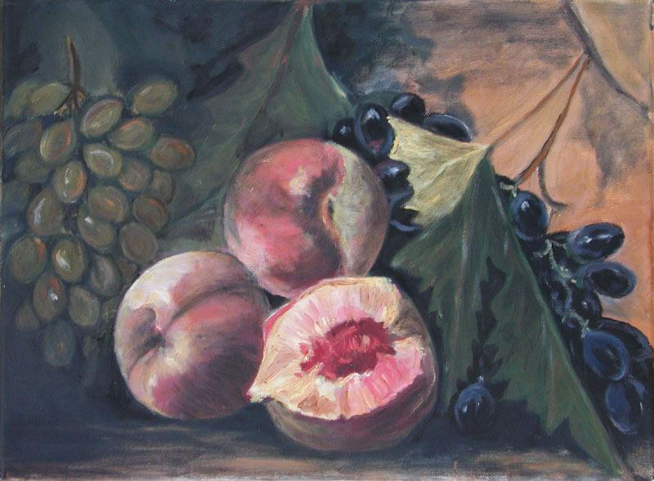

Slide 19
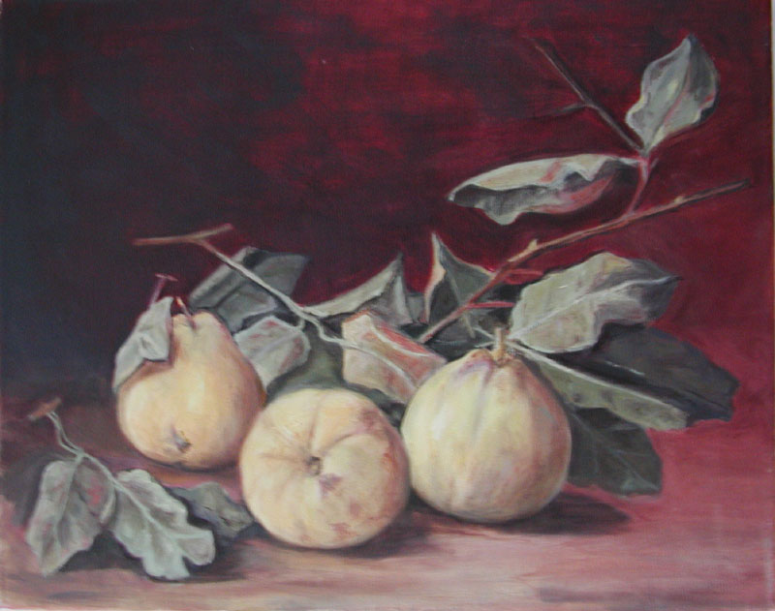

Slide 20
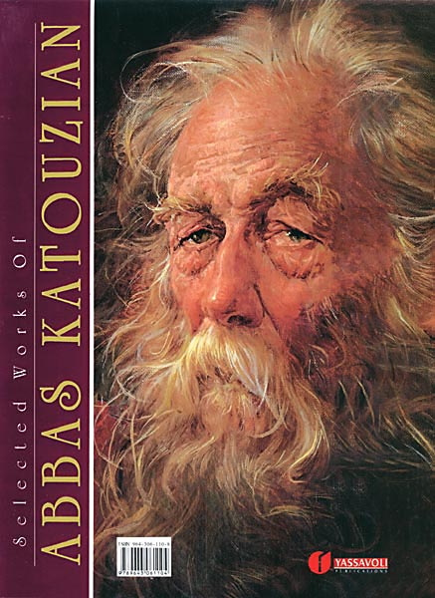
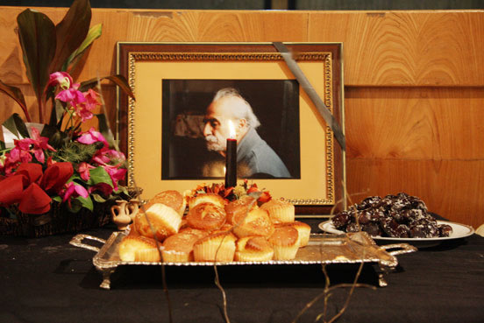
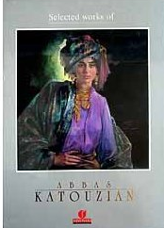

Slide 21
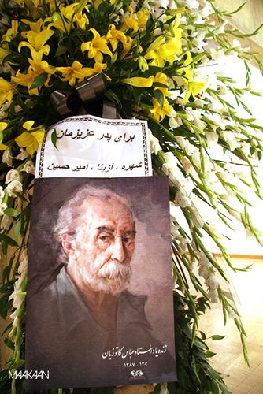
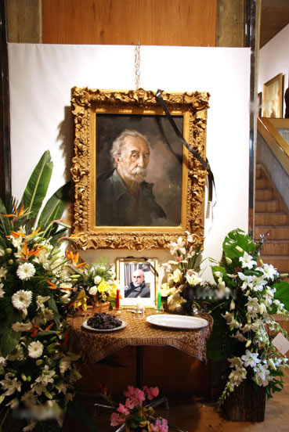

Slide 22
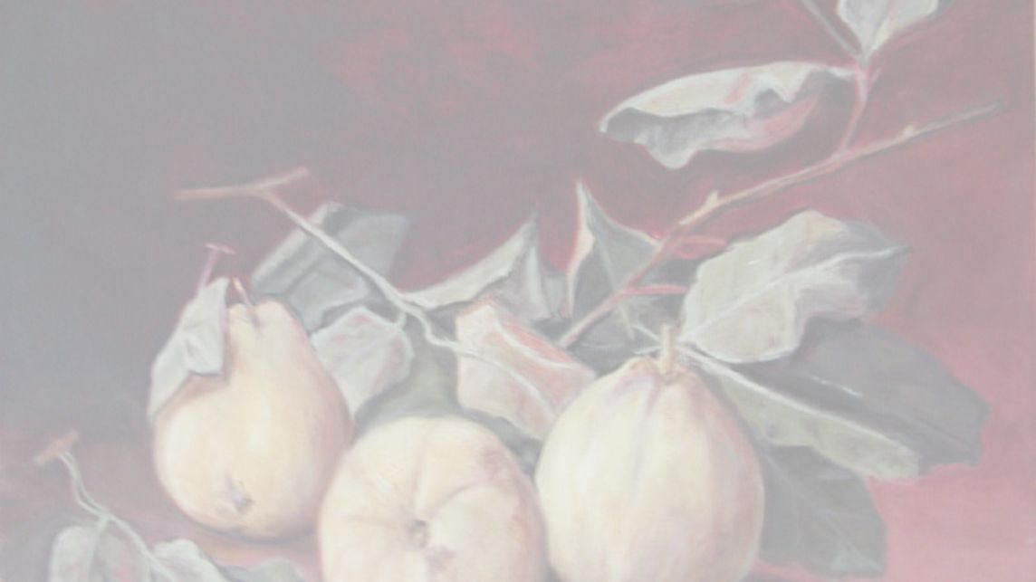


Text and pictures: Internet
Copyright: All the images belong to their authors
Arangement: Sanda Foişoreanu
www.slideshare.net/michaelasanda
Sound: persian sad song

