Slide 1
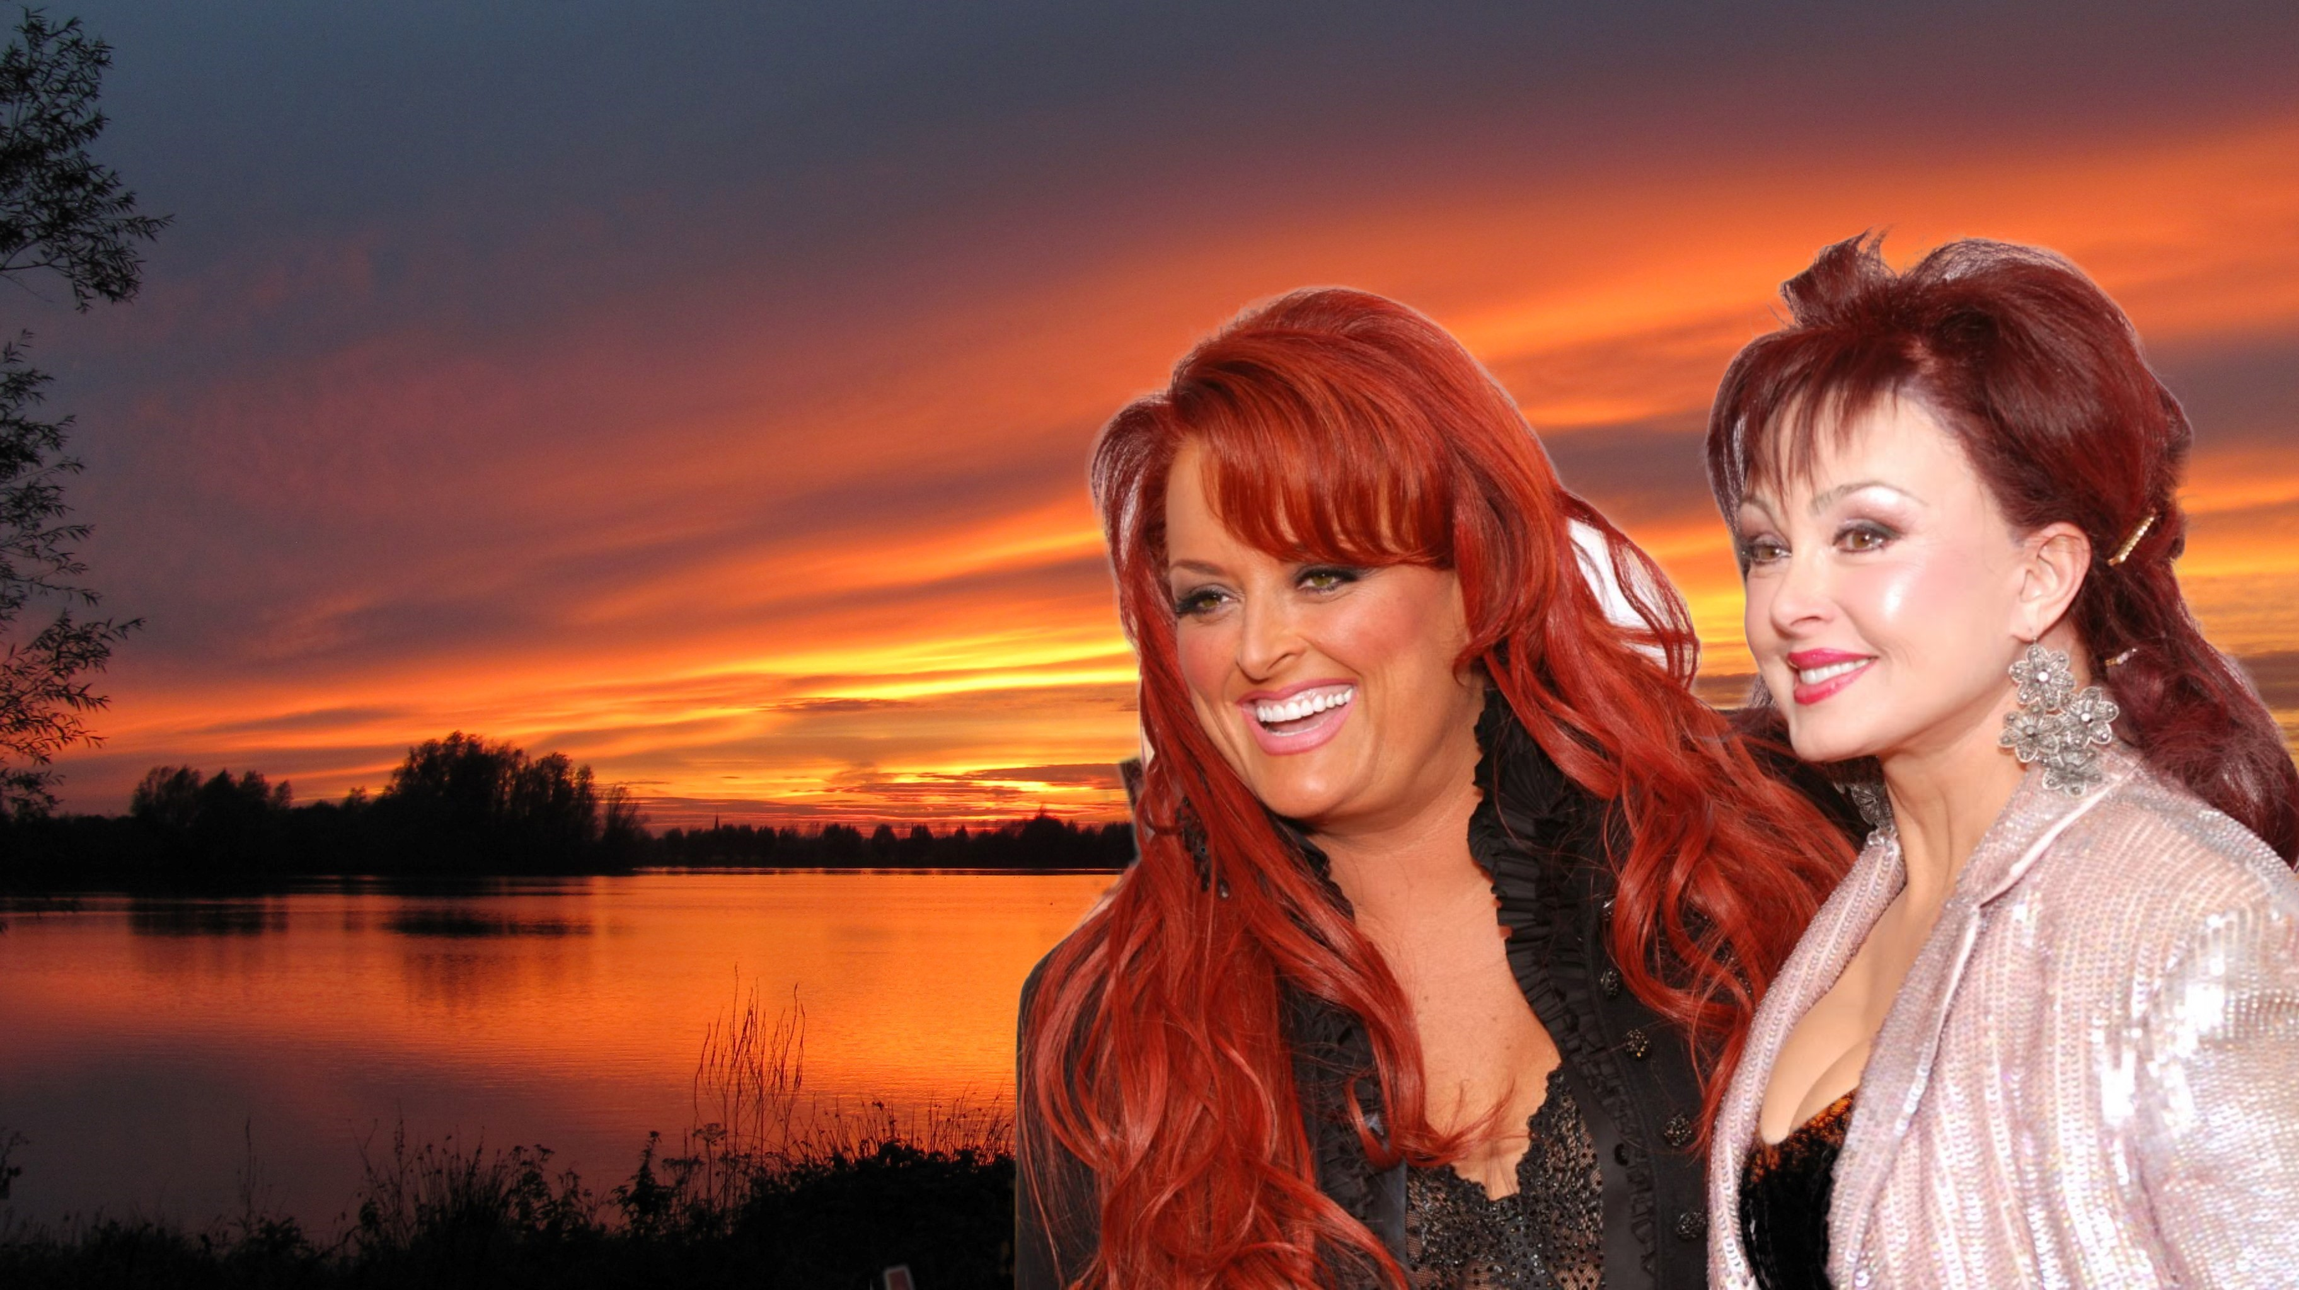
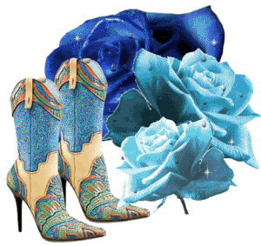
The Judds
Born To Be Blue
Don't You Hear Jerusalem Moan
More Fun Than The Law Allows
Don't Be Cruel
Give A Little Love To Me
Guardian Angels
Lazy Country Evening
John Deere Tractor
Love Can Build A Bridge
Sweetest Gift
Old Pictures
Working In A Coal Mine
One Little Teardrop

