Slide 1


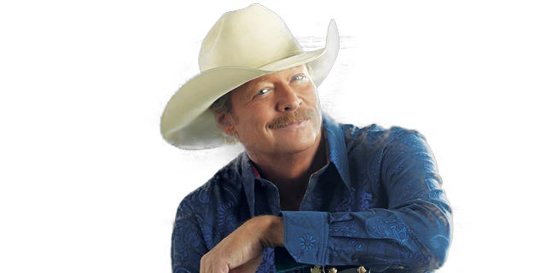
Alan Jackson
A Woman's Love
Rainy Day In June
Gone Crazy
Remember When
Here In The Real World
She's Got The Rhythm
Livin' On Love
When Somebody Loves You
Nothing Sure Looked Good On You
You Can't Give Up On Love

