Slide 1





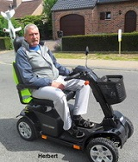
DANA WINNER & FRANK GALAN
Delilan
Never Never Never
Ik Hou Van Jou
Je T’aime Mon Amour
Galan-Gira Corazon
Immer,Immer Wieder
When You Say Nothing
Stay With Me Till The Morning

