Slide 1





Most magical village settlements in the world
We all love cities and towns for our day to day living, but there are a lot of them around the world and they are remarkably similar. They feature skyscrapers, crowded streets and busy people in business suits.
In travelling around I have found that one of the best ways to experience a fundamentally different culture is to explore the smaller remote villages away from the big cities. Here are some really unique beautiful village settlements where people have adapted to the difficult but really beautiful natural places. Some of them are naturally beautiful places in sync with nature’s landscape beauty.
If you are a lover of travel, remember that villages reflect the culture and food habits of a region and the nation. Bear this in mind when you are planning the next tour of a new nation.
With regards,
TONY CHACKO
Magical Villages
of the World

Slide 2
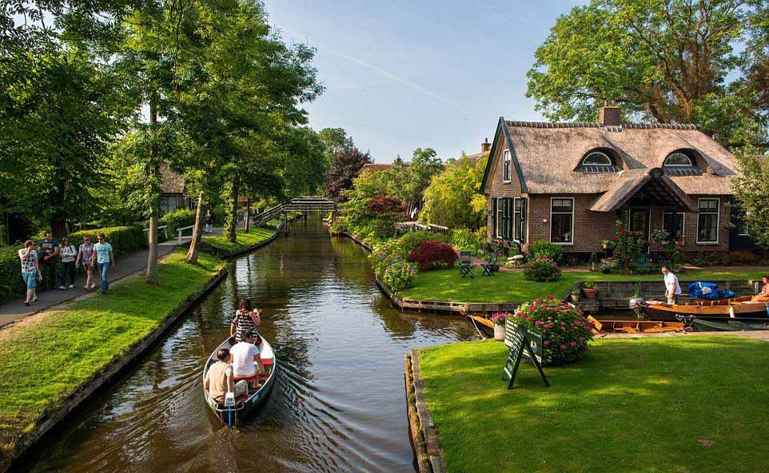
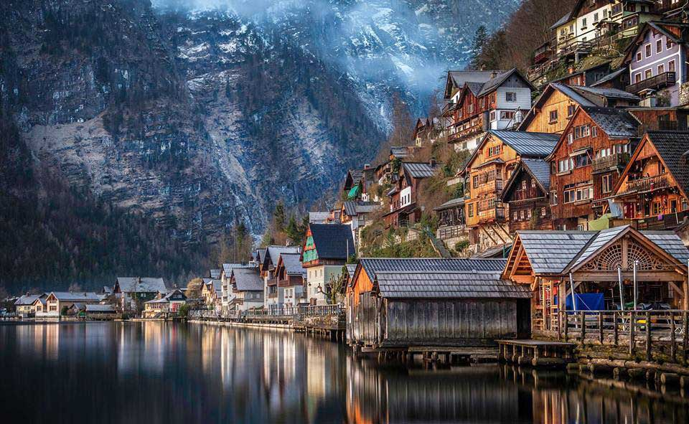
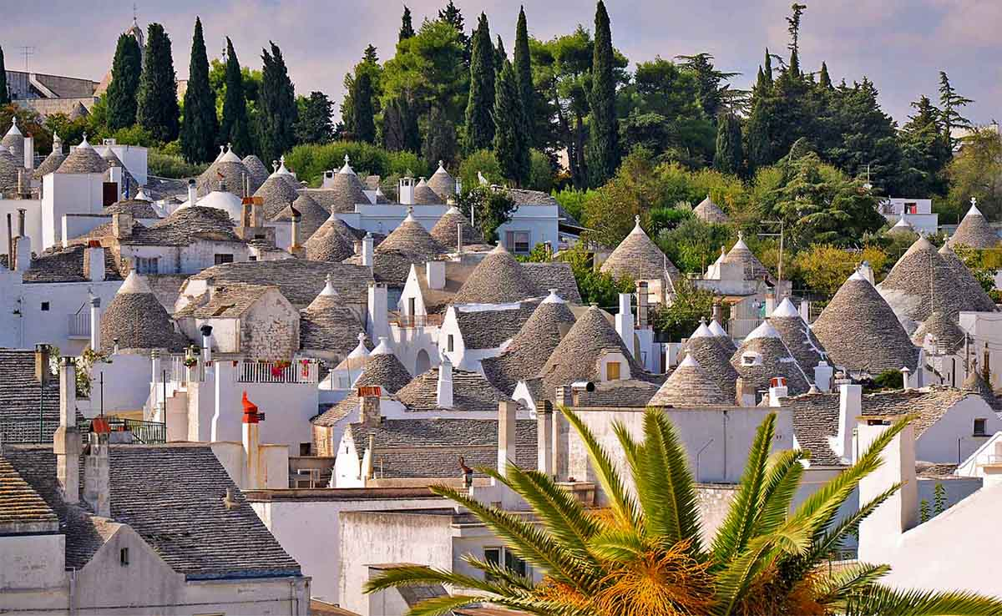
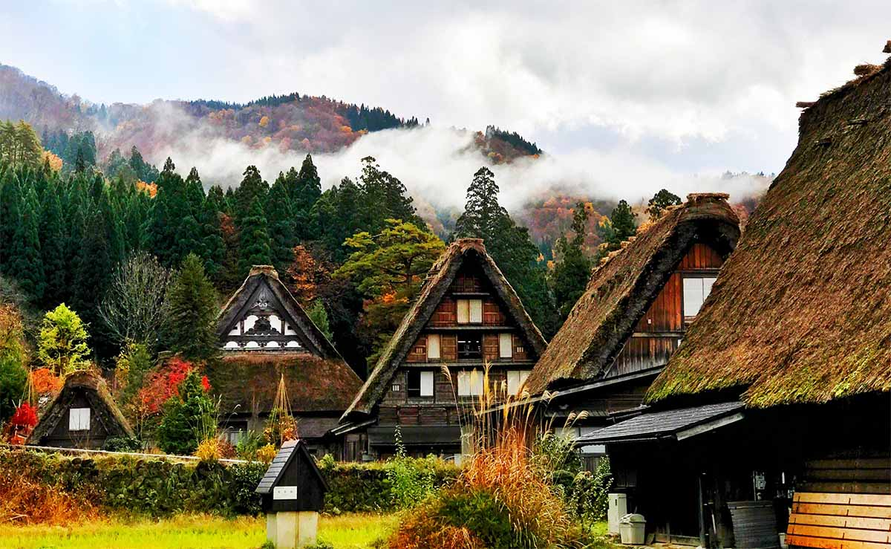

Slide 3
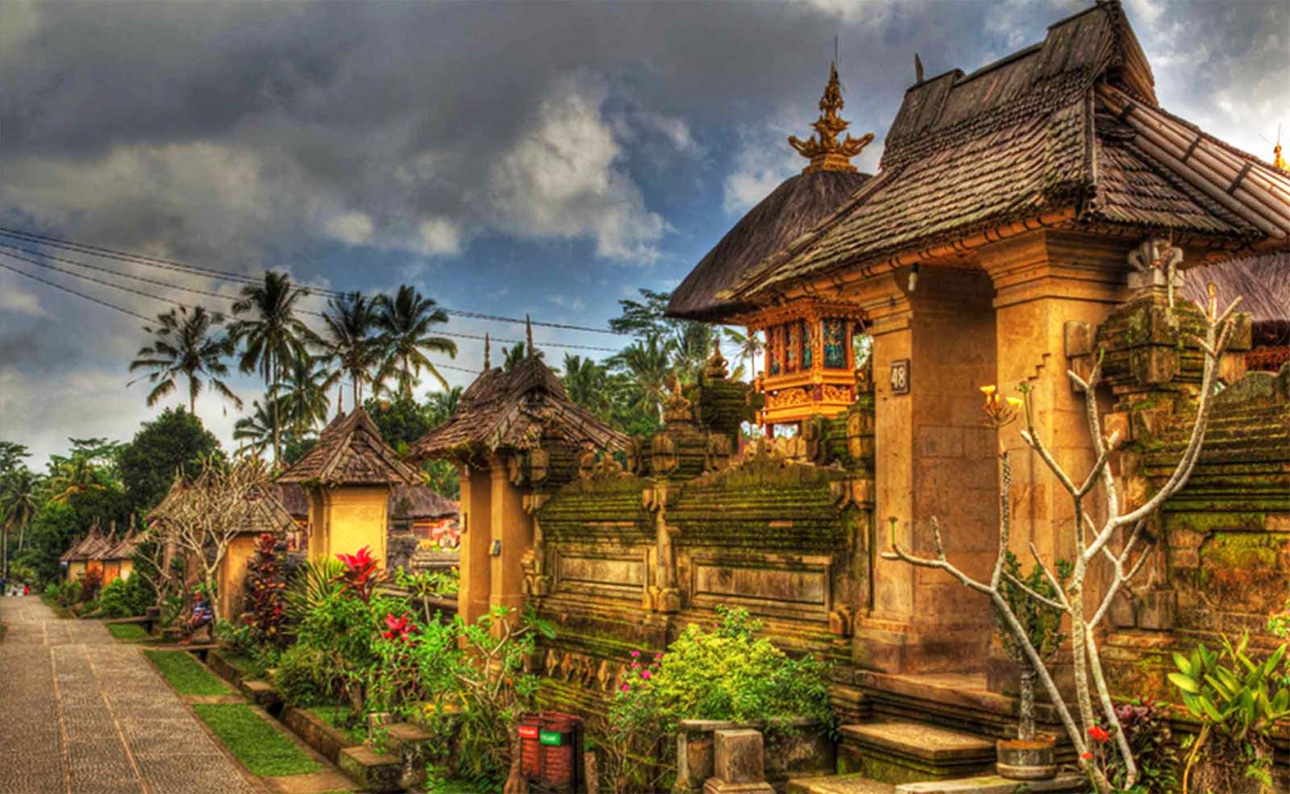
Penglipuran Village, Bali, Indonesia. It is a village showcasing Balinese culture with a variety of traditional buildings.

Slide 4
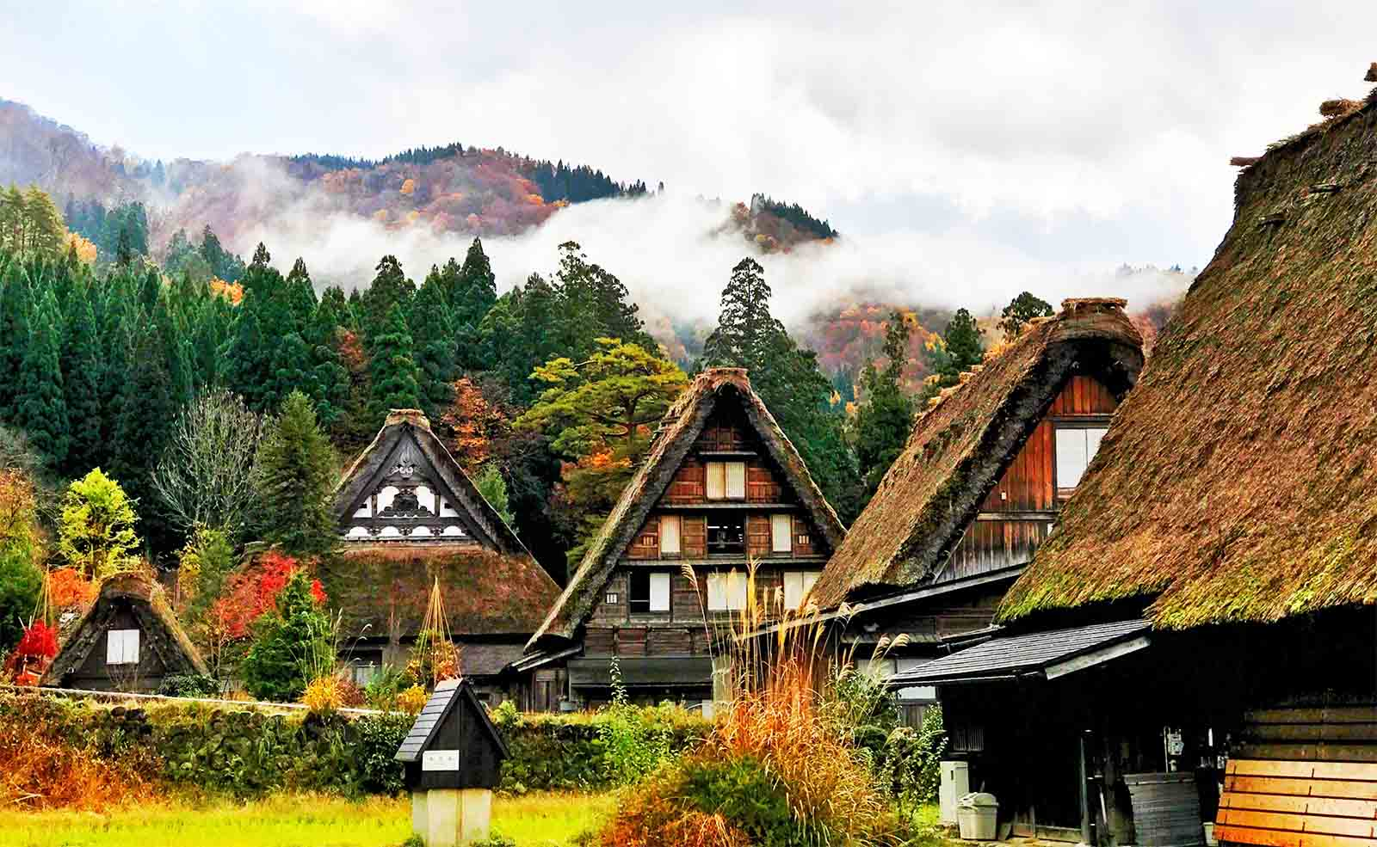
Historic village Shirakawa-go, Japan. It is a small, traditional village showcasing a building style known as gassho-zukuri.

Slide 5
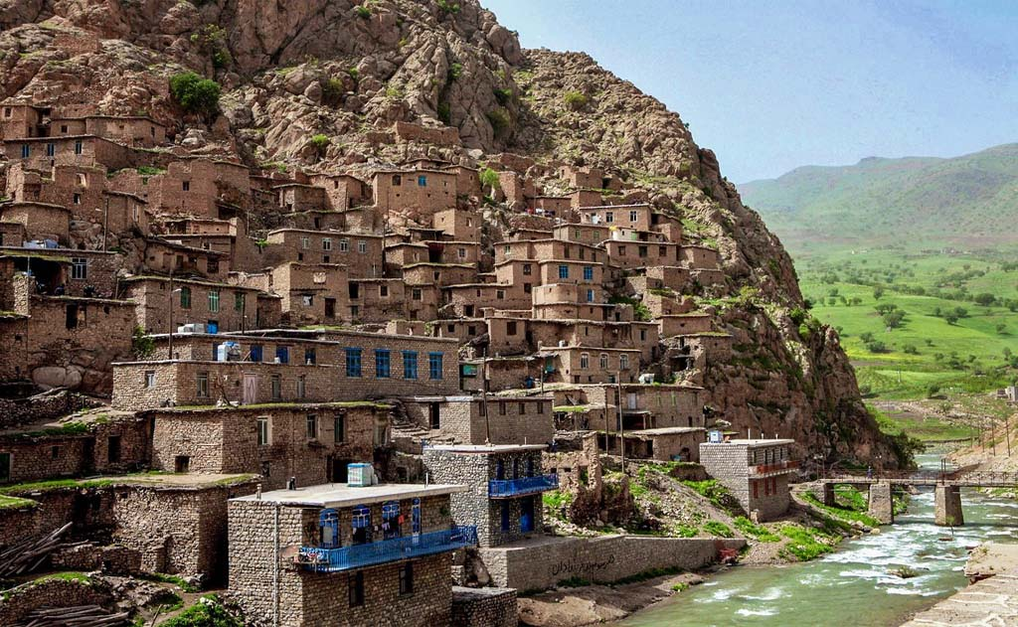
A mountainous Kurdish village Palangan, Iran. Could you believe this is a real village? Yes, this village does exist.

Slide 6
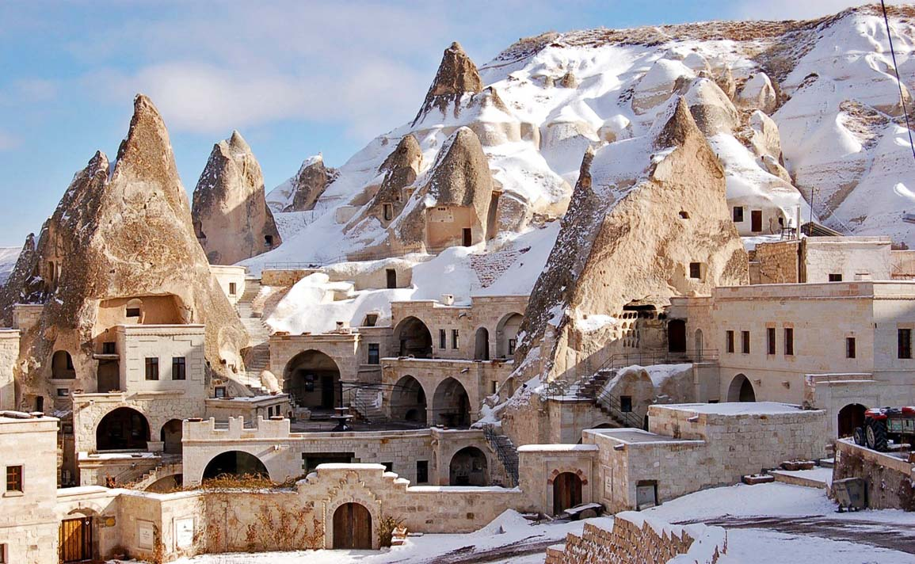
Göreme, located among the "fairy chimney" rock formations in Cappadocia, Turkey

Slide 7
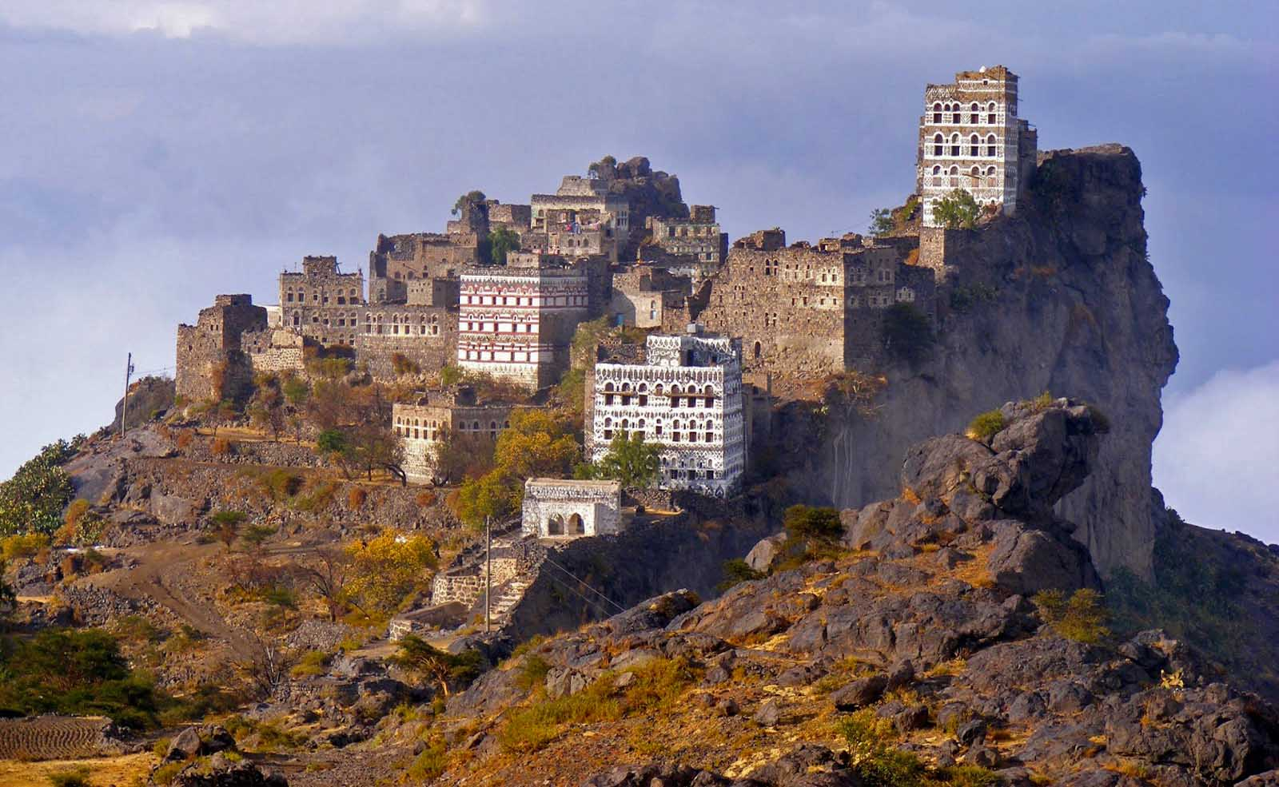
Jabal Haraz, Yemen

Slide 8
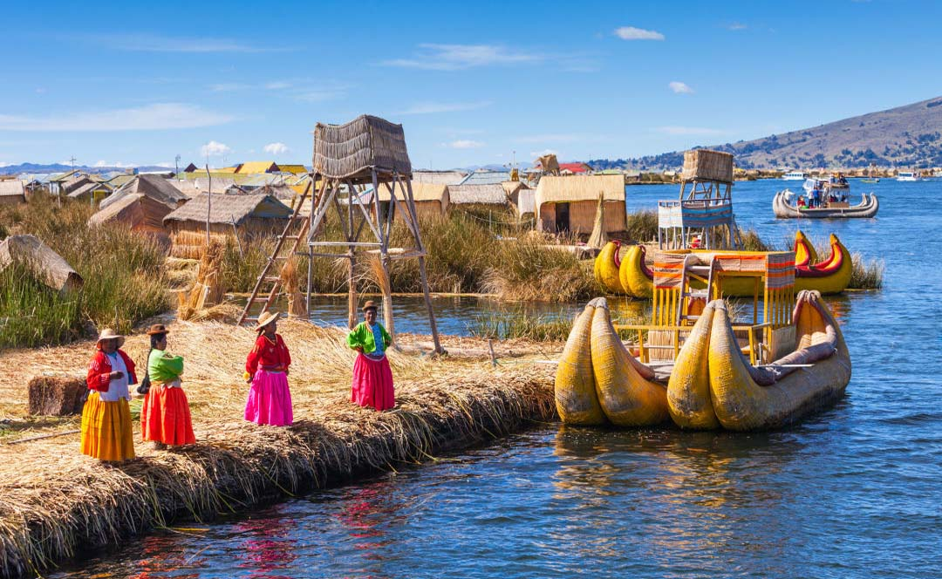
Floating Villages of Lake Titicaca in Peru. The Uros tribe members create their land from the long totora reeds. They all look like many floating villages on Lake Titica.

Slide 9
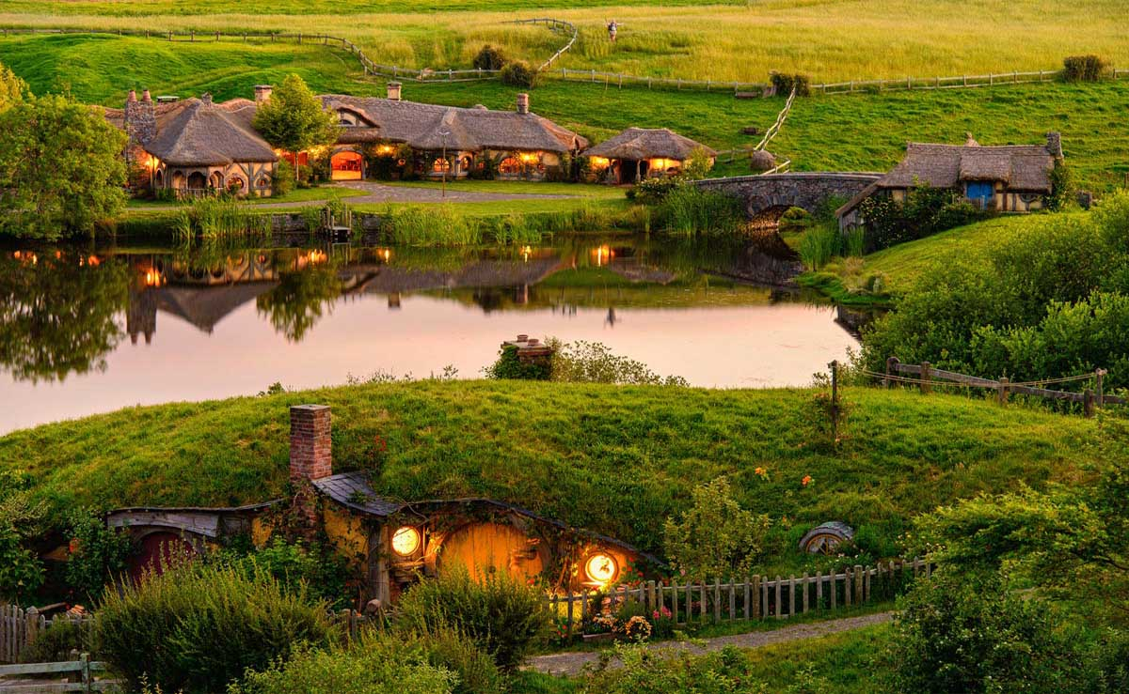
Hobbiton Village, New Zealand. Hobbiton was a set, built for the movie Lord Of The Rings. After the filming was finished this Hobbit village was leave as the tourist attraction.

Slide 10
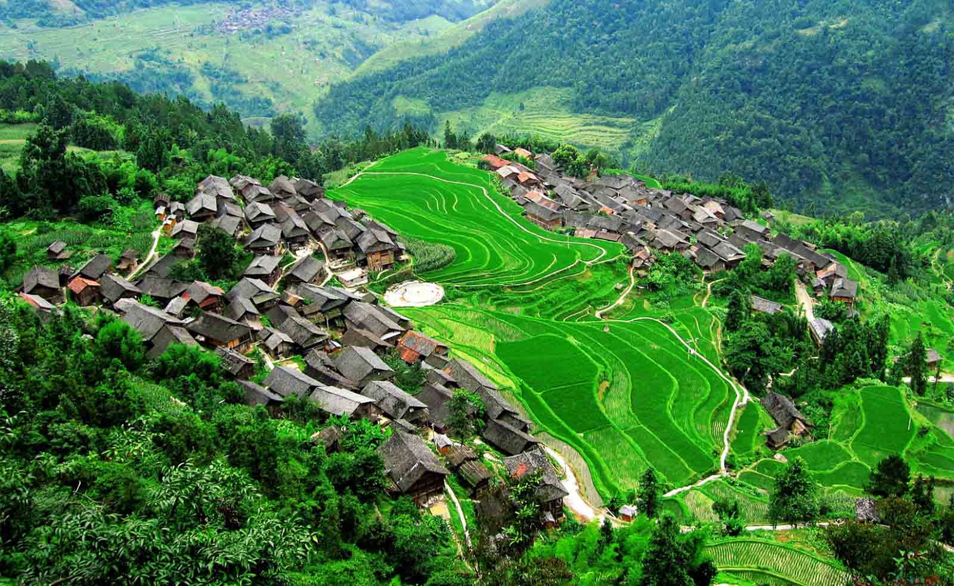
Sandu Village of Guizhou province in China. This village is so beautiful being surrounded by majestic mountains

Slide 11
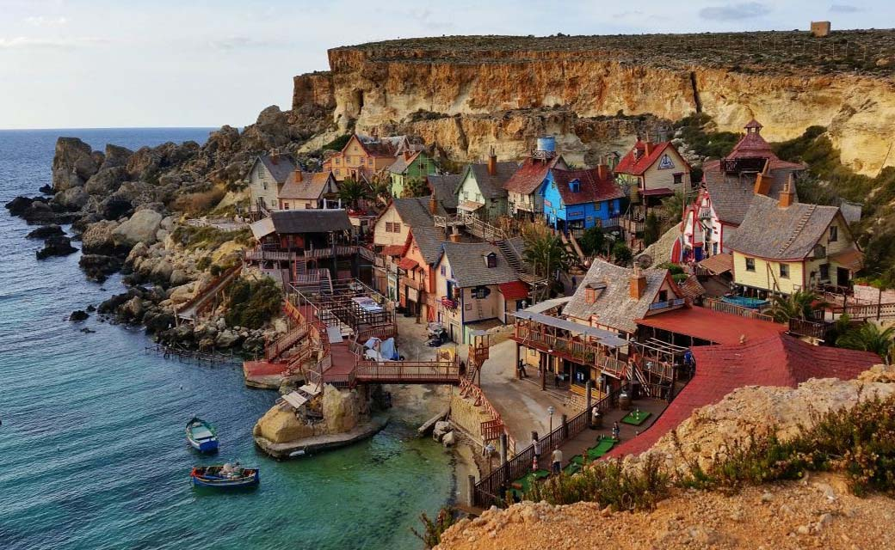
Popeye Village, is a group of rustic and ramshackle wooden buildings located at Anchor Bay in the north-west corner of the Mediterranean island of Malta.

Slide 12
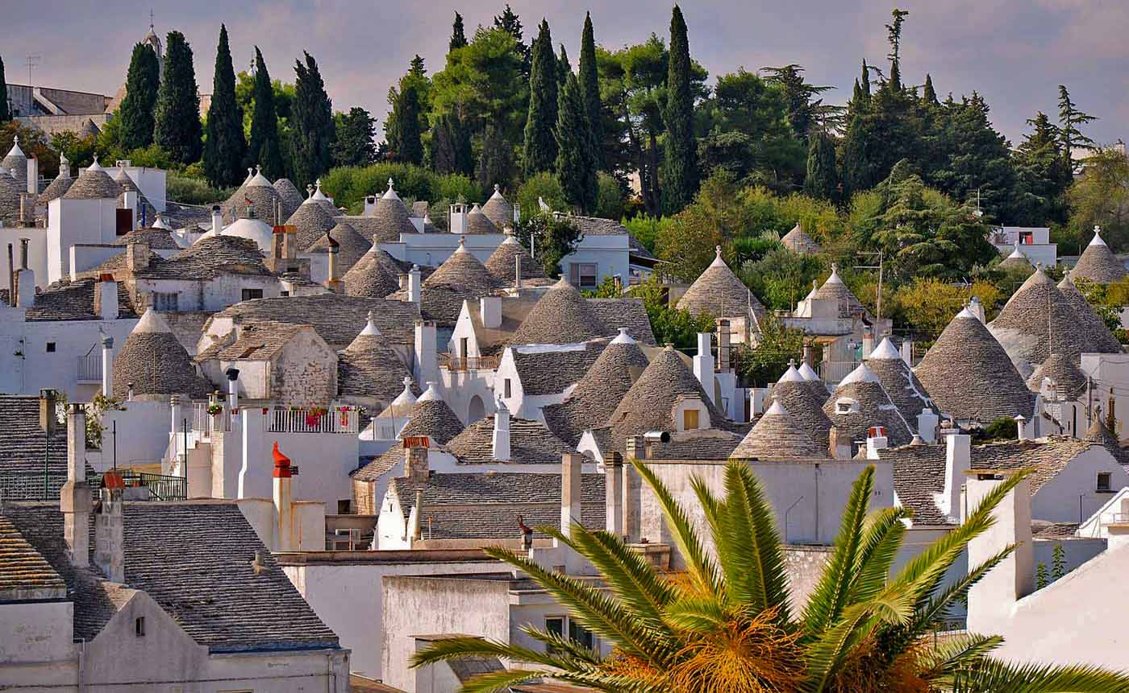
Village Alberobello - have been designated as a UNESCO World Heritage site, Italy.

Slide 13
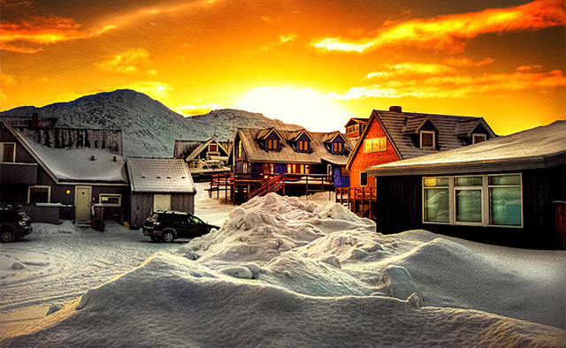
Myggedalen Village, Greenland

Slide 14
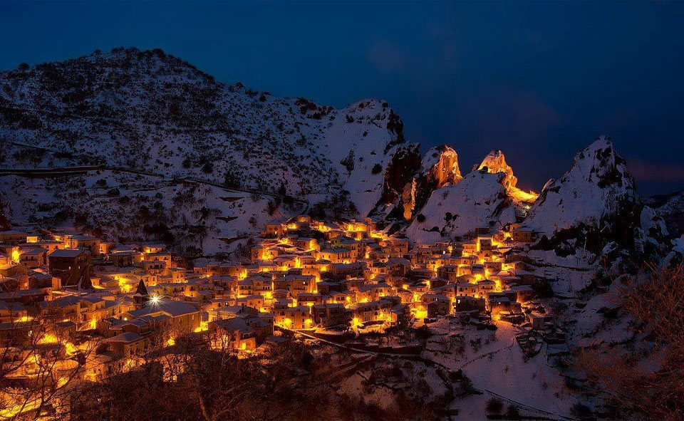
Village Castelmezzano, Italy

Slide 15
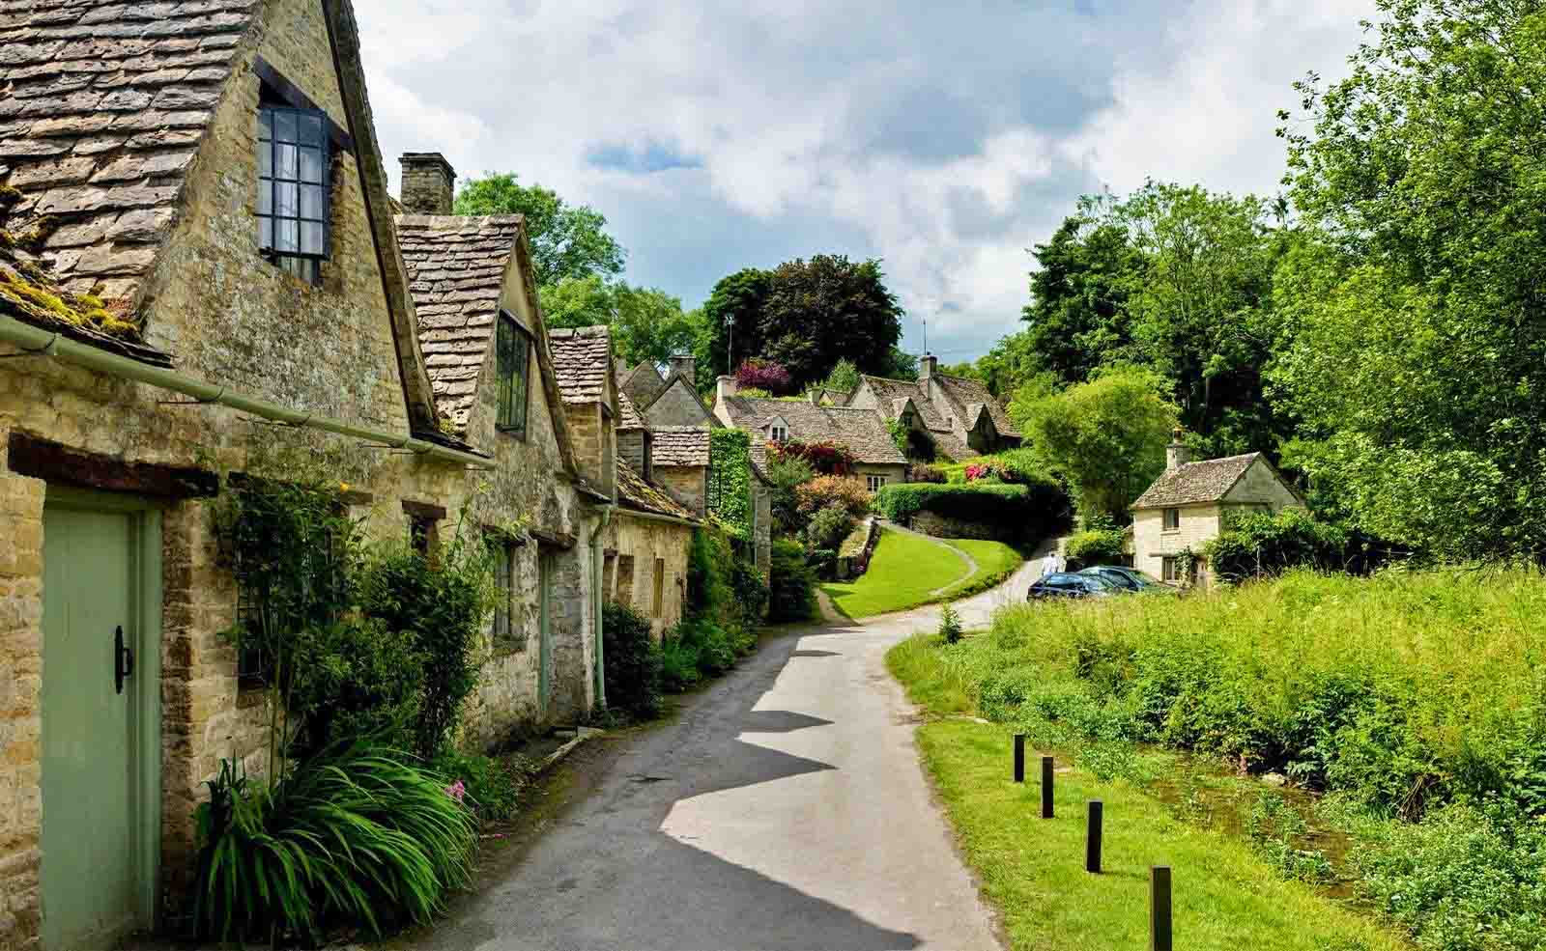
Bibury stone row houses, Bibury, England

Slide 16
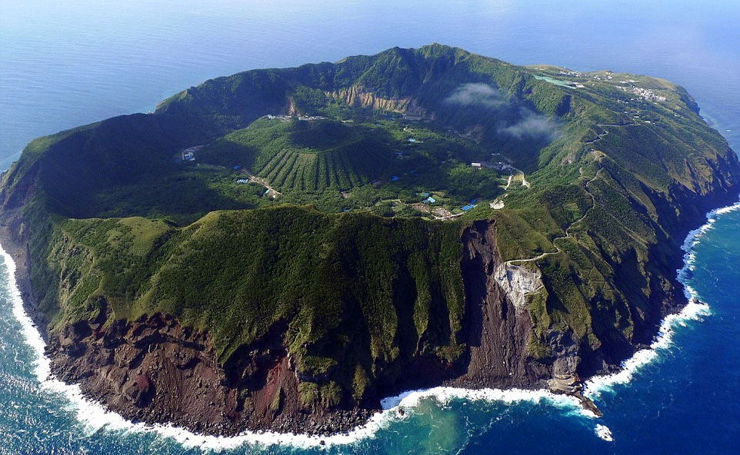
Aogashima Island, Japan. Bravest village ever? The settlement of Aogashima in the Philippine Sea has 200 inhabitants who live in the middle of a volcanic crater.

Slide 17
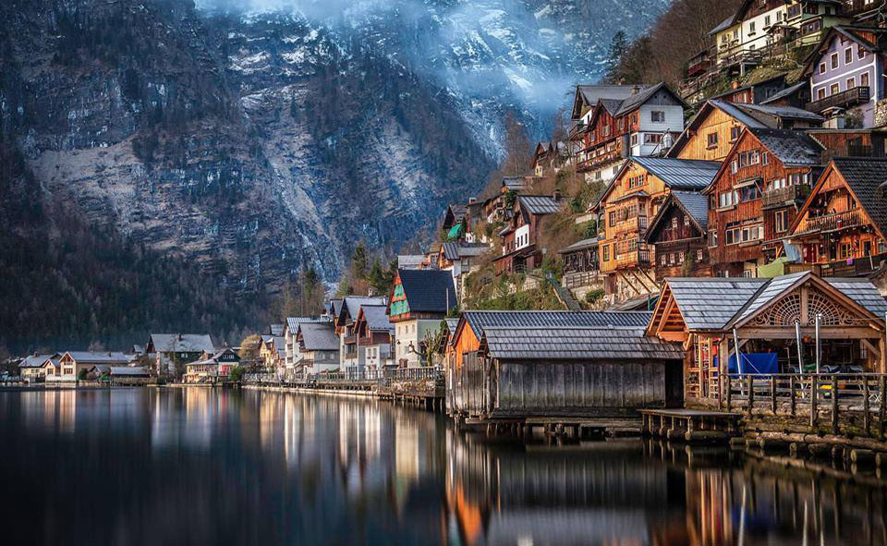
Hallstatt, Upper Austria, is a village in the region Salzkammergut in Austria. At the 2001 census, it had only 946 inhabitants.

Slide 18
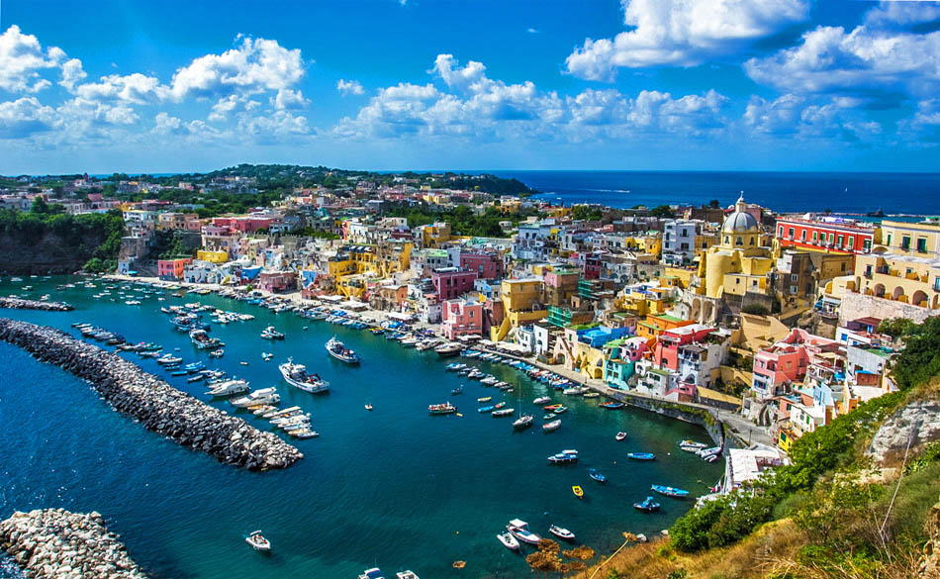
Procida fisherman’s Village in Naples, Italy

Slide 19
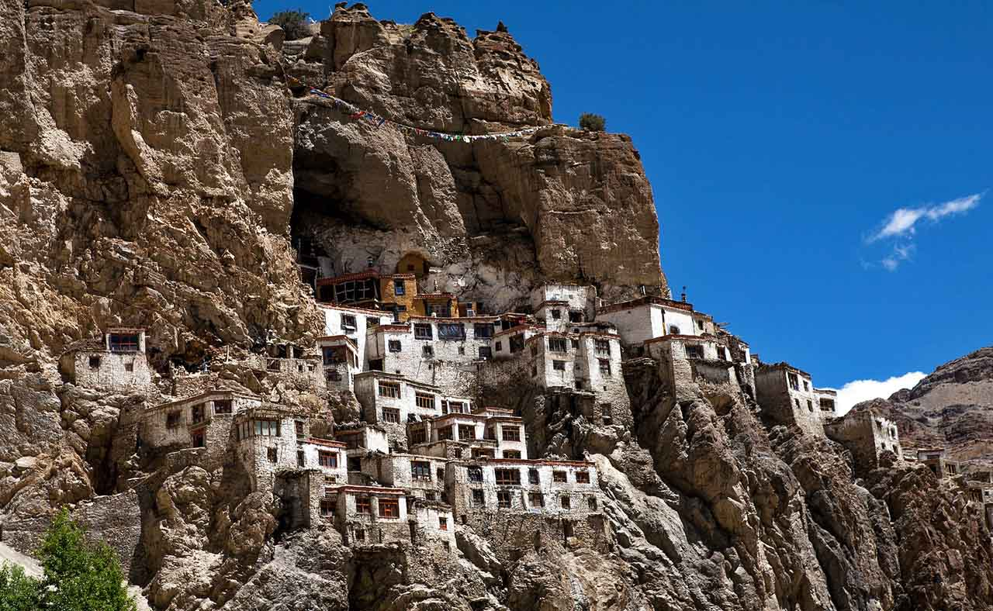
The hidden cliff village of Phuktal is one of the most isolated monasteries in northern India. Constructed from mud and timber. It is located in Ladakh district.

Slide 20
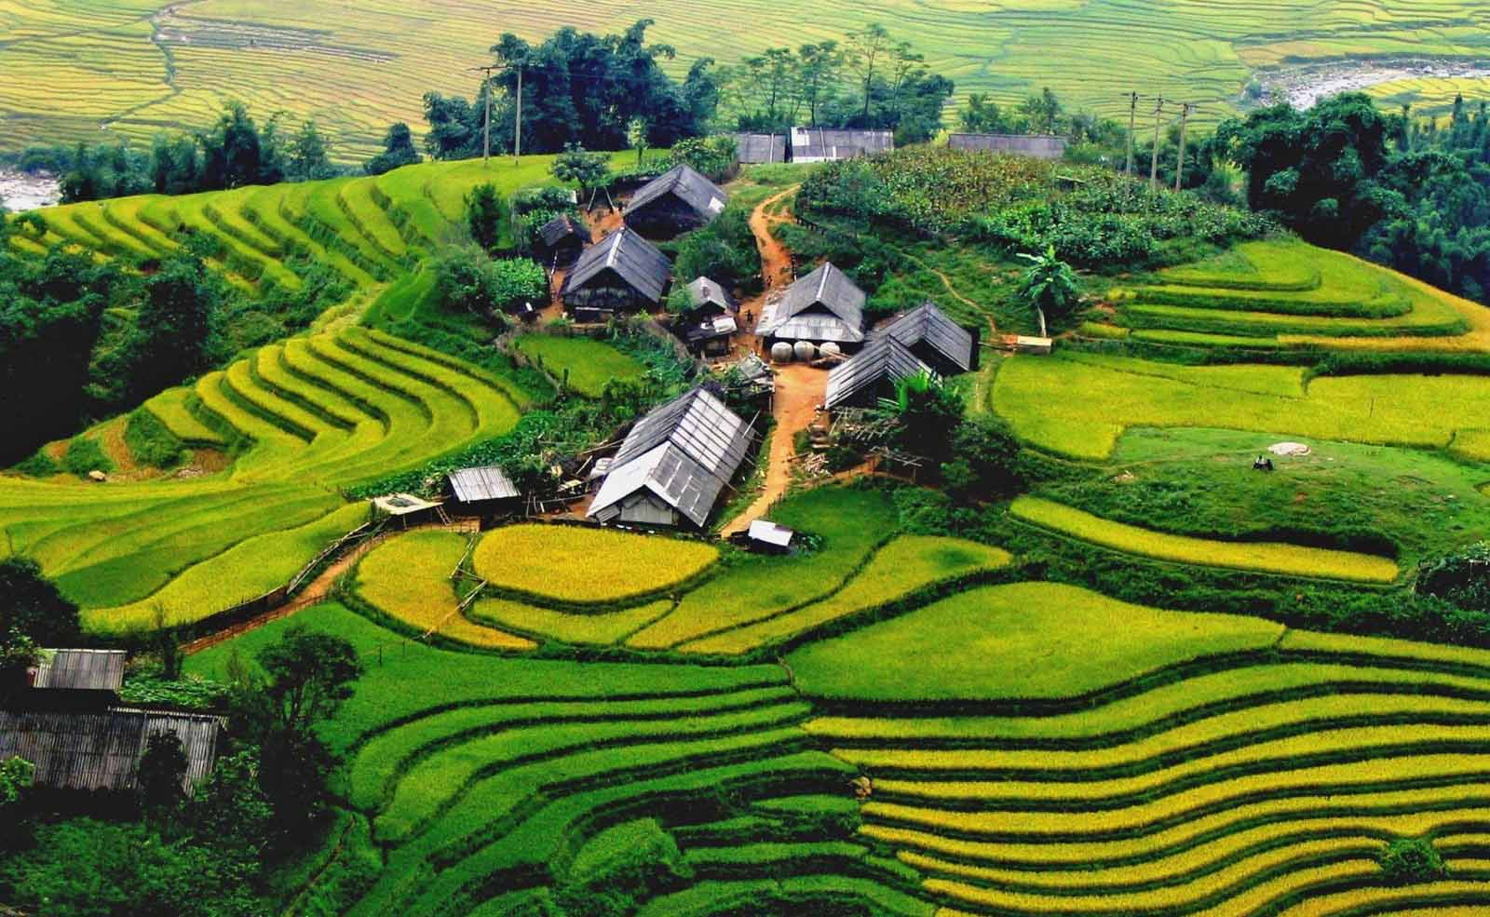
Sapa, Vietnam. Green haven! Sapa is one of the most beautiful places in earth, and is home to villagers who farm the rice fields and sell trinkets to visitors.

Slide 21
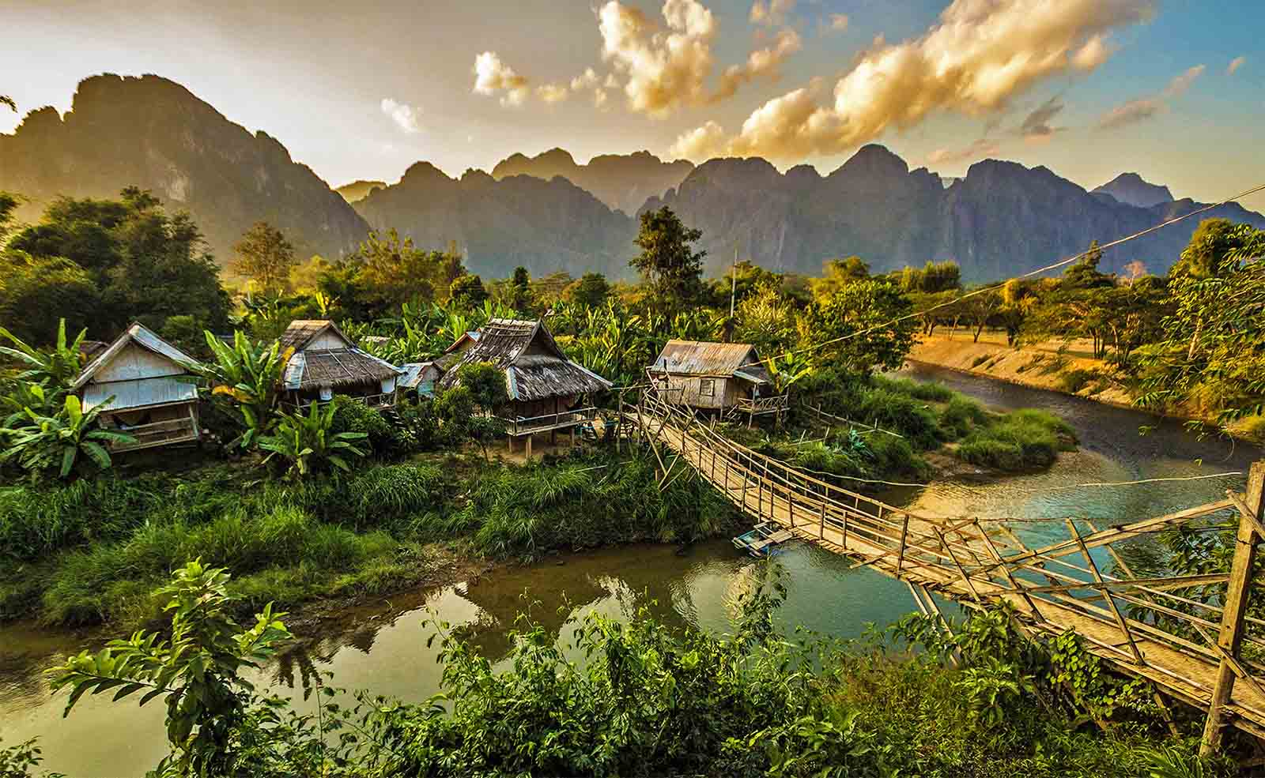
Van Vieng village of Laos, a riverside village of huts, a common sight in most Asian countries.

Slide 22
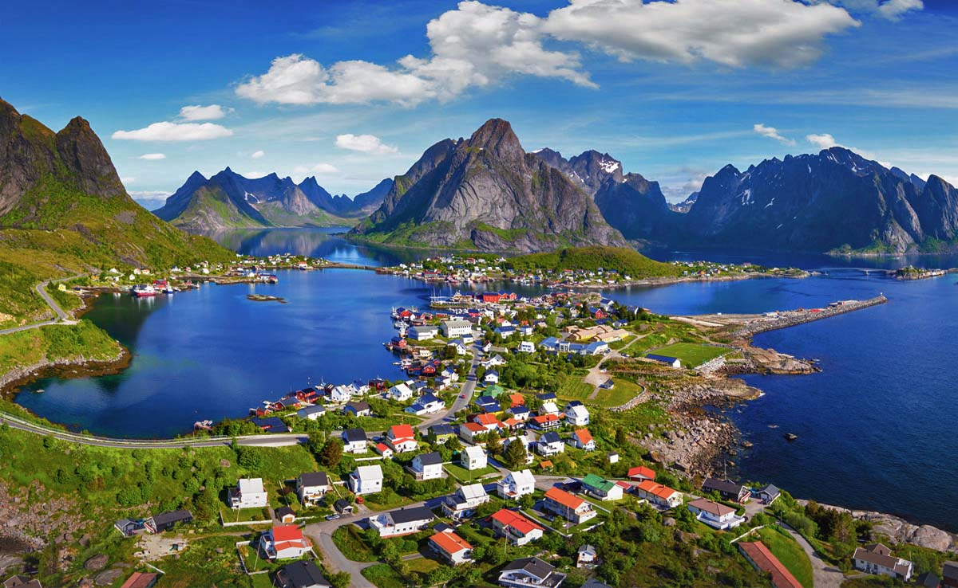
Gorgeous village in Reine, Lofoten, Norway

Slide 23
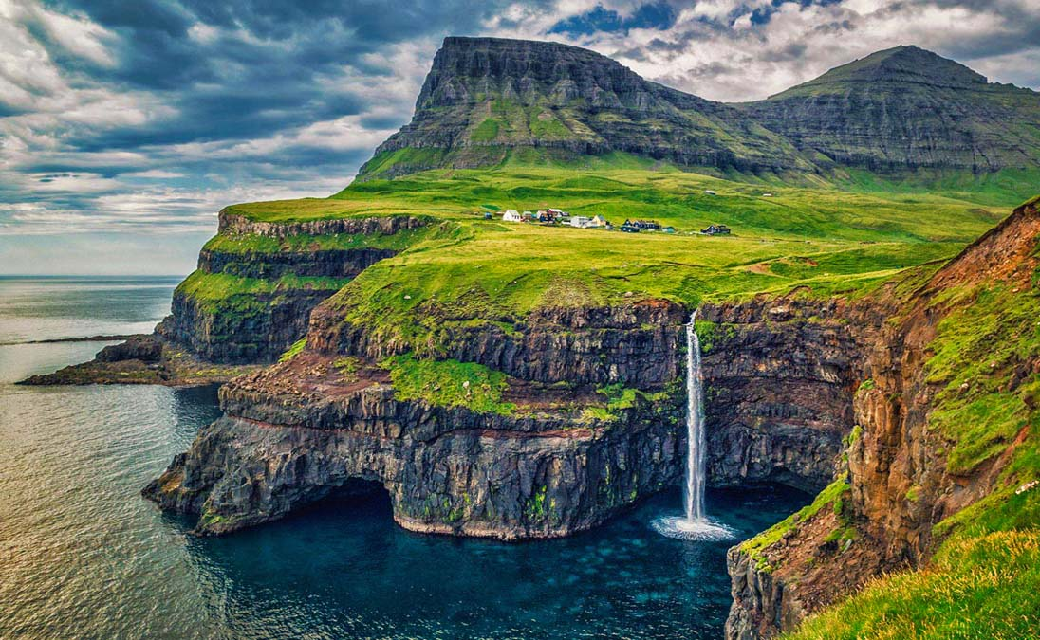
Gásadalur Village, Faroe Islands. Only 16 residents live in the peaceful settlement, with stunning views of tumbling cliffs overlooking the North Atlantic's Gulf Stream.

Slide 24
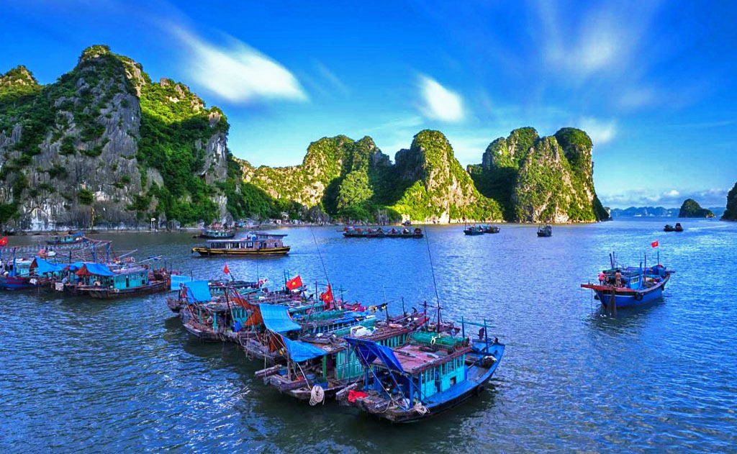
Incredible beautiful floating boat villages of Halong Bay, Vietnam.

Slide 25
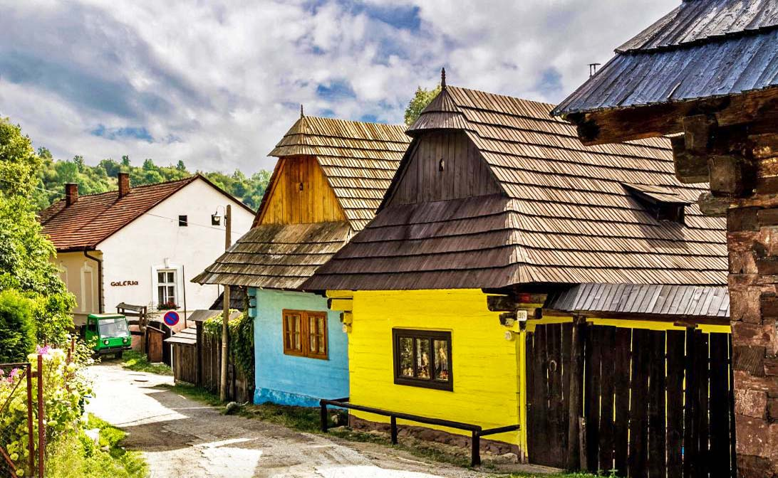
Village Vlkolínec - listed as a UNESCO World Heritage site, Slovakia

Slide 26
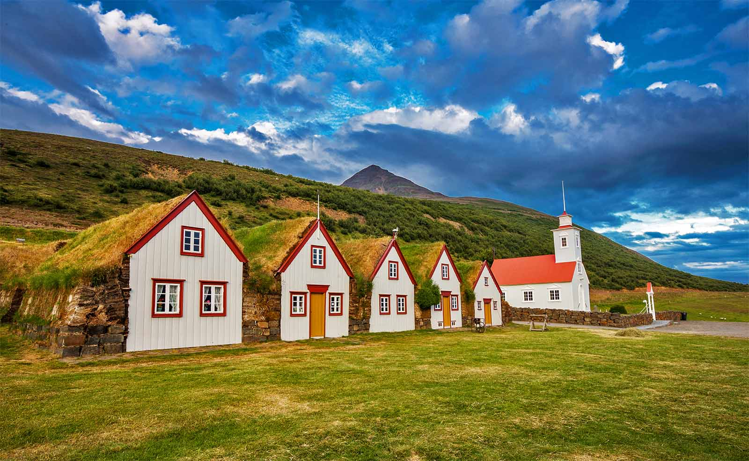
Turf houses and Church of Laufáskirkja, Iceland

Slide 27
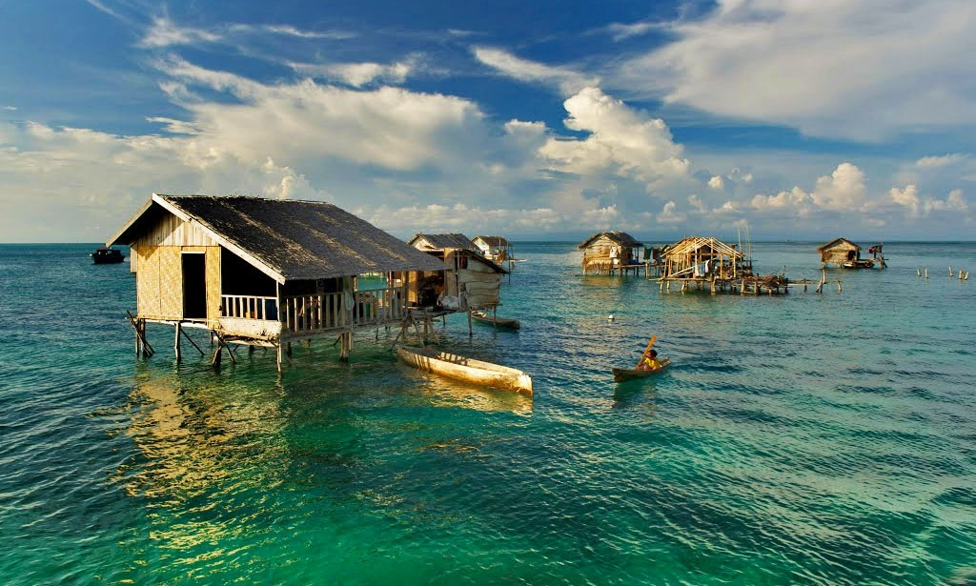
Stilt Huts of Sea Gypsies at Bodgaya Island, Semporna, Sabah, Malaysia

Slide 28
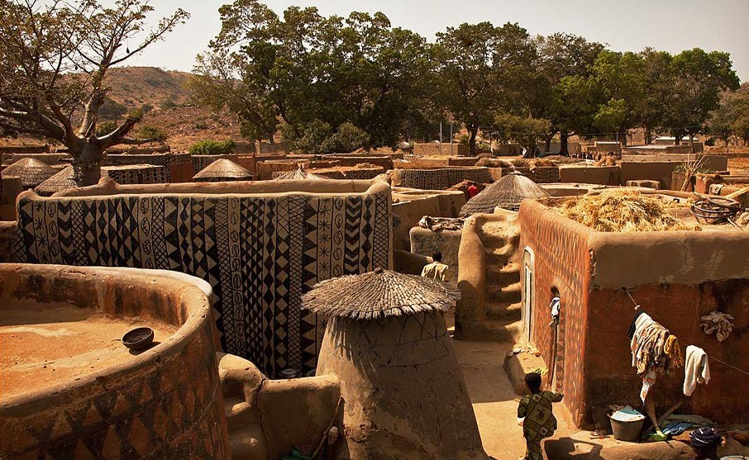
Hand painted houses of Tiebele, Burkina Faso, Africa

Slide 29

The beautiful Giethoorn Village of Netherlands connected only by water cannels.

Slide 30
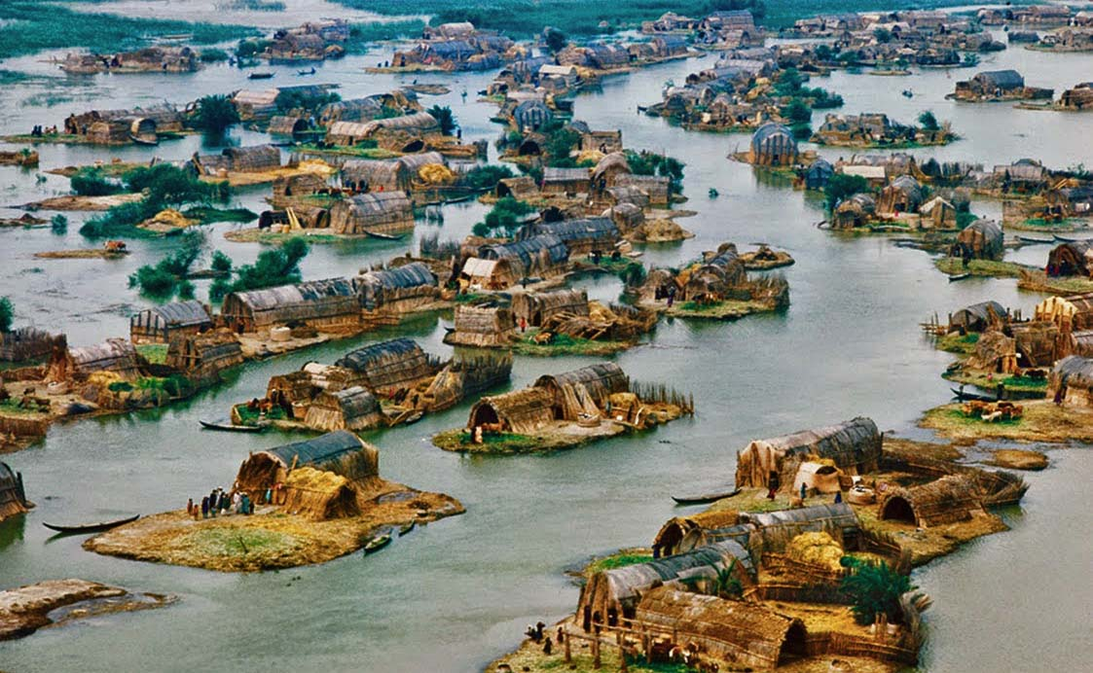
Al Qabab Village, Iraq

Slide 31
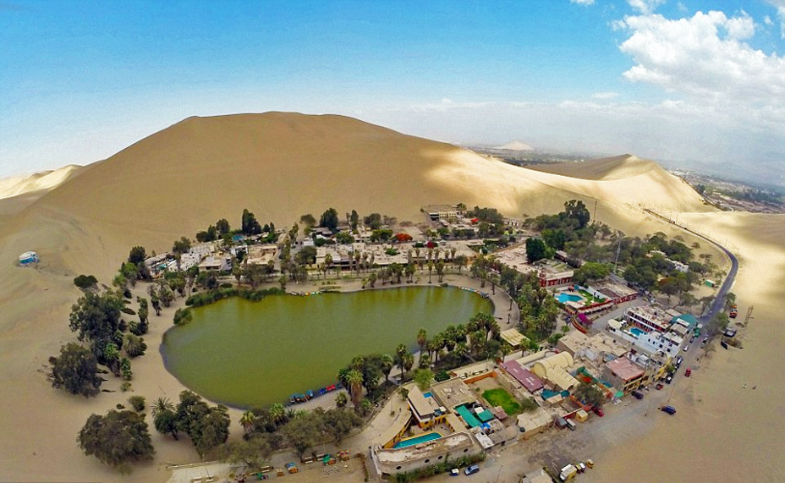
Huacachina is a desert oasis and tiny village just west of the city of Ica in southwestern Peru.

Slide 32
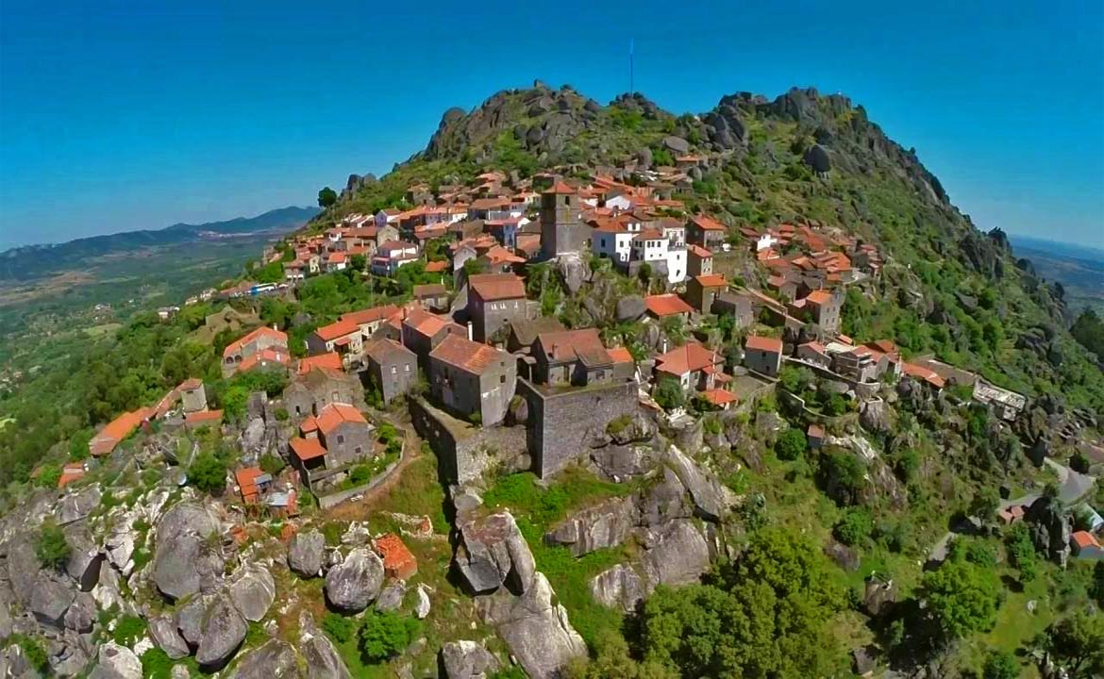
Monsanto village of Portugal amidst mountainous boulders.

Slide 33
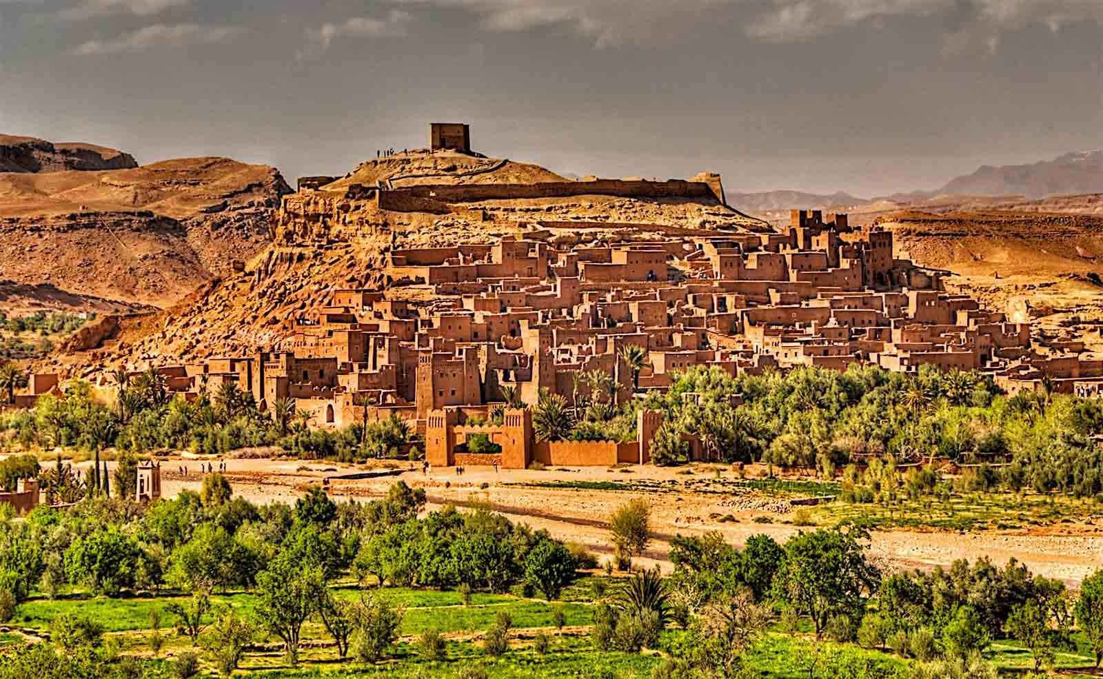
Ait Ben-Haddou in Morocco is an impressive fortified dwelling made up of many kasbahs. A kasbah is buildings made entirely from mud and straw.

Slide 34
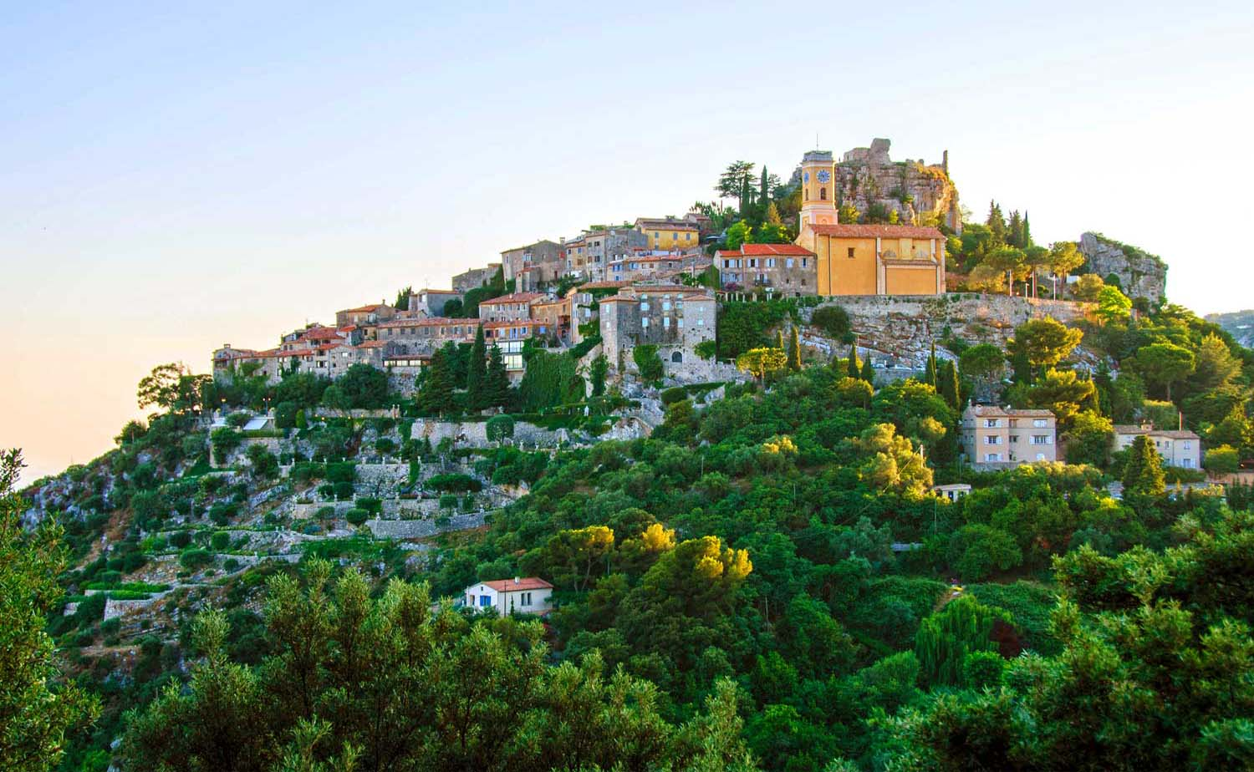
Eze, French Riviera

Slide 35
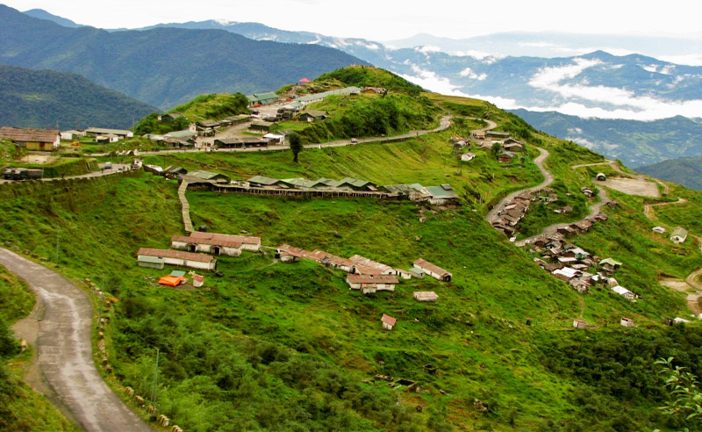
Zuluk village of Sikkim along the mountainous winding silk route. India

Slide 36
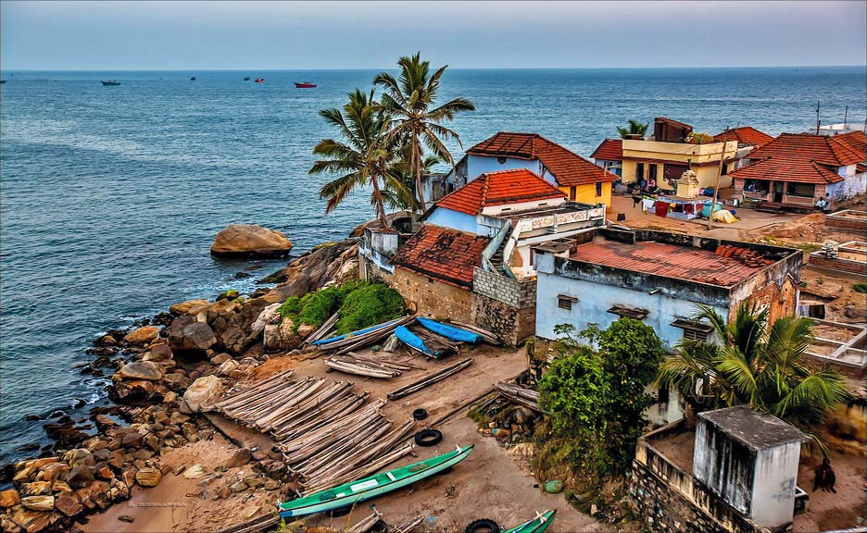
Muttom seaside village of Kanyakumari, India

Slide 37
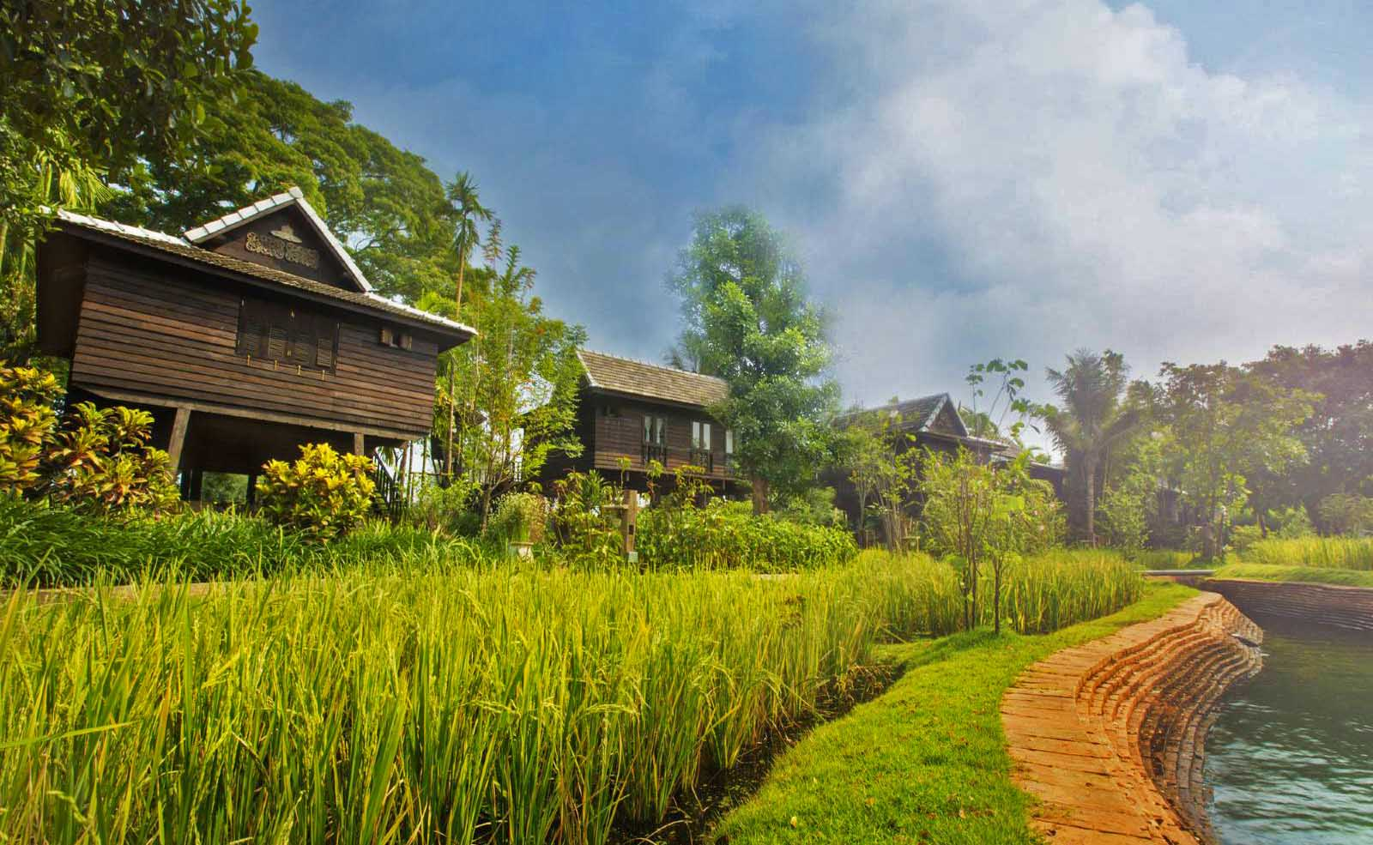
Marndadee Heritage River Village of Chiangmai in Thailand.

Slide 38
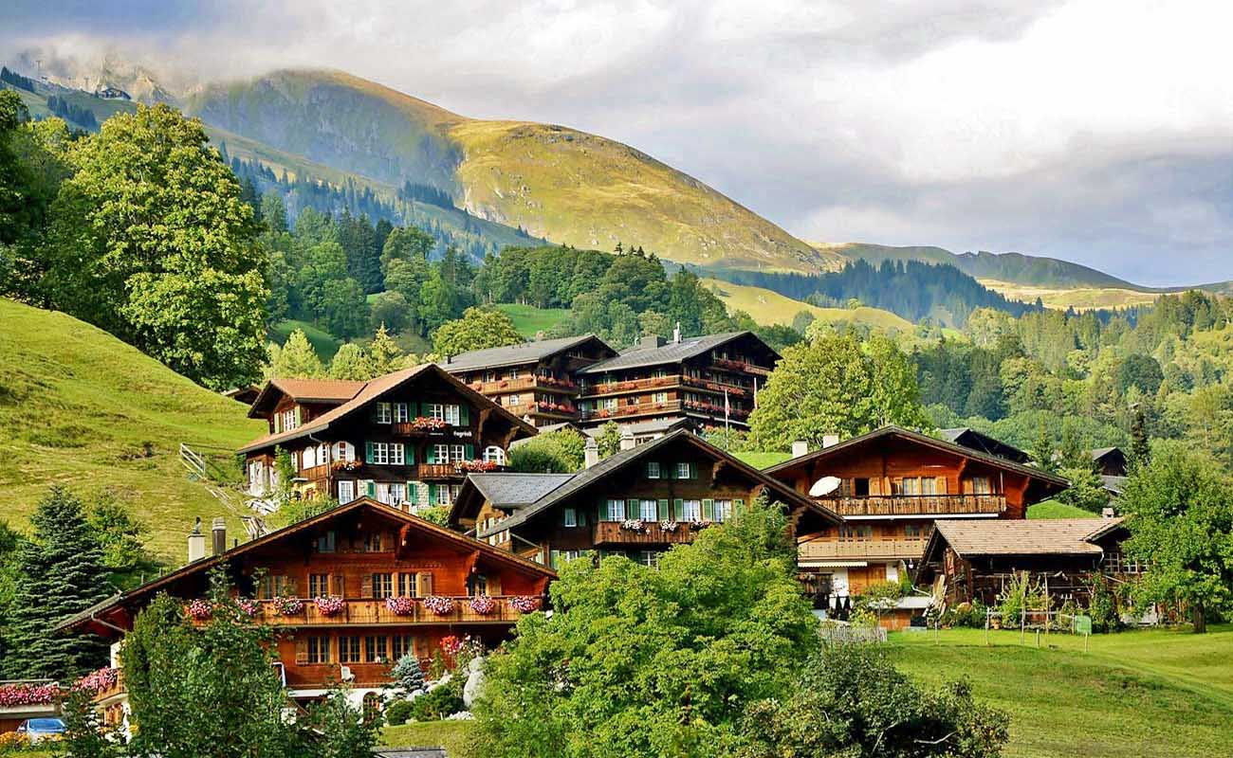
Grindelwald, Switzerland

Slide 39
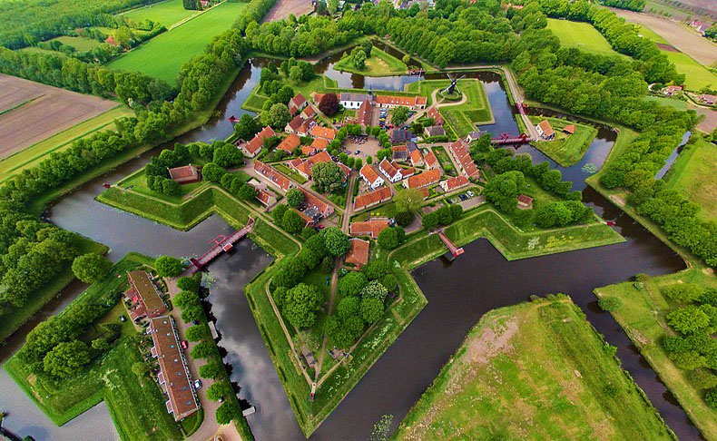
Fort Bourtanger Village, Groningen, Netherlands

Slide 40
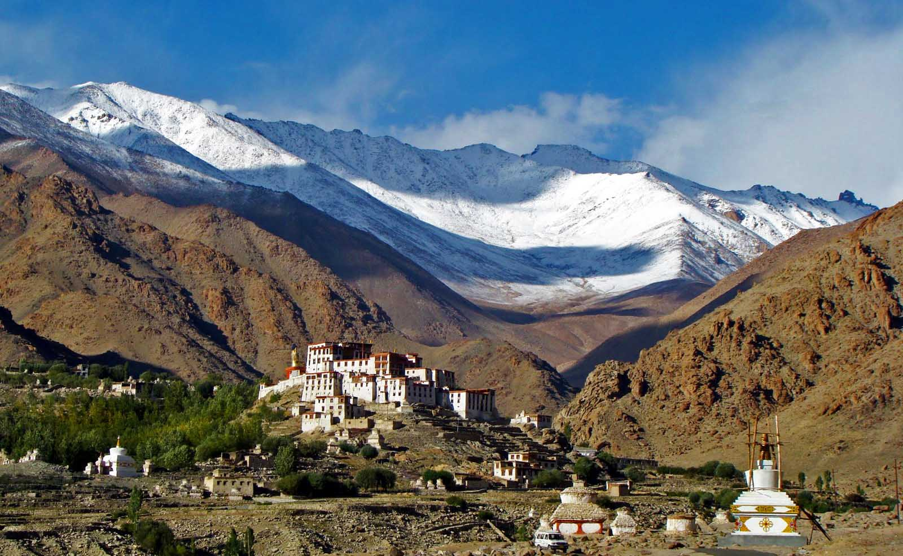
Alchi village of Leh in Jammu Kashmir, India perched on the high Himalayan mountain range.

Slide 41
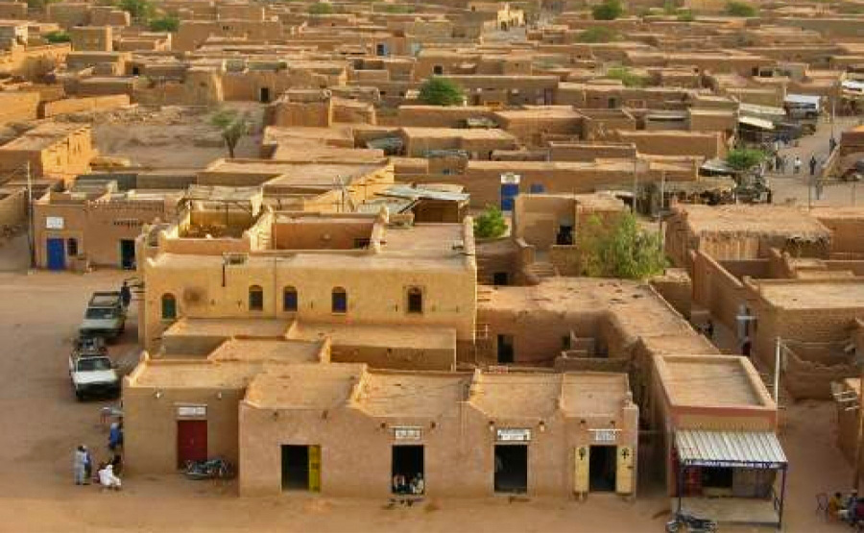
Densely built mud houses, Niger, Africa

Slide 42
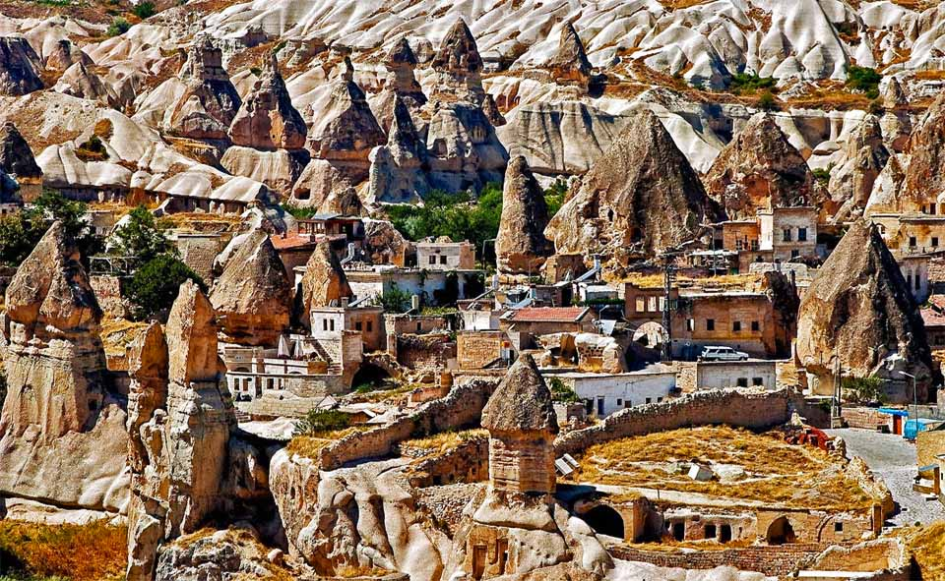
The Abi Barak Village is a beautiful village located in Afghanistan

Slide 43
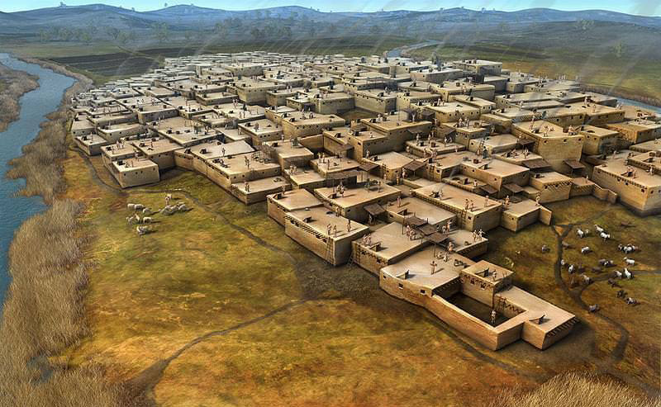
Village Çatalhöyük, Turkey

Slide 44
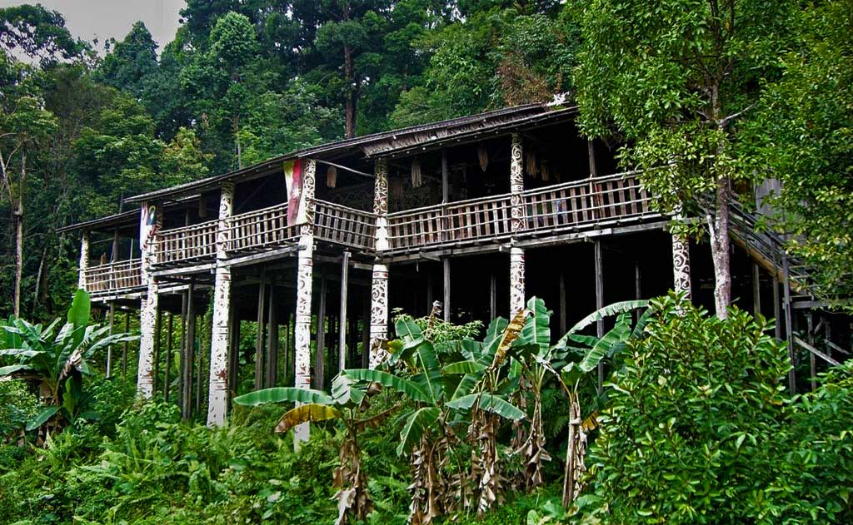
Orang Ulu Longhouse village in the jungles of Sarawak, Malaysian part of Borneo.

Slide 45
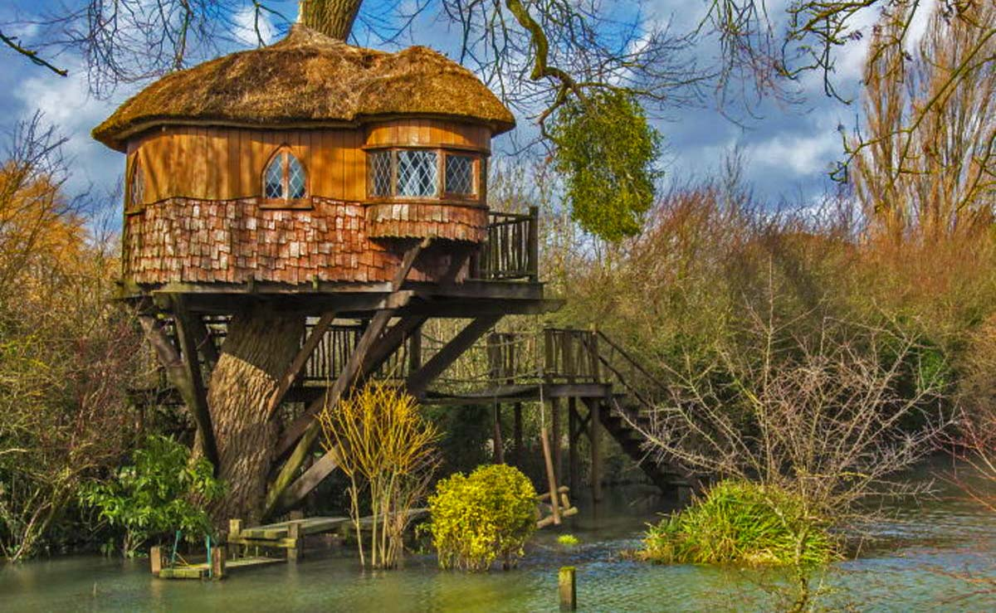
Finally guys and ladies, I have yet to identify a tree houses village. Here is an apt destination to enjoy a holiday.

Slide 46





Hope you have enjoyed viewing this presentation
Have a nice day
Music : Moreza - Tell Me Why
With regards - Tony Chacko and Steve Rumpler
(tonychacko2000@gmail.com / bubenikx22@gmail.com)

