Slide 1

Portrait
The Finalists of the World Photographic Cup 2018
© Haseo Hasegawa, Japan

Slide 2
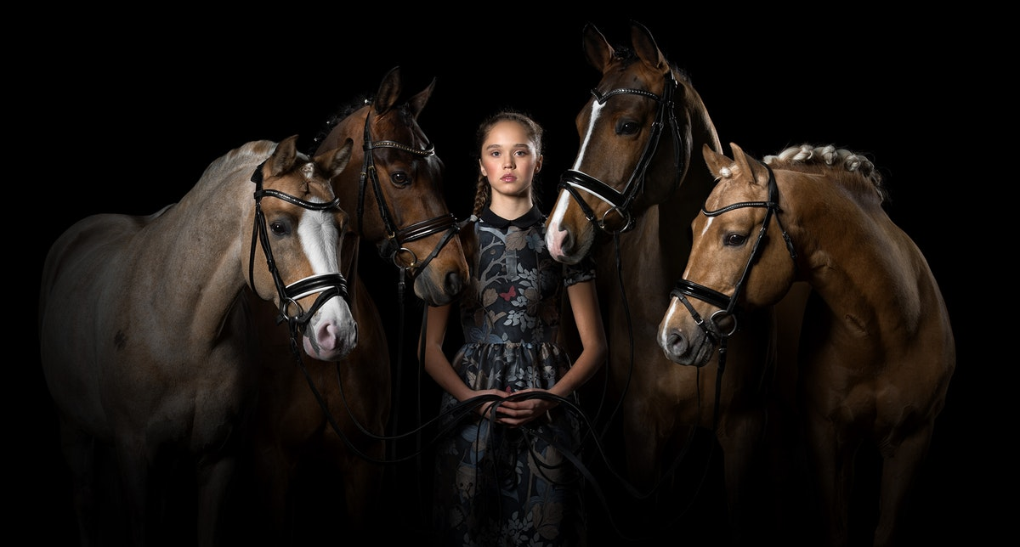
© Svetlana Petrova, Russia

Slide 3
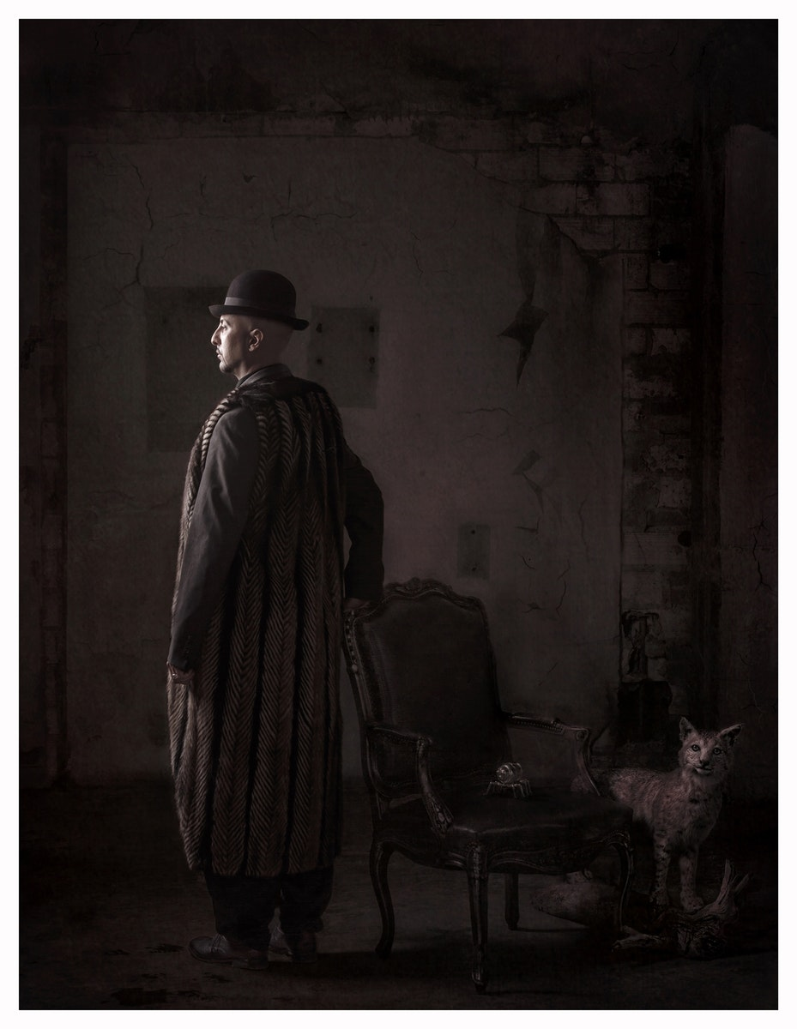
© Francie Baltazar Stonestreet, United States

Slide 4

© Claude Brazeau, Canada

Slide 5

© Erich Caparas, United States

Slide 6

© Gaétan Lecire, France

Slide 7
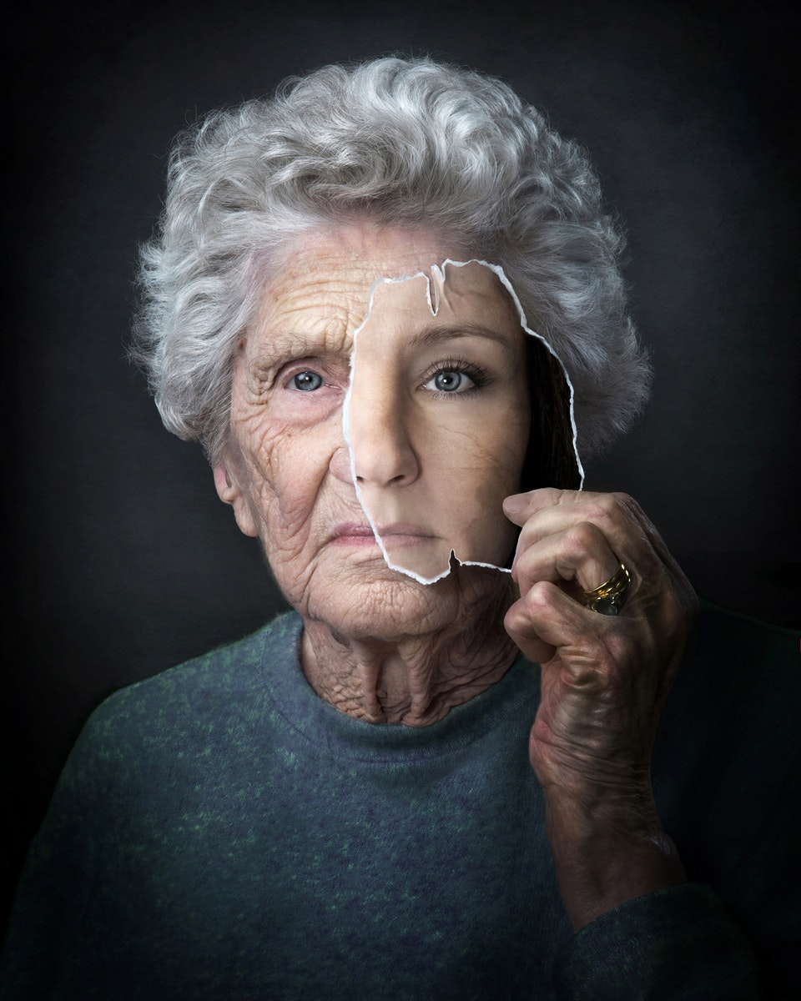
© Jenny Puronne, Sweden

Slide 8

© Keren Dobia, Australia

Slide 9
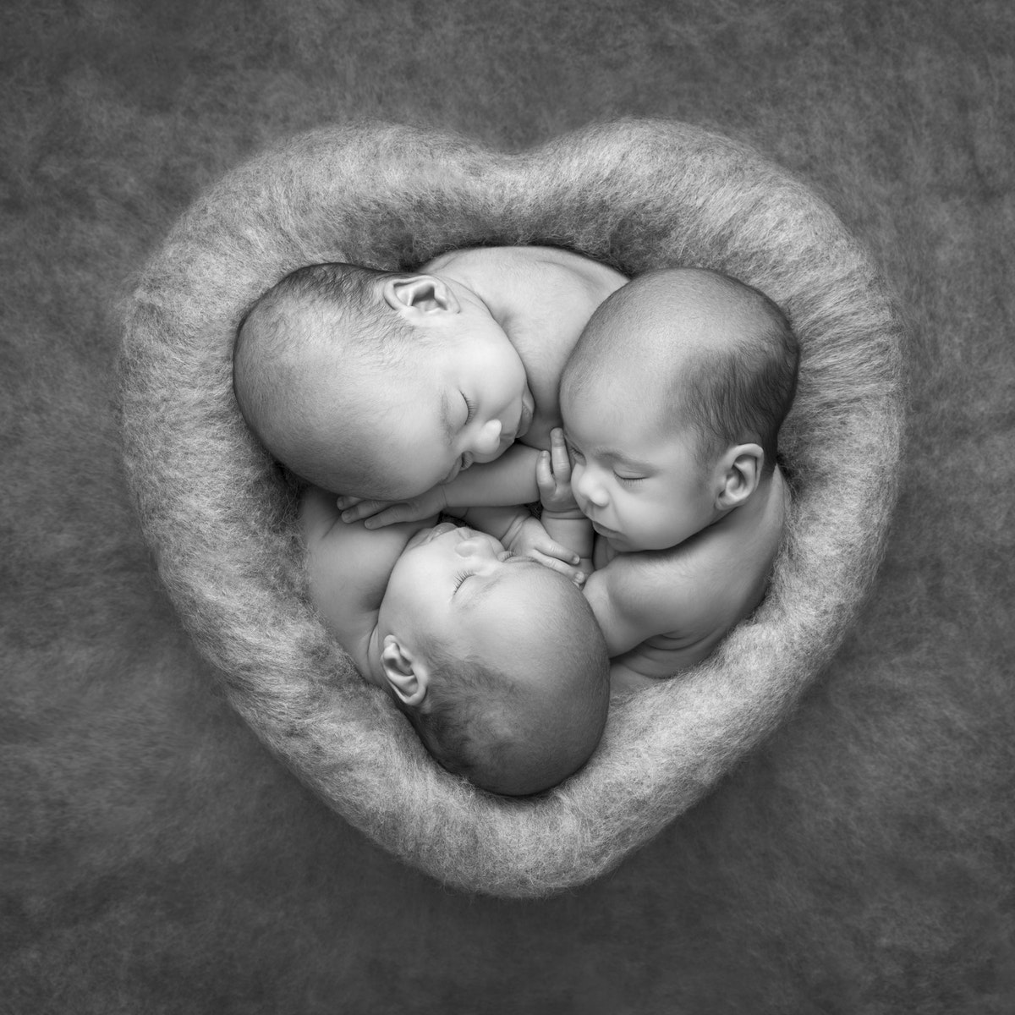
© Laila Villebeck, Sweden

Slide 10
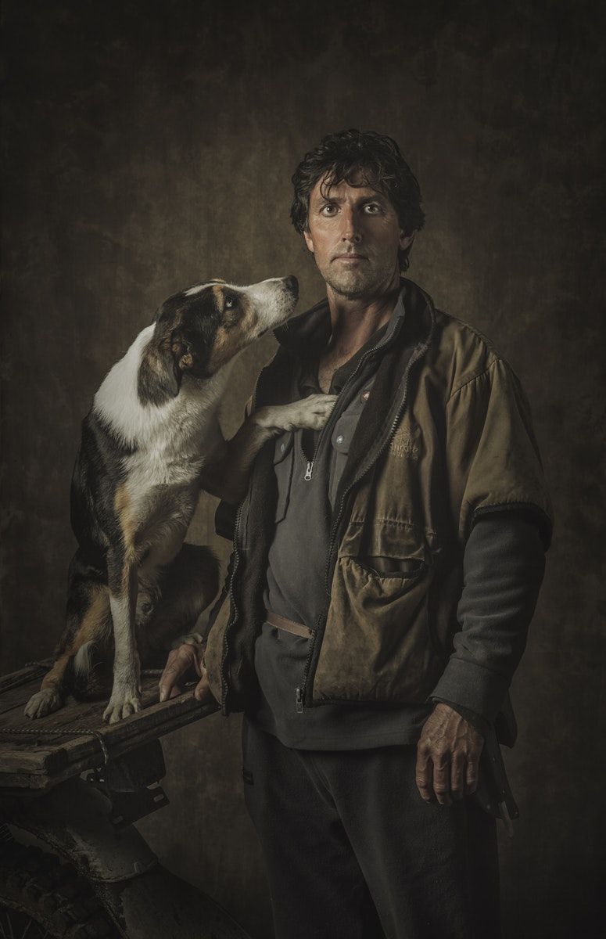
© Loren O'Connor, New Zealand

Slide 11

Commercial
© Ben Shirk, United States

Slide 12

© Andrey Bronnikov, Russia

Slide 13

© Brent Lewis, United States

Slide 14

© Andreas Varro, Sweden

Slide 15

© Angela Miller, Australia

Slide 16
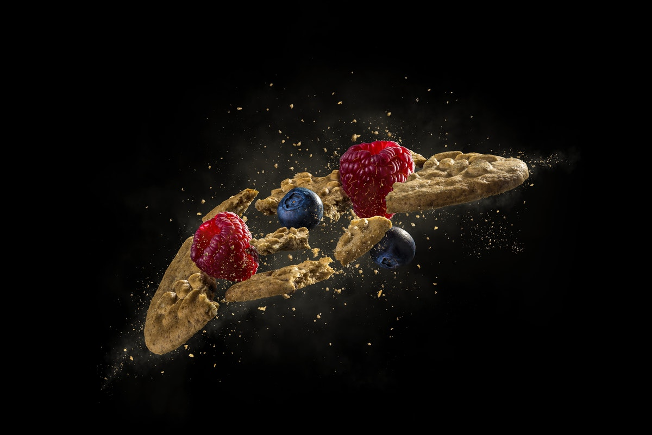
© Dušan Holovej, Slovakia

Slide 17
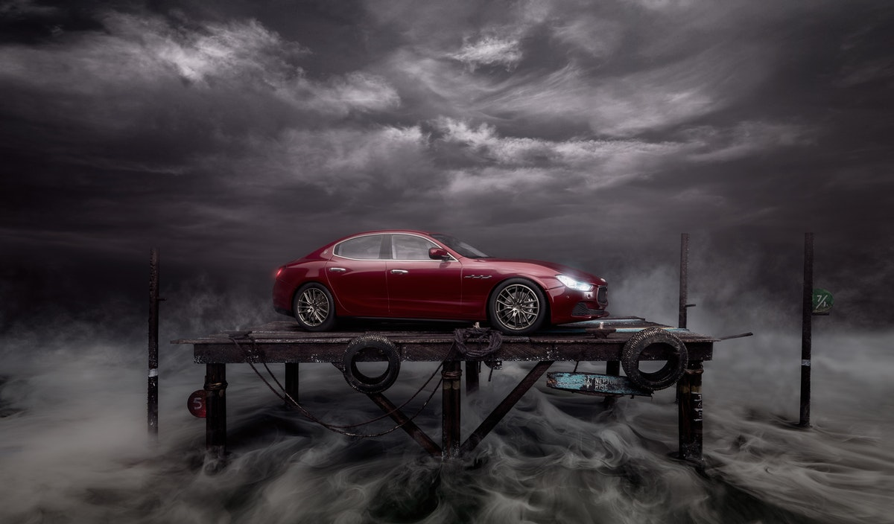
© Felix Hernández, Mexico

Slide 18

© Igor Sakharov, Russia

Slide 19

© Onni Wiljami Kinnunen, Finland

Slide 20

© Vincent O'Byrne, Ireland

Slide 21

Illustration / Digital Art
© Andreas Varro, Sweden

Slide 22
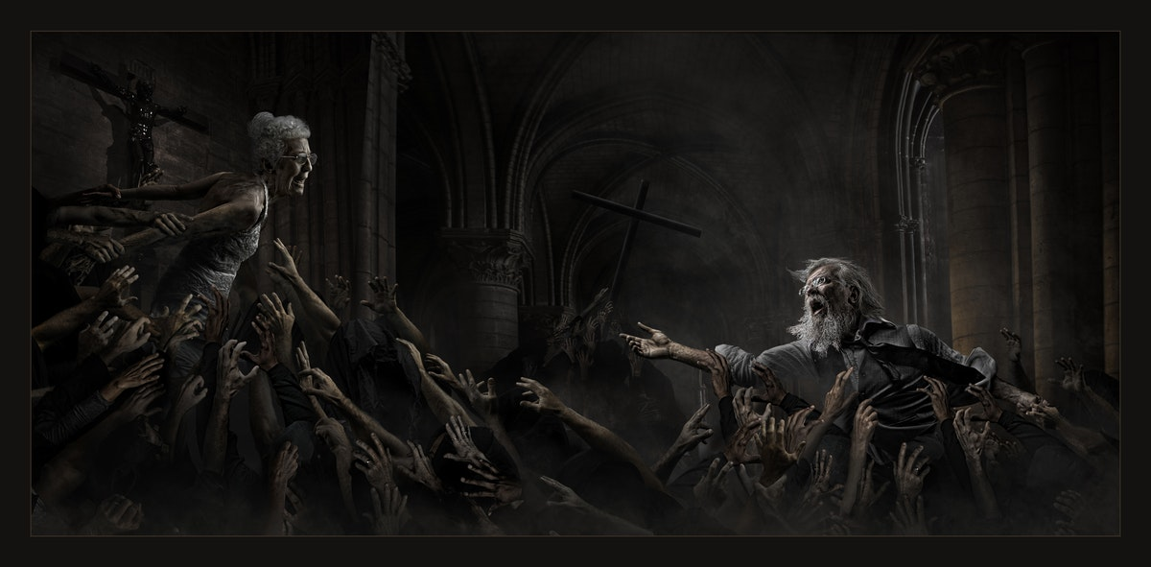
© Ben Shirk, United States

Slide 23

© Daniel Murphy, Australia

Slide 24

© Diamantino Jesus, Portugal

Slide 25
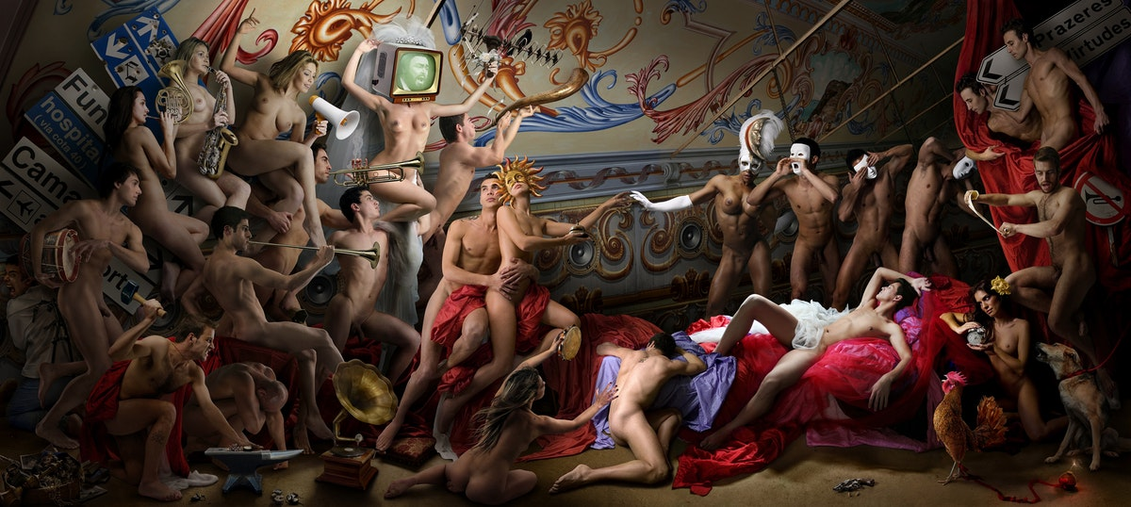
© Diogo Freitas, Portugal

Slide 26
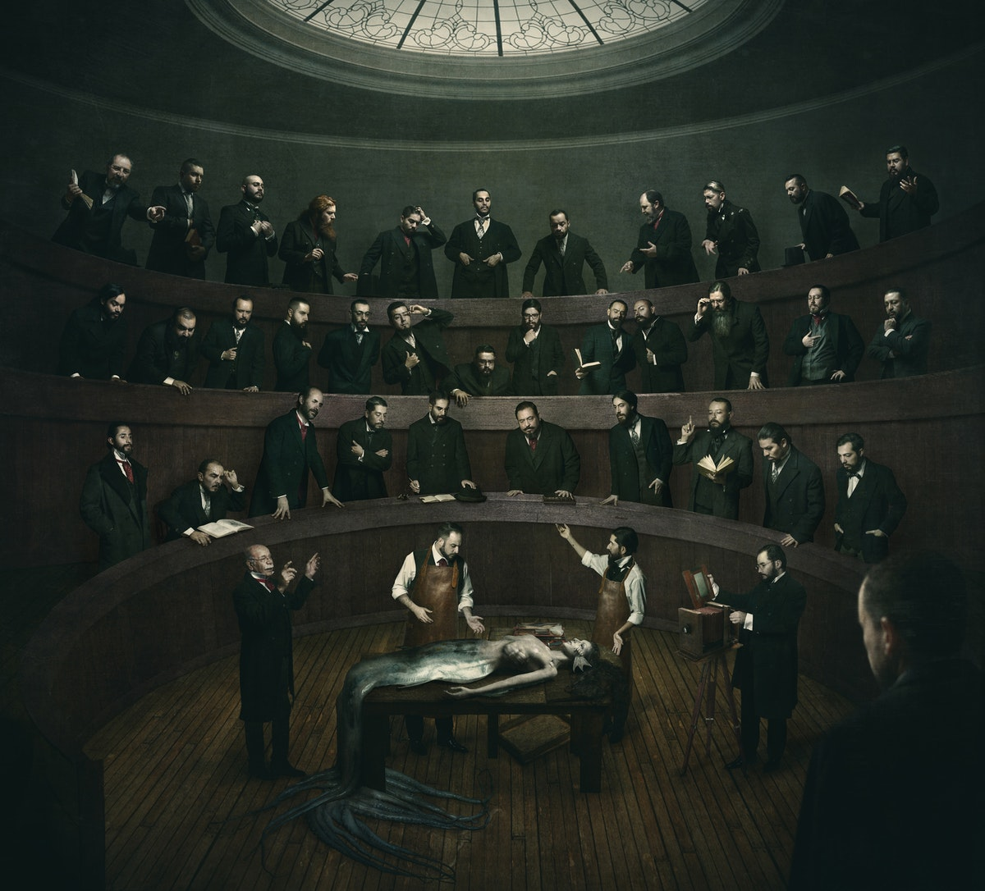
© Eduardo Gómez, Mexico

Slide 27

© Felix Hernández, Mexico

Slide 28

© José D´Almeida, Portugal

Slide 29

© Onni Wiljami Kinnunen, Finland

Slide 30
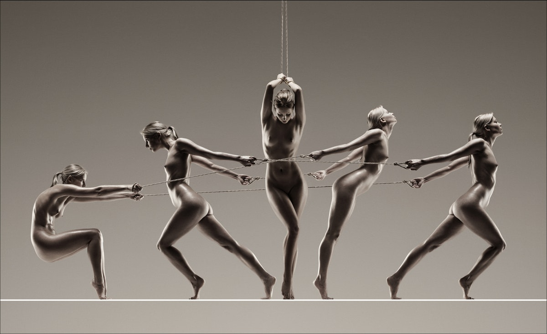
© Vincent O'Byrne, Ireland

Slide 31
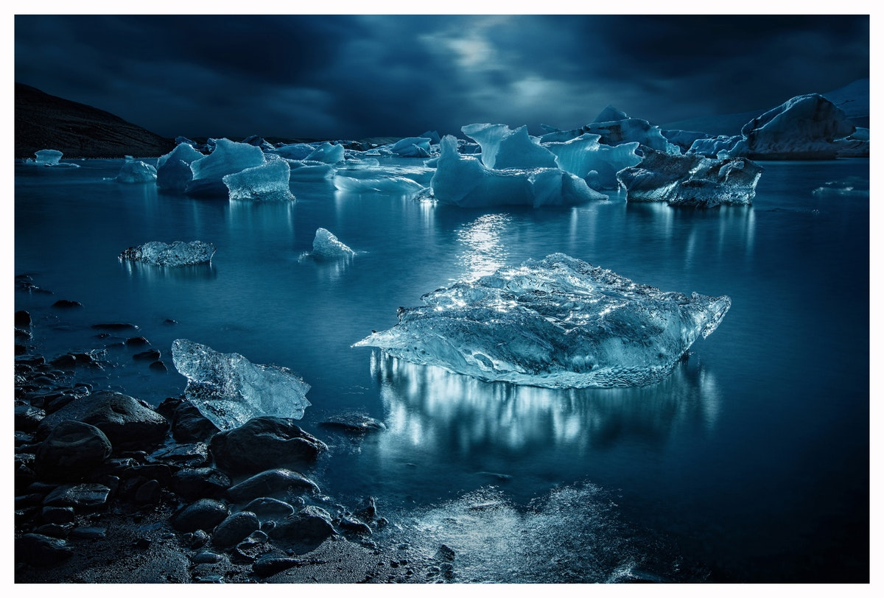
Nature (Landscape and Wildlife)
© Dan McClanahan, United States

Slide 32

© Daniel Korzhonov, Russia

Slide 33

© David Eliud Gil Samaniego Maldonado, Mexico

Slide 34
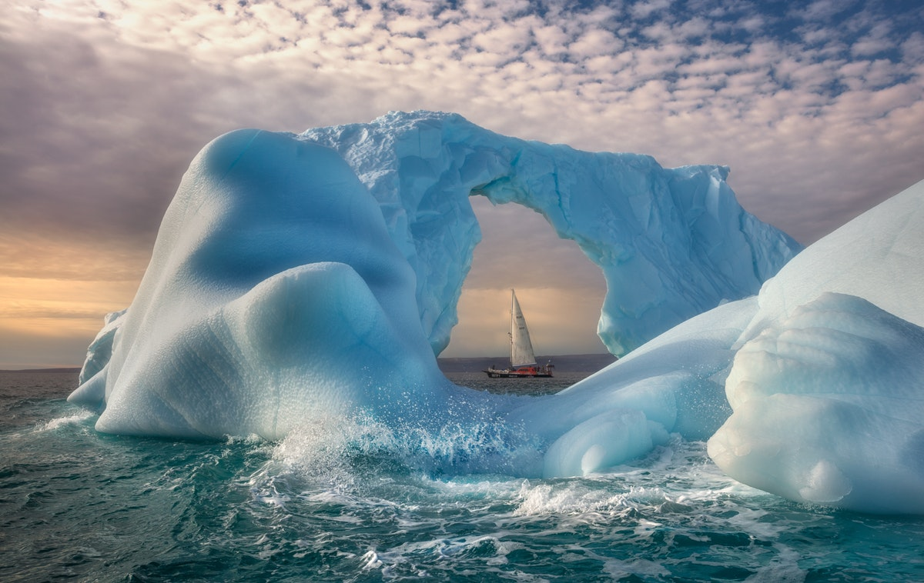
© Dmitry Arkhipov, Russia

Slide 35

© EngTong Tan, Malaysia

Slide 36
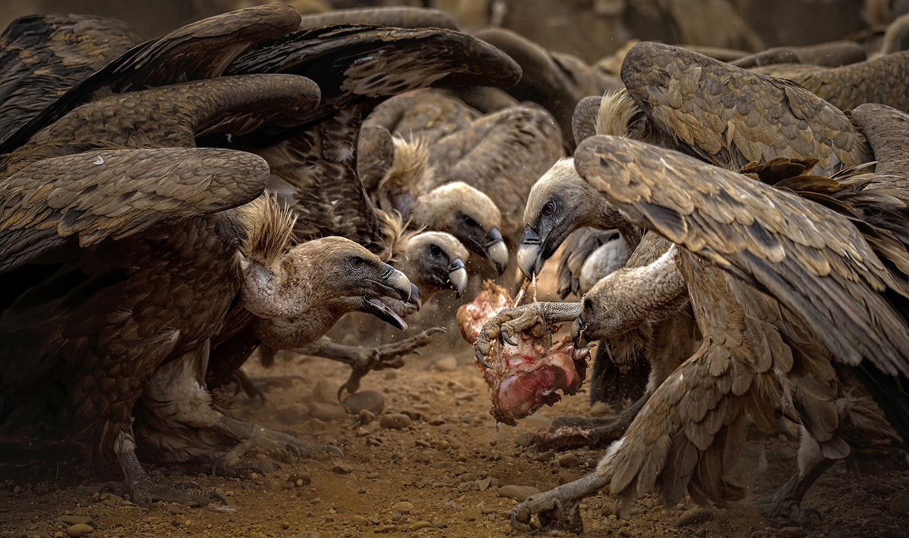
© Jesús de Pedro García, Spain

Slide 37
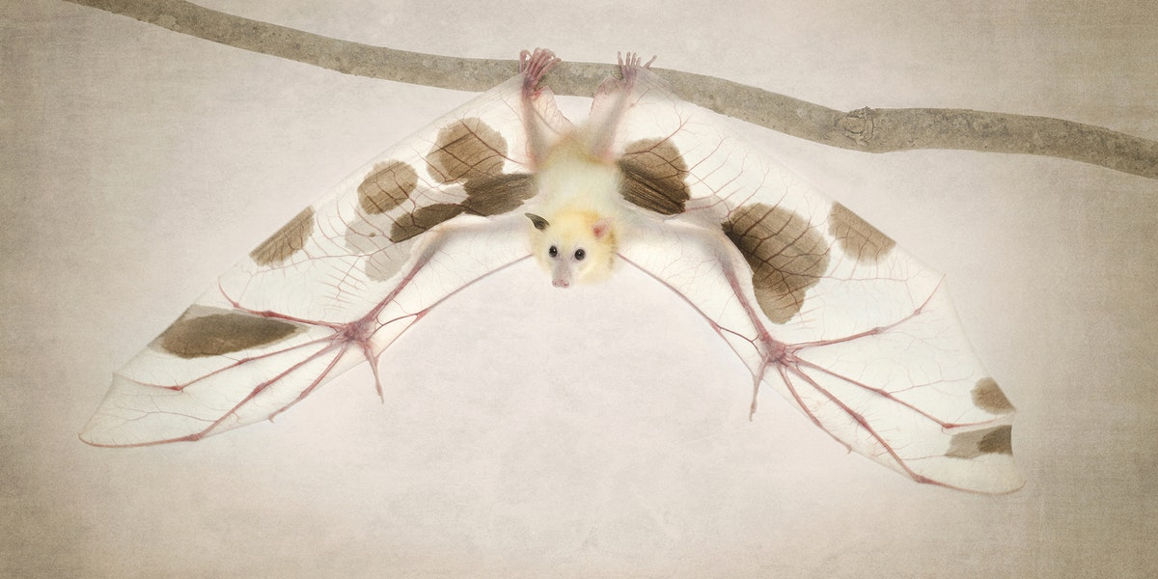
© Ken Drake, Australia

Slide 38
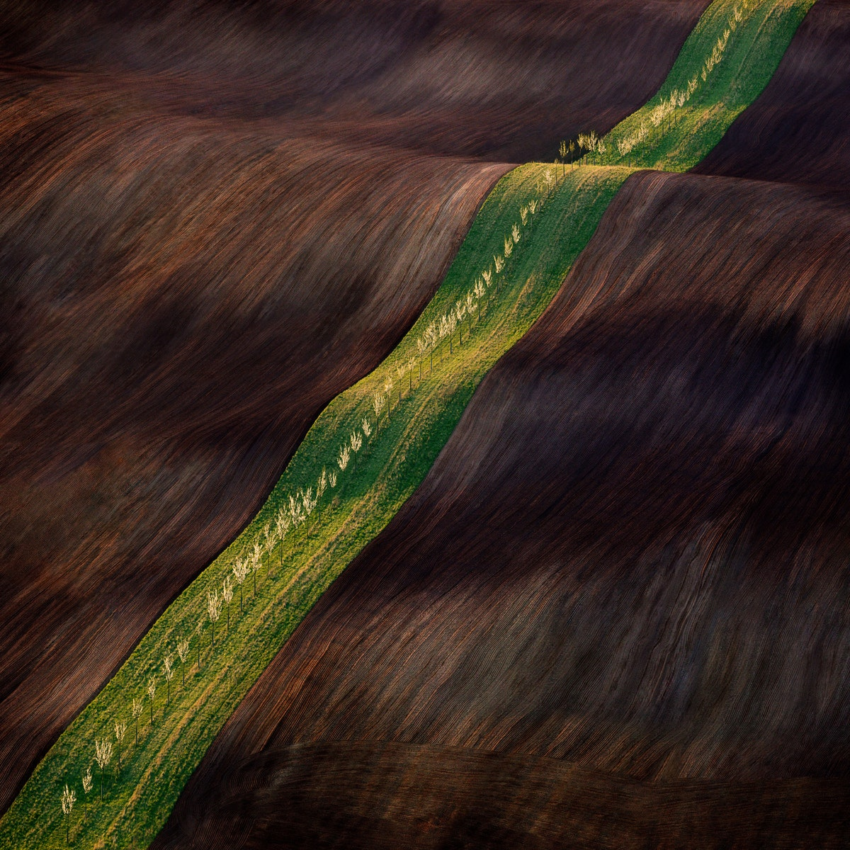
© Ladislav Kamarád, Czech Republic

Slide 39
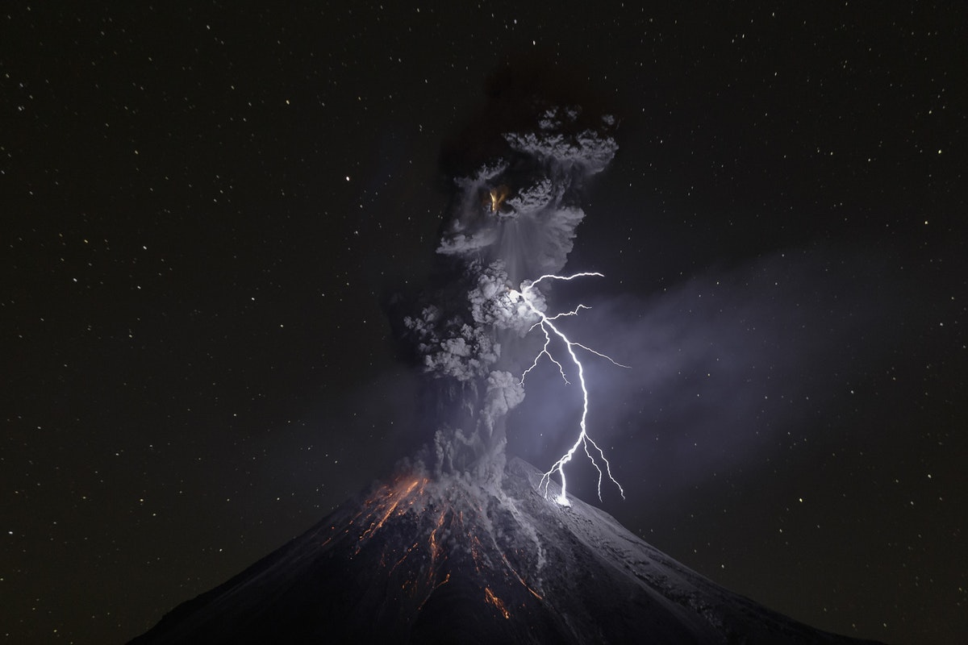
© Sergio Tapiro, Mexico

Slide 40
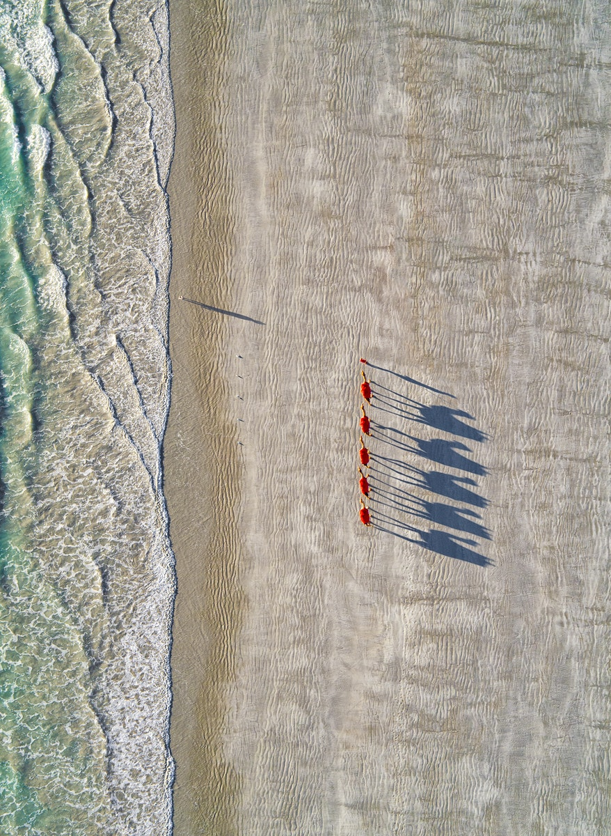
© Yane Sotiroski, Australia

Slide 41
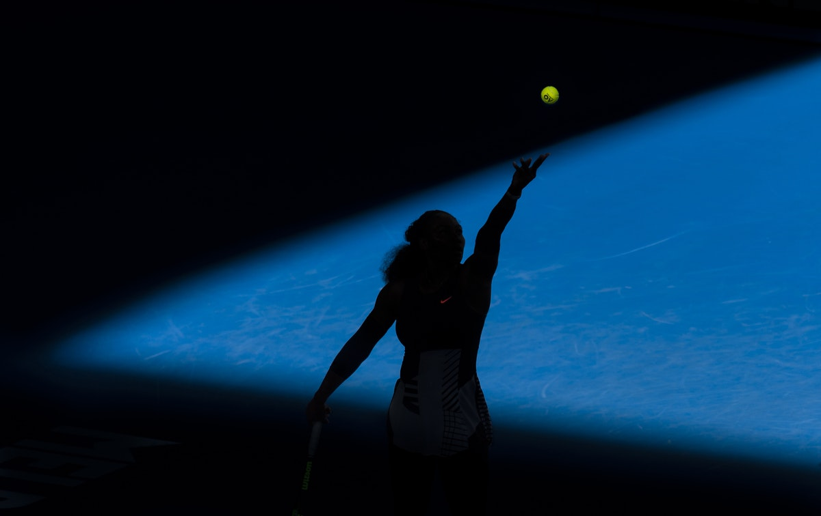
Reportage / Photojournalism
© Andy Cheung, Australia

Slide 42
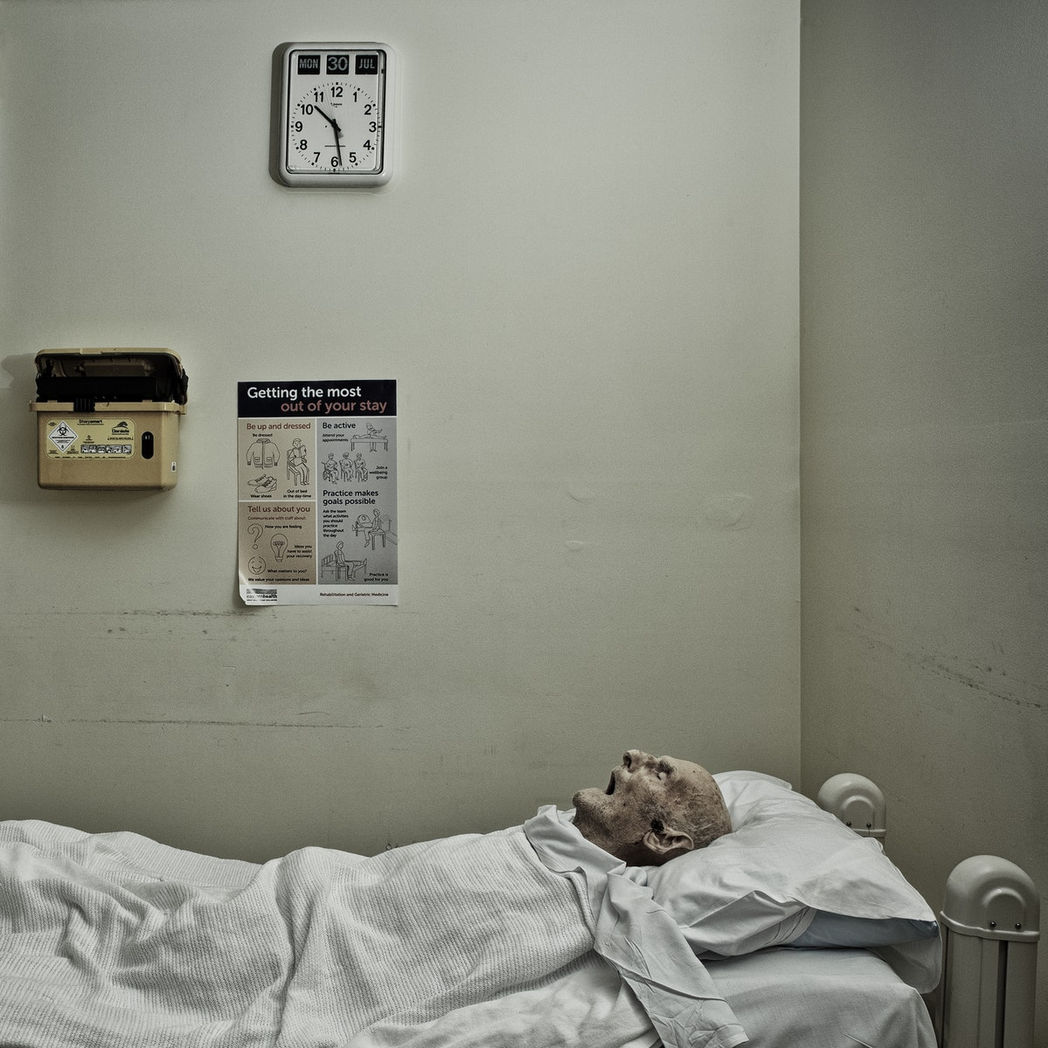
© Christopher Ian, Australia

Slide 43
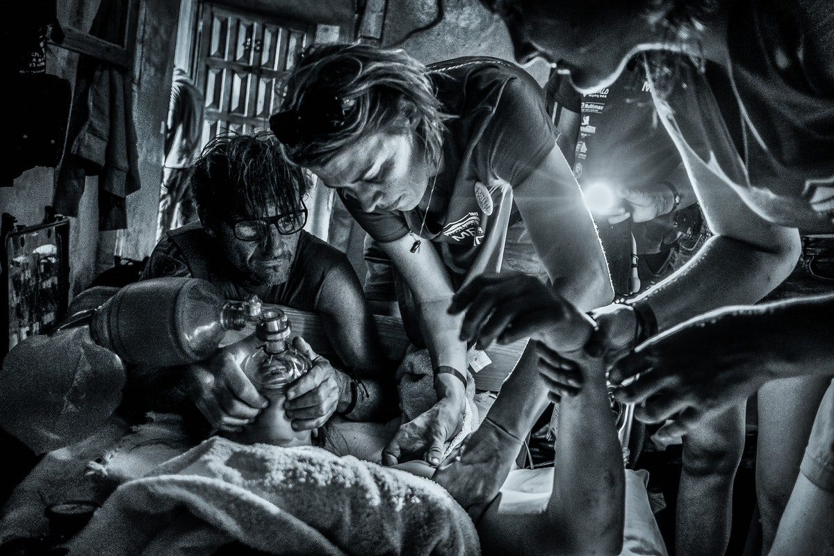
© Evi Polak, Belgium

Slide 44
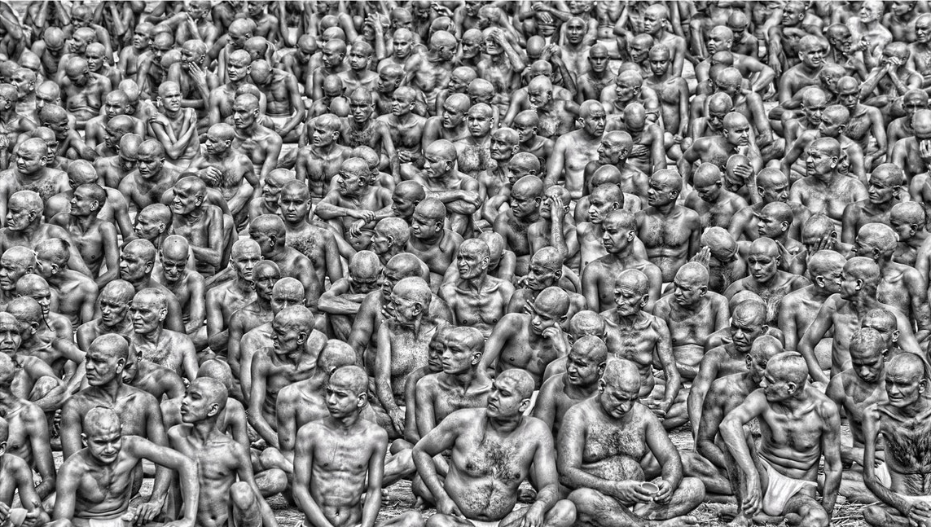
© Gail Nogle, United States

Slide 45
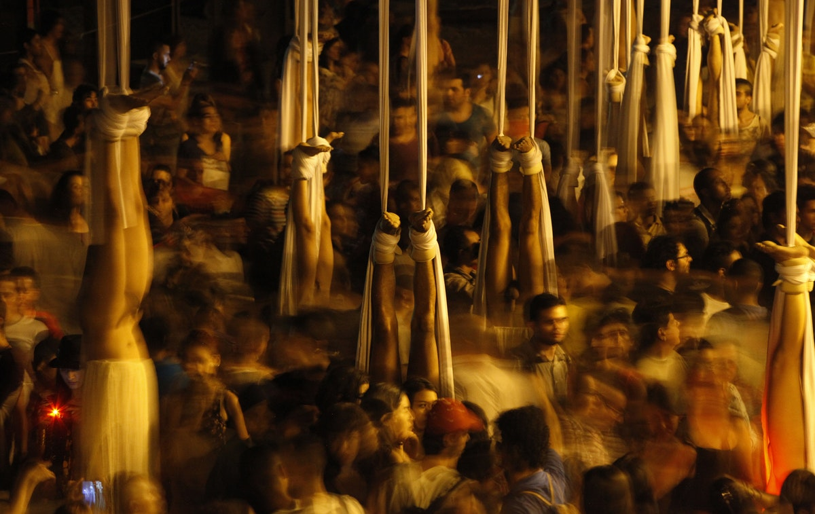
© Henry Agudelo Cano, Colombia

Slide 46
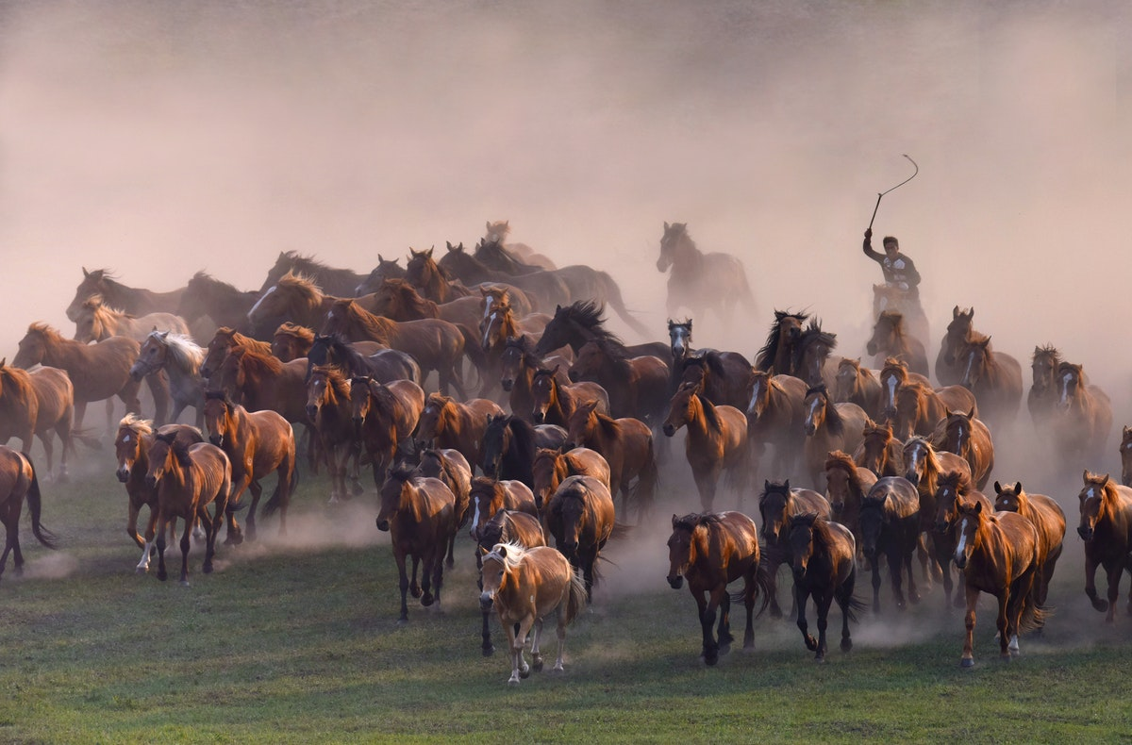
© Kazuyoshi Shimoda, Japan

Slide 47
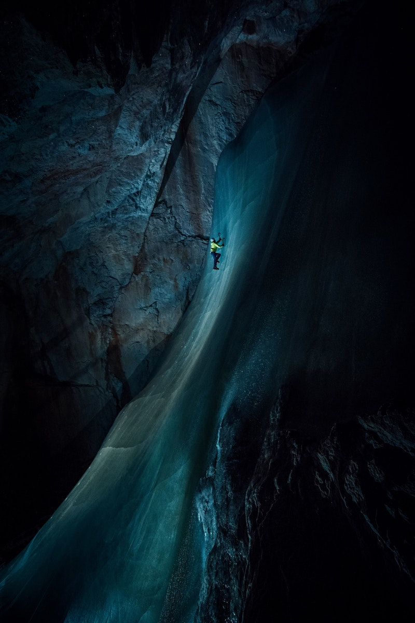
© Markus Berger , Austria

Slide 48
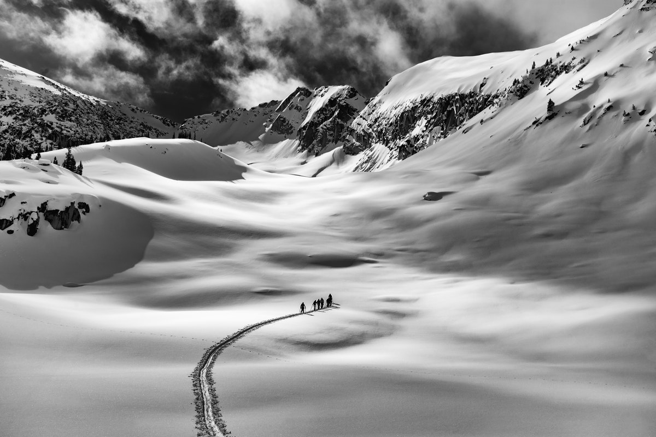
© Paul Wright, Canada

Slide 49
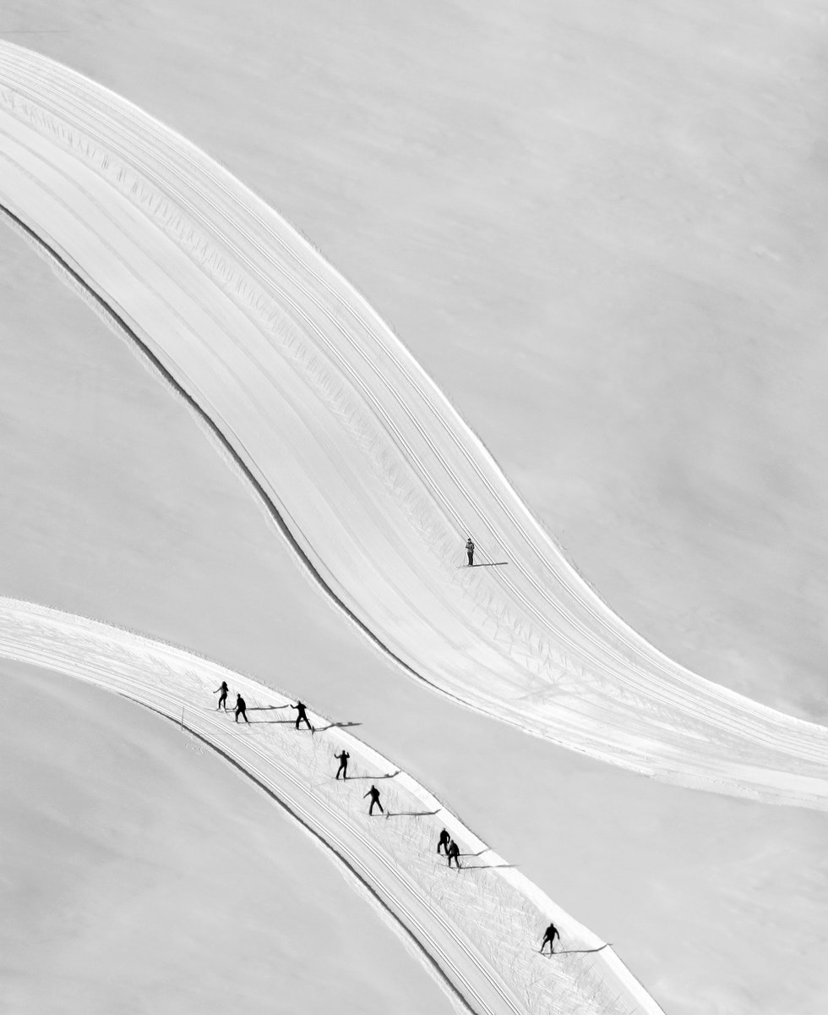
© Peter Svoboda, Slovakia

Slide 50
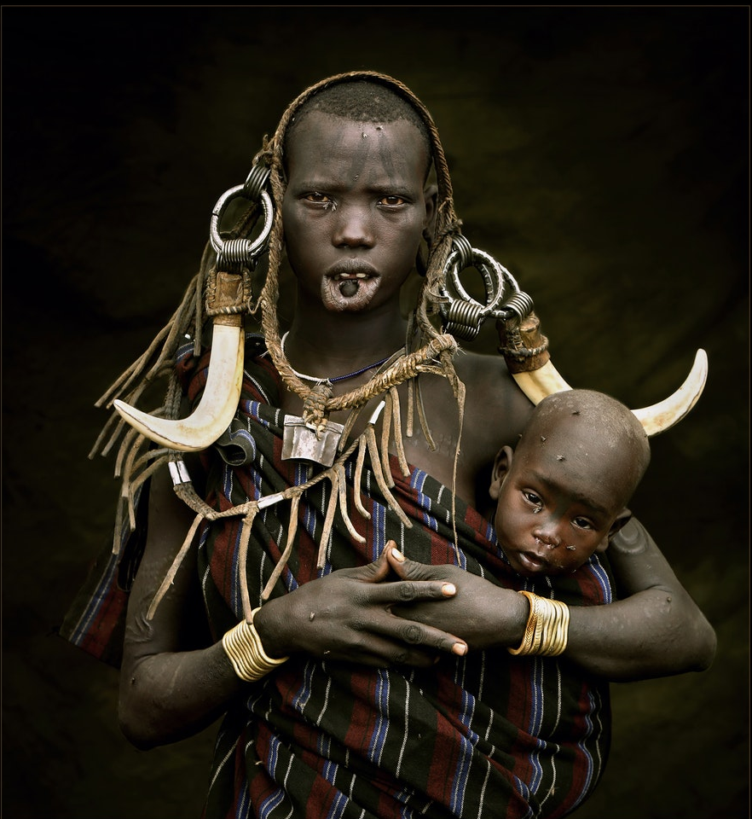
© Ulrich Schulte, Sweden

Slide 51

Wedding
© Anka Zhuravleva, Russia

Slide 52
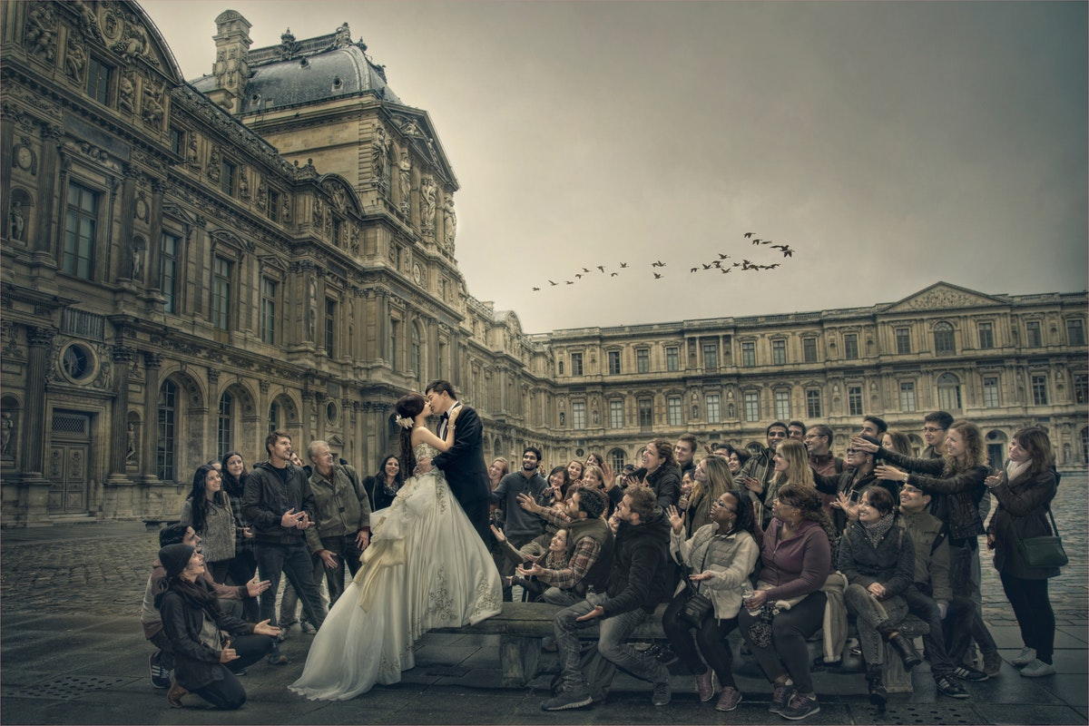
© Deric Wan Kin Tong, Malaysia

Slide 53
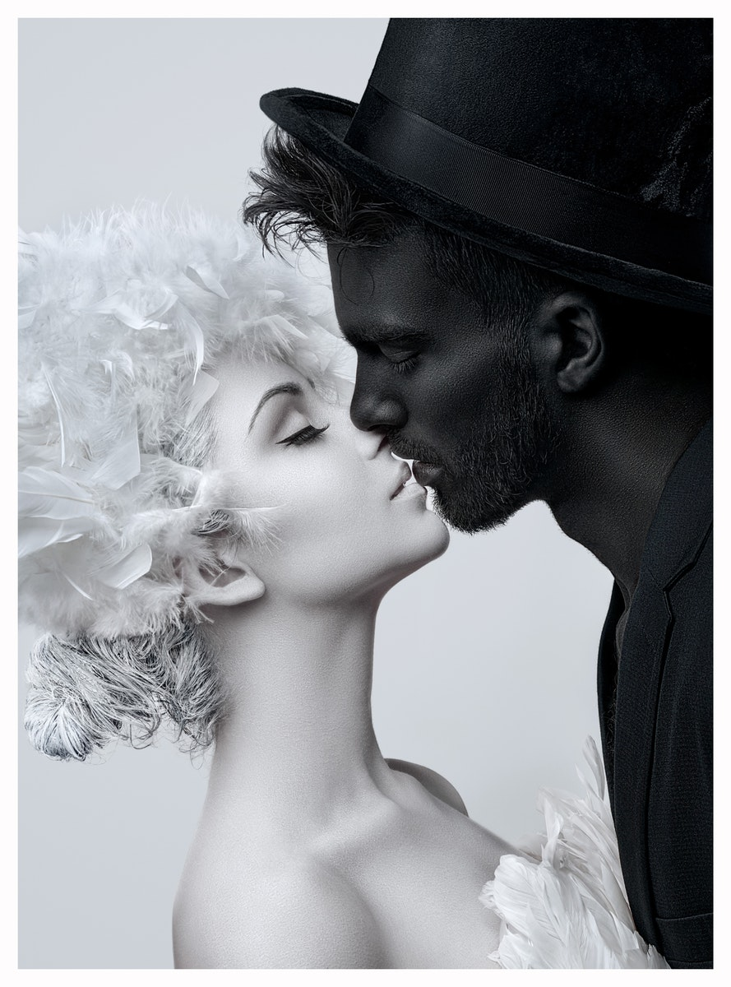
© Erich Caparas, United States

Slide 54

© Francie Baltazar Stonestreet, United States

Slide 55

© José Presencia, Spain

Slide 56

© Jun Matsuoka, Japan

Slide 57
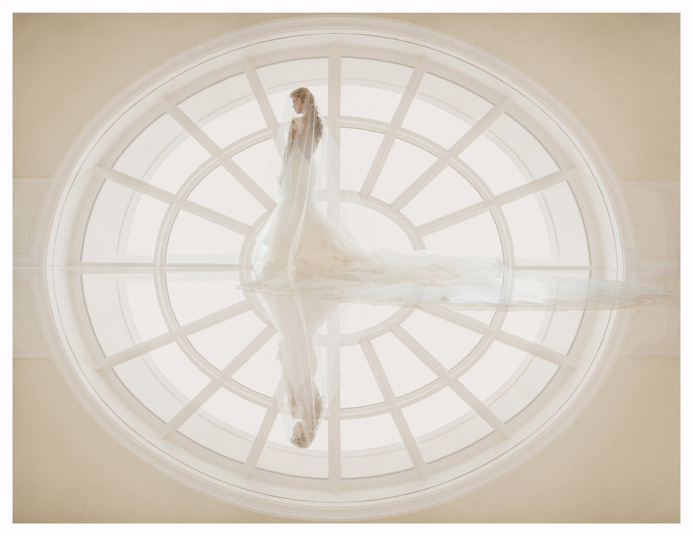
© Marceliano Munoz, United States

Slide 58
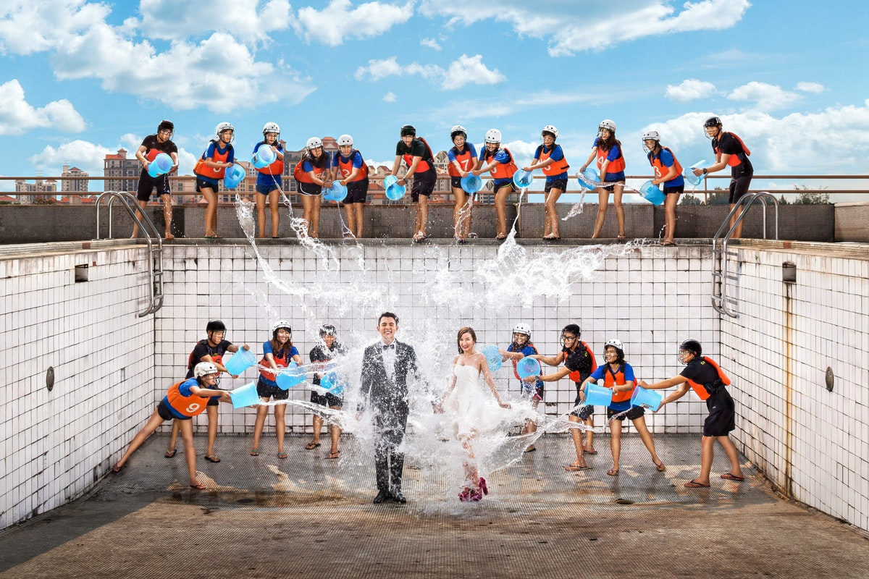
© Raymond Phang, Singapore

Slide 59
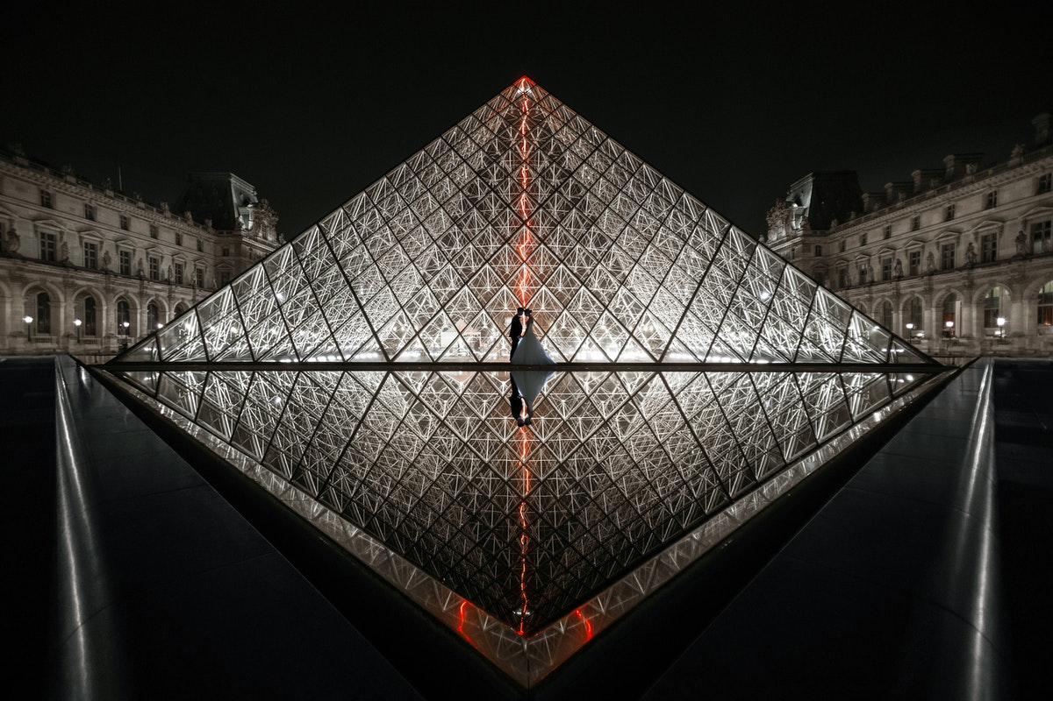
© Silvio Pinto, Portugal

Slide 60

January 23, 2018 王文堯 Kaohsiung Taiwan R.O.C
All photos were taken from WPC.
Sound : The Carpenters - Goodbye and I Love
© Xiaojun Fan, China
THE END

