Slide 1
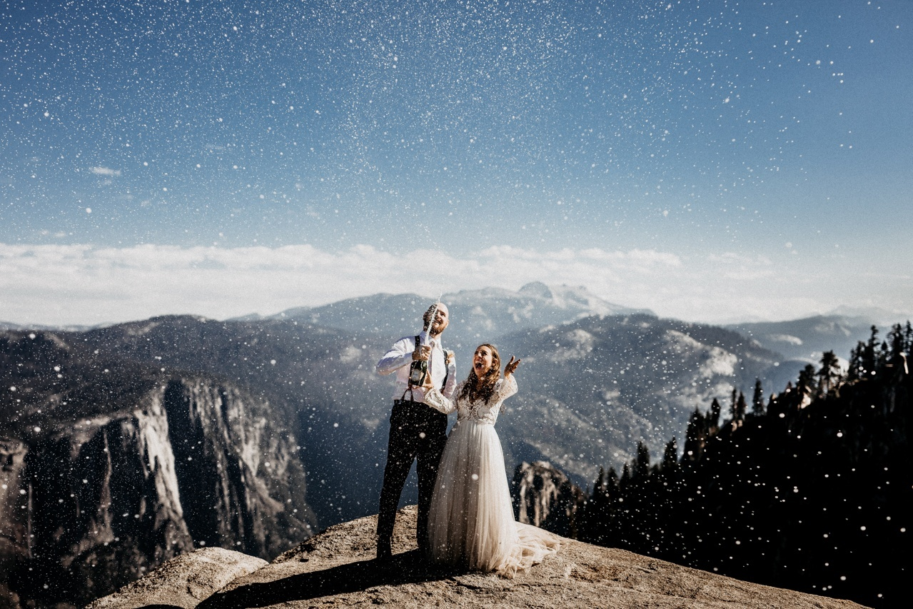
the Best of the Best 2017
THE BEST WEDDING PHOTOS OF THE YEAR
Junebug weddings.com

Slide 2
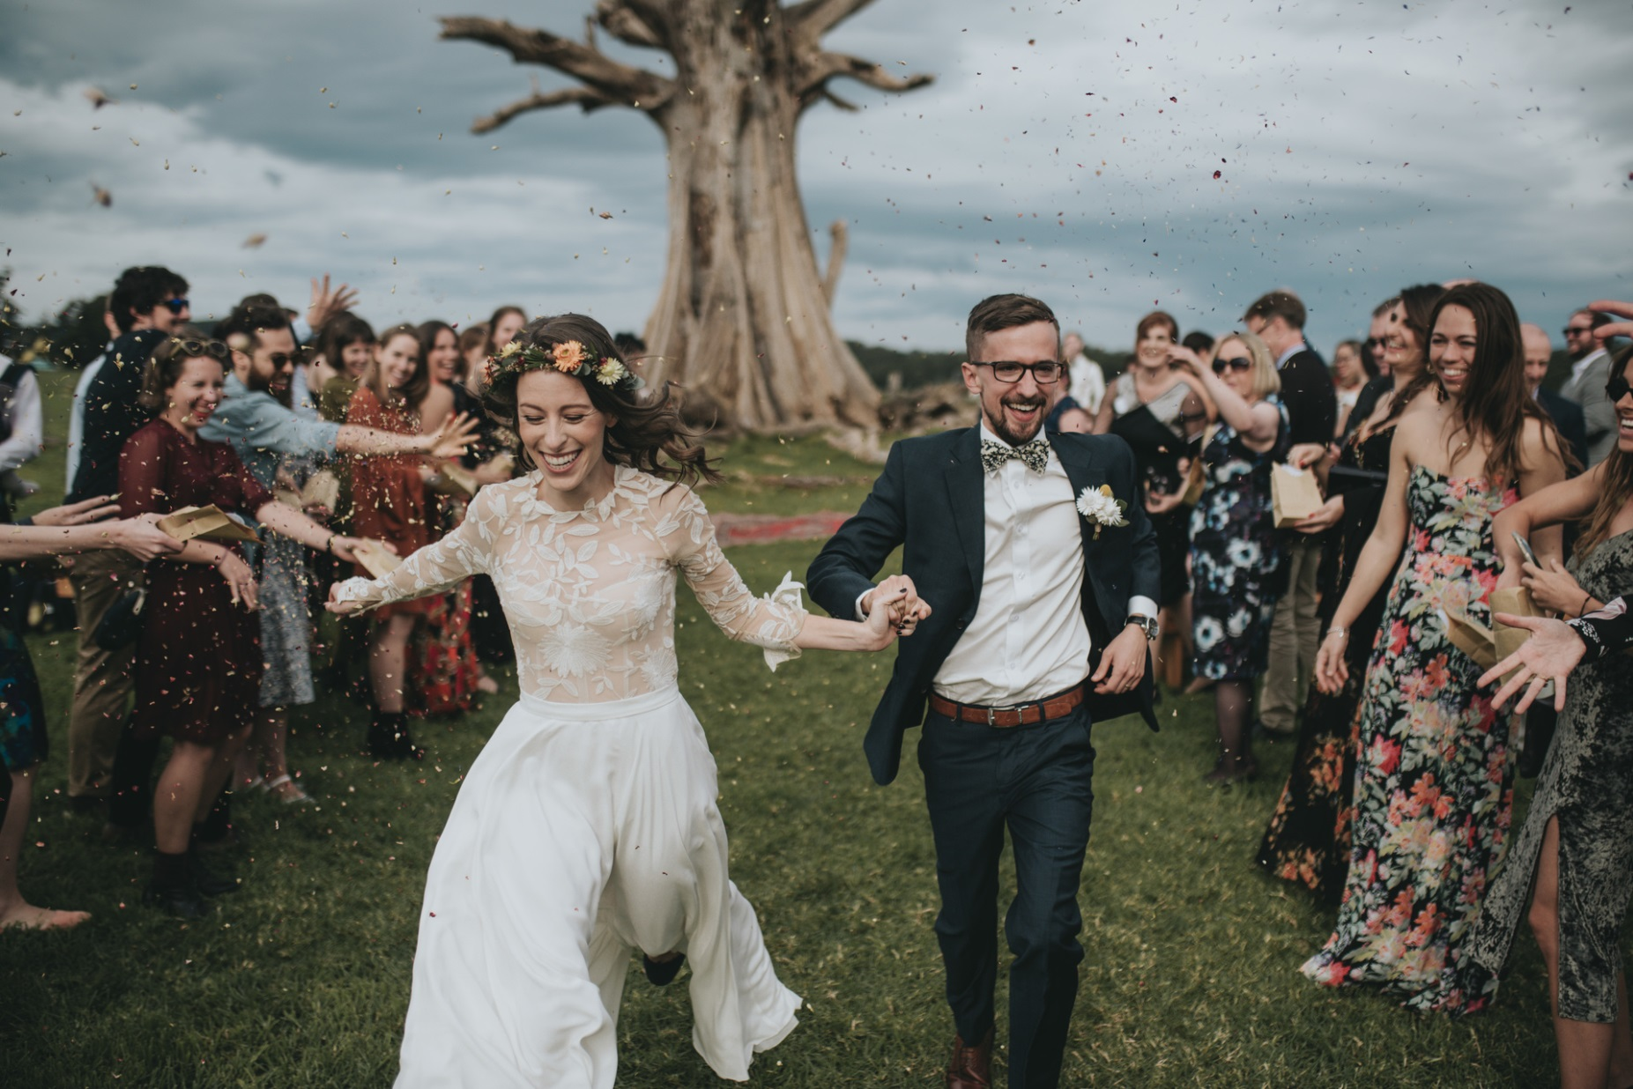
© Ben Sowry of Ben Sowry Photo

Slide 3
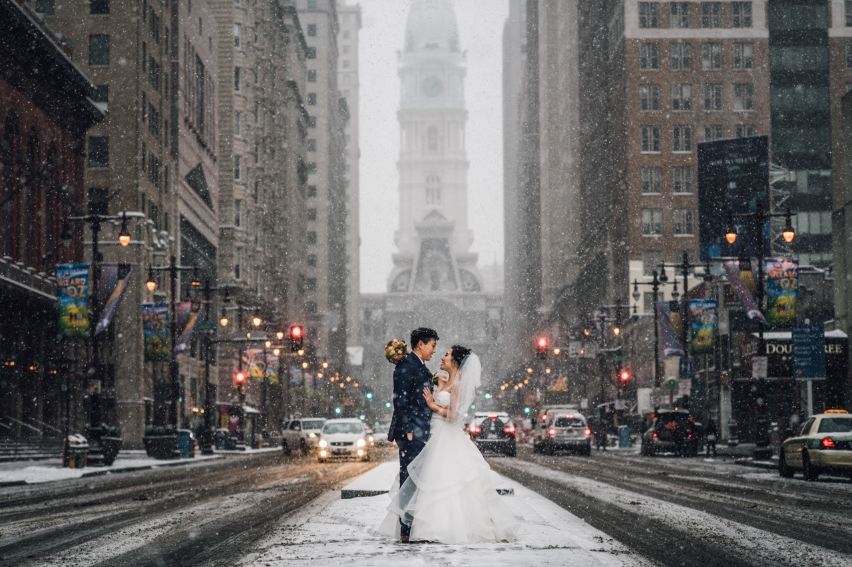
© JD Land of Two15 Photography

Slide 4
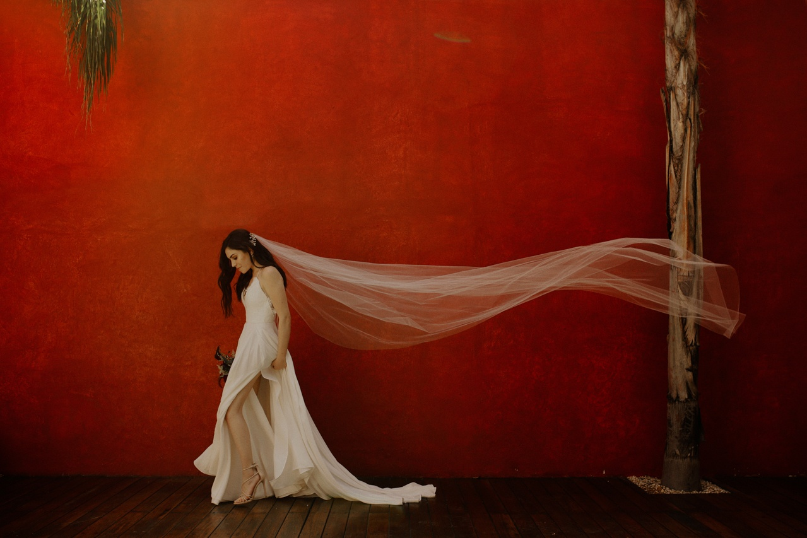
© Oscar Castro of Oscar Castro Photography

Slide 5
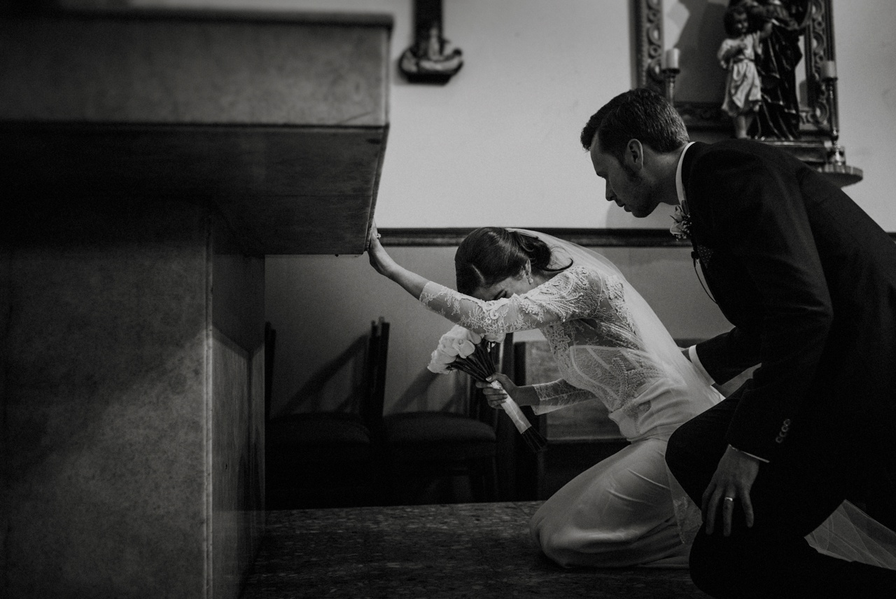
© Mario Tijerina of Mario Tijerina Photography

Slide 6

© Steve Stemmler of Tara Lilly Photography

Slide 7
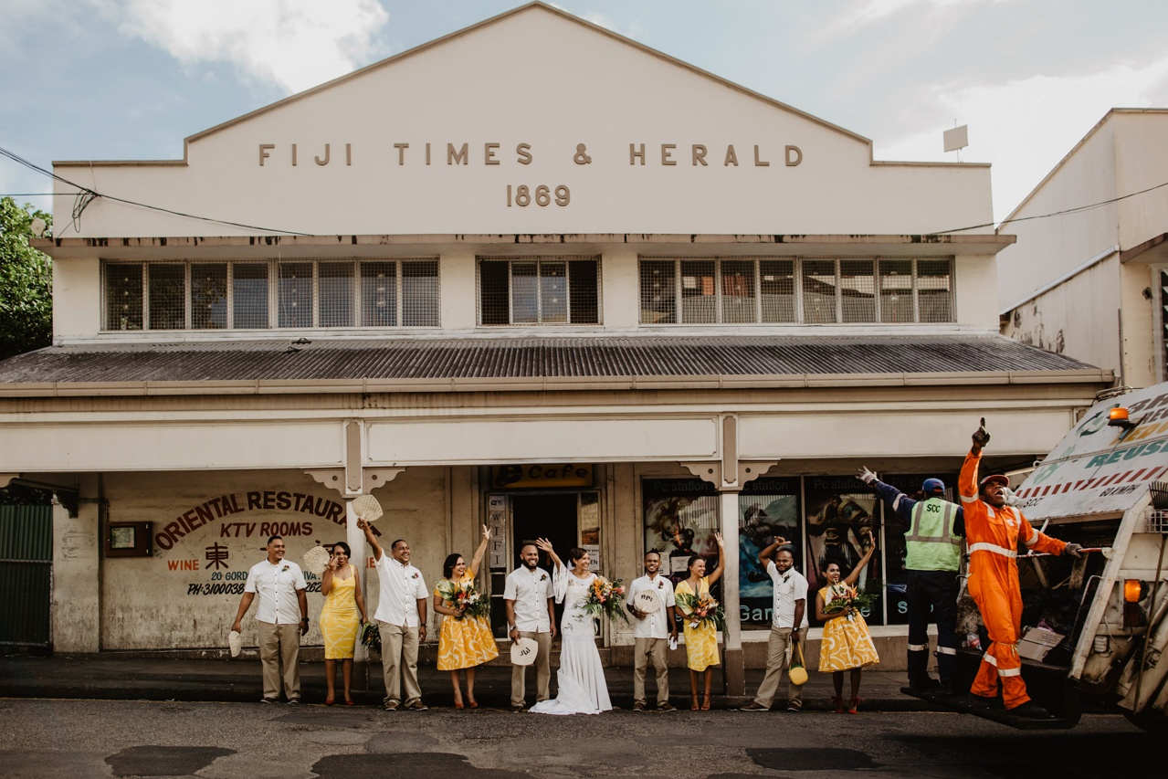
© Ropate Kama of Kama Catch Me

Slide 8
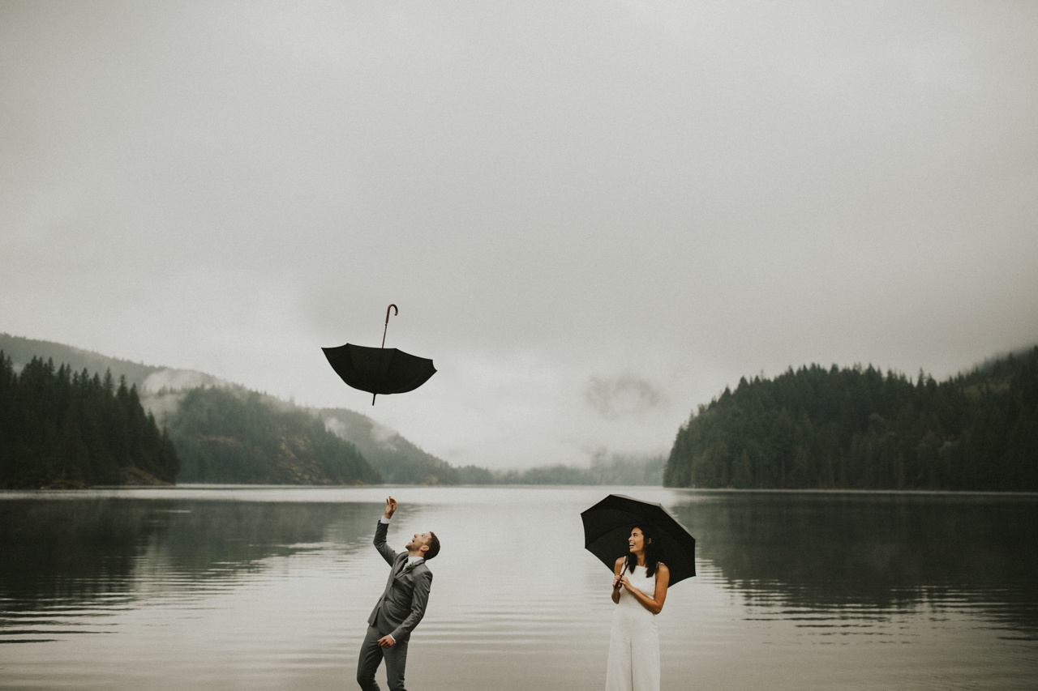
© Jeff Chang of Jeff and Cat of The Apartment Photography

Slide 9
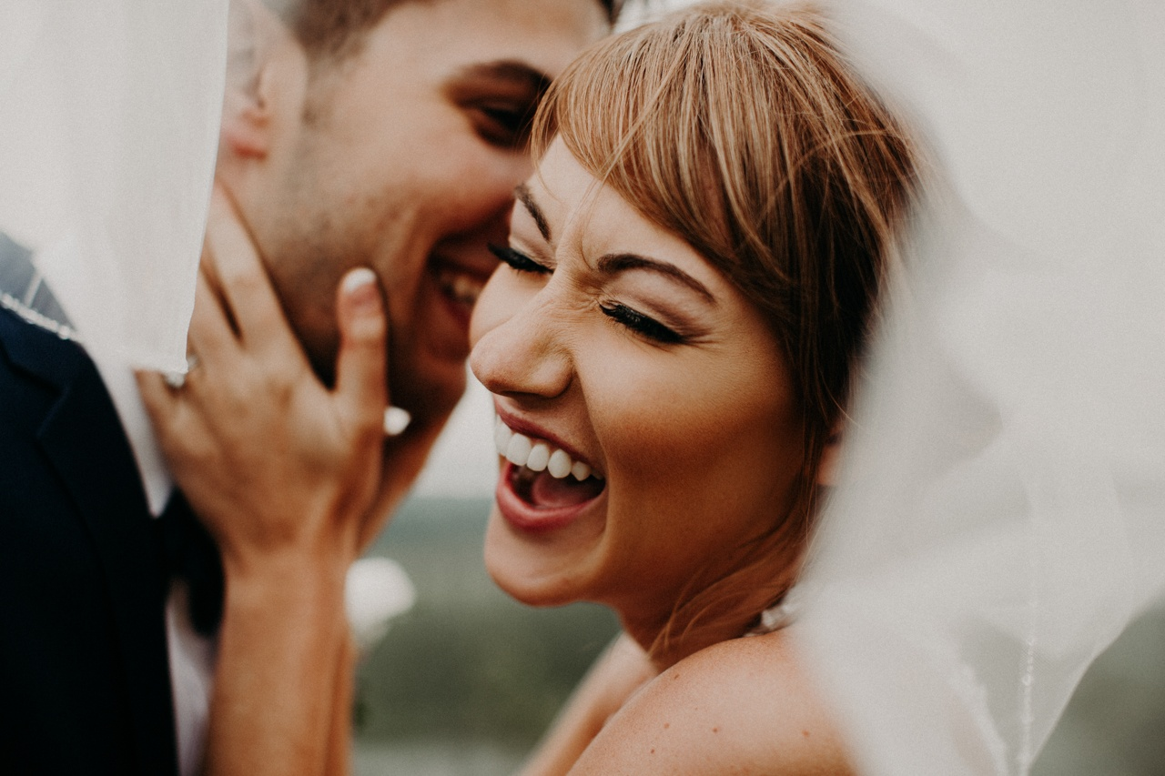
© Candice Anderson of Candice Marie Photography

Slide 10
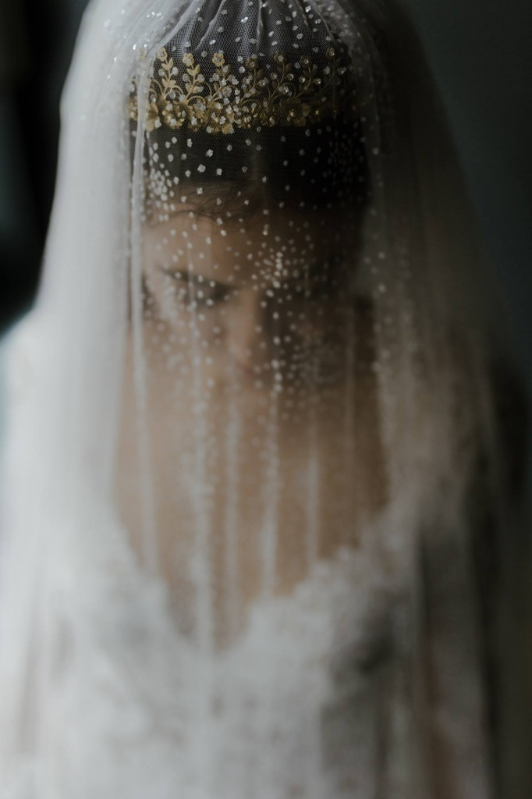
© Irina Florschutz of Irina and Matej

Slide 11
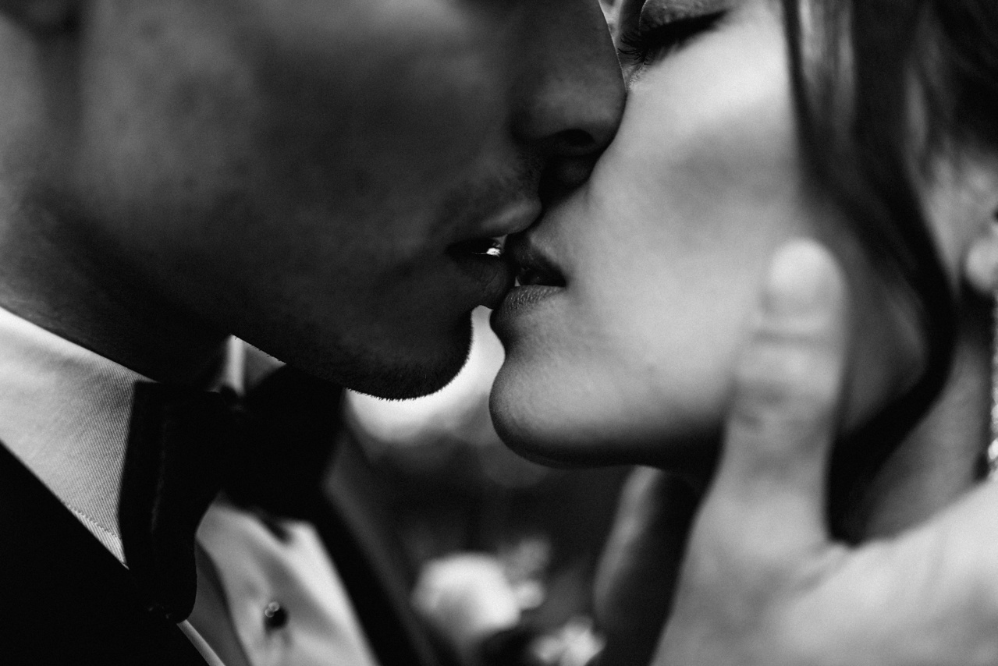
© Erika Floor of In beeld met Floor

Slide 12
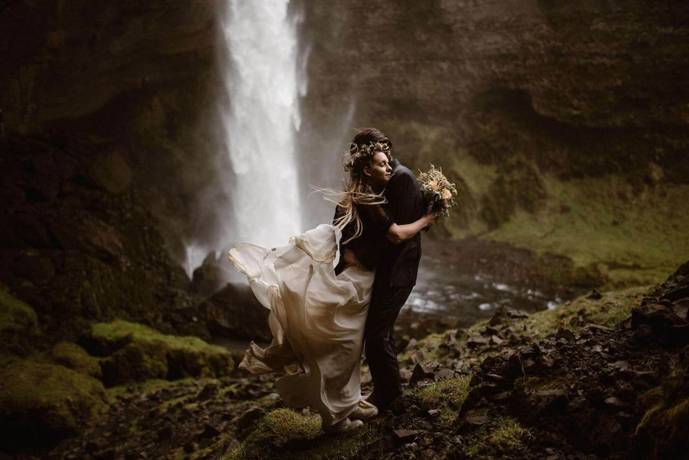
© Maddie Mae of Maddie Mae Adventure Elopement

Slide 13
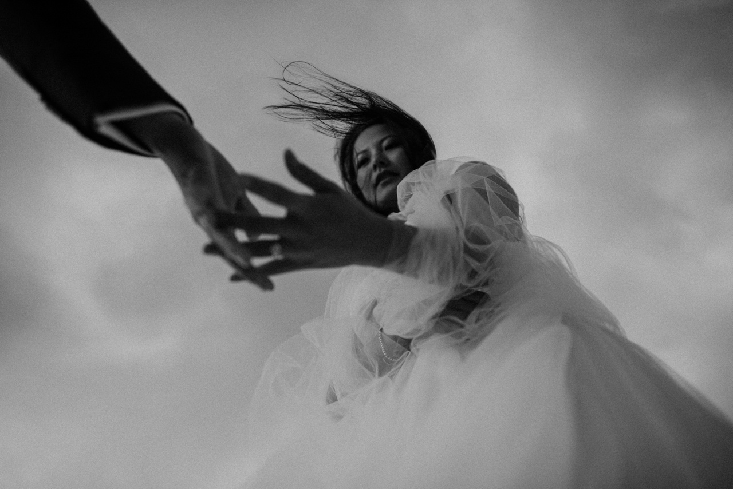
© Kyle Wilson of Hinterland Stills

Slide 14
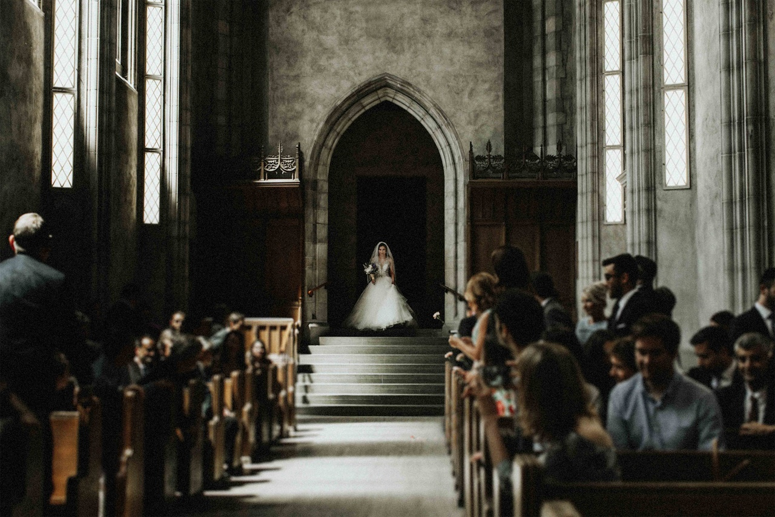
© Jessy Pesce of Bows & Lavender

Slide 15
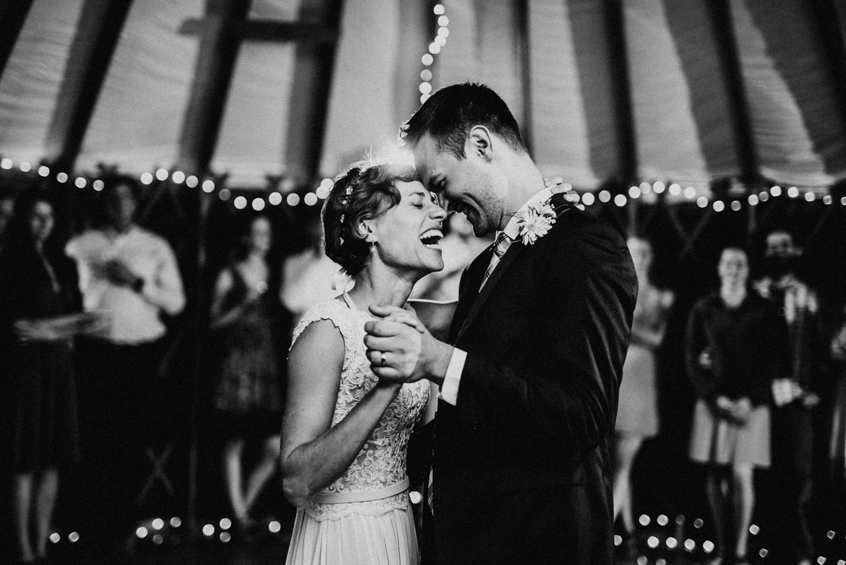
© Katie Forbis of Vein + Vessel

Slide 16
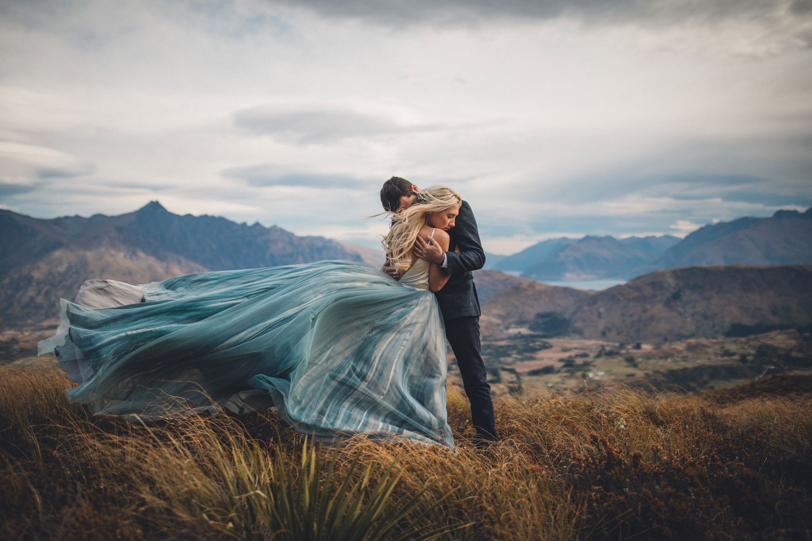
© Jim Pollard of Pollard We Are

Slide 17
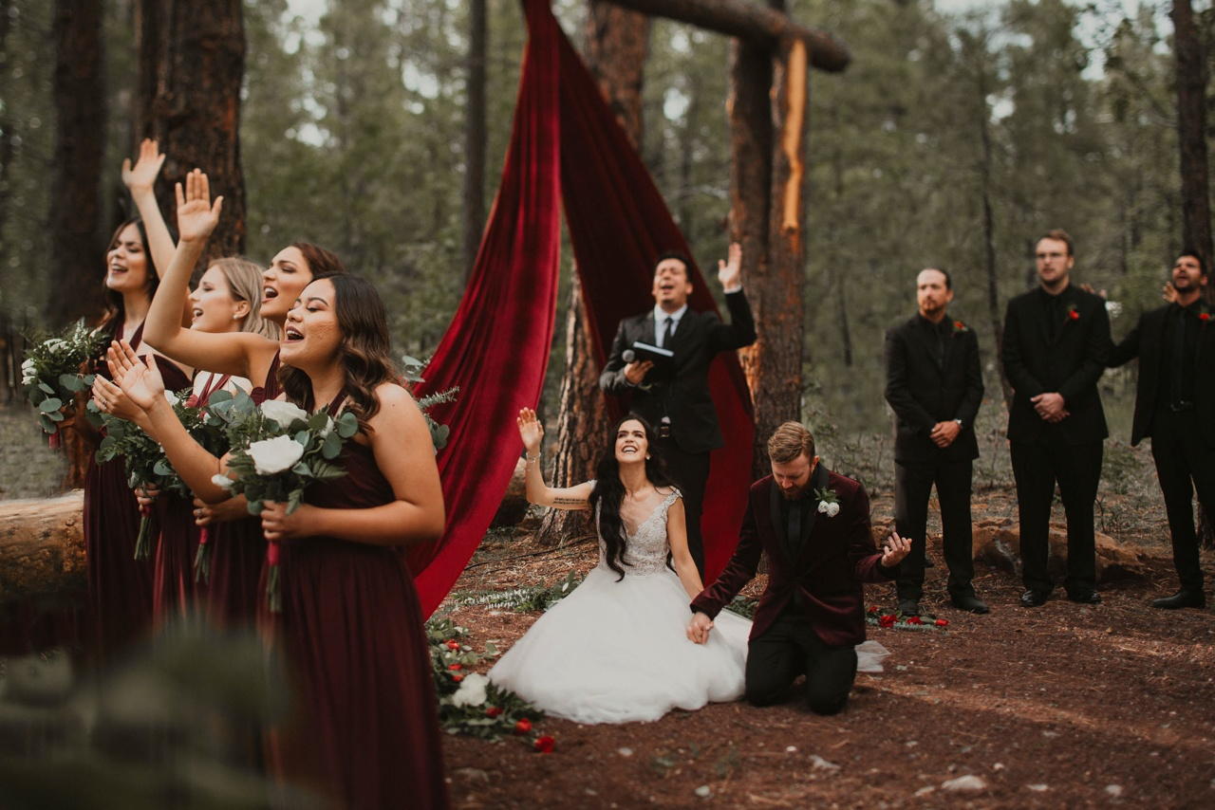
© Cody Harris of CODY & ALLISON

Slide 18
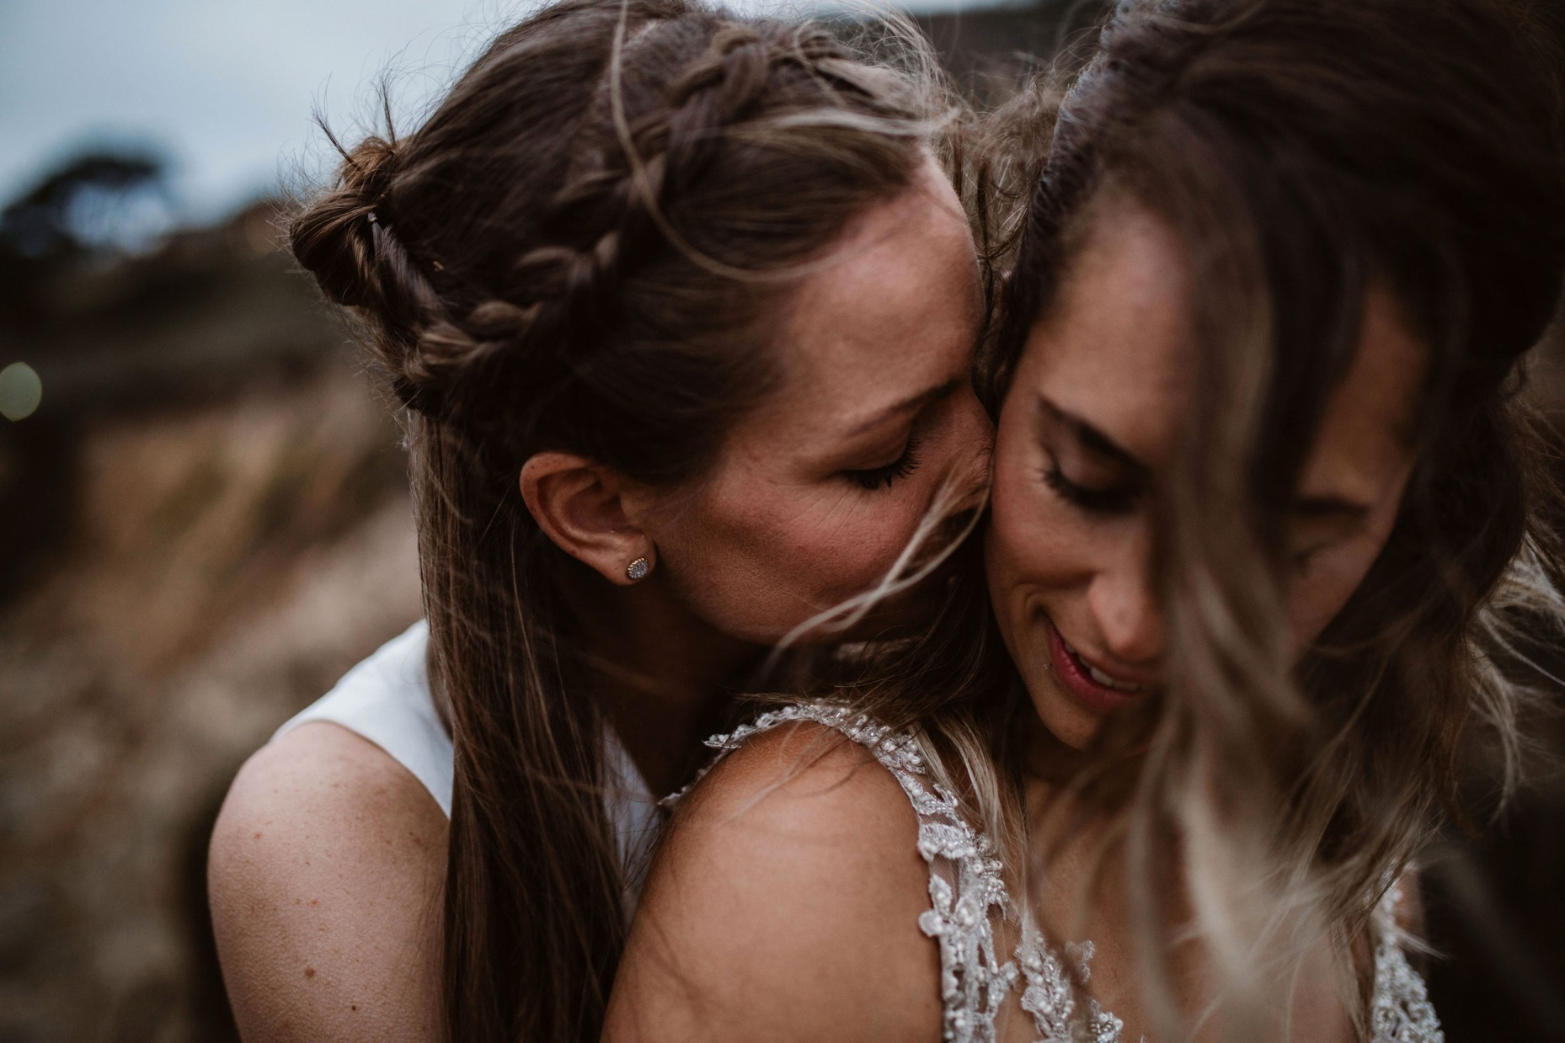
© Jake Mcanally of Whitney Justesen Photography

Slide 19
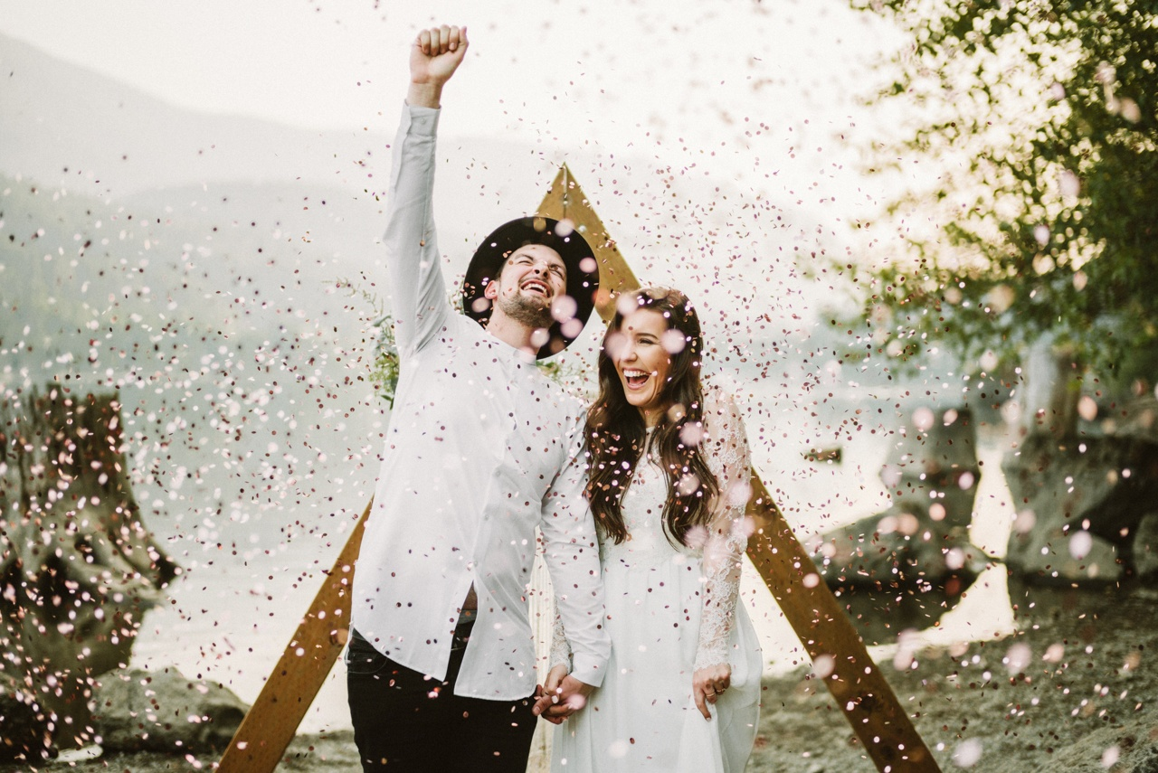
© Benj Haisch

Slide 20
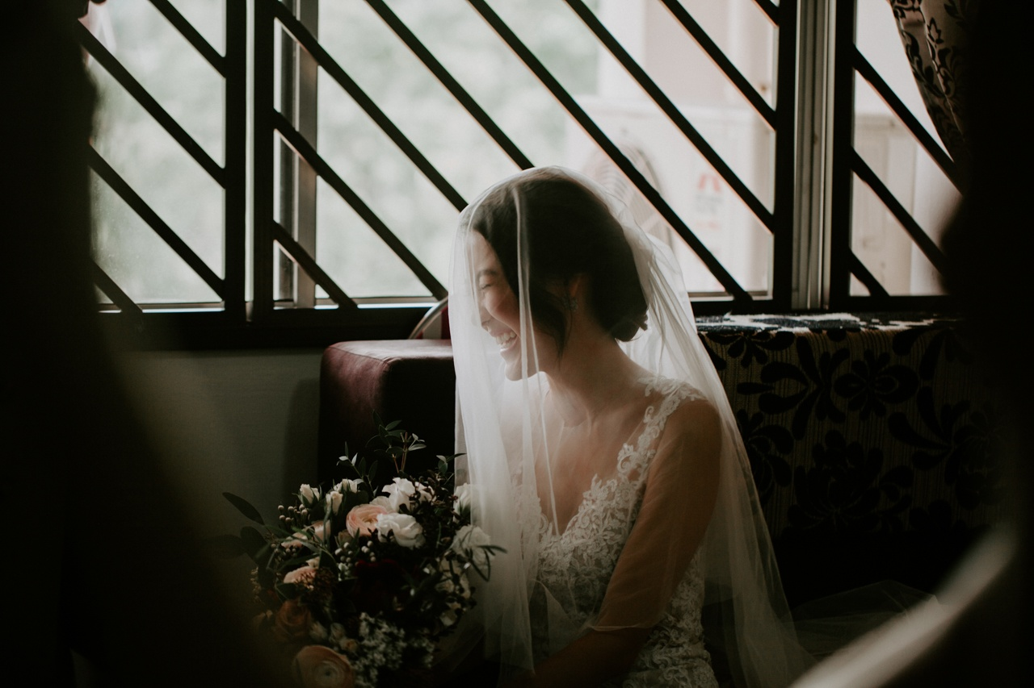
© Kuoloon Chong of Kompactfaen

Slide 21

© Eric Floberg

Slide 22
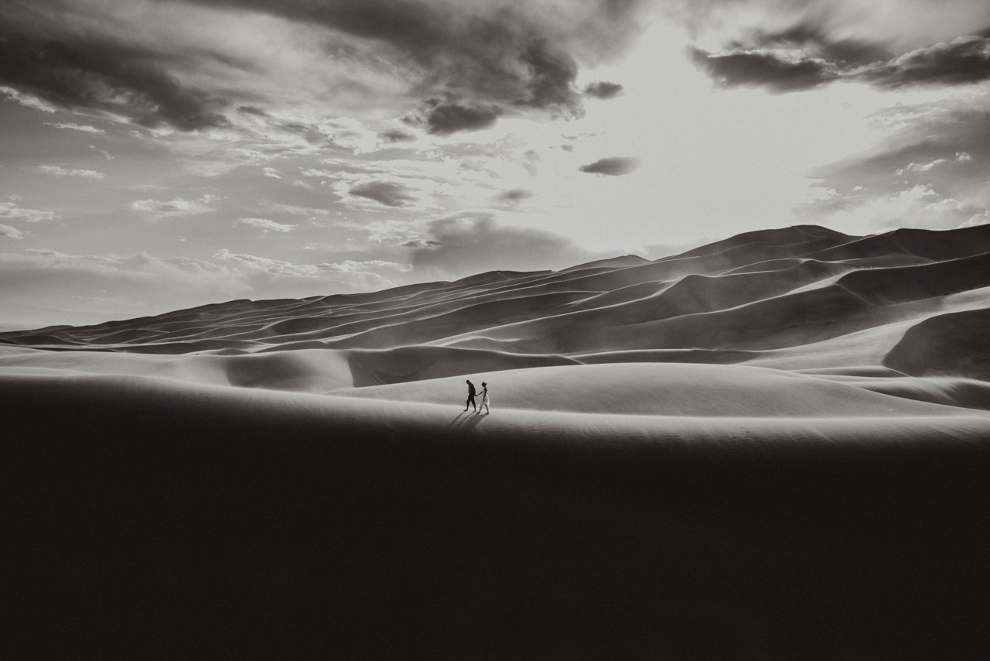
© Amy Painter of Amy Bluestar Photography

Slide 23
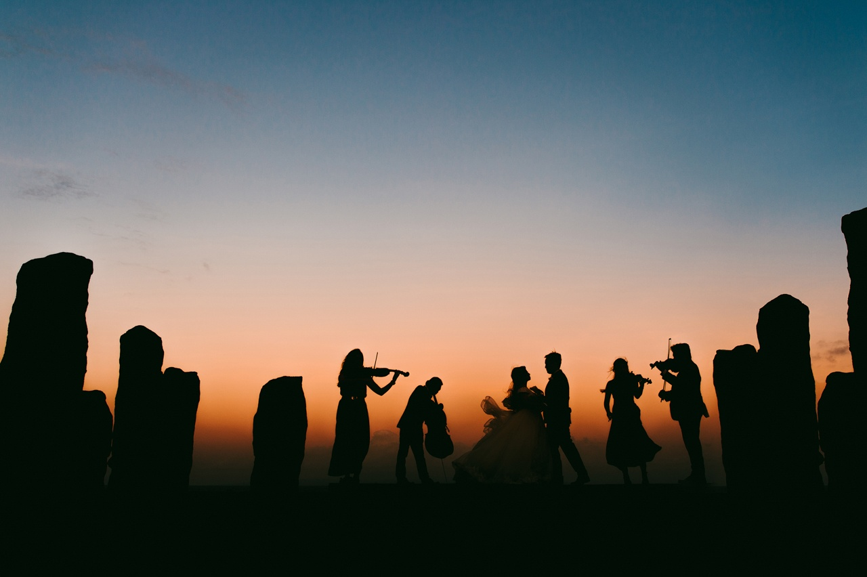
© Kadek Artayasa of diktatphotography

Slide 24
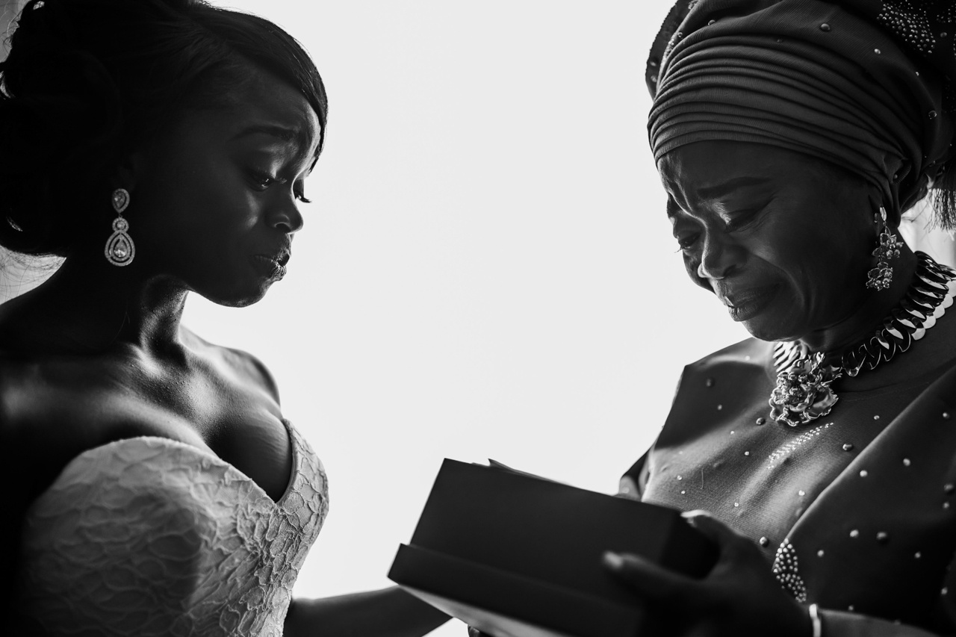
© Paul Woo of Wandering Woo

Slide 25
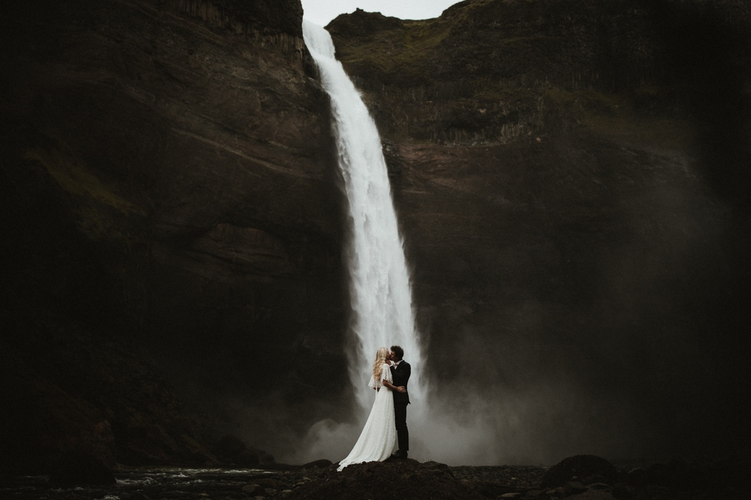
© James Frost of James Frost Photography

Slide 26
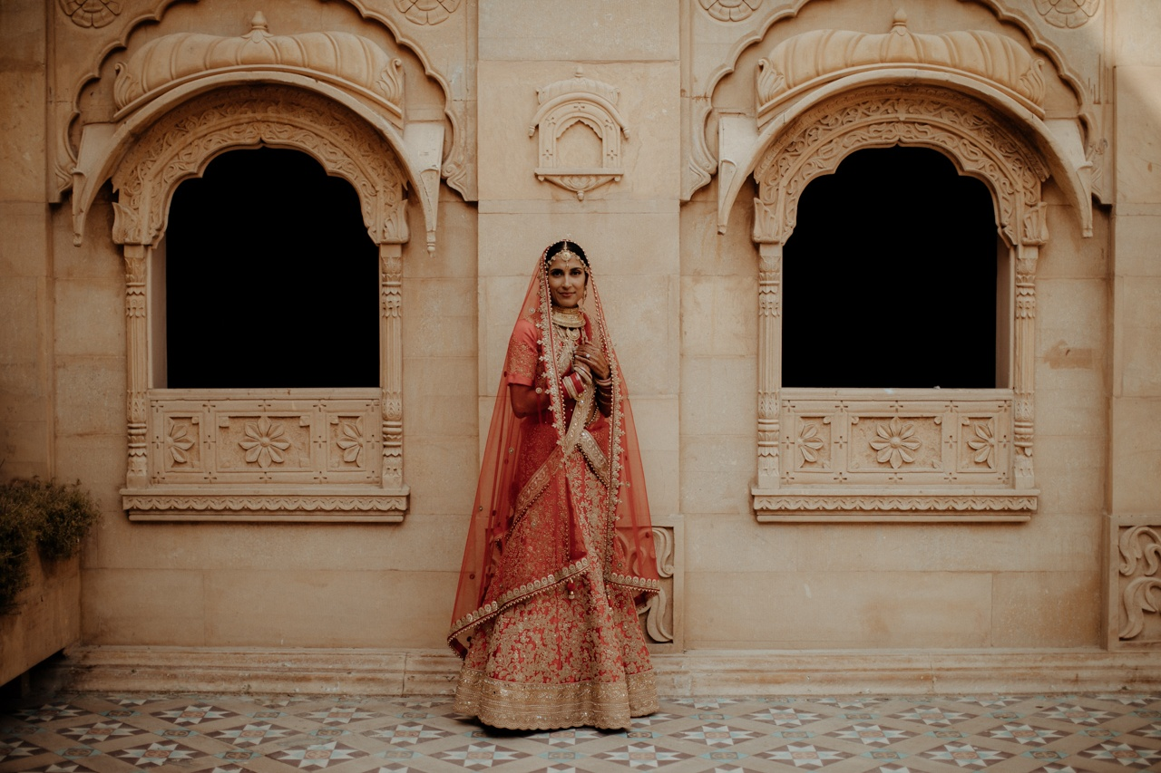
© James Broadbent of Chasewild

Slide 27
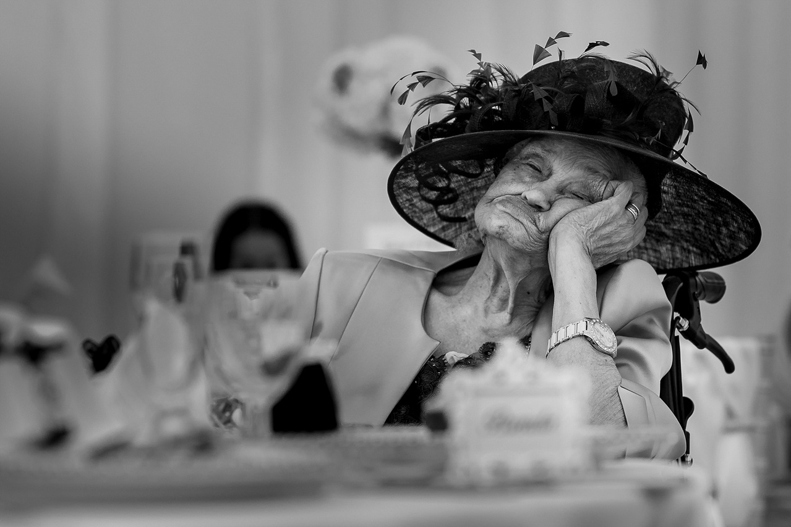
© Soven Amatya of Photography by Soven

Slide 28
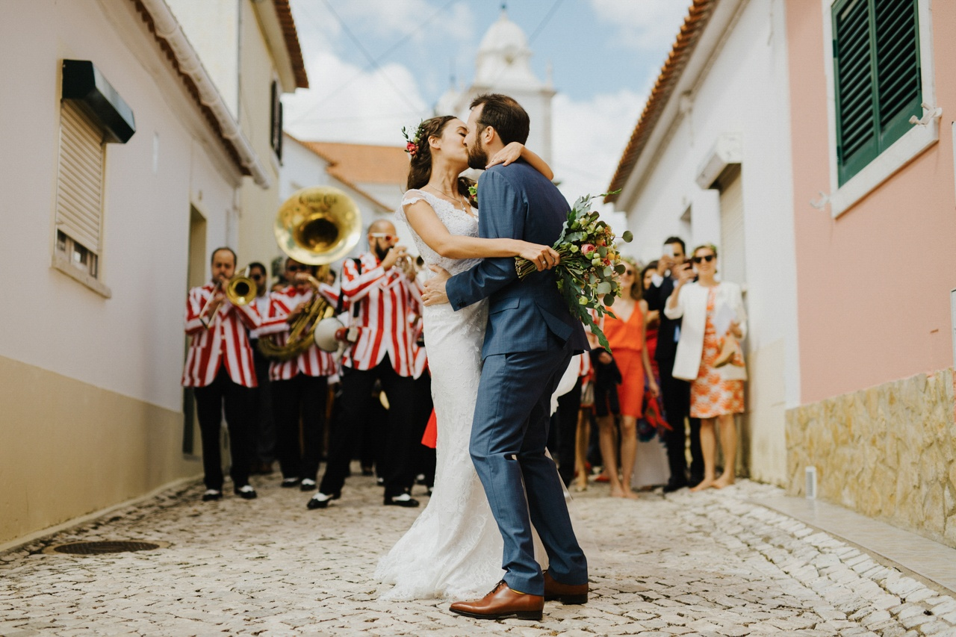
© Filipa Rosa of The Framers

Slide 29
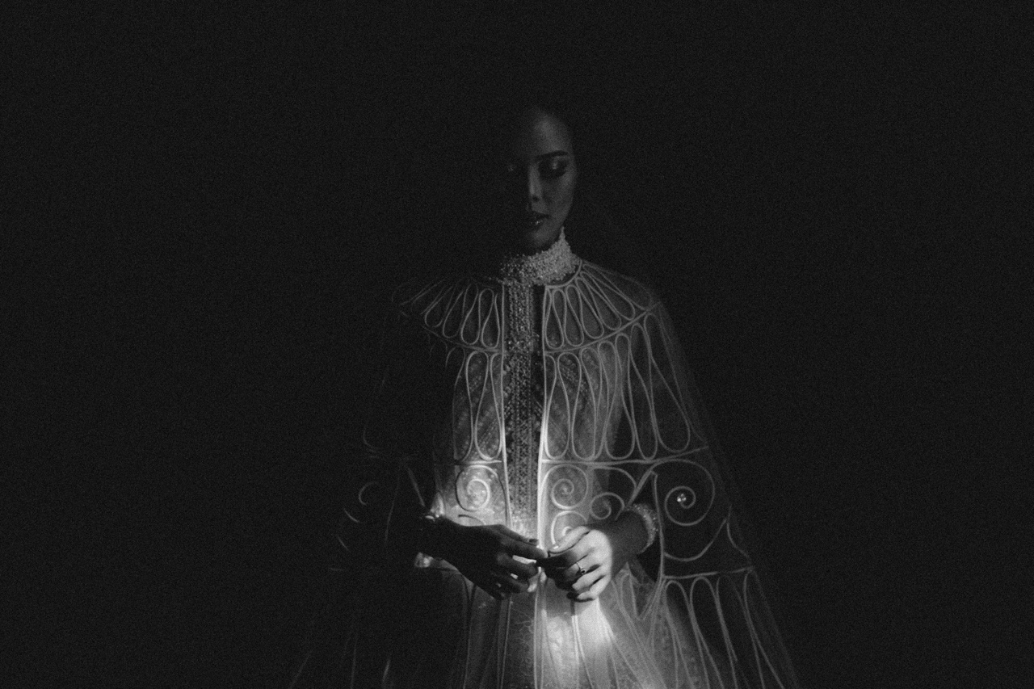
© Govinda Rumi of Terralogical

Slide 30
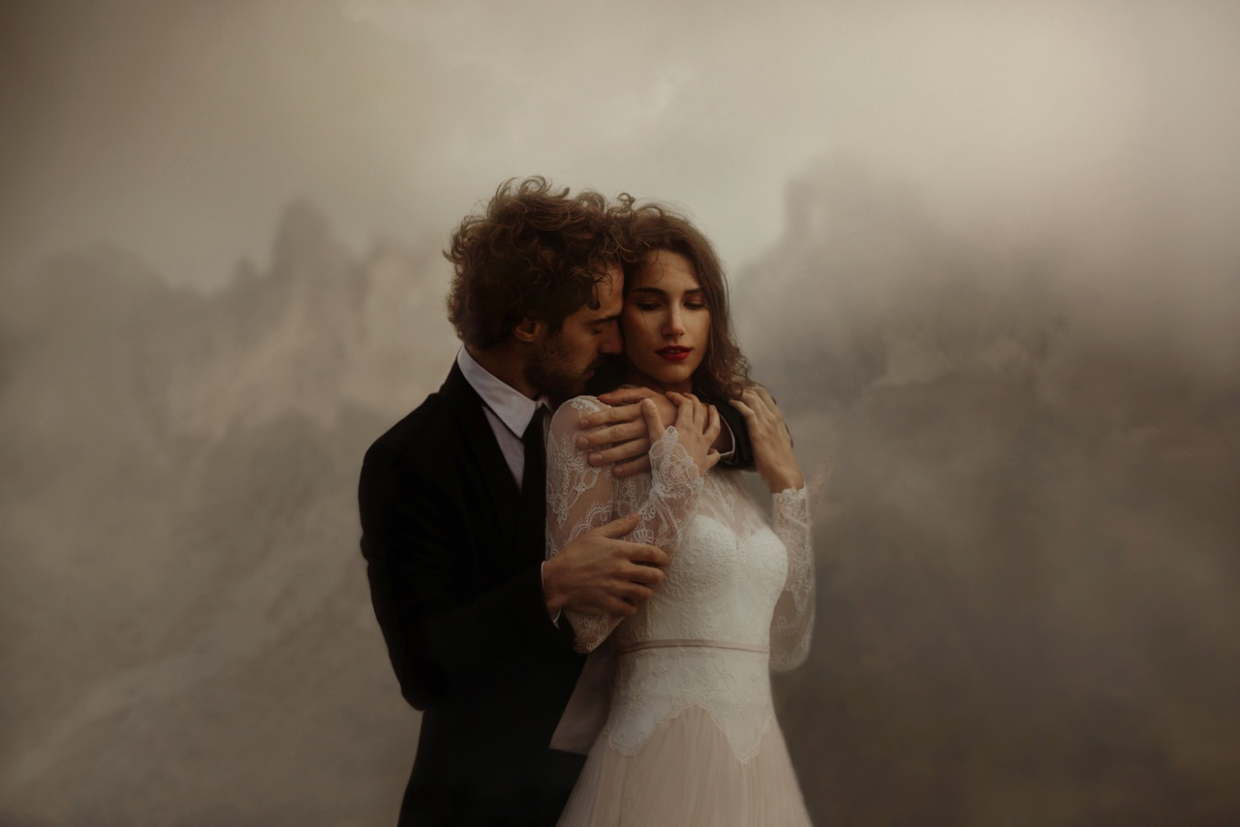
© Nico Roscini and Vinx Ferrara of The Ferros

Slide 31
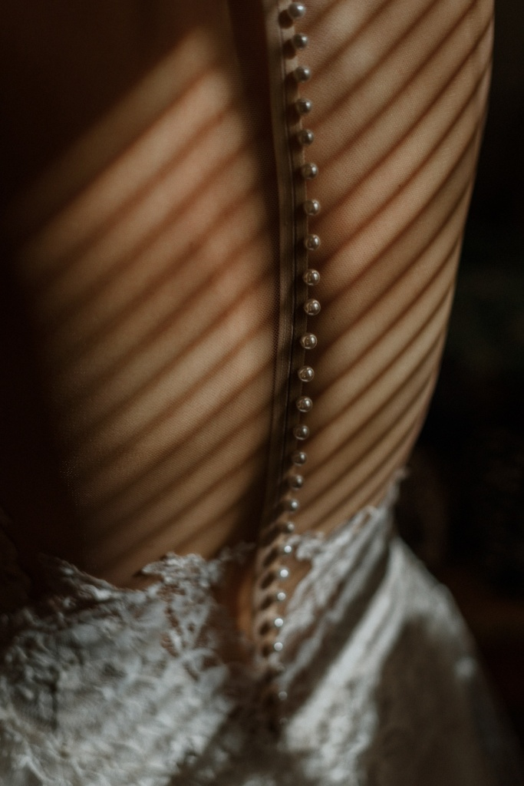
© Helena and Laurent Martin of Helena and Laurent

Slide 32
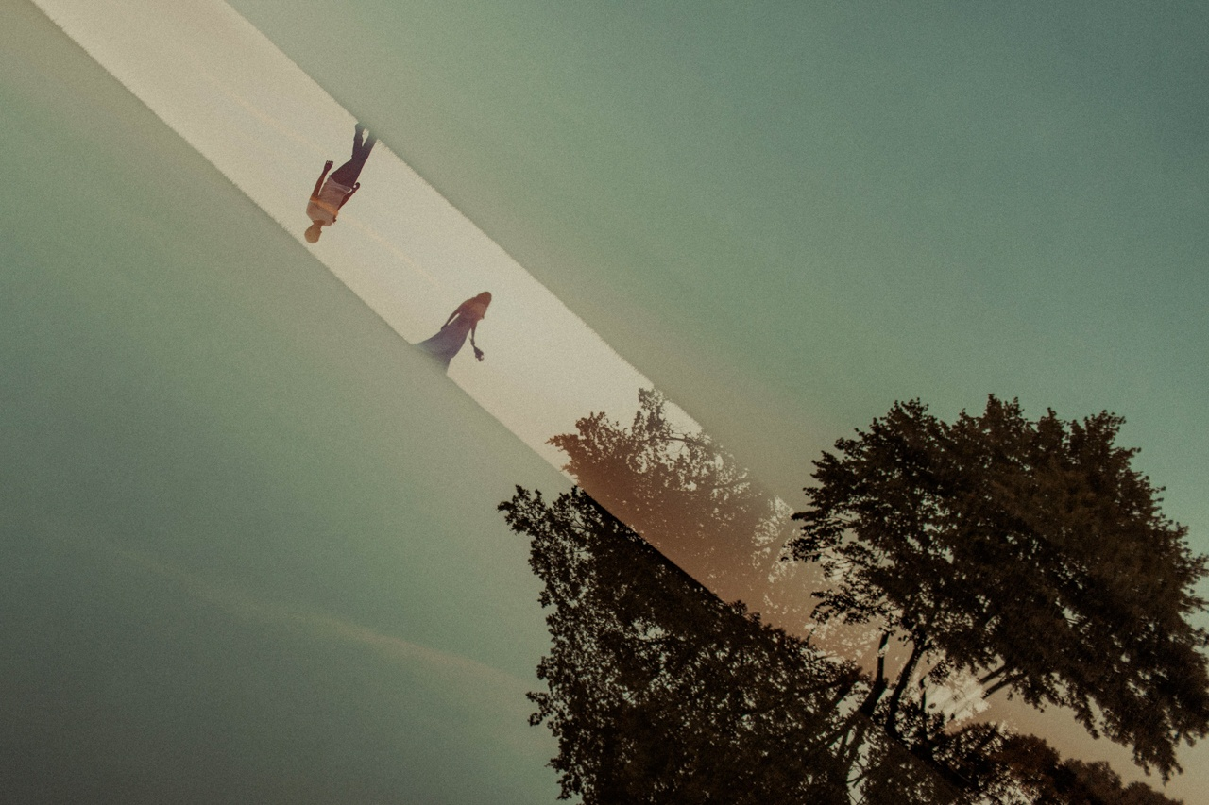
© Jacob Loafman

Slide 33
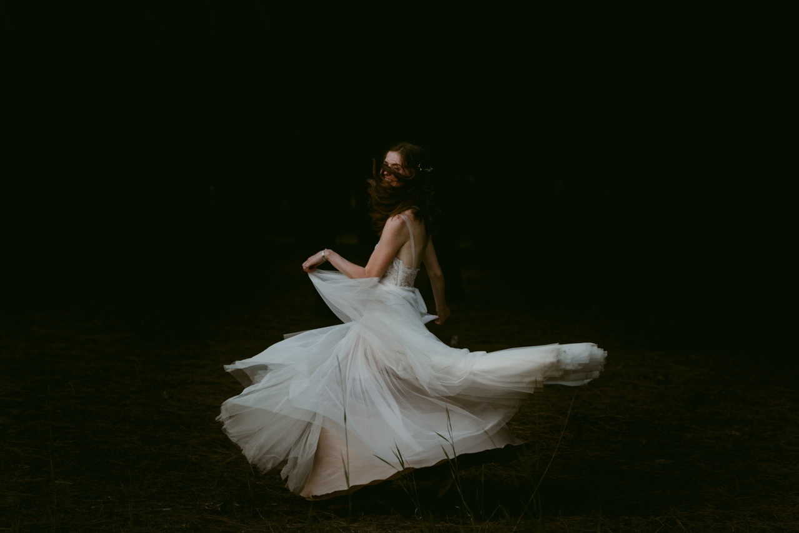
© Tori Pintar

Slide 34
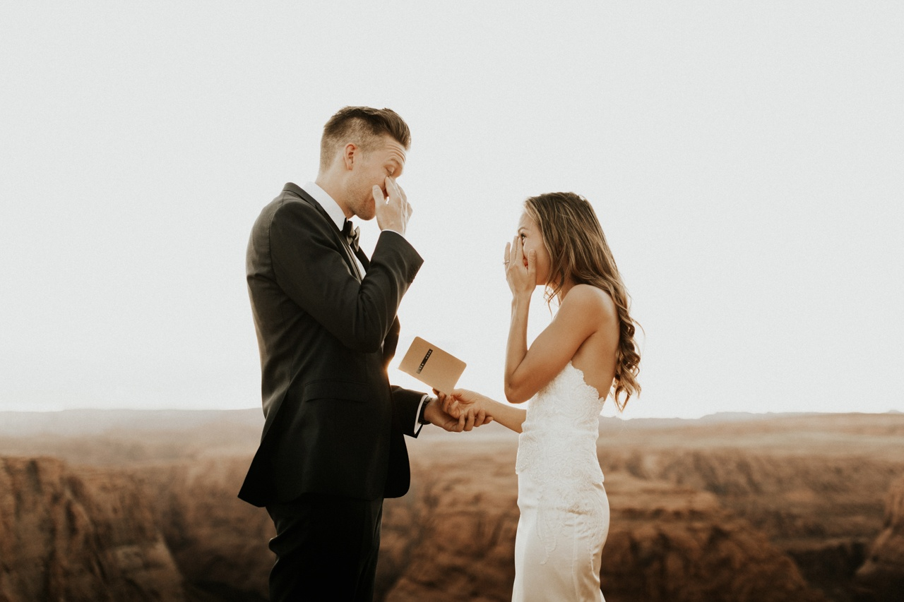
© Anni Graham

Slide 35
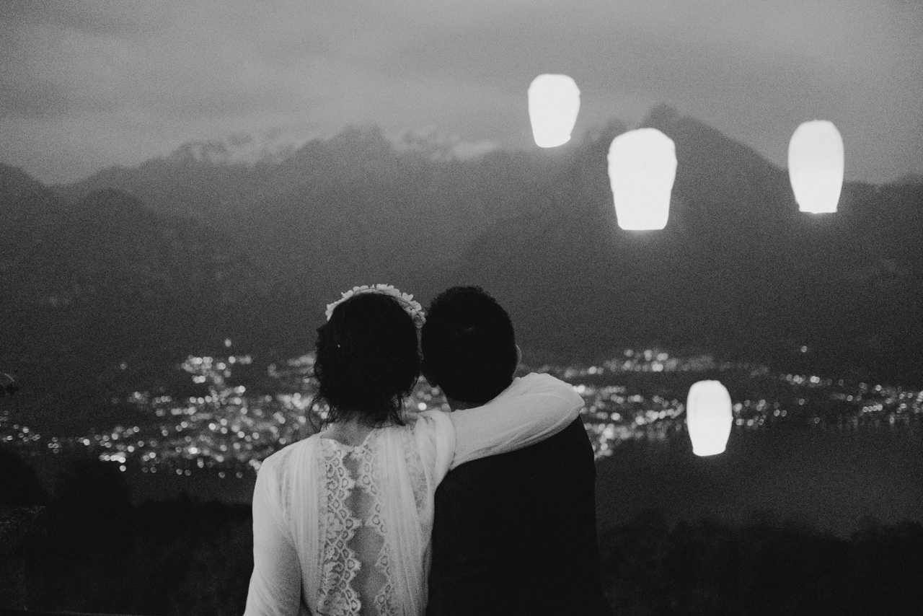
© Matteo Coltro of matrimoni all'italiana

Slide 36
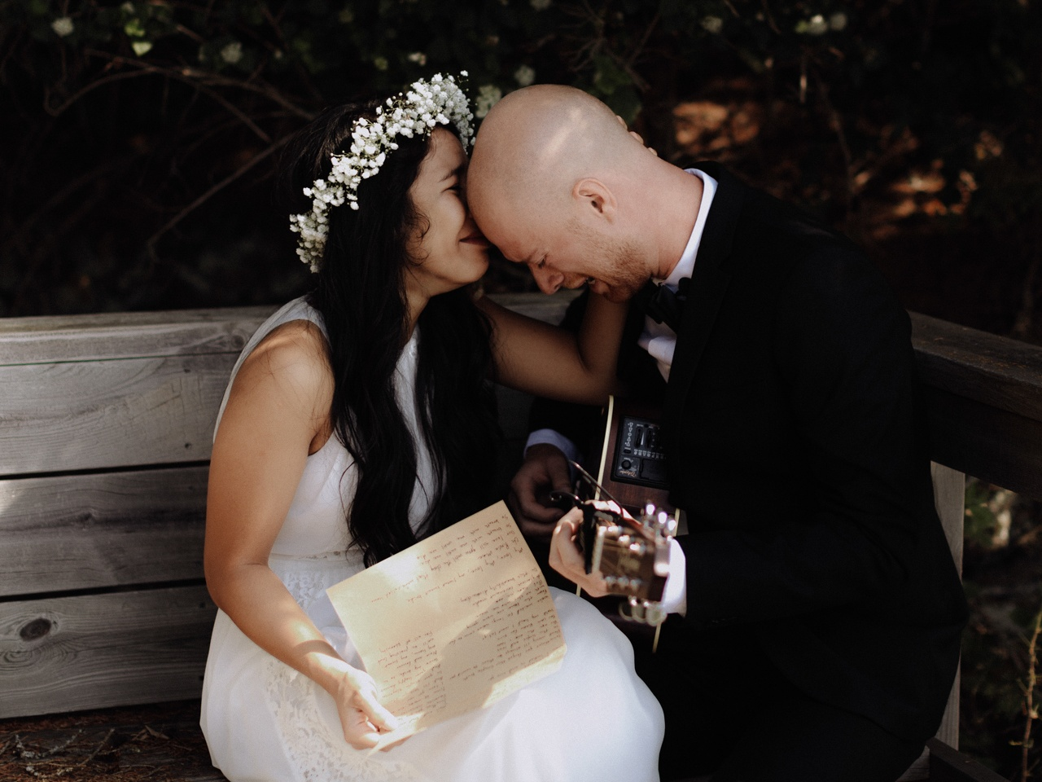
© Levi Tijerina

Slide 37
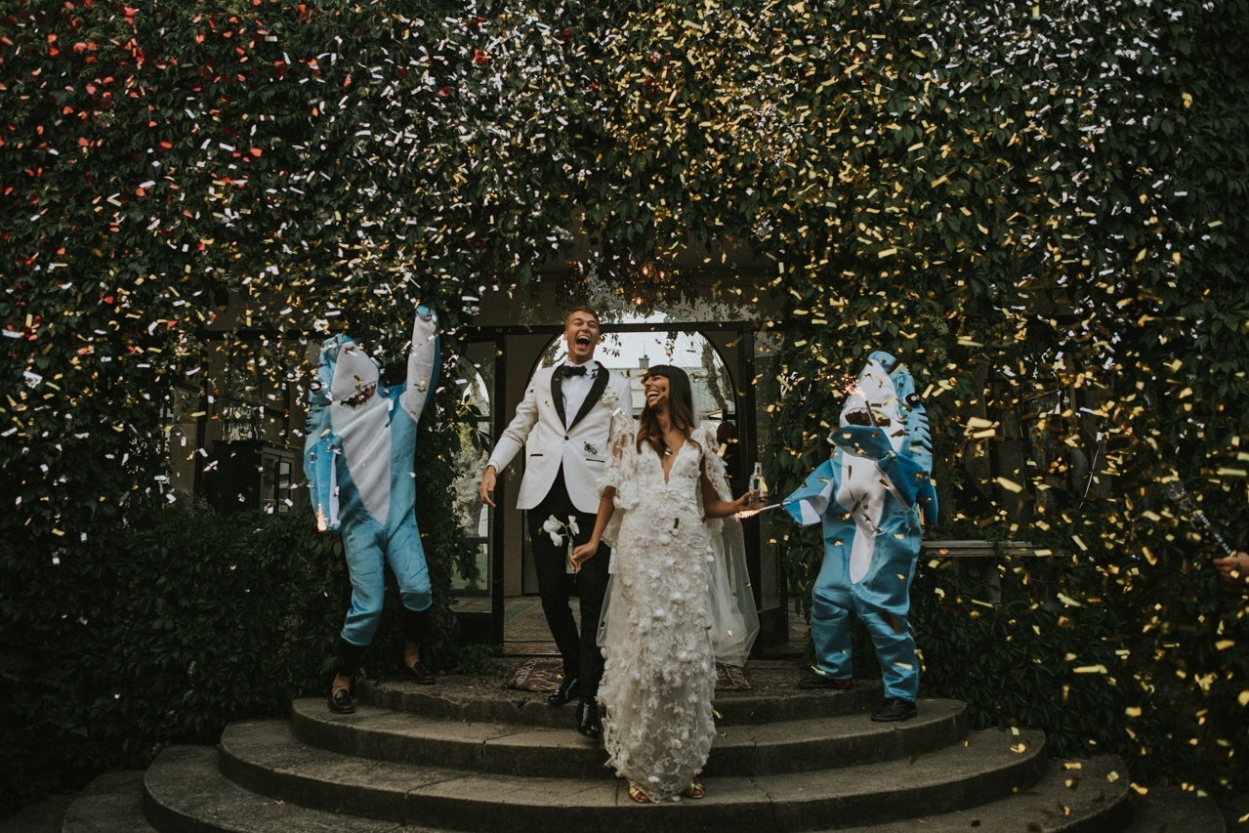
© Johanna Rosenlew of Johanna Rosenlew Photography

Slide 38
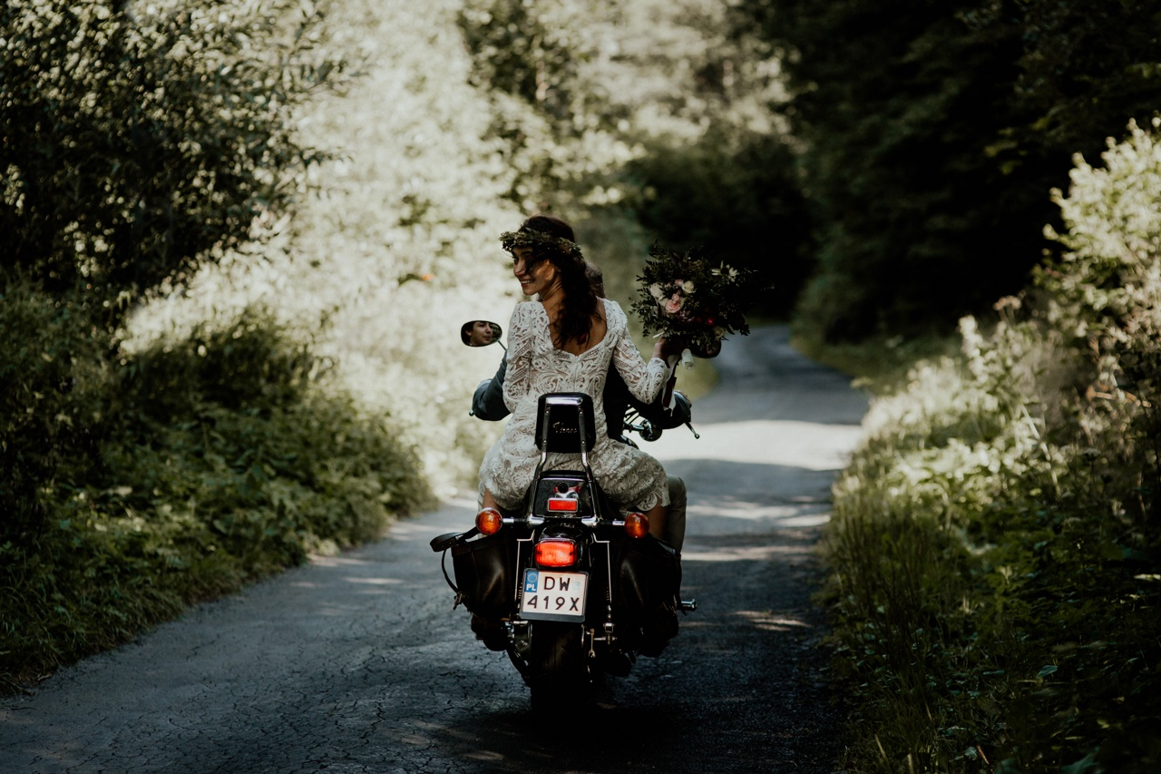
© Joanna Jaskólska of Joanna Jaskólska Photography

Slide 39
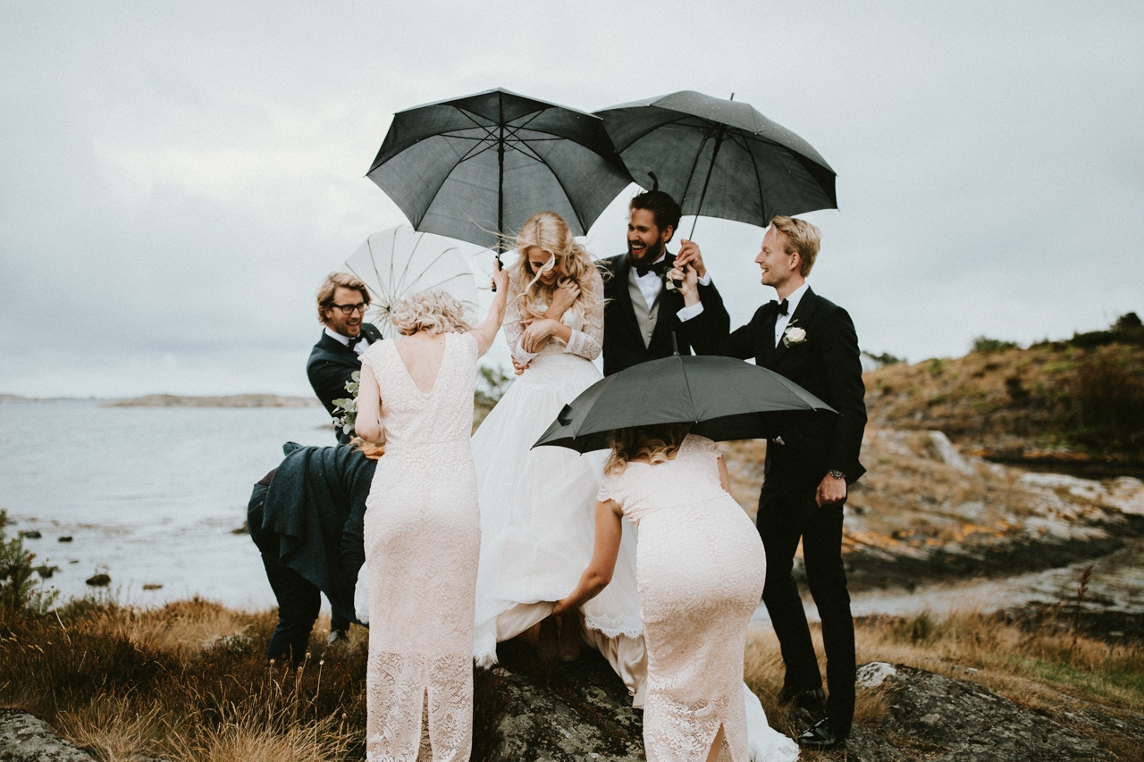
© Melanie Ng of Assemblage Photography

Slide 40

© Budy Pratama of Terralogical

Slide 41
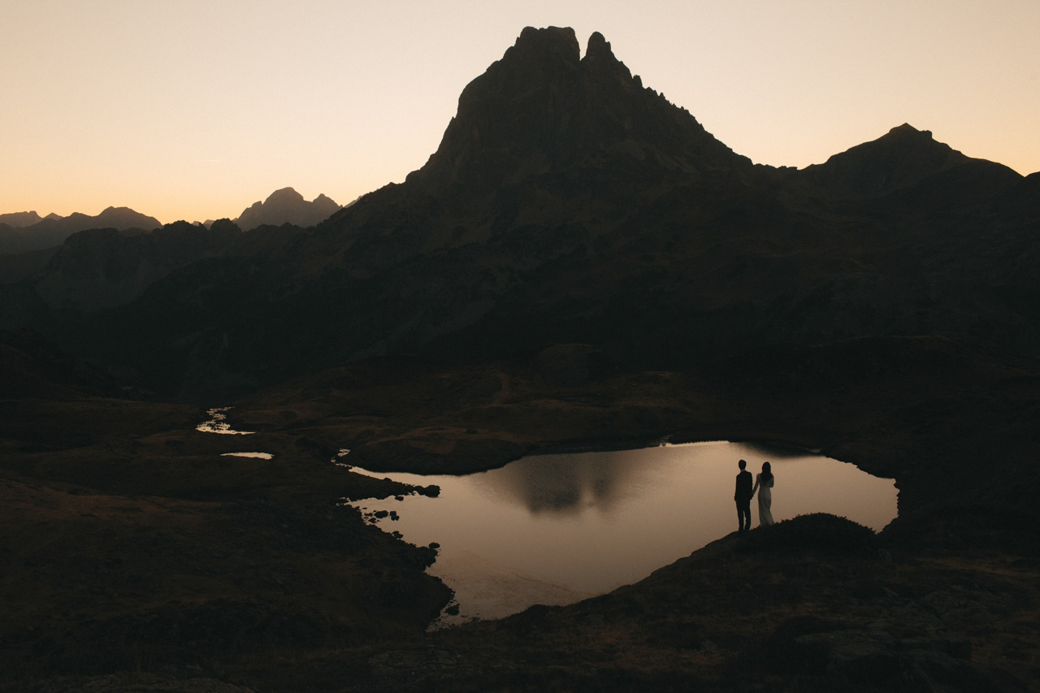
© Tim Kelly of Tim Kelly and Nadine Ellen

Slide 42
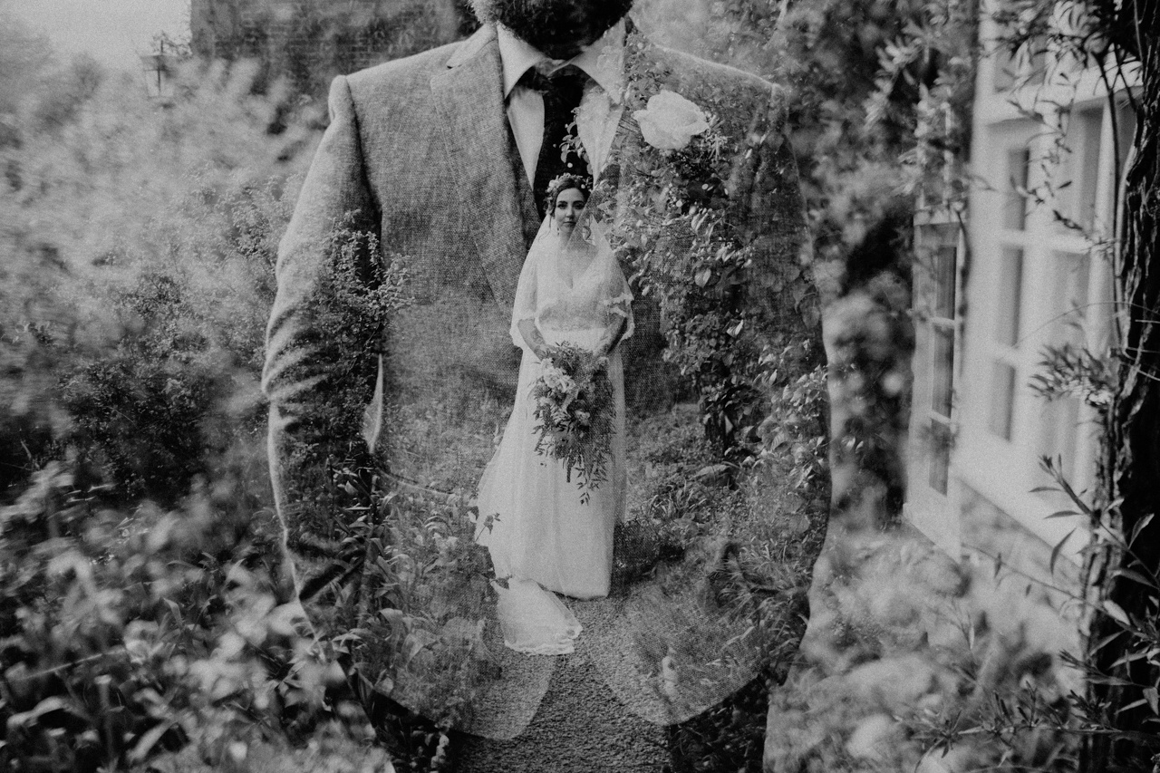
© Chris Parkinson of Beneath the Pines

Slide 43
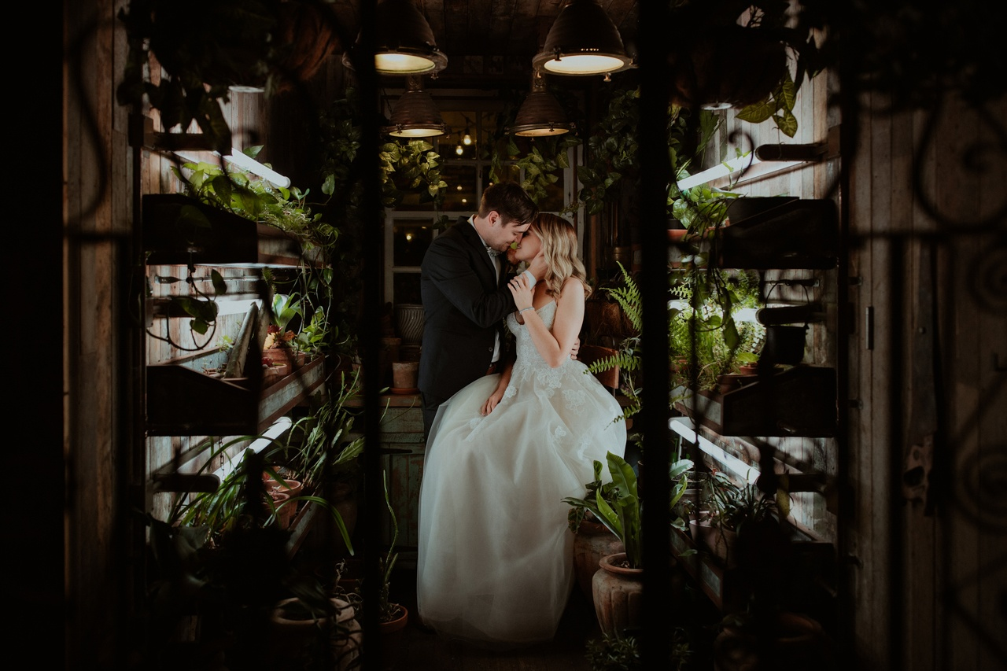
© Alex Olguin of Olguin Photography

Slide 44
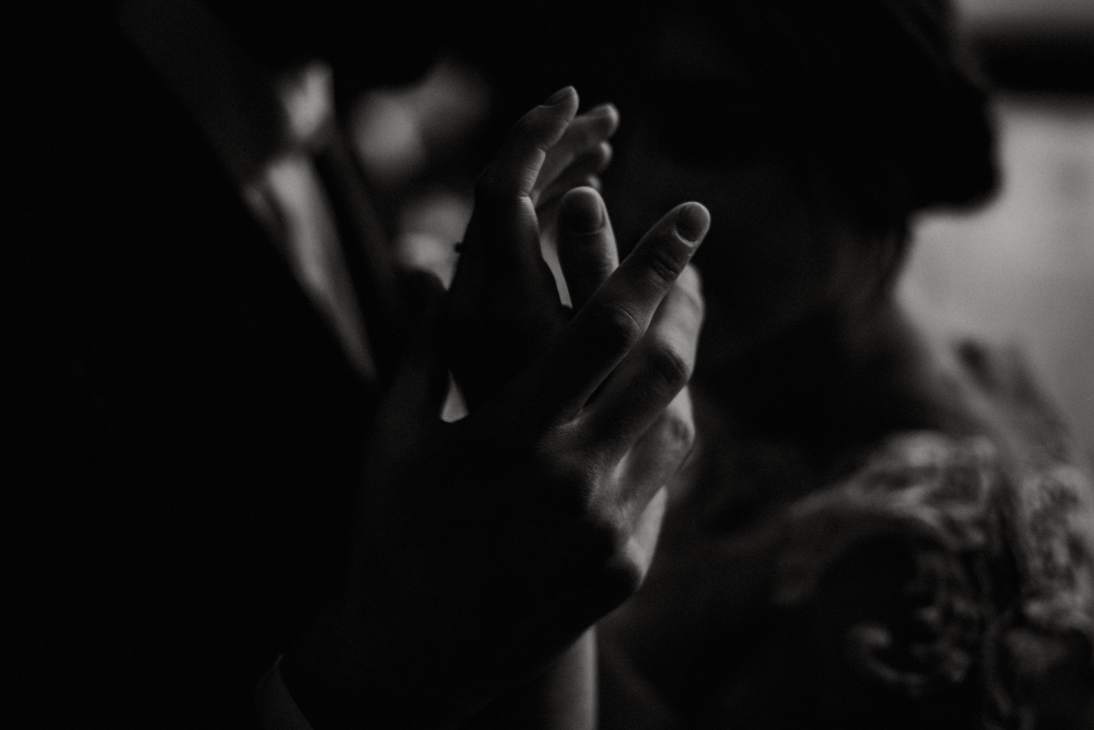
© Darya Elfutina

Slide 45
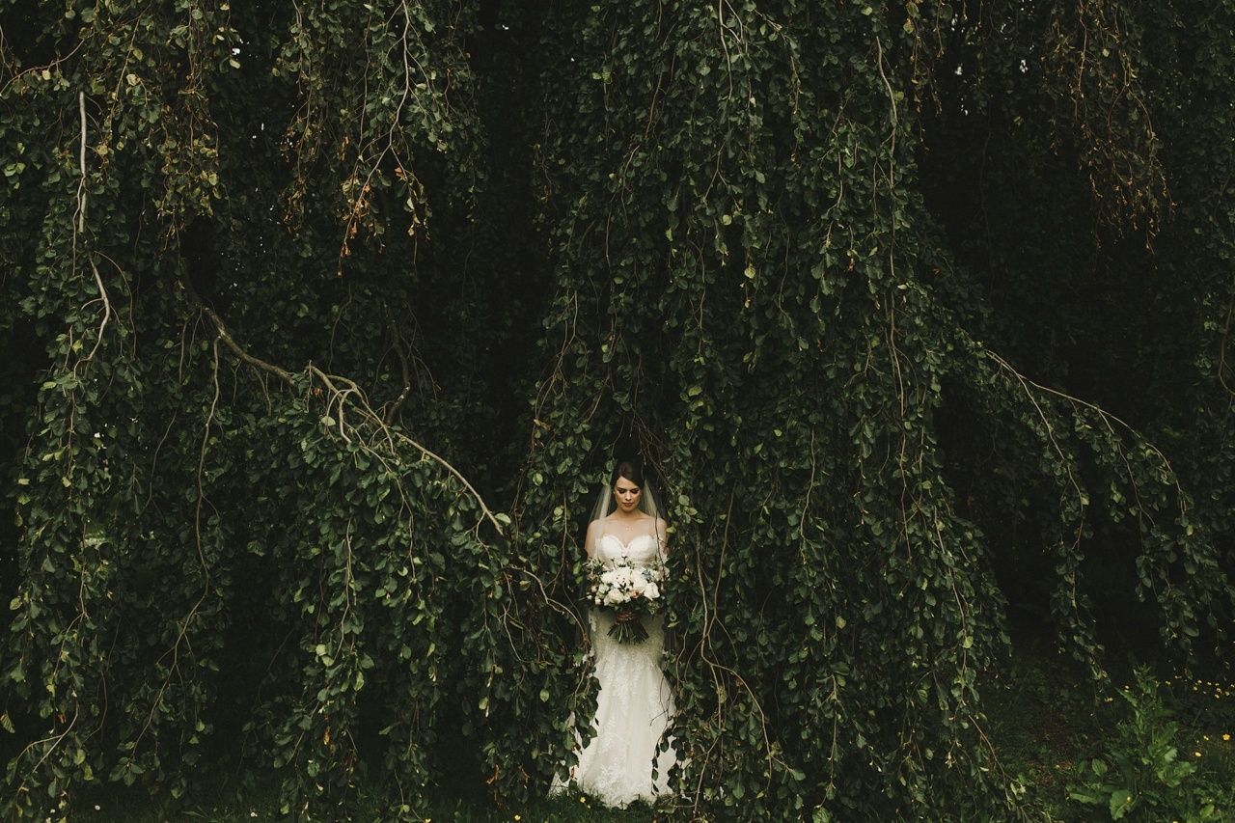
© Shari Vallely of Shari + Mike Photographers

Slide 46
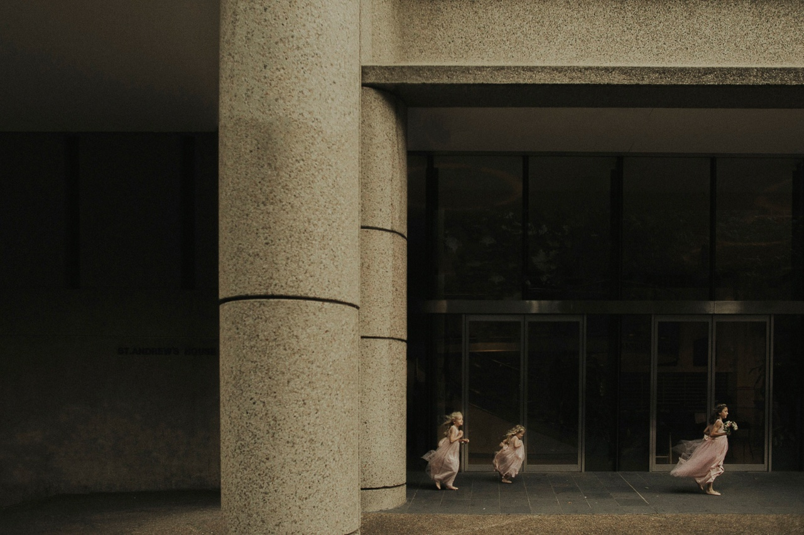
© Dan O'Day

Slide 47
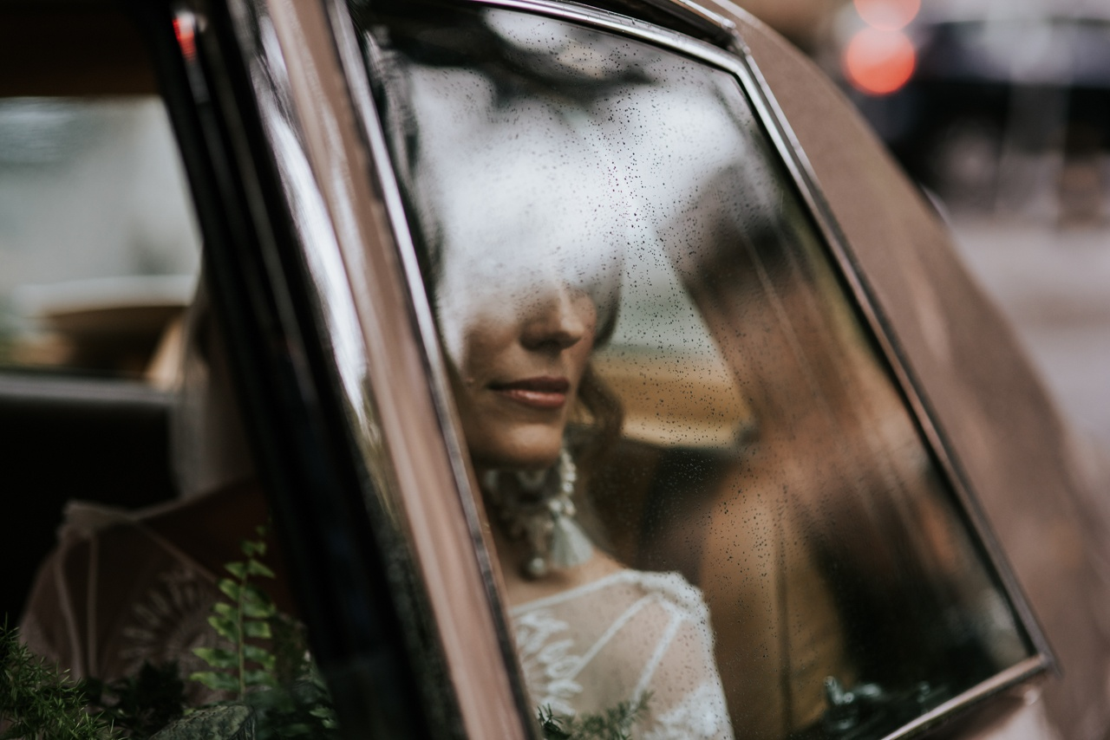
© Damien Milan of Damien Milan Photography

Slide 48
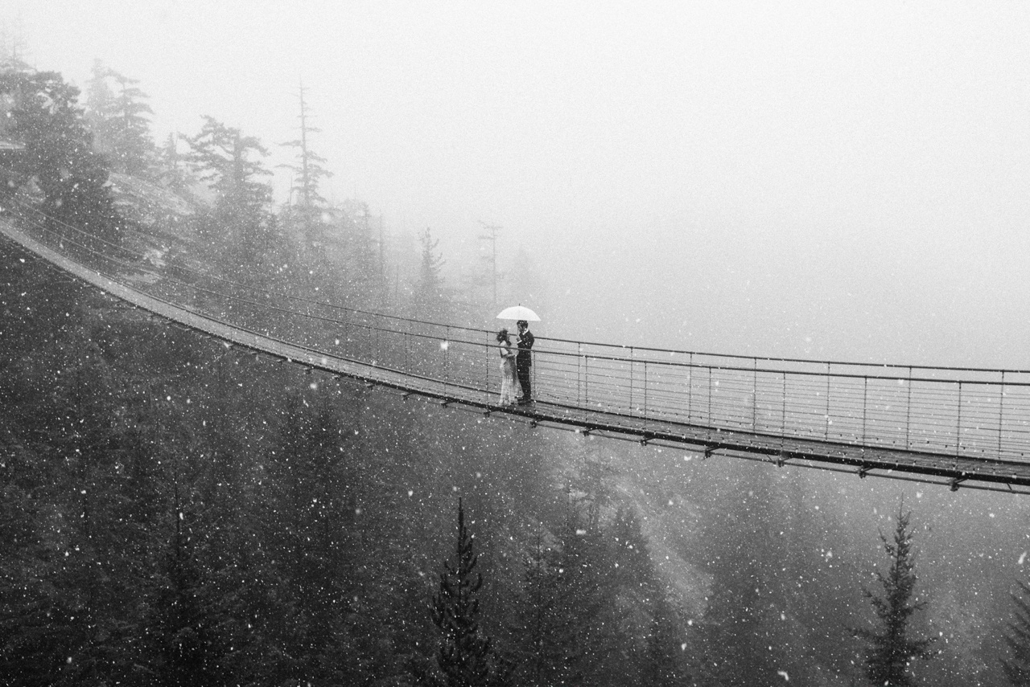
© Tim O'Shea of Michaela Joy Photography

Slide 49
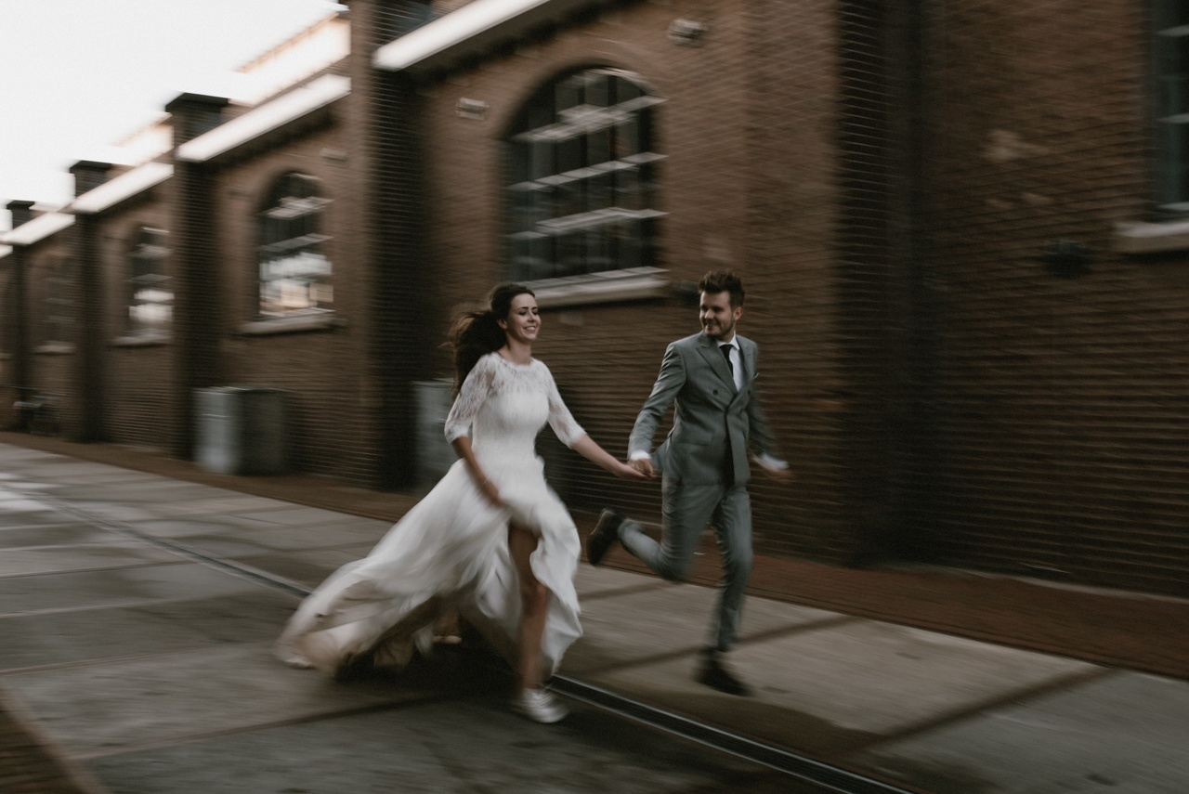
© Naomi van der Kraan of KnowMe fotografie

Slide 50
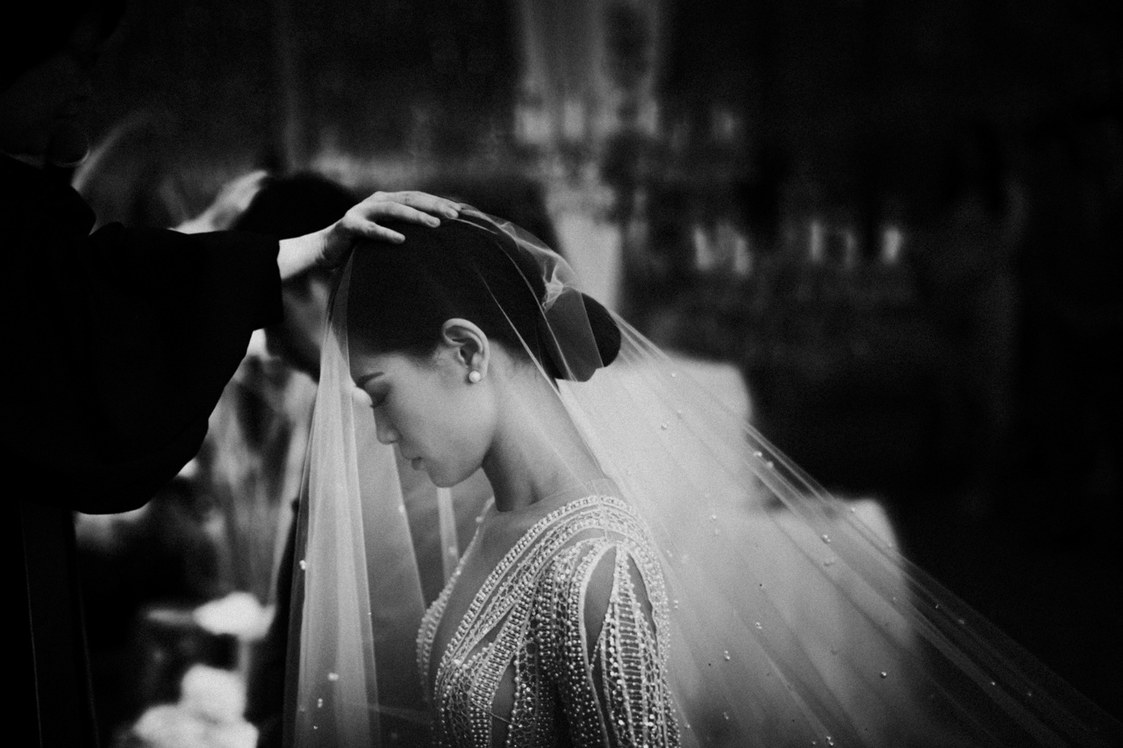
© Indra Permana Kantawibawa of ILUMINEN

Slide 51
January 6, 2018 王文堯 Kaohsiung Taiwan R.O.C
All photos were taken from boredpanda, Internet.
Sound : Shania Twain - From This Moment On
© Will Khoury of Will Khoury Photography
THE END

