Slide 1


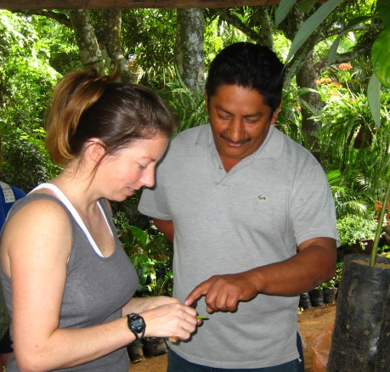
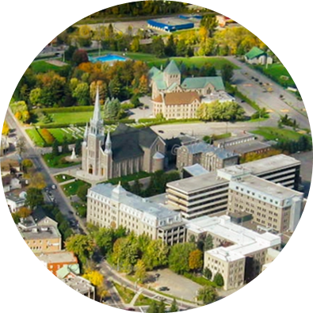
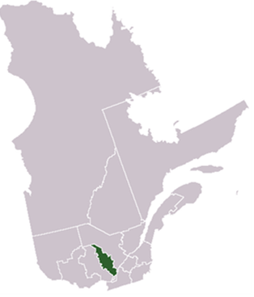

36 higher education programs
2500 students
International and
intercultural
education profile
25 years of international collaborations
20 partnerships across the world
Downtown based institution
Rural location near Montreal
Rooted in folk and contemporary culture
Hélène Bailleu, Director
Isabelle Beaudry, English Teacher
Marilène Poitras, German Teacher
Anaëlle Dubuc, Pedagogical counsellor

Slide 2
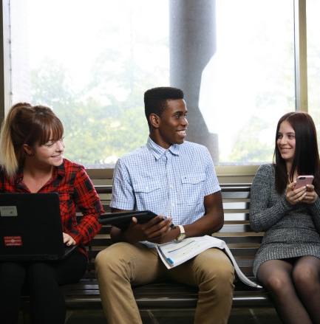
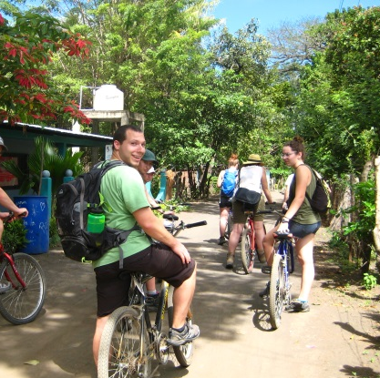
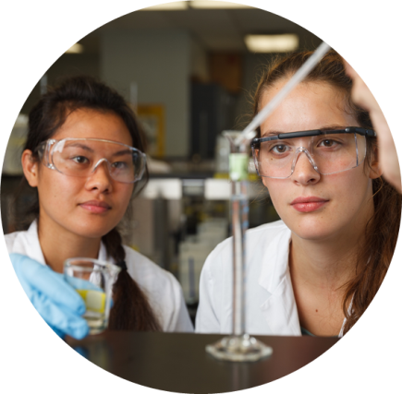
Faculty Mobility
Intercultural and international research projects
Capacity building/experience sharing with international partners
Student Mobility
International internships
Pedagogical projects abroad
Welcoming International Students
Double diploma programs
International trainee program
Continuing education and regular programs
Exploring pedagogies

Slide 3
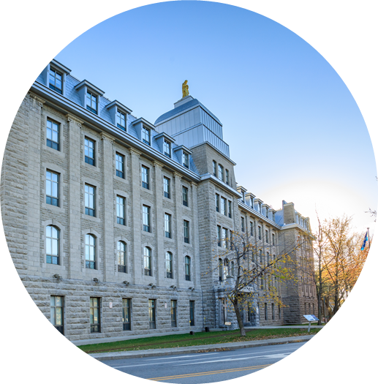




Building
Opportunities
Our Objectives
To increase and broaden relevant international student and
faculty mobility and telecollaboration opportunities
To establish new partnerships promoting skills acquisition in
international and intercultural contexts
To find international partners for our Modern Languages
Program (ESL, German, Spanish)
Please come and meet us at the Partner Find Reception !
Hélène Bailleu, Director
Isabelle Beaudry, English Teacher
Marilène Poitras, German Teacher
Anaëlle Dubuc, Pedagogical counsellor
Collaboration and sharing
@cegeplanaudiere

