Slide 1
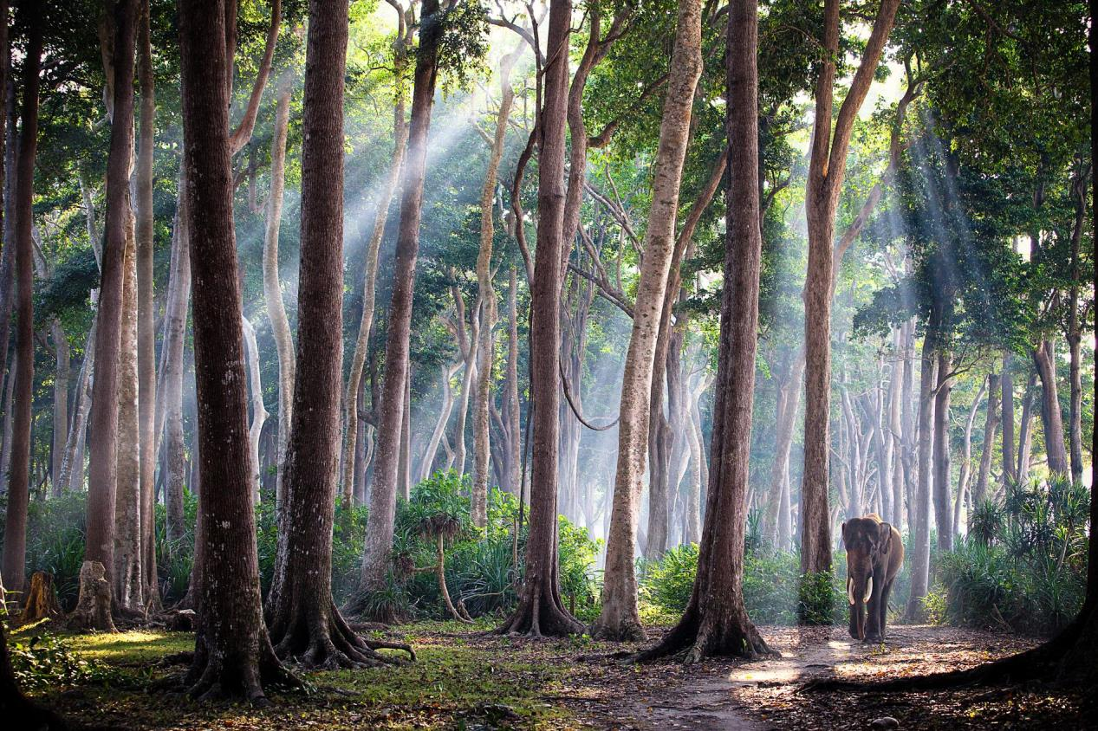

26 Beautiful Travel Photos of 2016
National Geographic
Photograph by Jody MacDonald

Slide 2
INDIA
India is one of my favorite countries in the world. It is a cultural and geographic wonder and the Andaman Islands are no exception. The Andaman Archipelago has more than 300 islands. The rain forests on these islands contain some 200 species of trees. With this incredible natural resource it’s not surprising that logging in the archipelago was prevalent in the 1970s through the 1990s.
In the 1970s, this elephant and a handful of others were brought to the islands as youngsters to work with logging companies. They spent the next 30 years hauling giant trees through the jungles. The logging companies had no way of transporting the elephants to the next islands, so the elephants swam. When logging became banned in 2002, the elephants were out of a job. This is the last remaining elephant of the group. He has been living out his days on one of the islands and lives among the giant trees he used to haul. See all of Jody's favorite places to photograph.
PHOTOGRAPH BY JODY MACDONALD
Eddie, Yao

Slide 3
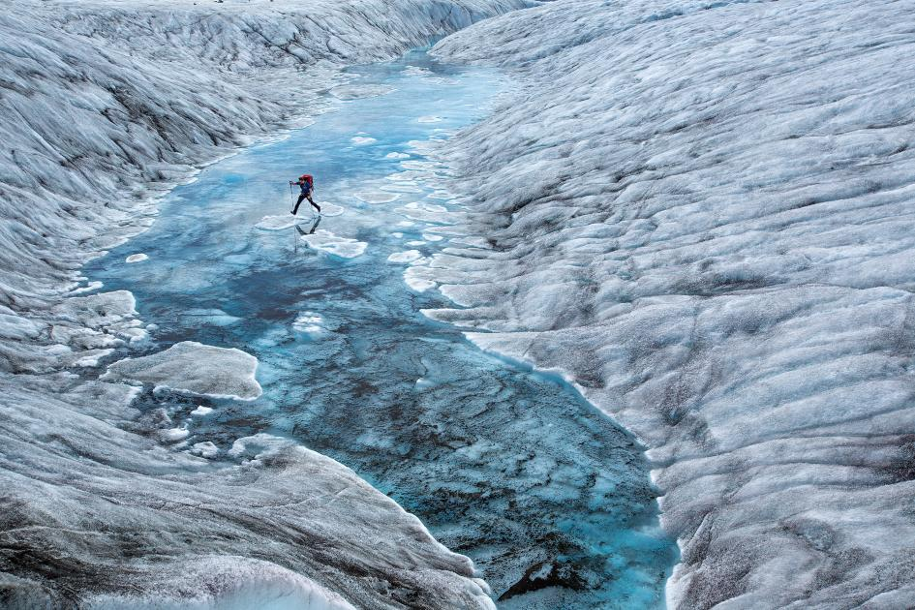
ALASKA
A hiker is seen crossing the lower Ruth Glacier in Alaska. The terrain is rugged, including icefalls, glacial pools, and glacial streams.
PHOTOGRAPH BY AARON HUEY

Slide 4
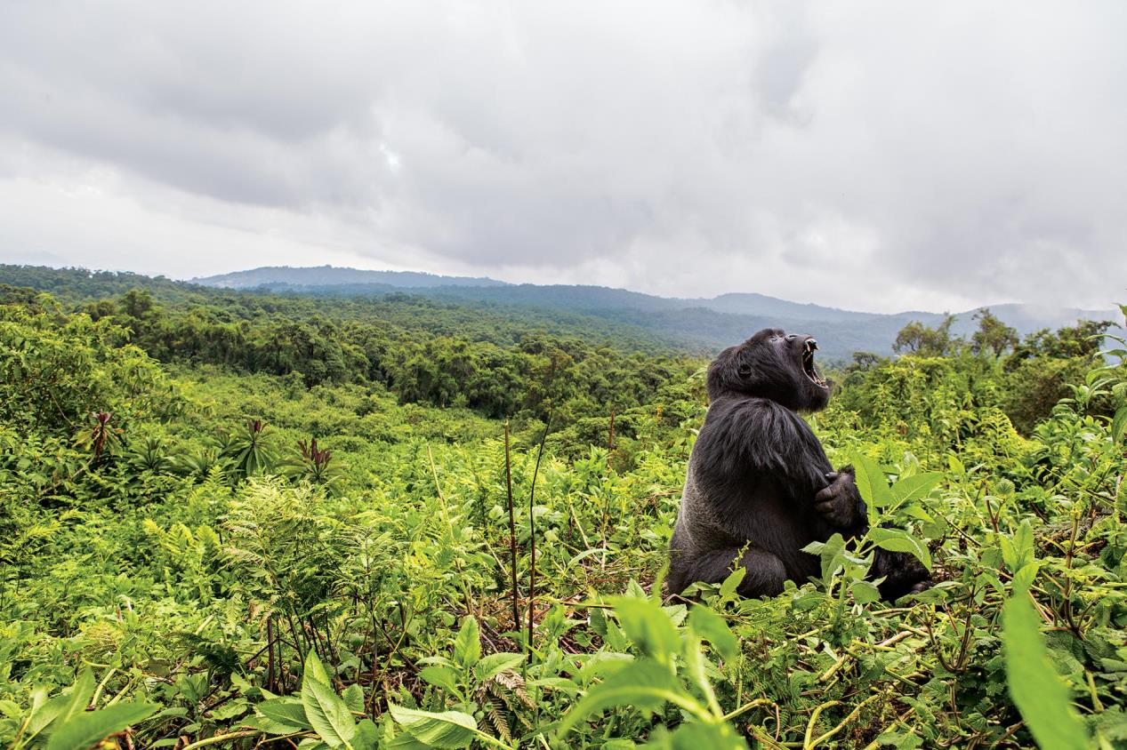
RWANDA
King of the rain forest, an adult silverback gorilla yawns wide, baring his teeth in Rwanda's Volcanoes National Park.
PHOTOGRAPH BY TEAGAN CUNNIFFE

Slide 5
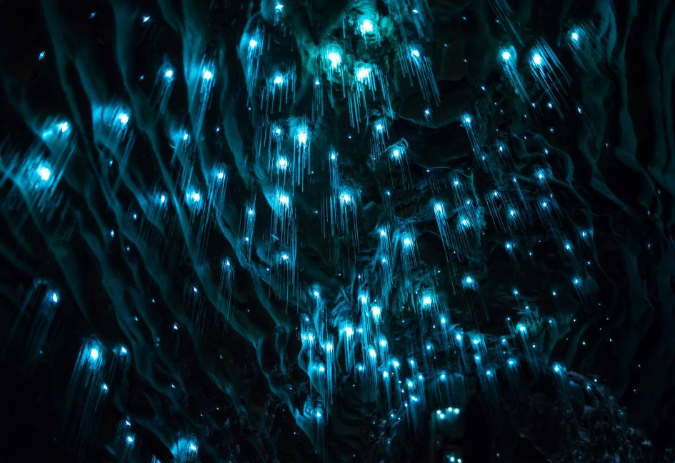
NEW ZEALAND
Did you know deep inside New Zealand's Waitomo Caves, blue glowworms dazzle visitors? Watch the video and learn about the experience of capturing footage of this natural phenomenon.
PHOTOGRAPH BY STOKED FOR SATURDAY

Slide 6
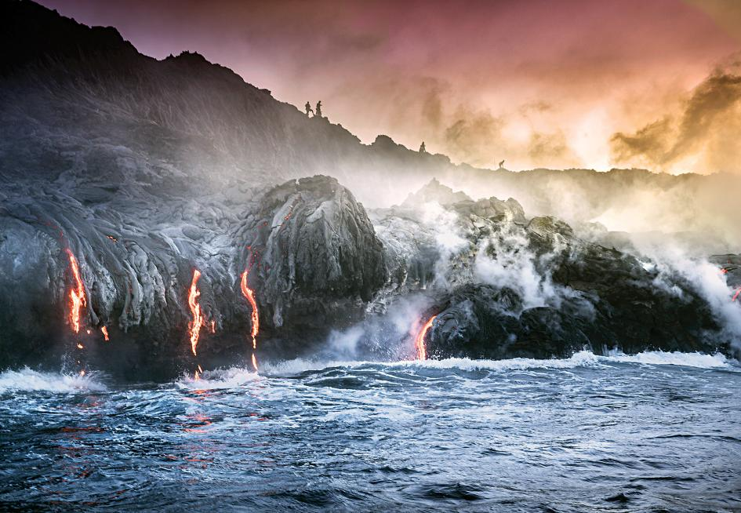
HAWAII
Lava flows into the ocean at Volcanoes National Park in Hawaii. Hawaii is one stop on Nat Geo Travel's action-packed trip around the world. To see more destinations, take a trip around the world in 24 hours.
PHOTOGRAPH BY ANDREW RICHARD-HARA

Slide 7
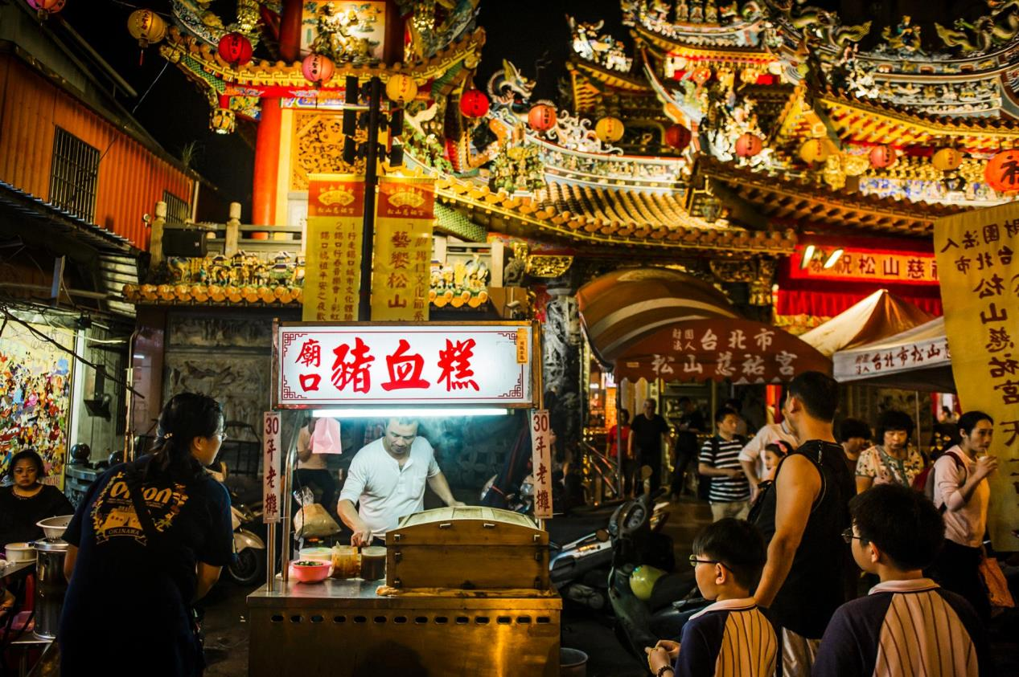
TAIWAN
At Raohe Street Night Market, in the Songshan District, dozens of food stalls sell local fare such as noodle soups, sausages, stinky tofu, and bubble tea. Read the full article.
PHOTOGRAPH BY DINA LITOVSKY

Slide 8
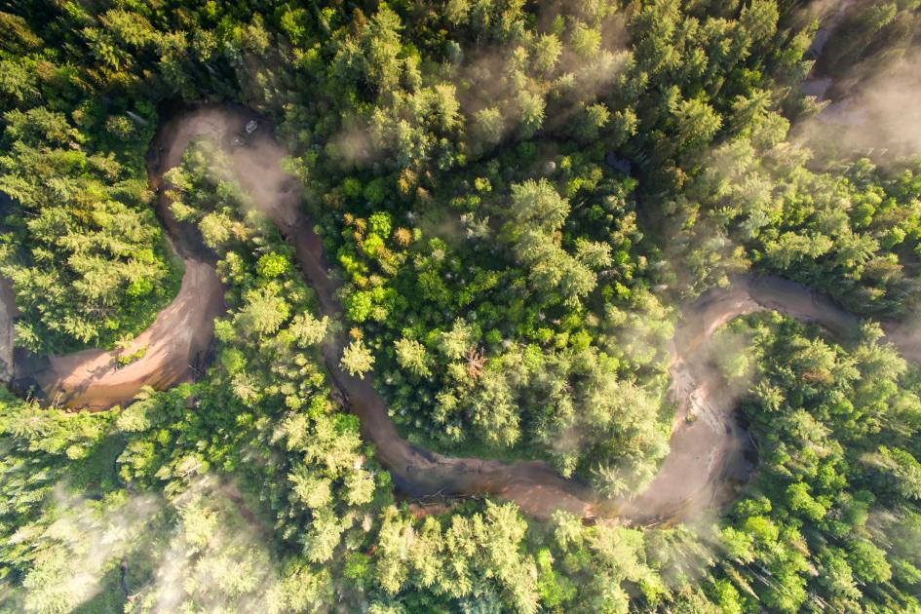
NEW HAMPSHIRE
The lush Kancamagus Highway connects Lincoln to Conway by way of the White Mountain National Forest. See more New Hampshire photography in the full story.
PHOTOGRAPH BY RONAN DONOVAN

Slide 9
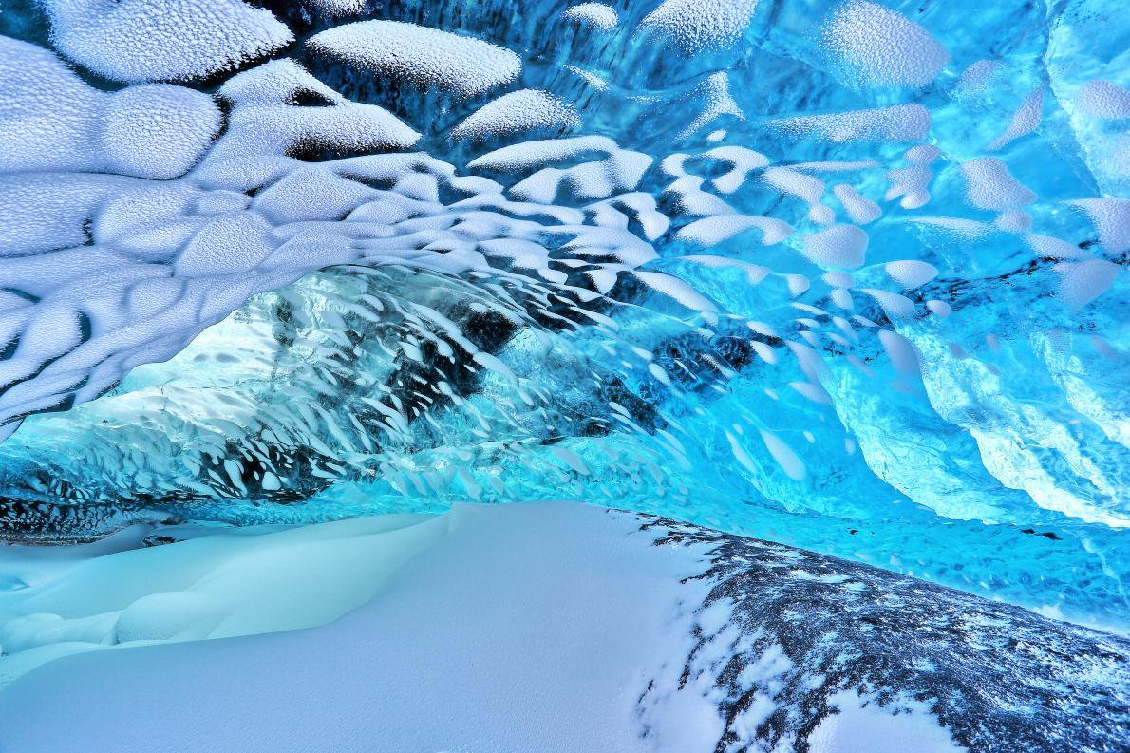
ICELAND
Pressurized ice, not privy to direct sunlight, sparkles a luminous blue deep in Breiðamerkurjökull ice cave. The cave is part of Iceland’s Vatnajökull Glacier, one of Europe’s largest ice caps, which began forming 2,500 years ago and sits atop several volcanoes. As a result, ebony often streaks the azure interiors. See more colorful destinations from around the world.
PHOTOGRAPH BY GETTY IMAGES

Slide 10
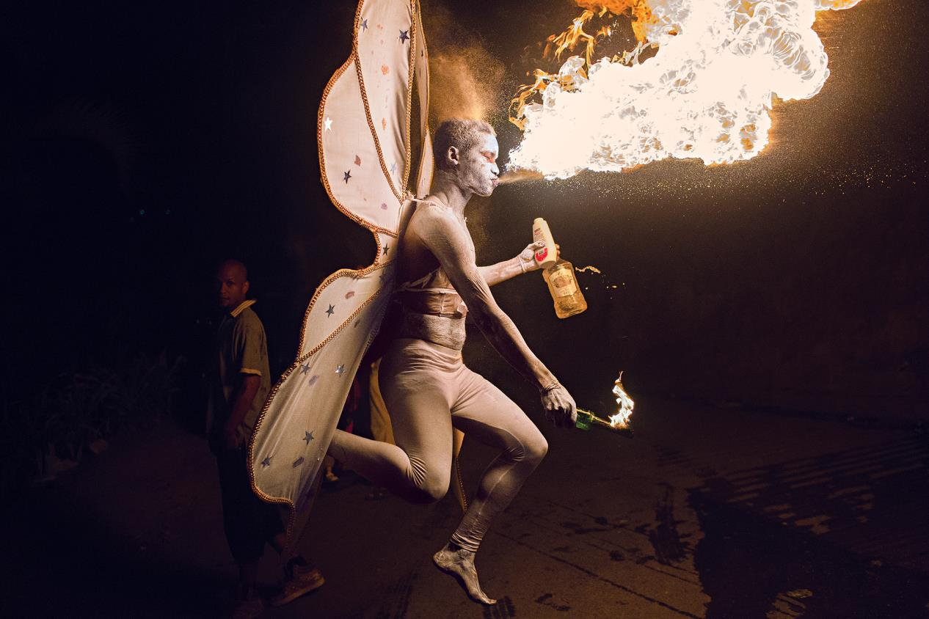
TRINIDAD
A winged "devil" experienced in the risky art of fire breathing throws out flames for nighttime Carnivalgoers. Read the full story about Carnival in Trinidad.
PHOTOGRAPH BY AARON HUEY

Slide 11
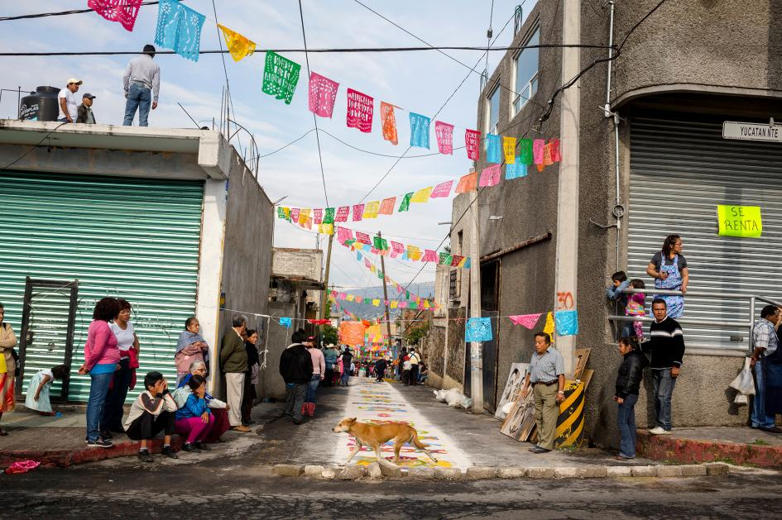
MEXICO
A dog scampers past a colorful alley in Milpa Alta, a borough of Mexico City. Milpa Alta is a district that loves to eat: Each year, it puts on more than 700 religious feasts, all despite more than half of the borough living below the poverty line.
PHOTOGRAPH BY CAROLYN DRAKE, NATIONAL GEOGRAPHIC CREATIVE

Slide 12
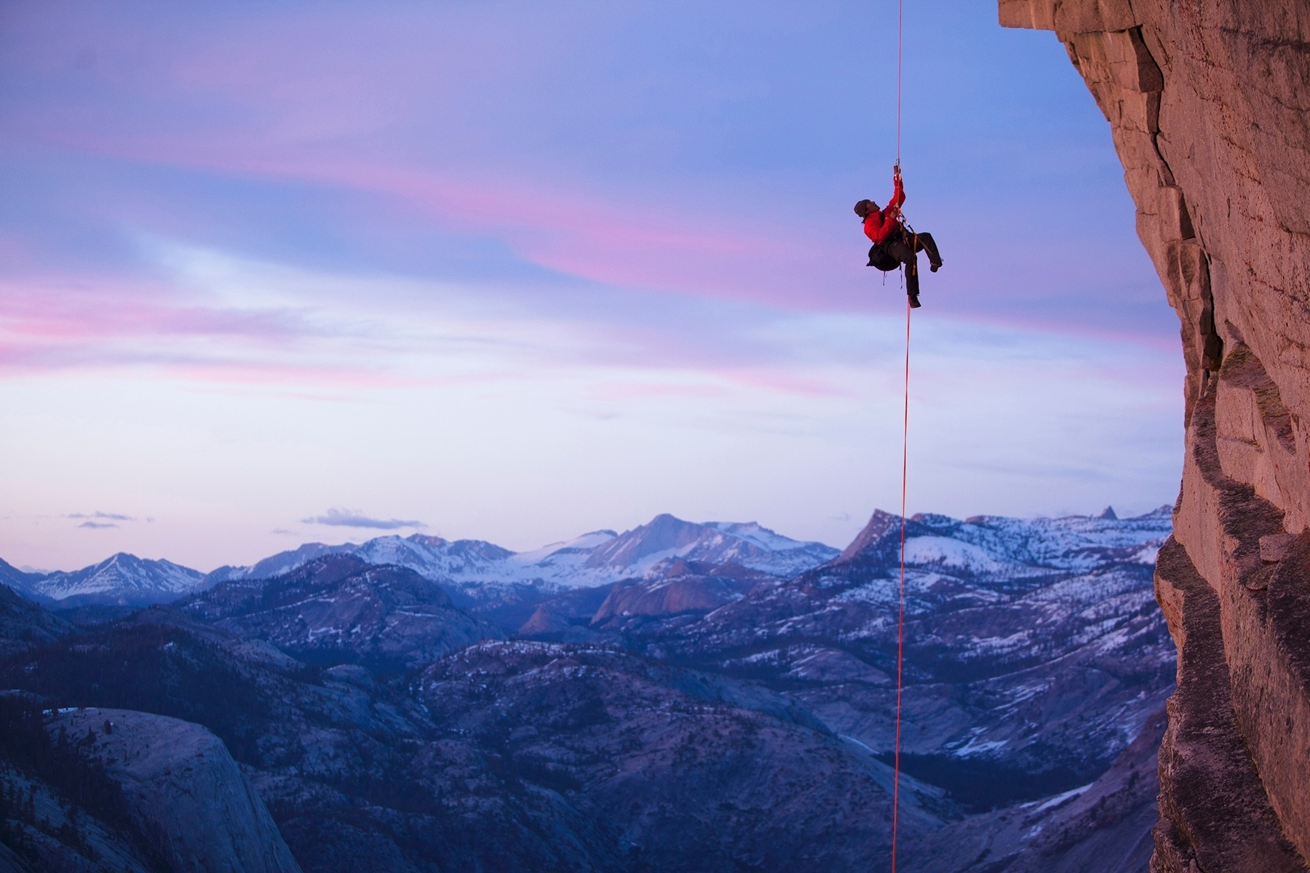
CALIFORNIA
Expert climber and photographer Jimmy Chin climbs Half Dome in Yosemite National Park.
PHOTOGRAPH BY MIKEY SCHAEFER, NATIONAL GEOGRAPHIC

Slide 13
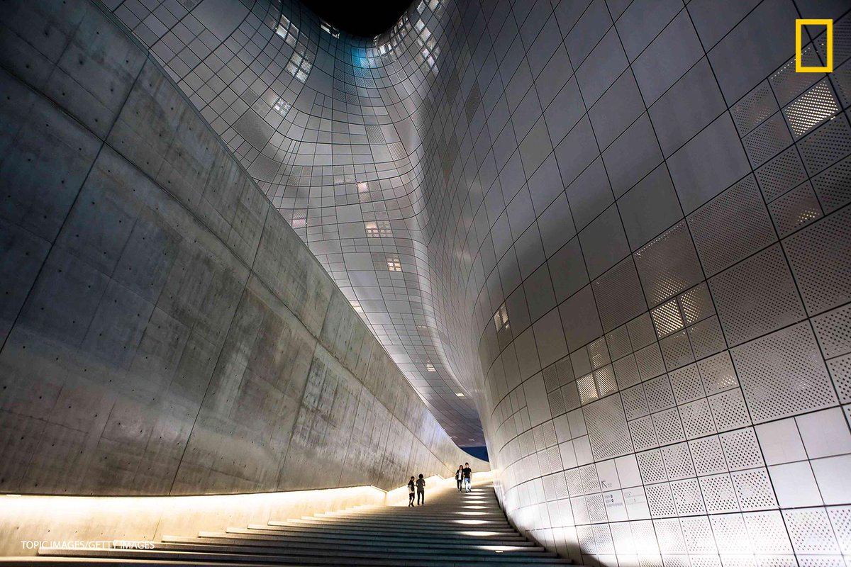
SOUTH KOREA
The contemporary Dongdaemun Design Plaza dwarfs visitors to Seoul's striking architectural centerpiece. Seoul is one of Nat Geo Travel's Best Trips for 2017. See the full best trips list.
PHOTOGRAPH BY TOPIC IMAGES, GETTY IMAGES

Slide 14
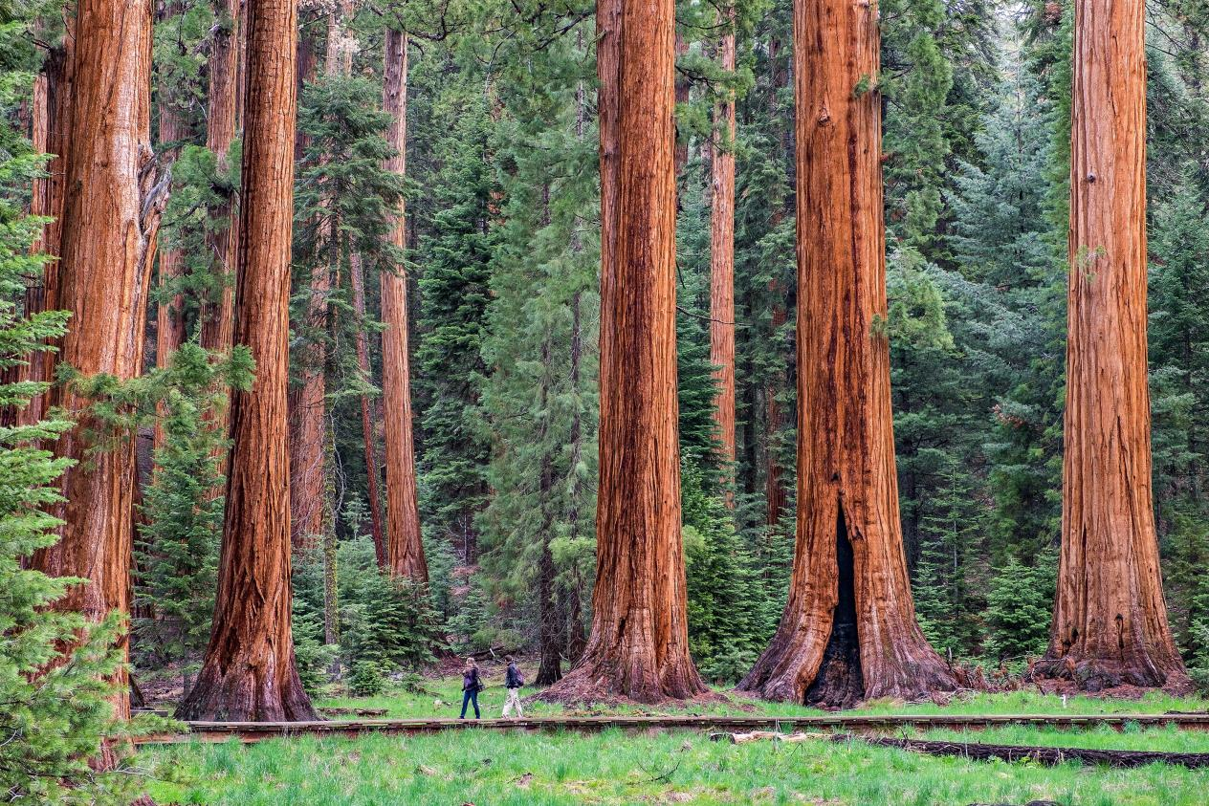
CALIFORNIA
Visitors walk below giant sequoia trees along the appropriately named Giant Tree Trail in Sequoia National Park. Adding people to images, especially with such large objects as these trees, provides a sense of scale.
PHOTOGRAPH BY JONATHAN IRISH

Slide 15
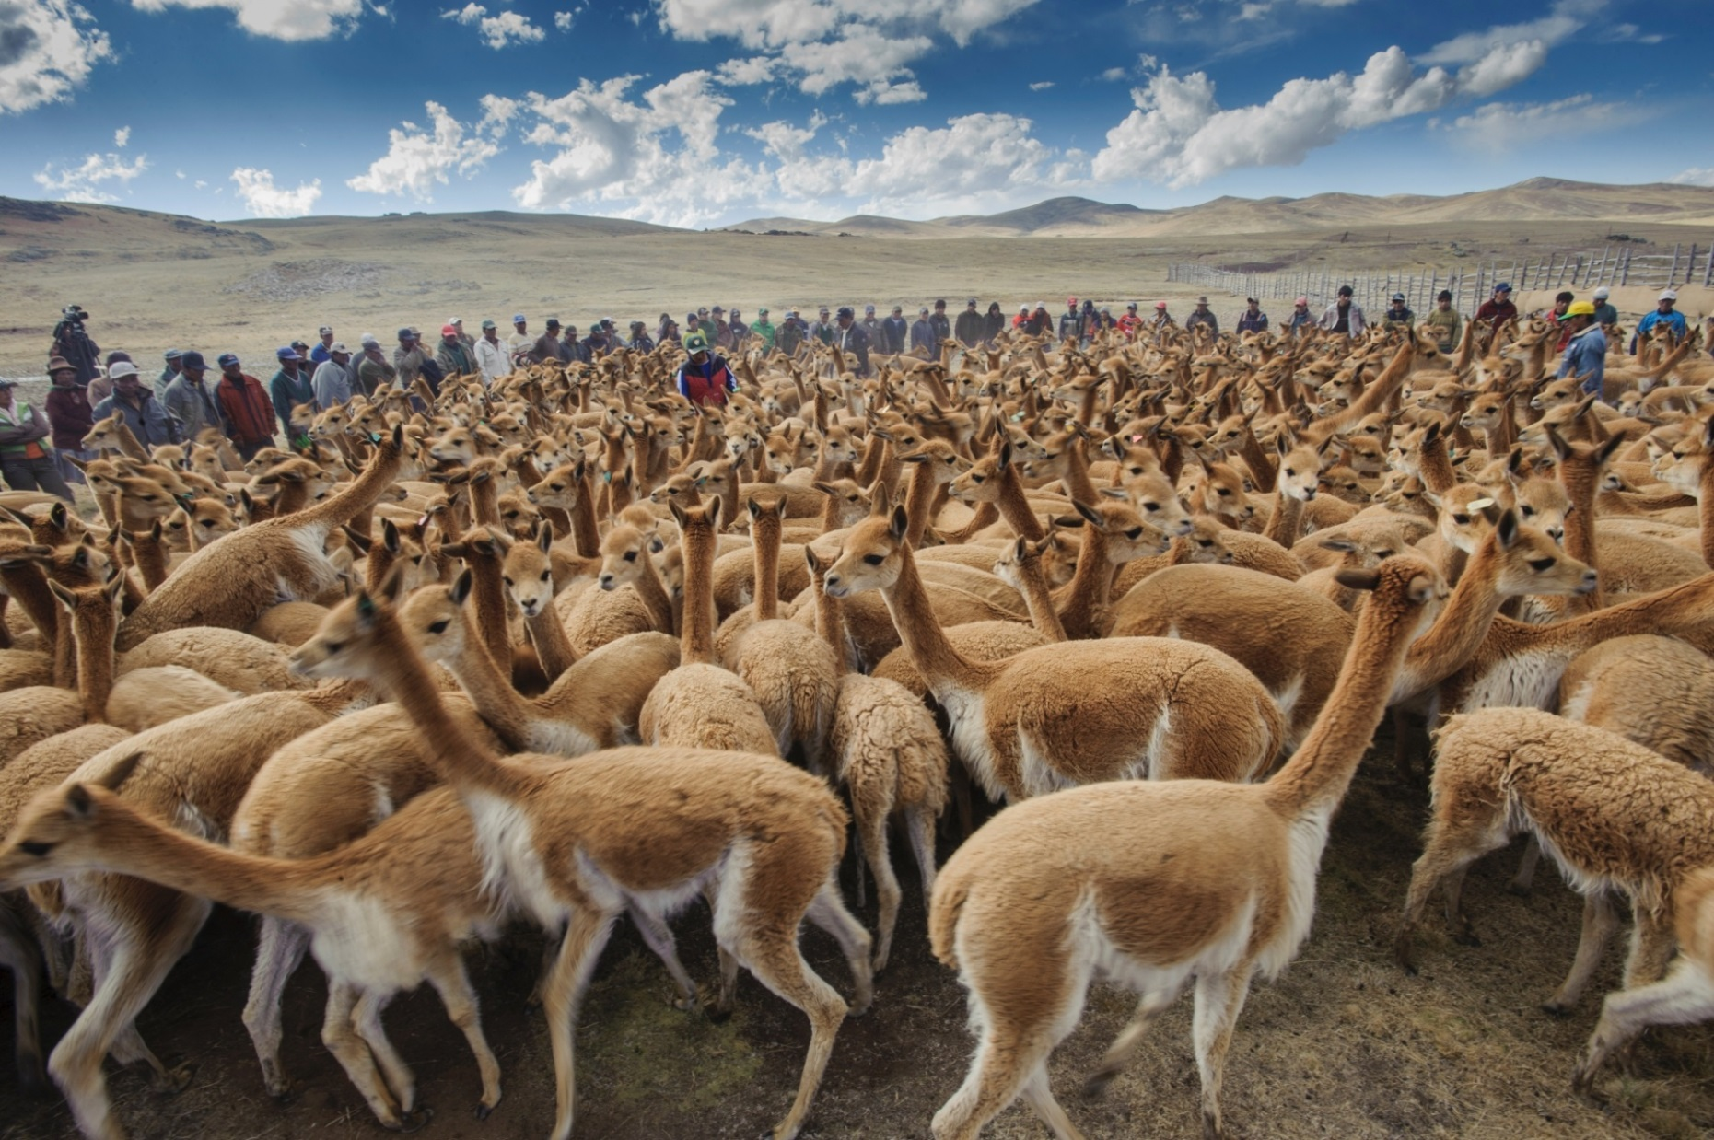
PERU
Wild vicuña walk and run in front of a line of Quechua villagers who herd them to corrals during the Gran Chaccu, a yearly vicuña roundup and shearing.
PHOTOGRAPH BY BETH WALD, NATIONAL GEOGRAPHIC CREATIVE

Slide 16
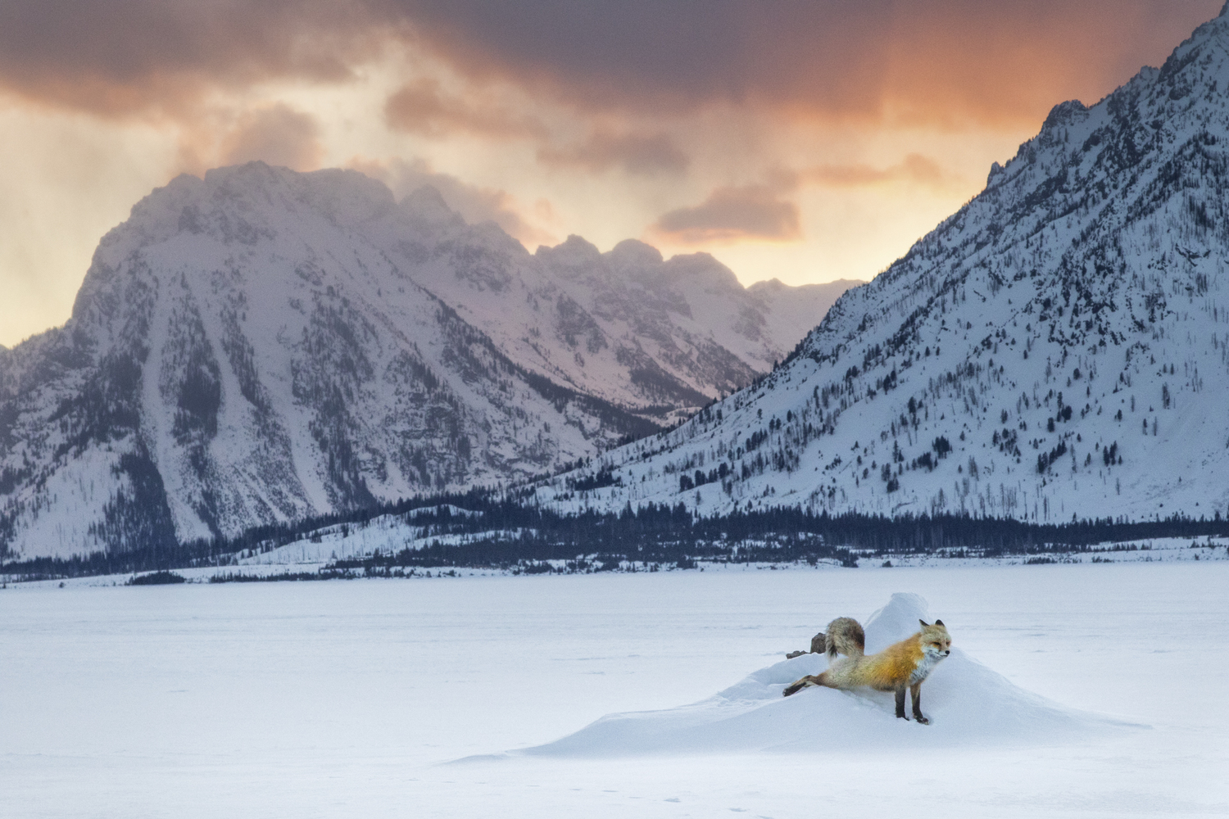
WYOMING
A red fox pauses in winter in Teton National Park.
PHOTOGRAPH BY CHARLIE HAMILTON JAMES

Slide 17
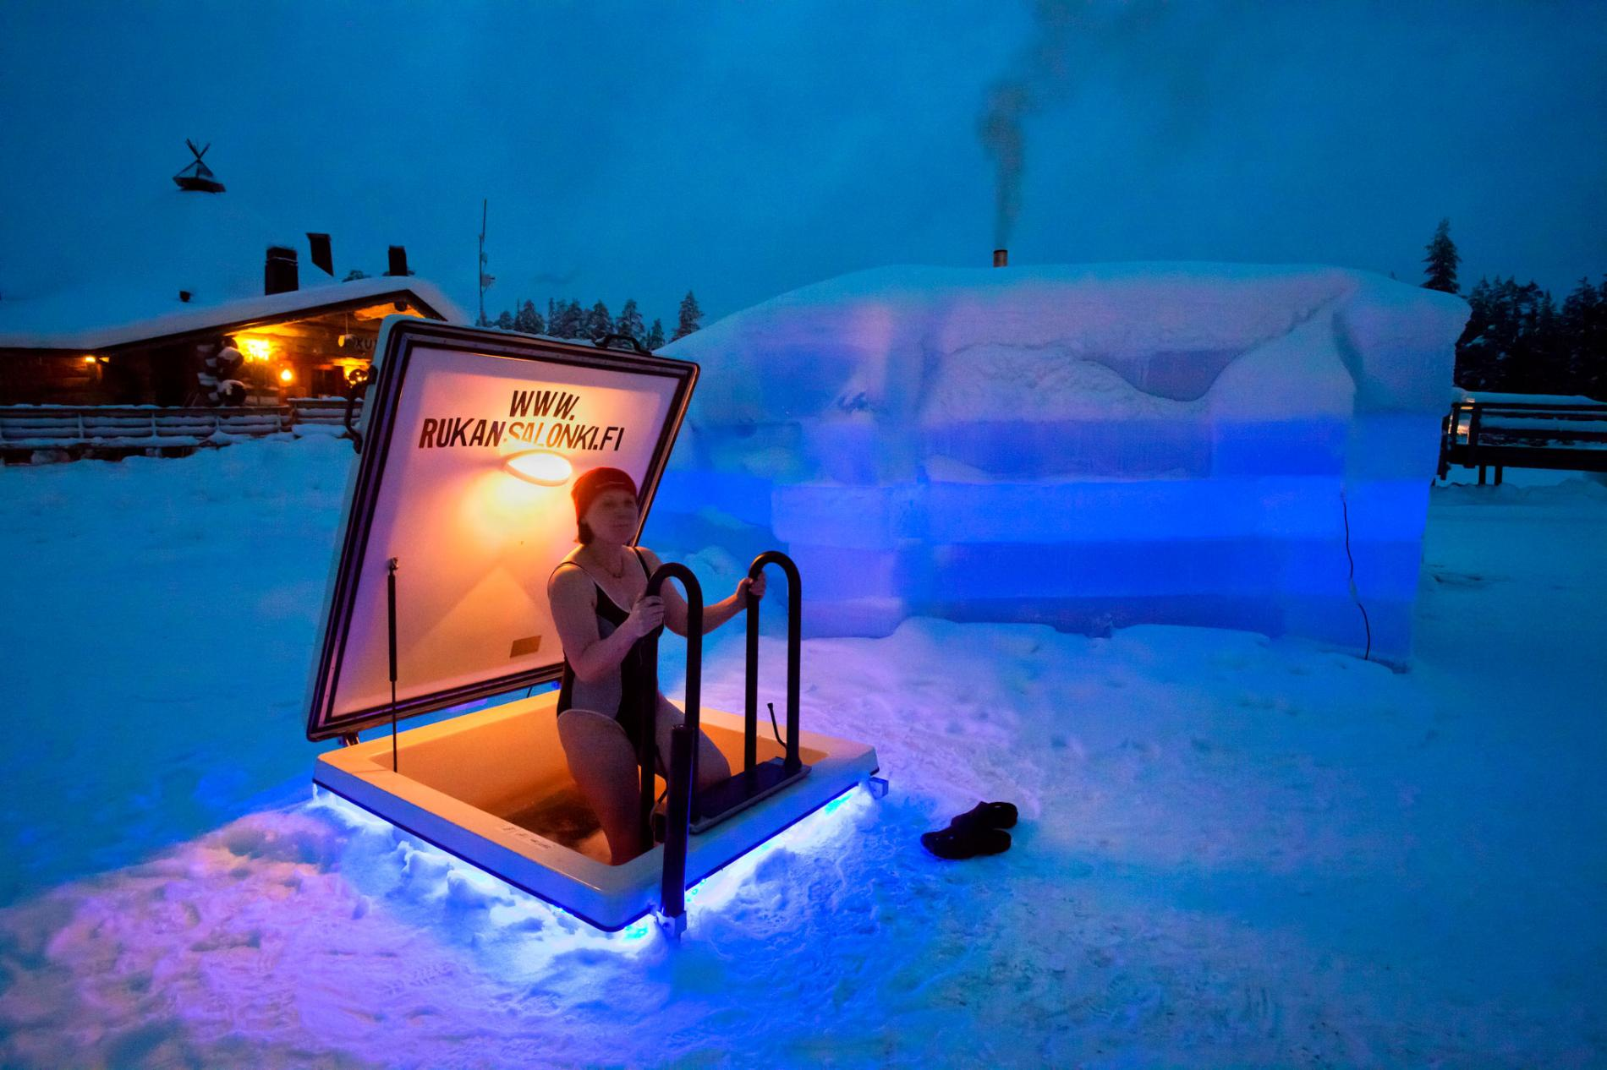
FINLAND
Saunas provide the ultimate form of relaxation in Finland, one of the 10 happiest countries in the world. Discover the 10 happiest countries.
PHOTOGRAPH BY FRANK HEUER, LAIF/REDUX

Slide 18
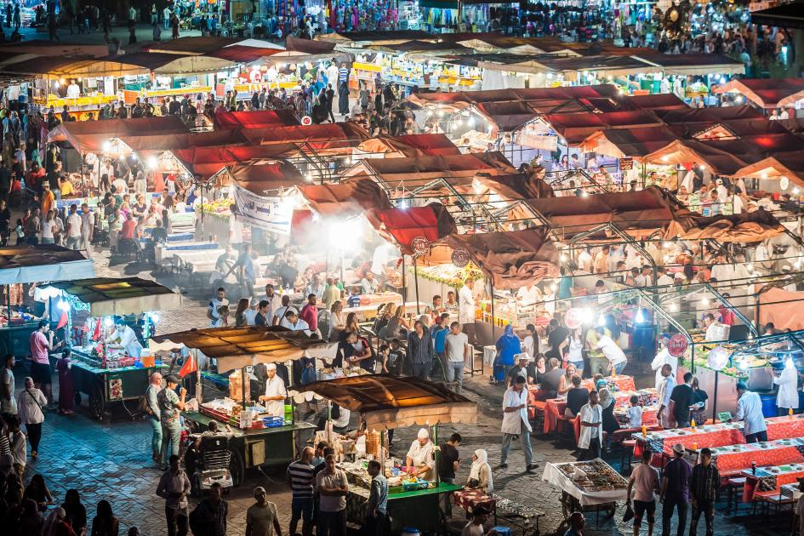
MOROCCO
Lights burn bright above food stalls in Marrakech's bustling Jemaa el Fna market. Find out where to travel for food.
PHOTOGRAPH BY LUTZ JAEKEL, LAIF/REDUX

Slide 19
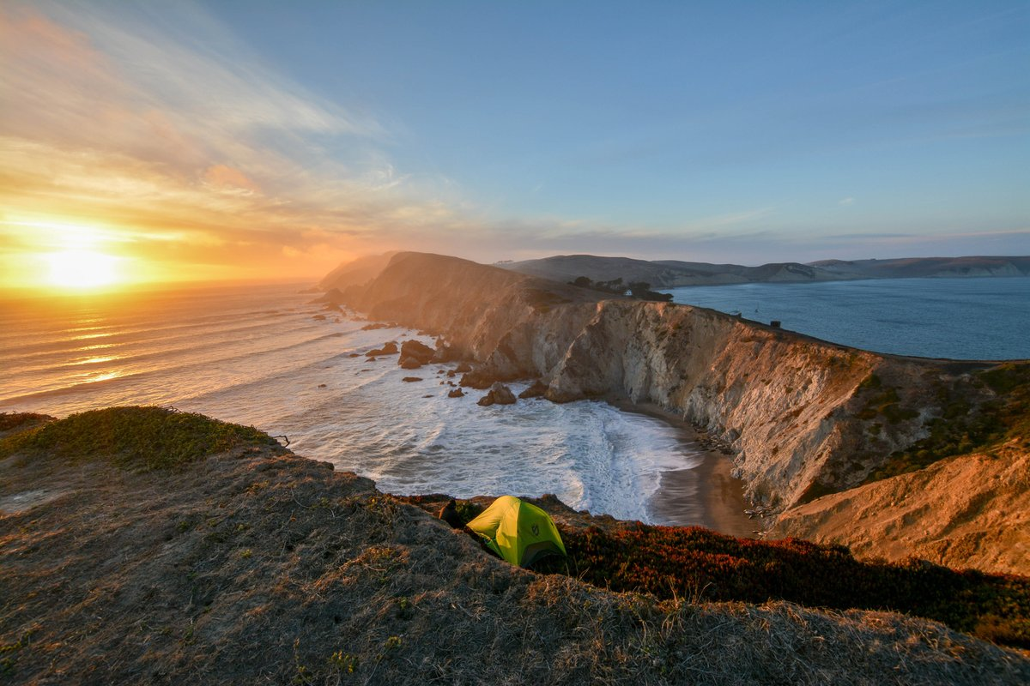
CALIFORNIA
A beautiful hike into Chimney Rock reveals stunning views. At the bottom of the sea cliff are hundreds of sea lions undisturbed by human activity. “I often come to this place for two reasons: mediation and to let the world go by,” photographer Bachir Badaoui says. See what happy travel looks like.
PHOTOGRAPH BY BACHIR BADAOUI, NATIONAL GEOGRAPHIC YOUR SHOT

Slide 20
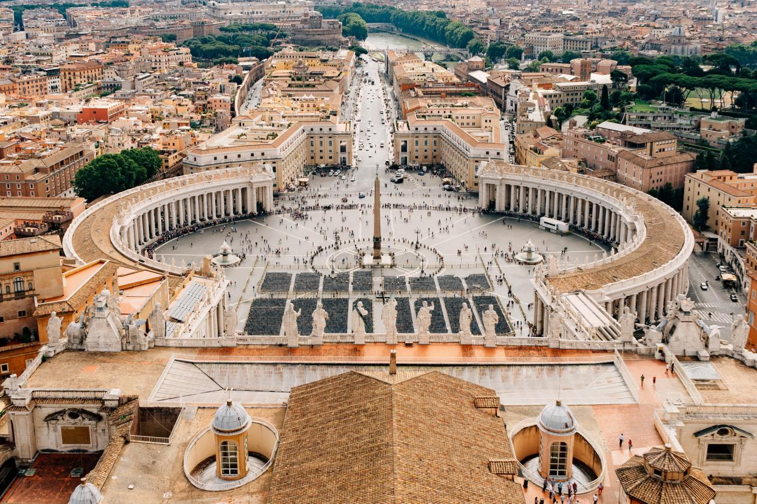
ROME
An aerial view of St. Peter's Square inside the Vatican City.
PHOTOGRAPH BY GETTY IMAGES

Slide 21
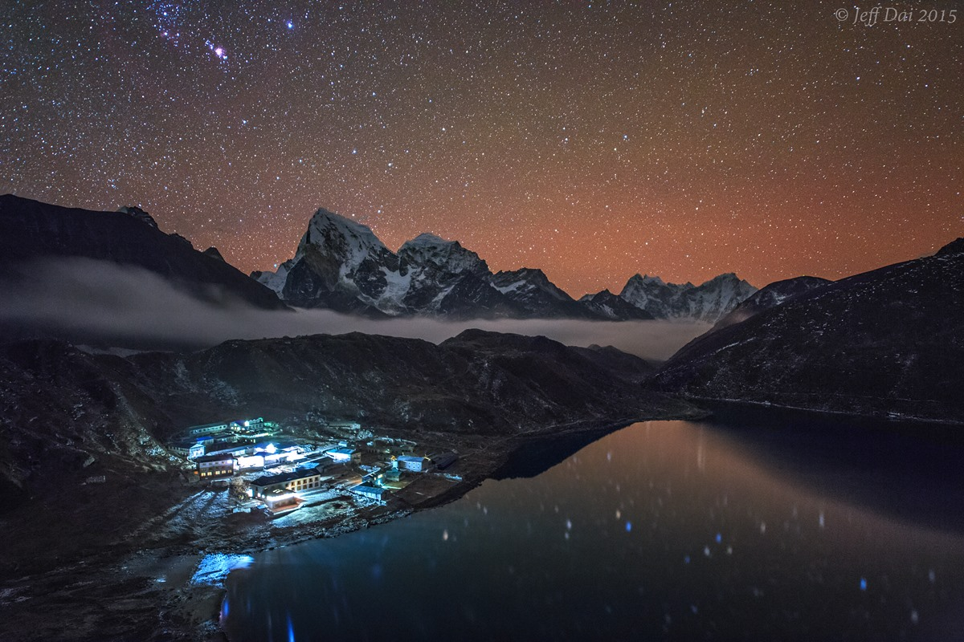
NEPAL
Starry night in Gokyo, a sherpa village located at the lake Dudh Pokhari in Sagarmatha National Park.
PHOTOGRAPH BY JEFF DAI, STOCKTREK IMAGES, INC./ALAMY

Slide 22
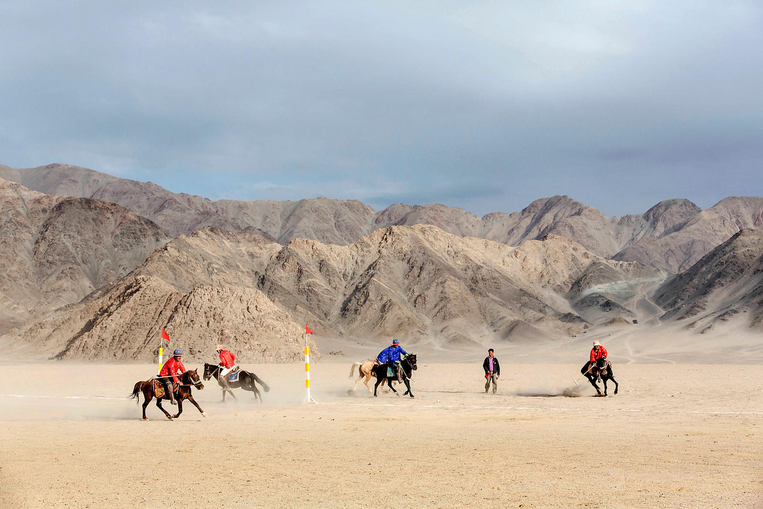
INDIA
A group of men plays polo on horseback in Ladakh, India, the “land of high passes” and one of the most visually stunning areas in the Indian Himalaya. The game is played in two 20-minute halves, with a 10-minute break in between. The horses play the entire match.
PHOTOGRAPH BY ARNAUD ROBIN, FIGAROPHOTO/REDUX

Slide 23
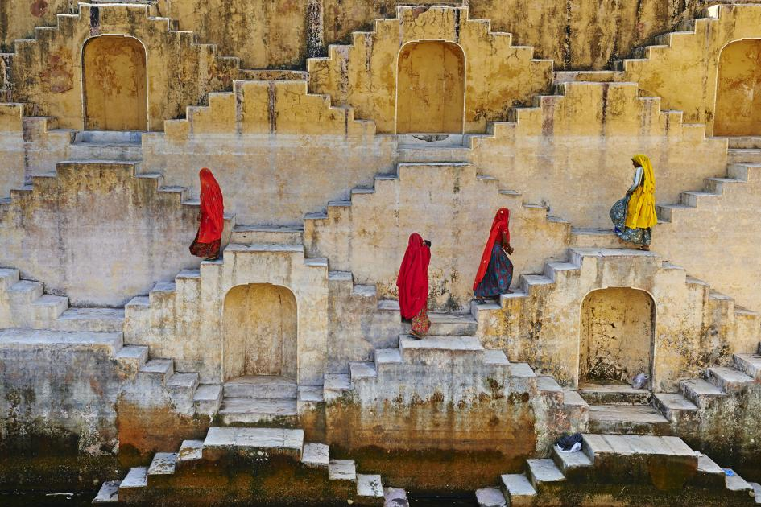
INDIA
The stepwells of India were once vital in dry, rain-starved regions like the Indian state Rajasthan. The Panna Meena ka Kund stepwell in Jaipur was built in the 16th century and was used not just as a place to collect water, but also to gather, relax, and swim.
PHOTOGRAPH BY TUUL AND BRUNO MORANDI, GETTY IMAGES

Slide 24
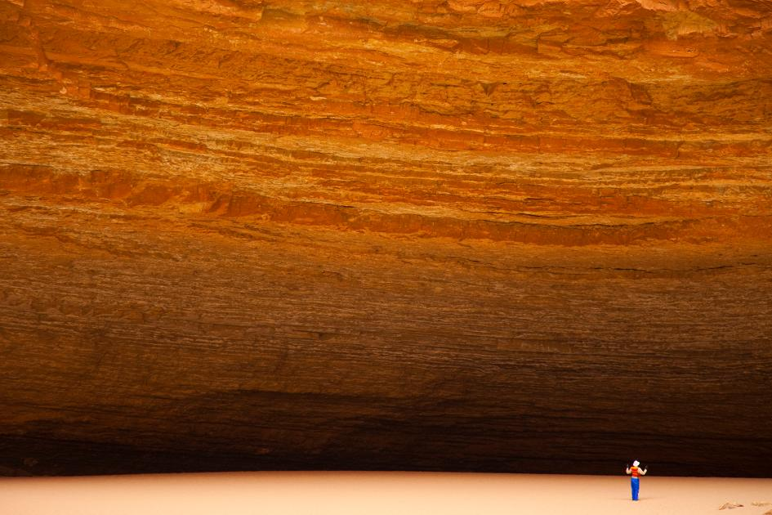
ARIZONA
Redwall Cavern, one of the Grand Canyon’s most iconic sites, dwarfs this visitor to the national park, which was established on February 26, 1919. The amphitheater was carved by the Colorado River’s flows through the limestone valley and is a popular stop on rafting trips.
PHOTOGRAPH BY RALPH LEE HOPKINS, NATIONAL GEOGRAPHIC CREATIVE

Slide 25
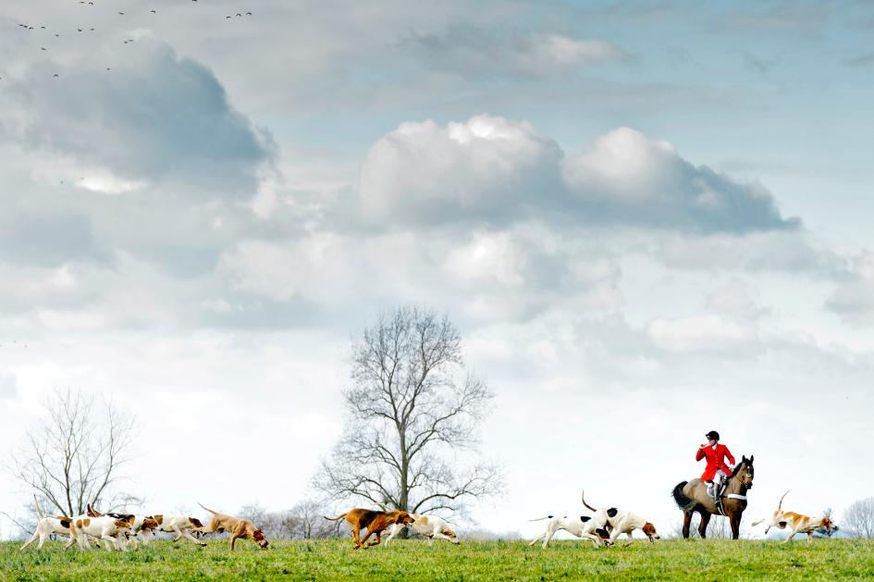
PENNSYLVANIA
Dressed in traditional garb, this mounted huntsman leads a group of hounds on a foxhunt in Unionville, Pennsylvania, a tradition that has endured in the area for more than a century. The hounds will often take part in their first hunt at 18 months and remain active in the sport for more than 10 years.
PHOTOGRAPH BY JIM GRAHAM, REDUX

Slide 26
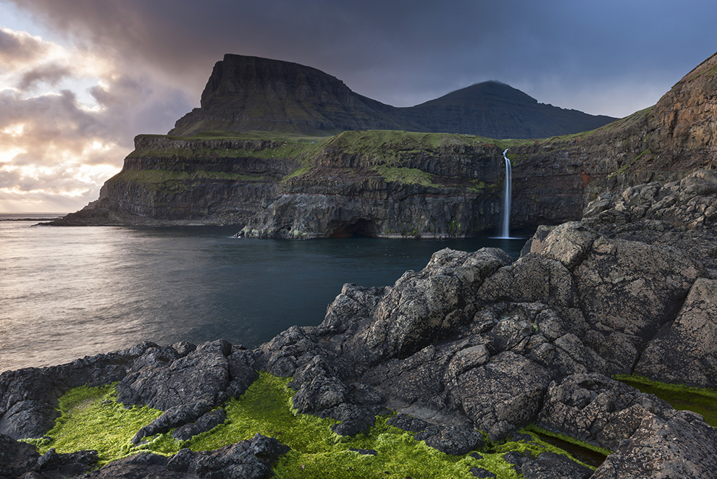
FAROE ISLANDS
It wasn’t until a tunnel was built in 2004 that the residents of Gásadalur had an easy path to and from their home. At the time, the village—perched above this iconic waterfall on Denmark’s Faroe Islands—had all of 16 residents. Now that the village is accessible by car, and not just via an arduous hike or horseback ride, that number has risen to 18 residents.
PHOTOGRAPH BY ADAM BURTON, JAI/CORBIS

Slide 27
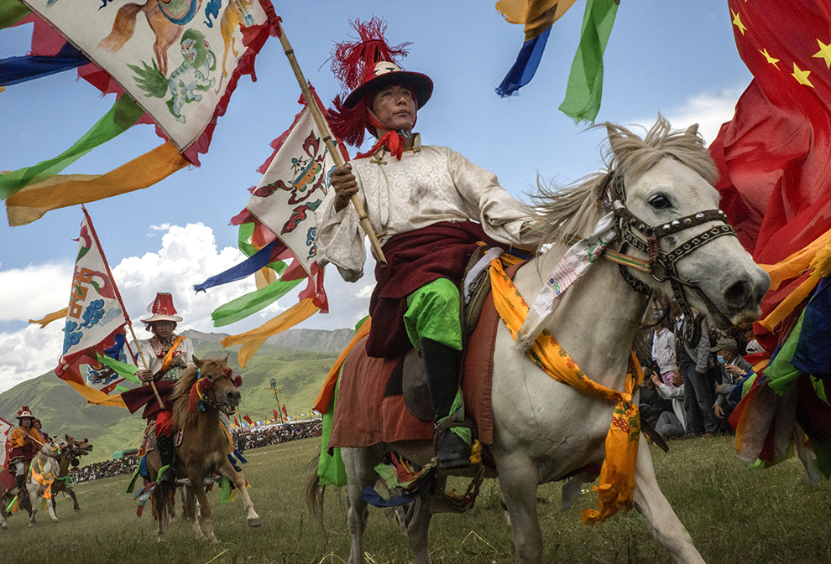
CHINA
In Yushu, an autonomous prefecture in China's Qinghai Province, riders participate in the Yushu Horse Festival. The summer event is held annually beginning July 25 and features colorful displays of traditional Tibetan costumes and culture, as well as horse races and athletic competitions.
PHOTOGRAPH BY GILLES SABRIE, NEW YORK TIMES/REDUX
December 8, 2016 王文堯 Kaohsiung Taiwan R.O.C
All photos were taken from National Geographic, Internet.
Music : Nazca - Arco Iris
THE END

