Slide 1
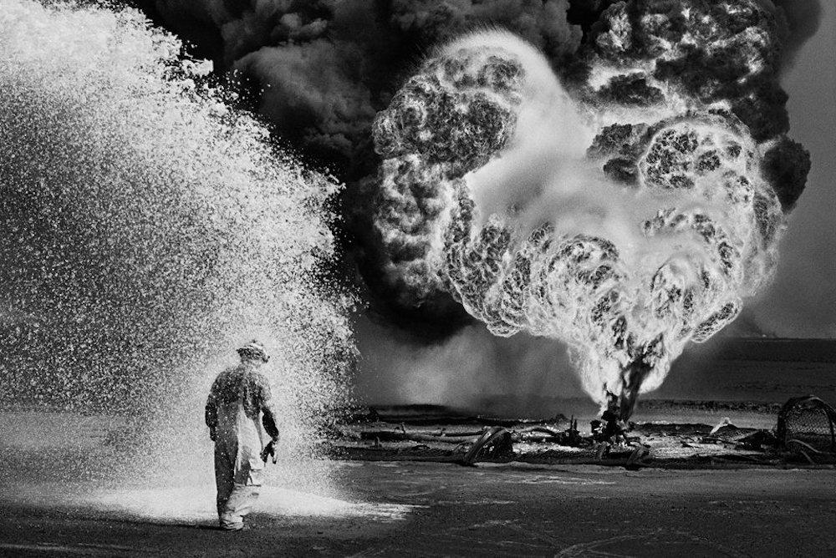


Slide 2
25th Anniversary of 1991 Kuwaiti Oil Fires
In 1991, Saddam Hussein’s troops set off an inferno in Kuwait, creating an environmental catastrophe.

Slide 3
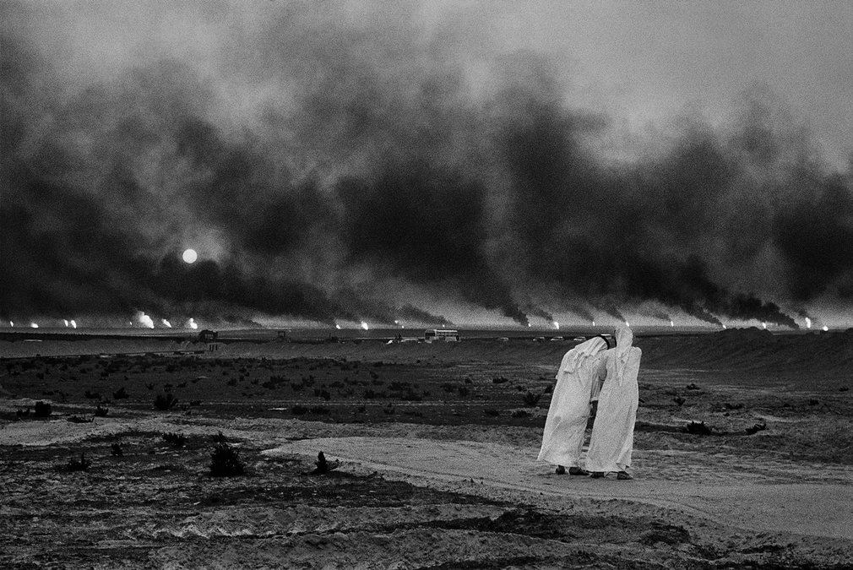
In January and February 1991, as the US–led coalition drove Iraqi forces out of Kuwait,Saddam Hussein’s troops retaliated with an inferno

Slide 4
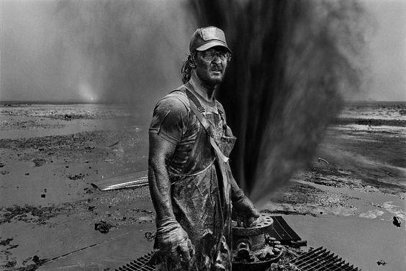

Slide 5
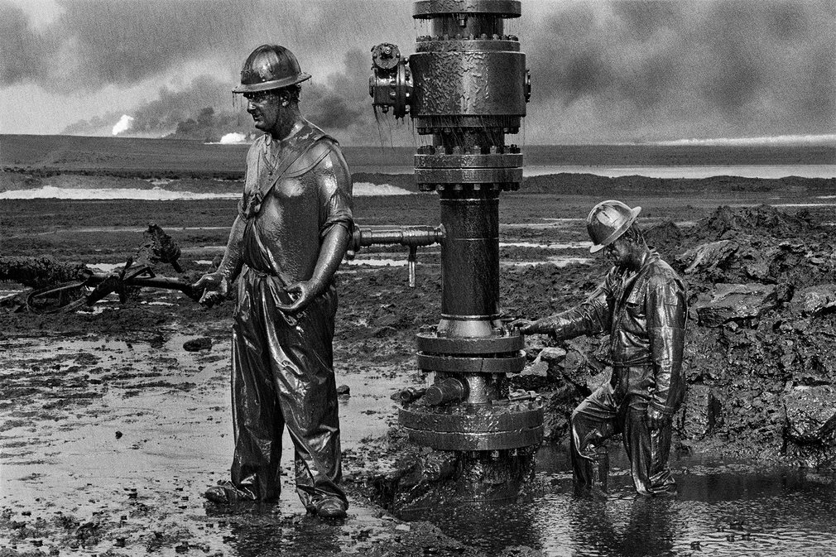

Slide 6
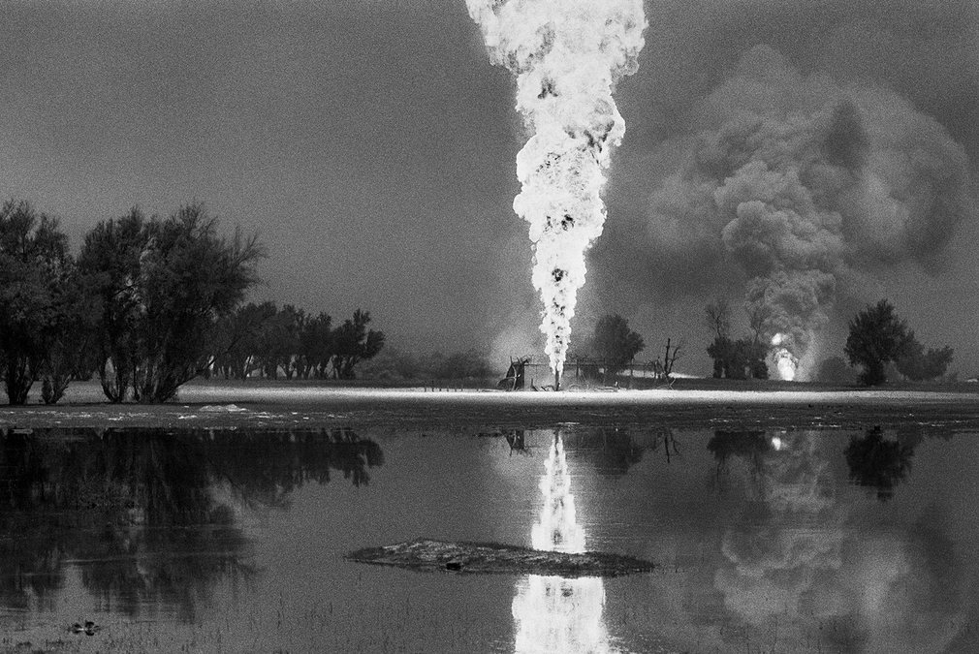

Slide 7
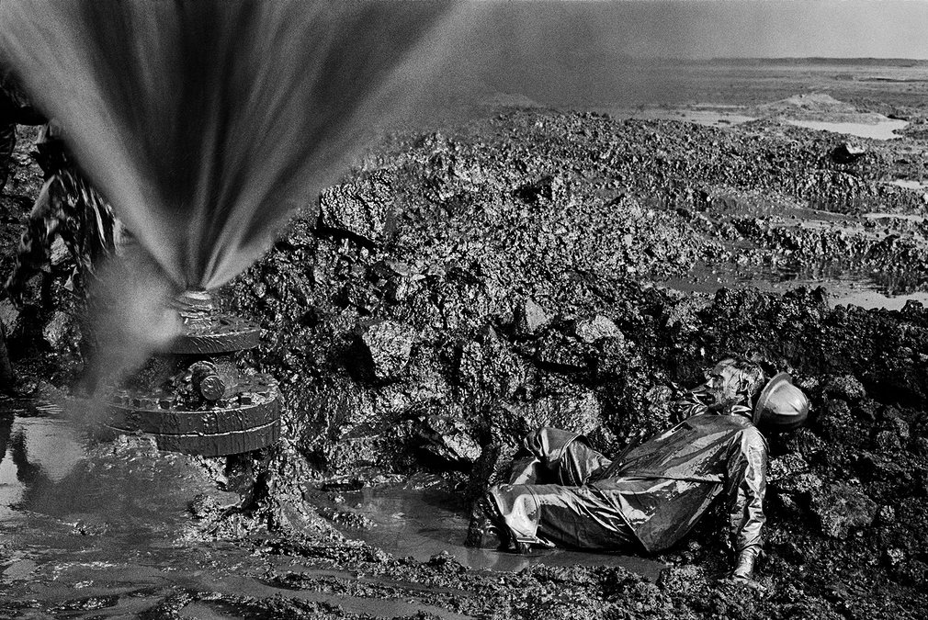

Slide 8
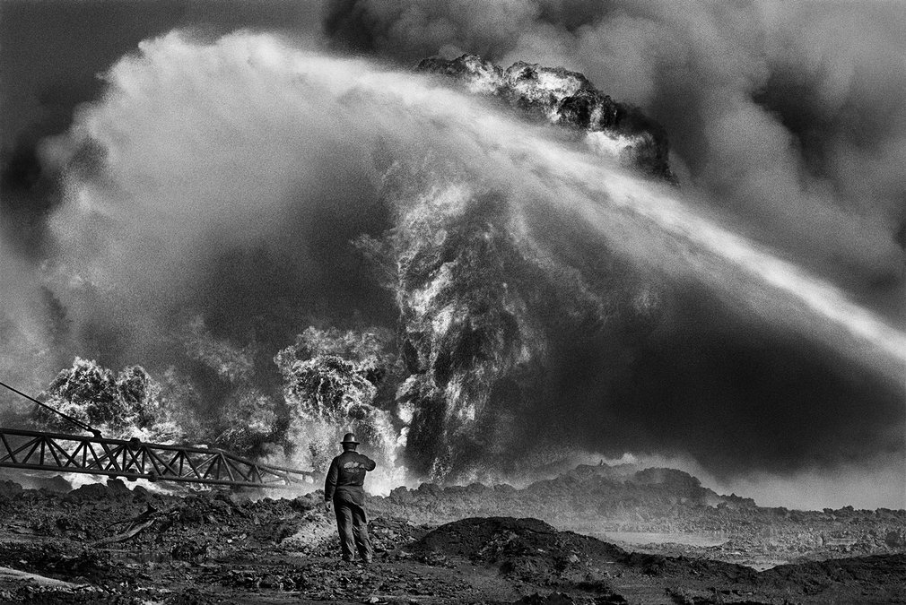

Slide 9
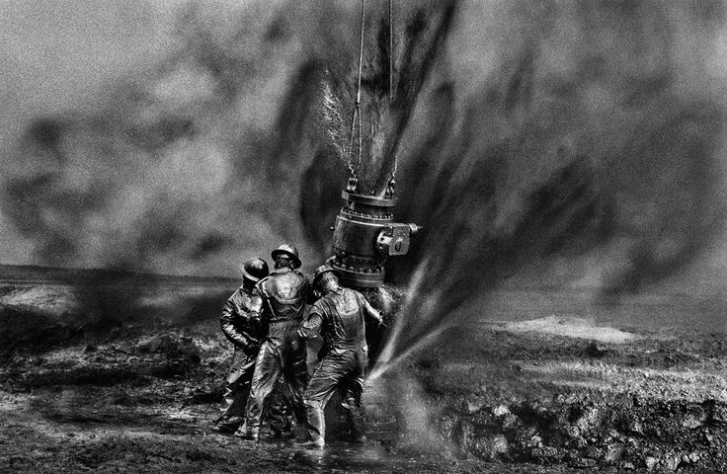
Concerted efforts to bring the fires and other damage under control began in April 1991

Slide 10
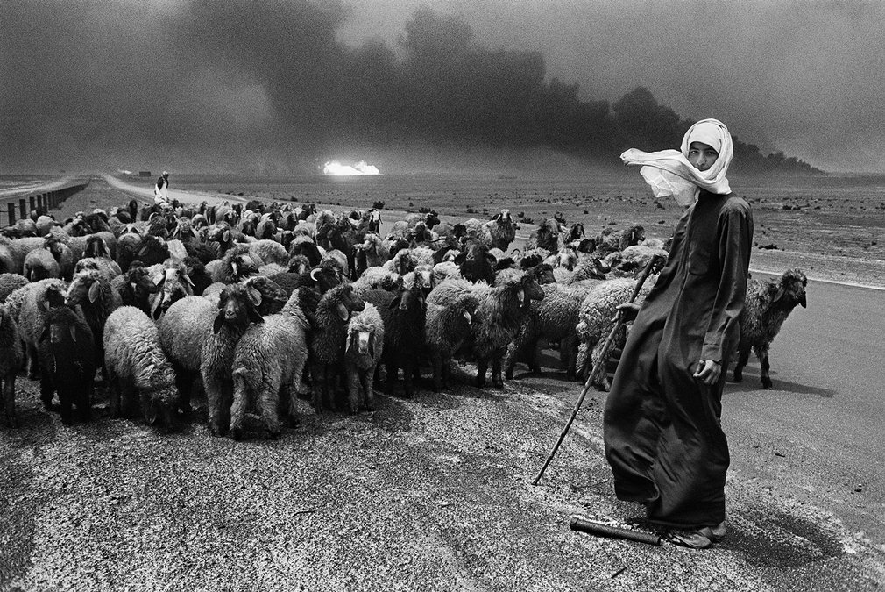

Slide 11
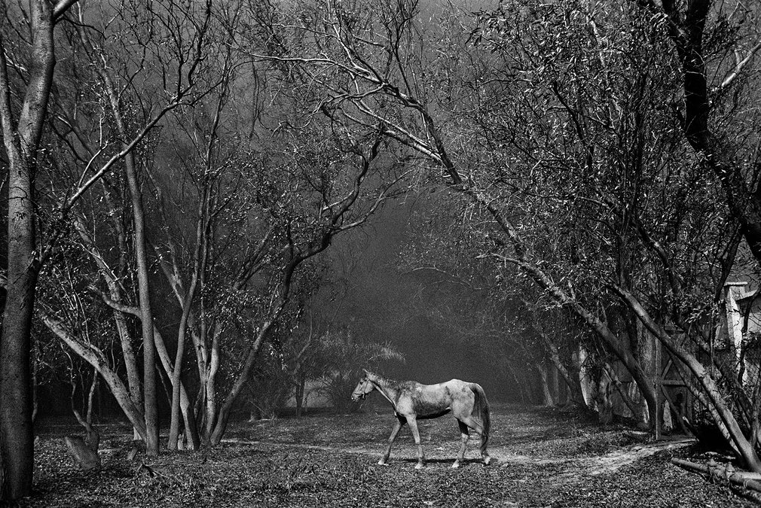
It has been reported that between 605 and 732 oil wells were set alight, causing an environmental disaster for the local people and farmers

Slide 12
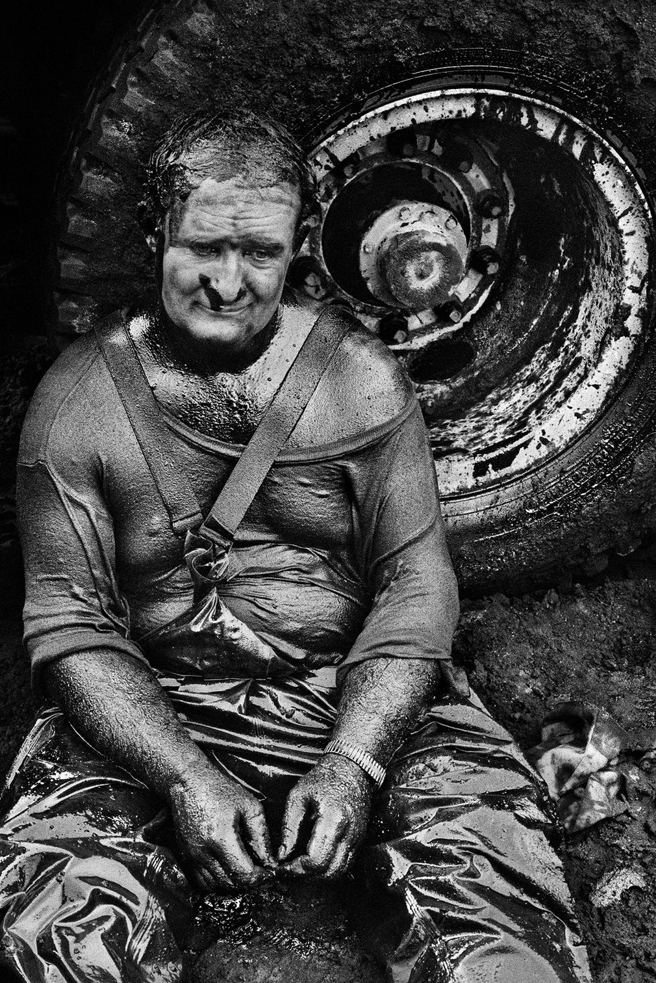

Slide 13
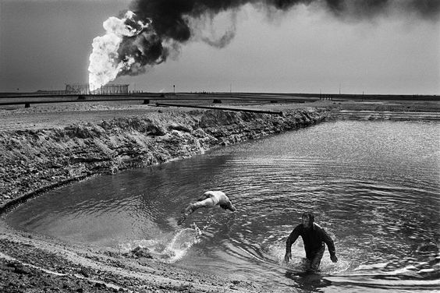

Slide 14
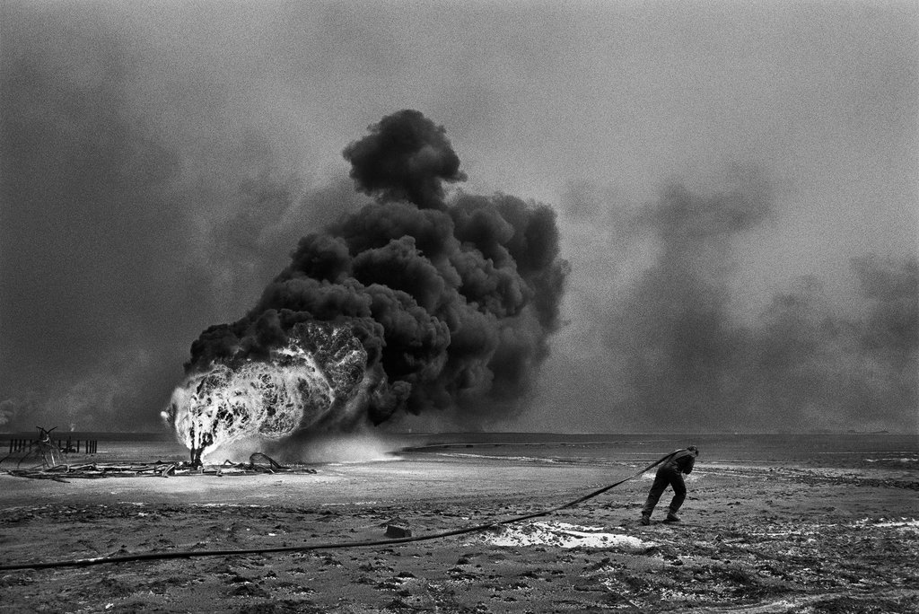

Slide 15
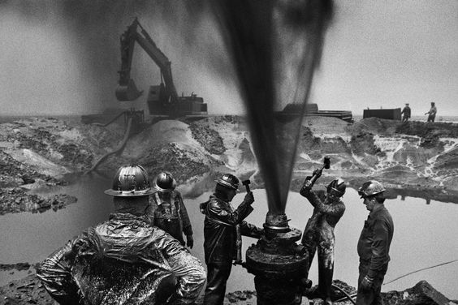

Slide 16
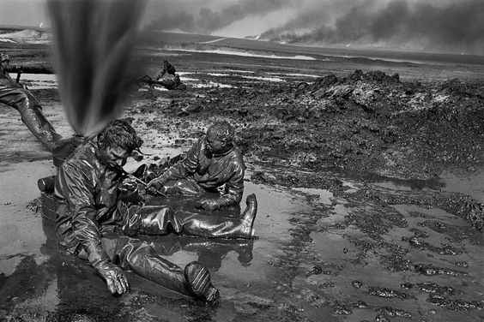

Slide 17
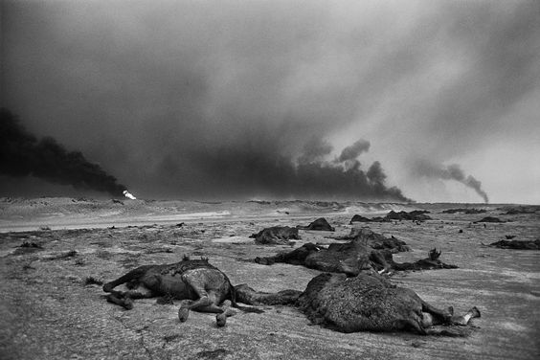

Slide 18
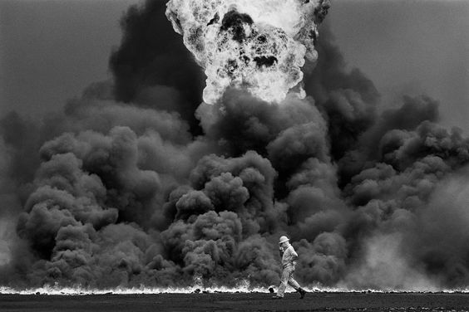

Slide 19
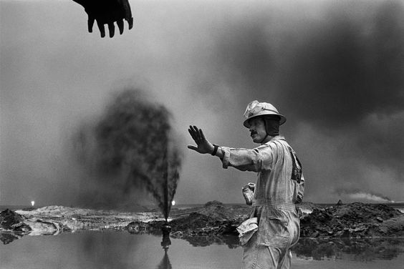

Slide 20
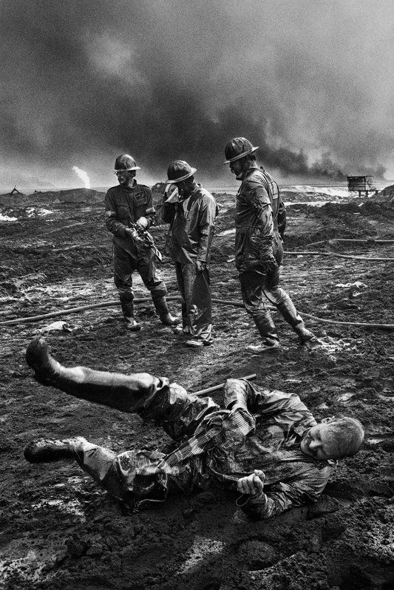

Slide 21
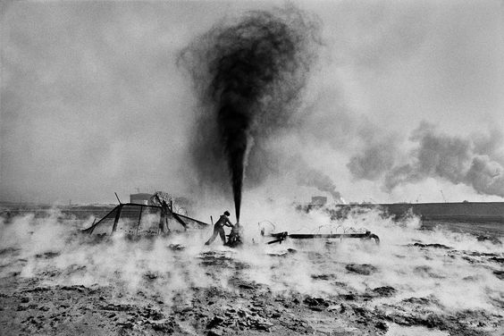

Slide 22
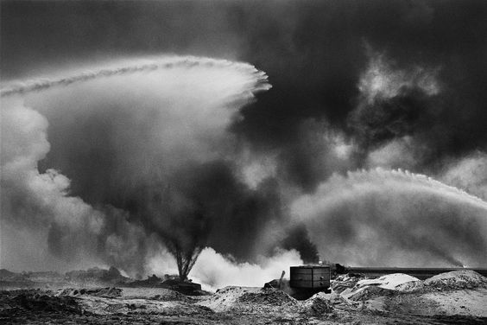

Slide 23
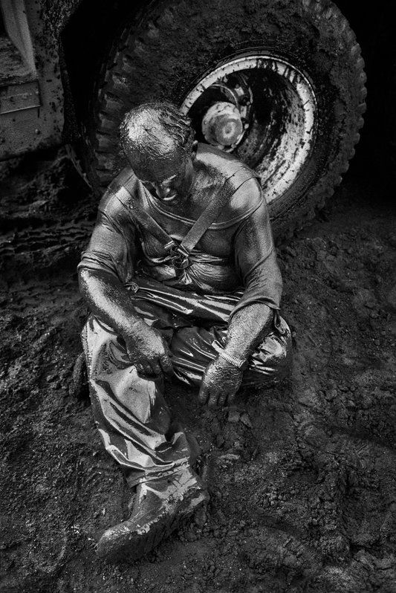

Slide 24
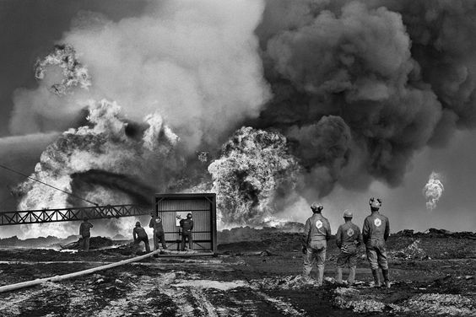

Slide 25
According to oil expert Larry Flak, 90% of all the fires in Kuwait were put out with nothing but sea water, sprayed from powerful hoses at the base of the fire

Slide 26
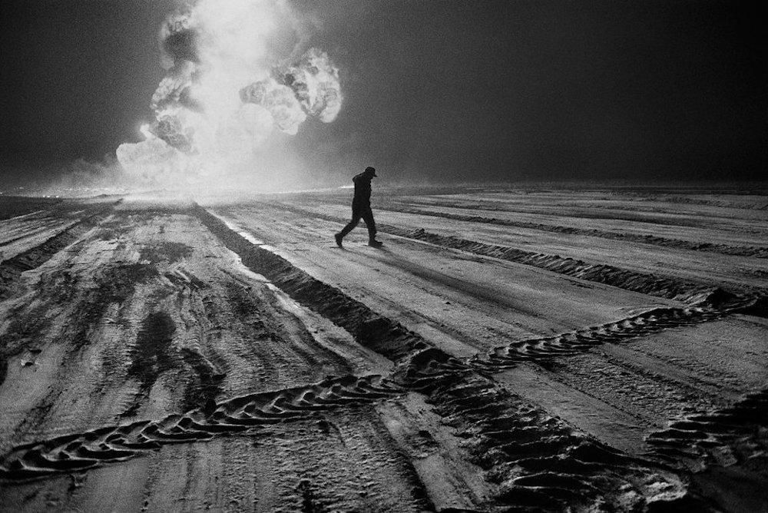

Slide 27
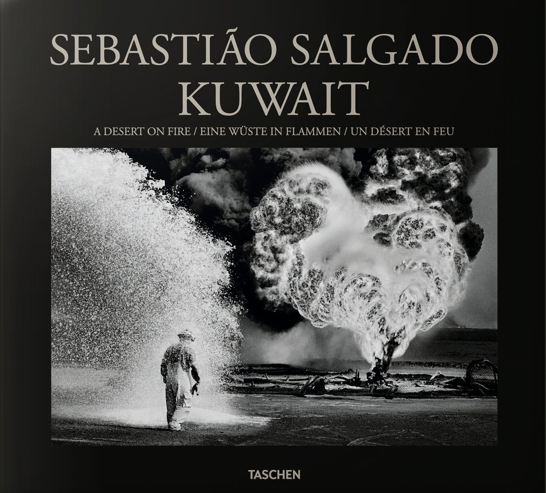

Slide 28
Sebastião Salgado is a documentary photographer and author of eleven books, including the forthcoming “Kuwait: Desert on Fire.”

Slide 29
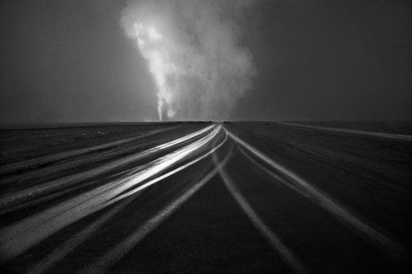
21-NOVIEMBRE-2016
END

