Slide 1

CHIHAB Tasnyme
JABRI Najoua
JABRI Jamal
2V

Slide 2

“An education that never sees skills and needs of everyone produces only idiots”
George Sand, 1848.

Slide 3


Slide 4
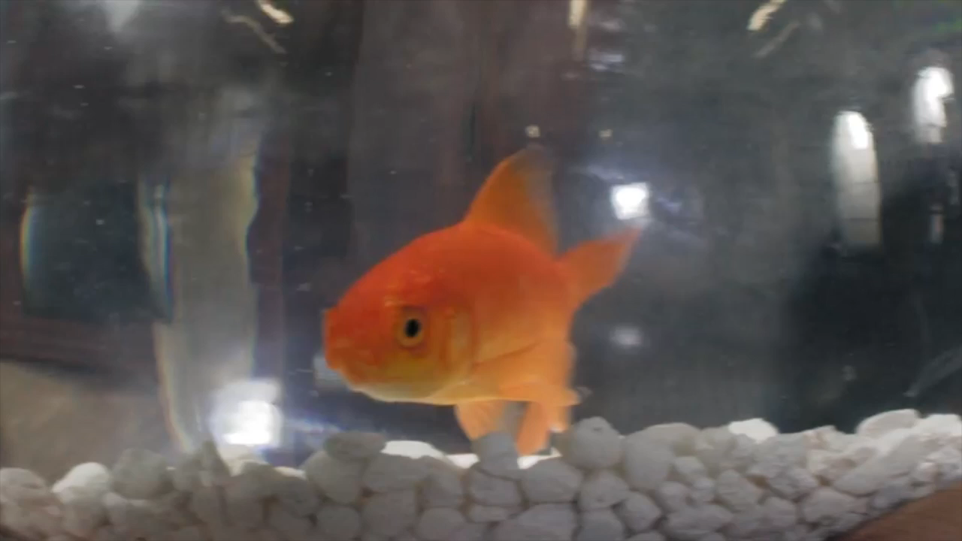

Slide 6


Sir Ken Robinson
Encouraging diversity
Stimulating curiosity
Focusing on creativity

Slide 7
According to Sir Robinson, what is the school system based on?

Slide 8

Academy ability
Access to university
Maths
Languages
Humanities
Arts

Slide 9
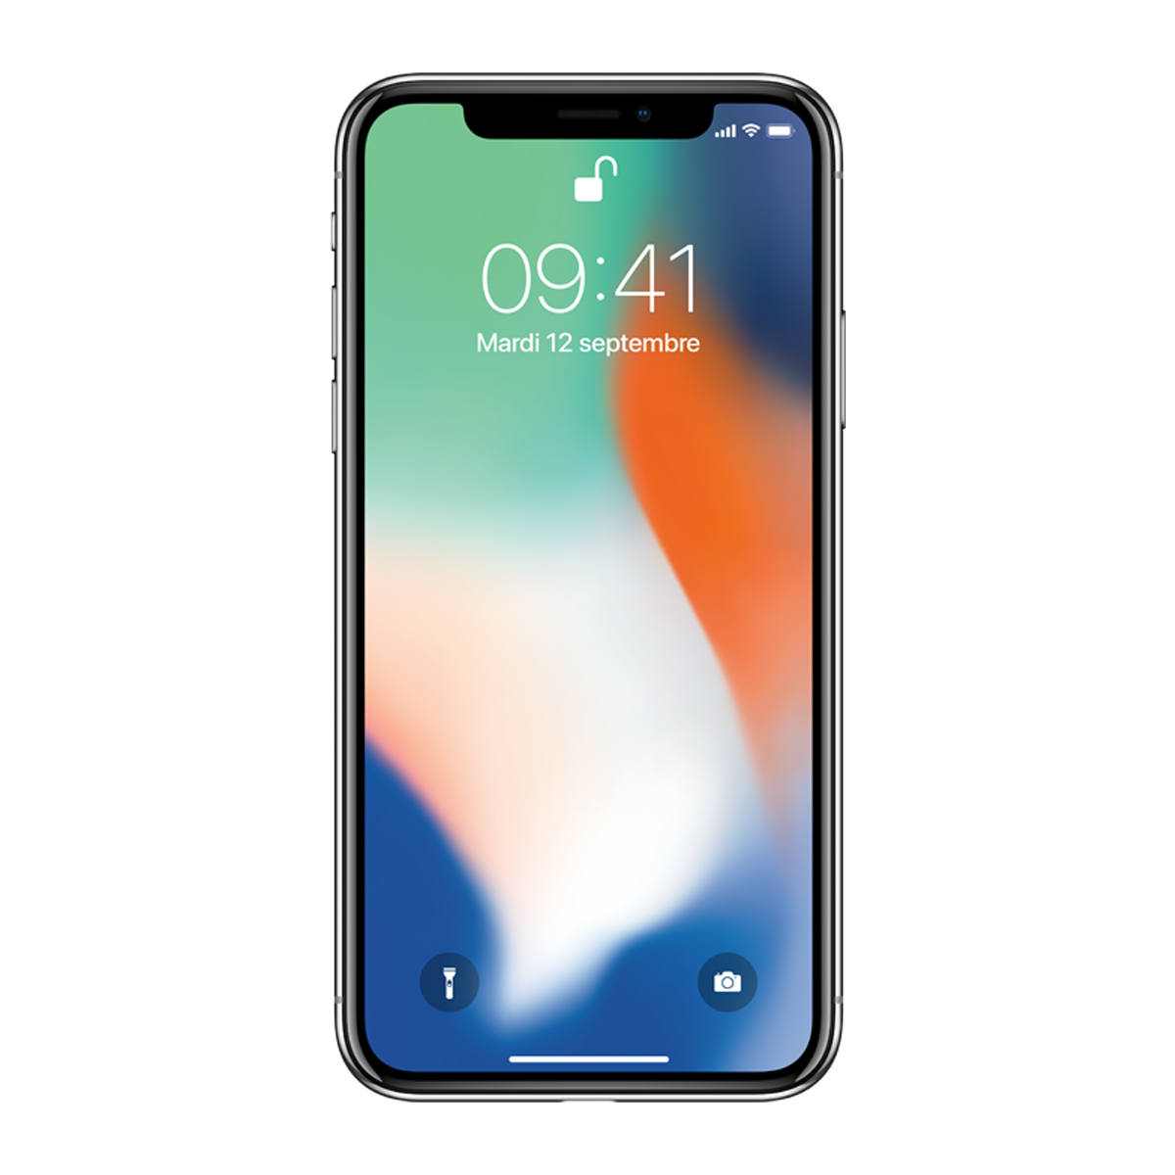
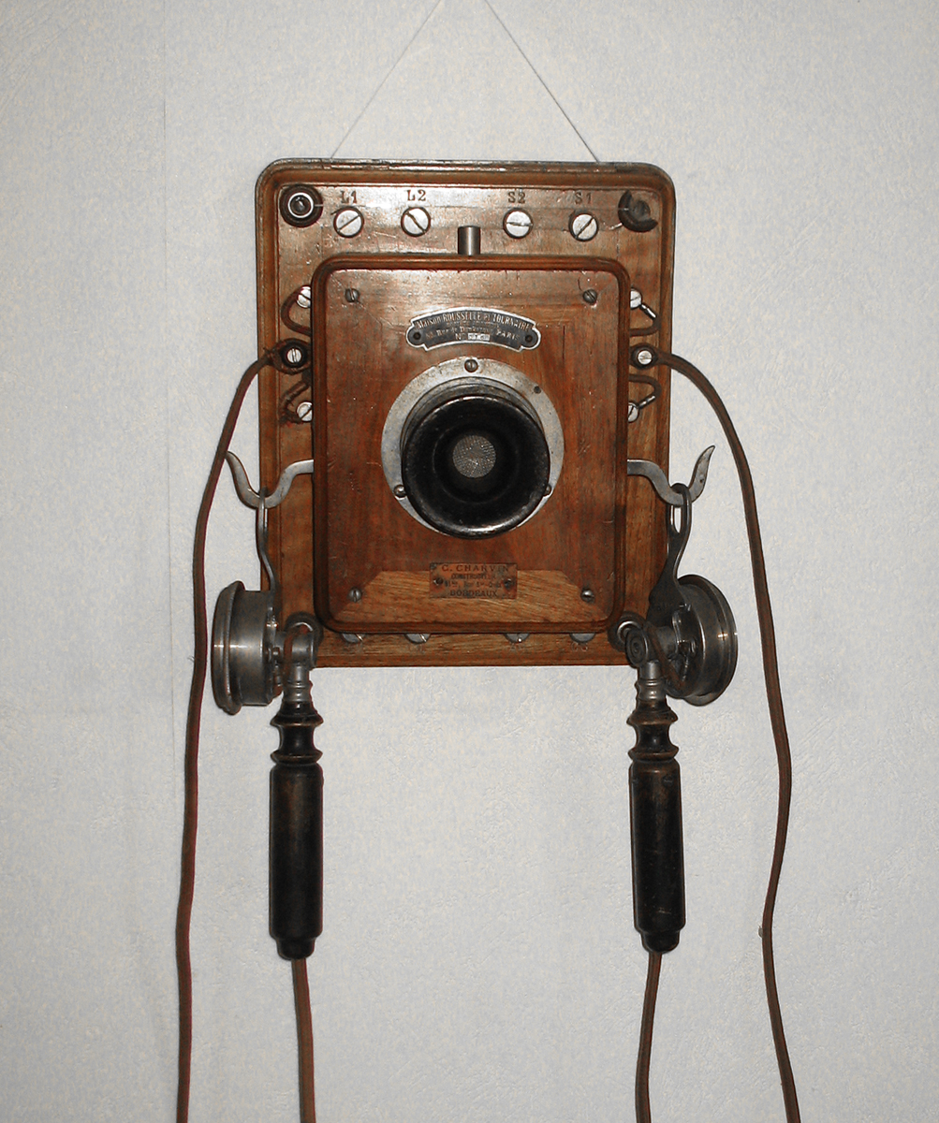

Slide 10
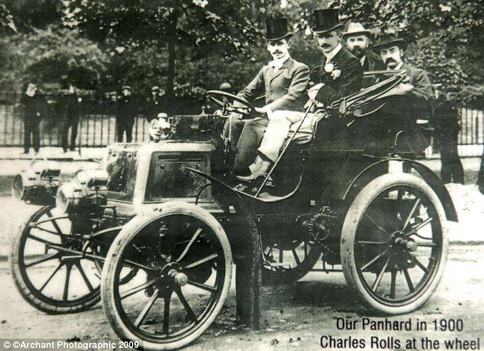


Slide 11
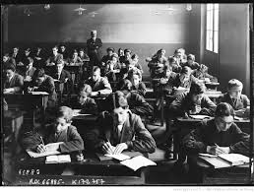
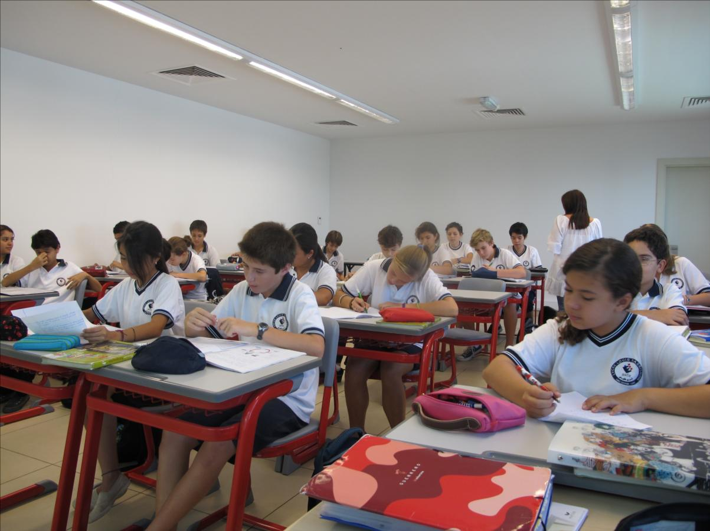

Slide 12
Nothing has changed

Slide 13


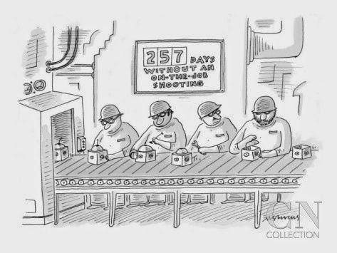


Evolution
Interactive Age
21st century
Technology Age
20th century
Industrialization
19th century
Public Education
1800

Slide 14



Finnish School System
Facts about the system
Facts about the results
Beginning at the age of 7
66% of students go to university
93% of success in the secondary school
30% can have help
75 minutes break & 10 weeks of summer break

Slide 17

Creativity ?
« Creativity is the ability to produce original and unusual ideas or to make something new or imaginative »

Slide 18

I
N
T
E
L
L
I
G
E
N
C
E
S
Dynamic
Distinct
Diverse

Slide 19

Dynamic
… Interactions
… Connections
Creativity

Slide 20
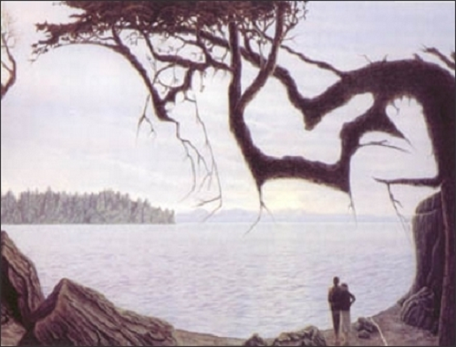

Slide 21

Distinct
« If you don’t succeed at school, you’re not an idiot »
“You will never earn a living as an artist”

Slide 22
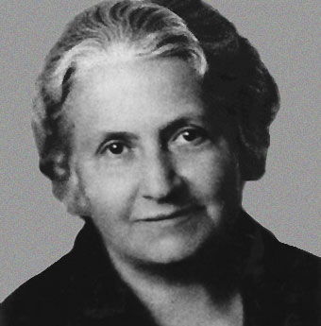


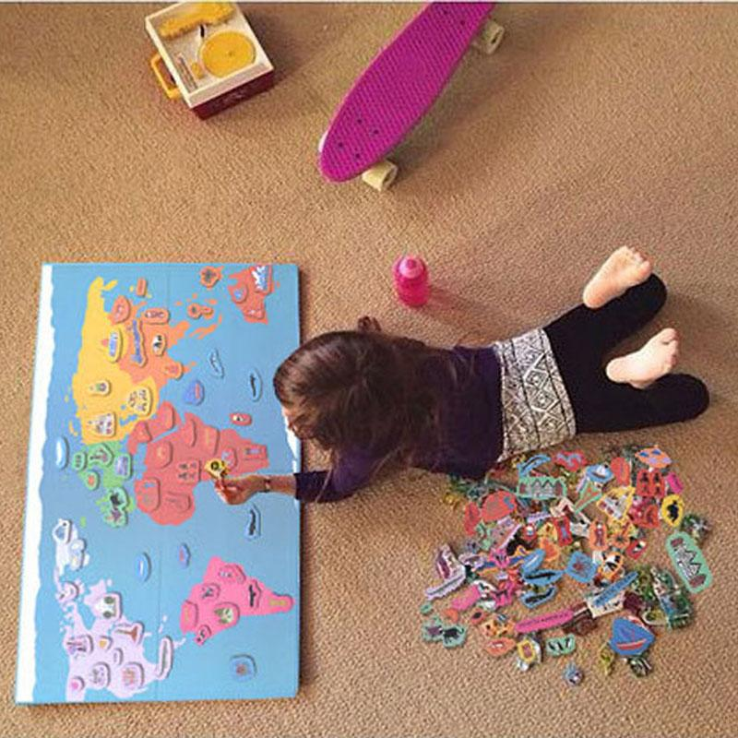
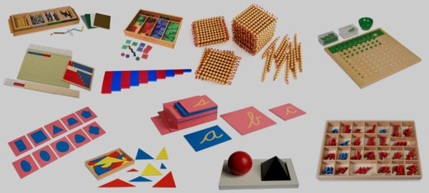
DIVERSE
MONTESSORI
Maria Montessori
1870 - 1952
We think …
Visualy
In sound
Kinesthetically
Self-directed activity
Hands-on learning
Collaborative play

Slide 23
Let’s conclude …

Slide 24

And now let’s talk about this …

Slide 25
If you had the ability to teach how would you do it? And without any restrictions …
We are sent to school to be prepared for the real world. But do you feel capable to work for system without hierarchy like Apple or Google?
If you had the choice or the ability, would you choose to study what you are passionate about?
Was it your choice n°1 to study International Business?

Slide 26
Do you think that with only creativity skills you can find a job? If yes, where?
What's the value of a degree/diploma today? Is it a guarantee to find a job?
"Do not study art, music, geography; you will never earn a living as a musician, ...". Have you ever heard that?

Slide 27

Thank You

