Slide 1
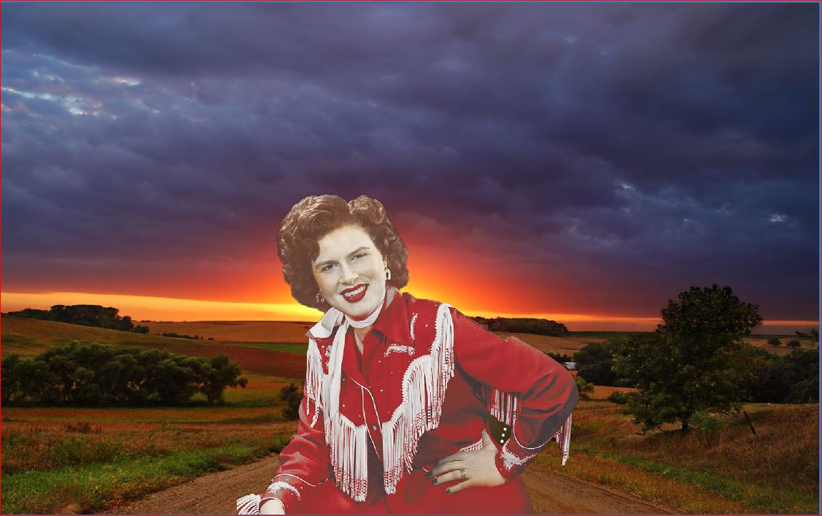
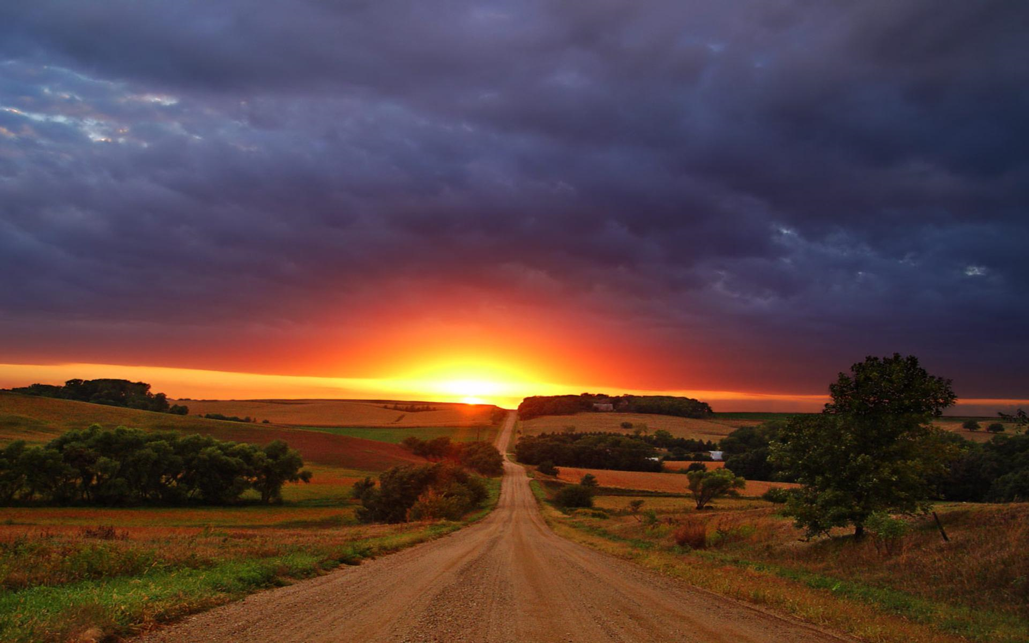

Patsy Cline (Winchester (Virginia), 8 september 1932 - Camden (Tennessee), 5 maart 1963) was een Amerikaanse countryzangeres
Back In Baby's Arms
Crazy Dreams
In care of the blues
Dear God
Let The Teardrops Fall
Hungry for love
Shoes
I'm Blue Again
Tra Le La Le La Triangle
Got a Lot of Rhythm in My Soul
You Belong To Me
I'm Movin' Along
Walkin' After Midnight

