Slide 1
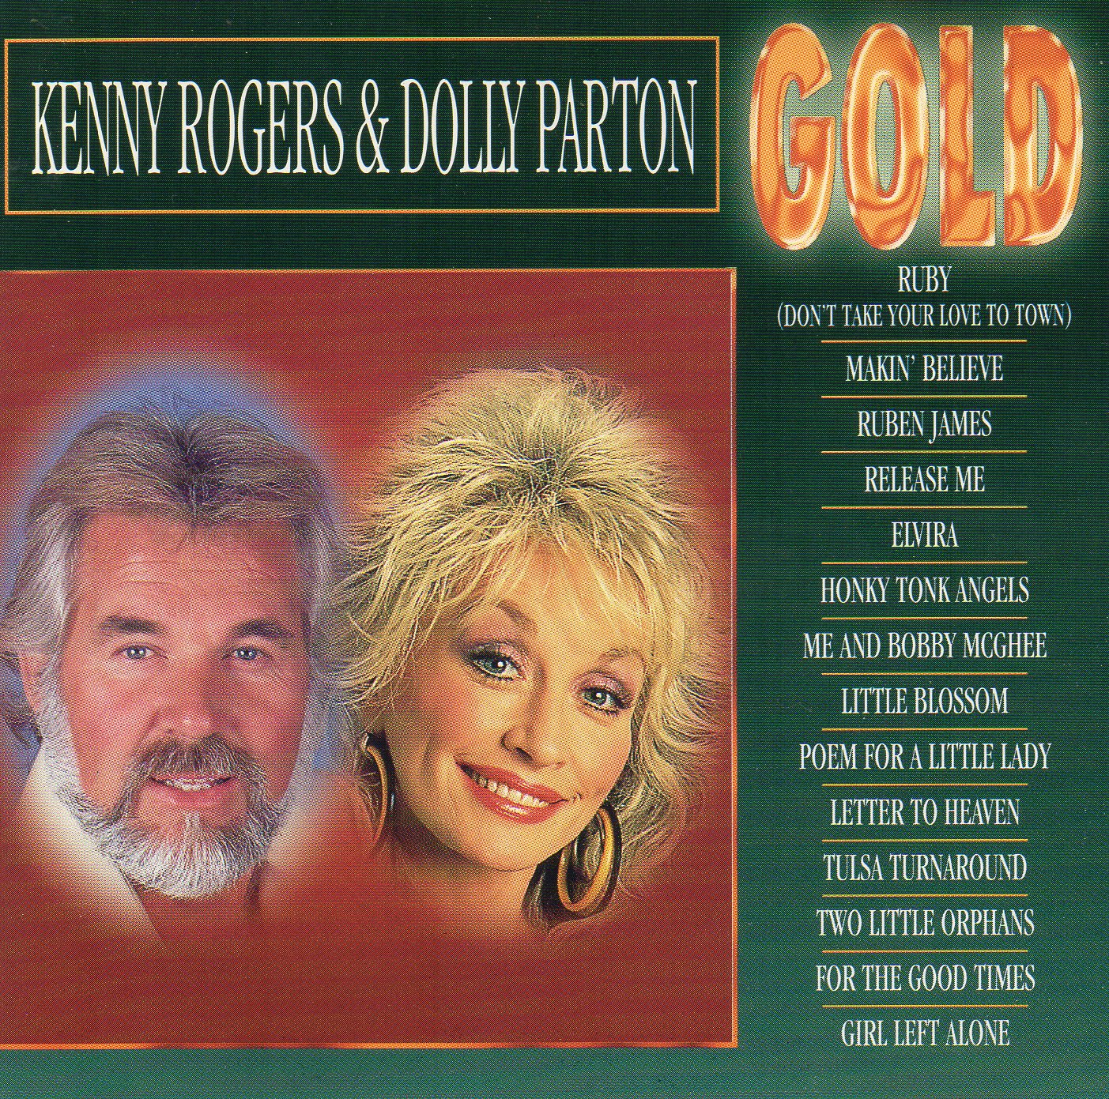
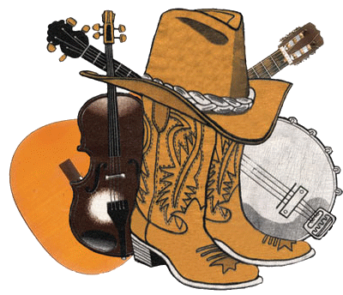
Kenny Rogers
Dolly Parton
Elvira
Makin' Believe
Ruben James
Release Me
Tulsa Turnaround
Letter To Heaven
For The Good Times
Two Little Orphans
Poem For A Little Lady
Girl Left Alone
Me And Bobby McGhee
Ruby
Little Blossom
Honky Tonk Angels

