Slide 1
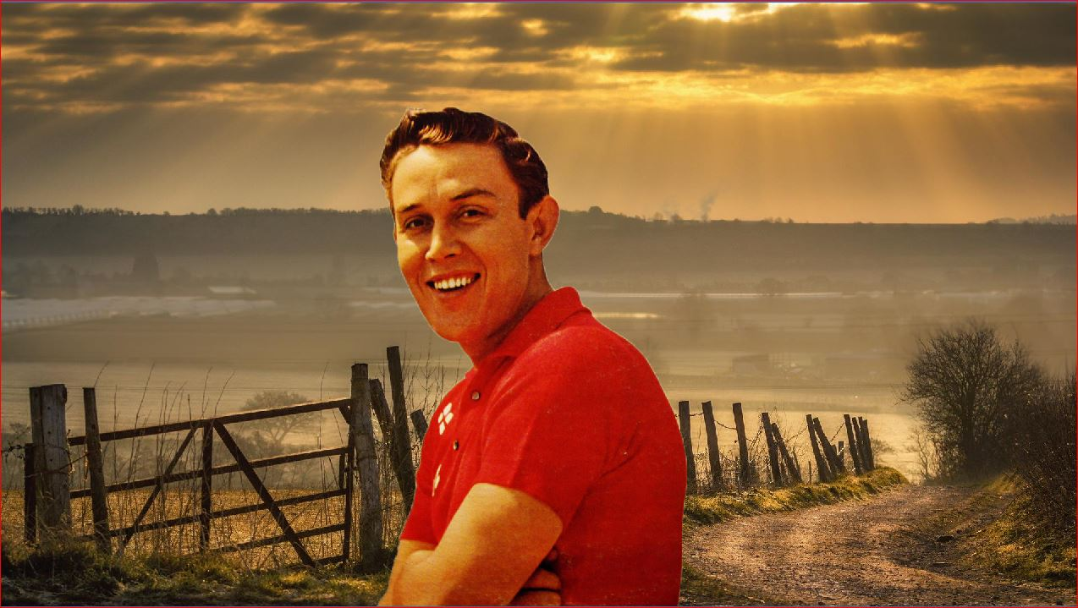
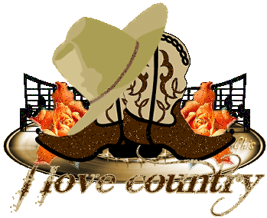
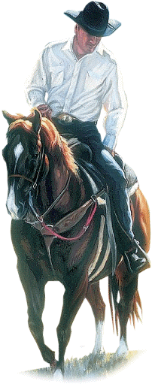
big bad john
night train to memphis
gotta travel on
oklahoma bill
grasshopper's mac clain
sixteen tons
i won't go hunting with you jake
to a sleeping beauty
Jimmy Ray Dean (10 augustus 1928 – 13 juni 2010), Amerikaanse countrymuzikant
make the waterwheel roll
smoke, smoke, smoke that cigarette

