Slide 1
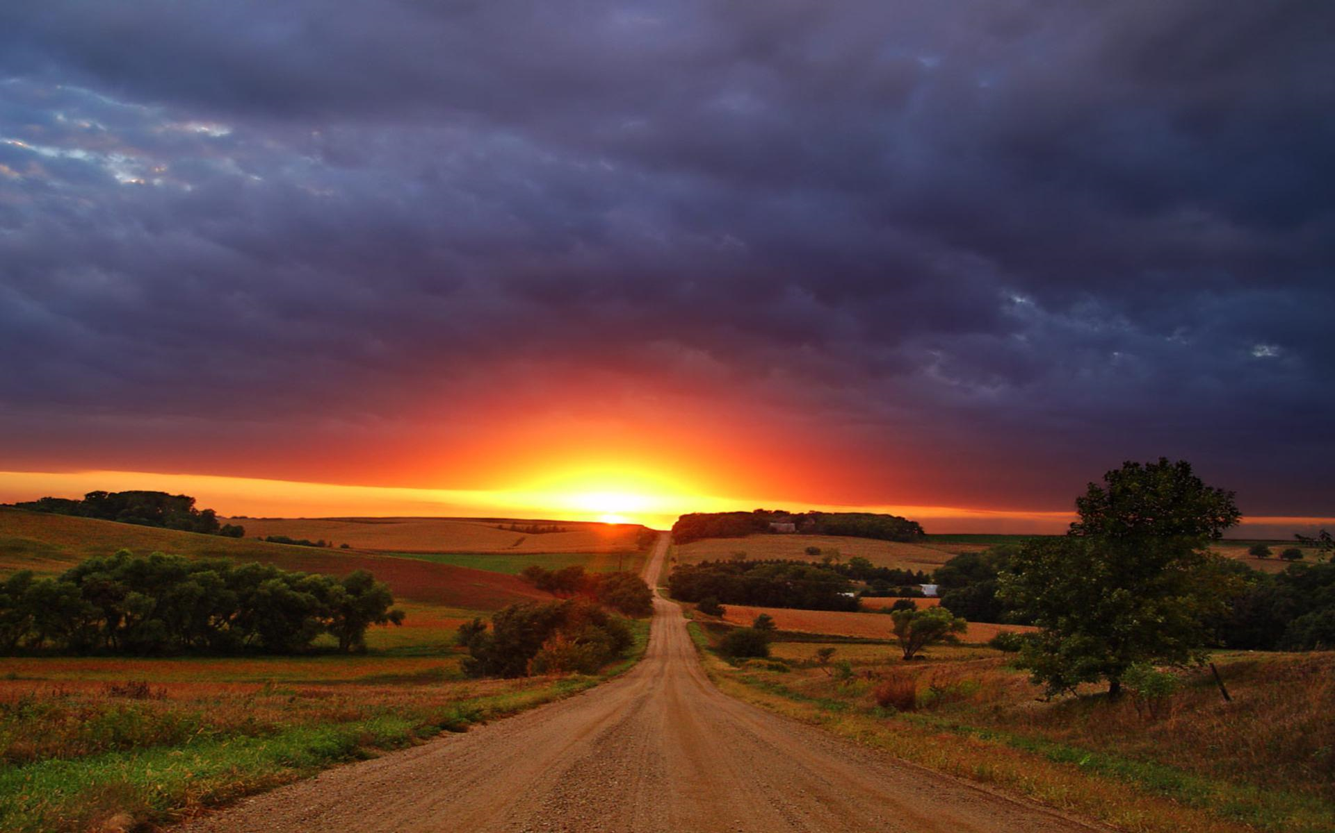

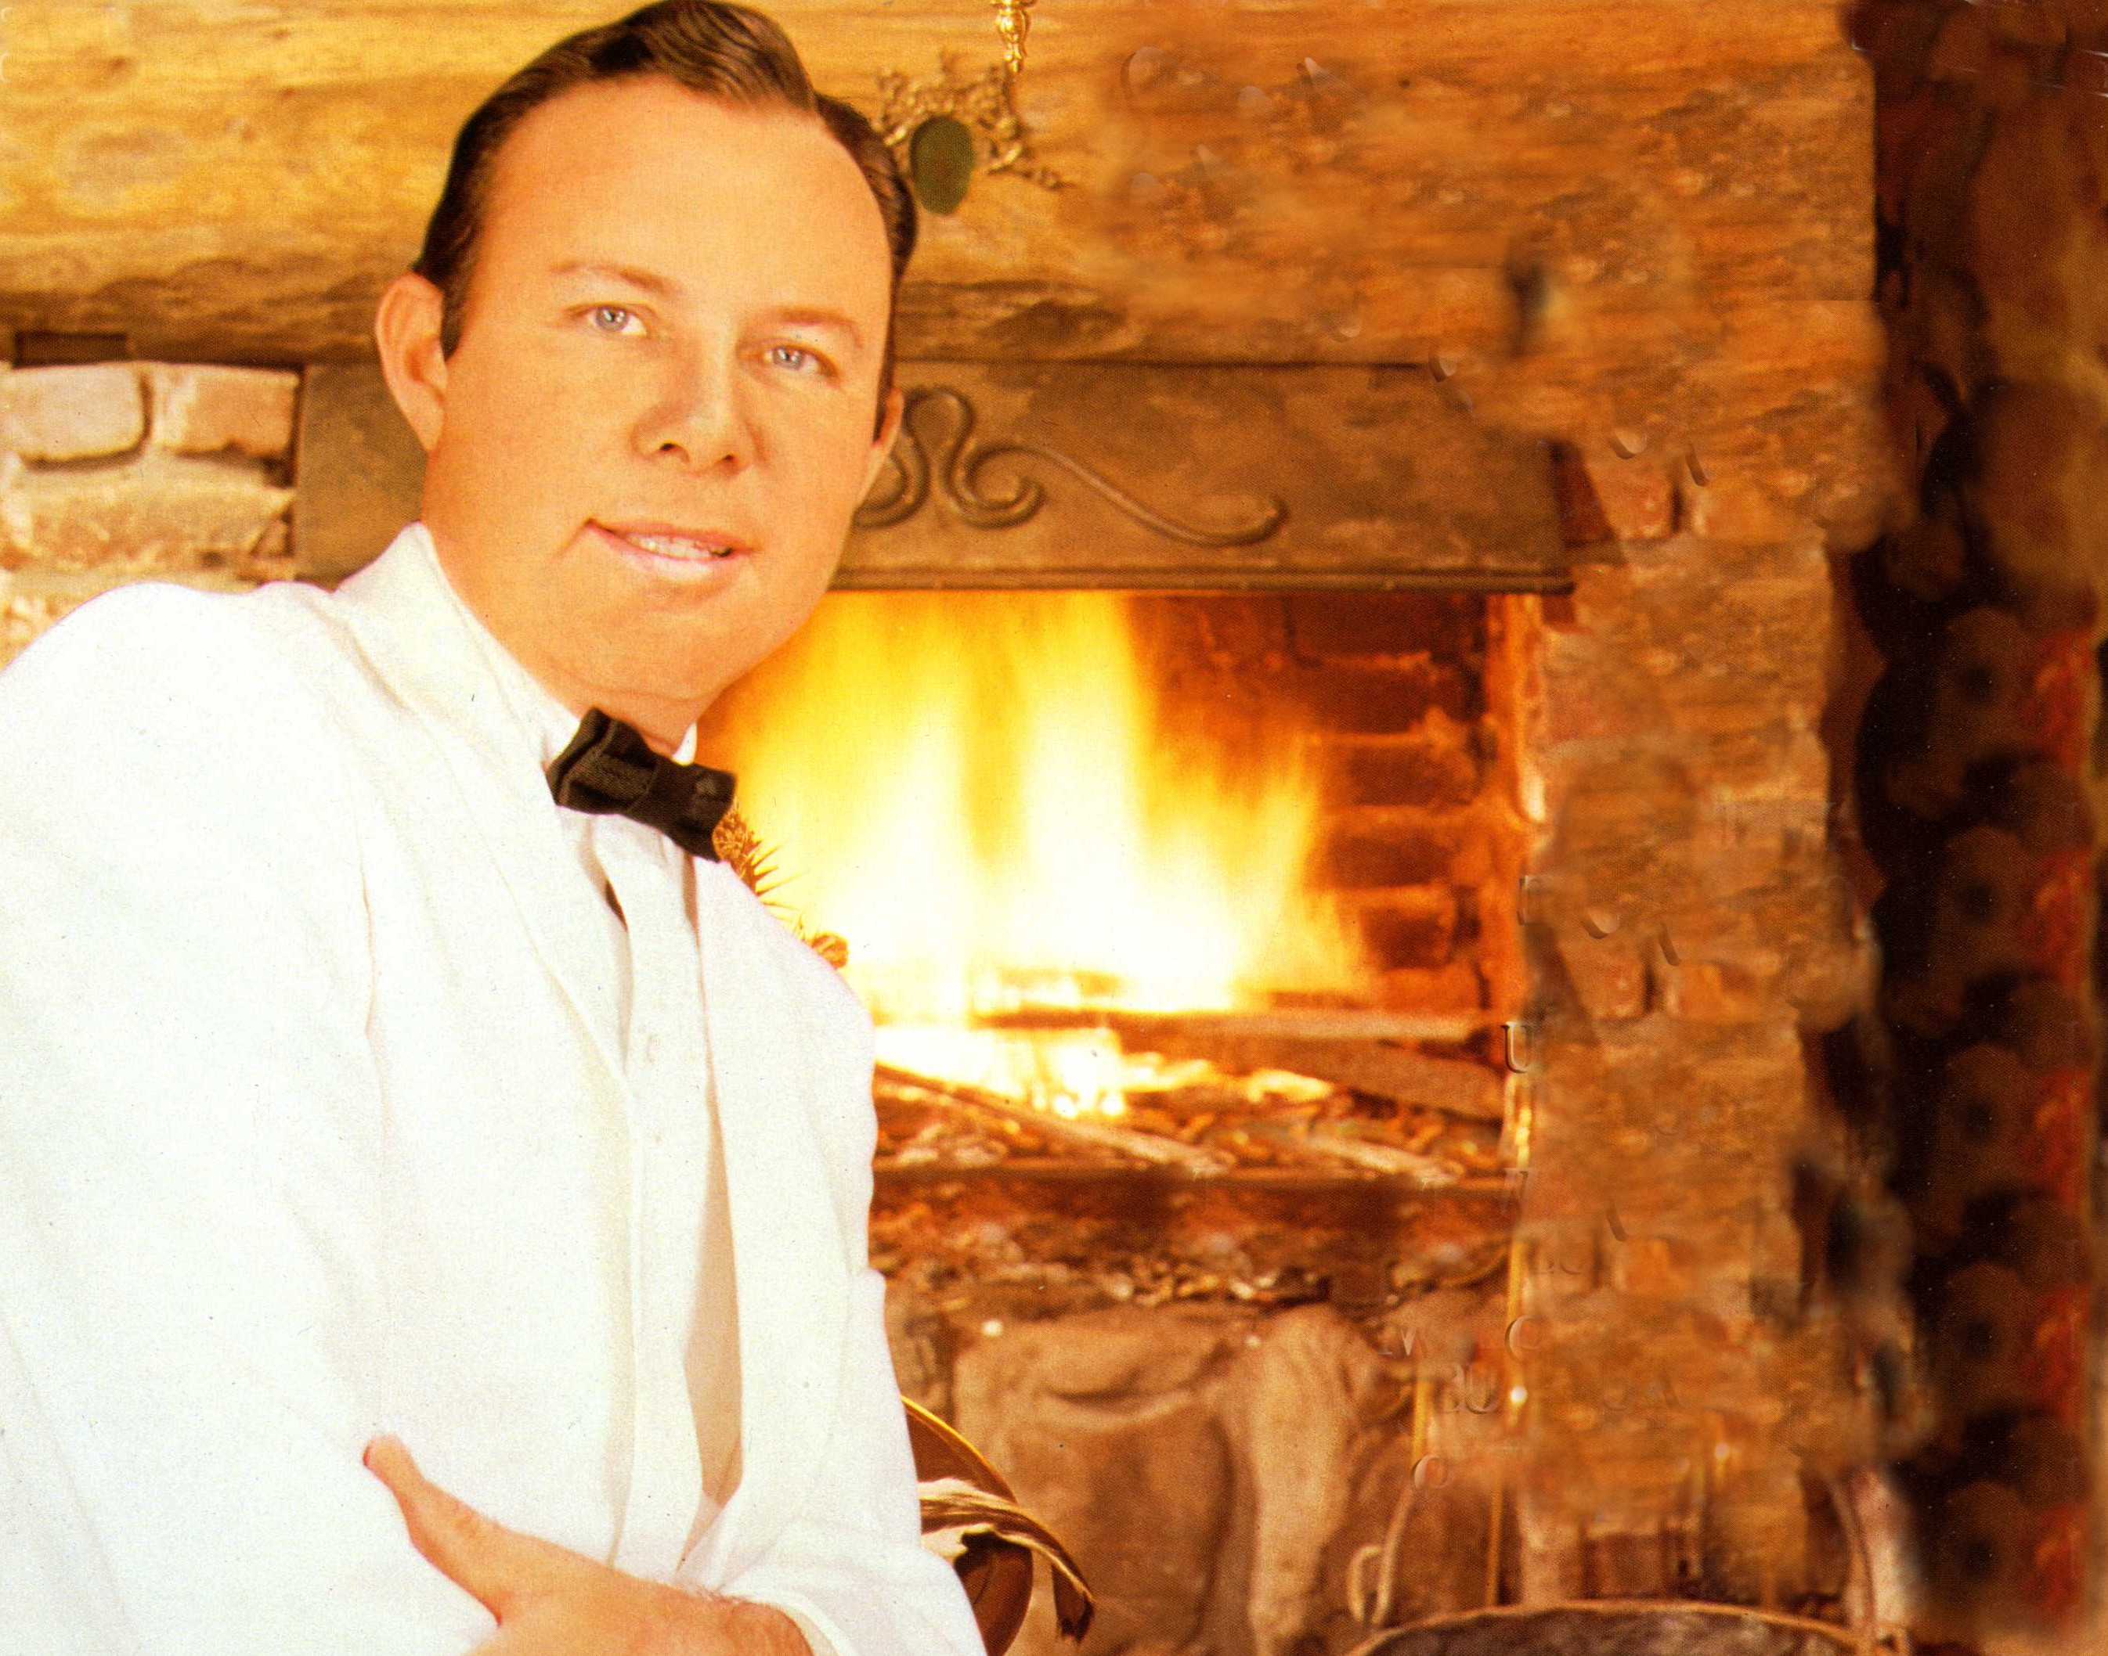
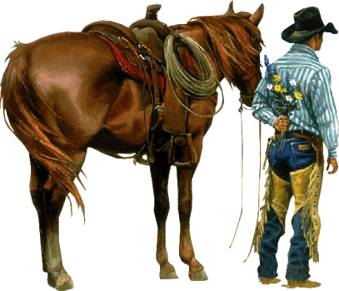
Jim Reeves (Galloway Texas, 20 augustus 1923 – Nashvile (Tennessee), 31 juli 1964) alias Gentleman Jim was een Amerikaanse country-zanger
A hundred kilo
Hillbilly Waltz
Blue Moon Betty
I Love You More
Diesel Smoke dangerous
In The Garden
Drag em of the interstate
It Is No Secret
El Rancho Del Rio
Let Me Remember
Gypsy Heart
Tahiti

