Slide 1


Ggitaris gakveTili damwyebTaTvis
Daukari Gitara

Slide 2

sarCevi
1 - gitaris saxeobebi
2 - gitaris agebuleba
3 - gitaris awyoba
4 - marcxena xeli
5 - marjvena xeli
6 - simReris swavla

Slide 3

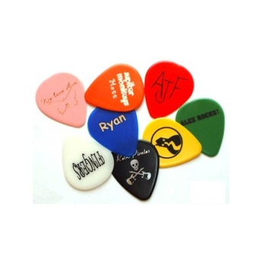
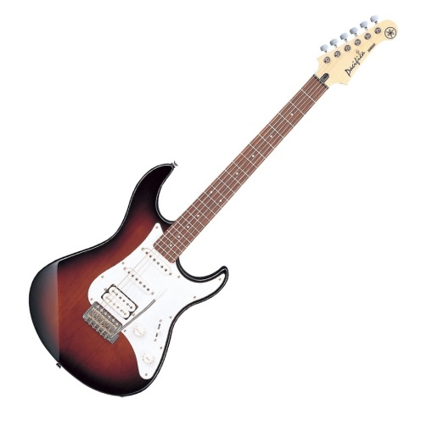
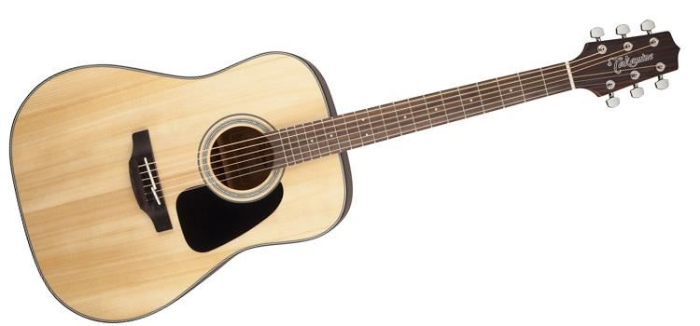
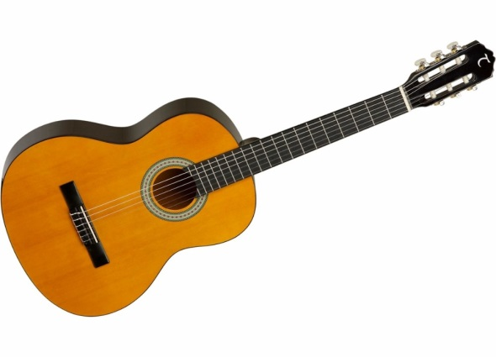
1 - gitaris saxeobebi
eleqtro
akustikuri
klasikuri
roki
hard roki
metali
popi
- folk-roki
bluzi
qanTri
- klasikuri
flamenko
regi
popi
qalaqurebi
kavkasiuri

Slide 4
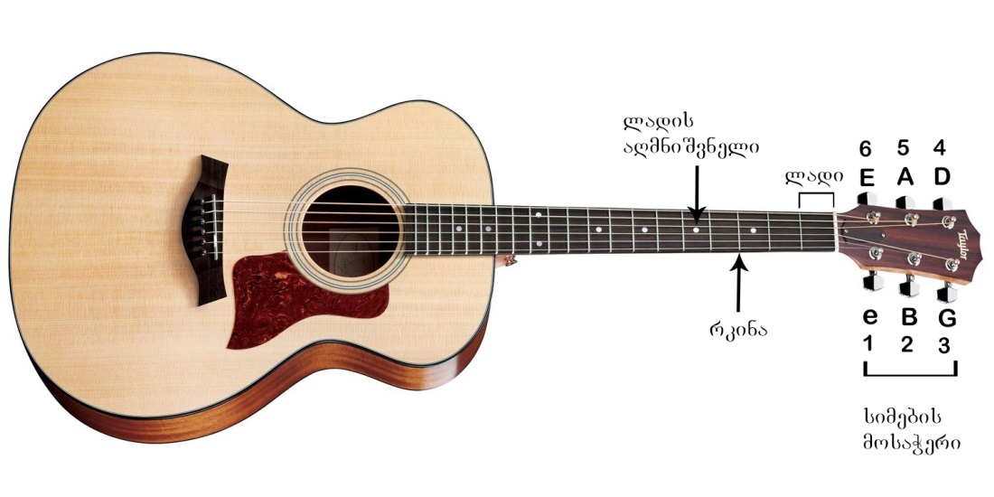
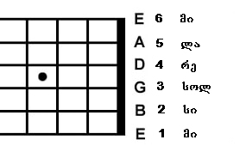
2 - gitaris agebuleba

Slide 5


3 - gitaris awyoba
smeniT
Aaplikacia - programiT

Slide 6

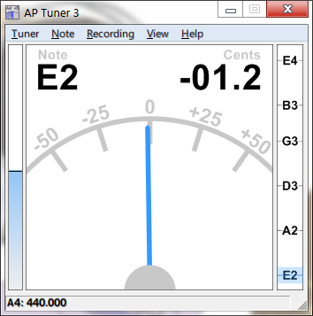
3 - gitaris awyoba
Aaplikacia - programiT
telefonze
kompiuterze
Gismart Guitar Tuner
AP Tuner 3

Slide 7
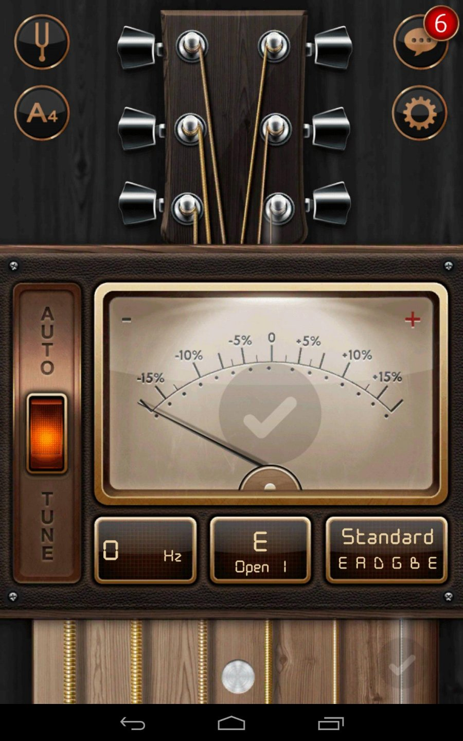
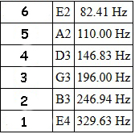
3 - gitaris awyoba
Aaplikacia - programiT
telefonze
Gismart Guitar Tuner

Slide 8
3 - gitaris awyoba
Aaplikacia - programiT
kompiuterze
Ap Tuner 3

Slide 9
4 – marcxena xeli
Aakordebis aRniSvna
laTinuri | inglisuri
Do | C
Re | D
Mi | E
Fa | F
Sol | G
La | A
Si | B

Slide 10

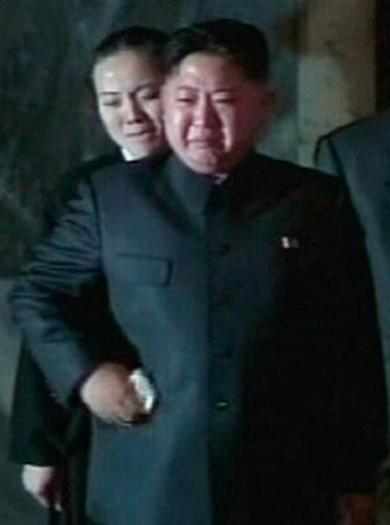
4 – marcxena xeli
maJori
minori
Mmxiaruli akordebi
sevdiani akordebi

Slide 11
4 – marcxena xeli
maJori da minori
maJori | minori
C | Cm
D | Dm
E | Em
F | Fm
G | Gm
A | Am
B | Bm

Slide 12
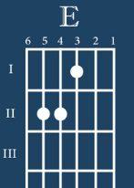
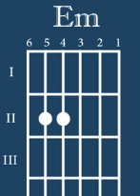
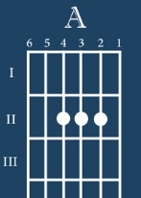
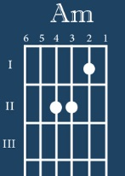
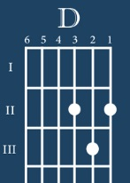
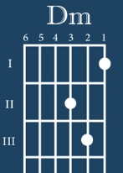
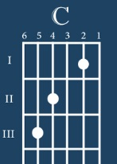
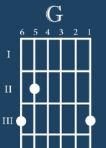
4 – marcxena xeli
Aakordebi romlebic unda icode

Slide 13
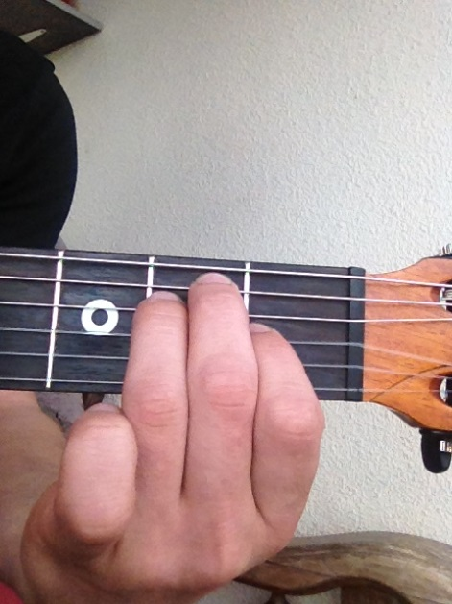
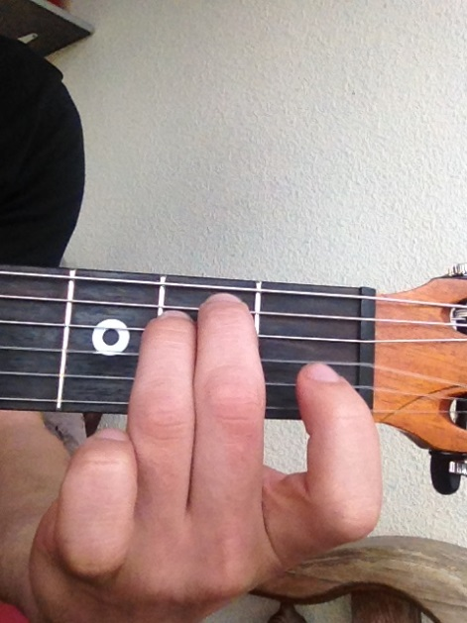
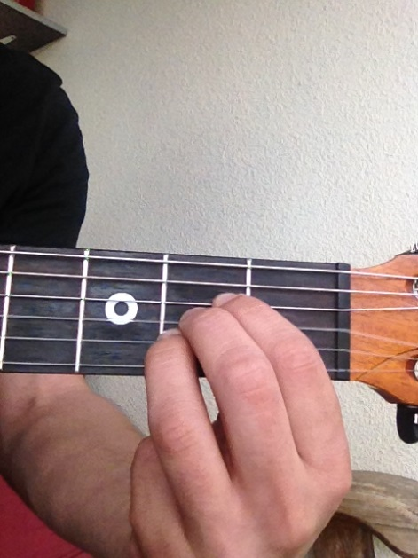
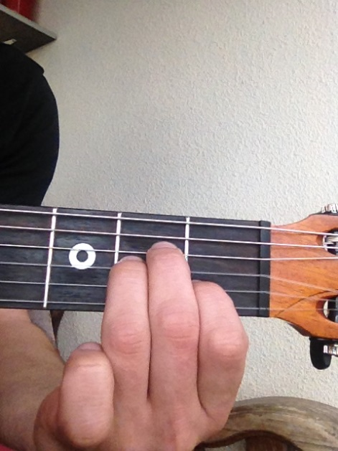
4 – marcxena xeli
Aakordebi romlebic unda icode

Slide 14
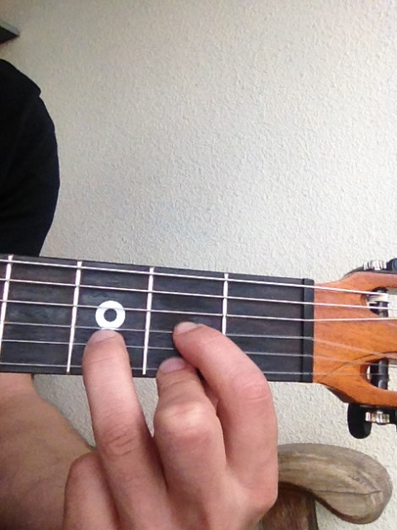
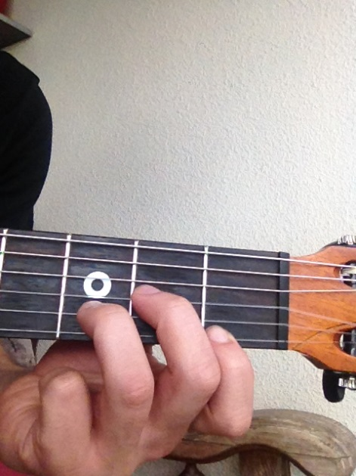
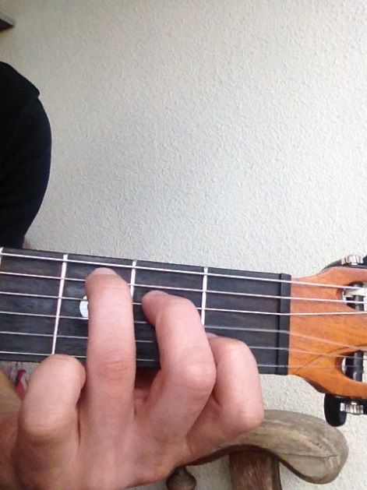
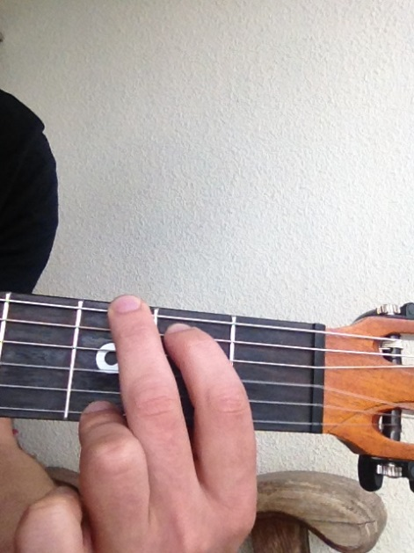
4 – marcxena xeli
Aakordebi romlebic unda icode

Slide 15

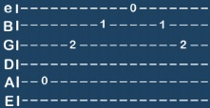
5 – marjvena xeli
Hharmonia - melodia
harmonia : ramdenime notze ukrav erTdroulad
melodia: notebs ukrav cal-calke

Slide 16
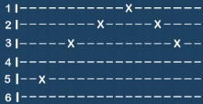
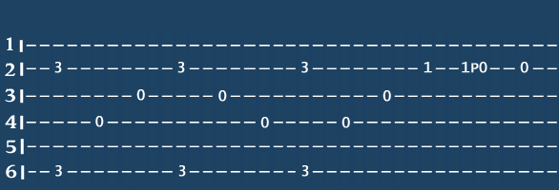
5 – marjvena xeli
Ddakvris saxeobebi
ritmi
arpejio
solo

Slide 17
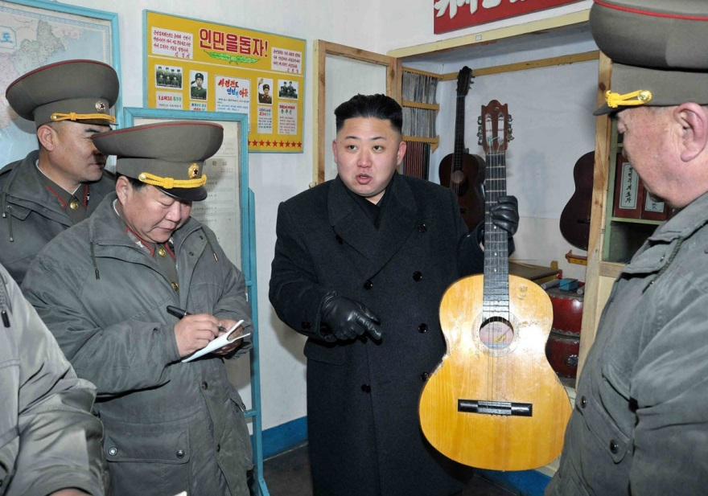
6 – pirveli simRera

Slide 18
Ggitaris gakveTili damwyebTaTvis
Daukari Gitara

