Slide 1
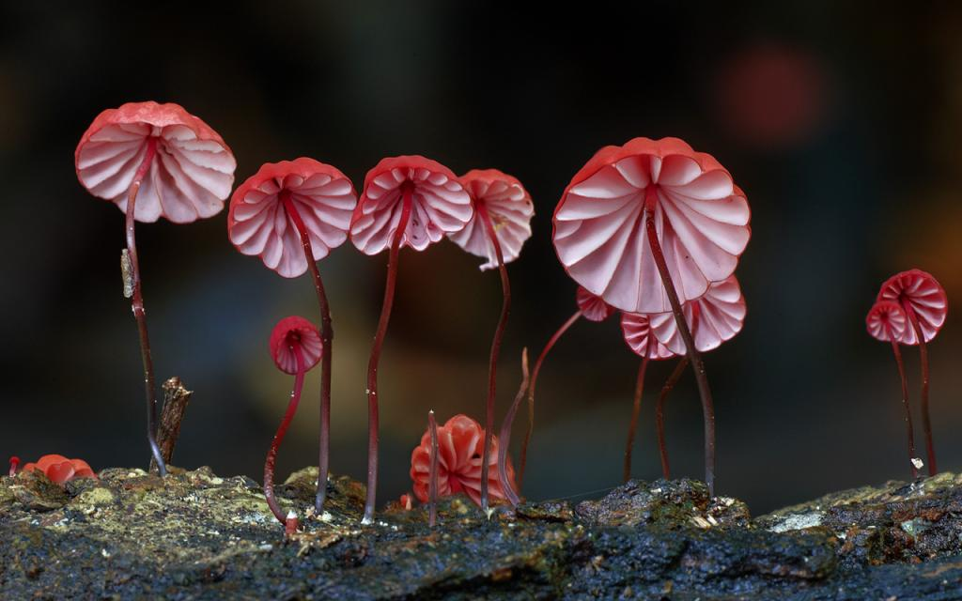
The Wonderful World of Mushrooms 蘑菇的奇妙世界
Marasmius haematocephalus.

Slide 2
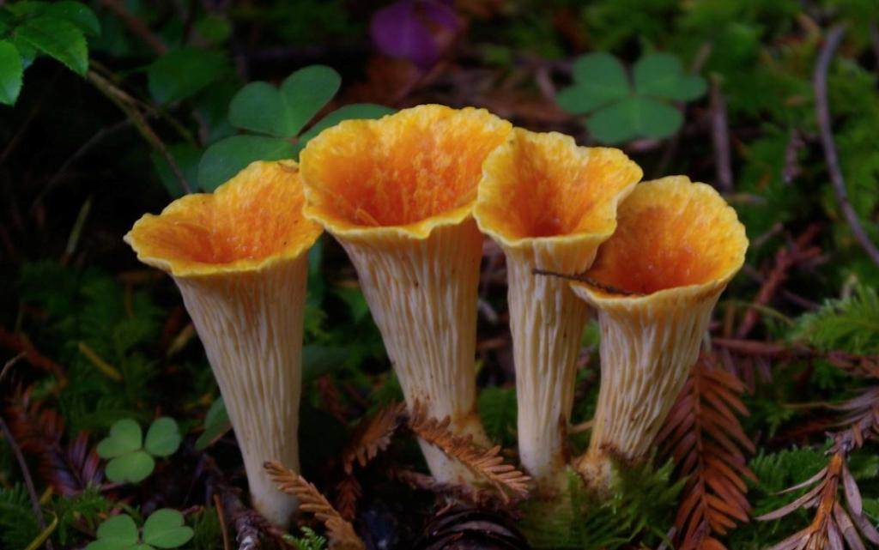
Has long been human for mushrooms filled with puzzles, It will be classified as "Flora",found that these "plant" very unusual, and then up the "Fungi",more people captivated to varied and colorful appearance of mushrooms.
Mushrooms — they don’t need psilocybin to be magical. photos by Elaine Owen, Taylor F. Lockwood, Mike Potts, Gorastos Papatsanis and Steve Axford.
--Awkward Situationist
長久以來人類對蘑菇充滿困惑，將它歸類為"植物界"之後才發現原來這些"植物"很不尋常，進而開闢"真菌界"，而蘑菇的多彩多變的外觀更是讓人為之著迷。部落格Awkward Situationist蒐集了來自Taylor F. Lockwood, Gorastos Papatsanis和Steve Axford等攝影師的作品。他們對蘑菇的捕捉讓我們以微觀的視角重新認識了這群奇怪、可愛，又美麗的生物。
--One Funny Joke
各蘑菇的中文不會翻譯，請欣賞照片即可。懂得的人請幫忙翻譯。

Slide 3
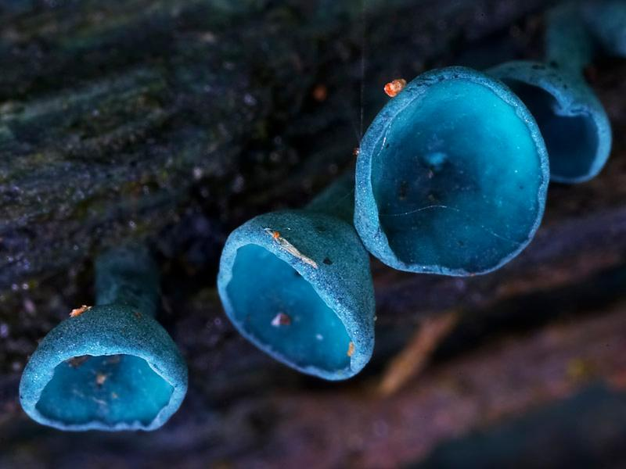
Blue mushrooms

Slide 4
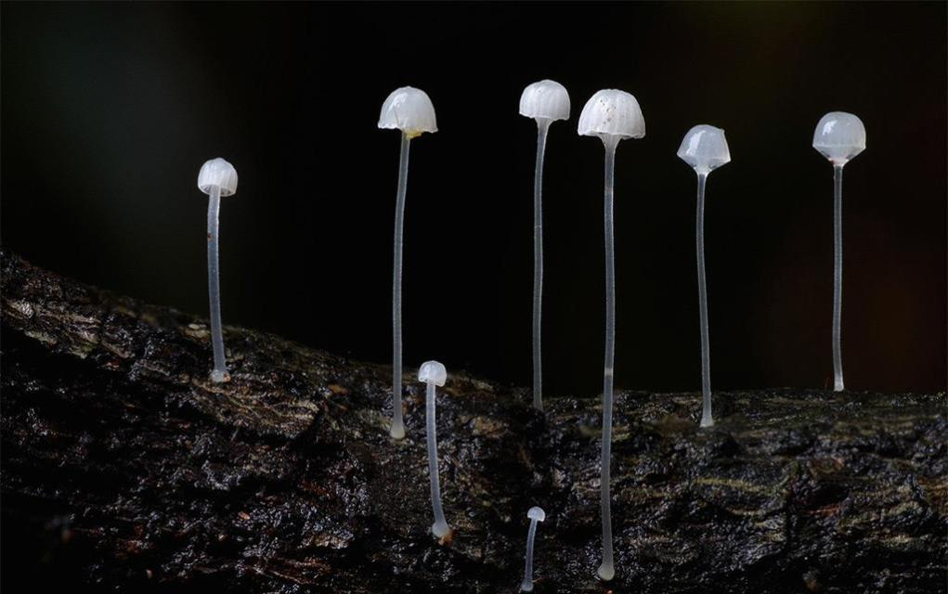
White Mycena

Slide 5
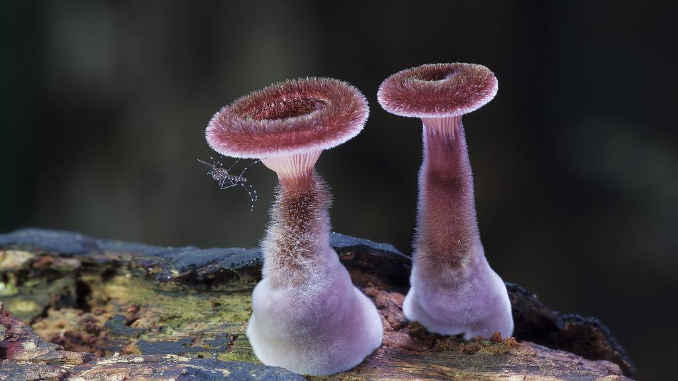
Panus fasciatus

Slide 6
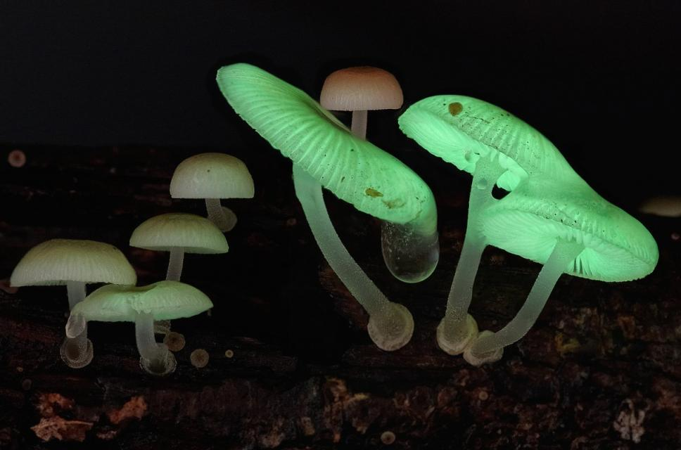
Mycena chlorophos

Slide 7
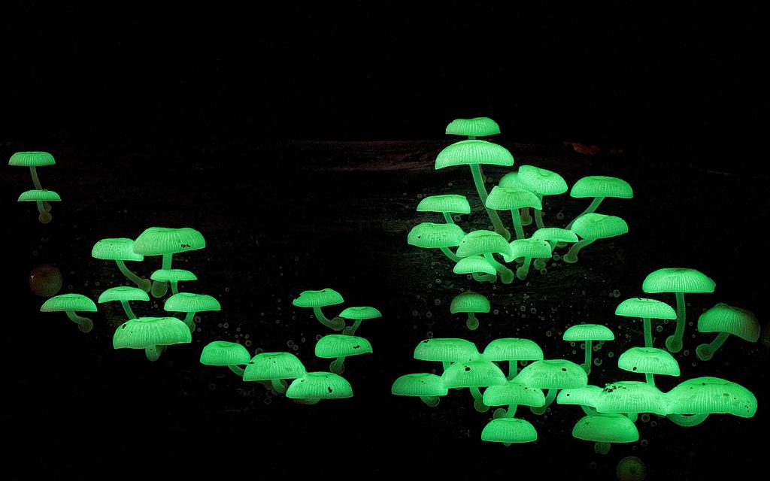
Mycena chlorophos

Slide 8
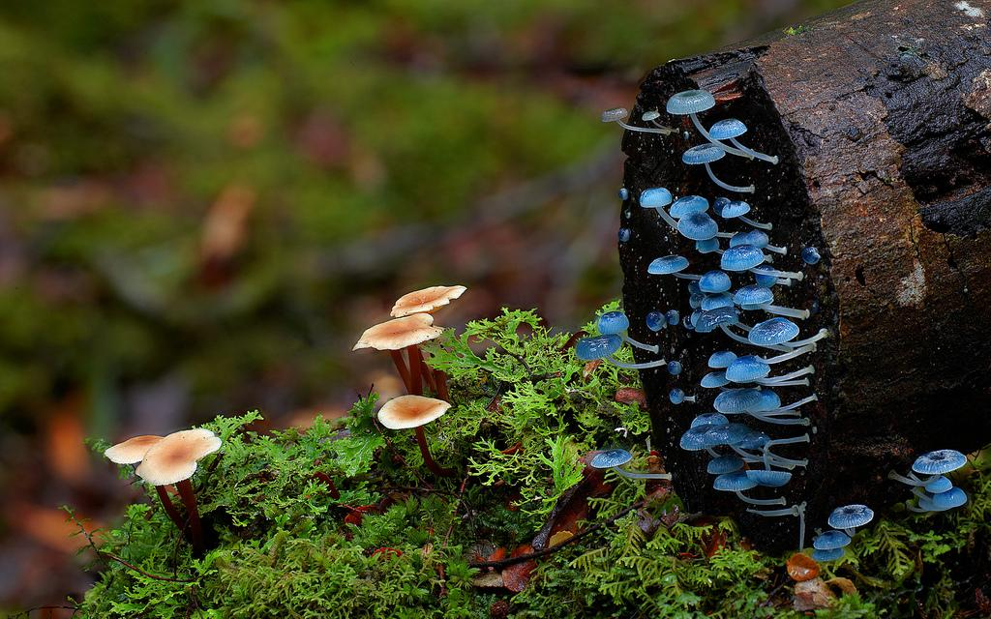
Cyptotrama aspratum or Gold tuft

Slide 9
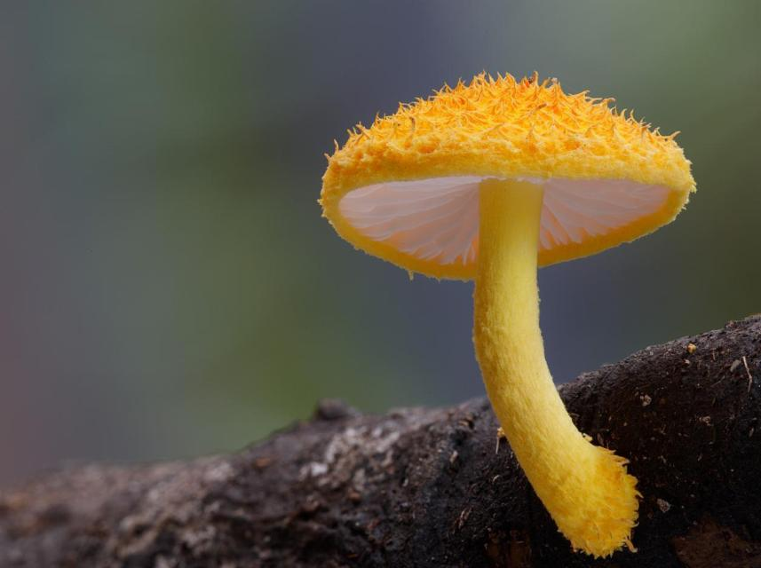
Cyptotrama aspratum or Gold tuft. By Steve Axford

Slide 10
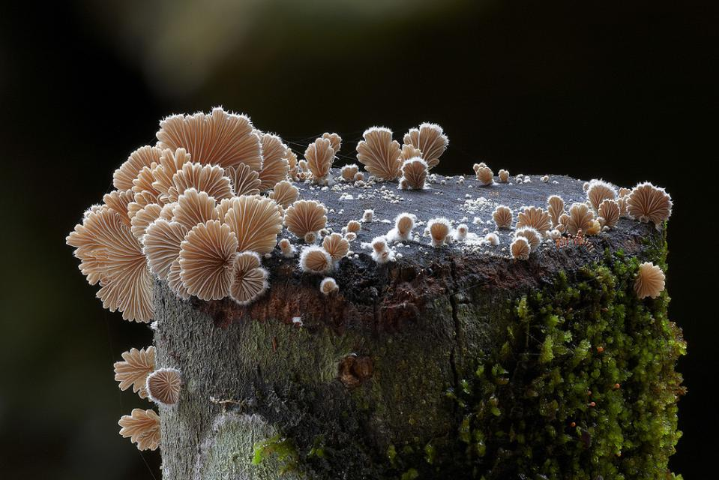
Schizophyllum commune

Slide 11
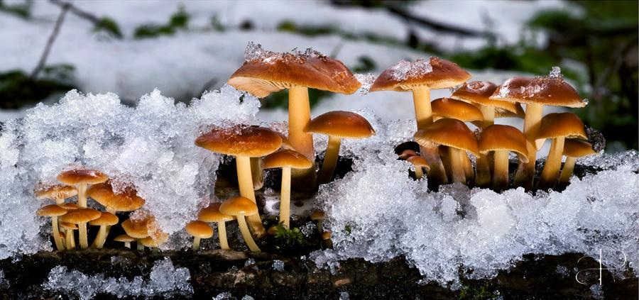
Flammulina velutipes by Gorastos Papatsanis

Slide 12
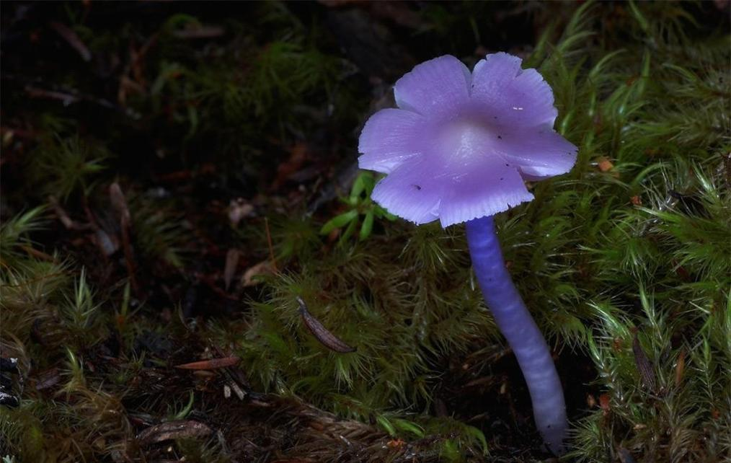
Mauve splitting waxcap

Slide 13
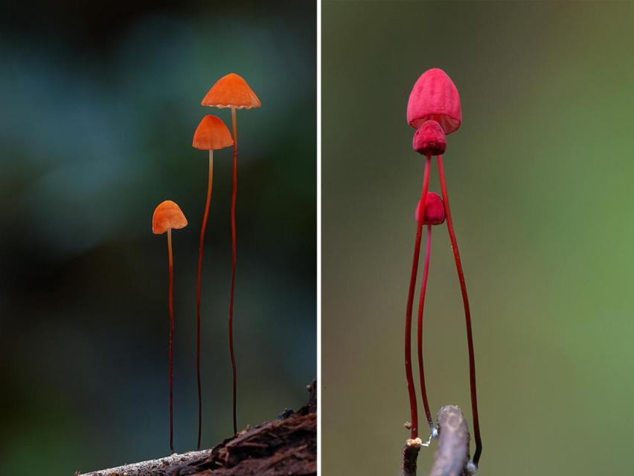
Marasmius haematocephala

Slide 14
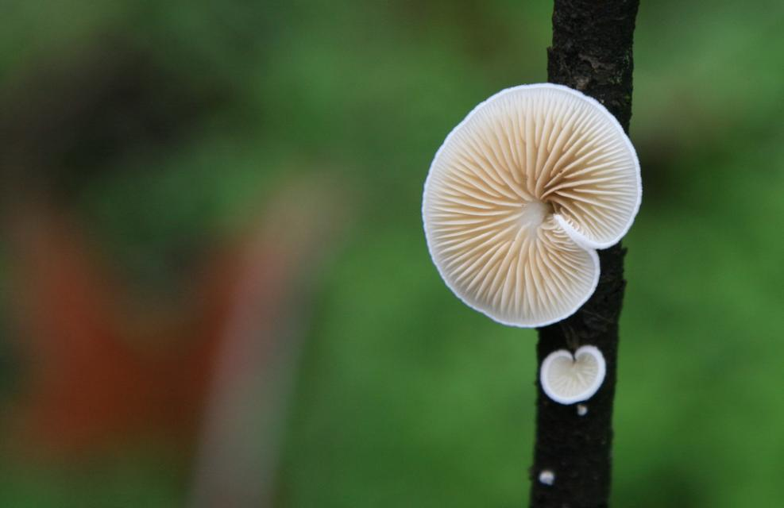

Slide 15
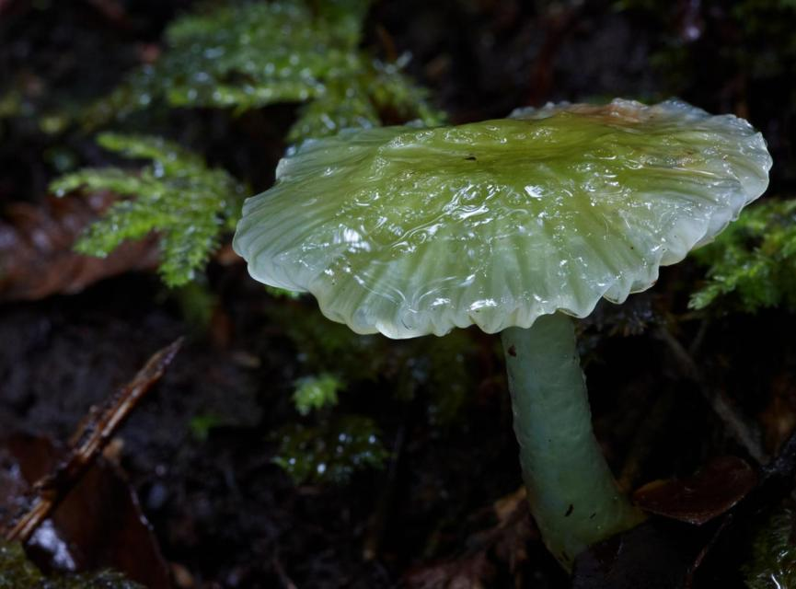
Hygrocybe stevensoniae, NZ.

Slide 16
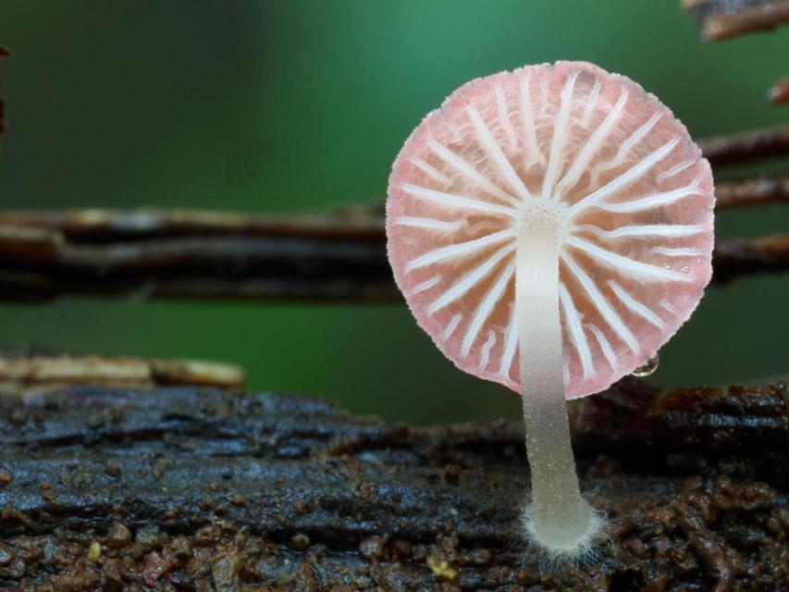
Mycena adonis.

Slide 17
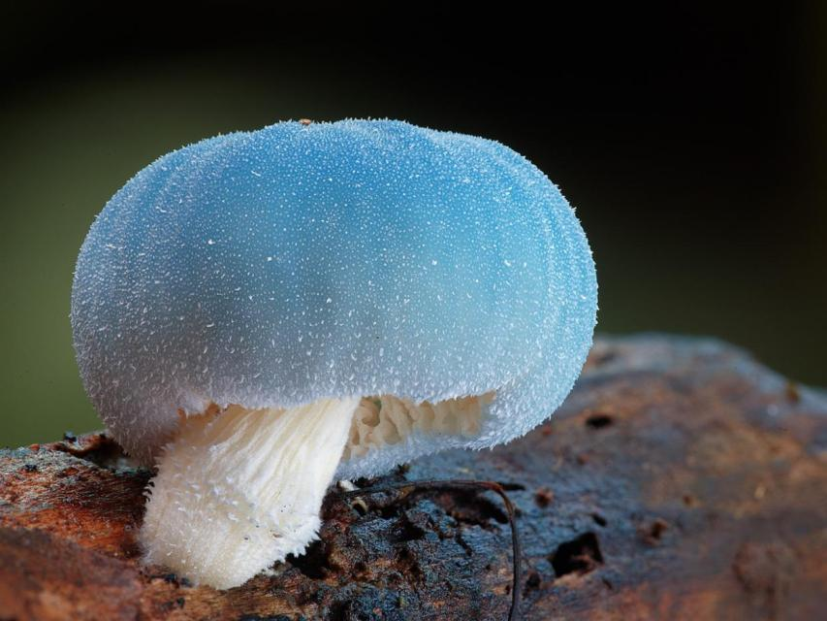
Leratiomyces sp. Booyong, NSW.

Slide 18
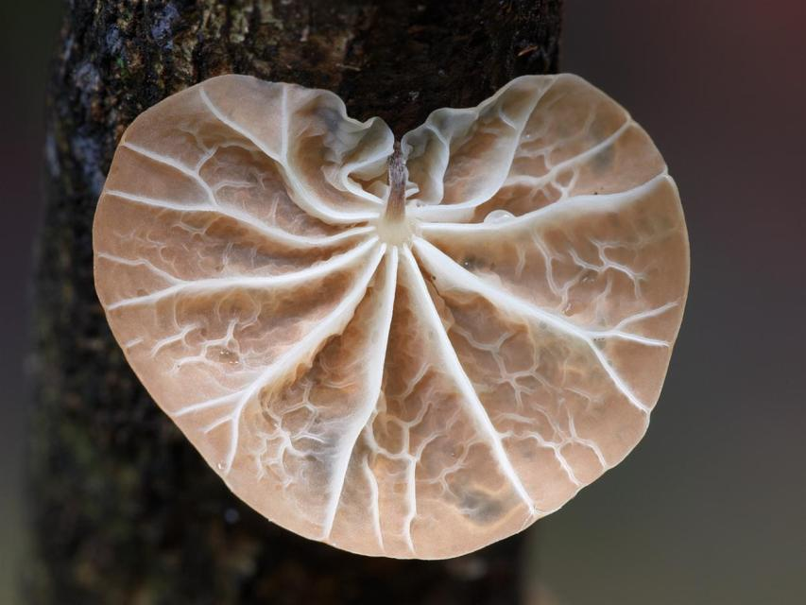
Campanella sp.

Slide 19
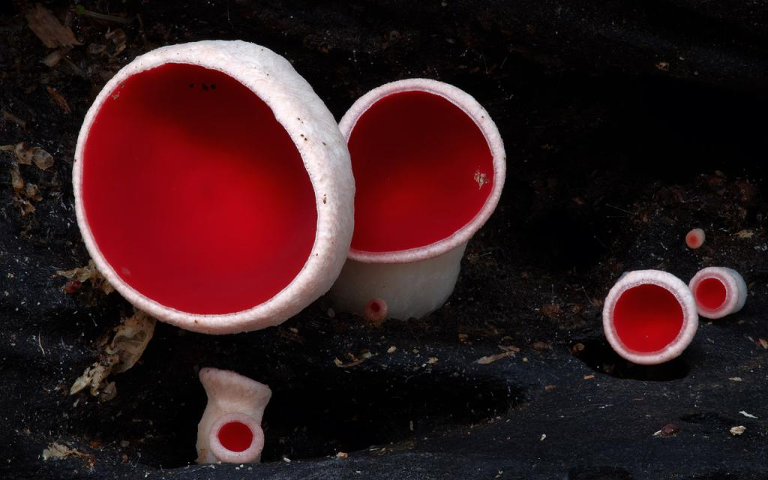
Red cup fungi.

Slide 20
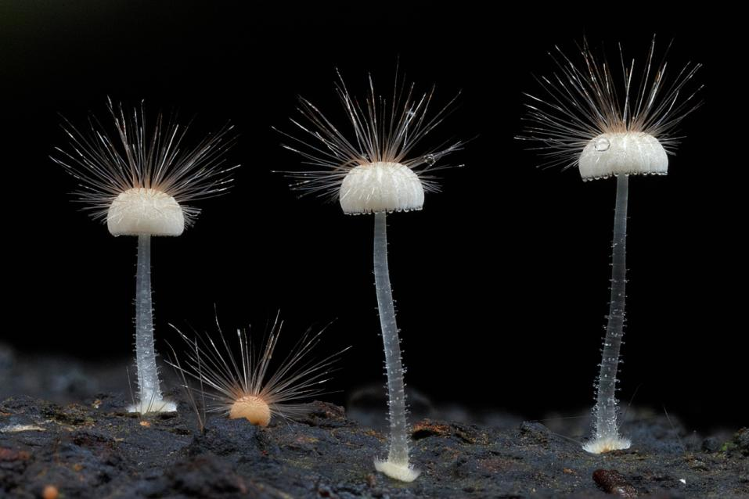
Hairy mycena. Closeup of tiny mycena fungi.

Slide 21
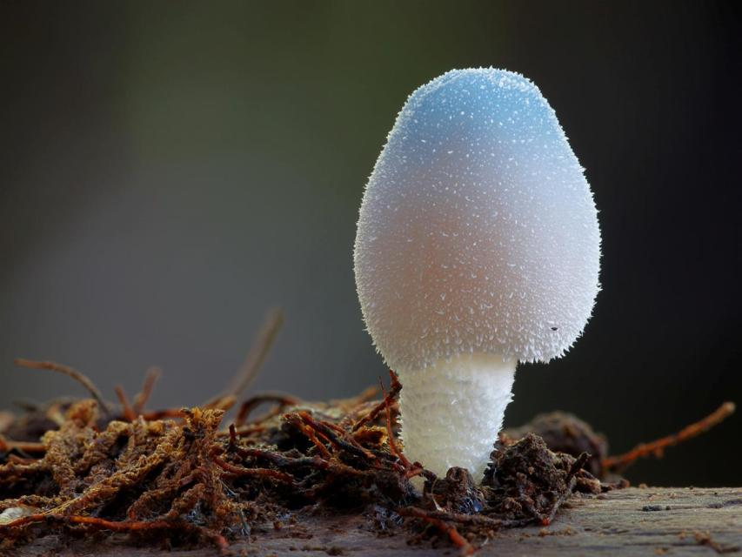
Blue fungi (Leratiomyces sp.).

Slide 22
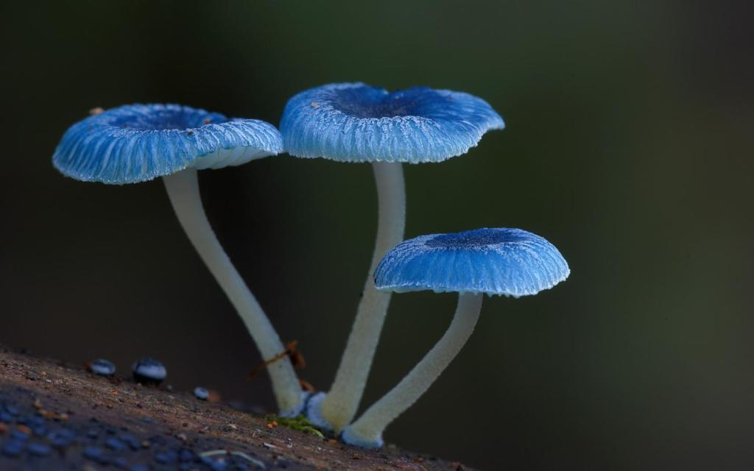
Mycena interrupta.

Slide 23
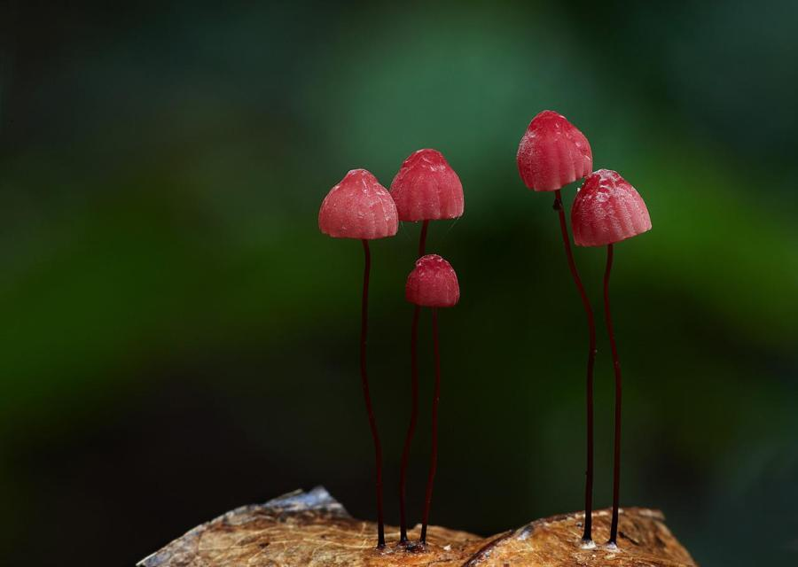
Marasmius haematocephalus, Booyong.

Slide 24
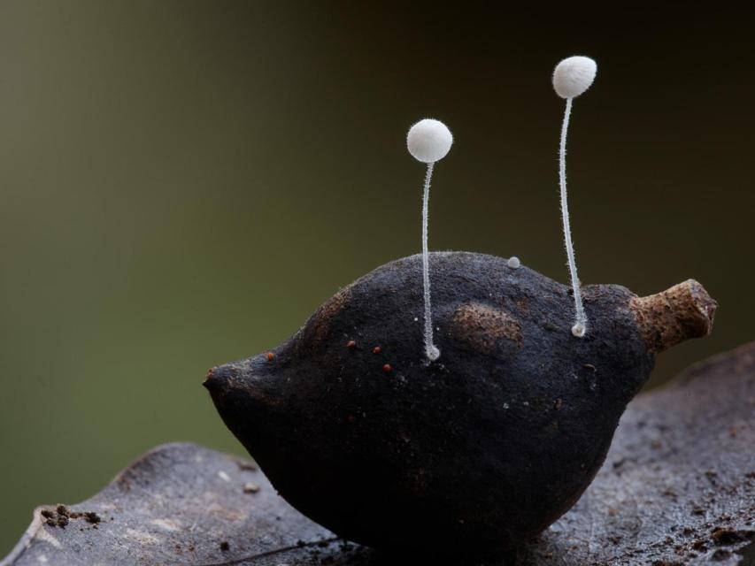
Mycena fungi on immature macadamia nut, near Booyong, NSW.

Slide 25
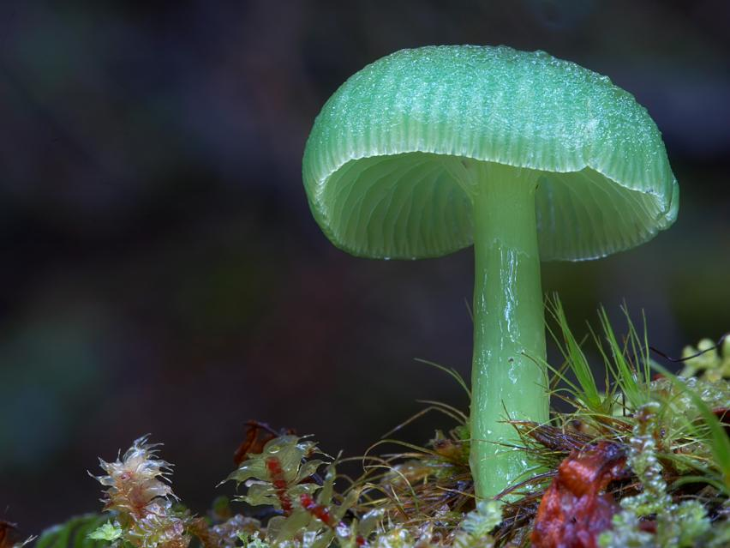
Hygrocybe graminicolor.

Slide 26
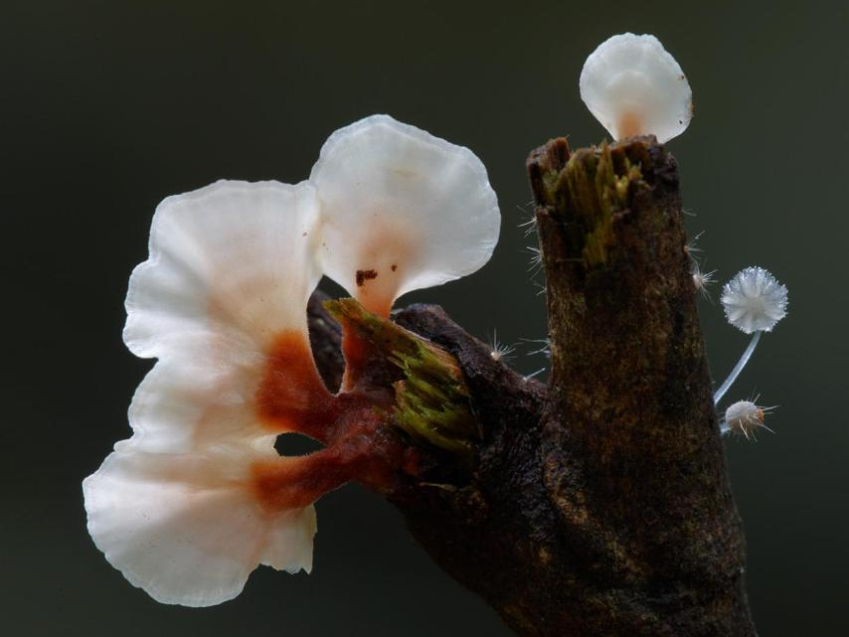
Fungi.

Slide 27
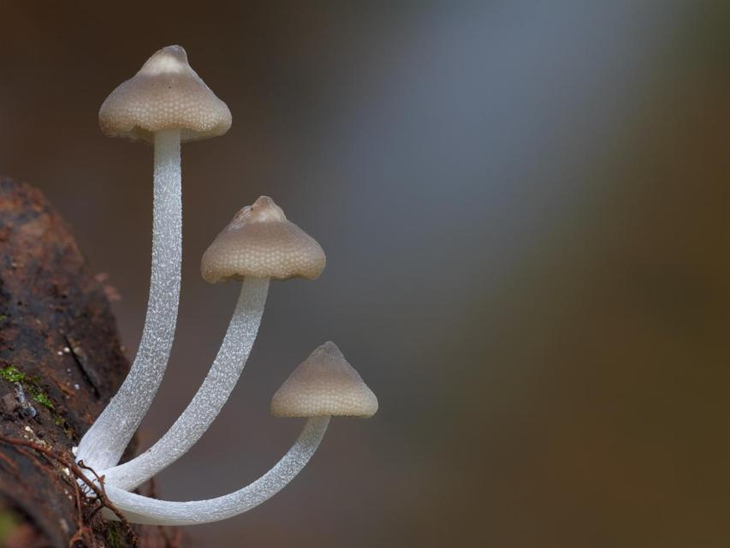
Filoboletus manipularis.

Slide 28
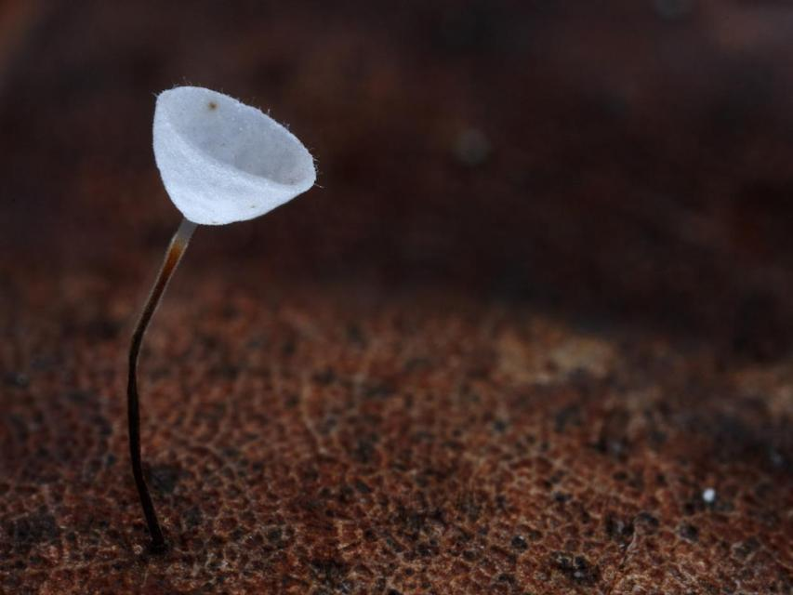
Marasmius c.f. meridionalis.

Slide 29
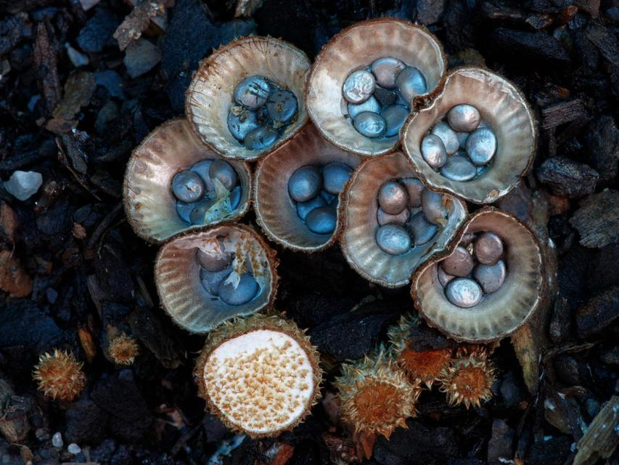
Cyathus novaezelandiae or Birds Nest Fungi, Tara Ridge.

Slide 30
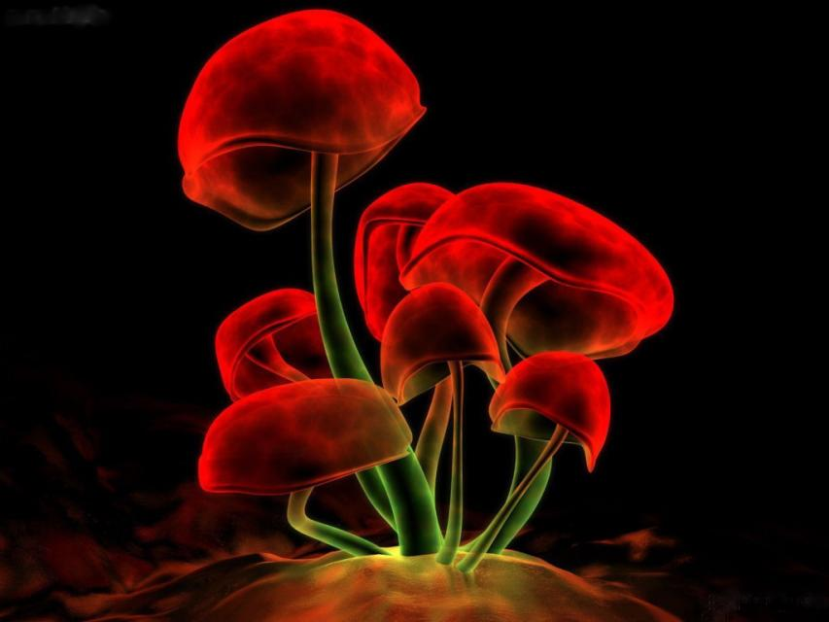
Red mushrooms

Slide 31
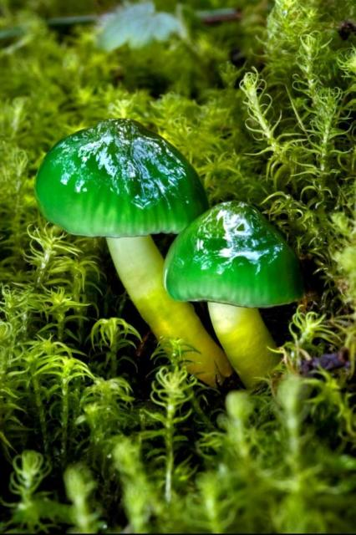
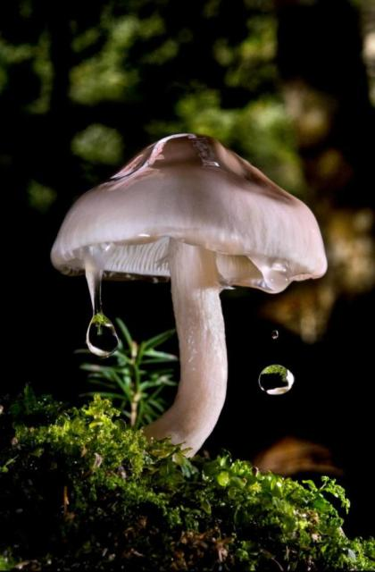
Hycrocybe psitaccina by Gorastos Papatsanis
Limacella illinita by Gorastos Papatsanis

Slide 32
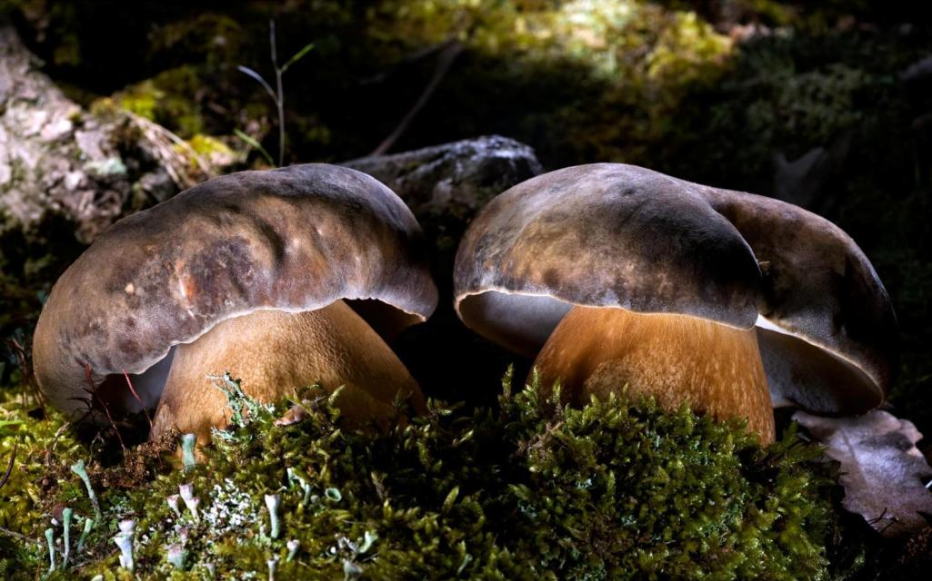
Boletus aereus by Gorastos Papatsanis

Slide 33
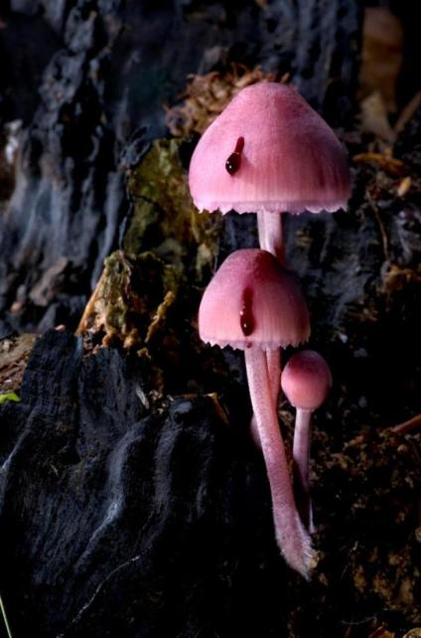
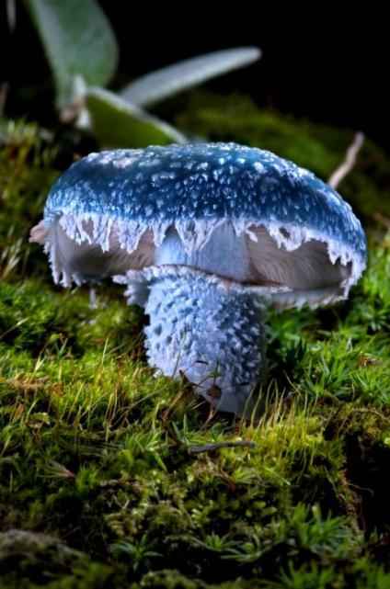
Mycena haematopus by Gorastos Papatsanis
Strofaria aeruginosa by Gorastos Papatsanis

Slide 34
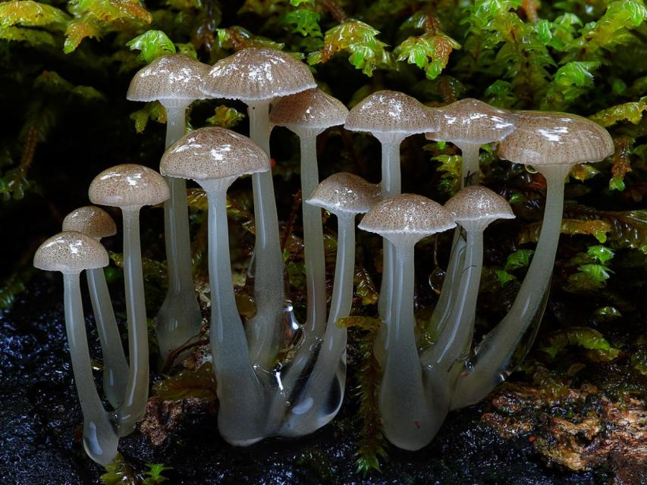
Mycena austrororida.

Slide 35
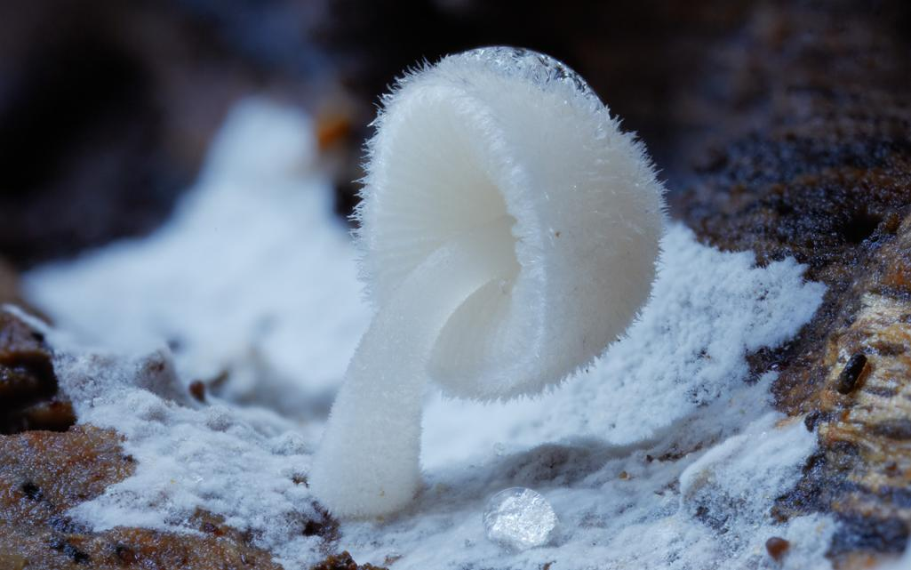
White mycena.

Slide 36
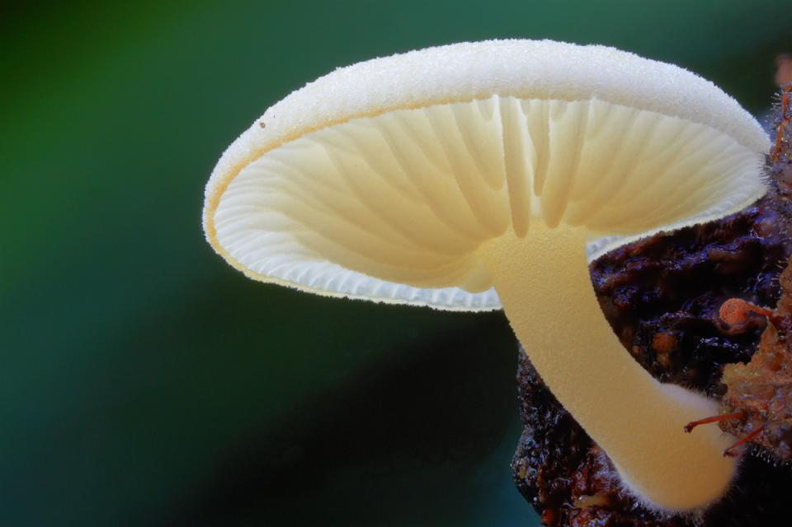
Yellow mycena.

Slide 37
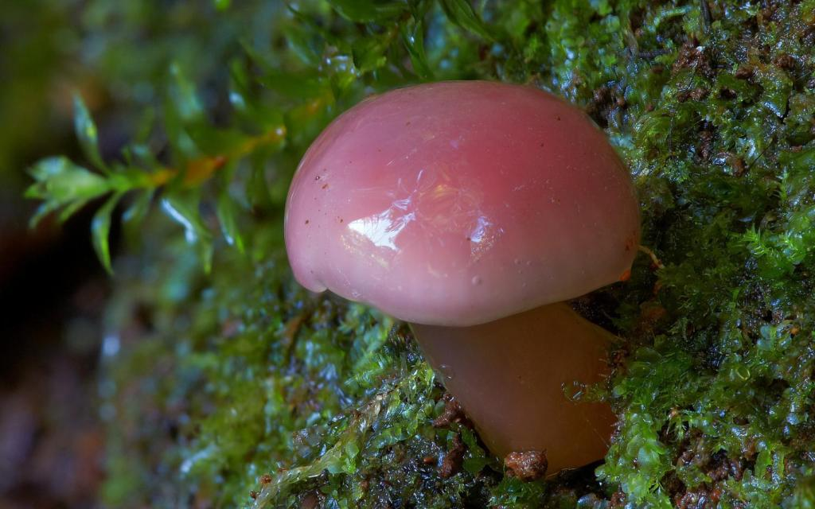
Pink Hygrocybe. Possibly Hygrocybe graminicolor.

Slide 38
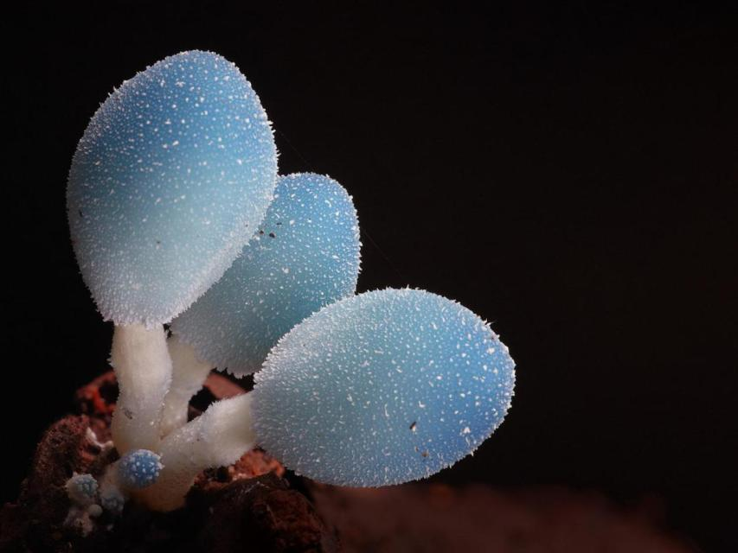
Leratiomyces sp. Like 3 little light globes. Found in Booyong Reserve, Booyong, NSW.

Slide 39
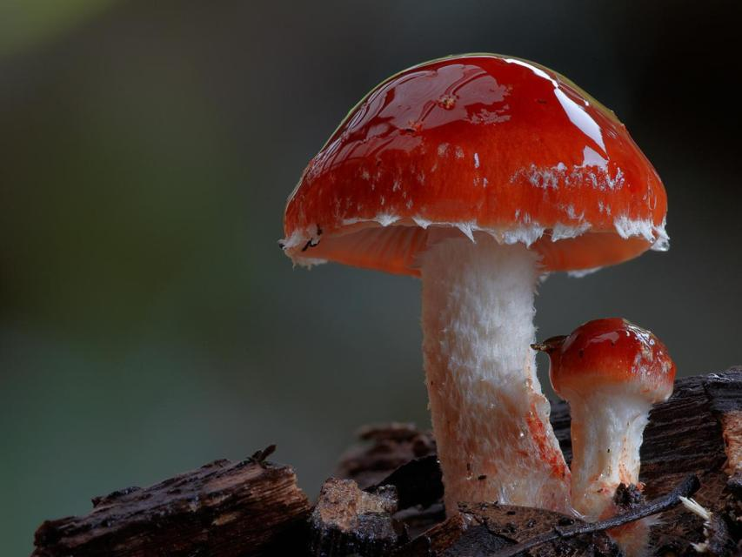
Leratiomyces ceres (Redlead Roundhead).

Slide 40
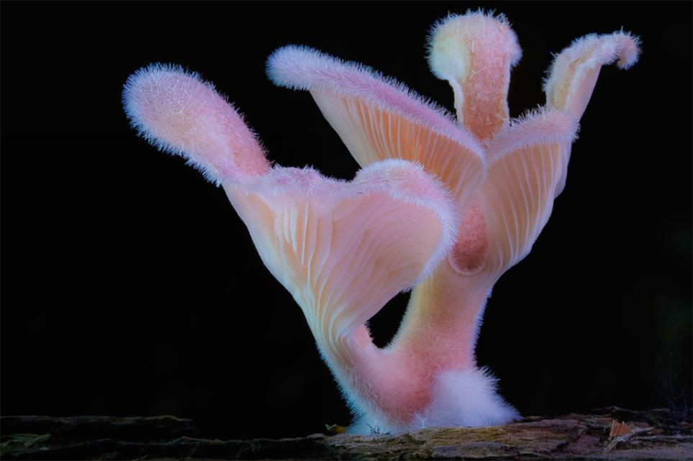
panus lecomtei

Slide 41
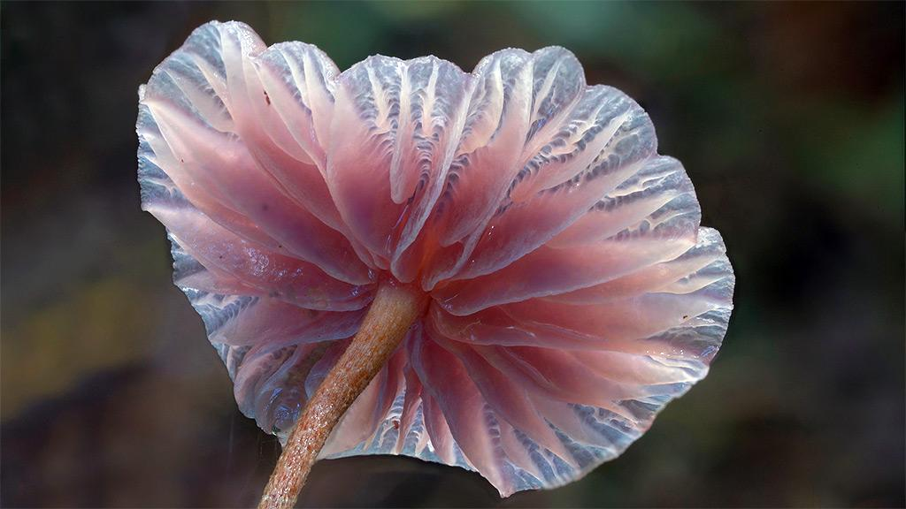
panus lecomtei

Slide 42
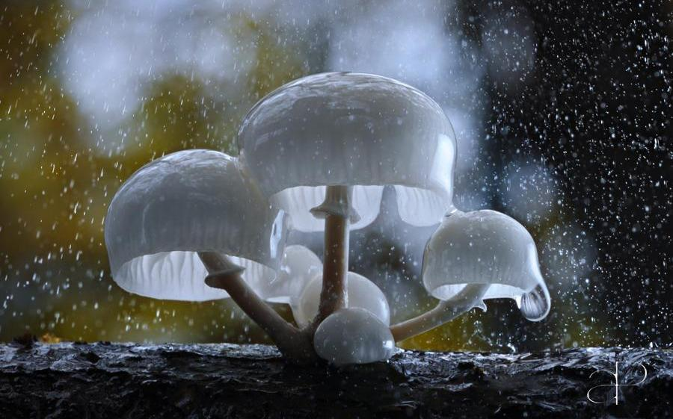
Oudemansiella mucida by Gorastos Papatsanis

Slide 43
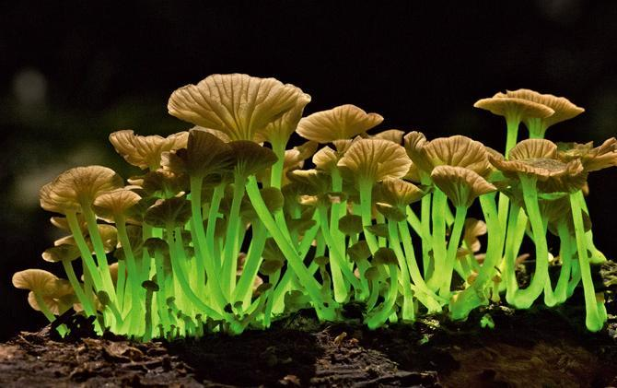
Mycena lucentipes
5/16/2014王文堯 Kaohsiung Taiwan R.O.C
All photos were taken from Awkward Situationist , Remarkable Pictures, …Internet,etc.
THE END

