Slide 1
Cleft lip and palate
Hakim BOUAZZAOUI
Samy El IDRISSI
04/26/2017
University Hospital of Limoges

Slide 2
Overview & Definition
Types and classification
Symptoms, Diagnosis
Causes
Therapeutic management
Outcome

Slide 3
Overview
Congenital malformation
Lip & palate development : 6th to 12th week of pregnancy
Split → palate and/or lip, uni/bilateral
Developmental and psychosocial problems
Worldwide : most common oro-maxillofacial difformity -> 1/500 to 1/1000 biths/year
Male/female ratio : 2/1

Slide 4
DEFINITION : orofacial cleft
Group of conditions including : unilateral, bilateral and submucous clefts
A cleft is a birth defect that occurs when the tissues of the lip and/or palate of the fetus do not fuse early in pregnancy.
A cleft lip, sometimes referred to as a harelip, is an opening in the upper lip that can extend into the base of the nostril.
A cleft palate is an opening in the roof of the mouth. That can affect the hard palate and can extend into the soft palate

Slide 5
Types
LIP
Unilateral or bilateral
1/10 cases
PALATE
1/3 cases
BOTH
1/2 cases
SUBMUCOUS
1/10 cases

Slide 6
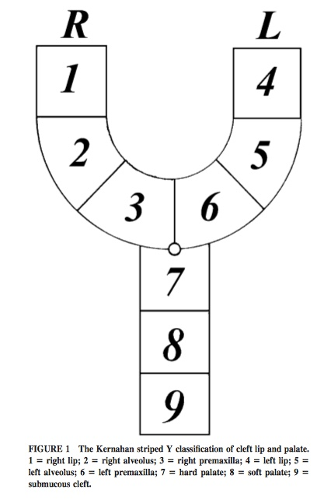
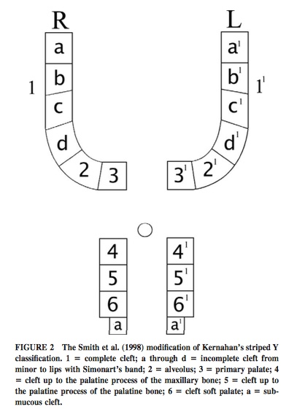
Fig 1: Kernahan & Stark classicifation (1958) Classification
  Fig 2 : The Smith et al. (1998) modification of Kernahan’s striped Y classification

Slide 7
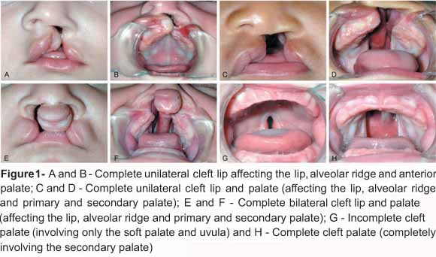
Figure 3 : the different types of clefts

Slide 8
Symptoms
- Obvious anatomical difformities
- milk out of the nose
- inability to suck or blow out a candle
- nasal-sounding speech

Slide 9
Diagnosis
Important risk factors and/or family history
Prenatal Ultra-Sound
(16 weeks or more)
Diagnosis confirmed at Birth
Visual assessment and
physical examination

Slide 10
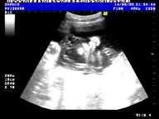
Diagnosis
Antenatal Ultra Sound -> 14% to 25% of clift lip ± clift palate detected antenatally.
Scan
NOTICEABLE except if it involves only soft palate -> may not show up on ultrasound

Slide 11
Causes
Inherited genes ( cannot be prevented)
Included in syndromes as Pierre robin (SOX9 transmission factor) or DiGeorge(22Q11 Deletion)
Environmental risk factors during pregnancy
- Maternal folic acid deficiency
- Maternal smoking
- Alcohol consumption
- Obesity and diabetisis
- Medication
Exposure to viruses or chemicals

Slide 12
Therapeutic management
Care plan:
Lip surgery (3months). Main treatment
Palate surgery (6-12 months)
Speech assessment (18 months→ 5 years)
Palate bone graft (8-11 years)
Hearing monitoring
Orthodontic treatment / monitoring (11-15years)
Additional surgery (18years)

Slide 13

Surgery and treatment for cleft lip and palate

Slide 14
Multi-disciplinary team
Patient
SURGERY
Feeding support
Monitoring hearing
Speech and language therapy
Orthodontic treatment

Slide 15
outcome
Prognosis
Most babies heal without problems.
Most children : no other serious medical problems, improvement of the appearance of the face
Small pink scar above the lips, fade over time -> become less noticeable as child gets older.
Some adults with CLP repair-> may be self-conscious or unhappy about their appearance.

Slide 16
Thank you for your attention
Do you have any question ?

