Slide 1





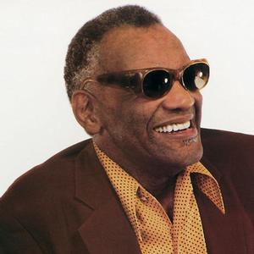



Lovesongs von Ray Charles
23.9.1930 – 10.6.2004
I had it all
Good Morning
dear
Sweet memories
If you were mine
Together again
Half as much
Beenden mit Esc - Bilder aus dem Internet - 2011 - jukebox2011@public-files.de

