Slide 1




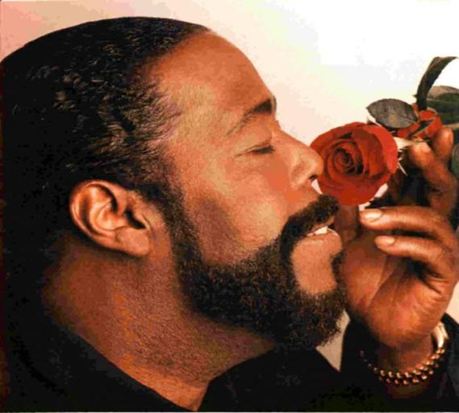



Barry White
12.9.1944 – 4.7.2003
Cant‘ get enough
of your love babe
I‘m gonna love just
a little more baby
You‘re the first, the last,
my everything
Never never gonna give
you up
I‘ll do for you anything
you want me to do
Beenden mit Esc - Bilder aus dem Internet - 2011 - jukebox2011@public-files.de

