Slide 1
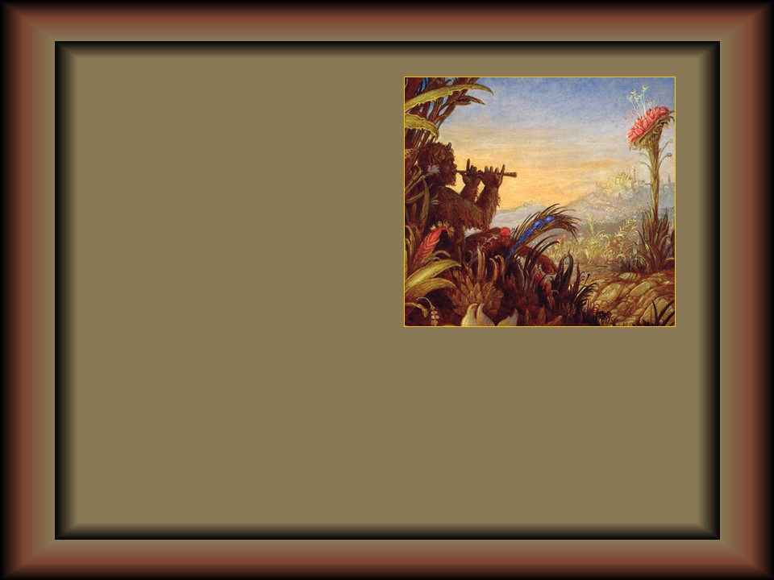
SOUNDED
AUTOMATIC
WOLFGANG HARMS
PAINTINGS WITH MAGIC

Slide 2
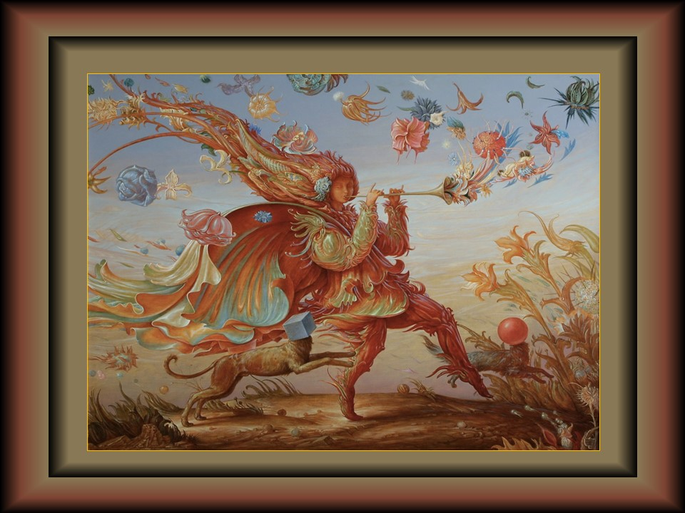

Slide 3
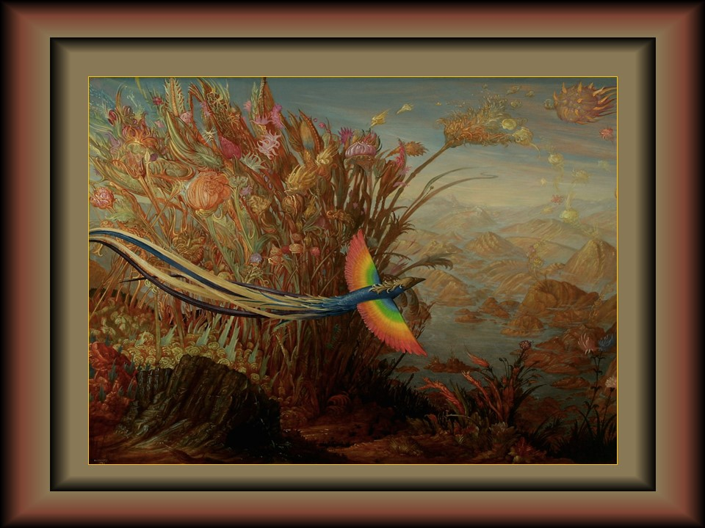

Slide 4
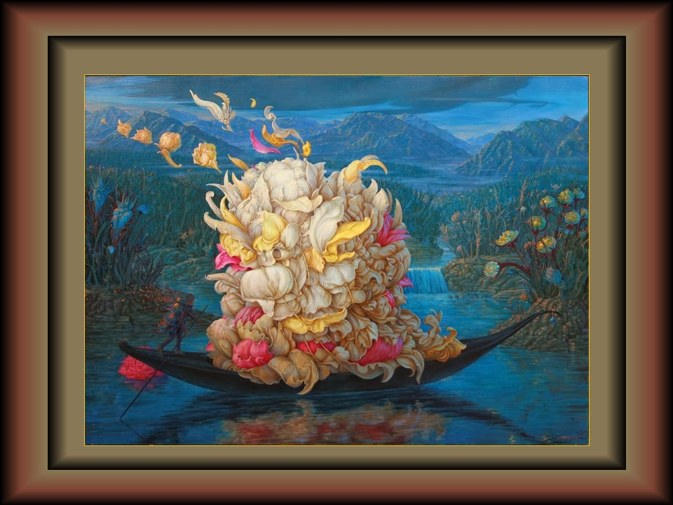

Slide 5
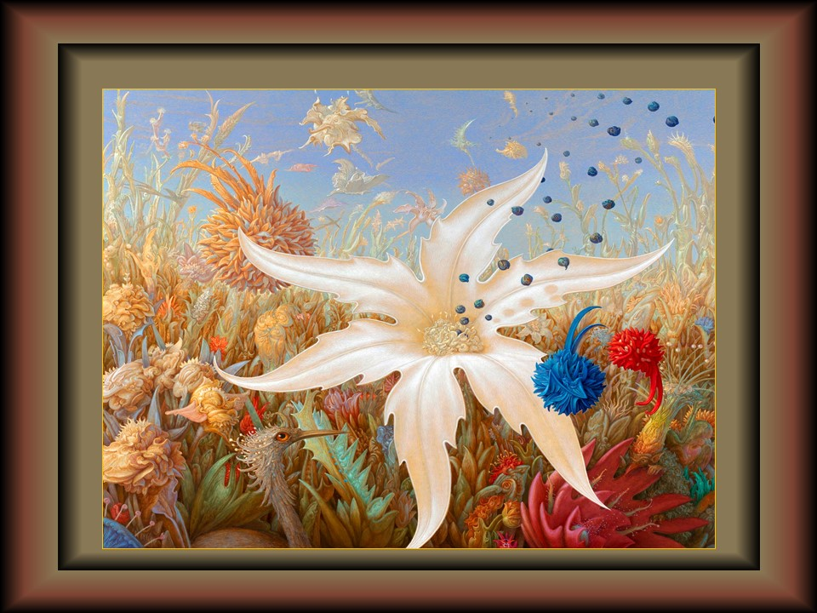

Slide 6
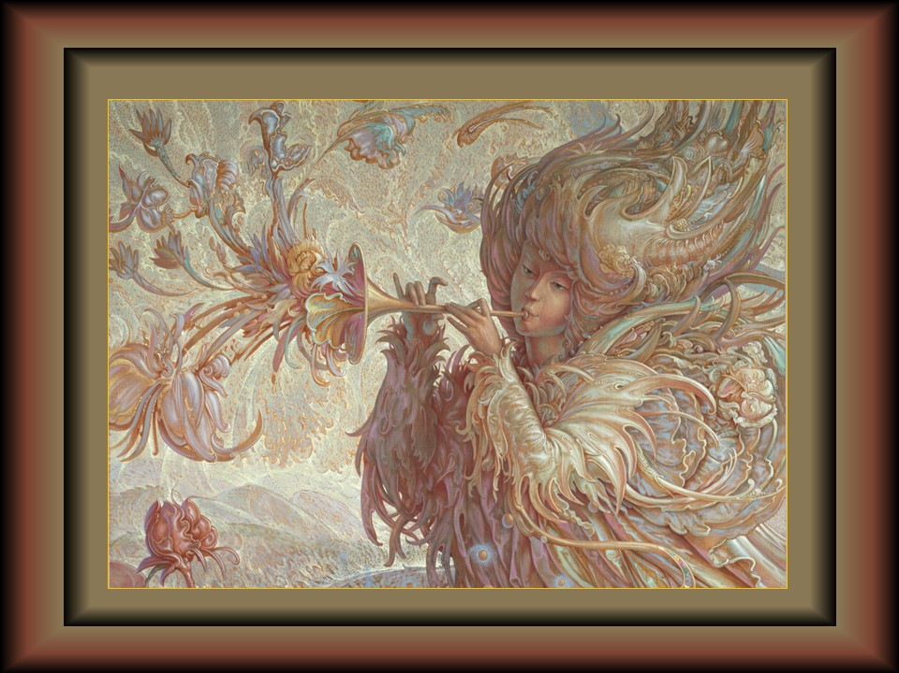

Slide 7
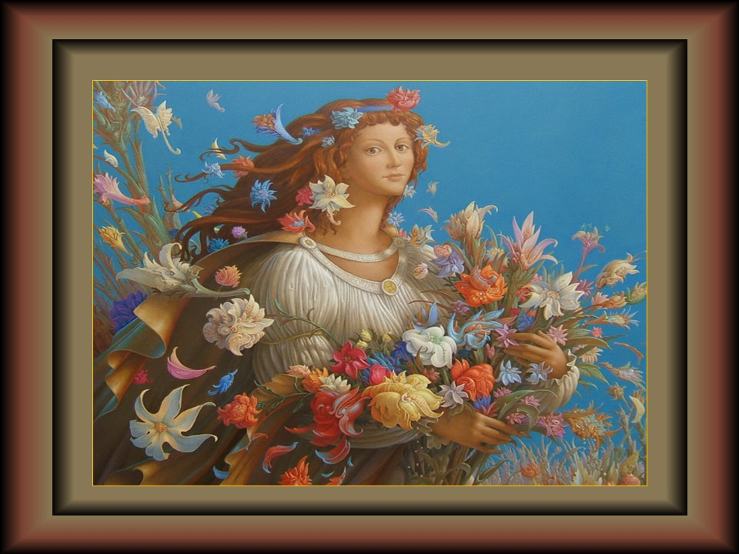

Slide 8
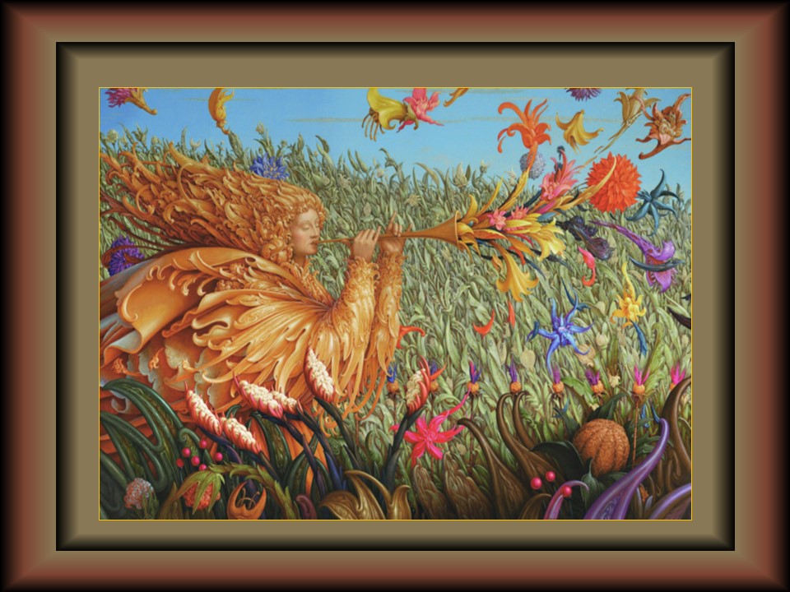

Slide 9
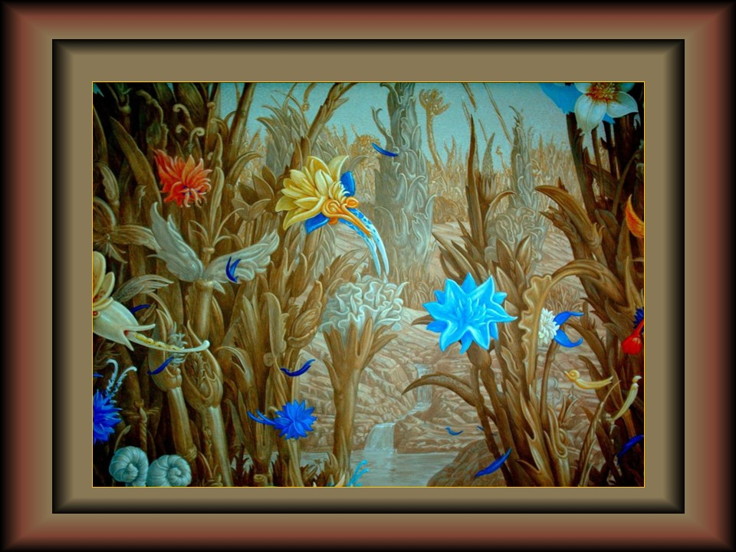

Slide 10
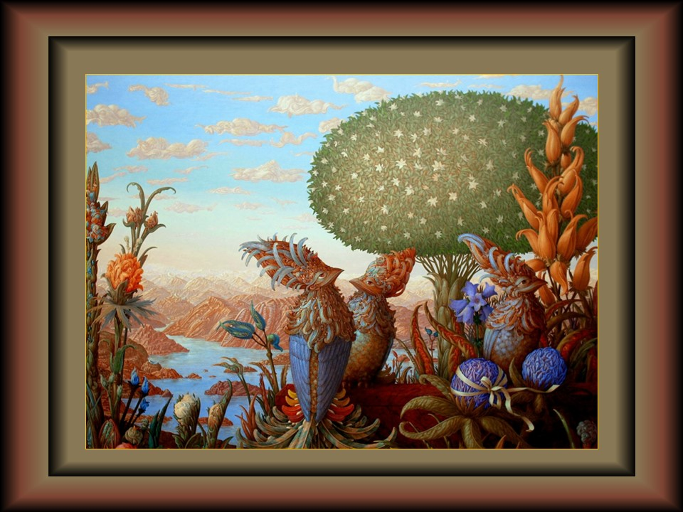

Slide 11
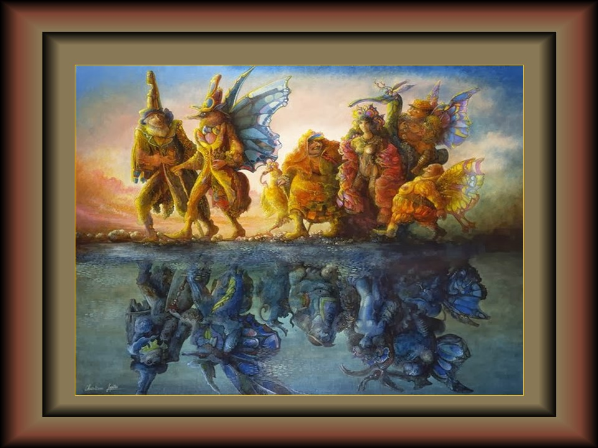

Slide 12
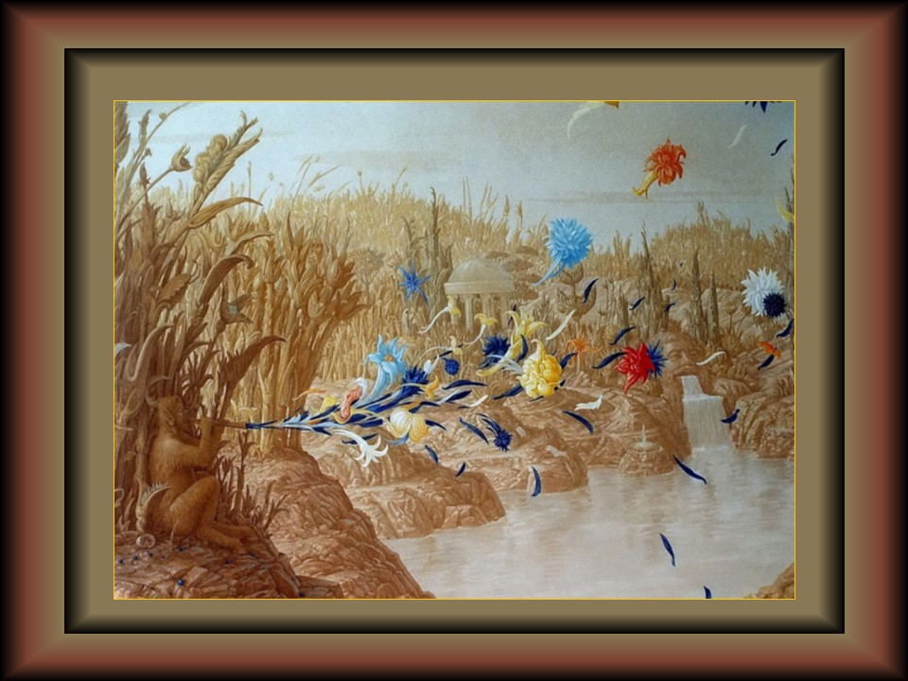

Slide 13
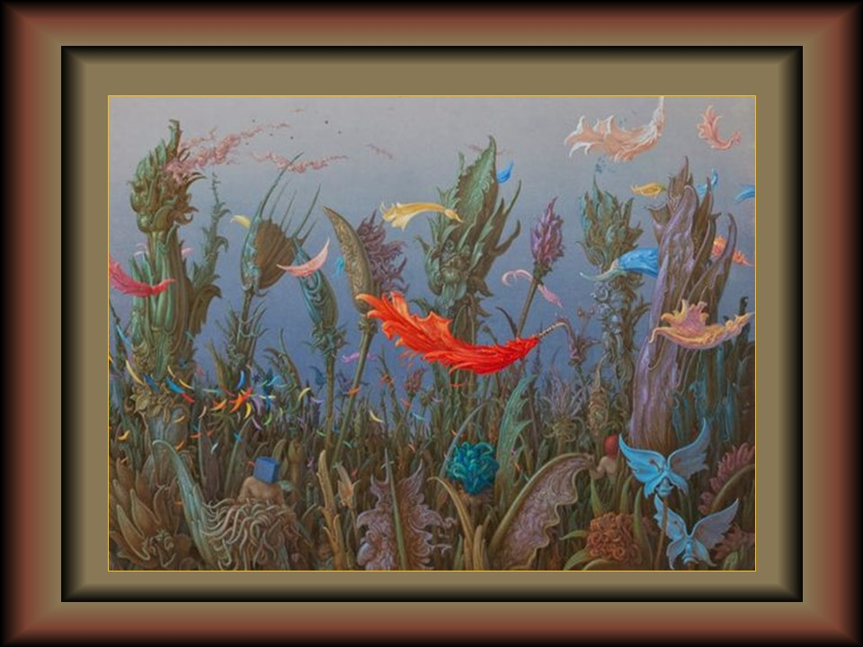

Slide 14
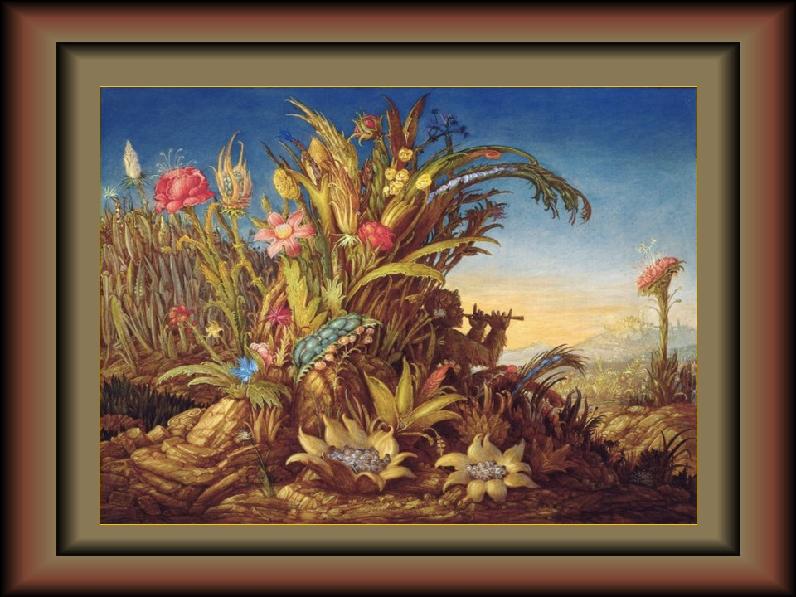

Slide 15
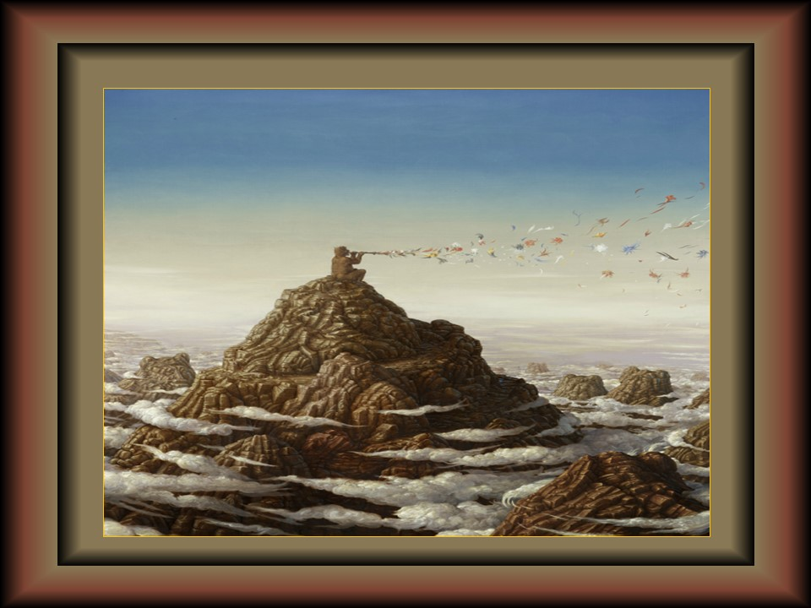

Slide 16
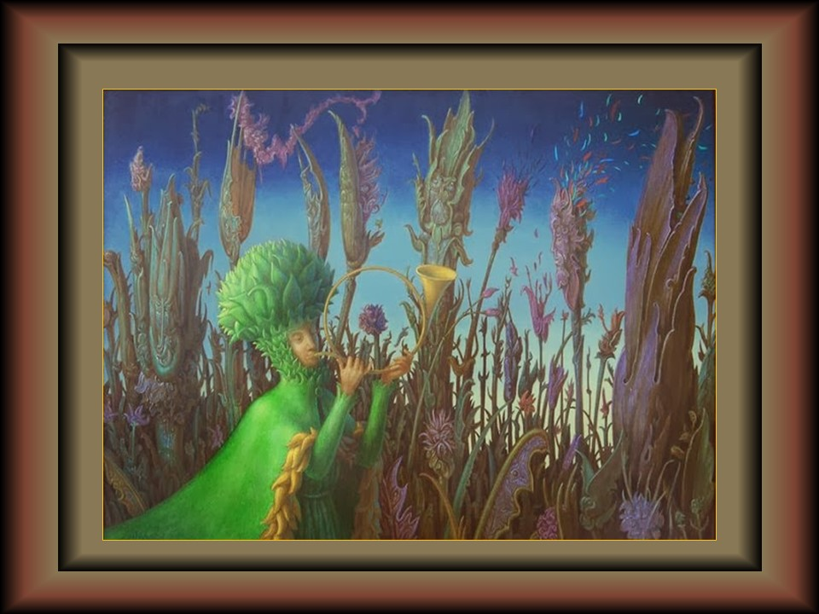

Slide 17
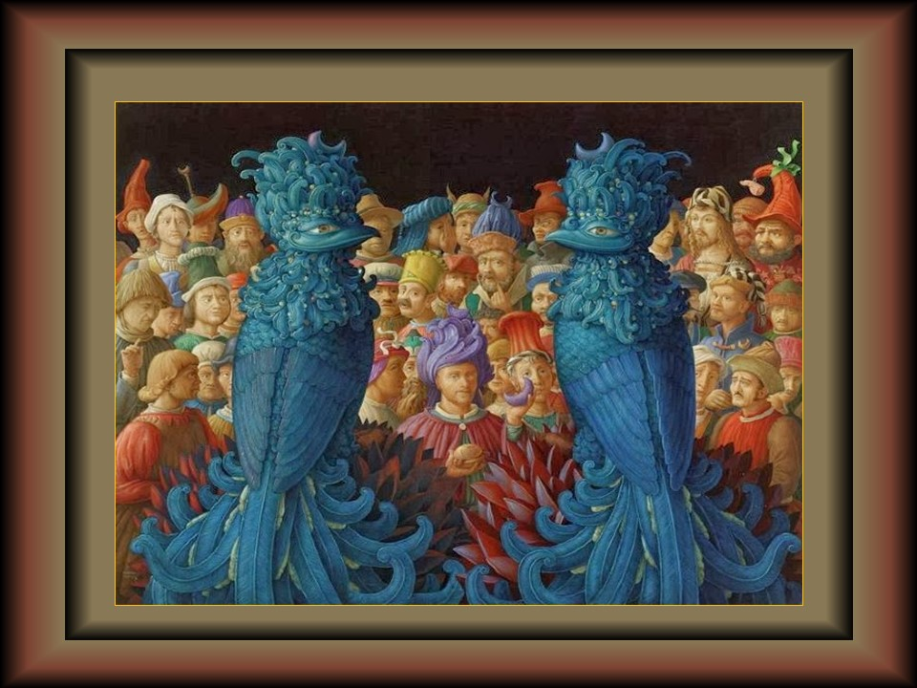

Slide 18
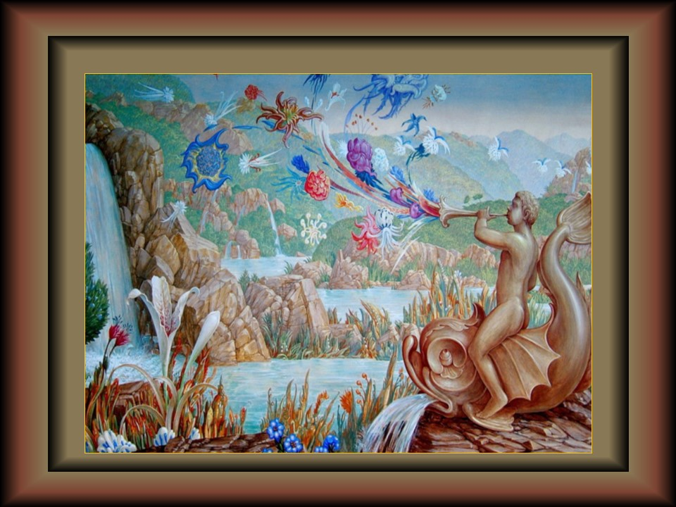

Slide 19
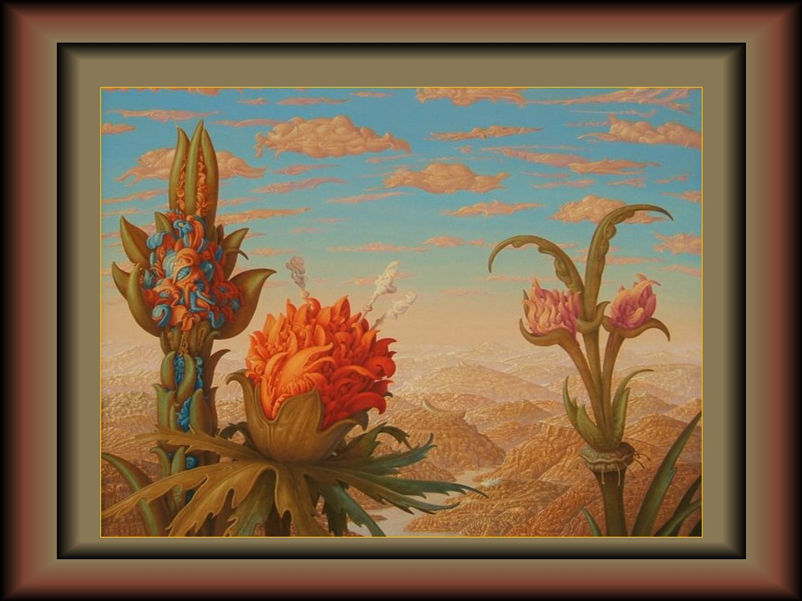

Slide 20
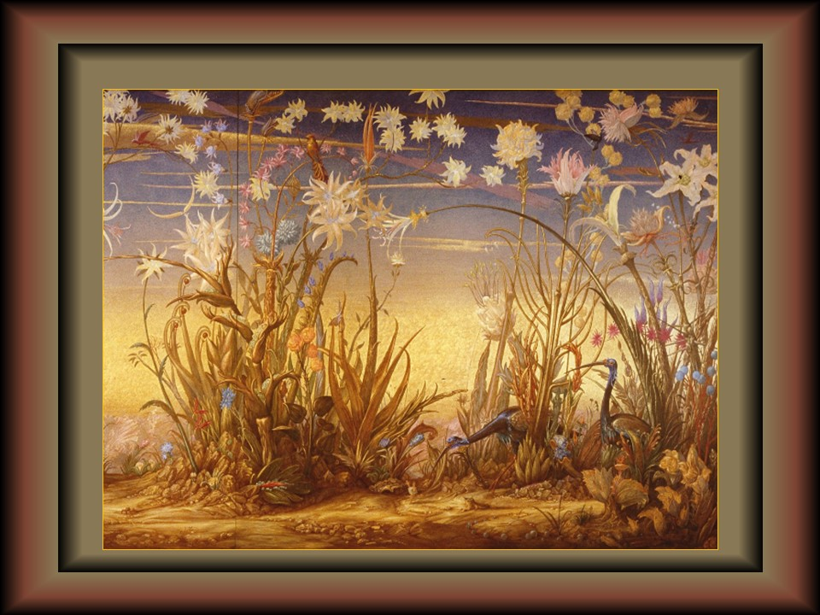

Slide 21
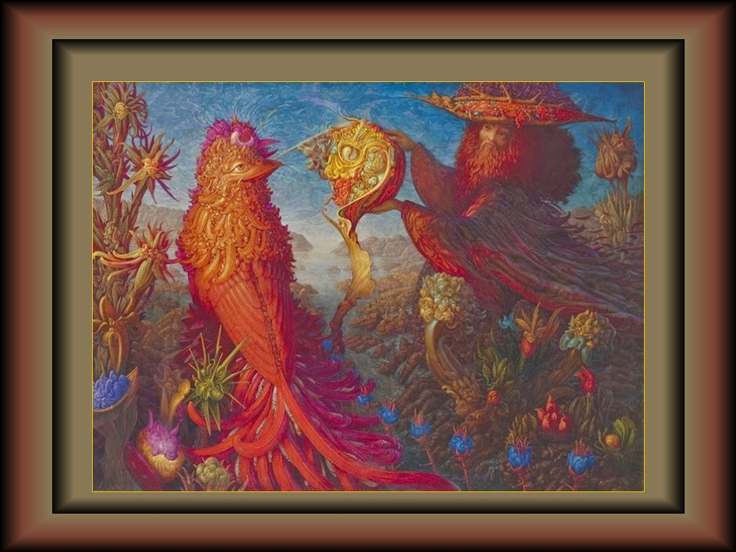

Slide 22
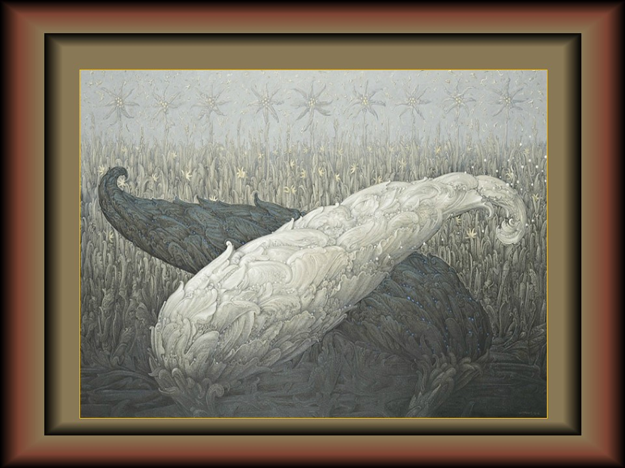

Slide 23
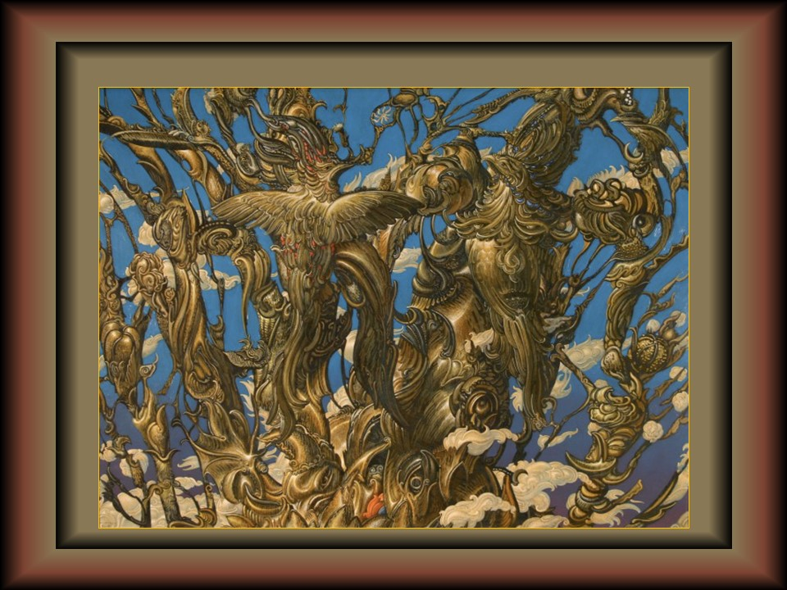

Slide 24
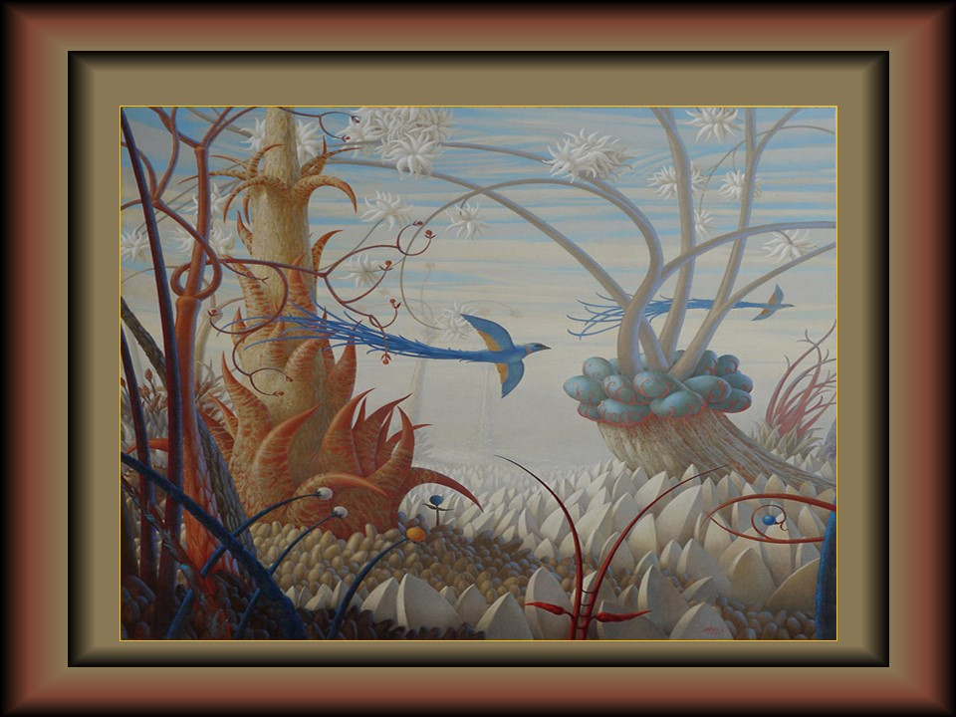

Slide 25
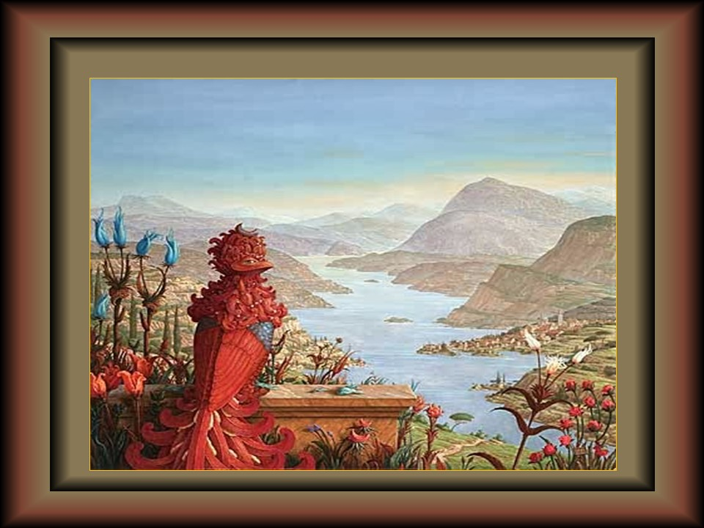

Slide 26
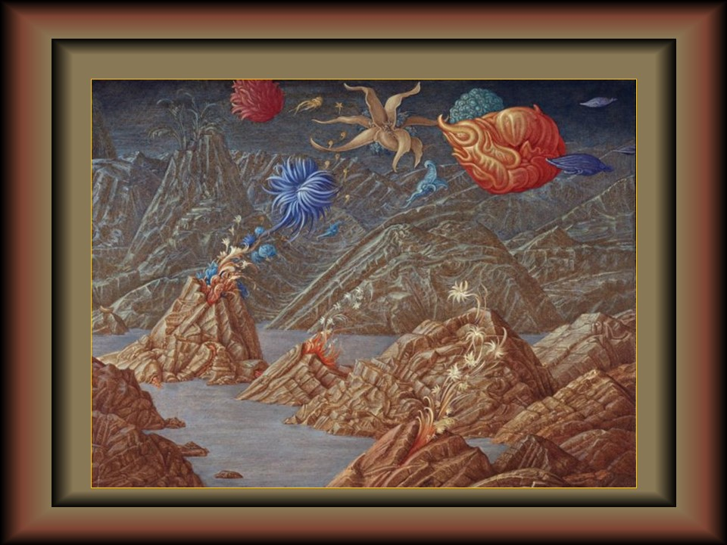

Slide 27
IMAGES MUSIC AND WRITING INTERNET
WITHOUT END OF ECONOMIC PROFIT
Susana Ferrari and Tomás Doran
WOLFGANG HARMS, born in 1950 in UNTERBISSINGEN, BAVARIA (GERMANY). He has always been fascinated by surrealism and fantastic realism, since 1980 he has been especially concerned with mural painting and has completed several national and international works.
Highly technical perfection is characteristic in his works.
Currently lives in NUREMBERG.

Slide 28


Visit us and discover more powerpoints in:
If you want to receive daily pps in your inbox subscribe here:

