Slide 1






Slide 2
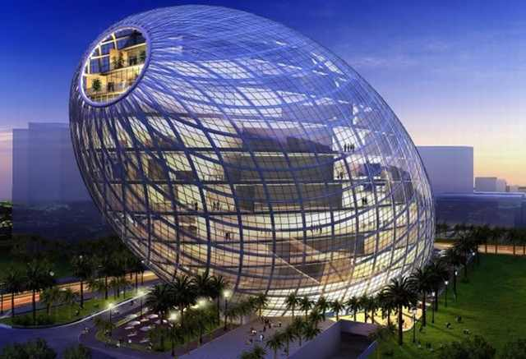
Cybertecture Egg - Mumbai, India

Slide 3
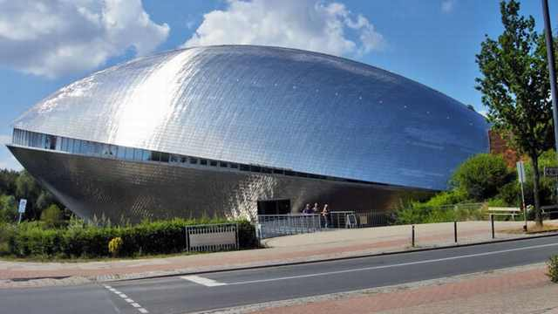
The Universum Science Museum - Bremen, Germany

Slide 4
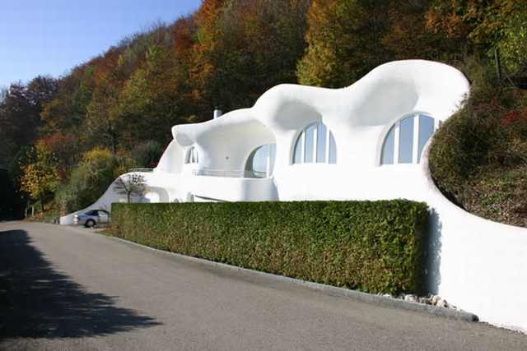
Earth House - Lostorf Switzerland

Slide 5
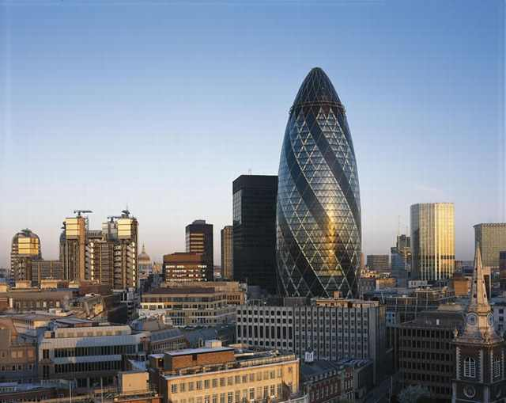
Gherkin Building - London City, United Kingdom

Slide 6
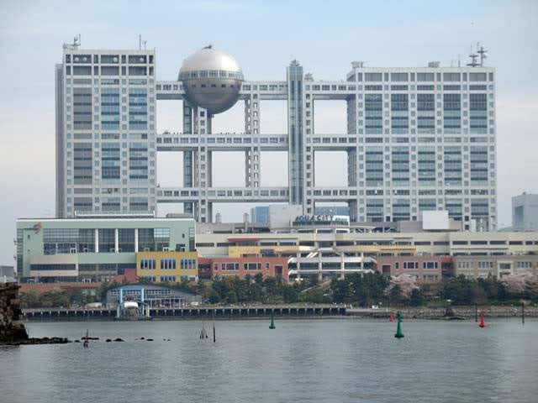
The Fuji Television Building - Tokyo, Japan

Slide 7
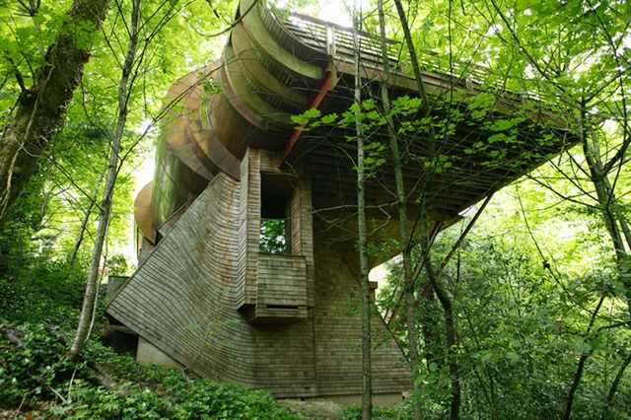
Wilkinson Residence - Portland, Oregon

Slide 8
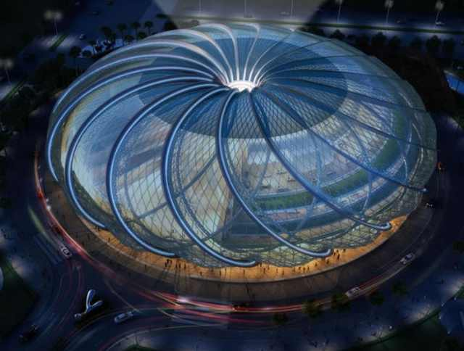
Mumbai University ASK Foundation Convention Center

Slide 9
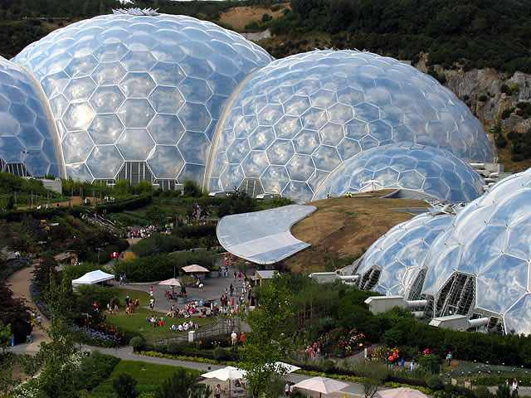
Eden Project - United Kingdom

Slide 10
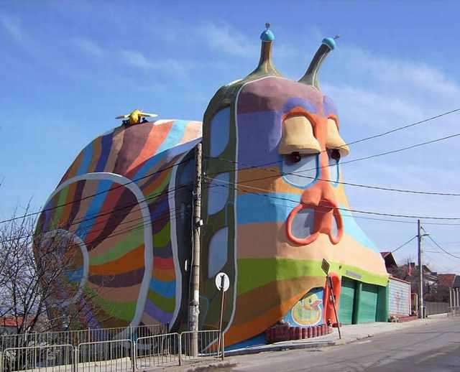
Snail House - Sofia, Bulgaria

Slide 11
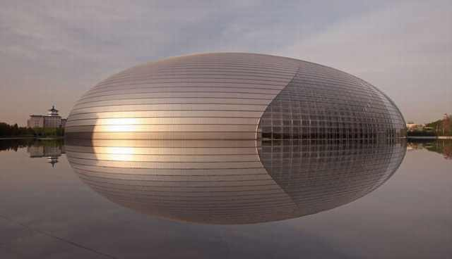
National Theatre - Beijing, China

Slide 12
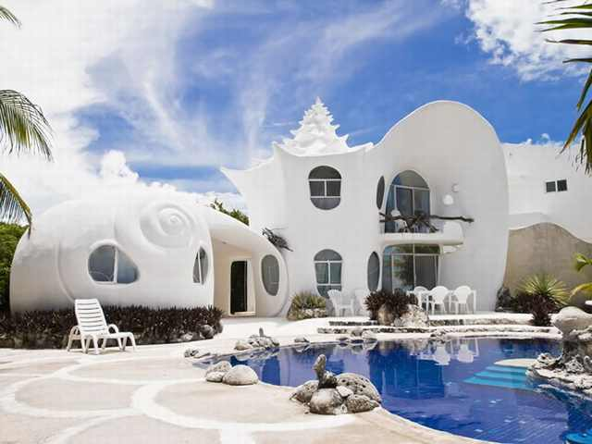
The Conch Shell House - Isla Mujeres, Mexico

Slide 13
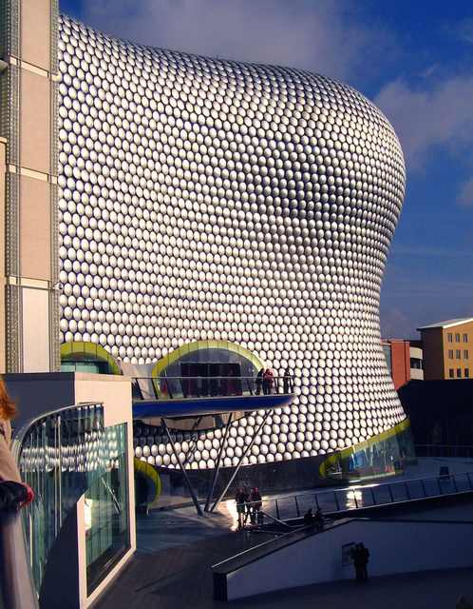
Bullring - Birmingham, United Kingdom

Slide 14
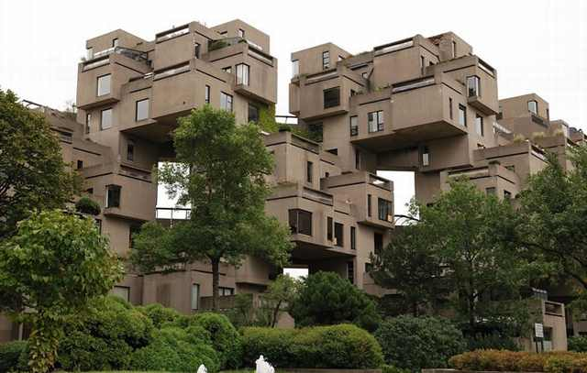
Habitat 67 - Montreal, Canada

Slide 15
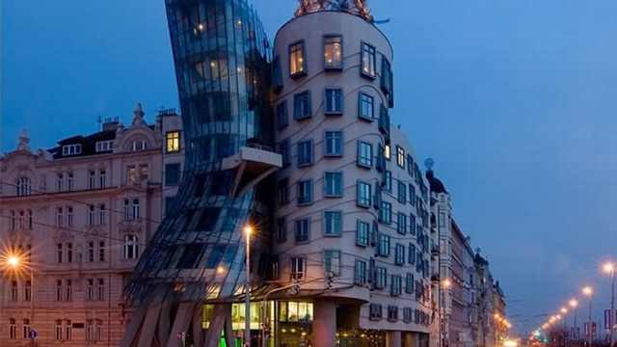
Dancing Building - Prague, Czech Republic

Slide 16
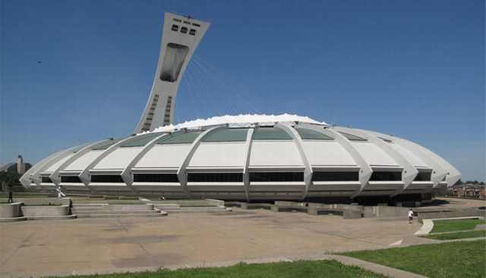
Olympic Stadium - Montreal, Canada

Slide 17
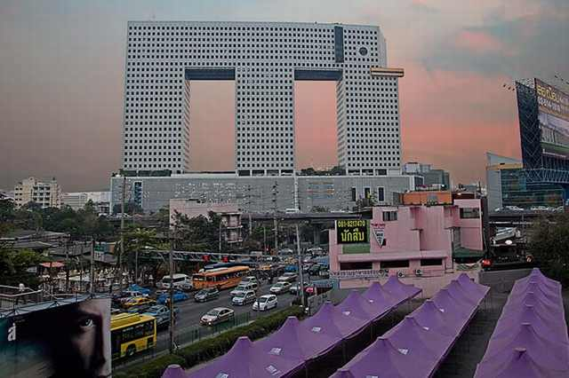
Elephant Building - Bangkok, Thailand

Slide 18
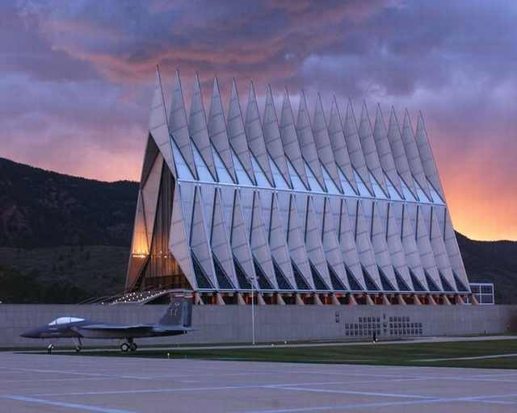
Air Force Academy - Chapel, Colorado

Slide 19
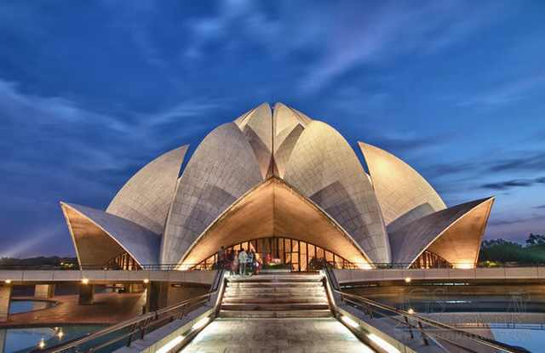
Lotus Temple - Delhi, India

Slide 20
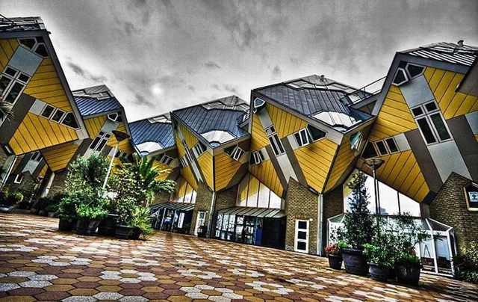
Cubic Houses - Rotterdam, Netherlands

Slide 21
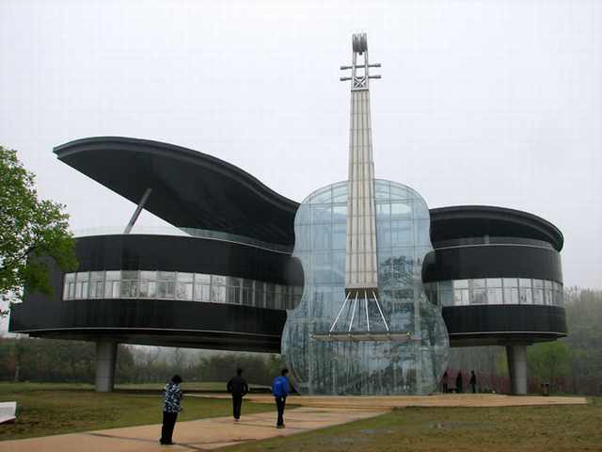
Piano and Violin-Shaped Building - Huainan, China

Slide 22
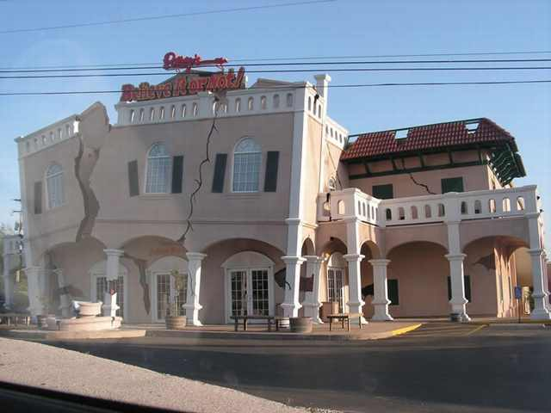
Ripley's Believe It Or Not - Ontario, Canada

Slide 23
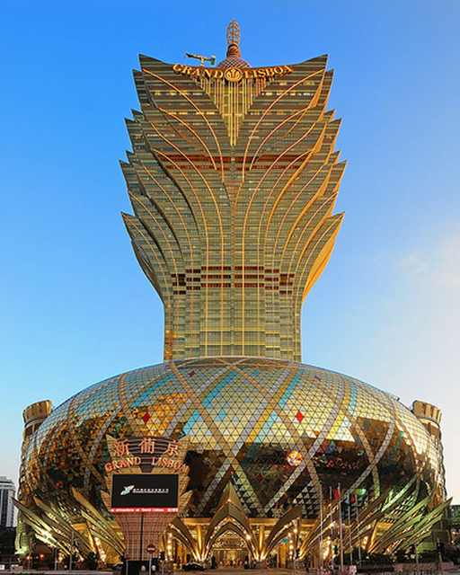
Grand Lisboa - Macao, China

Slide 24
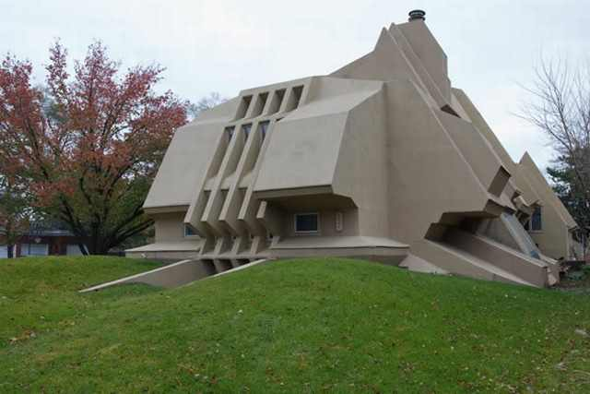



marinettek@yahoo.fr
Bunker House - Chicago, Illinois

