Slide 1


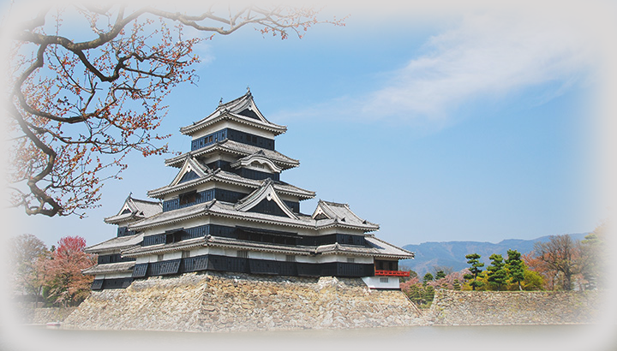
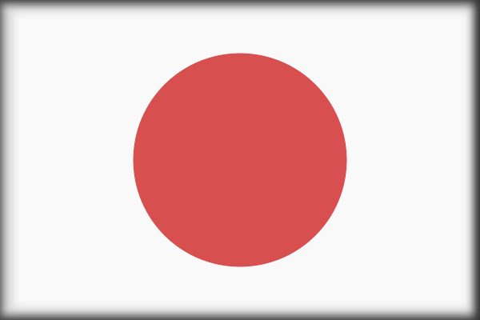
VOIR LE MONDE AVEC MOI
SAUVER LA TERRE
JAPON
Châteaux (1)
Kumamoto Castle
10
Tommy55
2017

Slide 2
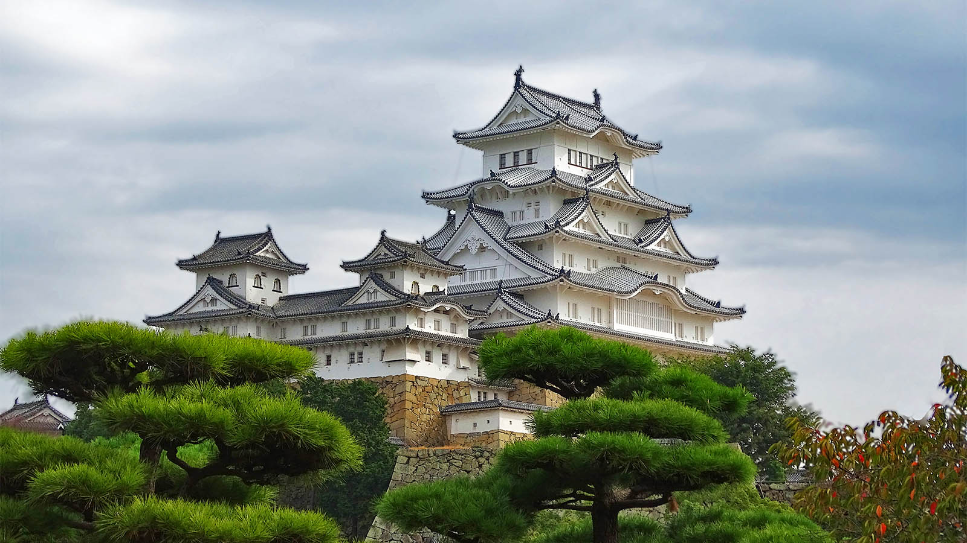


Wallpaper Abyss
Himeji Castle
Origin

Slide 3
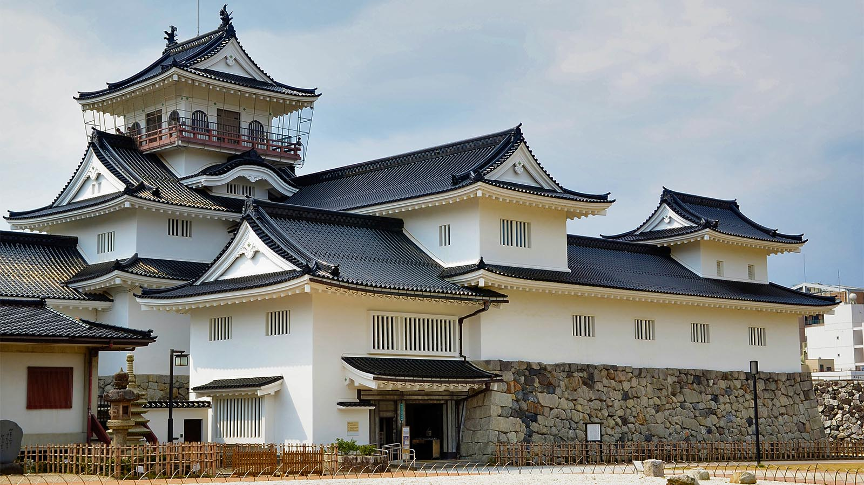
Jpellgen
Toyama Castle
Origin

Slide 4
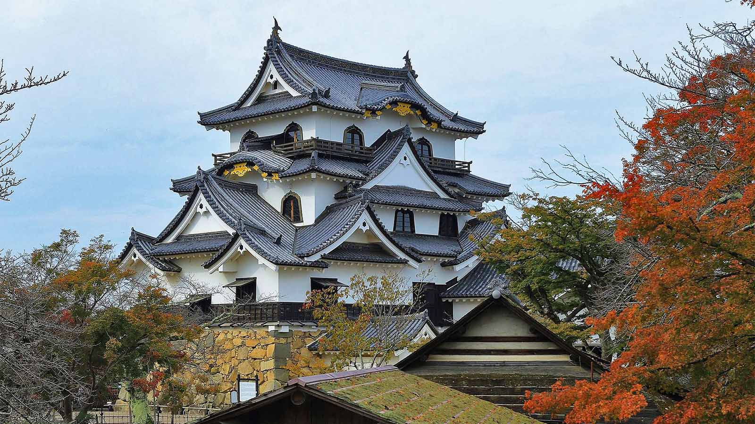
Wikipedia
Hikone Castle
Origin

Slide 5
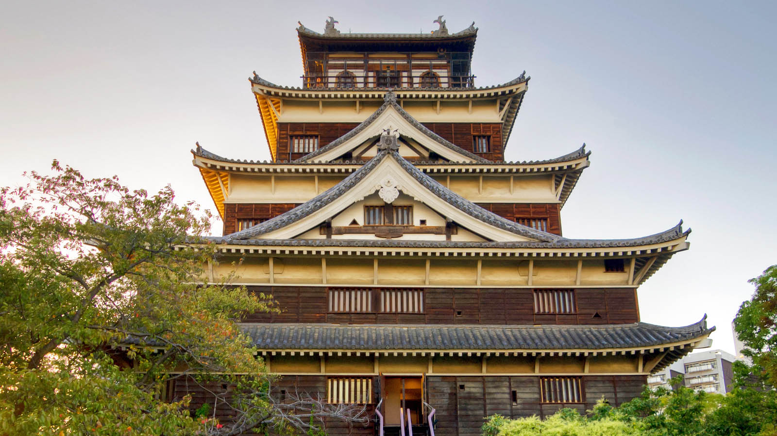
Dellboyy Art
Hiroshima Castle
Origin

Slide 6
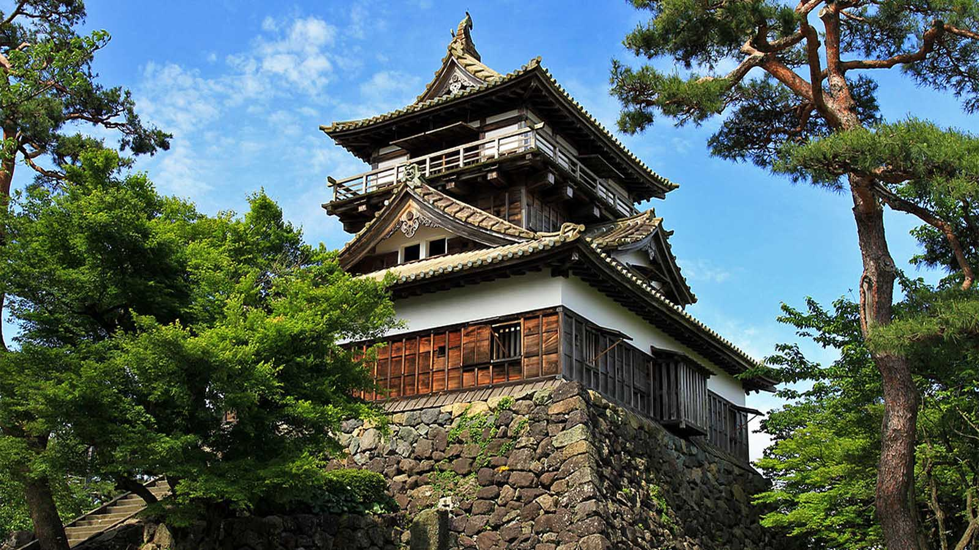
Wikipedia
Maruoka Castle
Origin

Slide 7
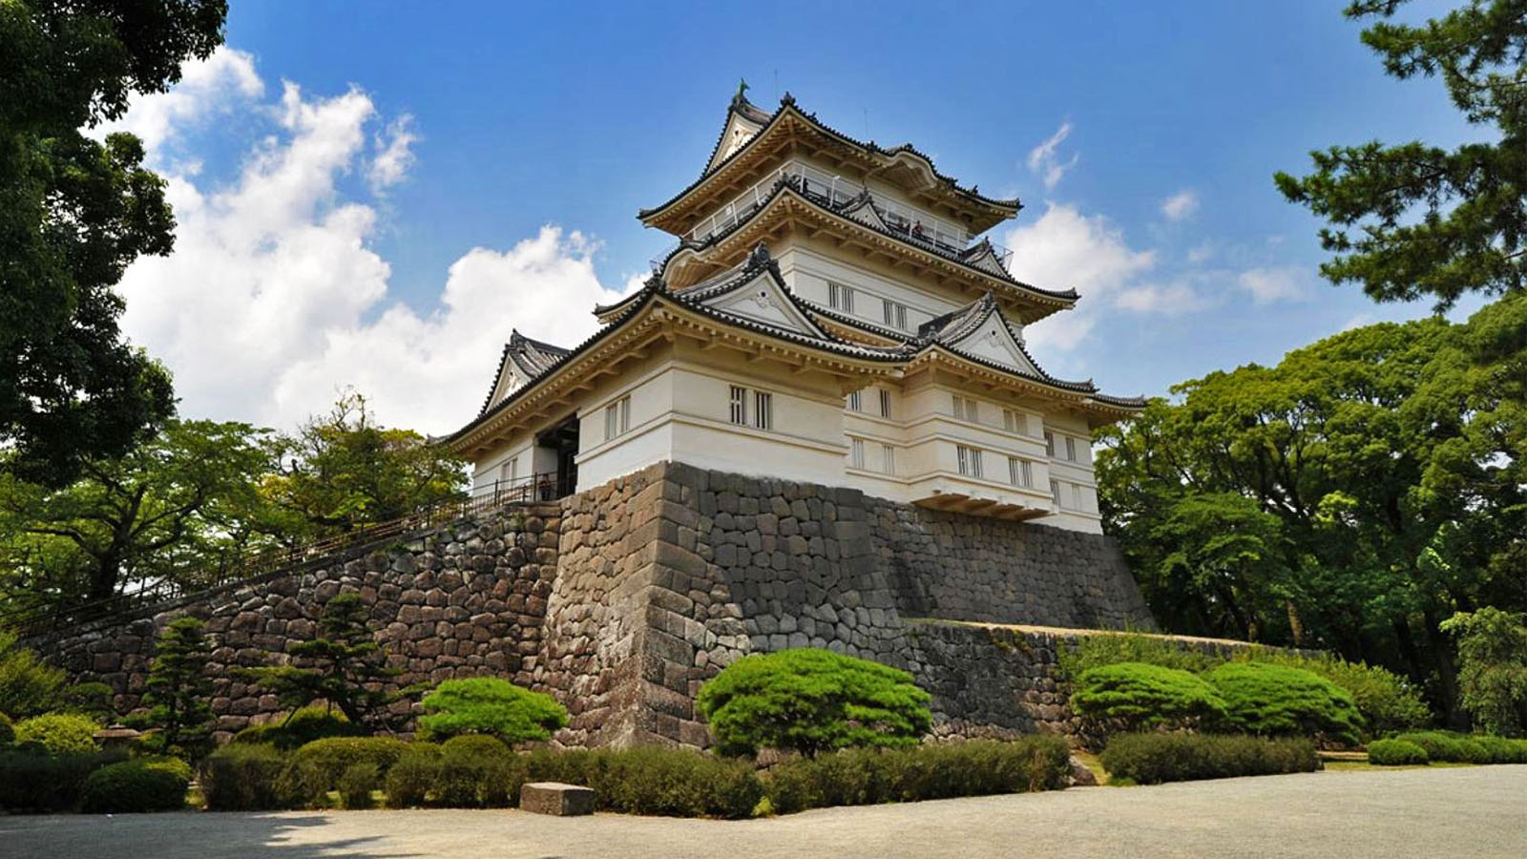
Castles
Odawara Castle
Origin

Slide 8
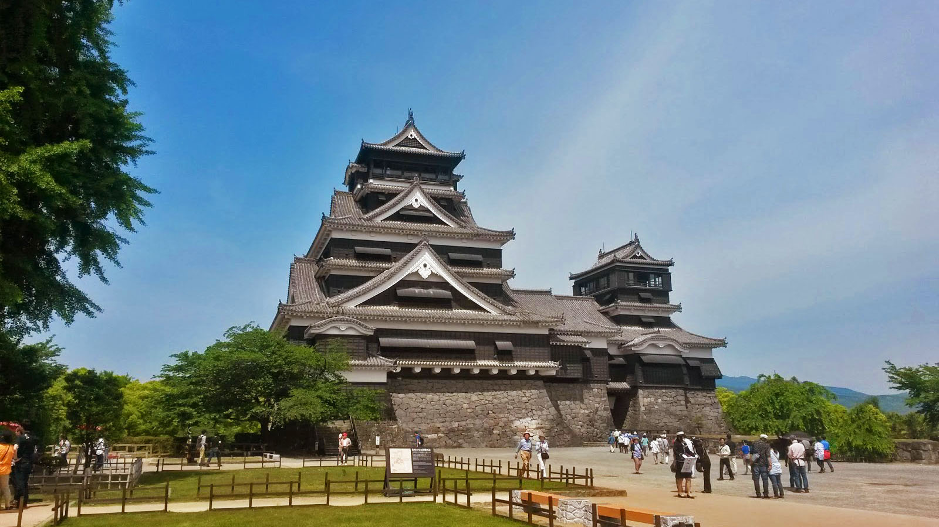
Kiwi in Japan
Fukuoka Castle
Origin

Slide 9
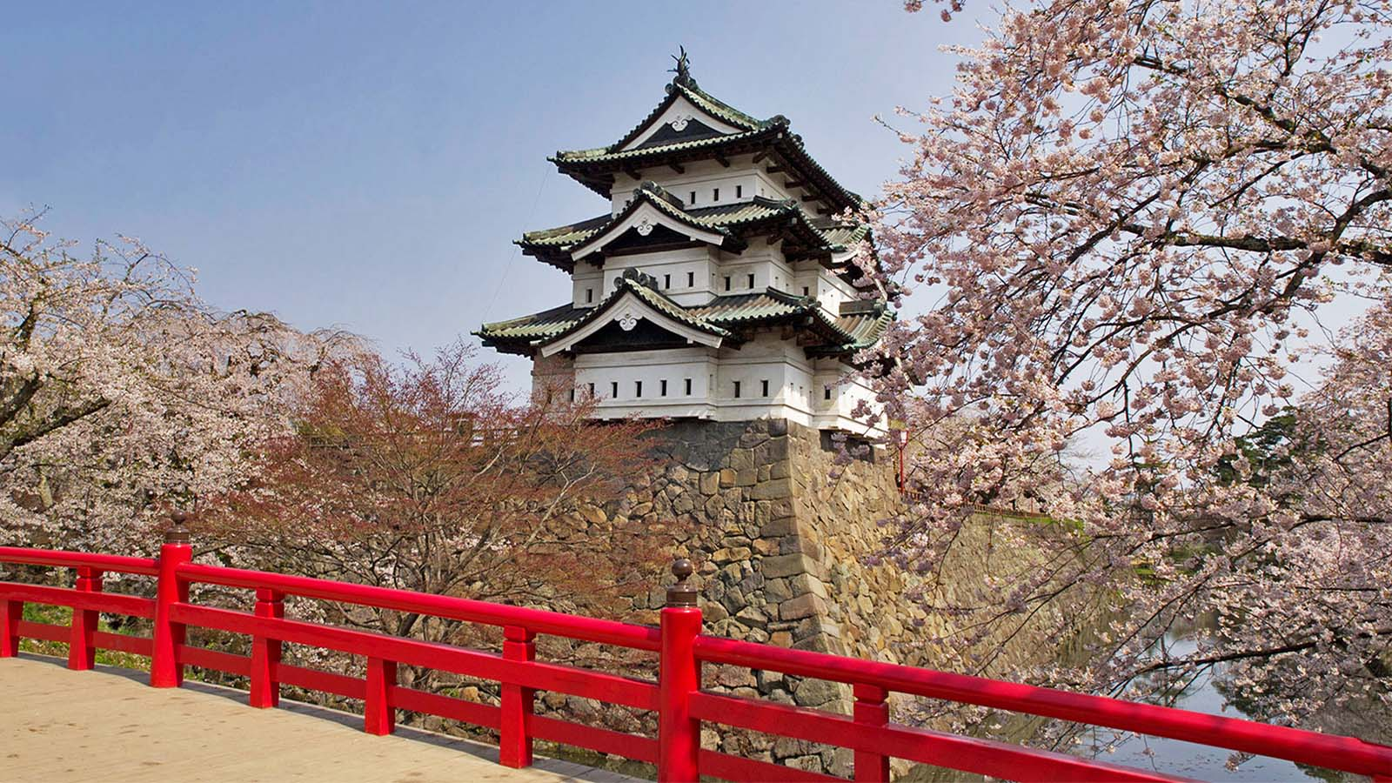
Aptinet
Hirosaki Castle
Origin

Slide 10
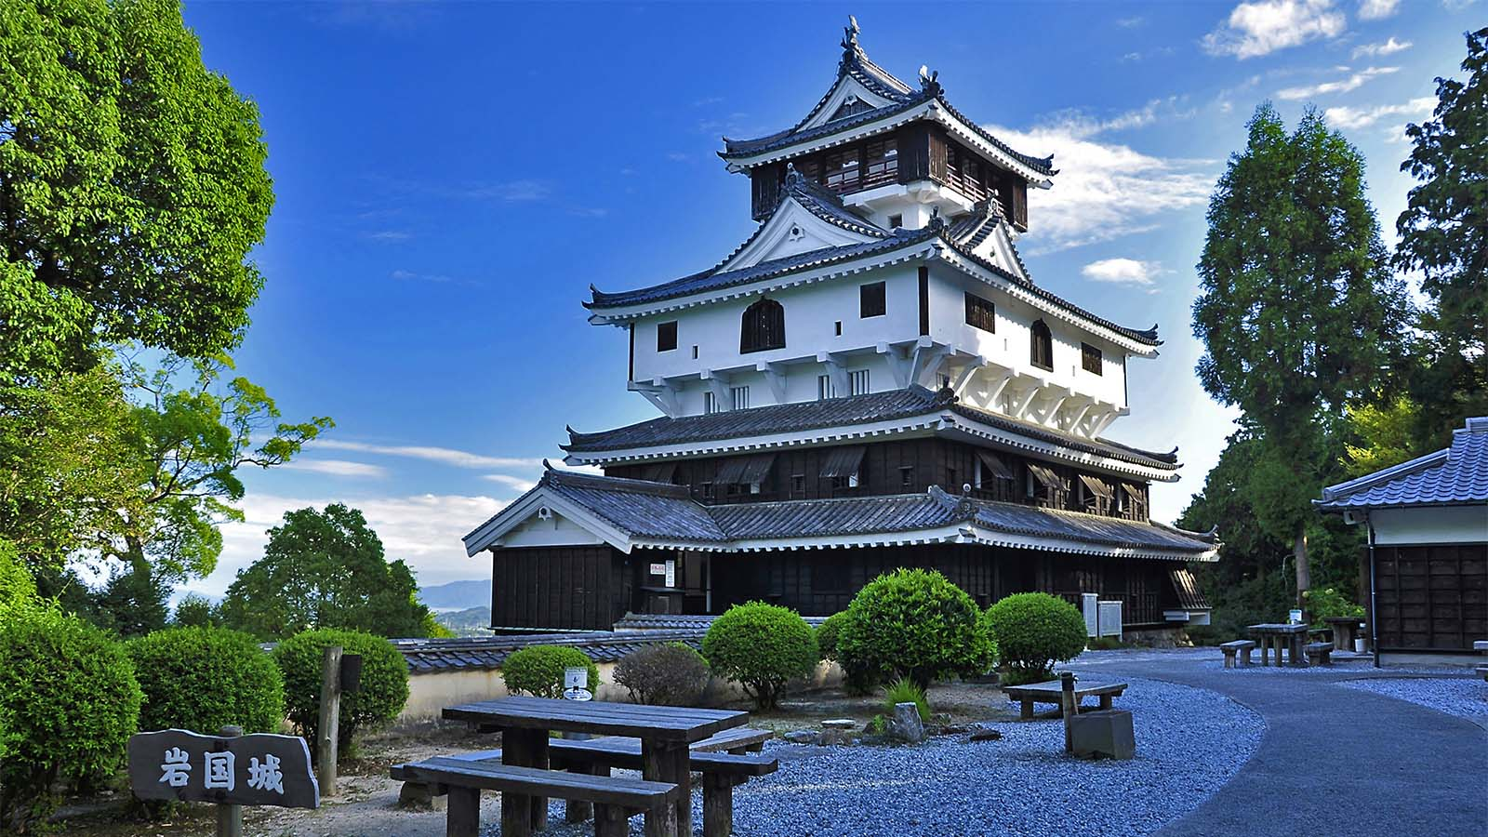
Go Vacations
Iwakuni Castle
Origin

Slide 11
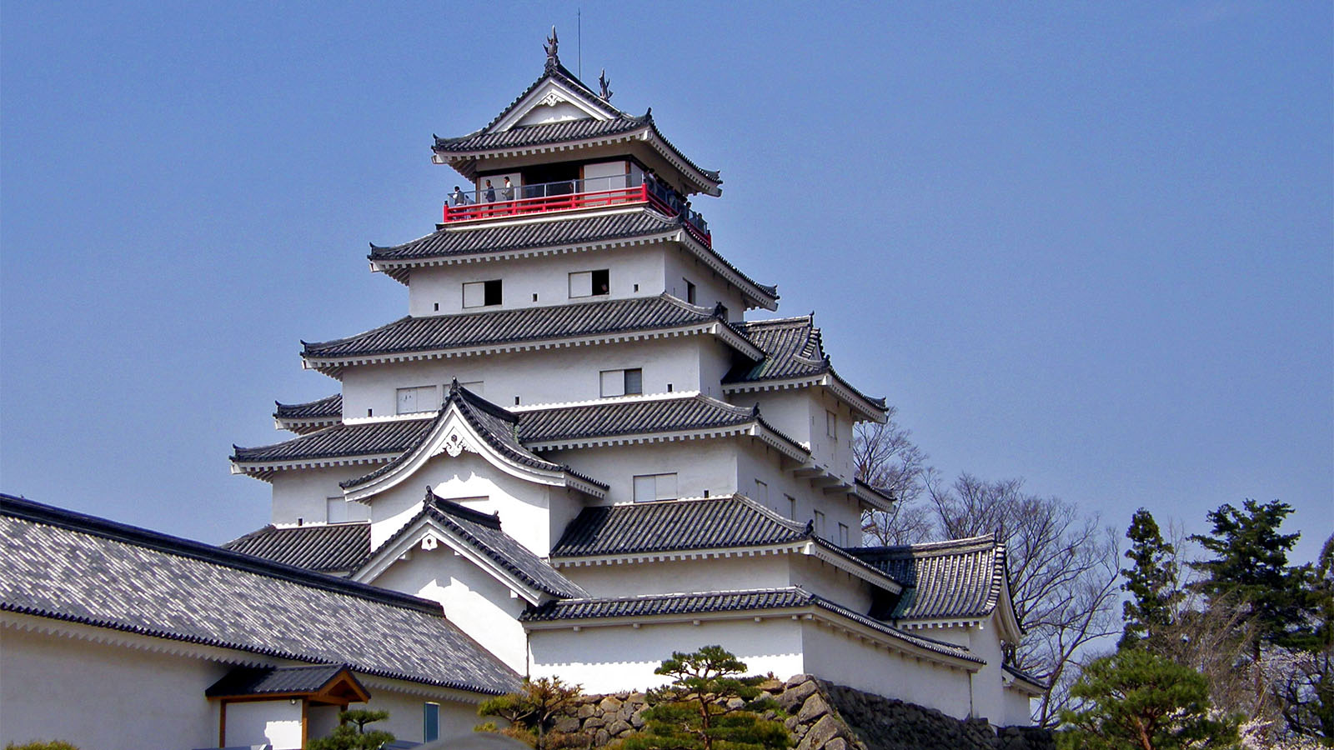
Thousand Wonders
Aizu-Wakamatsu Castle
Origin

Slide 12
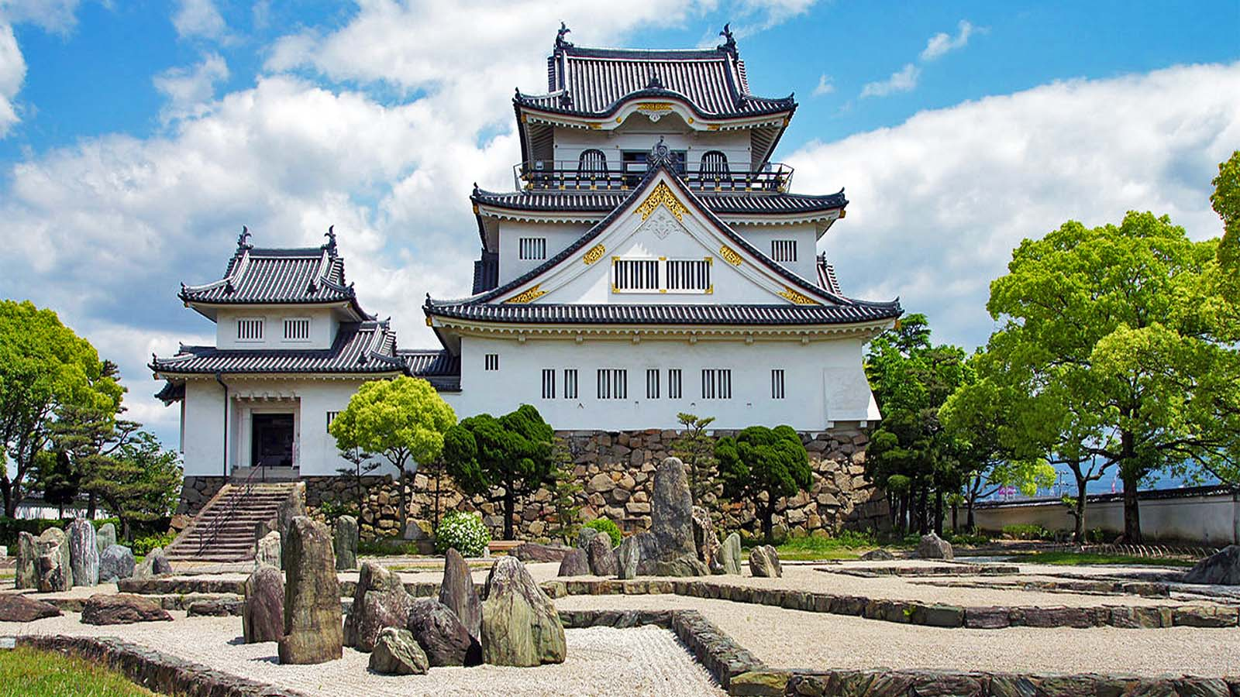
663highland
Kishiwada Castle
Origin

Slide 13
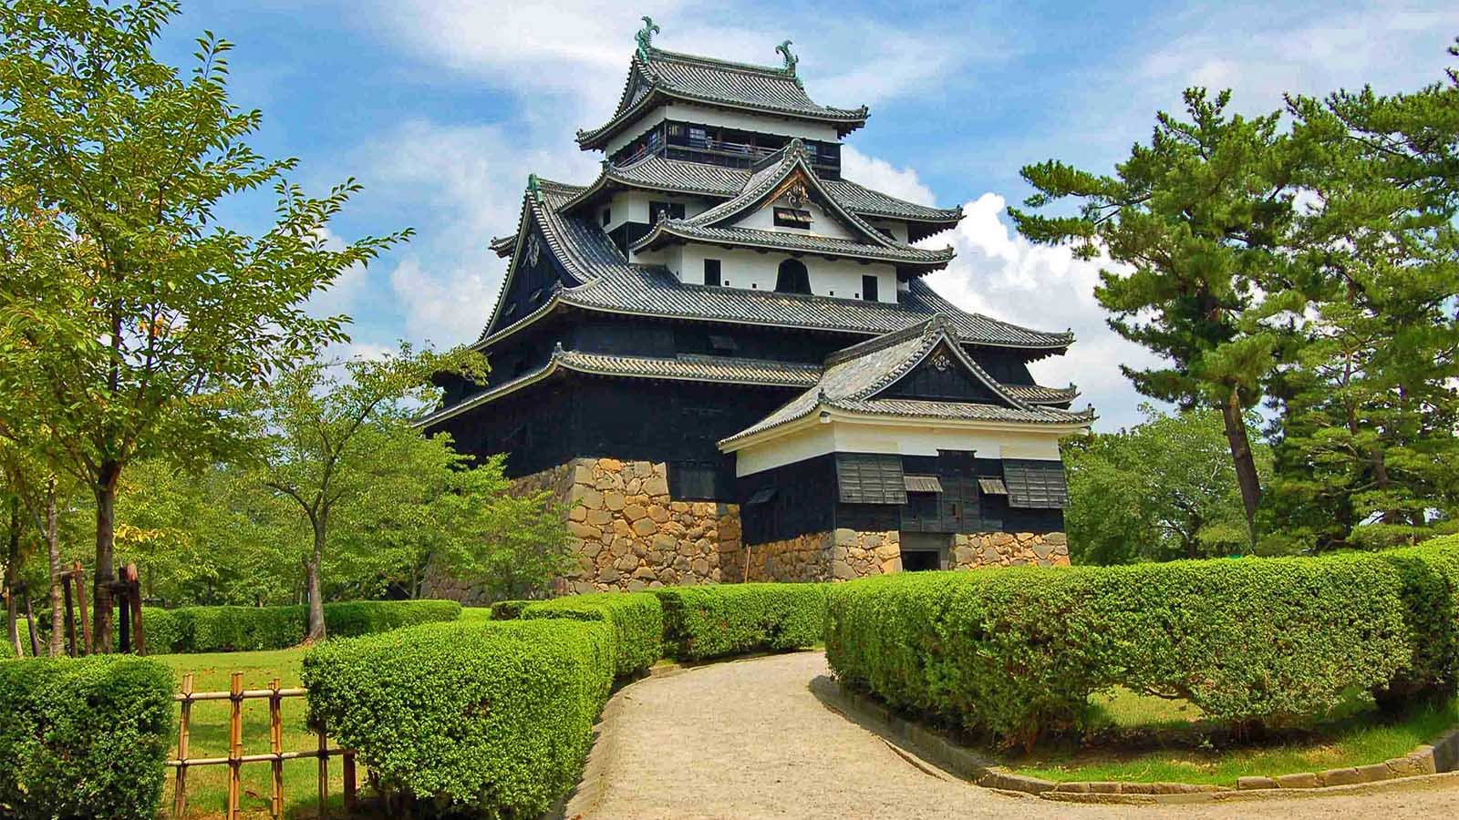
Kerry La
Matsue Castle
Origin

Slide 14
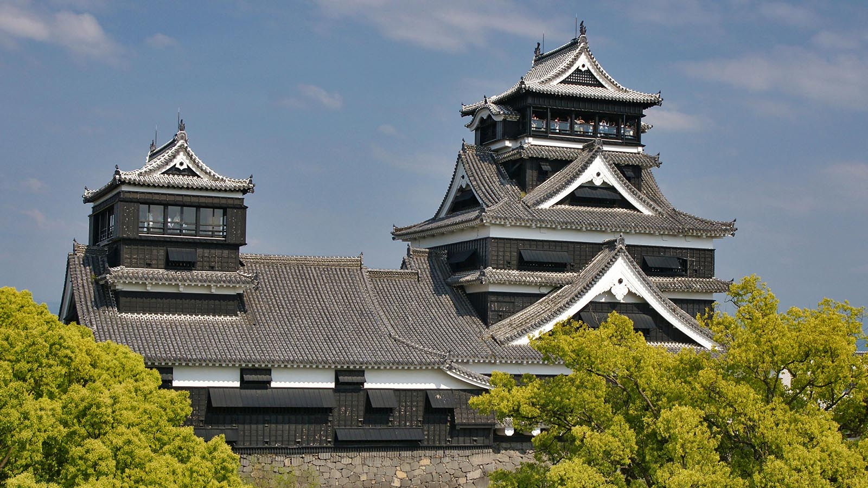
REMIO Japan
Kumamoto Castle
Origin

Slide 15
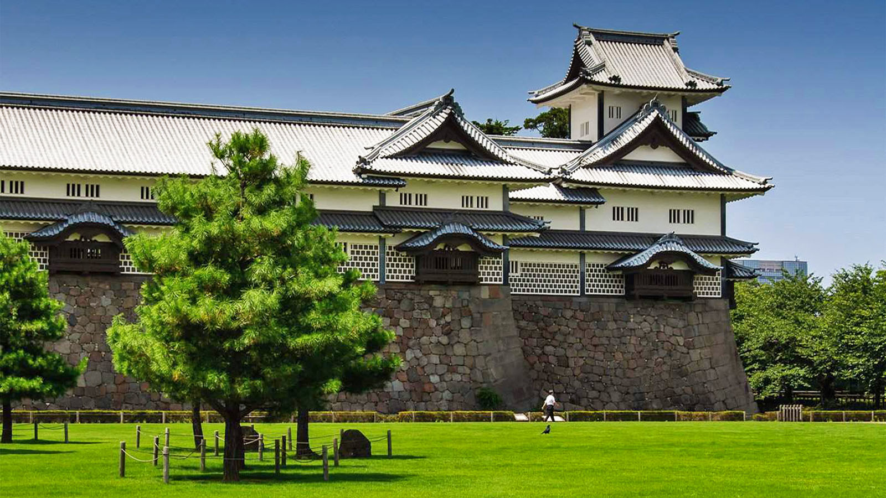
Nerd Nomads
Kanazawa Castle
Origin

Slide 16
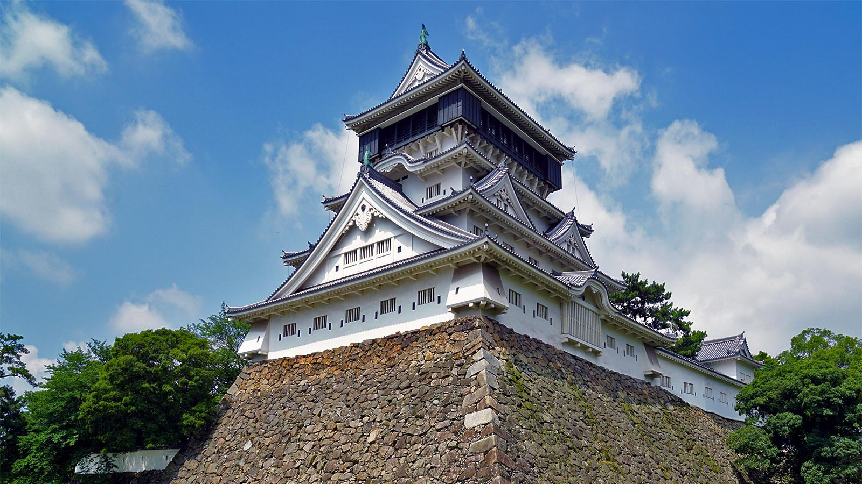
Wikipedia
Kokura Castle
Origin

Slide 17
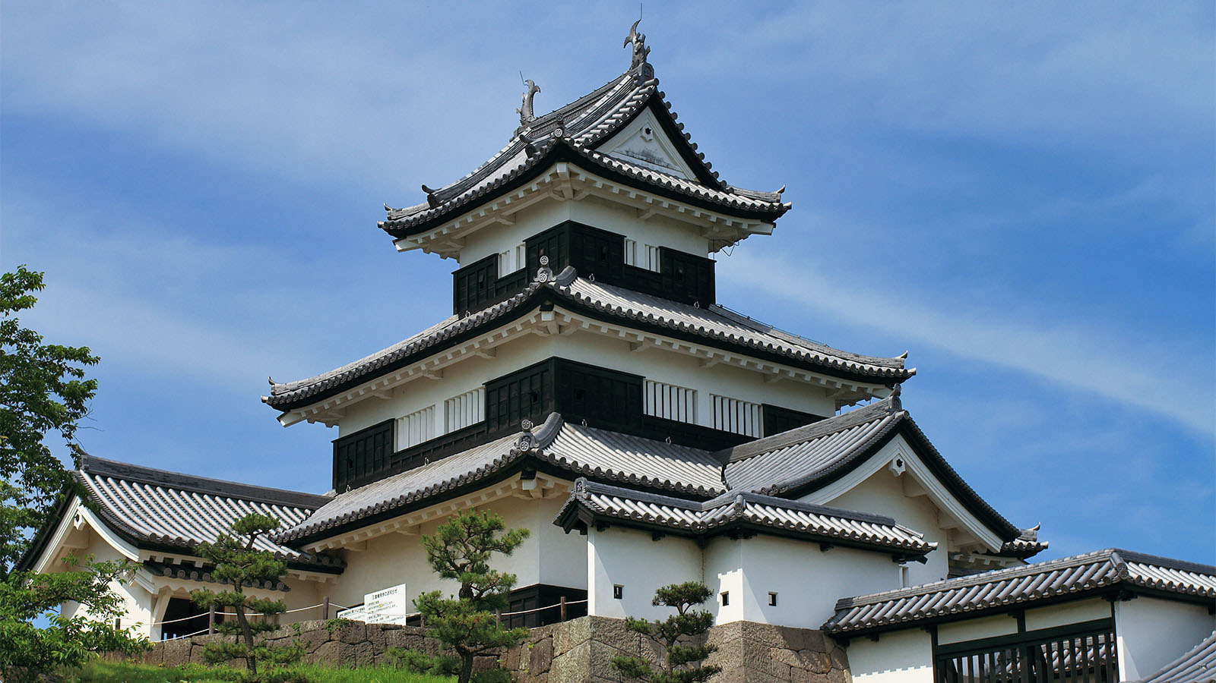
Wikimedia
Komine Castle
Origin

Slide 18
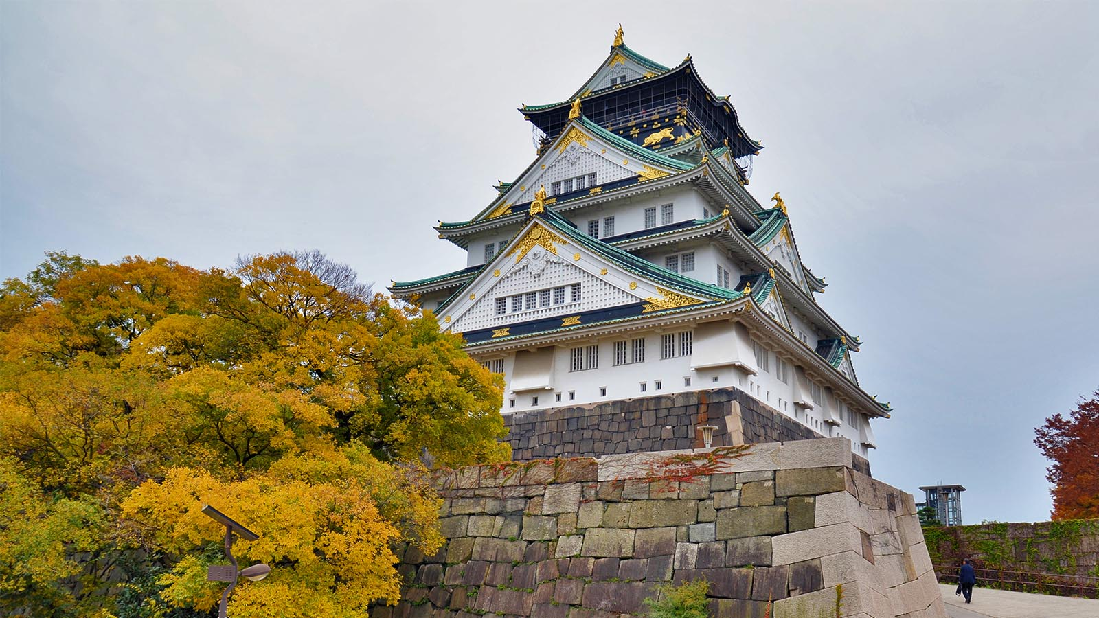
Jpellgen
Osaka Castle
Origin

Slide 19
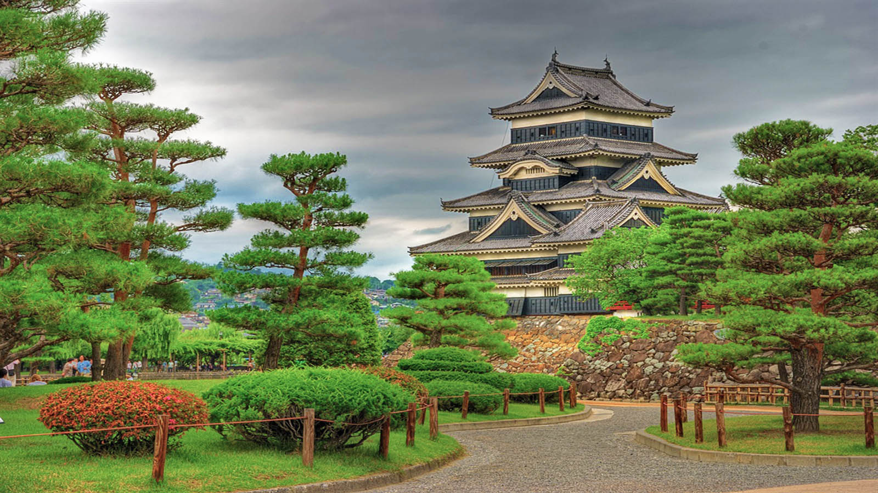
Yevgen Pogoryelov
Matsumoto Castle
Origin

Slide 20
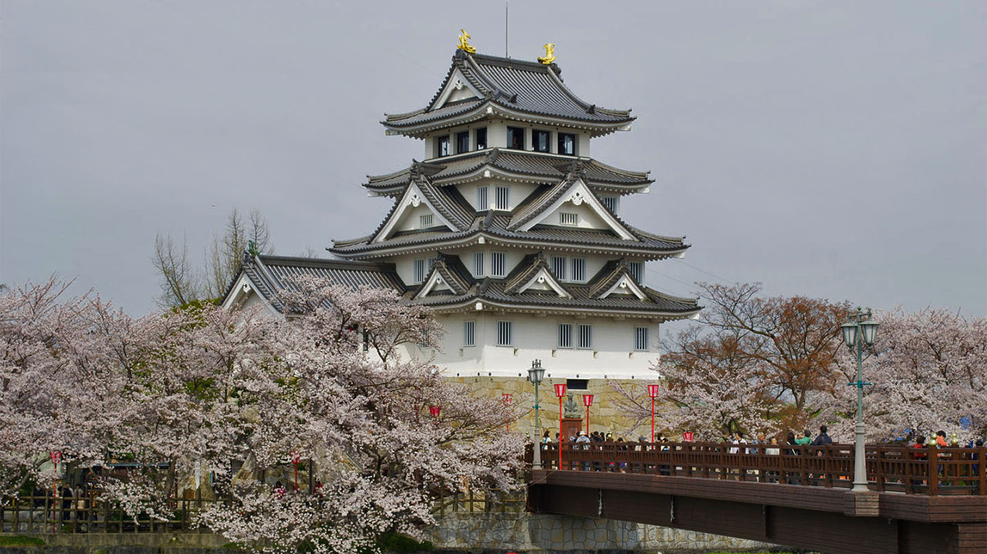
Gaijin Pot
Sunomata Castle
Origin

Slide 21
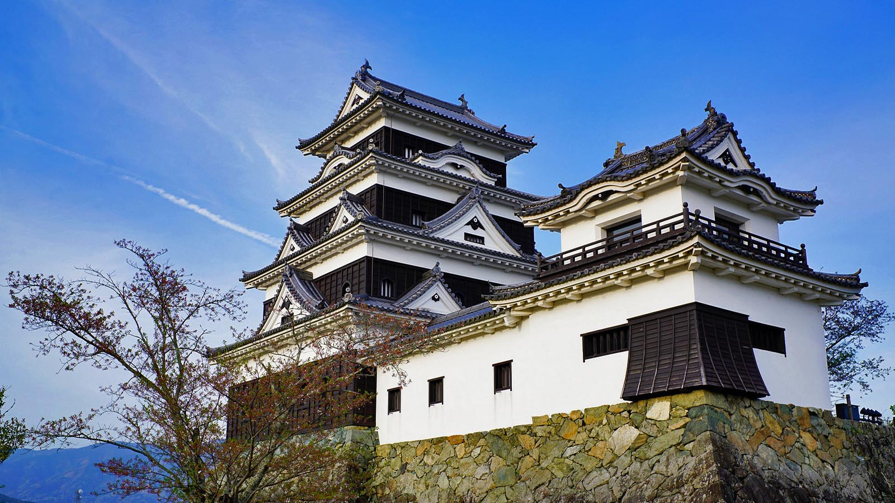
Skyscraper City
Ozu Castle
Origin

Slide 22
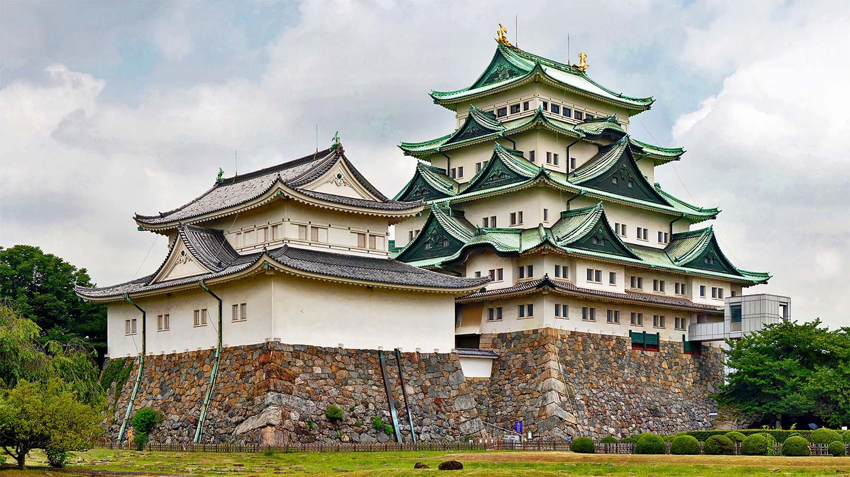
Wikipedia
Nagoya Castle
Origin

Slide 23

À LA PROCHAINE
SAUVER LA TERRE
F I N
CONT.
tomi55jutt@mail.com
Non pour un usage commercial! / Photos á partir d'Internet / Musique : Cherry Blossoms

