Slide 1
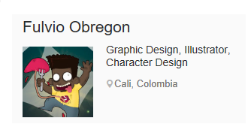


Erkan Biçici erkn9@hotmail.com erkanbcc@gmail.com 30.09.2016
Before&After Illustrations Of Female Celebrities With Their Younger Selves
Me & My Other Me
Fat Players FIFA World Cup
Music : Tomorrow's Dream – James Last

Slide 2
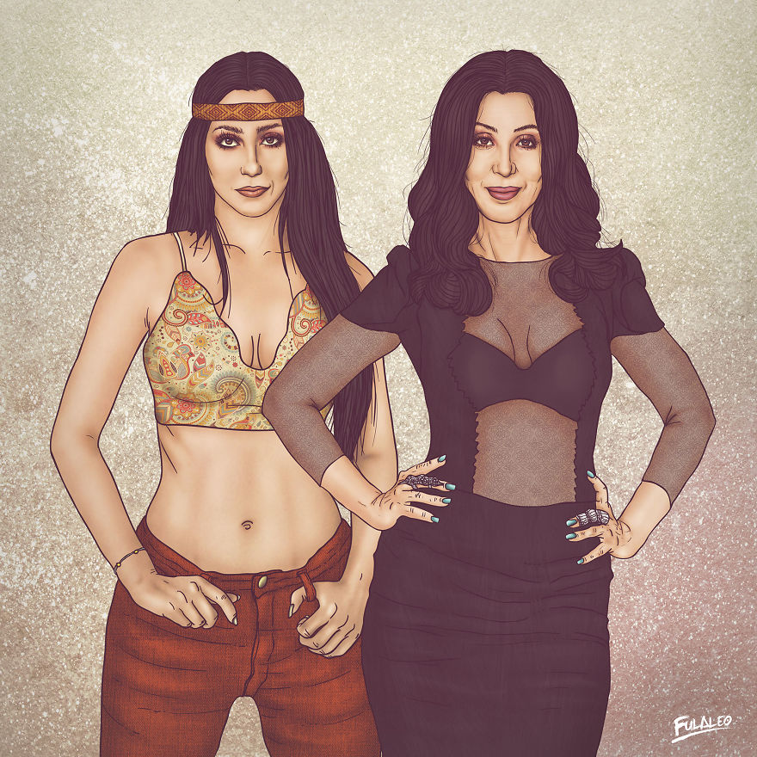
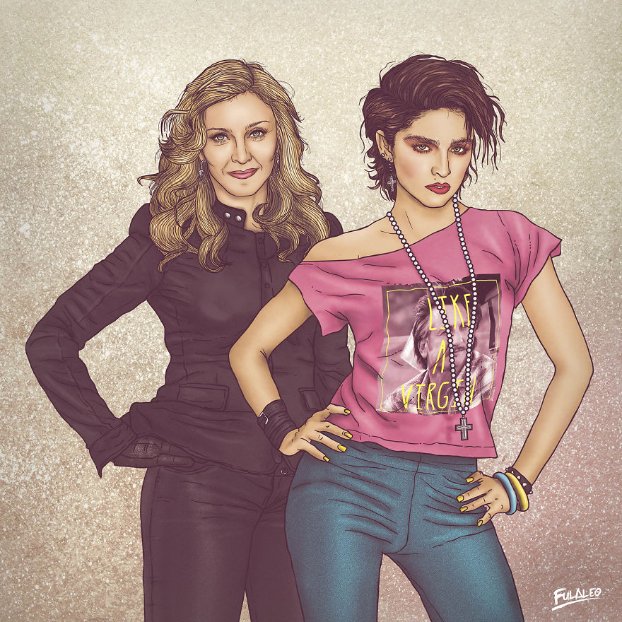
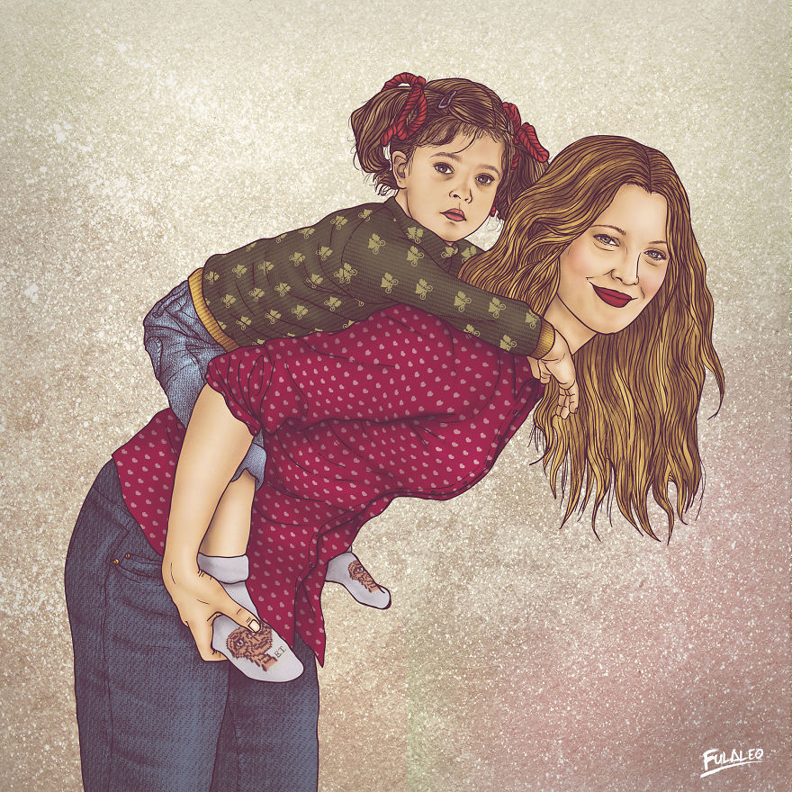
Before&After Illustrations Of Female Celebrities With Their Younger Selves
Erkan Biçici erkn9@hotmail.com erkanbcc@gmail.com 30.09.2016
Madonna
Cher
Drew Barrymore

Slide 3
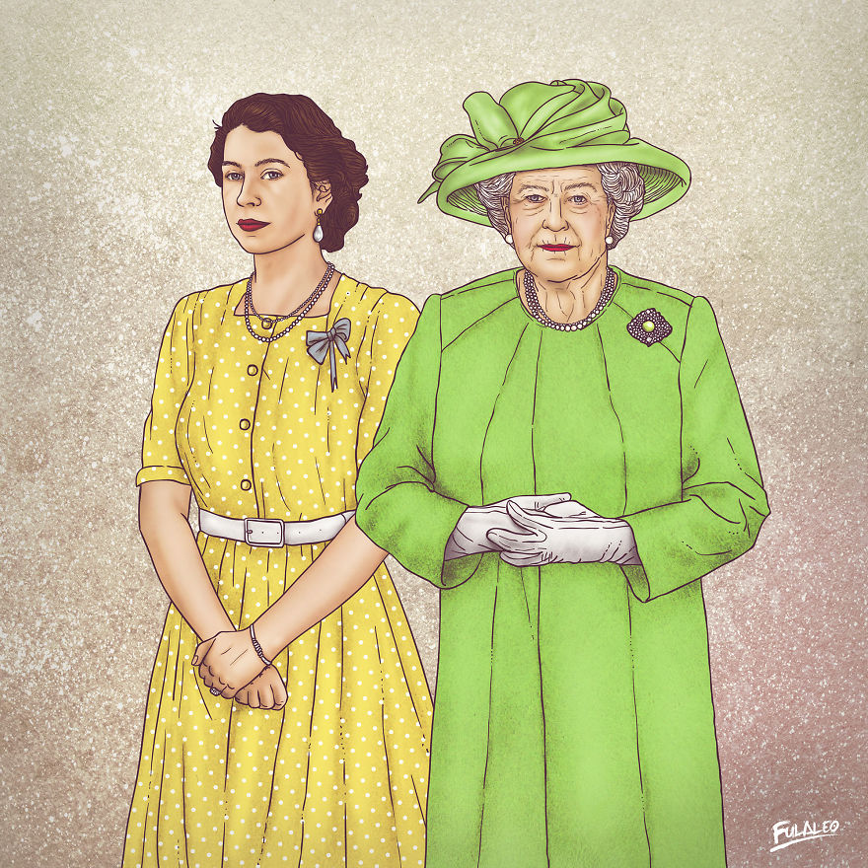
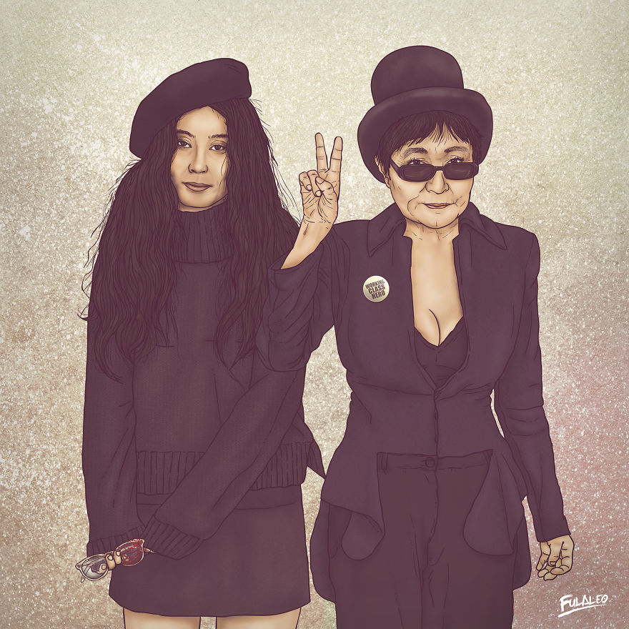
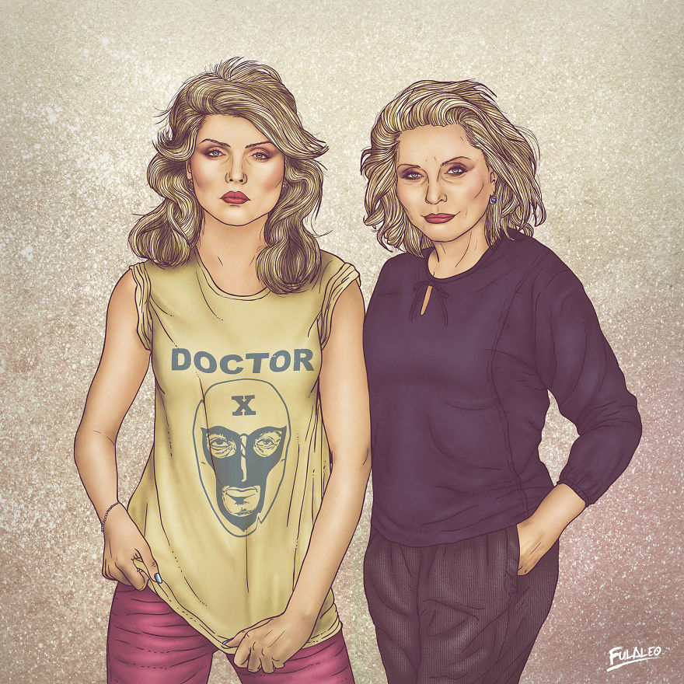
Before&After Illustrations Of Female Celebrities With Their Younger Selves
Erkan Biçici erkn9@hotmail.com erkanbcc@gmail.com 30.09.2016
Yoko Ono
Debbie Harry
The Queen

Slide 4
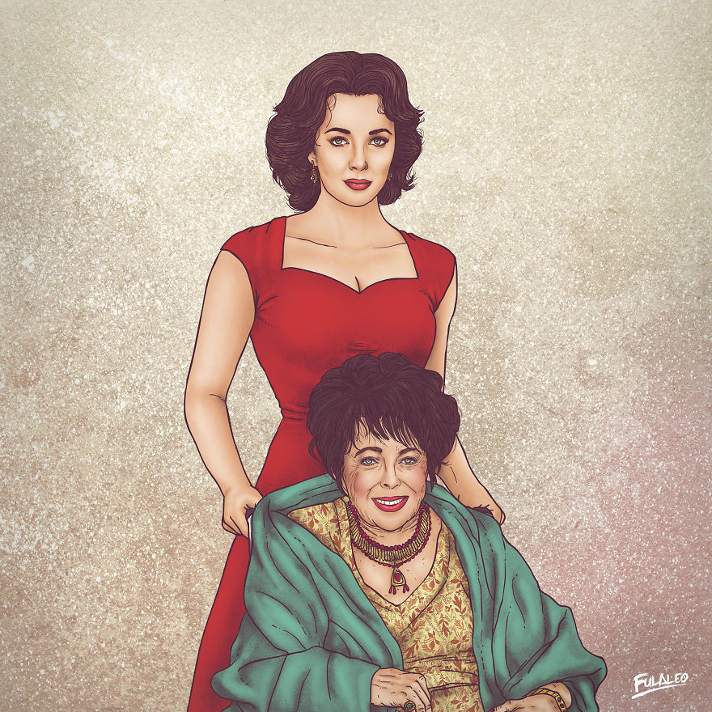
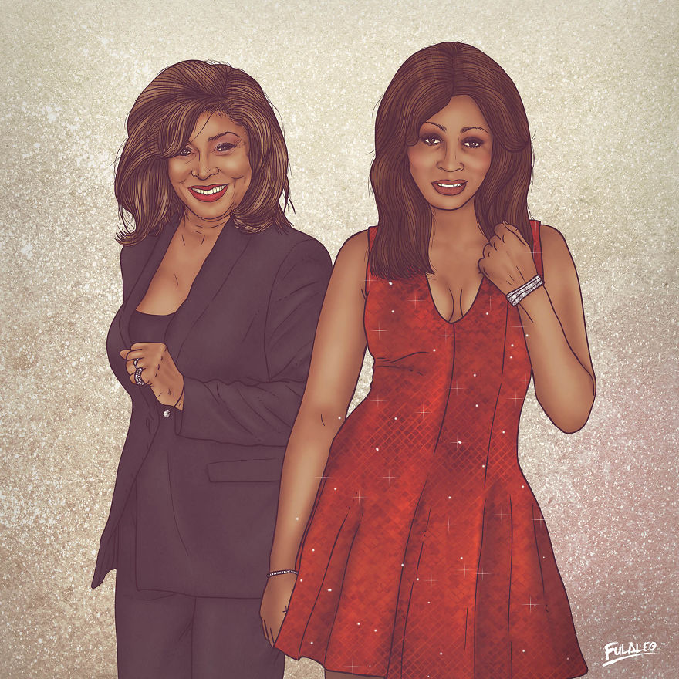
Before&After Illustrations Of Female Celebrities With Their Younger Selves
Erkan Biçici erkn9@hotmail.com erkanbcc@gmail.com 30.09.2016
Tina Turner
Elizabeth Taylor

Slide 5
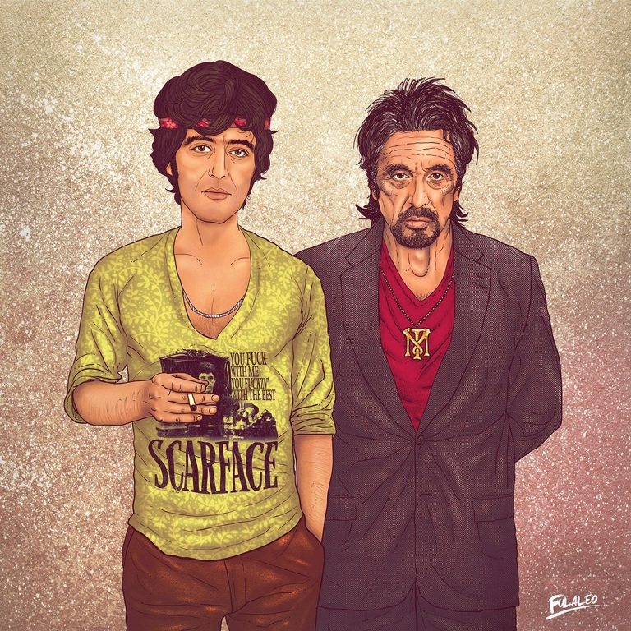
Me & My Other Me
Erkan Biçici erkn9@hotmail.com erkanbcc@gmail.com 30.09.2016
Al Pacino

Slide 6
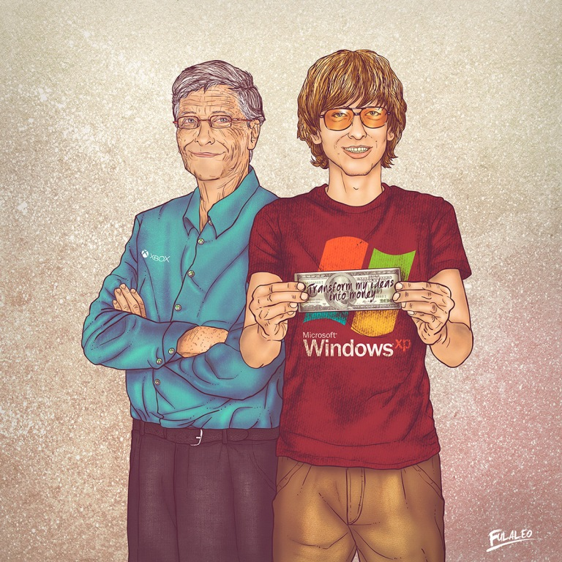
Me & My Other Me
Erkan Biçici erkn9@hotmail.com erkanbcc@gmail.com 30.09.2016
Bil Gates

Slide 7
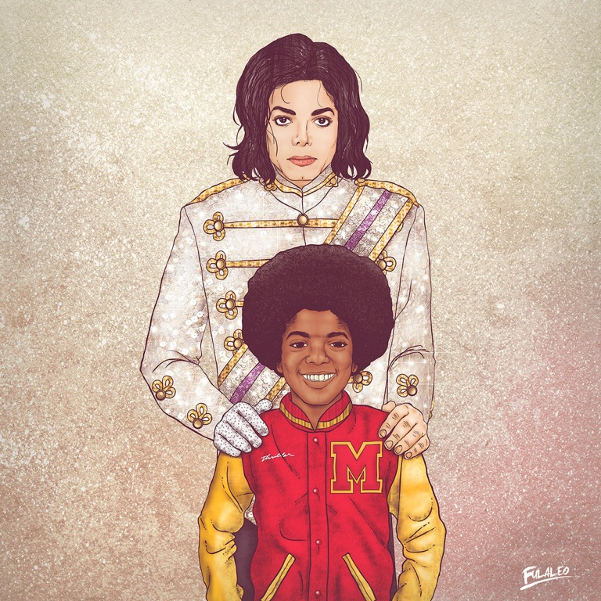
Me & My Other Me
Erkan Biçici erkn9@hotmail.com erkanbcc@gmail.com 30.09.2016
Michael Jackson

Slide 8
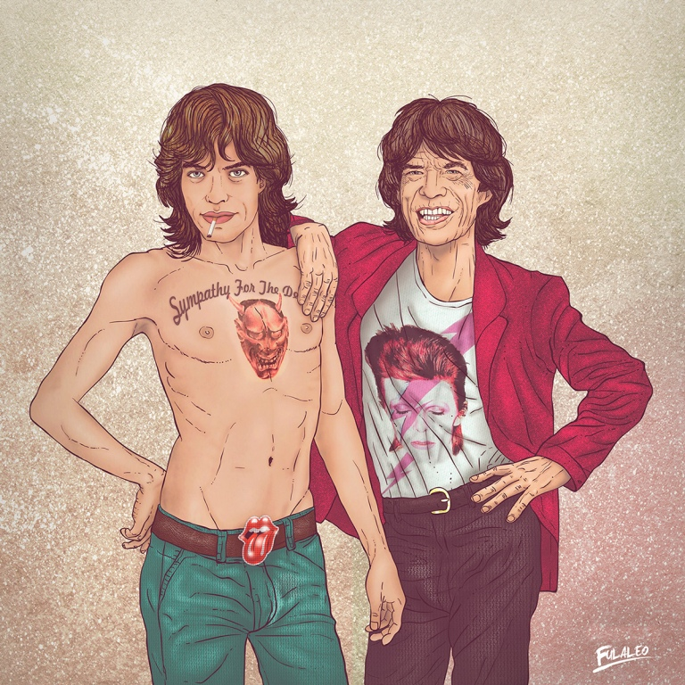
Me & My Other Me
Erkan Biçici erkn9@hotmail.com erkanbcc@gmail.com 30.09.2016
Mick Jagger

Slide 9
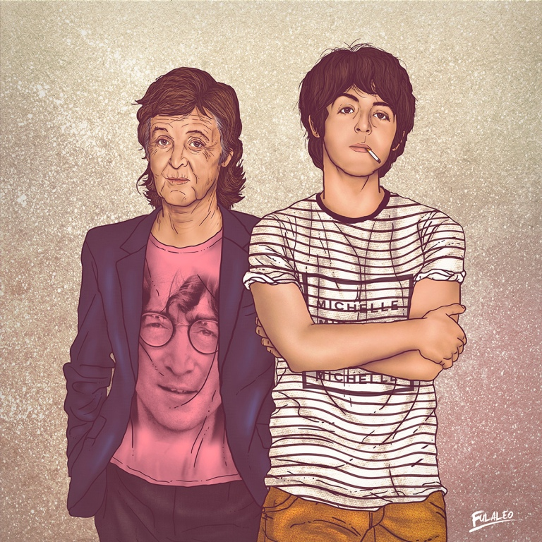
Me & My Other Me
Erkan Biçici erkn9@hotmail.com erkanbcc@gmail.com 30.09.2016
Paul McCartney

Slide 10
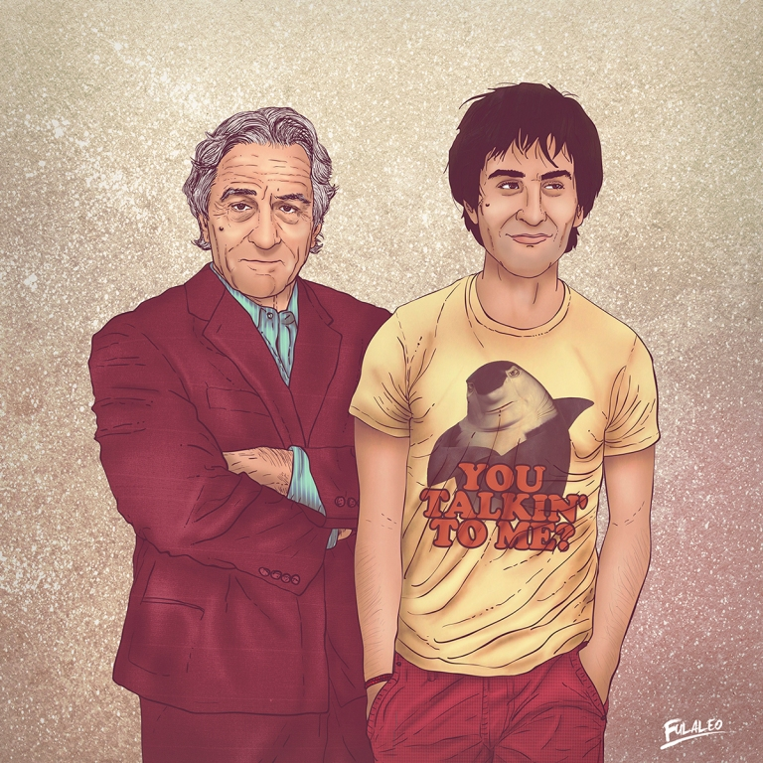
Me & My Other Me
Erkan Biçici erkn9@hotmail.com erkanbcc@gmail.com 30.09.2016
Robert de Niro

Slide 11
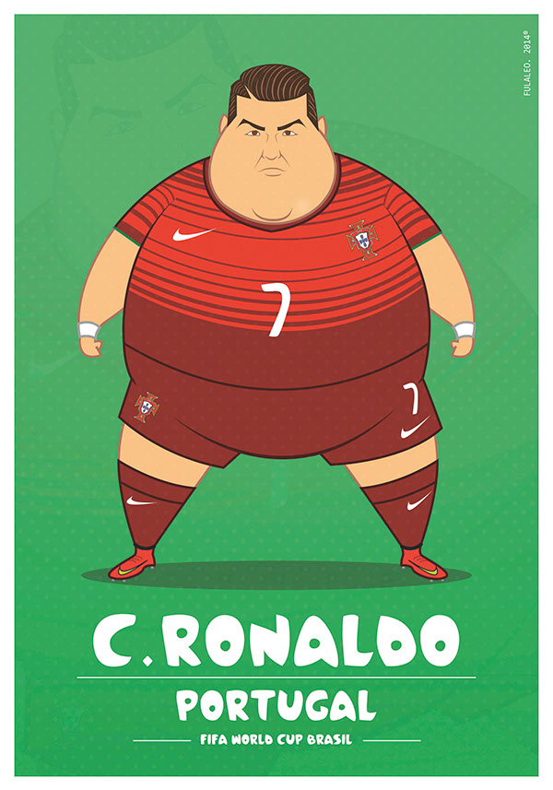
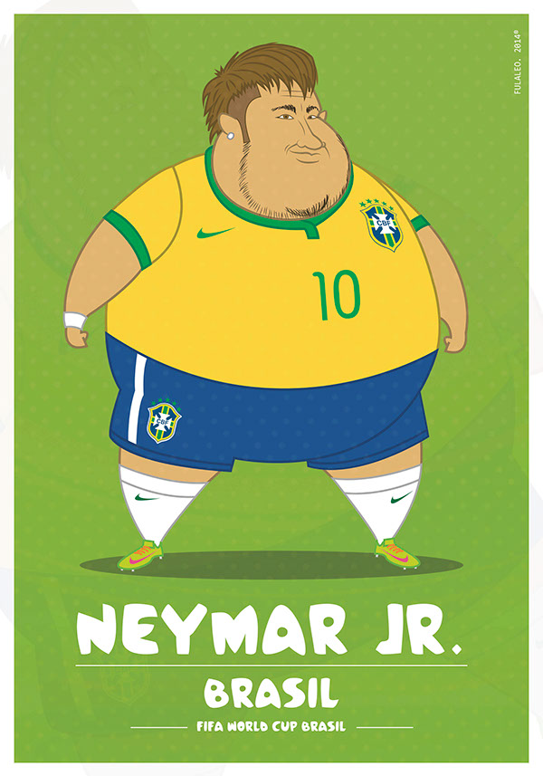
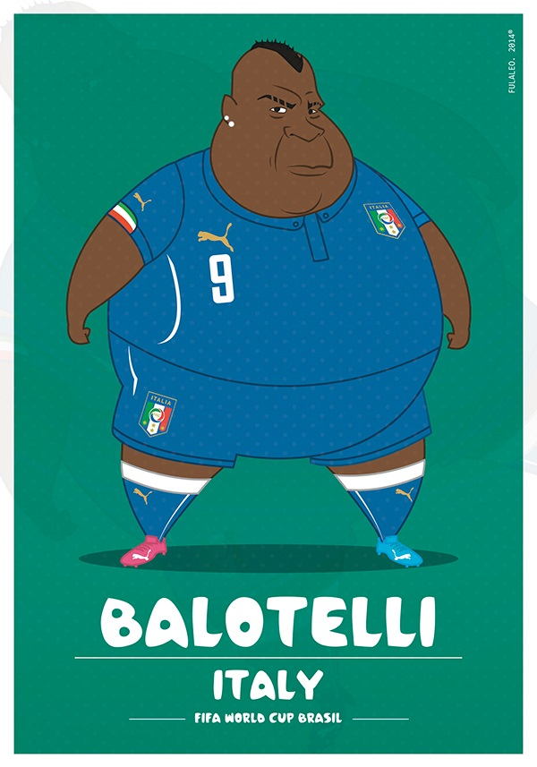
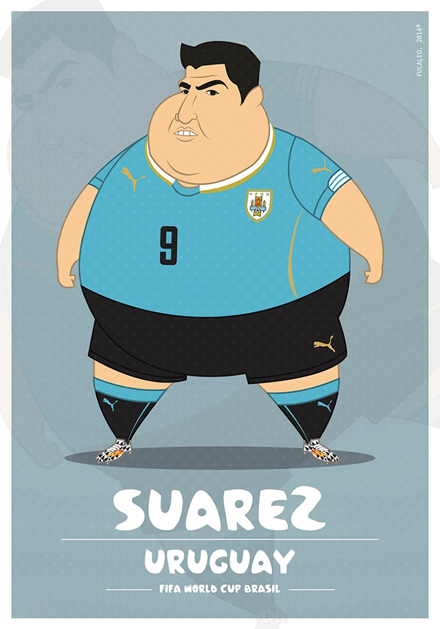
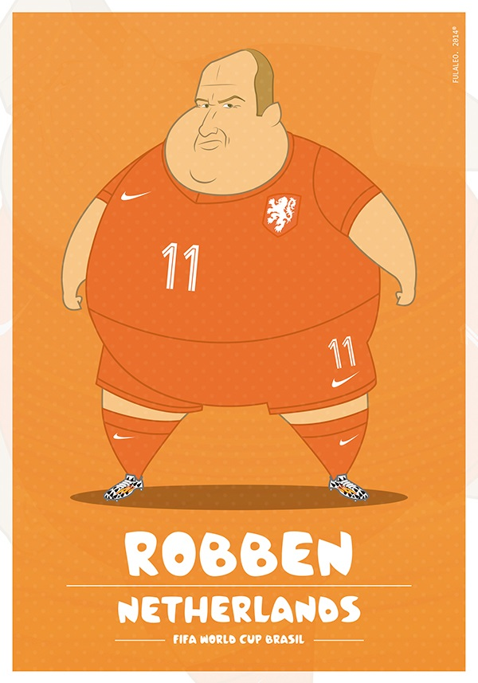
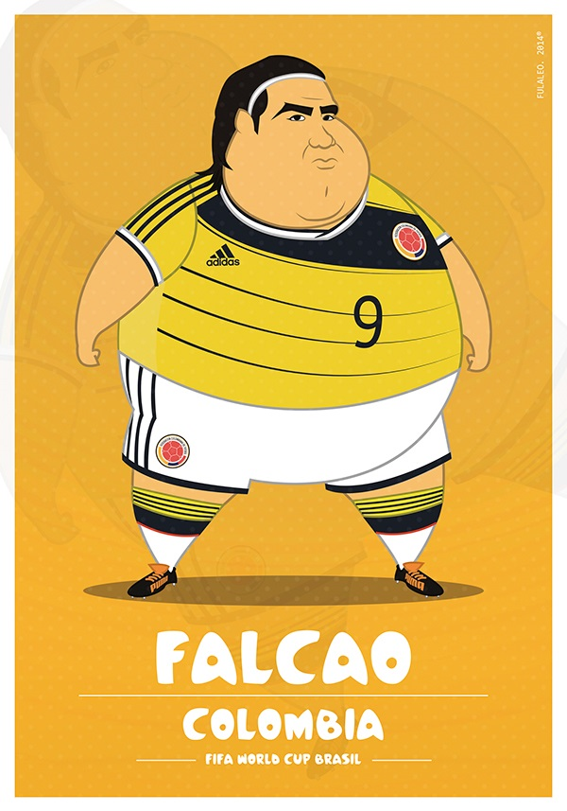
Fat Players FIFA World Cup
Erkan Biçici erkn9@hotmail.com erkanbcc@gmail.com 30.09.2016

Slide 12
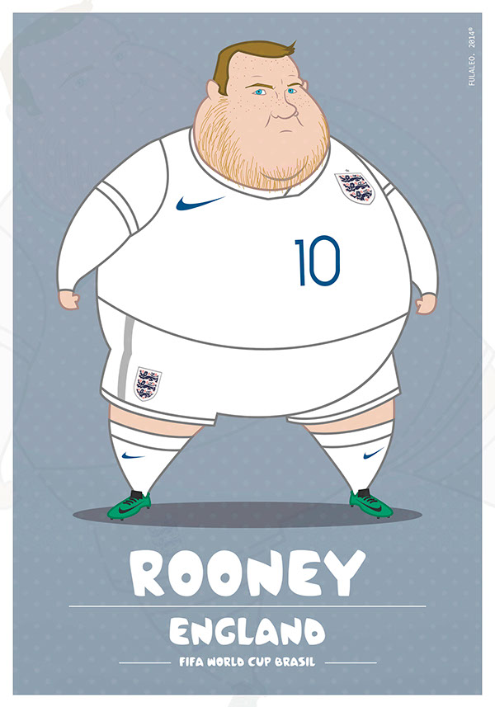
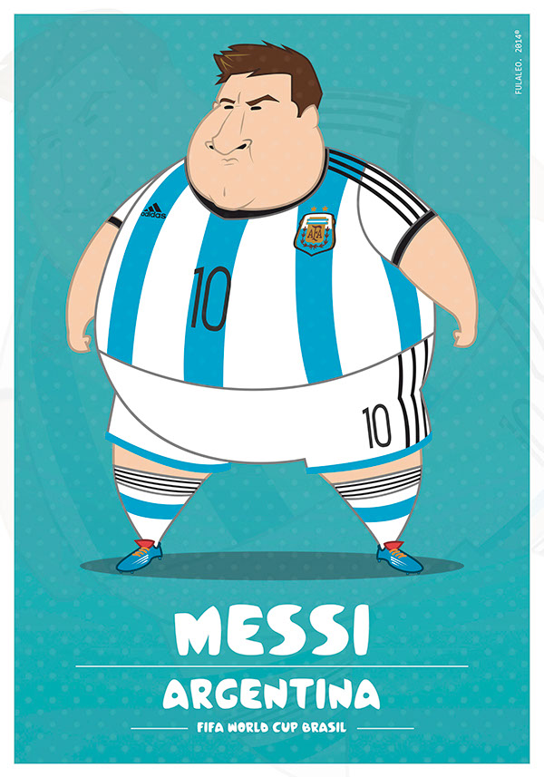
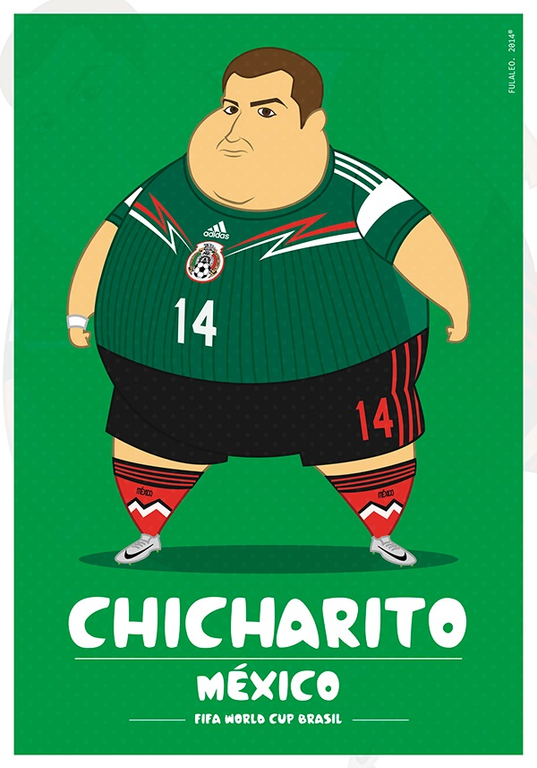
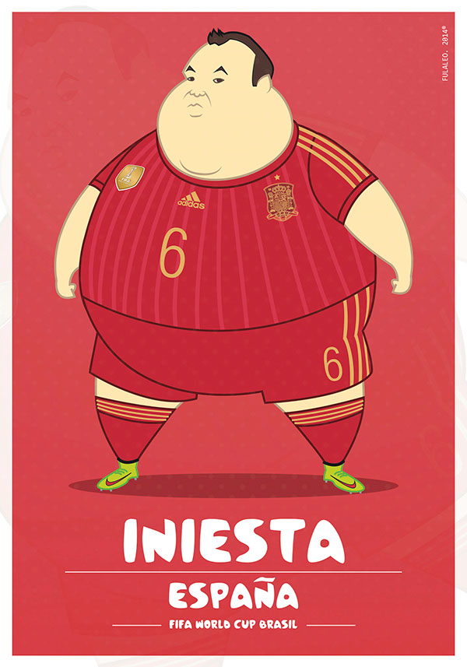
Fat Players FIFA World Cup
Erkan Biçici erkn9@hotmail.com erkanbcc@gmail.com 30.09.2016

Slide 13
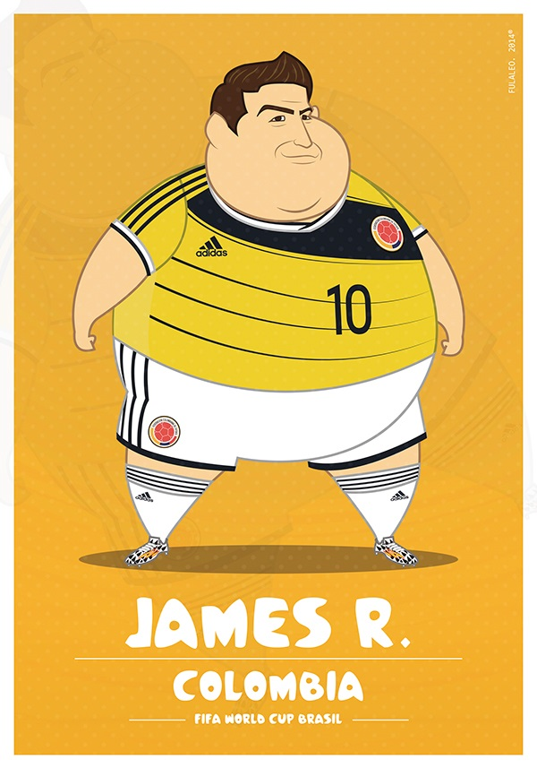
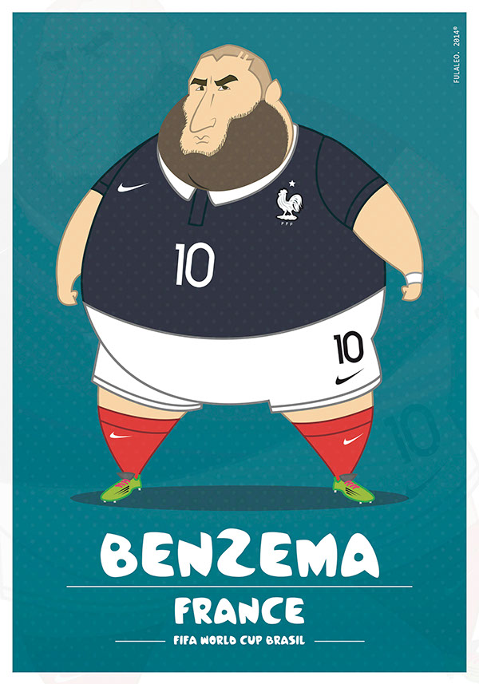
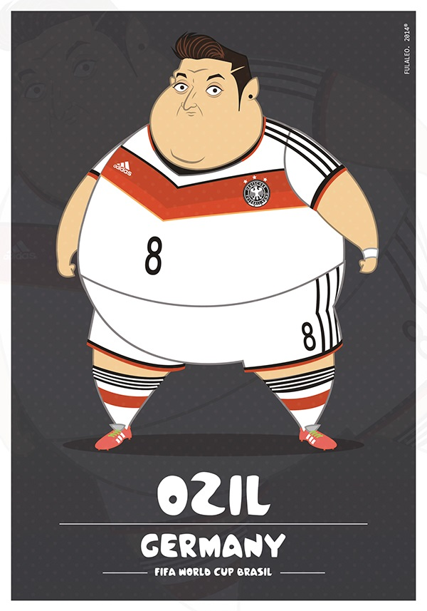

Fat Players FIFA World Cup
Erkan Biçici erkn9@hotmail.com erkanbcc@gmail.com 30.09.2016
the game ended

