Slide 1
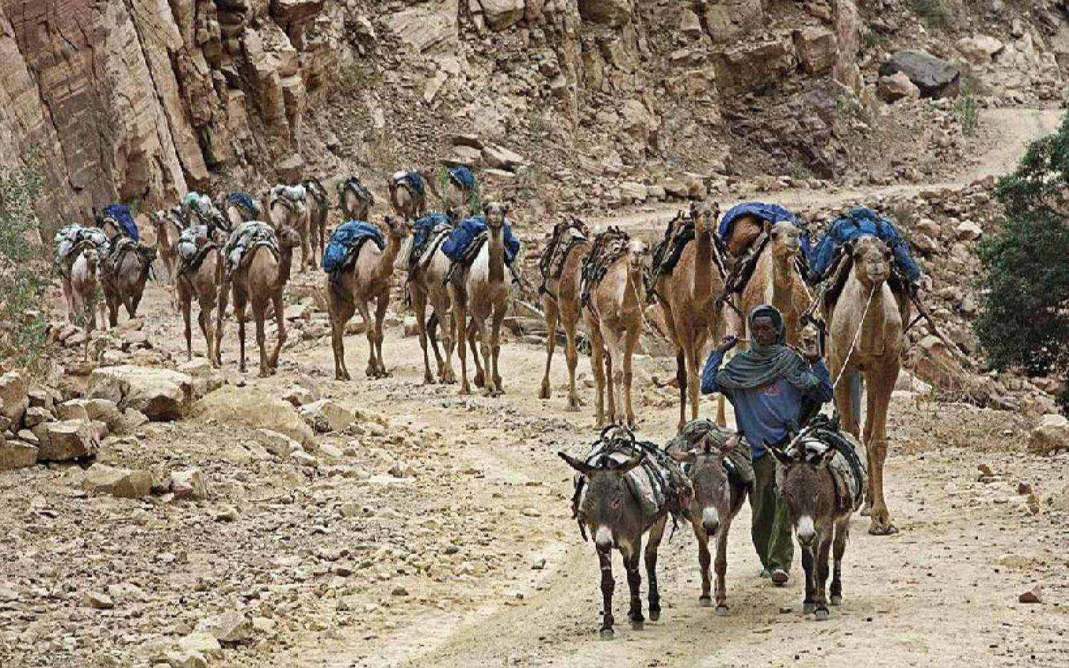

Ethiopia's Ancient Salt Trade

Slide 2
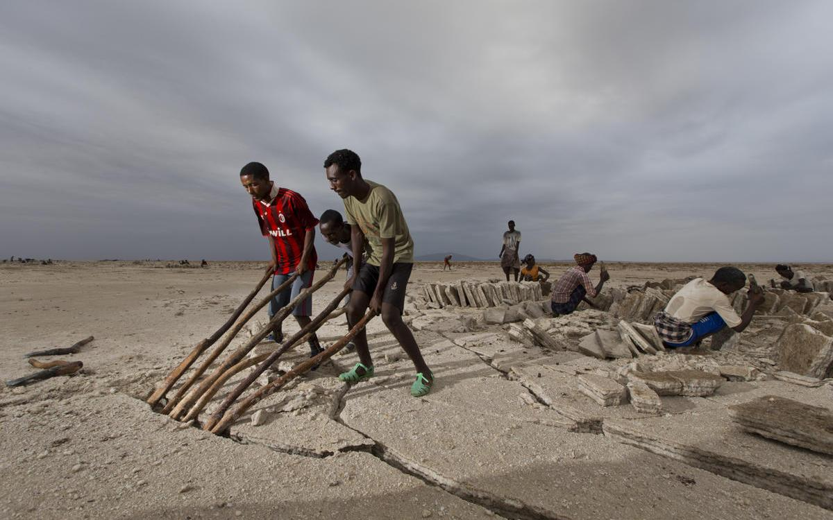
Workers mining salt at the quarry. (Ziv Koren/Polaris)

Slide 3
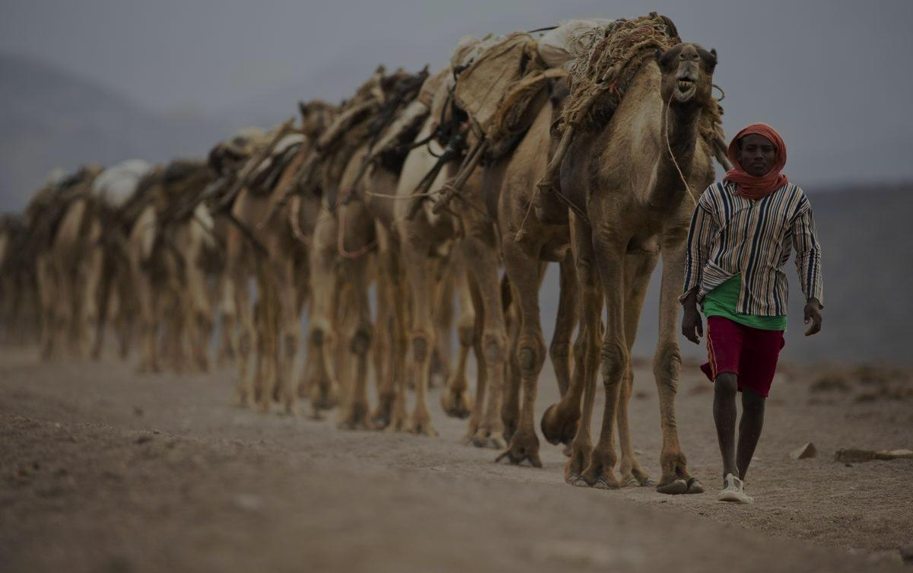
Sparkling slabs of the 'white gold' at the heart of Ethiopia's ancient salt trade form patterns in a vast desert basin in this incredible image.
For centuries Ethiopians have made the long trek to the Danakil Depression - one of the hottest and harshest environments in the world - to collect salt from the sun-blasted earth before transporting the slabs back by camel.
But a tradition that has continued for hundreds of years could be set to change beyond recognition, with the construction of a paved road cutting through the Danakil Depression. --Daily Mail

Slide 5
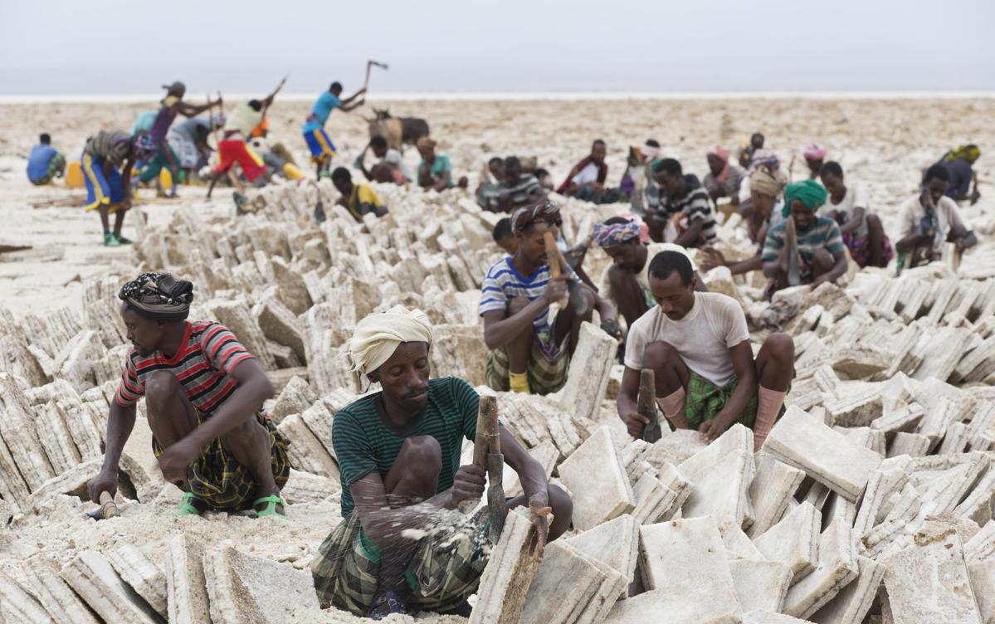
Workers mining salt at the quarry. (Ziv Koren/Polaris)

Slide 6
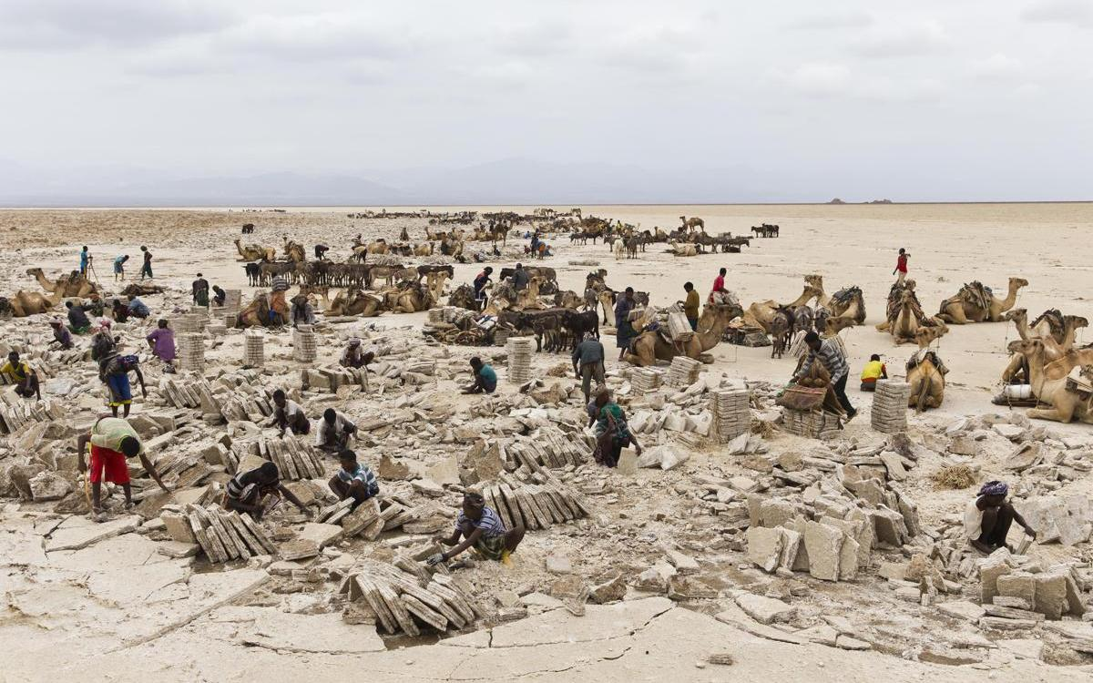
Workers mining salt at the quarry. (Ziv Koren/Polaris)

Slide 7
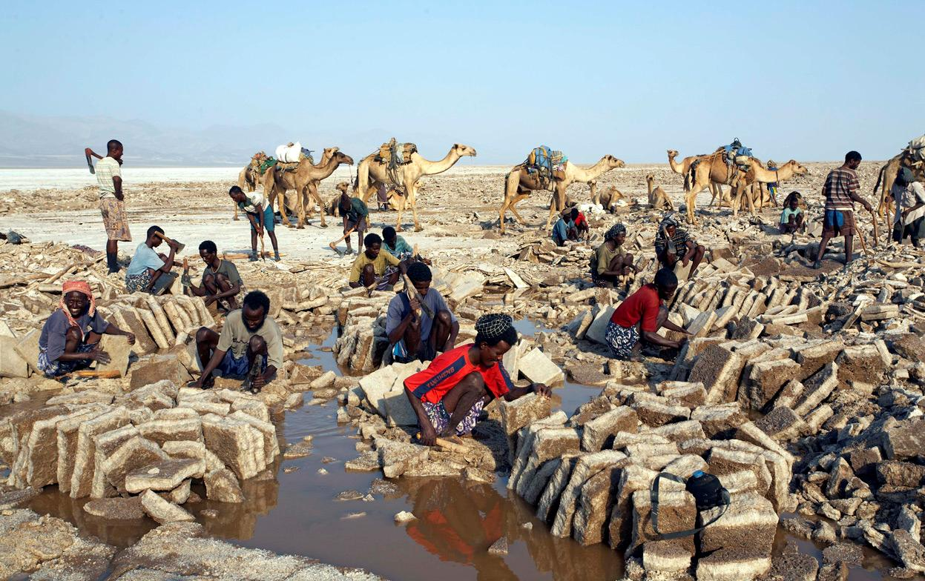
A camel caravan at the edge of the salt pan in Ethiopia's Danakil depression, near Dallol volcano.(Reuters/Michel Laplace-Toulouse)

Slide 8
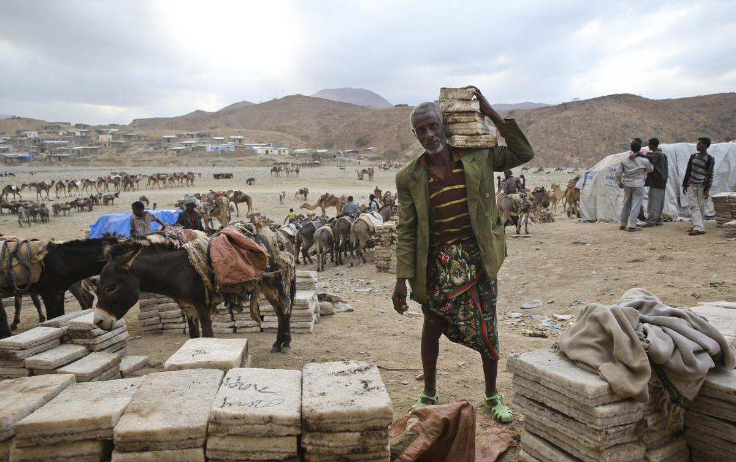
Unloading salt slabs in Berahile. (Ziv Koren/Polaris)

Slide 9
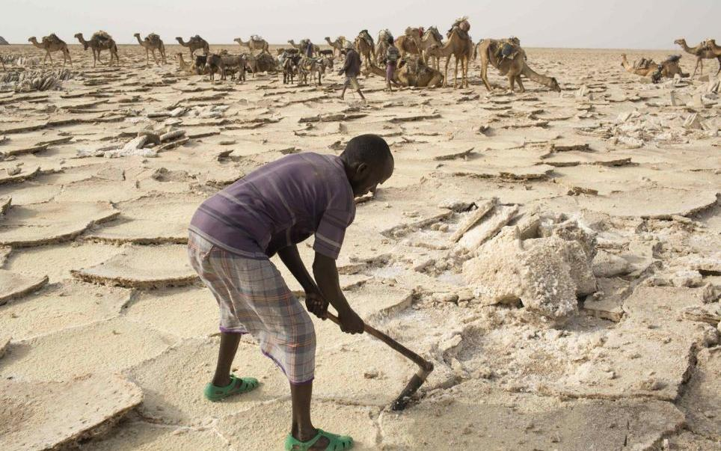
Mining: A worker sets about extracting salt from the desert in the Danakil Depression in northern Ethiopia, which has an average annual temperature of 94F (34.4C)

Slide 10
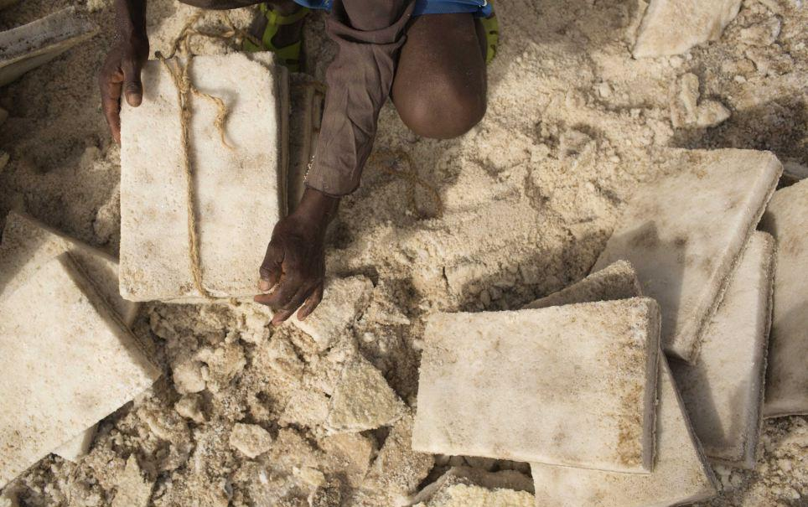
Manual work: A worker ties together slabs of salt that have been extracted from the sun-blasted earth in the vast Danakil Depression/ Reuters

Slide 11
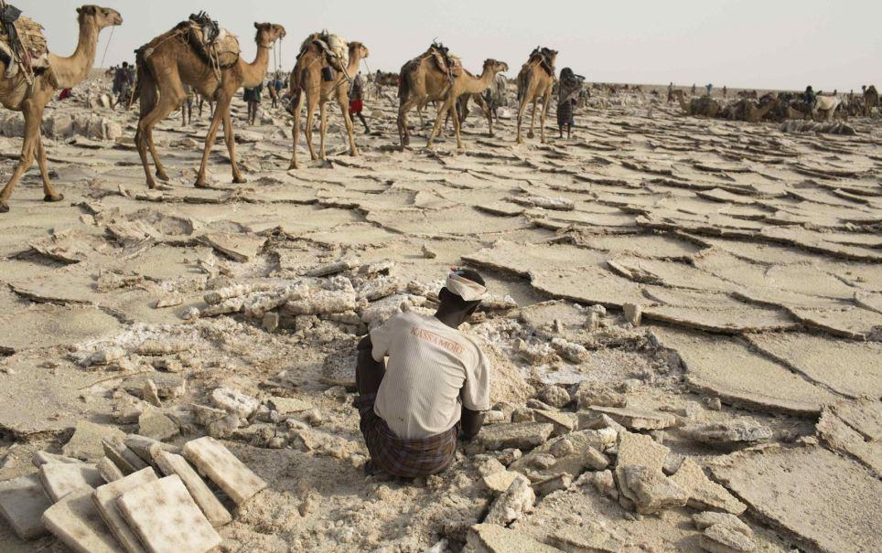
Arid: A man extracts salt from the desert in the Danakil Depression, where rain never falls and average annual temperatures creep towards 100F/ Reuters

Slide 12
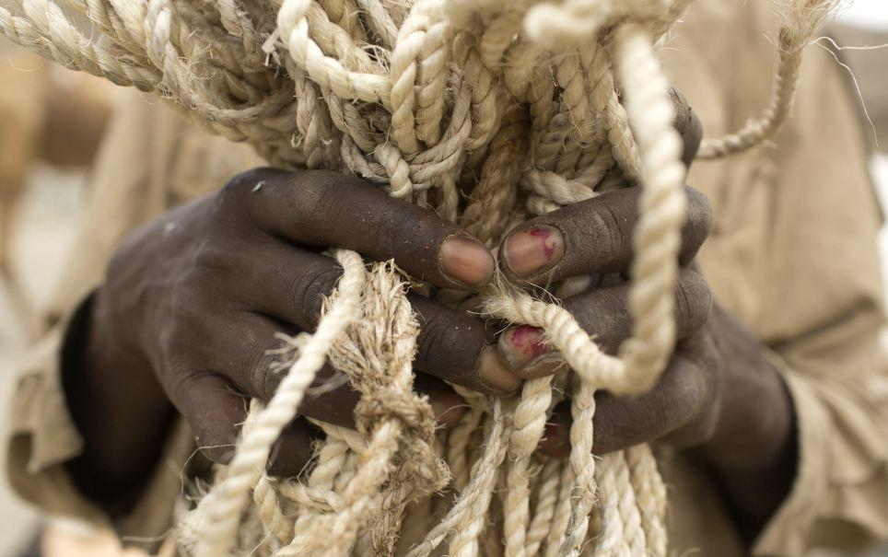
African tradition: A camel herder and salt merchant clutches rope in the Danakil Depression, the unforgiving region at the heart of Ethiopia's ancient salt trade/ Reuters

Slide 13
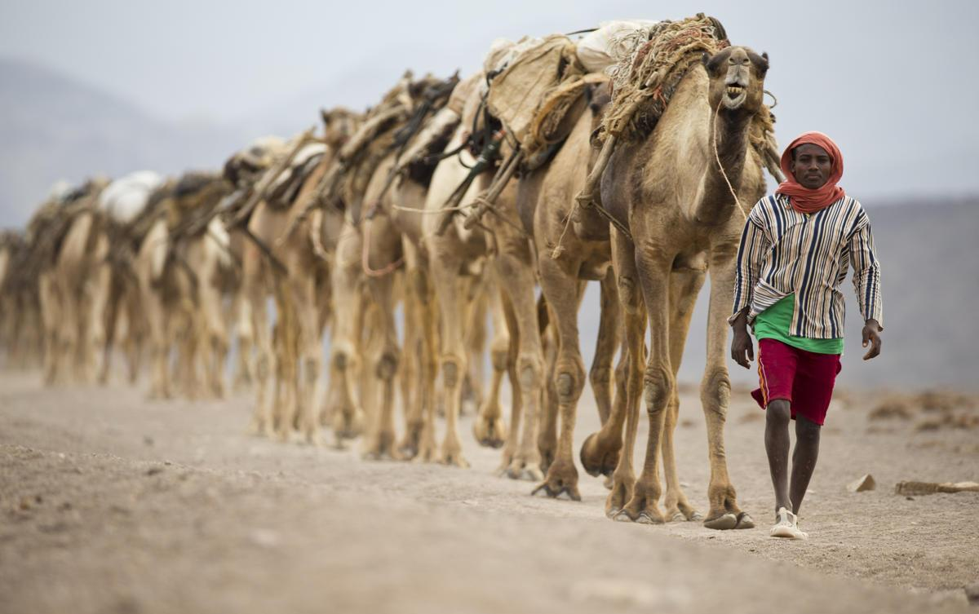
Camel caravans are used for carrying salt through the Danakil desert in the Afar Triangle. (Ziv Koren/Polaris)

Slide 14
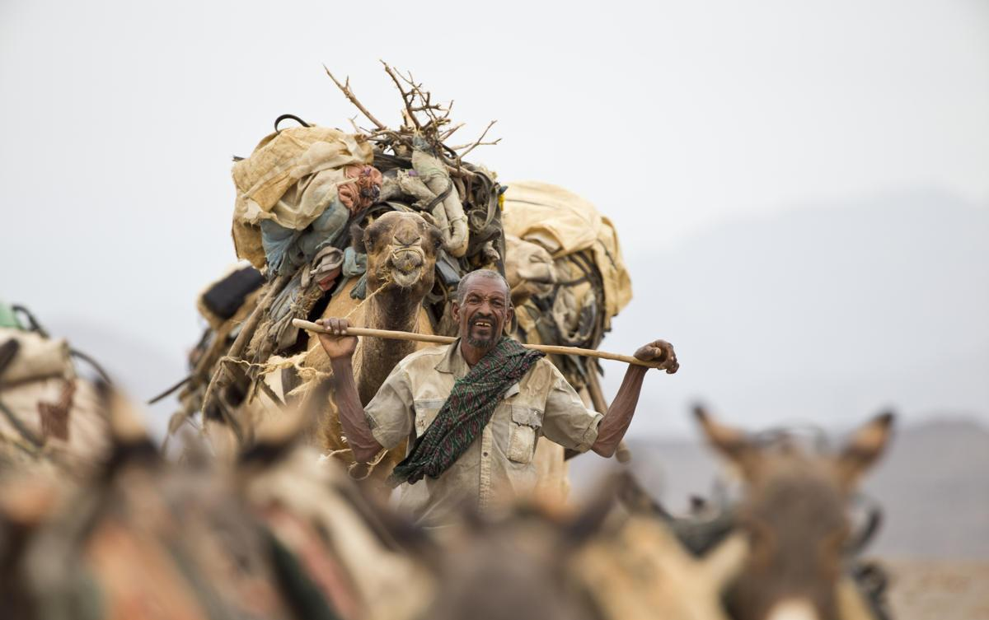
(Ziv Koren/Polaris)

Slide 15
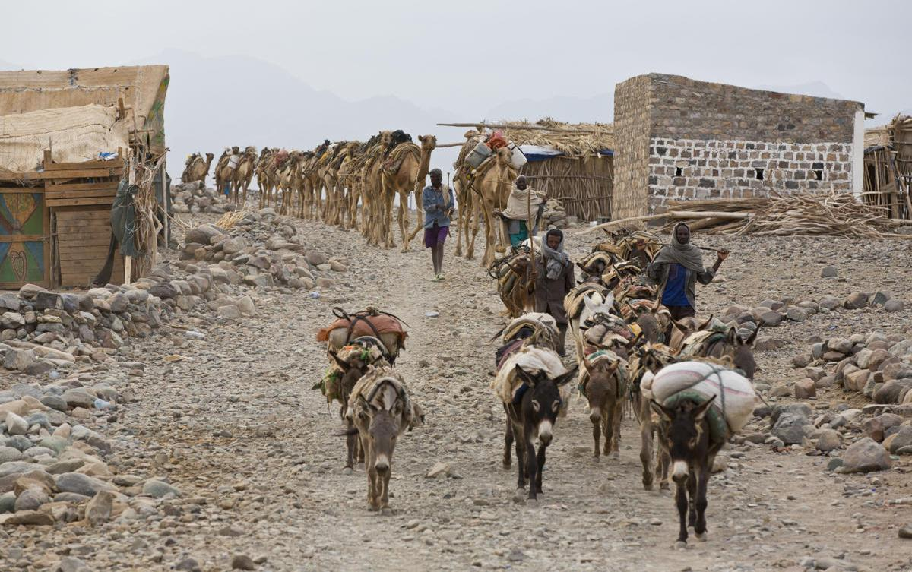
Danakil Desert, Ethiopia, Africa: An isolated village on the road of the camel caravans used for carrying salt through the Danakil desert in the Afar Triangle. (Ziv Koren/Polaris)

Slide 16
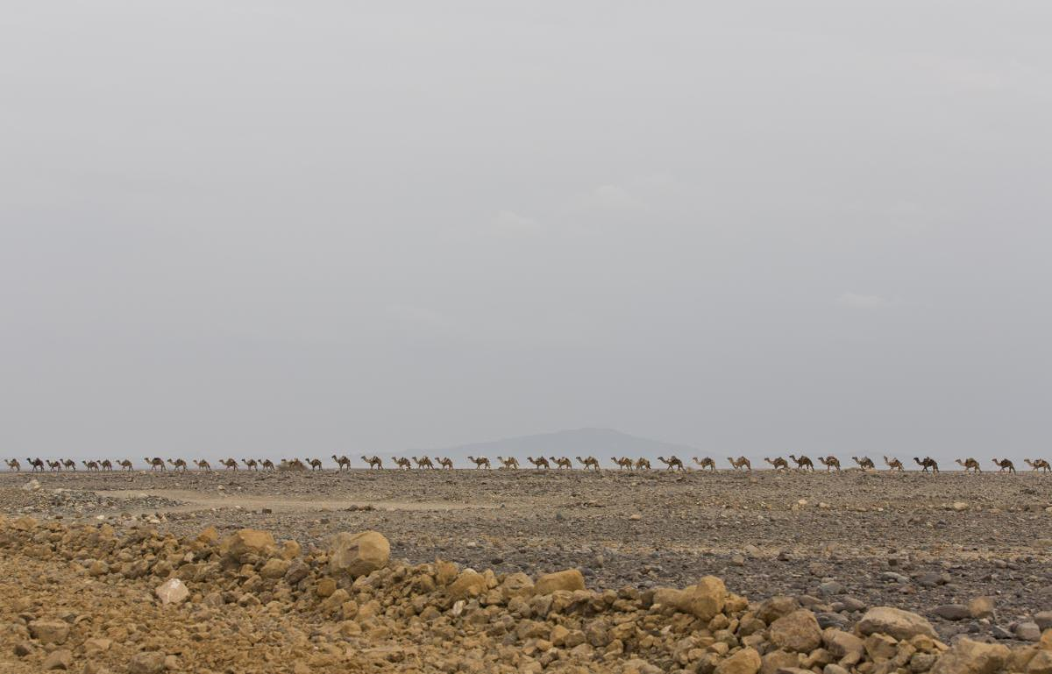
(Ziv Koren/Polaris)

Slide 17
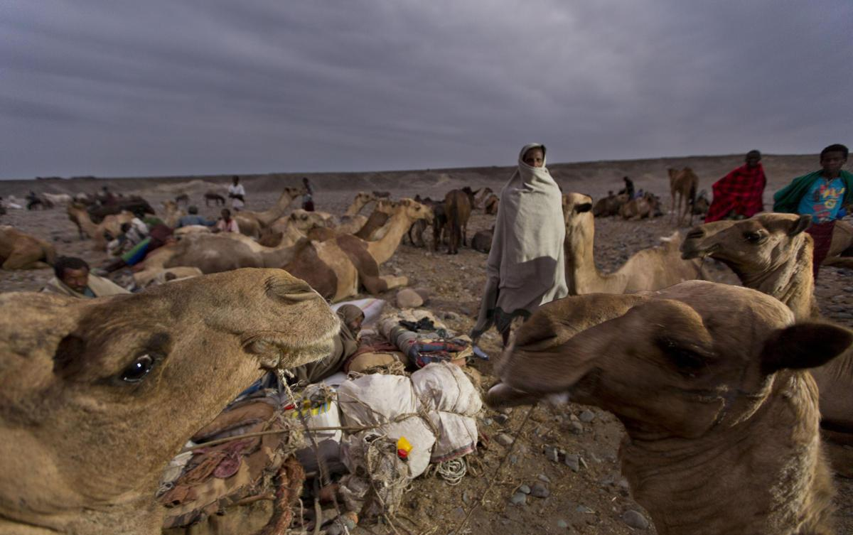
Salt merchants rest for the night in a canyon during their journey to and from the Danakil Depression. (Ziv Koren/Polaris)

Slide 18
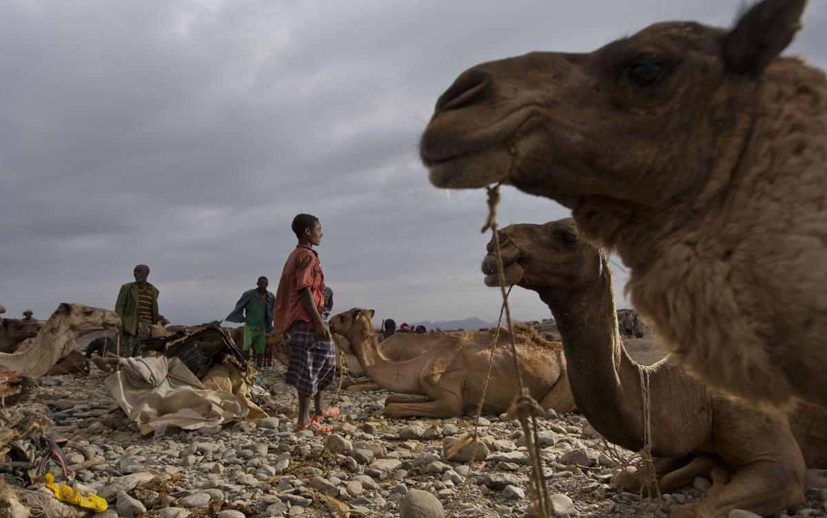
Salt merchants rest for the night in a canyon during their journey to and from the Danakil Depression. (Ziv Koren/Polaris)

Slide 19
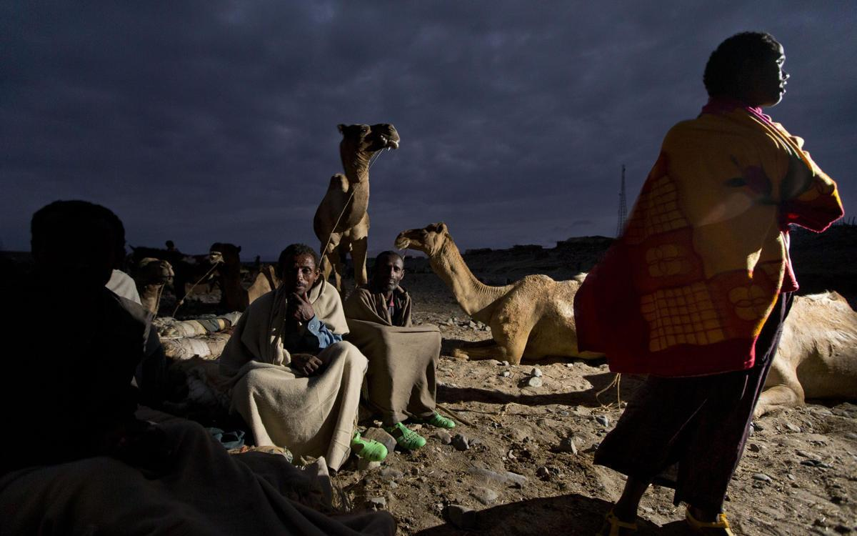
Salt merchants rest for the night in a canyon during their journey to and from the Danakil Depression. (Ziv Koren/Polaris)

Slide 20
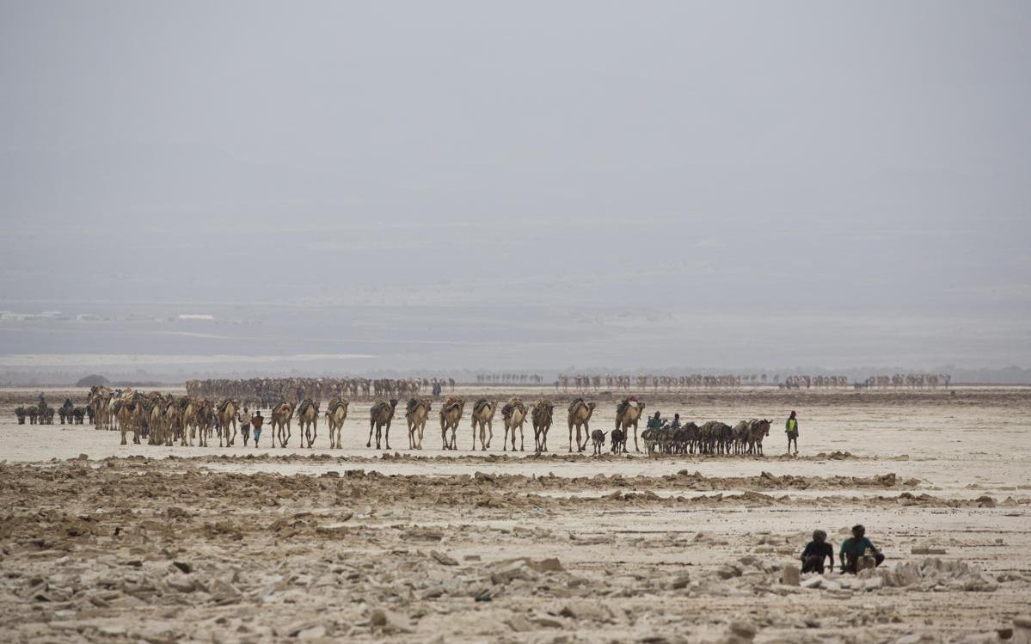
Camel caravans are used for carrying salt through the Danakil desert in the Afar Triangle. (Ziv Koren/Polaris)

Slide 21
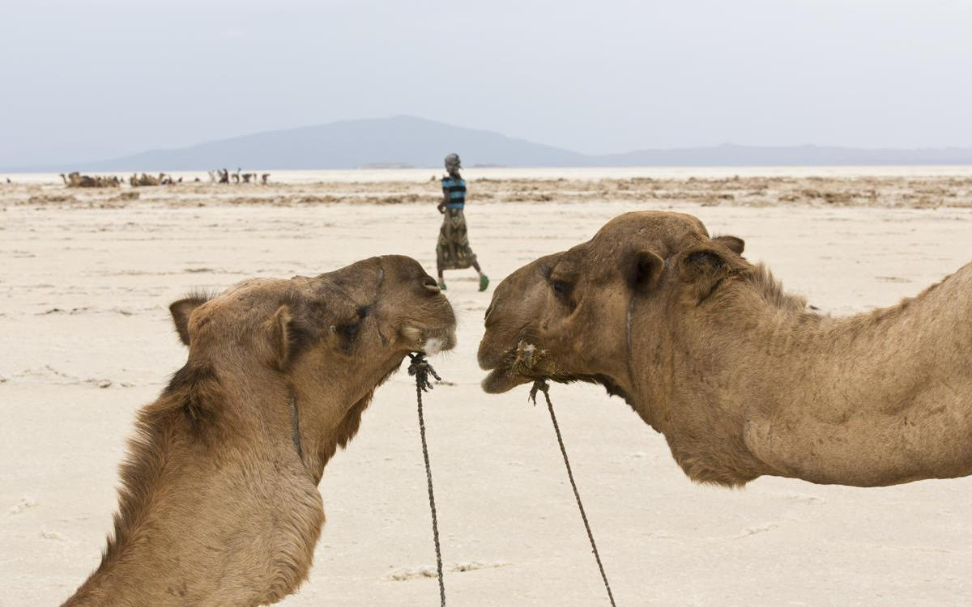
Camels in the Danakil desert in the Afar Triangle. (Ziv Koren/Polaris)

Slide 22
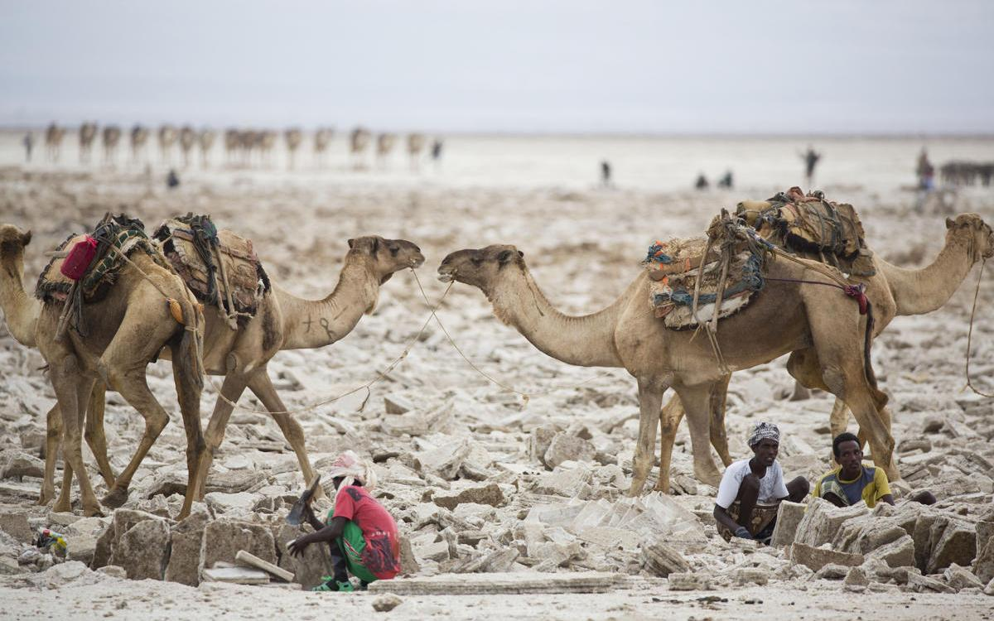
Workers mining salt at the quarry. (Ziv Koren/Polaris)

Slide 23
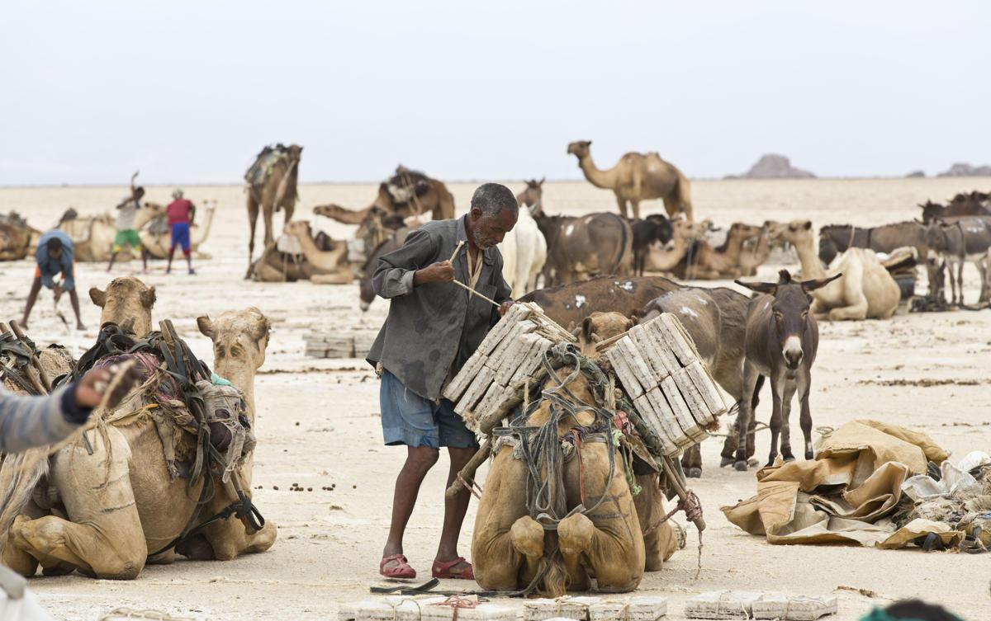
Camel caravans are used for carrying salt through the Danakil desert in the Afar Triangle. (Ziv Koren/Polaris)

Slide 24
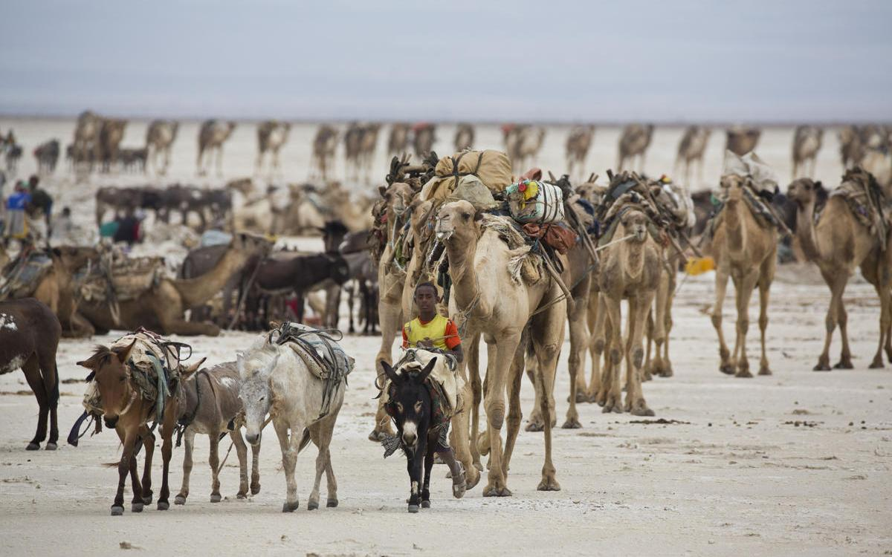
Camel caravans are used for carrying salt through the Danakil desert in the Afar Triangle. (Ziv Koren/Polaris)

Slide 25
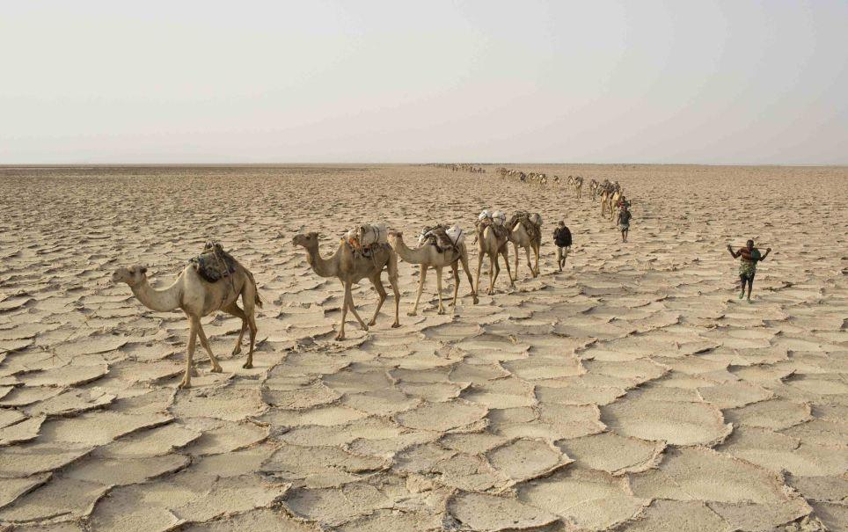
Danakil Depression: Once the merchants find a suitable place to mine, they extract, shape and pack as many salt slabs as possible before embarking on the two-day journey back to the town of Berahile/ Reuters

Slide 26
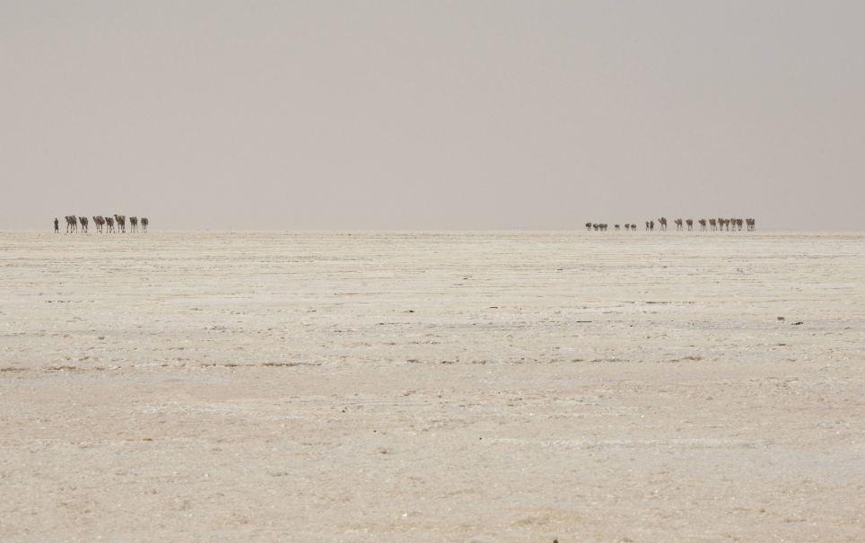
Lonely landscape: A camel caravan loaded with slabs of salt can be seen making its way back to civilisation from the Danakil Depression in the north of the African country/ Reuters

Slide 27
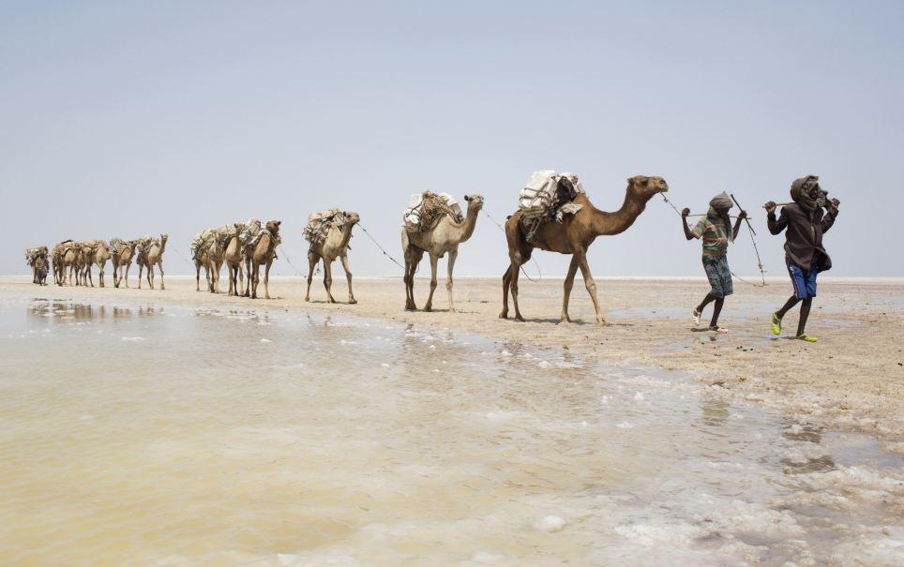
Arduous trek: Camel caravans and journeyed to and from the remote Ethiopian salt desert in this way for hundreds of years/ Reuters

Slide 28
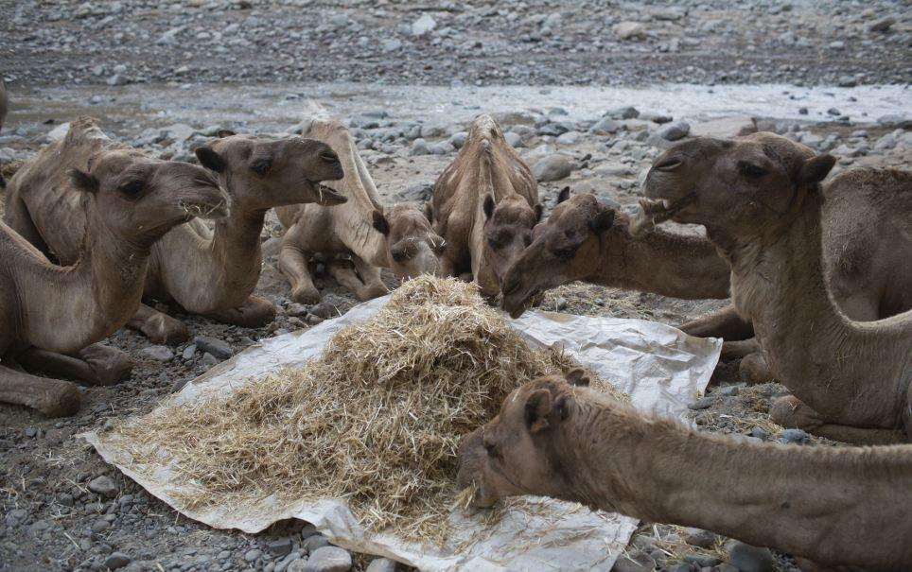
Feeding time: Miners who have relied on camels to make the long journey to the salt desert for centuries fear a planned road making the region more accessible could threaten their ancient/ Reuters

Slide 29
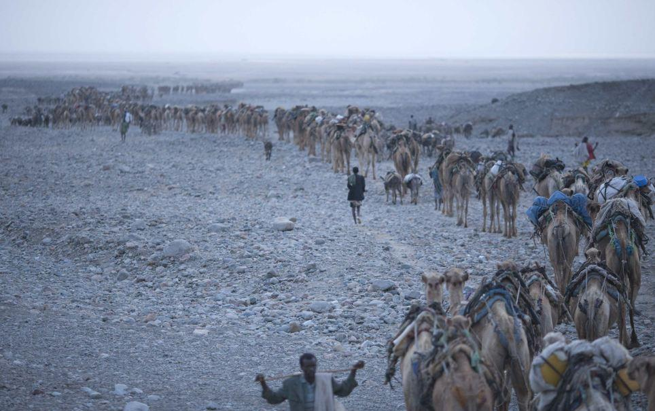
Changing times: Camel caravans have been making the journey to the Danakil Depression for hundreds of years, but construction is now underway on a tarmac road through the desert basin/ Reuters

Slide 30
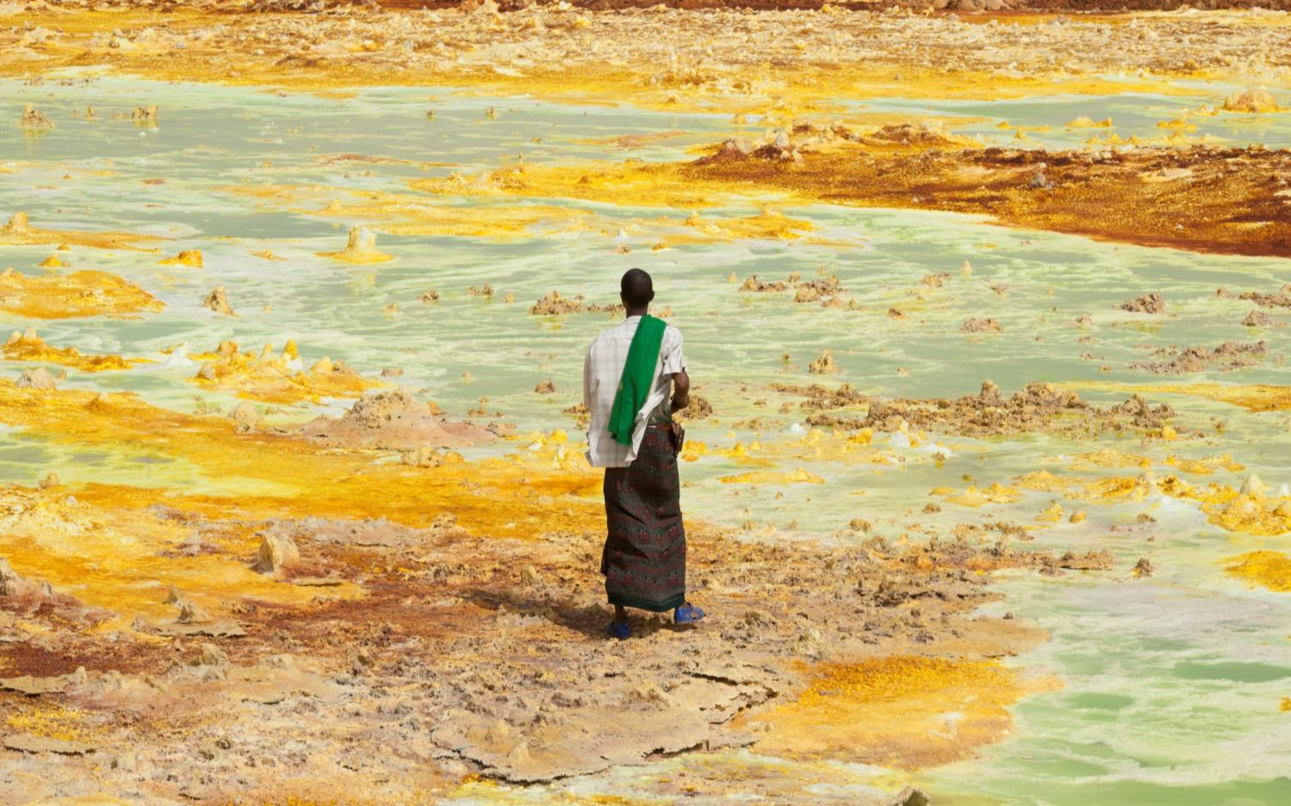
The Danakil Depression is one of the lowest points on Earth that is not covered in water. Geologists believe that in 10 million years, this searing desert will once again be submerged under water.

Slide 31
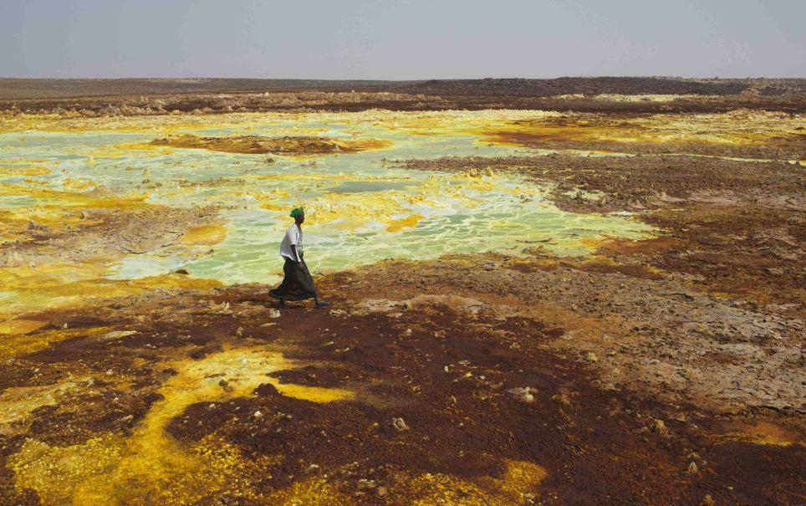
Unforgiving environment: A man walks along sulphur and mineral salt formations near Dallol inthe Danakil Depression, northern Ethiopia, where merchants have been travelling for centuries to collect salt from the vast desert basin

Slide 32
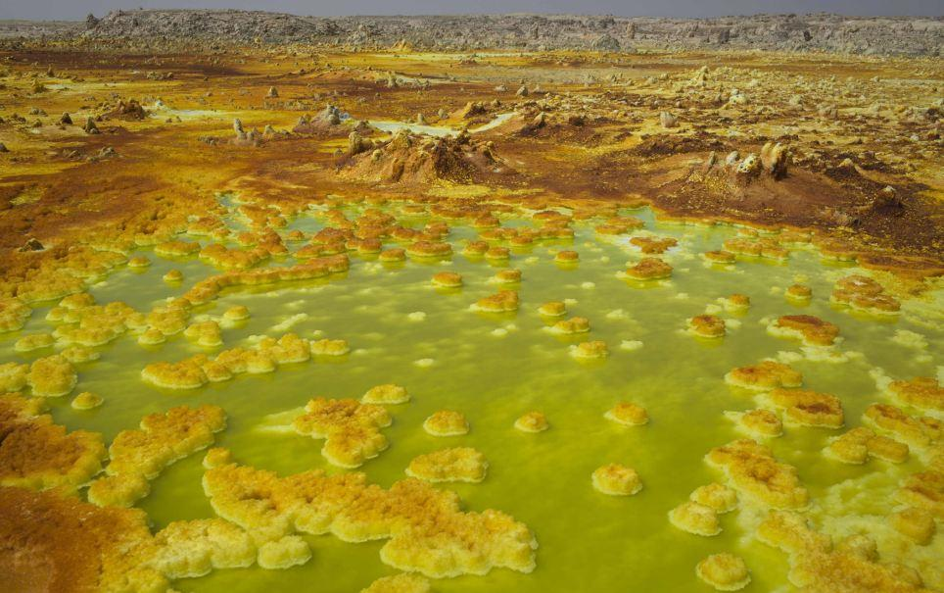
Other-worldly: Swirling sulphur and mineral salt formations can be seen in the Danakil Depression, one of the hottest and harshest environments on earth/ Reuters

Slide 33
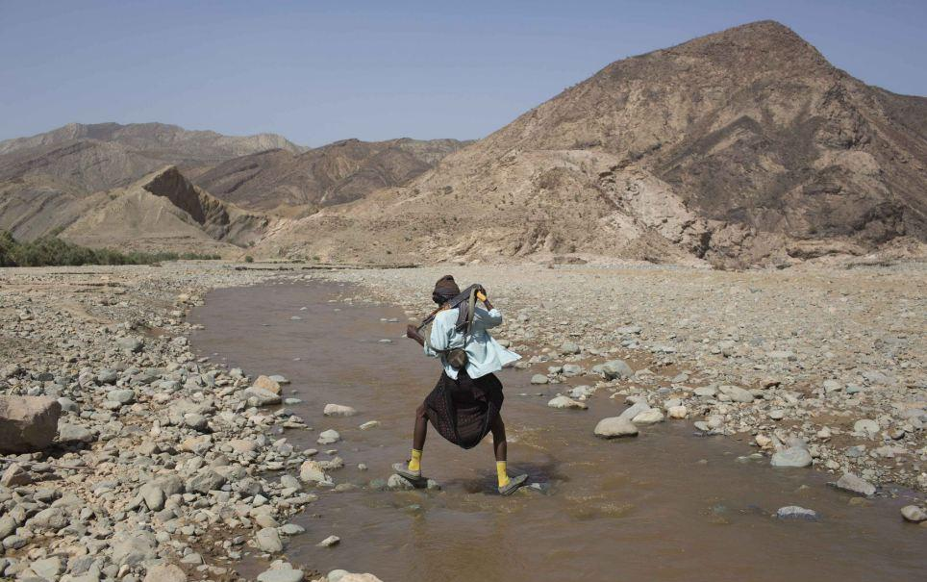
Solitary trek: An armed Afar man steps on rocks as he crosses a river close to the Danakil Depression in Ethiopia/ Reuters

Slide 34
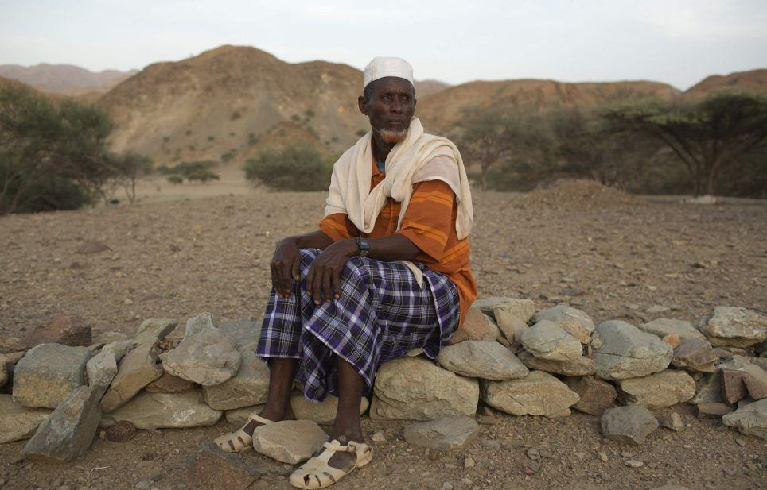
Years of journeys: Abu Ibrahim Mohammed, a retired salt merchant, was 15 years old when he first began trekking with caravans of camels to the desert basin in northern Ethiopia/ Reuters

Slide 35
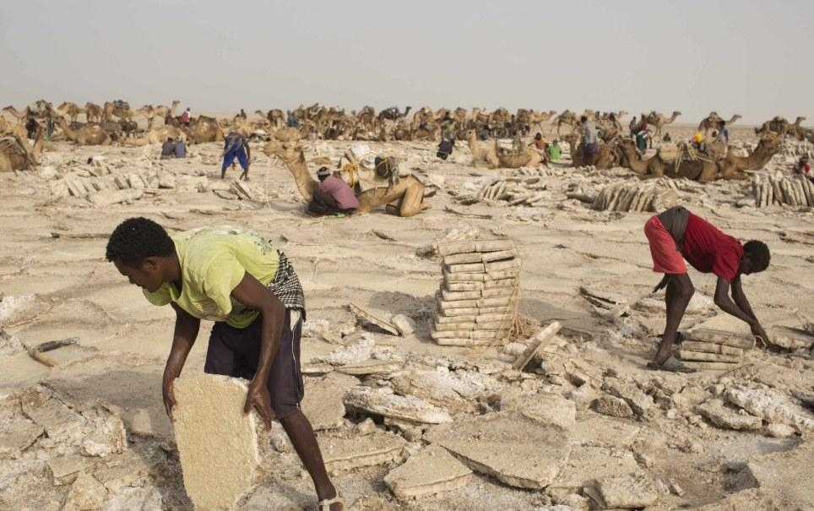
Toiling in the heat: Miners extract salt before shaping and packing the slabs, loading up their camels and preparing for the long, slow trek across the vast desert basin back to the nearest town. / Reuters

Slide 36
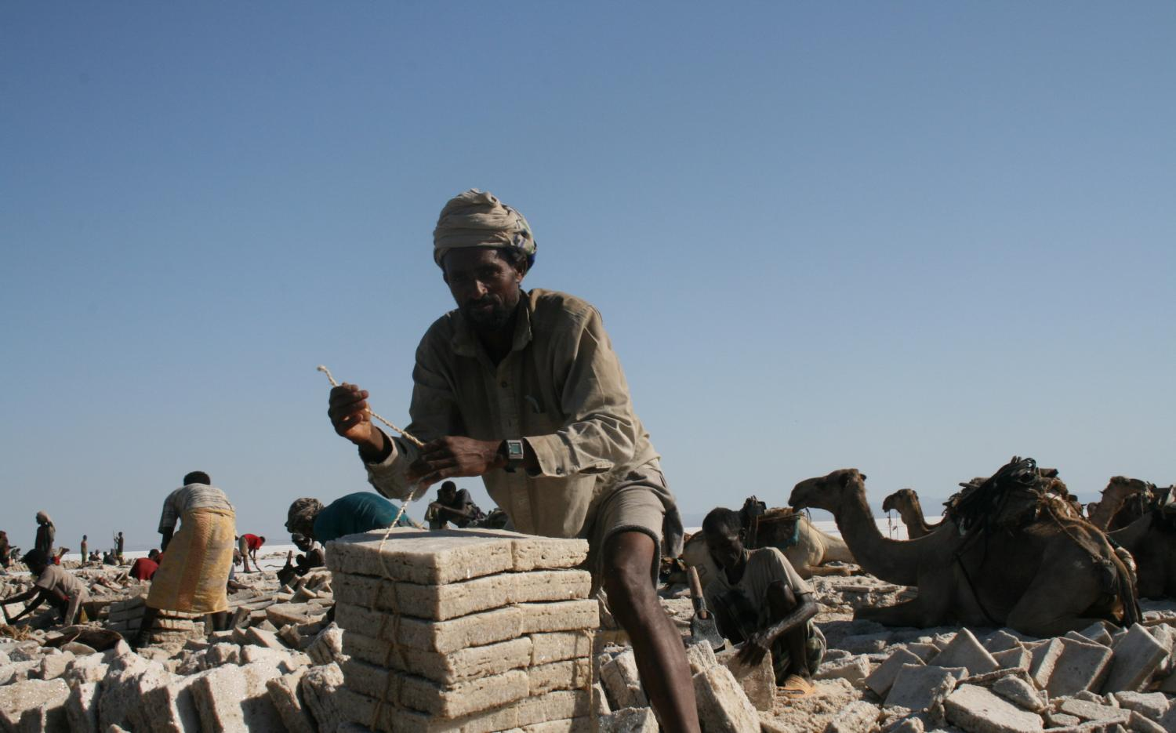

Slide 37
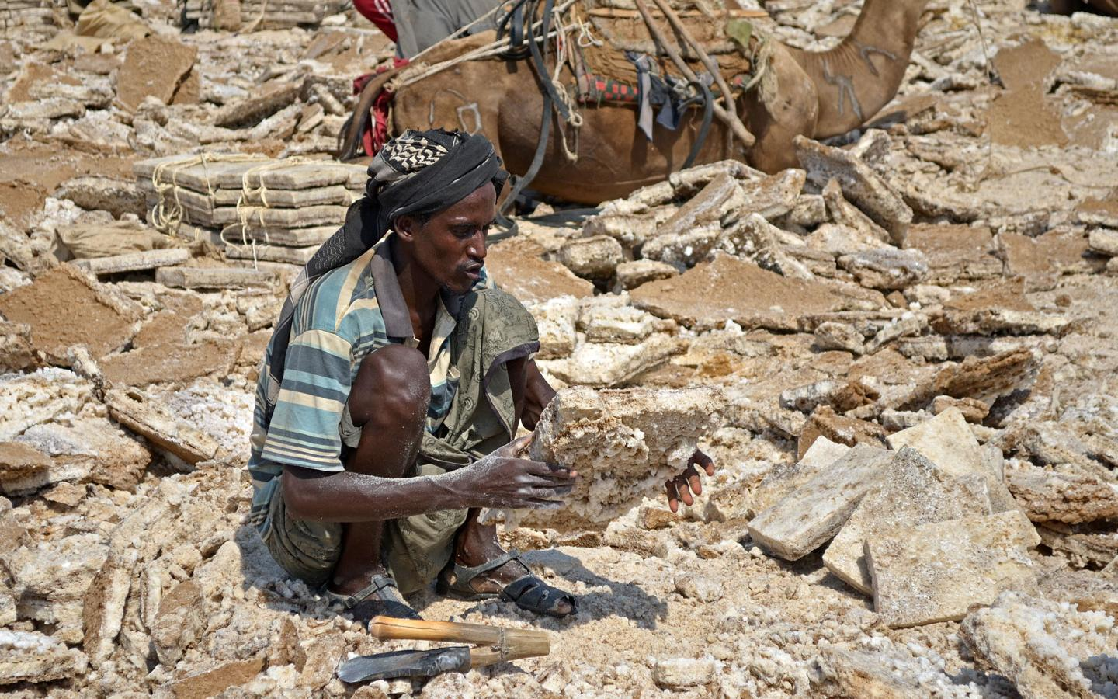
The Afar use axes and long sticks to break the salt crust and lift up large slabs. Unfortunately, they were not doing it , they were cutting up the large slabs into market sized blocks.

Slide 38
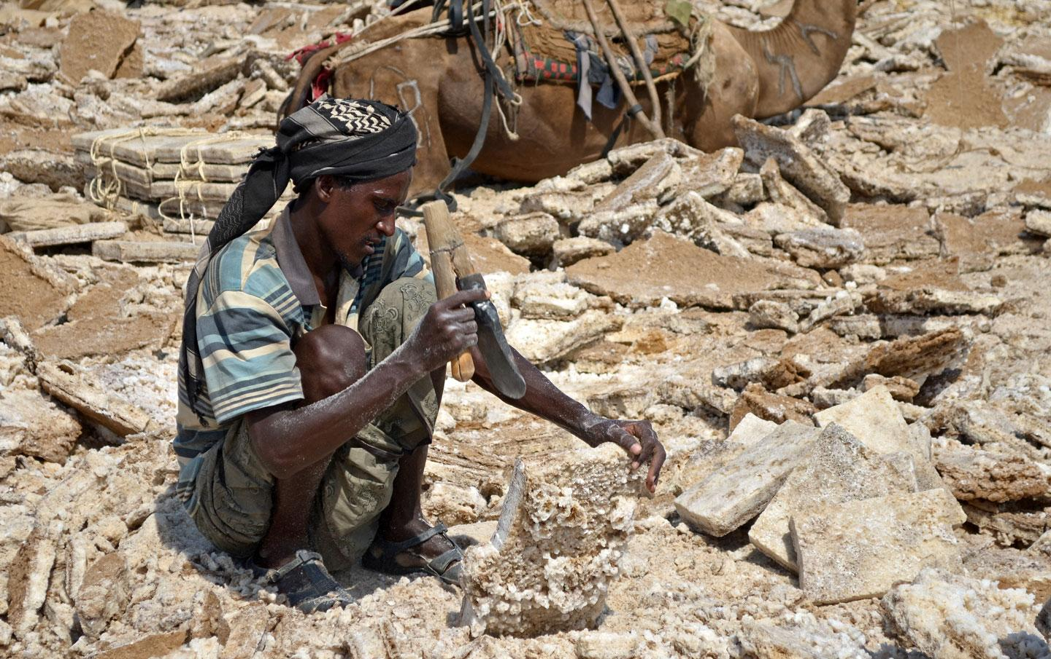
Using homemade tools, they remove the mud layer and then carve the slab into a nice square block, of two or three relatively standard sizes.

Slide 39
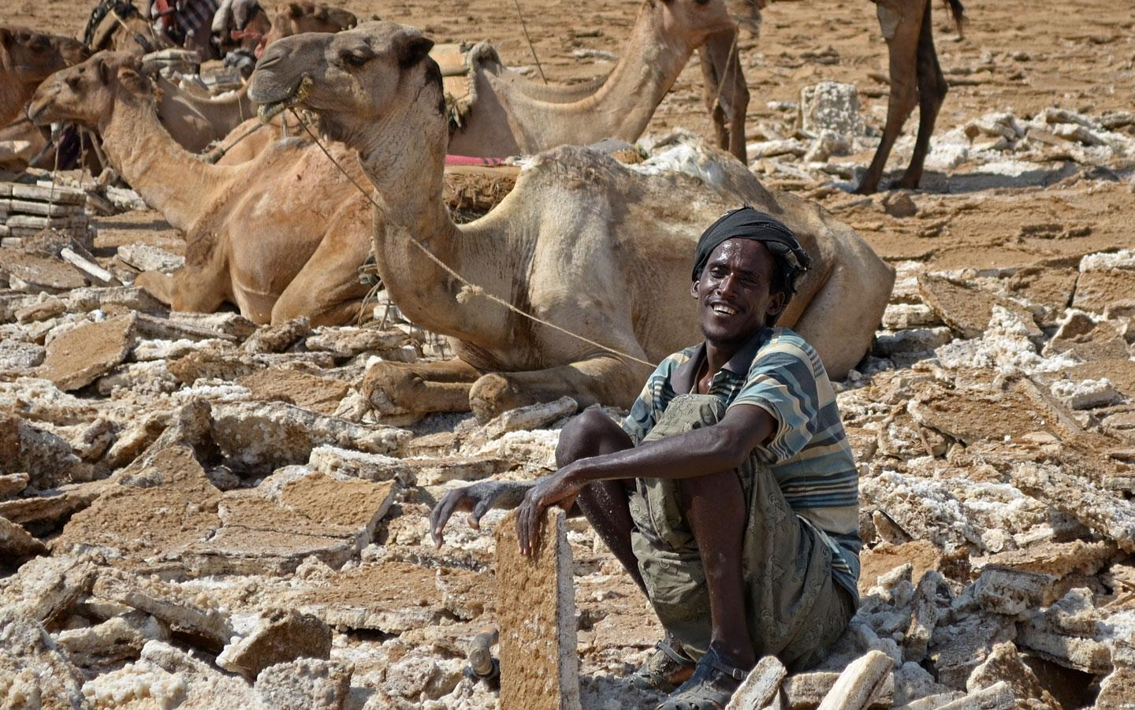
A large block, once completed. It only takes a short time to make one, and they sell it for about 2 Birr ($0.10). Large camels will carry up to forty blocks, donkeys less than half.

Slide 40
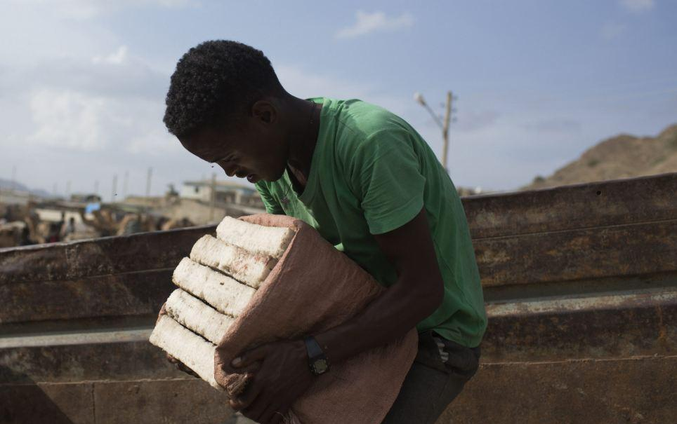
Precious cargo: A young man heaves slabs of salt onto a truck in Berahile in Ethiopia, after the long journey from the Danakil Depression/ Reuters

Slide 41
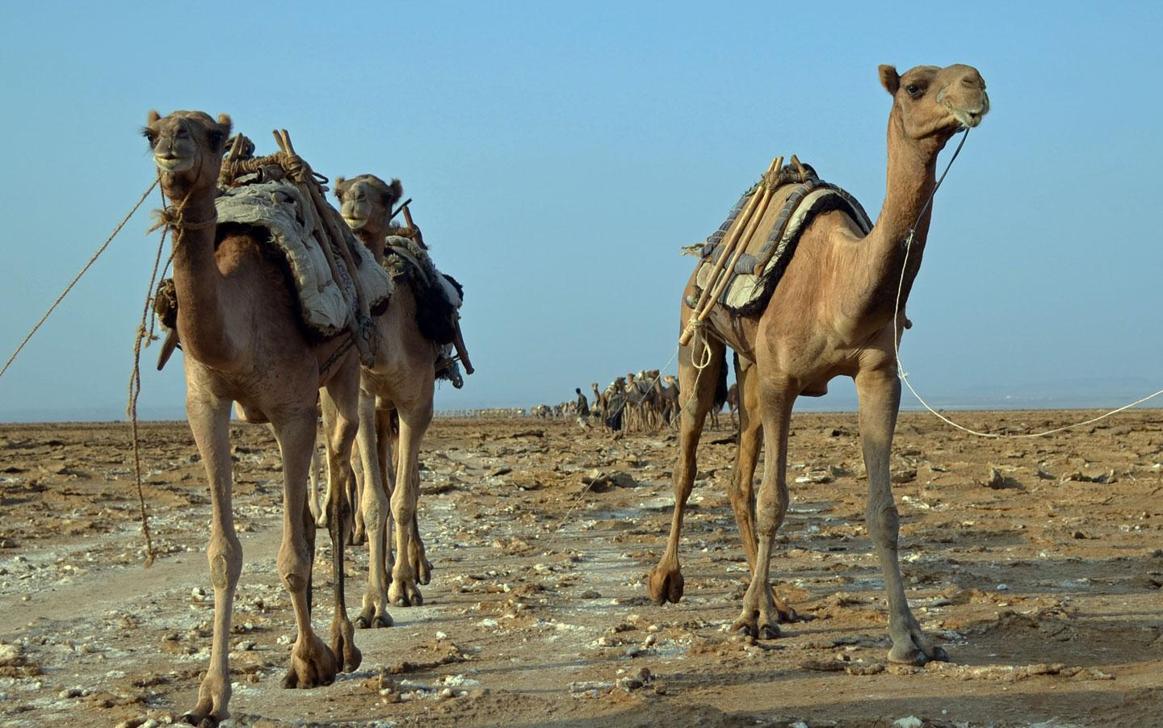
Empty camels, ready to be loaded up with salt blocks.

Slide 42
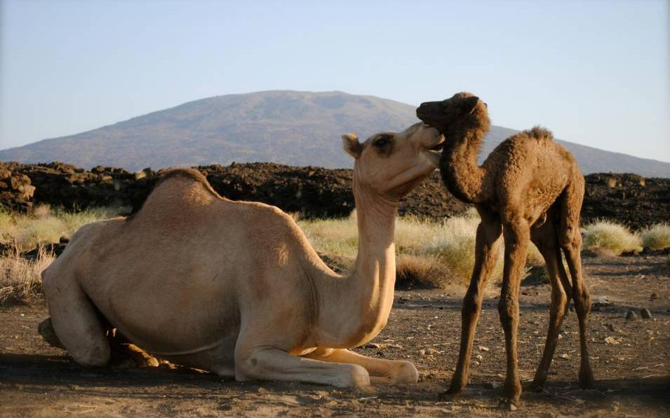

Slide 43
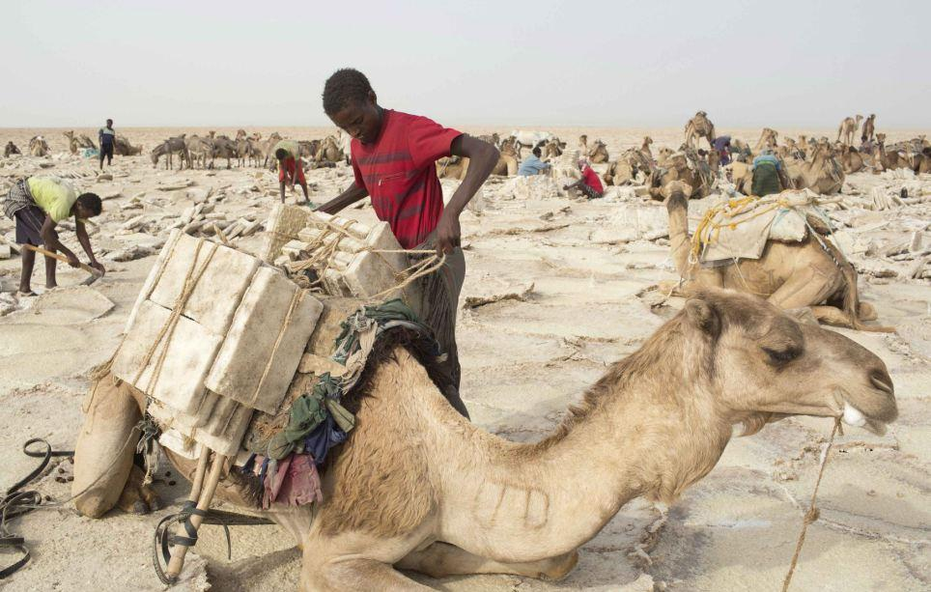
Long journey: A worker loads a camel with slabs of salt in the Danakil Depression in northern Ethiopia, before making the long journey back across the desert basin/ Reuters

Slide 44
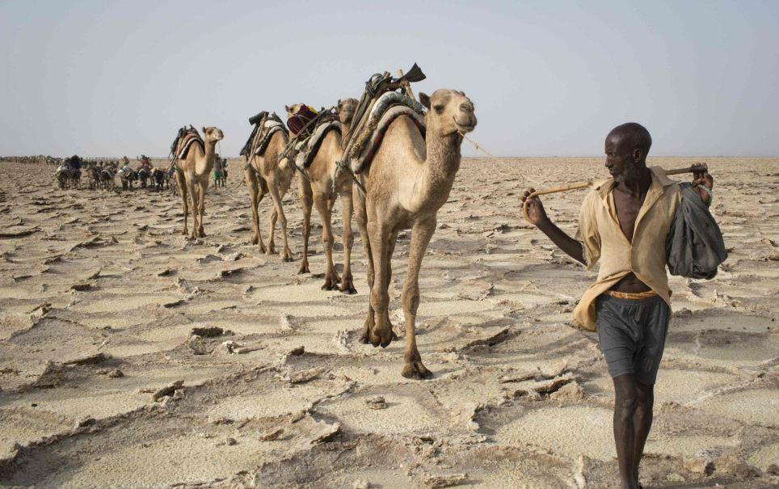
Pack animals: Camels walk in single file behind a salt merchant through the vast, barren landscape/ Reuters

Slide 45
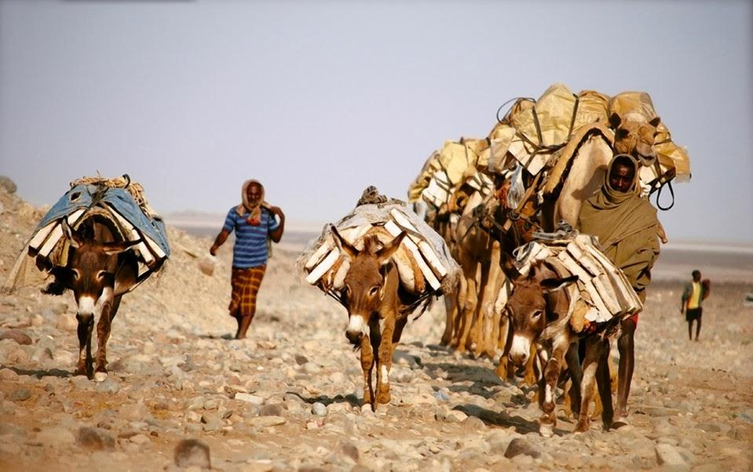

Slide 46
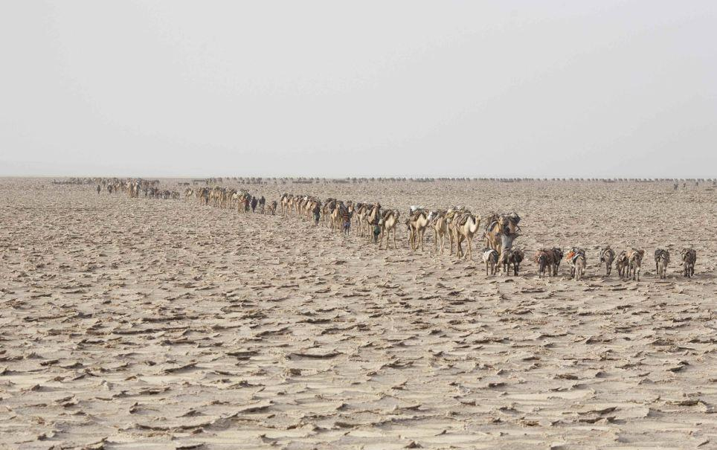
Dry heat: Scores of camels form a caravan to trek across the barren landscape in the African desert

Slide 47
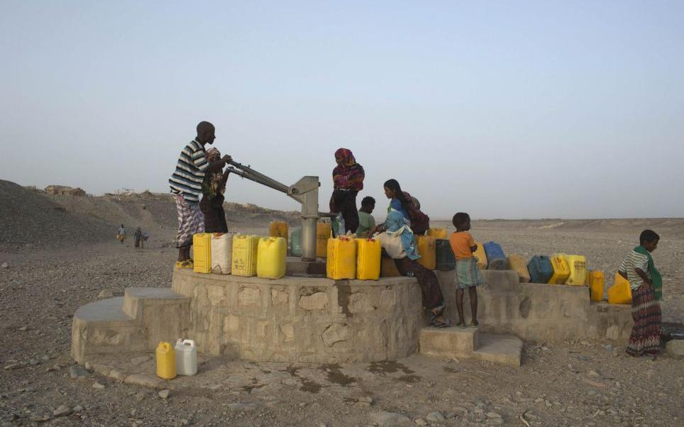
Water source: Young residents of Hamad-Ile pump water from a well in the Danakil Depression/ Reuters

Slide 48
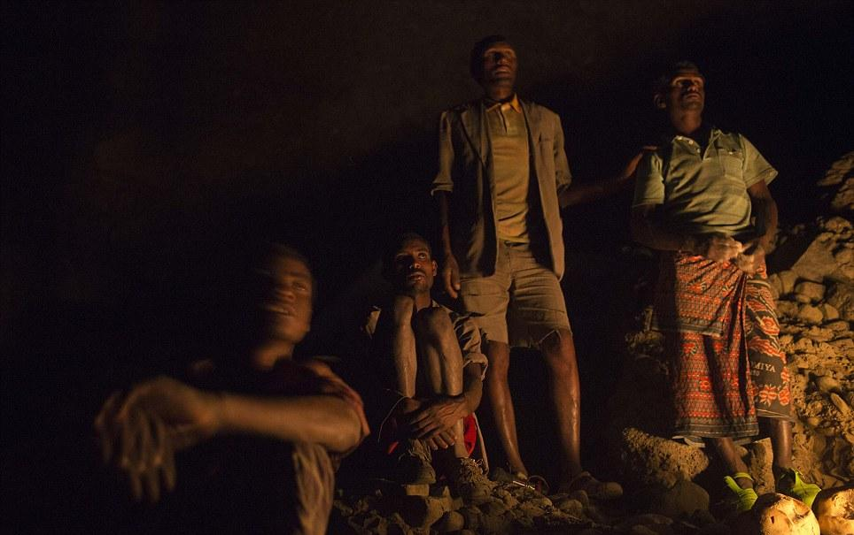
Rest stop: Salt merchants are seen posing for a photograph after they stop to rest for the night in a canyon on their way back to town from the remote salt desert/ Reuters

Slide 49
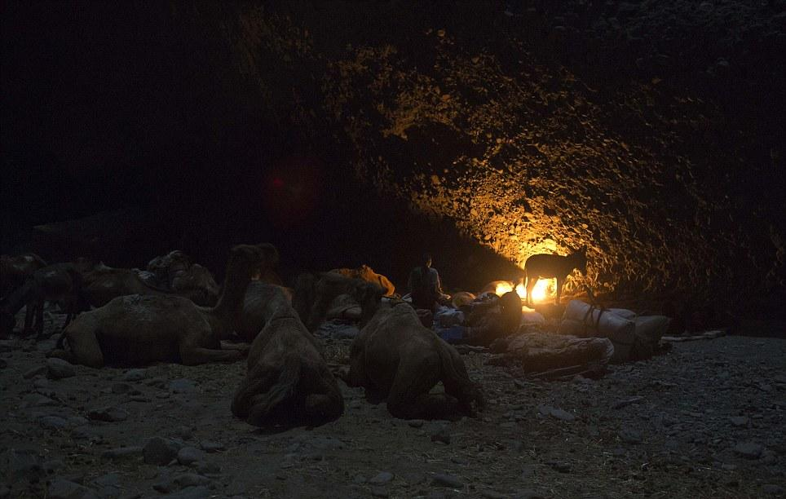
Making camp: Merchants and their pack animals rest side by side as they journey back from extracting salt from the desert basin/ Reuters

Slide 50
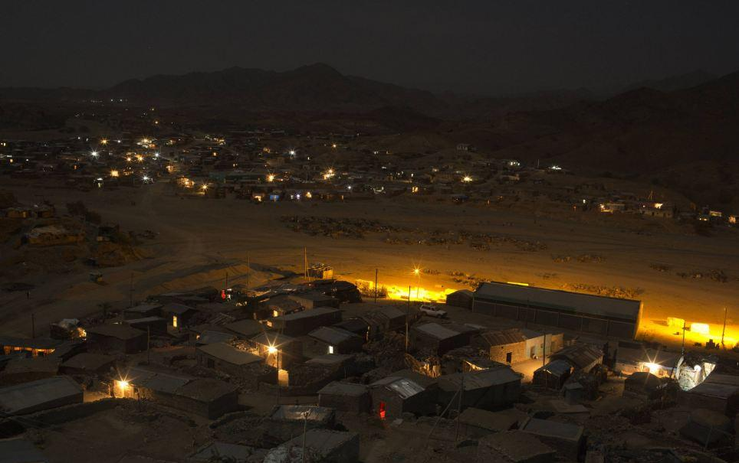
Final destination: The lights of Berahile in Afar, where much of the economy revolves around the salt trade/ Reuters

Slide 51
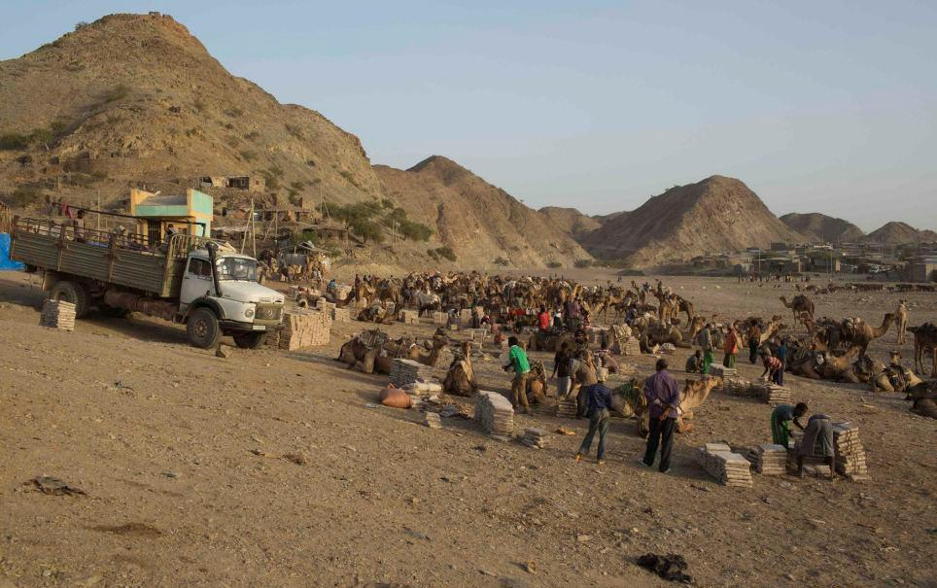
Wares: Workers unload slabs of salt from their camels upon arrival in the town of Berahile, in Afar/ Reuters

Slide 52

Men prepare bars of salt to be sold in the main market of the city of Mekele, northern Ethiopia, in this April 24, 2013, file photo.

Slide 53

A man prepares bars of salt to be sold in the main market of the city of Mekele, northern Ethiopia. (Pic: Reuters)

Slide 54

Salt used to act as a form of currency in the region. Now, most people prefer cash.

Slide 55


Slide 56
End Report…
5/01/2014王文堯 Kaohsiung Taiwan R.O.C
All photos were taken from NG, Daily Mail, Yahoo New, Internet…etc
Seen on Bigfun.be

