Slide 1
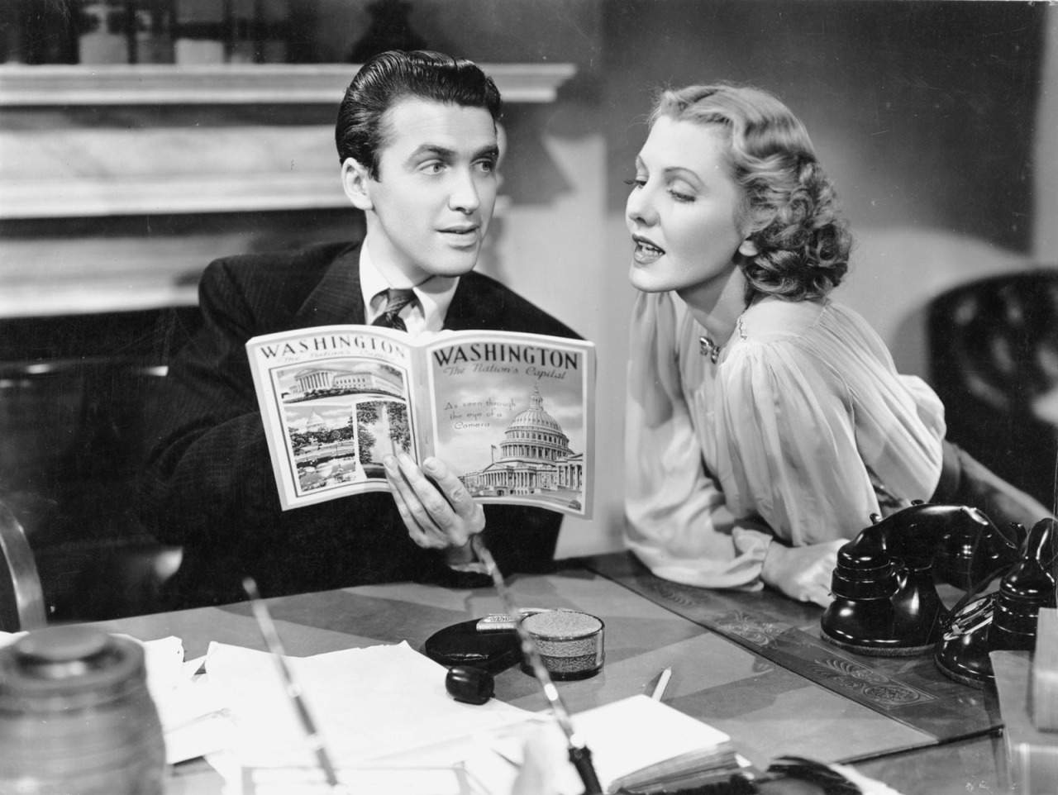

Slide 2
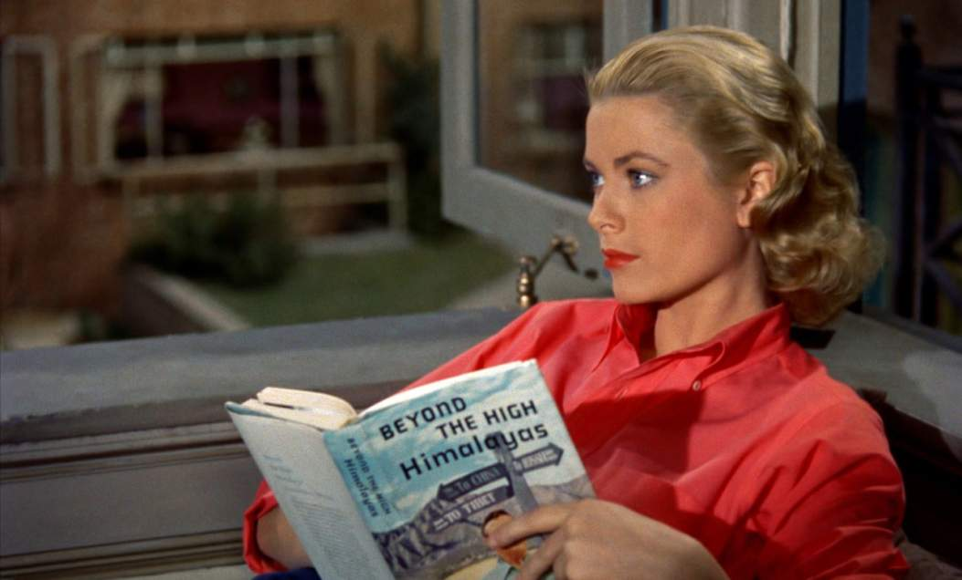

Grace Kelly (1954).

Slide 3
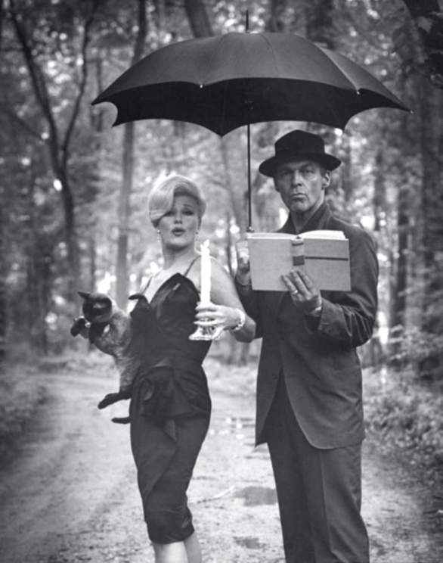

Ginger Rogers and William Marshall reading by candlelight, June 1961.

Slide 4
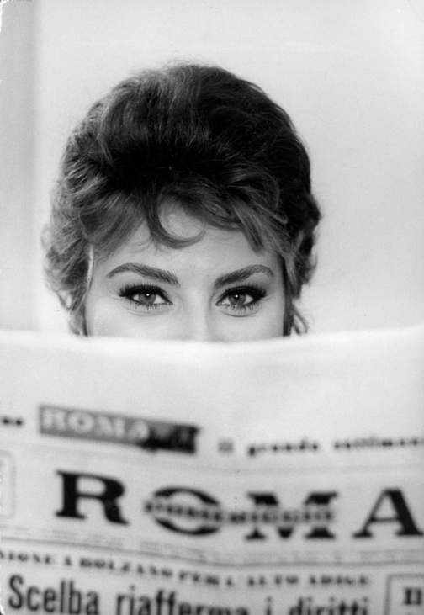
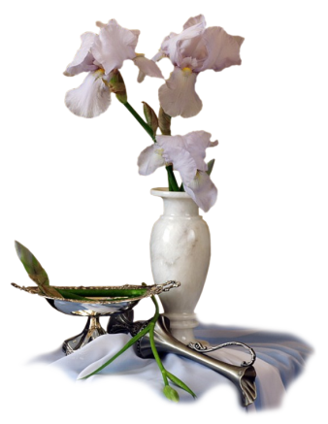
Sophia Loren , 1961.

Slide 5
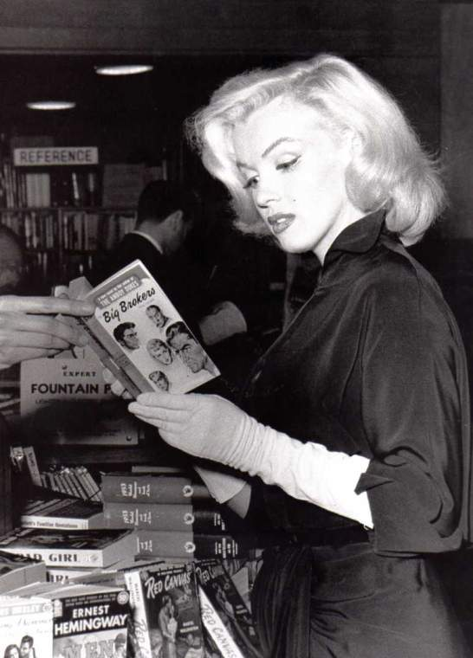

Marilyn Monroe , 1953

Slide 6
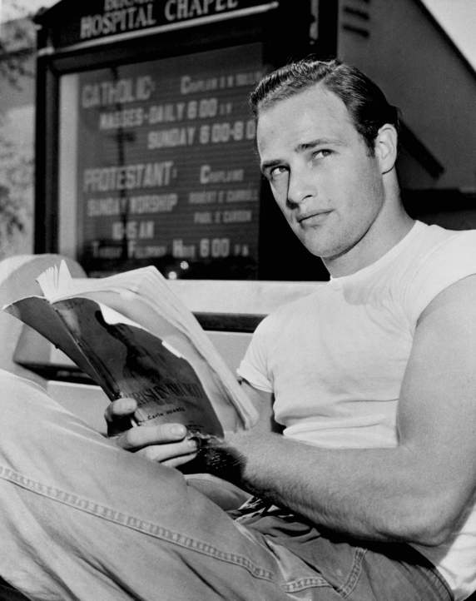
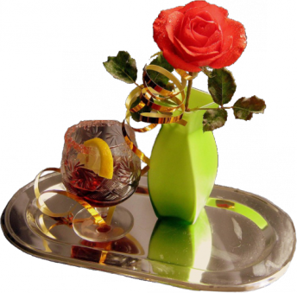
Marlon Brando (1924-2004).

Slide 7
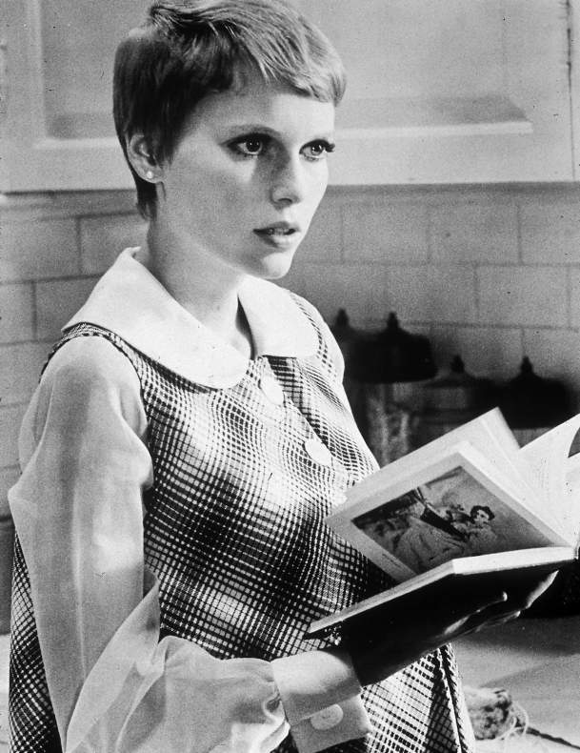
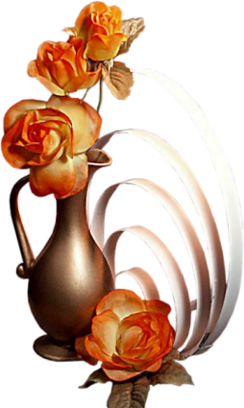
Mia Farrow, 1968.

Slide 8
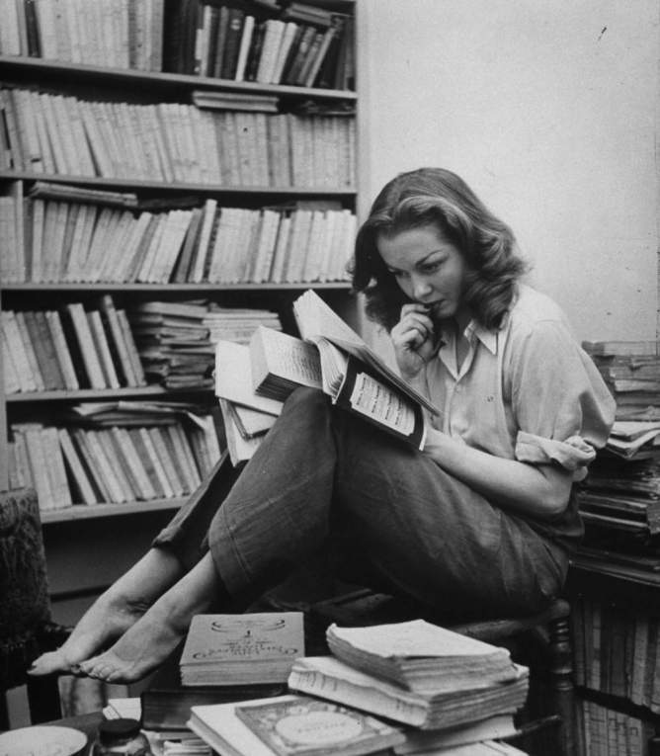
French actress Barbara Laage
(May 1946).

Slide 9
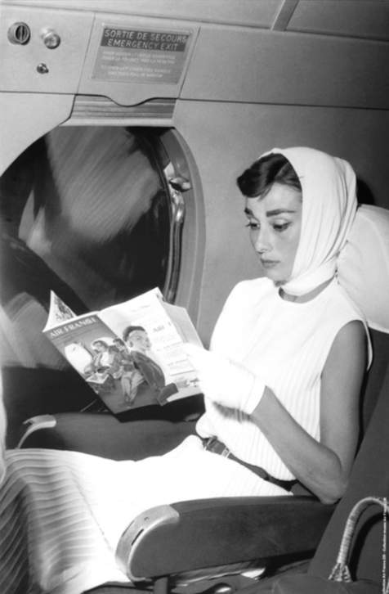
Audrey Hepburn reading on board an Air France airliner, c.1955.

Slide 10
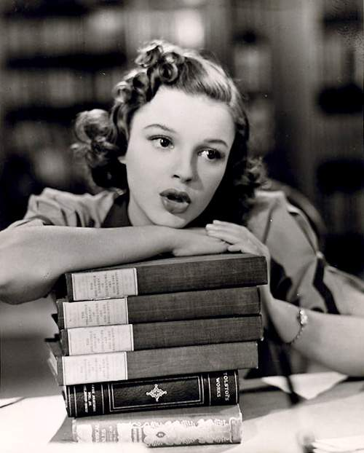
Judy Garland.

Slide 11
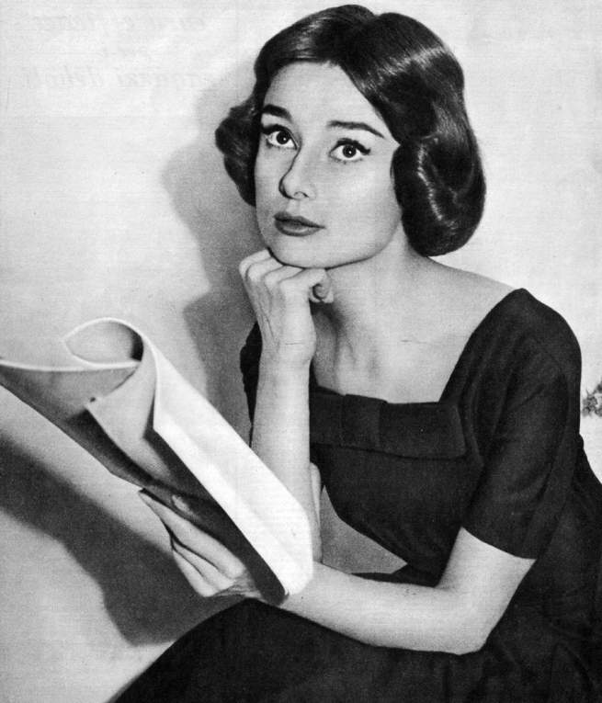
Audrey Hepburn (1957).

Slide 12
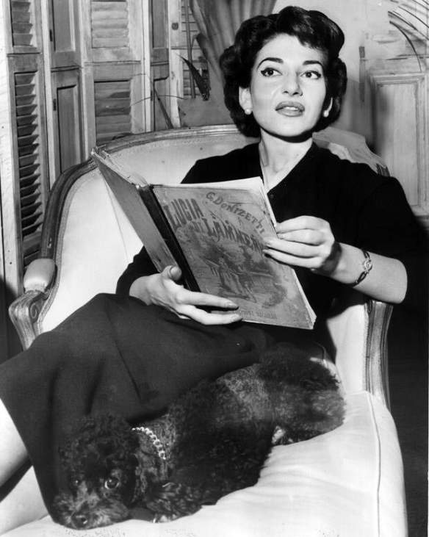
Maria Callas

Slide 13
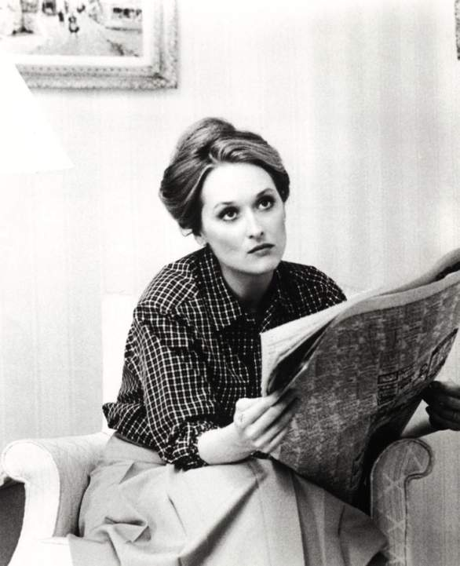
Meryl Streep, (1979).

Slide 14
James Stewart and Jean Arthur (1939).

Slide 15
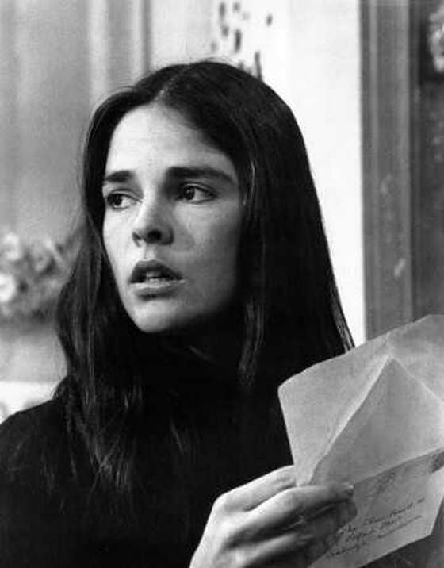
Ali MacGraw reading a letter
in Love Story (1970).

Slide 16
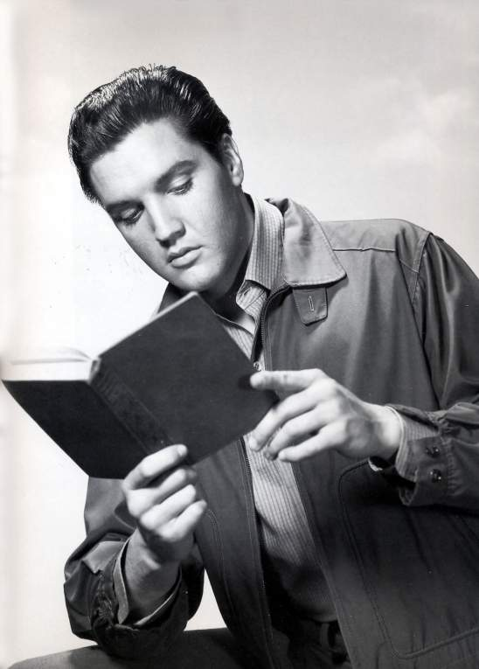
Elvis reading, 1961.

Slide 17
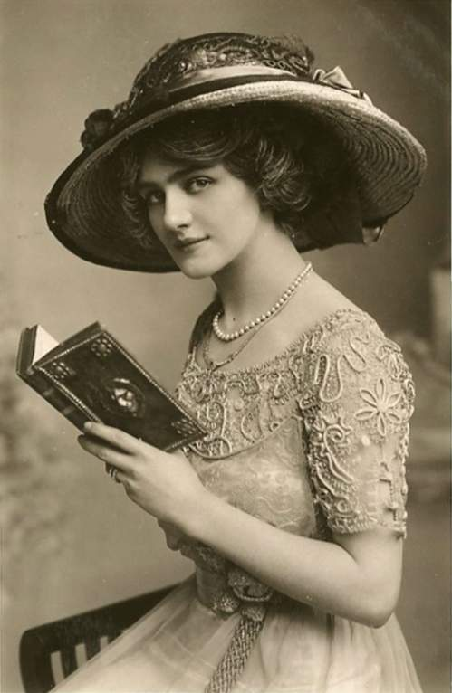
Elsie (1886–1962) was a popular English actress and singer during the Edwardian

Slide 18
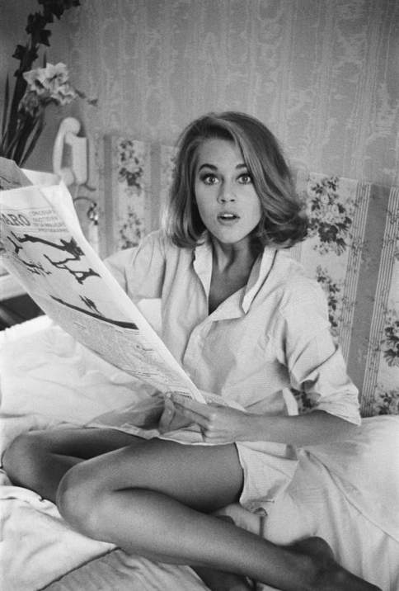
Jane Fonda reading the newspaper in bed in pajamas, 1963.

Slide 19
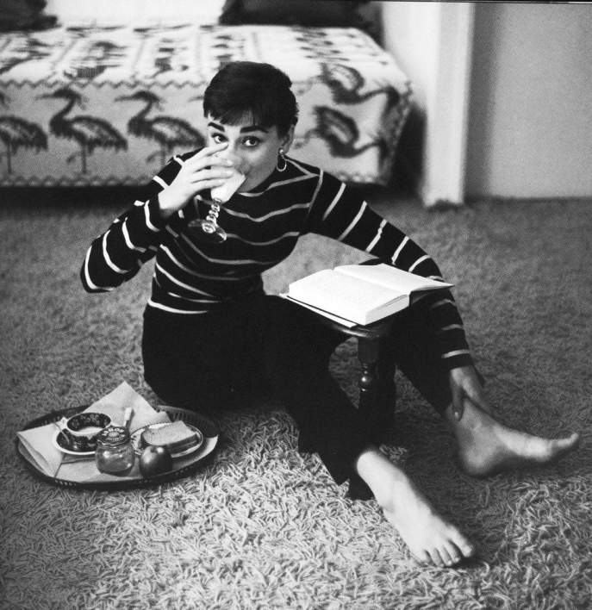
Audrey Hepburn (1929-1993).

Slide 20
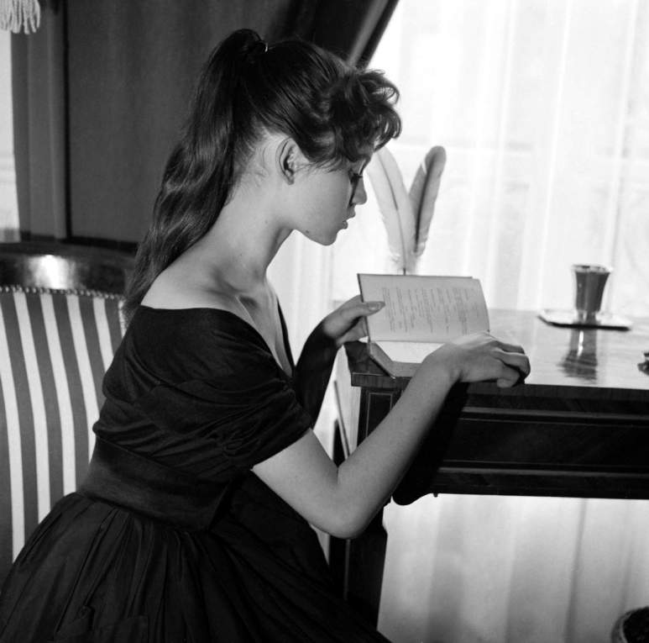
Brigitte Bardot reading a book at her home, Paris, 1955.

Slide 21
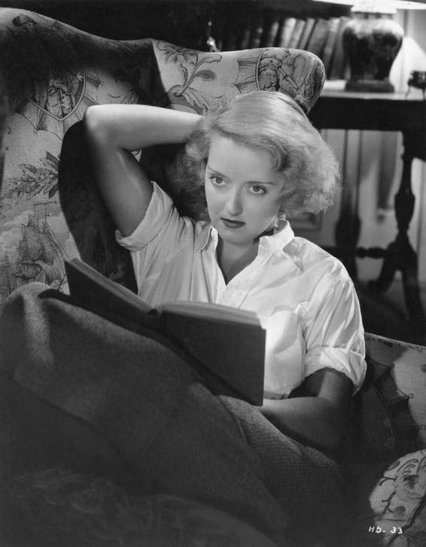
Bette Davis, (1935).

Slide 22
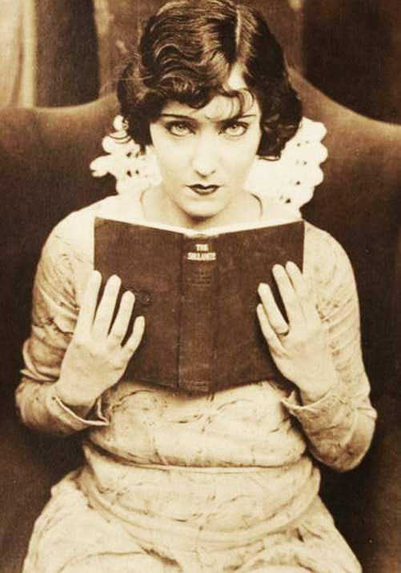
Gloria Swanson , 1904.

Slide 23
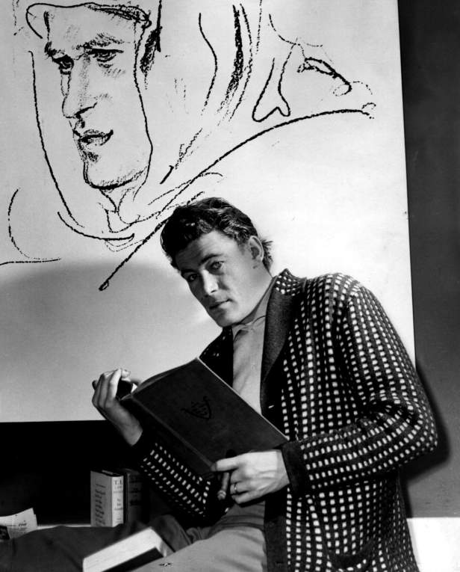
Irish actor Peter O’Toole (1962).

Slide 24
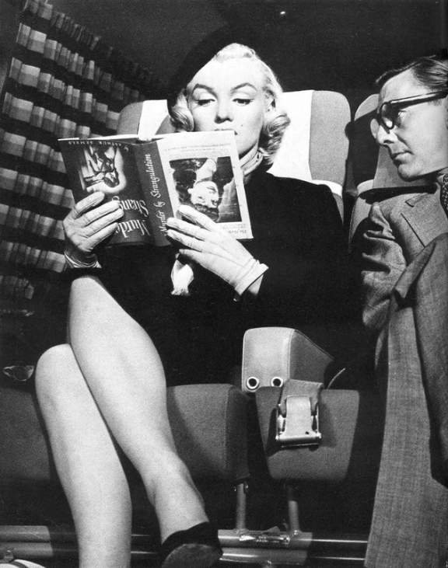
Marilyn Monroe (1953).

Slide 25
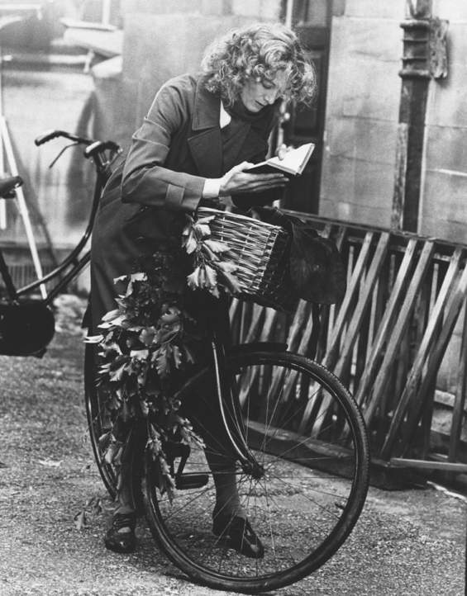
Vanessa Redgrave, 1977.

Slide 26
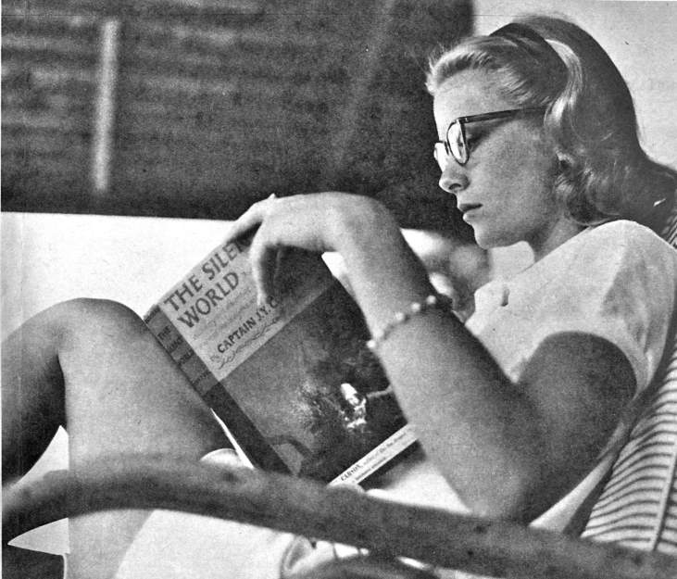
Grace Kelly

Slide 27
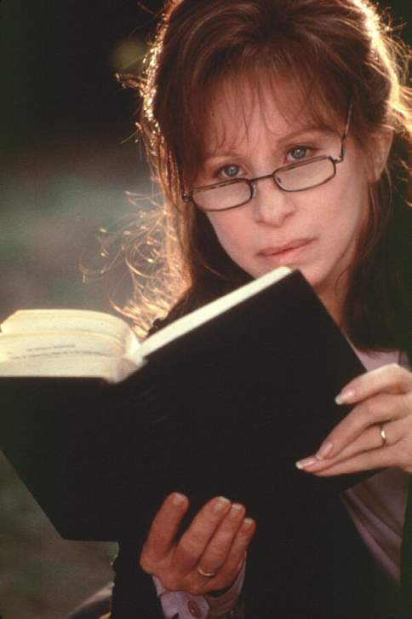
Barbra Streisand reads in The Mirror Has Two Faces (1996).

Slide 28
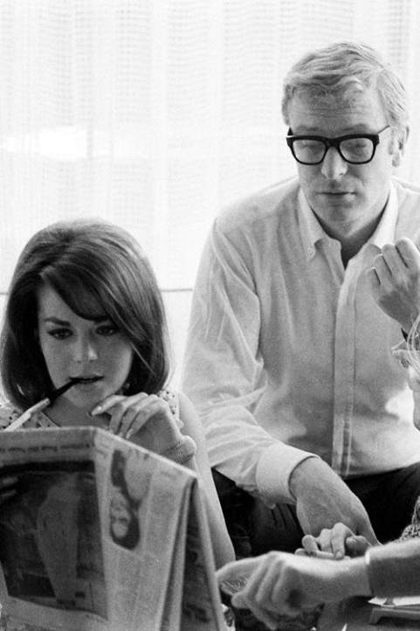
Michael Caine and Natalie Wood, 1966.

Slide 29
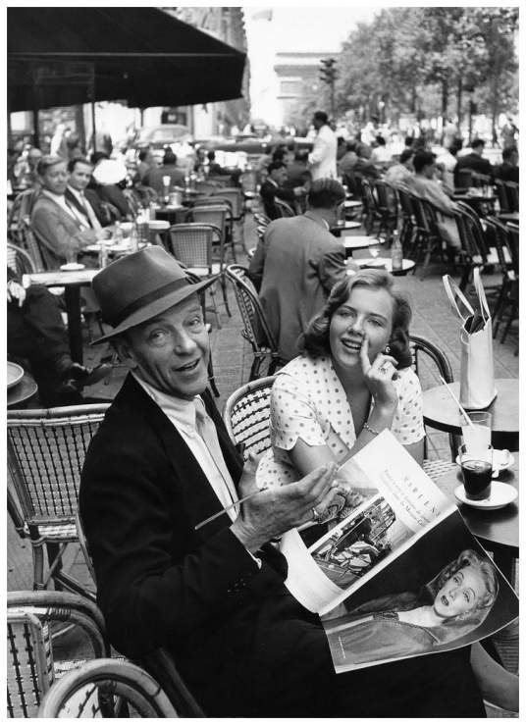
Fred Astaire with his daughter Ava ,
Paris,1961.

Slide 30
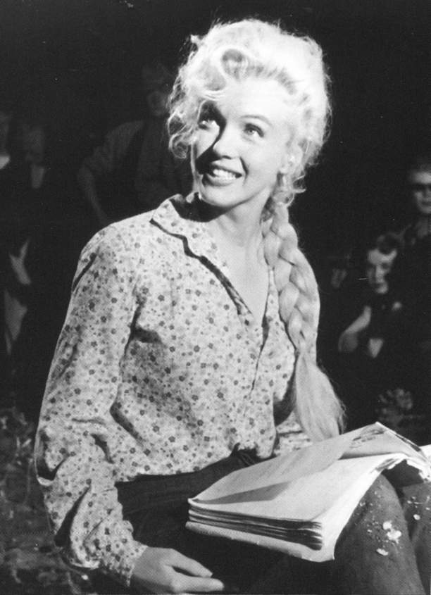
Marilyn Monroe, 1953.

Slide 31
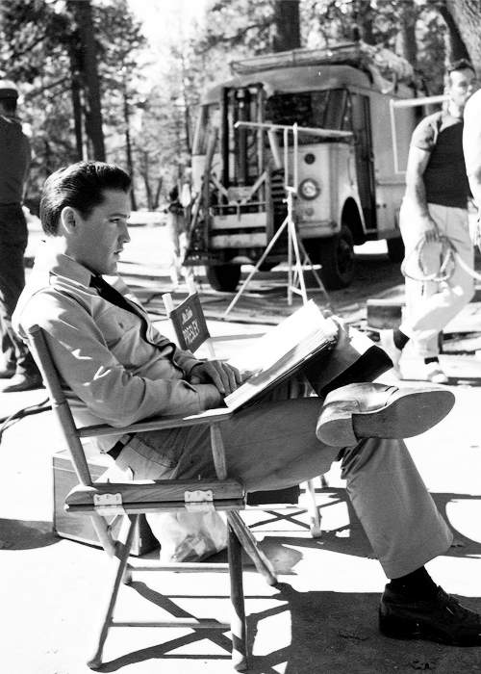
Elvis in August 1962.

Slide 32
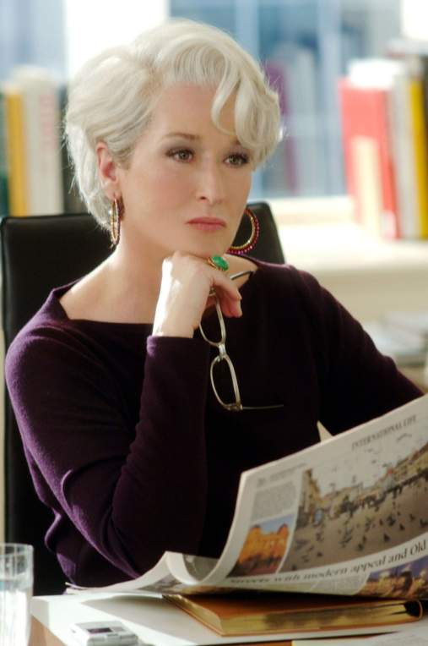
Meryl Streep, (2006).

Slide 33
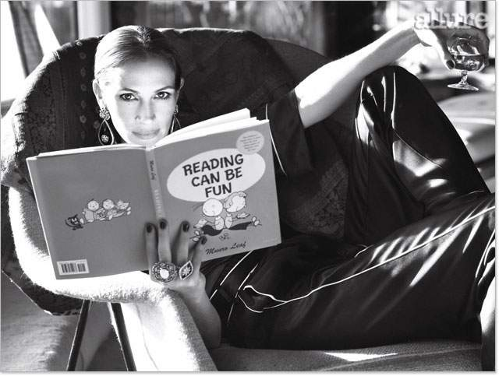
Julia Roberts, 2009

Slide 34
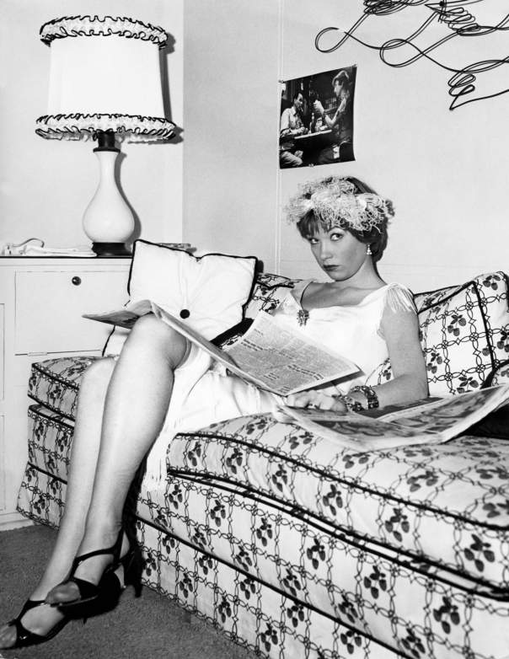
Shirley MacLaine, (1958).

Slide 35
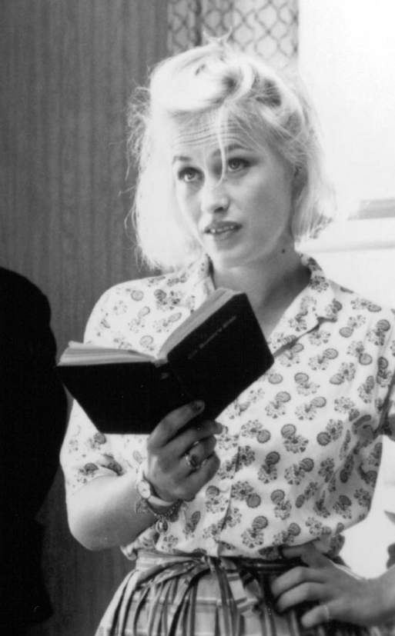
Patricia Arquette, 1994.

Slide 36
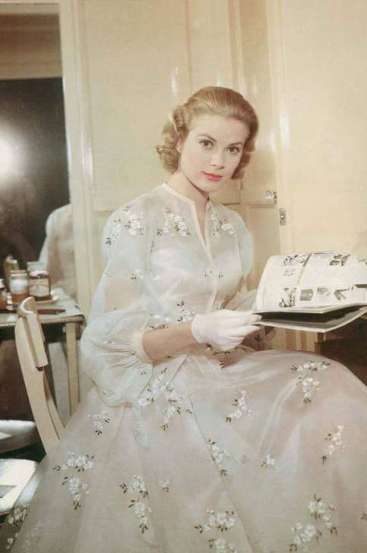
Grace Kelly reading on set of High Society (1956).

Slide 37
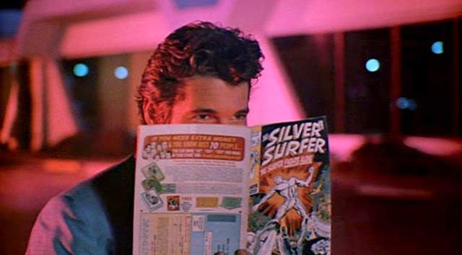
Richard Gere, 1983

Slide 38
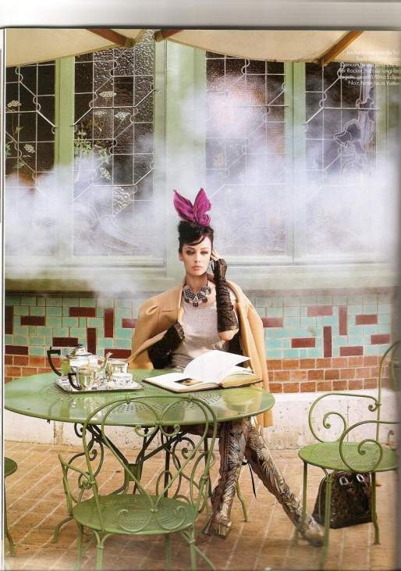
Model Andreea Raicu, 2009

Slide 39
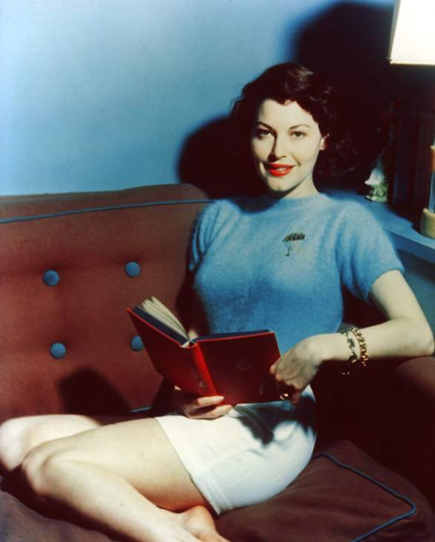
Ava Gardner reading a
book with a red cover.

Slide 40
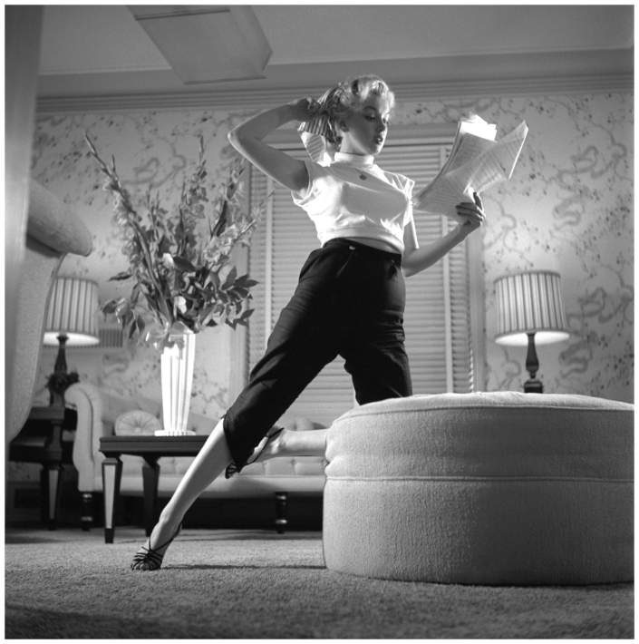
Marilyn Monroe , November 8, 1952.

Slide 41
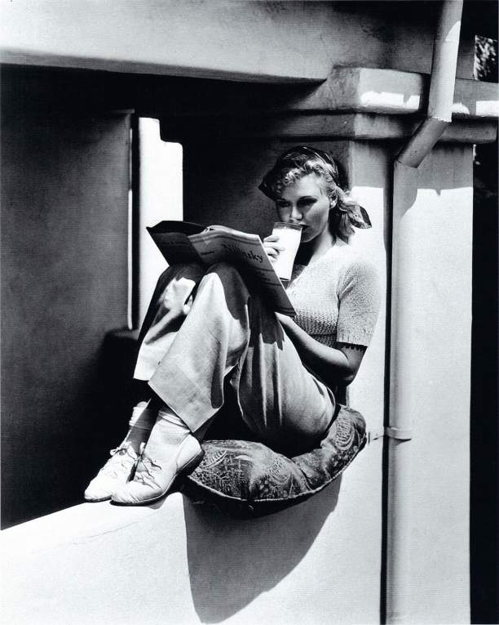
Ginger Rogers (1933).

Slide 42
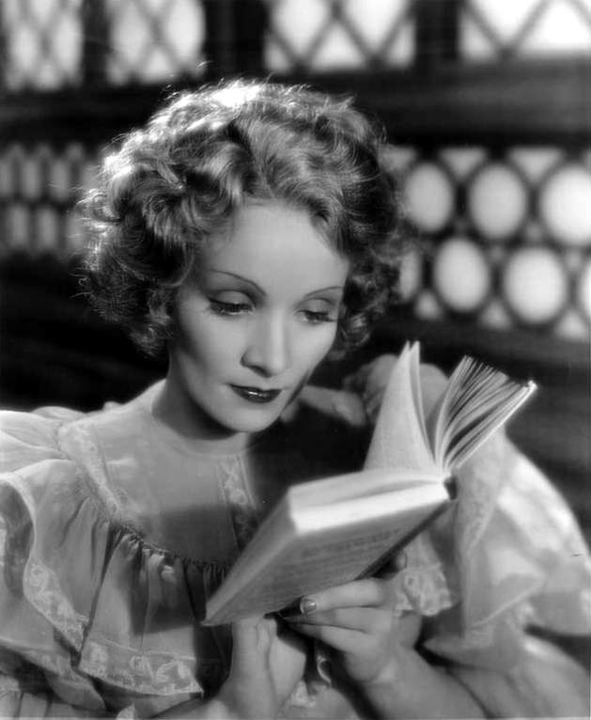
Marlene Dietrich, 1933.

Slide 43
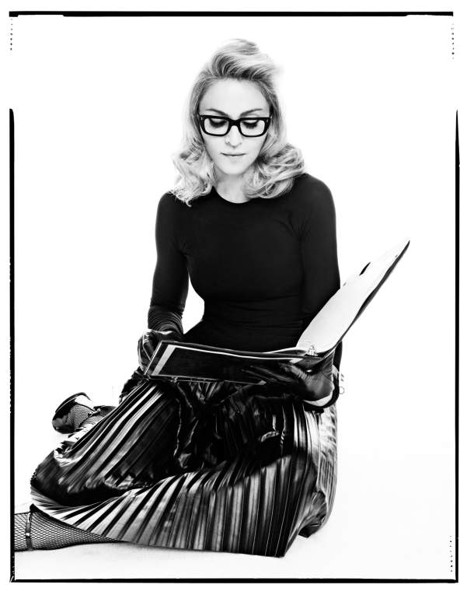

Madonna reads in Madonna

Slide 44








