Slide 1


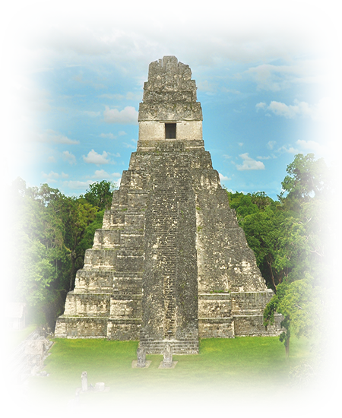

VOIR LE MONDE AVEC MOI
SAUVER LA TERRE
GUATEMALA
Tikal Petén
Tikal Petén
07
Tommy55
2016

Slide 2
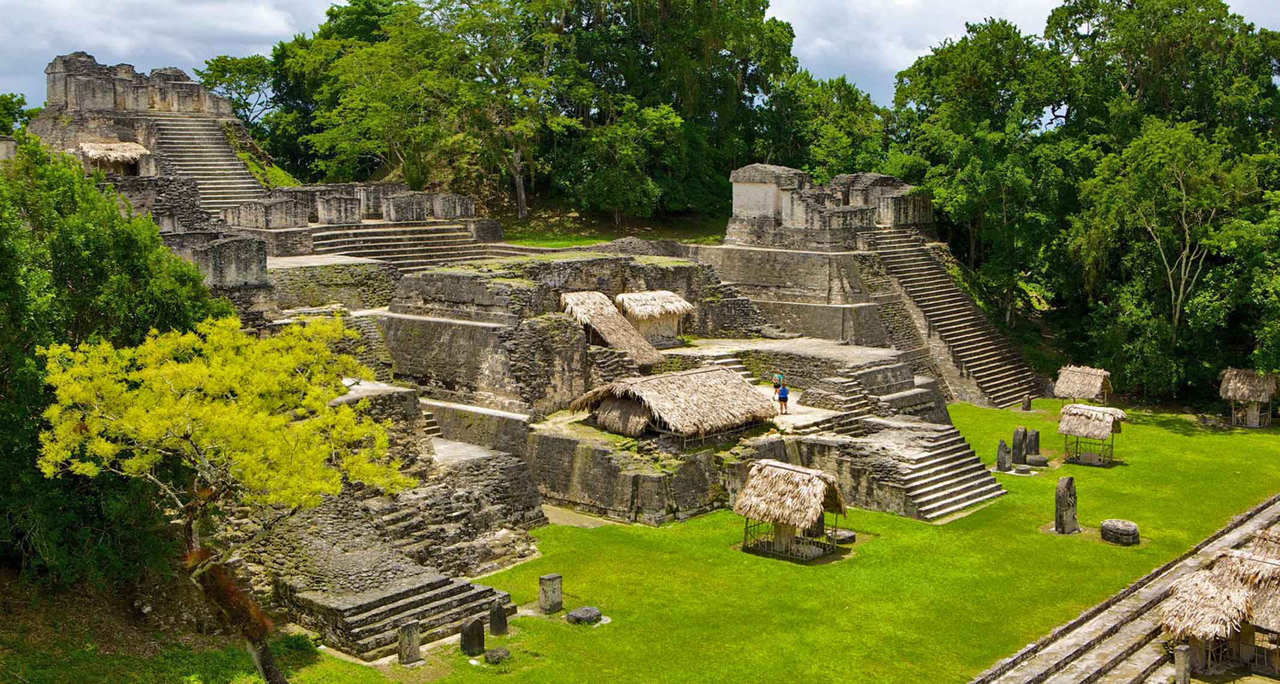

(Expedia)
ORIGIN

Slide 3
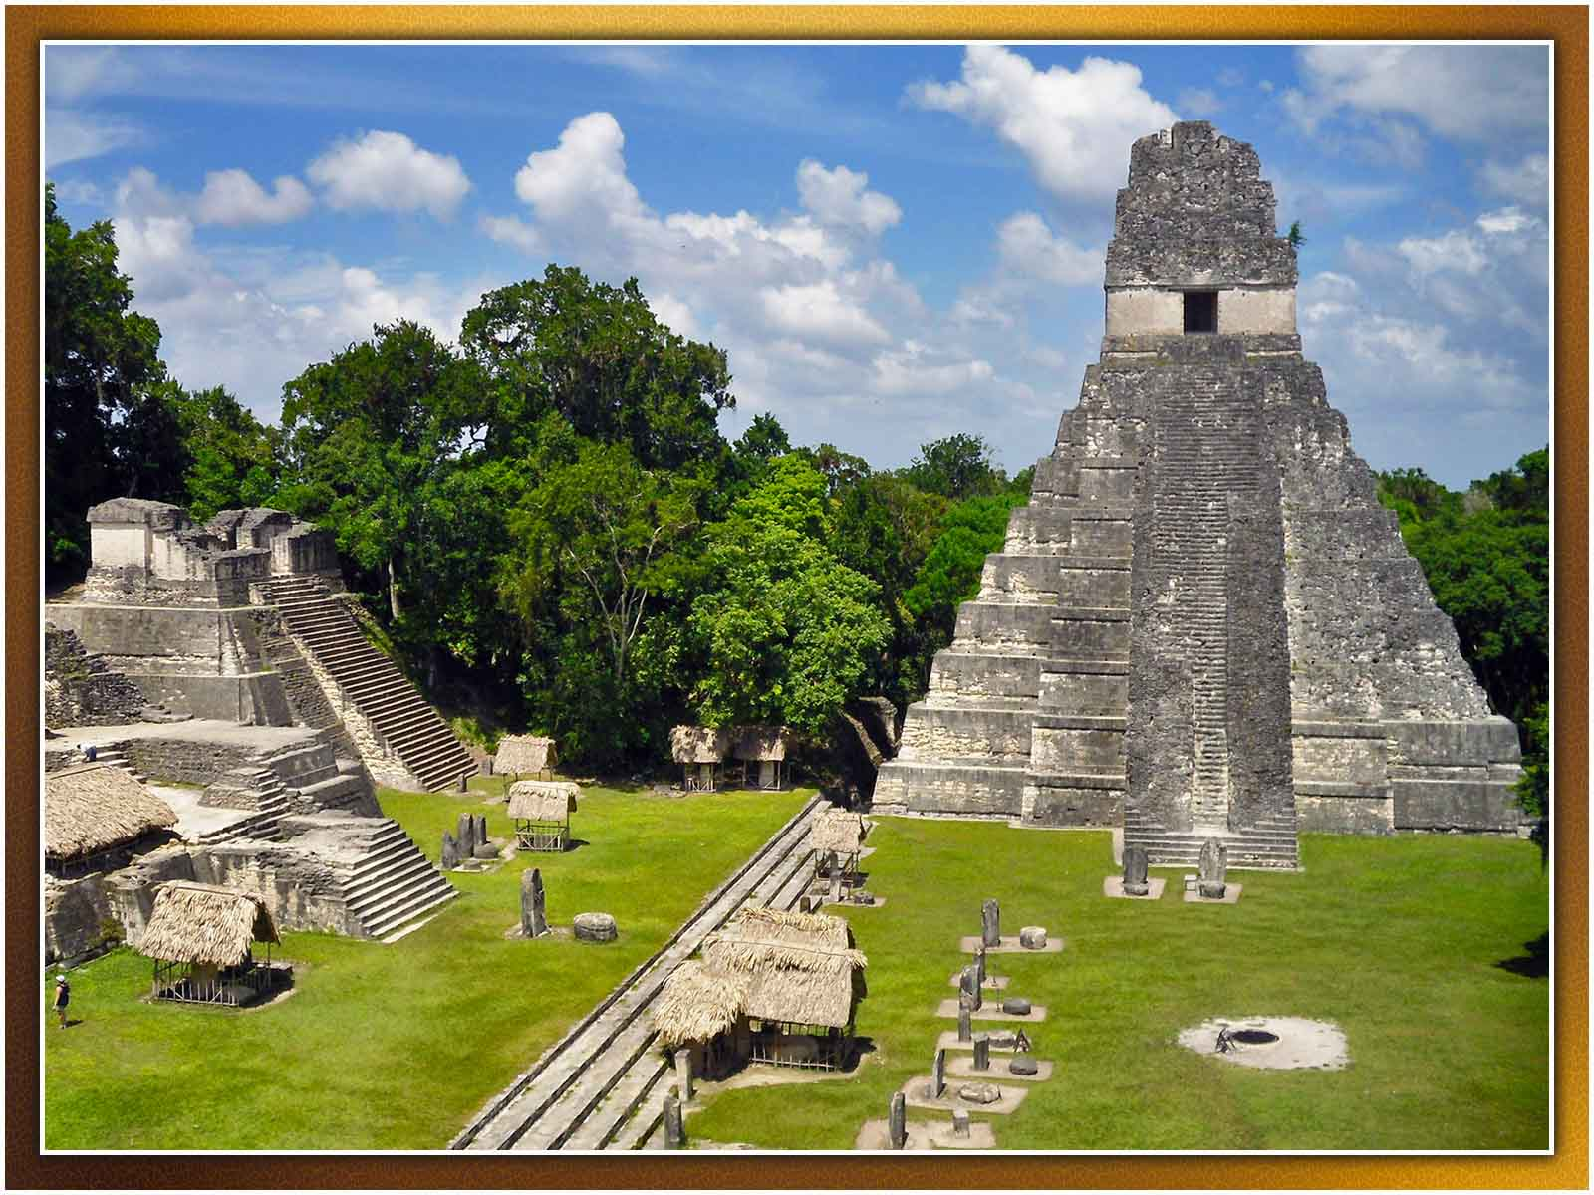
Veronica Vera
ORIGIN

Slide 4
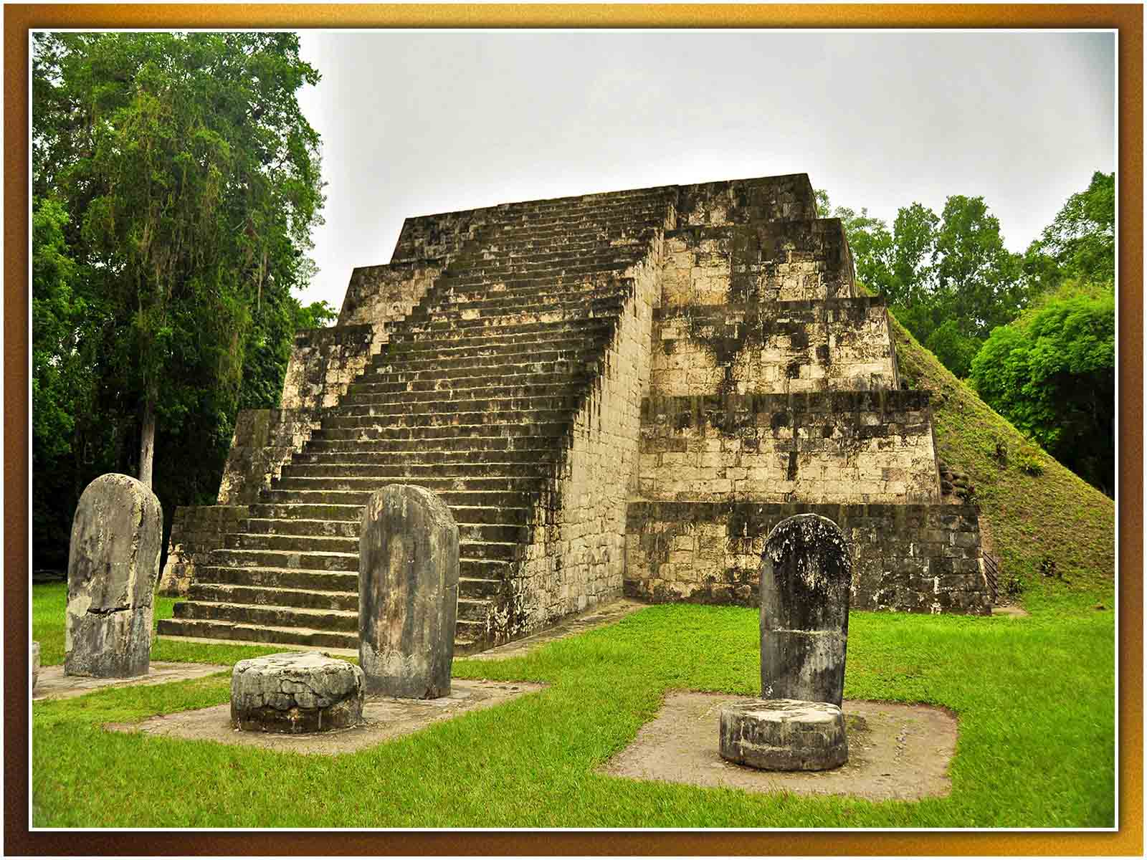
Ben Belske
ORIGIN

Slide 5
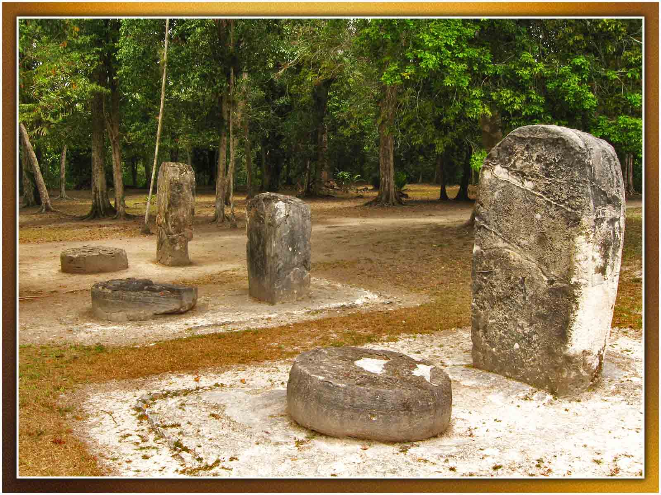
Hector Garcia
ORIGIN

Slide 6
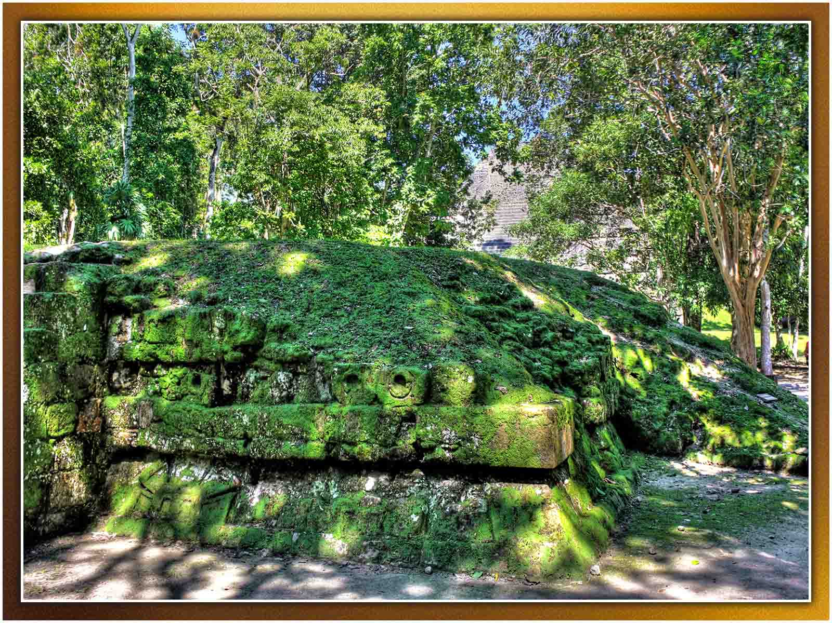
Daniel Mennerich
ORIGIN

Slide 7
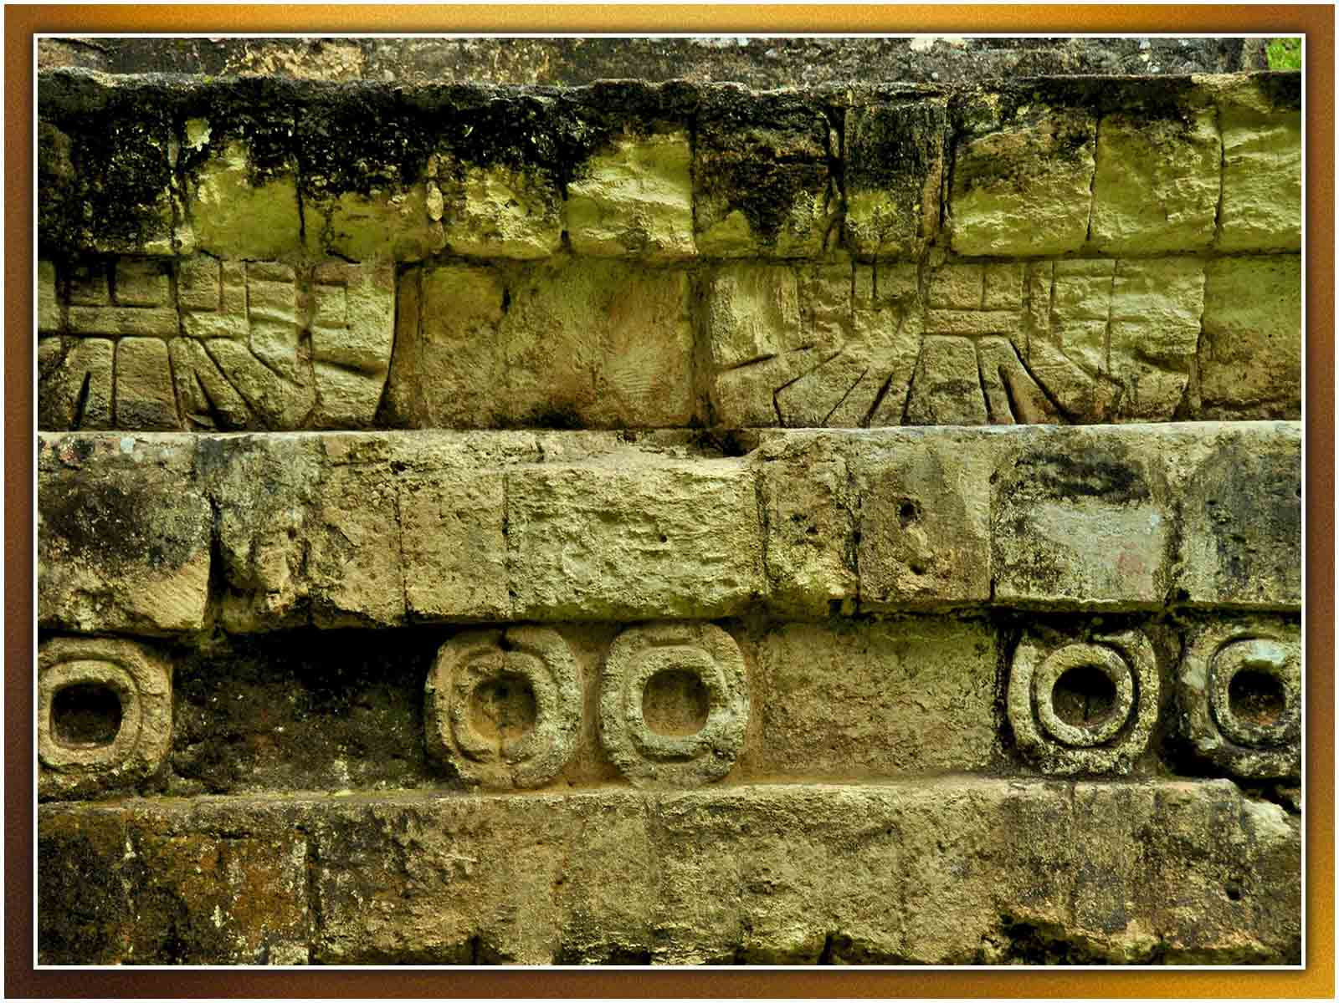
Mario Bollini
ORIGIN

Slide 8
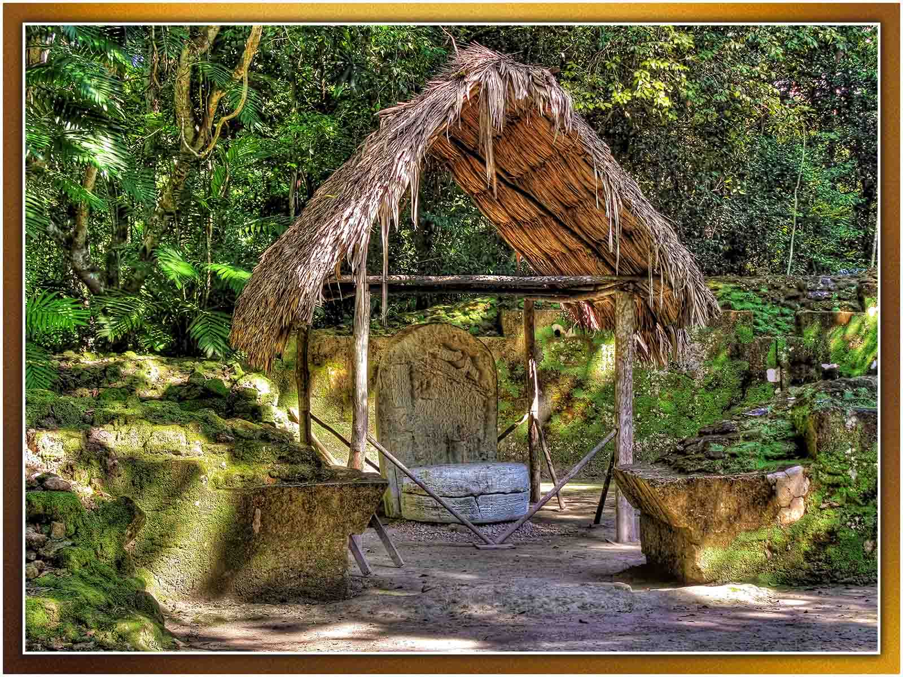
Daniel Mennerich
ORIGIN

Slide 9
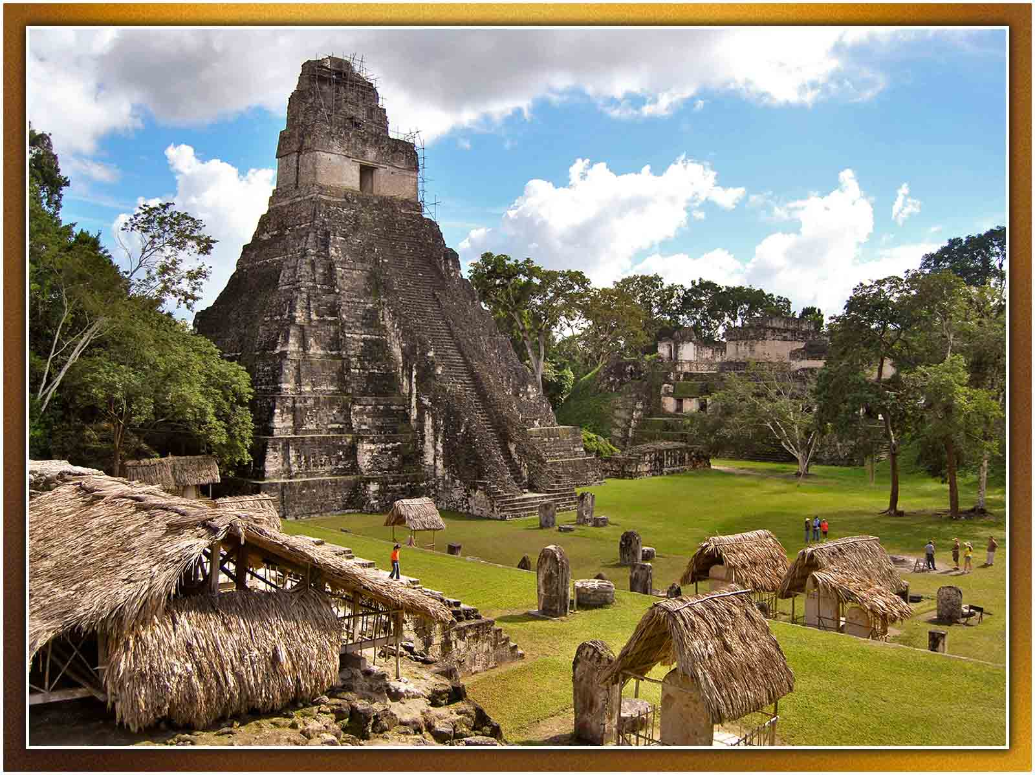
Zhu
ORIGIN

Slide 10
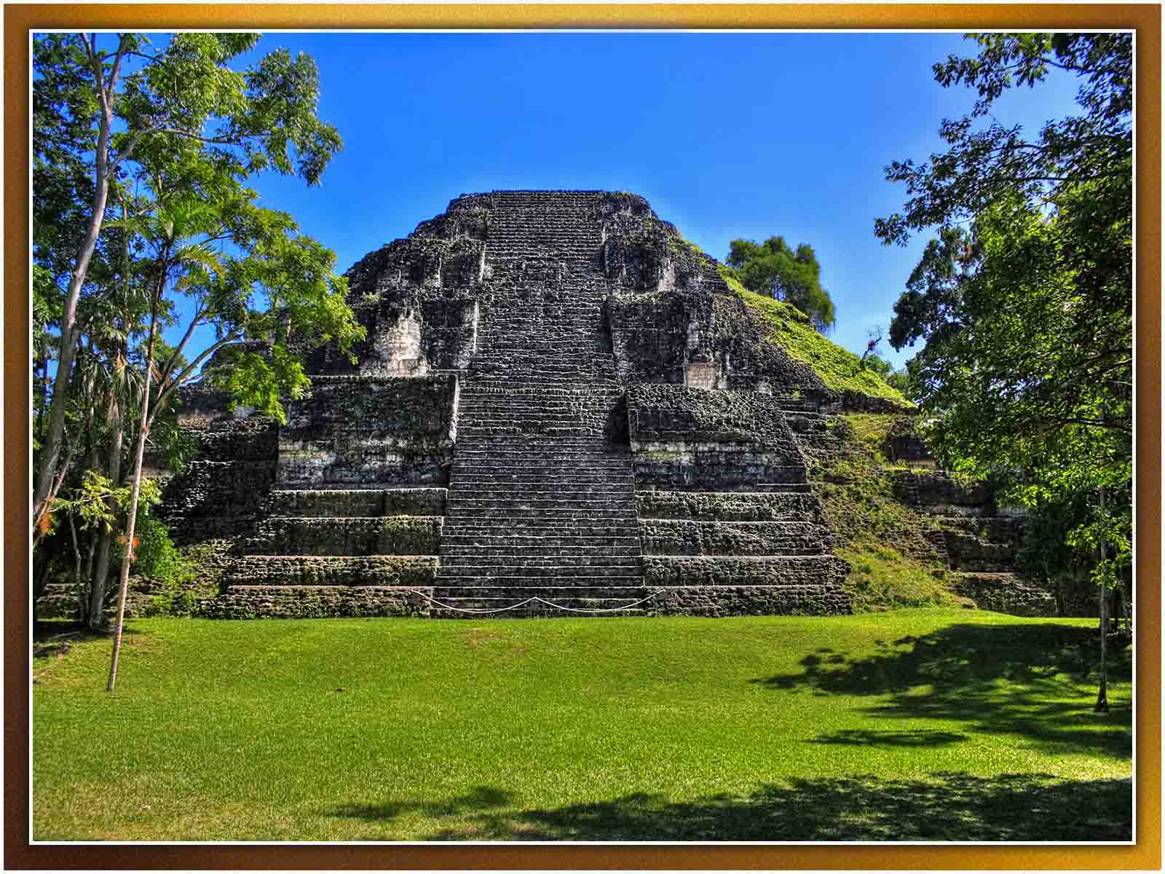
Daniel Mennerich
ORIGIN

Slide 11
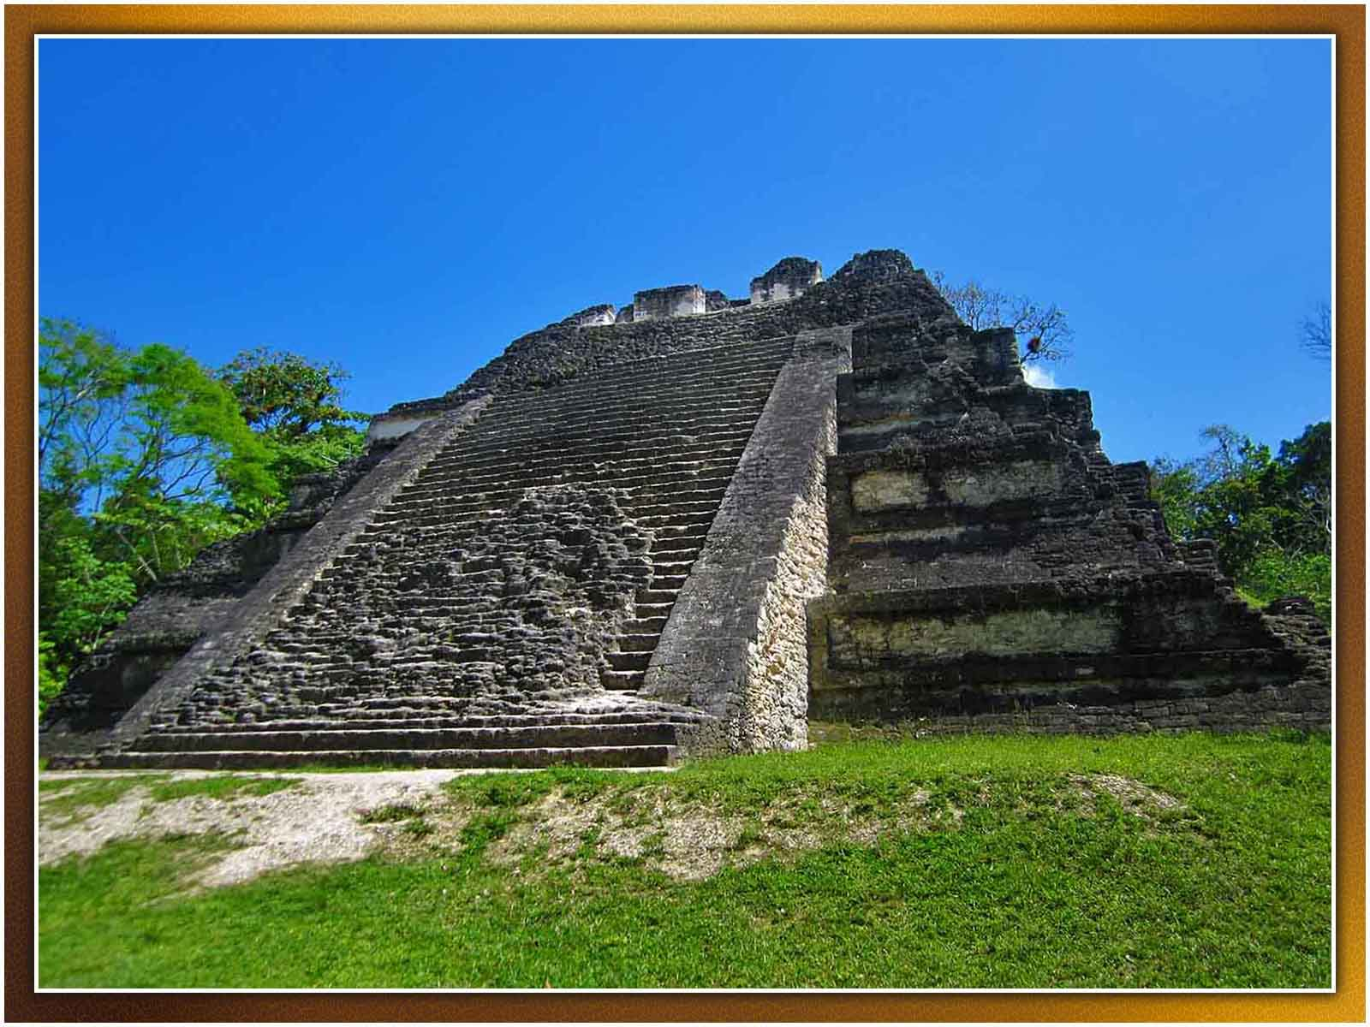
Ben Belske
ORIGIN

Slide 12
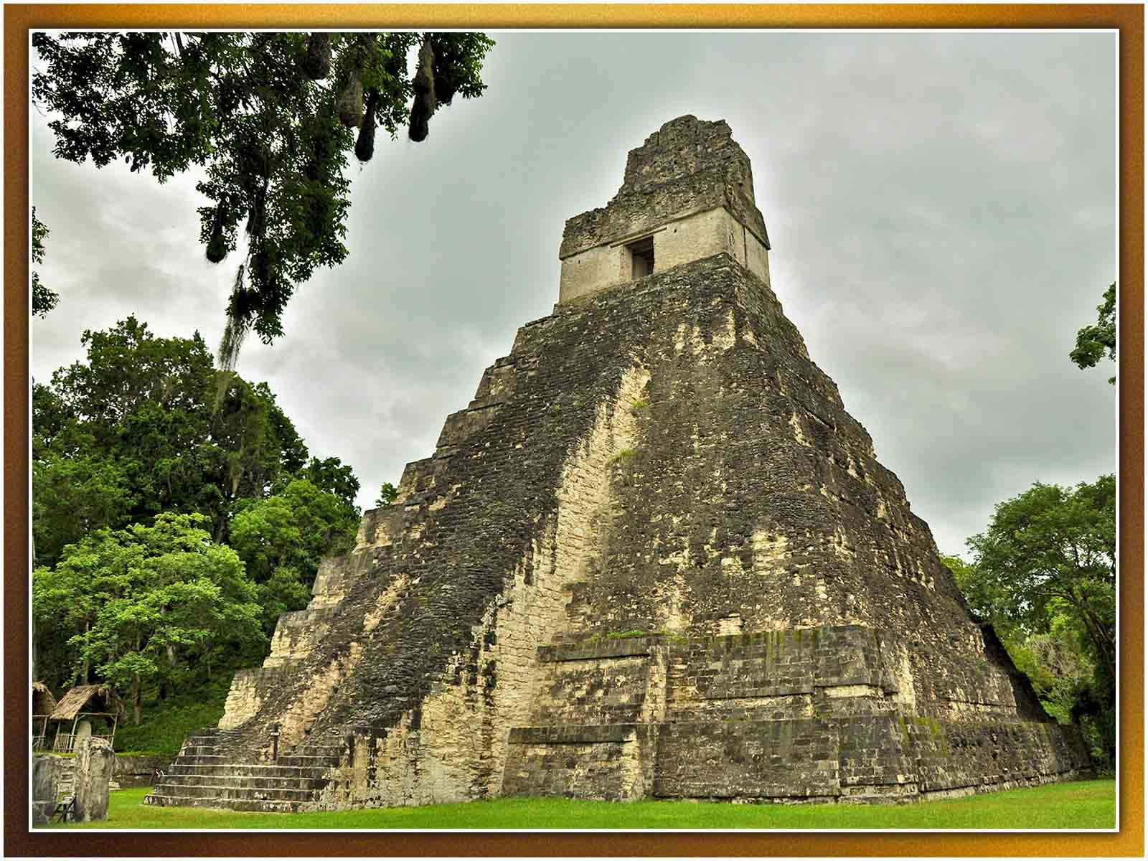
Mario Bollini
ORIGIN

Slide 13
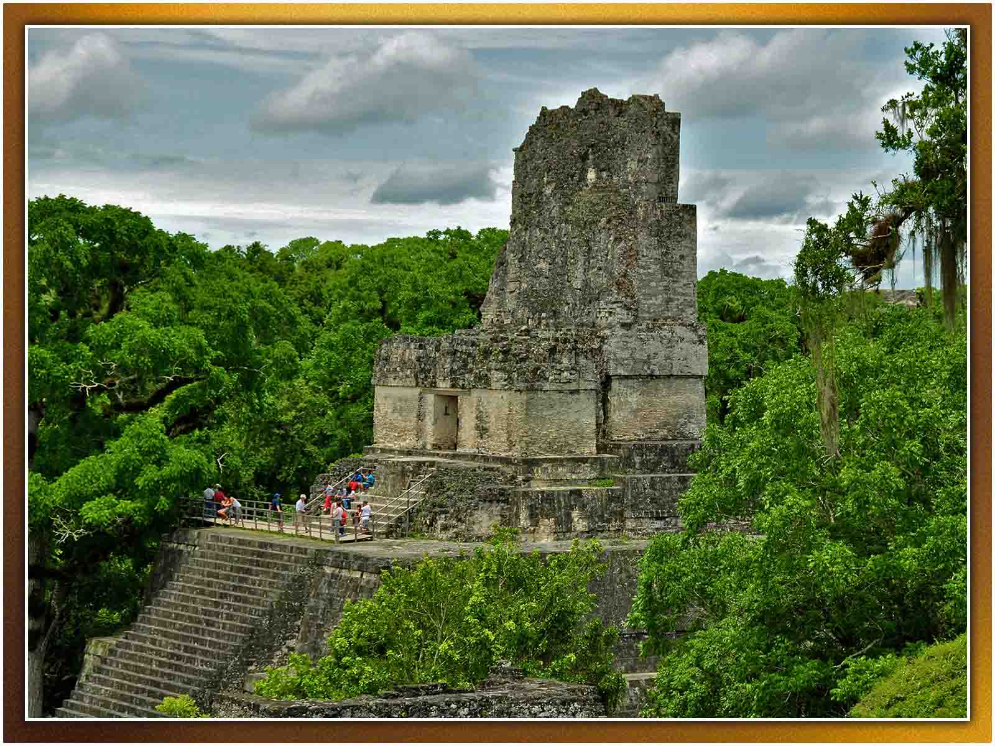
Mario Bollini
ORIGIN

Slide 14
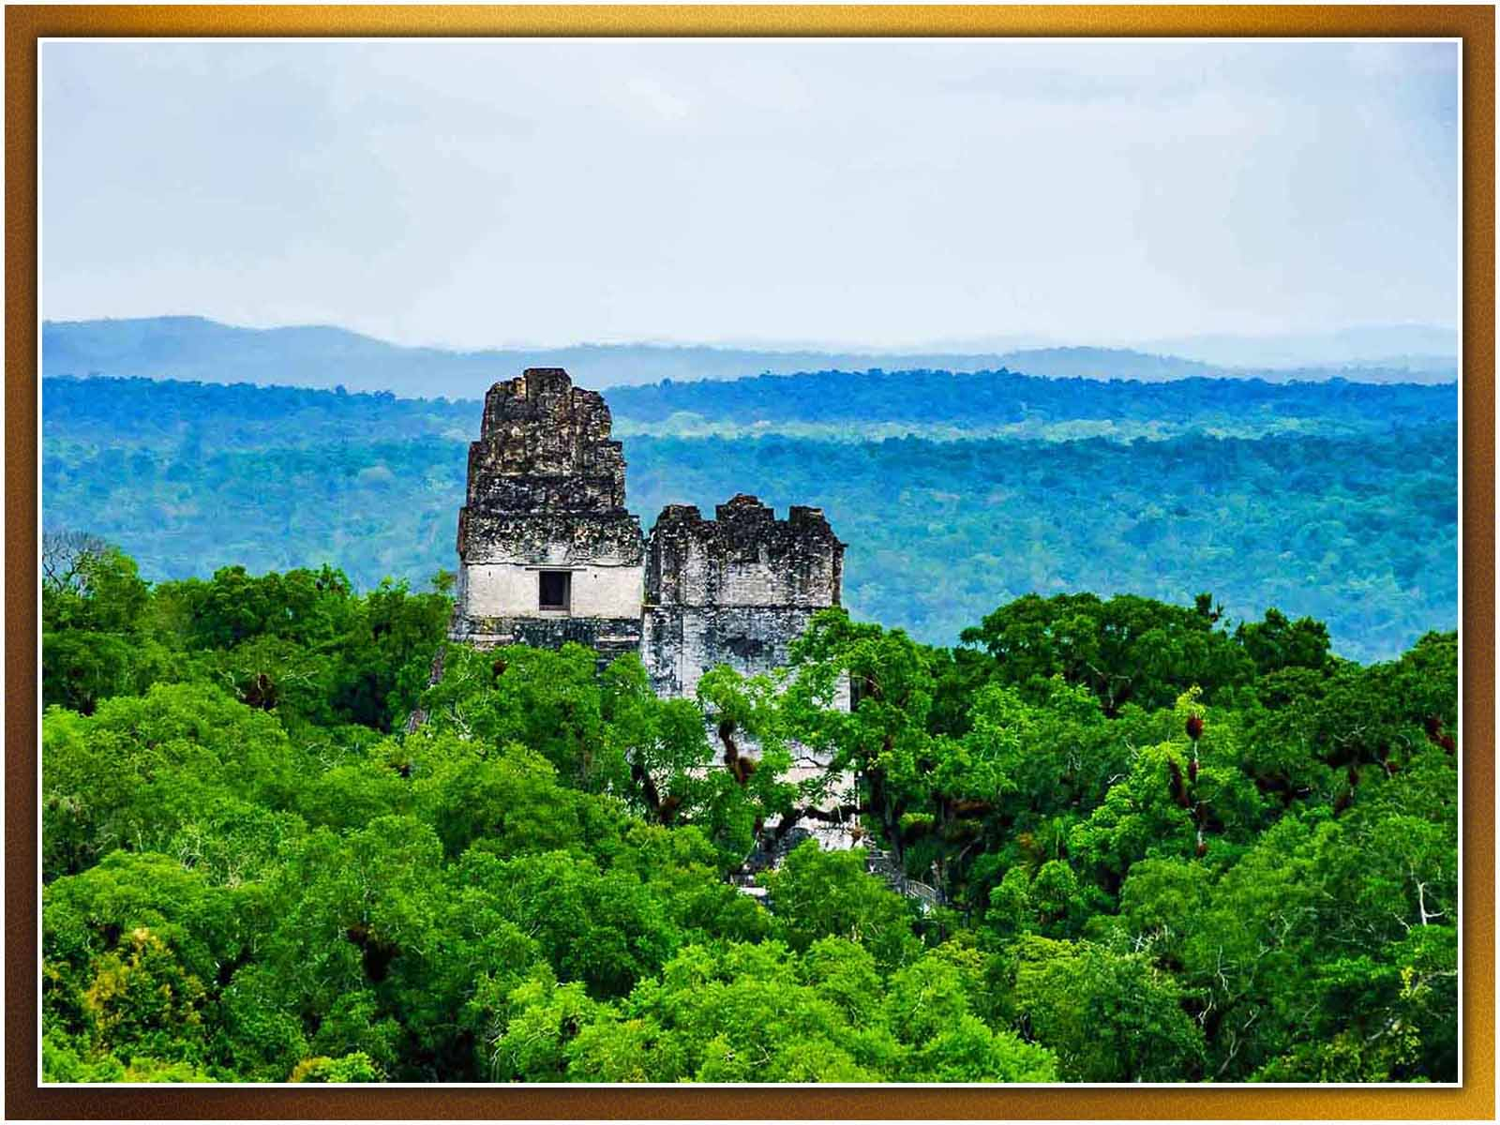
(Enjoy It)
ORIGIN

Slide 15
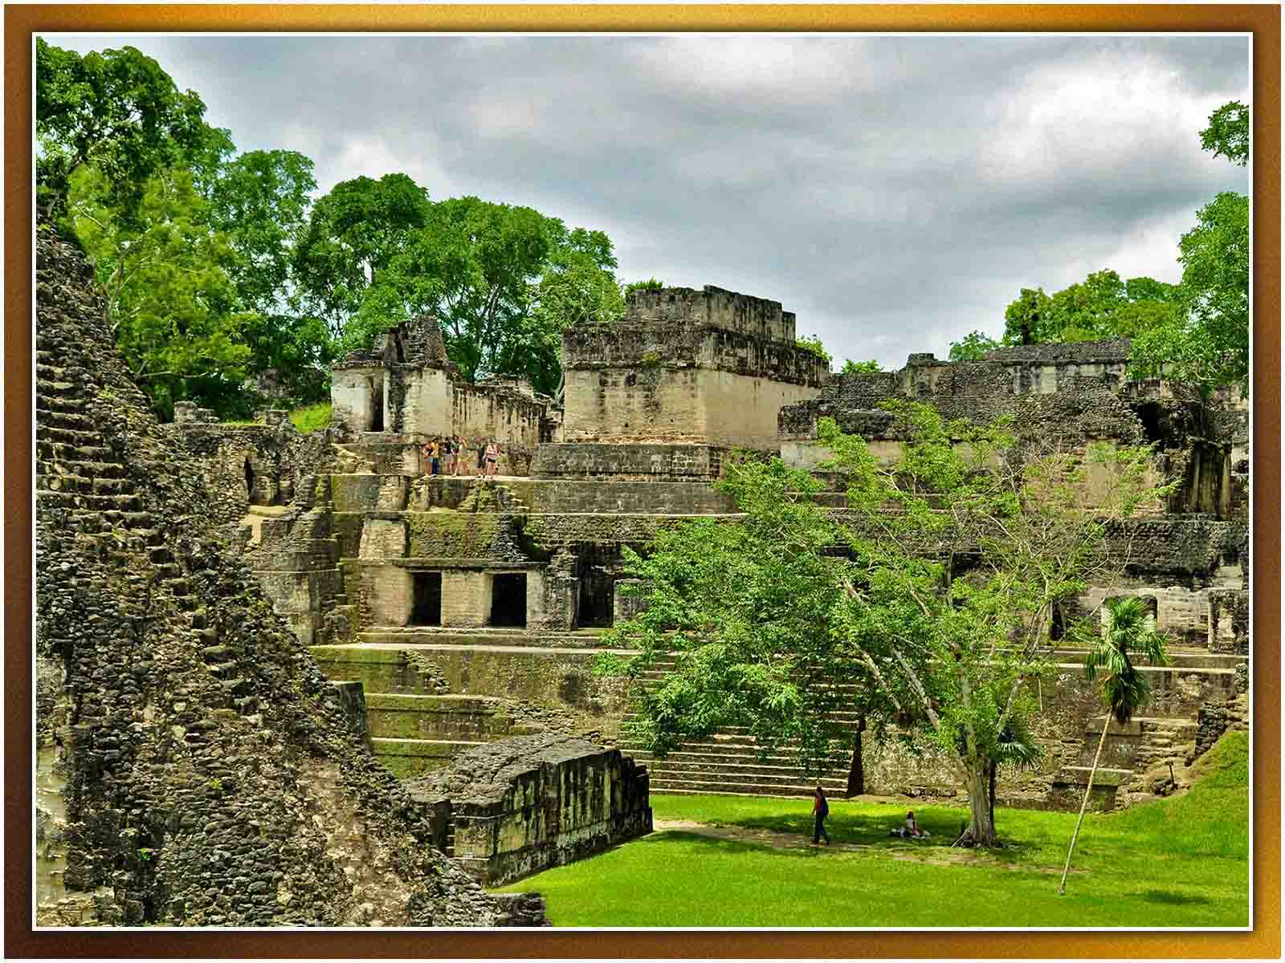
Mario Bollini
ORIGIN

Slide 16
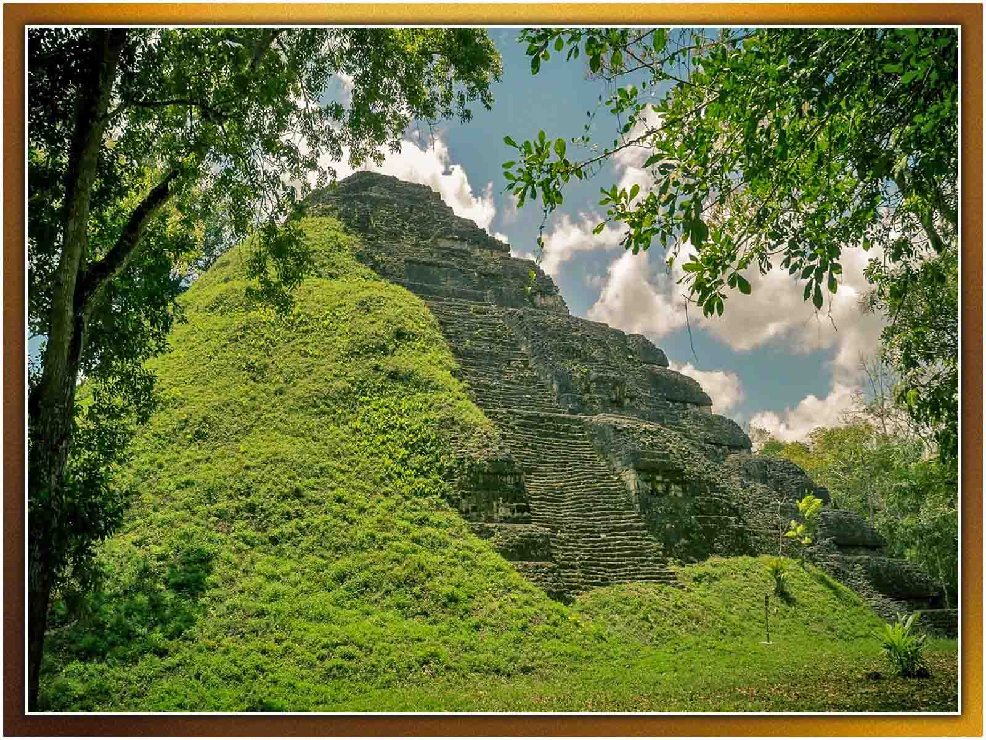
Milan Škrob
ORIGIN

Slide 17
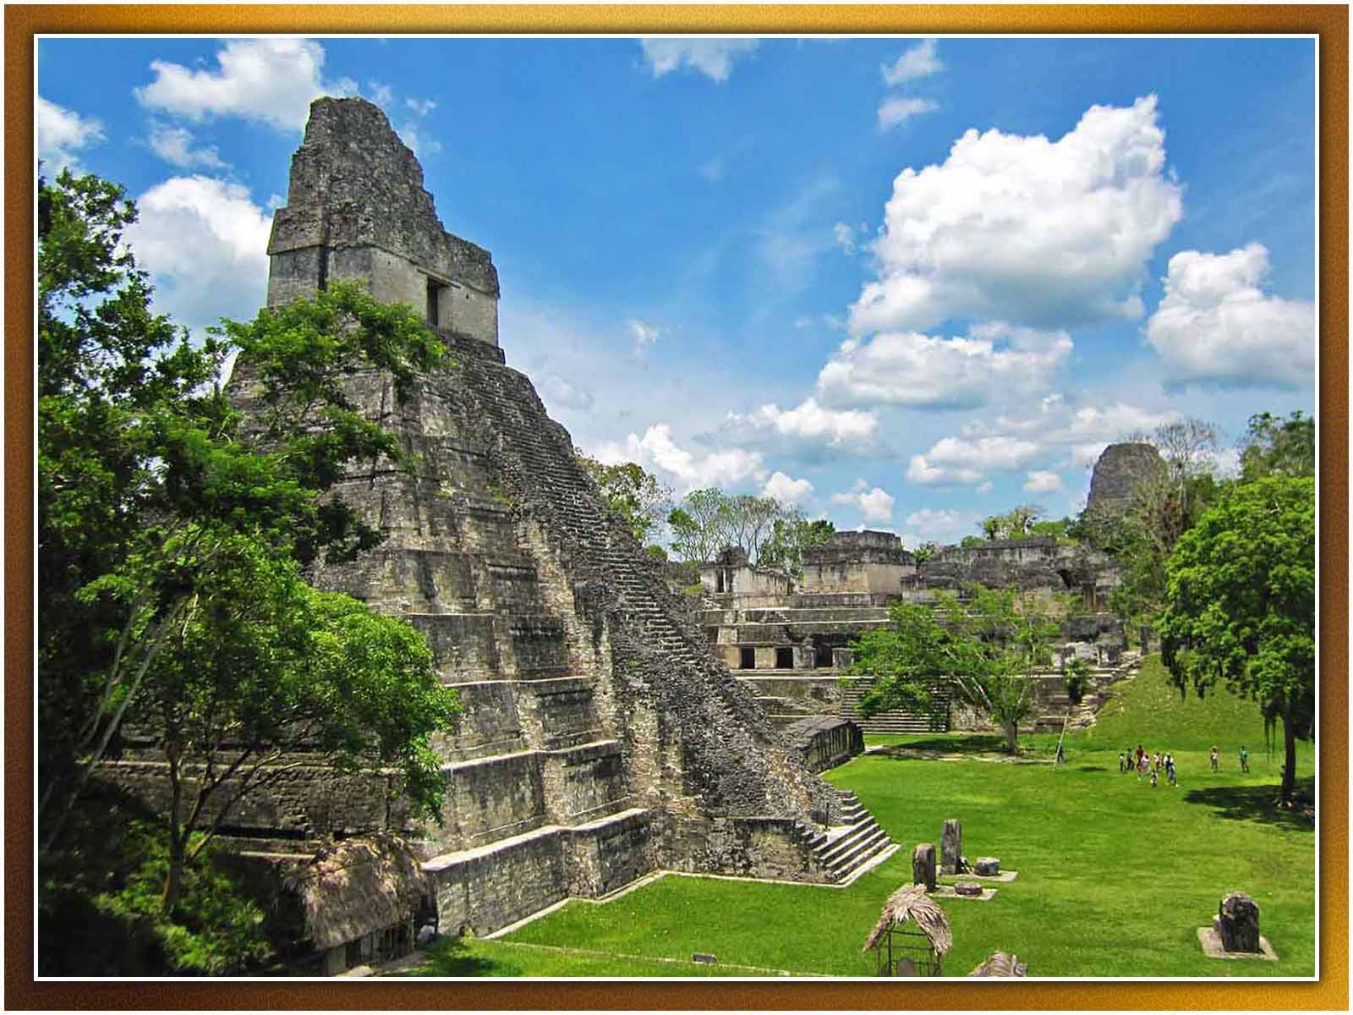
Ben Belske
ORIGIN

Slide 18
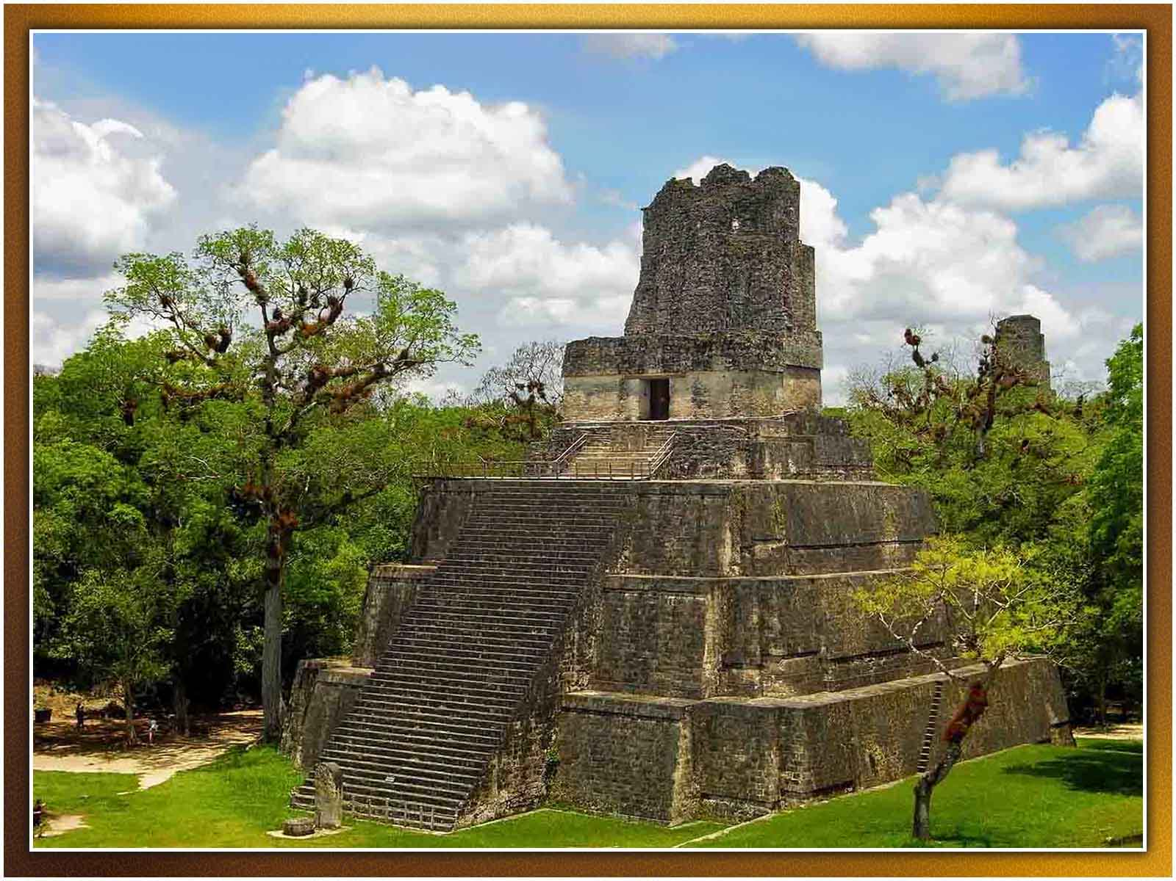
Ben Belske
ORIGIN

Slide 19
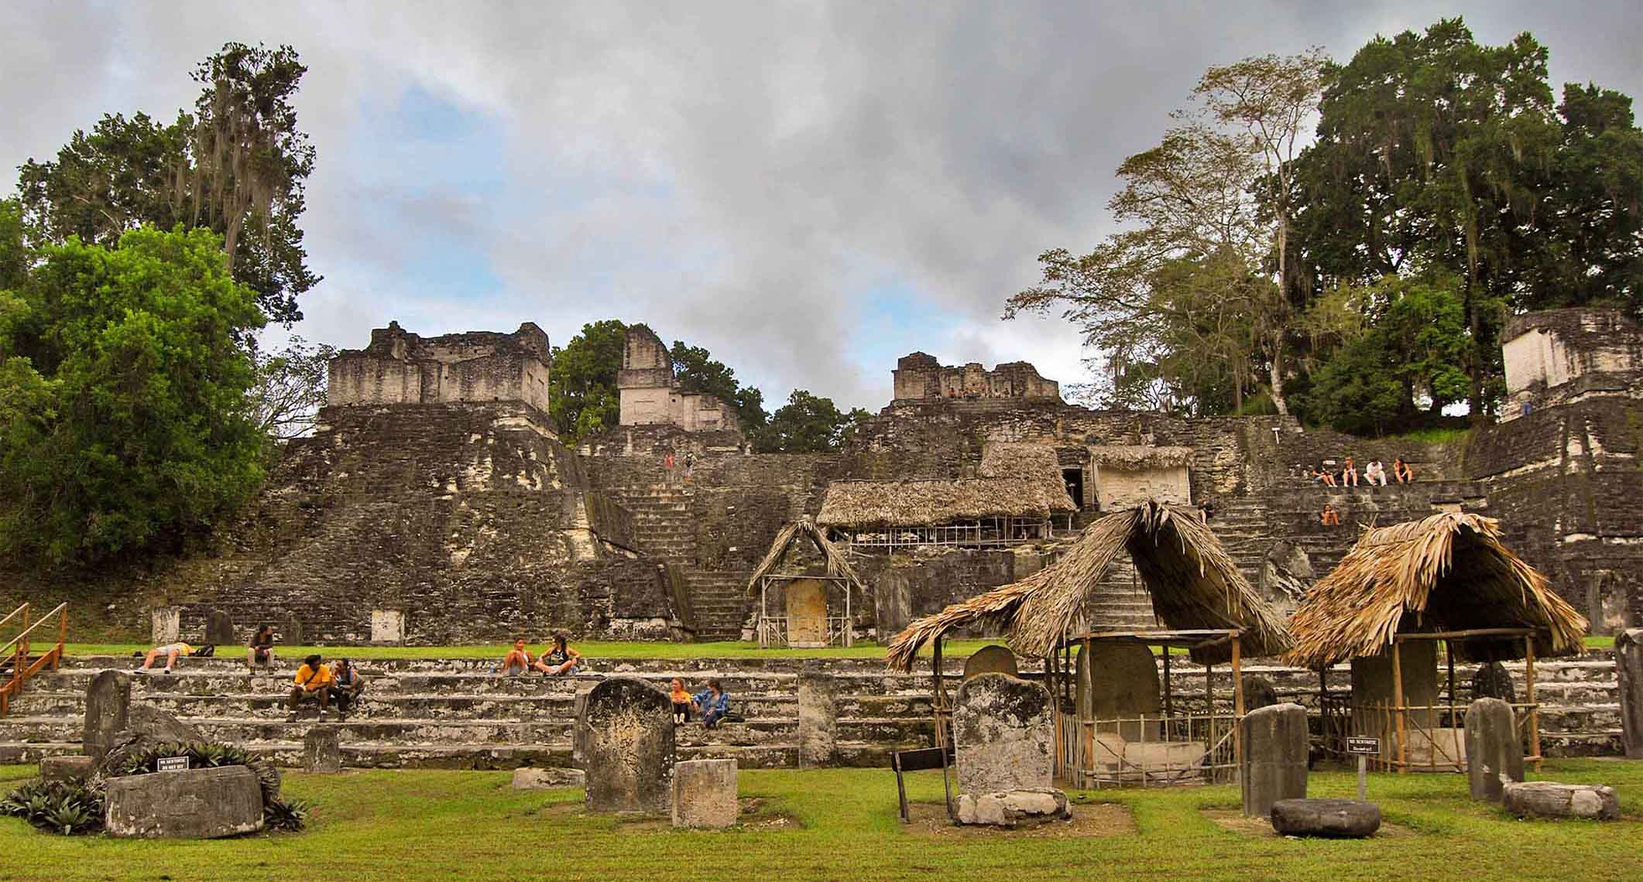
Zhu
ORIGIN

Slide 20
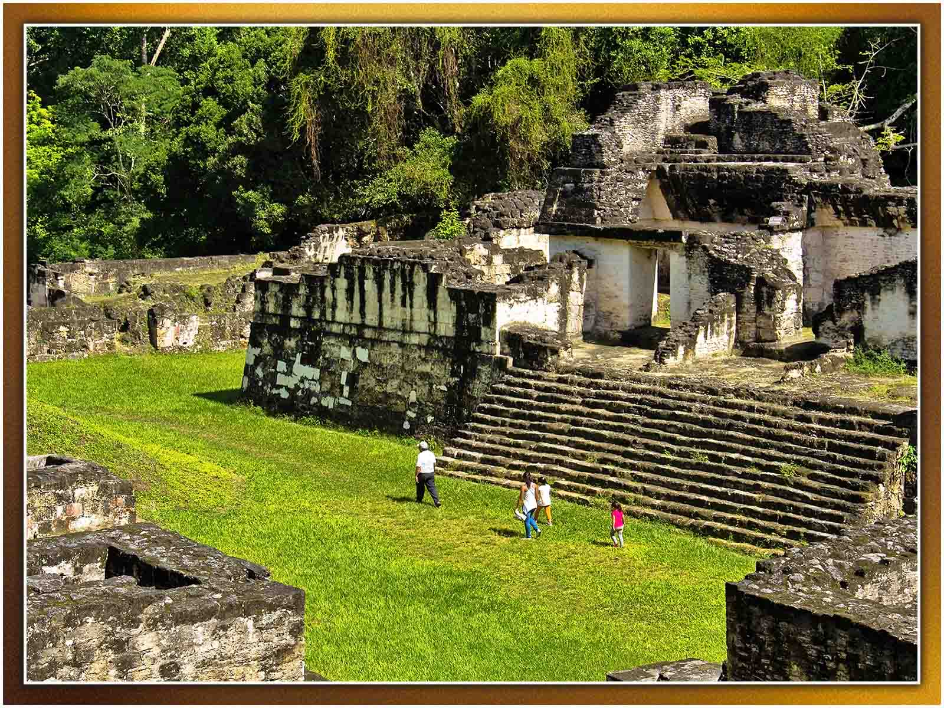
Guillén Pérez
ORIGIN

Slide 21
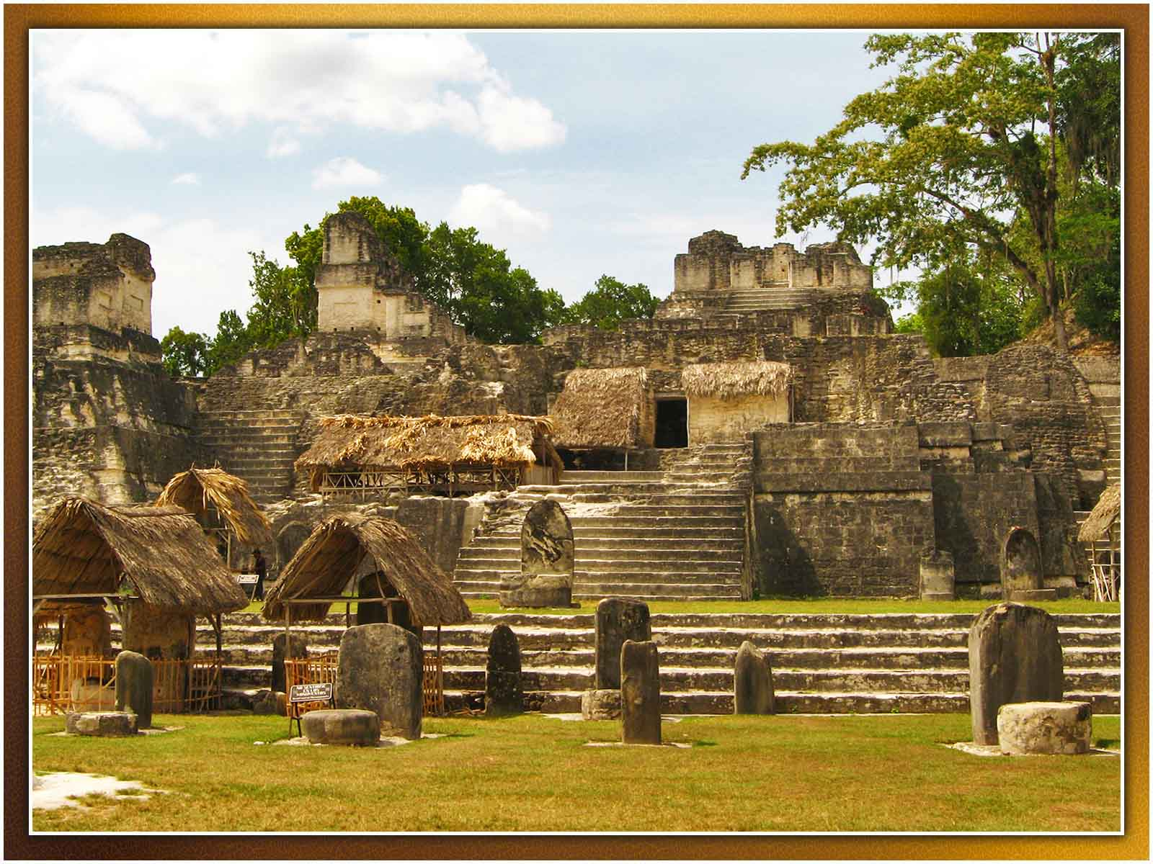
Hector Garcia
ORIGIN

Slide 22
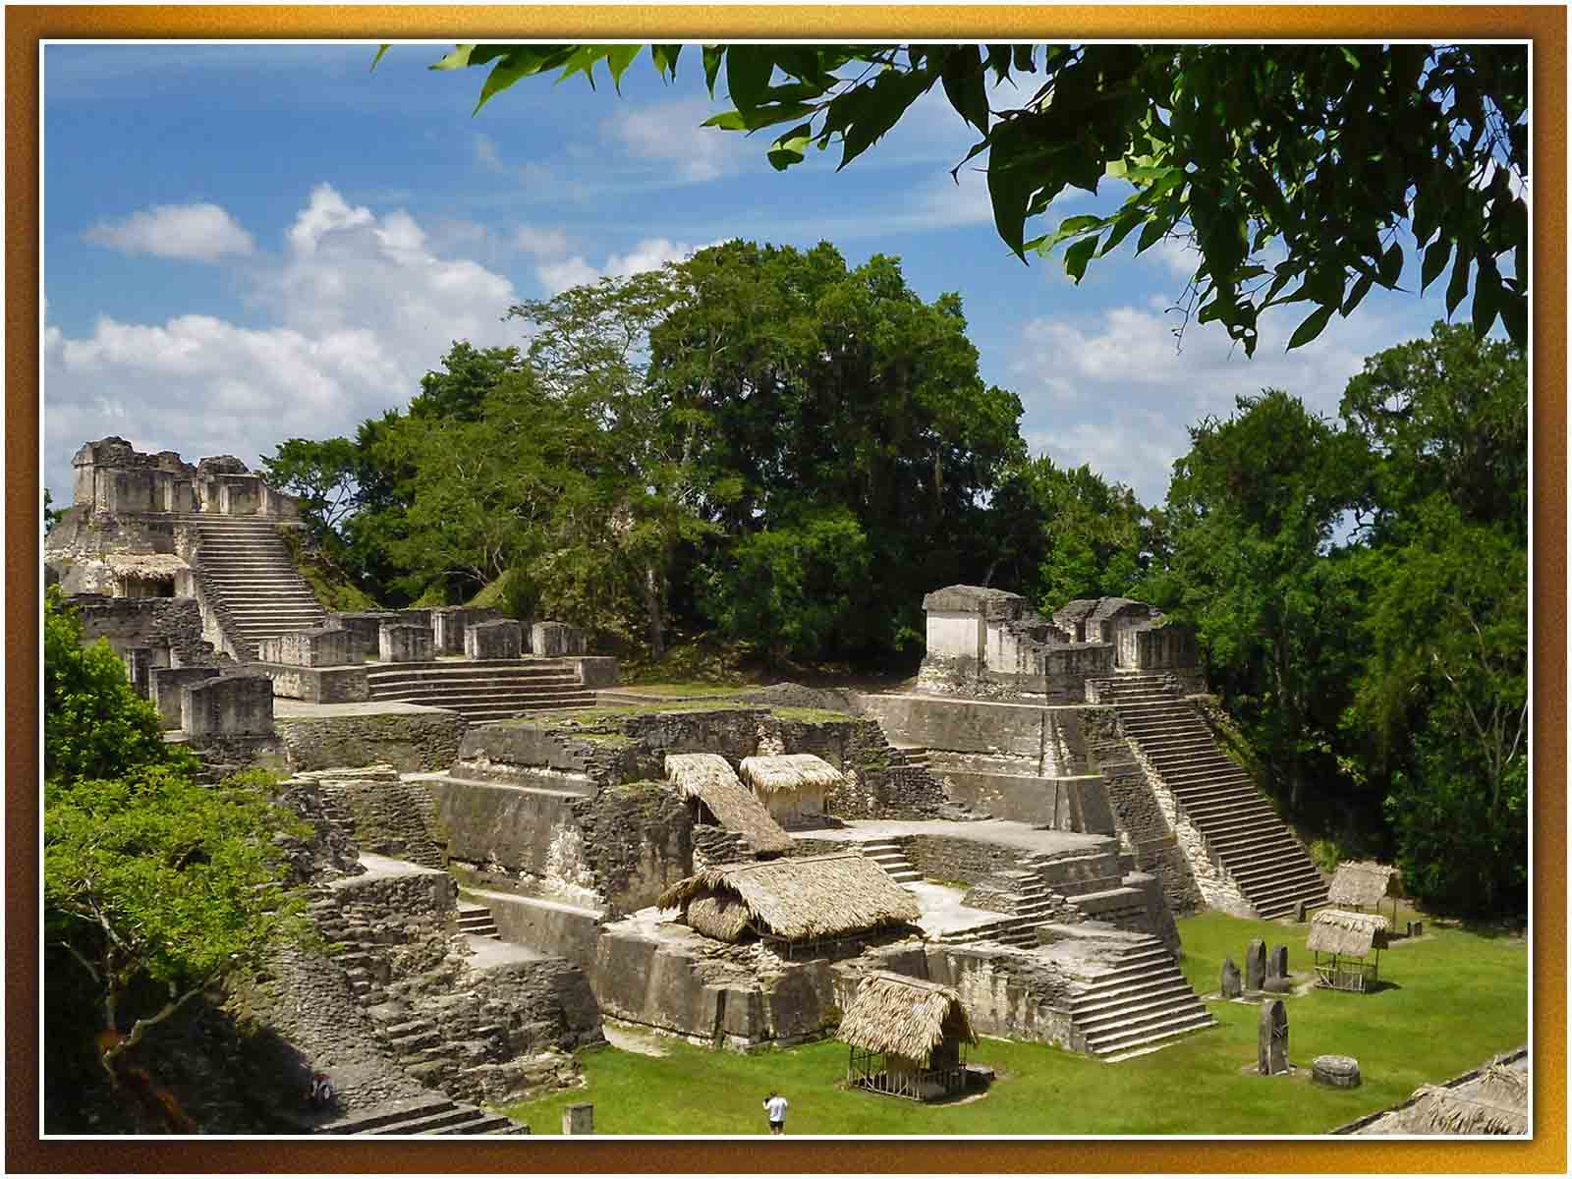
Veronica Vera
ORIGIN

Slide 23
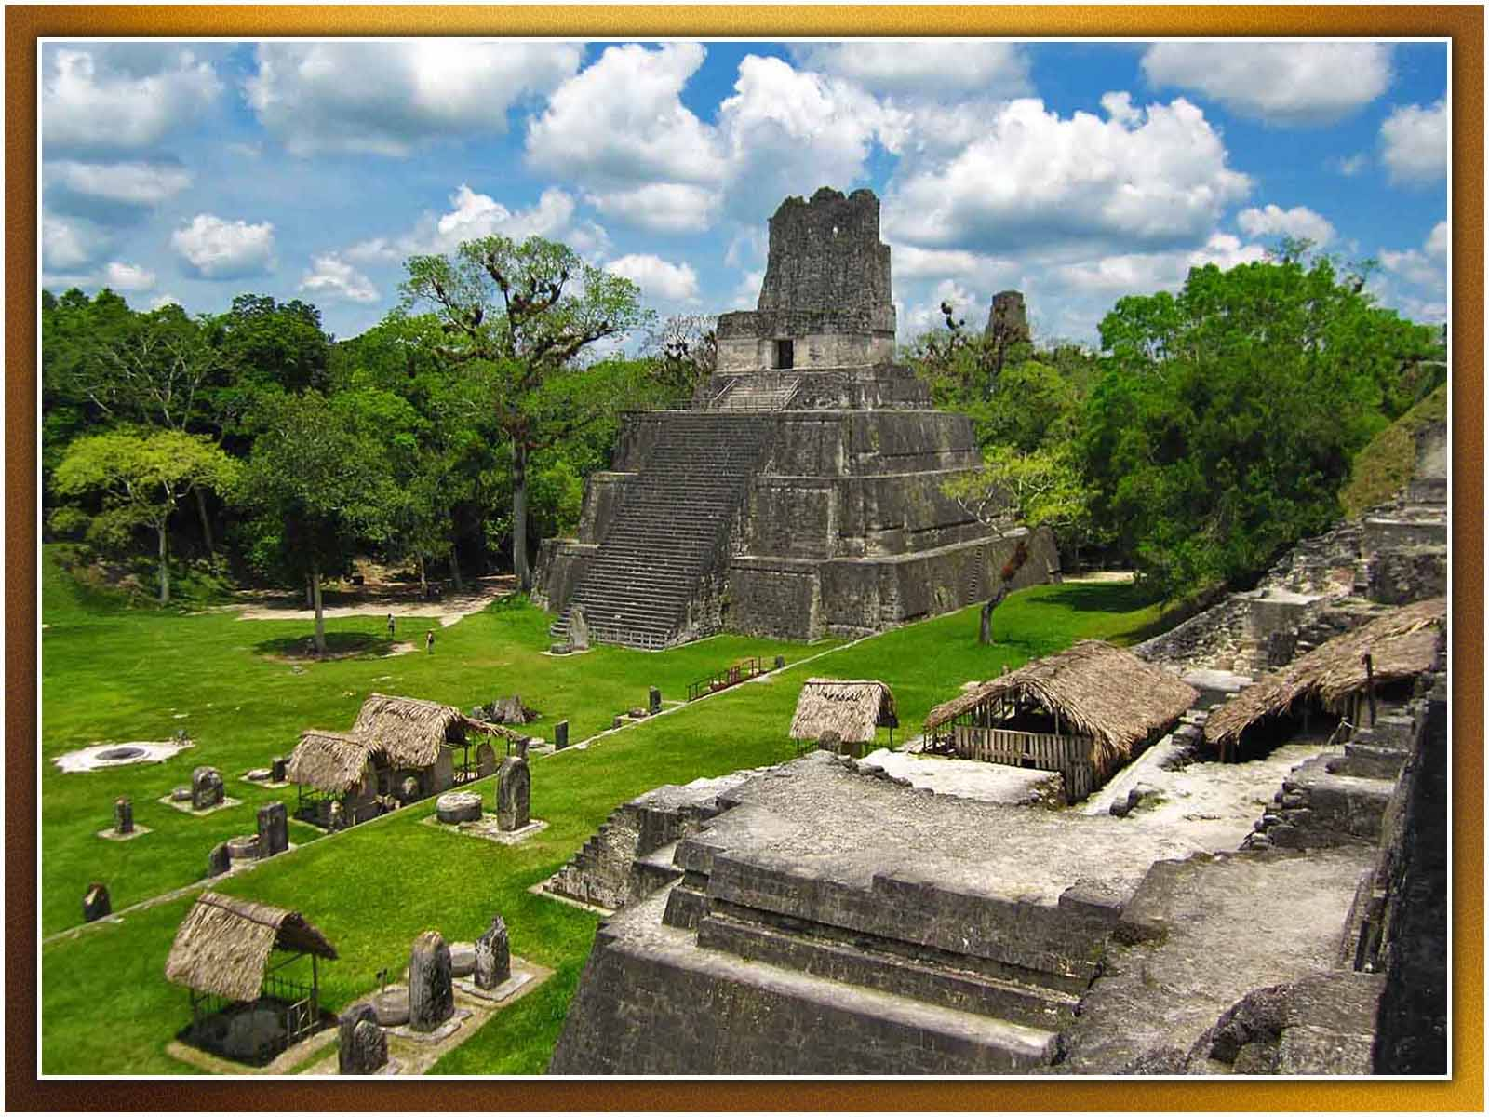
Ben Belske
ORIGIN

Slide 24
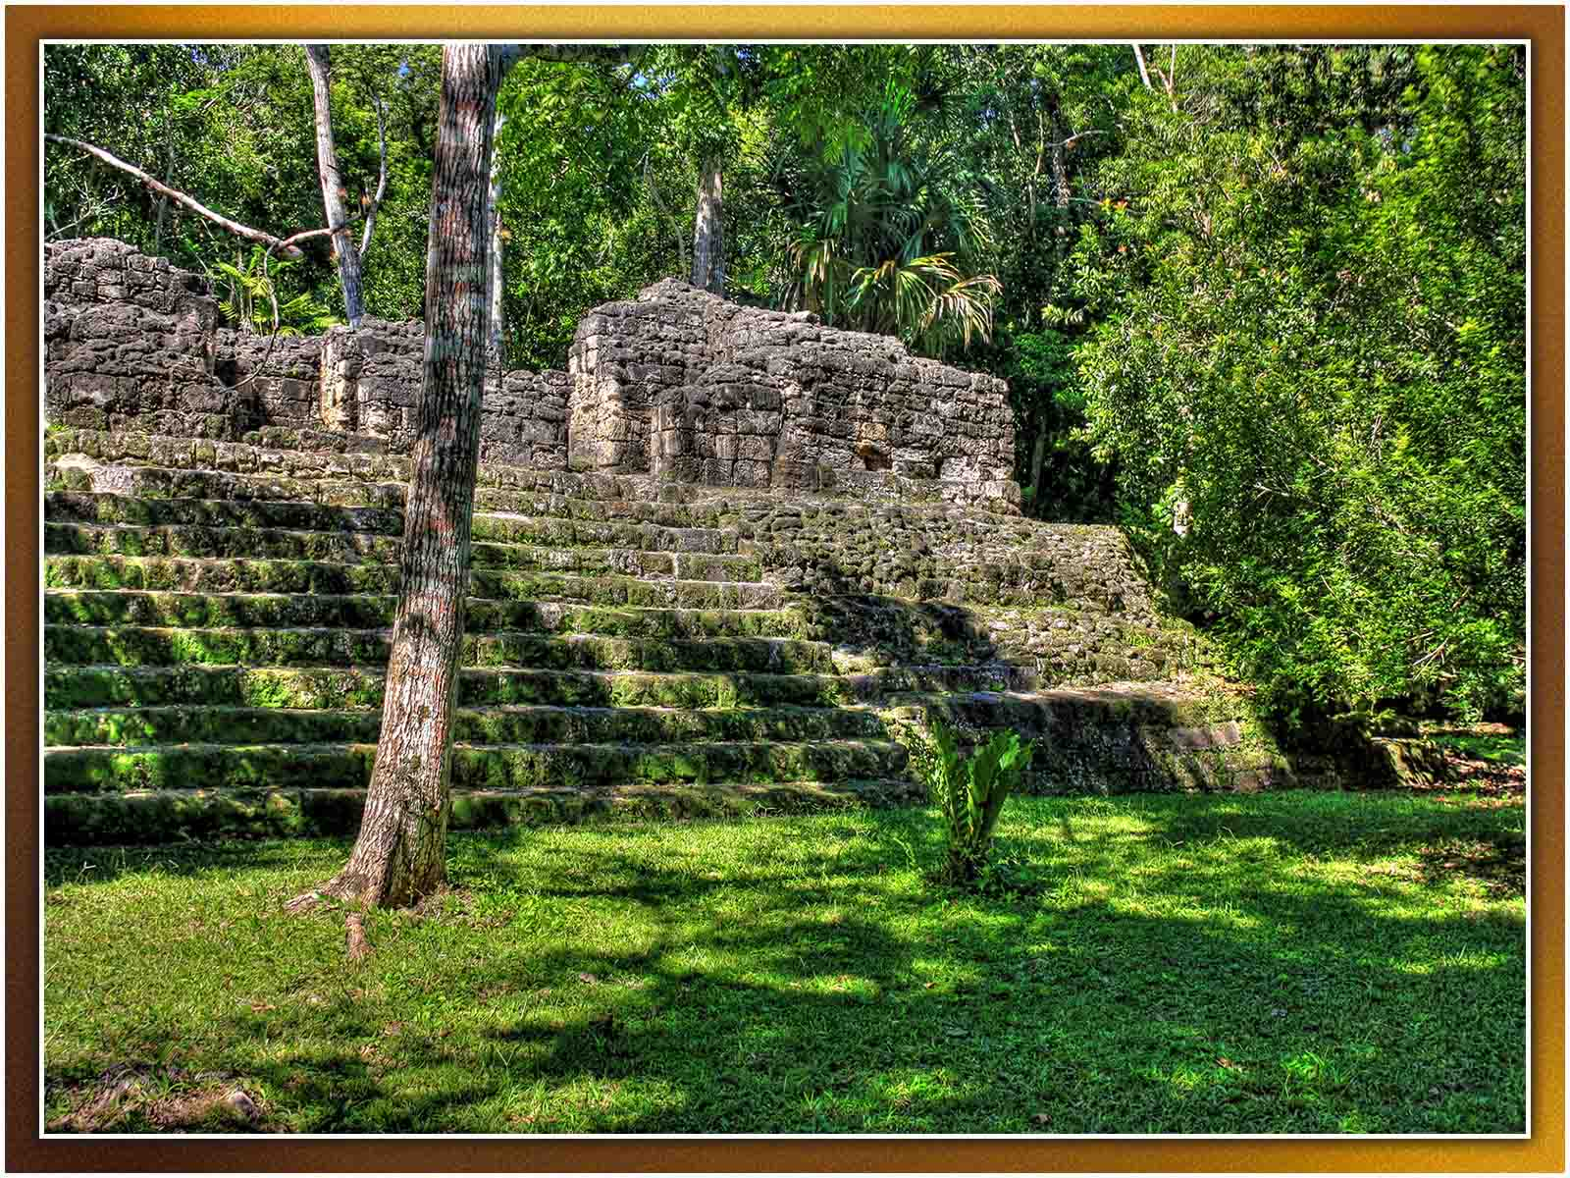
Daniel Mennerich
ORIGIN

Slide 25
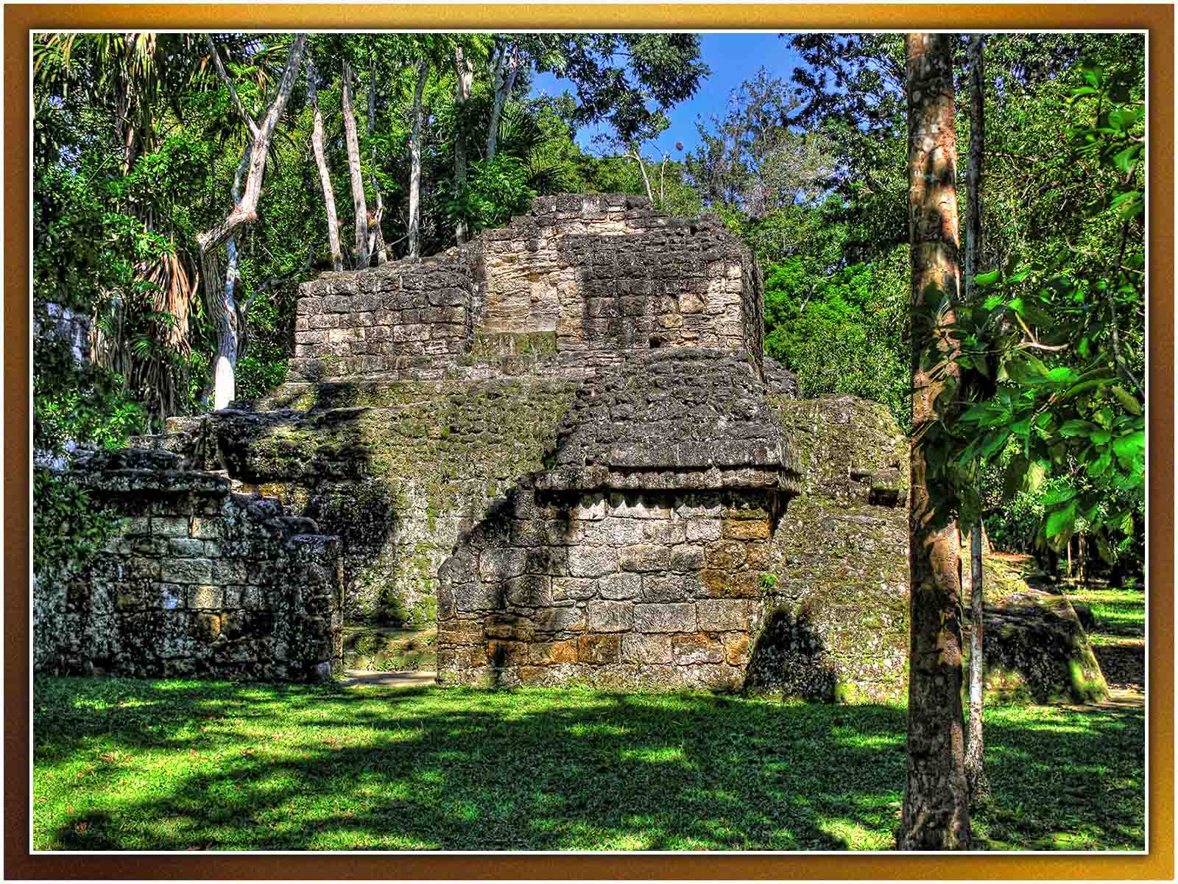
Daniel Mennerich
ORIGIN

Slide 26
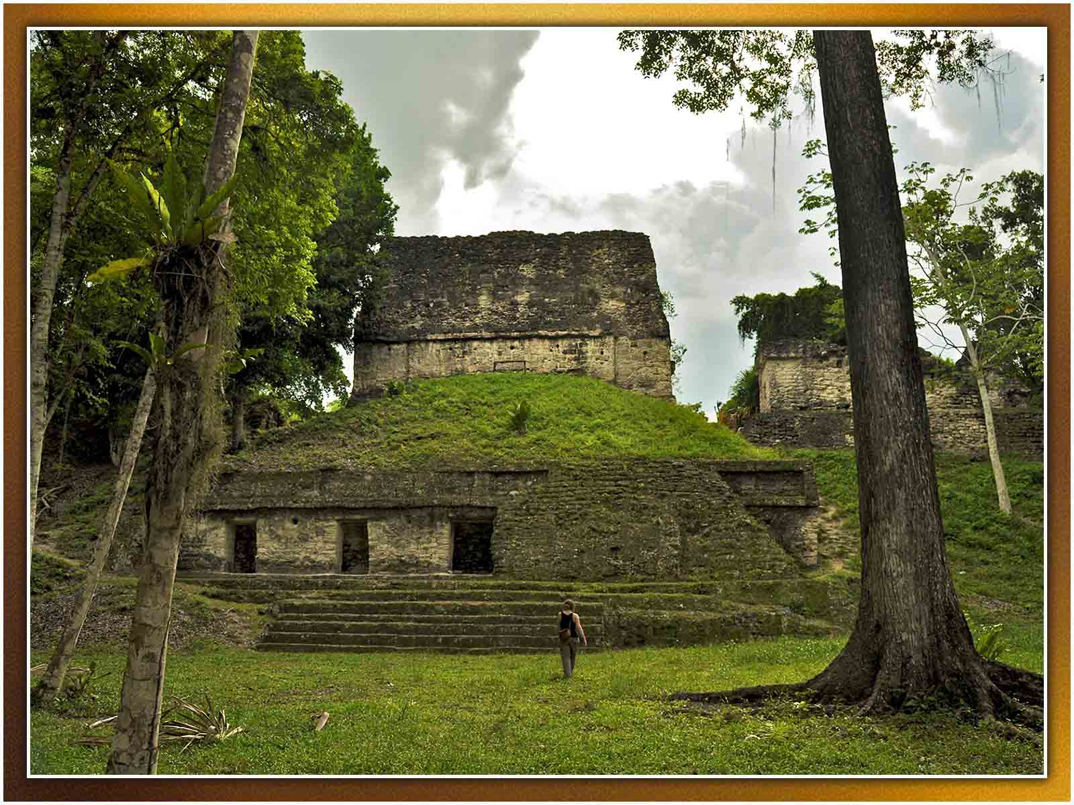
Mario Bollini
ORIGIN

Slide 27
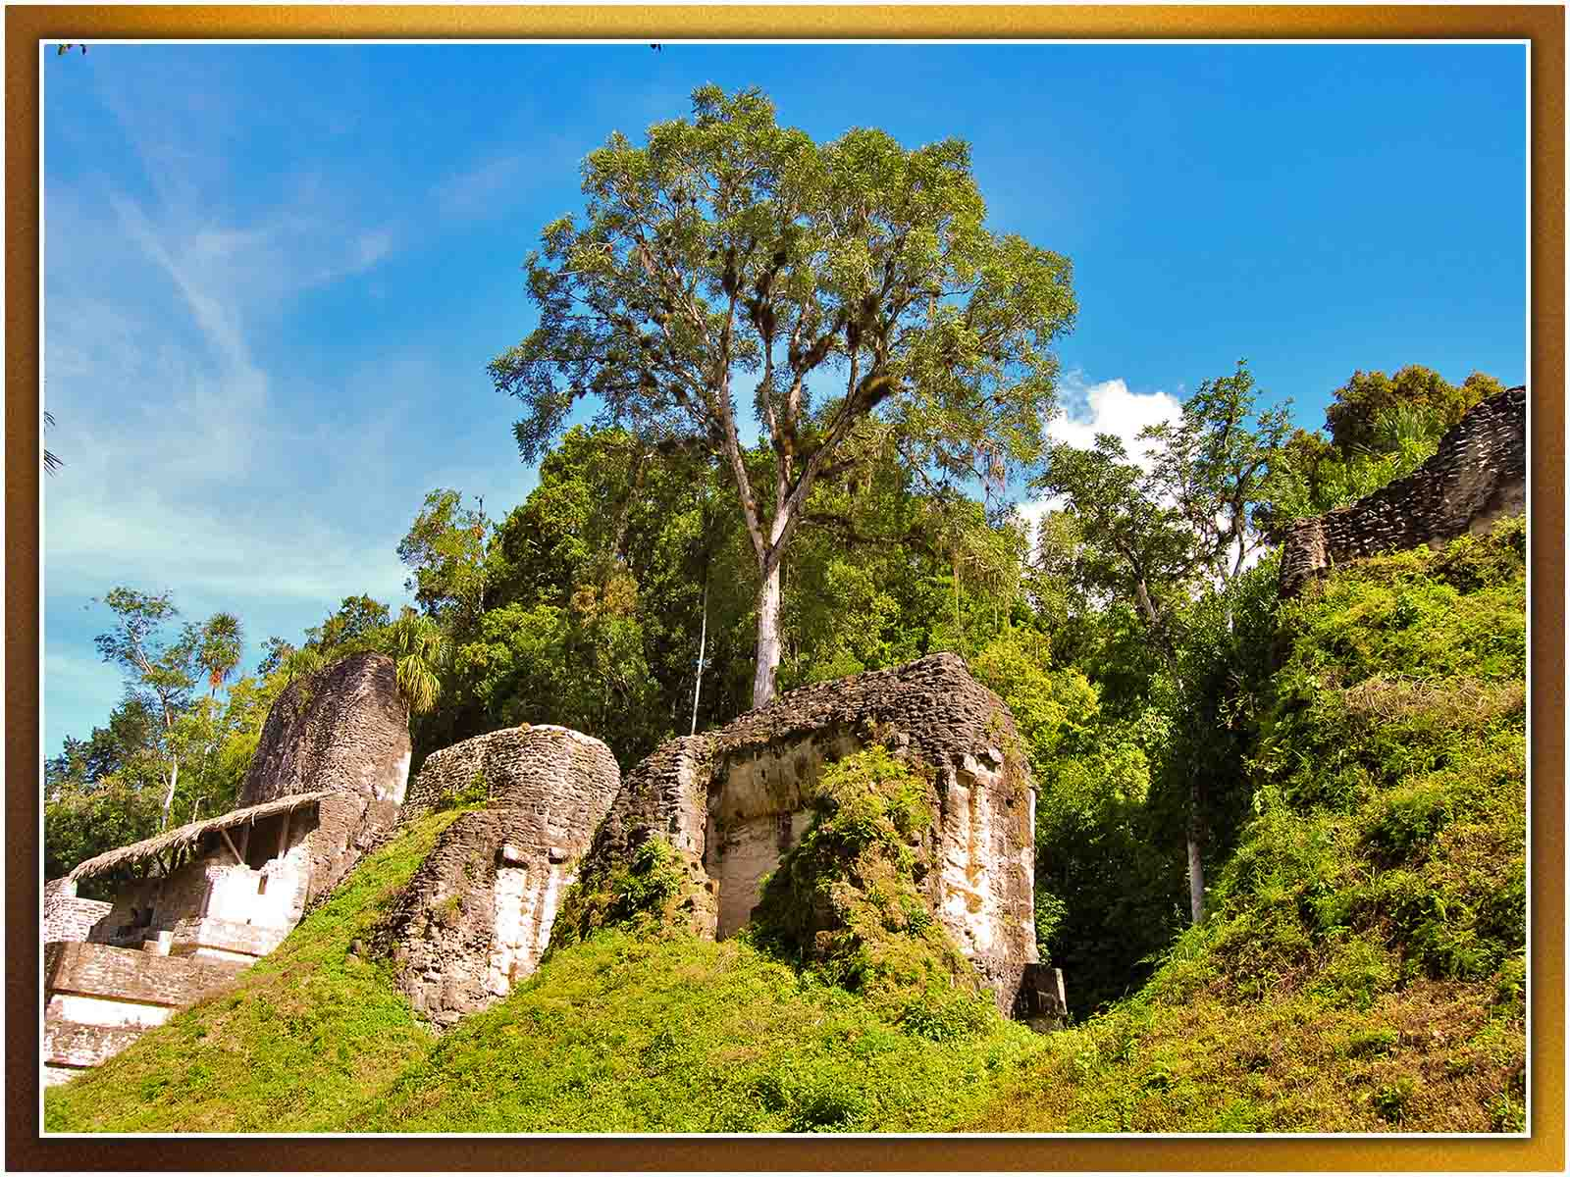
Zhu
ORIGIN

Slide 28
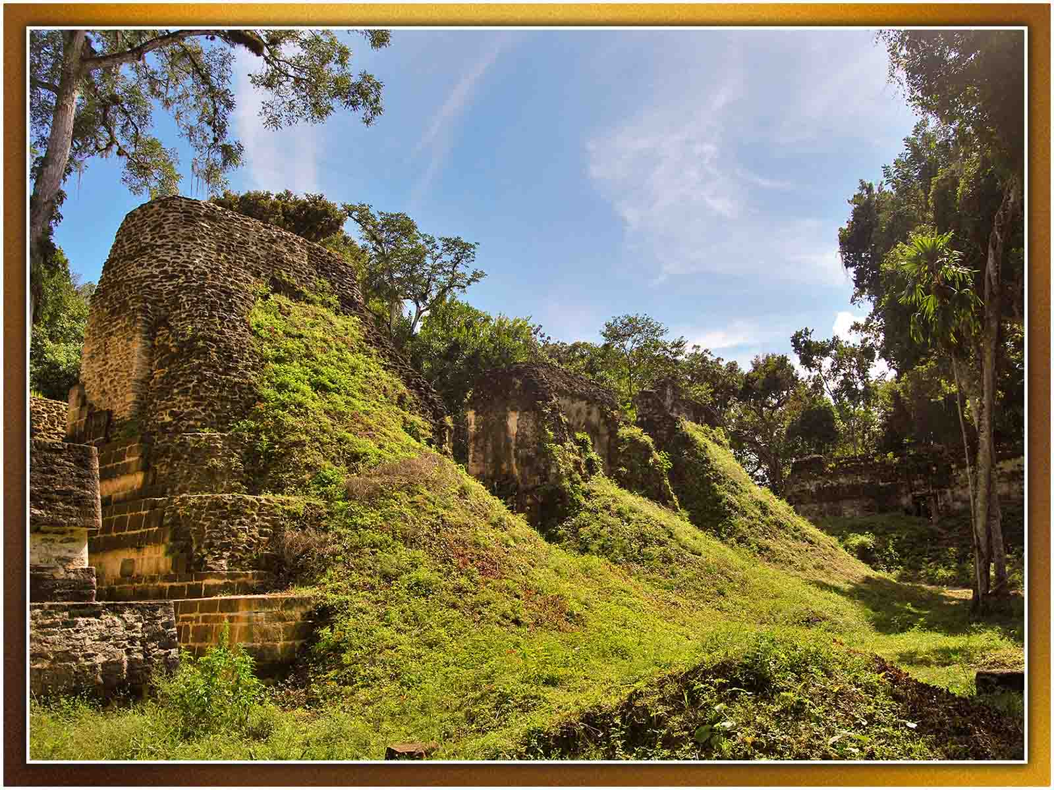
Zhu
ORIGIN

Slide 29
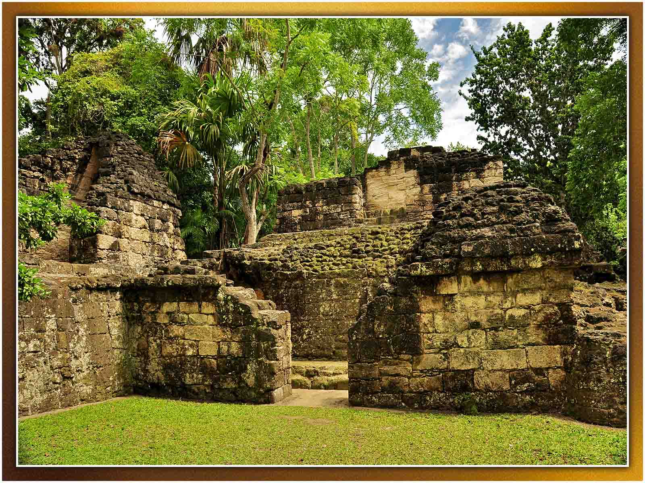
Mario Bollini
ORIGIN

Slide 30
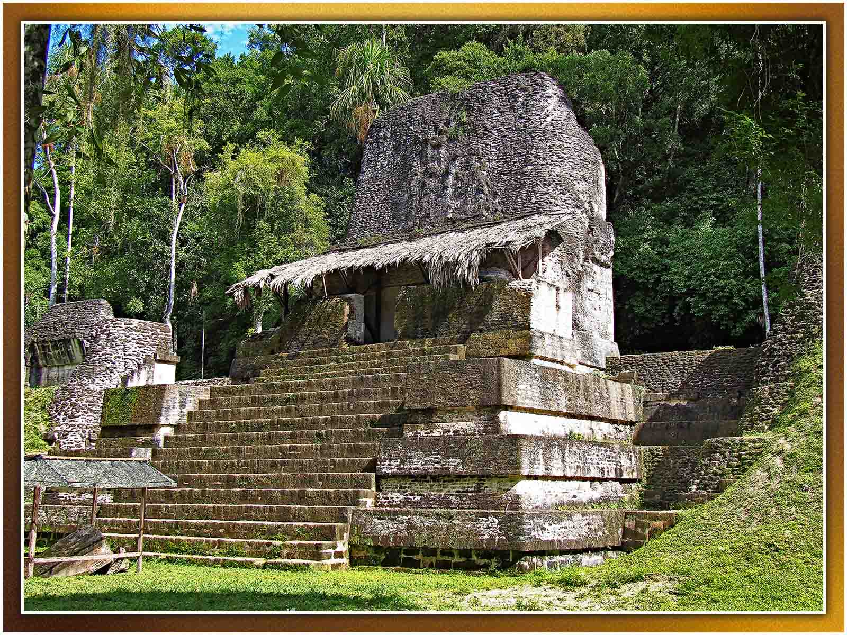
Jeremy Seto
ORIGIN

Slide 31
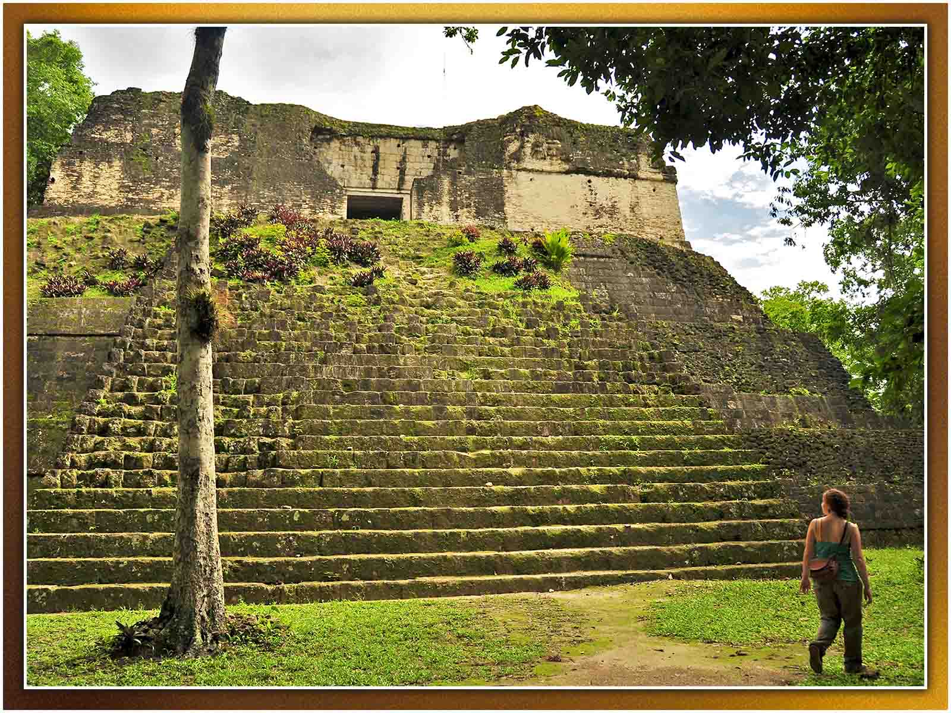
Mario Bollini
ORIGIN

Slide 32
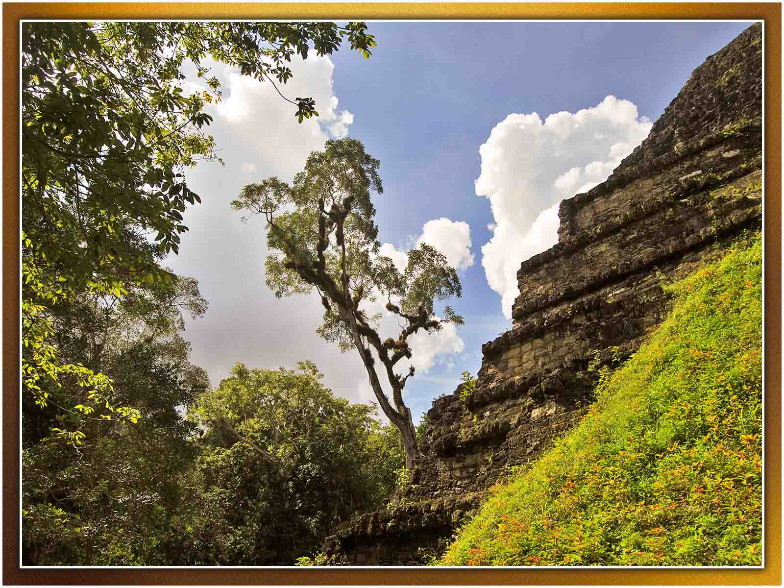
Zhu
ORIGIN

Slide 33
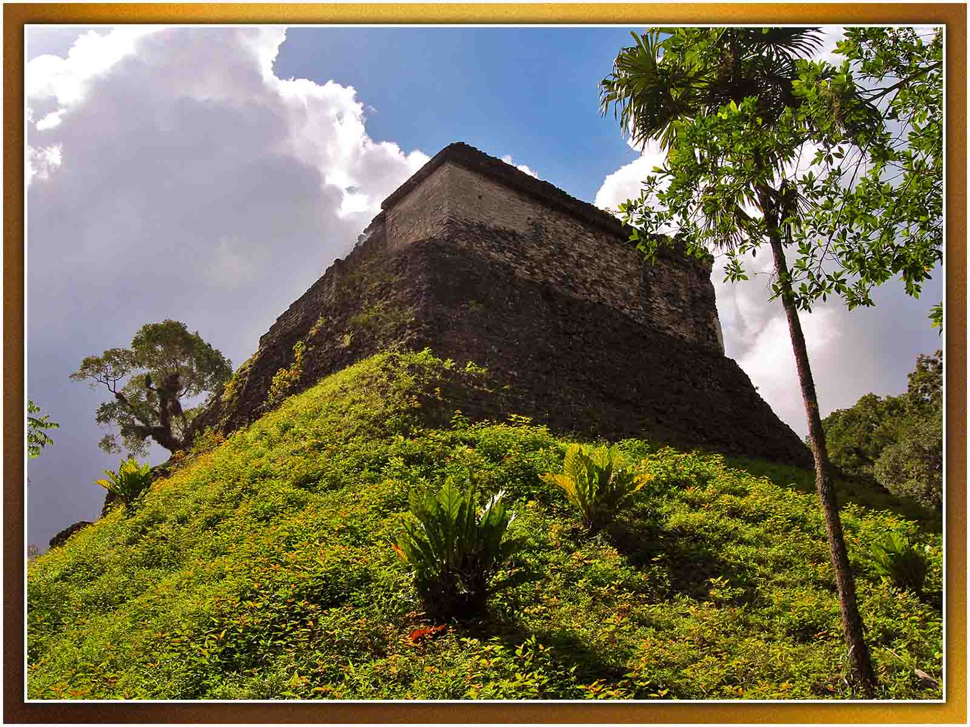
Zhu
ORIGIN

Slide 34
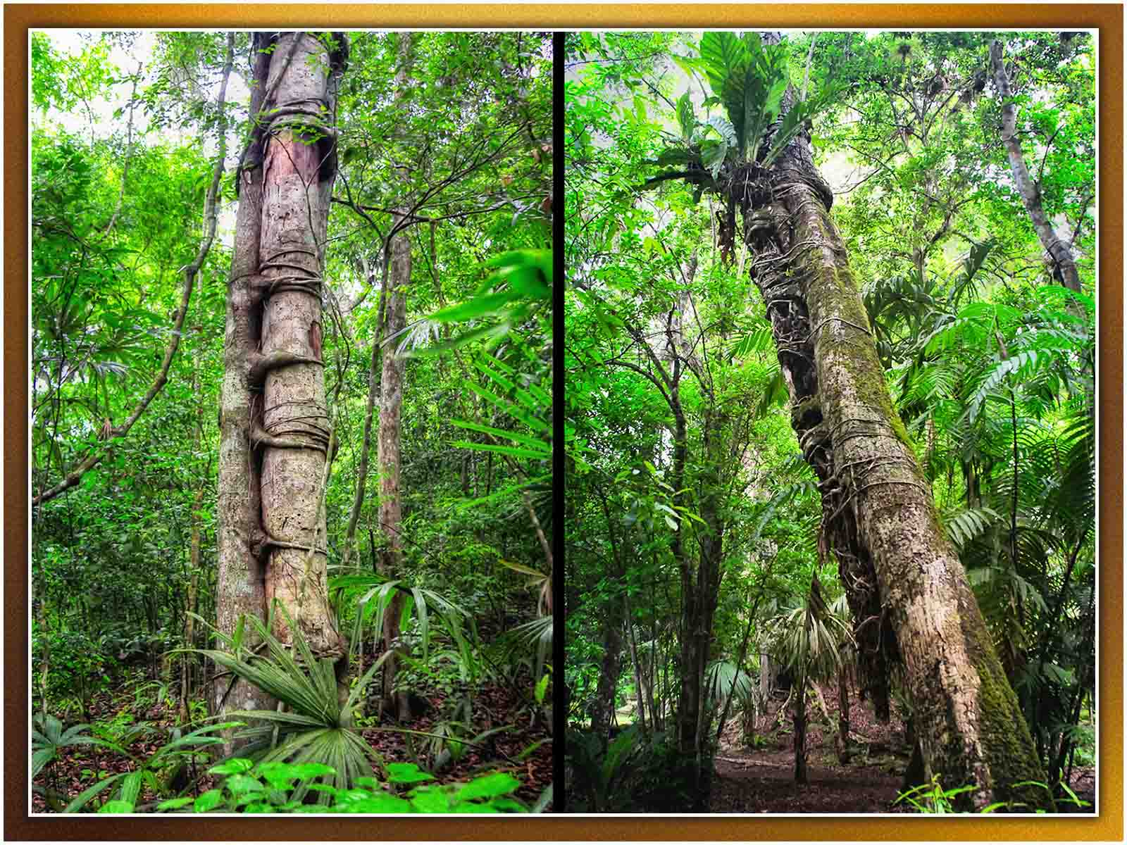
Pedro Szekely
ORIGIN

Slide 35
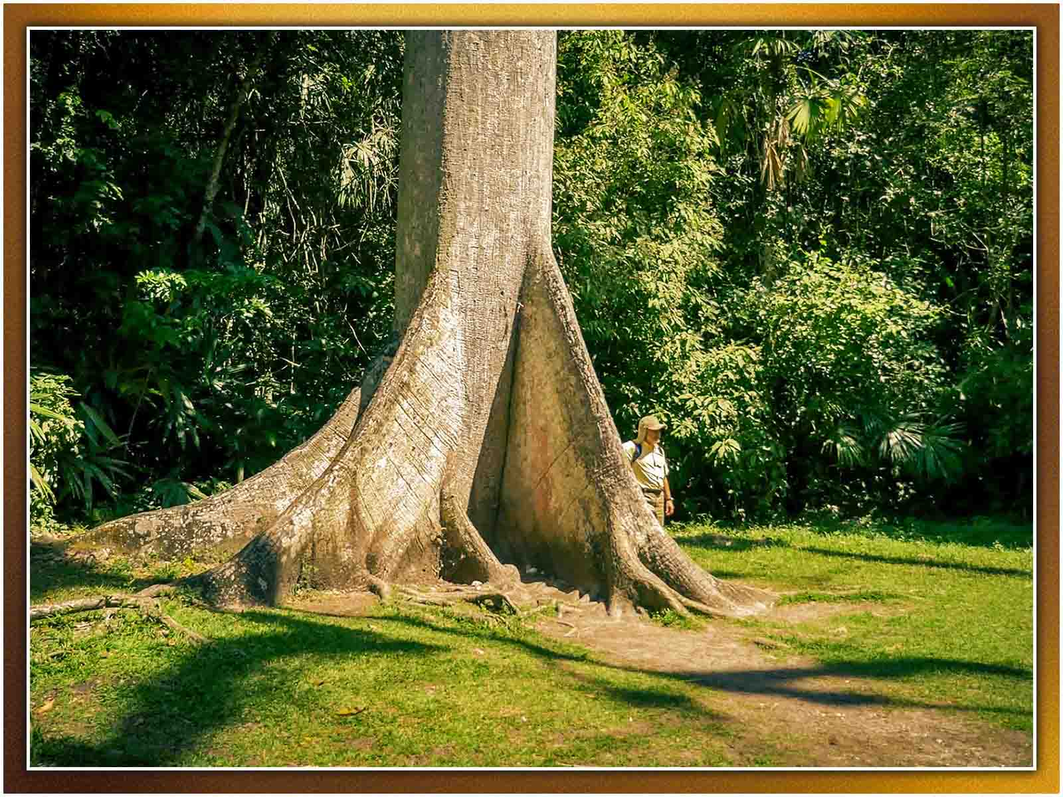
Milan Škrob
ORIGIN

Slide 36
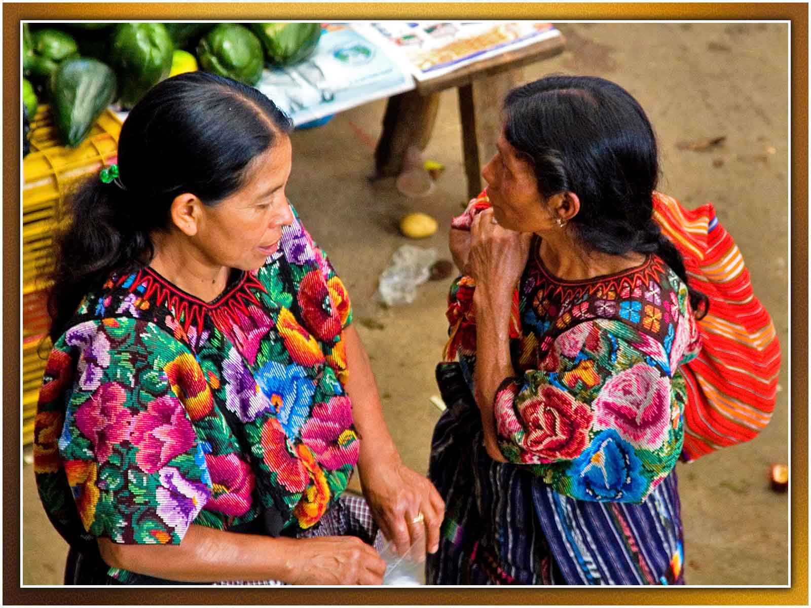
Ismael Alonso
ORIGIN

Slide 37
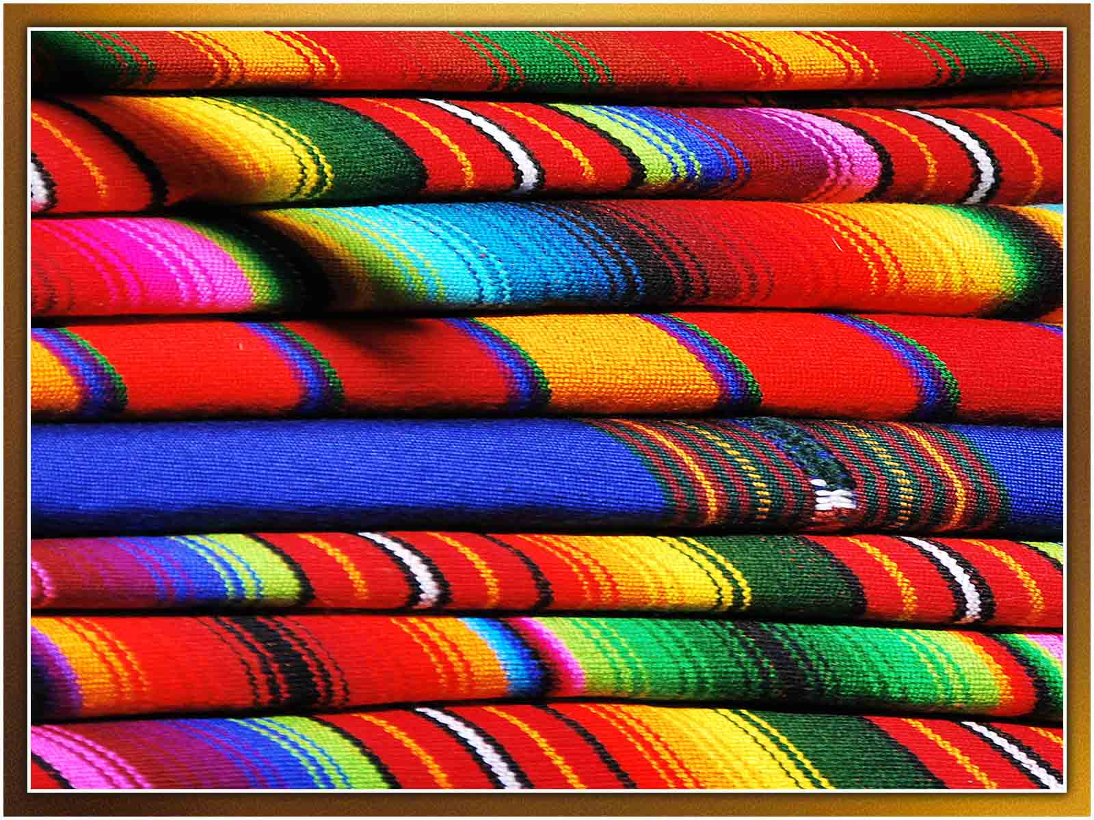
Zhu
ORIGIN

Slide 38
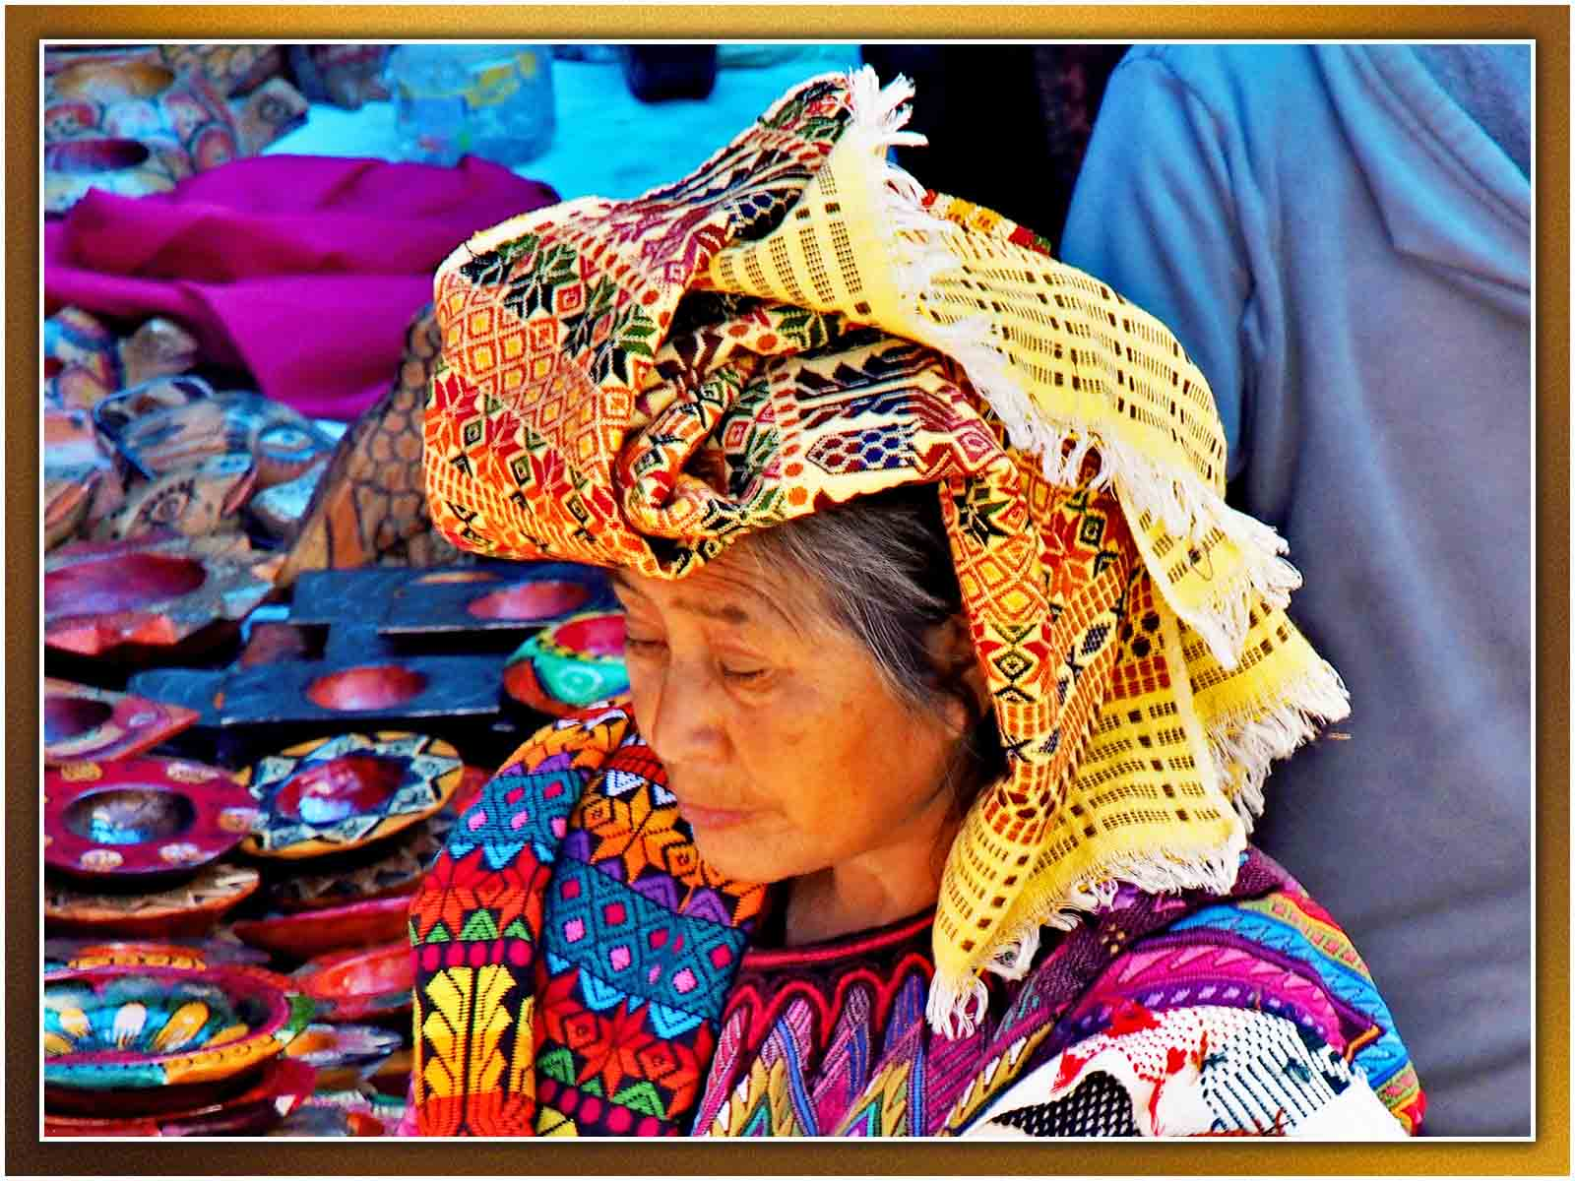
Jeremy Seto
ORIGIN

Slide 39

À LA PROCHAINE
SAUVER LA TERRE
N E X T
F I N
Non pour un usage commercial! / Photos à partir d'Internet / Musique : folclore de Guatemala
tomi55jutt@mail.com

