Slide 1


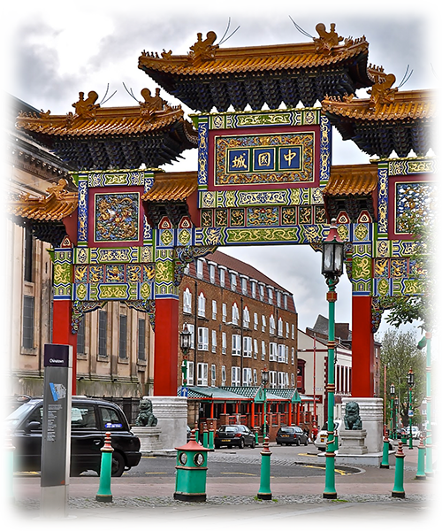

VOIR LE MONDE AVEC MOI
SAUVER LA TERRE
GRANDE BRATAGNE
Liverpool
Liverpool
01
Tommy55

Slide 2

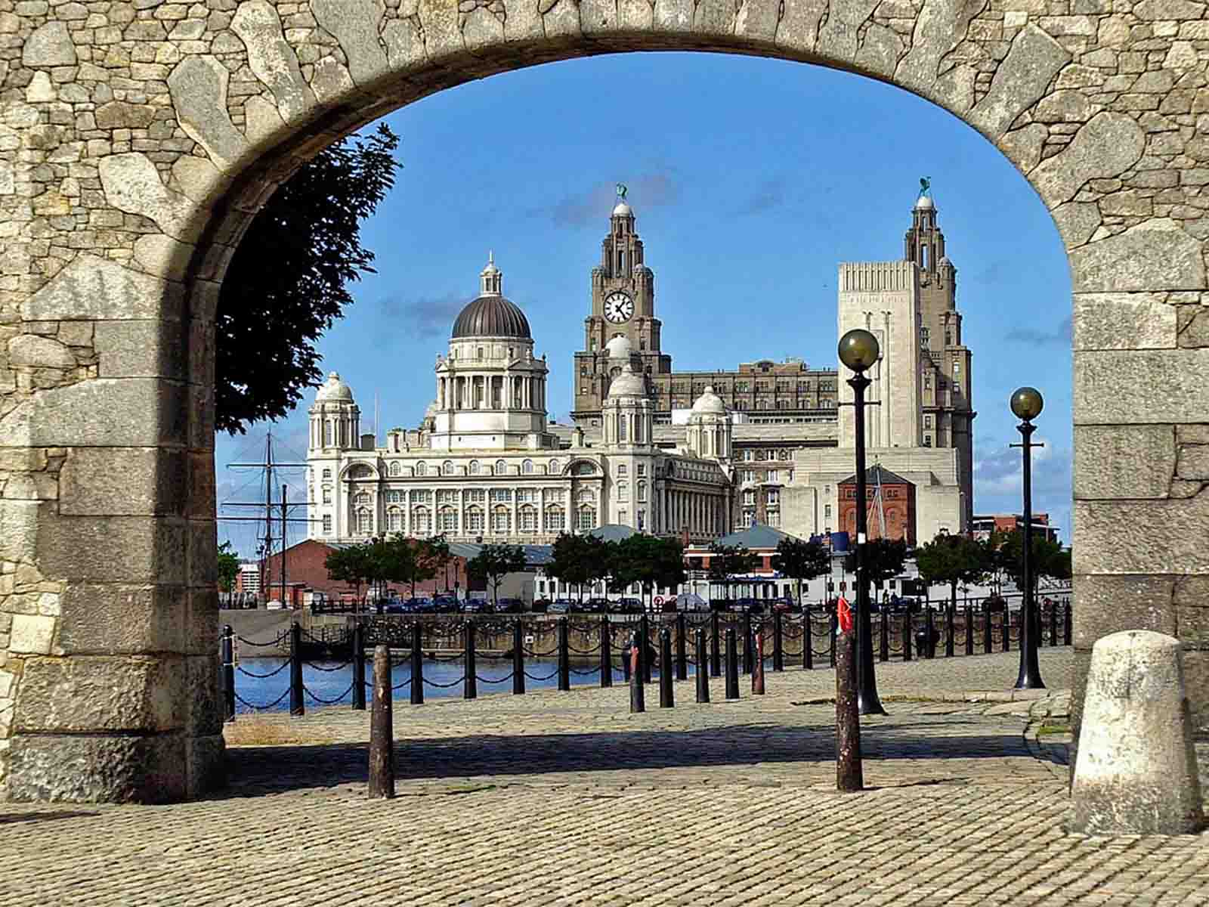
View Across Salthouse Dock
(Pool of Life)
ORIGIN

Slide 3
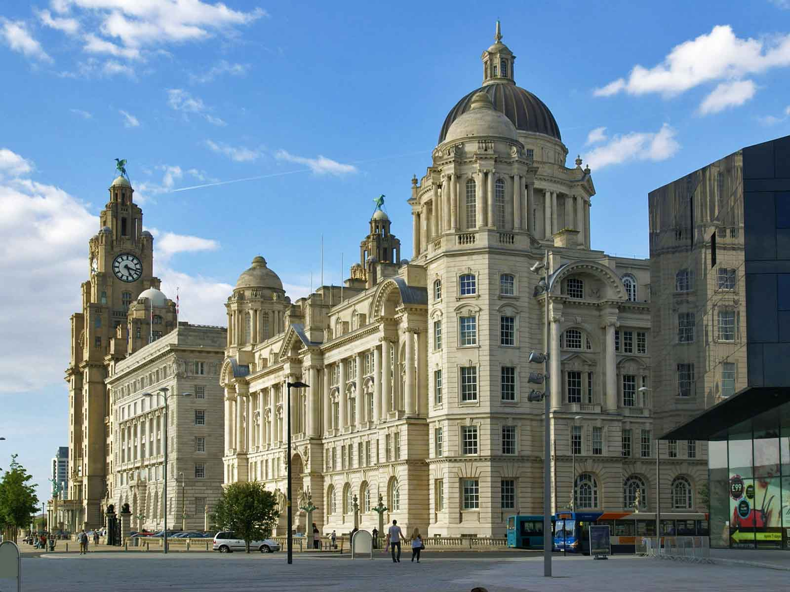
Buildings of Pier Head
(World Countries)
ORIGIN

Slide 4
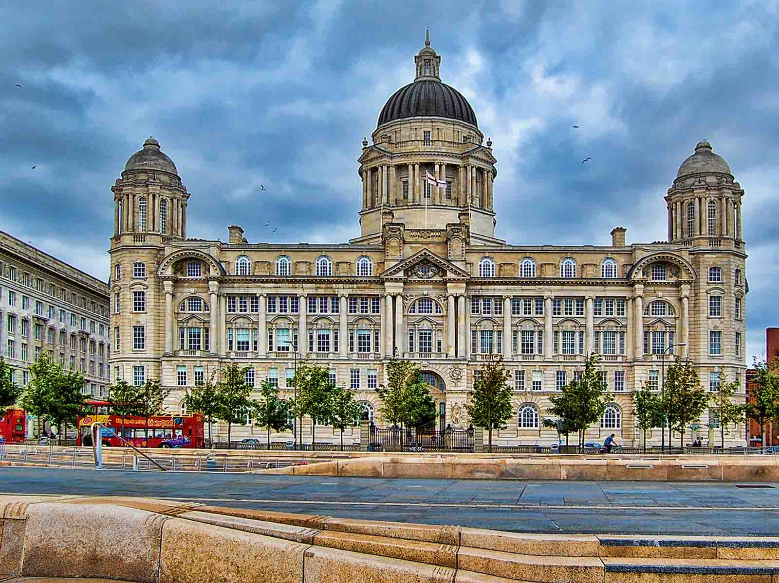
Liverpool Port Building
(Psyche Della - Flickr)
ORIGIN

Slide 5
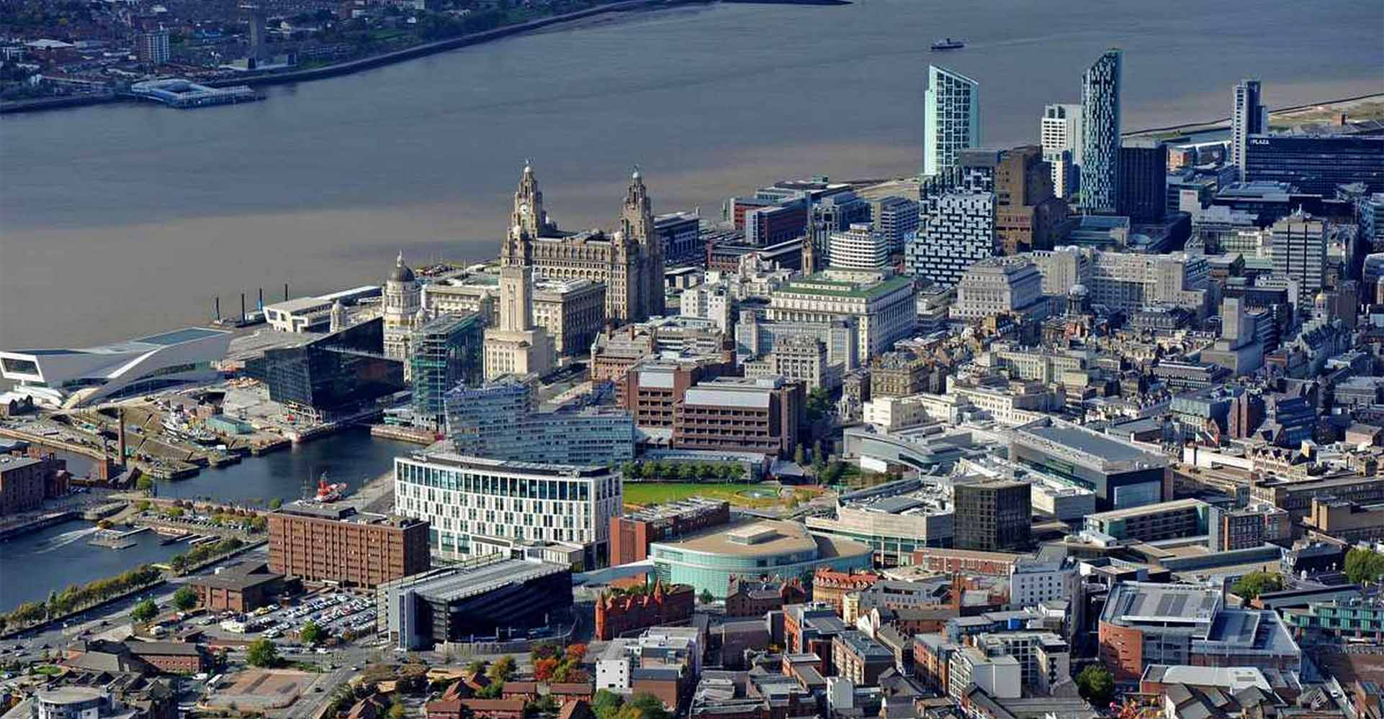
City Centre
(YB News)
ORIGIN

Slide 6
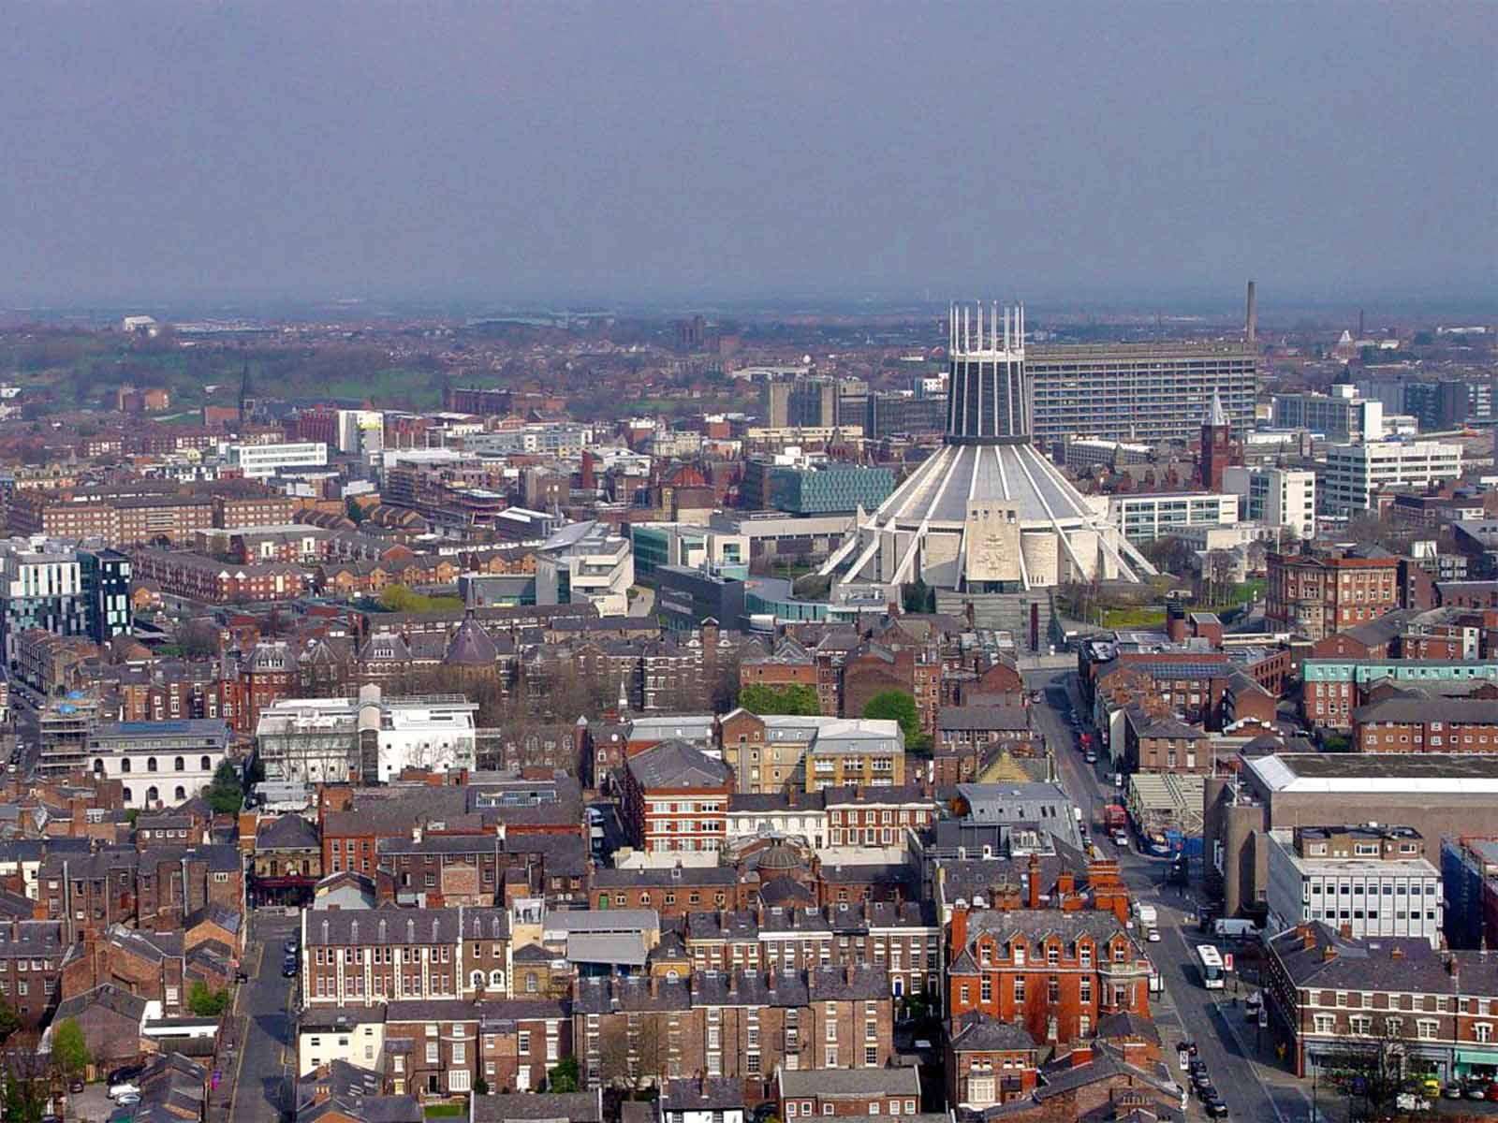
View from the Anglican Cathedral Tower
(Ronnie Hughes)
ORIGIN

Slide 7
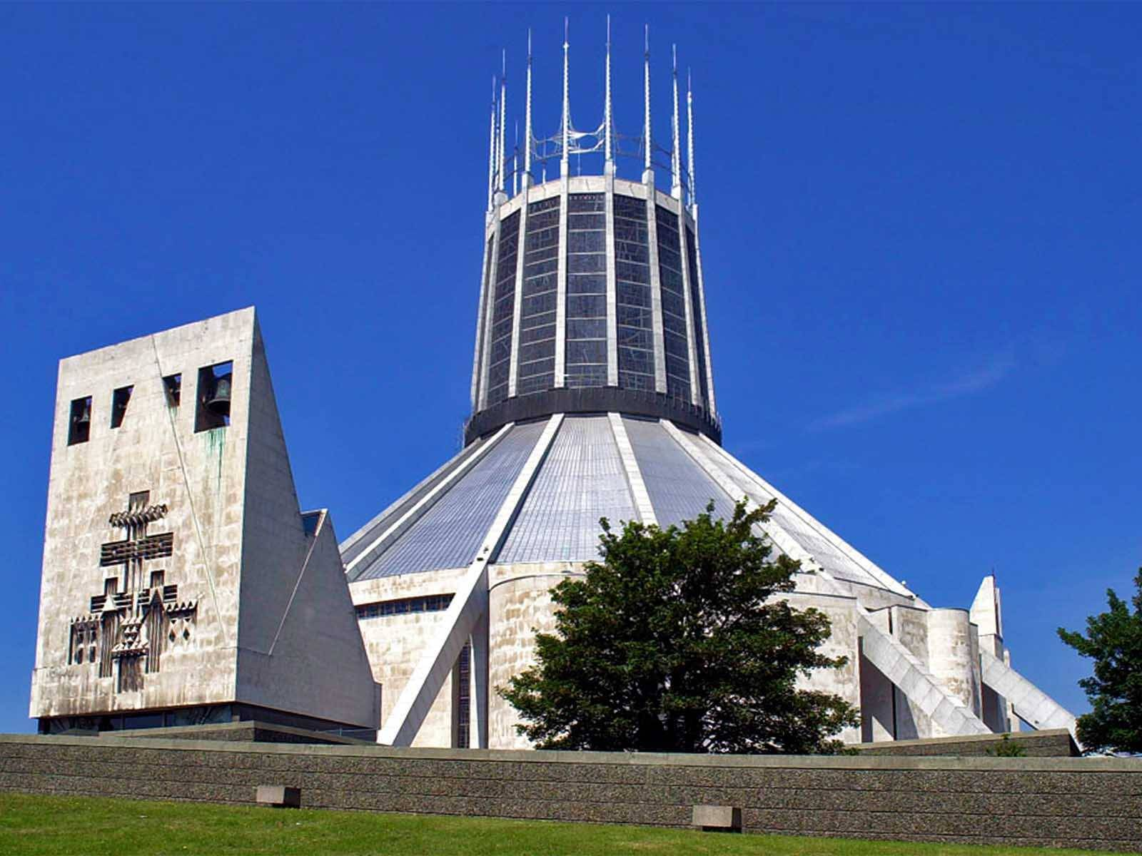
Metropolitan Cathedral
(Pool of Life)
ORIGIN

Slide 8
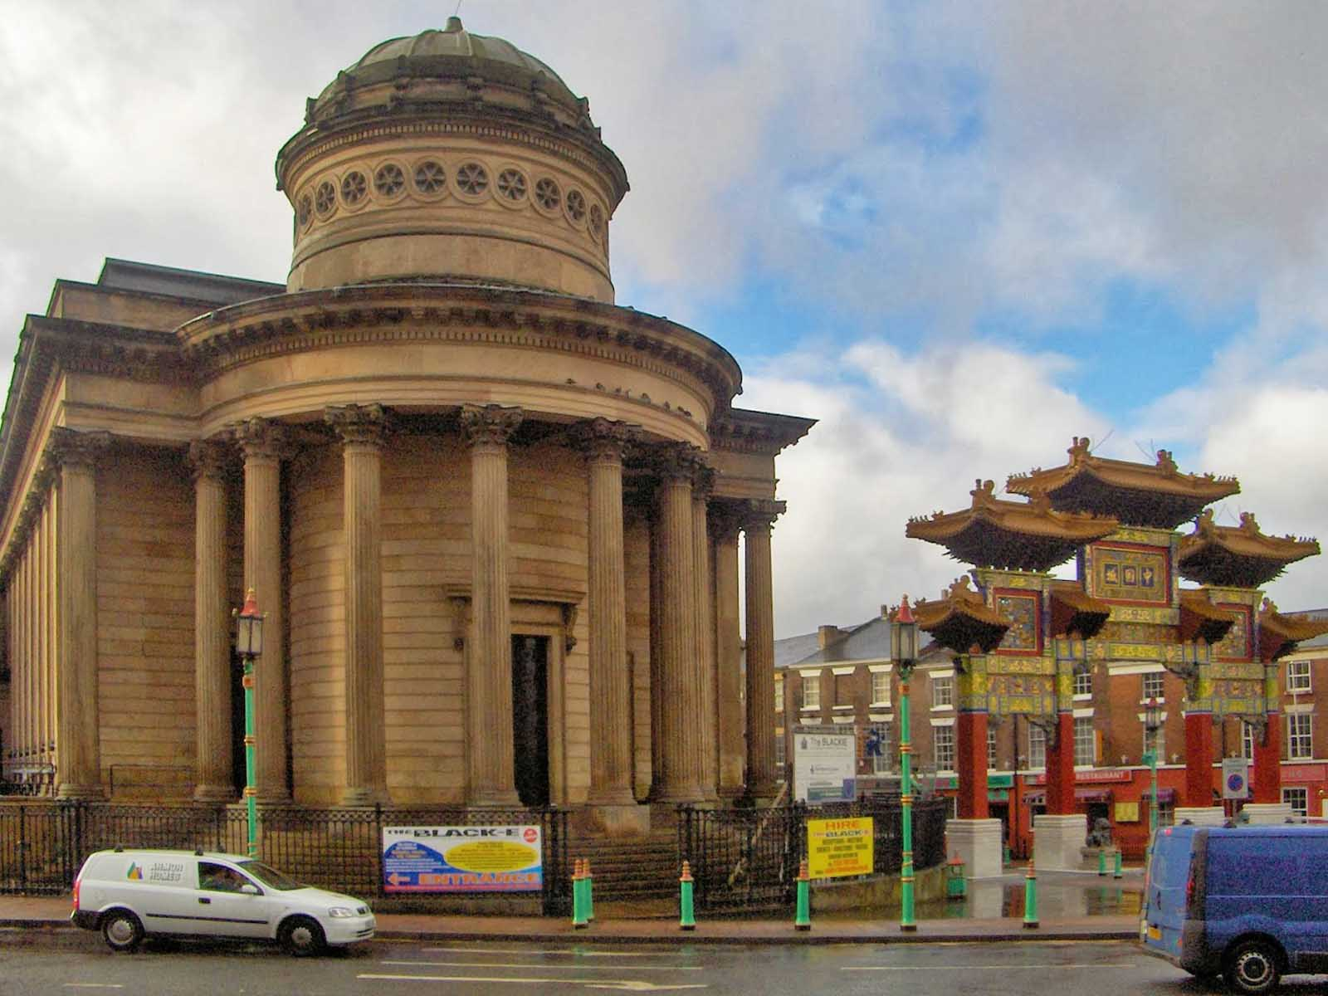
The Black-E Art Centre
(Jorge Gutiérrez)
ORIGIN

Slide 9
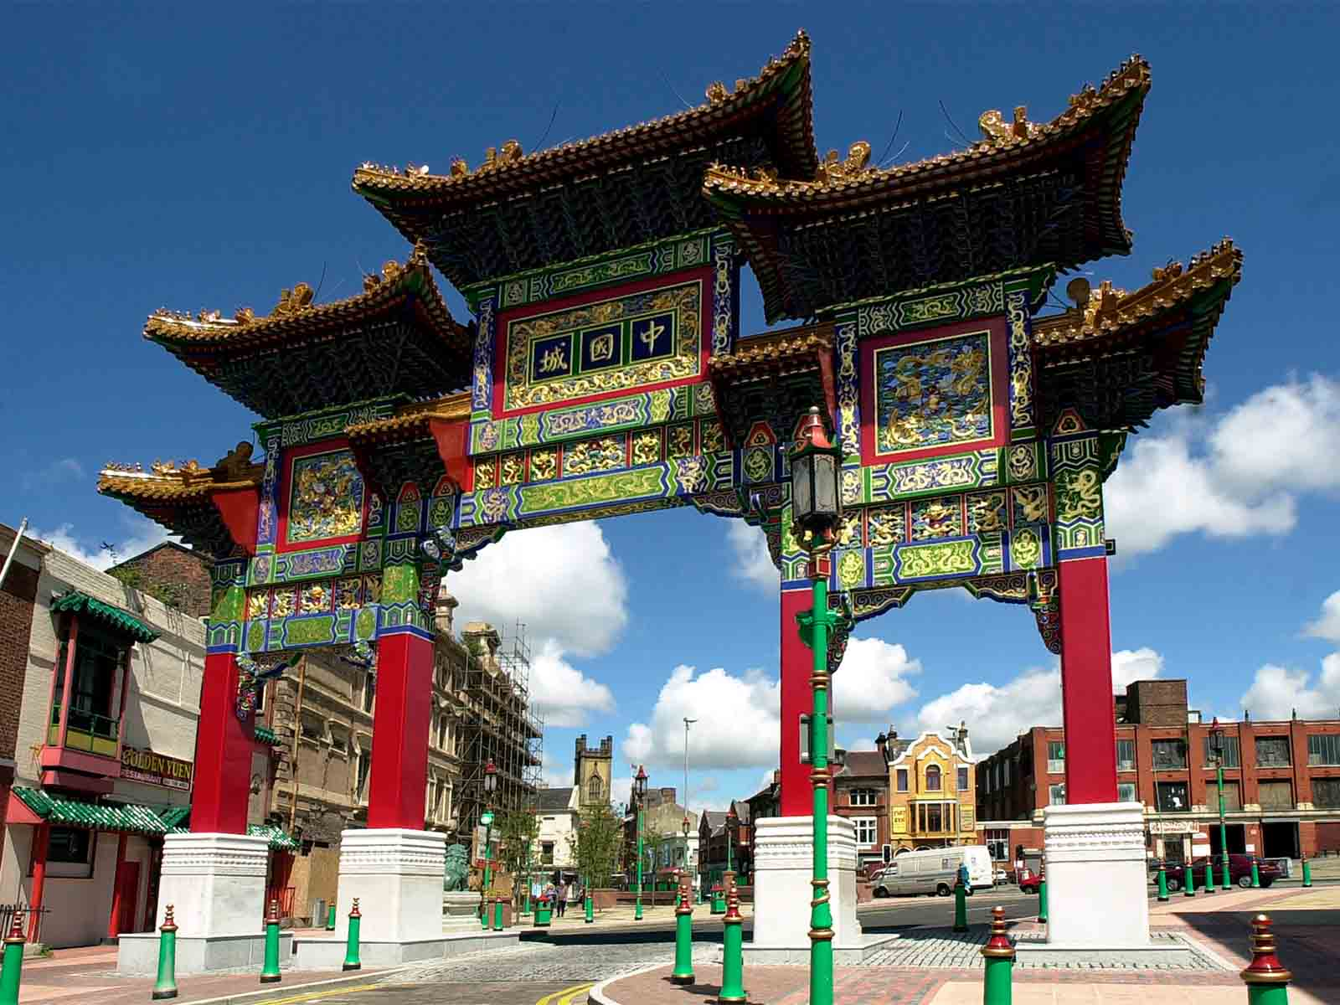
Chinese Arch
(Pool of Life)
ORIGIN

Slide 10
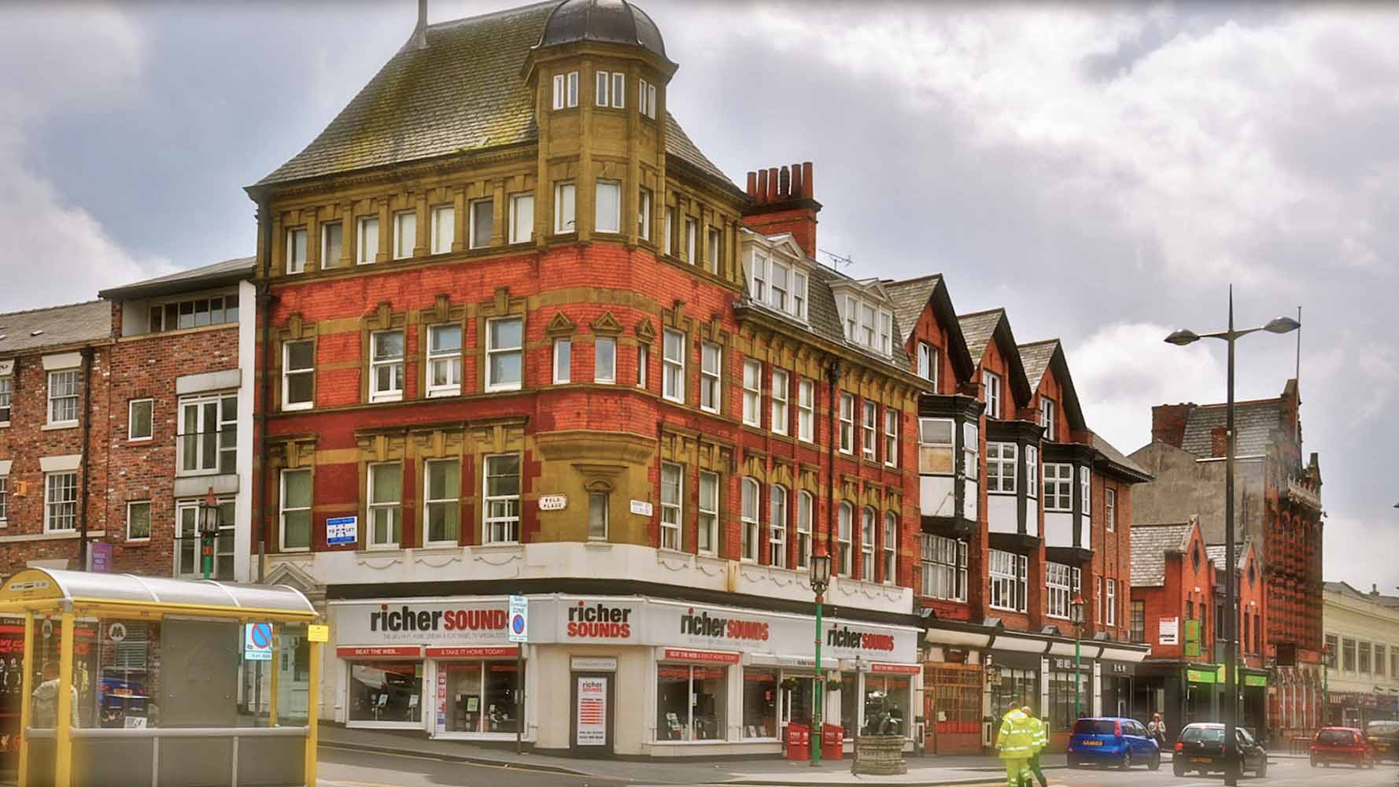
St.Lukes Chambers
(Paco Piniella - El Lobo Bobo)
ORIGIN

Slide 11
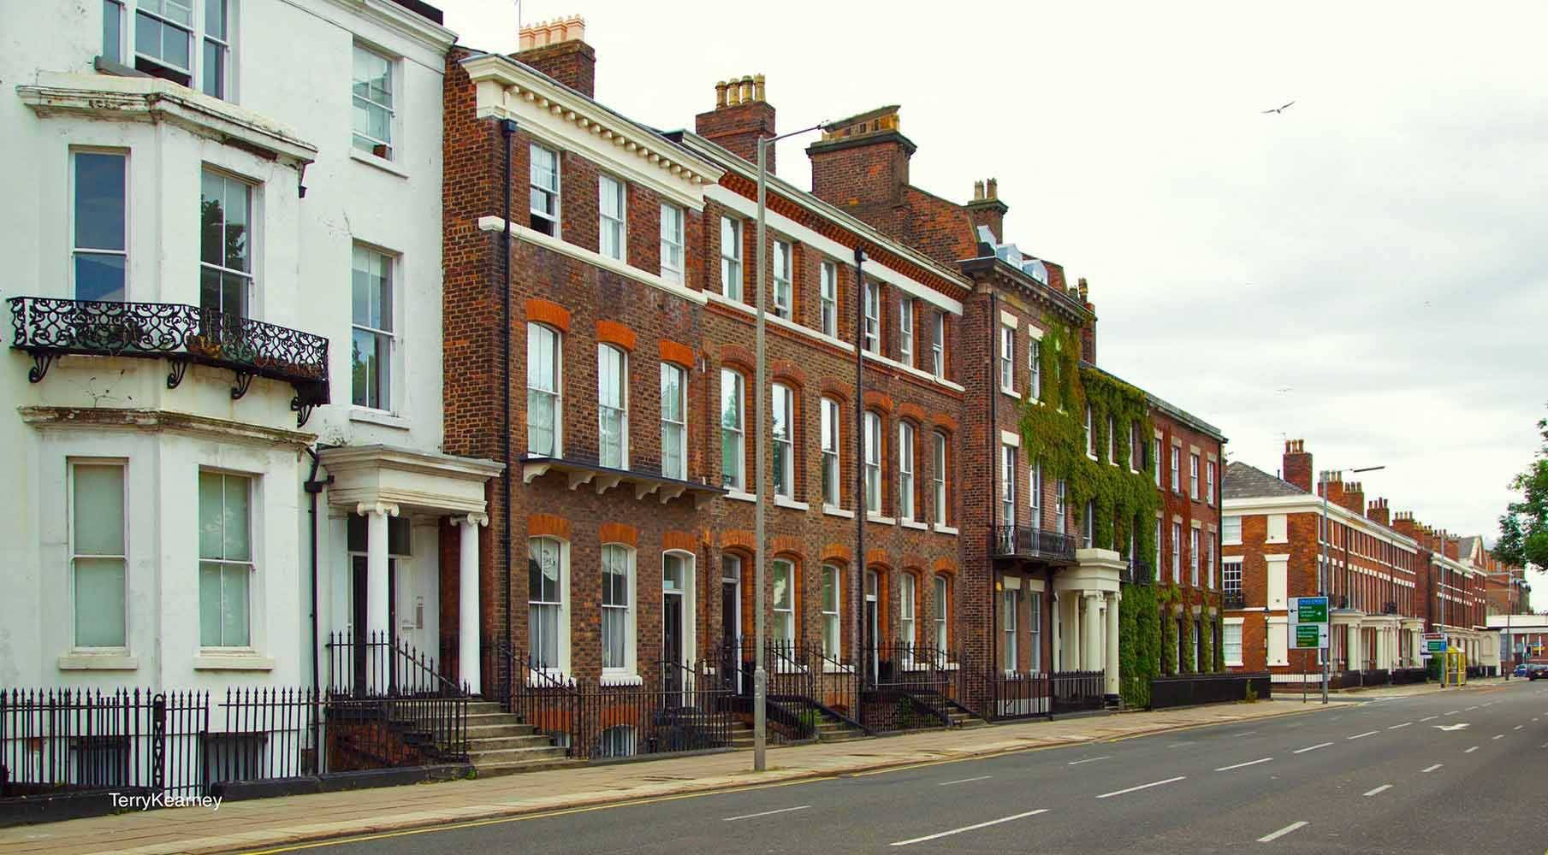
Georgian Liverpool
(Terry Kearney - Flickr)
ORIGIN

Slide 12
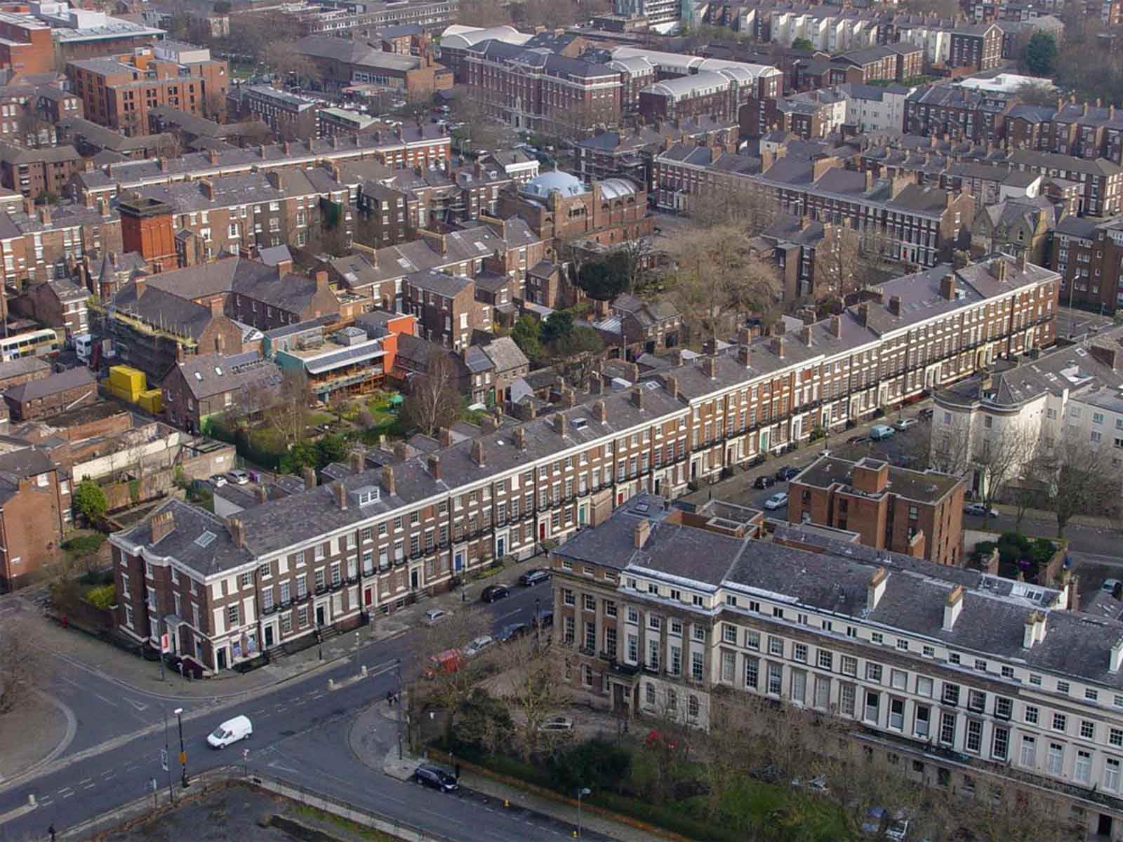
Gregorian Quarter
(Ronnie Hughes)
ORIGIN

Slide 13
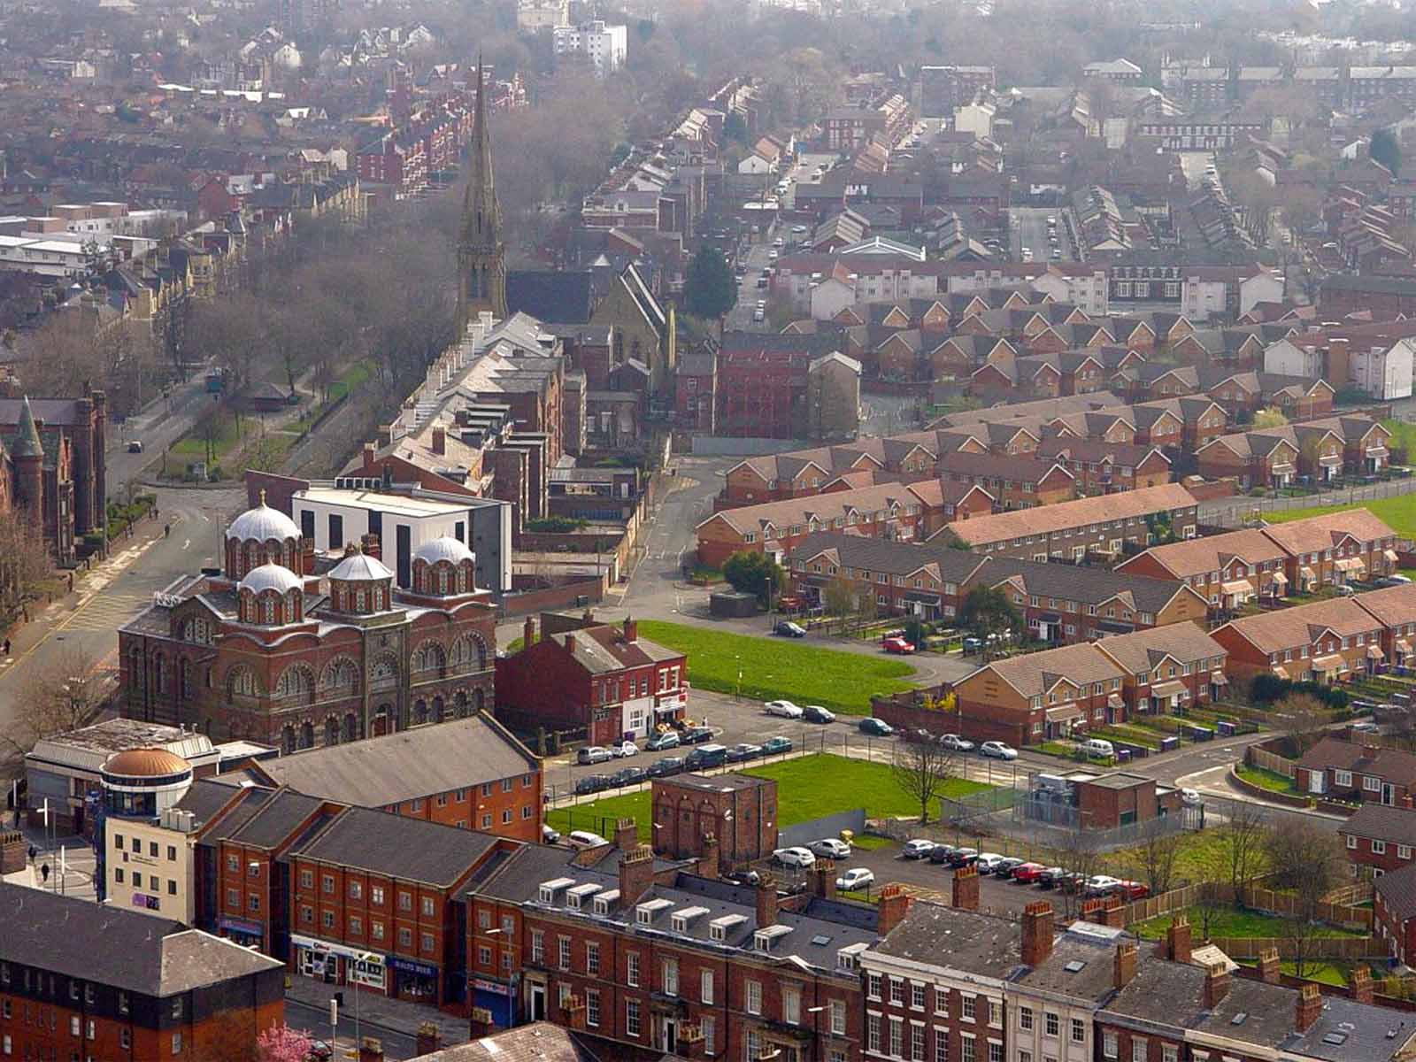
The Greek Orthodox Church
(Ronnie Hughes)
ORIGIN

Slide 14
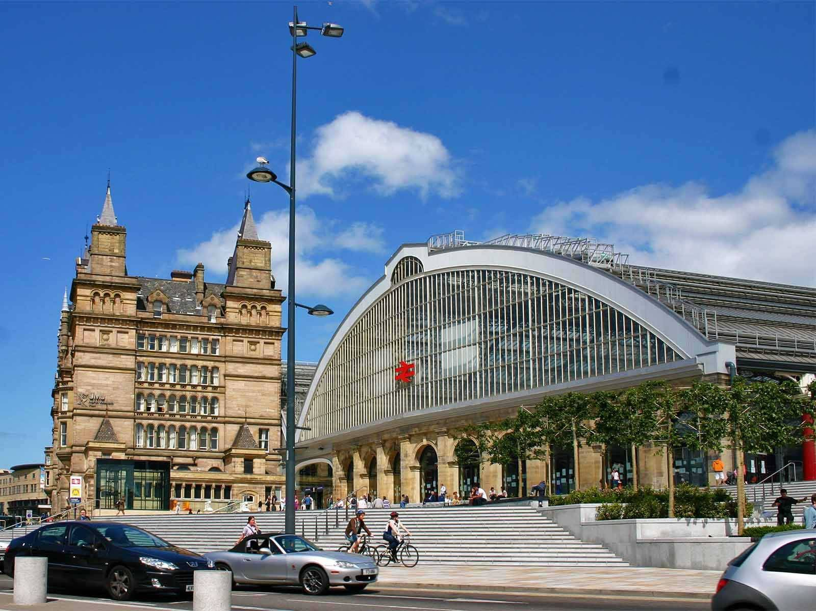
Lime Street Station
(Wikipedia)
ORIGIN

Slide 15
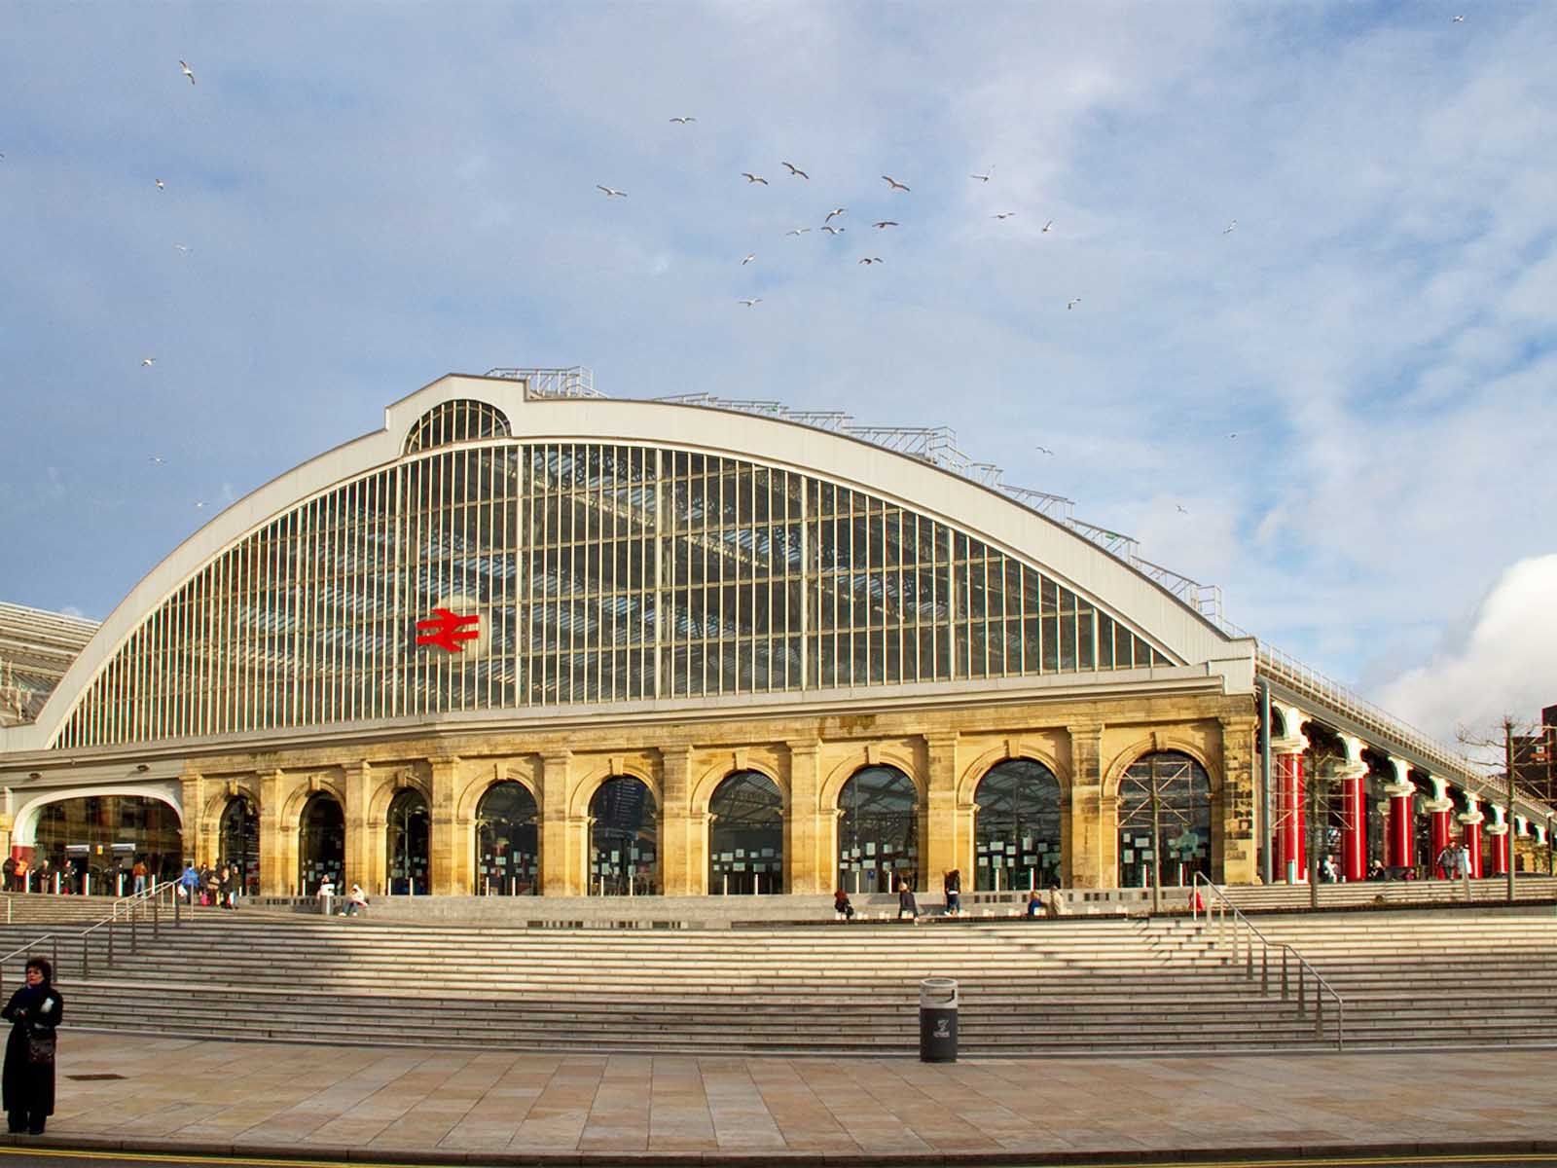
Lime Street Station
(Rail Technology Magazine)
ORIGIN

Slide 16
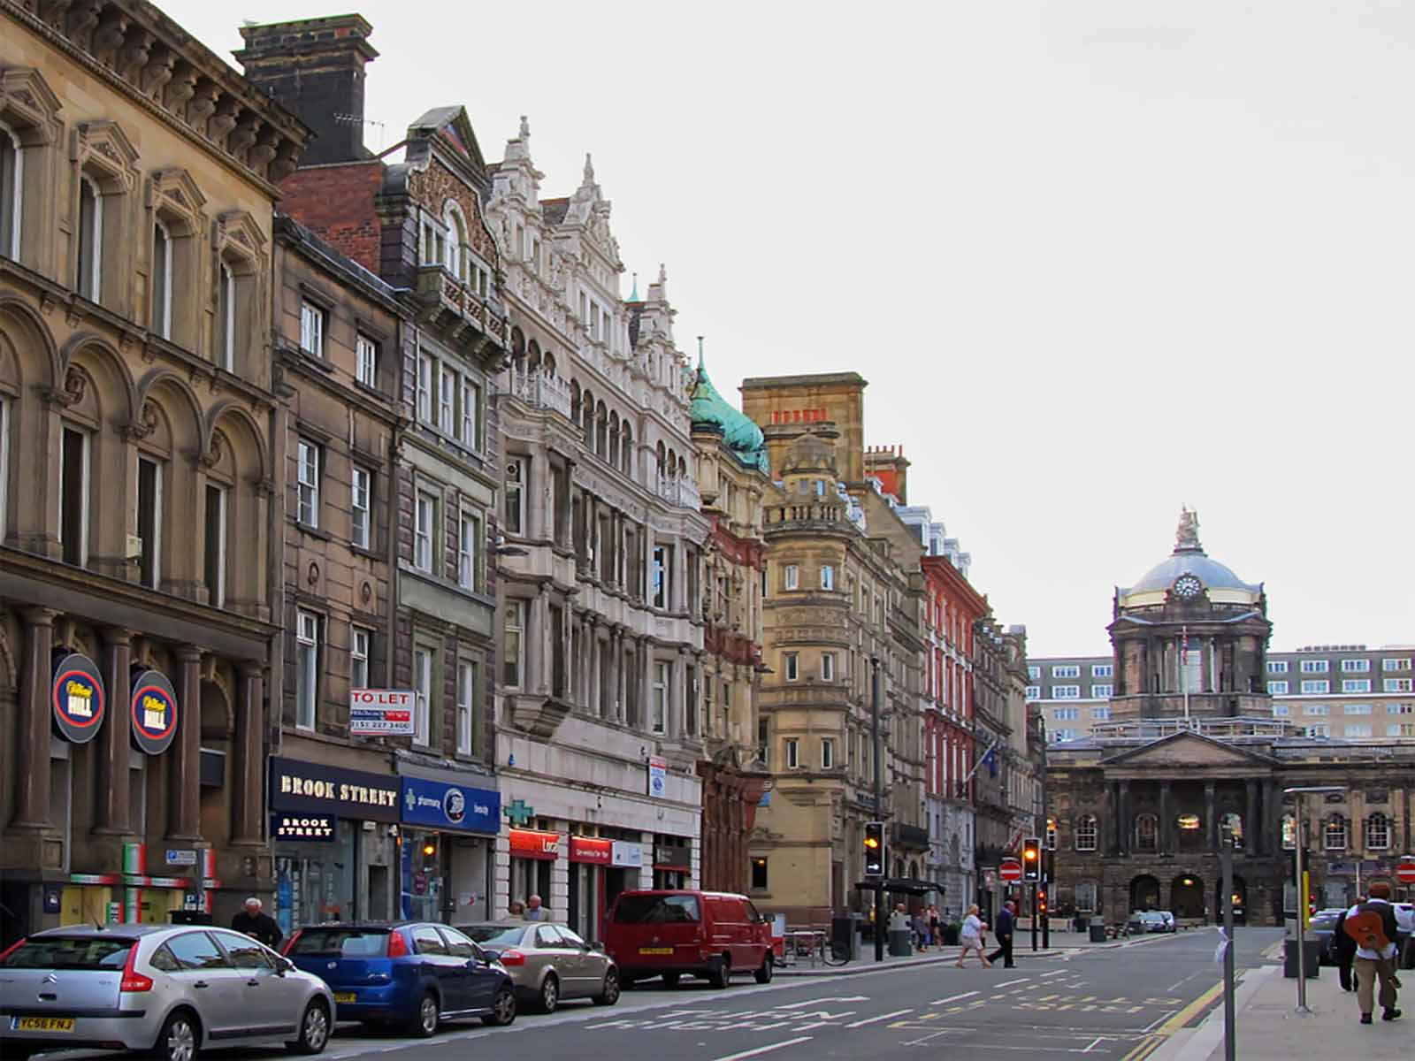
Castle Street
(Jump)
ORIGIN

Slide 17
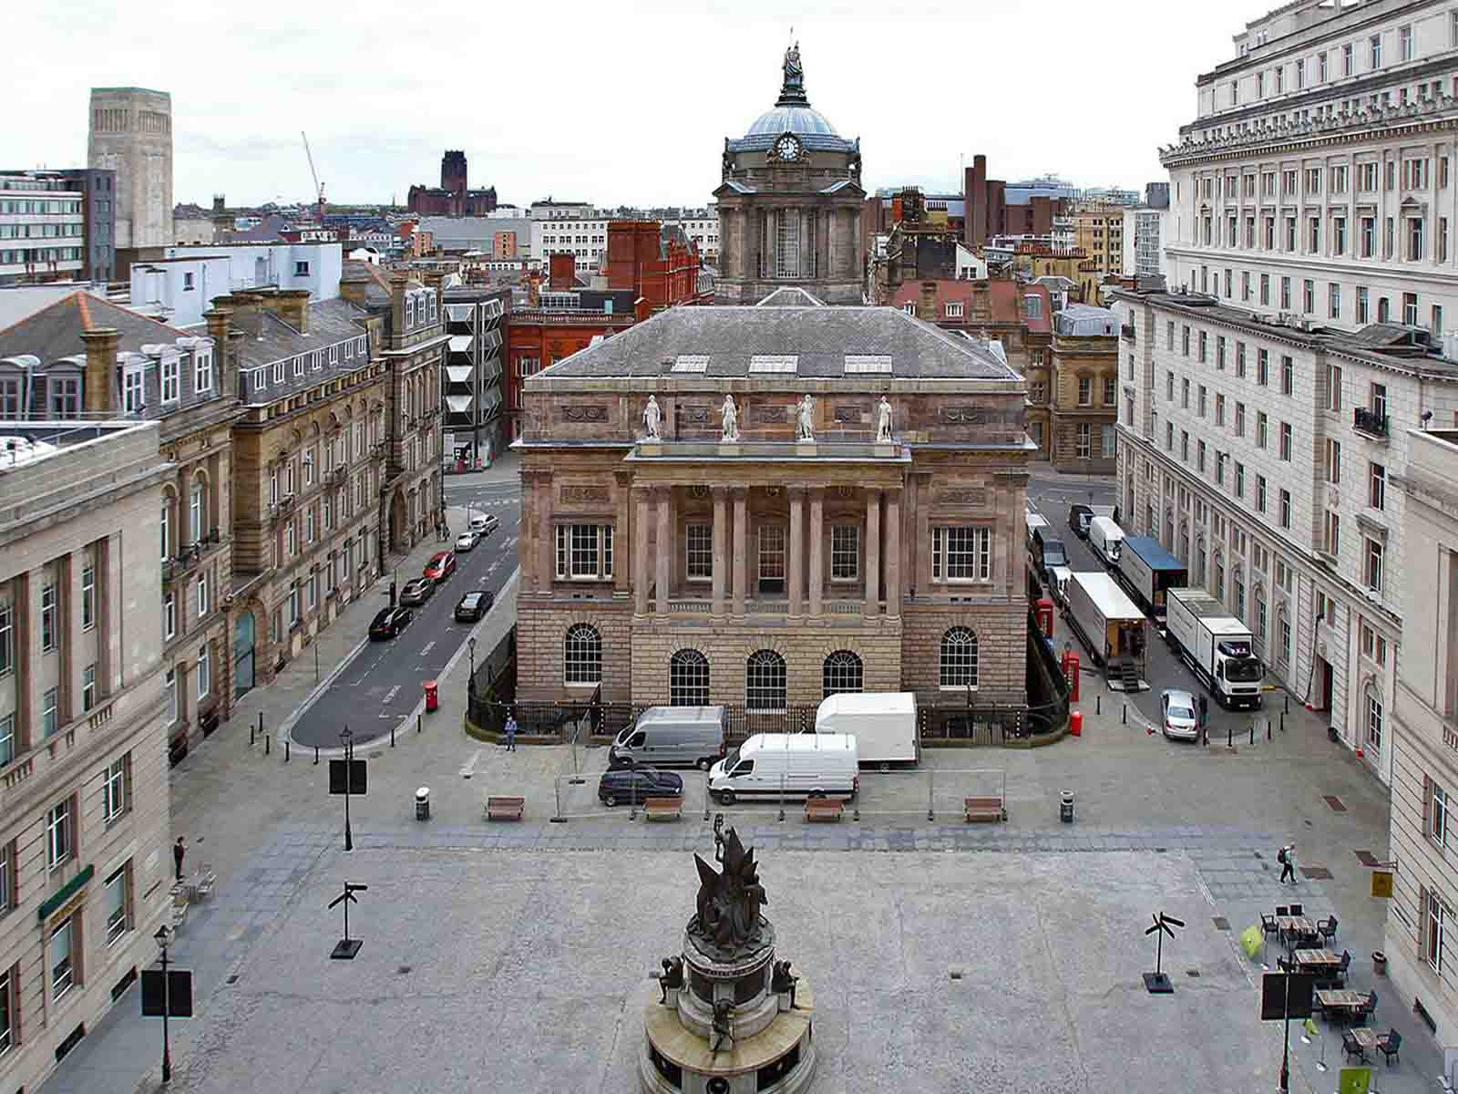
Town Hall
(Liverpool Echo)
ORIGIN

Slide 18
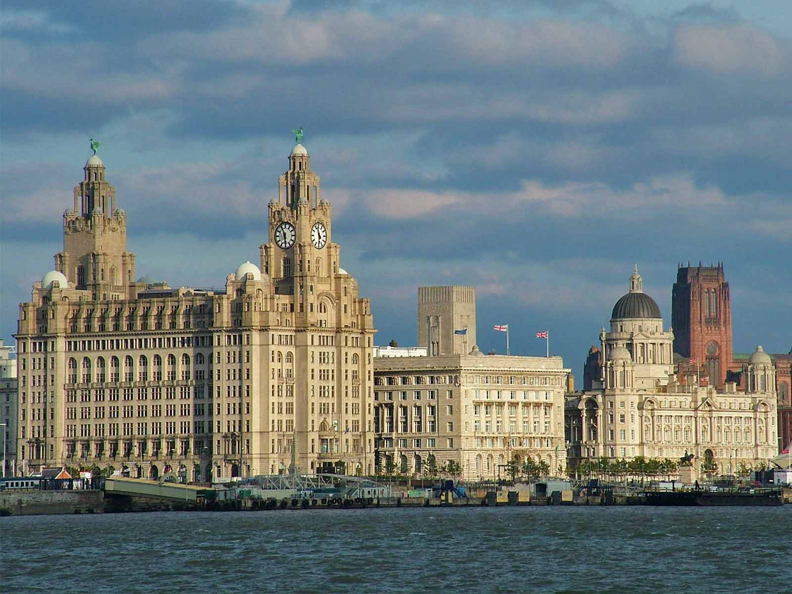
Pier Head
(Alfonso Rojo - Periodista Digital)
ORIGIN

Slide 19
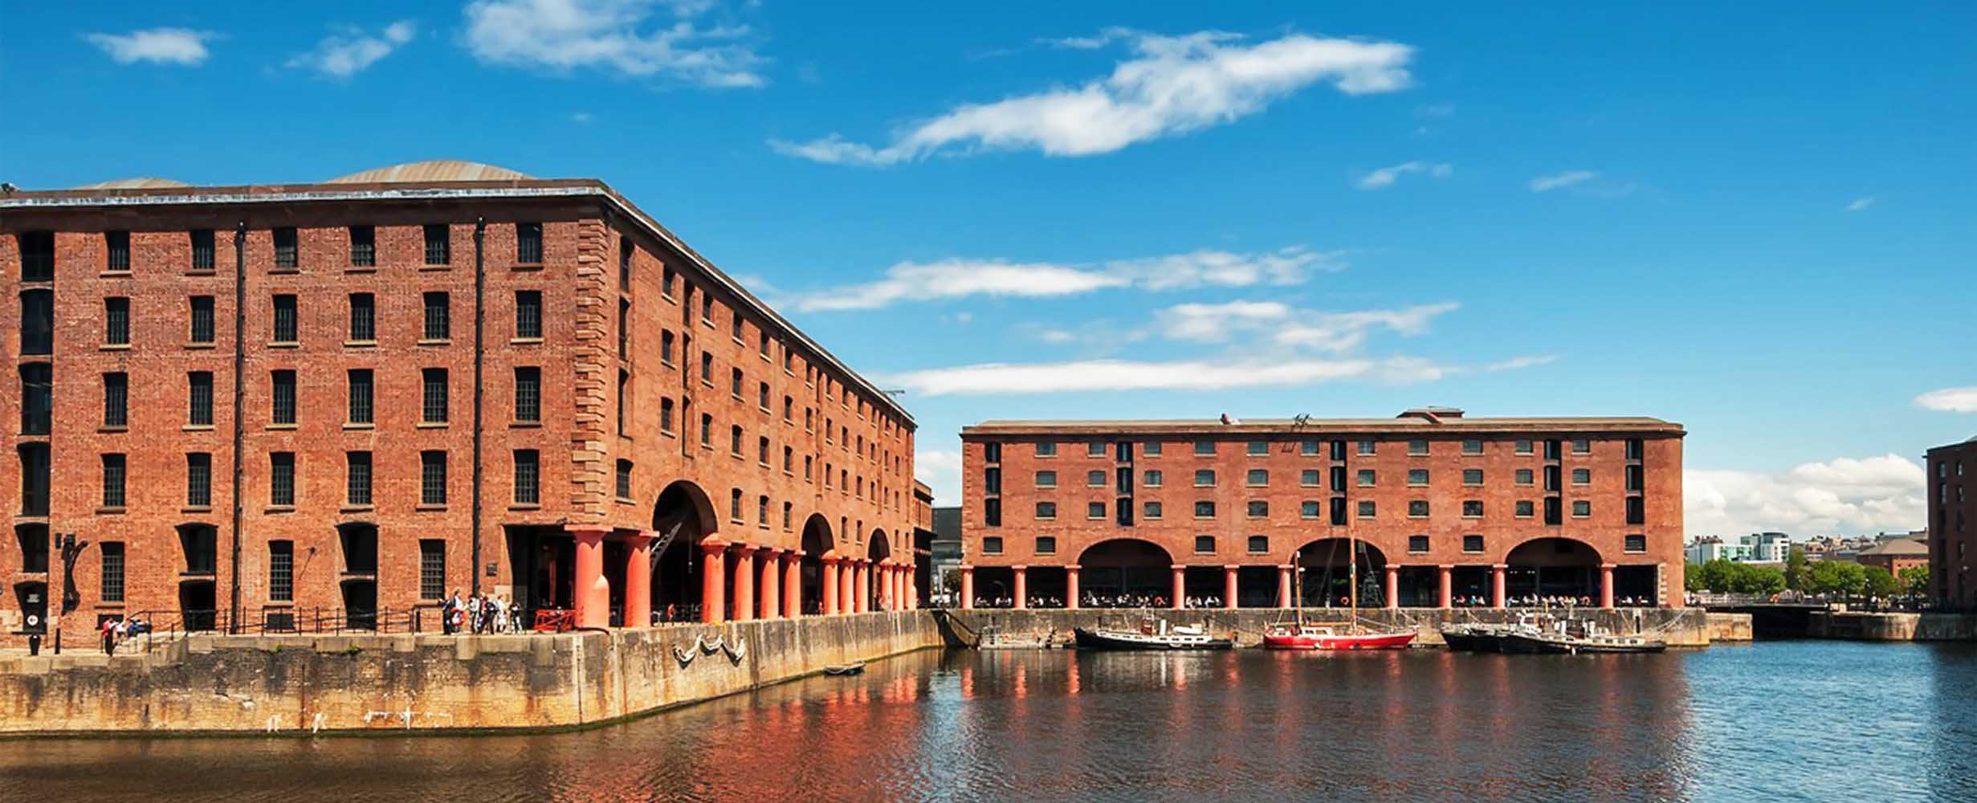
Albert Docks
(Shutterstock)
ORIGIN

Slide 20
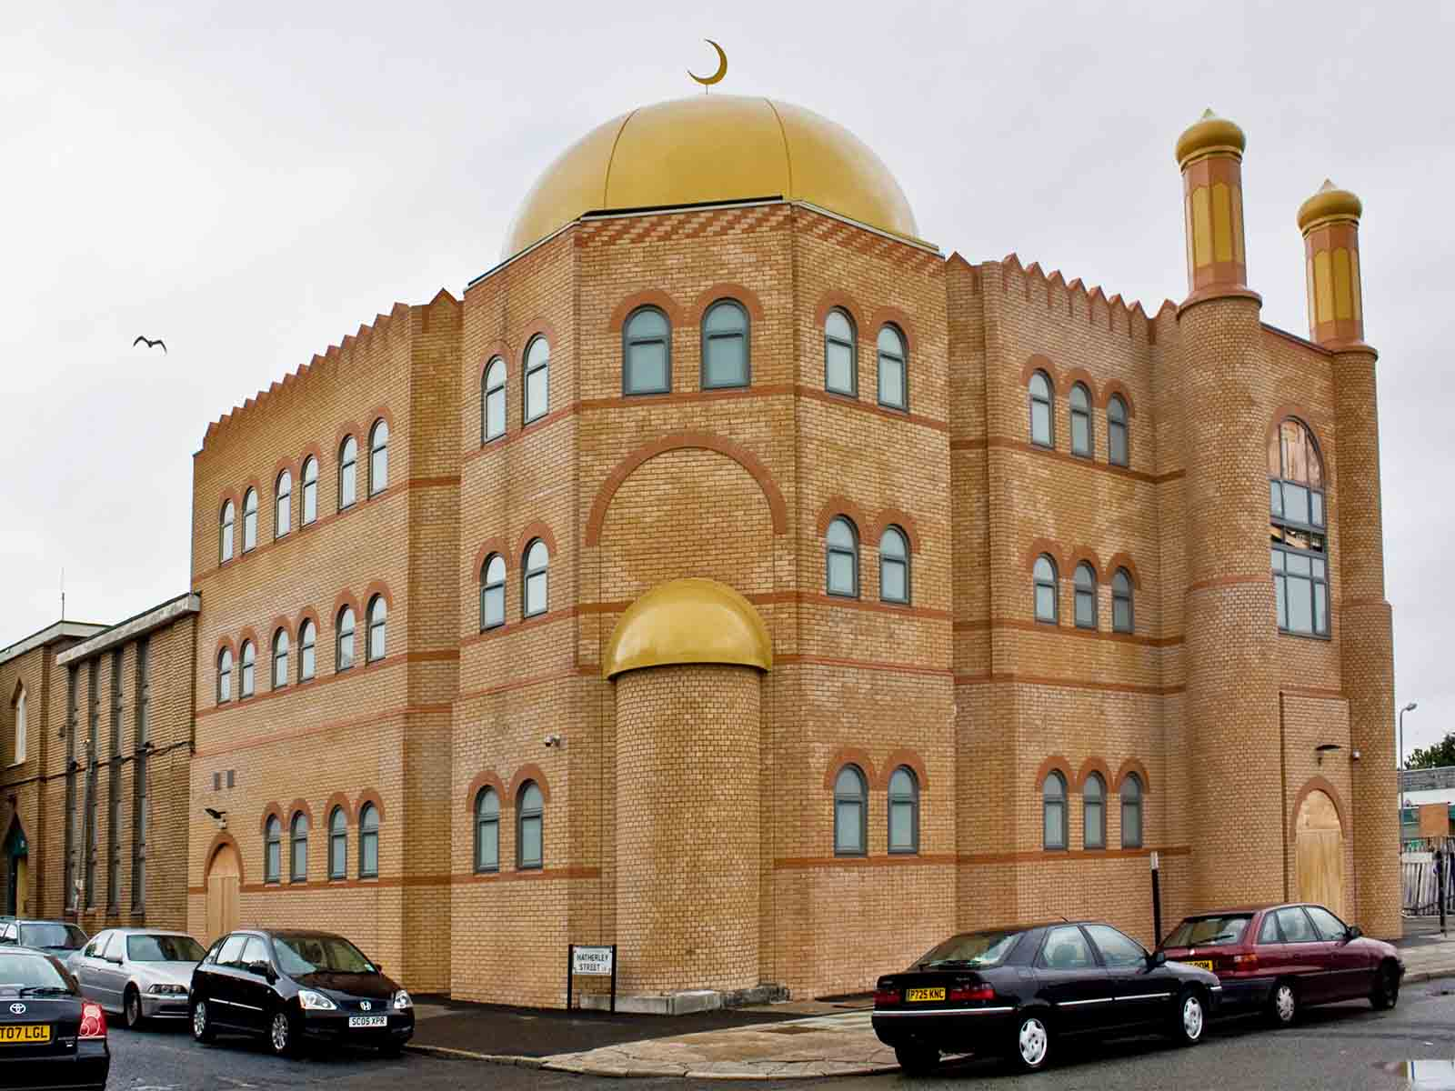
Al-Rahma Mosque
(Wikia)
ORIGIN

Slide 21
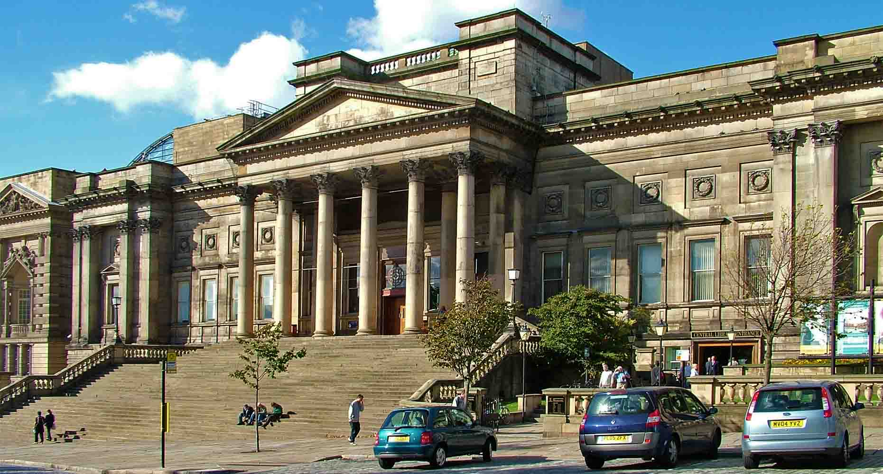
World Museum
(Notimex)
ORIGIN

Slide 22
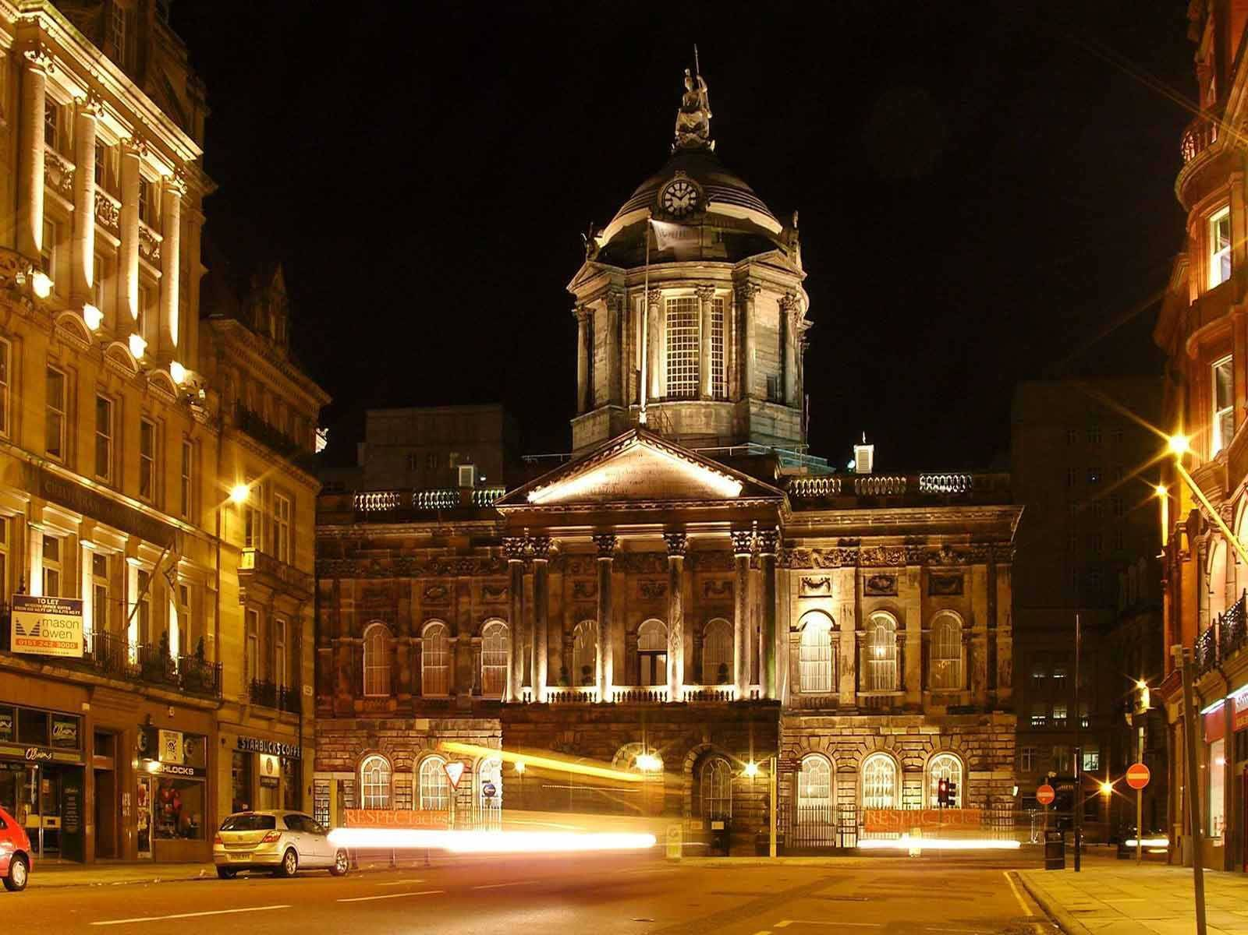
Town Hall (at night)
(Sen Together)
ORIGIN

Slide 23
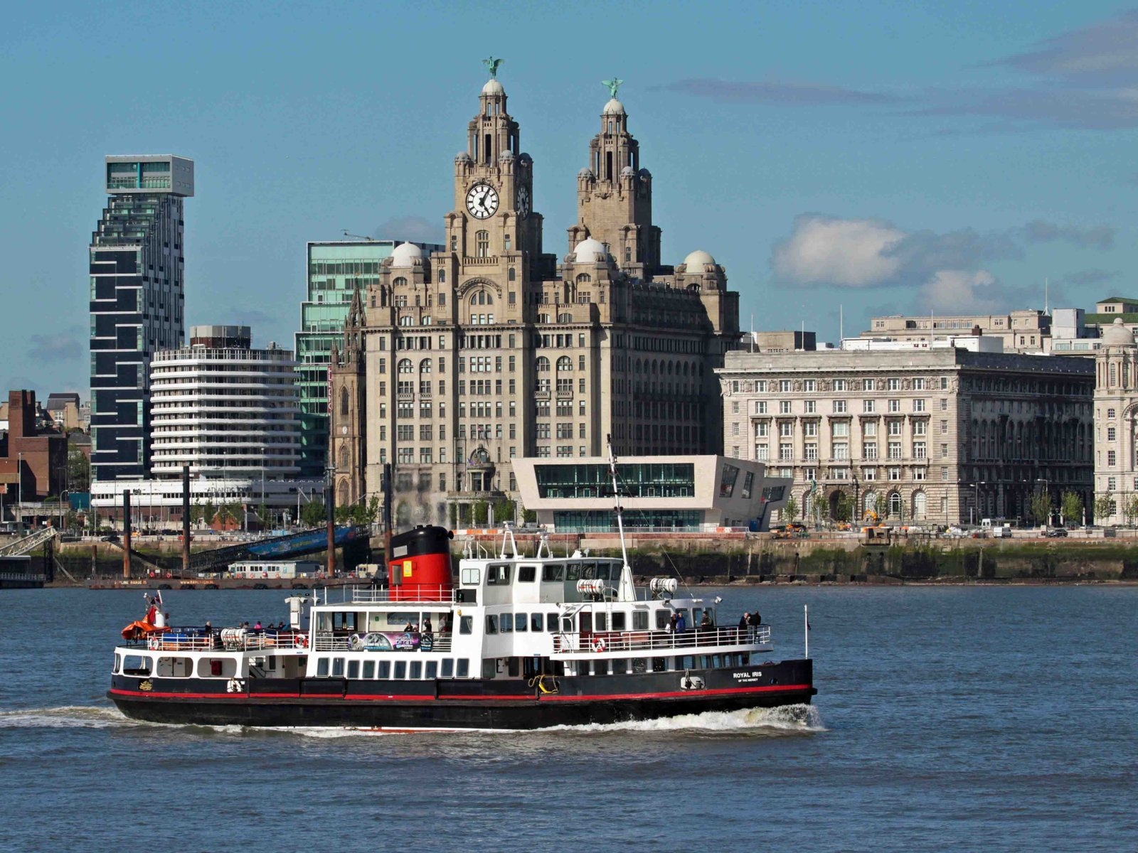
Pier Head
(Abode Group)
ORIGIN

Slide 24
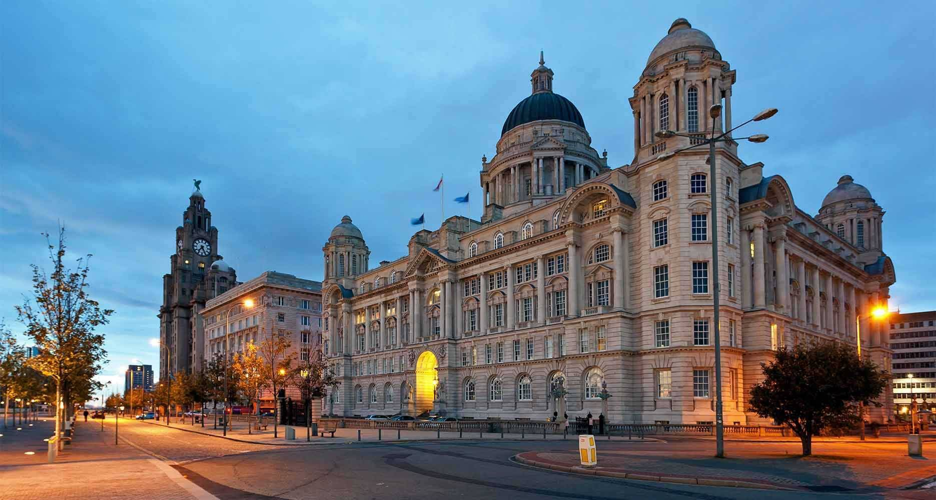
Buildings of Pier Head
(Princess Cruises)
ORIGIN

Slide 25
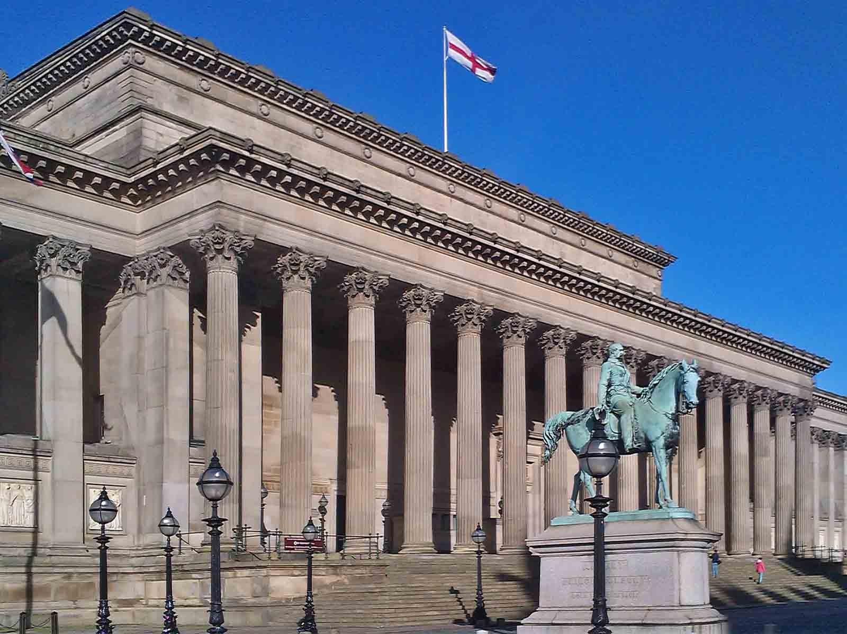
St.George‘s Hall
(Mi diario de viajes)
ORIGIN

Slide 26
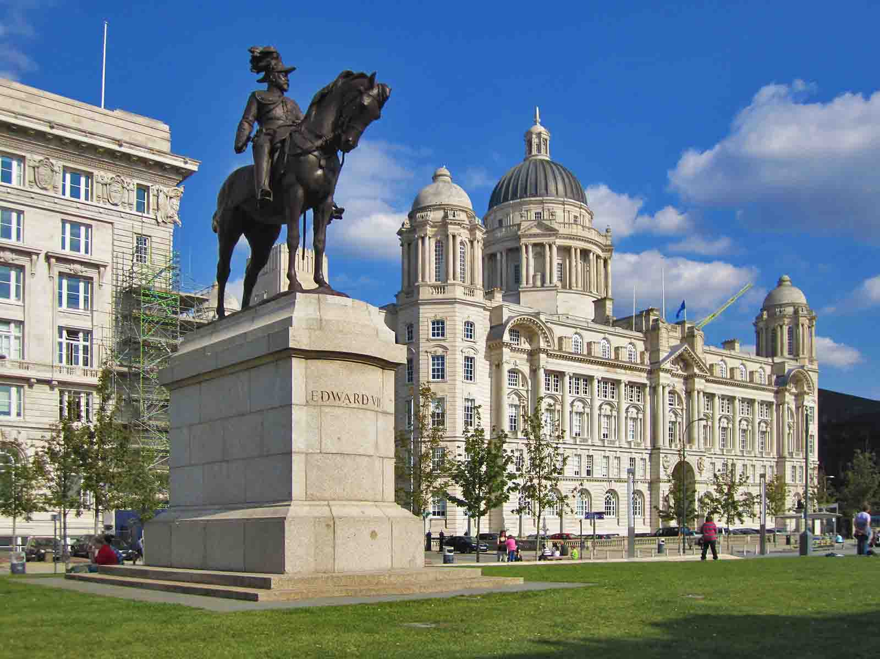
Port of Liverpool Building
(Here There Everywhere)
ORIGIN

Slide 27
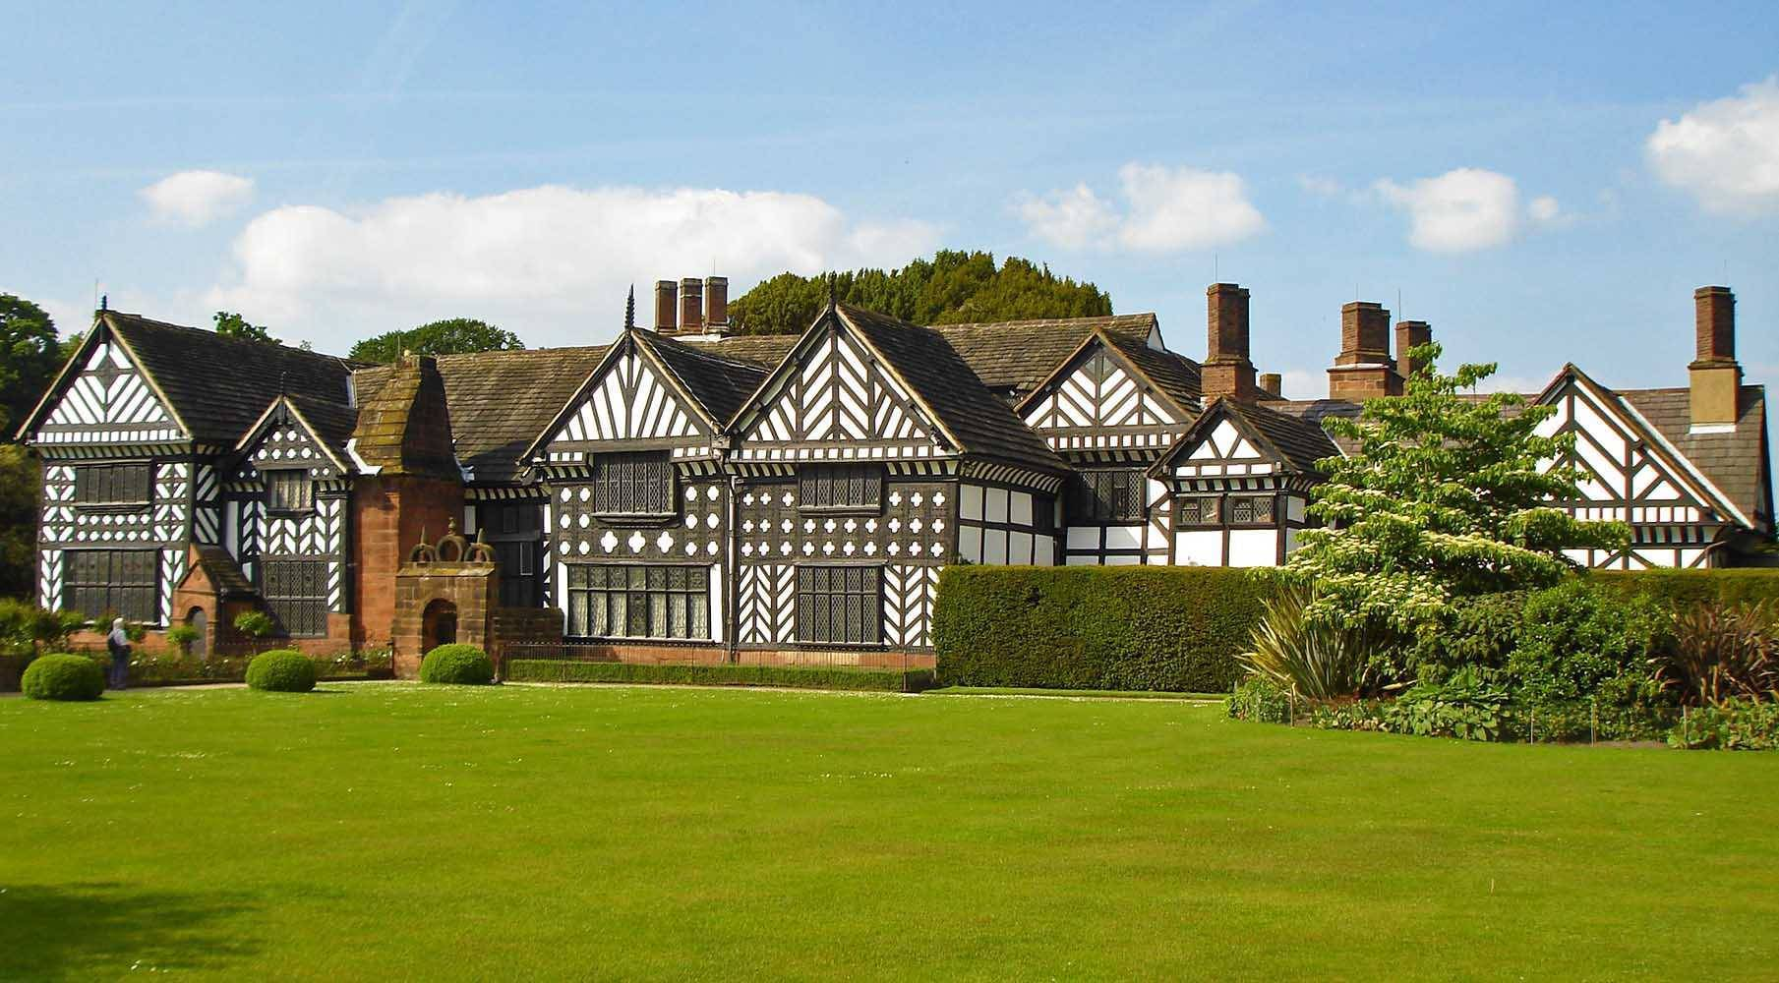
Speke Hall
(Wikia)
ORIGIN

Slide 28
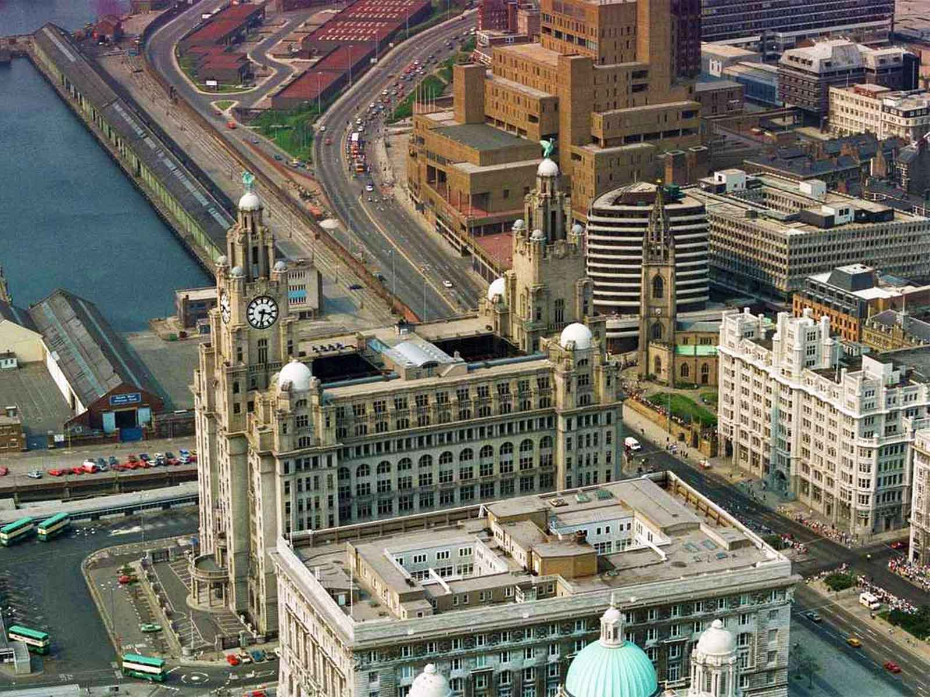
Royal Liver Building
(Liverpool Echo)
ORIGIN

Slide 29
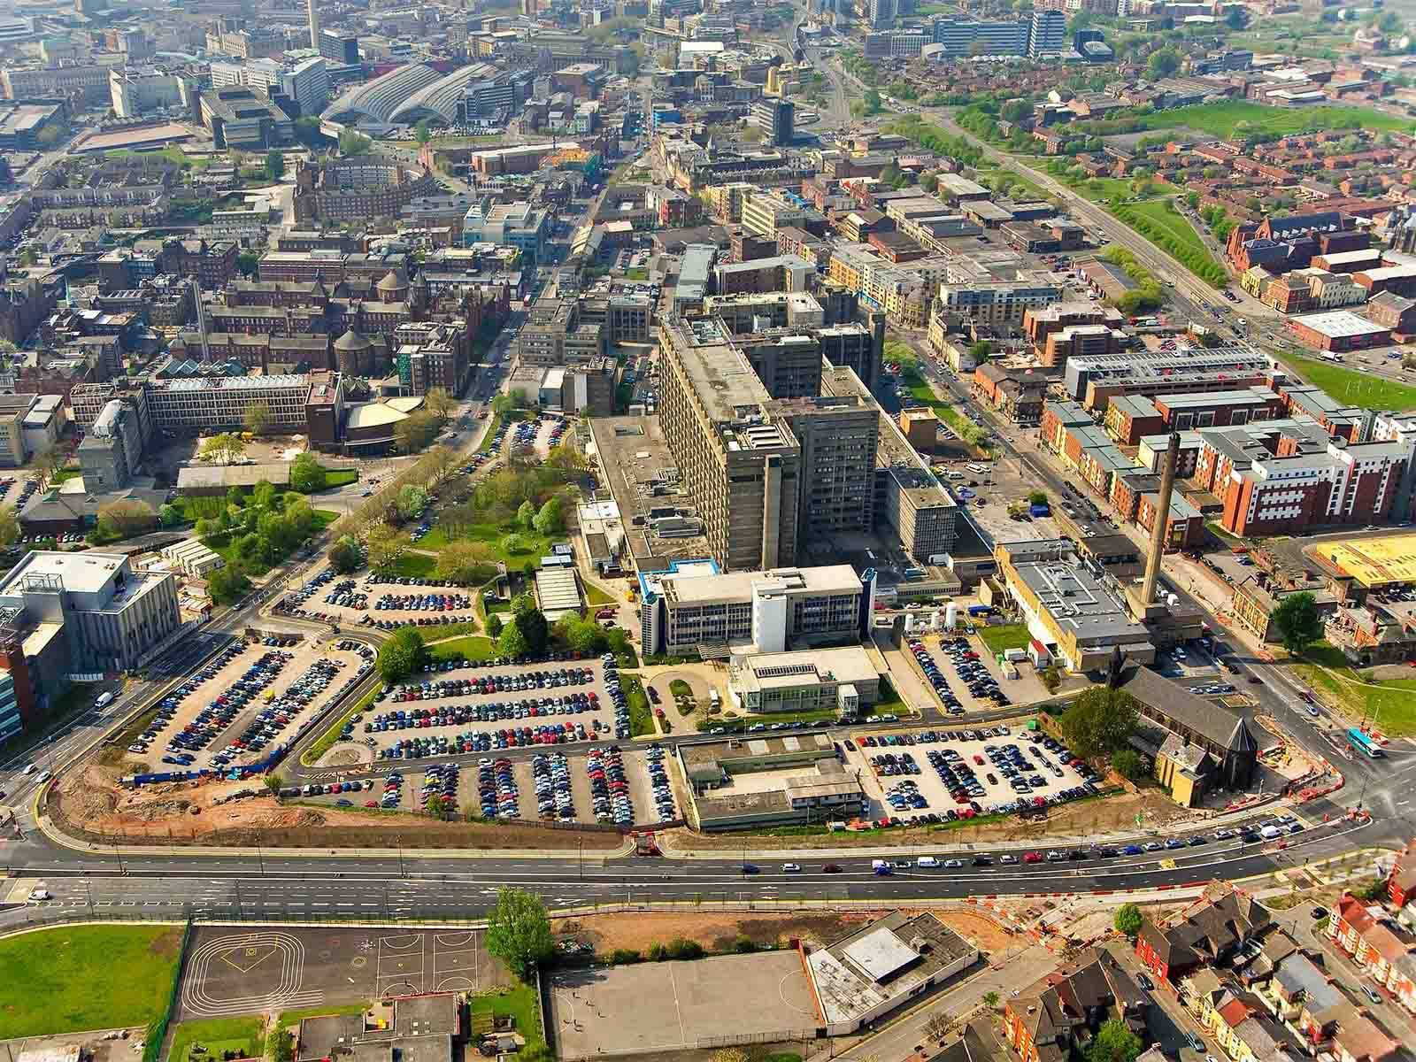
Royal Liverpool Hospital
(Royal Liverpool Hospitals)
ORIGIN

Slide 30
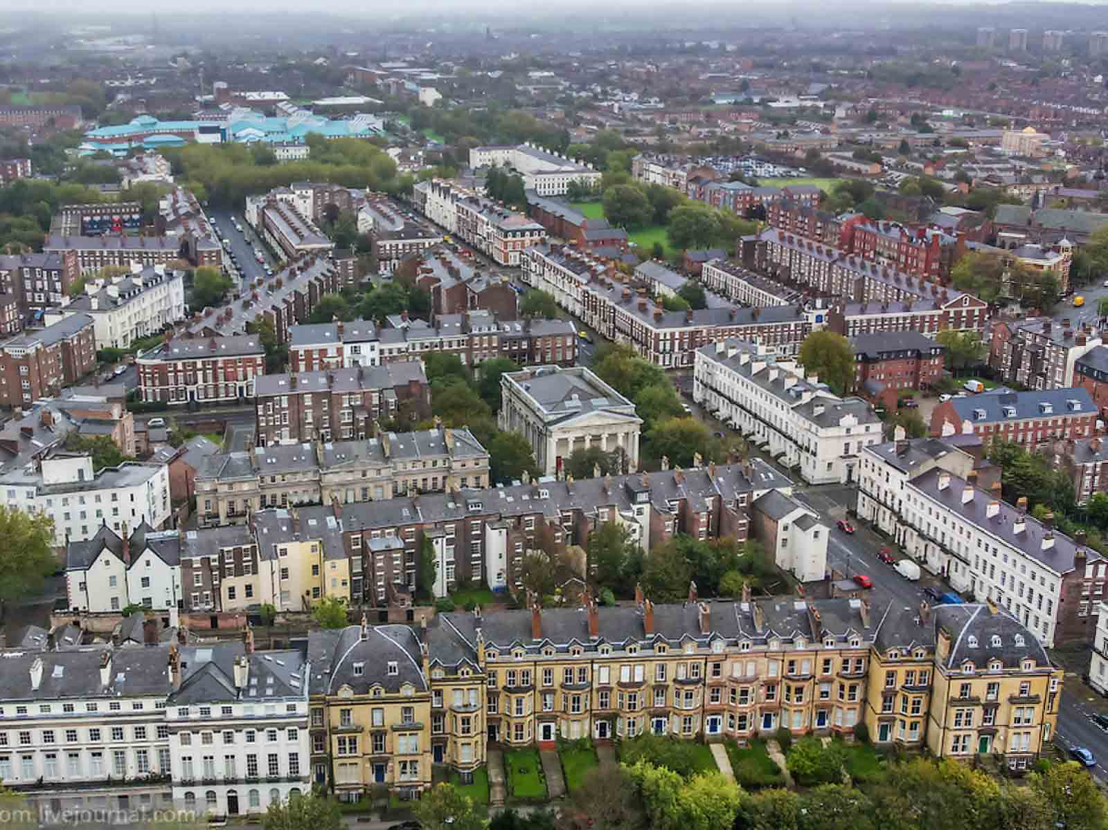
Terraced Houses
(World Countries)
ORIGIN

Slide 31
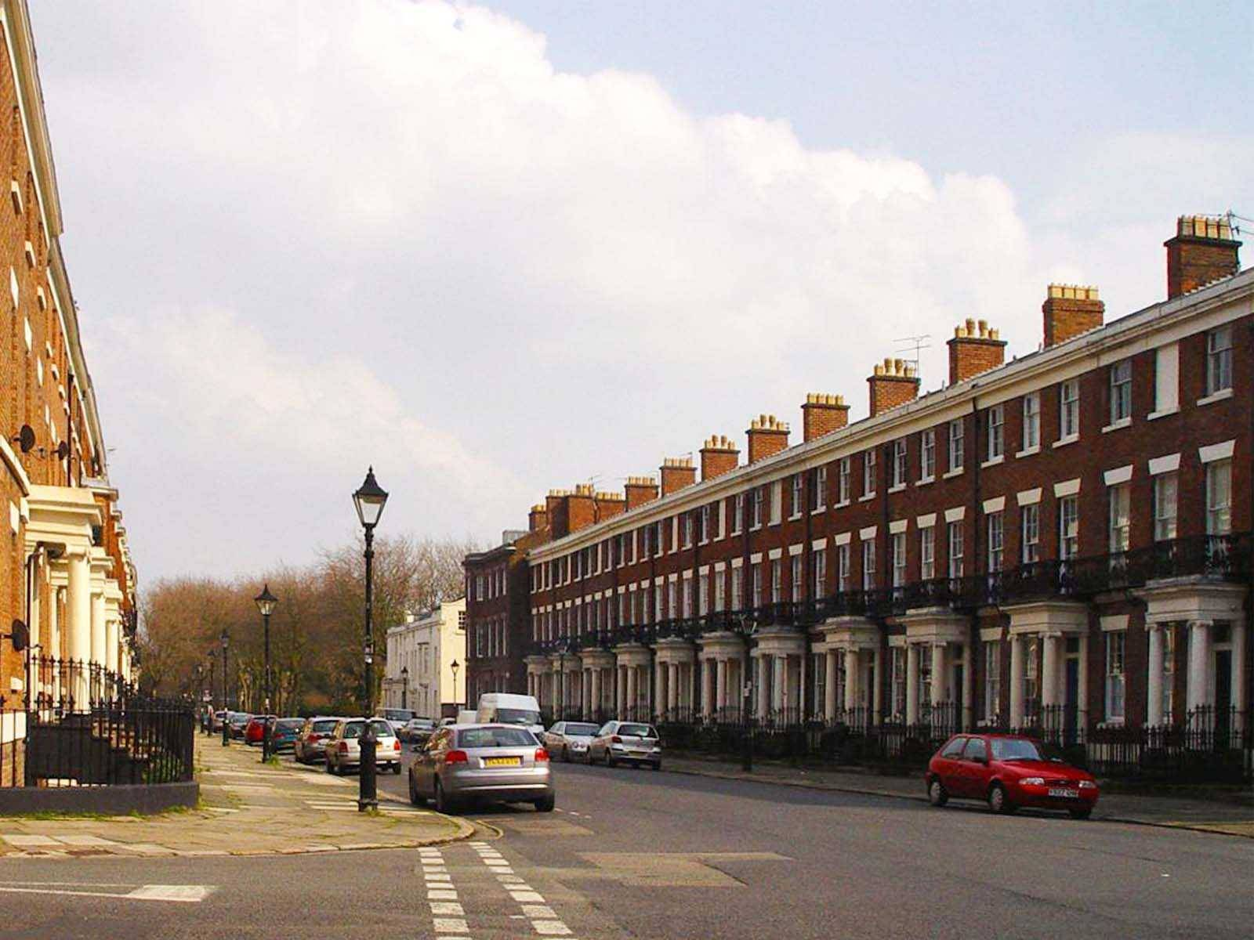
Georgian Liverpool
(Ronnie Hughes)
ORIGIN

Slide 32
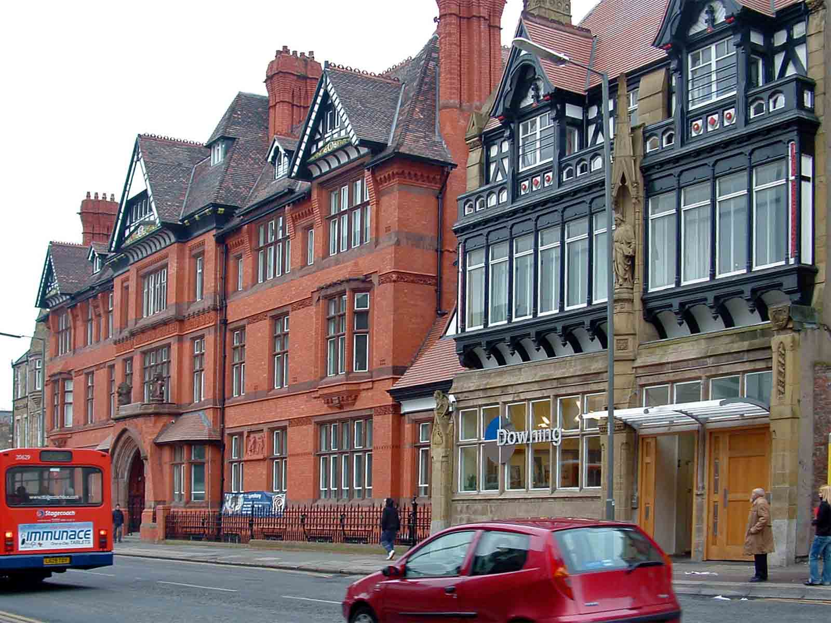
Georgian Houses
(Paul Holloway - Wikimedia)
ORIGIN

Slide 33
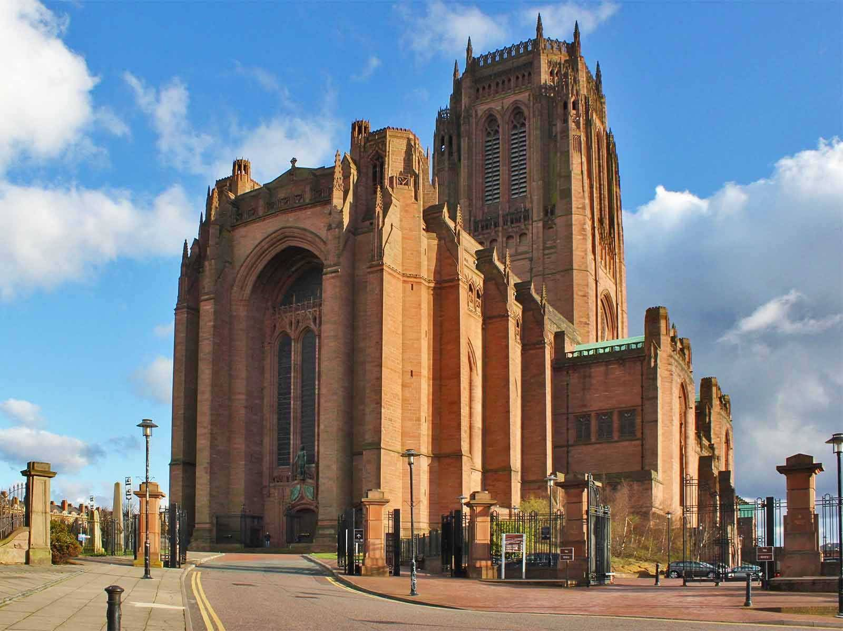
Anglican Cathedral
(Wikia)
ORIGIN

Slide 34
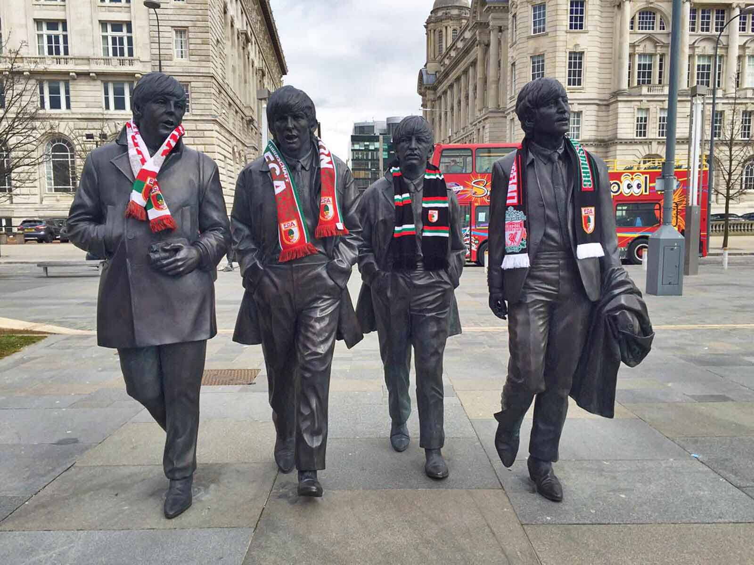
Beatles Statue
(FC Augsburg)
ORIGIN

Slide 35
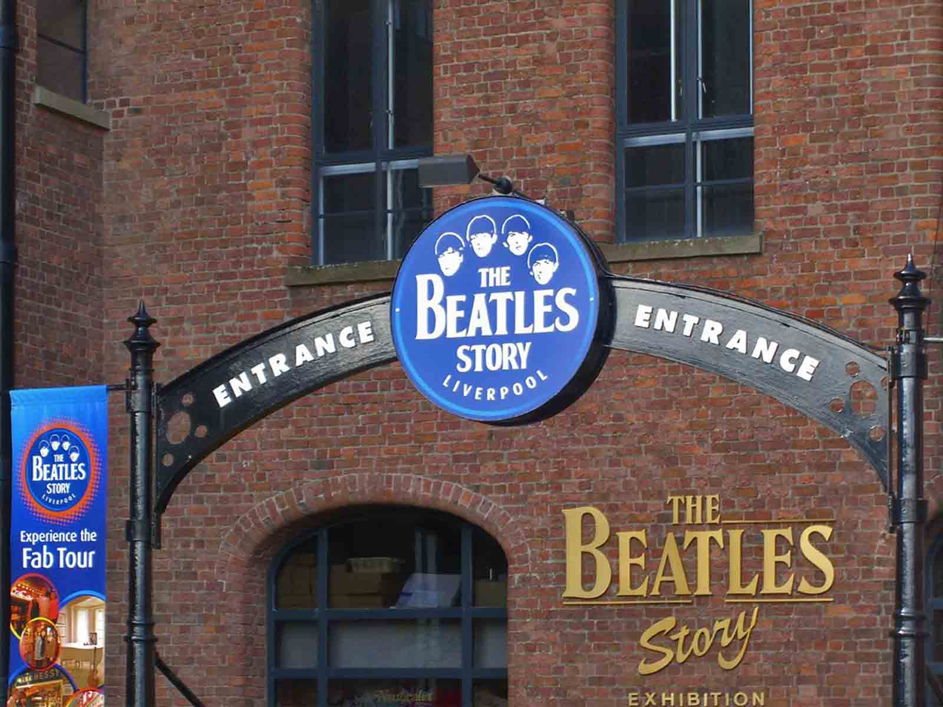
The Beatles Story
(Mapio Net)
ORIGIN

Slide 36
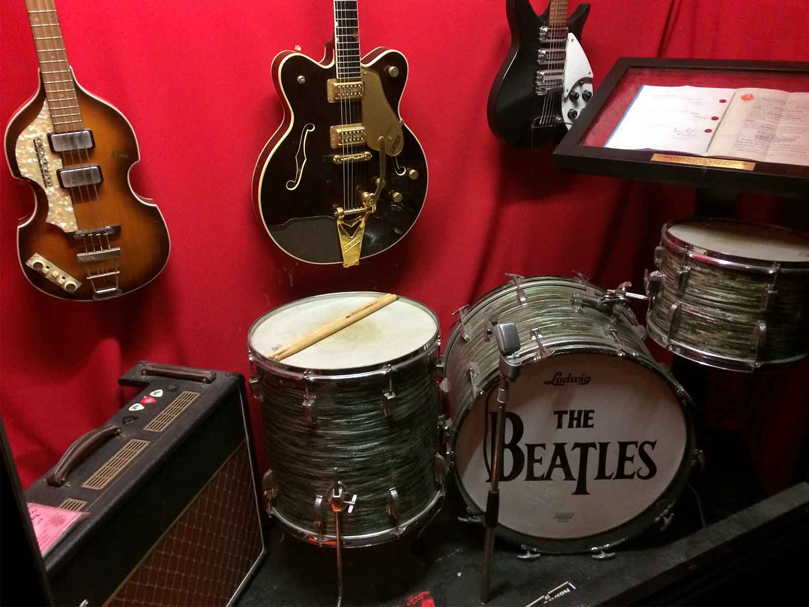
The Beatles Story (inside)
(Maura Sweeney)
ORIGIN

Slide 37
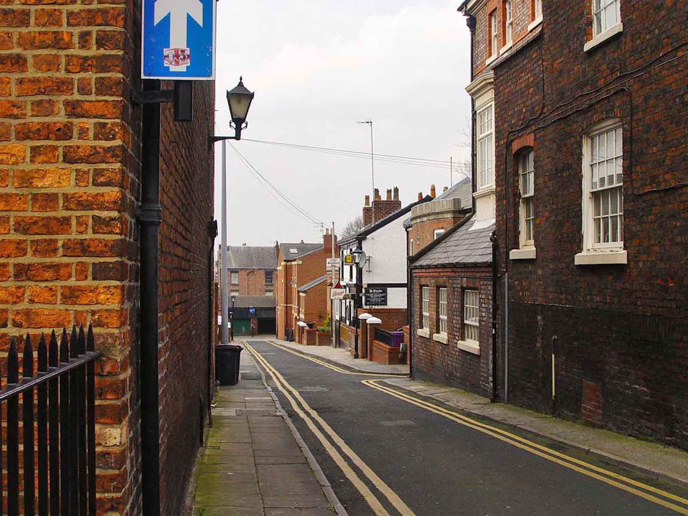
Back Street
(Ronnie Hughes)
ORIGIN

Slide 38
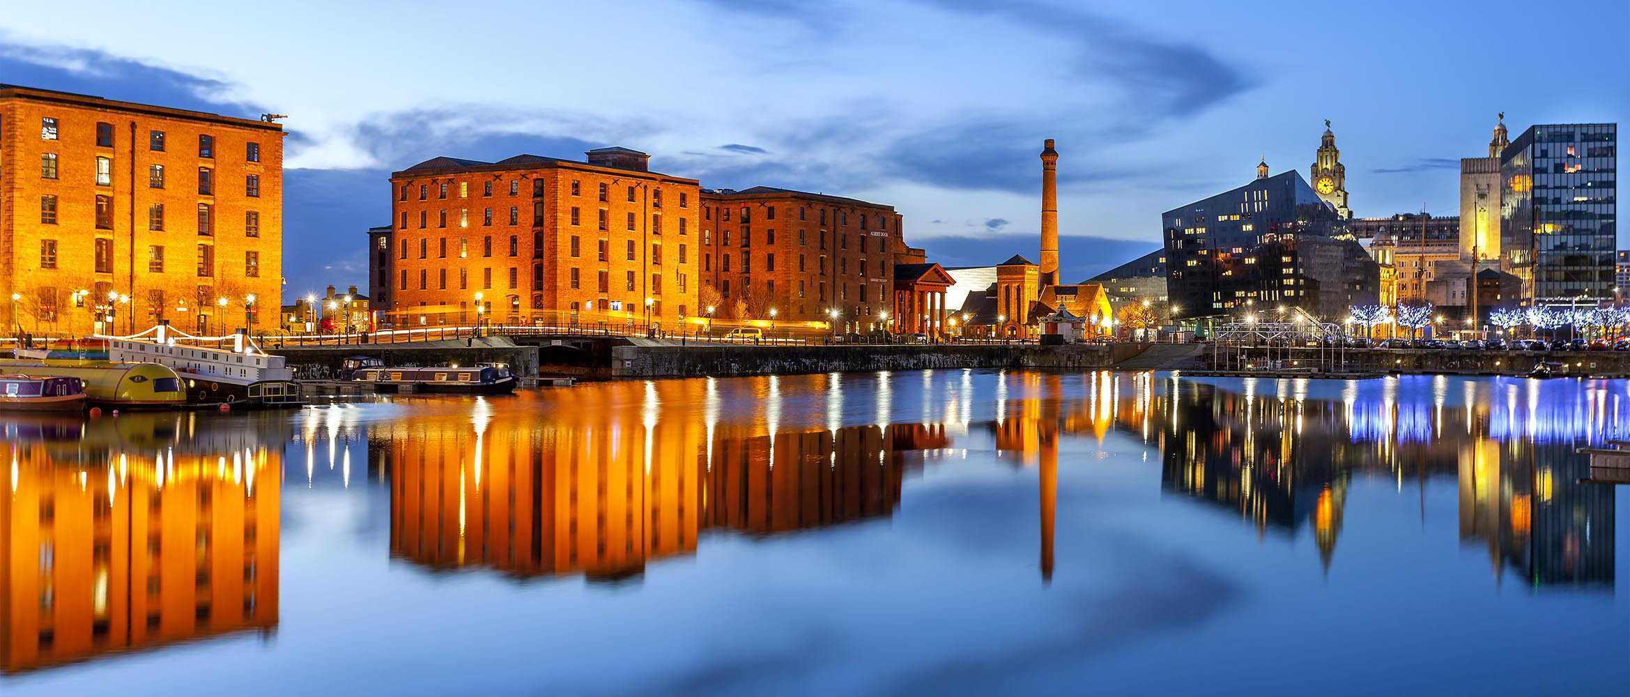
Albert Docks (at night)
(SC Sheffield)
ORIGIN

Slide 39
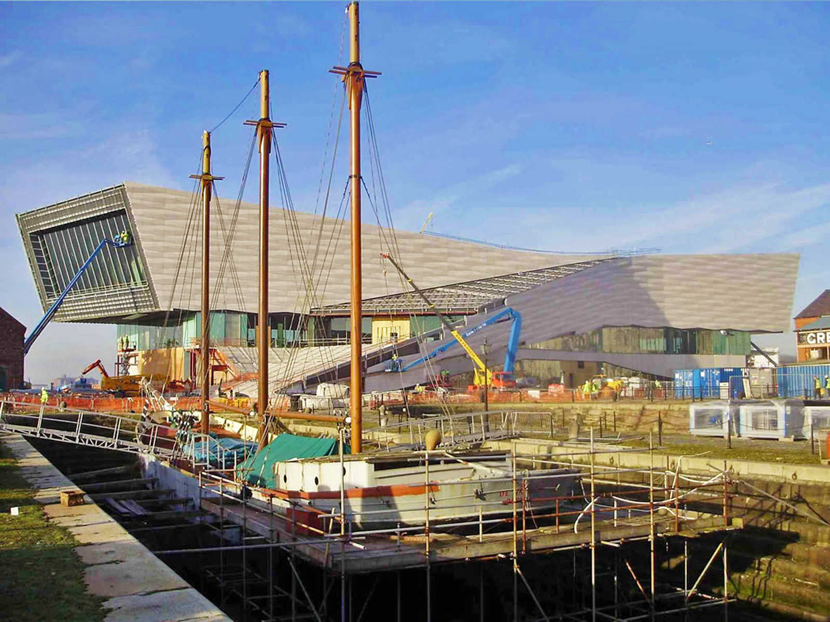
Museum of Liverpool
(Jump)
ORIGIN

Slide 40
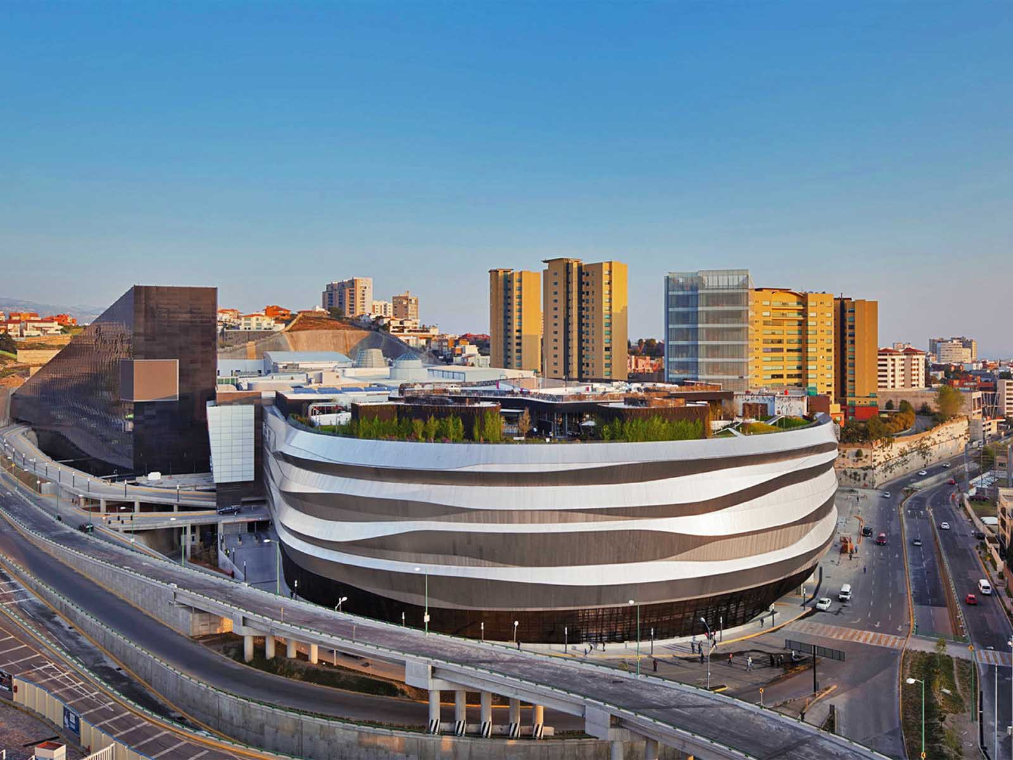
Department Store
(Arch Daily)
ORIGIN

Slide 41
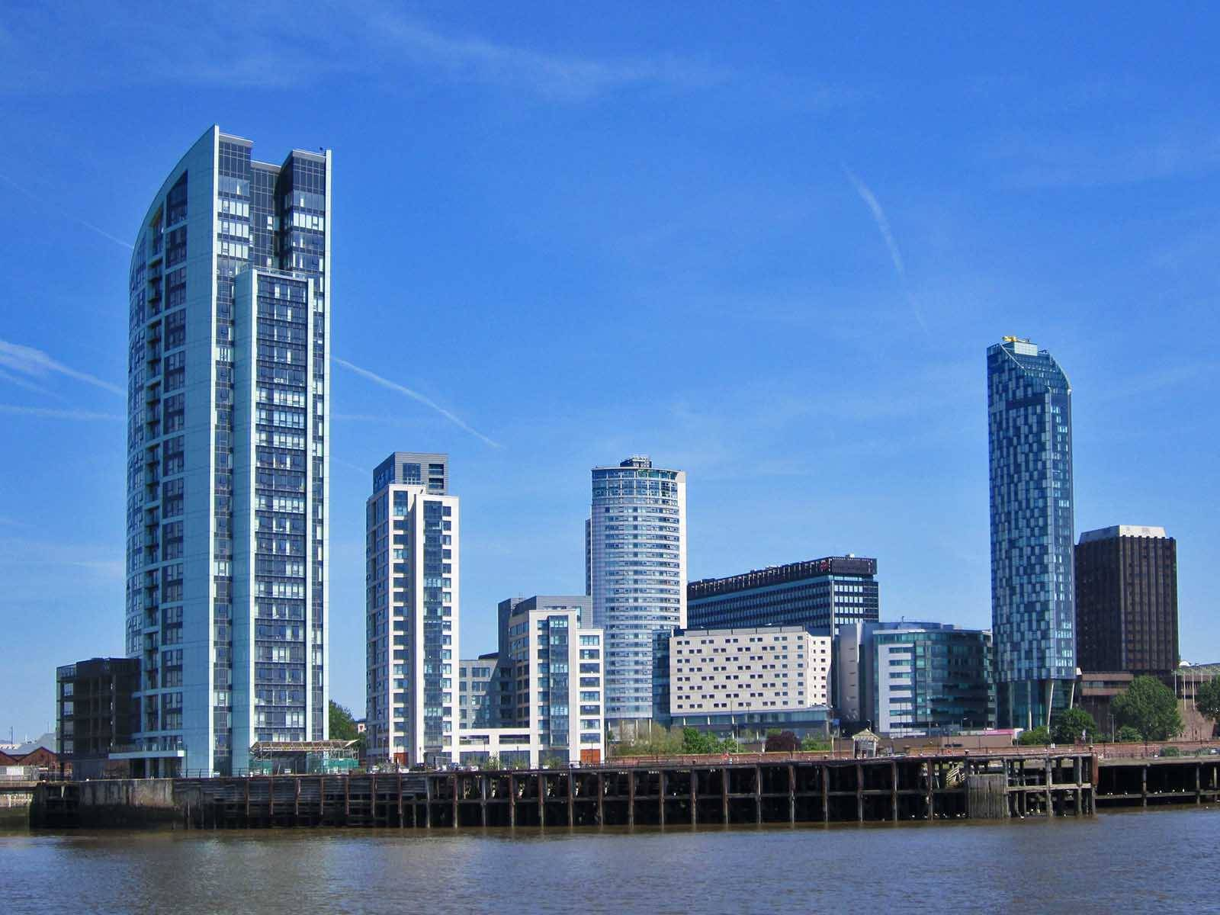
New Commercial District
(Wikia)
ORIGIN

Slide 42
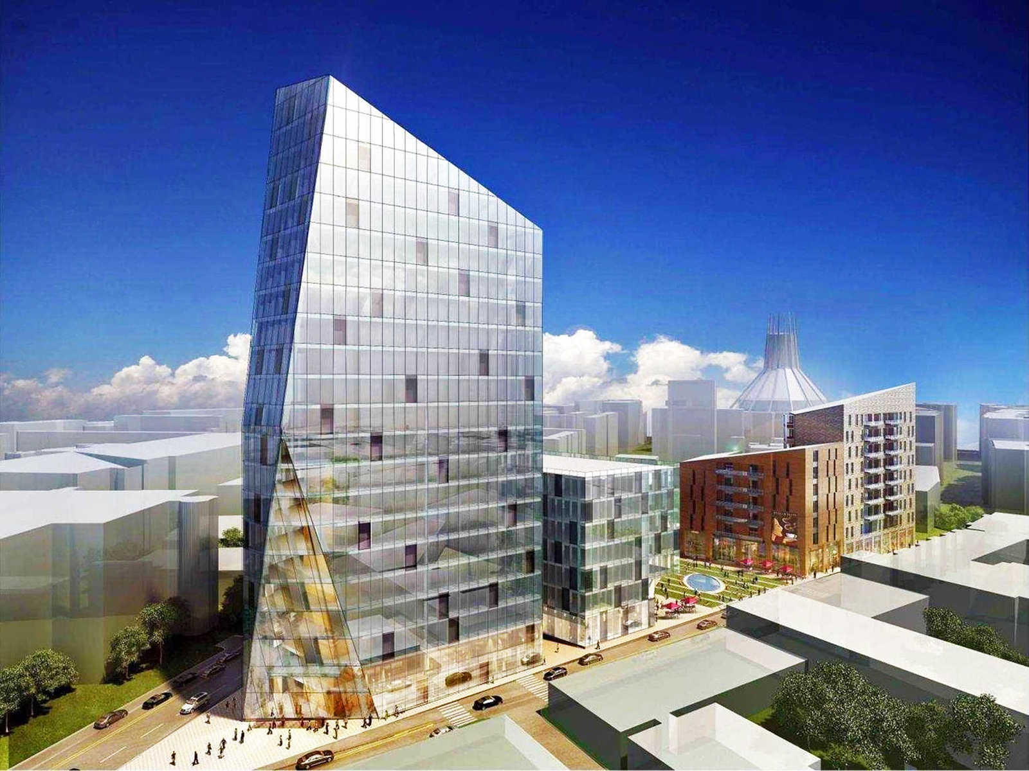
Liverpool City Centre (plans)
(Liverpool Echo)
ORIGIN

Slide 43
À LA PROCHAINE
SAUVER LA TERRE
F I N
TERMINER
Not for commercial use! / Photos from internet / Music : (unknown artist)
tomi55jutt@mail.com

Slide 44


http://ppsmania.net/
F I N

