Slide 1
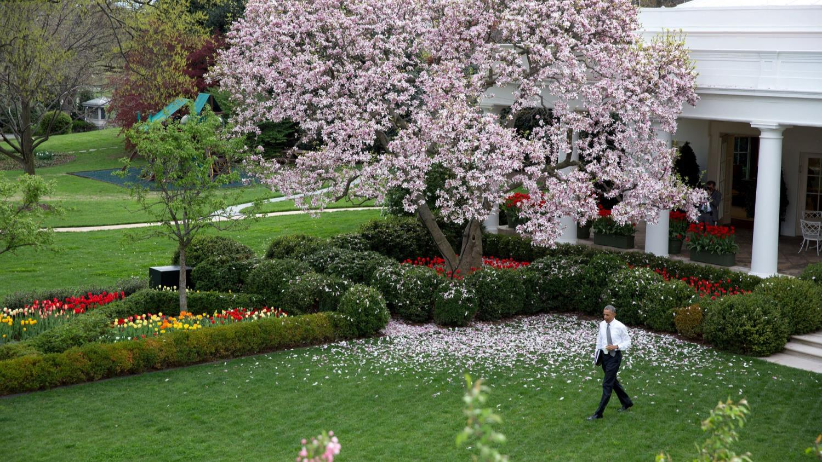

2 Million Photos in 8 Years : Pete Souza on Photographing President Obama (1)
MANUAL
ADVANCE
Music : Johann Strauss II - Vienna Blood Waltz

Slide 2
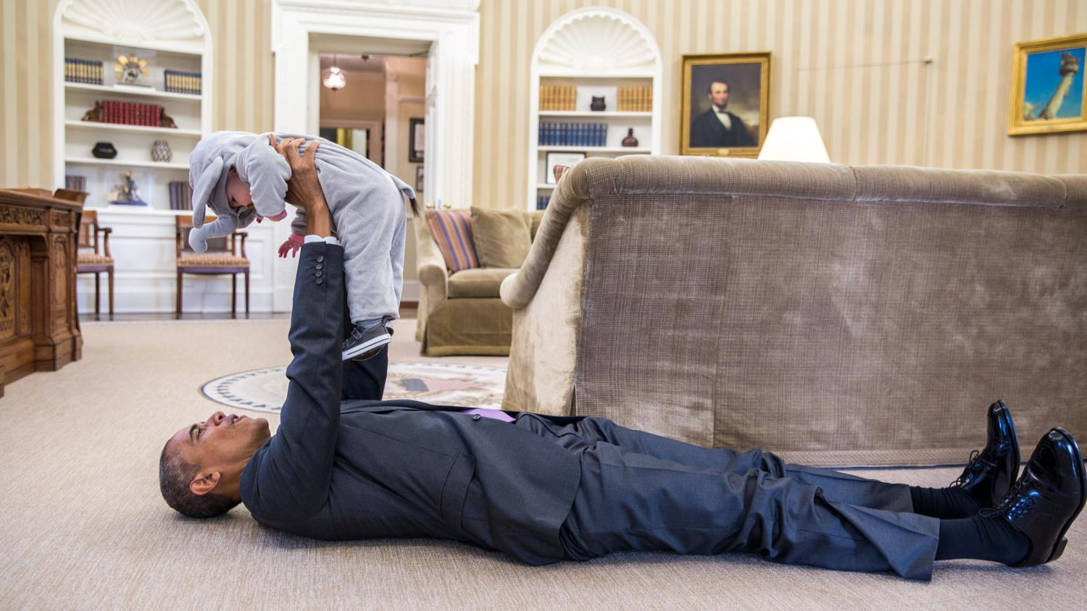
#1 Barack Obama And Ella Rhodes, Daughter Of Deputy National Security Advisor Ben Rhodes

Slide 3
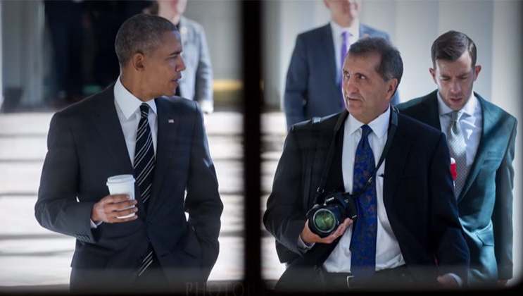
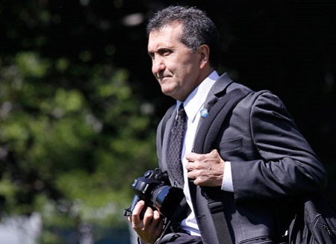
Few jobs look cooler on a business card than "Official White House Photographer." But that's precisely the job of Pete Souza, the man who's spent the last eight years documenting Barack Obama's two terms in The Oval Office.
"When you add up (the president's) day, and all the things that I photograph, I take a lot of pictures," said the photographer in a short interview for BBC Newsnight. "Someone in my office who monitors this said that I'll probably end up taking, at the end of eight years, two million photographs."
Souza, who was also Ronald Reagan's official photographer from 1983 to 1989, actually took his first pictures of Obama back in 2005. “He’s walking around Red Square, he’s on a sidewalk, and nobody knows who he is," said the photographer. Just four years later however, Obama was elected as the 44th President of the United States.
--Bored Panda

Slide 4
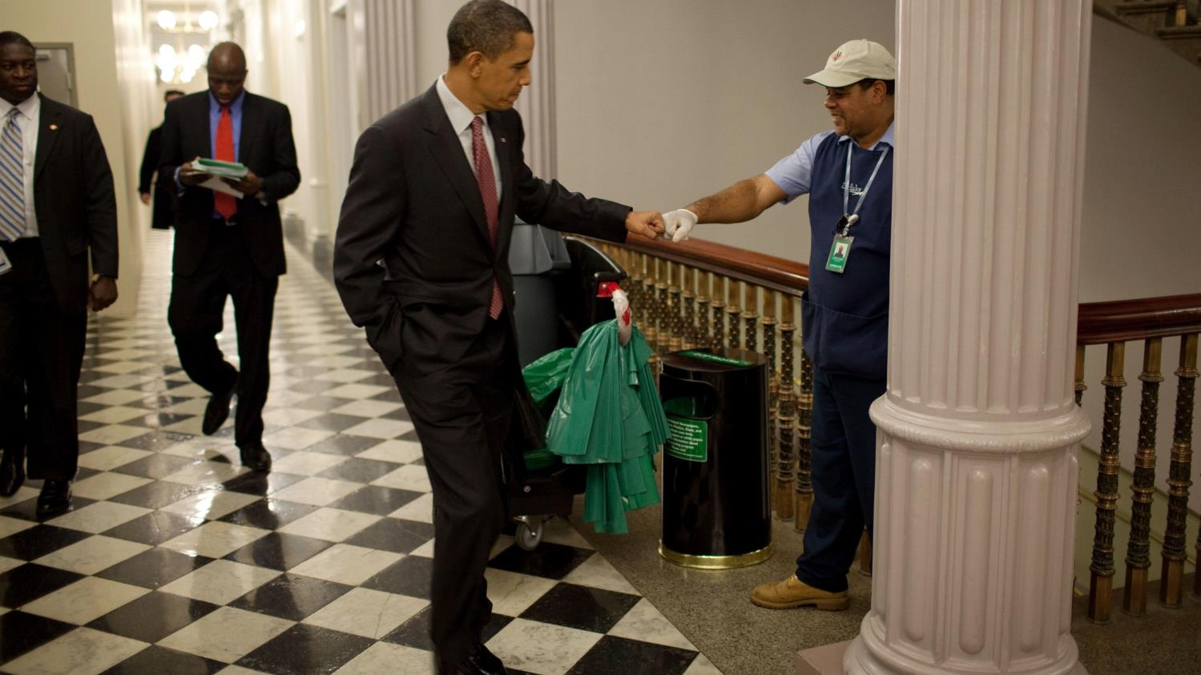
#2 President Barack Obama Fist-Bumps Custodian Lawrence Lipscomb

Slide 5
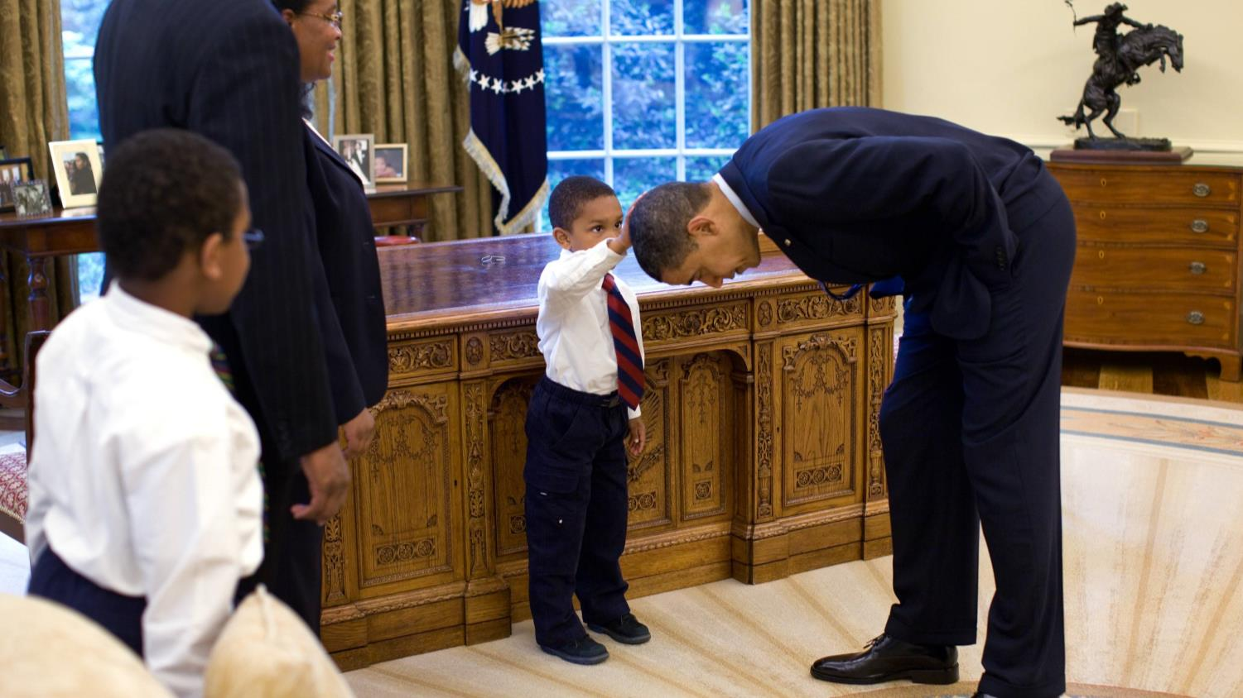
#3 A Young Boy Reaches Up To Compare The President's Hair To His Own

Slide 6
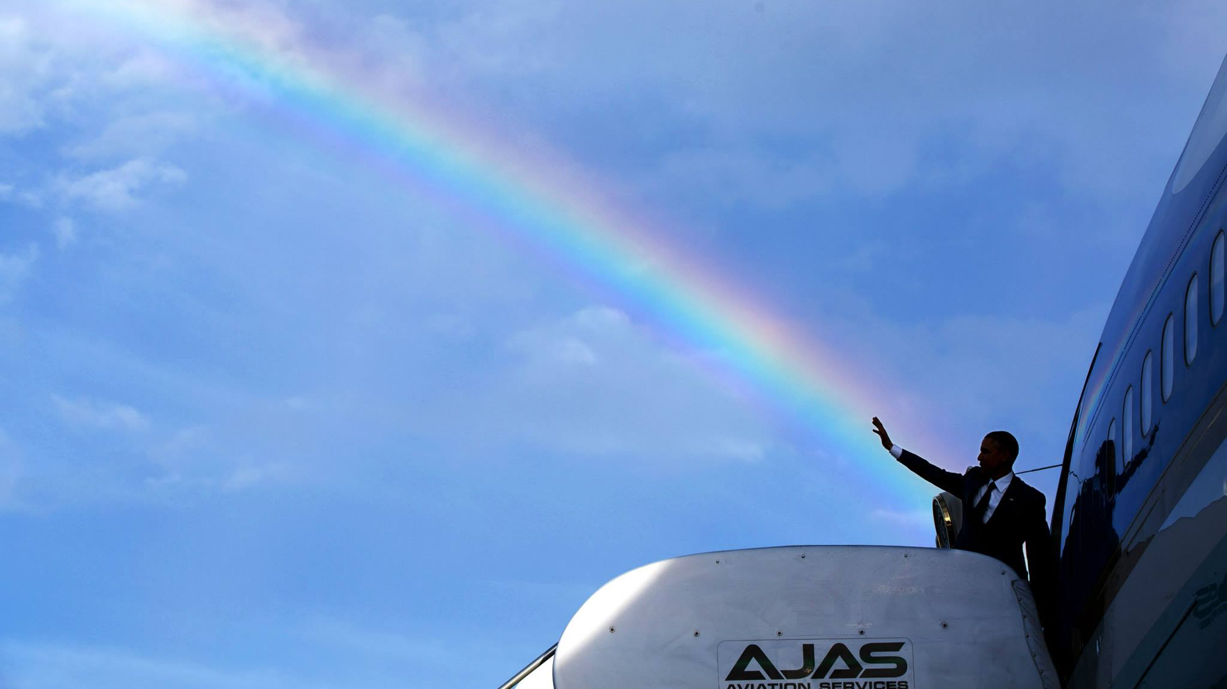
#4 President Obama Delivers A Colorful Farewell As He Leaves Jamaica

Slide 7
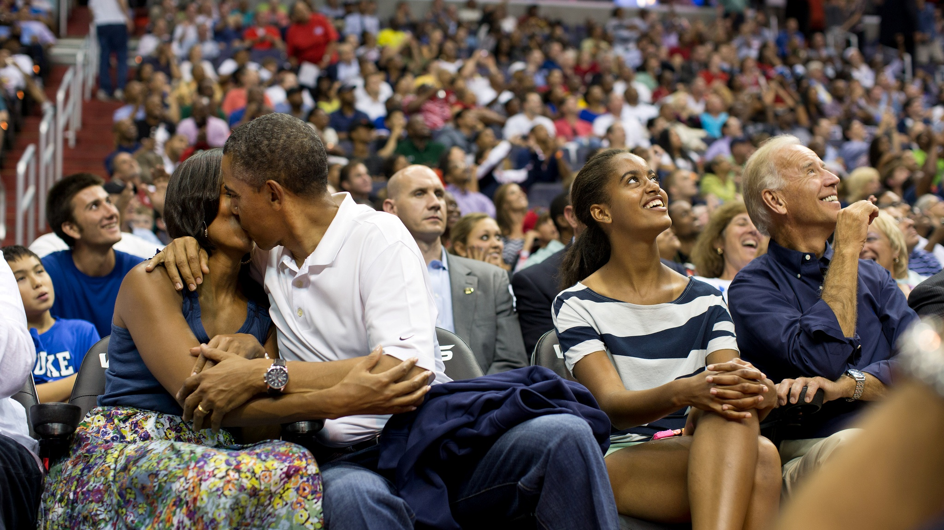
#5 President Barack Obama Kisses First Lady Michelle Obama For The "Kiss Cam"

Slide 8
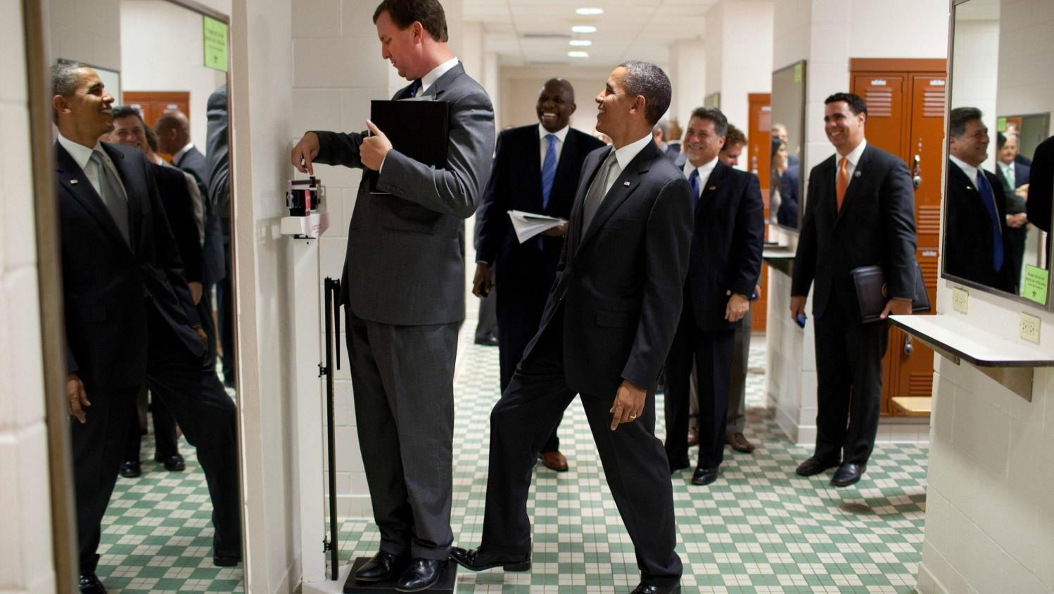
#6 President Barack Obama Jokingly Puts His Toe On The Scale As Trip Director Marvin Nicholson Weighs Himself

Slide 9
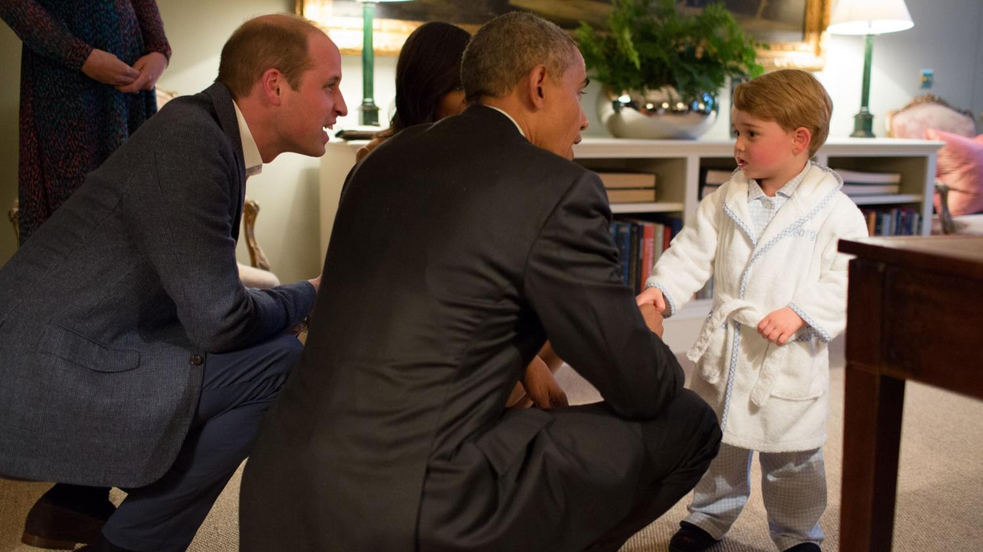
#7 President Barack Obama With First Lady Michelle Obama Meets Prince George

Slide 10
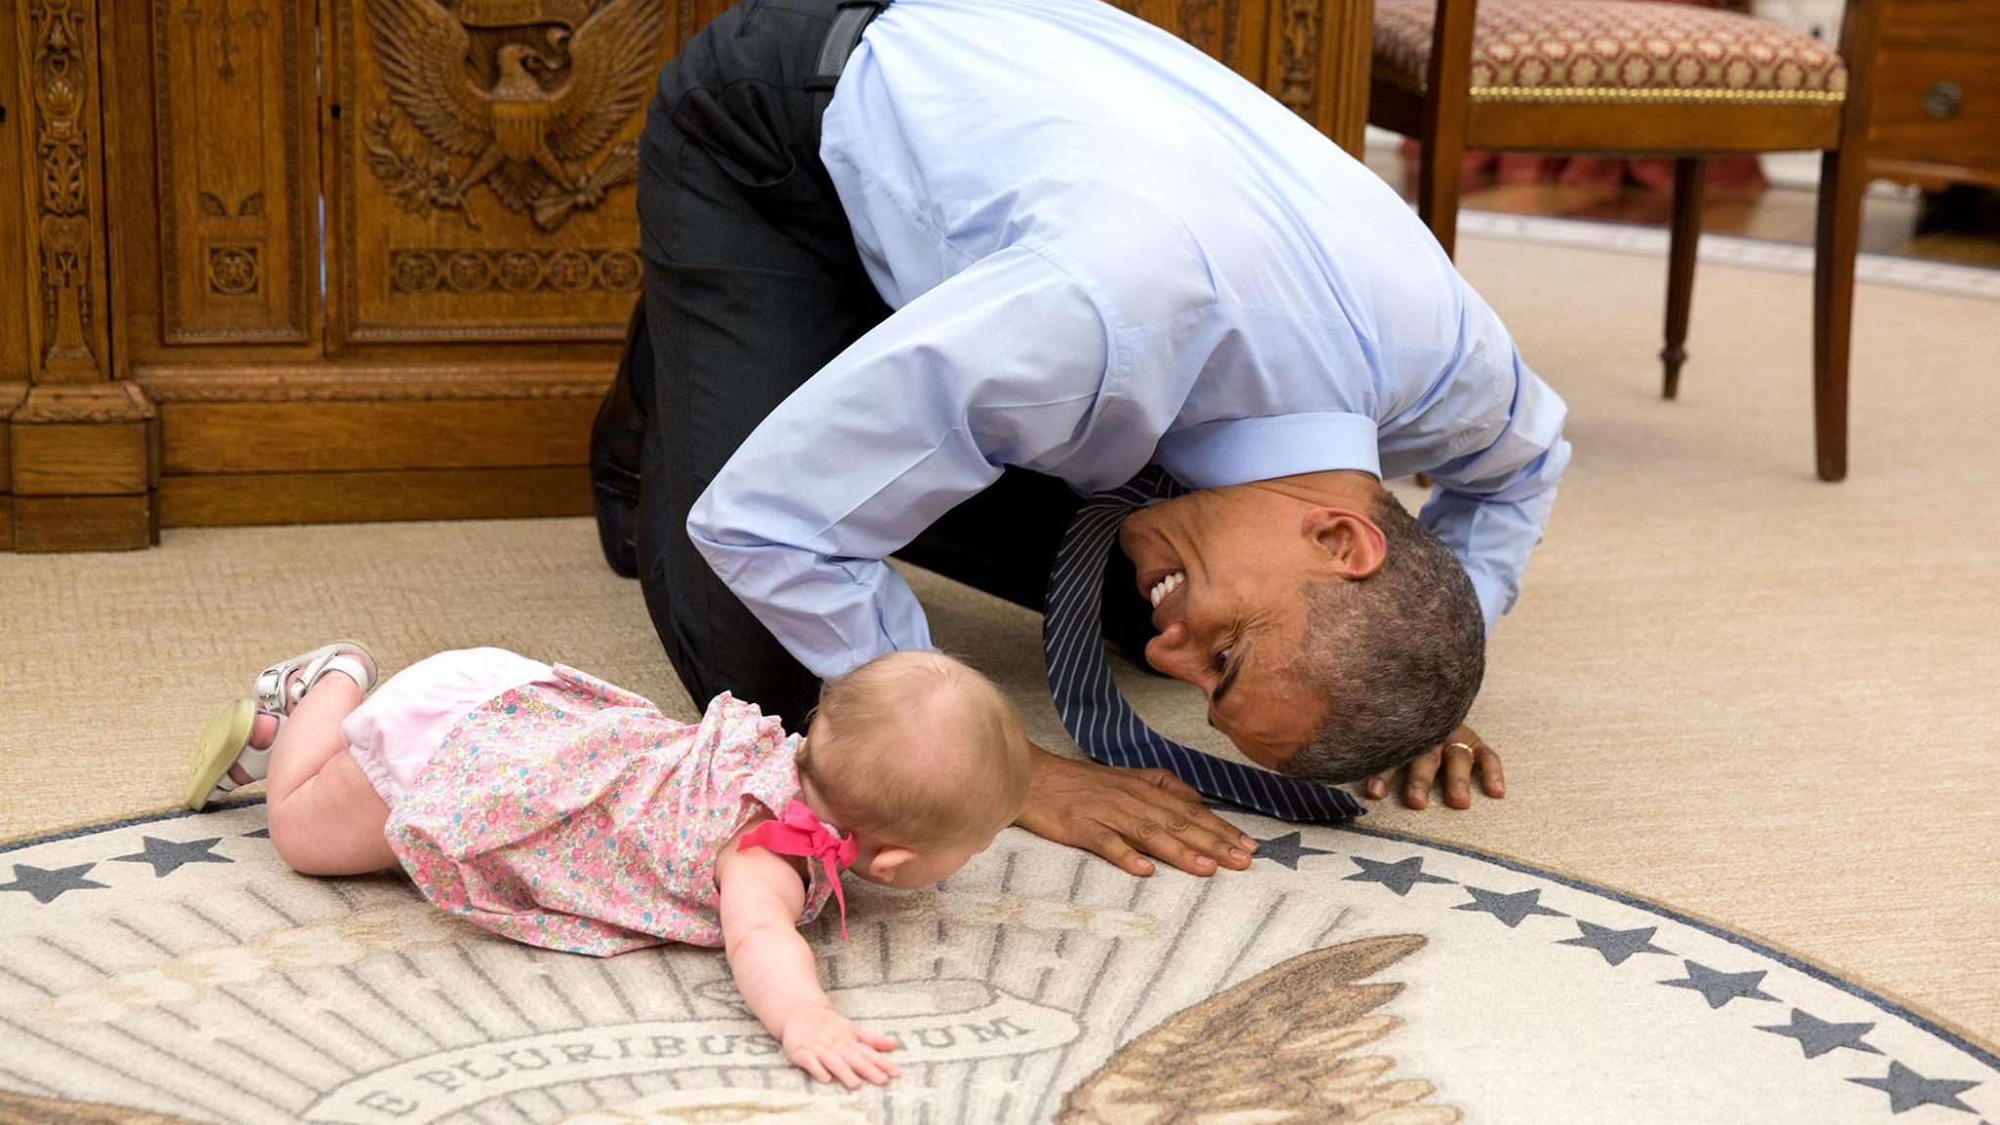
#8 Barack Obama Crawling With Ella Rhodes

Slide 11
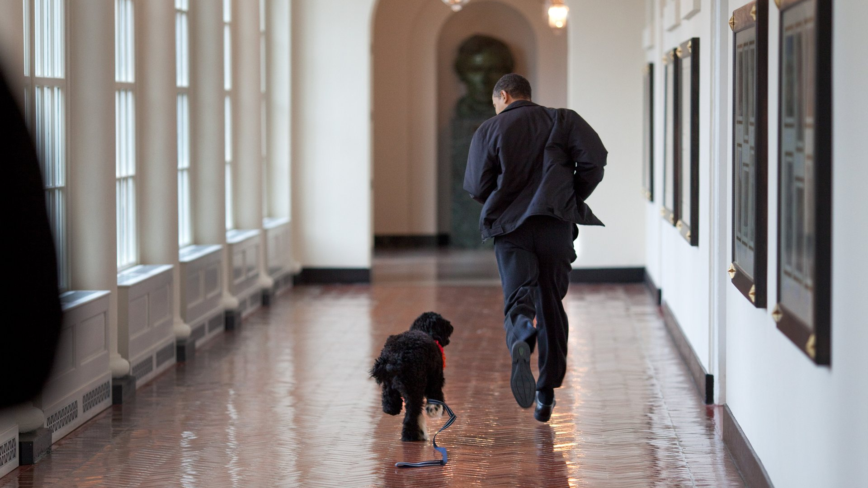
#9 Playing With Bo

Slide 12
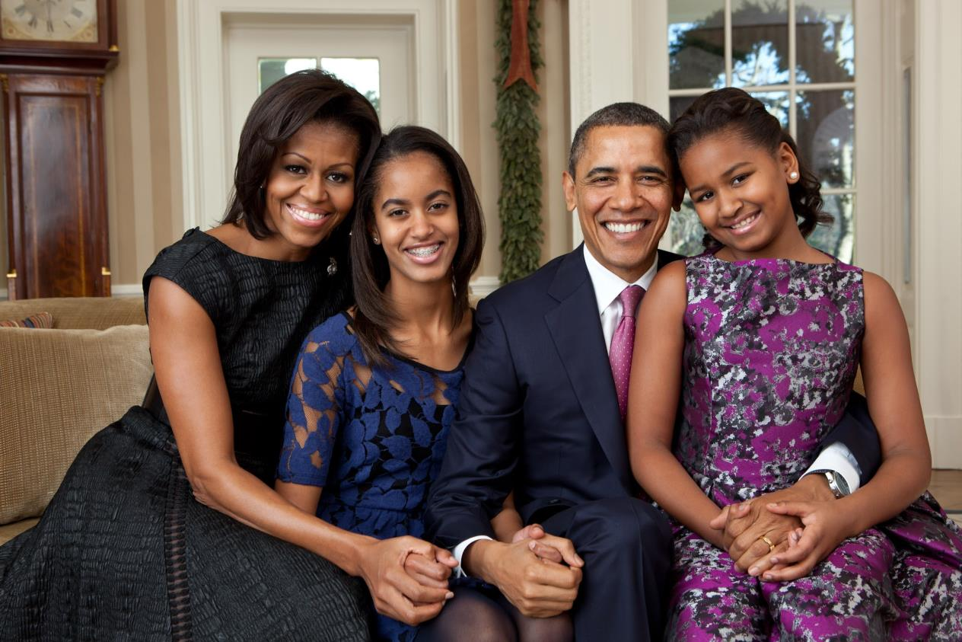
#10 Family Portrait In The Oval Office

Slide 13
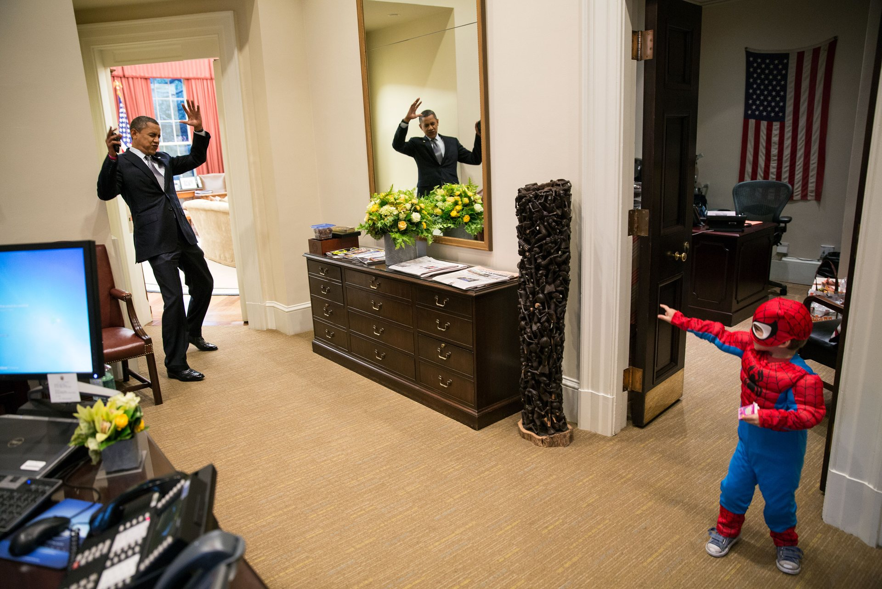
#11 The President Shows His Fun Side, Playing The Villain To A Three-Year-Old Spider-Man

Slide 14
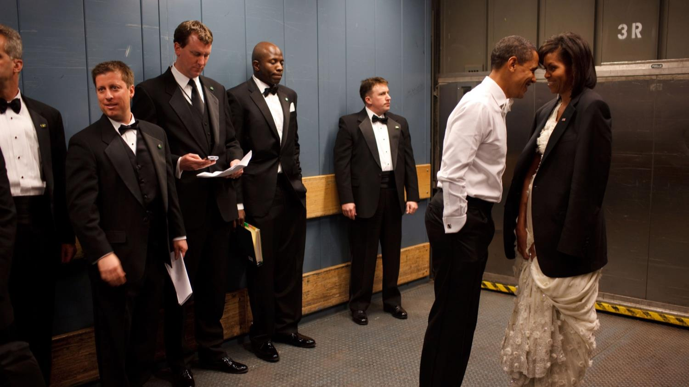
#12 President Barack Obama And First Lady Michelle Obama Share A Private Moment

Slide 15
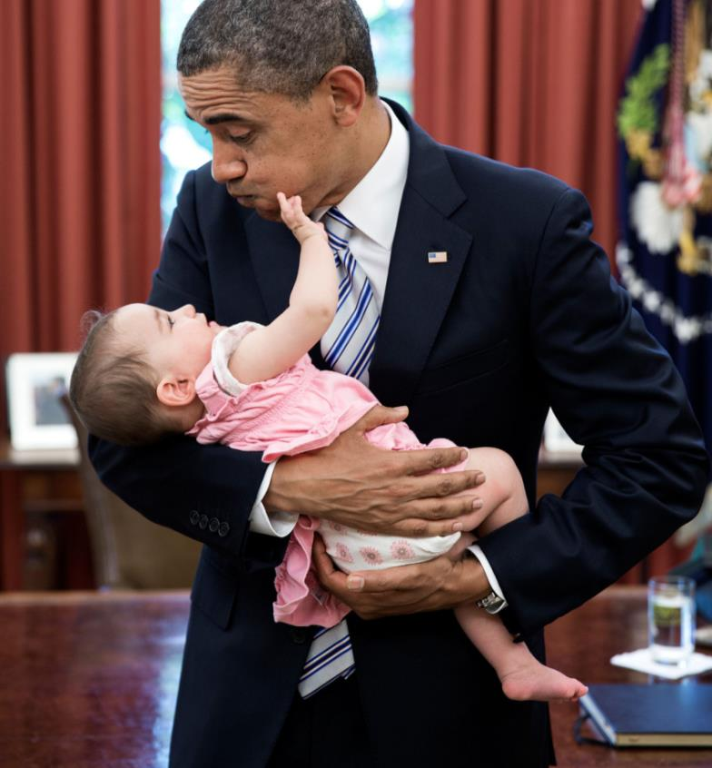
#13 President Barack Obama Holds Six-Month-Old Talia Neufeld, Daughter Of Departing Staff Member Adam Neufeld

Slide 16
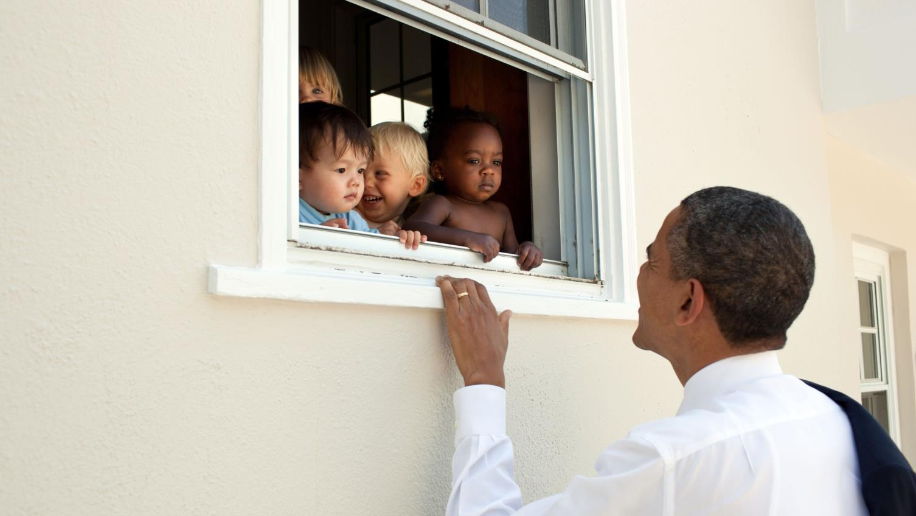
#14 Skeptical Infants Peer At The POTUS Through A Window

Slide 17
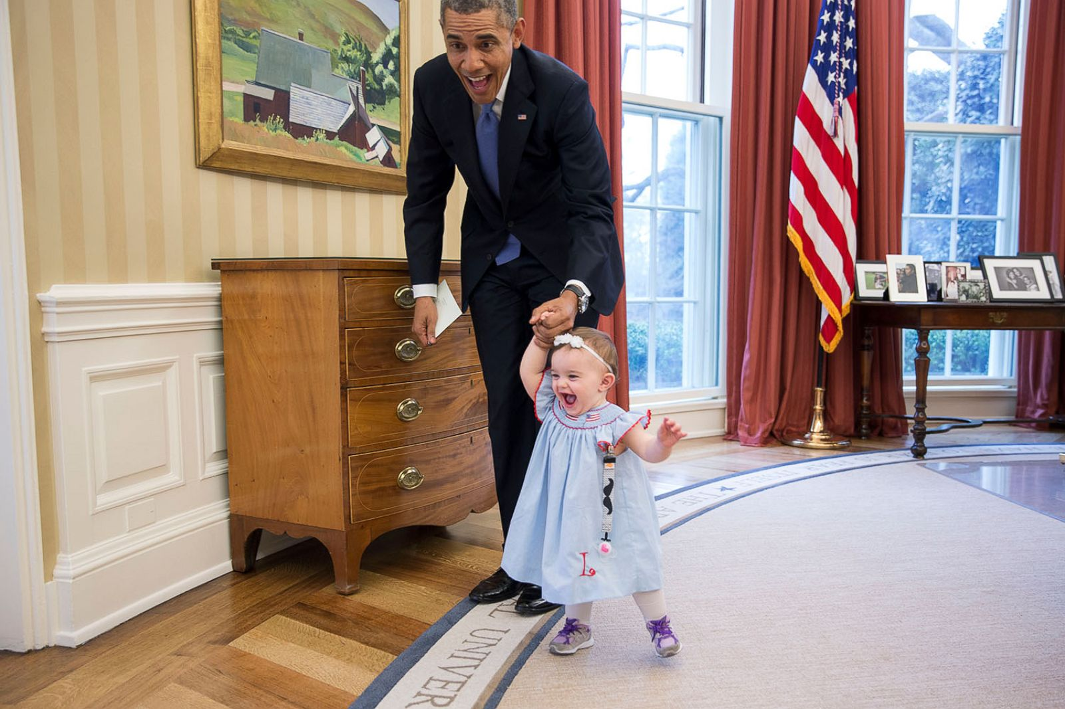
#15 One-Year-Old Lincoln Rose Smith Learns To Walk

Slide 18
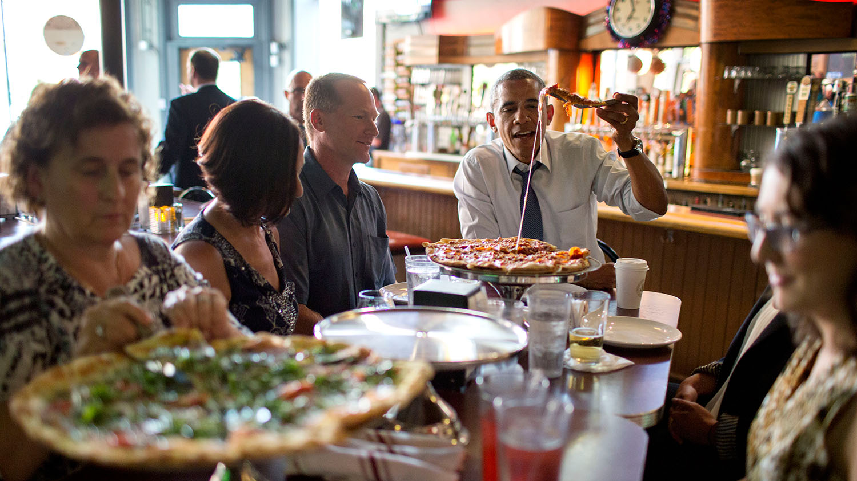
#16 President Barack Obama Shares A Pizza Dinner With Individuals Who Wrote Letters To Him, At The Wazee Supper Club In Denver, Colo

Slide 19
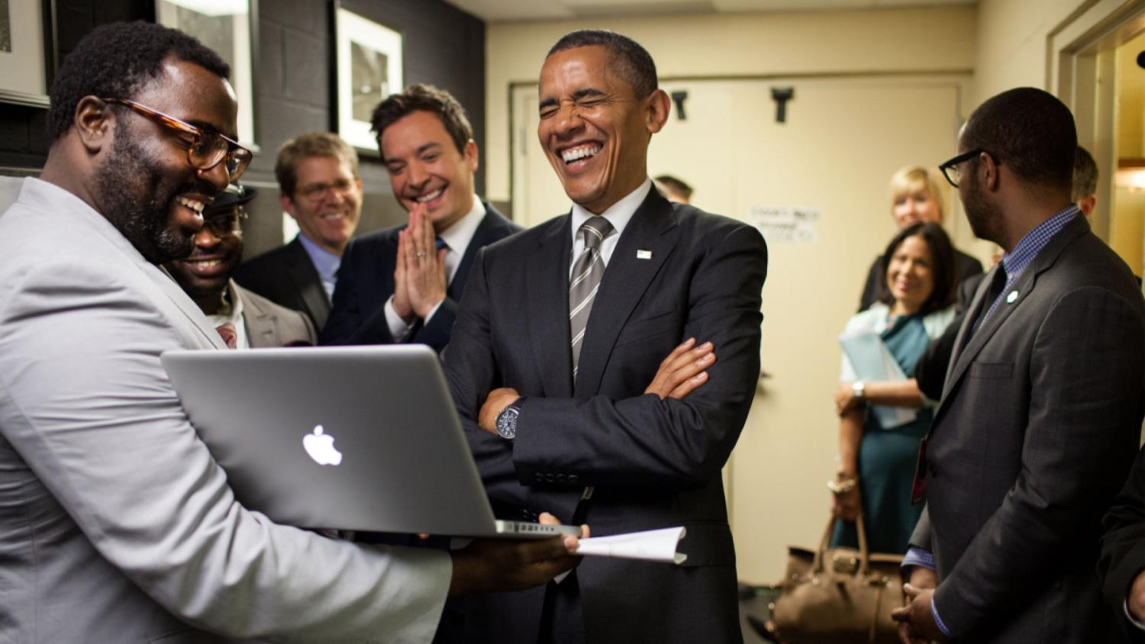
#17 The President Let Out A big Laugh As He Was Being Briefed By The Producers And Mr. Fallon On The 'Slow Jam The News' Segment

Slide 20
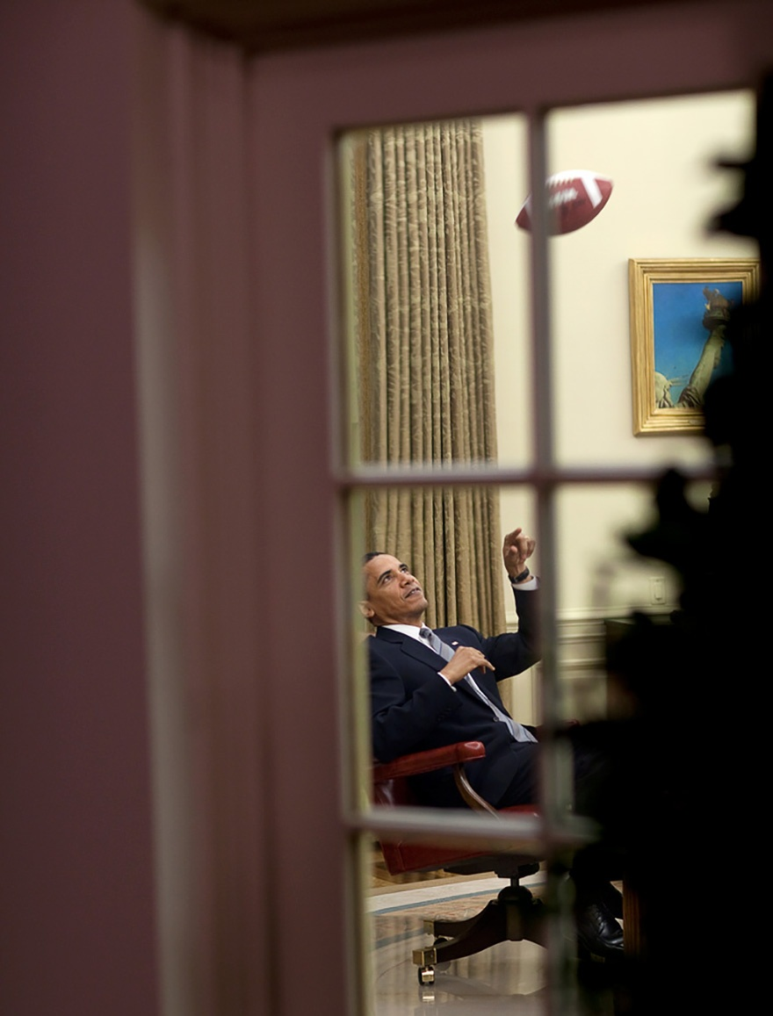
#18 The President Tosses Around The Ball Before A Meeting In The Oval Office

Slide 21
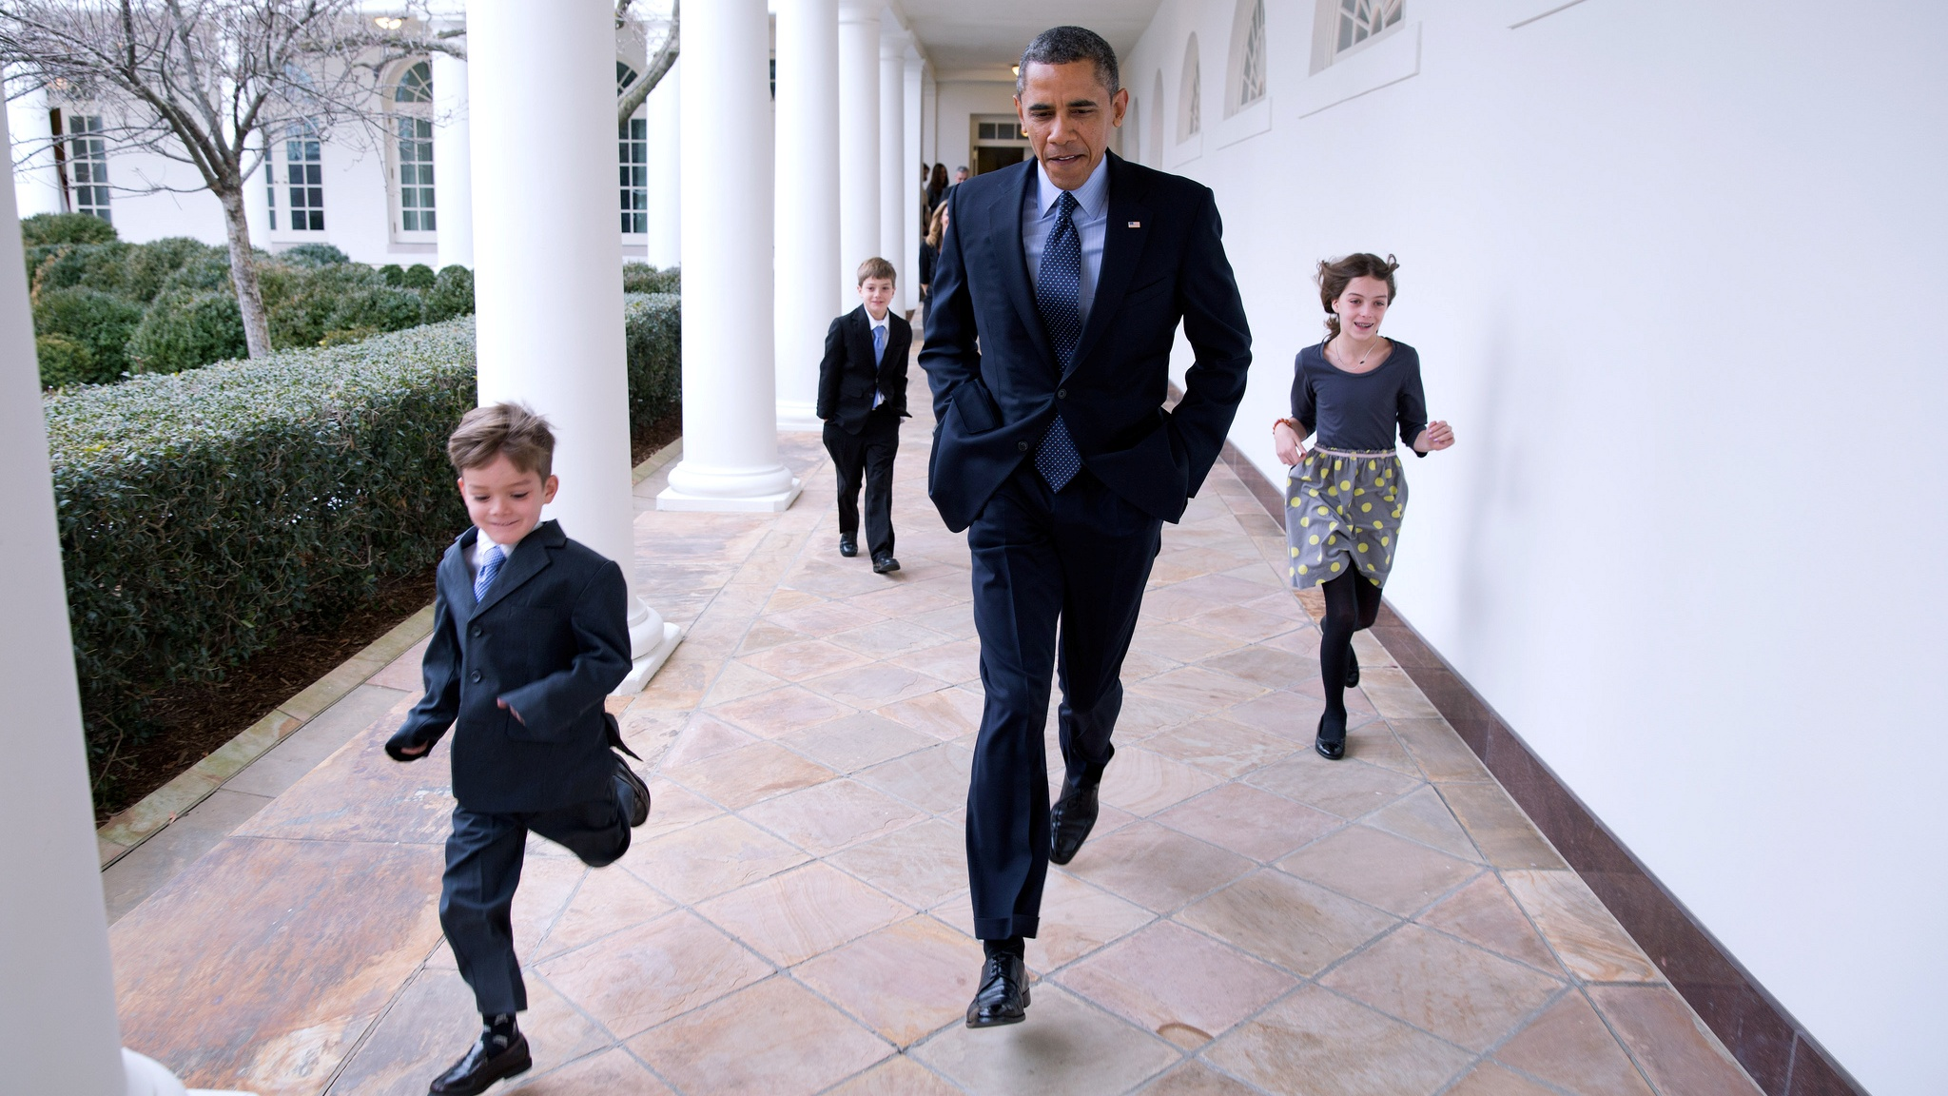
#19 On A Cold Day, The President Races Down The Colonnade With Denis McDonough's Children

Slide 22
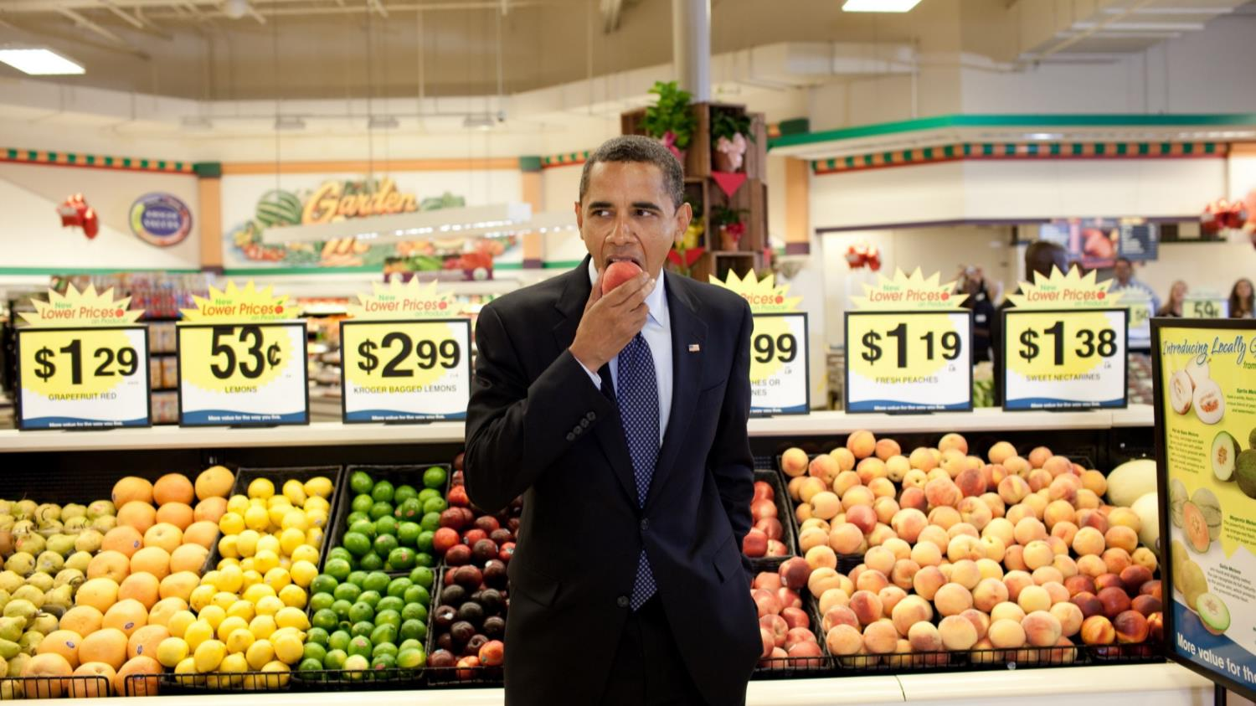
#20 President Barack Obama Eats A Peach Following A Town Hall Meeting At Kroger's Supermarket

Slide 23
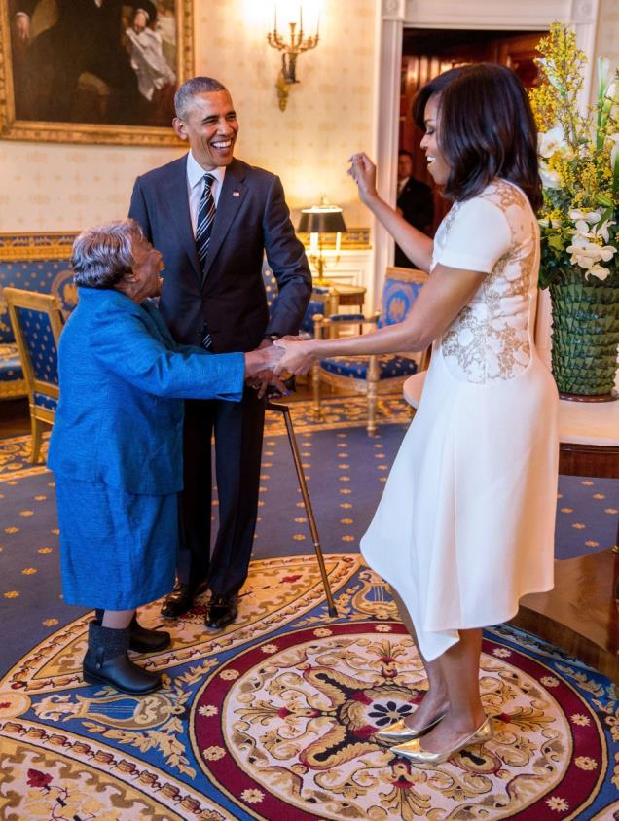
#21 President Barack Obama Watches First Lady Michelle Obama Dance With 106-Year-Old Virginia McLaurin Prior To A Reception Celebrating African American History

Slide 24
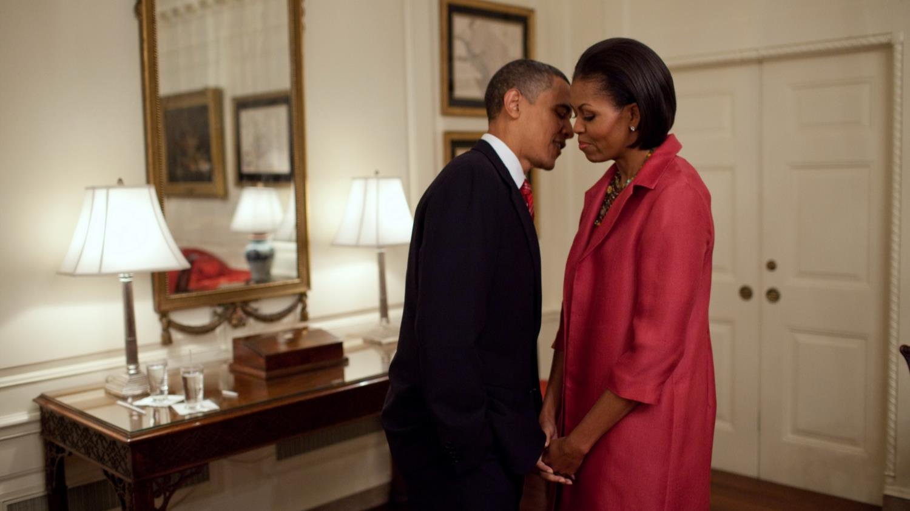
#22 President Barack Obama And First Lady Michelle Obama

Slide 25
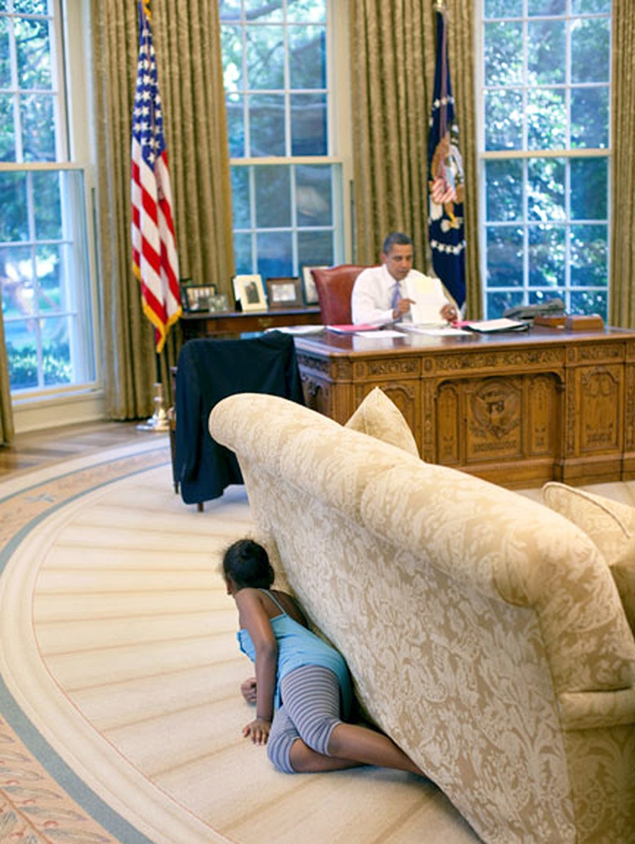
#23 President Barack Obama's Daughter Sasha Hides Behind The Sofa As She Sneaks Up On Him At The End Of The Day In The Oval Office

Slide 26
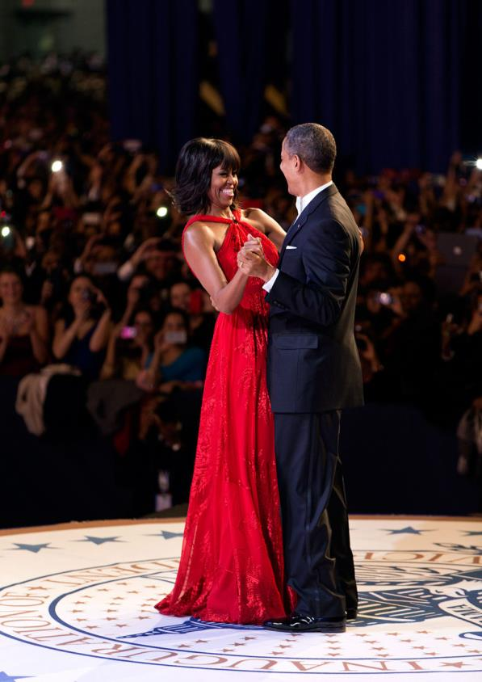
#24 President Barack Obama And First Lady Michelle Obama Dance Together During The Inaugural Ball At The Walter E. Washington Convention Center

Slide 27
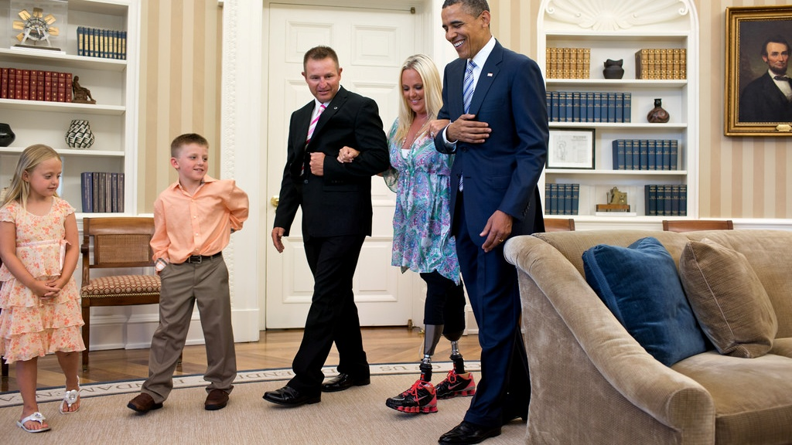
#25 President Barack Obama Welcomes Stephanie Decker. Decker lost her legs while saving her two children during a tornado in southern Indiana in March

Slide 28
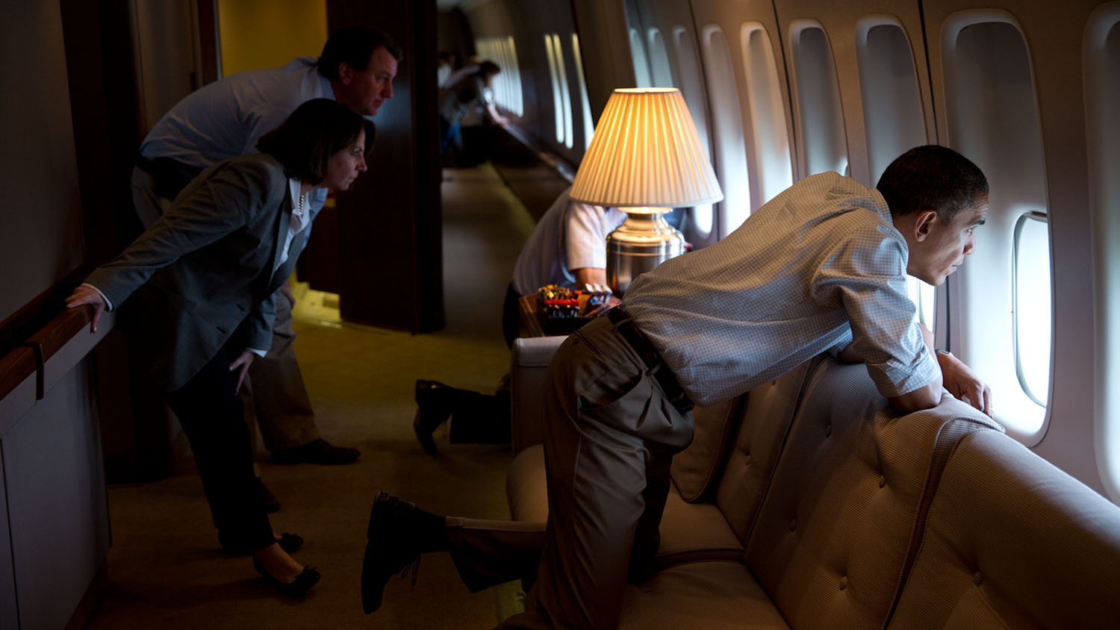
#26 The President And Members Of The White House Staff Look Out The Window Of Air Force One To View Tornado Damage Over Moore, Oklahoma

Slide 29
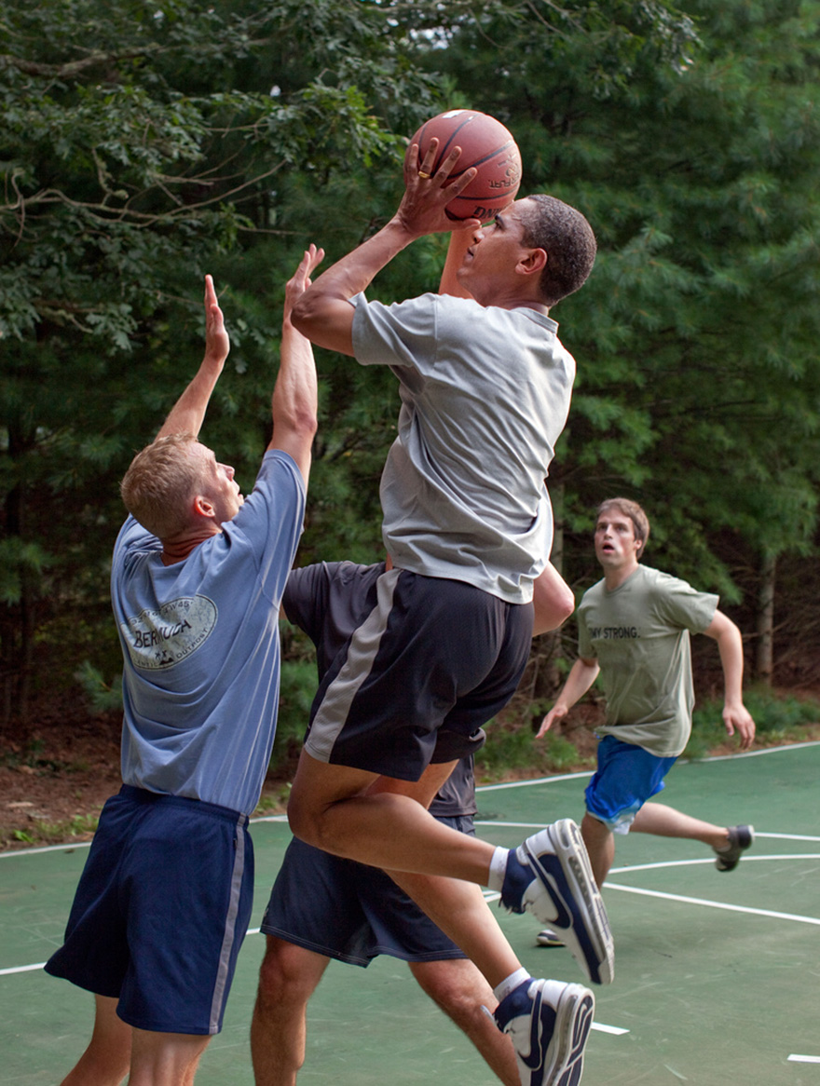
#27 President Barack Obama Plays Basketball With White House Staffers While On Vacation On Martha's Vineyard

Slide 30
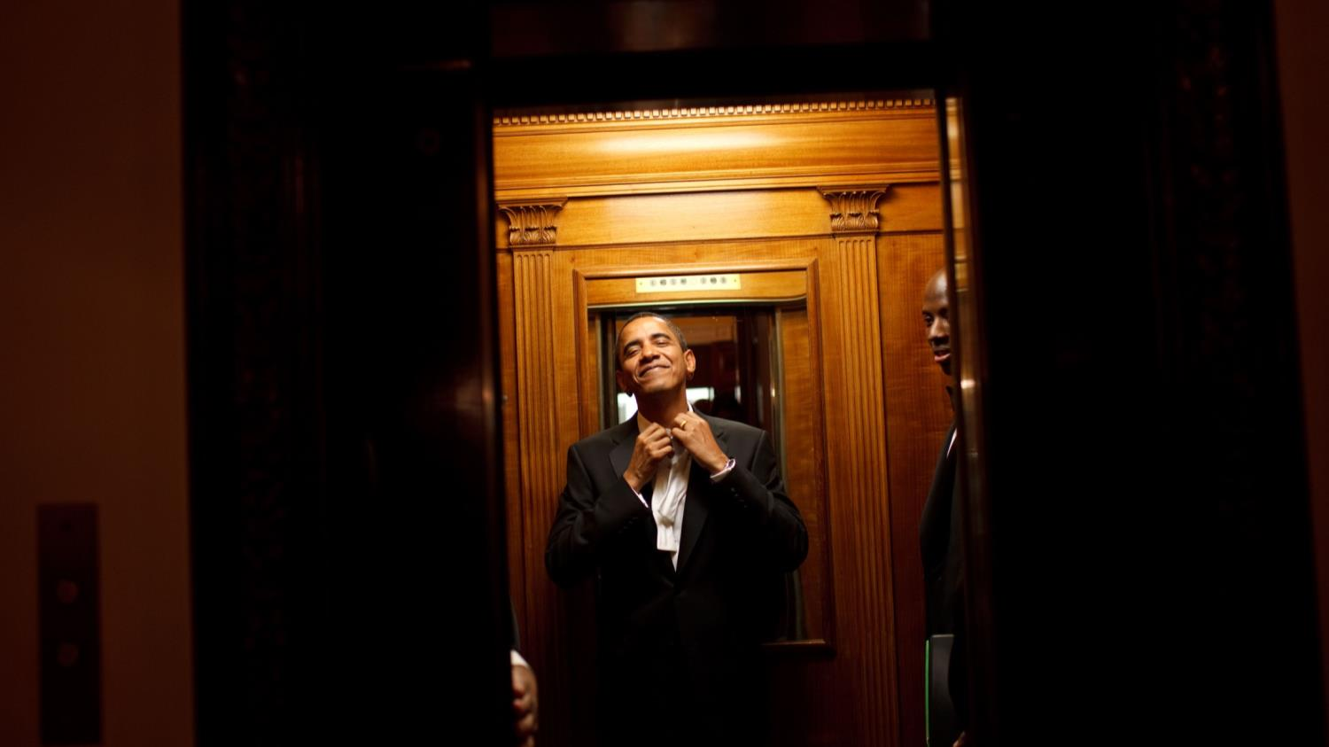
#28 President Barack Obama Rides The Elevator To The Private Residence Of The White House After Attending 10 Inaugural Balls And A Long Day, Including Being Sworn In As President

Slide 31
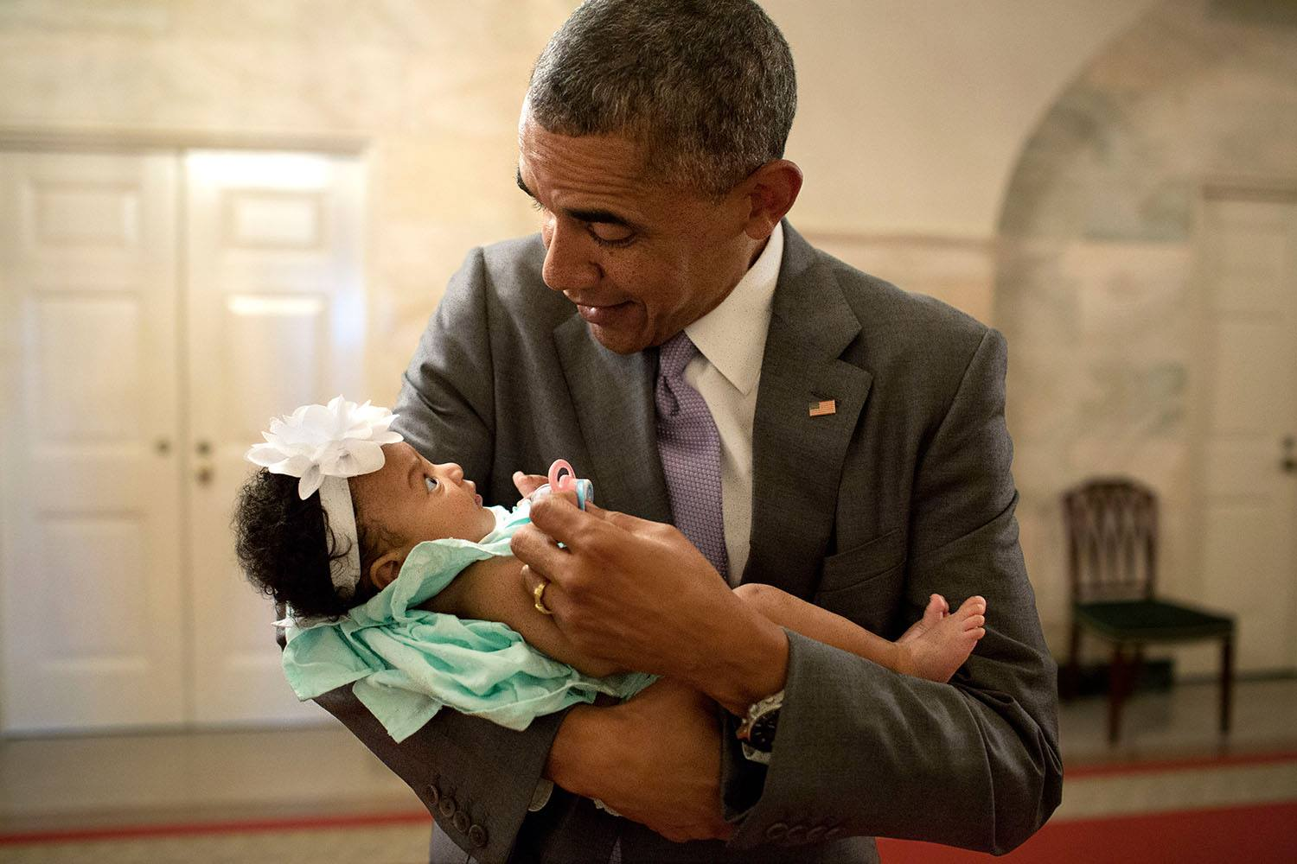
#29 President Barack Obama Holds The Baby Daughter Of Former Staff Members Darienne Page Rakestraw And London Rakestraw

Slide 32
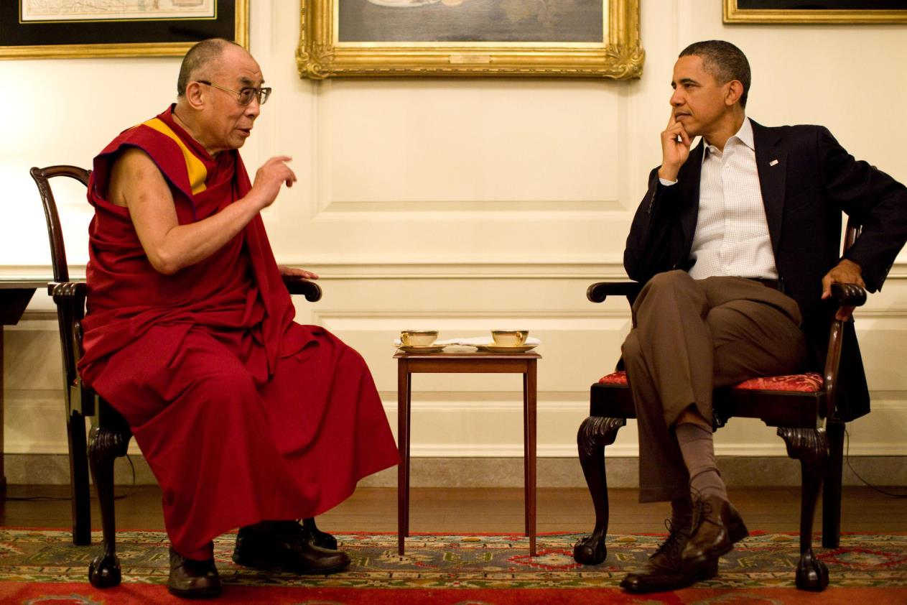
#30 President Barack Obama Meets With His Holiness The XIV Dalai Lama

Slide 33
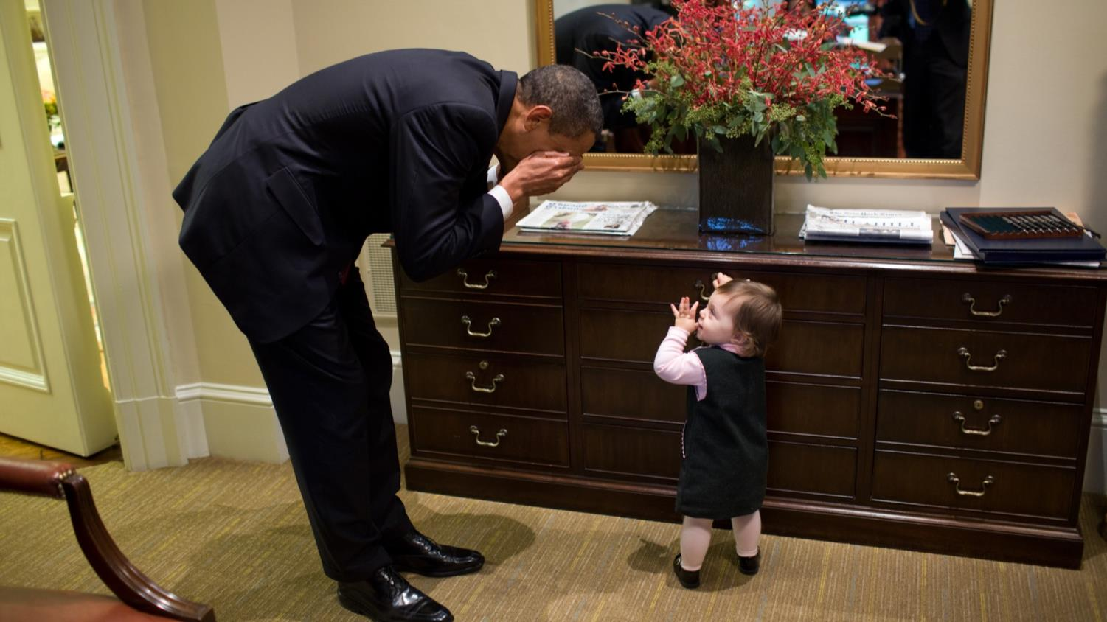
#31 The President Plays Peek-A-Boo With The Daughter Of White House Staffer Emmett Beliveau In The Outer Oval Office

Slide 34
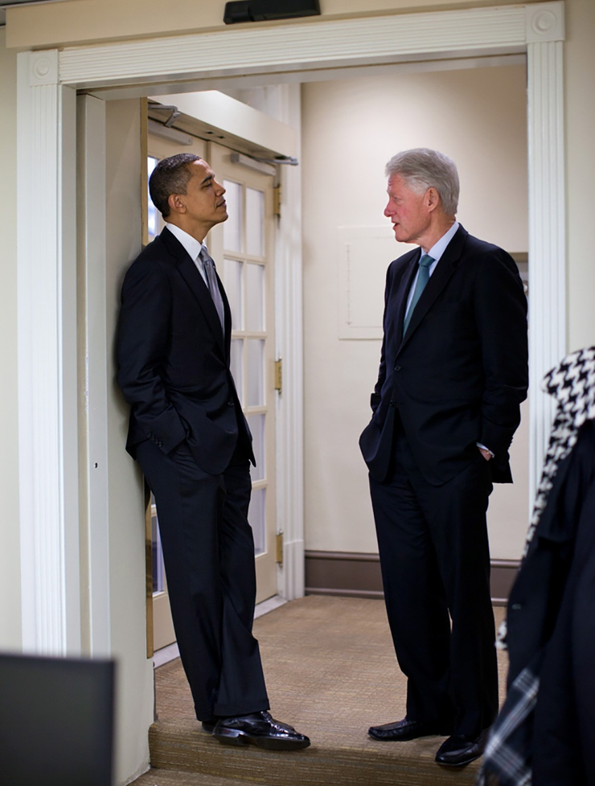
#32 Two Presidents Waiting Near Locked Door

Slide 35
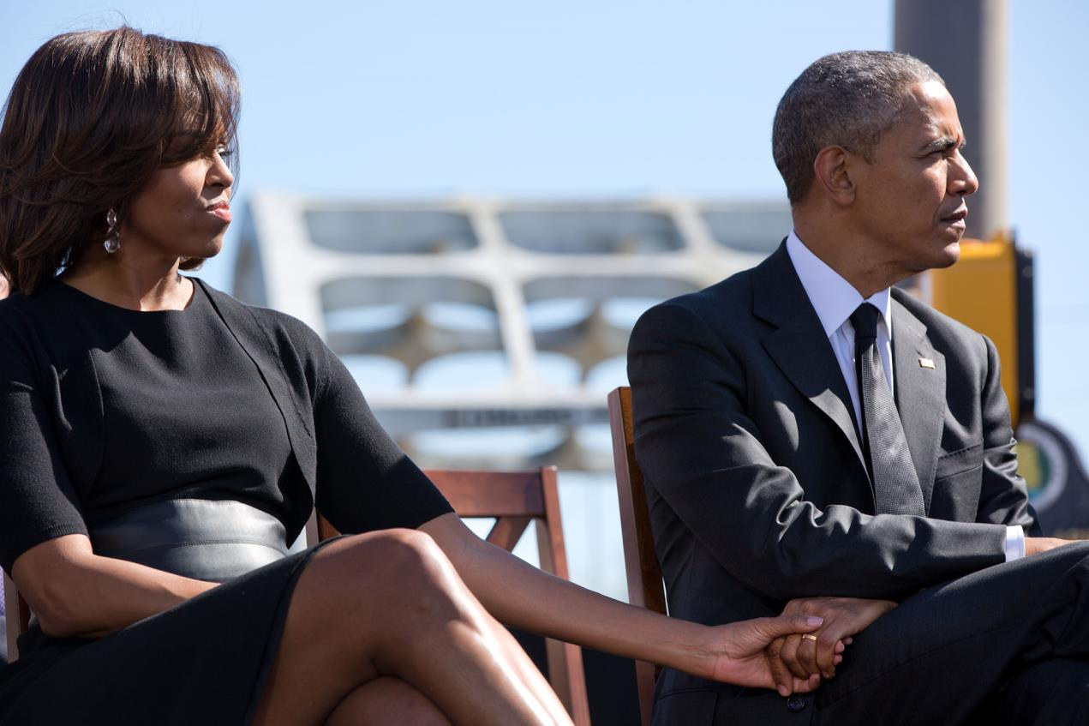
#33 The President And First Lady Holding Hands At The 50th Anniversary Of Bloody Sunday

Slide 36
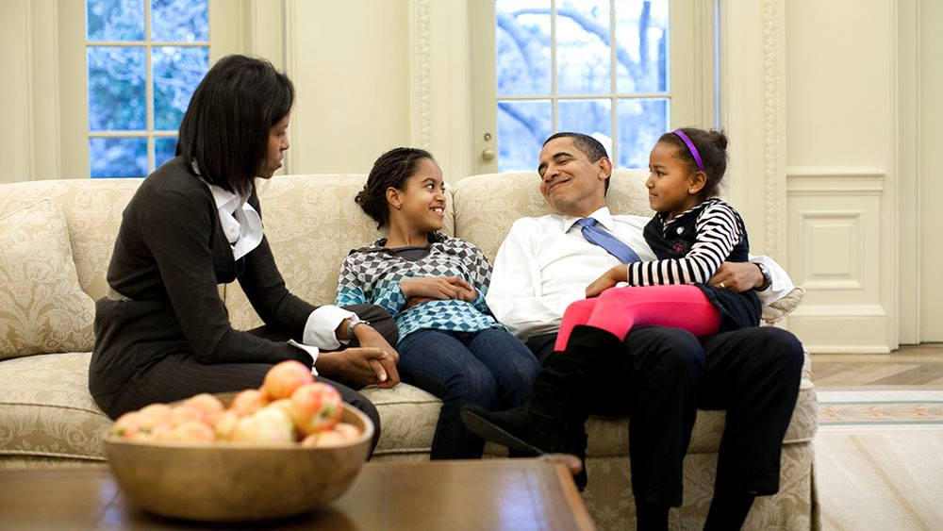
#34 Obama Family In The Oval Office

Slide 37
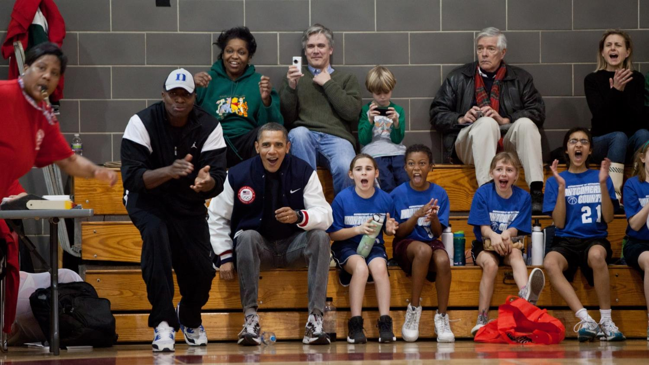
#35 The Two Coaches For Sasha Obama's Basketball Team Couldn't Make It To One Of Her Games, So The President And His Then Personal Aide Filled In As Coaches For This Game

Slide 38
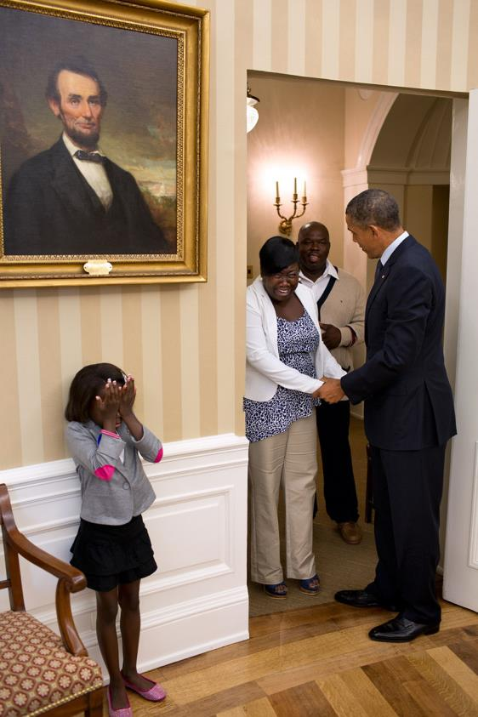
#36 Eight-Year Old Make-A-Wish Child Janiya Penny Reacts After Meeting President Barack Obama As He Welcomes Her Family To The Oval Office

Slide 39
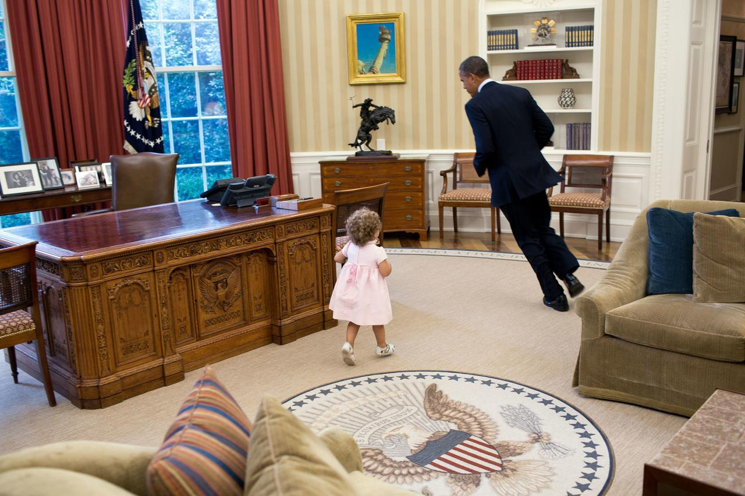
#37 President Barack Obama Runs Around His Desk In The Oval Office With Sarah Froman, Daughter Of Nancy Goodman And Mike Froman, Deputy National Security Advisor For International Economics

Slide 40
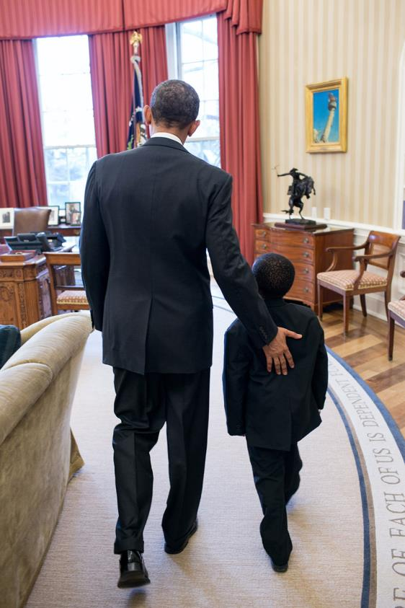
#38 President Barack Obama Welcomes Robby Novak, Known As “Kid President,” To The Oval Office

Slide 41
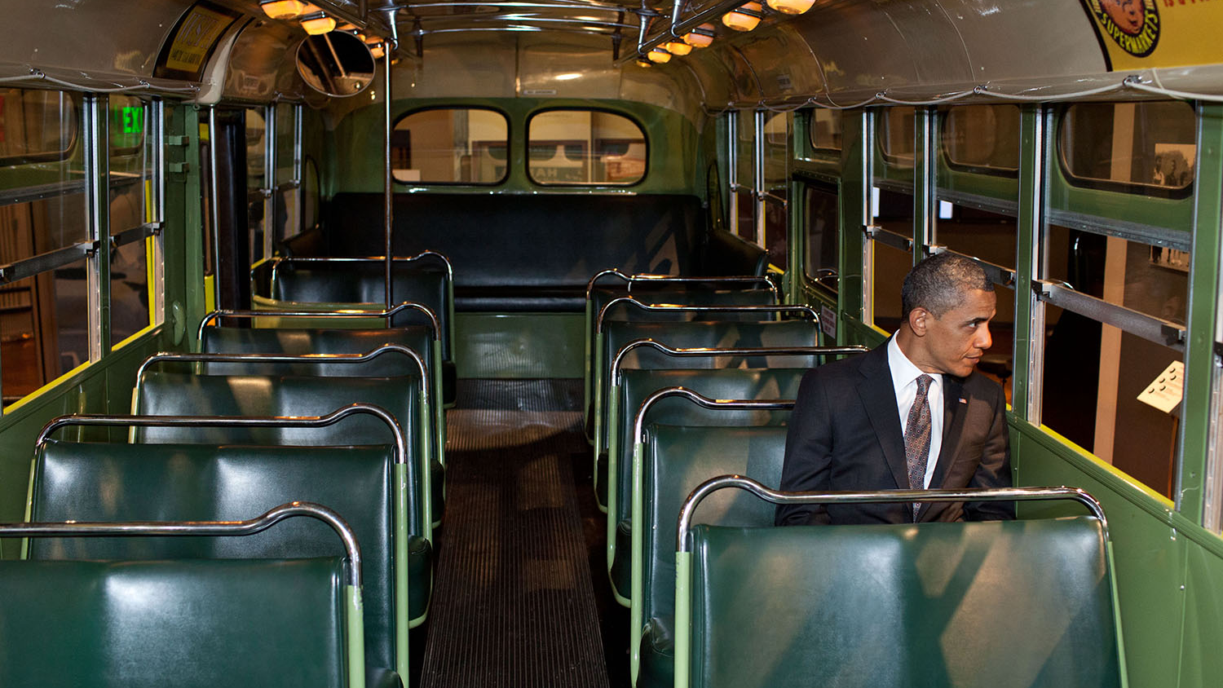
#39 President Barack Obama Sits On The Famed Rosa Parks Bus At The Henry Ford Museum

Slide 42
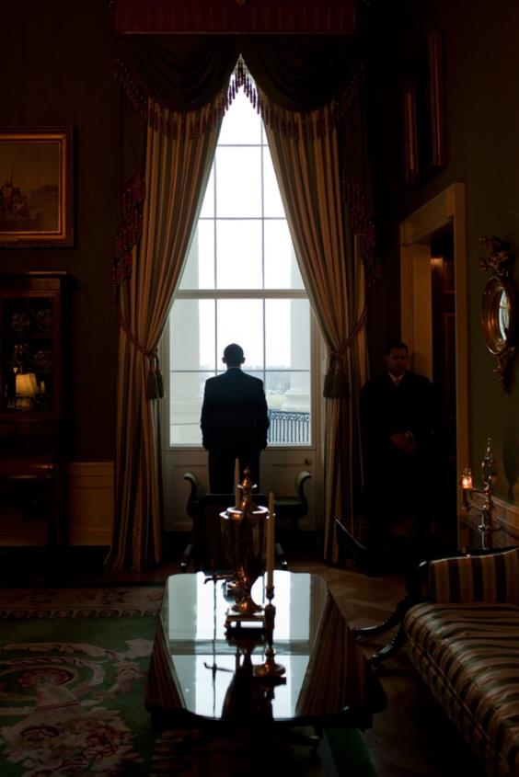
#40 President Barack Obama Looks Out The Green Room Window

Slide 43
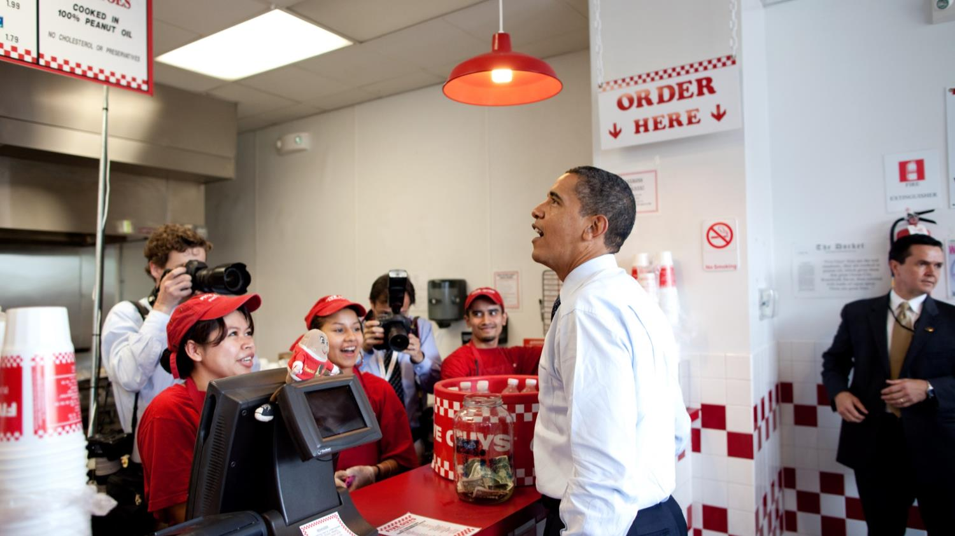
#41 President Obama Orders Lunch At Five Guys In Washington, D.C. During An Unannounced Lunch Outing

Slide 44
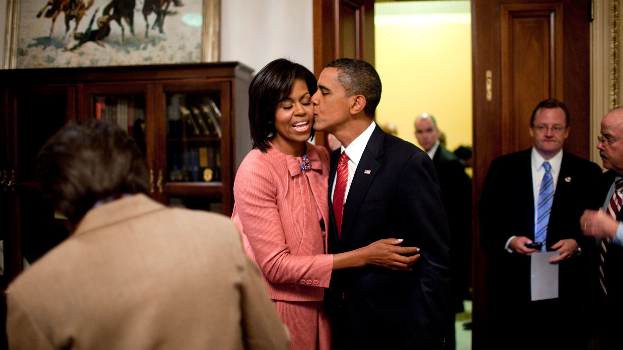
#42 President Barack Obama Kisses First Lady Michelle Obama

Slide 45
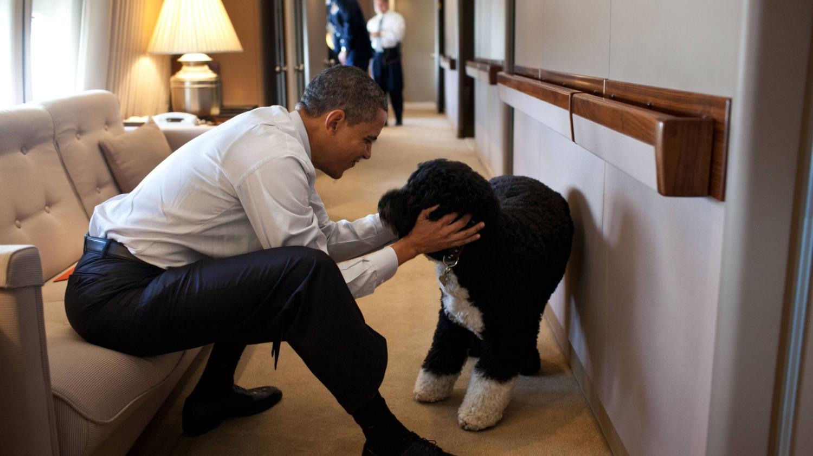
#43 President Barack Obama Plays With Bo, The Obama Family Dog, Aboard Air Force One During A Flight To Hawaii

Slide 46
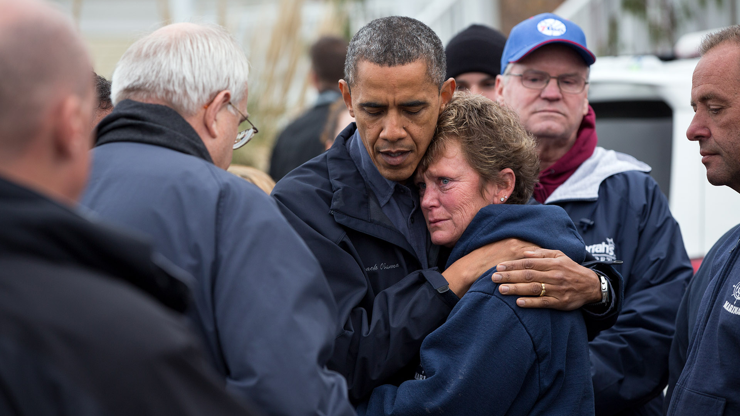
#44 President Barack Obama Hugs Donna Vanzant, The Owner Of North Point Marina, As He Tours Damage From Hurricane Sandy In Brigantine, N.J.

Slide 47
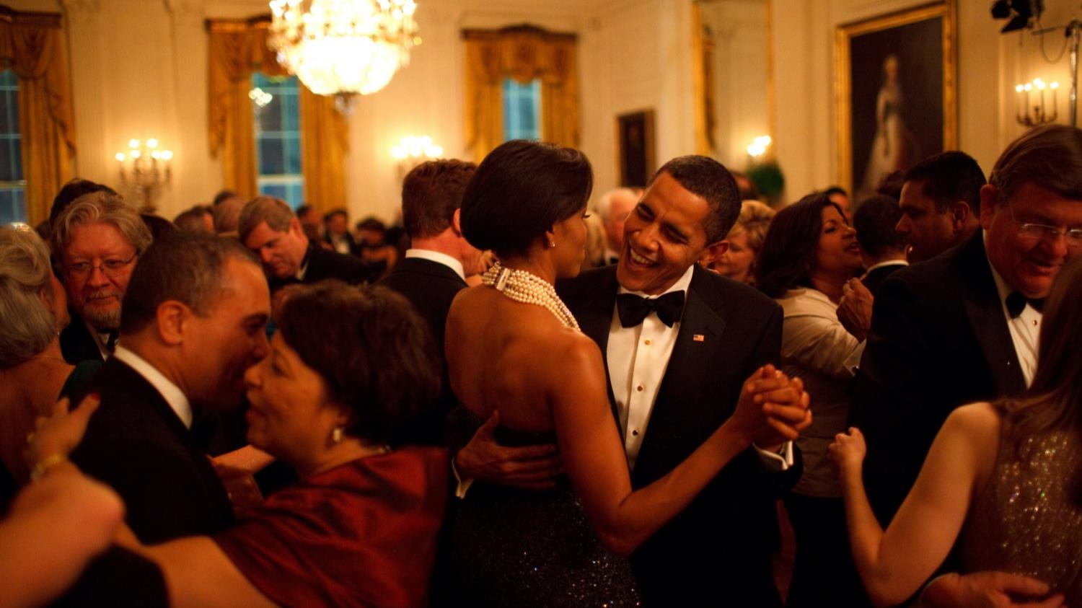
#45 President Barack Obama And First Lady Michelle Obama Dance At The Governors Ball

Slide 48
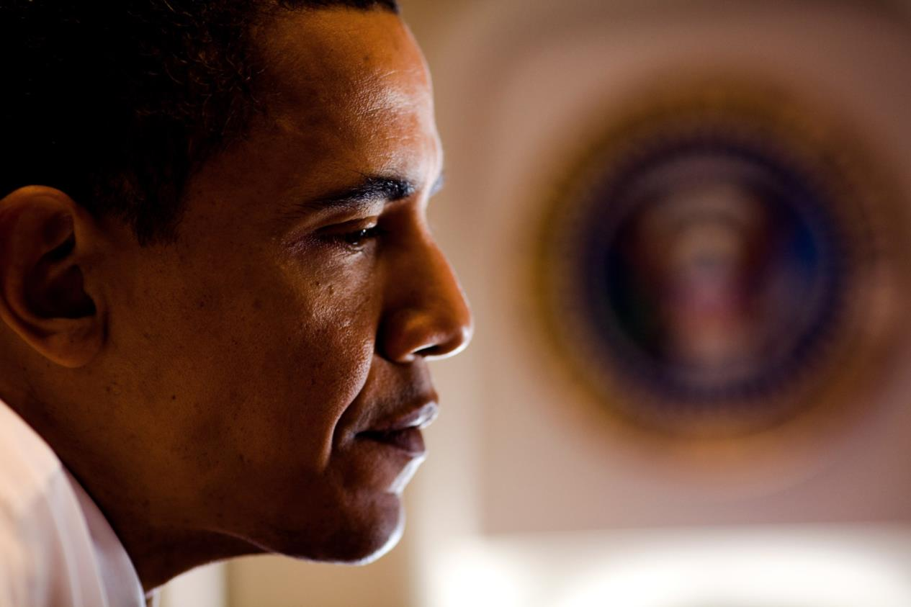
#46 Barack Obama

Slide 49
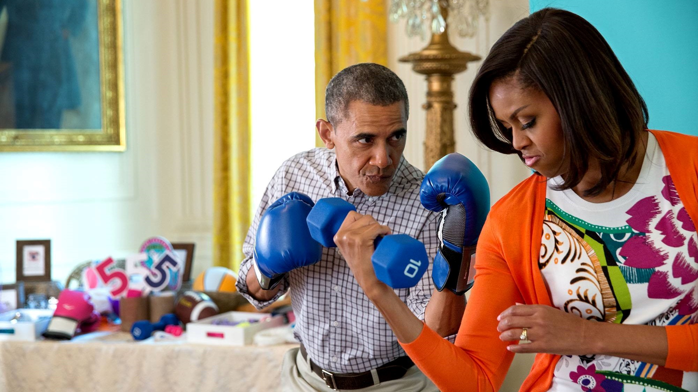
#47 President Obama And First Lady Pose For Photos At The Instagram #GimmeFive Photo Booth In The East Room Of The White House

Slide 50

#48 President Barack Obama And His Daughters Watch On Television As First Lady Michelle Obama Begins Her Speech At The Democratic National Convention

Slide 51

#49 President Barack Obama Cheers On A Young Child As She Rolls Her Egg Toward The Finish Line During The White House Easter Egg Roll

Slide 52

#50 Barack Obama Takes One Last Look In The Mirror, Before Going Out To Take Oath

Slide 53

#51 President Barack Obama Holds A Baby While Greeting Guests During An Independence Day Celebration

Slide 54

#52 Barack Obama

Slide 55

#53 President Barack Obama Stands By A Cut-Out Picture Of First Lady Michelle Obama During A Visit To Miami Central High School

Slide 56

#54 President Barack Obama Holds 3-D Glasses While Watching The Super Bowl Game At A Super Bowl Party

Slide 57

#55 President Barack Obama Waits In The Green Room Before Being Introduced At The White House Summit On Community Colleges

Slide 58

#56 President Barack Obama Greets Zoe Mahan, Daughter Of Hunter And Kandi Mahan, During A Reception For The 2013 President's Cup Championship Golf Teams

Slide 59

#57 President Barack Obama Talks With Aides Outside The U.S. Ambassador's Residence In Paris Before Returning To Washington

Slide 60

#58 Barack Obama, First Lady Michelle Obama And Marian Robinson Welcome Children From Washington, D.C., Maryland And Virginia Schools For Halloween Festivities At The North Portico Of The White House

Slide 61

#59 President Barack Obama Greets U.S. Troops At A Mess Hall At Bagram Airfield In Afghanistan

Slide 62

#60 President Barack Obama Smiles While Talking With Russian President Dmitry Medvedev

Slide 63

#61 President Obama And First Lady, Joined By Family Pets Sunny And Bo, Wait To Greet Visitors In The Blue Room During A White House Tour

Slide 64

#62 President Barack Obama And First Lady Michelle Obama Look Out At The Chicago, Ill., Skyline

Slide 65
End Part 1 of 2
June 20, 2016 王文堯 Kaohsiung Taiwan R.O.C
All photos were taken from The White House & Internet
Seen on Bigfun.be

