Slide 1
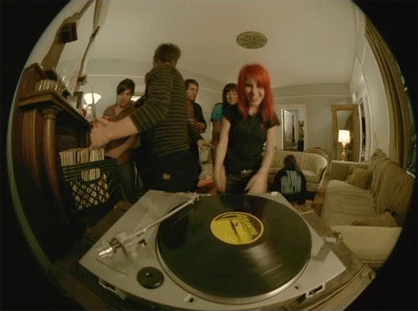

Jukebox 2582
Création SHARK
The Everly Brothers - Problems
George Baker Selection - Beautiful Rose
Johnny Tillotson Well I'm Your Man
The Ad Libs - The Boy From New York City
The Supremes - Baby Love
Sister Sledge Lost In Music
Eddie Gormé - Blame It On The Bossa Nova
Ritchie Valens - Come on, Let's Go

