Slide 1


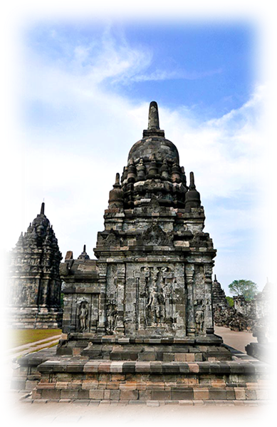

VOIR LE MONDE AVEC MOI
SAUVER LA TERRE
INDONÉSIE
Candi Sewu
Candi Sewu (Java)
04
2016
Tommy55

Slide 2
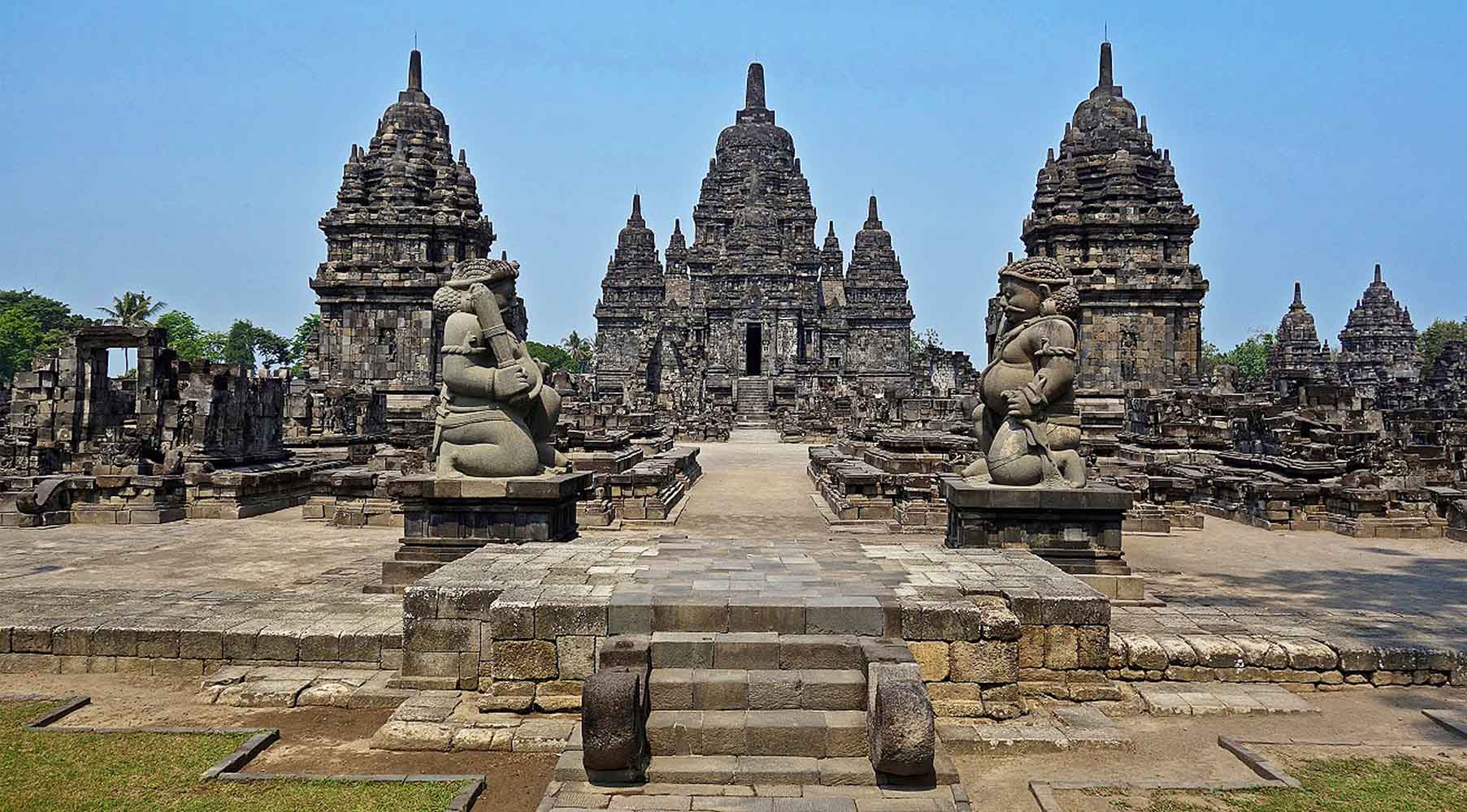

ORIGIN
Jean-Claude Latombe

Slide 3
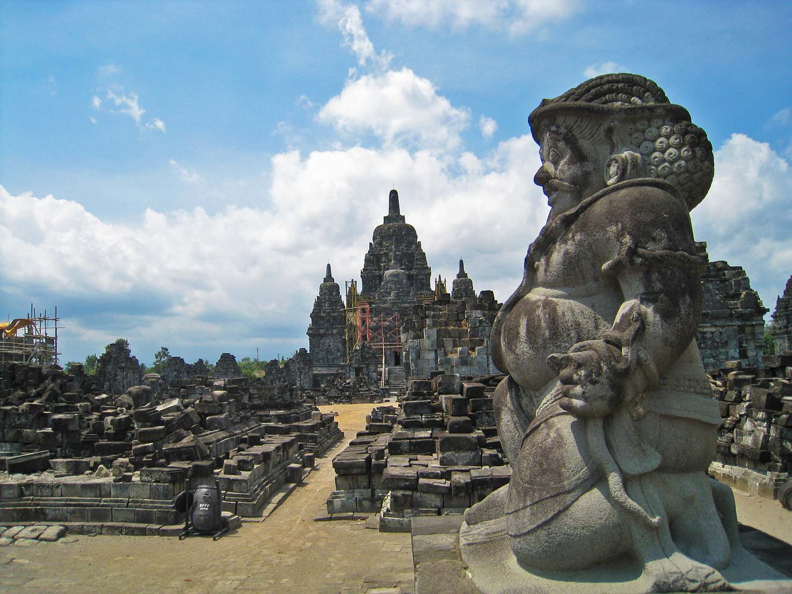
ORIGIN
(Photo Darma)

Slide 4
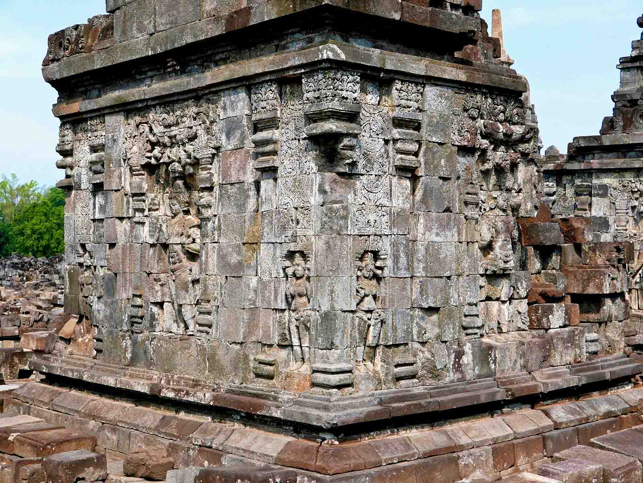
ORIGIN
Anandajoti Bhikkhu (Photo Dharma)

Slide 5
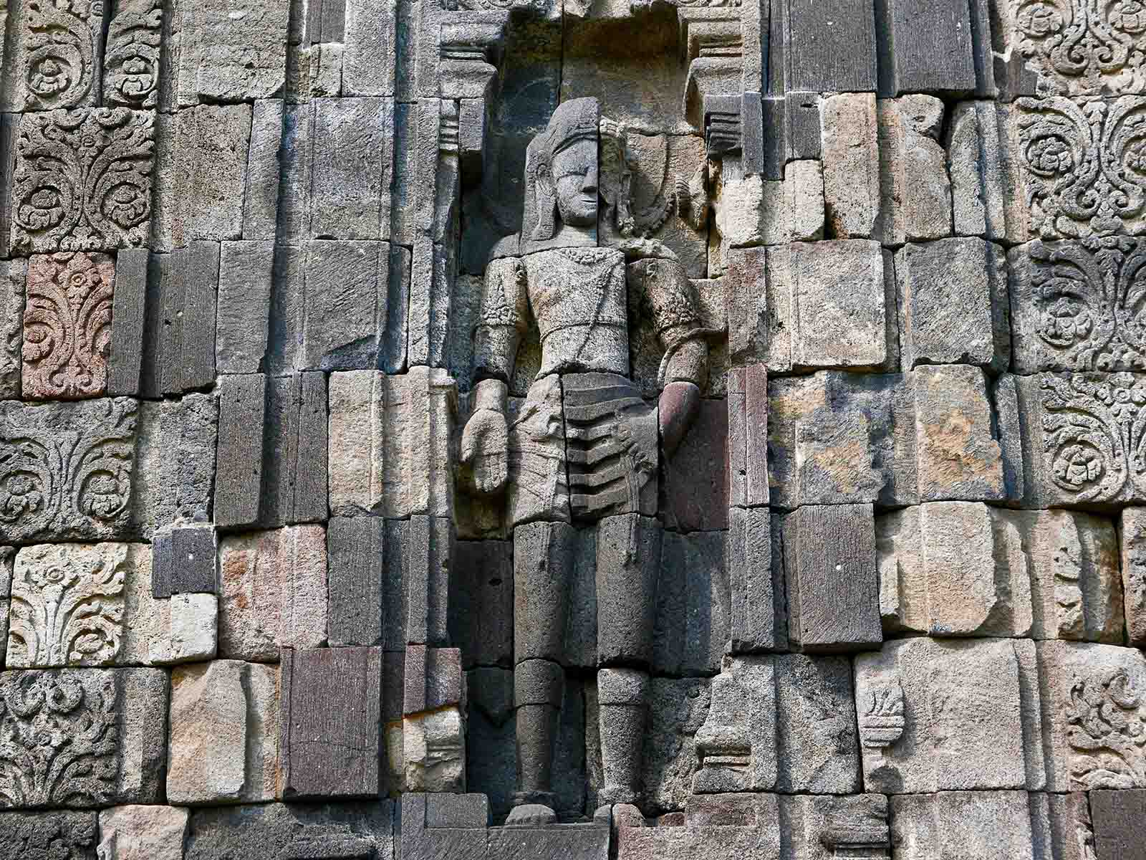
ORIGIN
Anandajoti Bhikkhu (Photo Dharma)

Slide 6

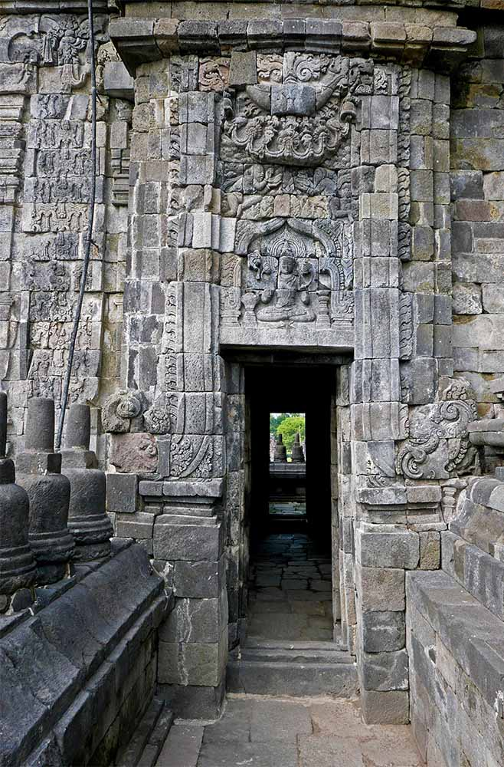
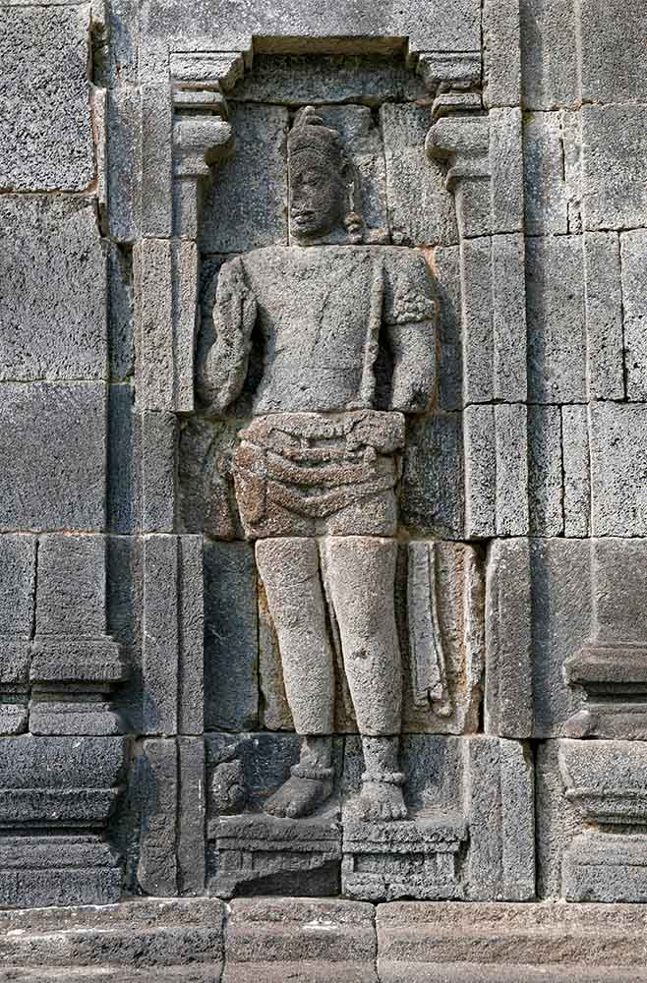
ORIGIN
ORIGIN
Anandajoti Bhikkhu (Photo Dharma)
Anandajoti Bhikkhu (Photo Dharma)

Slide 7
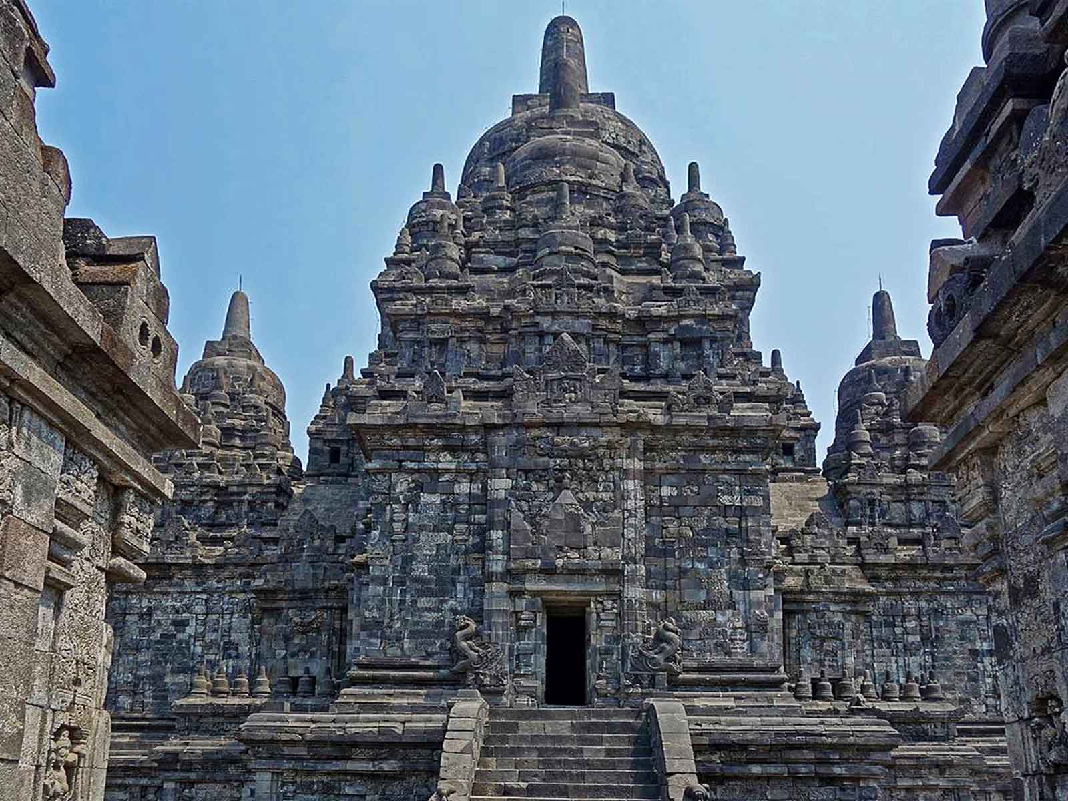
ORIGIN
Jean-Claude Latombe

Slide 8
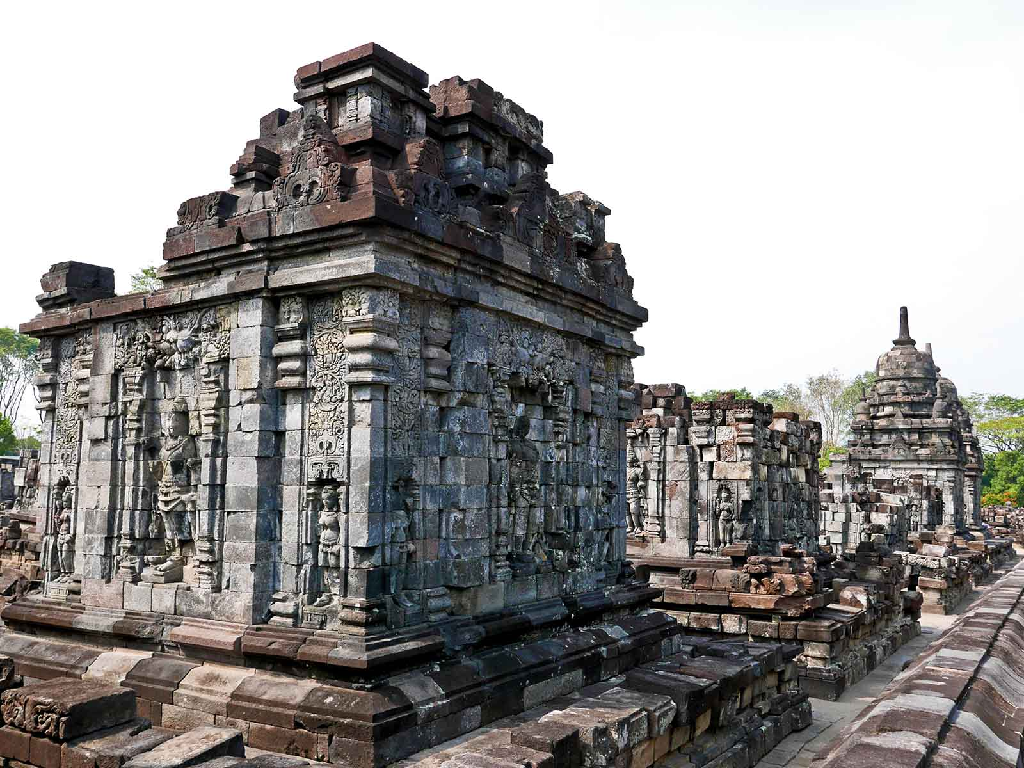
ORIGIN
Anandajoti Bhikkhu (Photo Dharma)

Slide 9
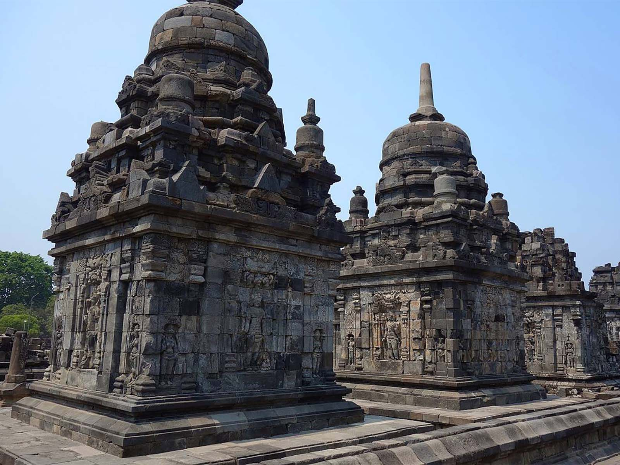
ORIGIN
Jean-Claude Latombe

Slide 10
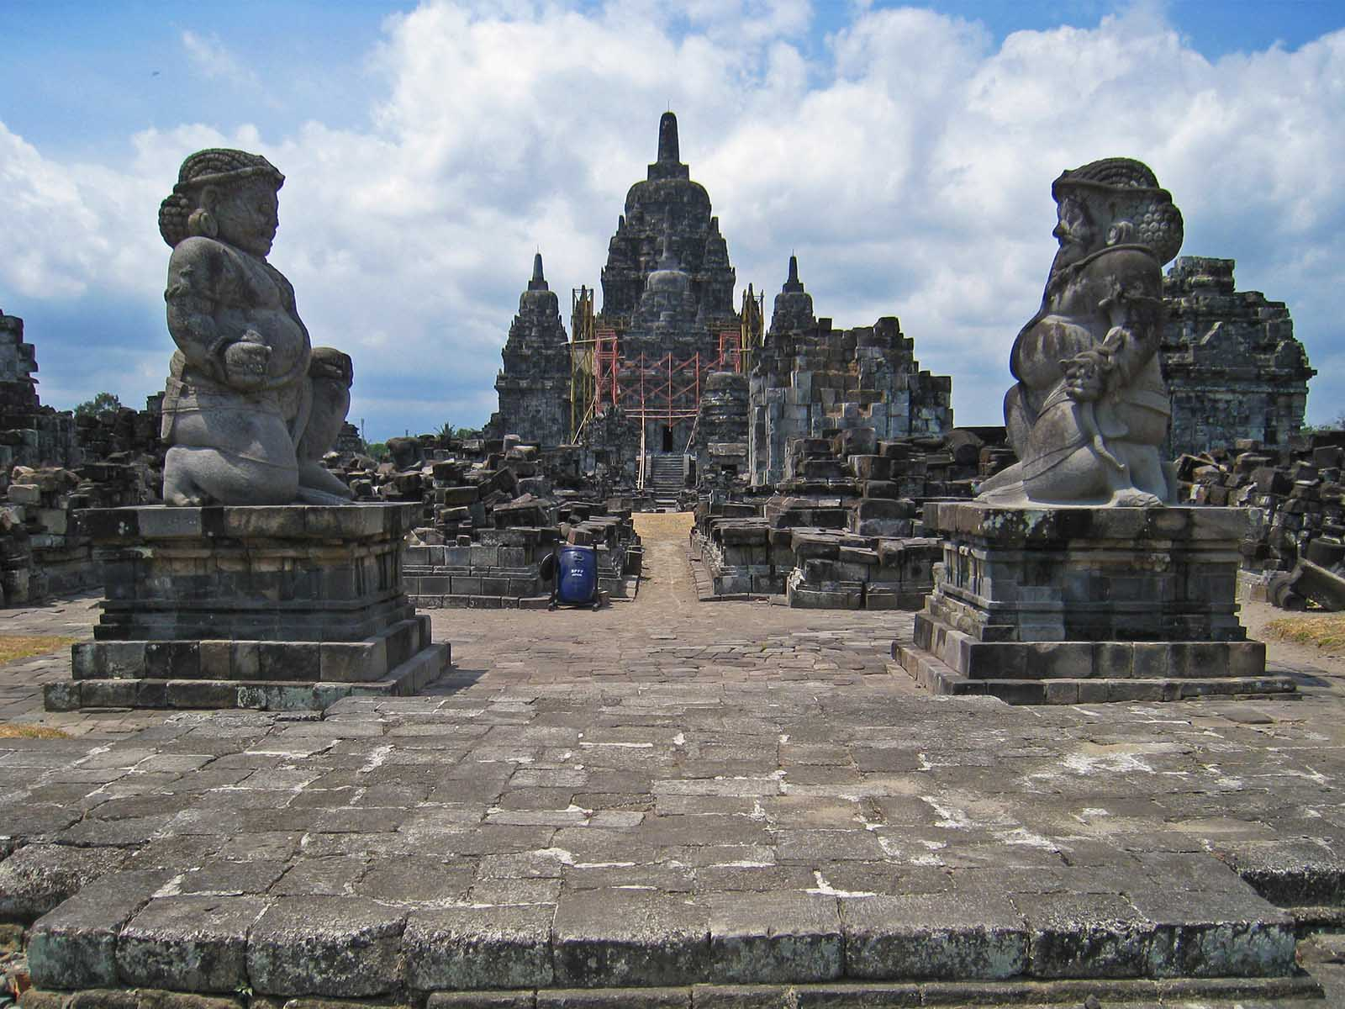
ORIGIN
(Photo Darma)

Slide 11
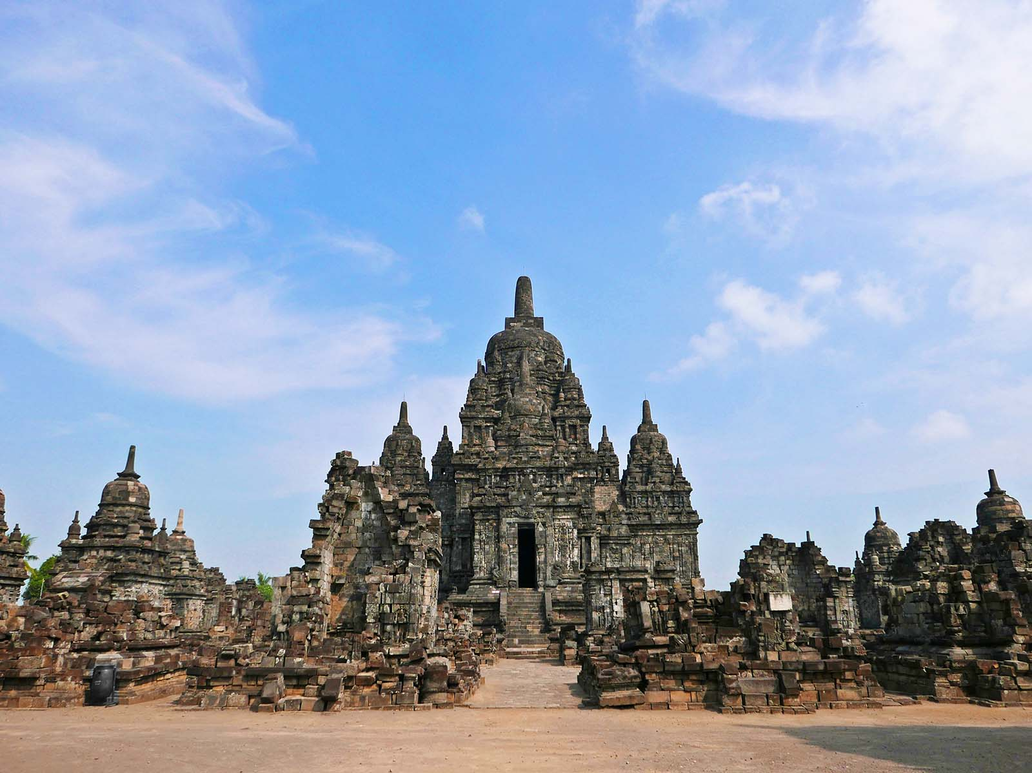
ORIGIN
Anandajoti Bhikkhu (Photo Dharma)

Slide 12
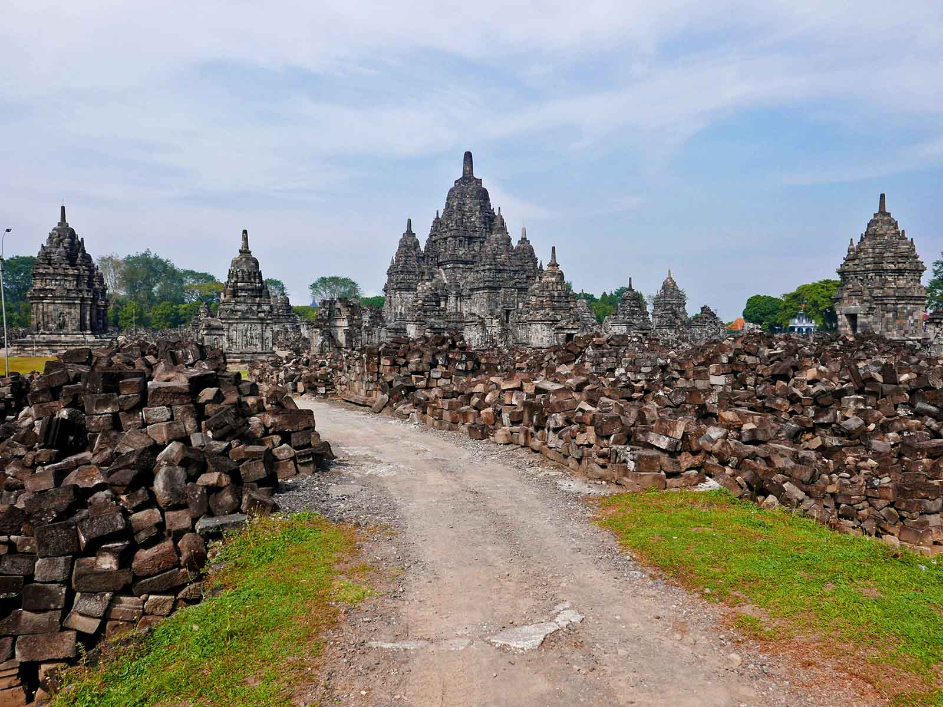
ORIGIN
Anandajoti Bhikkhu (Photo Dharma)

Slide 13
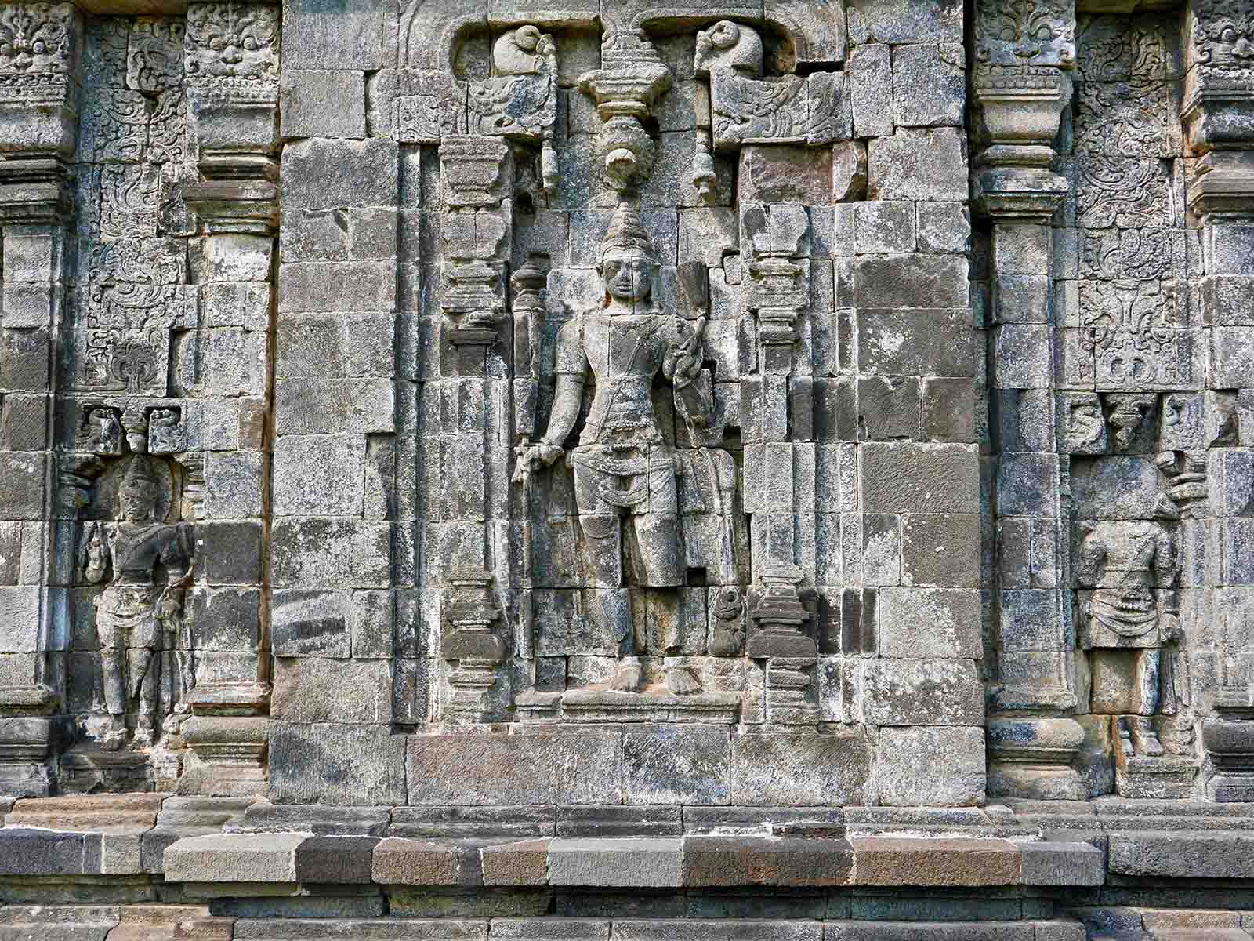
ORIGIN
Anandajoti Bhikkhu (Photo Dharma)

Slide 14
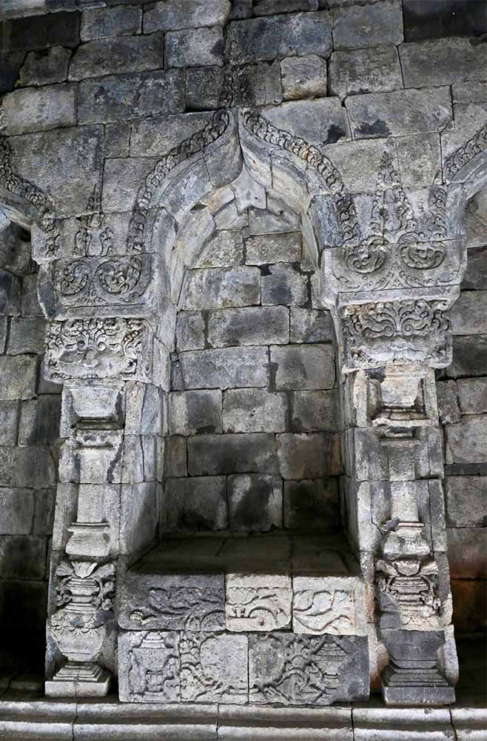
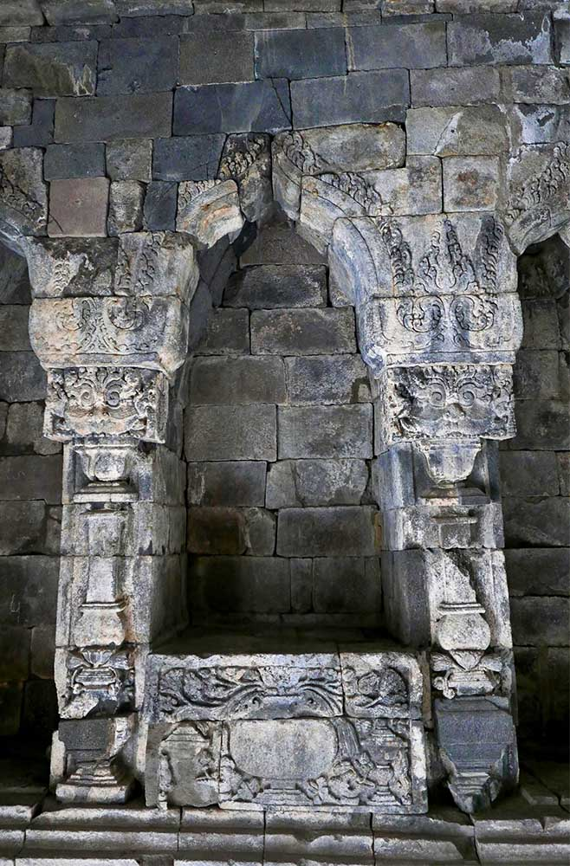
ORIGIN
ORIGIN
Anandajoti Bhikkhu (Photo Dharma)
Anandajoti Bhikkhu (Photo Dharma)

Slide 15
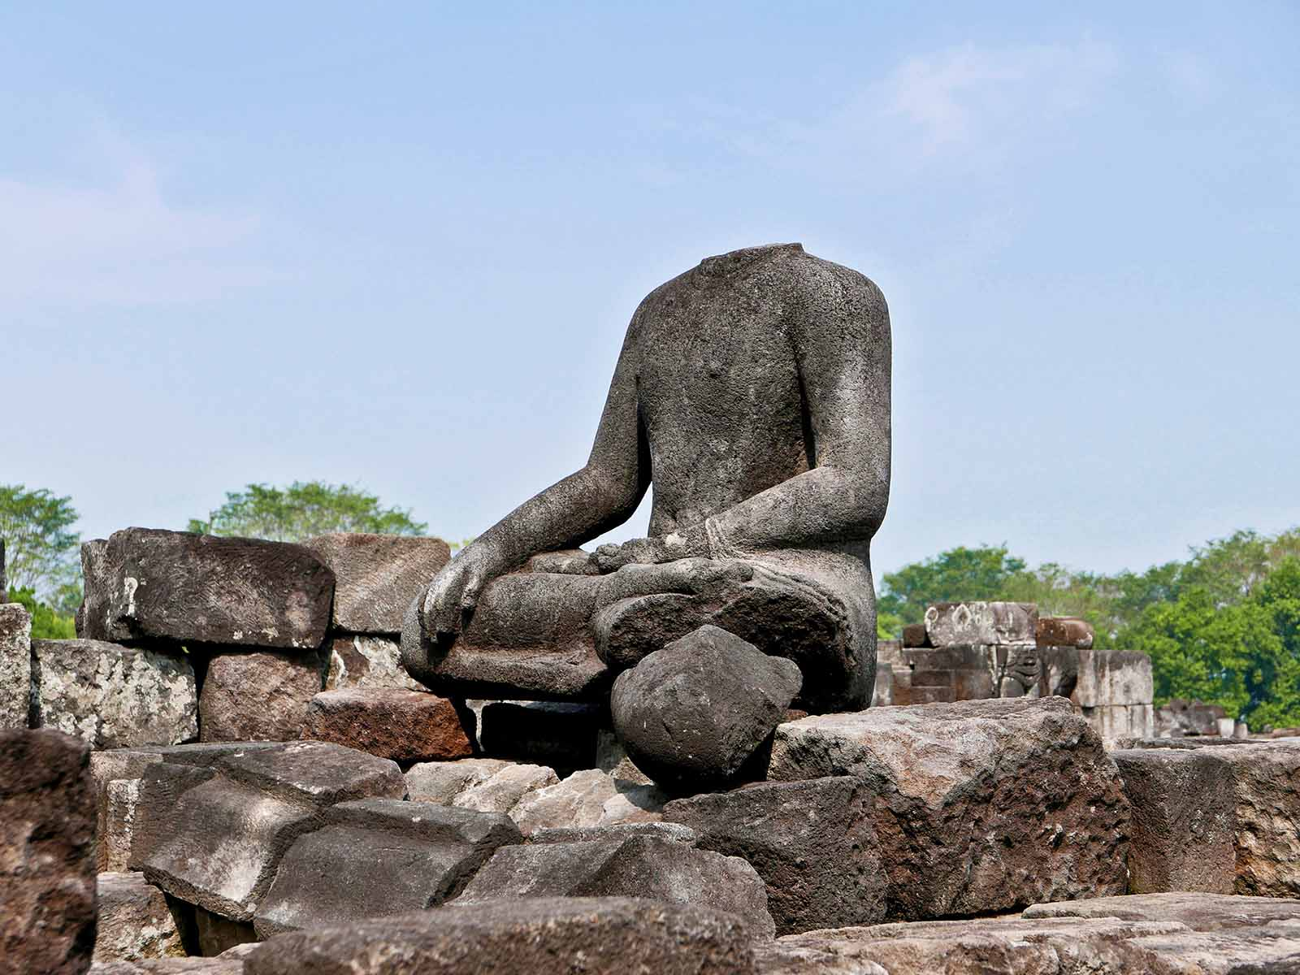
ORIGIN
Anandajoti Bhikkhu (Photo Dharma)

Slide 16
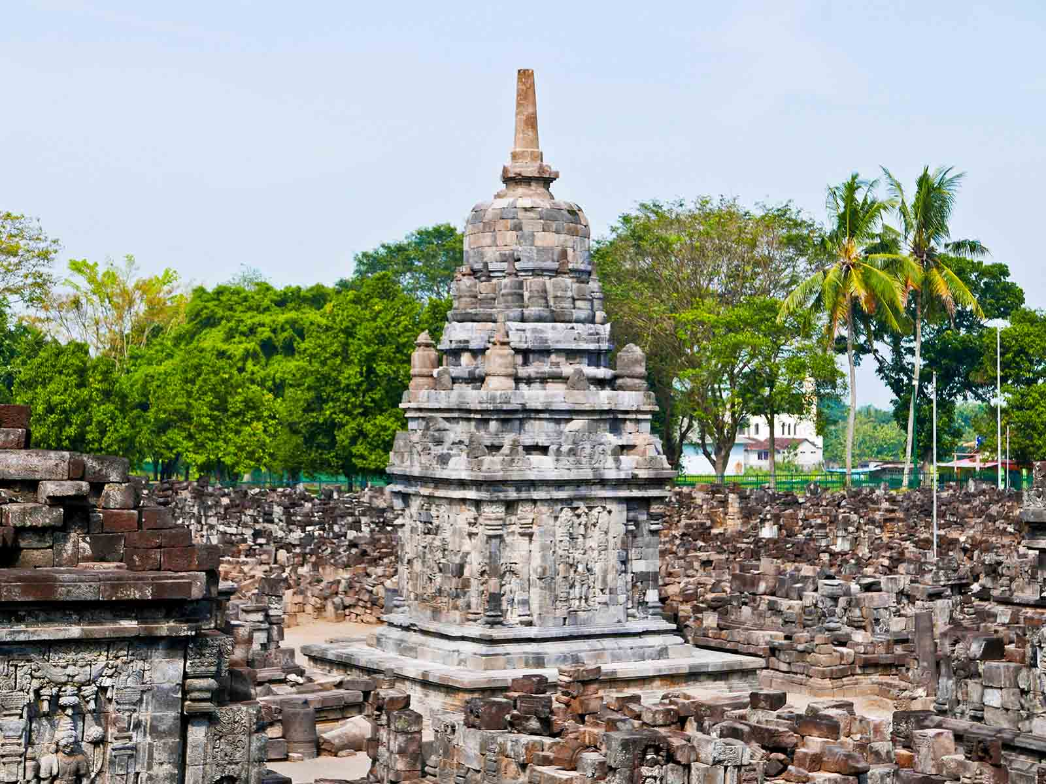
ORIGIN
Anandajoti Bhikkhu (Photo Dharma)

Slide 17
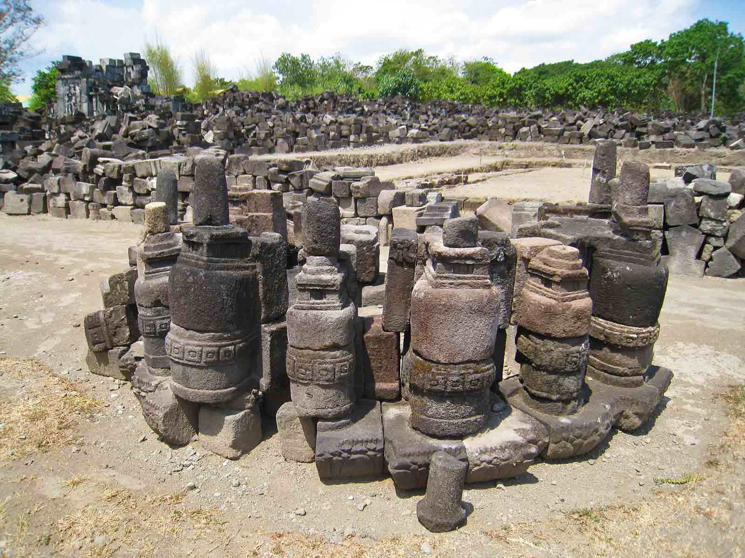
ORIGIN
Anandajoti Bhikkhu (Photo Dharma)

Slide 18
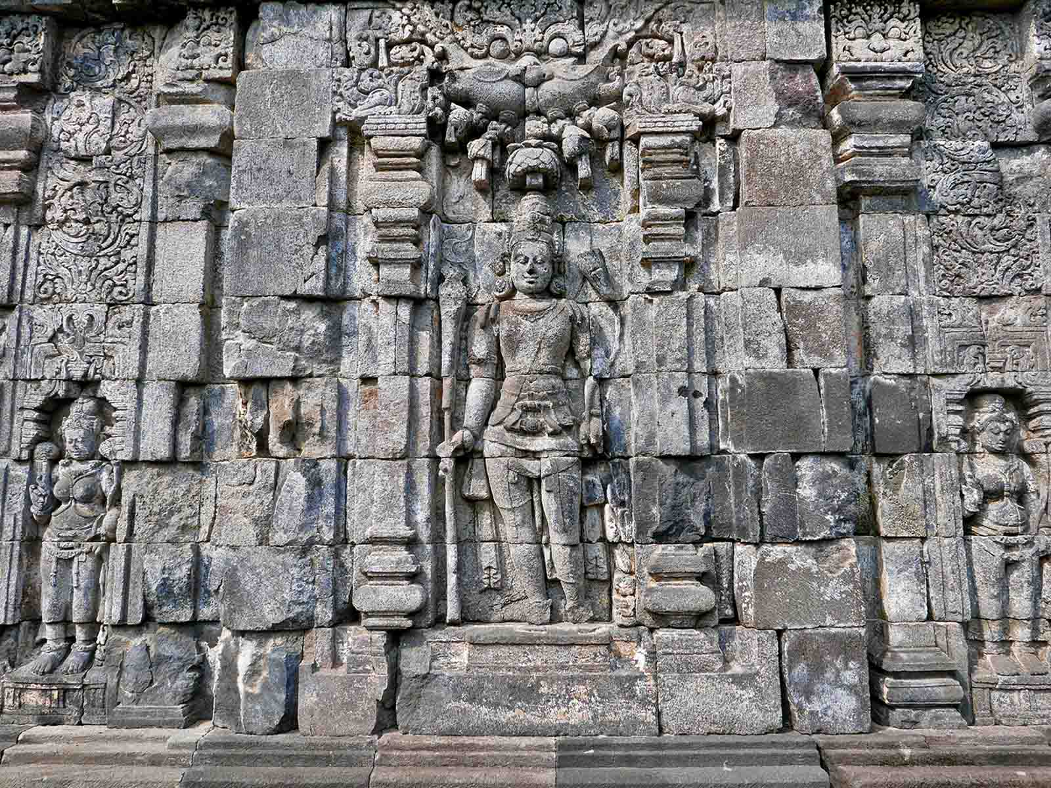
ORIGIN
Anandajoti Bhikkhu (Photo Dharma)

Slide 19
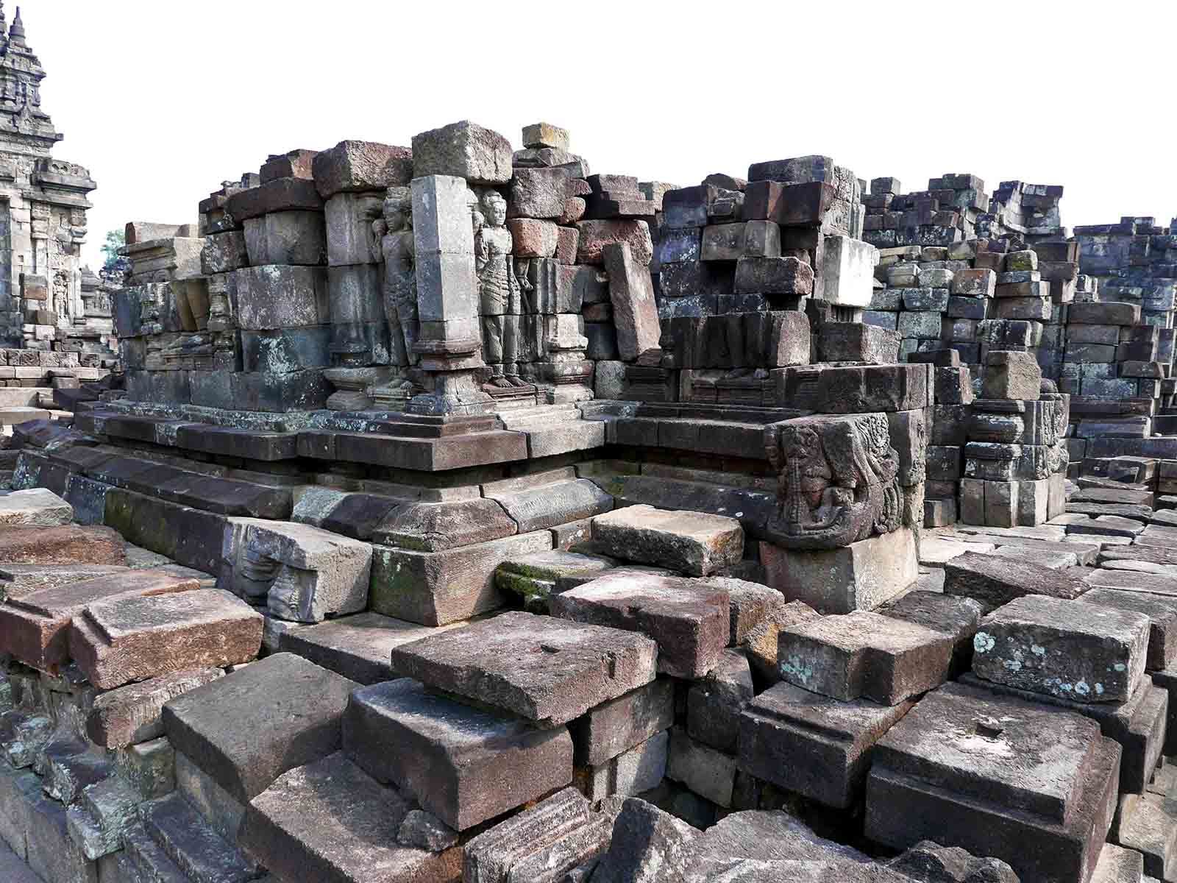
ORIGIN
Anandajoti Bhikkhu (Photo Dharma)

Slide 20
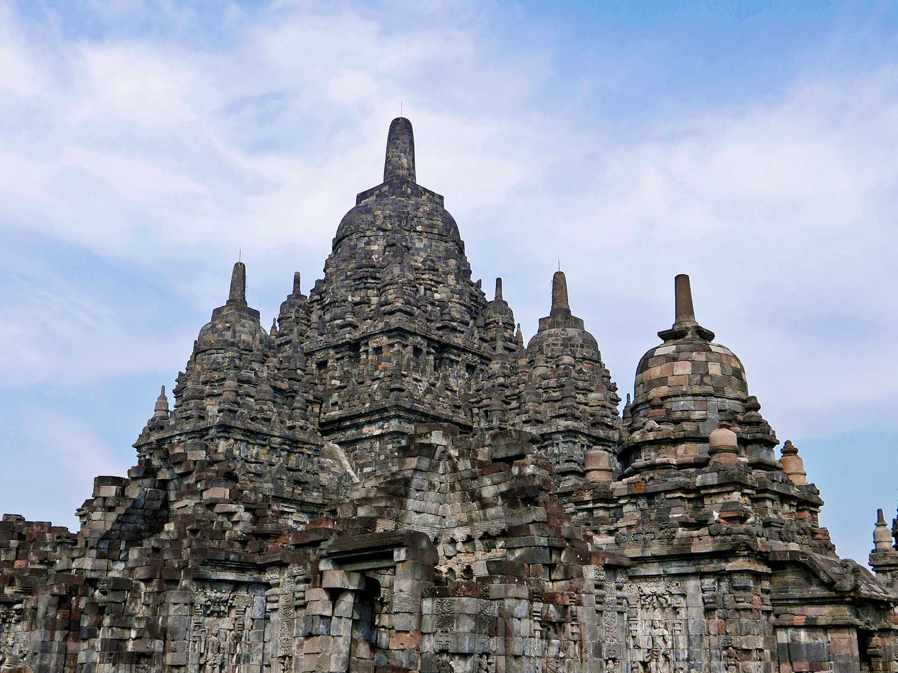
ORIGIN
Anandajoti Bhikkhu (Photo Dharma)

Slide 21
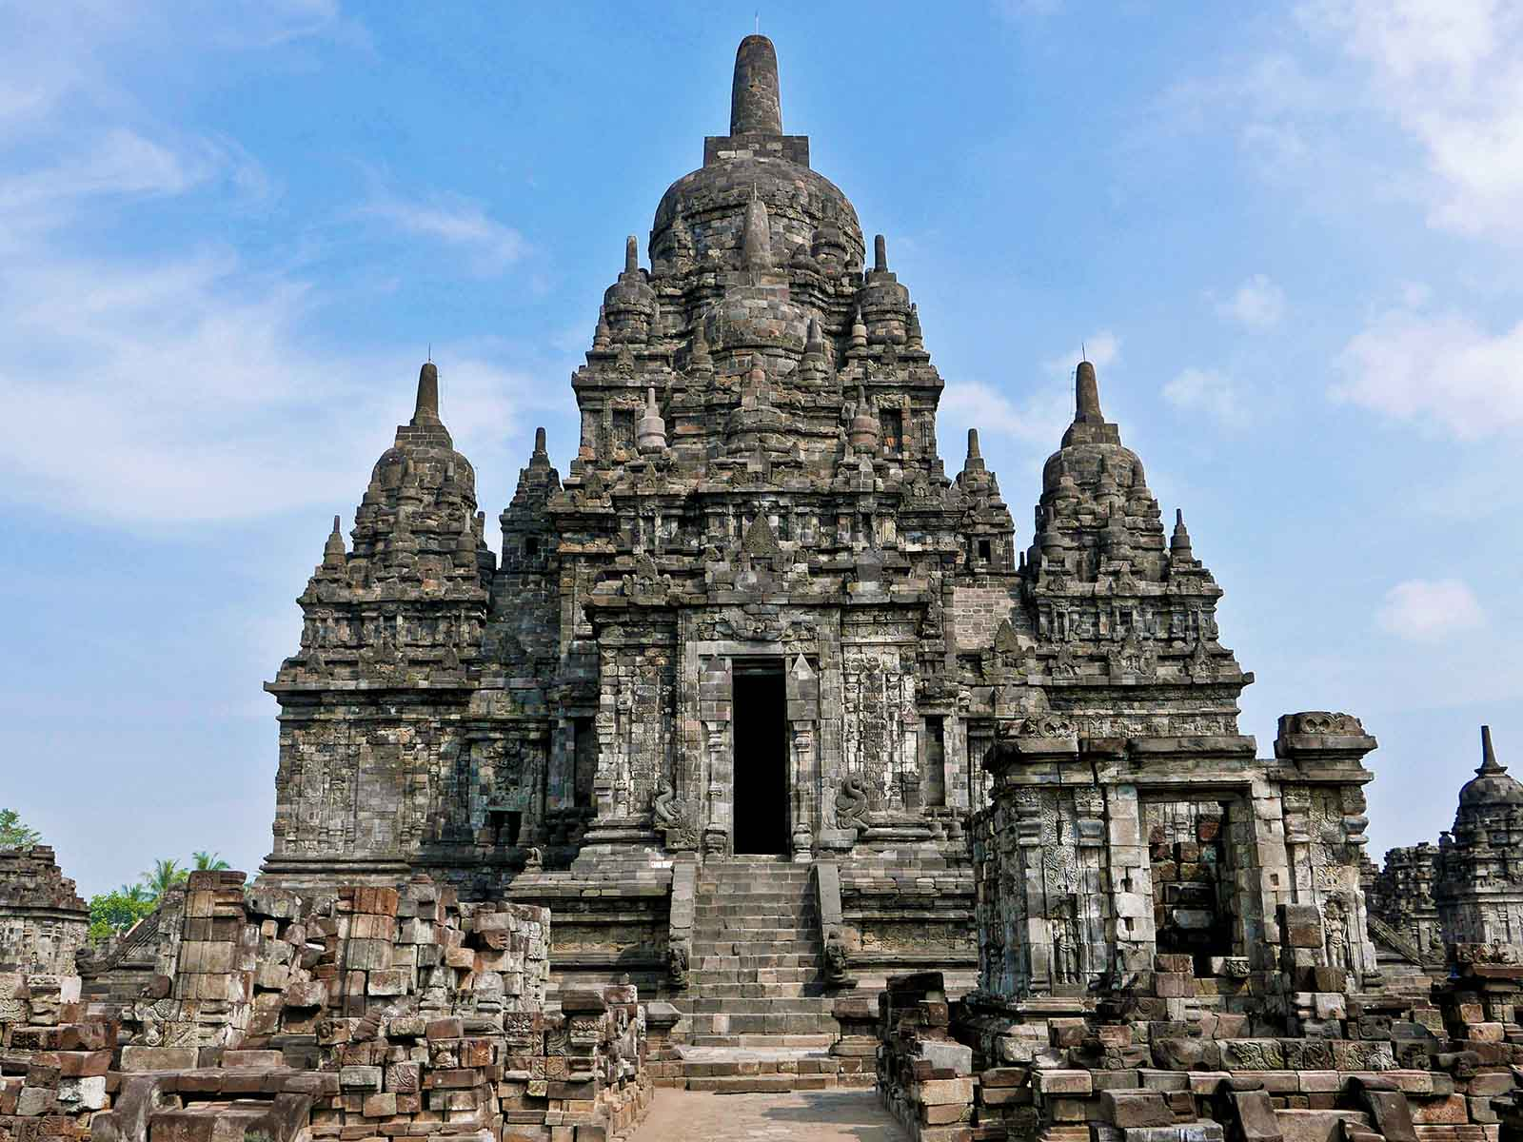
ORIGIN
Anandajoti Bhikkhu (Photo Dharma)

Slide 22
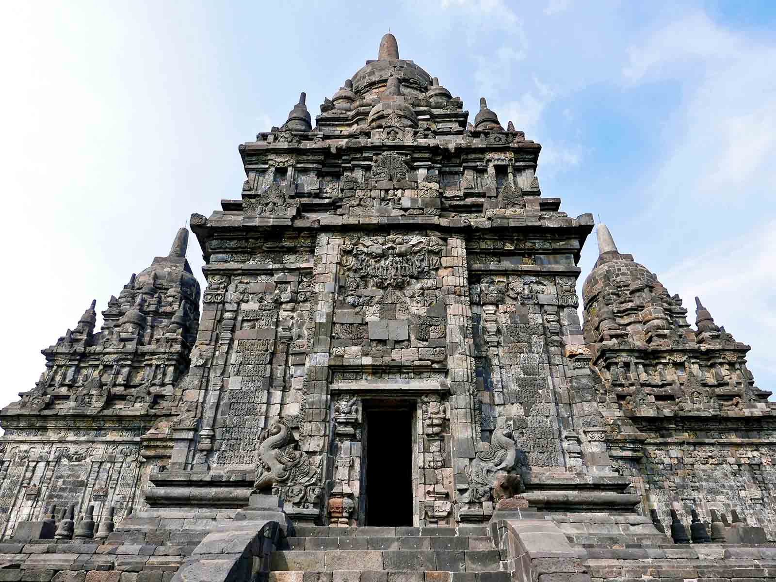
ORIGIN
Anandajoti Bhikkhu (Photo Dharma)

Slide 23
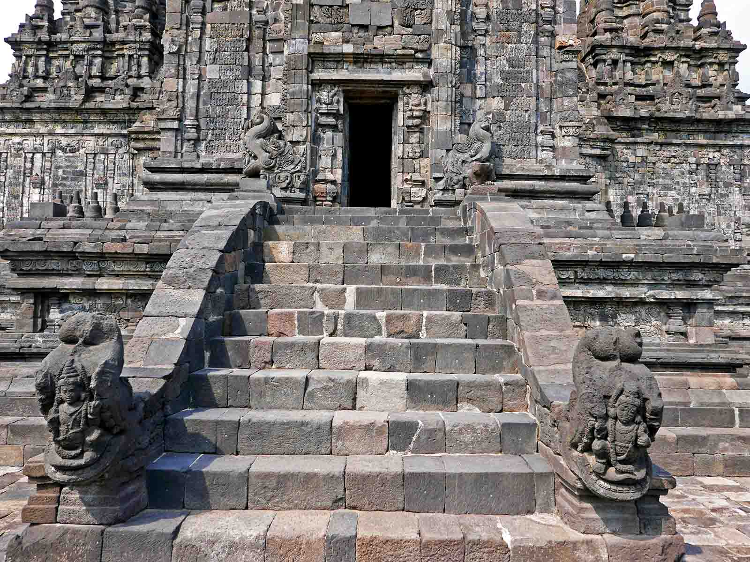
ORIGIN
Anandajoti Bhikkhu (Photo Dharma)

Slide 24
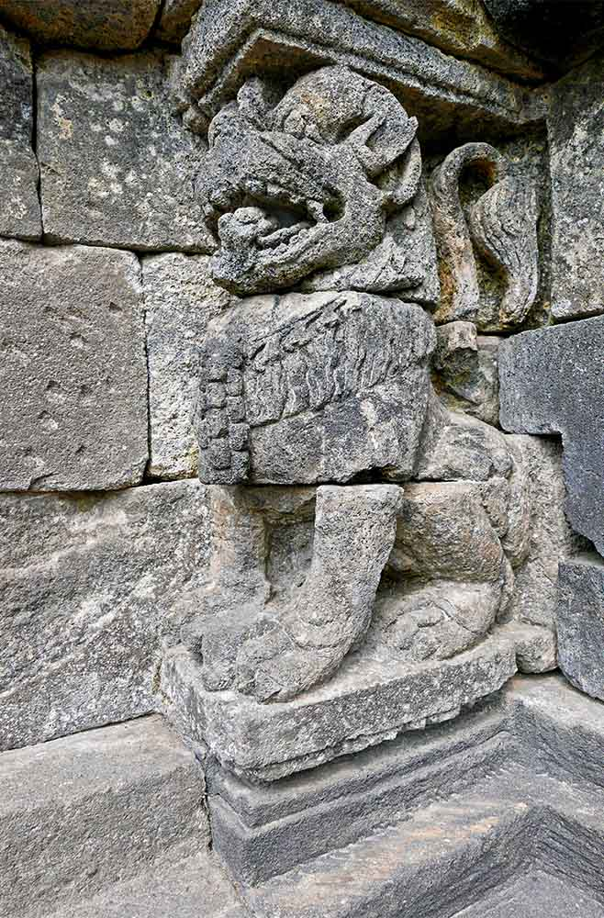
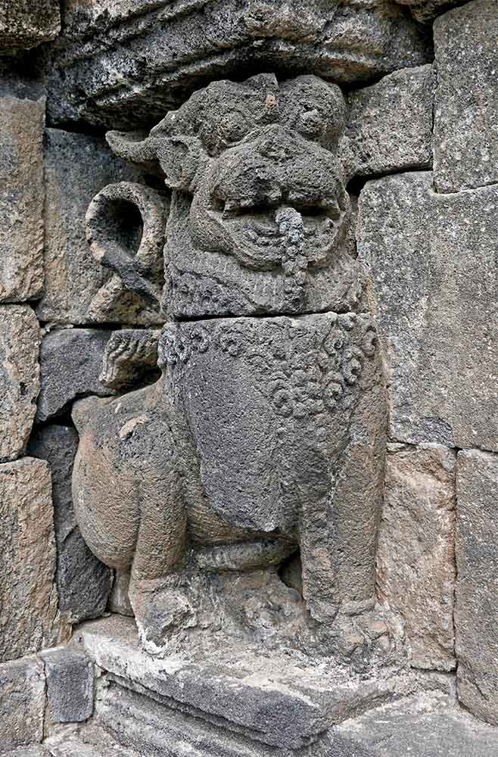
ORIGIN
ORIGIN
Anandajoti Bhikkhu (Photo Dharma)
Anandajoti Bhikkhu (Photo Dharma)

Slide 25
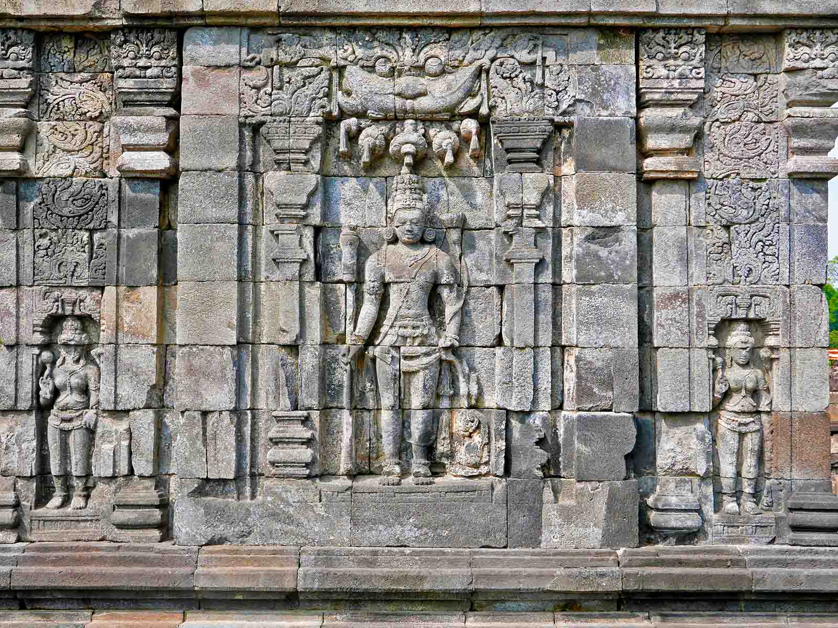
ORIGIN
Anandajoti Bhikkhu (Photo Dharma)

Slide 26
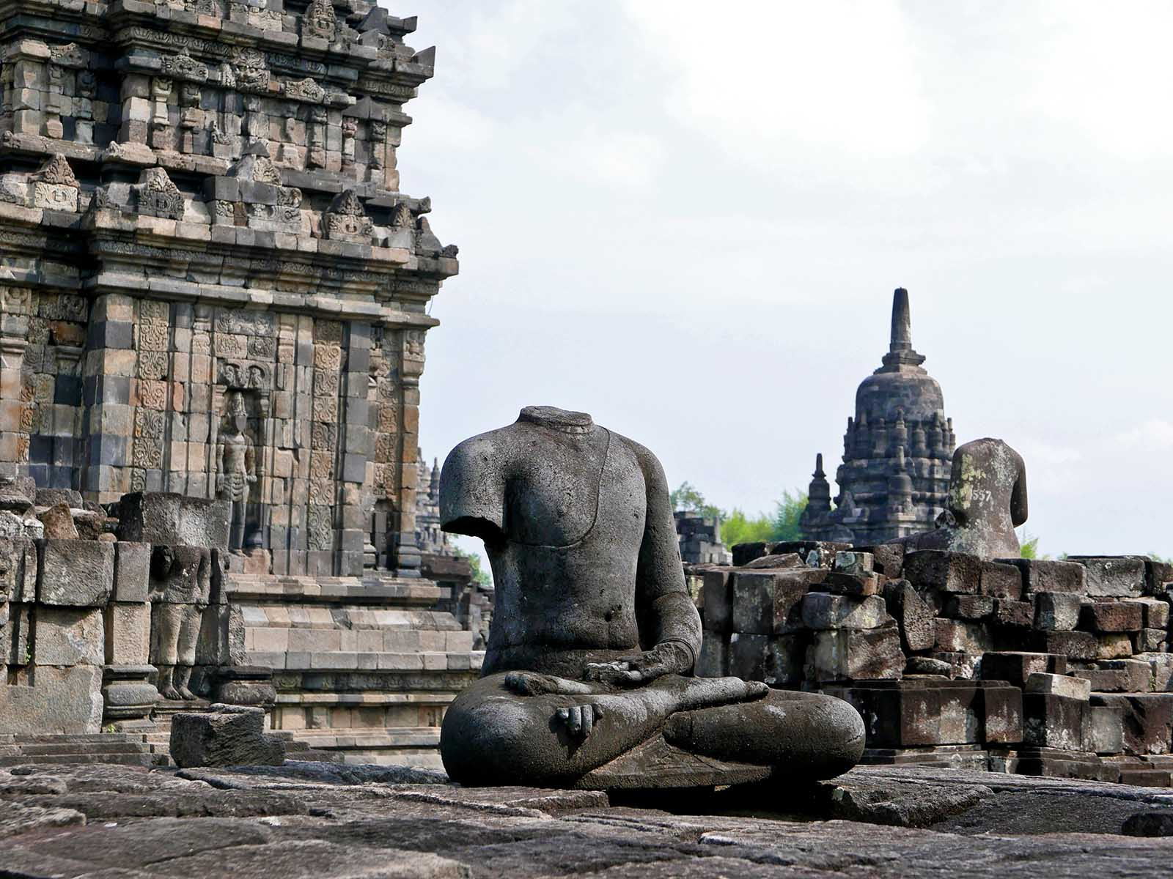
ORIGIN
Anandajoti Bhikkhu (Photo Dharma)

Slide 27
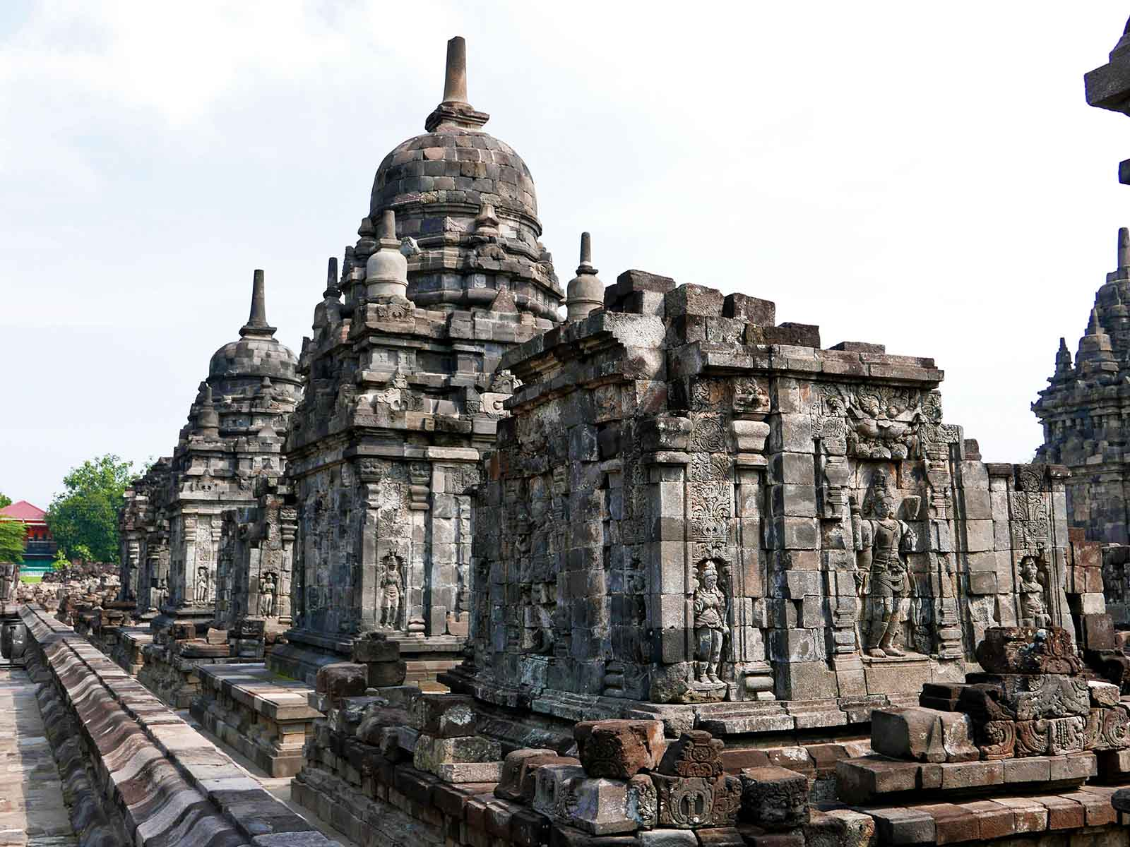
ORIGIN
Anandajoti Bhikkhu (Photo Dharma)

Slide 28
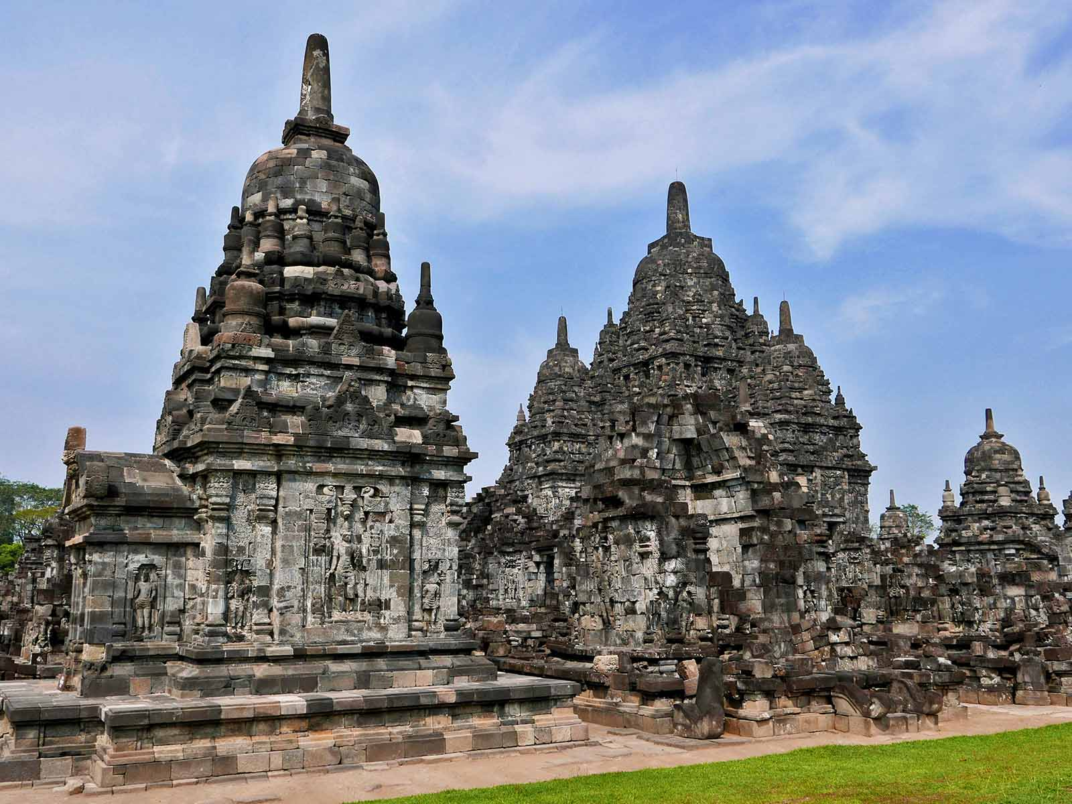
ORIGIN
Anandajoti Bhikkhu (Photo Dharma)

Slide 29
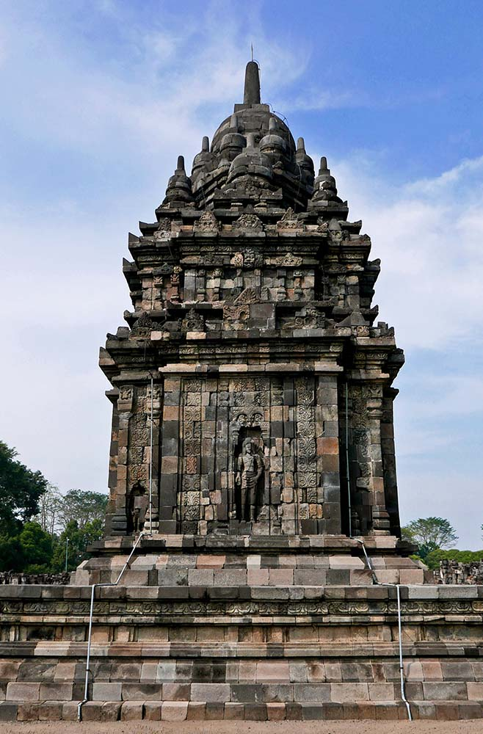
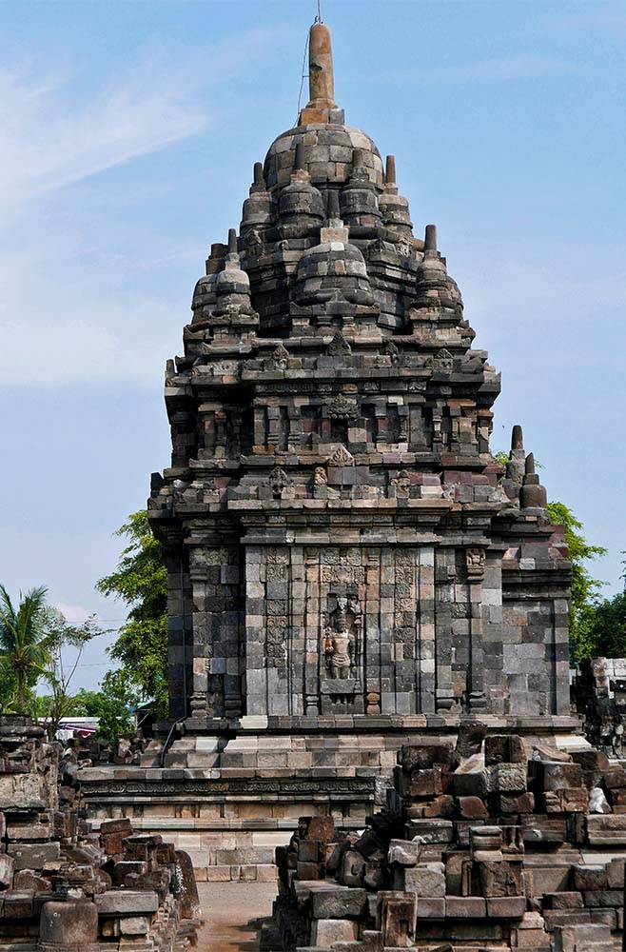
ORIGIN
ORIGIN
Anandajoti Bhikkhu (Photo Dharma)
Anandajoti Bhikkhu (Photo Dharma)

Slide 30
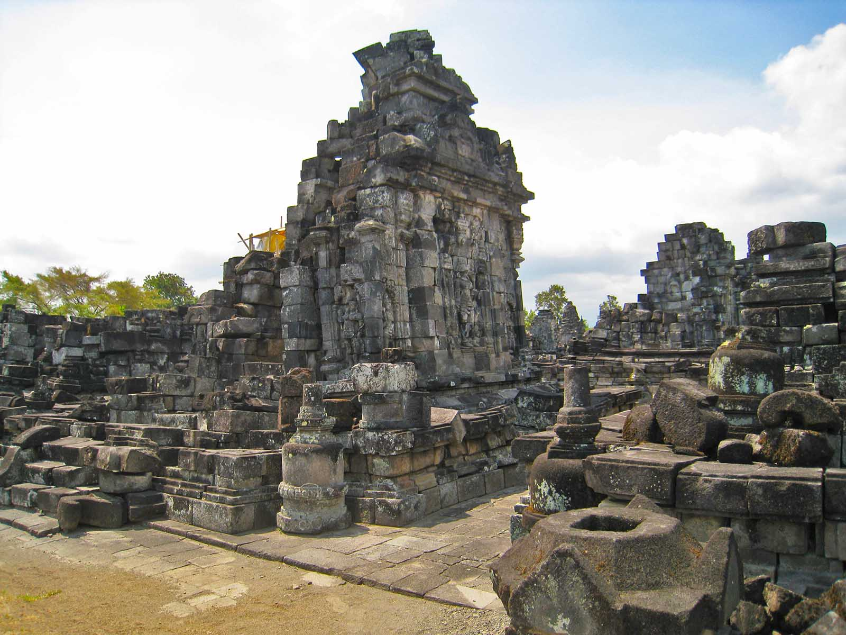
ORIGIN
Anandajoti Bhikkhu (Photo Dharma)

Slide 31
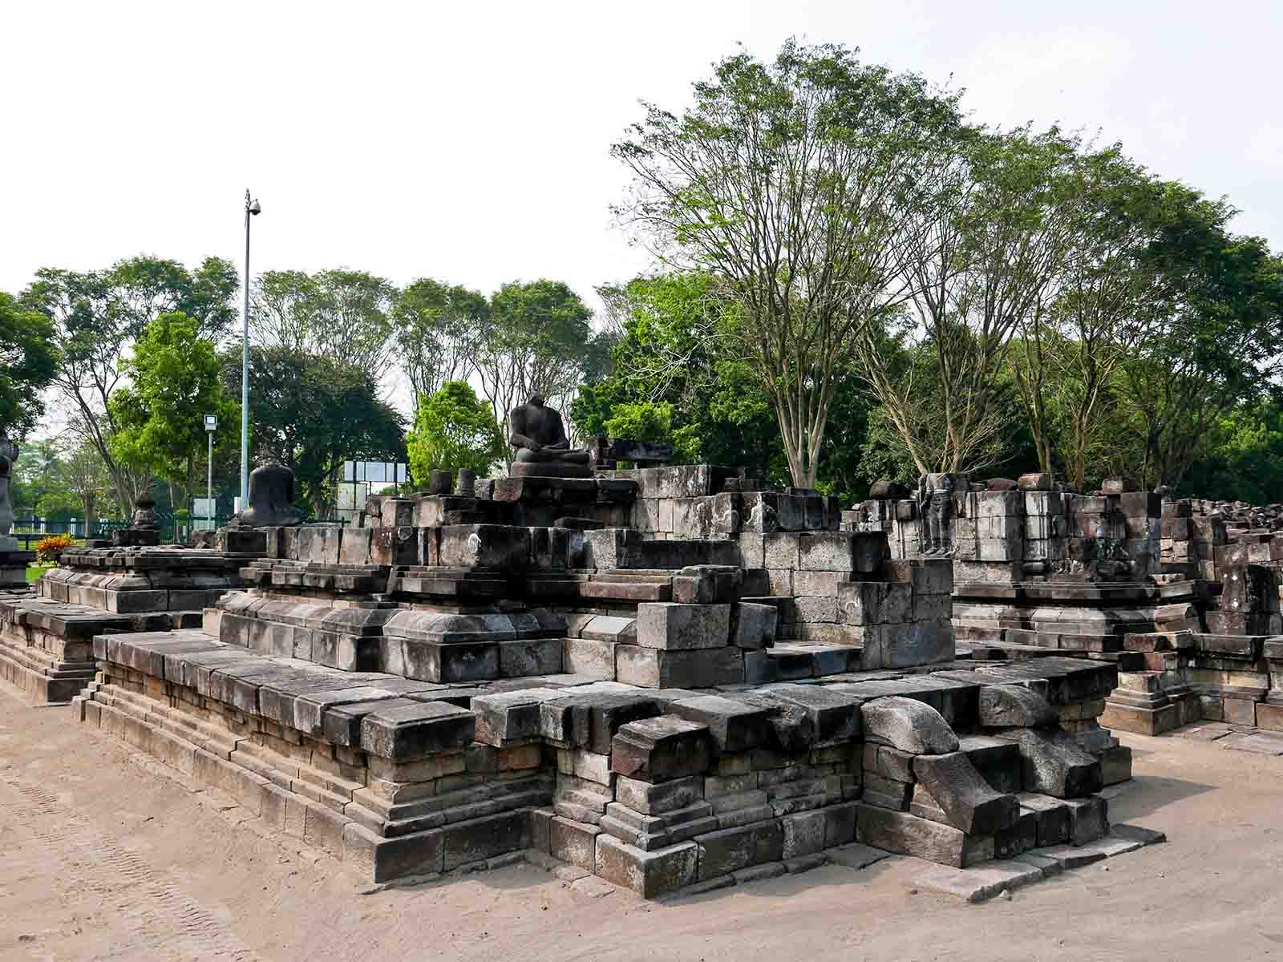
ORIGIN
Anandajoti Bhikkhu (Photo Dharma)

Slide 32
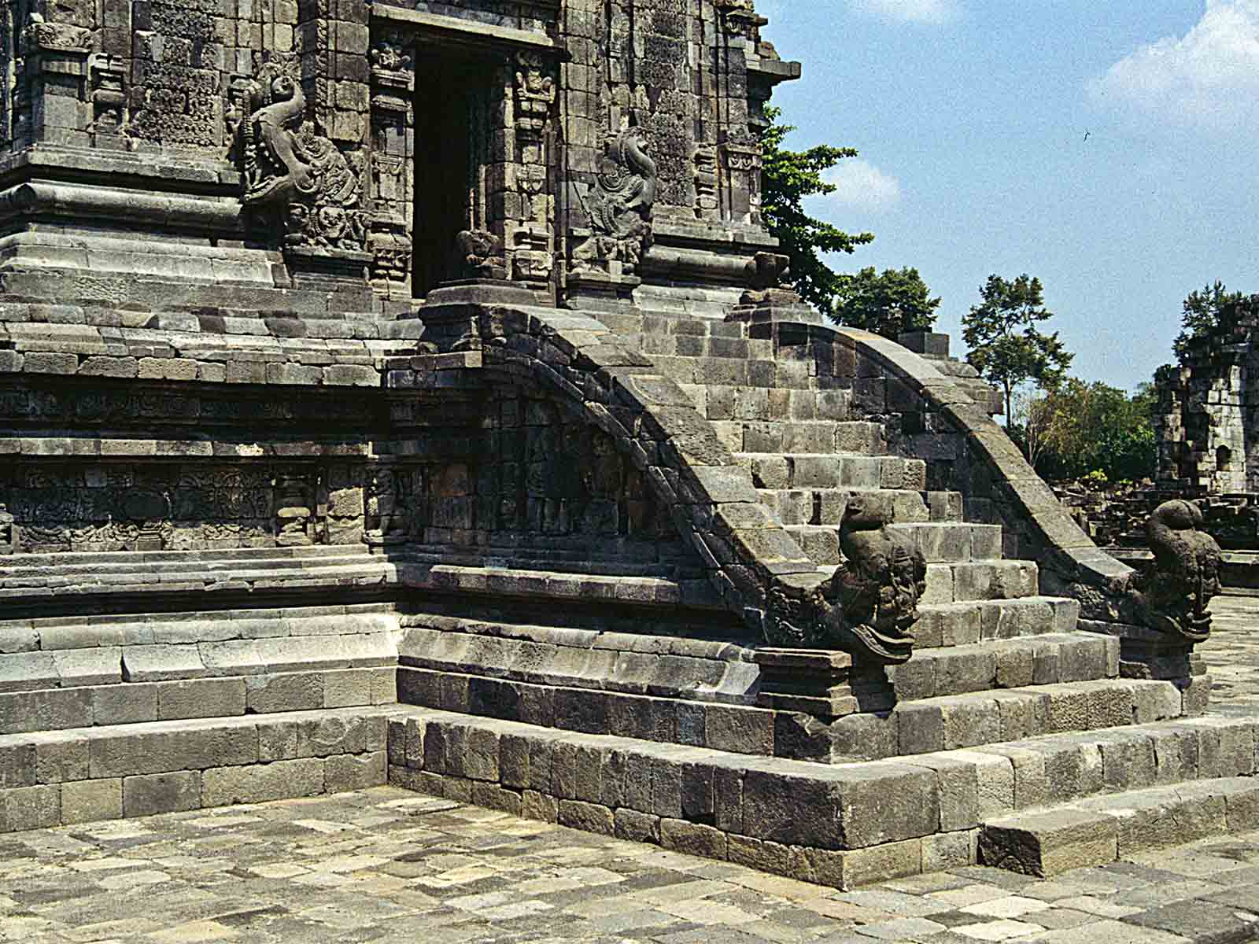
ORIGIN
Ziegler 175

Slide 33
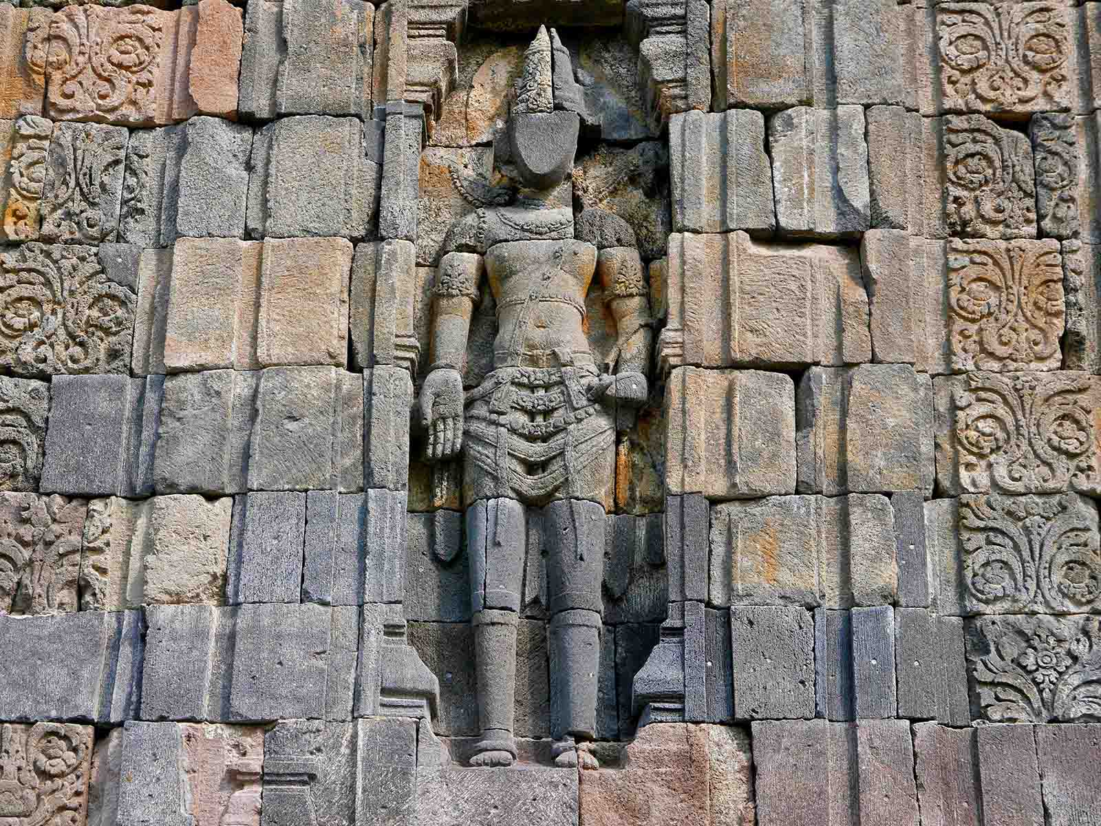
ORIGIN
Anandajoti Bhikkhu (Photo Dharma)

Slide 34
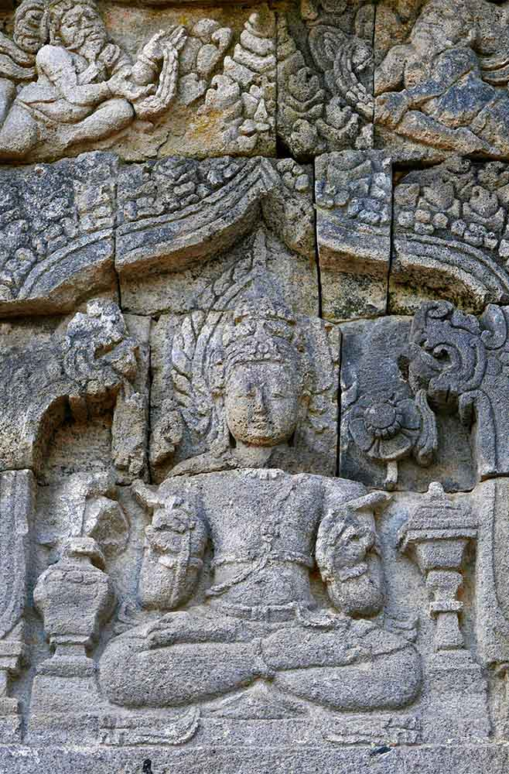
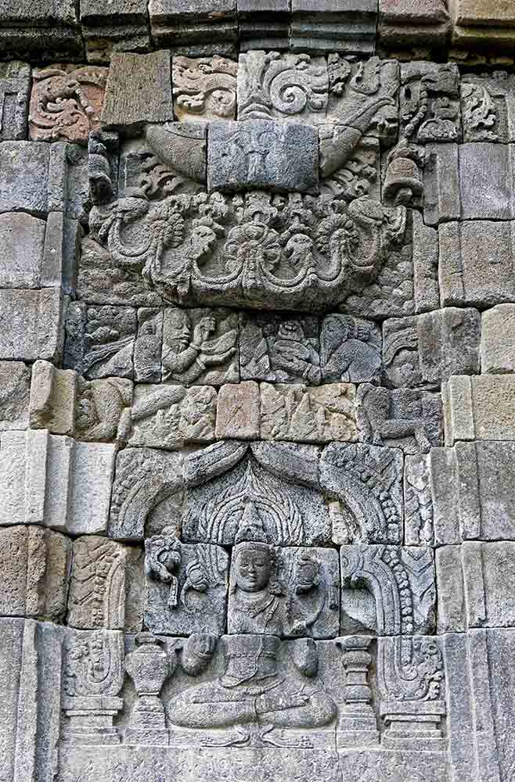
ORIGIN
ORIGIN
Anandajoti Bhikkhu (Photo Dharma)
Anandajoti Bhikkhu (Photo Dharma)

Slide 35
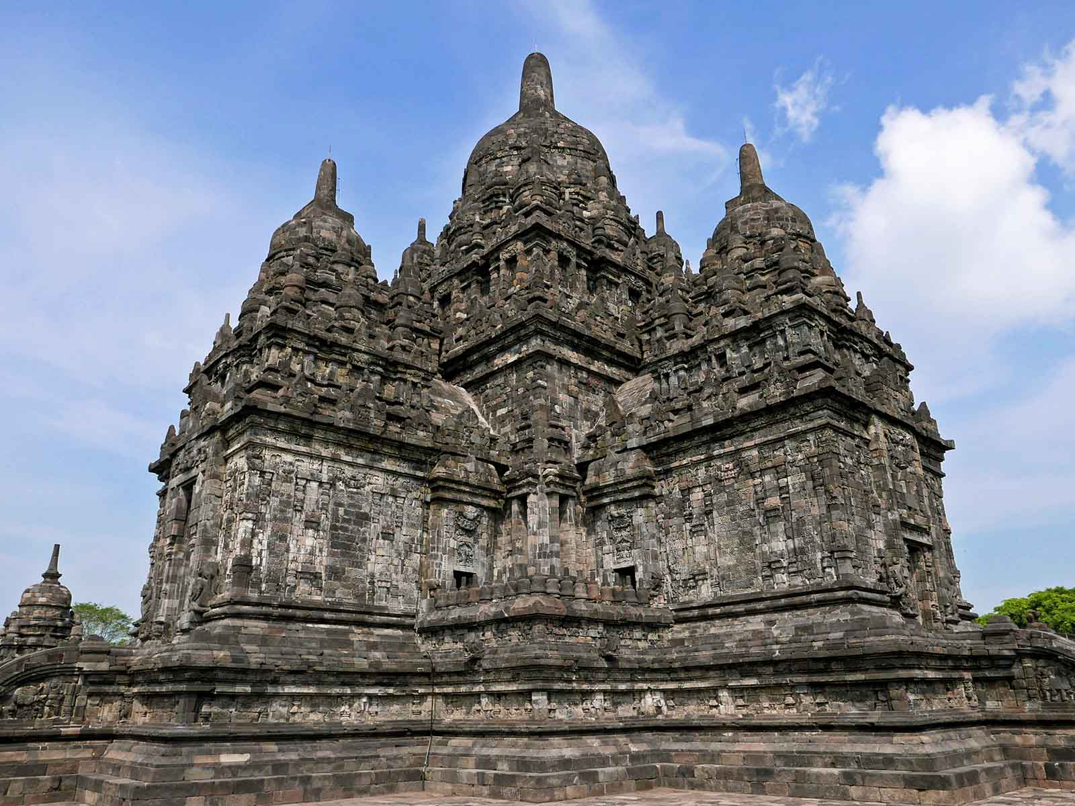
ORIGIN
Anandajoti Bhikkhu (Photo Dharma)

Slide 36
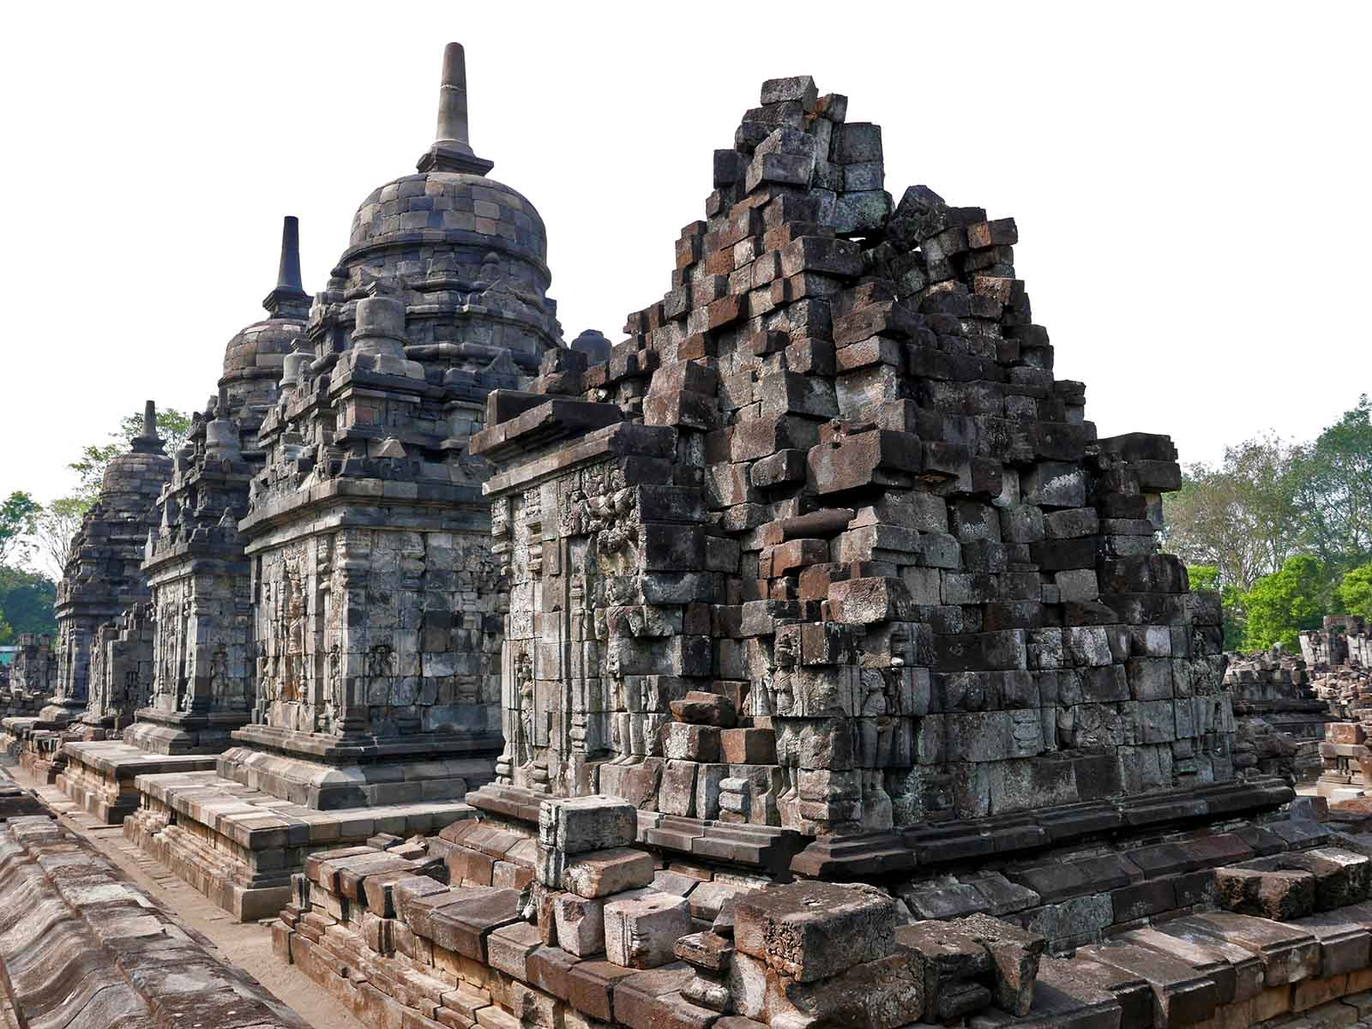
ORIGIN
Anandajoti Bhikkhu (Photo Dharma)

Slide 37
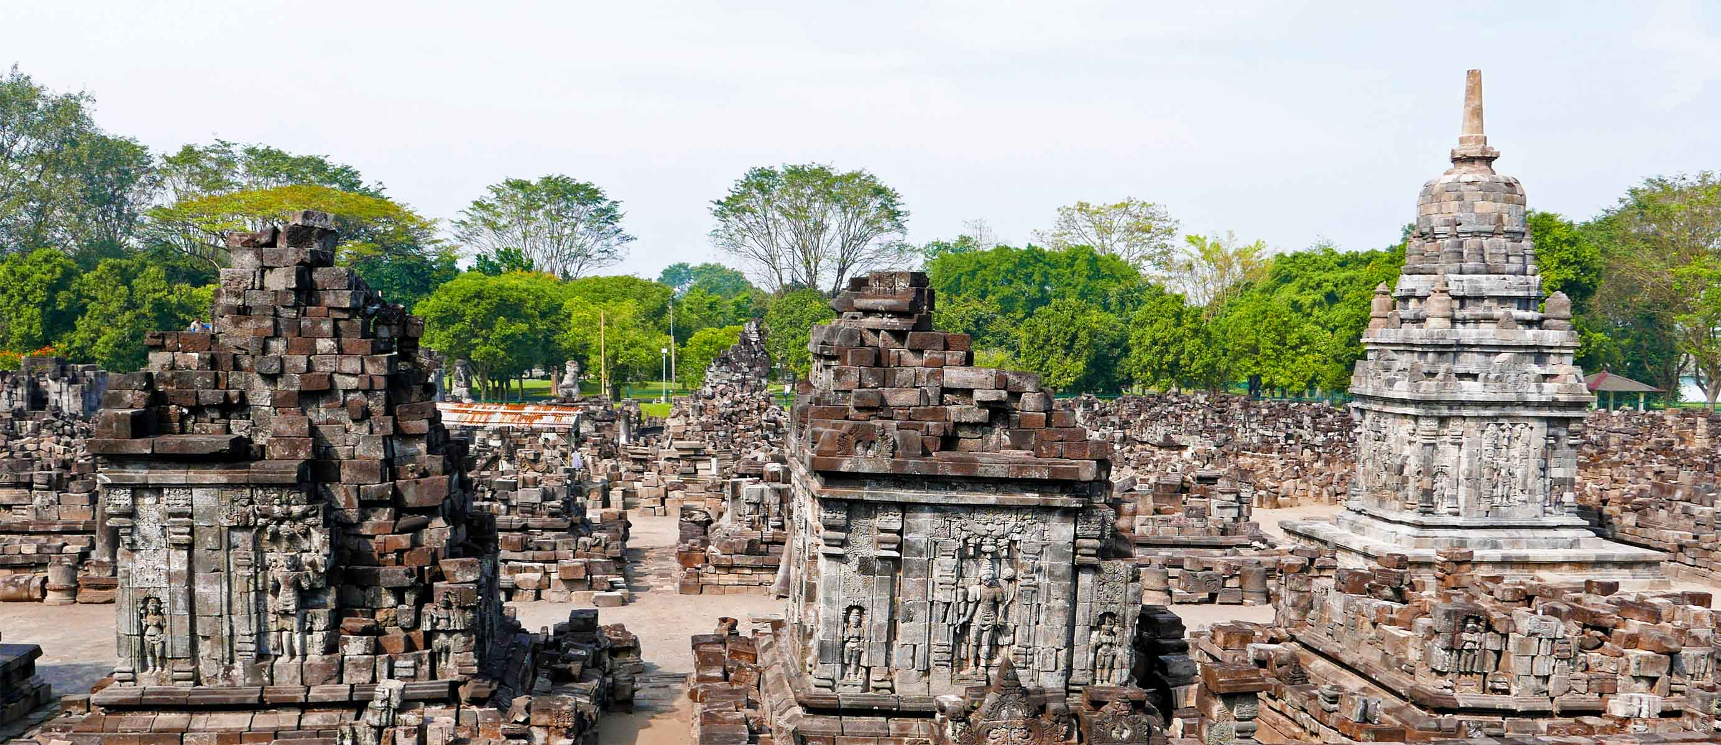
ORIGIN
Anandajoti Bhikkhu (Photo Dharma)

Slide 38
À LA PROCHAINE
SAUVER LA TERRE
CONTINUER
F I N
Non pour un usage commercial! / Photos à partir d'Internet / Musique : Gus Teja
tomi55jutt@mail.com

