Slide 1

Ethiopia
Inside The Ancient
Mountain Churches…
MANUAL
ADVANCE

Slide 2
The northern Ethiopian town of Lalibela, one of the holiest sites in the country, is known worldwide for its medieval monolithic rock-cut churches.
Though the dating of the churches is not well established, most are thought to have been built during the reign of King Lalibela during the 12th and 13th centuries.
According to legend, angels helped King Lalibela build these churches below ground after he received an order from God to create a new Jerusalem in Ethiopia.

Slide 3
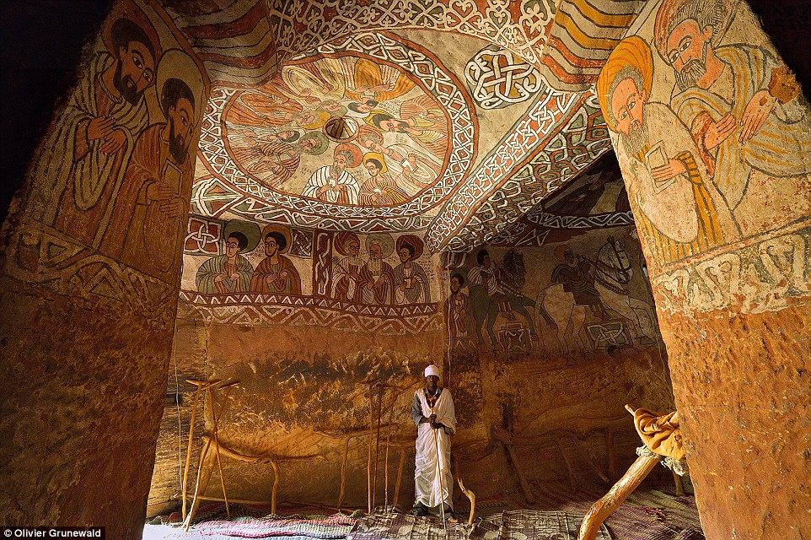
Interior design: The stunning frescoes inside the Abune Yemata Guh church remain extremely well preserved thanks to their remote location.

Slide 4
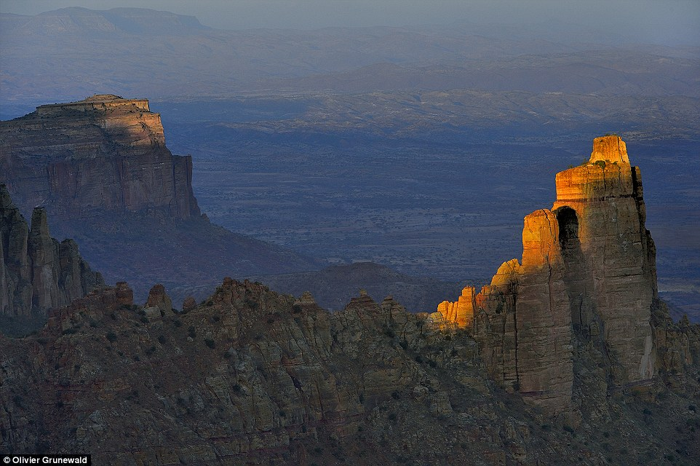
Historic: The mountains where the Abune Yemata Guh church is located, 2,500ft above ground level - and carved out by an Egyptian priest.

Slide 5
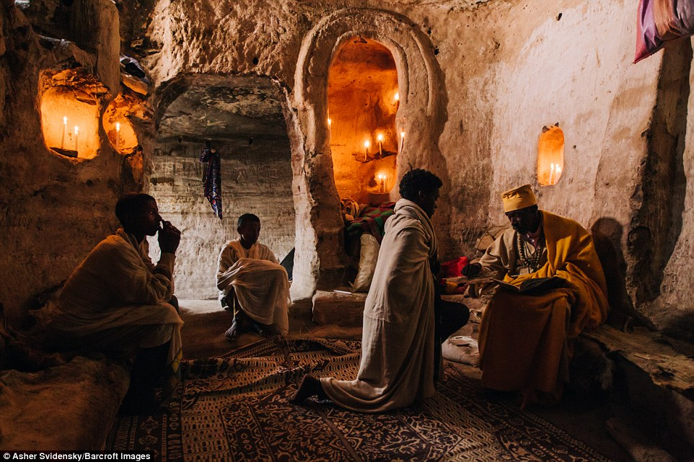
Tradition:Some of the teachers in the churches have lived there for more than 40 years, dedicating their lives to teaching young Orthodox Christian boys as they journey to becoming priests.

Slide 6
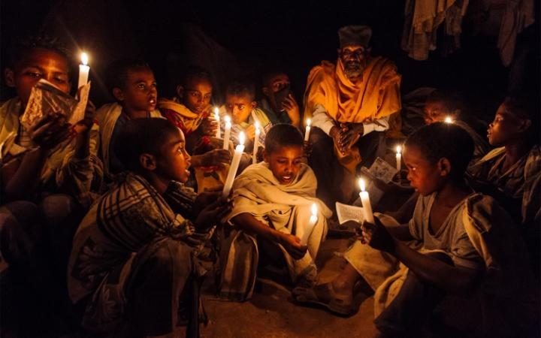
Hundreds of feet above sea level stand ancient churches that have been carved into the side of jagged rock faces. CREDIT: ASHER SVIDENSKY/BARCROFT IMAGES

Slide 7
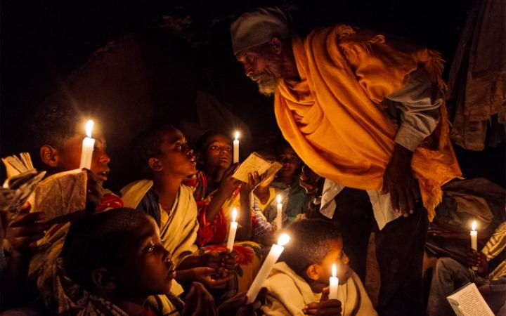
Children study texts under candle light. CREDIT: ASHER SVIDENSKY/BARCROFT IMAGES

Slide 8
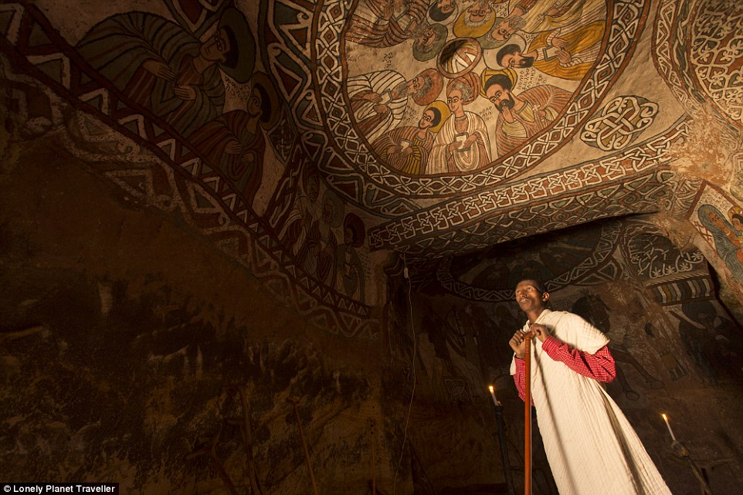

Slide 9
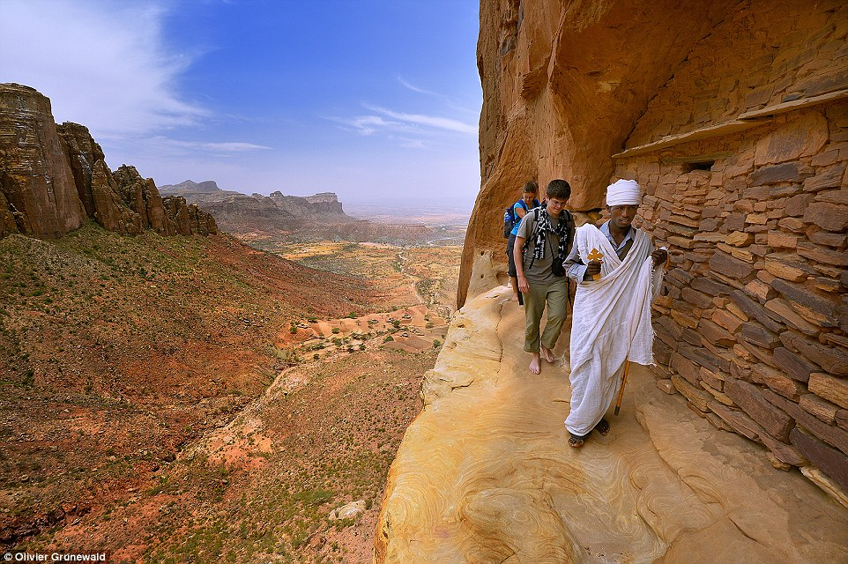
Journey: Anyone visiting the Abune Yemata Guh church must make their way along narrow ledges and cross a rickety makeshift bridge.

Slide 10
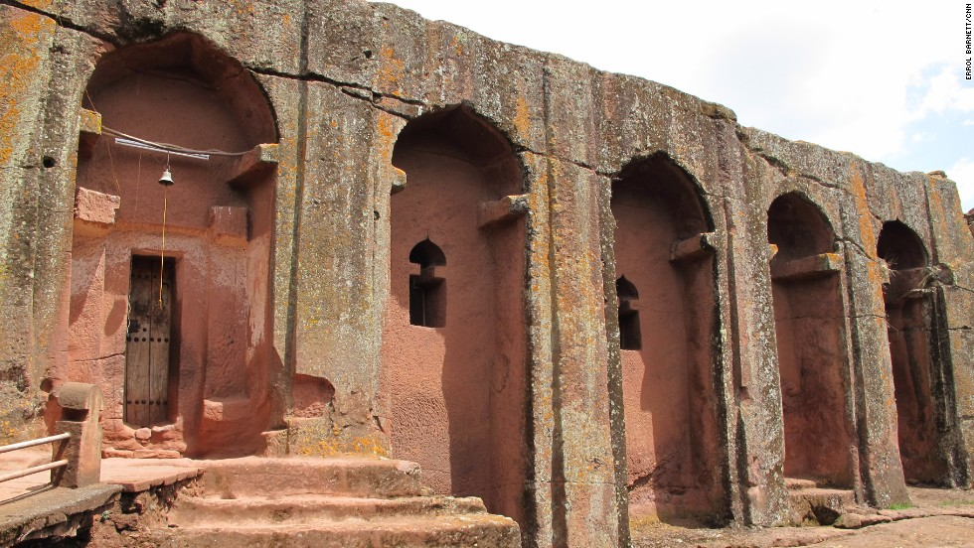
Ethiopia's rock-hewn churches

Slide 11
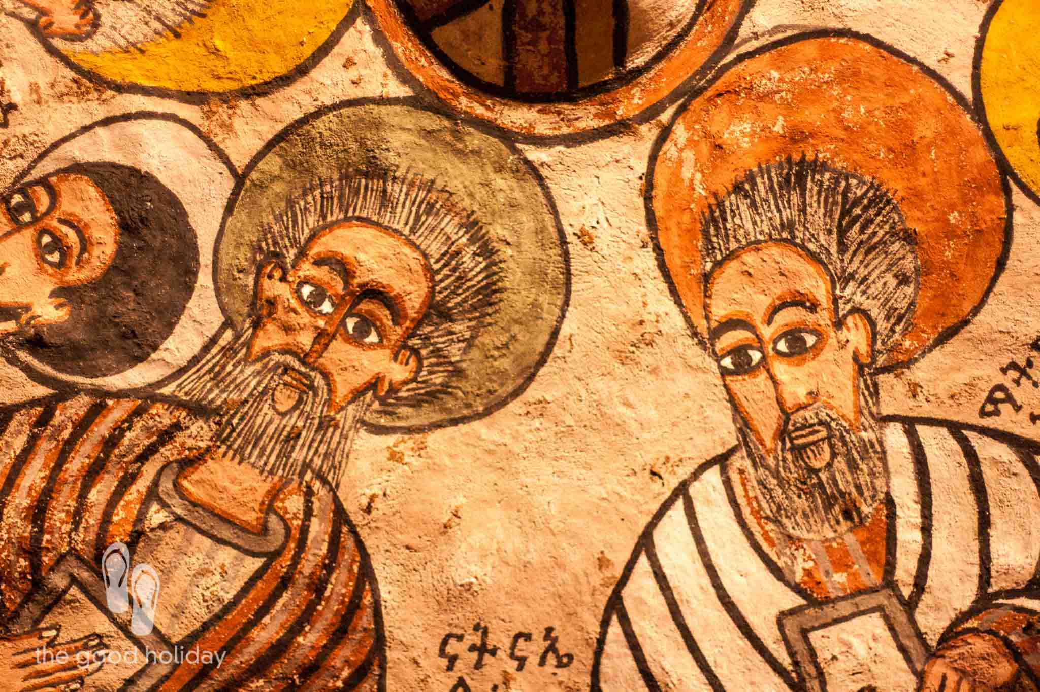
Debre Damo Church Ethiopia

Slide 12
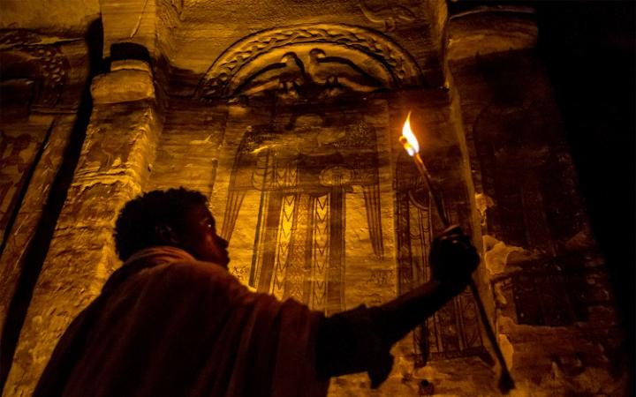
A young boy uses candlelight to guide himself around one of the churches. CREDIT: ASHER SVIDENSKY/BARCROFT IMAGES

Slide 13
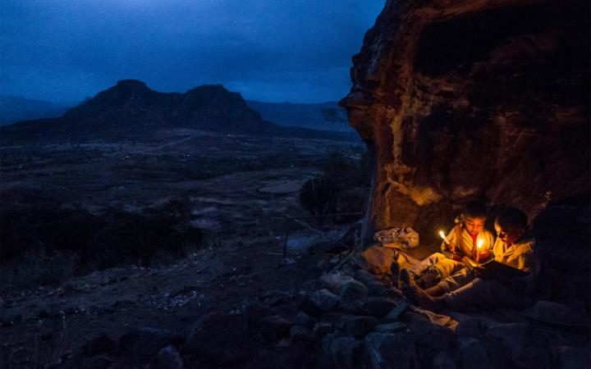
The churches are for those hoping to get closer to God literally and figuratively.CREDIT: ASHER SVIDENSKY/BARCROFT IMAGES

Slide 14
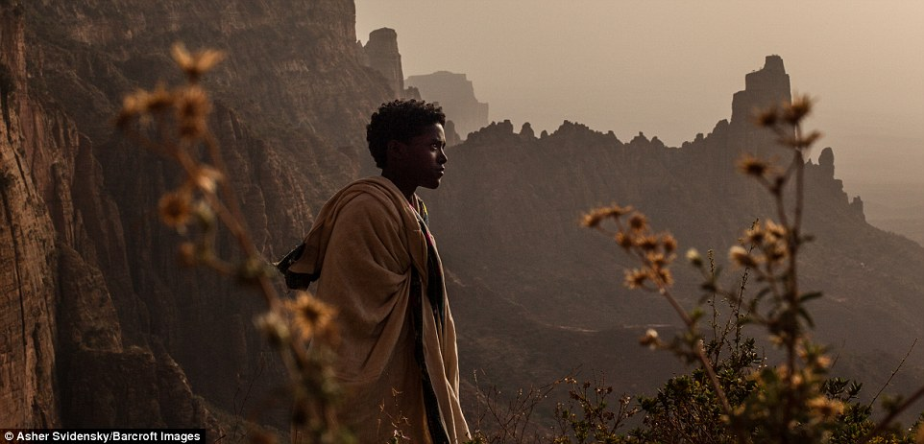

Slide 15
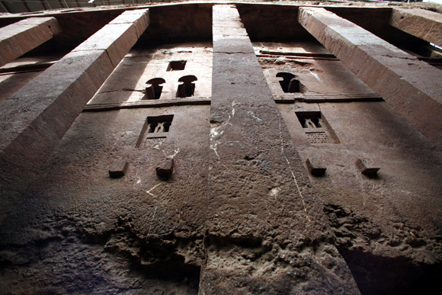
General view of a damaged facade of a rock-hewn church in Lalibela. Radu Sigheti/Reuters

Slide 16
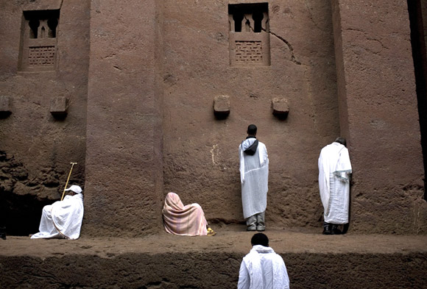
Siegfried Modola/Reuters

Slide 17
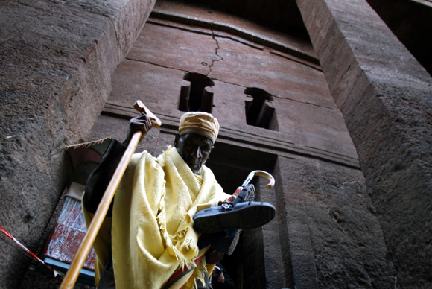
A Christian Orthodox monk leaves a rock-hewn church after prayers in Lalibela. Radu Sigheti/Reuters

Slide 18
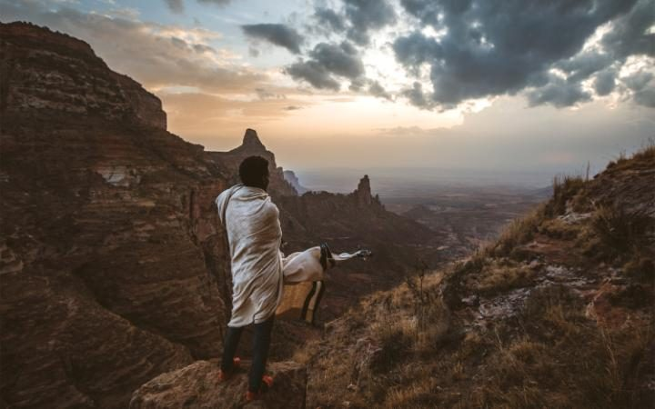
Believed to have been built over a thousand years ago the remote mountains have been a place of worship and study for Orthodox Christians in the region. CREDIT: ASHER SVIDENSKY/BARCROFT IMAGES

Slide 19
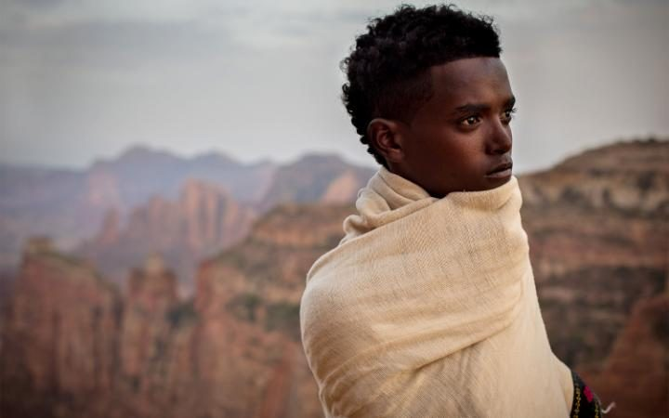
A man stands on the edge of a mountain in Tigray. CREDIT: ASHER SVIDENSKY/BARCROFT IMAGES

Slide 20
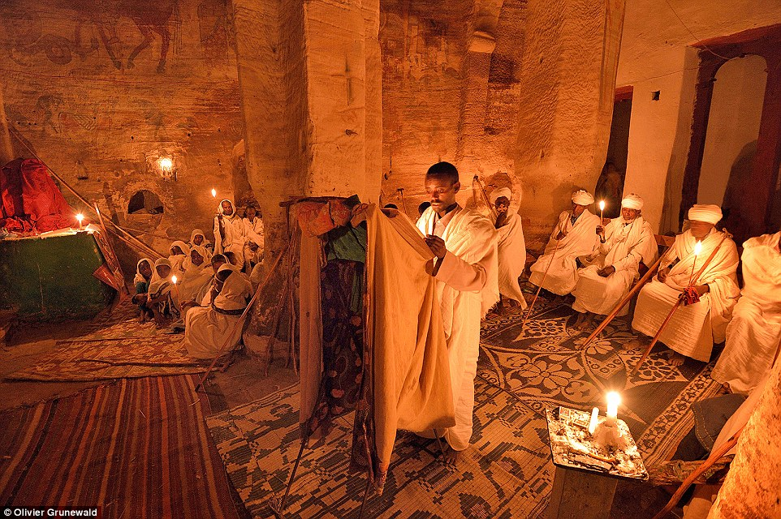
Mariam Korkor church: This is one of the extraordinary Christian places of worship carved into the sandstone Gheralta mountains in Ethiopia.

Slide 21
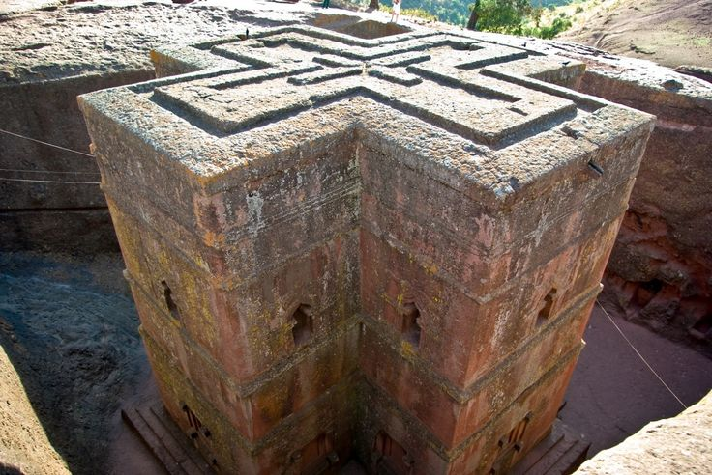
The Church of Saint George, one of many churches hewn into the rocky hills of Lalibela

Slide 22
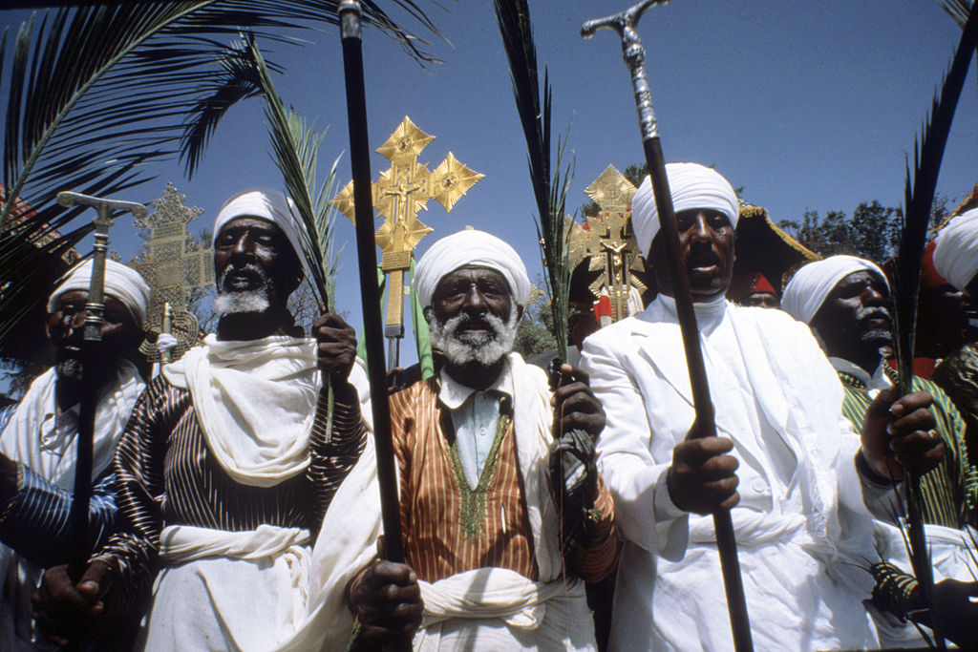
Priest of rock-hewn churches of Lalibela, a high place of Ethiopian Christianity, still today a place of pilgrimage and devotion. Lalibela, Ethiopia

Slide 23
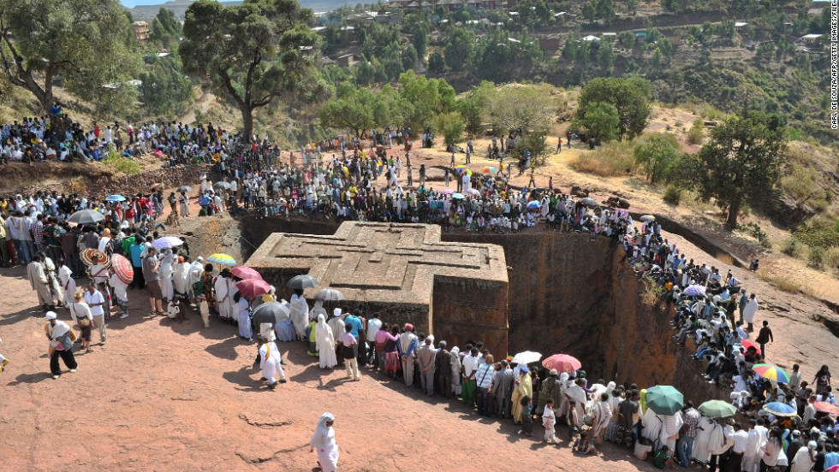

Slide 24
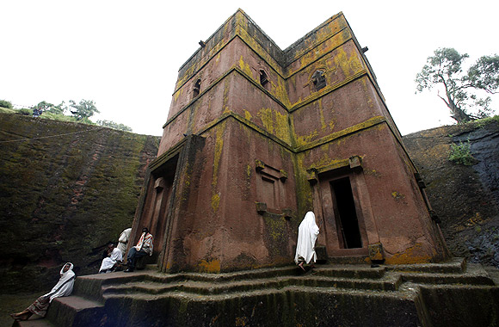
Radu Sigheti/Reuters

Slide 25
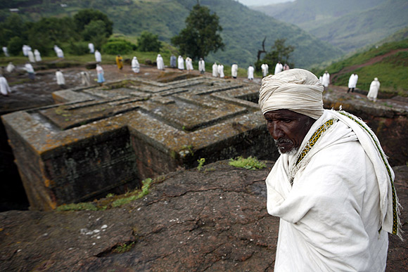
A man stands near Saint George, one of the 11 rock-hewn churches in Lalibela. Radu Sigheti/Reuters

Slide 26
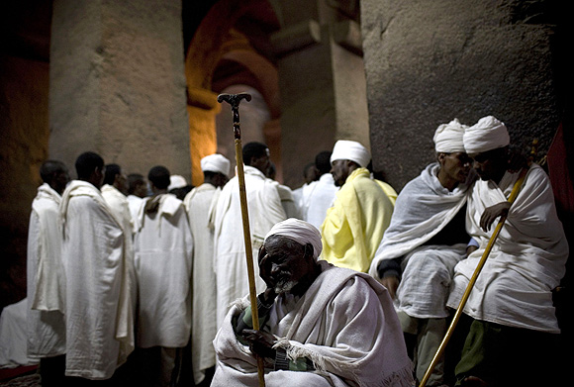
Orthodox Christian pilgrims pray at Bet Medhane Alem rock church in Lalibela. Siegfried Modola/Reuters

Slide 27
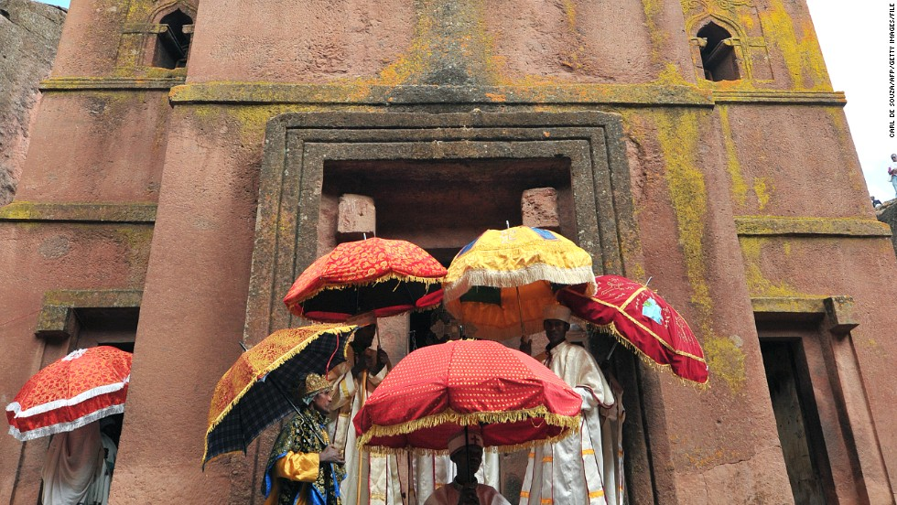

Slide 28
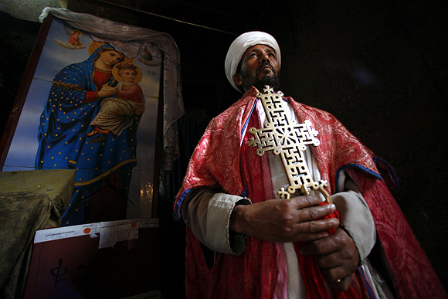
Christian Orthodox priest Mesganaw Tarkgn raises an ancient cross in a picture-perfect pose inside a rock-hewn church in Lalibela. Radu Sigheti/Reuters

Slide 29
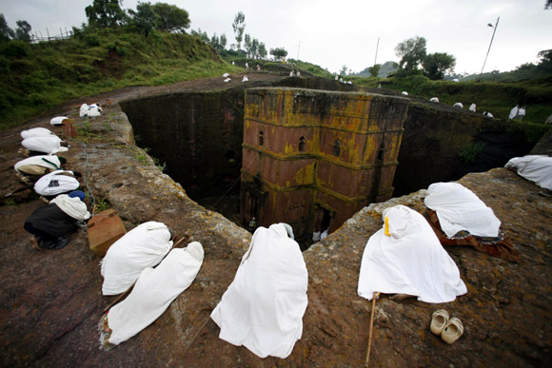
People pray around Saint George, one of the 11 rock-hewn churches in Lalibela, an ancient site that draws tens of thousands of foreign tourists every year. Radu Sigheti/Reuters

Slide 30
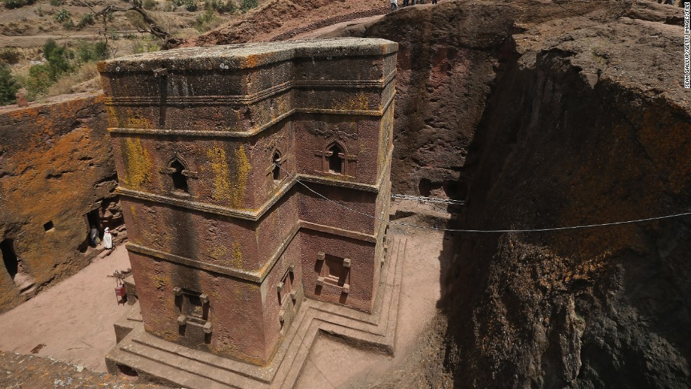
The Church of Saint George, one of many churches hewn into the rocky hills of Lalibela

Slide 31
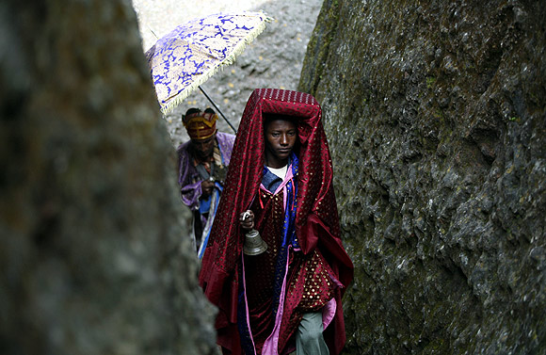
A priest rings a bell to call the faithful to a mass outside Saint George church in Lalibela. Radu Sigheti/Reuters

Slide 32
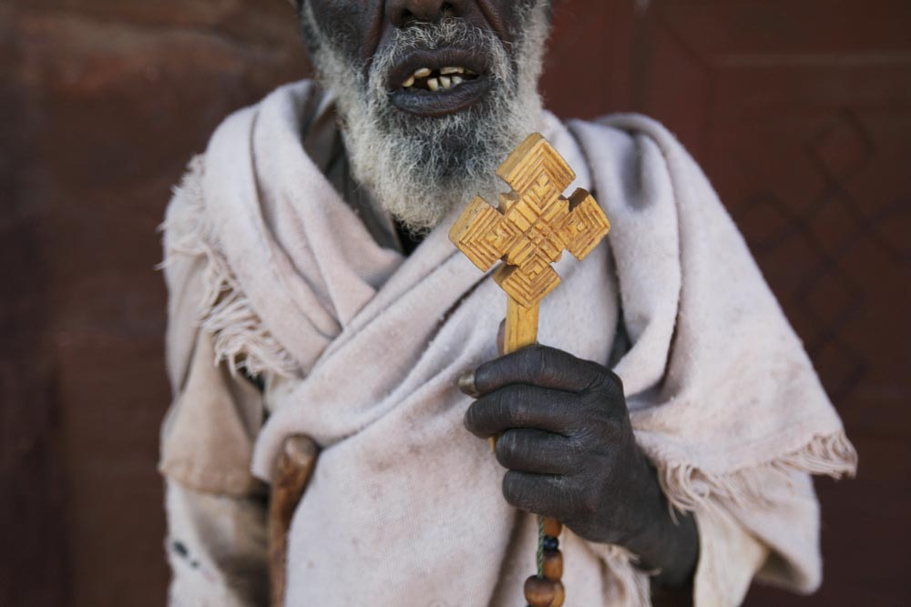
Photo by Luke Duggleby

Slide 33
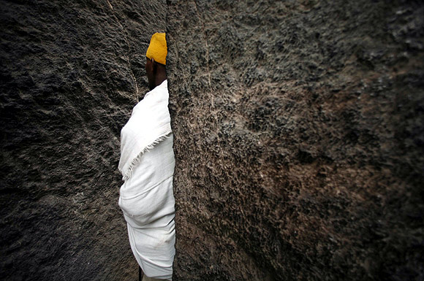
A Christian Orthodox monk prays outside a rock-hewn church after priers in Lalibela. Radu Sigheti/Reuters

Slide 34
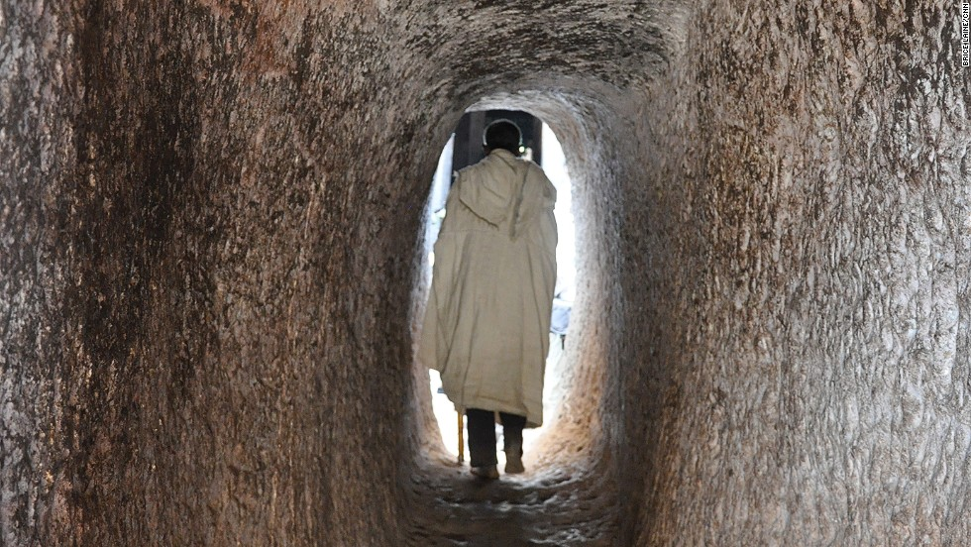
A Complex and extensivesystem of drainage ditches, tunnels and subterranean passageways connect the underground churches, which were carvedout of volcanic rock

Slide 35
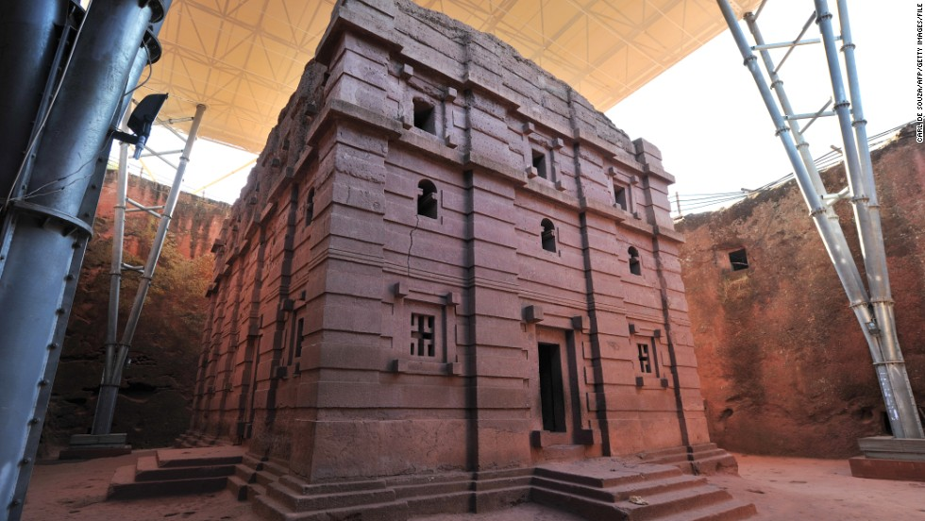
UNESCO Declared Lalibela a World Heritage Site in 1978

Slide 36
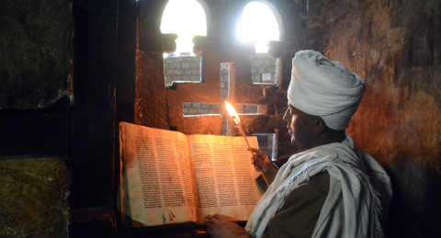

Slide 37
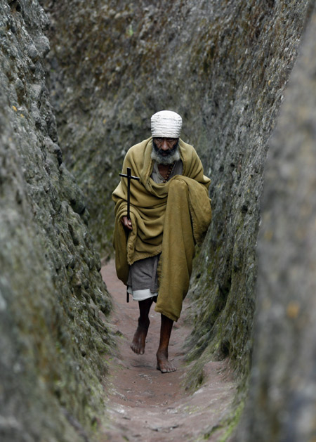
A Christian Orthodox monk leaves a rock-hewn church after prayers in Lalibela. Radu Sigheti/Reuters

Slide 38
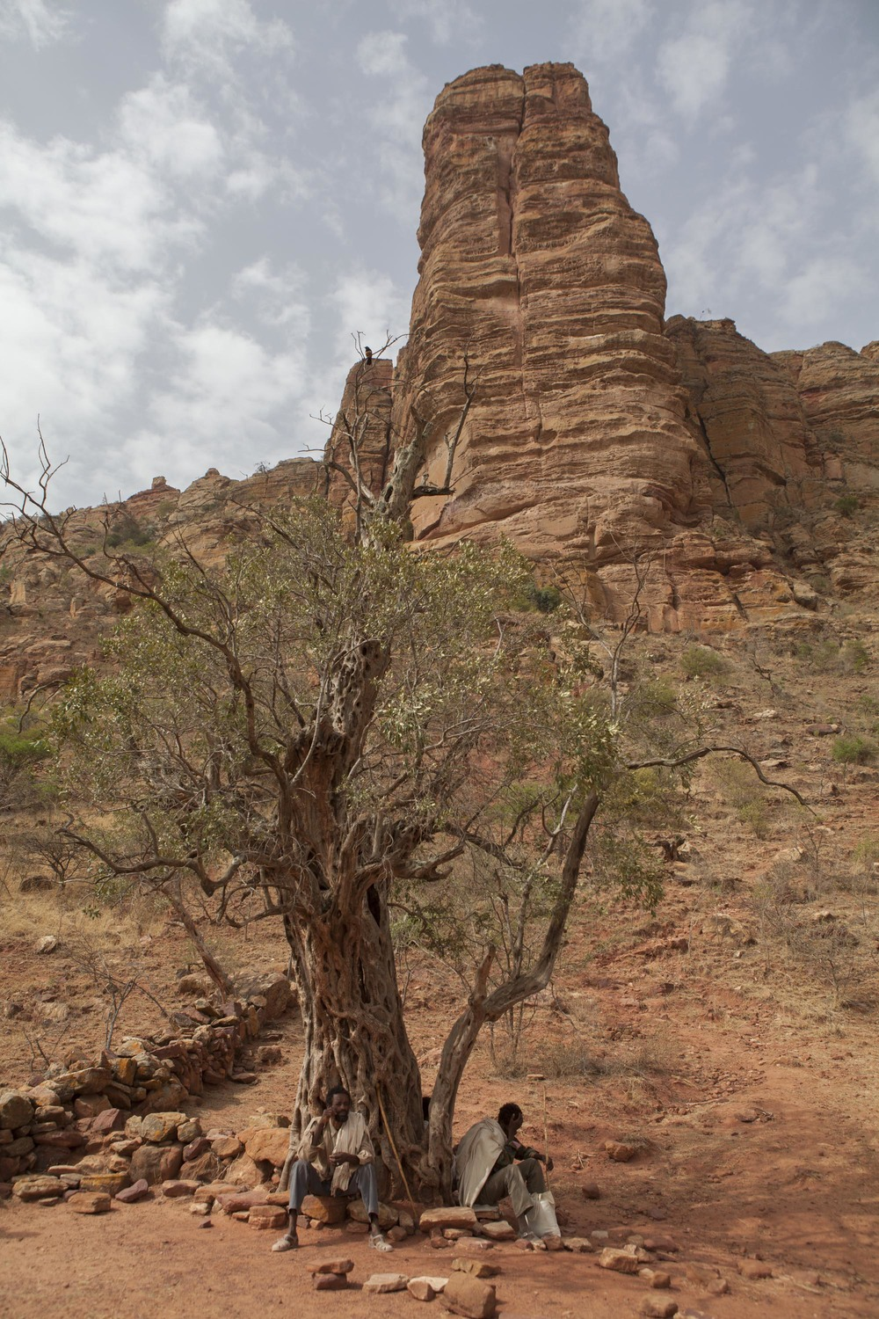
Two scouts sit at an ancient olive tree at the base of the mountain containing Abuna Yemata Church.

Slide 39
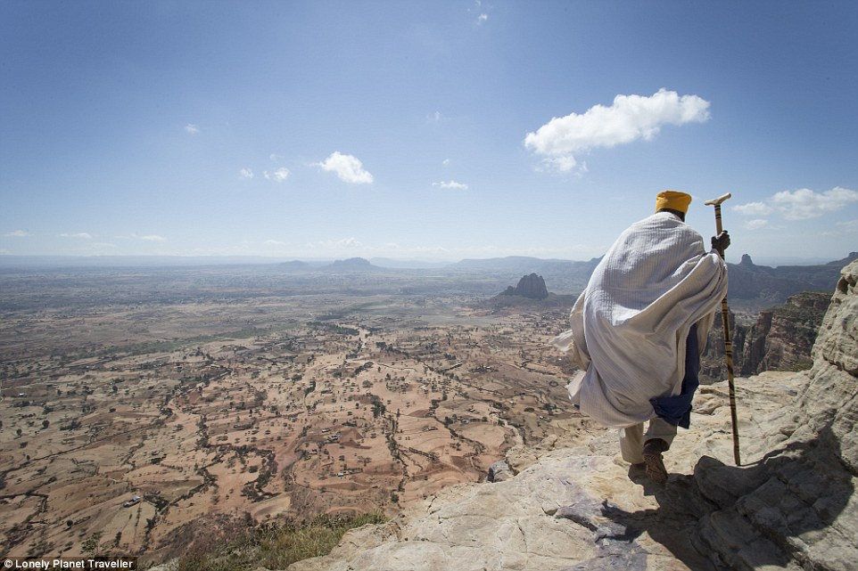
Devoted: Some priests have not left the mountaintop for 30 to 40 years.

Slide 40
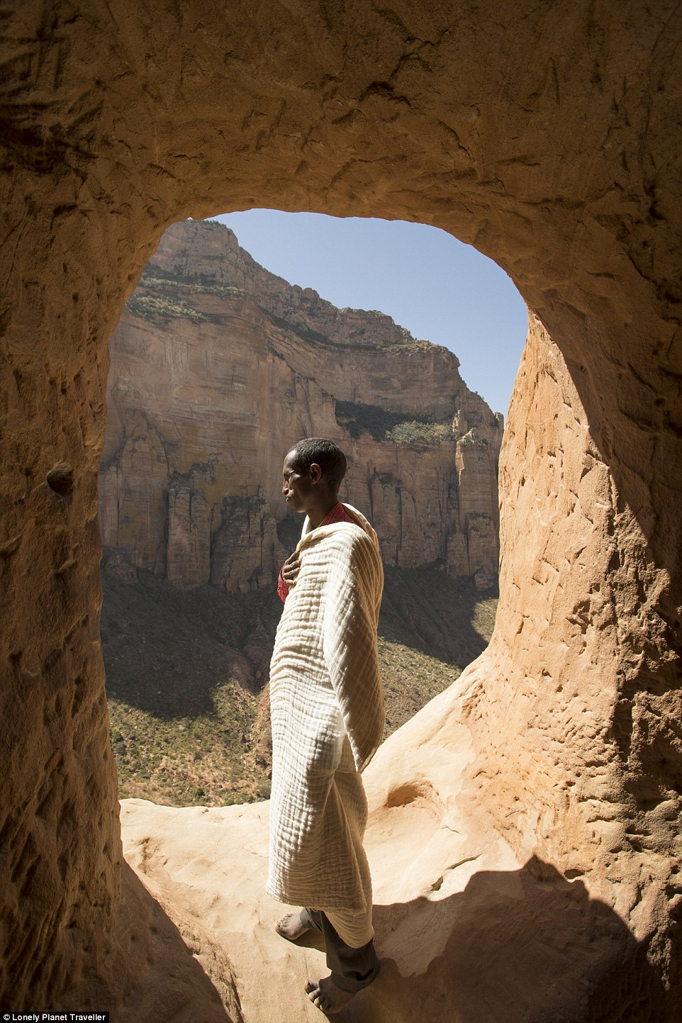
Ancient traditions: Ethiopia is home to some of the world's oldest strands of Christianity.

Slide 41
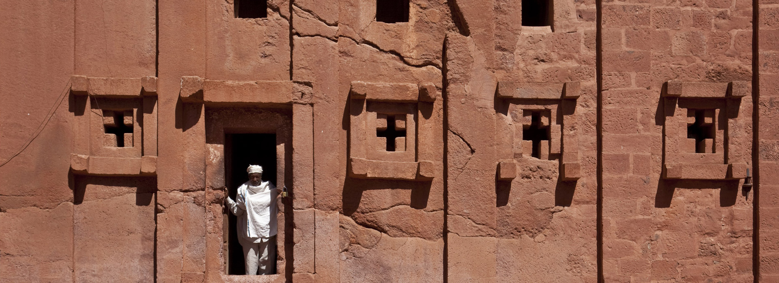
Bet Abba Libanos Church, Lalibela, Ethiopia

Slide 42
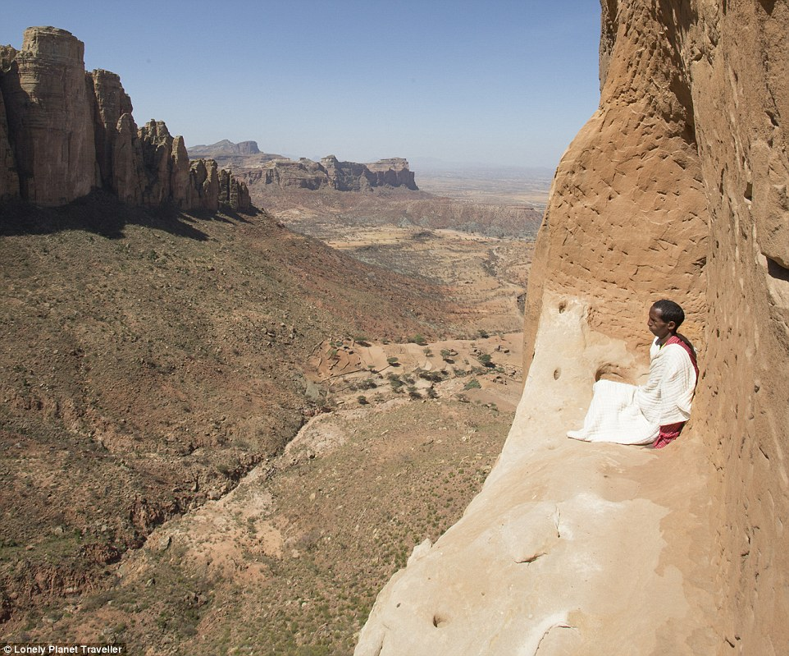
Church in the sky: A priest at Abuna Yemata Guh, a church 2,500 feet high on a clifftop in northern Ethiopia.

Slide 43
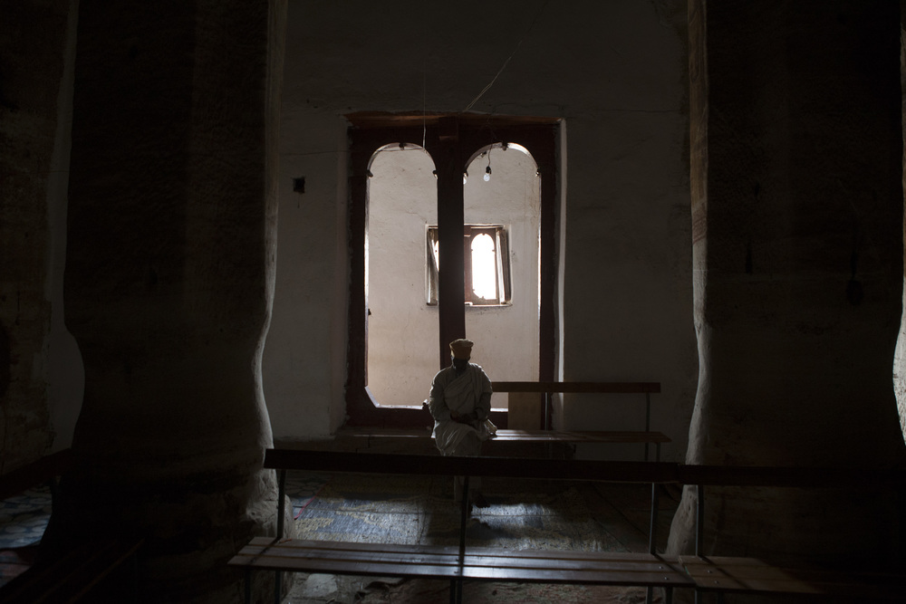
A priest is pictured inside the Miriam Korkor Church. The church is completely carved of solid rock, dating back to the 4th century in local records, though historians have dated it around 11th century.

Slide 44
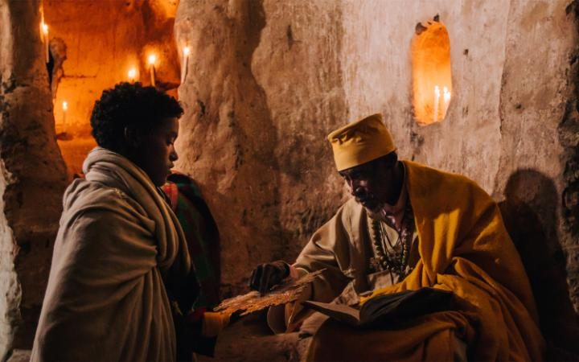
Most of the children that attend the churches have been brought there by their family seeking a better life . CREDIT: ASHER SVIDENSKY/BARCROFT IMAGES

Slide 45
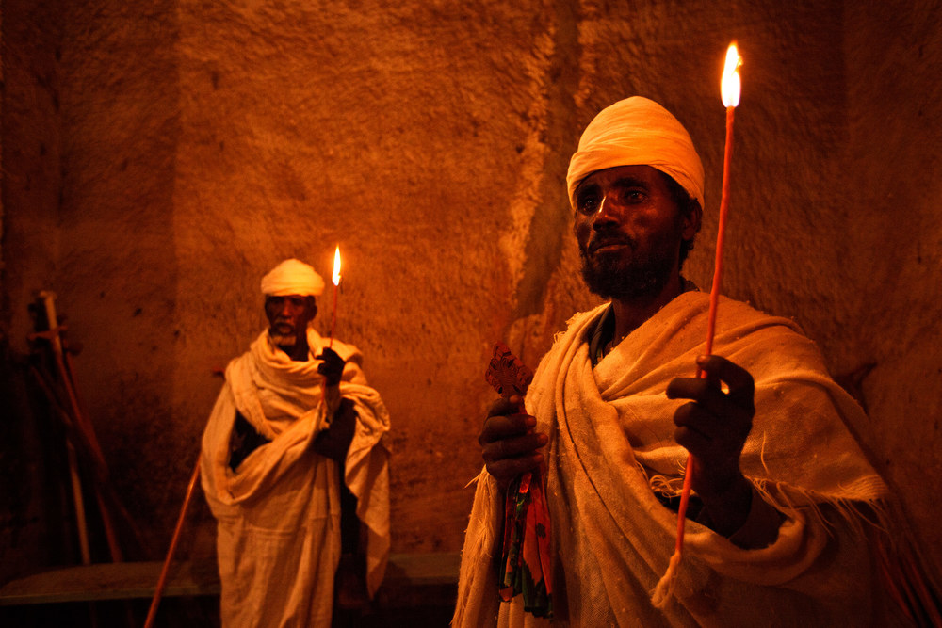

Slide 46
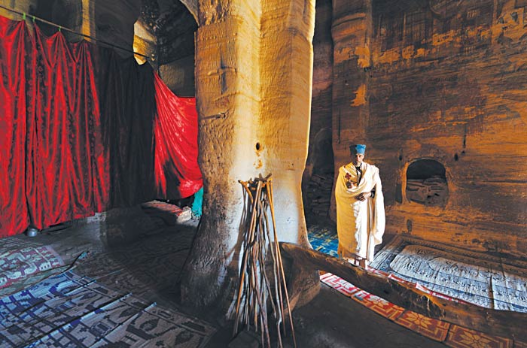
The interior of the Church of St Mary Korkor in Ethiopia

Slide 47
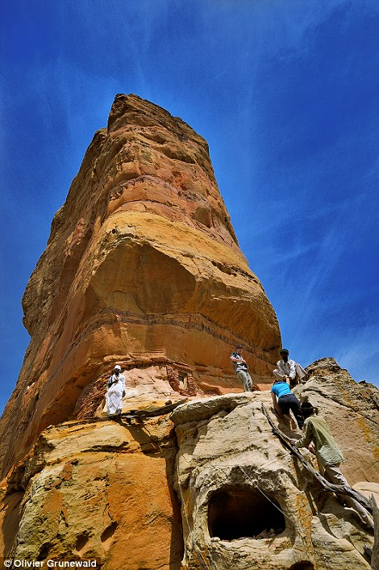
Climbing: Visitors must take a dangerous route to the Abune Yemata Guh.

Slide 48
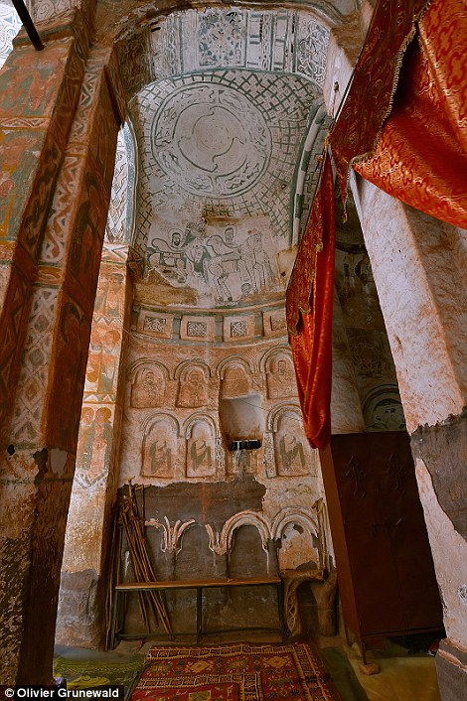
Interior of Abune Abraham church

Slide 49
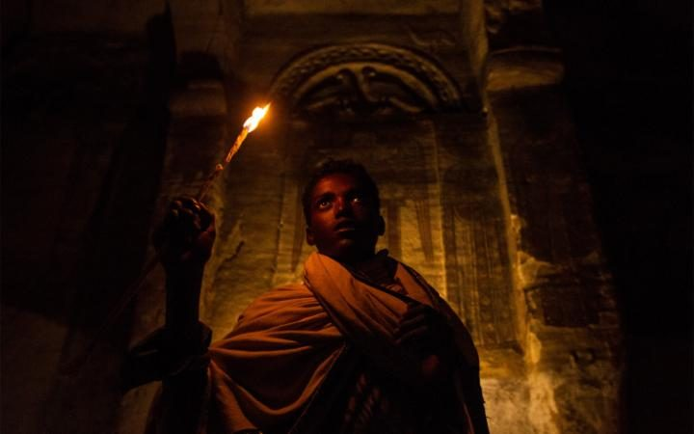
The sacred places of worship are scattered around the mountains of Tigray, northern Ethiopia. CREDIT: ASHER SVIDENSKY/BARCROFT IMAGES

Slide 50

END SHOW
Seen on Bigfun.be
Author: Magdalena

