Slide 1

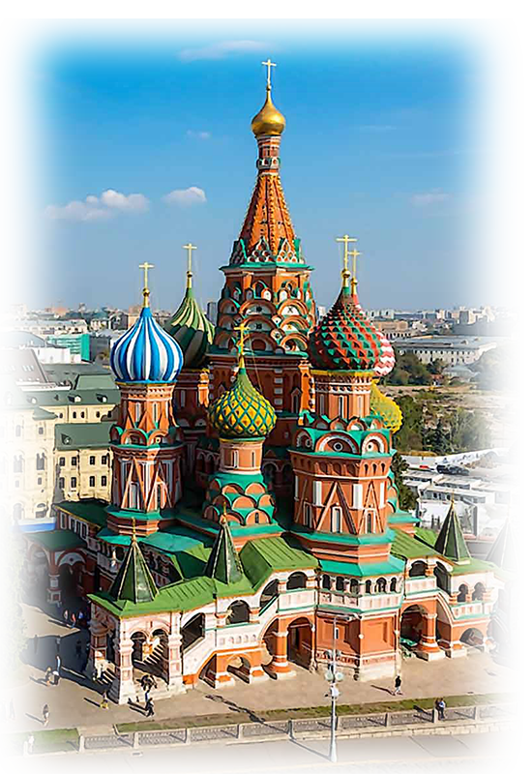
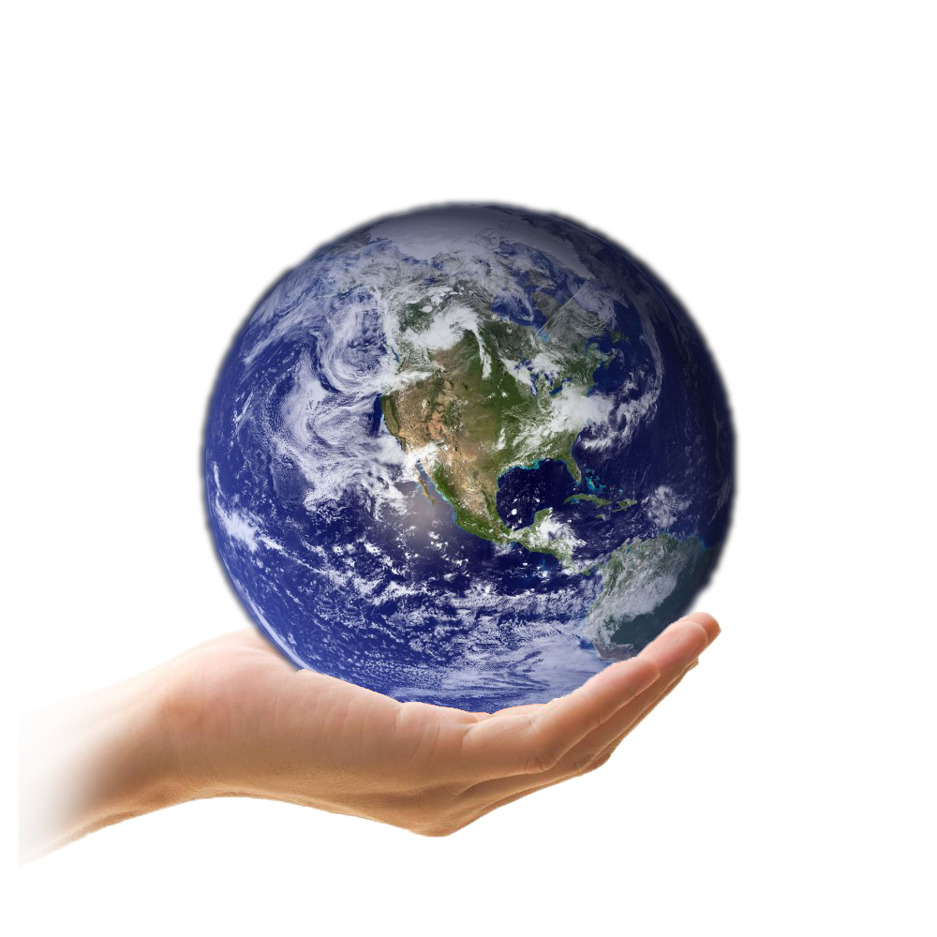
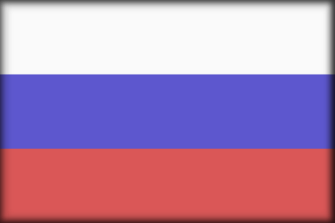
VOIR LE MONDE AVEC MOI
SAUVER LA TERRE
RUSSIE
Moscou
Moscou
02
Tommy55

Slide 2

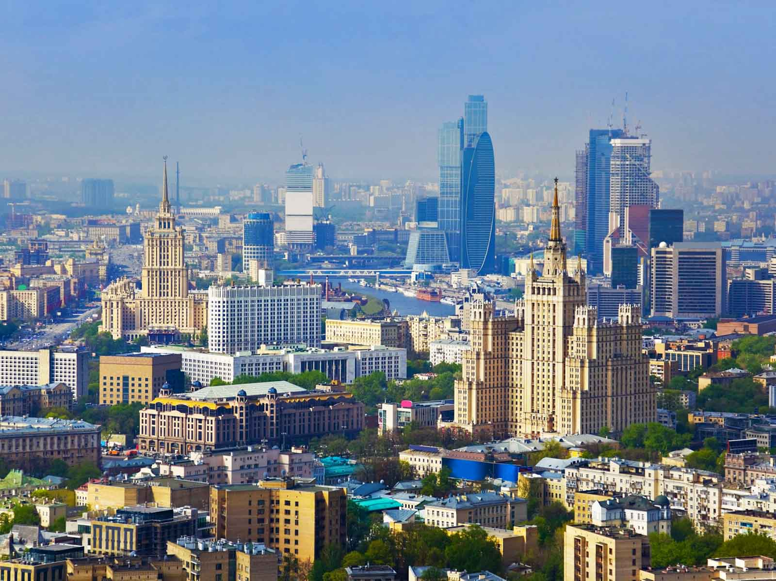
Panorama
Rabstol Net
ORIGIN

Slide 3
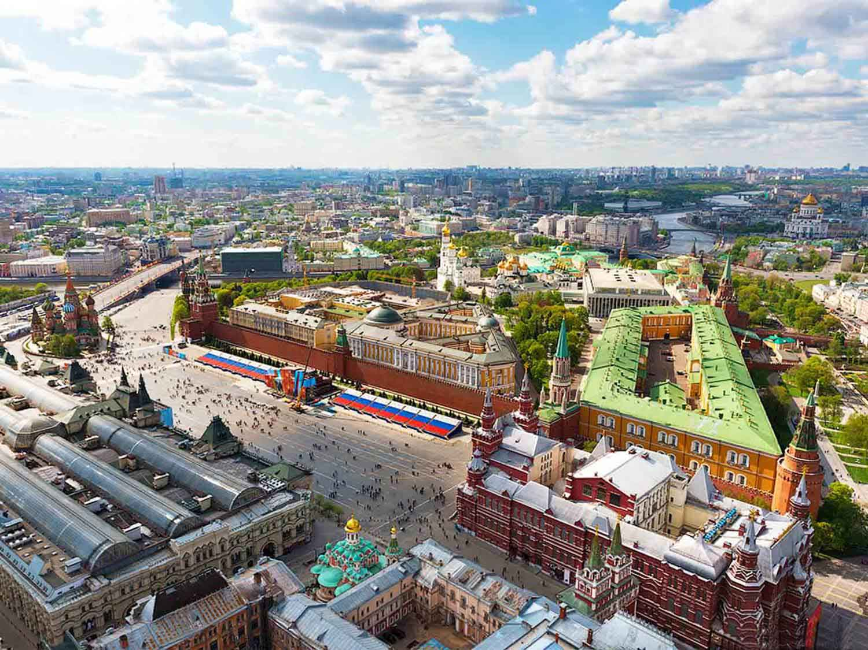
The Red Square
Slava Stepanov
ORIGIN

Slide 4
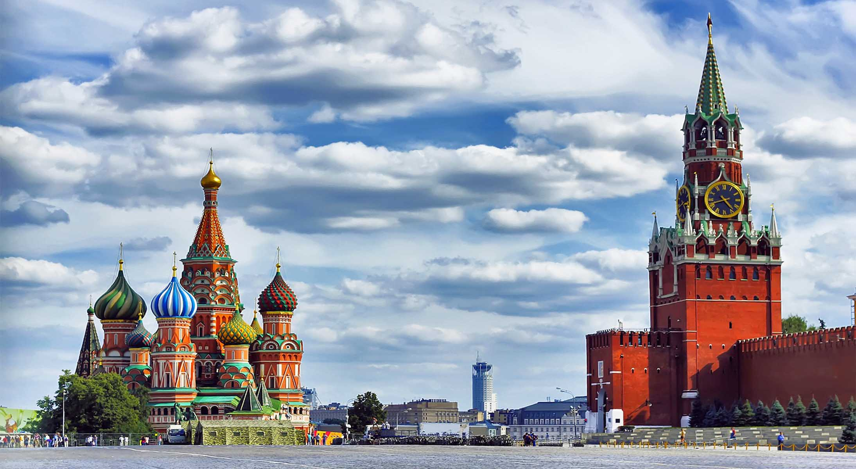
The Red Square
Apostrof Tour
ORIGIN

Slide 5
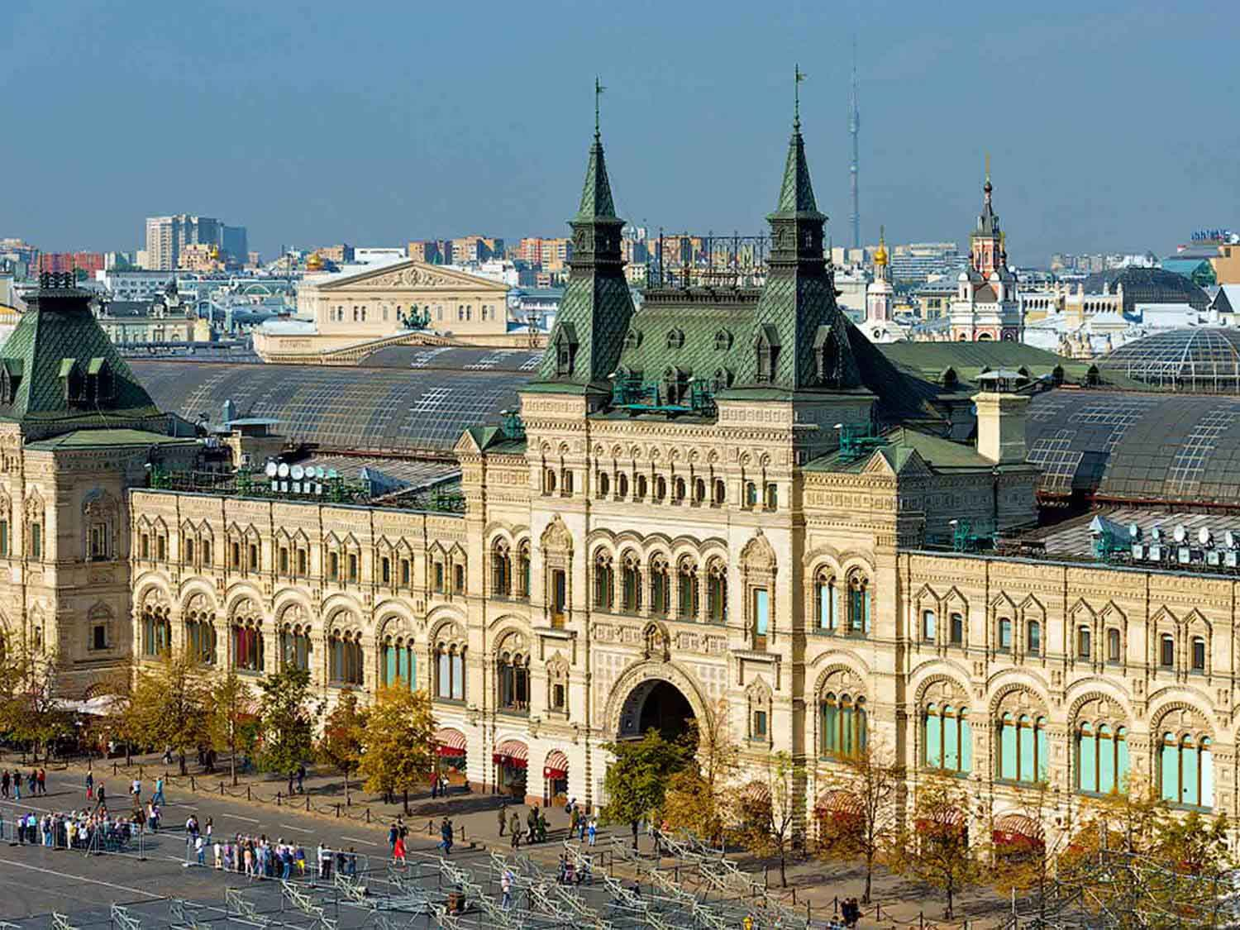
State Department Store
Slava Stepanov
ORIGIN

Slide 6
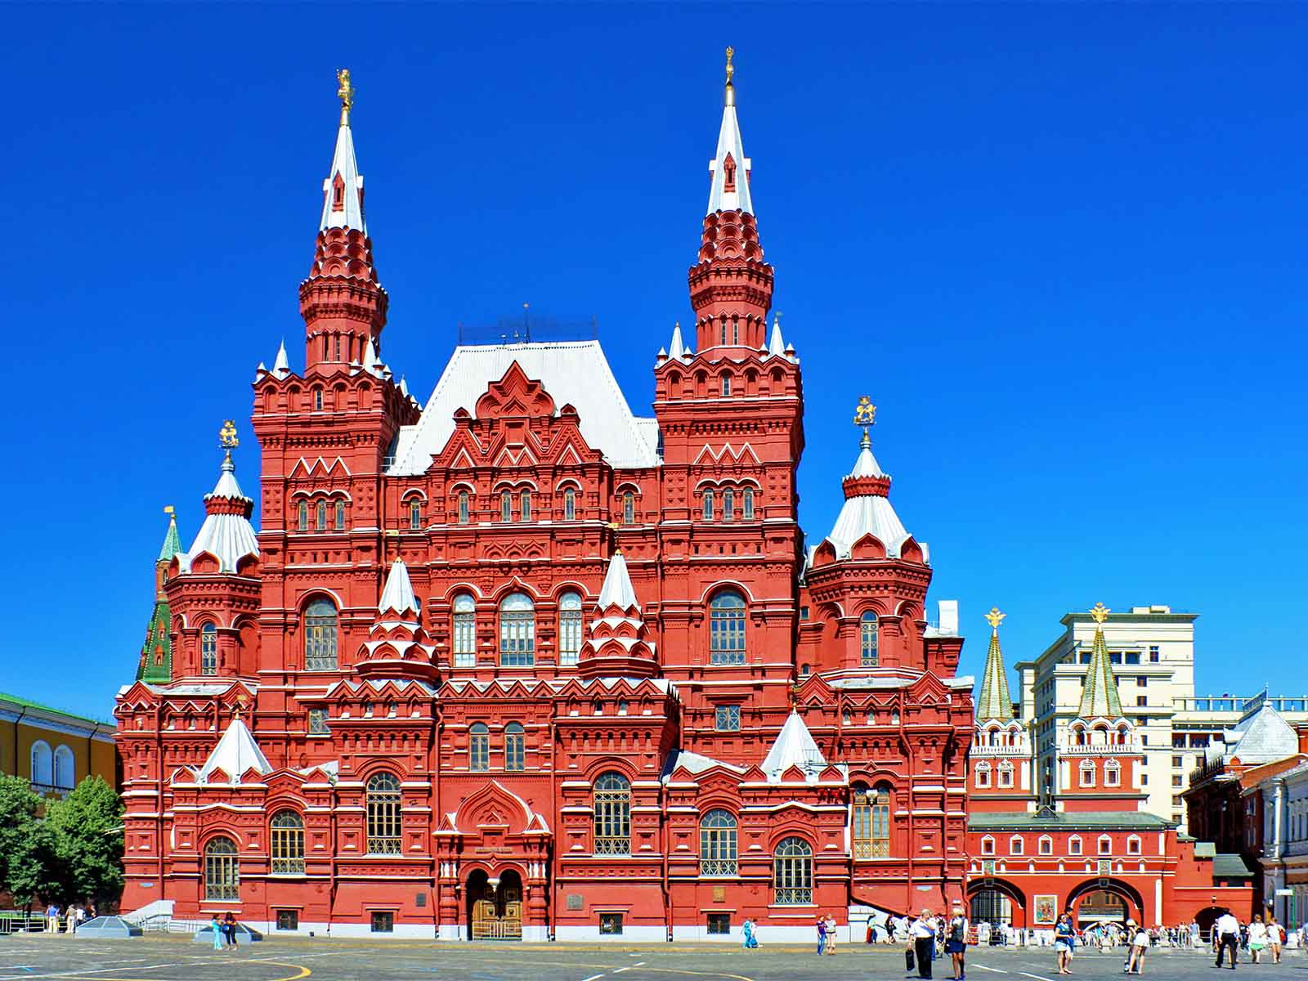
State Historical Museum
Hons084 - Wikimedia
ORIGIN

Slide 7
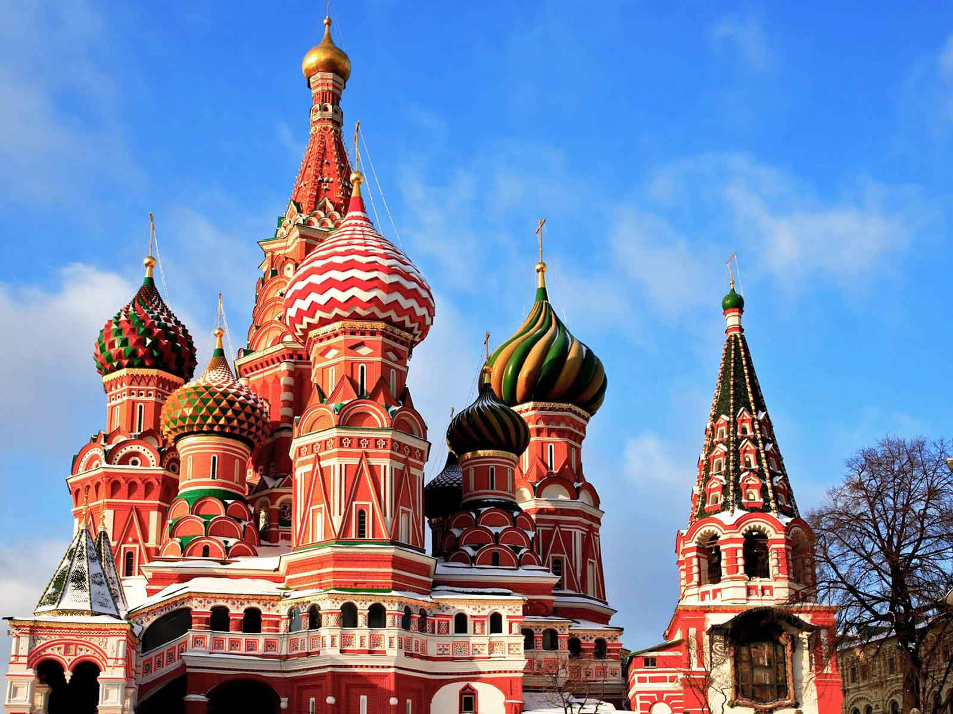
St.Basil's Cathedral
Rabstol Net
ORIGIN

Slide 8
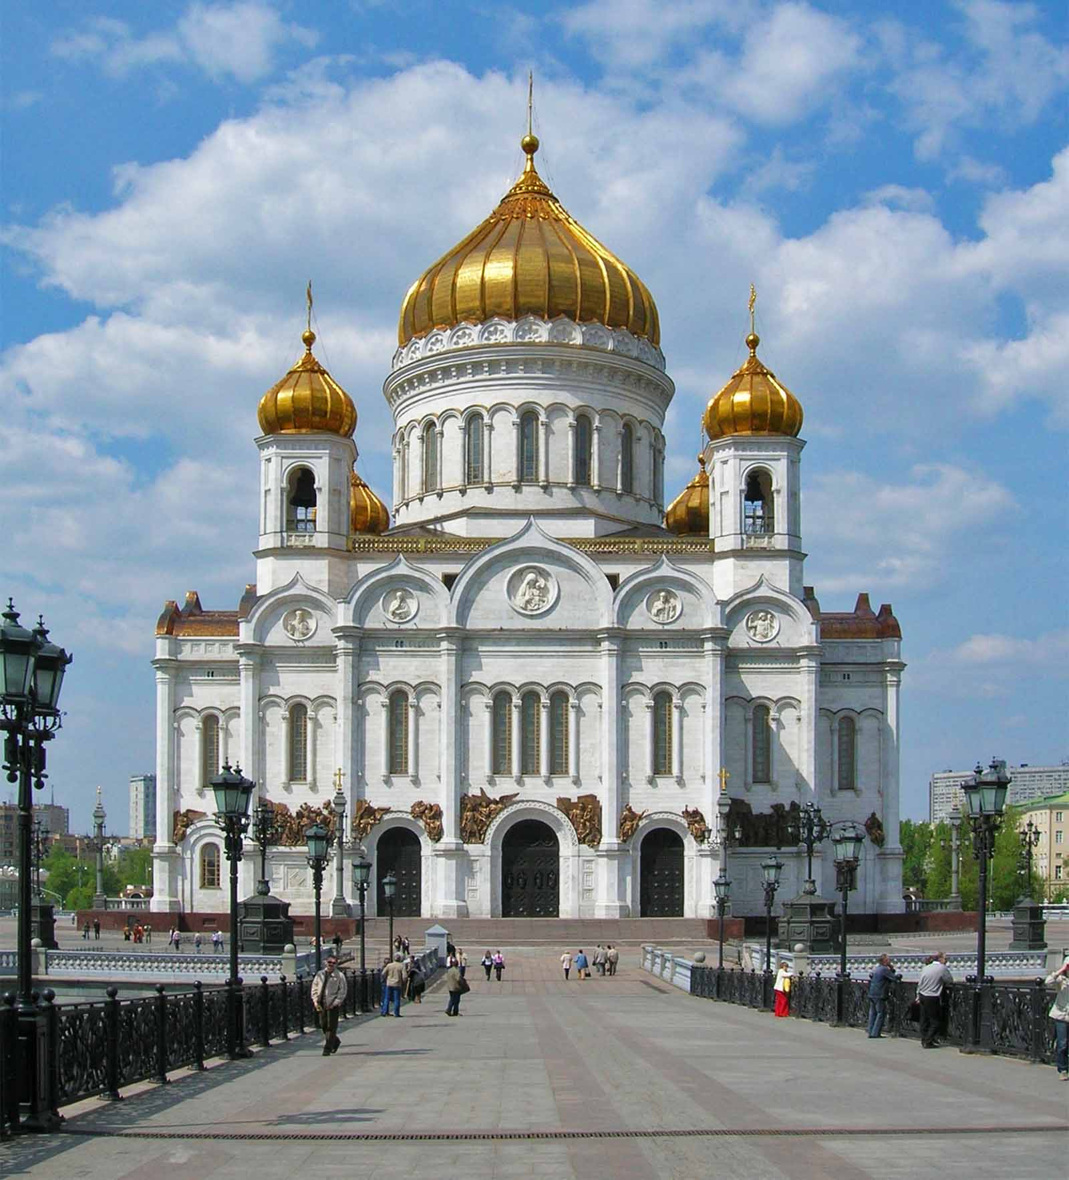
Cathedral of Christ the Saviour
Voytek S - Wikimedia
ORIGIN

Slide 9
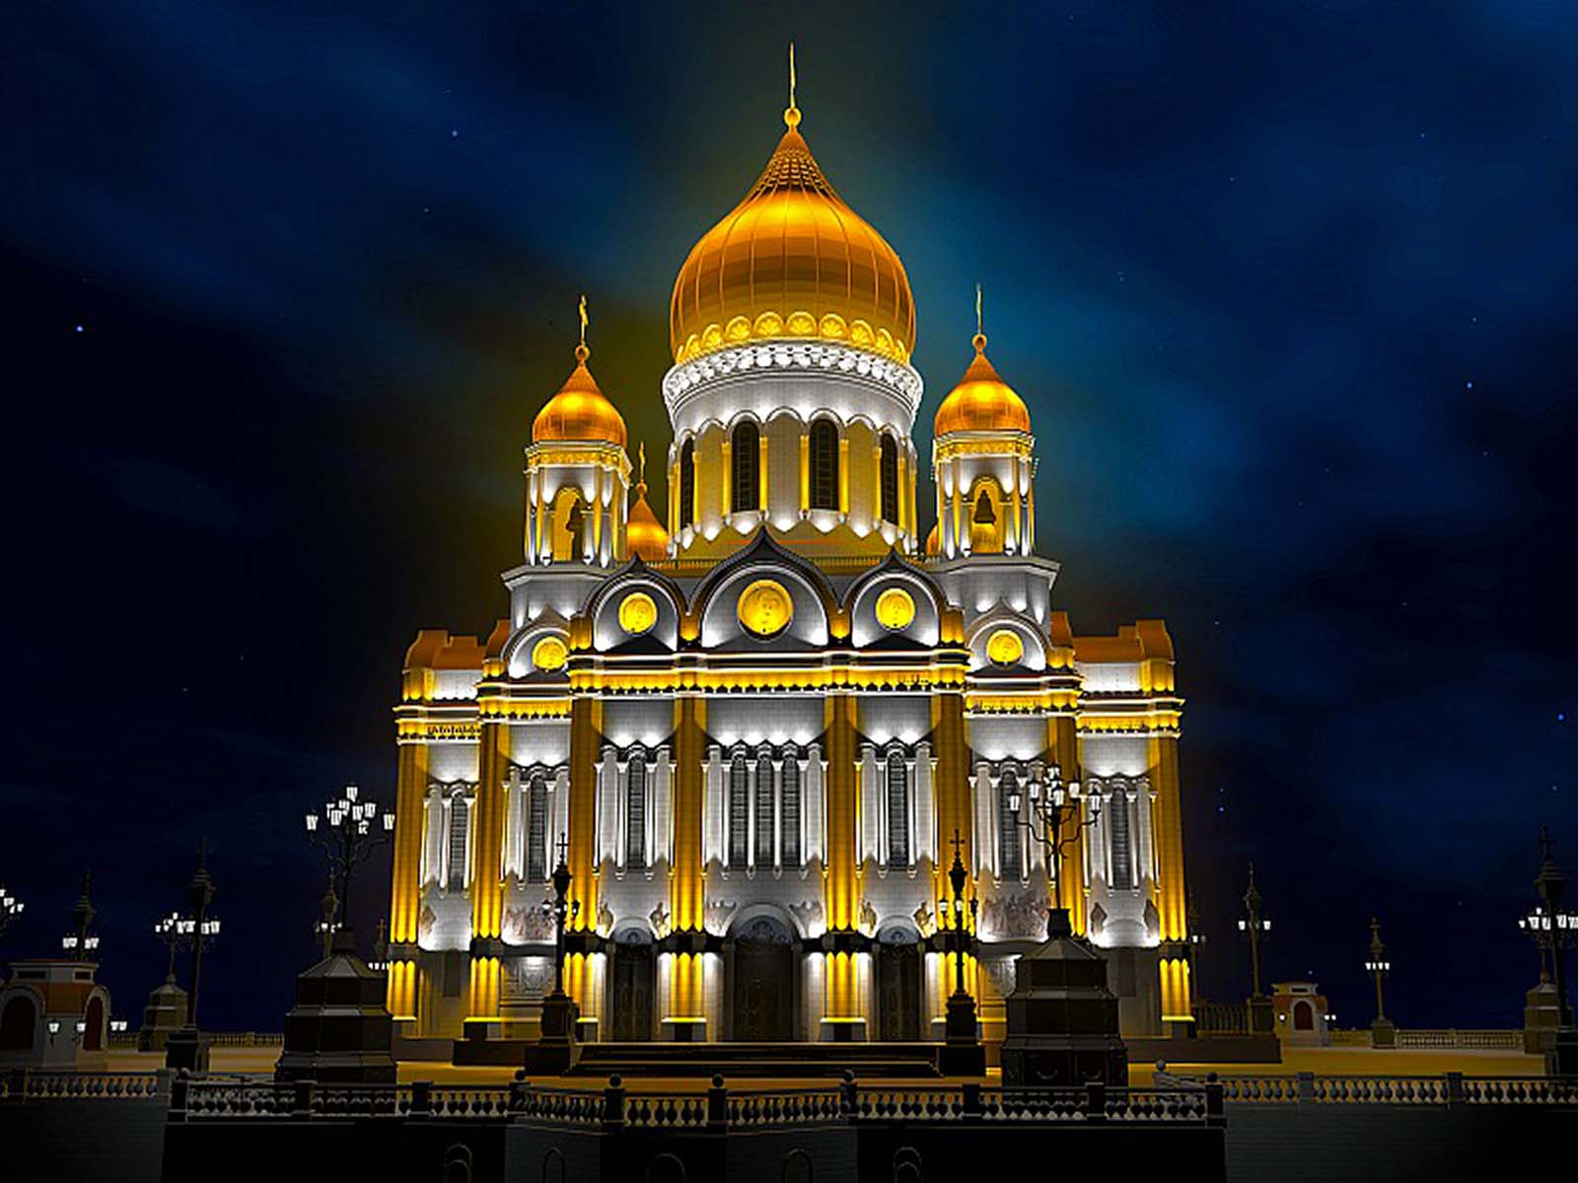
Cathedral of Christ the Saviour
IMIGO
ORIGIN

Slide 10
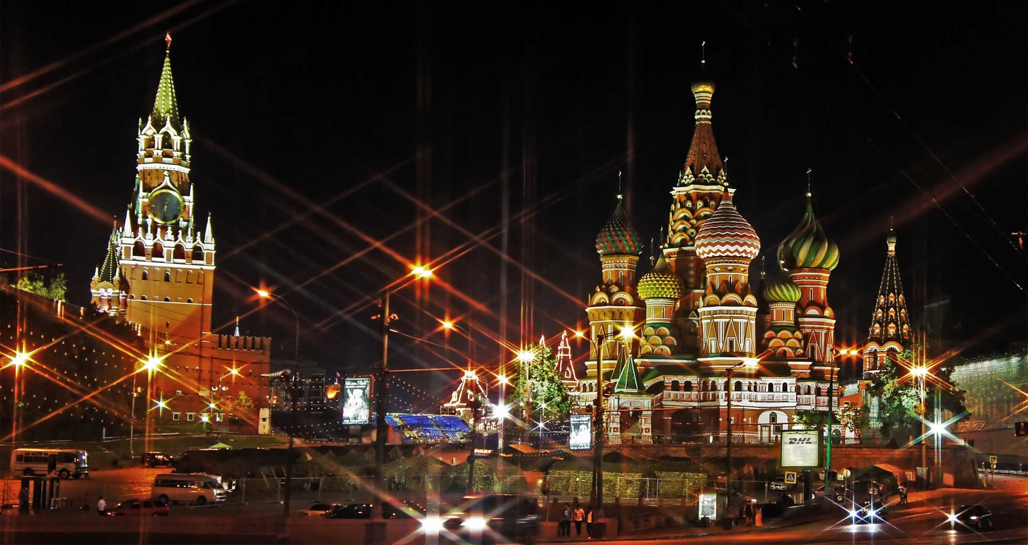
The Red Square
Képguru
ORIGIN

Slide 11
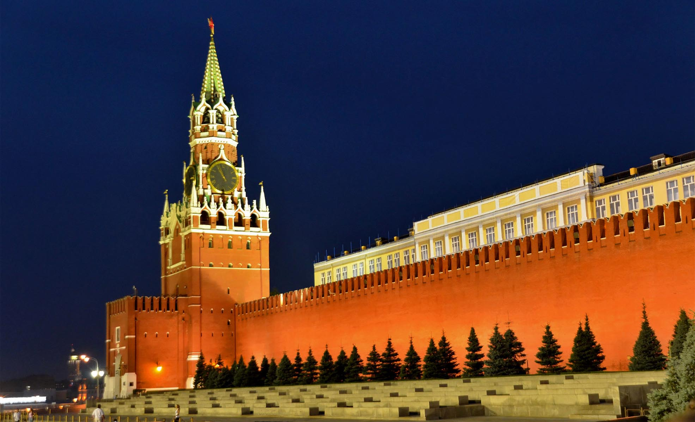
Kremlin
All Free Photos
ORIGIN

Slide 12
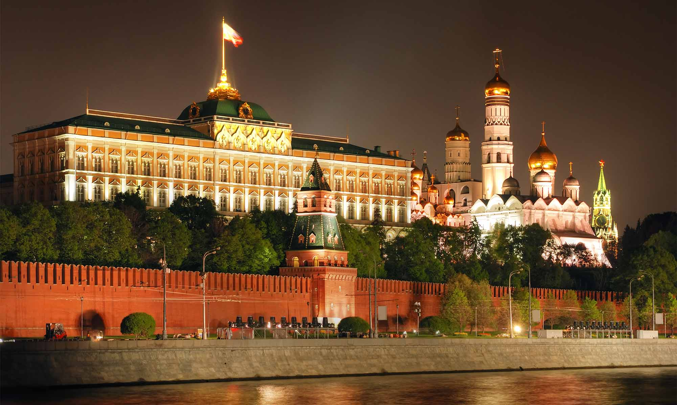
Kremlin
Aelitefon
ORIGIN

Slide 13
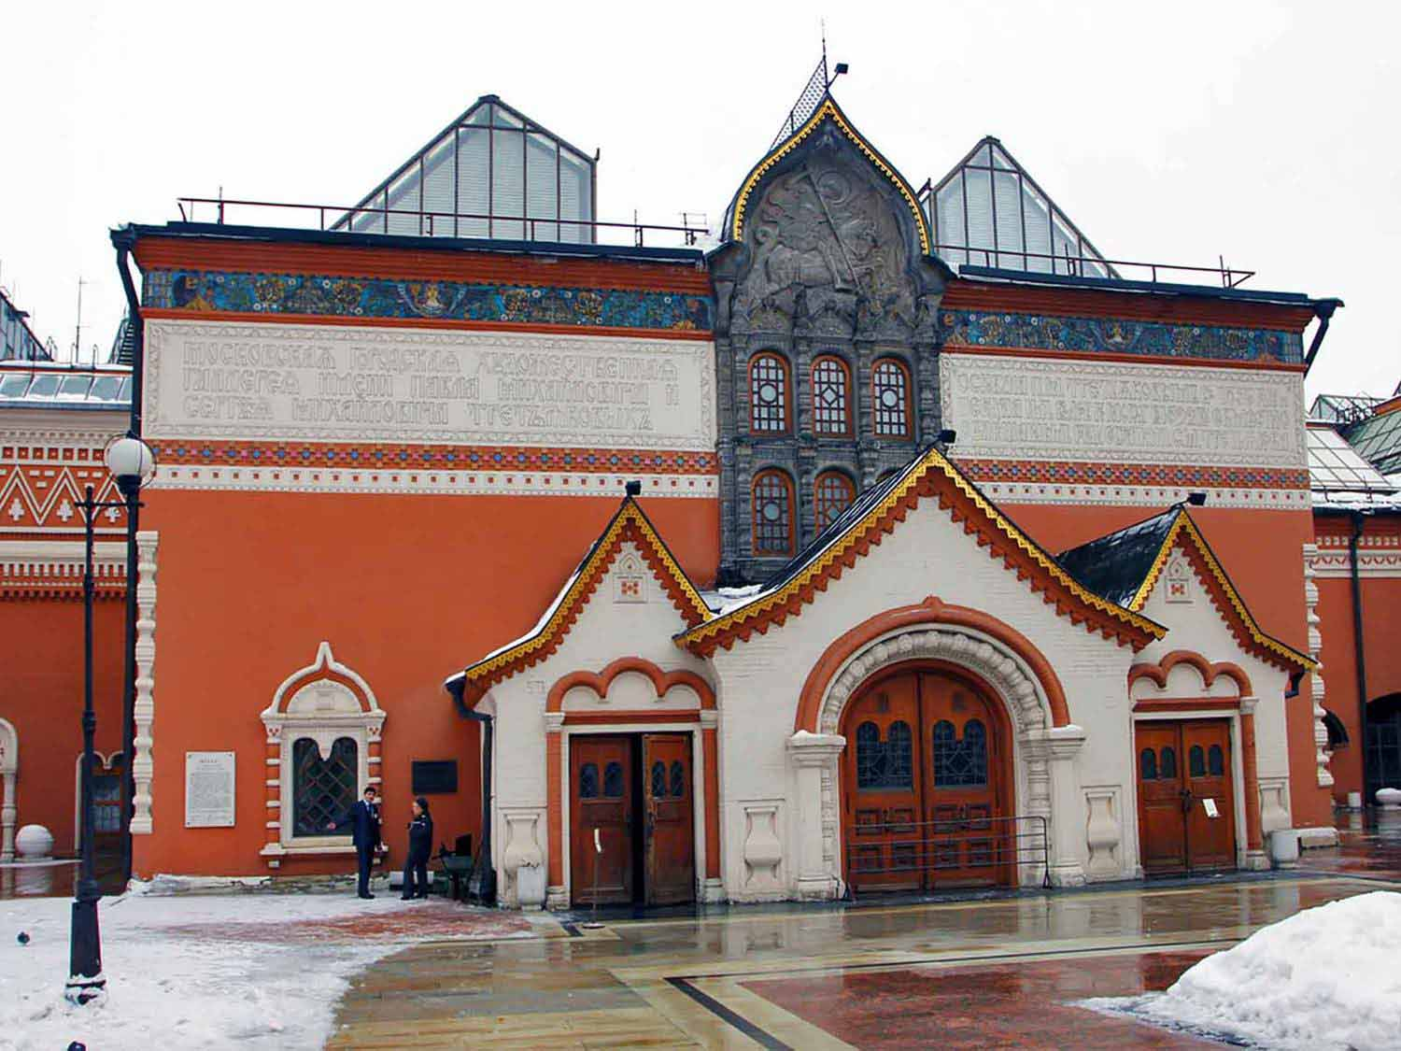
Tretyakov Gallery
Liv In Msk
ORIGIN

Slide 14
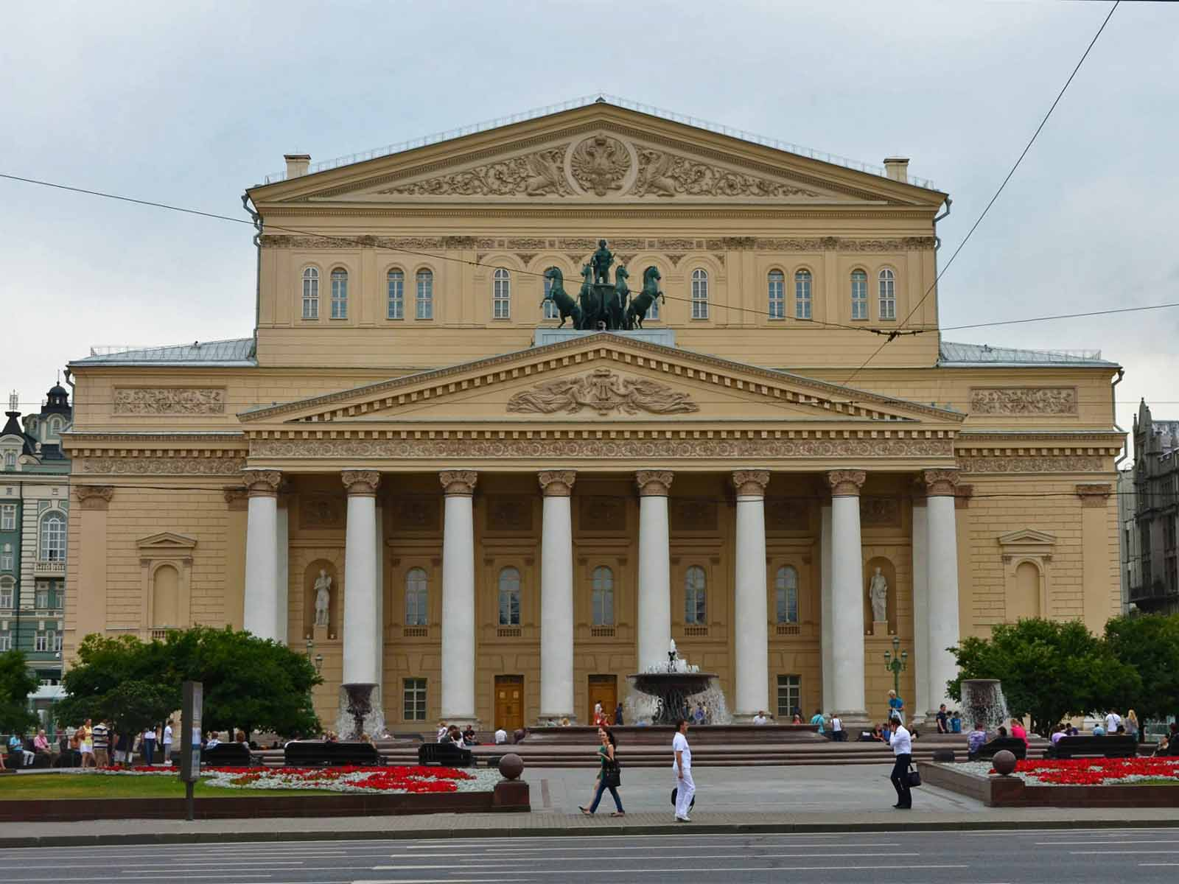
Bolshoi Theatre
All Free Photos
ORIGIN

Slide 15
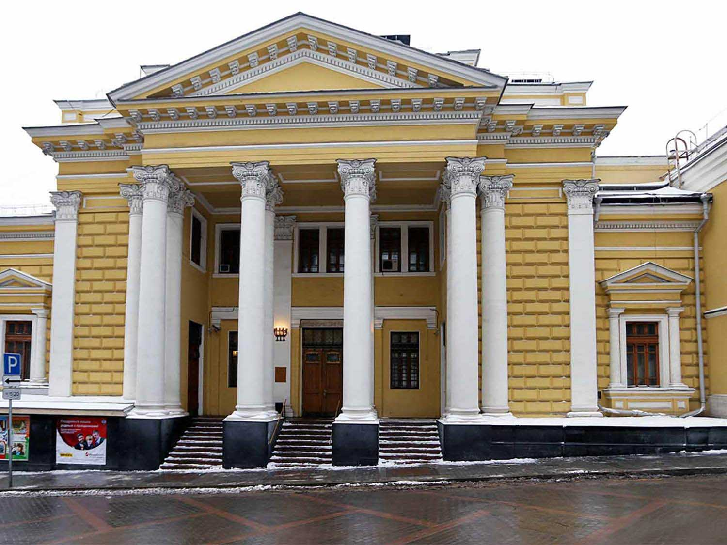
Moscow Choral Synagogue
Liv In Msk
ORIGIN

Slide 16
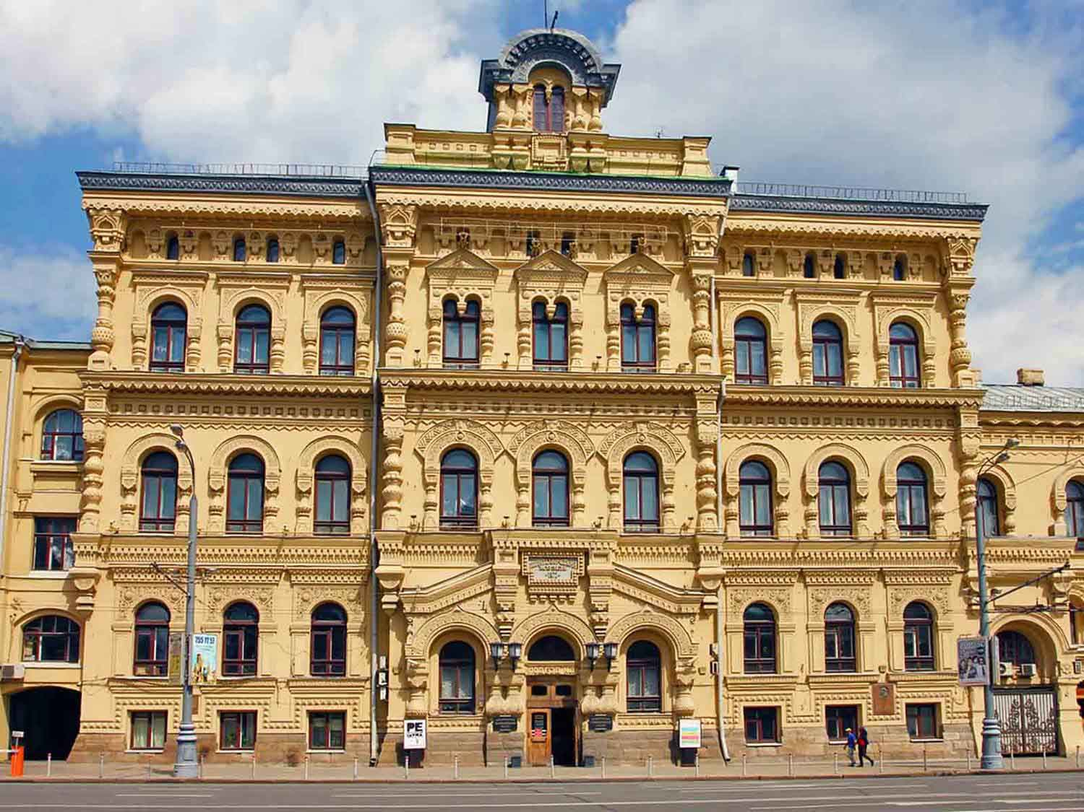
Polytechnic Museum
Liv In Msk
ORIGIN

Slide 17
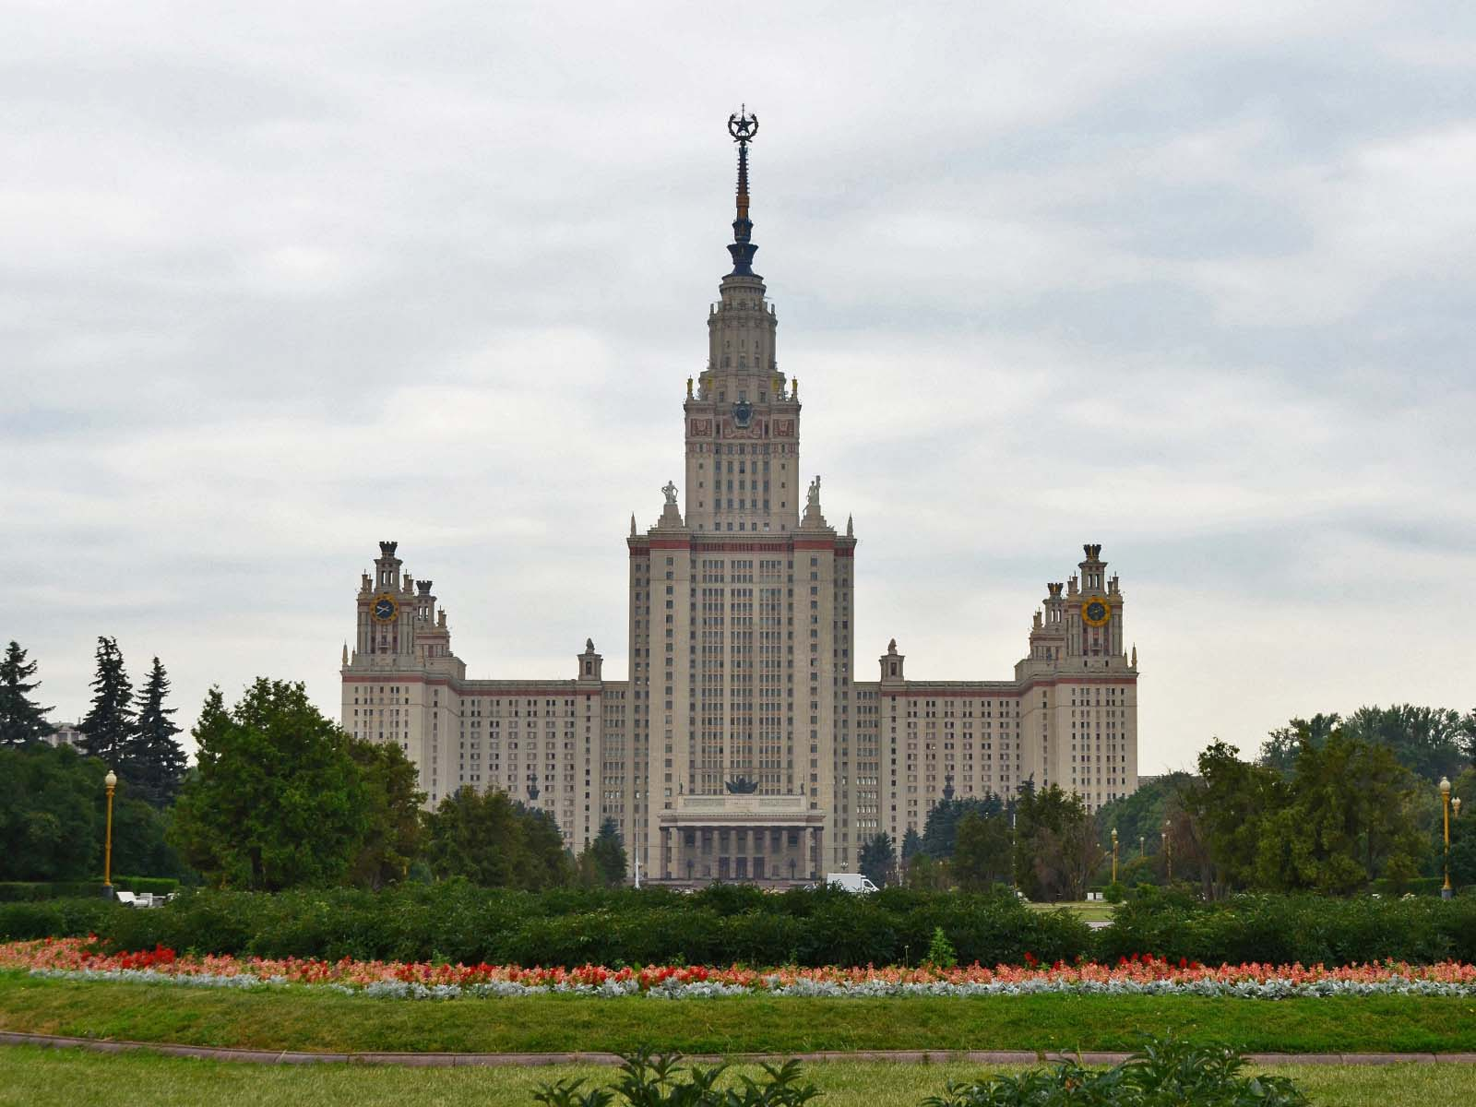
Moscow State University
All Free Photos
ORIGIN

Slide 18
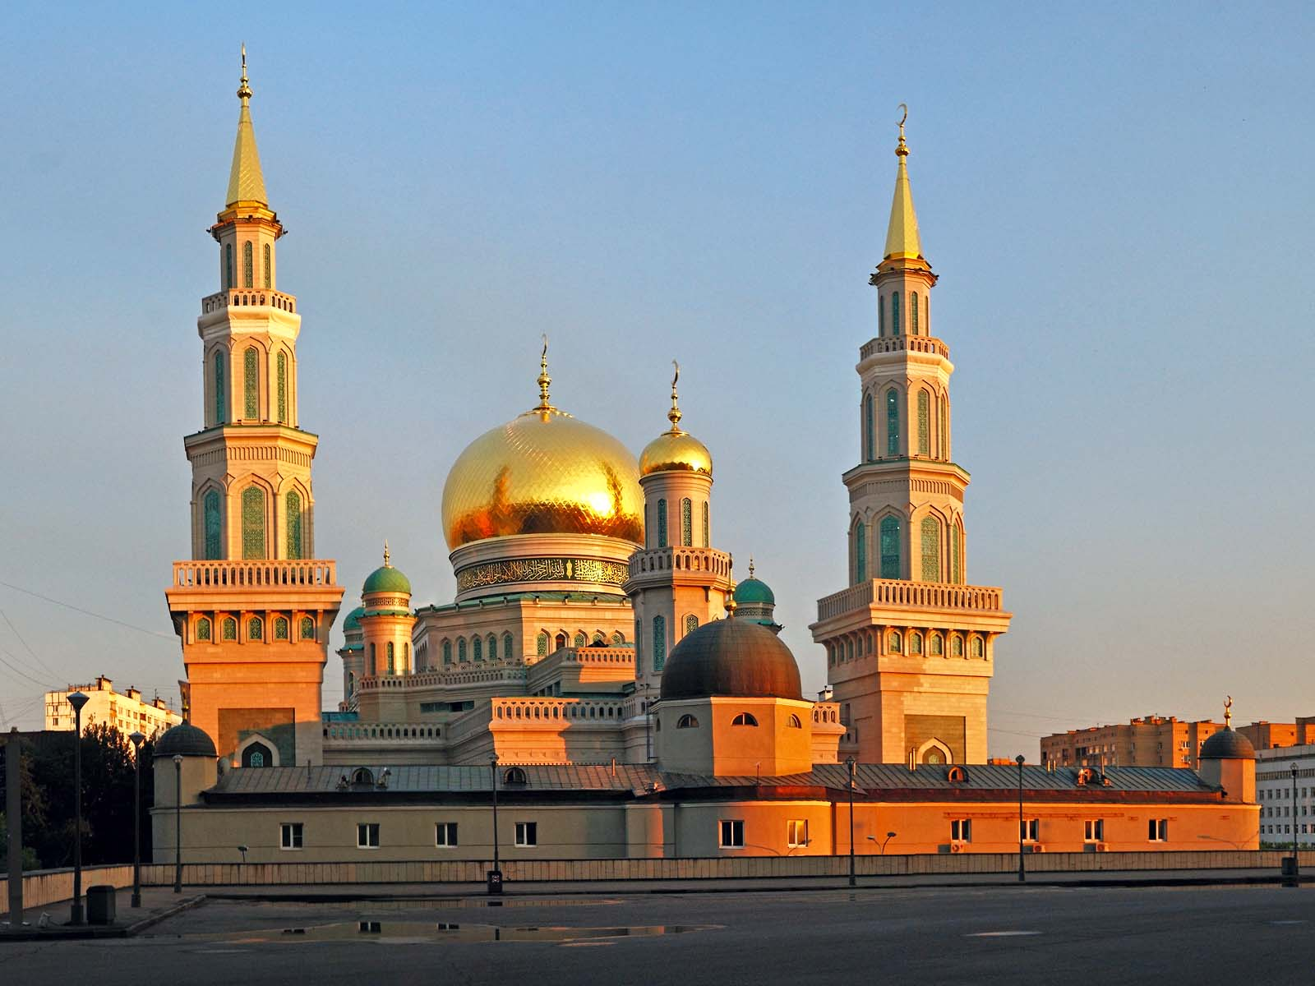
The Grand Mosque
Erbala - Jandex
ORIGIN

Slide 19
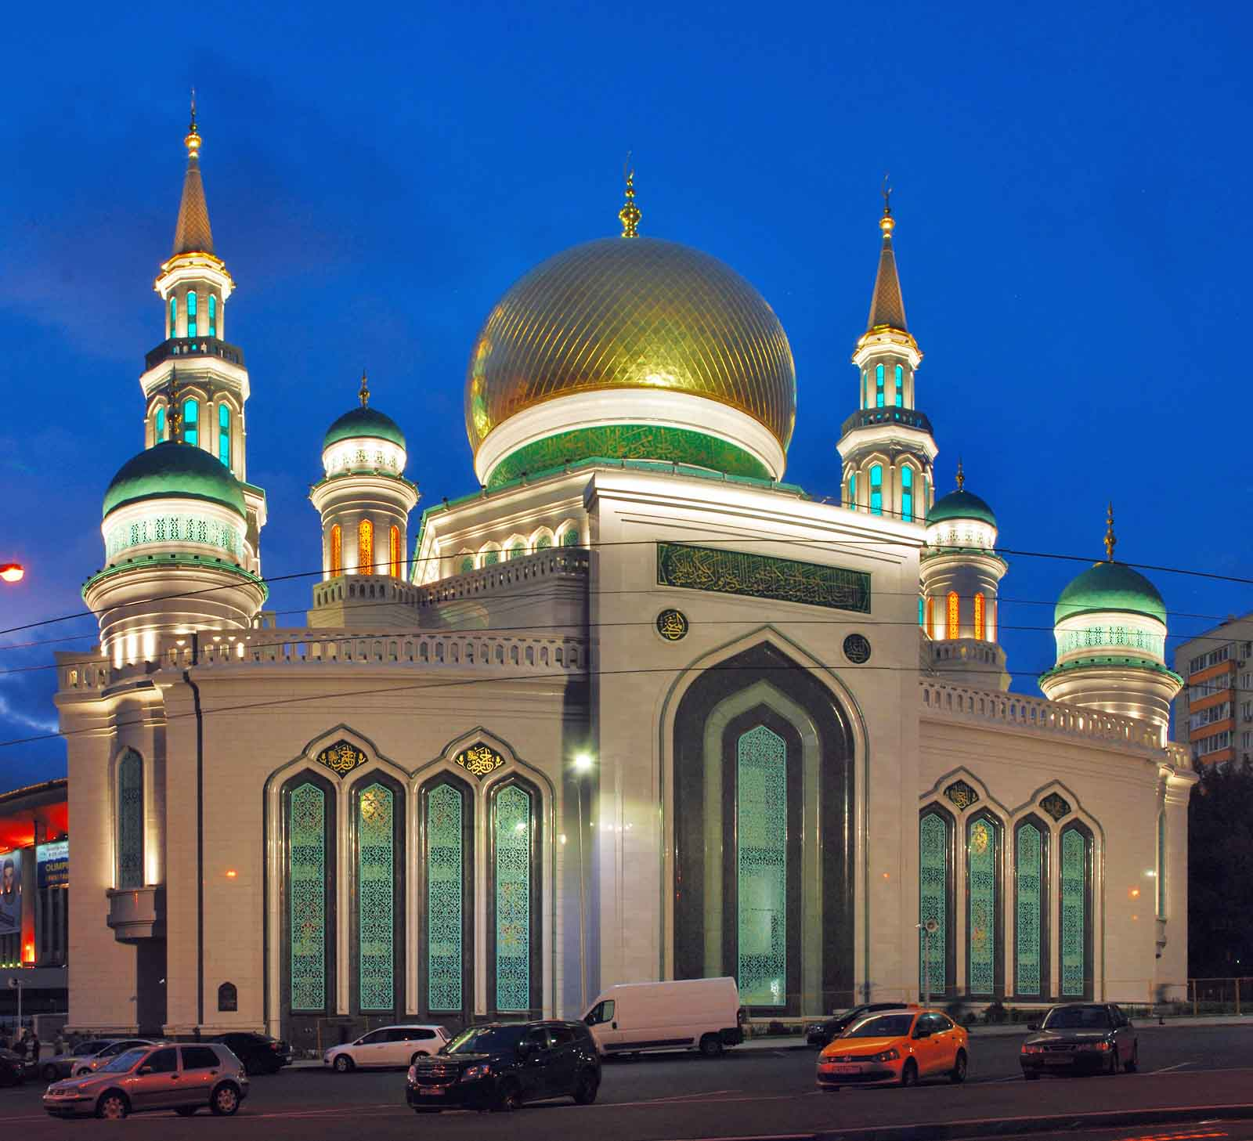
The Grand Mosque
Erbala - Jandex
ORIGIN

Slide 20
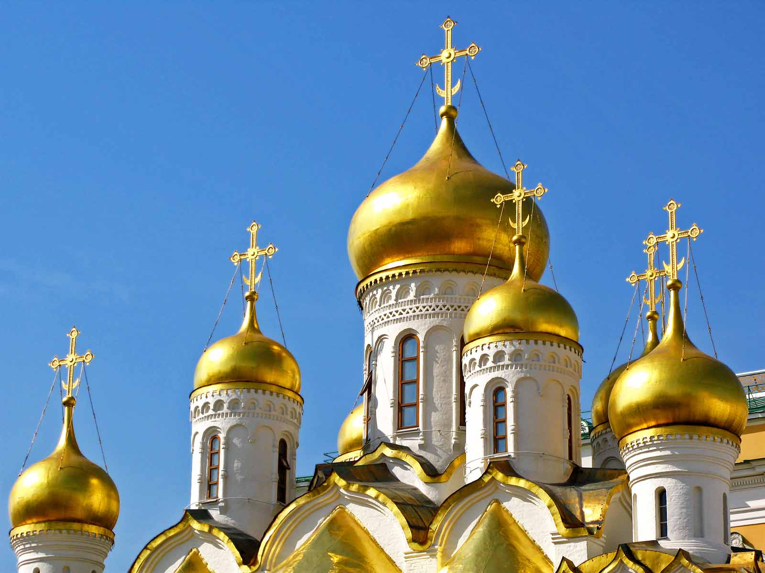
Cathedral of the Annunciation
Petar Milošević - Wikimedia
ORIGIN

Slide 21
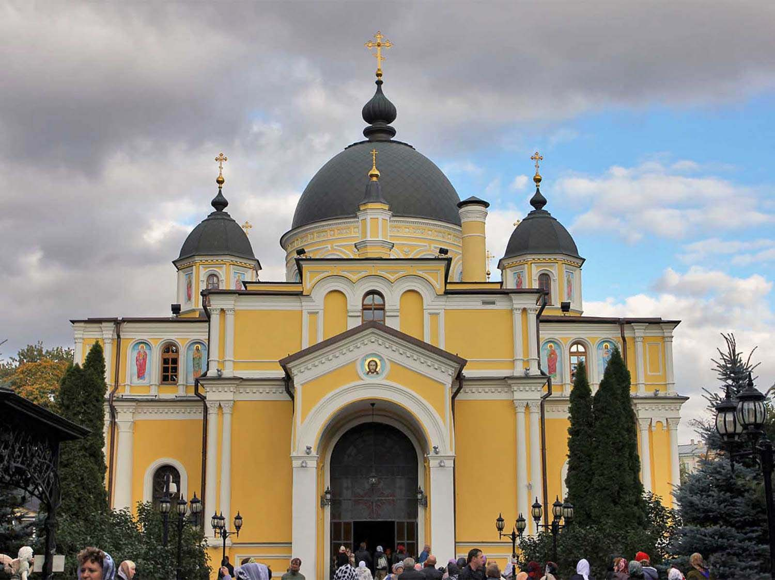
Pokrovsky Monastery
Liv In Msk
ORIGIN

Slide 22
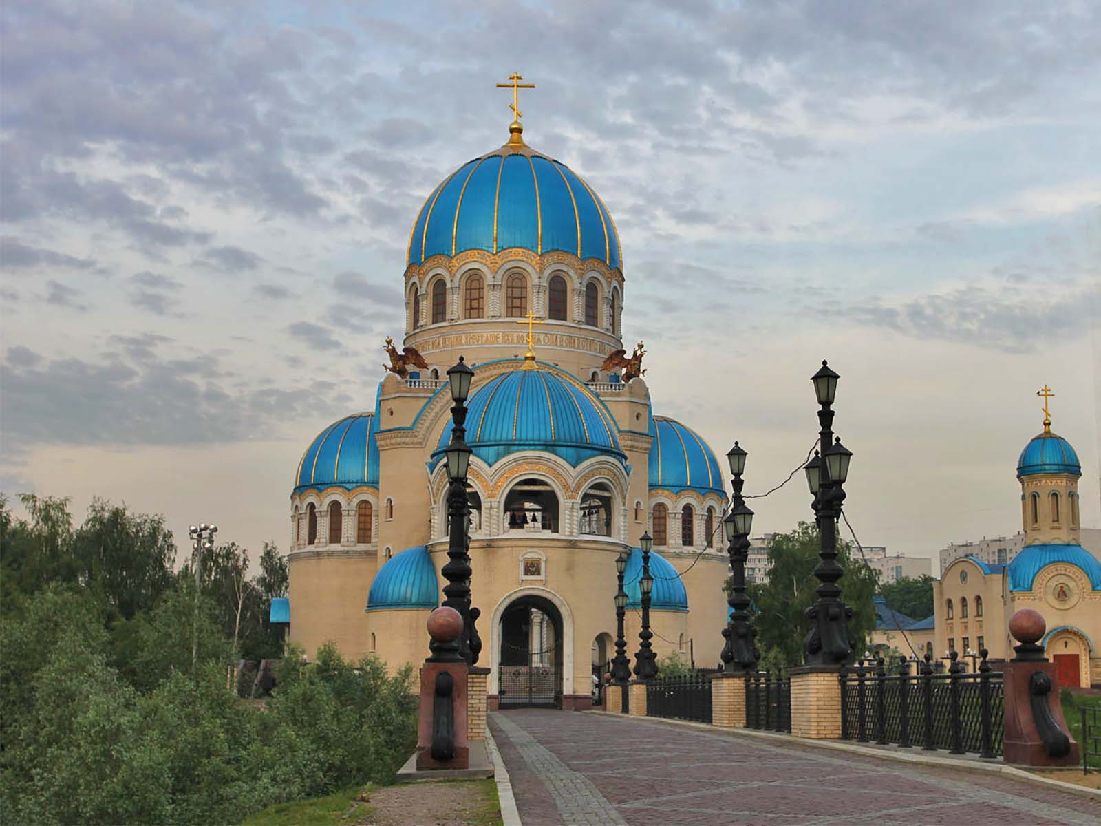
Temple of the Holy Trinity
Liv In Msk
ORIGIN

Slide 23
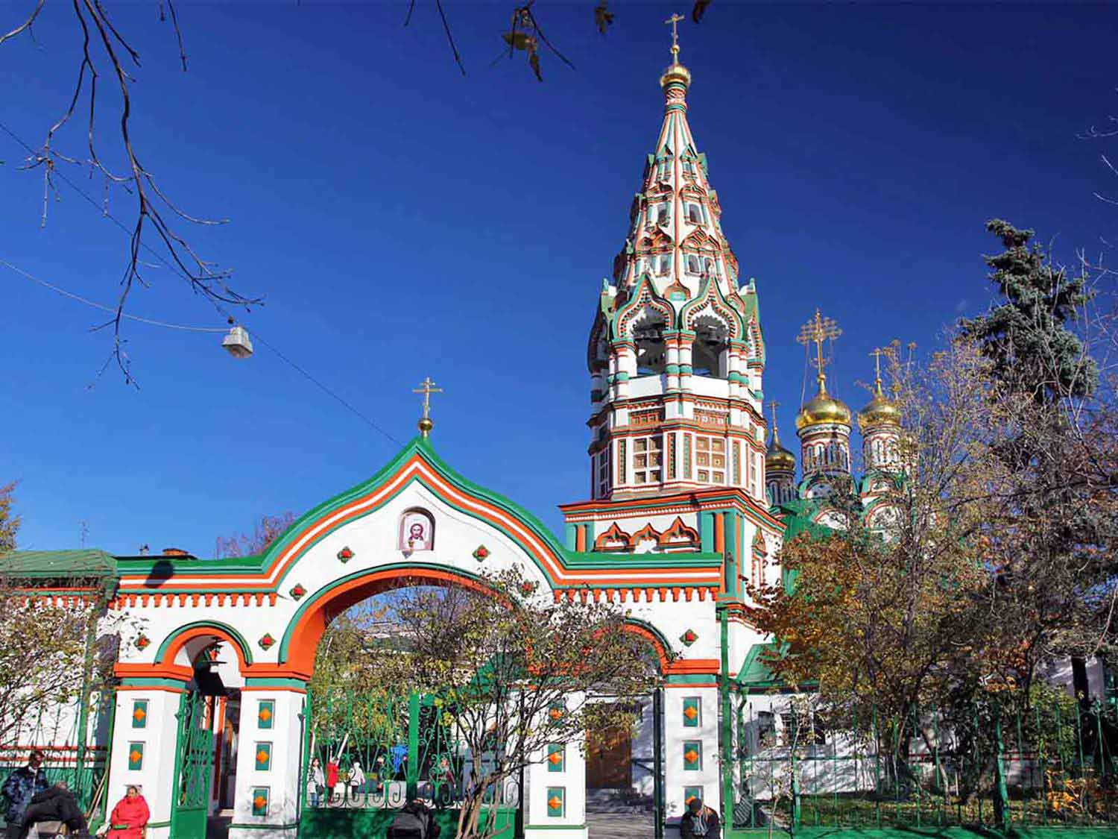
St.Nicholas Church
Liv In Msk
ORIGIN

Slide 24
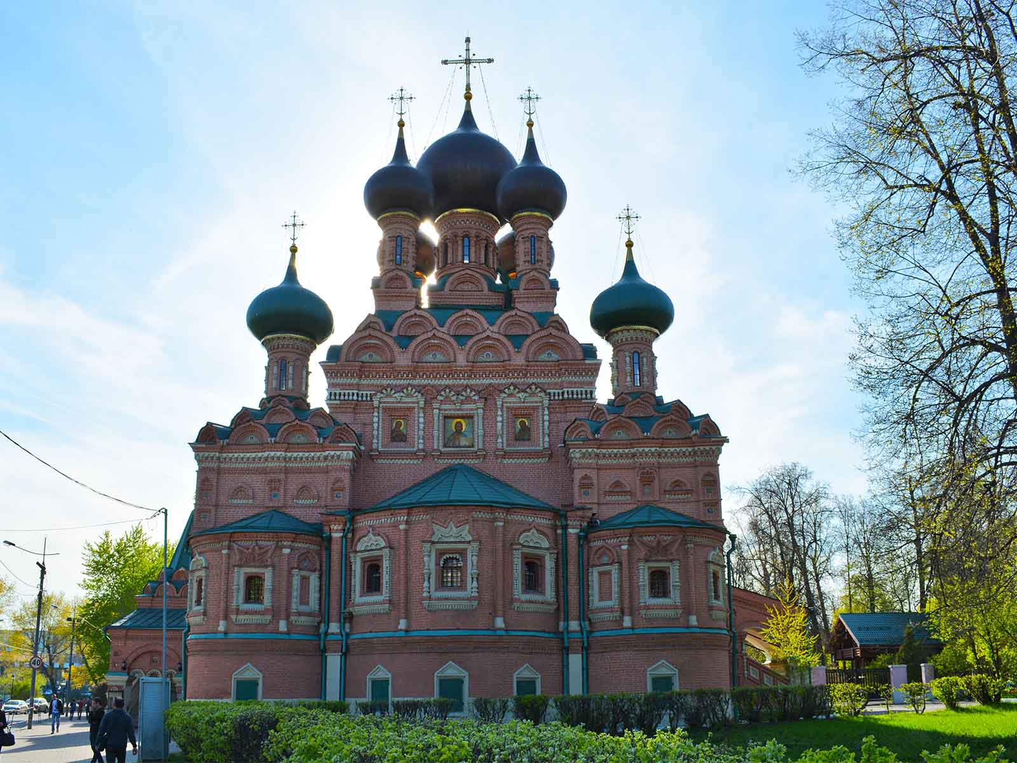
Trinity Temple
ProtoplasmaKid - Wikimedia
ORIGIN

Slide 25
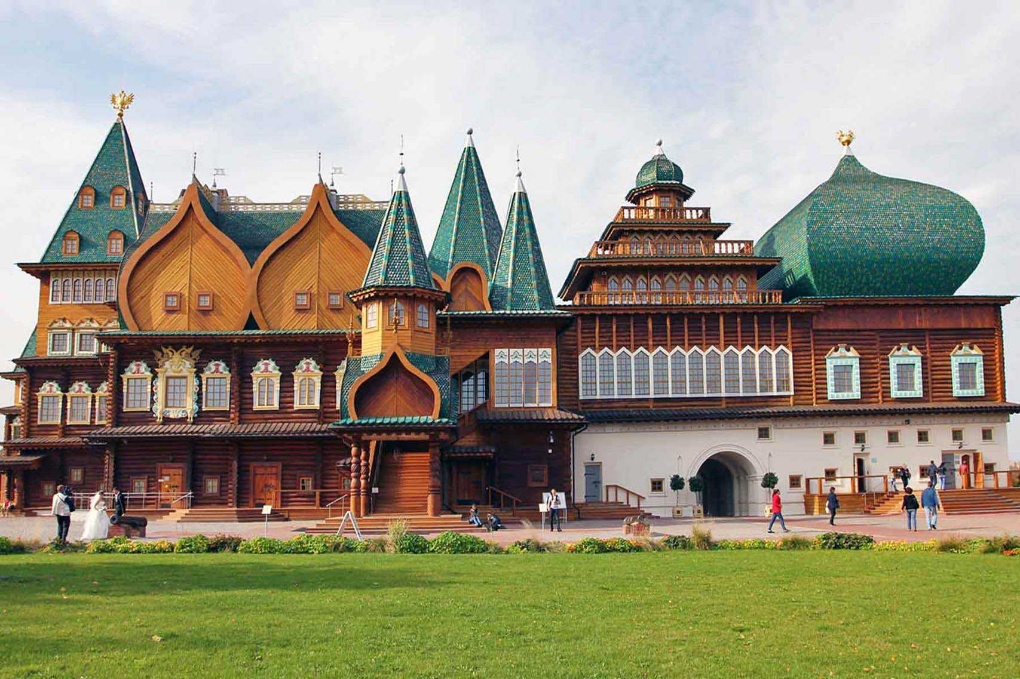
Kolomensky Palace
Liv In Msk
ORIGIN

Slide 26
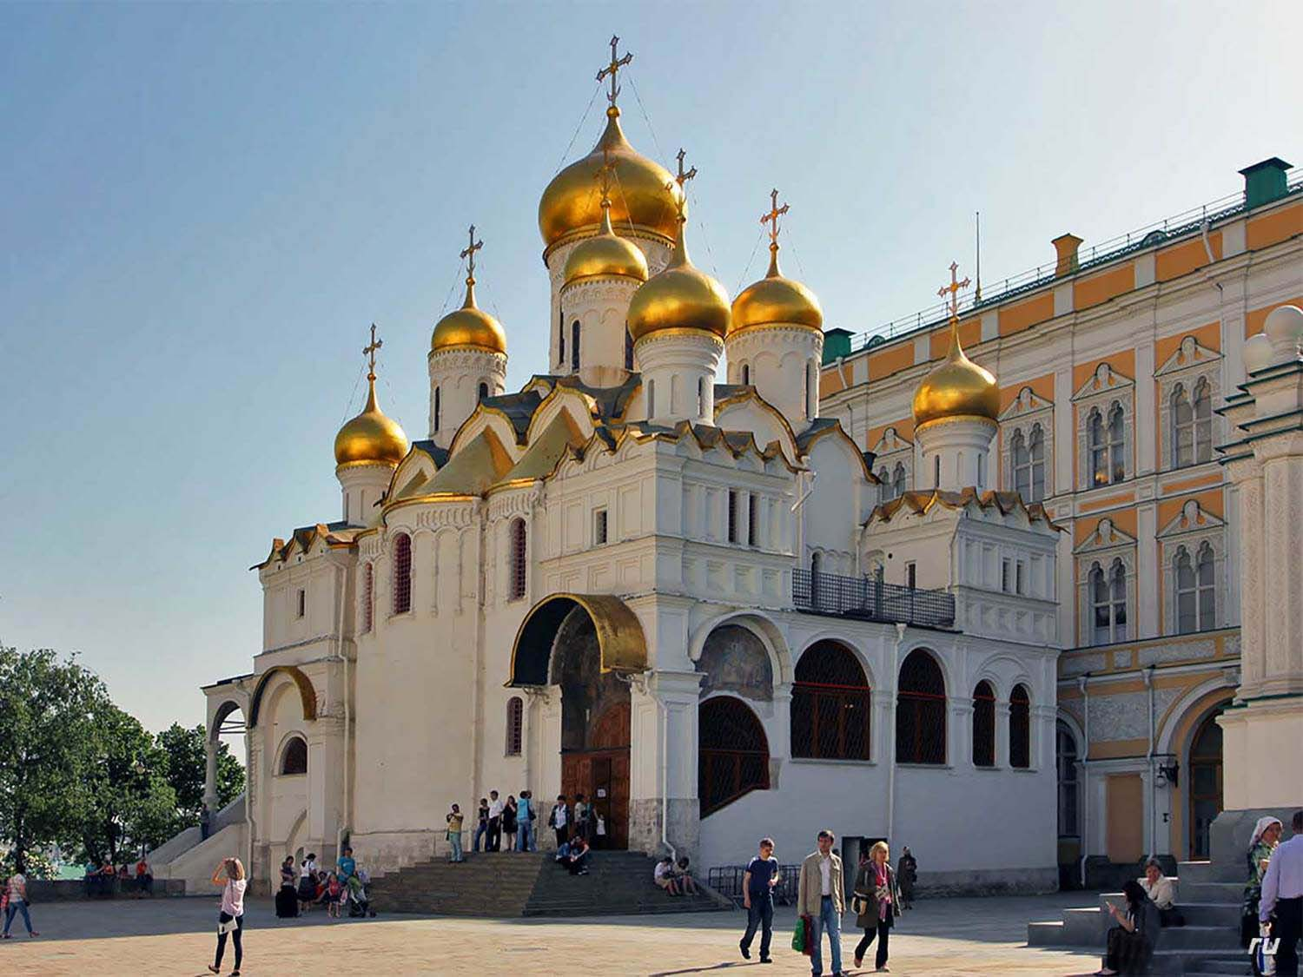
Blagoveshchensky Cathedral
Liv In Msk
ORIGIN

Slide 27
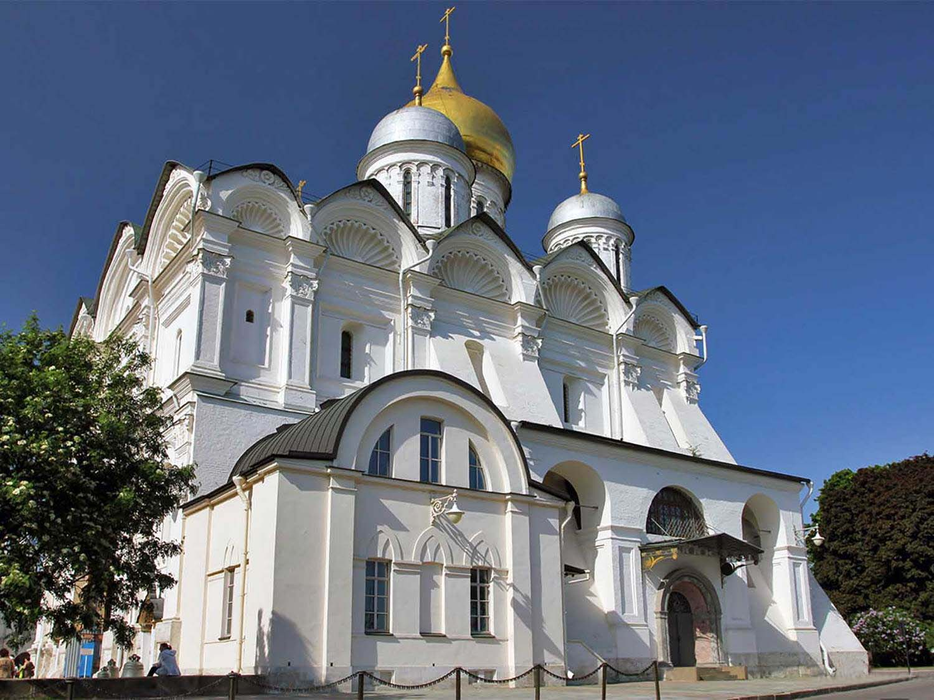
Cathedral of the Archangel
Liv In Msk
ORIGIN

Slide 28
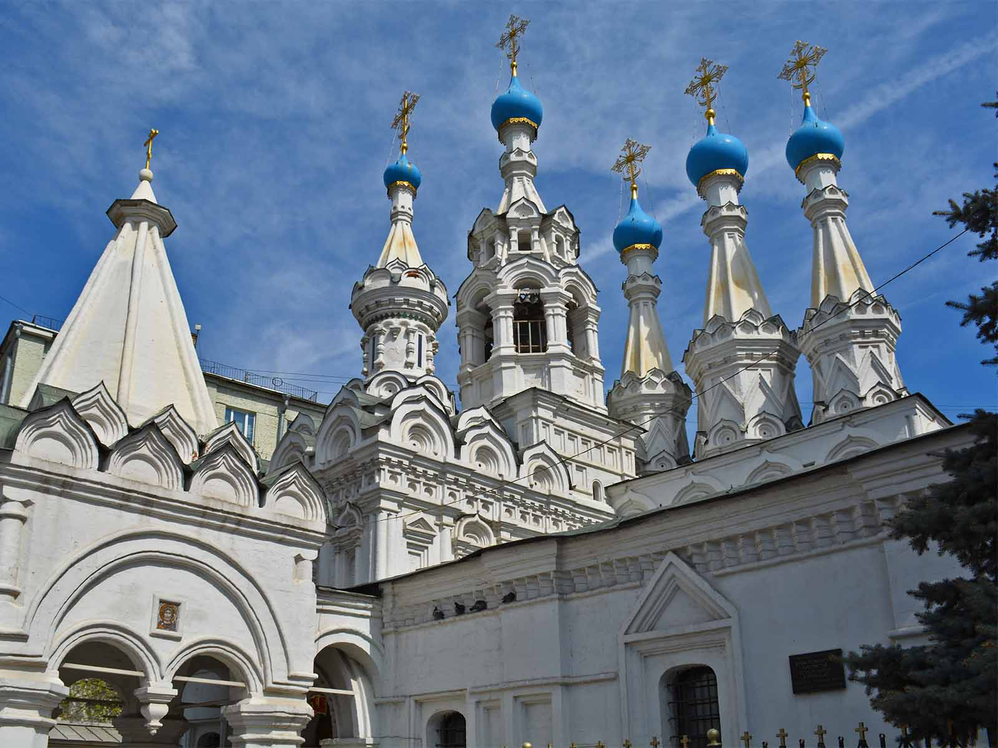
Church of the Nativity of the Virgin
ProtoplasmaKid - Wikimedia
ORIGIN

Slide 29
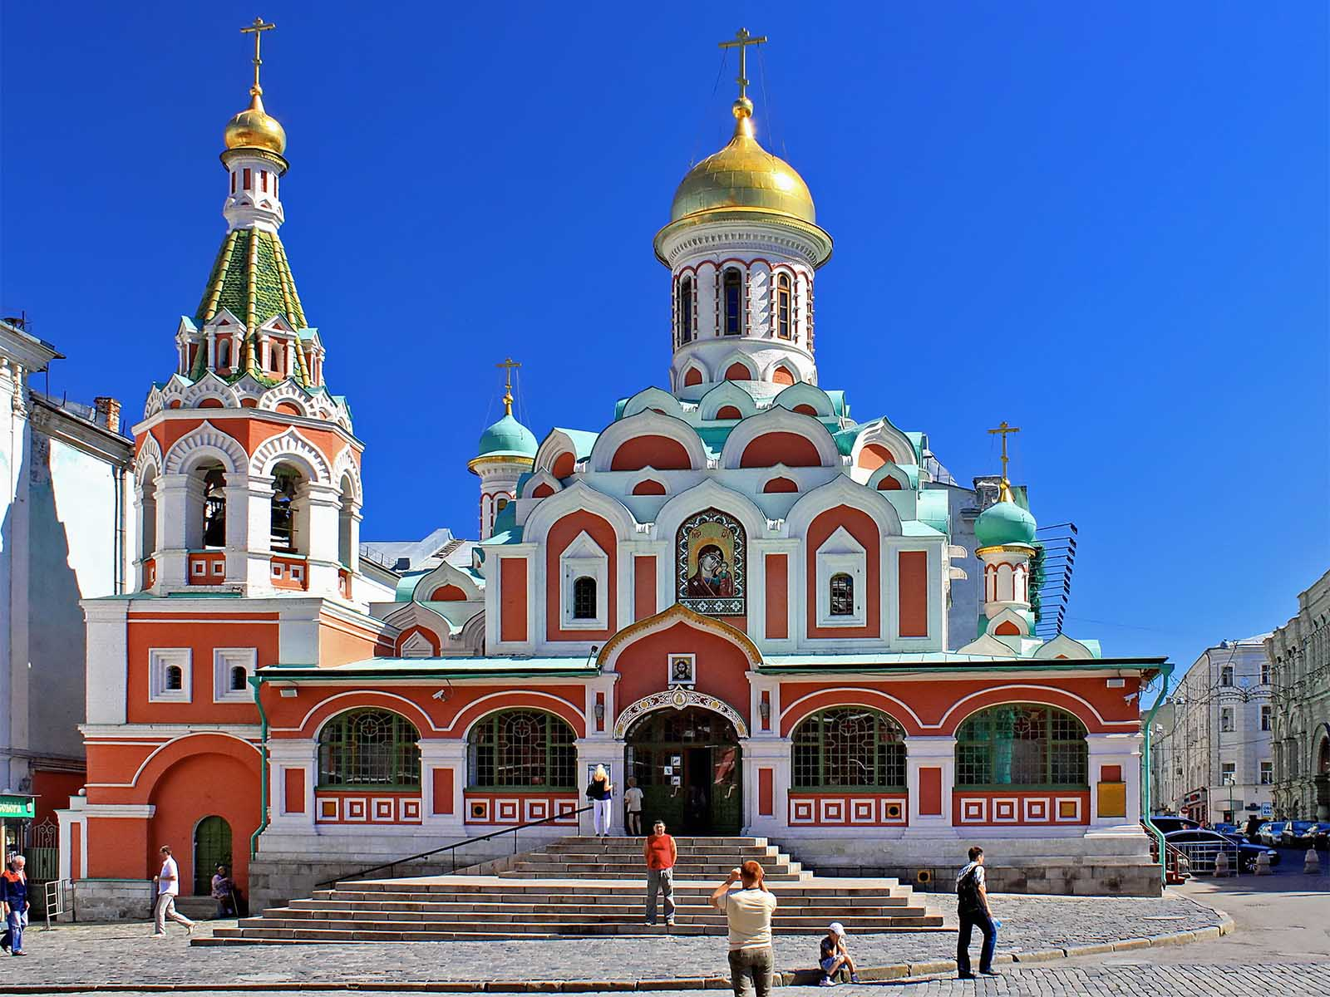
Cathedral of Kazan
Hons084 - Wikimedia
ORIGIN

Slide 30
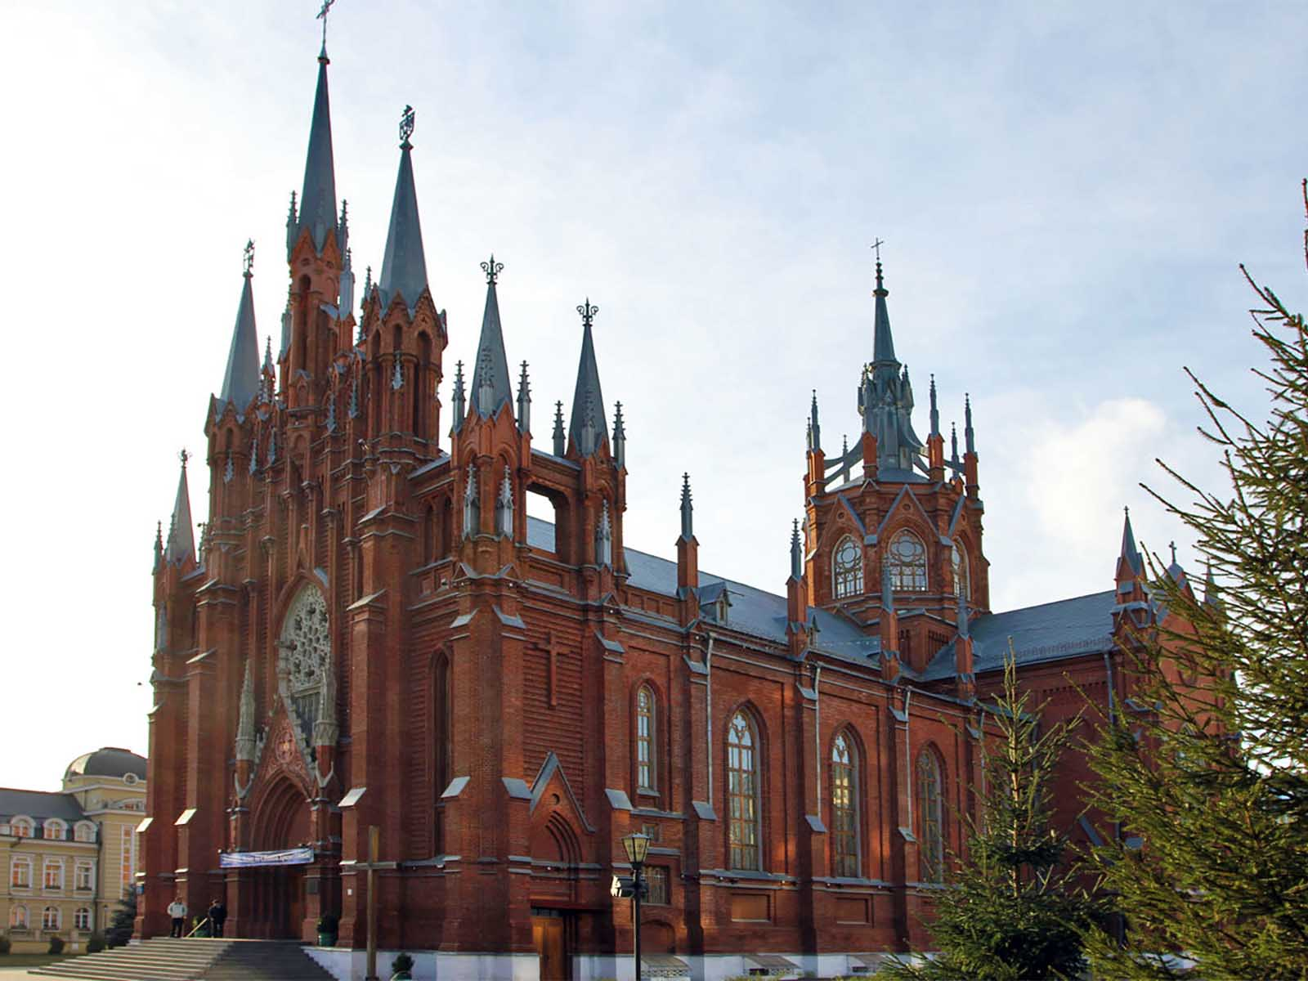
Immaculate Conception Cathedral
Liv In Msk
ORIGIN

Slide 31
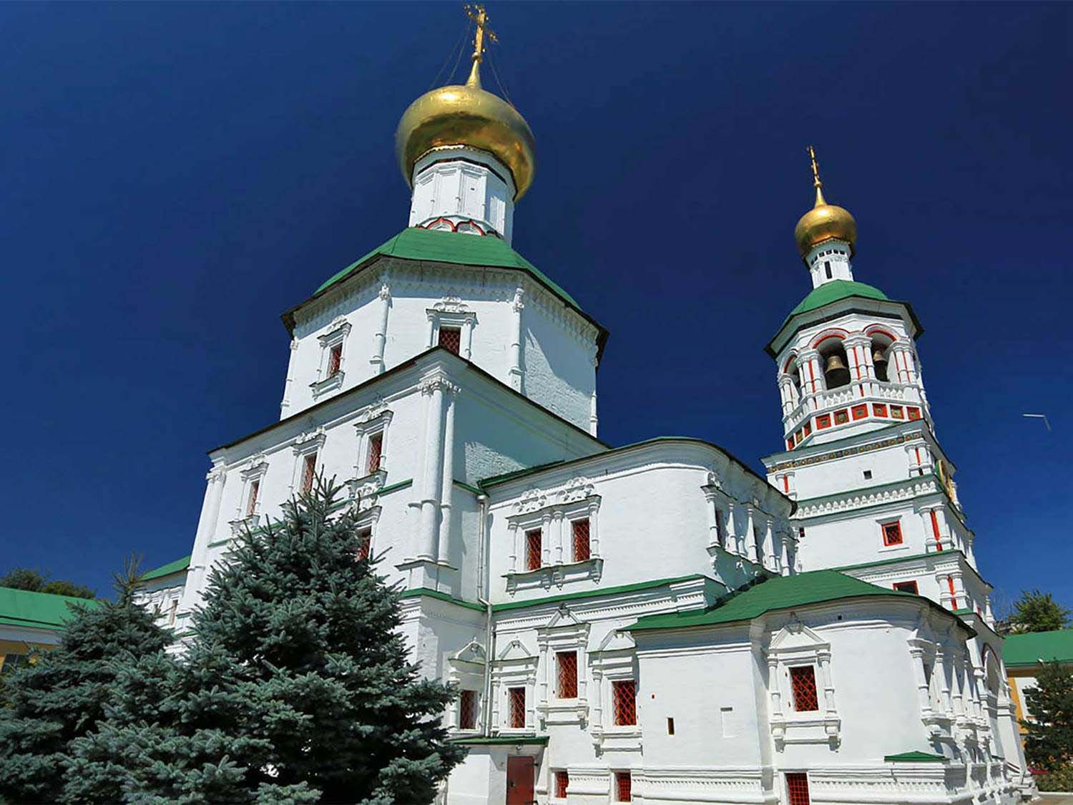
St.Nicholas Perervinsky Monastery
Liv In Msk
ORIGIN

Slide 32
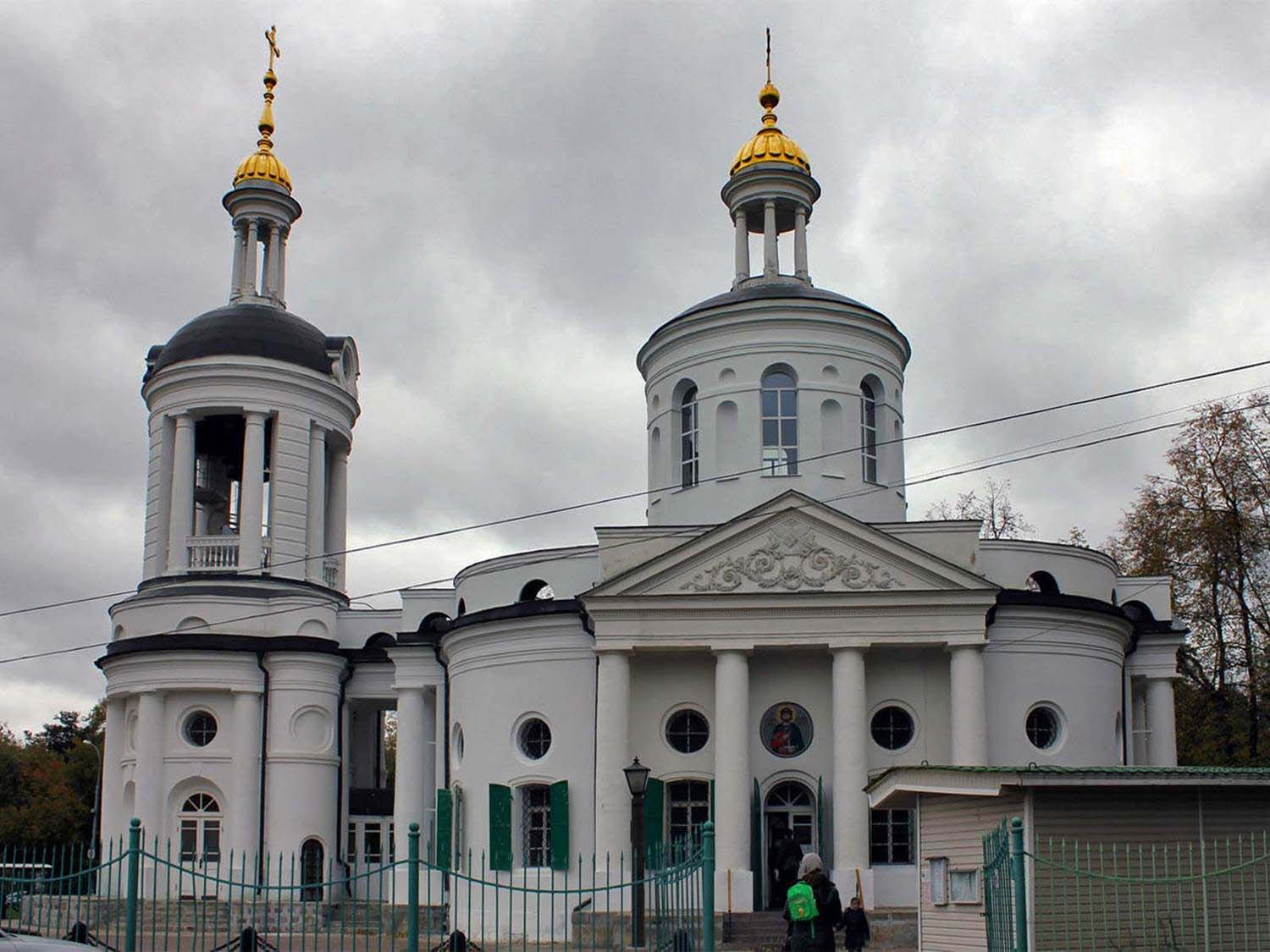
Vlachernae Temple
Liv In Msk
ORIGIN

Slide 33
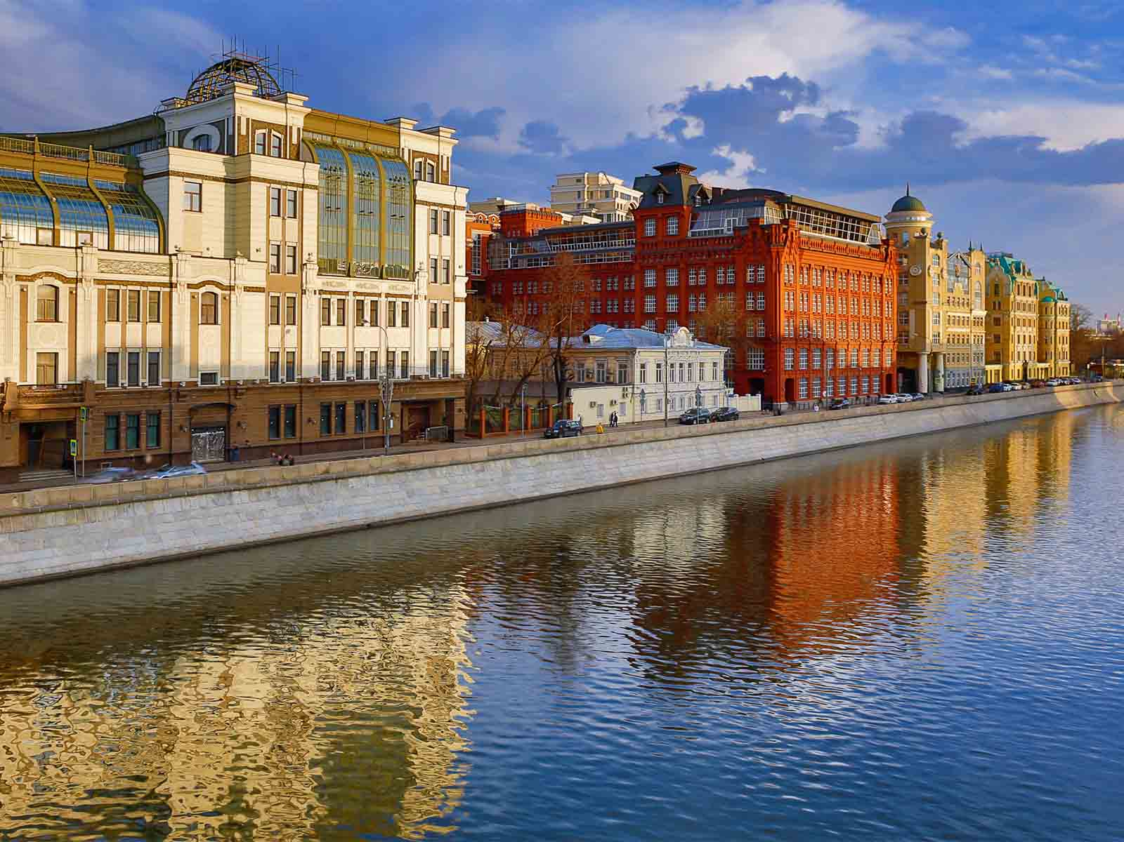
Embankment of Moscow River
Erbala - Jandex
ORIGIN

Slide 34
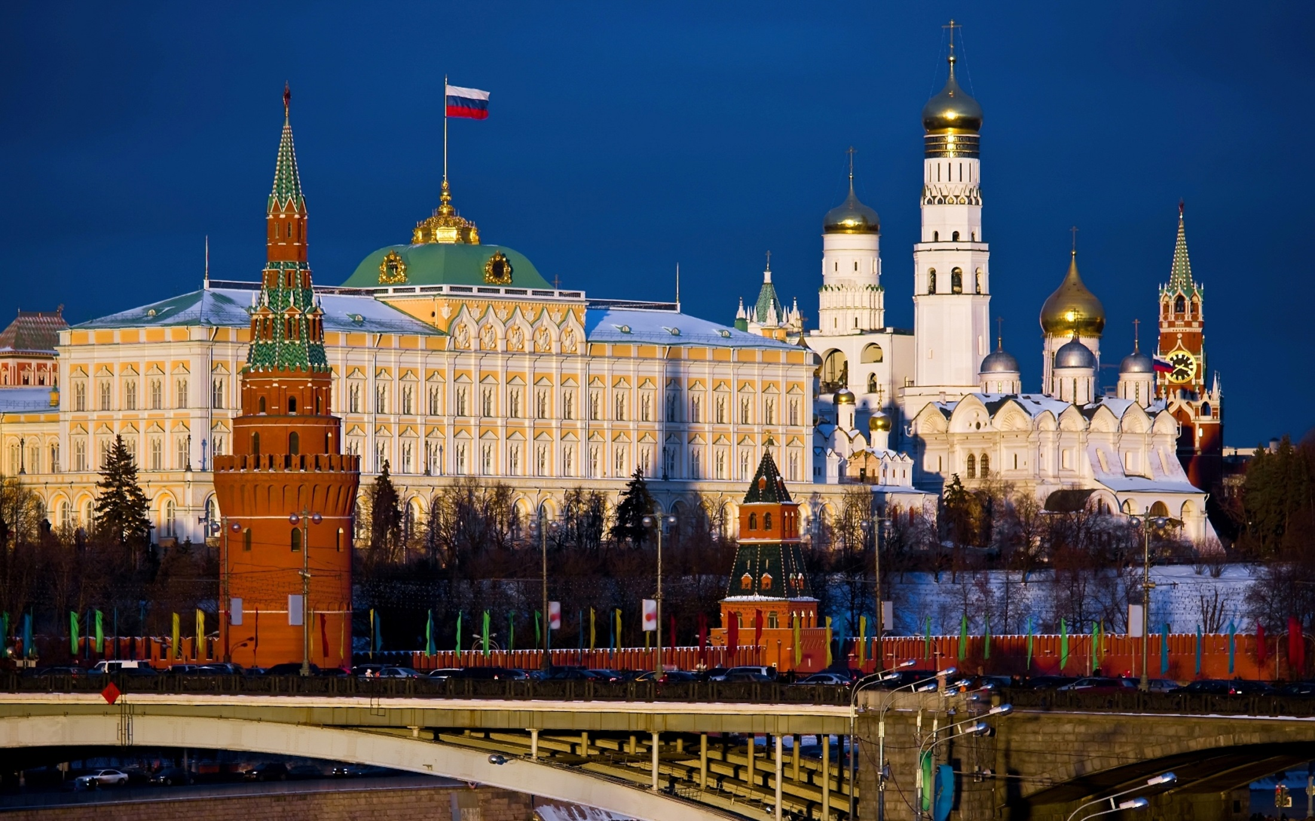
Kremlin
Rabstol Net
ORIGIN

Slide 35
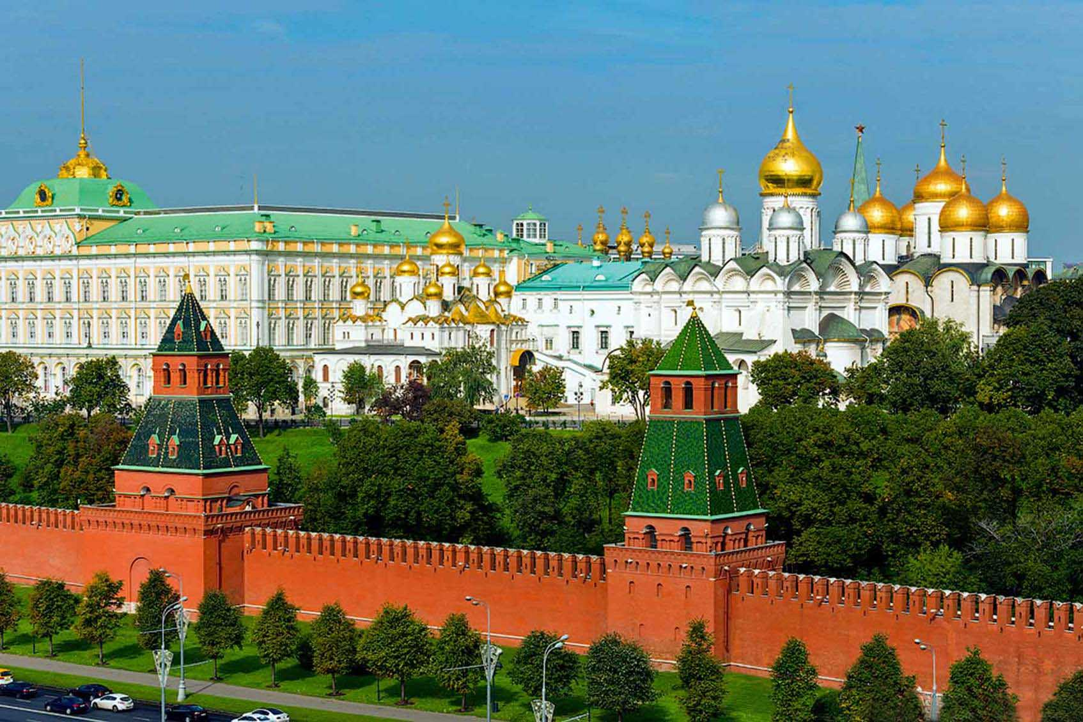
Kremlin
Slava Stepanov
ORIGIN

Slide 36
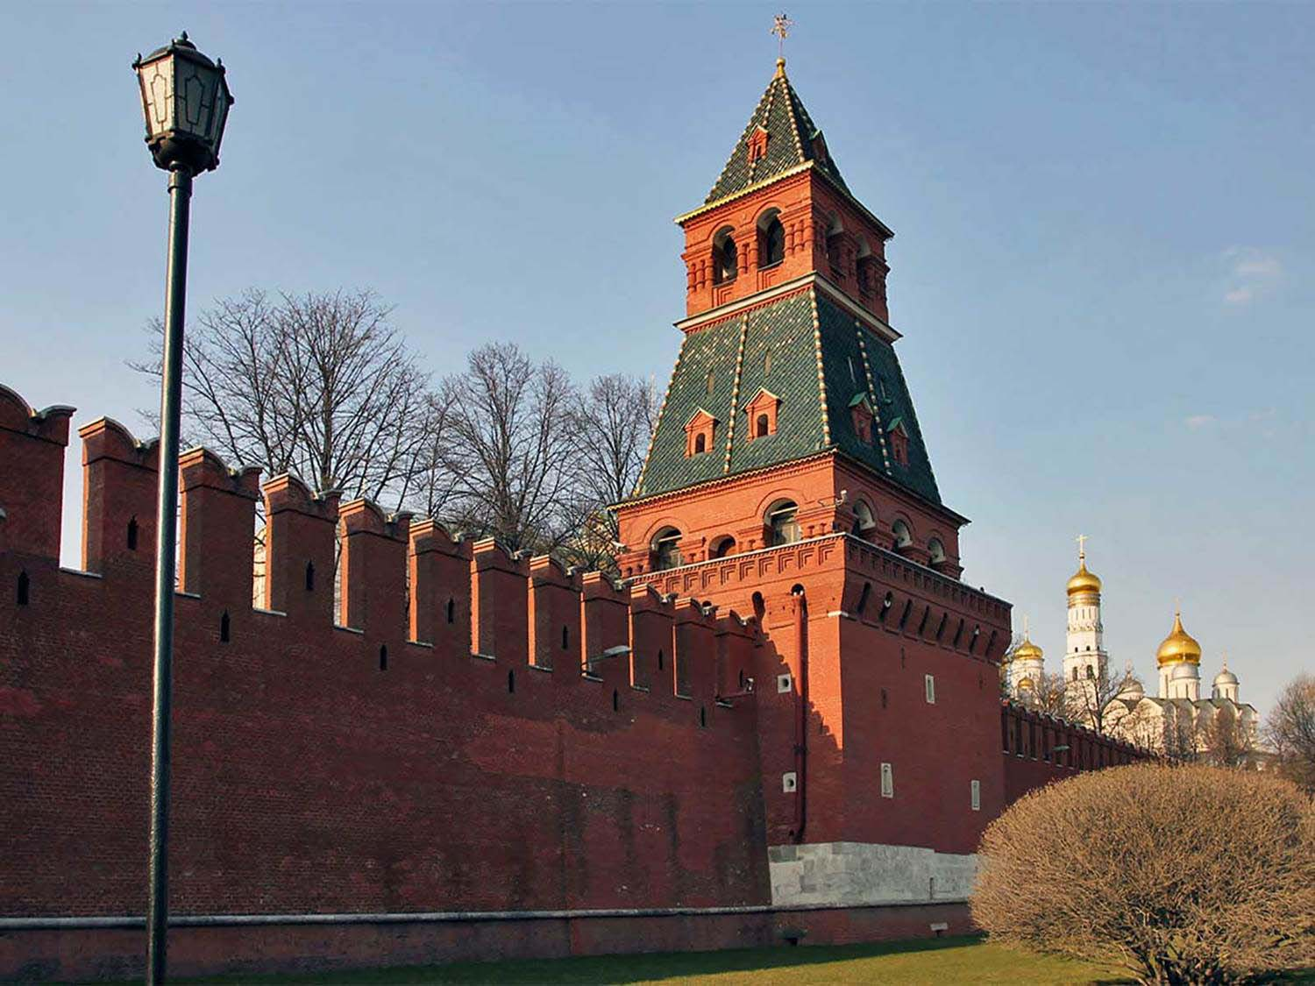
Blagovestsensky Tower - Kremlin
Liv In Msk
ORIGIN

Slide 37
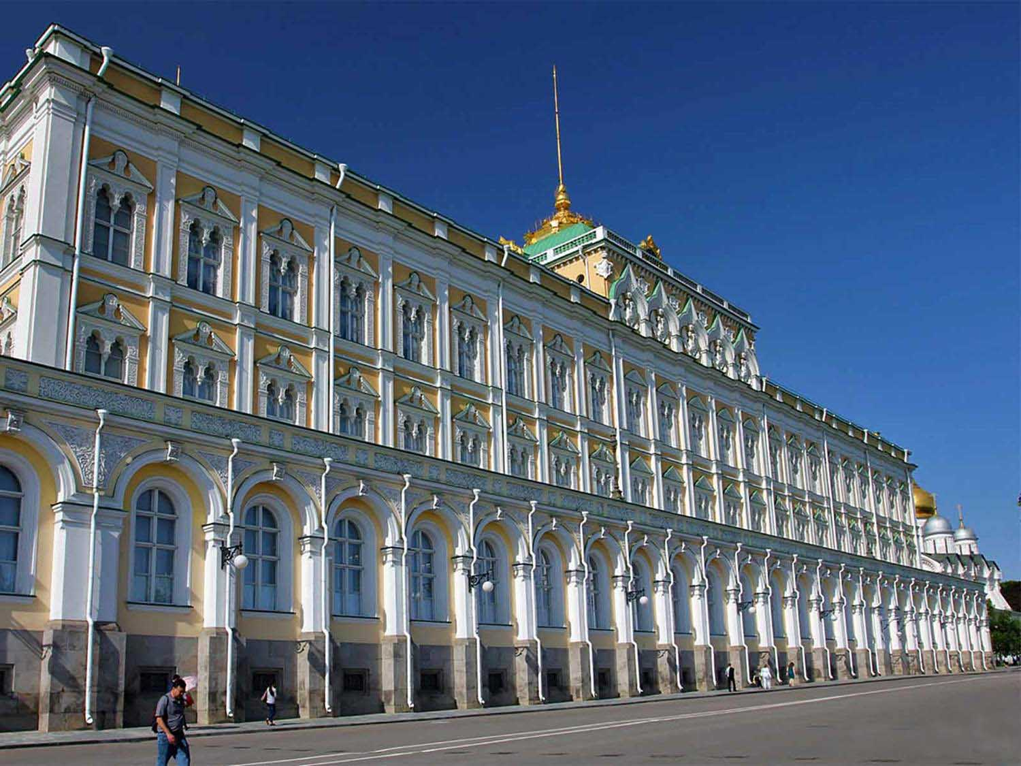
Grand Kremlin Palace
Liv In Msk
ORIGIN

Slide 38
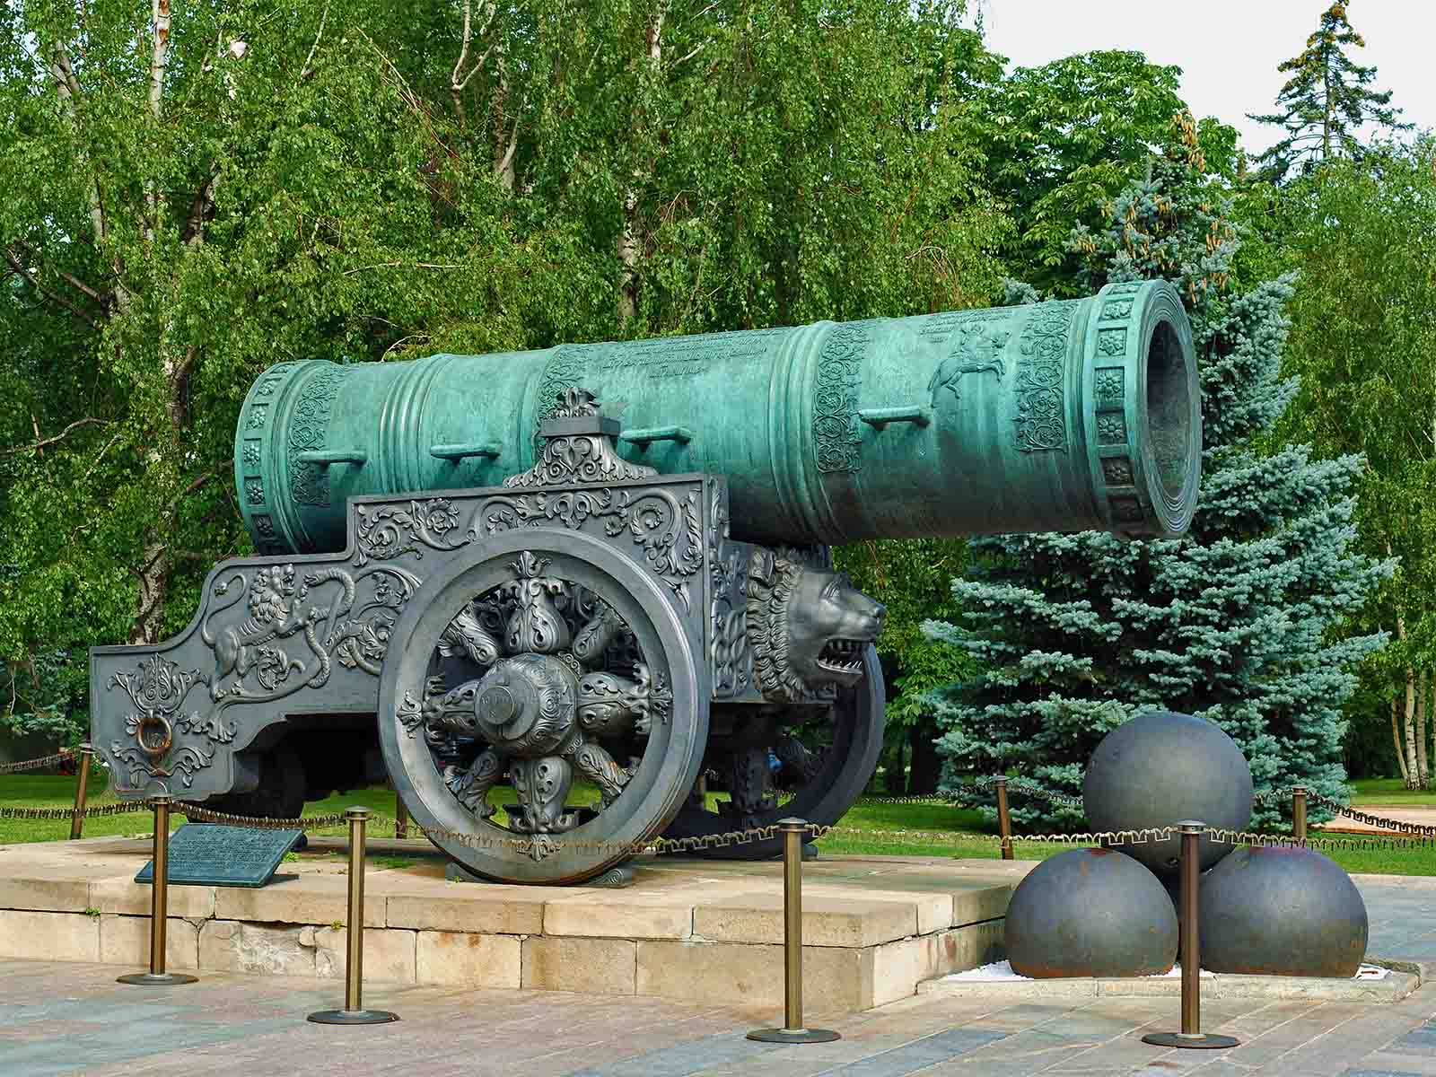
Tsar Cannon
Alvesgaspar - Wikimedia
ORIGIN

Slide 39
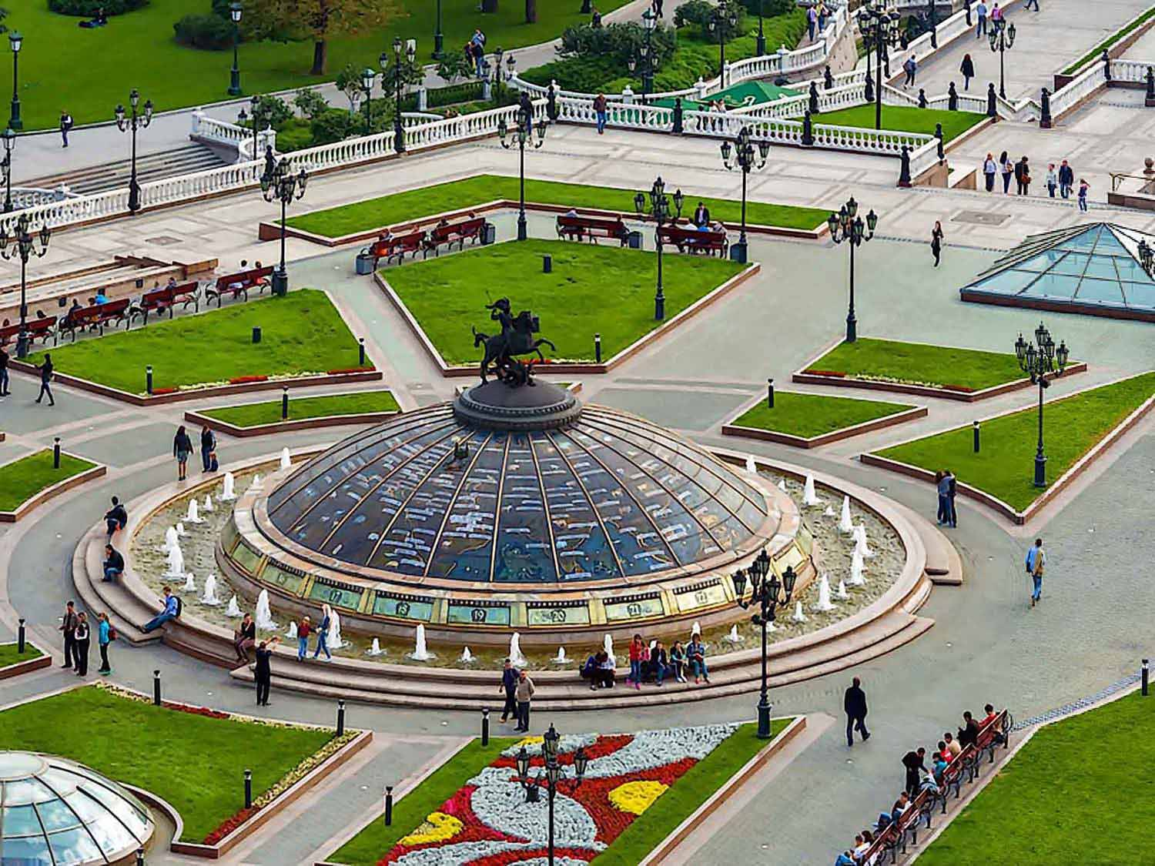
Fountain Watch of the World
Slava Stepanov
ORIGIN

Slide 40
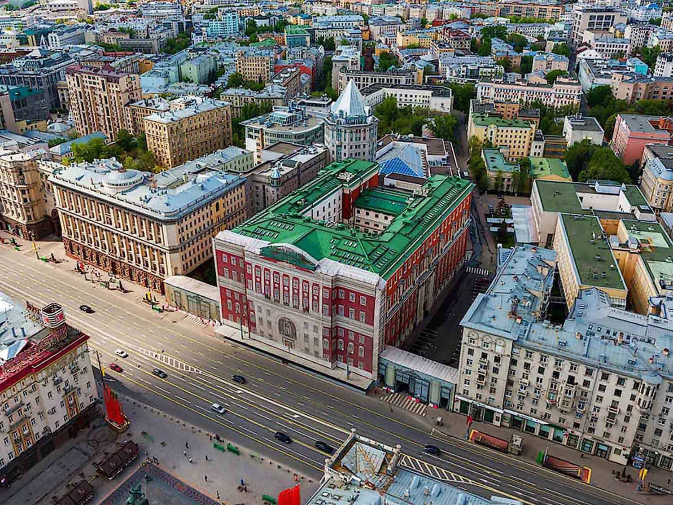
Aerial View
Slava Stepanov
ORIGIN

Slide 41
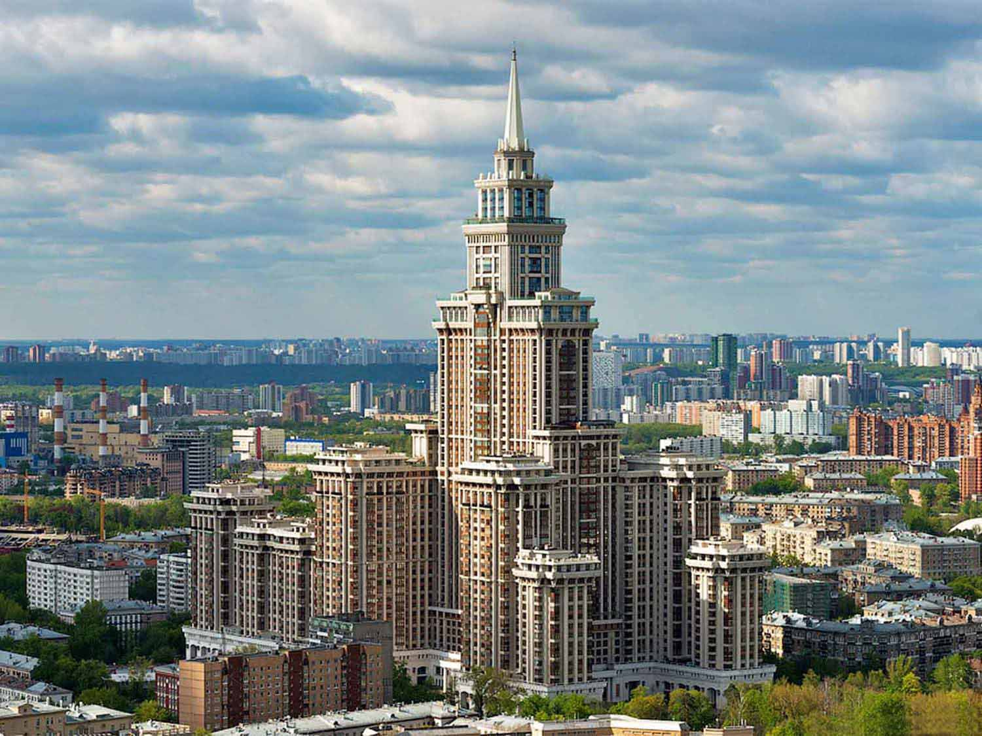
Palace of Triumph
Slava Stepanov
ORIGIN

Slide 42
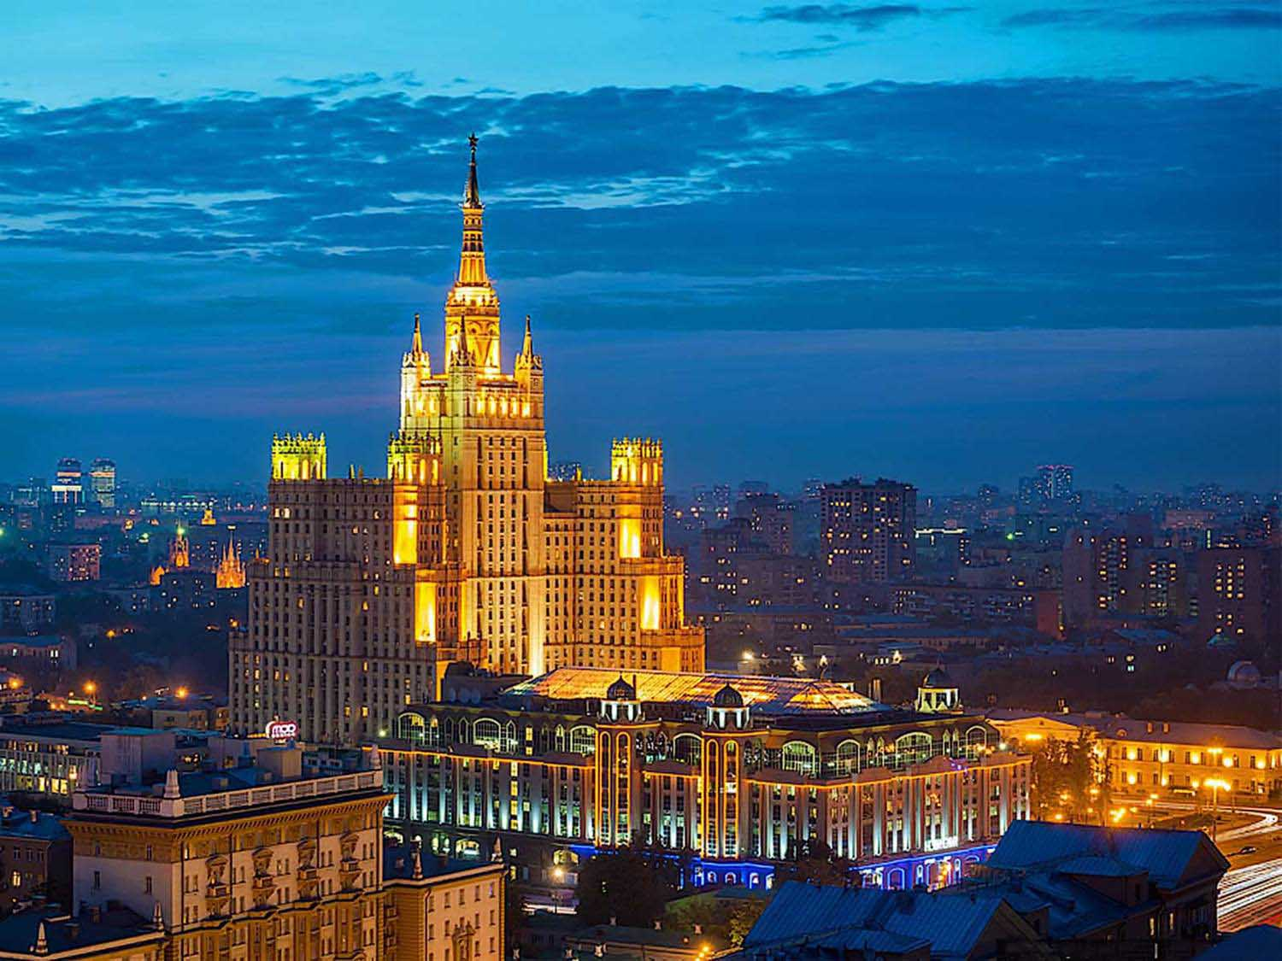
Residential House
Slava Stepanov
ORIGIN

Slide 43
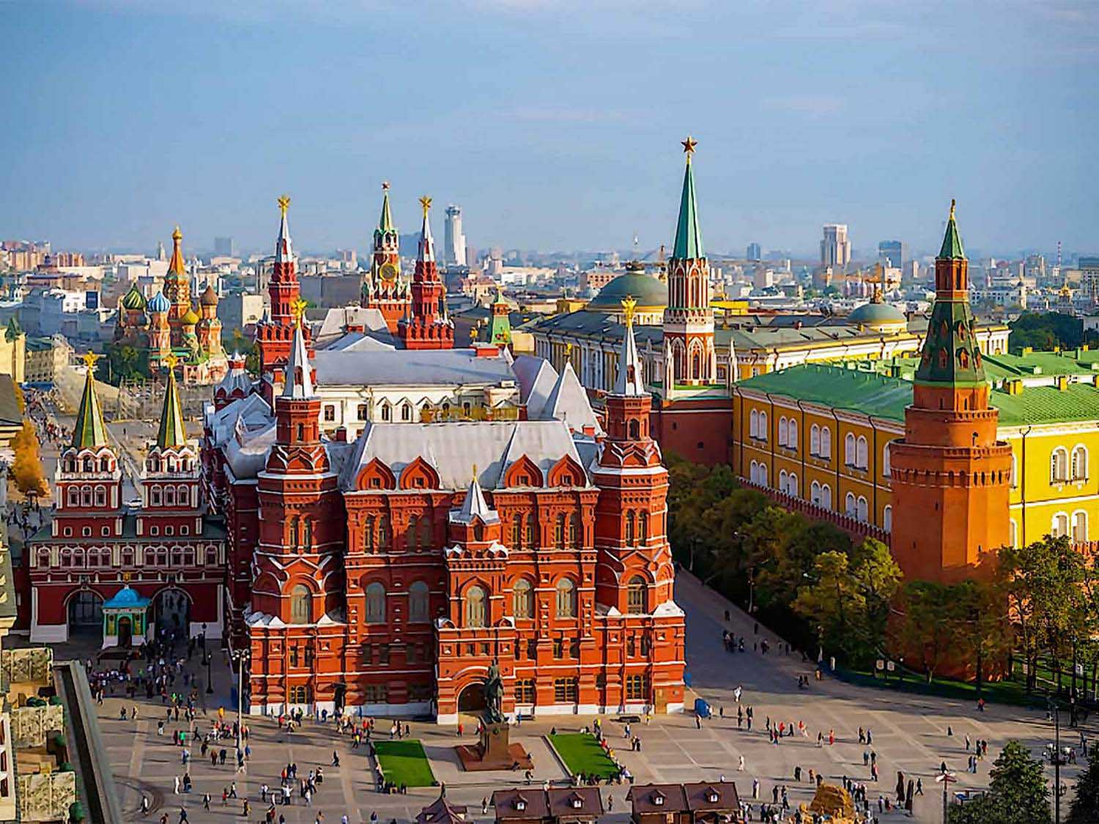
State Historical Museum
Slava Stepanov
ORIGIN

Slide 44
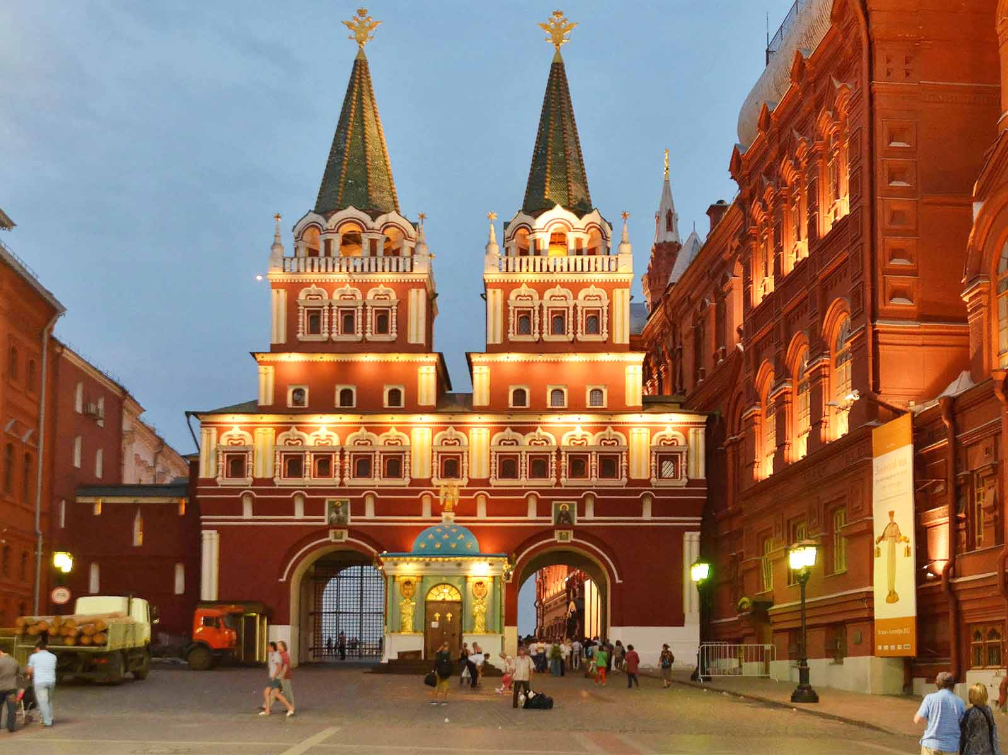
State Historical Museum
All Free Photos
ORIGIN

Slide 45
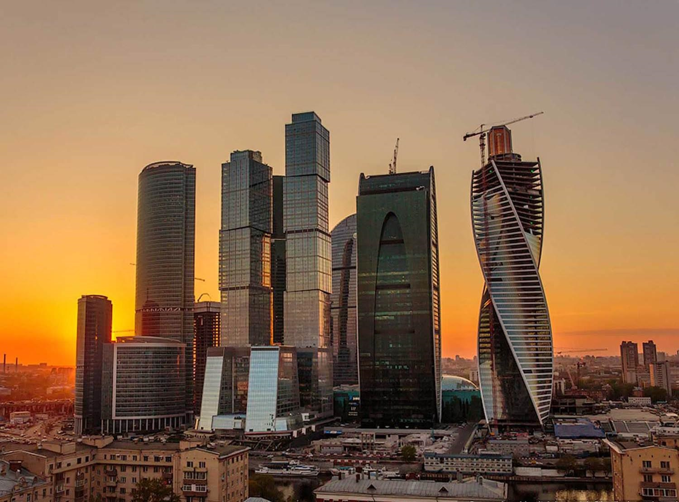
International Business Center
Sergey Anashkevitch
ORIGIN

Slide 46
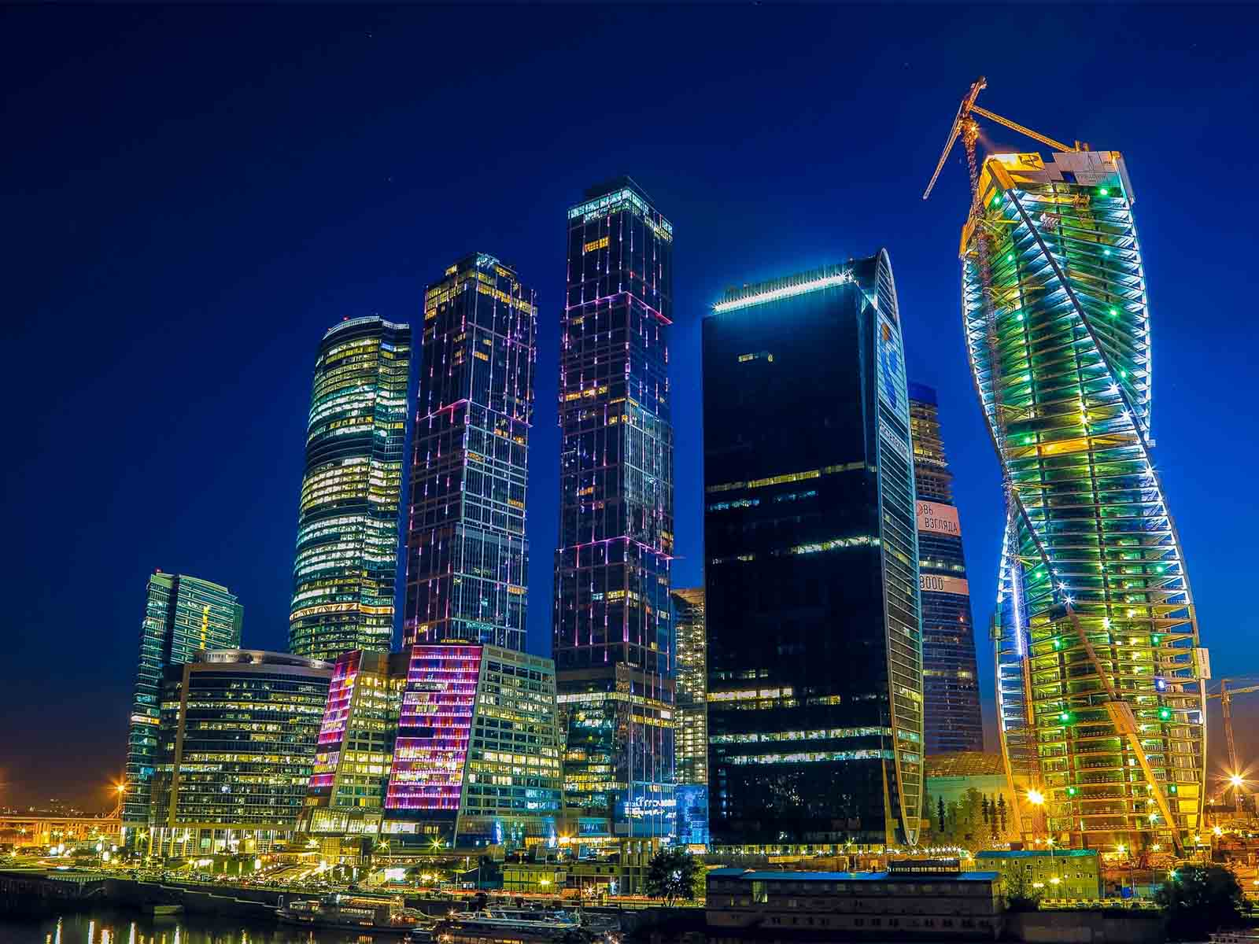
International Business Center
Rabstol Net
ORIGIN

Slide 47
À LA PROCHAINE
SAUVER LA TERRE
CONTINUER
F I N
Non pour un usage commercial! / Photos à partir d'Internet / Musique : Isao Saito
tomi55jutt@mail.com

