Slide 1
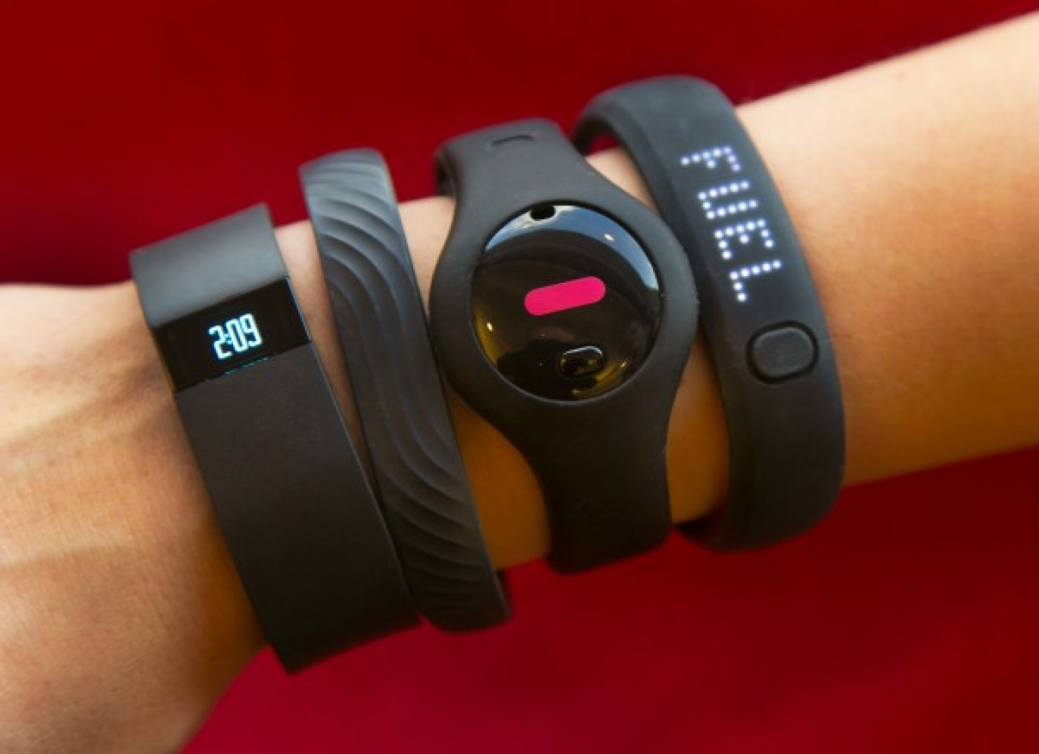
Wearable Tech

Slide 2
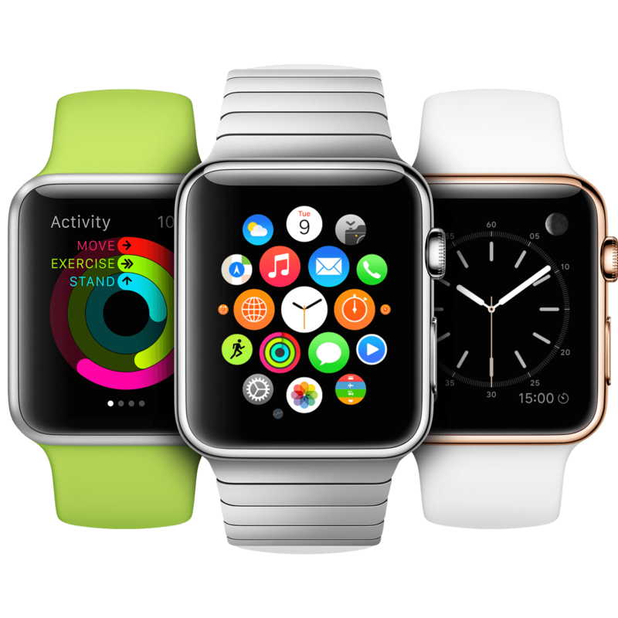
Smart watches

Slide 3
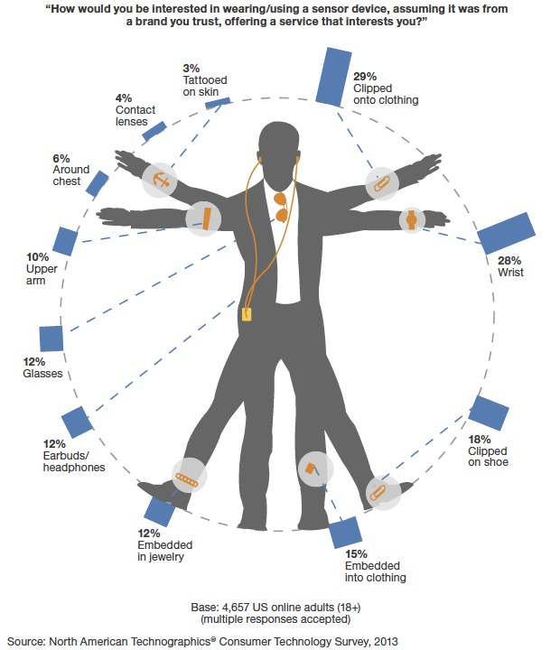
There’s more

Slide 4
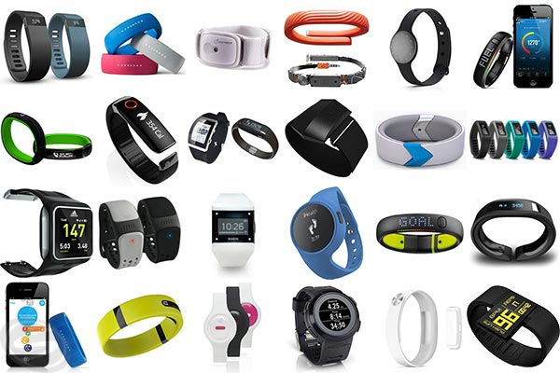
Activity tracker
Track Sleep, activty, HR.
Cheaper
Focus on one thing
Wrist, shoe or Clip-on

Slide 5
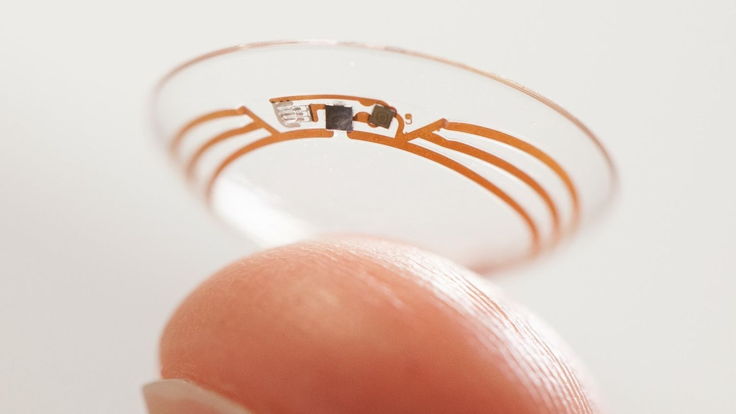
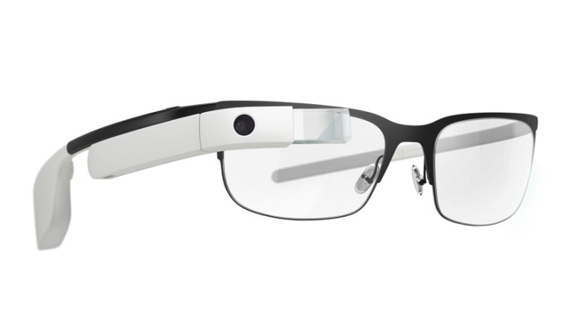
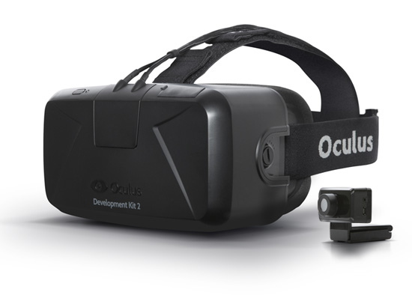
Optics
Google glasses : Augmented Reality
Oculus Rift : Virtual Reality
Google Contact lenses

Slide 6
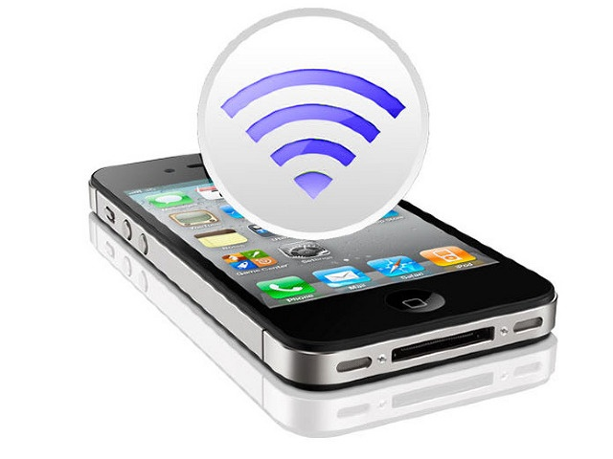
Phones

Slide 7
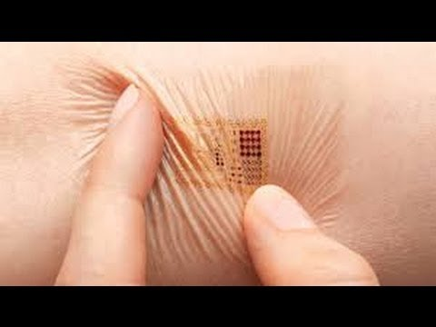
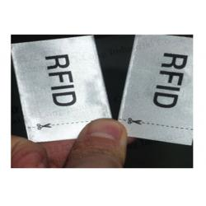
RFID tags
Cards
Clothing
Tattoos

Slide 8
