Slide 1
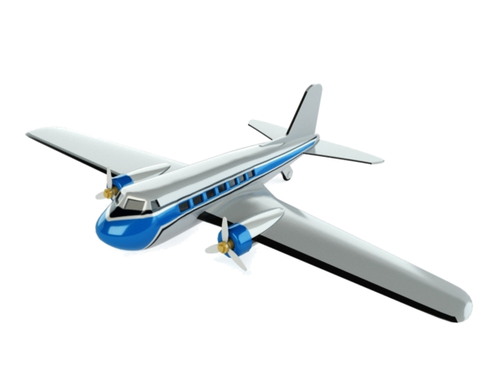
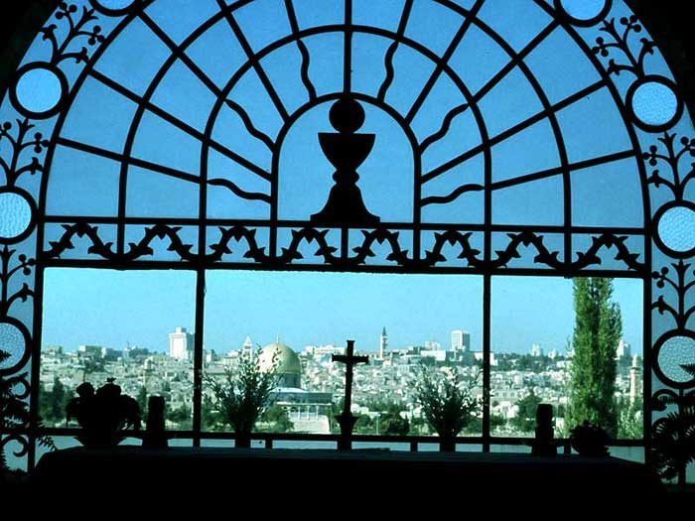
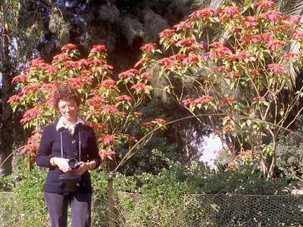
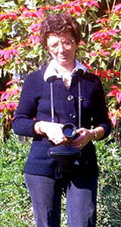

Welcome to my
Israel (1980) Memories
Slides will advance automatically

Slide 2
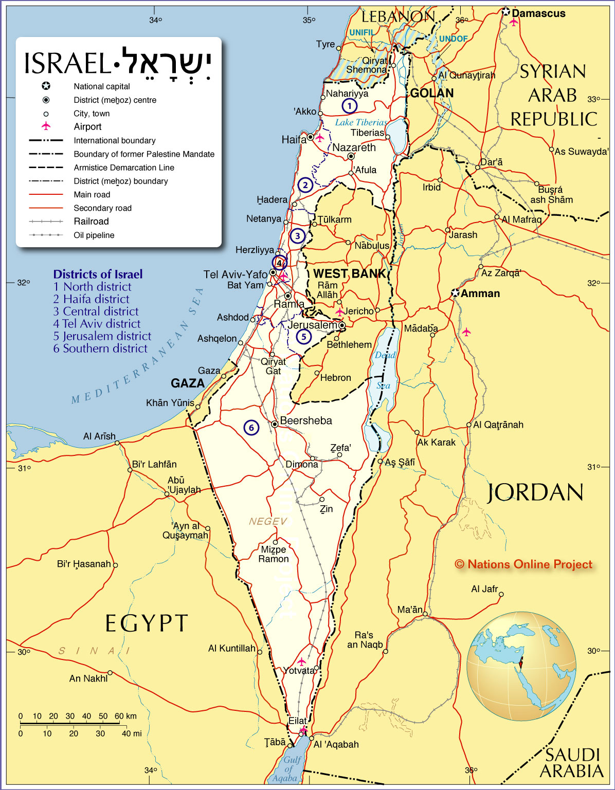
Map of Israel 2016

Slide 3
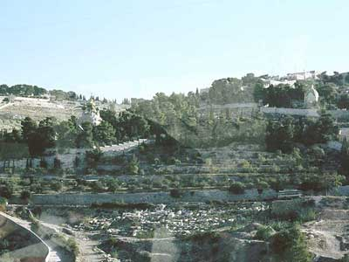
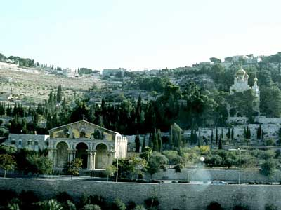
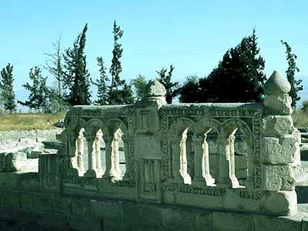
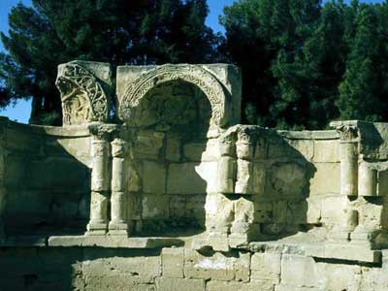
Jerusalem

Slide 4
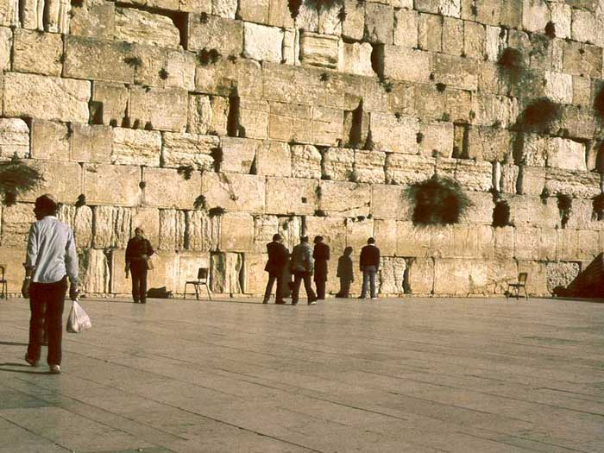
Jerusalem - Western Wall

Slide 5
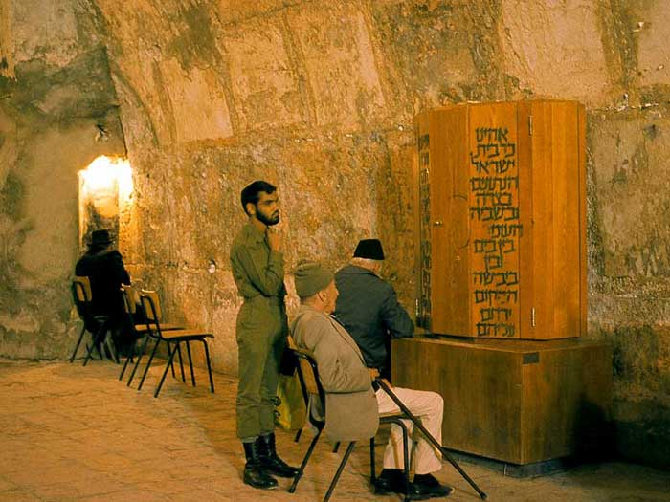
Men praying

Slide 6
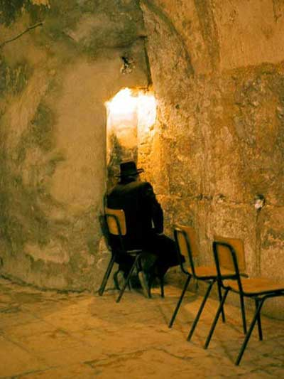
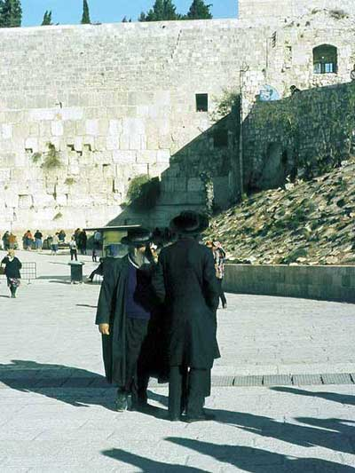
Men praying
Hasidim

Slide 7
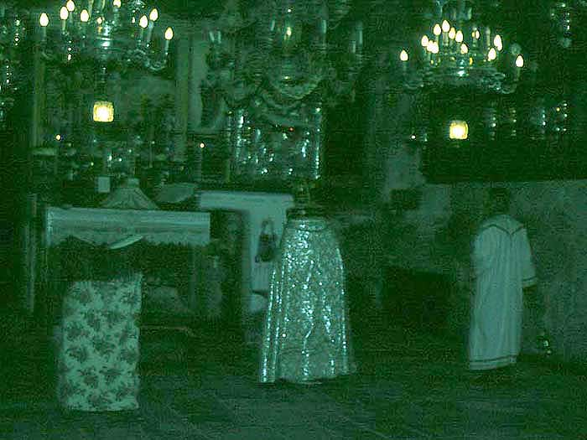

Slide 8
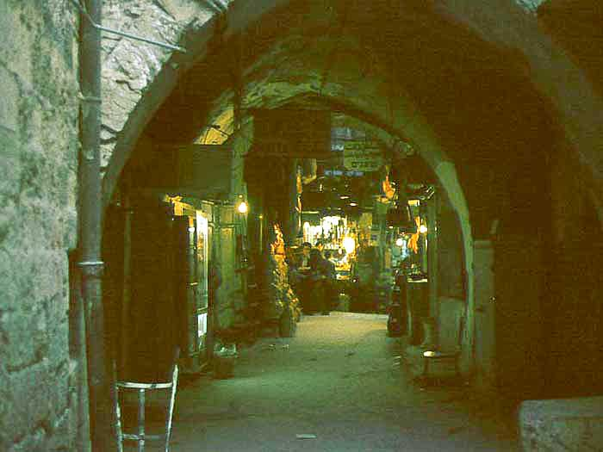

Slide 9
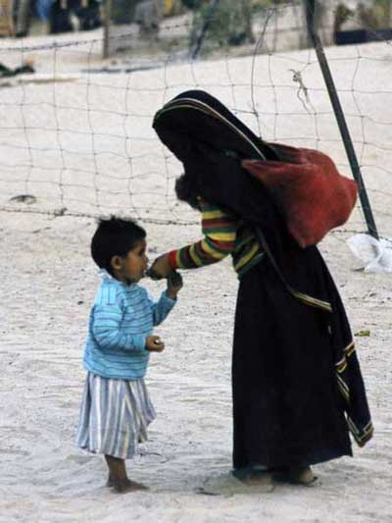
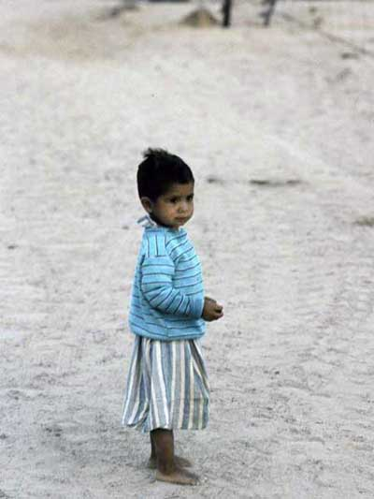
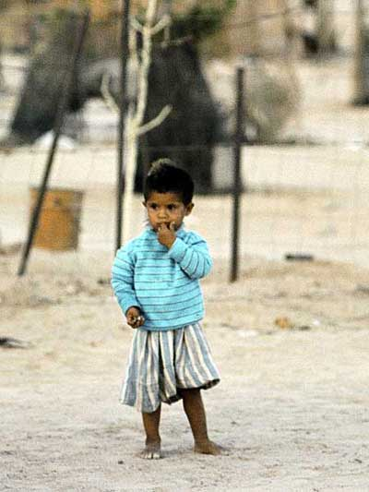

Slide 10
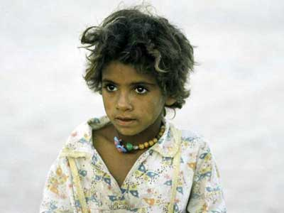
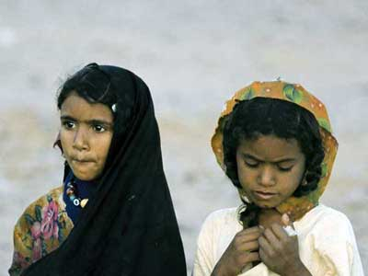
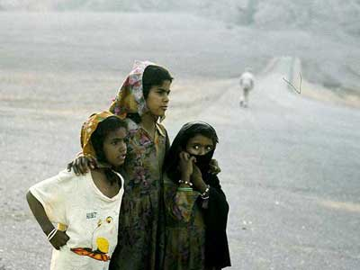

Slide 11
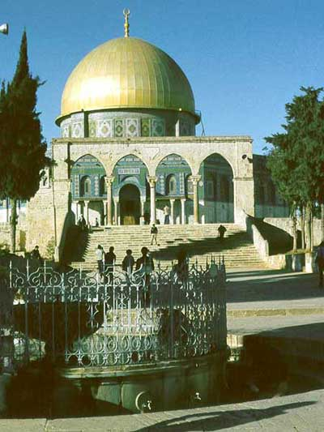
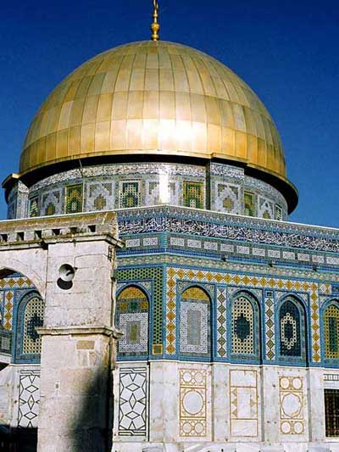
Jerusalem - Dome of the Rock on Temple Mount

Slide 12
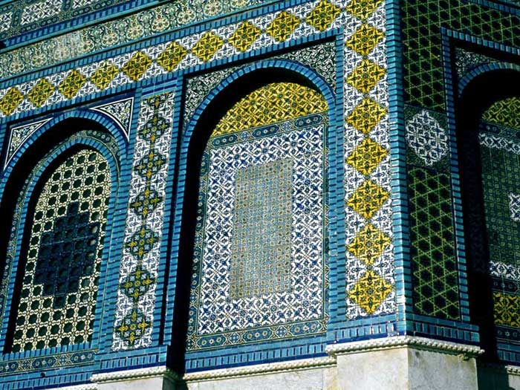
Jerusalem – Details of the Dome of the Rock on Temple Mount

Slide 13
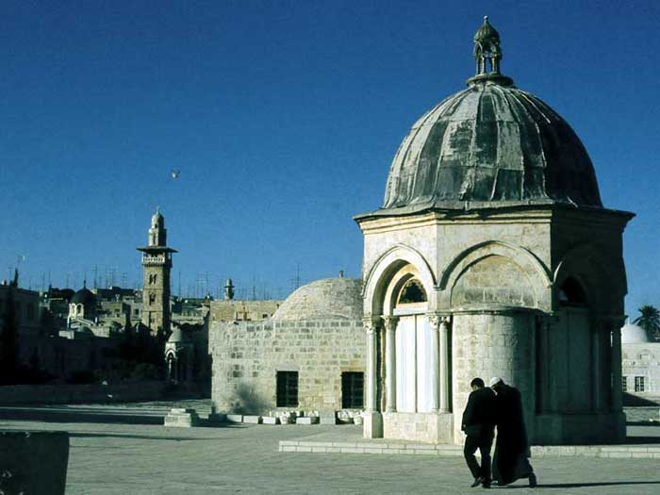

Slide 14
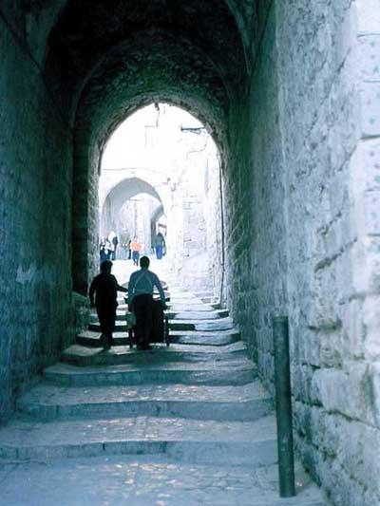
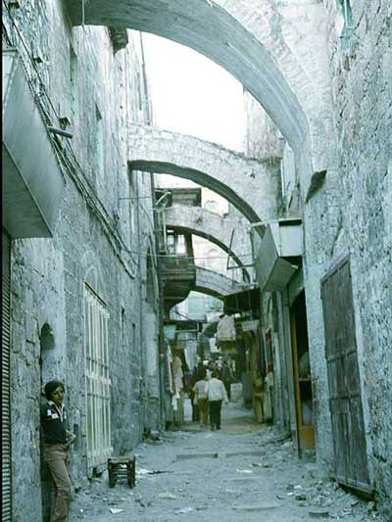
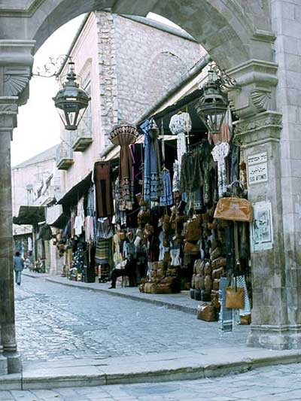

Slide 15
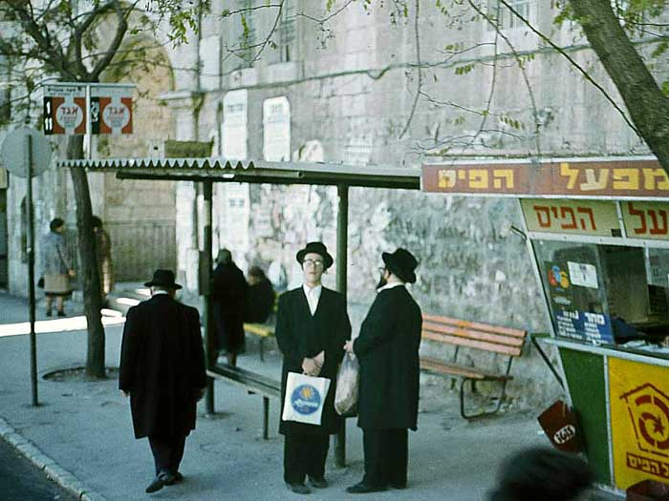
Hasidim

Slide 16
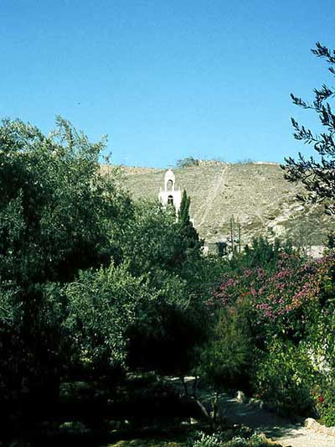
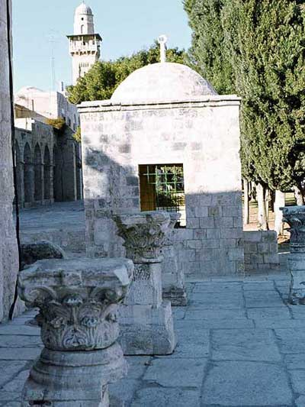
Gethsemane

Slide 17
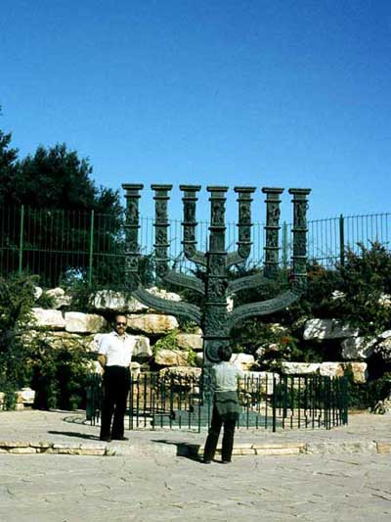
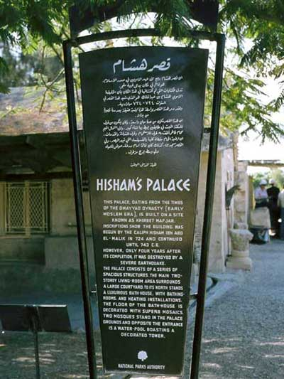

Jerusalem
Jerico

Slide 18
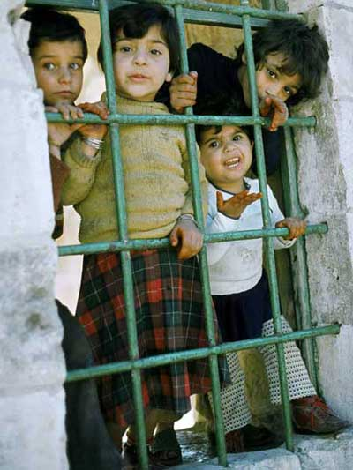
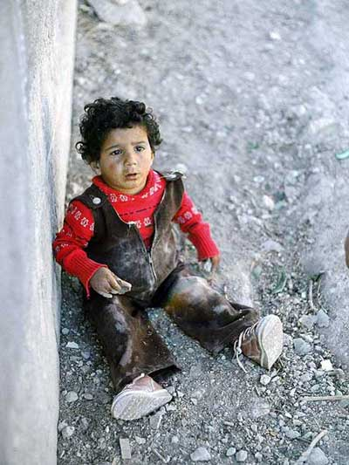

Slide 19
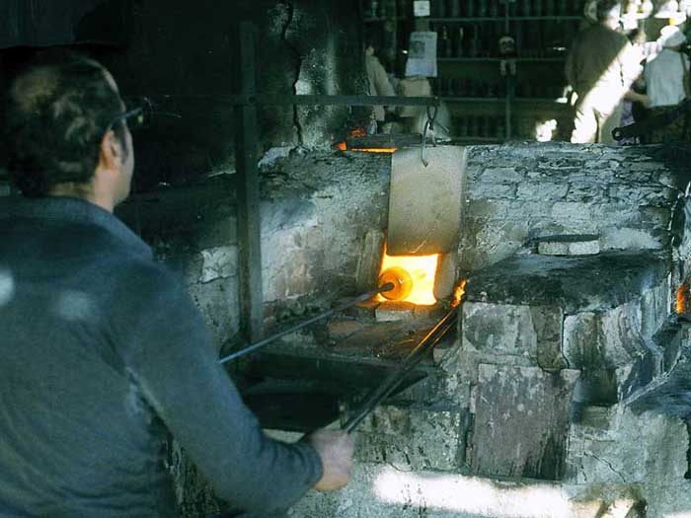

Slide 20
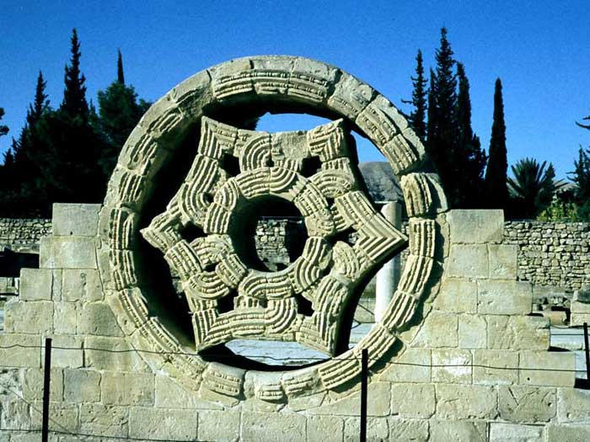
Jericho – Ruins of Hisham’s Palace, one of the
earliest examples of Islamic architecture

Slide 21
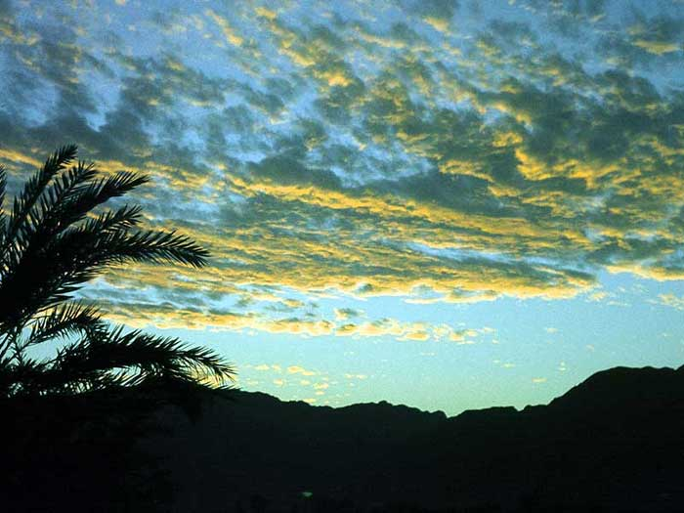

Slide 22
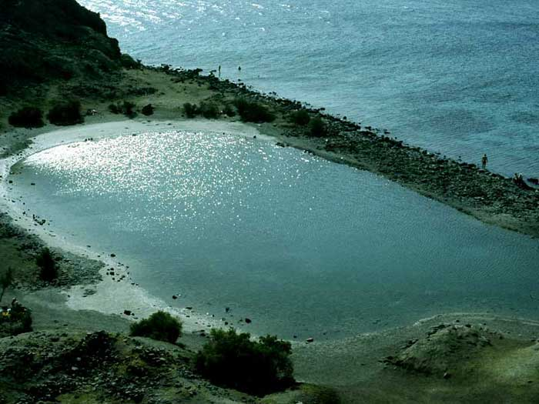

Slide 23
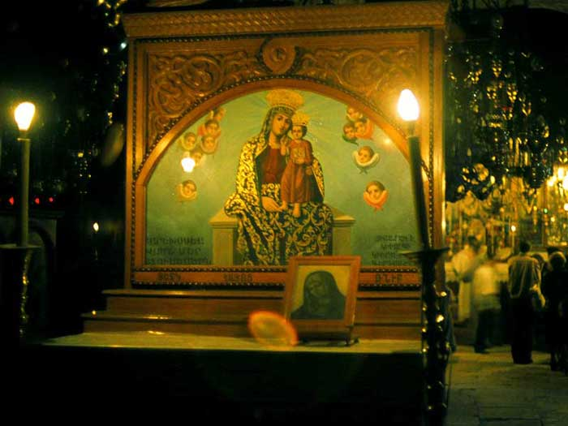

Slide 24
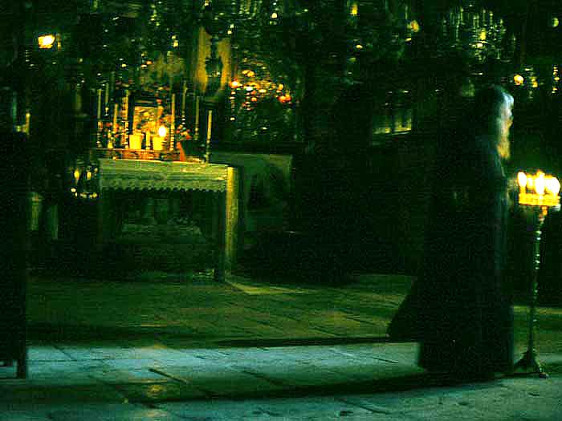

Slide 25
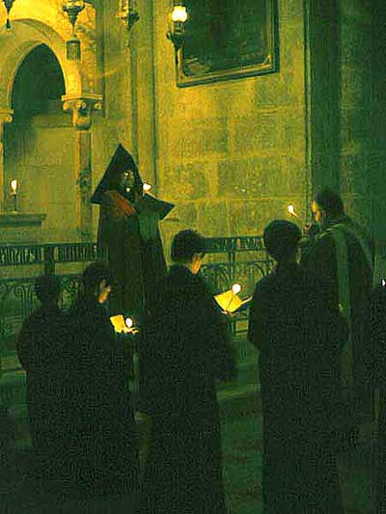
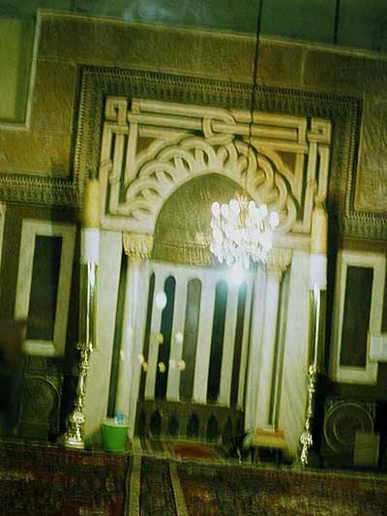
Abraham Mosque – Patriarch’s tombs - Hebron

Slide 26
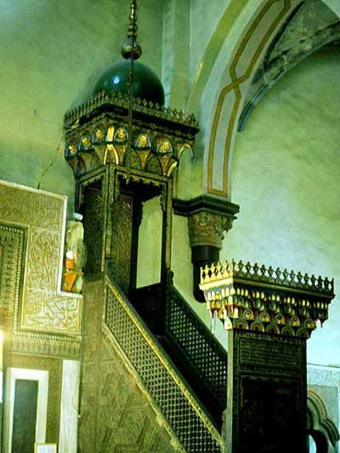
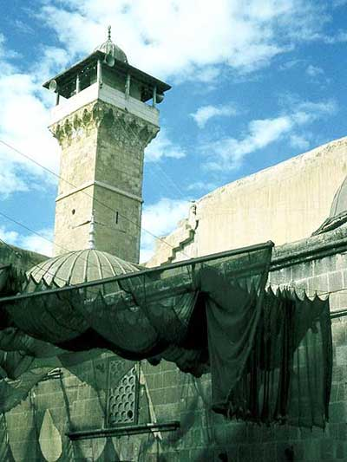
Abraham Mosque

Slide 27
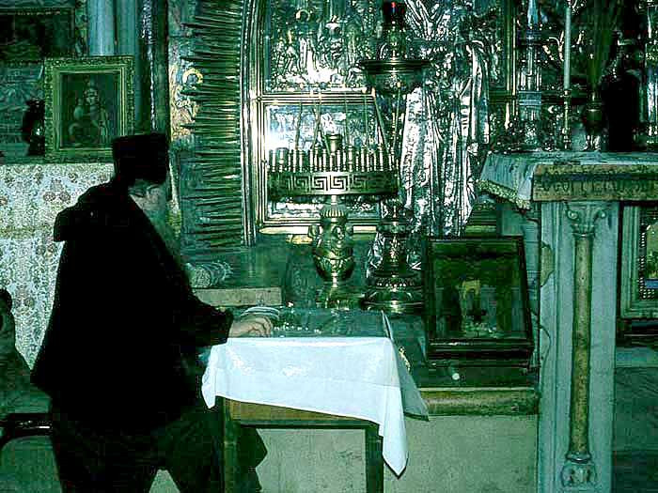
Jerusalem – Church of Holy Sepulchre - Chapel of Calvary

Slide 28
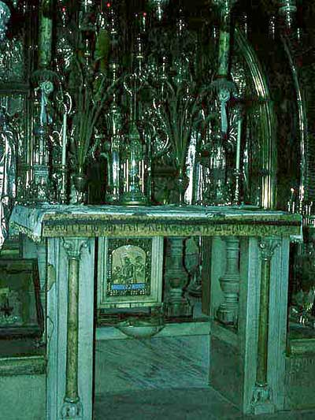
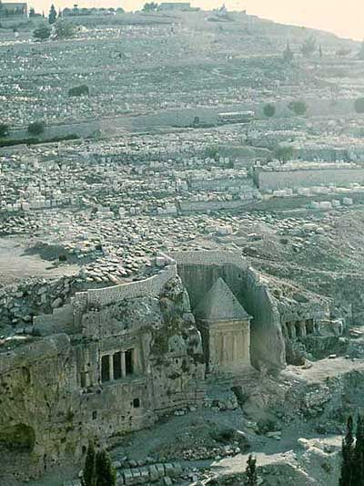
Kidron Valley – Tombs
Chapel of Calvary - Greek-orthodox shrine at the site of the crucifixion altar

Slide 29
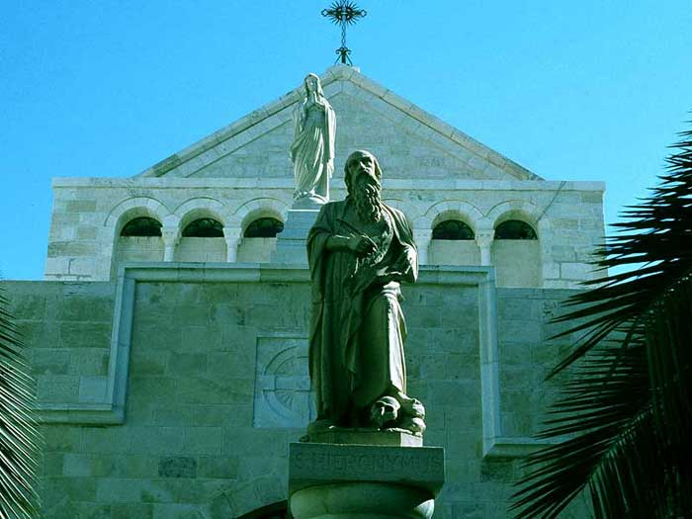
Bethlehem - Church of Saint Catherine

Slide 30
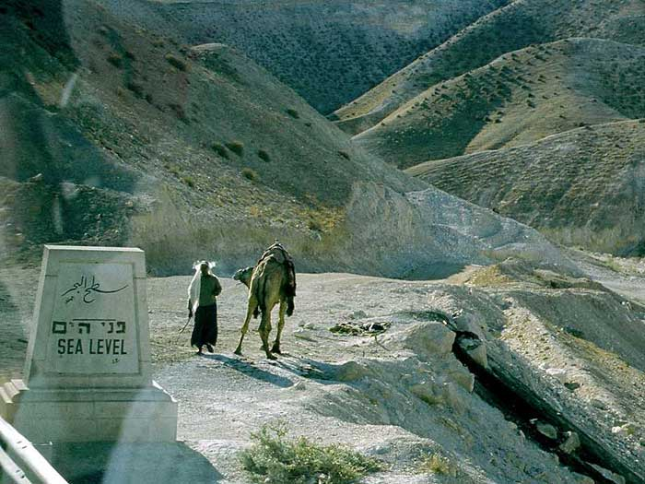

Slide 31

Passing the Dead Sea on our way to Masada

Slide 32





Slide 33



Slide 34

Negev brigade Memorial

Slide 35


Slide 36



Slide 37


Slide 38


Slide 39


Slide 40

Red Sea

Slide 42

The silver Star of Bethlehem that marks the exact spot where Jesus was born in the Church of the Nativity in Bethlehem

Slide 43


Slide 44



Slide 45


Slide 46




Nabatei
Neghev
Jerico

Slide 47


Nazareth – church door

Slide 48




Tabgha Mosaic - the ancient mosaic showing the Loaves and Fishes in the Church of the Loaves and Fishes in Tabgha by the Sea of Galilee

Slide 49

Acre – The cruisader fortress of Cesarea

Slide 50




Cesarea
Capernaum
Capernaum – Synagogue sculpture

Slide 51

Remains of the Roman Aqueduct at Caesarea from the 1st Century CE

Slide 52

Caesarea

Slide 53


Haifa - Bahai
The Persian gardens

Slide 54


Slide 55


Slide 56


Slide 57


Slide 58


Slide 59



Underwater World and Observatory, Eilat

Slide 60




Slide 61




Slide 62





Slide 63




Photos from old slides shot during our past trip to Israel in 1980 with Nikkormat not digital camera .
Click ici pour le revoir
Music: Romanza - Mozart
To play show
again, click here
by Carla and Carlo
February 2016

