Slide 1
How it works ?

Slide 2
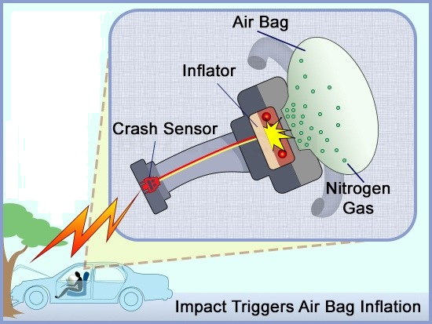

Slide 3
Our former chemical composition of our airbags was made with sodium amide.
t > 110ºC
2 Na2O + N2O + NH3 → NaN3 + 3 NaOH

Slide 4
Too much humidity/water + sodium amide = introduction of water molecules
=
Strongly lowered reaction temperature which causes anomalous combustion

Slide 5
New chemical composition of our airbags with sodium azide
175ºC
3 NaNH2 + NaNO3 → NaN3 + 3 NaOH + NH3

Slide 6
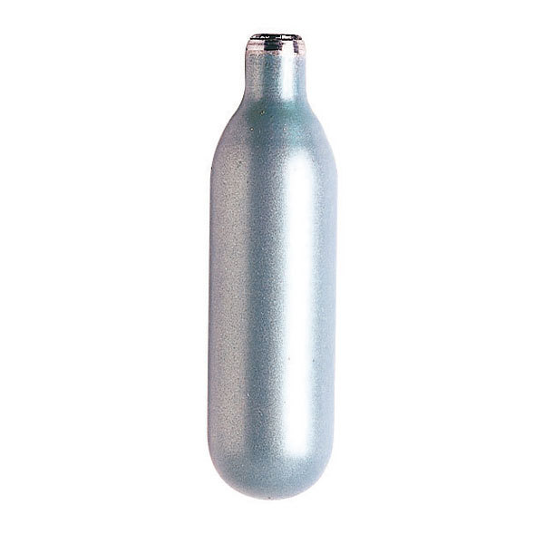
And for the cars with the former chemical composition ?
We’ll give to :
Garages
Distributors
Customers (if they wish)
FREE little caplets of zodium ions (Na+) wich will stabilize the chemical reaction making safe airbag.

