Slide 1
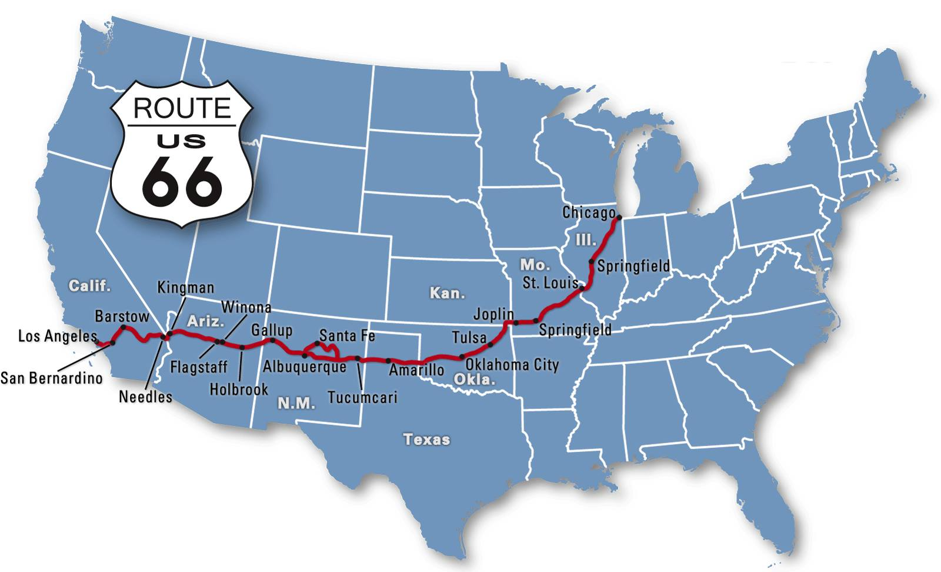

Slide 2
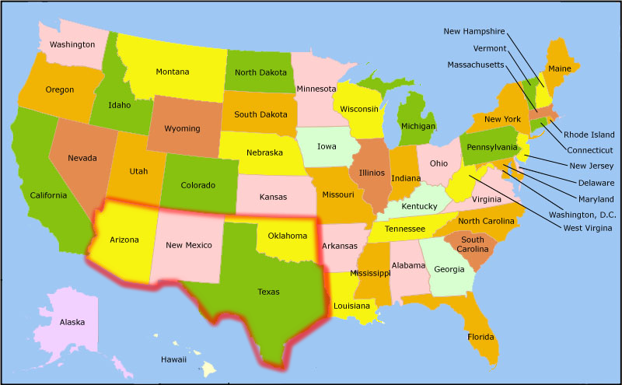
Southwest
Notes:
The Southwest differs from the Midwest in 3primary ways.
The first one is that it’s drier; you’ll notice it thanks to the landscapes in the powerpoint
Because it’s drier, it’s emptier; Outside the cities, the region is a land of wide open spaces. One can travail for miles without seeing signs of human life
Thirdly the population comprises a different ethnic mix. In fact, parts of the Southwest once belonged to Mexico. The USA gained this land follow a war with Mexico between 1846 and 1848. Today, 3southwestern states lie along the Mexican border: Tewas, New Mexico and Arizona. They all have a large Spanish-speaking population.

Slide 3
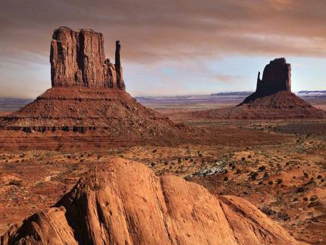
Arizona
Nickname : Grand canyon state
Capital : Phoenix
Entrance in the Union : 1912 (48th state)
Population : 6,731 million people
Superficie : 295 254 km2
Neighboring states : California, Nevada, Colorado, Utah, New Mexico
Landscape : deserts, woods, lakes

Slide 4
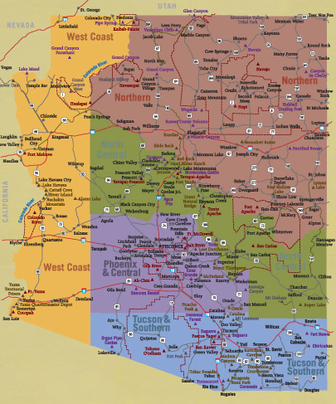
Arizona

Slide 5
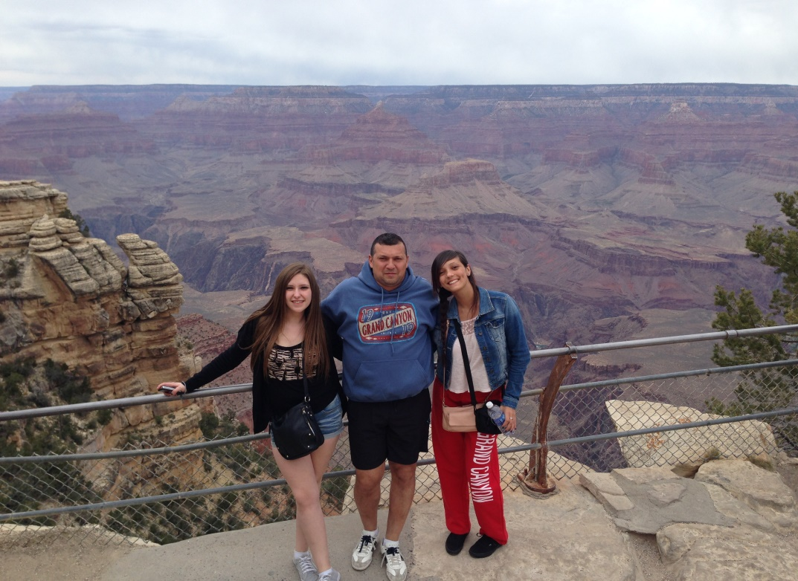
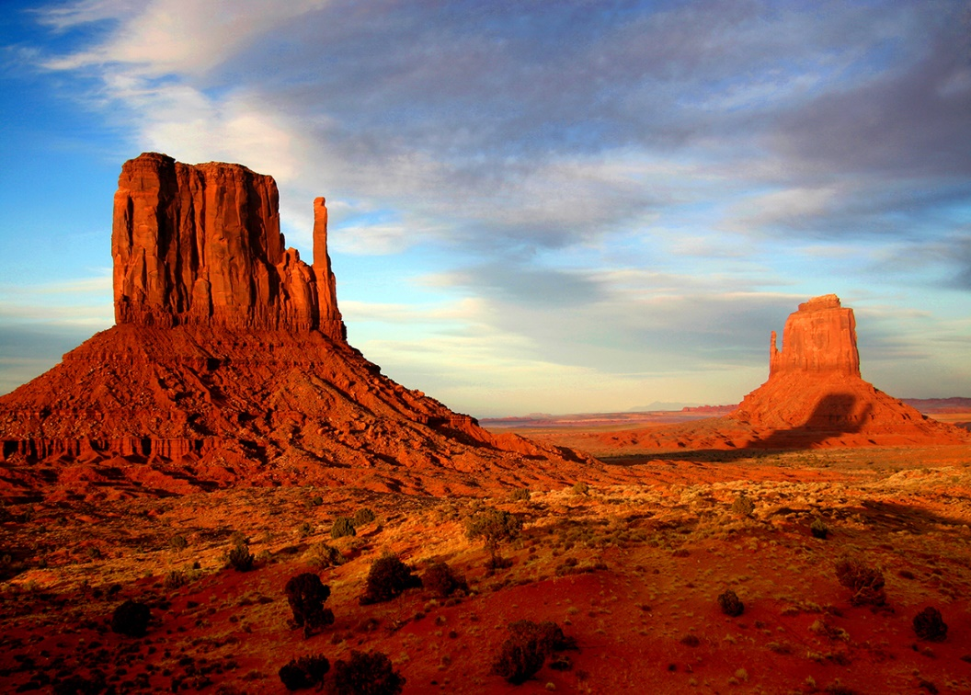
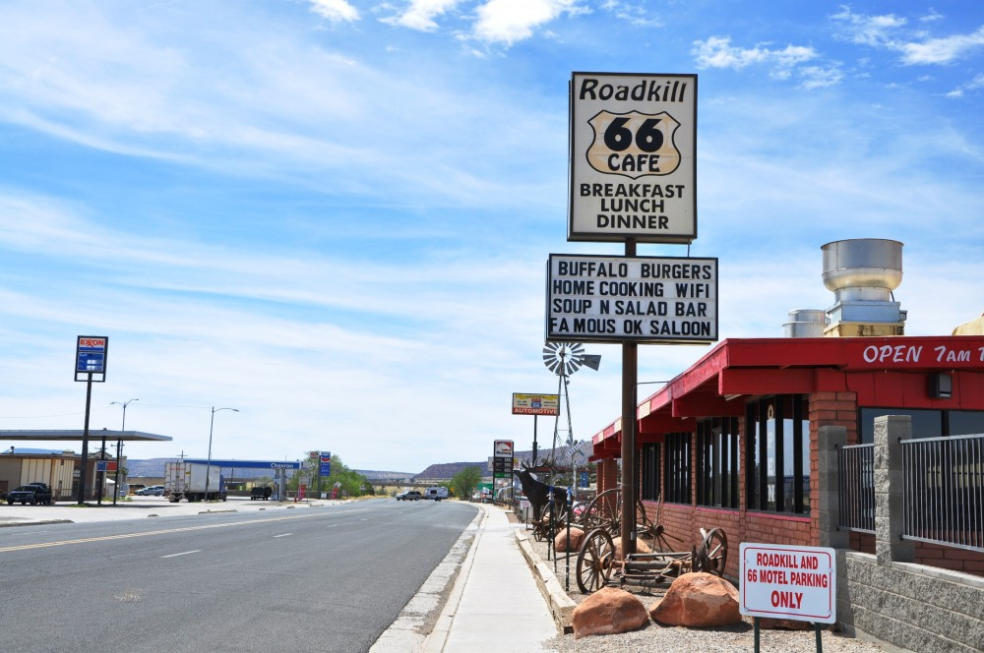
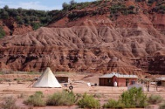
Northen Arizona

Slide 6
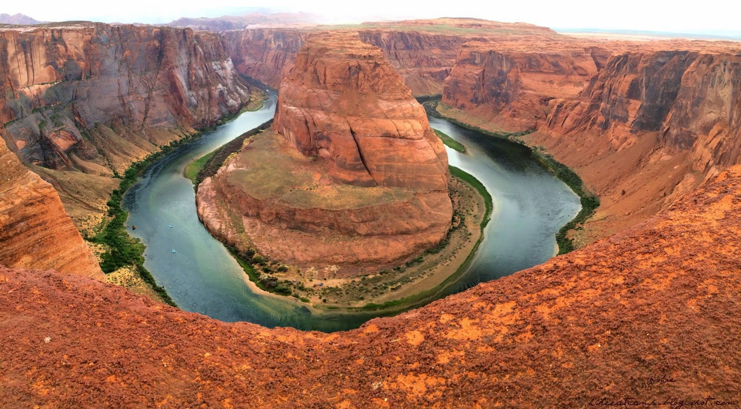
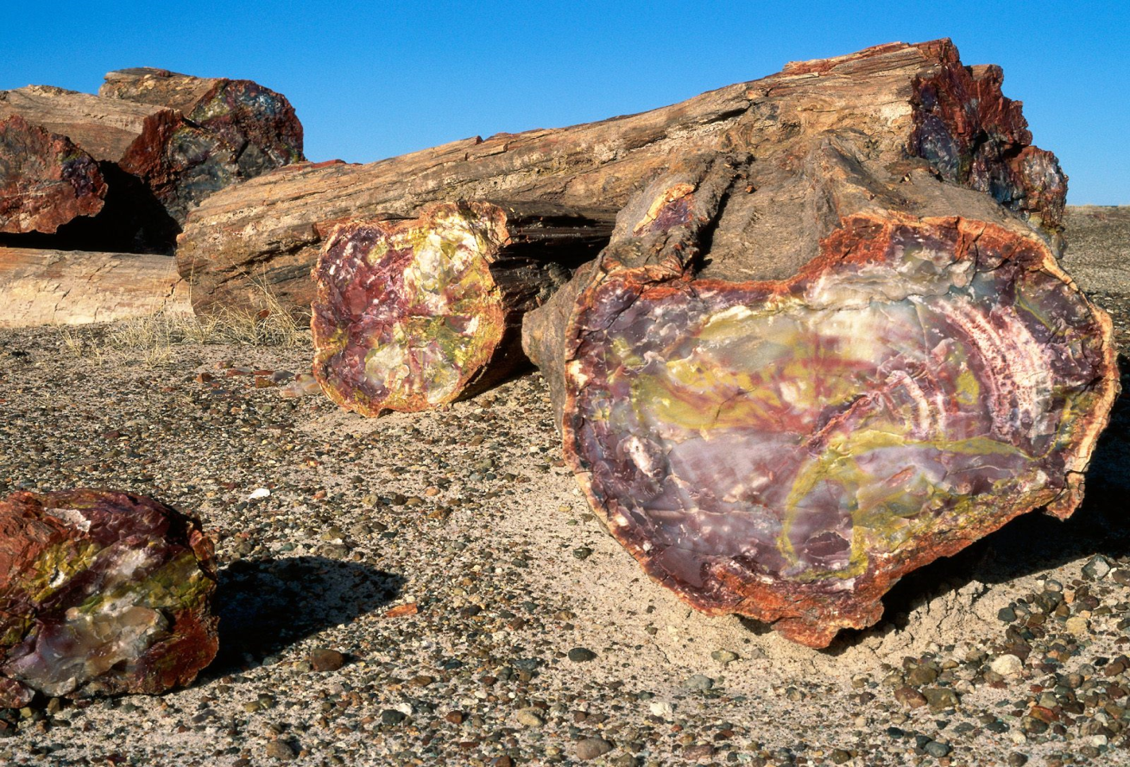

Slide 7
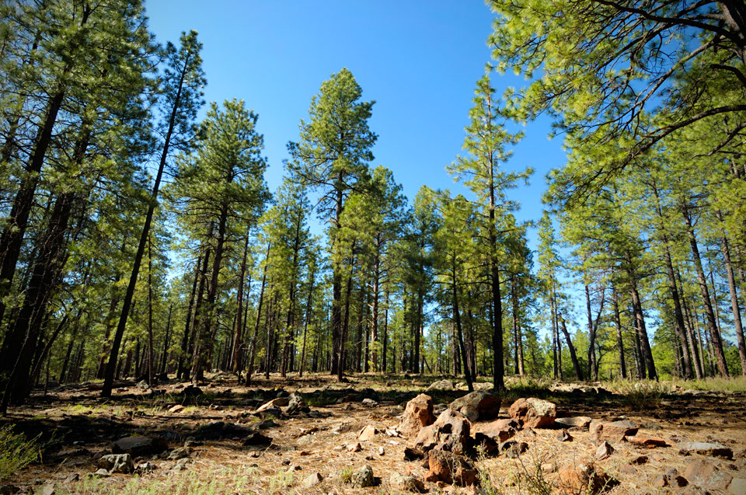
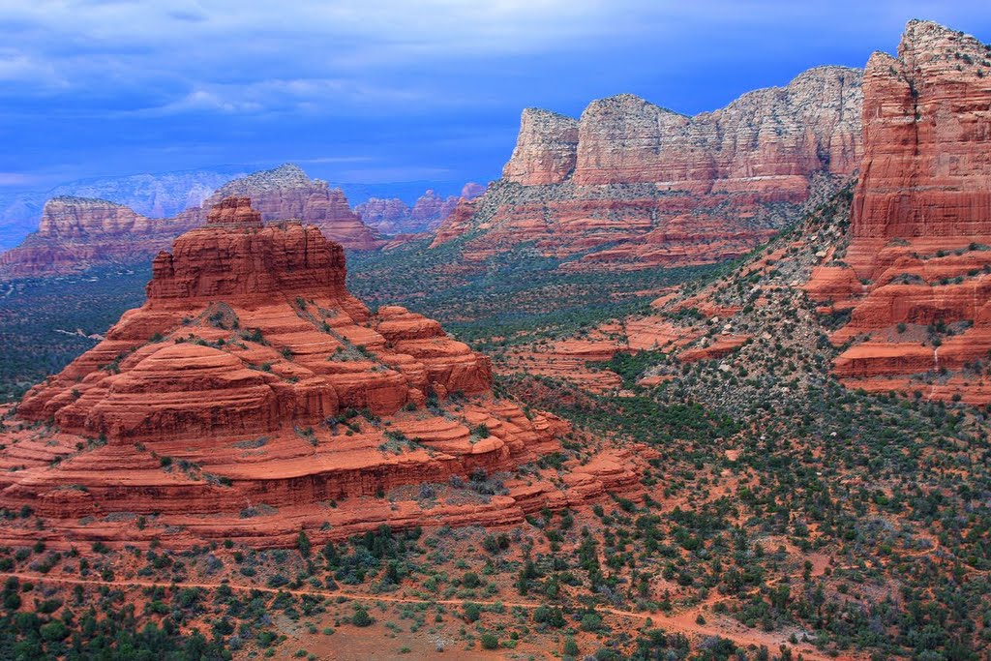
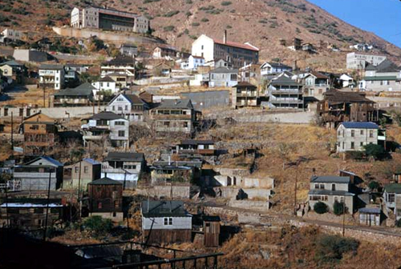
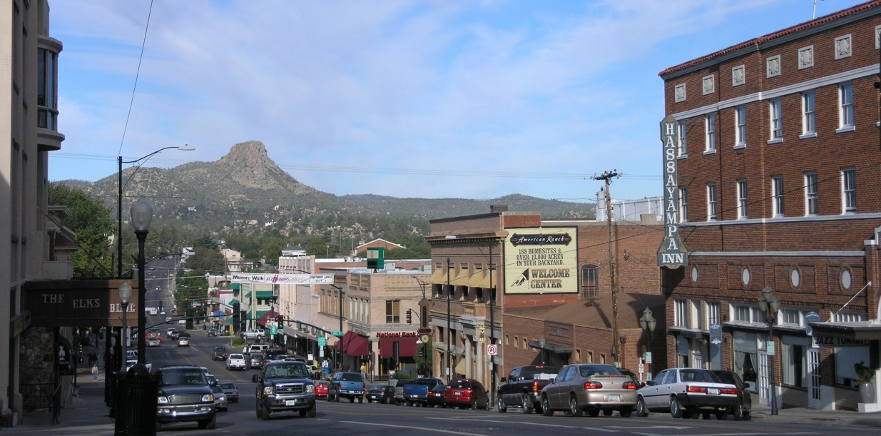
North-Central Arizona

Slide 8
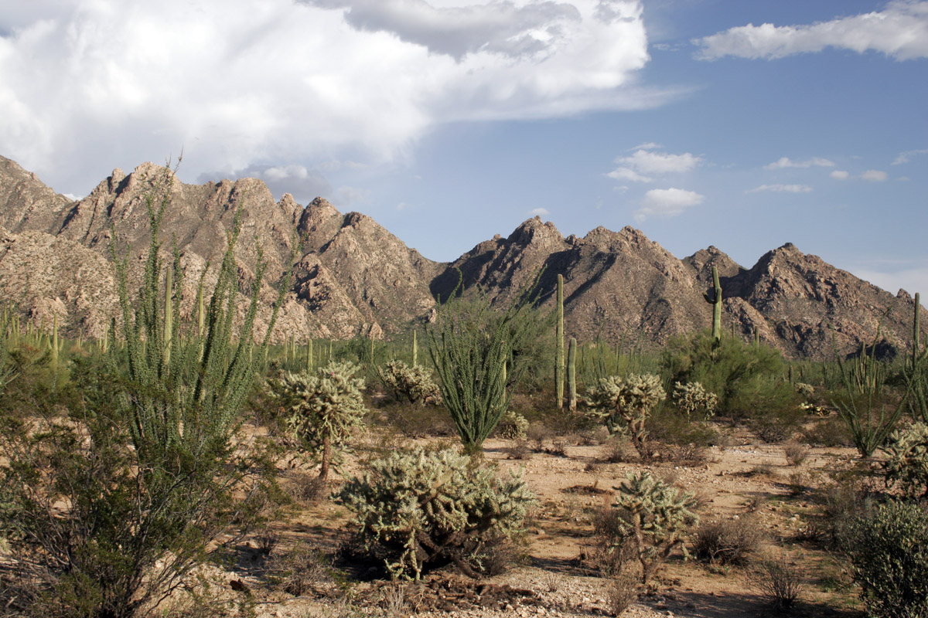
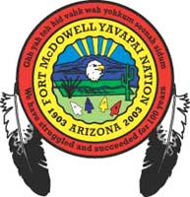
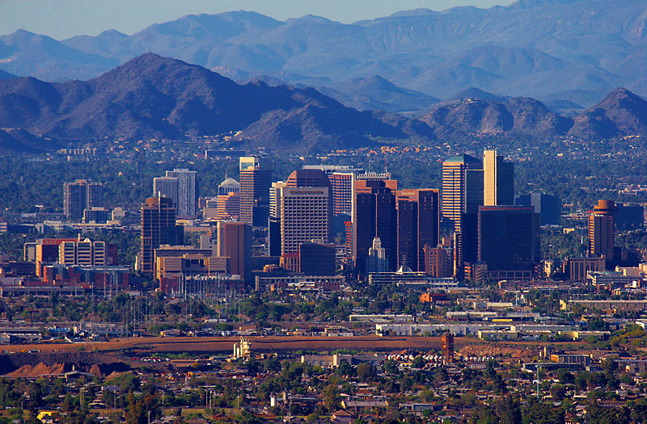
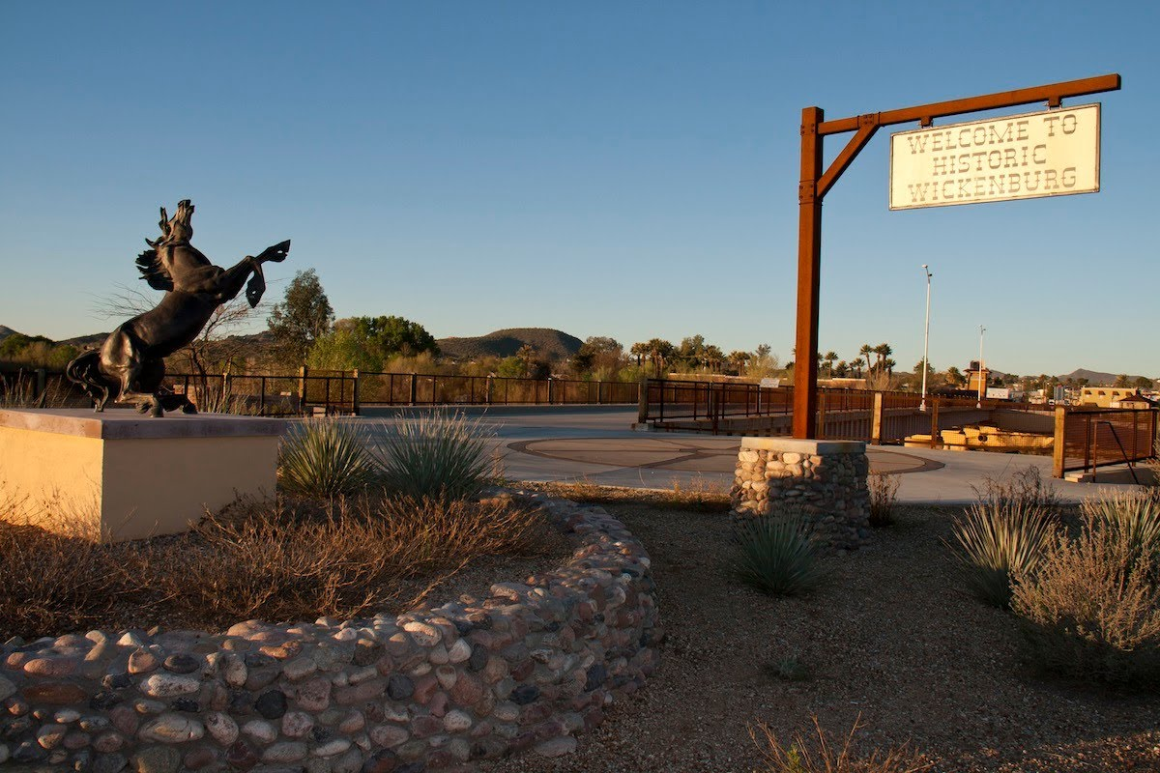
Central Arizona

Slide 9
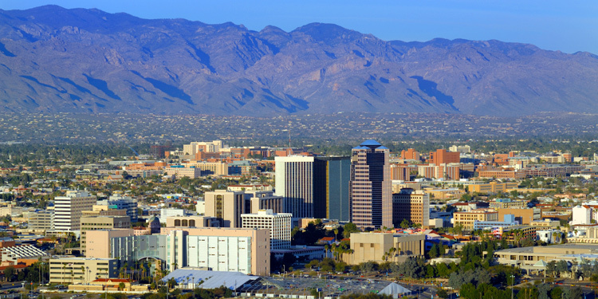
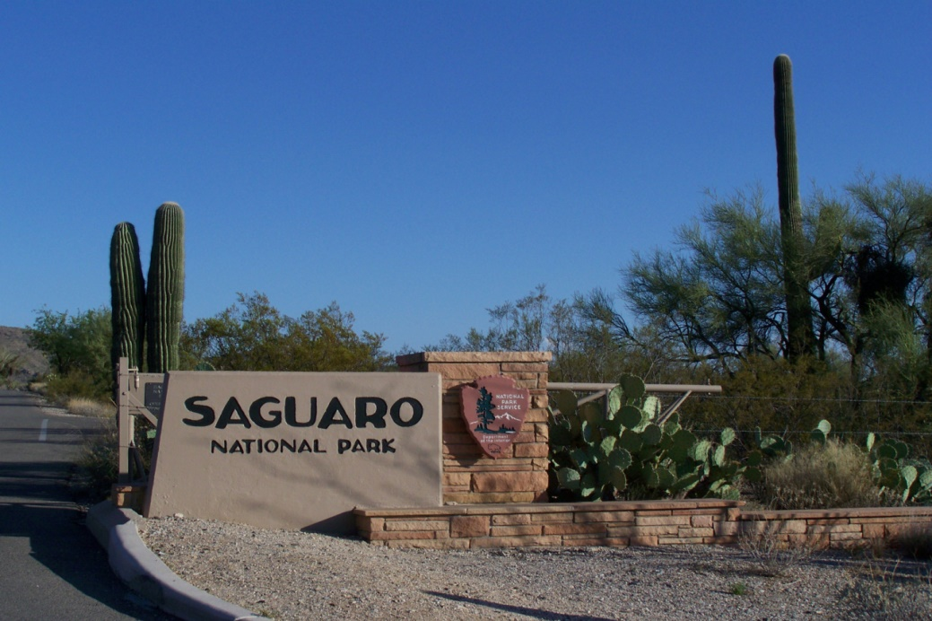
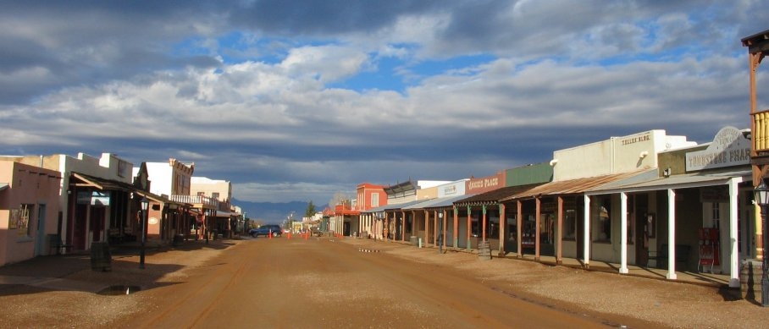
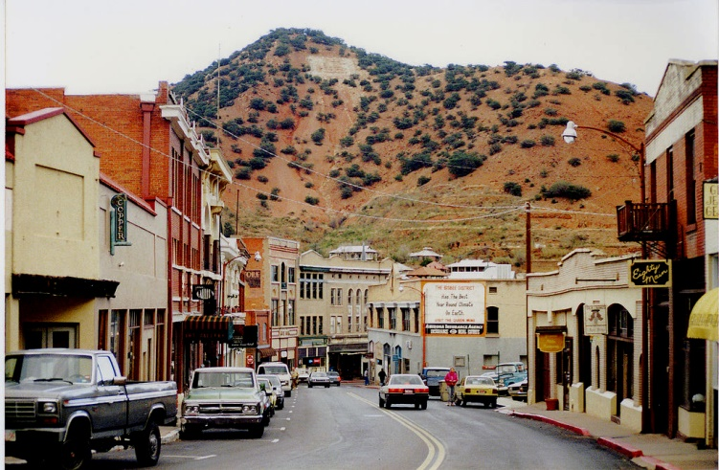
Southern Arizona

Slide 10
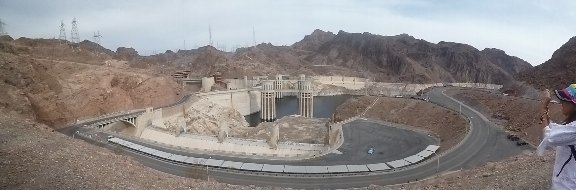
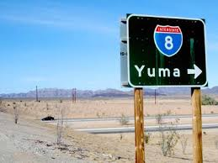
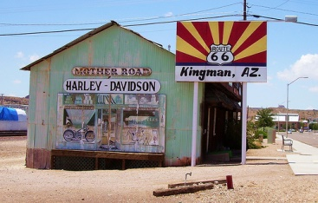
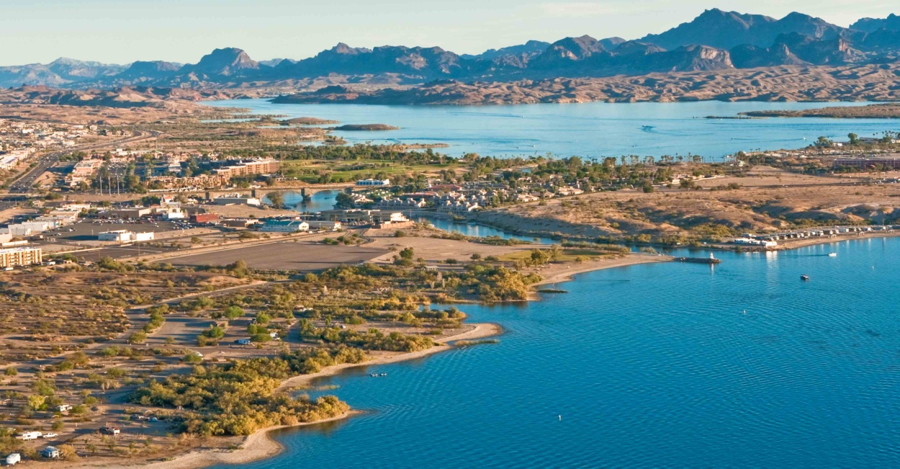
West Coast of Arizona

Slide 11
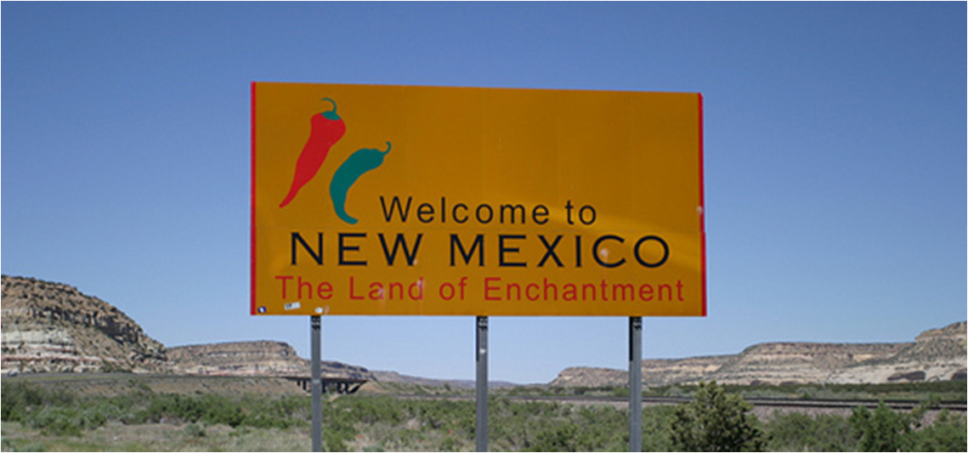

Slide 12
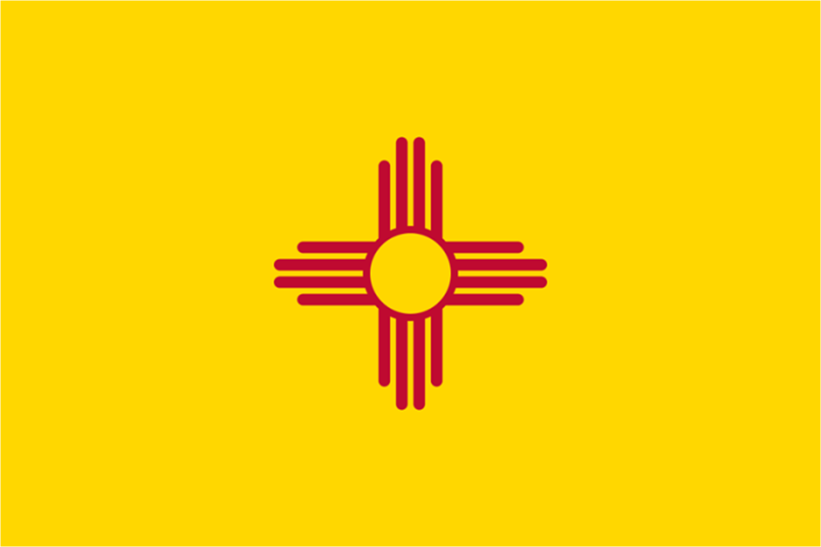
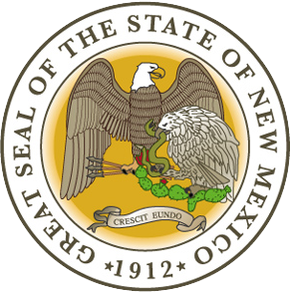
New Mexico
Capital : Santa Fe
Entrance in the Union : 1912 (47th state)
Neighboring states : Arizona, Colorado, Oklahoma, Texas, Utah
Landscape : rose-colored deserts to broken mesas to high, snow-capped peaks
Notes:
The colors on New Mexico's state flag are the red and yellow of old Spain. The simple, elegant center design is the ancient Zia Indians sun symbol, which represents the unique character of New Mexico (Zia sun symbol also appears on New Mexico's state quarter).

Slide 13
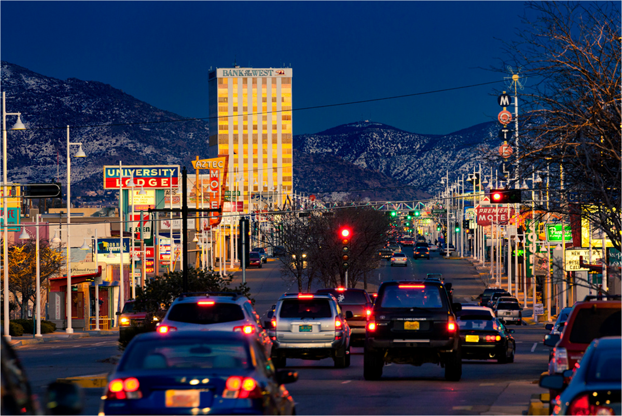
Notes:
Let’s begin with the Central Avenue, Nob hill, that has been described as "the heart of Albuquerque's Route 66 culture and also its hippest, funkiest retail and entertainment district“

Slide 14
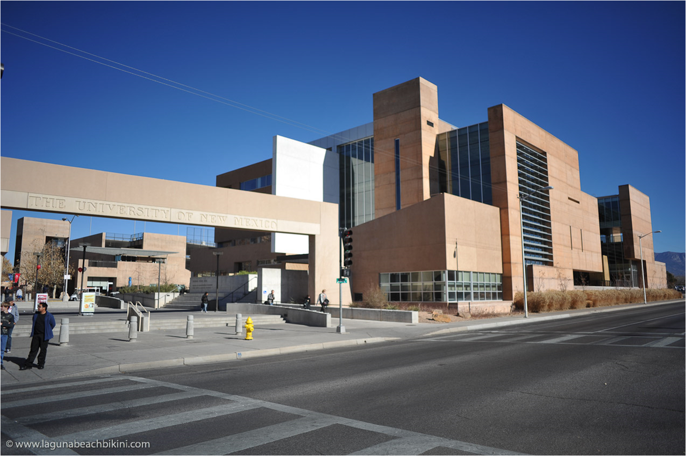
Notes:
The University of New Mexico, a.k.a. UNM, is a state university located in Albuquerque, New Mexico, U.S.A. UNM is the showcase university for the state of New Mexico. It is situated on a beautiful campus in front of the backdrop of the Sandia moutains, just a couple of miles from downtown Albuqeurque,

Slide 15
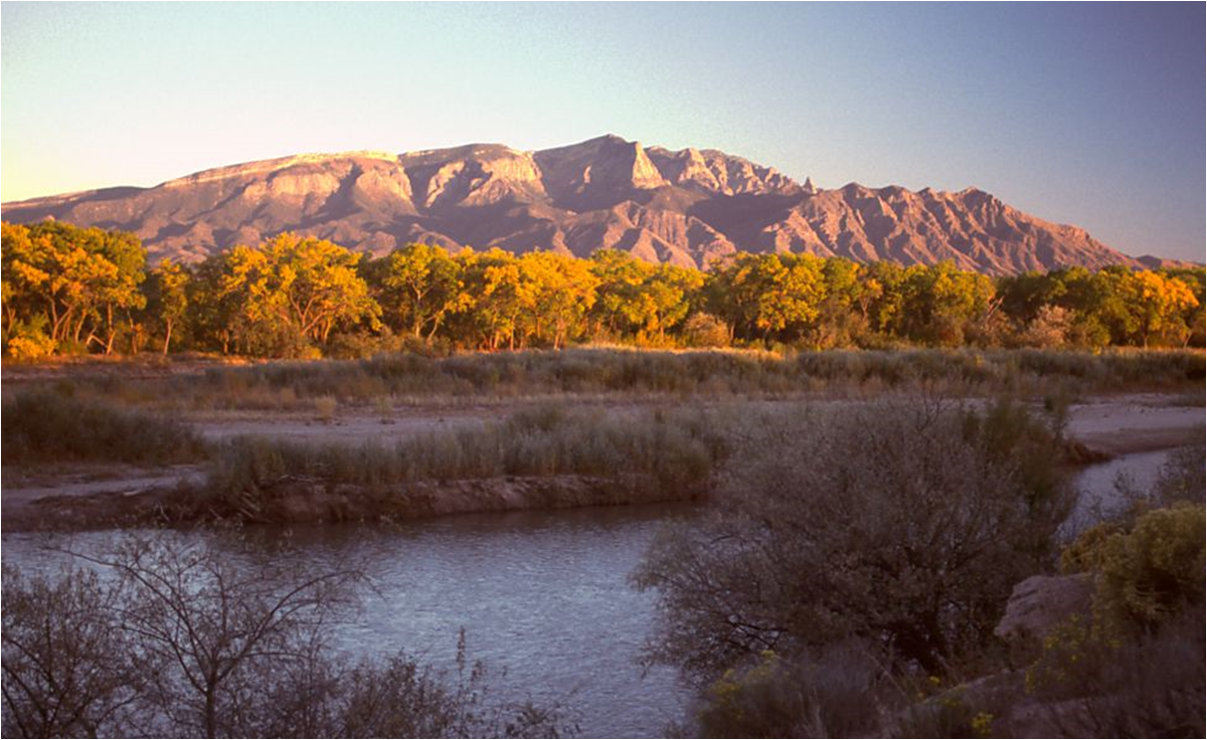
Notes:
The Sandia Mountains

Slide 16
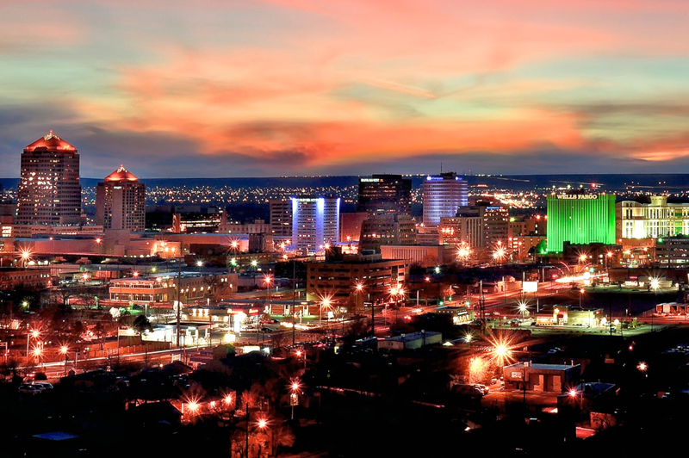
Notes:
Downtown, the central business district of Albuquerque.Here you’ll find bustling nightlife along Central Avenue (Route 66), including many nightclubs, theaters, restaurants and events.

Slide 17
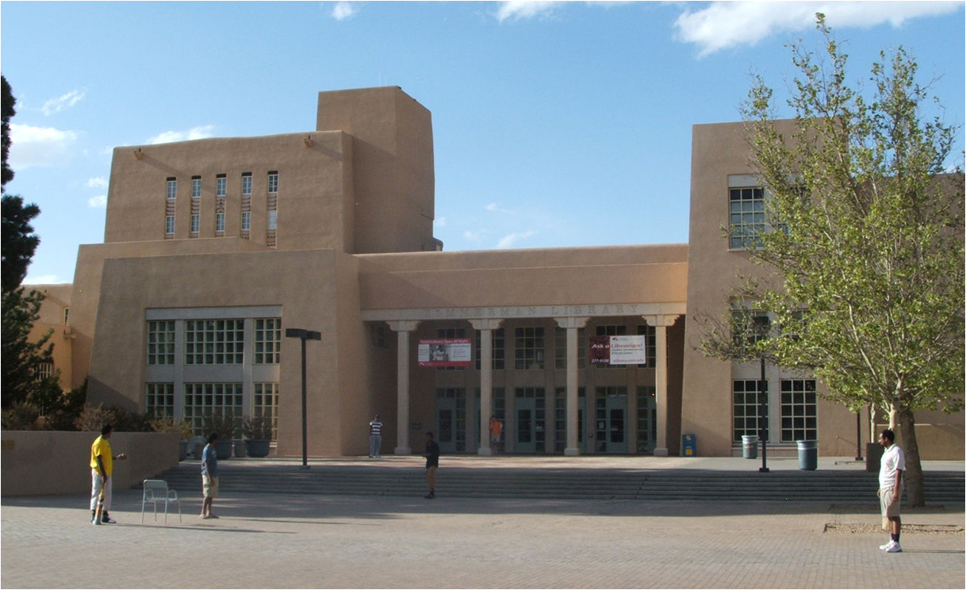
Notes:
If you want to do some researches for your TFE, Zimmerman Library at The University of New Mexico

Slide 18

Notes:
International Balloon Fiesta
For nine days in October, the New Mexico skies are painted as hundreds of balloons lift off from Albuquerque's Balloon Fiesta Park. For ballooning fans worldwide, the Albuquerque International Balloon Fiesta is a pilgrimage. When if you want to take a selfie with all those beautiful hot air balloons,

Slide 19
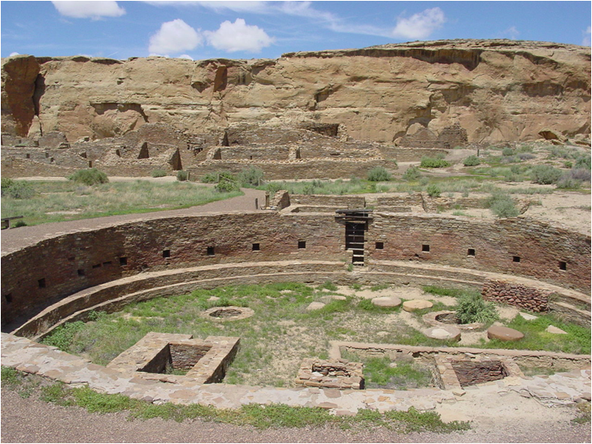
Notes:
In the Chaco Culture National Historical Park, containing the most sweeping collection of ancient ruins north of Mexico, the park preserves one of the United States' most important pre-Columbian cultural and historical areas

Slide 20
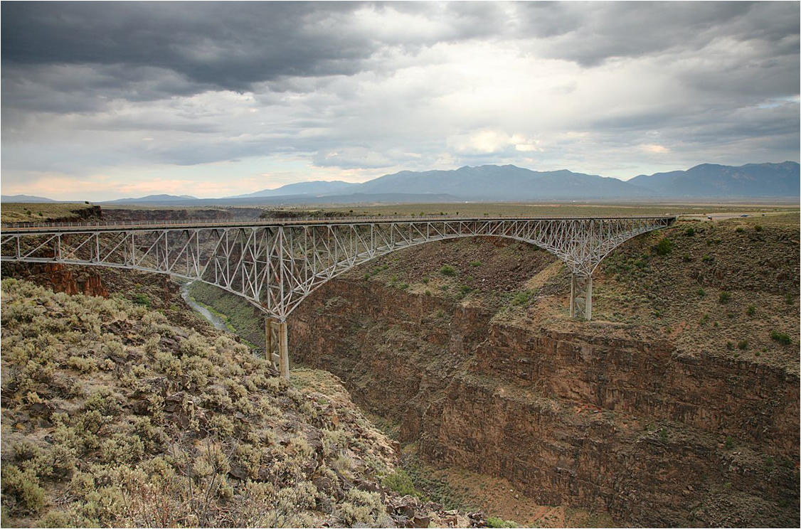
Notes:
The Gorge Bridge is a steel deck arch bridge across the Rio Grande Gorge northwest of Taos, New Mexico
the seventh highest bridge in the United States

Slide 21
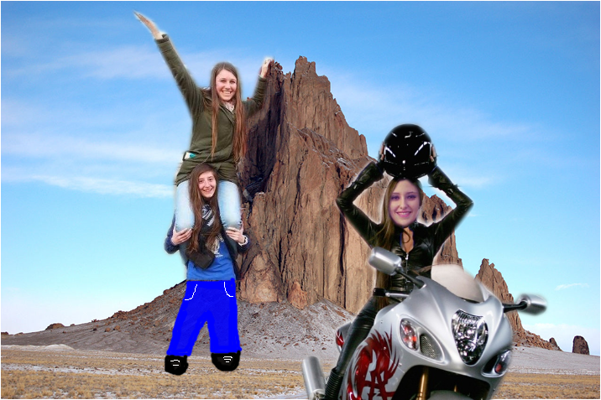
Notes:
Shiprock in San Juan County

Slide 22
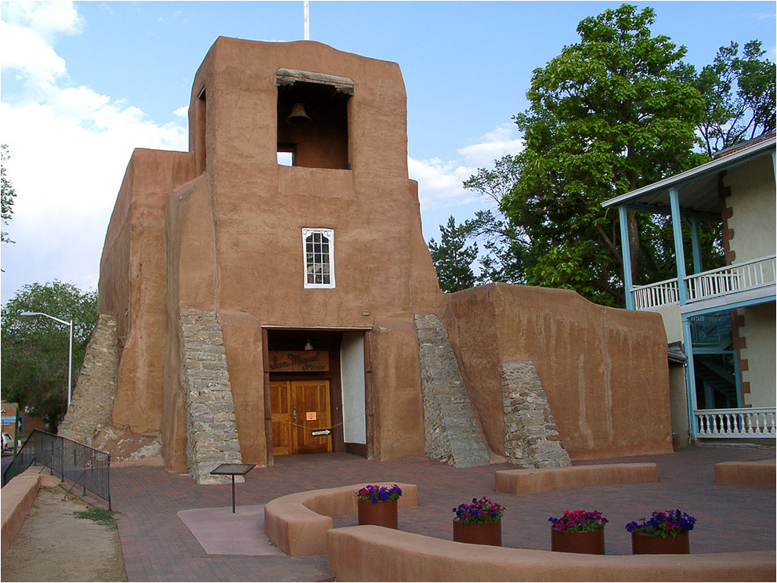
Notes:
San Miguel Chapel in Santa Fe. Oldest church structure in the U.S., built in 1610.

Slide 23
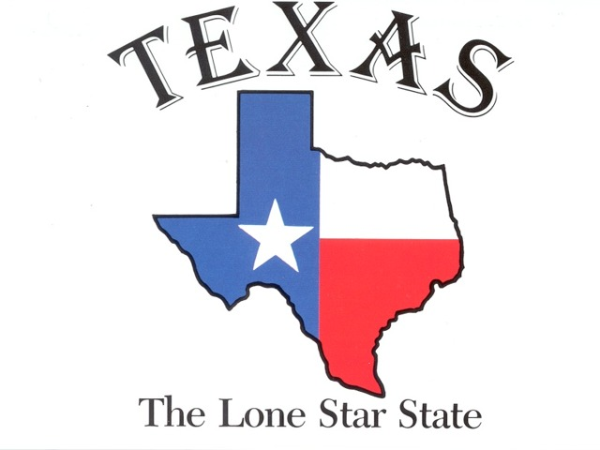
> « tehshas » = allies/friends

Slide 24
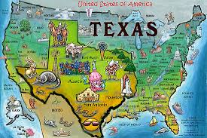
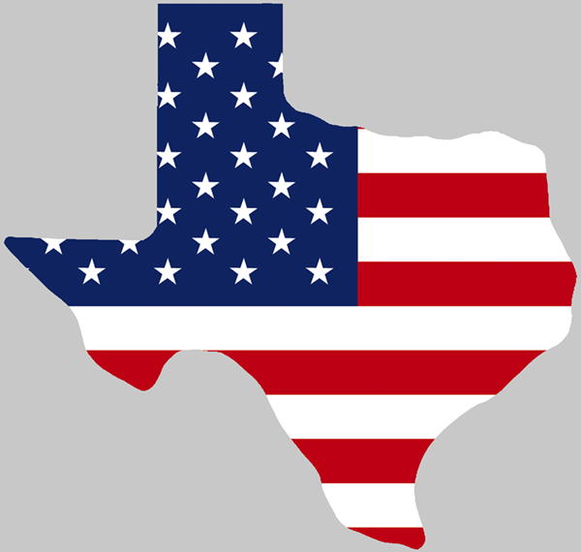
Nickname :The Lone Star State
Capital : Austin
Entrance in the Union : 1845 (28th state)
Population : 27 million people approximatively
Area : 696 241km2, 2nd biggest state of the USA, Spain x1.4
Neighboring states : Mexico (country), New Mexico, Oklahoma, Arkansas, Louisiana, Gulf of Mexico (gulf)
Landscape : deserts, woods, lakes, mountains
Weather: varies widely

Slide 25
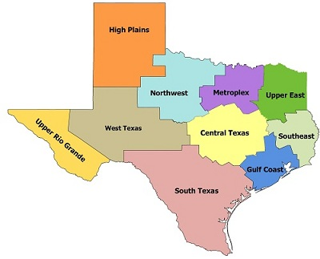
10 regions (political)

Slide 26
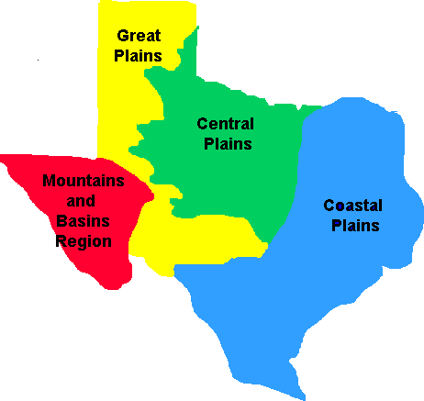
4 regions (geography)

Slide 27
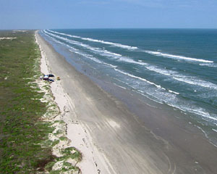
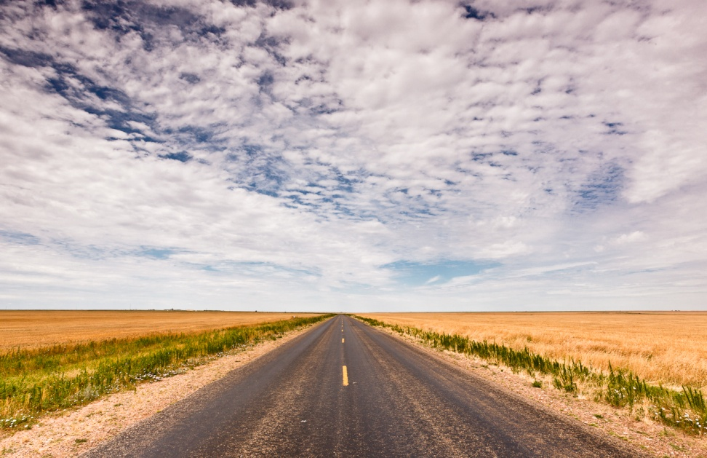
GEOGRAPHY
Coast
Plains

Slide 28
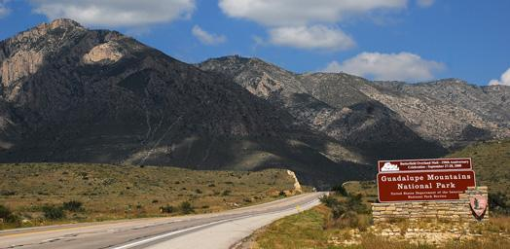
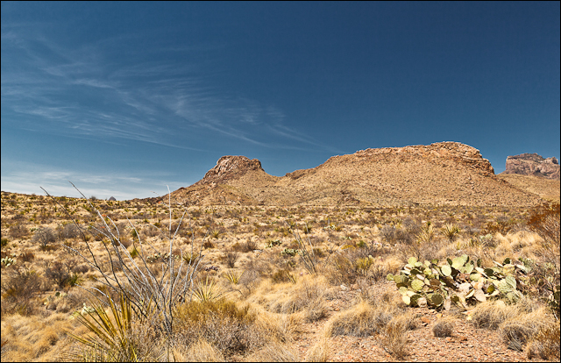
GEOGRAPHY
Mountain
Big Bend National Park
(West)
Guadalupe Peak
highest point
2,667m
Desert

Slide 29
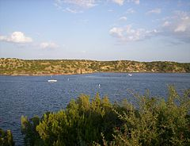
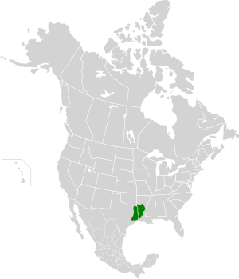
GEOGRAPHY
Piney woods
Temperature coniferous forest terrestrial region
54, 400 square miles (141 000 km2)
Lake
Lake Alan Henry
Garza County
(West)
Woods

Slide 30
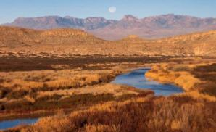
Rio Grande
Longest river
Along the border with Mexico
3, 051 km long
( 1 920 km in Texas)

Slide 31
CLIMATE
Gulf coast => mild winters
West: 8.7 inches (220 mm) annual rainfall
Southeast: 64 inches (1, 600 mm) per year
North central region and Dallas: mode moderate, 37 inches (940 mm)
Snow: multiple times, moutaineous areas (West)
1-2 x /year Northern Texas
Once every few years in Central and East
South: 65°F (20°C) in winter (Kingsville)

Slide 32
CLIMATE
Summer: max. 80s°F (26°C) (mountains)
Gavestone Island: 100°F (38°C) (Rio Grande Valley)
Most of Texas: hot summer, in the 90°F (32°C) range
At night: 50°F (14°C) mountains
80°F (27°C) Gavestone Island (South)

Slide 33
CLIMATE
Tornadoes: 139 a year (April, May, June), North
Hurricanes
Thunderstorms (East and North)

Slide 34
SPORT: football
American football = most popular sport in Texas
Watch football every Sunday with friends

Slide 35



The Dallas Cowboys
and their cheerleaders

Slide 36
SPORT: baseball
Baseball is also very popular. It’s considered as the US national sport.

Slide 37



><
Astros from Houston
Rangers from Dallas

Slide 38


SPORT: Rodeo
Cowboys and cowgirls show off their talents
Riding bulls and lassoing cows

Slide 39


SPORT: NASCAR
Car race each other around a track
Winner = person who finishes in the first place

Slide 40


FOOD AND DRINK
Barbecue
Iced tea

Slide 41




FOOD AND DRINK: TEX MEX
Nachos
Fajitas
Tacos
Quesadillas

Slide 42


IMPORTANT CITIES
Houston
4th largest (US)
2 million people
Austin
4th largest (Texas)
790, 000 people

Slide 43


ECONOMY
2nd wealthiest state of the USA
Important sectors: agriculture, mining, energy, technology, commerce

Slide 44


Do you know that…
One of the NASA’s offices is in Houston

Slide 45
Do you speak Texas language?
Howdy : how do you do?
Big O’ : huge (sandwich or bull)
Fizyu : if I were you
Hooda thunk it : who would have thought of that ?
Afar : on fire

Slide 46
Texas language rules
The more you shorten, the better
No more G: cookin’, playin’
Play with vowels: aiggs (eggs), laht (light), nawth (north), daints (dance)

Slide 47
Some expressions
Big hat, no cattle
Don’t call him a cowboy till you’ve seen him ride
Never slap a man who’s chewin’ tobacco
If you find yourself in a hole, the first thing to do is stop diggin’
There’s two theories to arguin’ with a woman. Neither one works

Slide 48

Oklahoma
Nickname : Sooner State
Capital : Oklahoma city
Entrance in the union : 1907 (46th state)
Population : 3,878 million people
Superficie : 181 196 km2
Neighboring states : Texas, Arkansas, Missouri, Kansas, Colorado, New Mexico
Landscape : most diversified of the USA with woods, sand dunes, undulating meadows, cypress marshes

Slide 49

Oklahoma

Slide 50




Oklahoma

Slide 51




Oklahoma – Route 66

Slide 52




Oklahoma – Nature

Slide 53




Oklahoma - Nature

Slide 54


Oklahoma – Nature

Slide 55

Weather forecast: http://on.aol.com/video/southwest-extended-regional-weather-forecast-519115632

