Slide 1
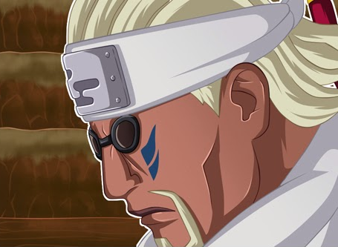
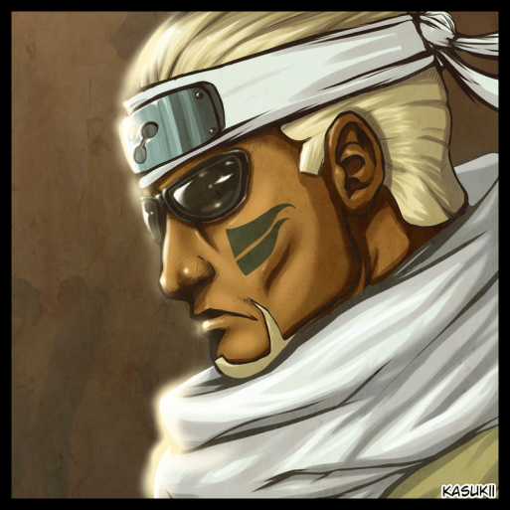
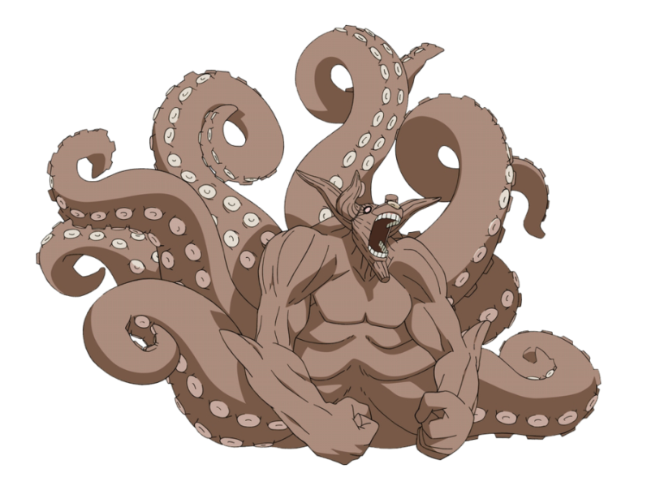
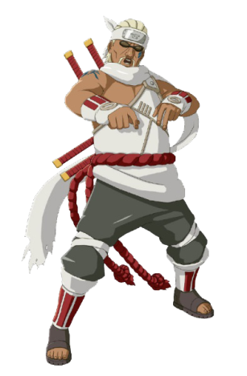
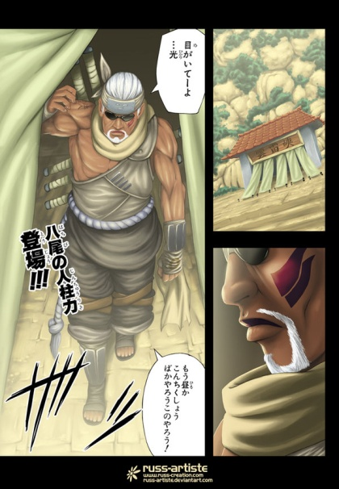
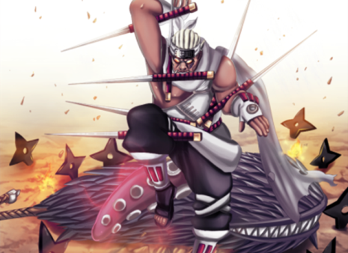
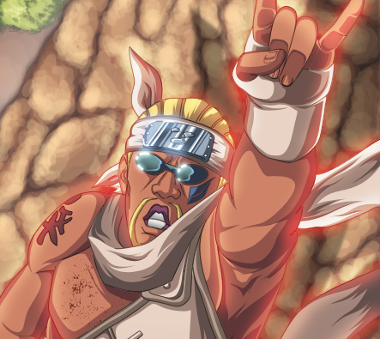
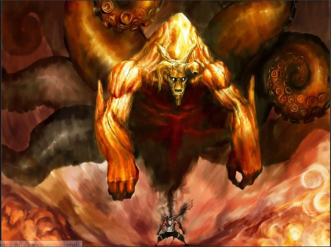
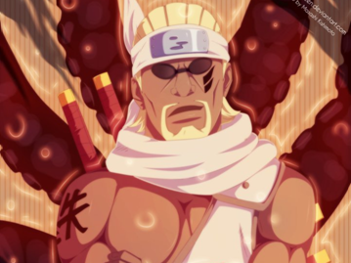
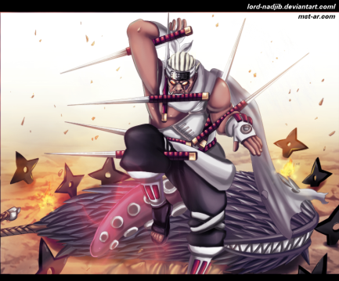
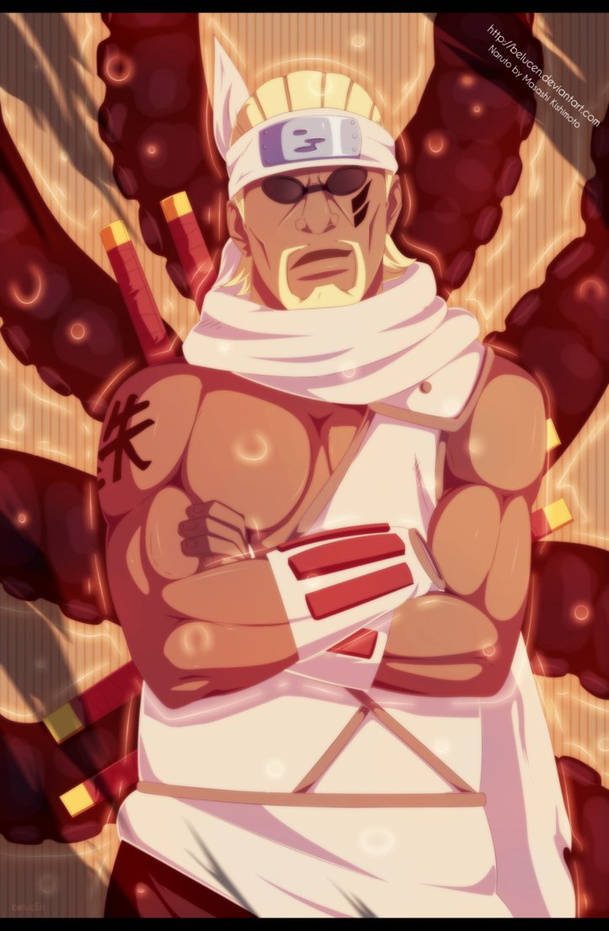
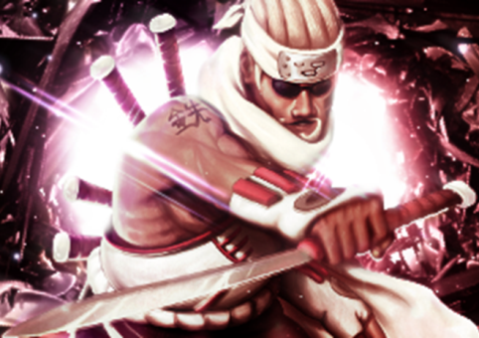
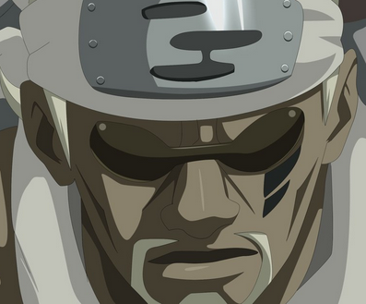
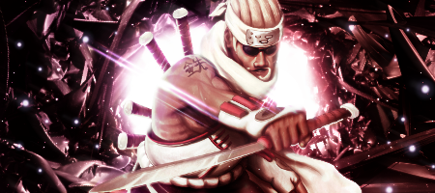
KillerBee le rappeur
KillerBee
?
KillerBee [73,95%]
Nin | Tai | Gen | Int | For | Vit | End | Sce
3,79 | 4,79 | 2,10 | 2,80 | 4,44 | 4,10 | 4,72 | 2,84
KillerBee [73,95%]
Nin | Tai | Gen | Int | For | Vit | End | Sce
3,79 | 4,79 | 2,10 | 2,80 | 4,44 | 4,10 | 4,72 | 2,84

Slide 2
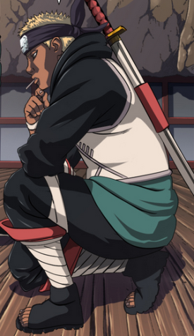
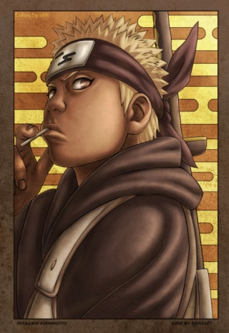
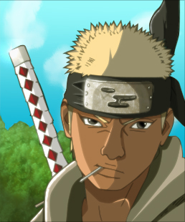
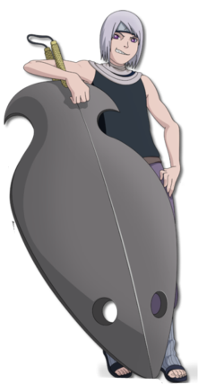
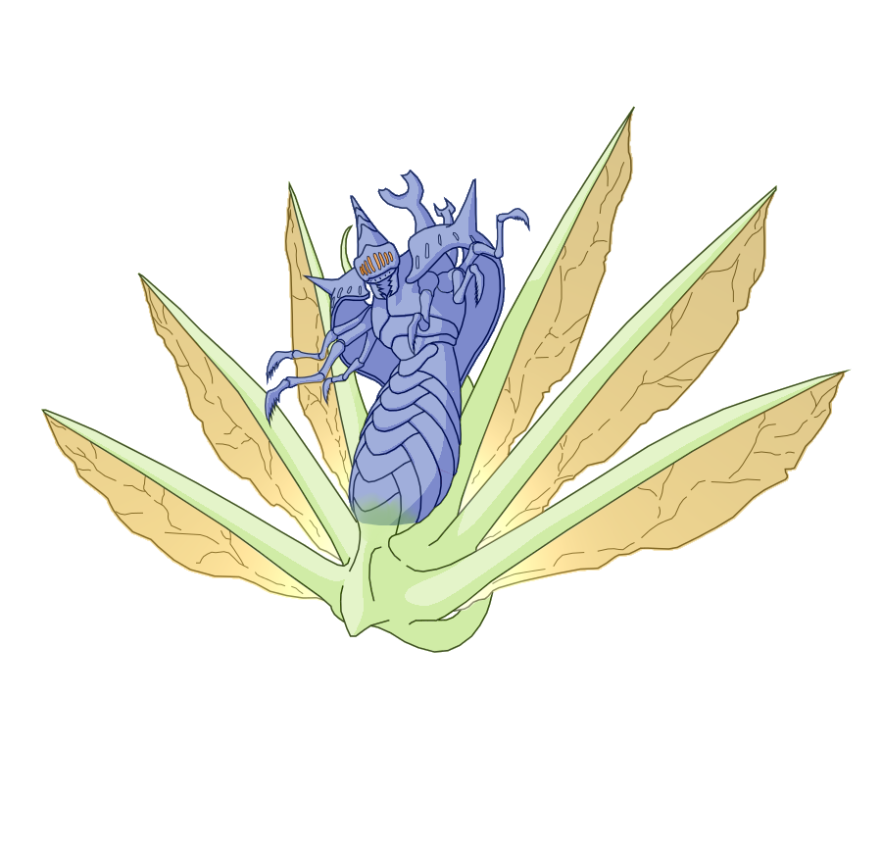
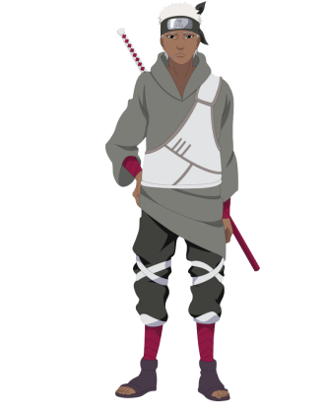

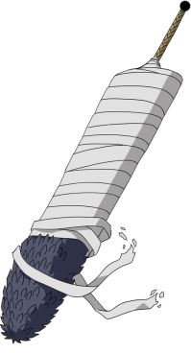
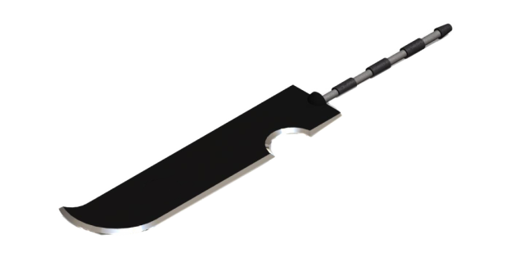
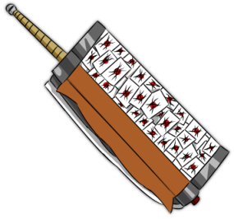
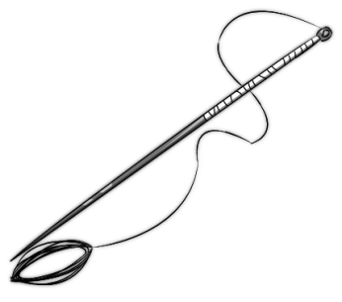
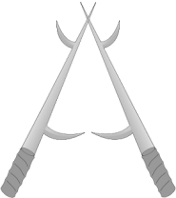
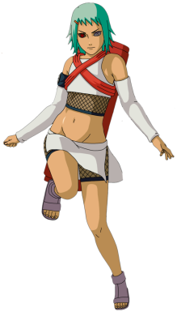
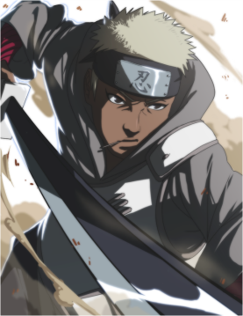
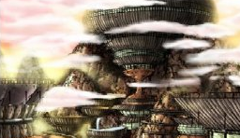
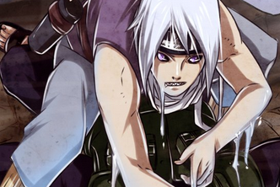
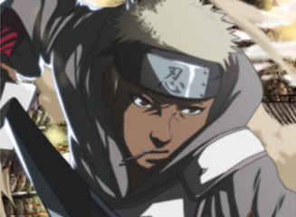
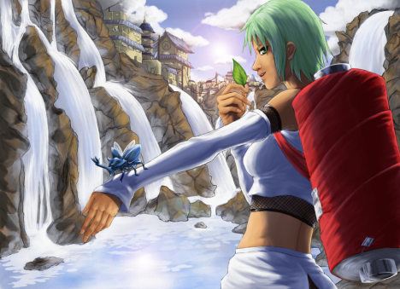
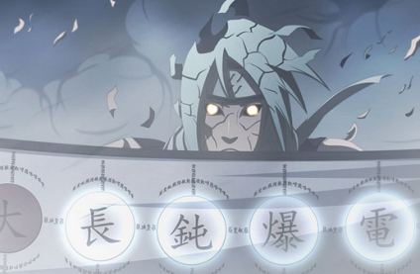
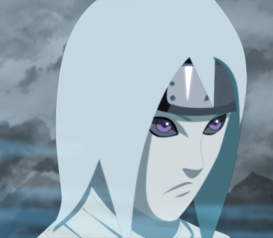
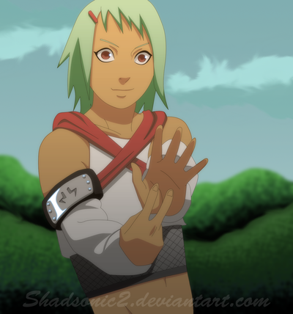
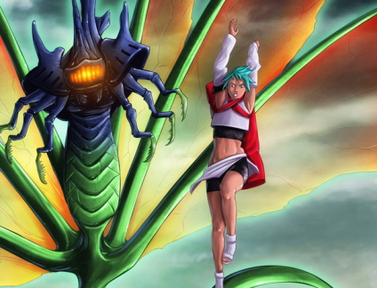

Mangetsu – Omoi
Mangetsu
Omoi
Bonus : Fu
?
Fû
?
?
Mangetsu Hozuki [56,83%]
Omoi [34,78%]
Fû [37,15%]
Nin | Tai | Gen | Int | For | Vit | End | Sce
2,86 | 4,33 | 1,42 | 2,45 | 3,17 | 2,81 | 3,74 | 1,95
Nin | Tai | Gen | Int | For | Vit | End | Sce
1,63 | 2,59 | 0,89 | 2,12 | 1,72 | 2,03 | 2,13 | 0,80
Nin | Tai | Gen | Int | For | Vit | End | Sce
2,27 | 1,90 | 0,83 | 2,02 | 1,61 | 2,13 | 2,57 | 1,53

Slide 3
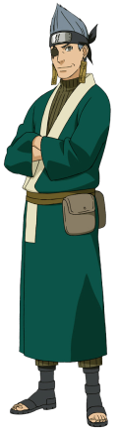
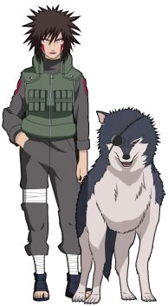
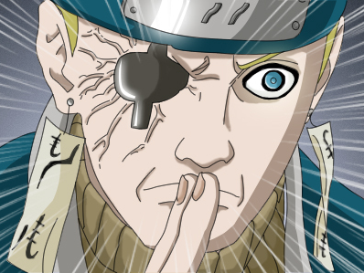
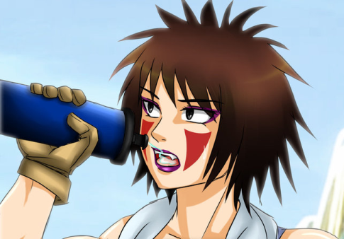
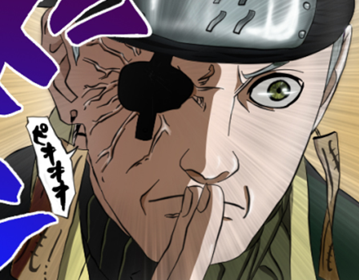
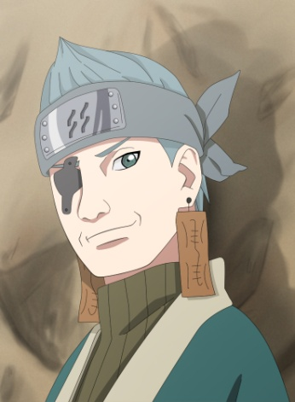
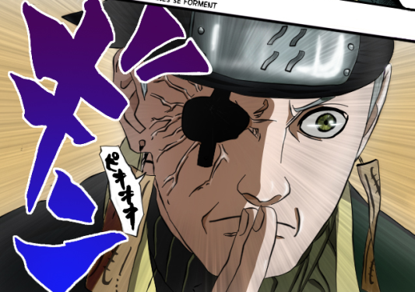
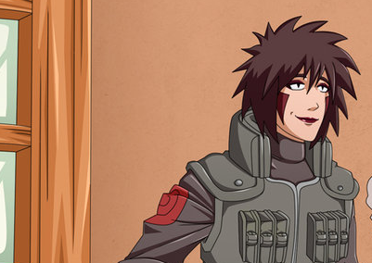
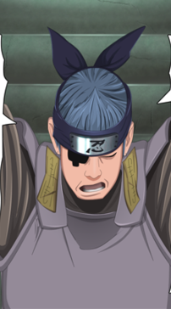
Les mal aimes 1
Tsume
Ao
?
?
Tsume Inuzuka [43,60%]
Ao [39,78%]
Nin | Tai | Gen | Int | For | Vit | End | Sce
1,89 | 3,04 | 1,22 | 2,15 | 2,63 | 2,87 | 2,35 | 1,29
Nin | Tai | Gen | Int | For | Vit | End | Sce
2,13 | 1,65 | 1,84 | 2,66 | 1,85 | 2,01 | 2,11 | 1,66

Slide 4
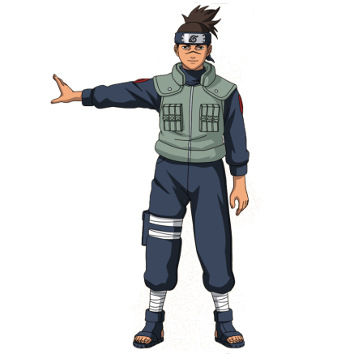
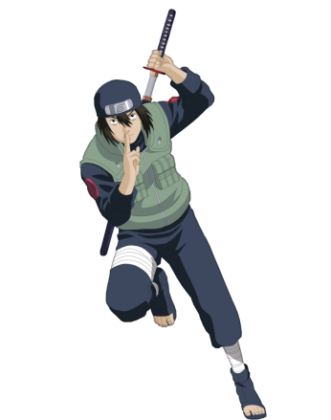
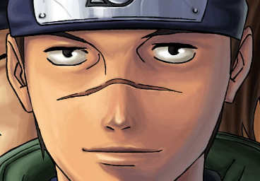
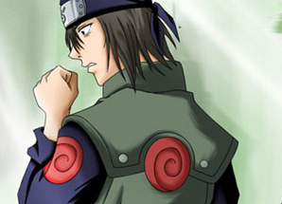
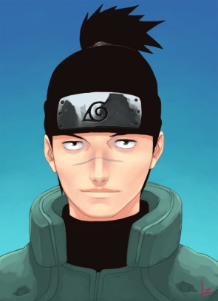
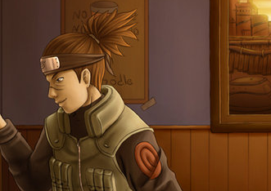

Les mal aimes 2
Iruka
Hayate
?
?
Iruka Umino [31,13%]
Hayate Gekko [37,08%]
Nin | Tai | Gen | Int | For | Vit | End | Sce
1,33 | 1,47 | 0,99 | 2,39 | 1,39 | 1,49 | 1,46 | 1,93
Nin | Tai | Gen | Int | For | Vit | End | Sce
1,83 | 2,60 | 1,10 | 2,11 | 1,81 | 2,38 | 2,01 | 0,99

Slide 5




Les mal aimes 3
Baki
Dan
?
?
Dan Katô [42,50%]
Baki [37,05%]
Nin | Tai | Gen | Int | For | Vit | End | Sce
2,90 | 2,12 | 1,26 | 2,67 | 1,90 | 2,36 | 2,27 | 1,52
Nin | Tai | Gen | Int | For | Vit | End | Sce
2,04 | 1,89 | 1,15 | 2,61 | 1,96 | 1,90 | 2,17 | 1,10

Slide 6








Les mal aimes 4
Karui
Ebisu
?
?
Karui [31,60%]
Ebisu [30,58%]
Nin | Tai | Gen | Int | For | Vit | End | Sce
1,13 | 2,43 | 0,79 | 1,87 | 1,75 | 1,95 | 1,98 | 0,74
Nin | Tai | Gen | Int | For | Vit | End | Sce
1,58 | 1,37 | 1,07 | 2,15 | 1,33 | 1,65 | 1,98 | 1,10

Slide 7





Les mal aimes 5
Aoba
Shibi
?
?
Aoba Yamashiro [34,35%]
Shibi Aburame [38,58%]
Nin | Tai | Gen | Int | For | Vit | End | Sce
2,31 | 1,65 | 1,24 | 1,94 | 1,52 | 1,78 | 1,87 | 1,43
Nin | Tai | Gen | Int | For | Vit | End | Sce
2,75 | 1,61 | 1,32 | 2,69 | 1,74 | 1,67 | 2,26 | 1,39

Slide 8





Les mal aimes 6
Yahiko
Ibiki
?
?
Yahiko [35,33%]
Ibiki Morino [38,35%]
Nin | Tai | Gen | Int | For | Vit | End | Sce
2,08 | 1,90 | 1,08 | 2,51 | 1,56 | 1,92 | 2,22 | 0,86
Nin | Tai | Gen | Int | For | Vit | End | Sce
1,65 | 1,82 | 1,61 | 2,56 | 1,92 | 1,88 | 2,29 | 1,61

Slide 9








Les Epeistes de Kiri
Ameyuri
Jinin
Kushimaru
?
?
?
Ameyuri Ringo [45,45%]
Jinin Akebino [43,23%]
Kushimaru Kuriarare [41,68%]
Nin | Tai | Gen | Int | For | Vit | End | Sce
2,56 | 3,51 | 1,38 | 2,28 | 1,76 | 2,87 | 2,52 | 1,30
Nin | Tai | Gen | Int | For | Vit | End | Sce
1,97 | 3,22 | 1,26 | 2,19 | 2,66 | 2,14 | 2,54 | 1,31
Nin | Tai | Gen | Int | For | Vit | End | Sce
1,97 | 3,25 | 1,30 | 2,15 | 1,53 | 2,81 | 2,42 | 1,24

Slide 10






Fuguki
Jinpachi
?
?
Fuguki Suikazan [47,38%]
Jinpachi Munashi [42,65%]
Nin | Tai | Gen | Int | For | Vit | End | Sce
2,58 | 3,17 | 1,77 | 2,25 | 2,80 | 1,99 | 3,06 | 1,33
Nin | Tai | Gen | Int | For | Vit | End | Sce
1,96 | 3,07 | 1,26 | 2,18 | 2,37 | 2,10 | 2,56 | 1,56

Slide 11






Les gardes de Minato
Genma
Raido
Iwashi
?
?
?
Genma Shiranui [39,25%]
Raido Namiashi [42,63%]
Iwashi Tatami [32,55%]
Nin | Tai | Gen | Int | For | Vit | End | Sce
2,36 | 1,93 | 1,34 | 2,33 | 1,69 | 2,05 | 2,13 | 1,87
Nin | Tai | Gen | Int | For | Vit | End | Sce
2,11 | 2,70 | 1,33 | 2,32 | 1,89 | 2,56 | 2,27 | 1,87
Nin | Tai | Gen | Int | For | Vit | End | Sce
1,88 | 1,49 | 1,14 | 2,04 | 1,49 | 1,63 | 1,65 | 1,70

Slide 12










Les derniers Uchihas
Fugaku
Izuna
Kagami
?
?
?
Fugaku Uchiha [59,75%]
Izuna Uchiha [63,50%]
Kagami Uchiha [54,85%]
Nin | Tai | Gen | Int | For | Vit | End | Sce
3,36 | 3,26 | 3,56 | 3,21 | 2,21 | 3,24 | 2,58 | 2,48
Nin | Tai | Gen | Int | For | Vit | End | Sce
3,91 | 3,75 | 3,90 | 2,62 | 1,97 | 3,47 | 2,95 | 2,83
Nin | Tai | Gen | Int | For | Vit | End | Sce
3,09 | 2,92 | 3,63 | 2,71 | 1,92 | 2,94 | 2,77 | 1,96

Slide 13






Les Edo Tensei
Gari
Toroi
Pakura
?
?
?
Gari [41,20%]
Toroi [40,15%]
Pakura [39,45%]
Nin | Tai | Gen | Int | For | Vit | End | Sce
2,69 | 2,72 | 1,22 | 2,12 | 1,83 | 2,25 | 2,23 | 1,42
Nin | Tai | Gen | Int | For | Vit | End | Sce
3,03 | 2,69 | 1,15 | 2,11 | 1,64 | 1,79 | 2,12 | 1,53
Nin | Tai | Gen | Int | For | Vit | End | Sce
3,08 | 2,16 | 1,24 | 2,12 | 1,27 | 2,30 | 2,19 | 1,42

Slide 14






Vers l’infini et au dela
Mabui
Mizuki
Hizashi
?
?
?
Mabui [31,58%]
Mizuki [26,43%]
Hizashi [50,98%]
Nin | Tai | Gen | Int | For | Vit | End | Sce
2,45 | 1,25 | 1,13 | 2,84 | 0,99 | 1,14 | 1,57 | 1,26
Nin | Tai | Gen | Int | For | Vit | End | Sce
1,27 | 1,56 | 0,92 | 2,08 | 1,40 | 1,49 | 1,04 | 0,81
Nin | Tai | Gen | Int | For | Vit | End | Sce
1,64 | 4,18 | 1,92 | 2,85 | 2,54 | 3,22 | 2,79 | 1,25

Slide 15







Les duos
Yashamaru
Izumo & Kotetsu
Atsui
?
?
?
Yashamaru [36,00%]
Izumo & Kotetsu [36,13%]
Atsui [28,70%]
Nin | Tai | Gen | Int | For | Vit | End | Sce
2,24 | 1,70 | 1,24 | 2,70 | 1,39 | 1,83 | 1,88 | 1,42
Nin | Tai | Gen | Int | For | Vit | End | Sce
1,70 | 2,49 | 1,58 | 1,96 | 1,76 | 2,17 | 1,75 | 1,04
Nin | Tai | Gen | Int | For | Vit | End | Sce
1,51 | 1,81 | 0,94 | 1,17 | 1,70 | 1,65 | 1,80 | 0,90

Slide 16





Le bout du tunel
Misumi
Meizu & Gôzu
?
?
Misumi [16,68%]
Meizu & Gôzu [22,78%]
Nin | Tai | Gen | Int | For | Vit | End | Sce
0,74 | 1,22 | 0,27 | 1,16 | 1,34 | 0,97 | 0,71 | 0,26
Nin | Tai | Gen | Int | For | Vit | End | Sce
1,25 | 1,49 | 0,92 | 1,12 | 1,26 | 1,23 | 1,29 | 0,55

Slide 17












Naruto, le héros de la guerre
Naruto KCM1
?
Naruto Uzumaki (KCM1) [69,23%]
Nin | Tai | Gen | Int | For | Vit | End | Sce
3,82 | 4,15 | 1,54 | 2,56 | 4,45 | 4,47 | 4,44 | 2,26

Slide 18









Obito jin’, le second rikudô
Obito jin’
?
Obito Uchiha (jin’) [90,00%]
Nin | Tai | Gen | Int | For | Vit | End | Sce
4,70 | 4,36 | 4,26 | 3,61 | 4,66 | 4,83 | 4,91 | 4,67
Obito Uchiha (jin’) [90,00%]
Nin | Tai | Gen | Int | For | Vit | End | Sce
4,70 | 4,36 | 4,26 | 3,61 | 4,66 | 4,83 | 4,91 | 4,67

Slide 19







Utakata – Zaku
Utakata
Zaku
?
?
Utakata [44,03%]
Zaku Abumi [14,28%]
Nin | Tai | Gen | Int | For | Vit | End | Sce
2,80 | 2,60 | 1,23 | 2,11 | 2,46 | 2,37 | 2,88 | 1,16
Nin | Tai | Gen | Int | For | Vit | End | Sce
1,24 | 0,78 | 0,25 | 0,97 | 0,76 | 0,69 | 0,88 | 0,14

Slide 20












Néji FG – Kurenai
Néji FG
Kurenai
?
?
Néji Hyûga (FG) [33,03%]
Kurenaï Yûhi [41,13%]
Nin | Tai | Gen | Int | For | Vit | End | Sce
0,86 | 2,98 | 1,01 | 2,31 | 1,45 | 2,11 | 1,74 | 0,75
Nin | Tai | Gen | Int | For | Vit | End | Sce
1,96 | 1,92 | 3,44 | 2,33 | 1,38 | 2,08 | 1,90 | 1,44
Kurenaï Yûhi [41,13%]
Nin | Tai | Gen | Int | For | Vit | End | Sce
1,96 | 1,92 | 3,44 | 2,33 | 1,38 | 2,08 | 1,90 | 1,44

Slide 21














Gai, le maître du taijutsu
Gai
?
Gai Maito [57,95%]
Nin | Tai | Gen | Int | For | Vit | End | Sce
1,52 | 5,00 | 1,47 | 2,16 | 4,23 | 4,50 | 2,89 | 1,51
Gai Maito [57,95%]
Nin | Tai | Gen | Int | For | Vit | End | Sce
1,42 | 5,00 | 1,47 | 2,16 | 4,23 | 4,50 | 2,89 | 1,51

Slide 22












Kinkaku – Lee FG
Kinkaku
Lee FG
?
?
Kinkaku [60,58%]
Rock Lee (FG) [26,70%]
Nin | Tai | Gen | Int | For | Vit | End | Sce
2,80 | 3,50 | 1,43 | 2,23 | 3,80 | 2,90 | 4,05 | 3,52
Nin | Tai | Gen | Int | For | Vit | End | Sce
0,04 | 2,94 | 0,03 | 1,11 | 2,41 | 2,63 | 1,50 | 0,02

Slide 23





Fû – Han
Fû
Han
?
?
Fû Yamanaka [40,33%]
Han [55,83%]
Nin | Tai | Gen | Int | For | Vit | End | Sce
2,17 | 2,32 | 1,46 | 2,61 | 1,64 | 1,83 | 2,15 | 1,95
Nin | Tai | Gen | Int | For | Vit | End | Sce
2,34 | 3,64 | 1,28 | 2,05 | 4,53 | 3,88 | 3,40 | 1,21

Slide 24












Nagato , le vainqueur du TMS
Nagato war
?
Nagato Uzumaki (war) [64,98%]
Nin | Tai | Gen | Int | For | Vit | End | Sce
4,69 | 3,05 | 3,33 | 3,77 | 1,29 | 1,44 | 3,83 | 4,59

Slide 25







Shizune – Kiba FG
Shizune
Kiba FG
?
?
Shizune [42,10%]
Kiba FG [23,40%]
Nin | Tai | Gen | Int | For | Vit | End | Sce
2,62 | 2,08 | 1,41 | 3,02 | 1,24 | 2,03 | 1,88 | 2,56
Nin | Tai | Gen | Int | For | Vit | End | Sce
1,10 | 1,90 | 0,33 | 1,16 | 1,46 | 1,74 | 1,46 | 0,21

Slide 26










Sandaime Kazekage - Kushina
Sandaime Kazekage
Kushina
?
?
Kushina Uzumaki [53,73%]
Sandaime Kazekage [50,88%]
Nin | Tai | Gen | Int | For | Vit | End | Sce
1,67 | 2,25 | 1,41 | 2,68 | 2,42 | 2,29 | 4,09 | 4,68
Nin | Tai | Gen | Int | For | Vit | End | Sce
3,75 | 2,75 | 1,52 | 3,34 | 2,05 | 2,18 | 2,81 | 1,95

Slide 27










Minato, l’éclair jaune
Minato war
?
Minato Namikaze (war) [80,35%]
Nin | Tai | Gen | Int | For | Vit | End | Sce
3,78 | 4,23 | 2,28 | 4,35 | 3,43 | 4,88 | 4,42 | 4,77

Slide 28




Dodai - Kakkô
Dodai
Kakkô
?
?
Dodai [45,23%]
Kakkô [41,18%]
Nin | Tai | Gen | Int | For | Vit | End | Sce
3,35 | 2,32 | 1,37 | 3,00 | 1,61 | 2,66 | 2,33 | 1,45
Nin | Tai | Gen | Int | For | Vit | End | Sce
2,28 | 2,60 | 2,08 | 2,21 | 1,86 | 2,23 | 2,10 | 1,11

Slide 29






Kitsuchi – Team Oboro
Kitsuchi
Team Oboro
?
?
Kitsuchi [54,70%]
Team Oboro [23,55%]
Nin | Tai | Gen | Int | For | Vit | End | Sce
3,53 | 3,36 | 1,45 | 3,00 | 3,25 | 2,74 | 3,14 | 1,41
Nin | Tai | Gen | Int | For | Vit | End | Sce
1,40 | 1,09 | 1,83 | 1,79 | 0,84 | 1,08 | 0,84 | 0,55

Slide 30




Naruto KCM2, le héros de la guerre
Naruto KCM2
?
Naruto Uzumaki (KCM2) [72,75%]
Nin | Tai | Gen | Int | For | Vit | End | Sce
4,18 | 4,21 | 1,87 | 2,82 | 4,48 | 4,56 | 4,64 | 2,34

Slide 31








Reevaluation : Les sceaux
Nidaime Mizukage
Yagura
Muu
Yondaime Kazekage
?
?
?
?
Reevaluation : genjutsu
Ae
Minato war
Yagura
Naruto KCM2
KillerBee
Naruto KCM3
?
?
?
?
?
?

Slide 32
















Madara, le plus puissant des shinobis
Madara jin’
?
Madara Uchiha (jin’) [97,73%]
Madara Uchiha (jin’) [97,73%]
Nin | Tai | Gen | Int | For | Vit | End | Sce
5,00 | 4,98 | 4,95 | 4,32 | 4,87 | 5,00 | 5,00 | 4,97
Nin | Tai | Gen | Int | For | Vit | End | Sce
5,00 | 4,98 | 4,95 | 4,32 | 4,87 | 5,00 | 5,00 | 4,97

Slide 33





Mito - Yoroi
Mito
Yoroi
?
?
Mito Uzumaki [63,68%]
Yoroi Akado [16,23%]
Nin | Tai | Gen | Int | For | Vit | End | Sce
2,67 | 2,49 | 1,70 | 3,44 | 2,87 | 3,01 | 4,44 | 4,85
Nin | Tai | Gen | Int | For | Vit | End | Sce
0,85 | 1,27 | 0,26 | 1,01 | 1,17 | 0,80 | 0,95 | 0,18

Slide 34








Hanabi – Obito&Guruguru
Hanabi
Obito & Guruguru
?
?
Hanabi Hyuga [17,73%]
Obito & Tobi [39,03%]
Nin | Tai | Gen | Int | For | Vit | End | Sce
0,61 | 1,71 | 0,78 | 1,28 | 0,56 | 1,07 | 0,88 | 0,20
Nin | Tai | Gen | Int | For | Vit | End | Sce
3,05 | 2,59 | 1,64 | 0,65 | 2,34 | 2,45 | 2,44 | 0,45

Slide 35








Kakashi au double MS
Kakashi & Obi’
?
Kakashi 2MS [72,15%]
Nin | Tai | Gen | Int | For | Vit | End | Sce
4,78 | 4,04 | 3,80 | 4,44 | 2,81 | 3,86 | 2,52 | 2,61

Slide 36





Daï - Taiseki
Daï
Taiseki
?
?
Daï Maito [41,25%]
Taiseki [35,38%]
Nin | Tai | Gen | Int | For | Vit | End | Sce
0,05 | 4,23 | 0,10 | 2,06 | 3,81 | 4,13 | 2,10 | 0,02
Nin | Tai | Gen | Int | For | Vit | End | Sce
2,36 | 2,25 | 1,02 | 2,08 | 2,15 | 1,65 | 1,53 | 1,11

Slide 37








4 du son - Mahiru
4 du son
Mahiru
?
?
Les 4 du son [53,35%]
Mahiru [38,18%]
Nin | Tai | Gen | Int | For | Vit | End | Sce
2,85 | 3,07 | 3,08 | 2,24 | 2,77 | 1,76 | 2,39 | 3,18
Nin | Tai | Gen | Int | For | Vit | End | Sce
2,19 | 2,45 | 1,23 | 2,07 | 1,70 | 2,10 | 2,44 | 1,09

Slide 38













Kyuubi, le renard a 9 queues
Kyuubi
?
Kurama [65,85%]
Nin | Tai | Gen | Int | For | Vit | End | Sce
3,29 | 3,55 | 1,73 | 3,35 | 4,64 | 3,53 | 4,85 | 1,40

Slide 39







Shukaku – Team Taka
Shukaku
Team Taka
?
?
Shukaku [62,48%]
Team Taka [71,78%]
Nin | Tai | Gen | Int | For | Vit | End | Sce
4,03 | 2,87 | 1,67 | 2,47 | 4,09 | 2,04 | 4,34 | 3,48
Nin | Tai | Gen | Int | For | Vit | End | Sce
4,16 | 3,97 | 3,87 | 3,41 | 3,32 | 3,48 | 4,01 | 2,49

Slide 40







Zetsu Blanc - Matatabi
Zetsu Blanc
Matatabi
?
?
Zetsu (blanc) [32,55%]
Matatabi [61,79%]
Nin | Tai | Gen | Int | For | Vit | End | Sce
2,69 | 1,31 | 0,85 | 1,64 | 1,62 | 1,79 | 2,44 | 0,68
Nin | Tai | Gen | Int | For | Vit | End | Sce
3,37 | 3,45 | 1,68 | 3,19 | 4,03 | 3,46 | 4,23 | 1,29

Slide 41
















Naruto, le heros de la guerre
Naruto Rikudo
?
Naruto Uzumaki (KCM4) [81,08%]
Nin | Tai | Gen | Int | For | Vit | End | Sce
4,86 | 4,83 | 2,00 | 2,88 | 4,82 | 4,95 | 4,91 | 3,18
Naruto Uzumaki (KCM4) [81,08%]
Nin | Tai | Gen | Int | For | Vit | End | Sce
4,86 | 4,83 | 2,00 | 2,88 | 4,82 | 4,95 | 4,91 | 3,18

Slide 42













Gokage – Sanbi
Gokage
Isobu
?
?
Gokage [84,33%]
Isobu [58,23%]
Nin | Tai | Gen | Int | For | Vit | End | Sce
4,85 | 4,62 | 2,29 | 4,56 | 4,66 | 4,24 | 4,57 | 3,94
Nin | Tai | Gen | Int | For | Vit | End | Sce
3,46 | 3,40 | 1,68 | 2,31 | 4,24 | 2,61 | 4,27 | 1,32

Slide 43







Pain et Konan, les fondateurs de l’akatsuki
Pain & Konan
?
Pain & Konan [78,53%]
Nin | Tai | Gen | Int | For | Vit | End | Sce
4,56 | 3,90 | 3,25 | 3,82 | 3,34 | 3,27 | 4,62 | 4,65

Slide 44










Songoku – Gaara NG
Songoku
Gaara NG
?
?
Gaara (NG) [47,68%]
Songoku [59,58%]
Nin | Tai | Gen | Int | For | Vit | End | Sce
3,63 | 1,02 | 1,69 | 3,47 | 1,27 | 1,76 | 3,56 | 2,67
Nin | Tai | Gen | Int | For | Vit | End | Sce
3,69 | 3,14 | 1,68 | 2,61 | 4,44 | 2,60 | 4,32 | 1,35

Slide 45





Kakuzu et Hidan, le duo des immortels
Hidan & Kakuzu
?
Hidan & Kakuzu [64,60%]
Nin | Tai | Gen | Int | For | Vit | End | Sce
4,29 | 3,95 | 1,78 | 3,00 | 3,46 | 2,92 | 4,55 | 1,89

Slide 46




Itachi et Kisame, les opposes
Itachi & Kisame
?
Itachi & Kisame [78,25%]
Nin | Tai | Gen | Int | For | Vit | End | Sce
4,29 | 4,35 | 4,55 | 4,17 | 3,15 | 3,57 | 3,54 | 3,68

Slide 47












Sasuke, l’antagoniste final
Sasuke Rinnegan
?
Sasuke Uchiha (rinnegan) [82,45%]
Nin | Tai | Gen | Int | For | Vit | End | Sce
4,74 | 4,48 | 4,79 | 3,64 | 2,24 | 4,85 | 4,43 | 3,81

Slide 48








Hiruzen full power - Chiriku
Hiruzen full power
Chiriku
?
?
Hiruzen Sarutobi (jeune) [63,88%]
Chiriku [42,48%]
Nin | Tai | Gen | Int | For | Vit | End | Sce
4,23 | 3,87 | 2,09 | 3,50 | 2,66 | 3,23 | 2,90 | 3,07
Nin | Tai | Gen | Int | For | Vit | End | Sce
2,21 | 2,51 | 1,30 | 2,51 | 1,78 | 2,11 | 2,03 | 2,54

Slide 49










Ino/Shika/Cho FG – Asuma&Kurenai
Ino-Shika-Cho FG
Asuma & Kurenai
?
?
Equipe 10 (FG) [35,55%]
Asuma & Kurenai [51,93%]
Nin | Tai | Gen | Int | For | Vit | End | Sce
1,79 | 1,79 | 1,41 | 3,46 | 2,64 | 1,09 | 1,23 | 0,81
Nin | Tai | Gen | Int | For | Vit | End | Sce
2,93 | 3,14 | 3,45 | 2,53 | 2,42 | 2,33 | 2,38 | 1,59

Slide 50










Ino/Shika/Cho war – Yugao
Yugao
Ino-Shika-Cho war
?
?
Equipe 10 (war) [57,48%]
Yugao Uzuki [39,25%]
Nin | Tai | Gen | Int | For | Vit | End | Sce
3,04 | 3,41 | 1,65 | 4,29 | 4,06 | 2,11 | 2,70 | 1,73
Nin | Tai | Gen | Int | For | Vit | End | Sce
2,00 | 2,59 | 1,26 | 2,18 | 1,70 | 2,23 | 2,24 | 1,50

Slide 51






Shikamaru, Naruto, Neji, Kiba et Choji
Team Shikamaru
?
Team Shikamaru [45,35%]
Nin | Tai | Gen | Int | For | Vit | End | Sce
2,36 | 3,16 | 1,39 | 3,49 | 2,60 | 1,71 | 2,18 | 1,25

Slide 52









Zabuza & Haku – Hana
Zabuza & Haku
Hana
?
?
Hana Inuzuka [39,43%]
Zabuza & Haku [53,98%]
Nin | Tai | Gen | Int | For | Vit | End | Sce
3,23 | 3,56 | 1,81 | 3,10 | 2,57 | 2,83 | 3,17 | 1,32
Nin | Tai | Gen | Int | For | Vit | End | Sce
1,89 | 2,73 | 1,00 | 2,14 | 2,17 | 2,58 | 2,14 | 1,12

Slide 53










Les mal aimes
Oboro
Meizu
Gozu
?
?
?
Oboro [21,70%]
Meizu [20,93%]
Gozu [20,95%]
Nin | Tai | Gen | Int | For | Vit | End | Sce
1,24 | 0,92 | 1,60 | 1,69 | 0,83 | 1,18 | 0,77 | 0,45
Nin | Tai | Gen | Int | For | Vit | End | Sce
1,14 | 1,18 | 0,77 | 1,01 | 1,26 | 1,23 | 1,27 | 0,51
Nin | Tai | Gen | Int | For | Vit | End | Sce
1,15 | 1,18 | 0,77 | 1,01 | 1,26 | 1,23 | 1,27 | 0,51
Kotetsu
Izumo
?
?
Kotetsu Hagane [33,65%]
Izumo Kamikuzi [32,33%]
Nin | Tai | Gen | Int | For | Vit | End | Sce
1,18 | 2,16 | 1,59 | 1,89 | 1,82 | 2,11 | 1,74 | 0,97
Nin | Tai | Gen | Int | For | Vit | End | Sce
1,60 | 2,16 | 1,16 | 1,89 | 1,59 | 2,11 | 1,71 | 0,71

Slide 54












Hagoromo Otsutsuki, le Rikudou Sennin
Hagoromo
?
Hagoromo Otsutsuki [98,53%]
Nin | Tai | Gen | Int | For | Vit | End | Sce
5,00 | 4,84 | 4,77 | 4,86 | 4,98 | 4,96 | 5,00 | 5,00
Hagoromo Otsutsuki [98,53%]
Nin | Tai | Gen | Int | For | Vit | End | Sce
5,00 | 4,84 | 4,77 | 4,86 | 4,98 | 4,96 | 5,00 | 5,00

Slide 55







Gobi – Kinkaku&Ginkaku
Kokuô
Kinkaku&Ginkaku
?
?
Kokuô [63,20%]
Kinkaku & Ginkaku [64,93%]
Nin | Tai | Gen | Int | For | Vit | End | Sce
3,57 | 3,66 | 1,71 | 2,63 | 4,51 | 3,55 | 4,35 | 1,30
Nin | Tai | Gen | Int | For | Vit | End | Sce
3,04 | 4,05 | 1,72 | 2,24 | 3,94 | 2,91 | 4,24 | 3,83

Slide 56








Indra - Rokubi
Indra
Saiken
?
?
Indra Otsutsuki [81,48%]
Saiken [54,20%]
Nin | Tai | Gen | Int | For | Vit | End | Sce
4,82 | 4,50 | 4,70 | 3,71 | 2,62 | 4,15 | 4,48 | 3,61
Nin | Tai | Gen | Int | For | Vit | End | Sce
3,72 | 2,36 | 1,67 | 2,45 | 3,86 | 1,85 | 4,46 | 1,31

Slide 57








La team des heros
Team 7
?
Team 7 (rikudo) [95,90%]
Nin | Tai | Gen | Int | For | Vit | End | Sce
4,98 | 4,97 | 4,83 | 4,03 | 4,96 | 4,77 | 5,00 | 4,82

Slide 58







Yamato&Tobi– Shishibi
Yamato&Tobi
Chômei
?
?
Yamato & Tobi [58,55%]
Chômei [61,05%]
Nin | Tai | Gen | Int | For | Vit | End | Sce
4,45 | 2,74 | 1,78 | 2,18 | 2,87 | 2,49 | 3,66 | 3,25
Nin | Tai | Gen | Int | For | Vit | End | Sce
3,29 | 3,42 | 1,69 | 2,51 | 4,24 | 3,51 | 4,44 | 1,32

Slide 59







Ashura - Hachibi
Ashura
Hachibi
?
?
Asura Otsutsuki [84,55%]
Gyûki [63,33%]
Nin | Tai | Gen | Int | For | Vit | End | Sce
4,71 | 4,68 | 2,11 | 3,56 | 4,70 | 4,61 | 4,81 | 4,64
Nin | Tai | Gen | Int | For | Vit | End | Sce
3,23 | 3,63 | 1,70 | 3,10 | 4,54 | 2,29 | 4,69 | 2,15

Slide 60






















Kaguya, la deesse lapine
Kaguya
?
Kaguya Otsutsuki [85,88%]
Kaguya Otsutsuki [85,88%]
Nin | Tai | Gen | Int | For | Vit | End | Sce
4,77 | 4,89 | 4,93 | 2,28 | 4,80 | 4,94 | 4,91 | 2,83
Nin | Tai | Gen | Int | For | Vit | End | Sce
4,77 | 4,89 | 4,93 | 2,28 | 4,80 | 4,94 | 4,91 | 2,83

Slide 61







Gamabunta – Gaara&Ônoki
Gamabunta
Gaara&Ônoki
?
?
Gamabunta [49,40%]
Gaara & Ônoki [60,30%]
Nin | Tai | Gen | Int | For | Vit | End | Sce
2,48 | 3,14 | 0,82 | 2,45 | 3,80 | 2,90 | 2,67 | 1,50
Nin | Tai | Gen | Int | For | Vit | End | Sce
4,63 | 1,63 | 2,00 | 4,19 | 1,91 | 3,33 | 3,46 | 2,97

Slide 62




Kuro Zetsu, l’horloger de l’histoire
Zetsu noir
?
Zetsu noir [51,48%]
Zetsu noir [51,48%]
Nin | Tai | Gen | Int | For | Vit | End | Sce
2,59 | 1,27 | 1,85 | 4,60 | 1,05 | 3,67 | 4,15 | 1,41
Nin | Tai | Gen | Int | For | Vit | End | Sce
2,59 | 1,27 | 1,85 | 4,60 | 1,05 | 3,67 | 4,15 | 1,41

