Slide 1


Slide 2
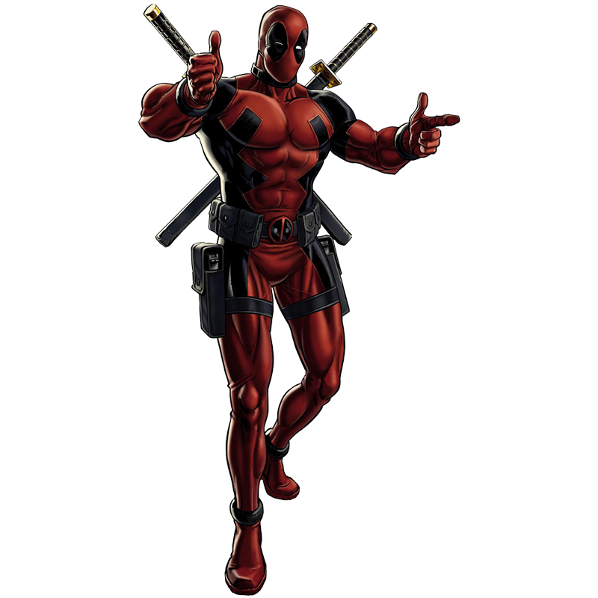
SUMMARY
1. Description
2. Deadpool’s powers and
Abilities
3. Deadpool’s enemies

Slide 3
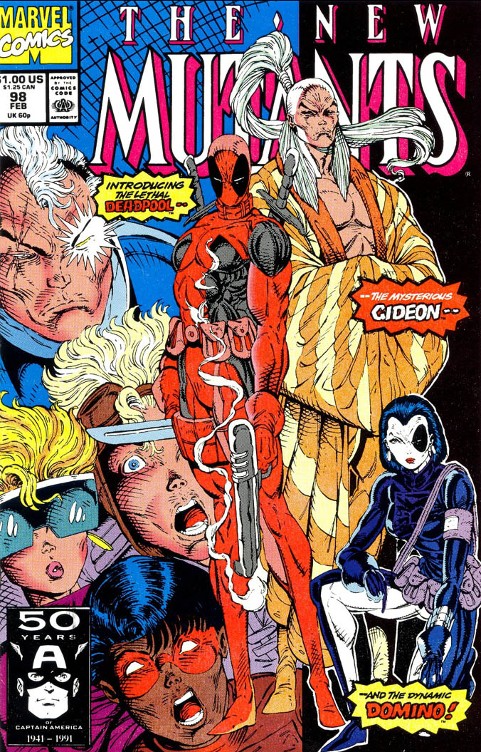
GENERAL DESCRIPTION
Deadpool is a fictional antihero appearing in American comic books published by Marvel Comics. The character first appear in the New Mutant number #98. His real name is Wade Wilson.

Slide 4
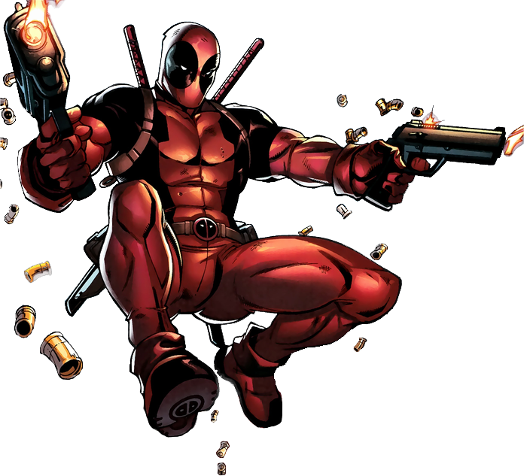
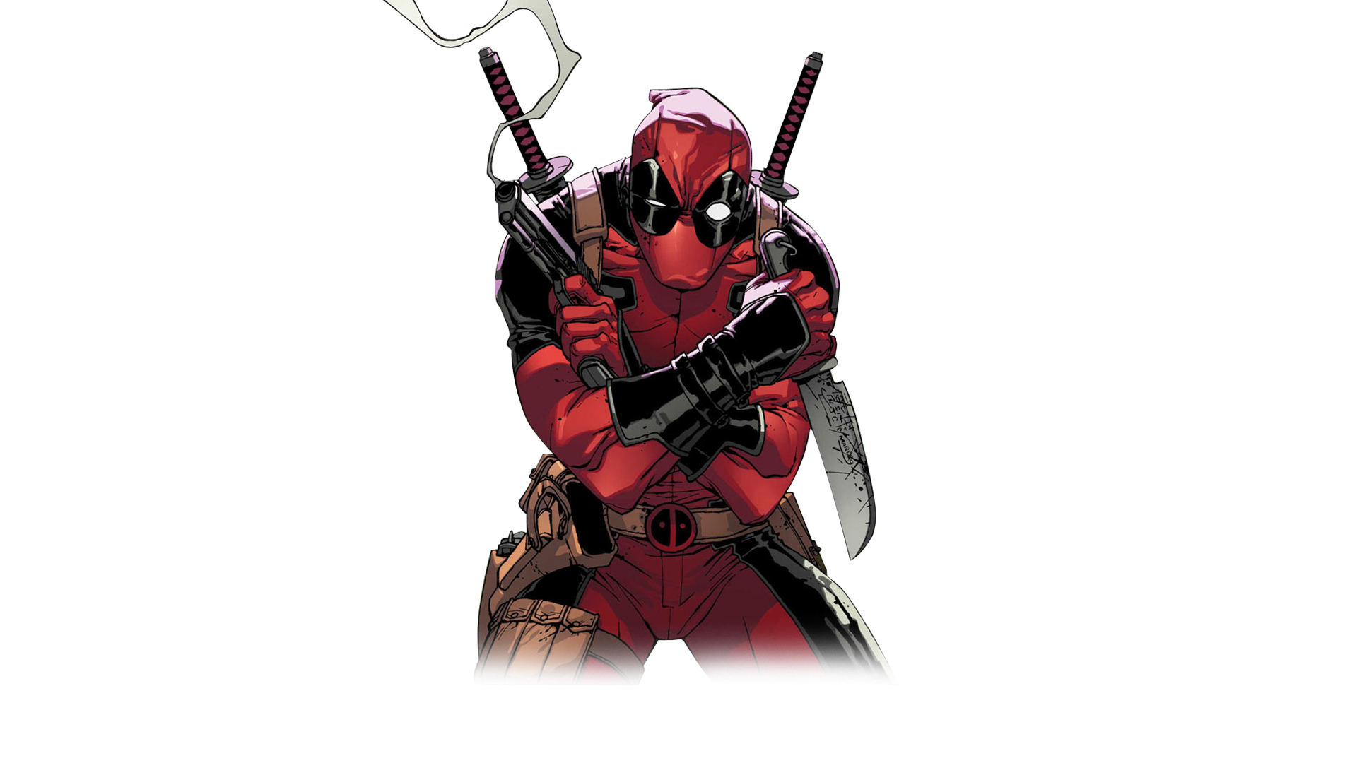
PHYSICAL DESCRIPTION
Two sabers
Double fireguns

Slide 5
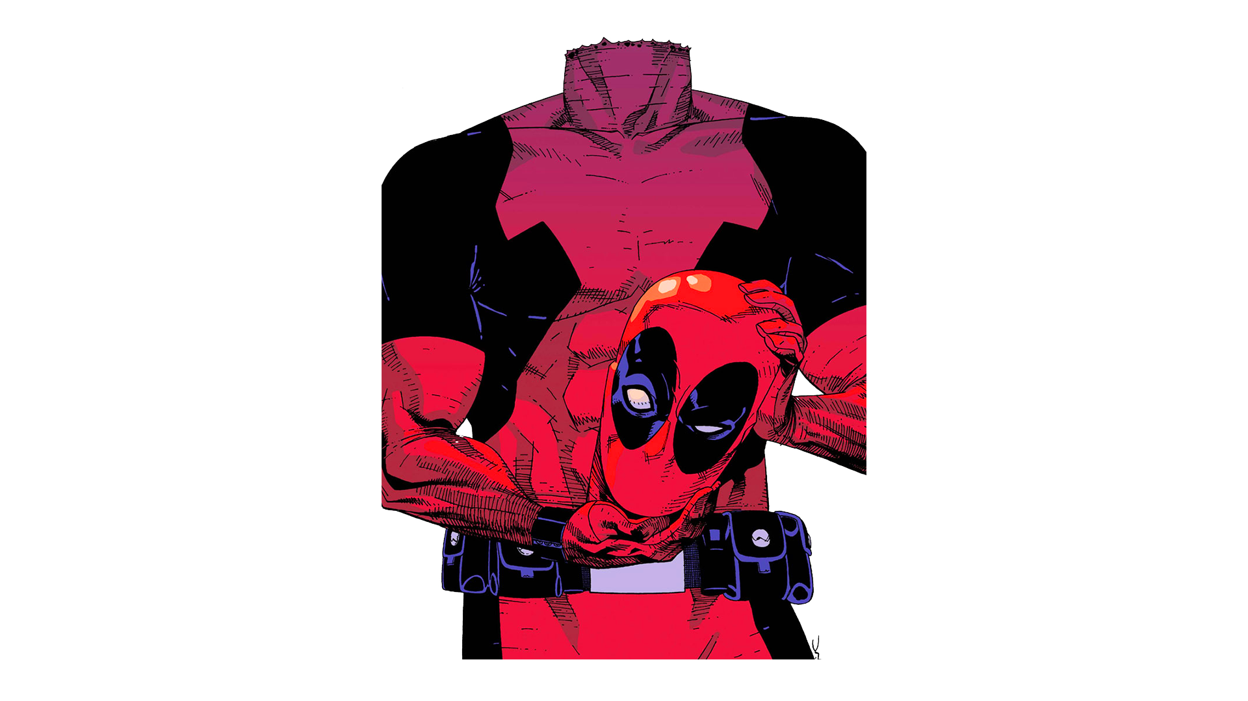
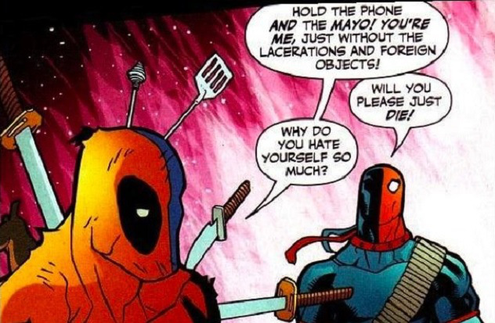
POWERS AND ABILITIES

Slide 6
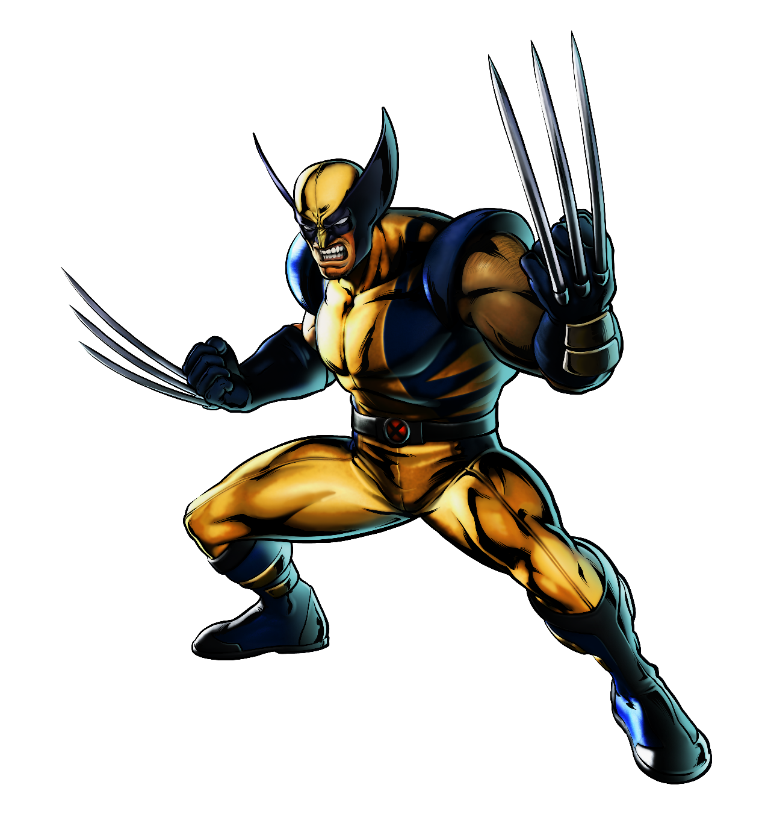
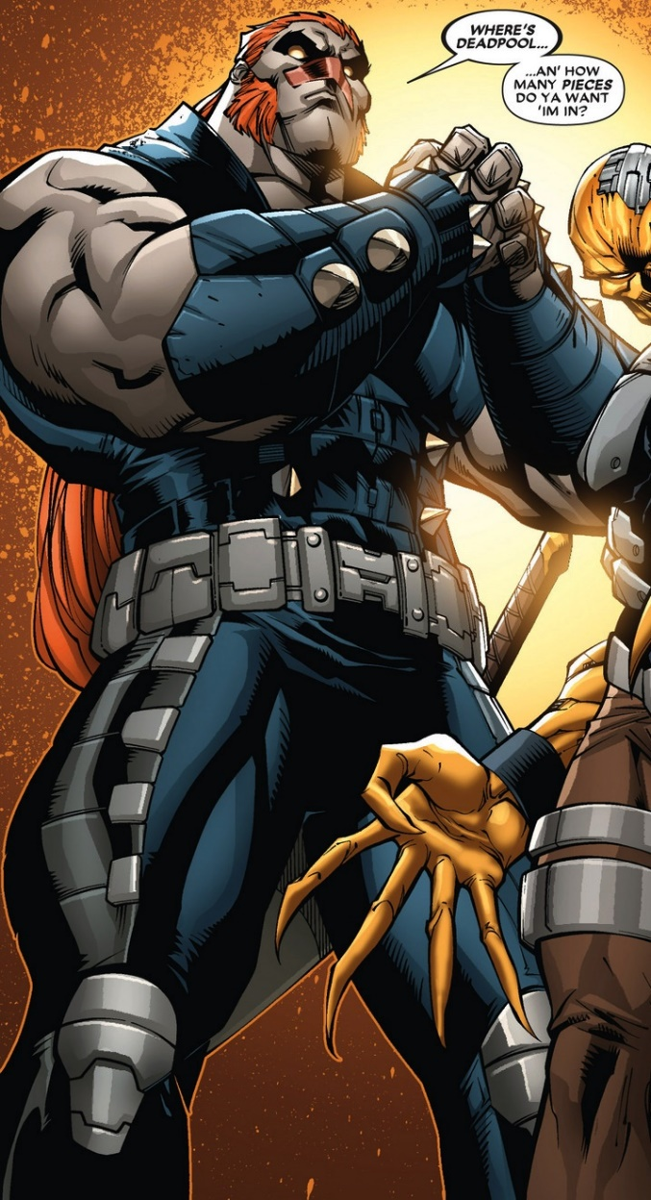
DEADPOOL’S ENEMIES

