Slide 1
Brew culture in France
Boullier Prescilla
Capron Agathe
Mazuras Isabelle
Pomies Louanna

Slide 2
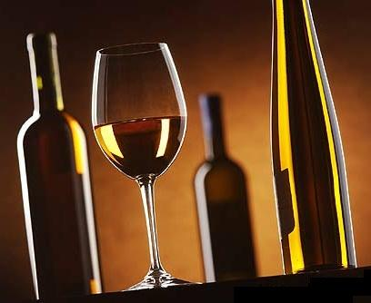
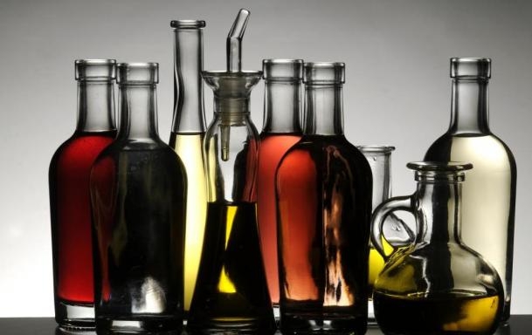
Wine and vinegar

Slide 3
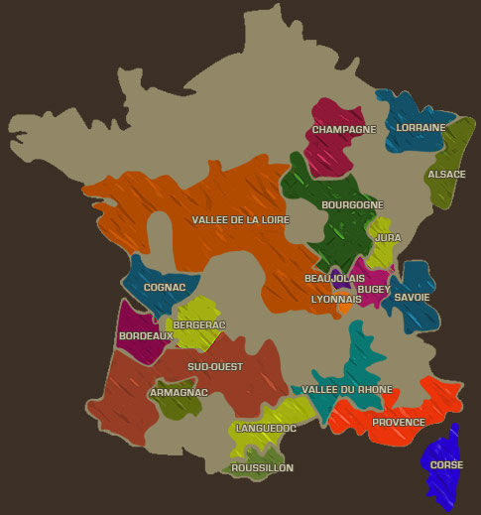
Some French wines :
Champagne
Chardonnay
Bordeaux
Beaujolais
Where ?

Slide 4
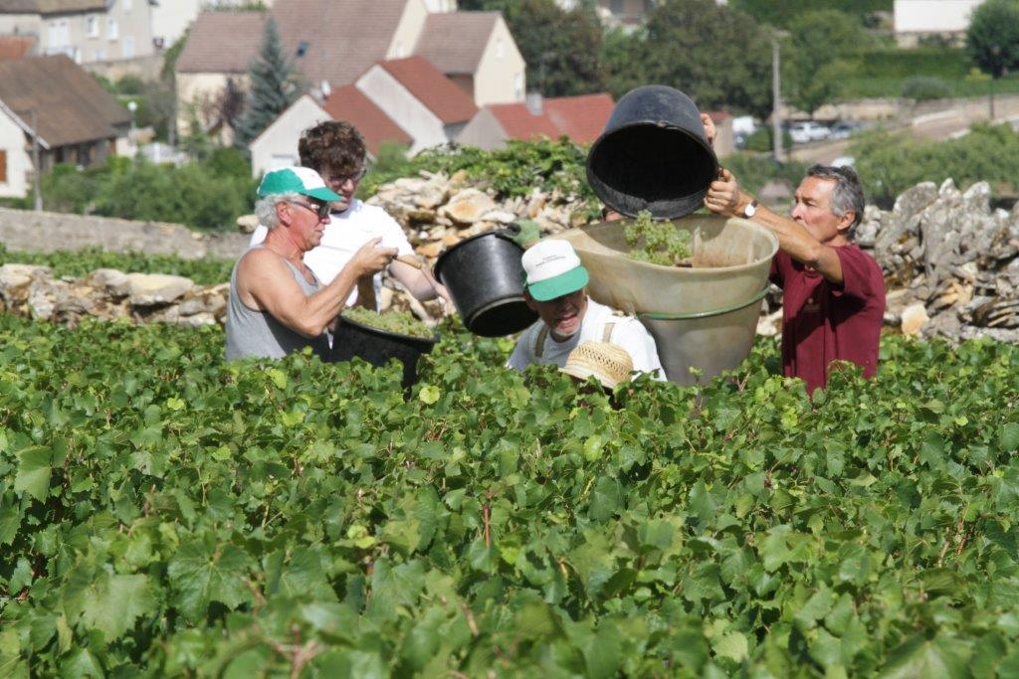
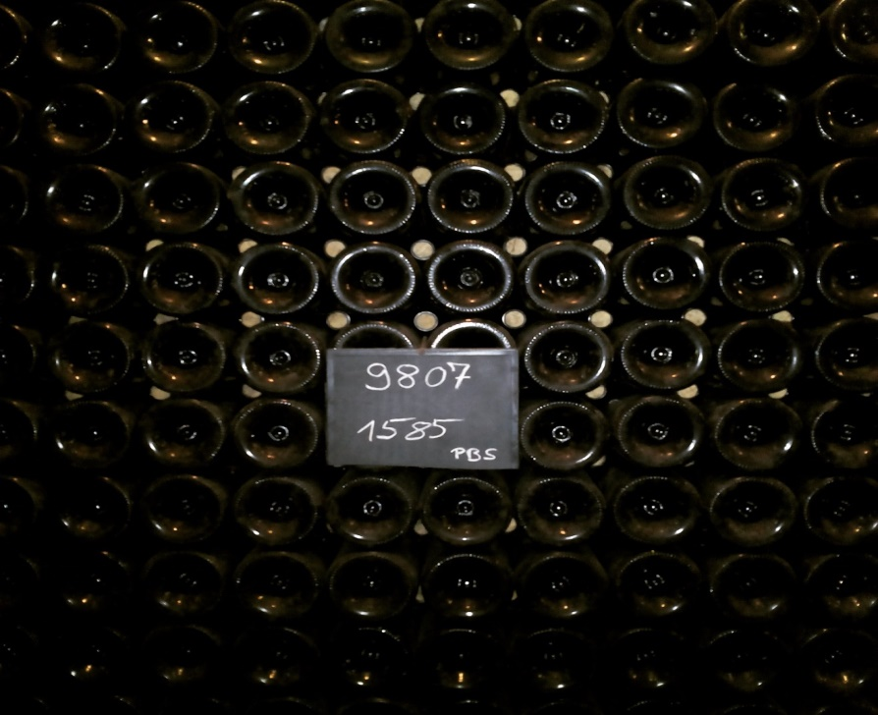
How ?
- Plantation and caring of the grape
- Harvest and Sorting
- Crushing
- Fermentation
- Pressing
- Fermentation
- Aging
- Bottling

Slide 5
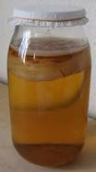
Vinegar in France
How is it made ?
- Take a pot
- Pour alcohol in it (ie: wine)
- Add mycoderma
- Close the pot
- Wait for the fermentation (1 to 3 month at least)
- Filter
- Add a bit of sugar

Slide 6
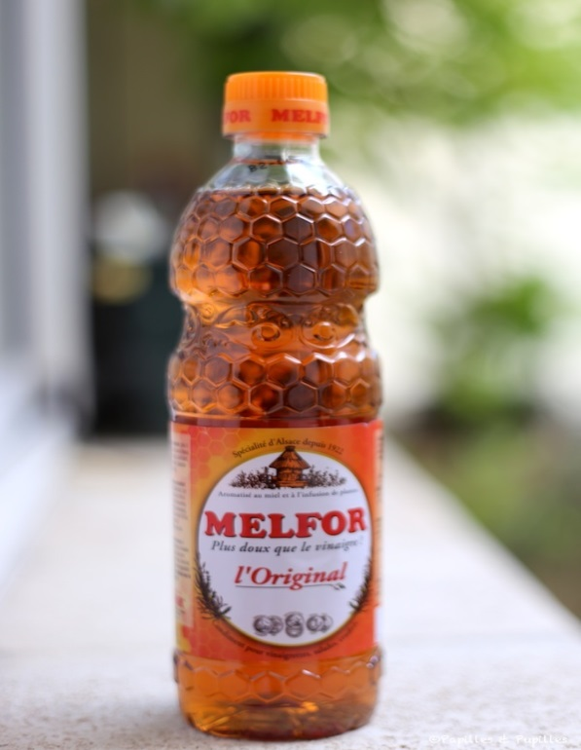
“Melfor” a French vinegar
It’s originated from Alsace and is created from alcohol, honey and plants infusion. It’s a sweet vinegar.

Slide 7
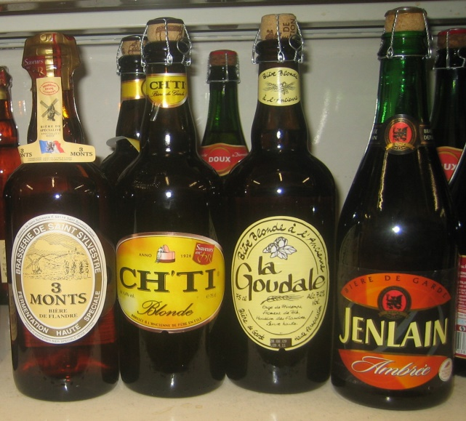


BEER
Before beer, there was Cervoise…
… and now there is beer.

Slide 8
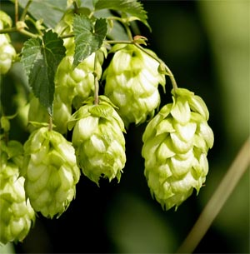
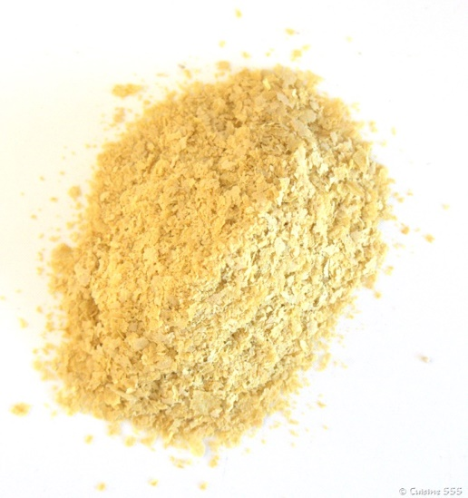
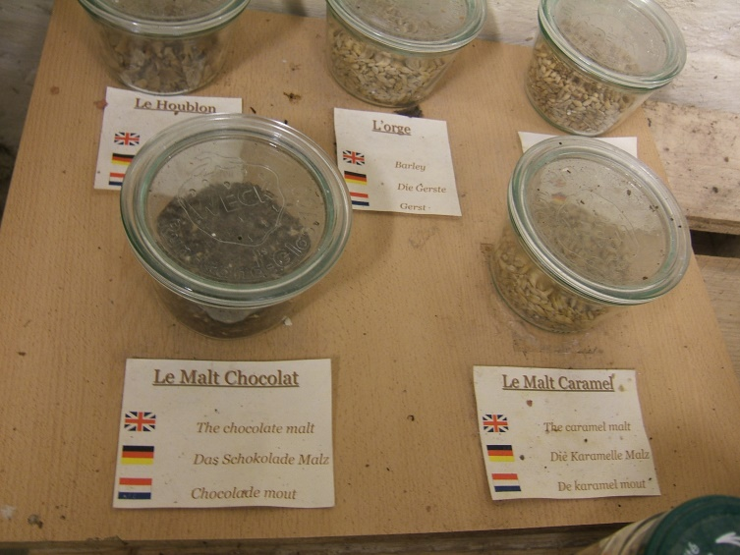
Ingredients
Hop :
Yeast :
Malt :
And clear water !

Slide 9
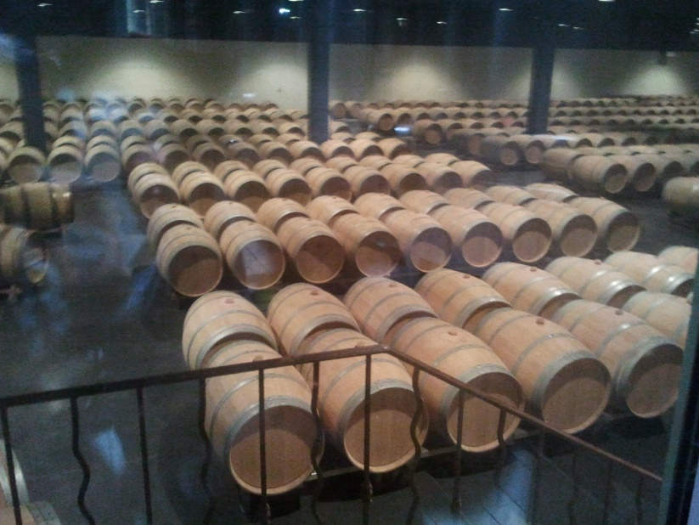
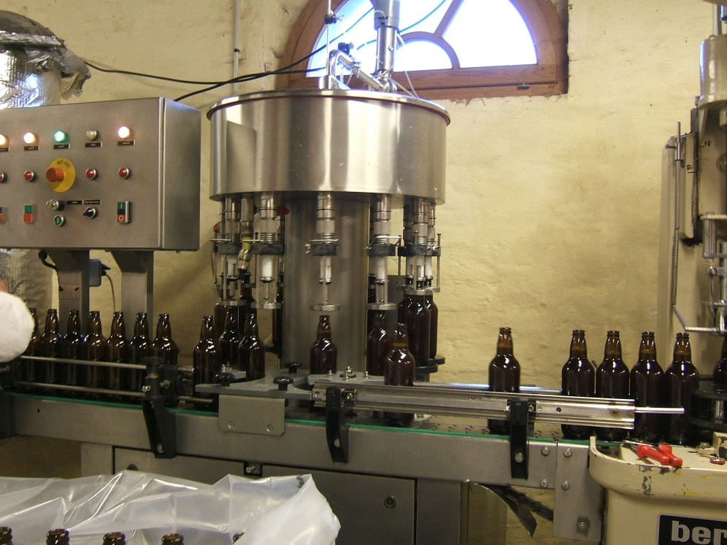
Brewing :
Bottling :
Fermentation in barrels

Slide 10
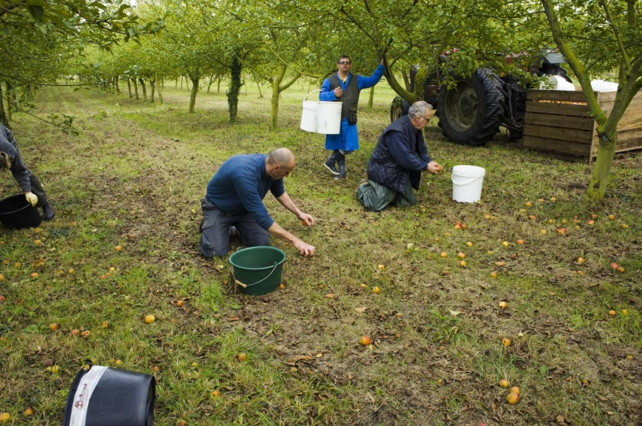
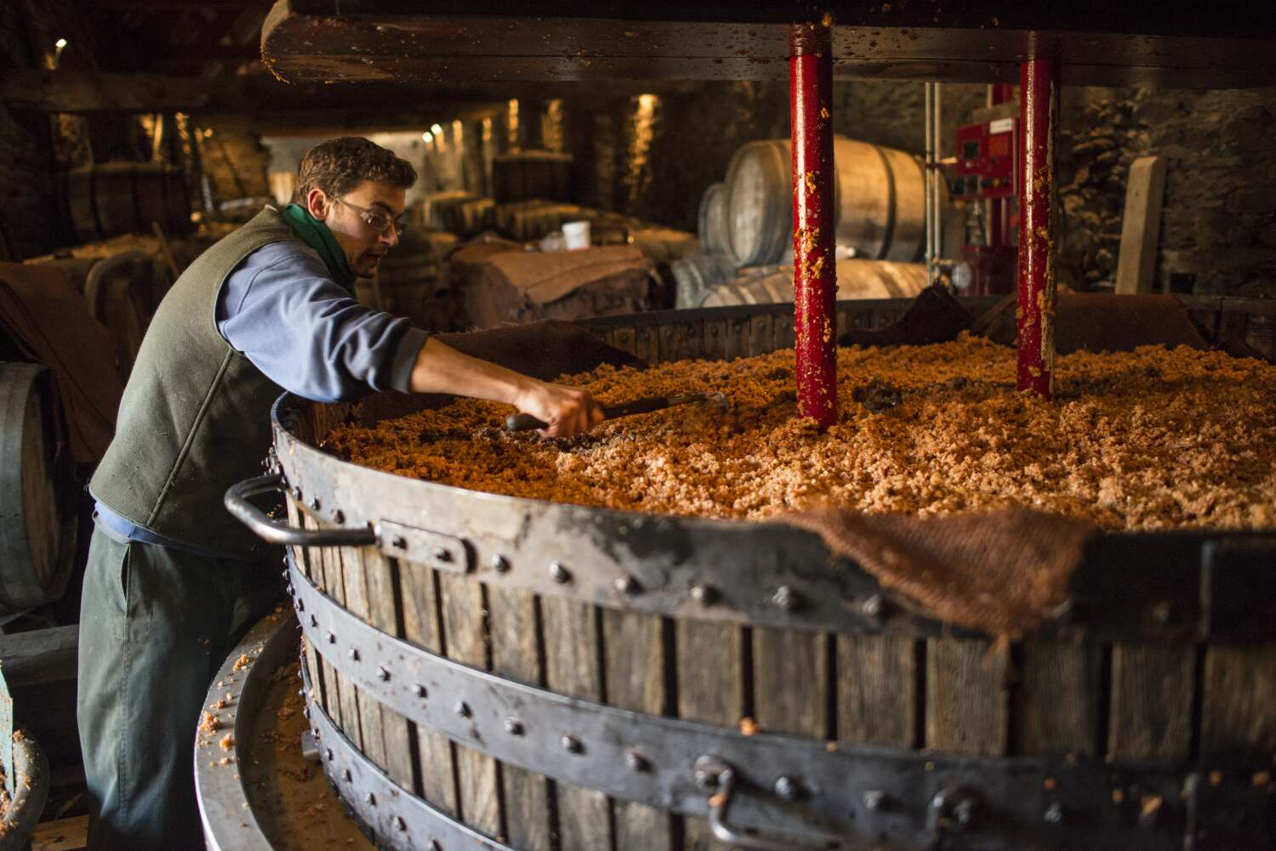
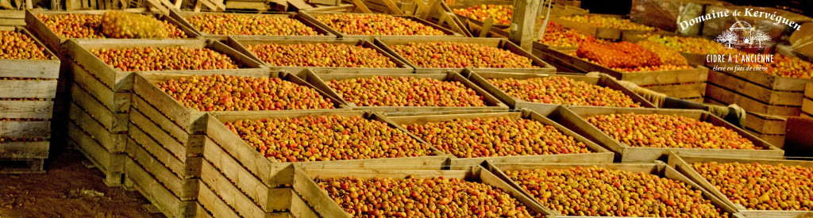
CIDER
Gathering, drying and smashing apples

Slide 11
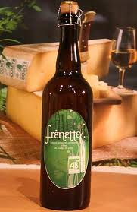
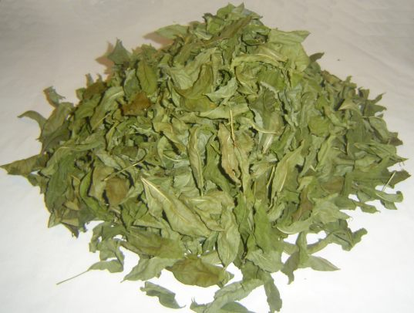
Homemade brewing
Ash drink : Frênette
Dry ash leaves
can give a low alcohol refreshing drink
After brewing

Slide 12

The country of wine
Creation of jobs, such as :
Winegrowers
Producers
Sellers
Sommeliers

Slide 13
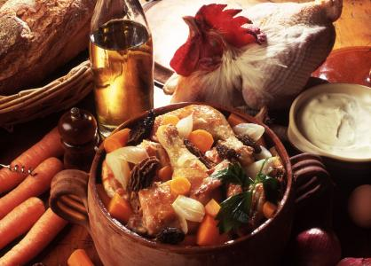
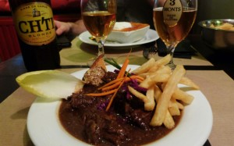
UNESCO intangible cultural heritage
Carbonade flamande
Coq au vin

Slide 14
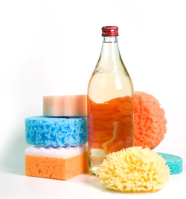
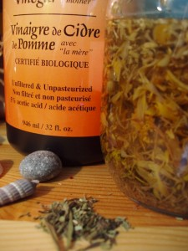
Everyday life
Cider vinegar and its multiple uses
White vinegar as an ecologic
cleaning product

Slide 15
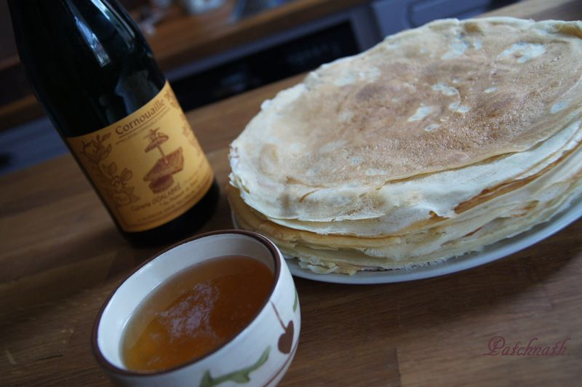
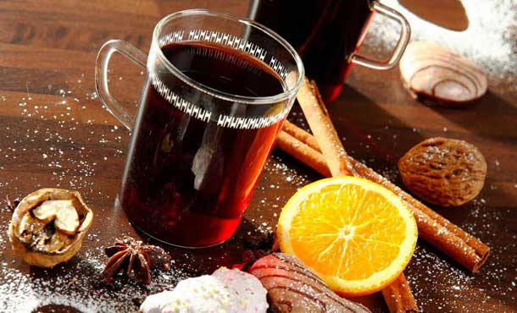
Habits and customs
Mulled wine during Christmas
Crepes and cider during Candlemas

Slide 16
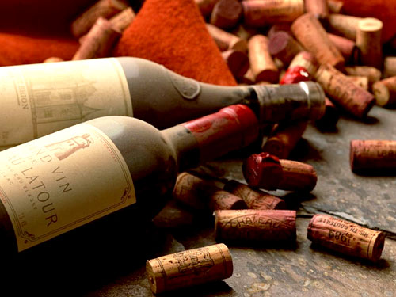
Import, export and consumption
Wine
wine
In 2010 :
World production : 259,9 million hectoliters
France production : 44,75 million hectoliters

Slide 17
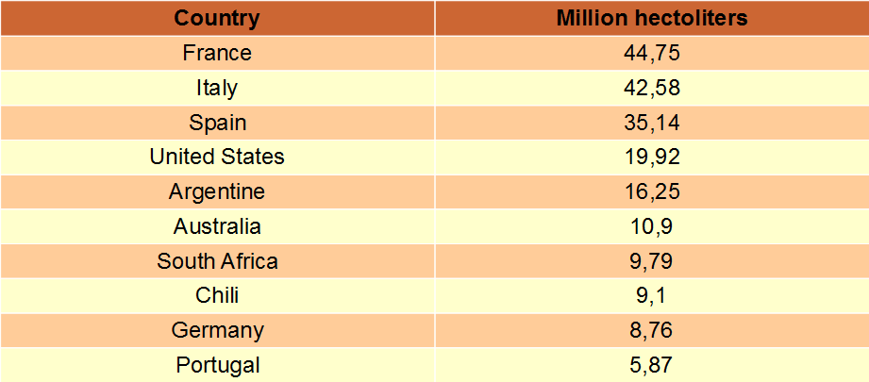
Leading producers of wine in 2010 (in million hectoliters)

Slide 18

A manga about wine
Consumption per inhabitant per year (2005) :
First place : Vatican (62,02 liters)
Second place : Andorra (60,13 liters)
Third place : France (55,85 liters)
Exporting country :
First place : Italy
Second place : France
However,
wine consumption in France was almost divided by three in fifty years, from 140 liters per inhabitant per year in 1960 to 80 liters in 1999 and 50 liters in 2010.

Slide 19
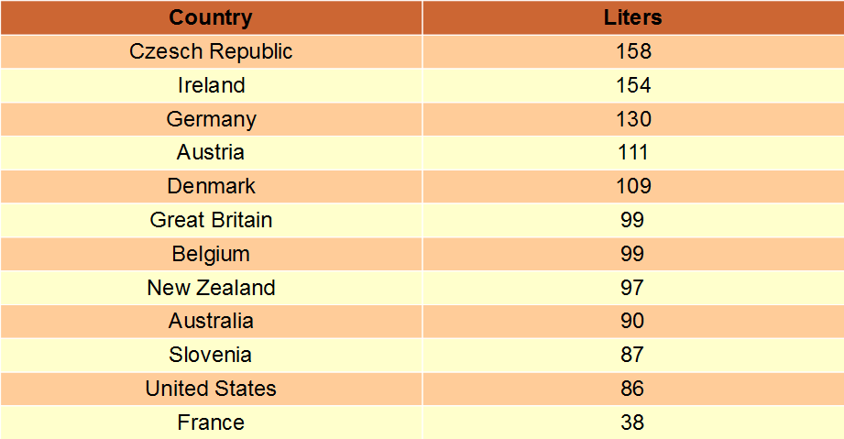
Beer :
Estimation of beer consumption per inhabitant per year
In the world, every year 182,69 billion liters of beer are consumed.
French consumption of beer is among the lowest in Europe :
38 liters per year and per inhabitant

Slide 20
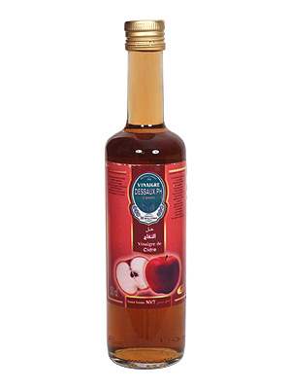
Vinegar
Vinegar
In France, 1 167 759 hectoliters of vinegar are produced per year.
Alcohol vinegar : 67%
Wine vinegar : 27%
Cider vinegar and others : 6%
Distribution of French vinegar sales :
Sales in France : 86%
export sales : 14%

Slide 21
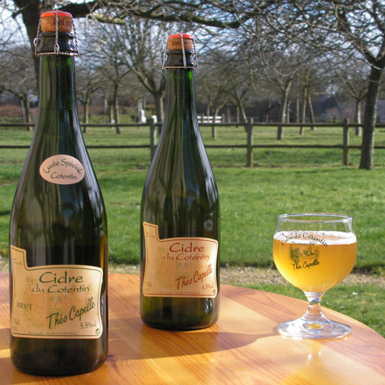
Cider
Cider
In France, cider consumption per inhabitant per year is only 2 liters.
This is a seasonal market :
- Epiphany
- Candlemas
- Shrove Tuesday
- The summer season
Only 10% of French production is exported. (November 2012)
Every year in France, 1.6 million hectoliters of cider are sold for a total turnover of 185 million euros.

Slide 22
ご清聴ありがとうございます
Thank you for listening

Slide 23
Sources :
http://partage.cra-normandie.fr/fichiers/cidre-etat-marche.pdf
http://www.planetoscope.com/Le-Vin/1185-production-mondiale-de-vin.html
http://www.planetoscope.com/boisson/954-consommation-de-biere-en-france.html
http://www.brasseurs-de-france.com/la-biere/economie/la-biere-dans-le-monde/asie/
http://vins-france.com/fr/
http://www.adaa-ase.com/le-vinaigre.php
http://www.brasseurs-de-france.com/la-biere/?age-verified=5baab59675
http://www.sommelier-france.org/
http://www.vinaigremalin.fr/le-vinaigre-de-cidre/

