Slide 1
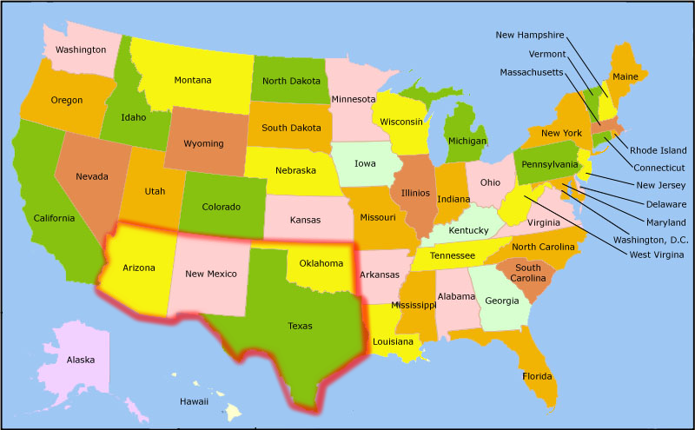
Southwest
Notes:
The Southwest differs from the Midwest in 3primary ways.
The first one is that it’s drier; you’ll notice it thanks to the landscapes in the powerpoint
Because it’s drier, it’s emptier; Outside the cities, the region is a land of wide open spaces. One can travail for miles without seeing signs of human life
Thirdly the population comprises a different ethnic mix. In fact, parts of the Southwest once belonged to Mexico. The USA gained this land follow a war with Mexico between 1846 and 1848. Today, 3southwestern states lie along the Mexican border: Tewas, New Mexico and Arizona. They all have a large Spanish-speaking population.

Slide 2
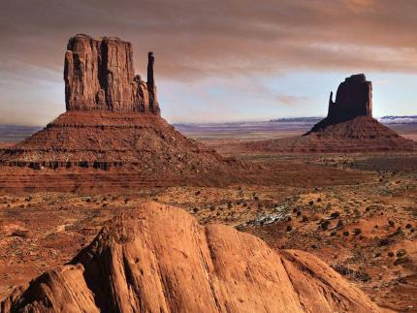
Arizona
Nickname : Grand canyon state
Capital : Phoenix
Entrance in the Union : 1912 (48th state)
Population : 6,731 million people
Superficie : 295 254 km2
Neighboring states : California, Nevada, Colorado, Utah, New Mexico
Landscape : deserts, woods, lakes

Slide 3
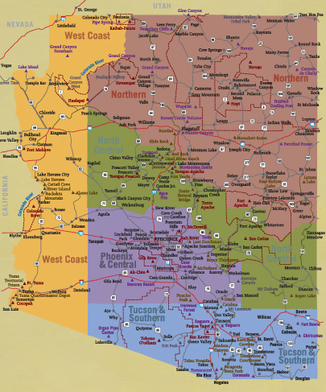
Arizona

Slide 4
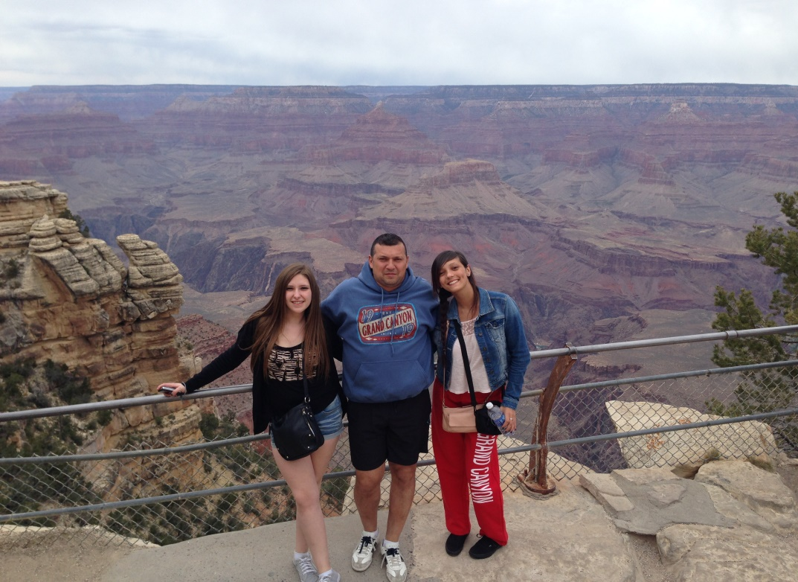
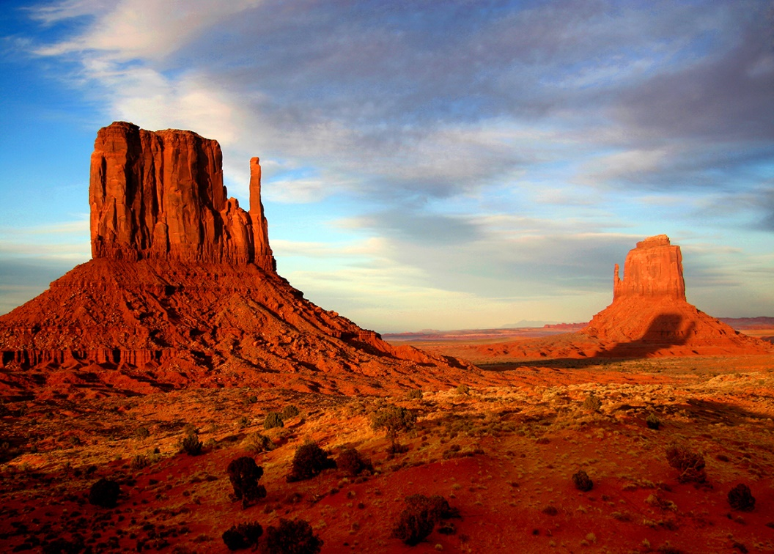
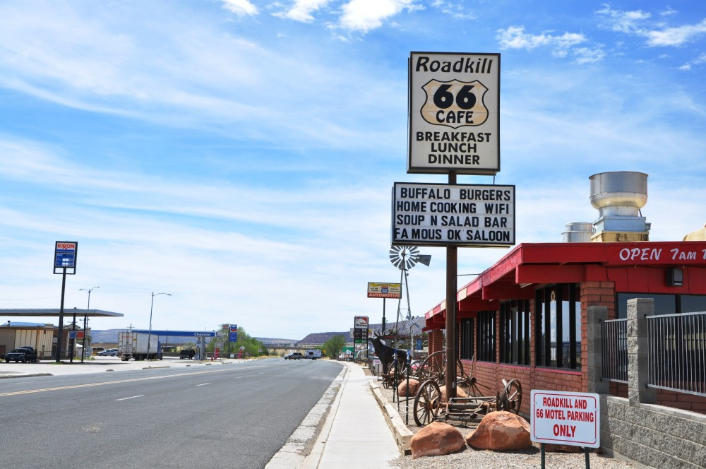
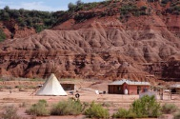
Northen Arizona

Slide 5
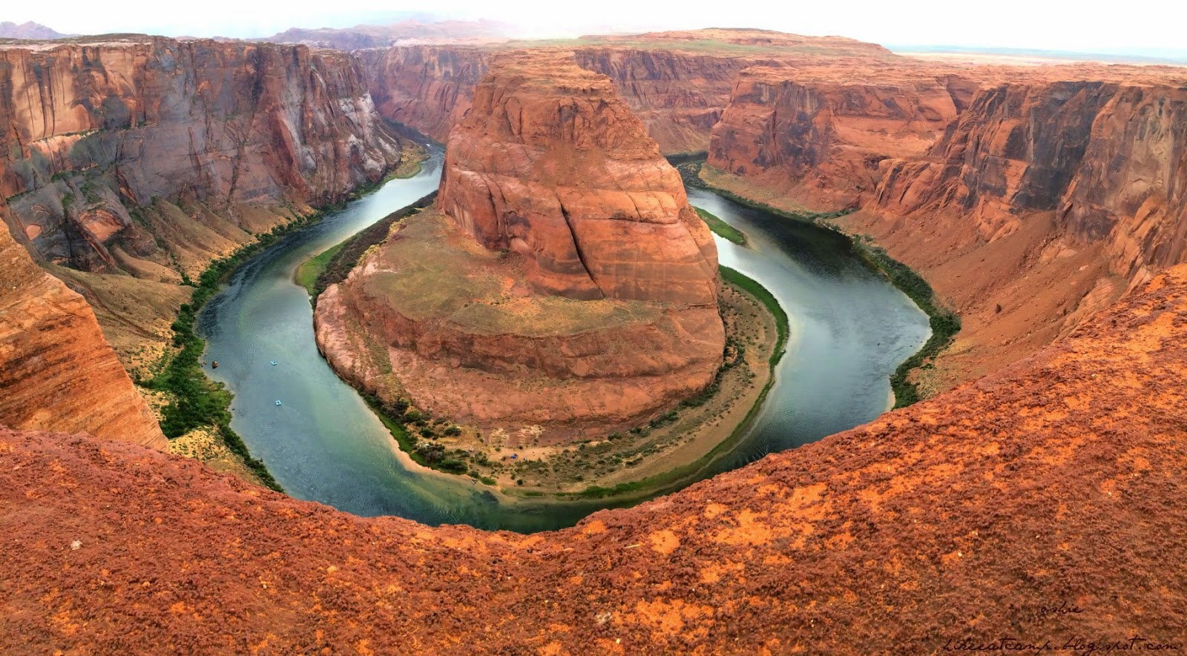
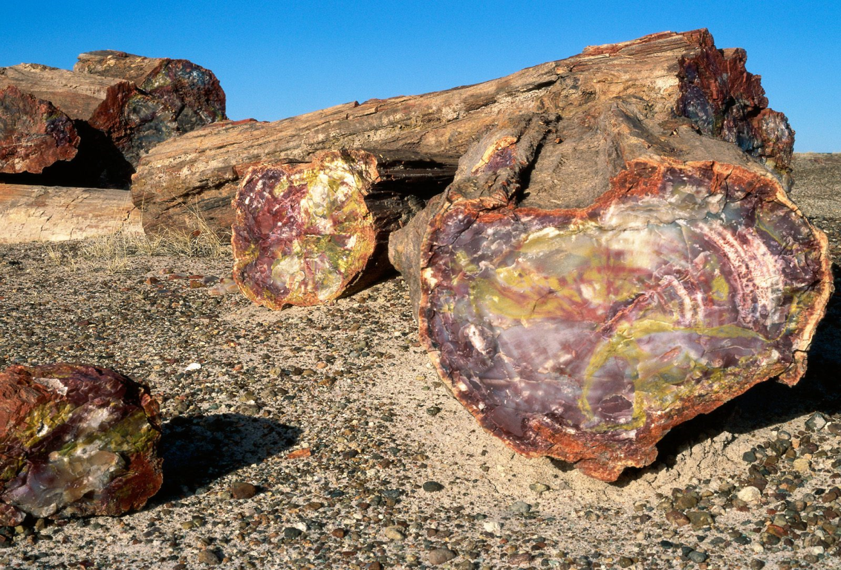

Slide 6
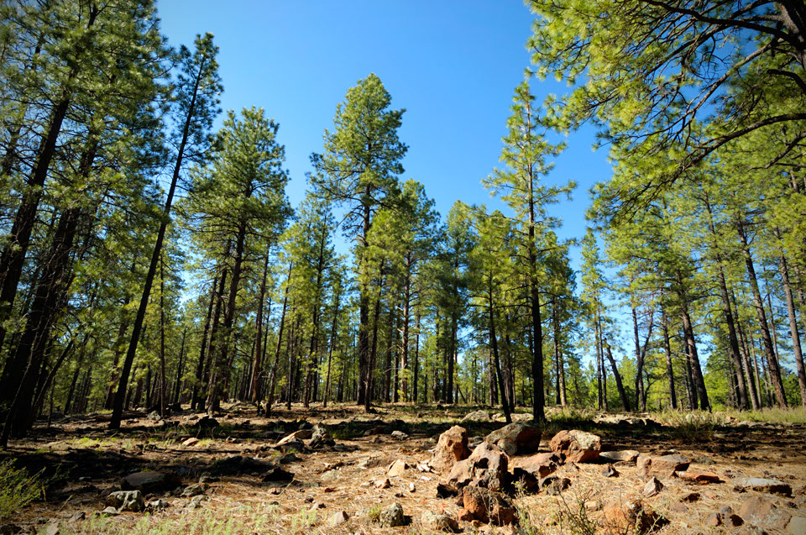
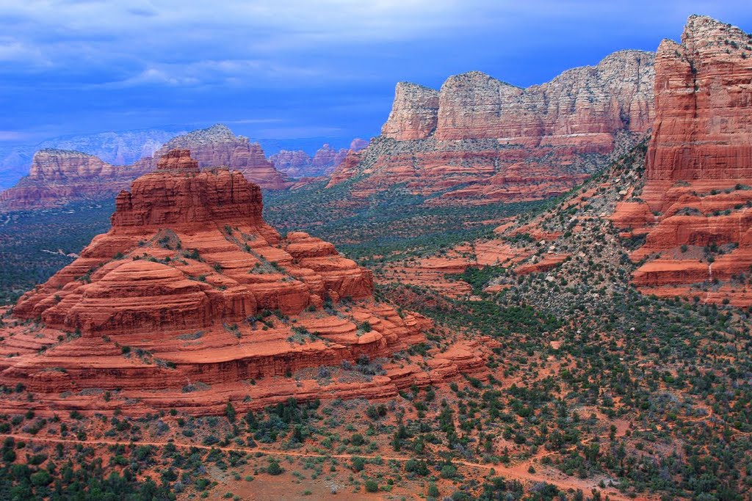
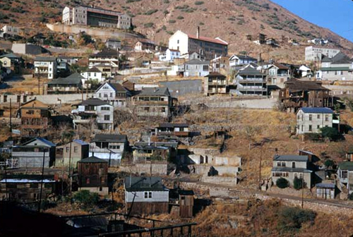
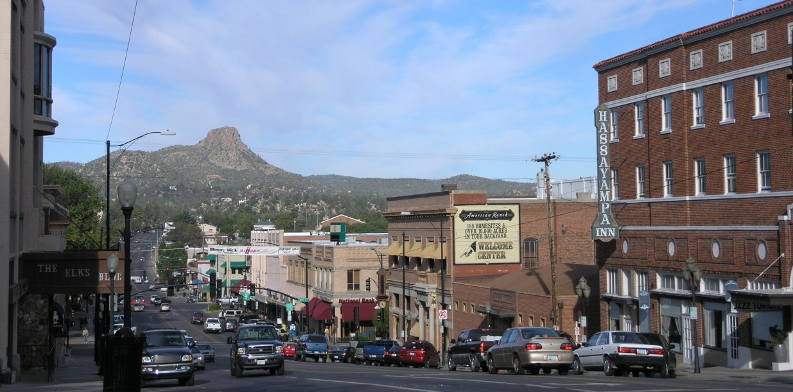
North-Central Arizona

Slide 7
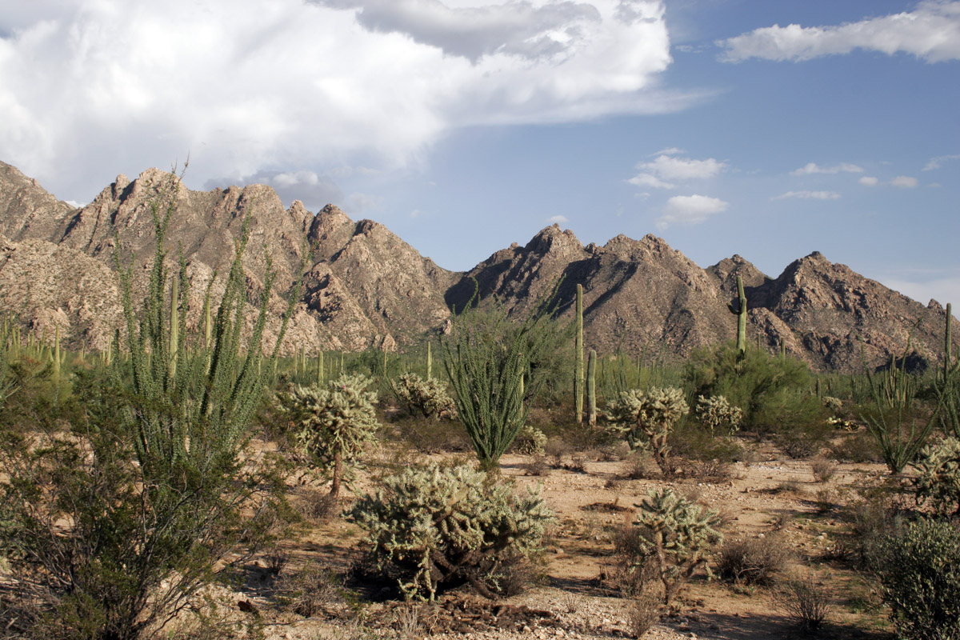
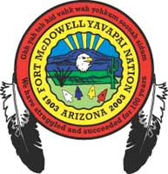
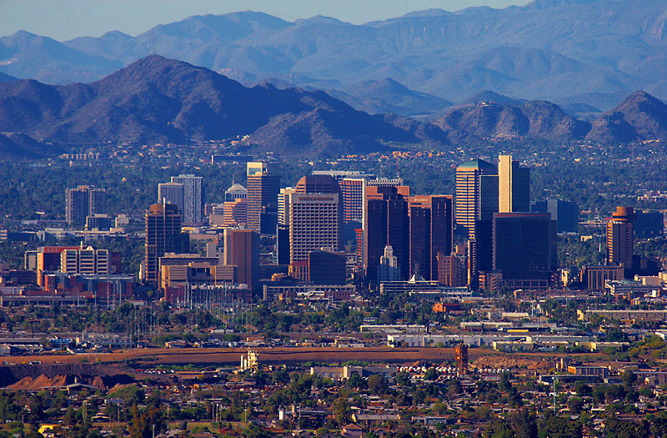
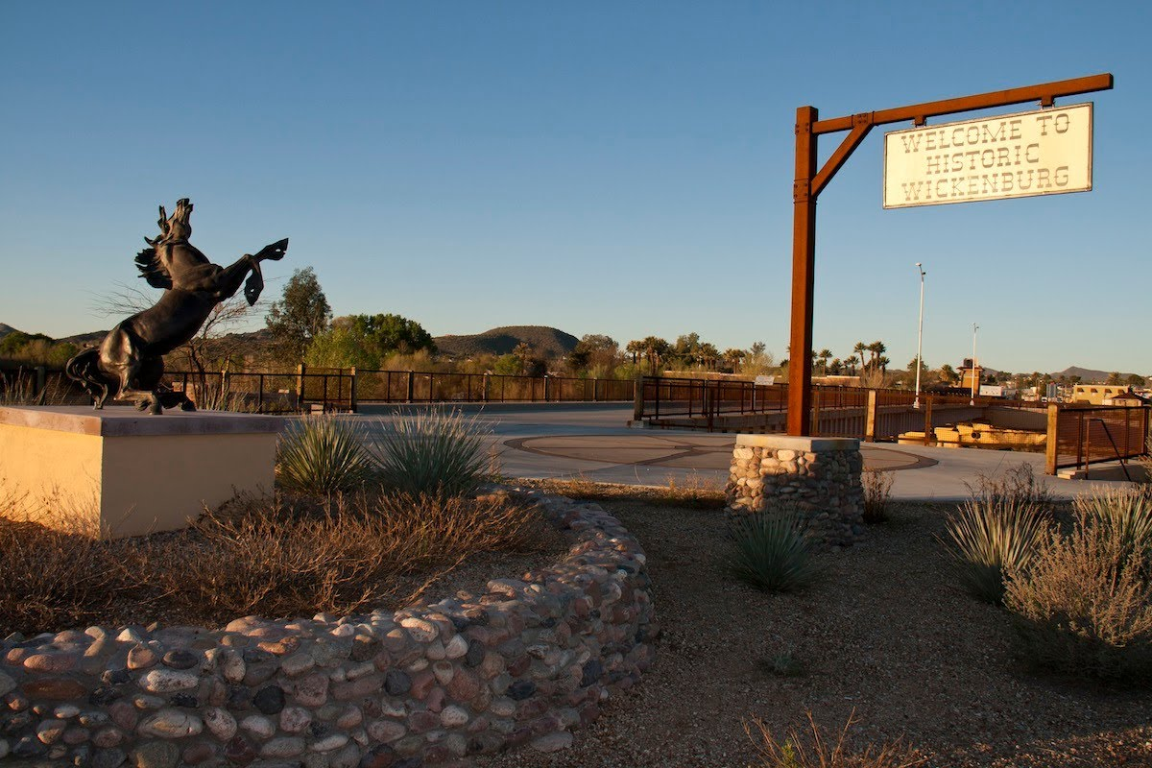
Central Arizona

Slide 8
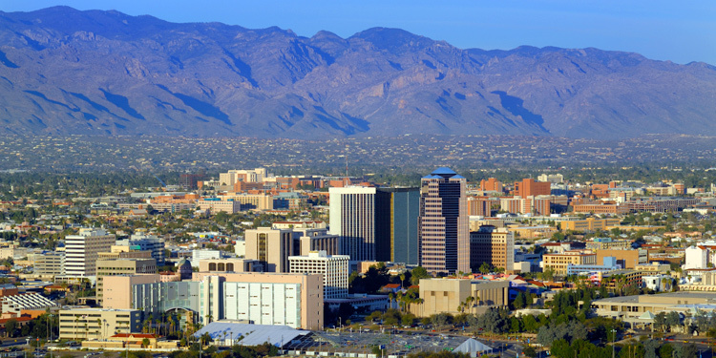
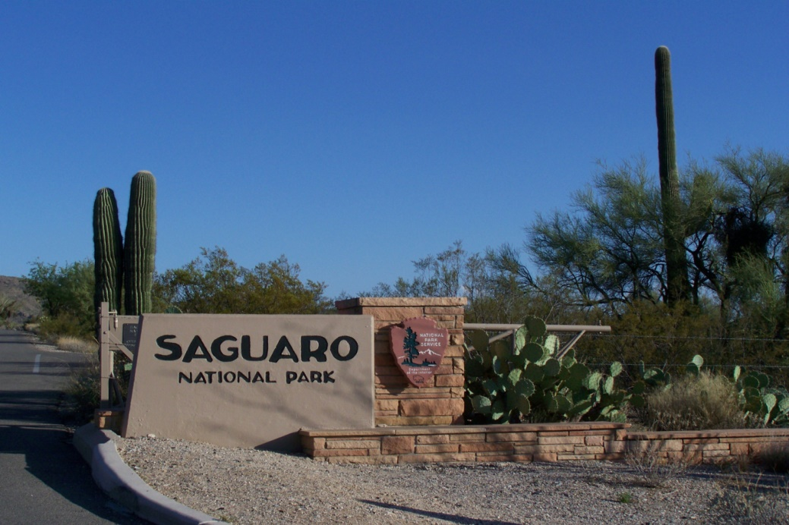
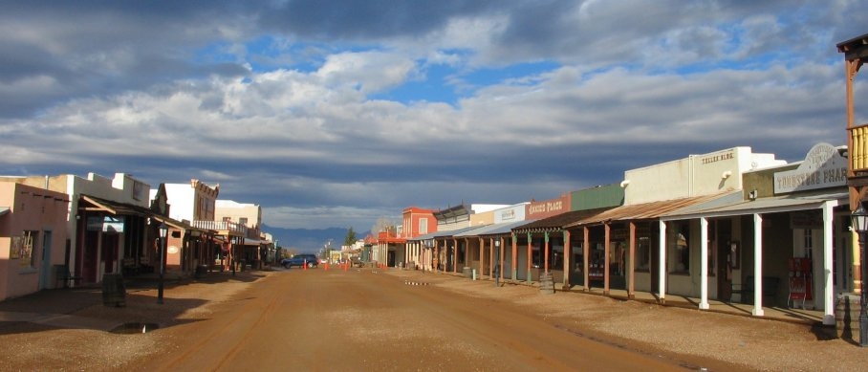
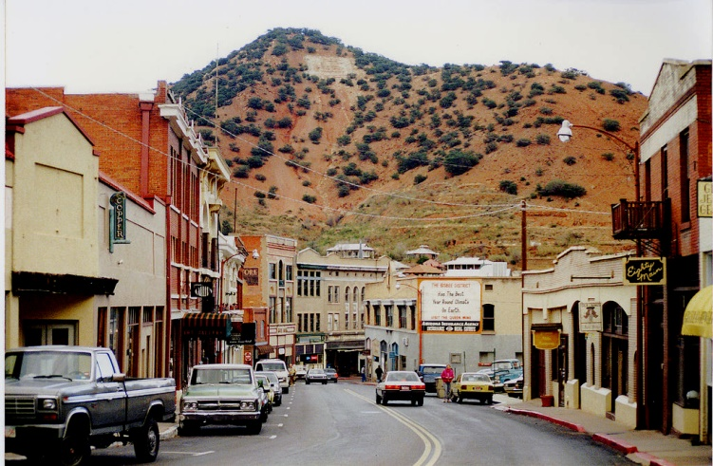
Southern Arizona

Slide 9
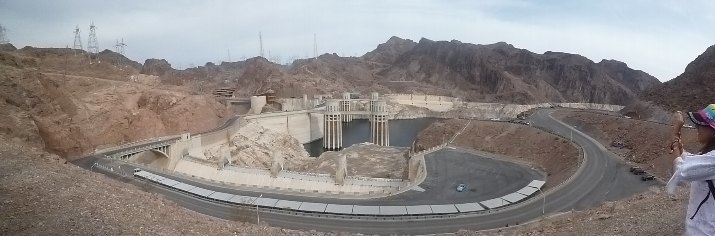
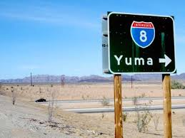
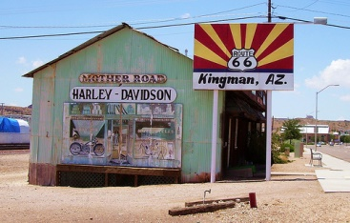
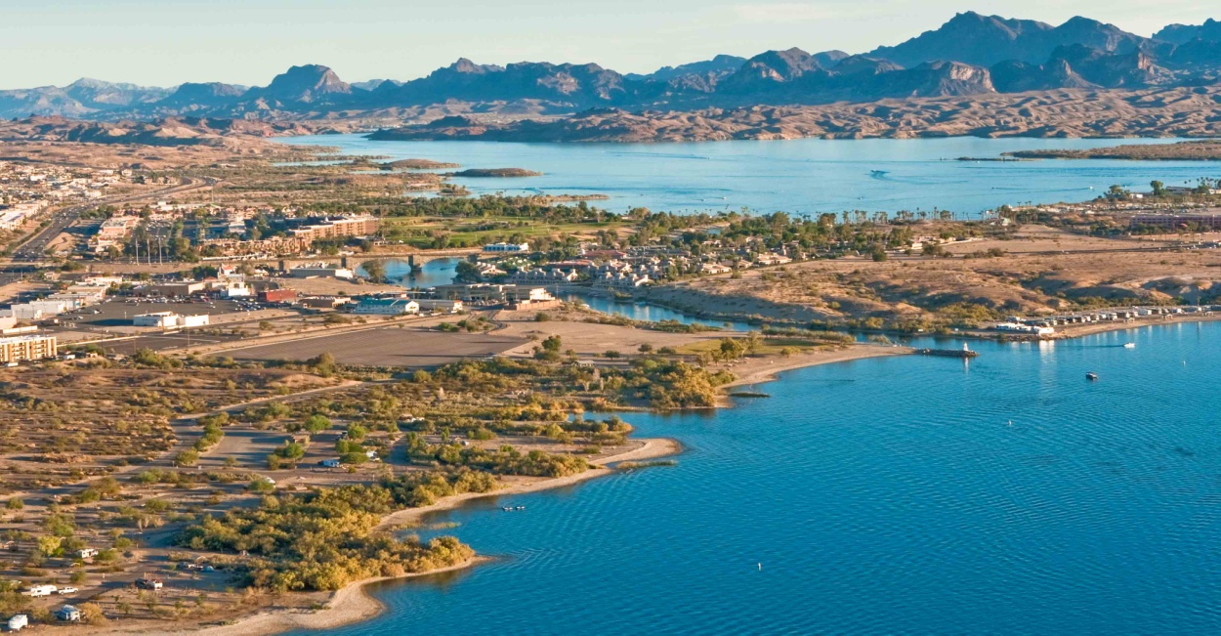
West Coast of Arizona

Slide 10
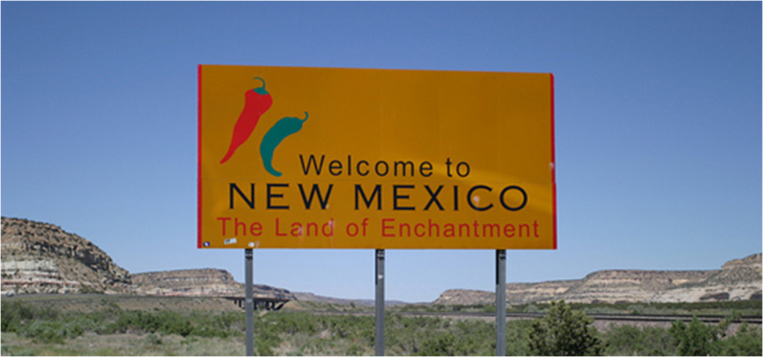

Slide 11
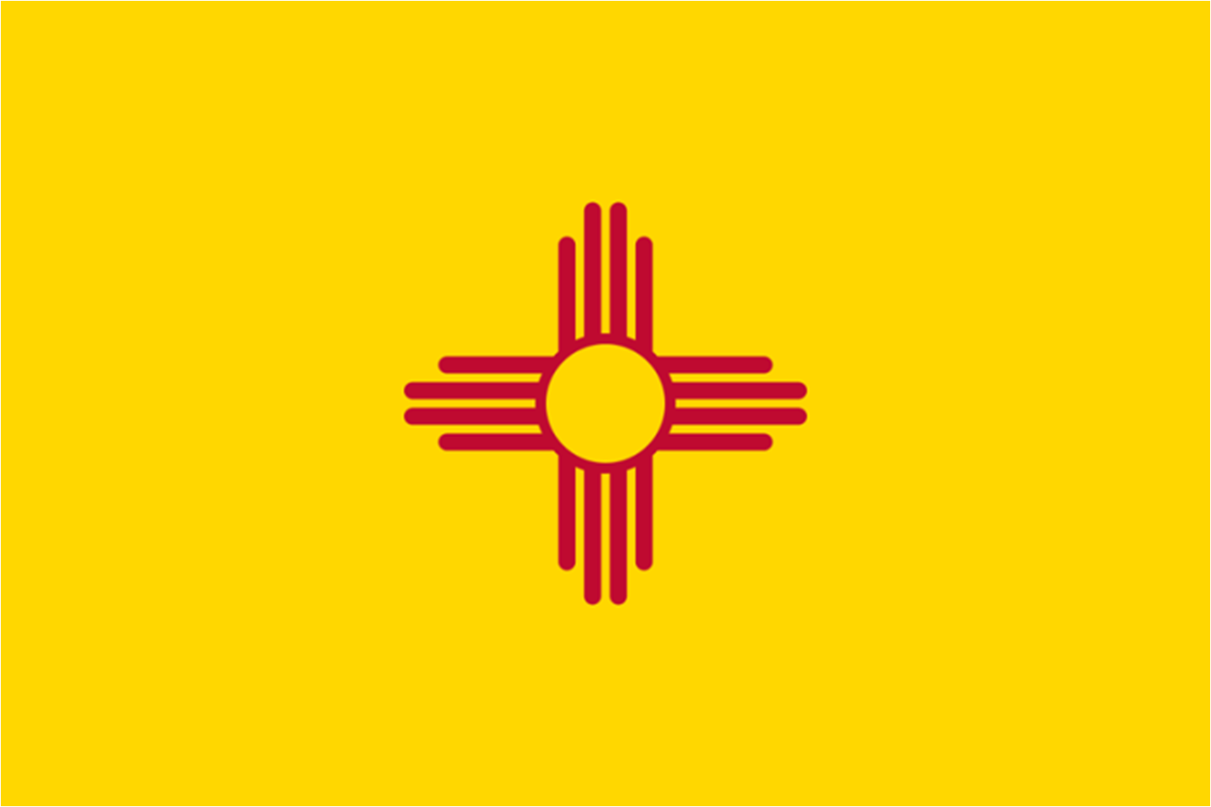
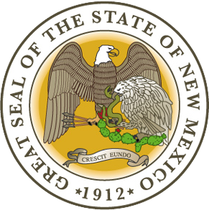
New Mexico
Capital : Santa Fe
Entrance in the Union : 1912 (47th state)
Neighboring states : Arizona, Colorado, Oklahoma, Texas, Utah
Landscape : rose-colored deserts to broken mesas to high, snow-capped peaks
Notes:
The colors on New Mexico's state flag are the red and yellow of old Spain. The simple, elegant center design is the ancient Zia Indians sun symbol, which represents the unique character of New Mexico (Zia sun symbol also appears on New Mexico's state quarter).

Slide 12
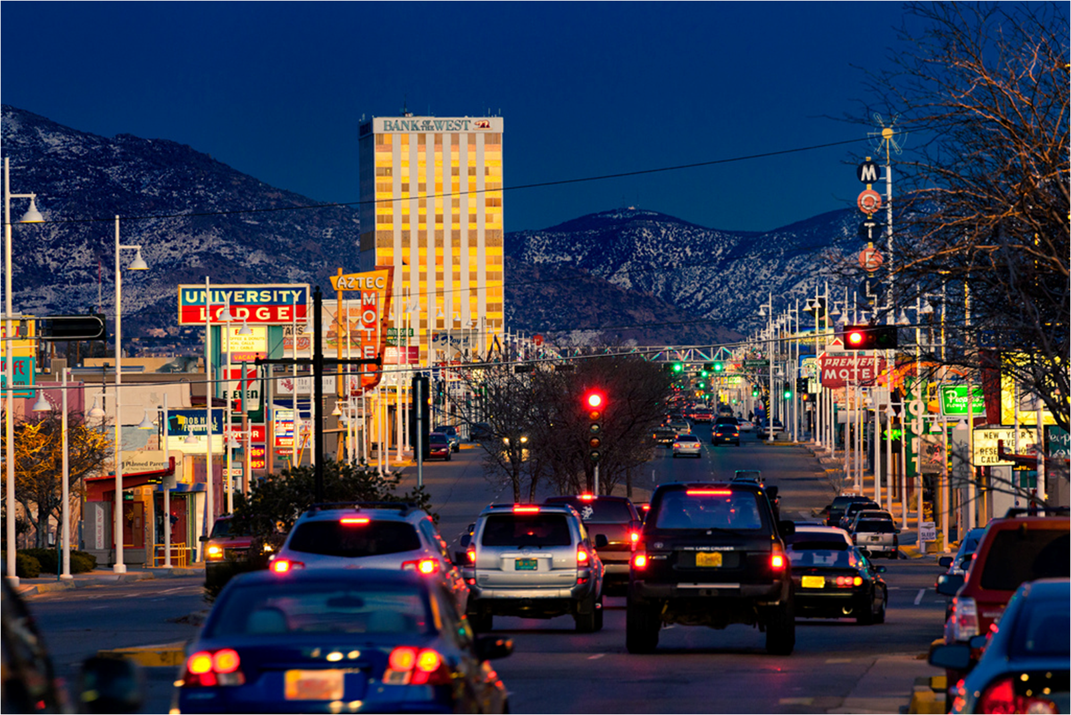
Notes:
Let’s begin with the Central Avenue, Nob hill, that has been described as "the heart of Albuquerque's Route 66 culture and also its hippest, funkiest retail and entertainment district“

Slide 13
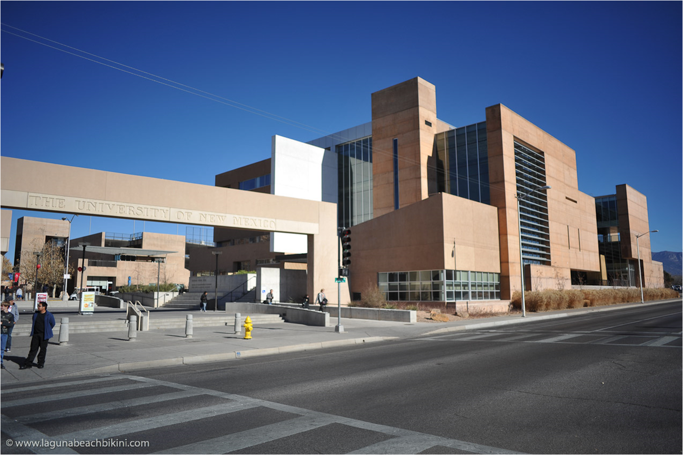
Notes:
The University of New Mexico, a.k.a. UNM, is a state university located in Albuquerque, New Mexico, U.S.A. UNM is the showcase university for the state of New Mexico. It is situated on a beautiful campus in front of the backdrop of the Sandia moutains, just a couple of miles from downtown Albuqeurque,

Slide 14
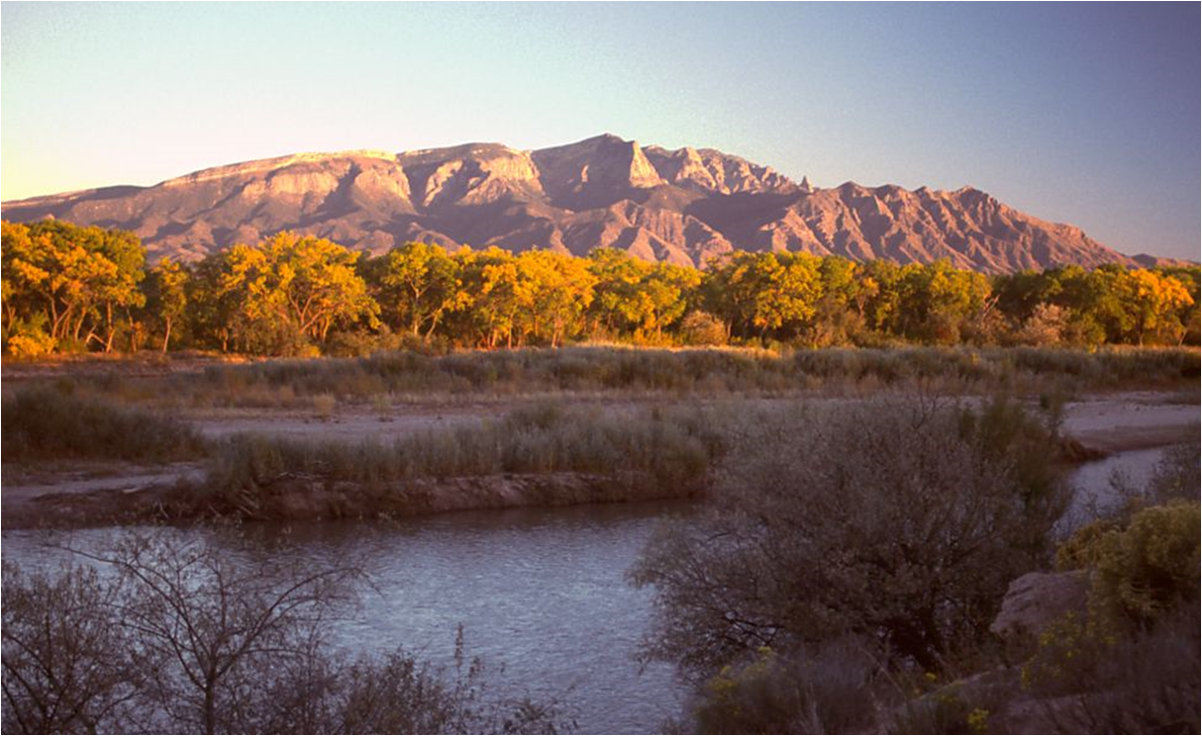
Notes:
The Sandia Mountains

Slide 15
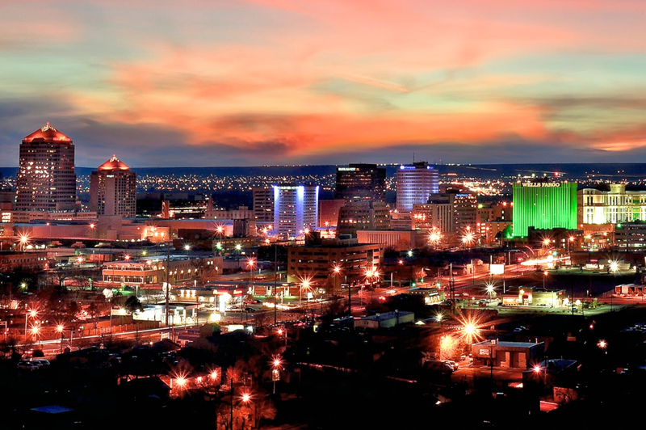
Notes:
Downtown, the central business district of Albuquerque.Here you’ll find bustling nightlife along Central Avenue (Route 66), including many nightclubs, theaters, restaurants and events.

Slide 16
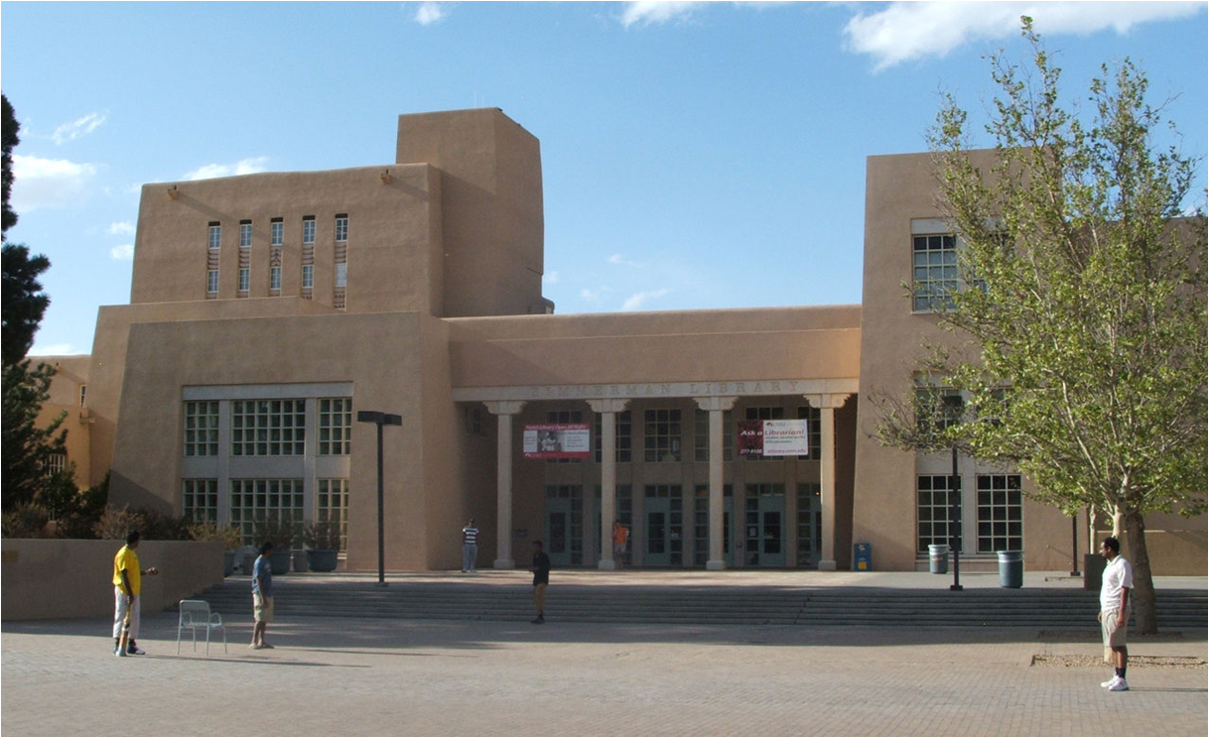
Notes:
If you want to do some researches for your TFE, Zimmerman Library at The University of New Mexico

Slide 17

Notes:
International Balloon Fiesta
For nine days in October, the New Mexico skies are painted as hundreds of balloons lift off from Albuquerque's Balloon Fiesta Park. For ballooning fans worldwide, the Albuquerque International Balloon Fiesta is a pilgrimage. When if you want to take a selfie with all those beautiful hot air balloons,

Slide 18
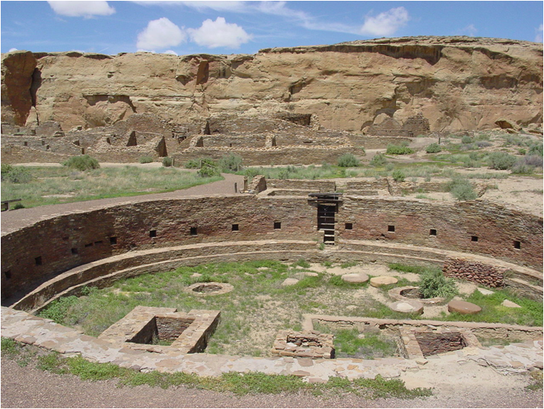
Notes:
In the Chaco Culture National Historical Park, containing the most sweeping collection of ancient ruins north of Mexico, the park preserves one of the United States' most important pre-Columbian cultural and historical areas

Slide 19
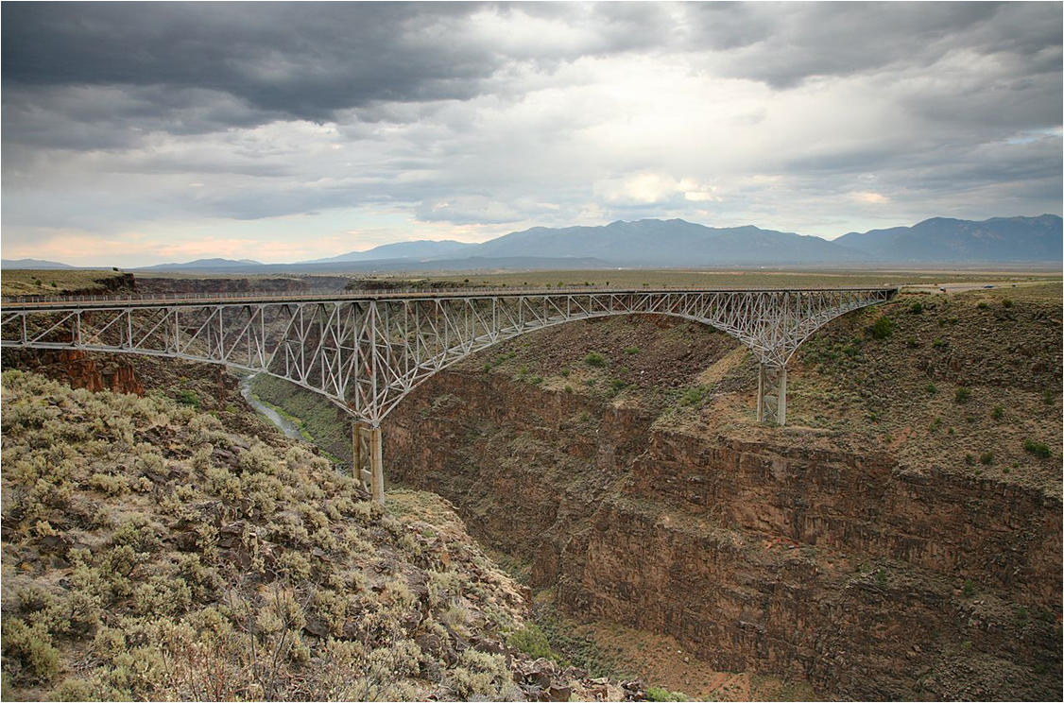
Notes:
The Gorge Bridge is a steel deck arch bridge across the Rio Grande Gorge northwest of Taos, New Mexico
the seventh highest bridge in the United States

Slide 20
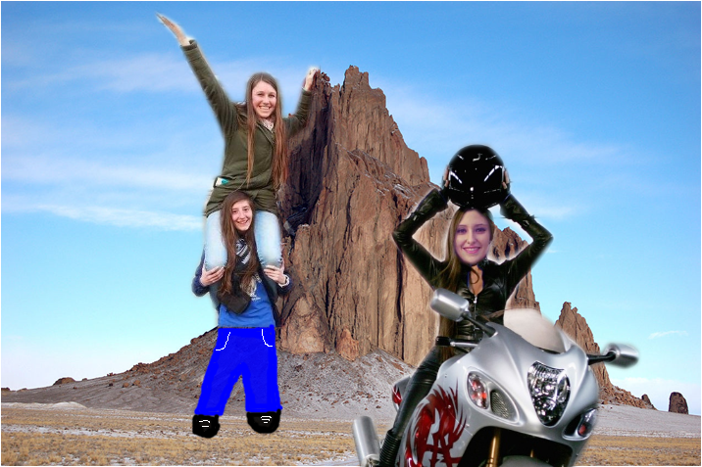
Notes:
Shiprock in San Juan County

Slide 21
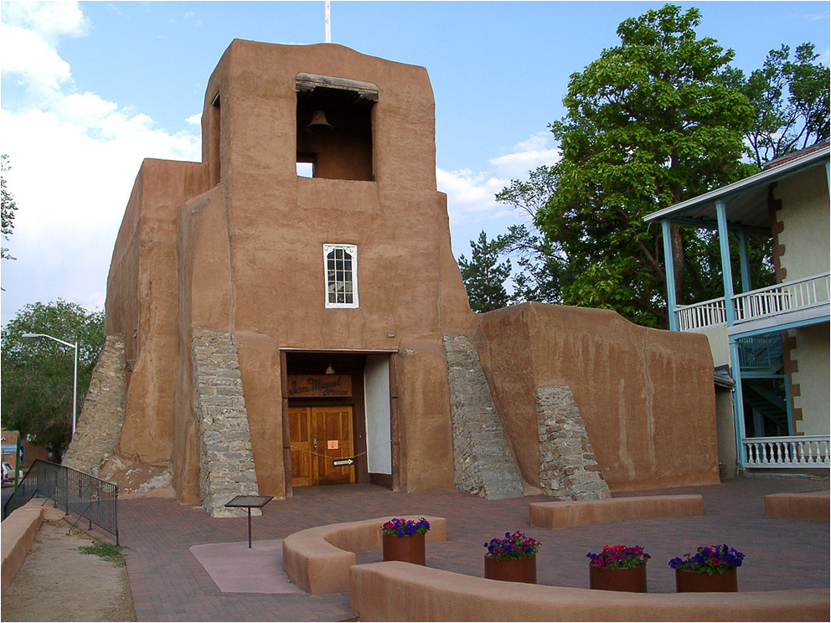
Notes:
San Miguel Chapel in Santa Fe. Oldest church structure in the U.S., built in 1610.

Slide 22
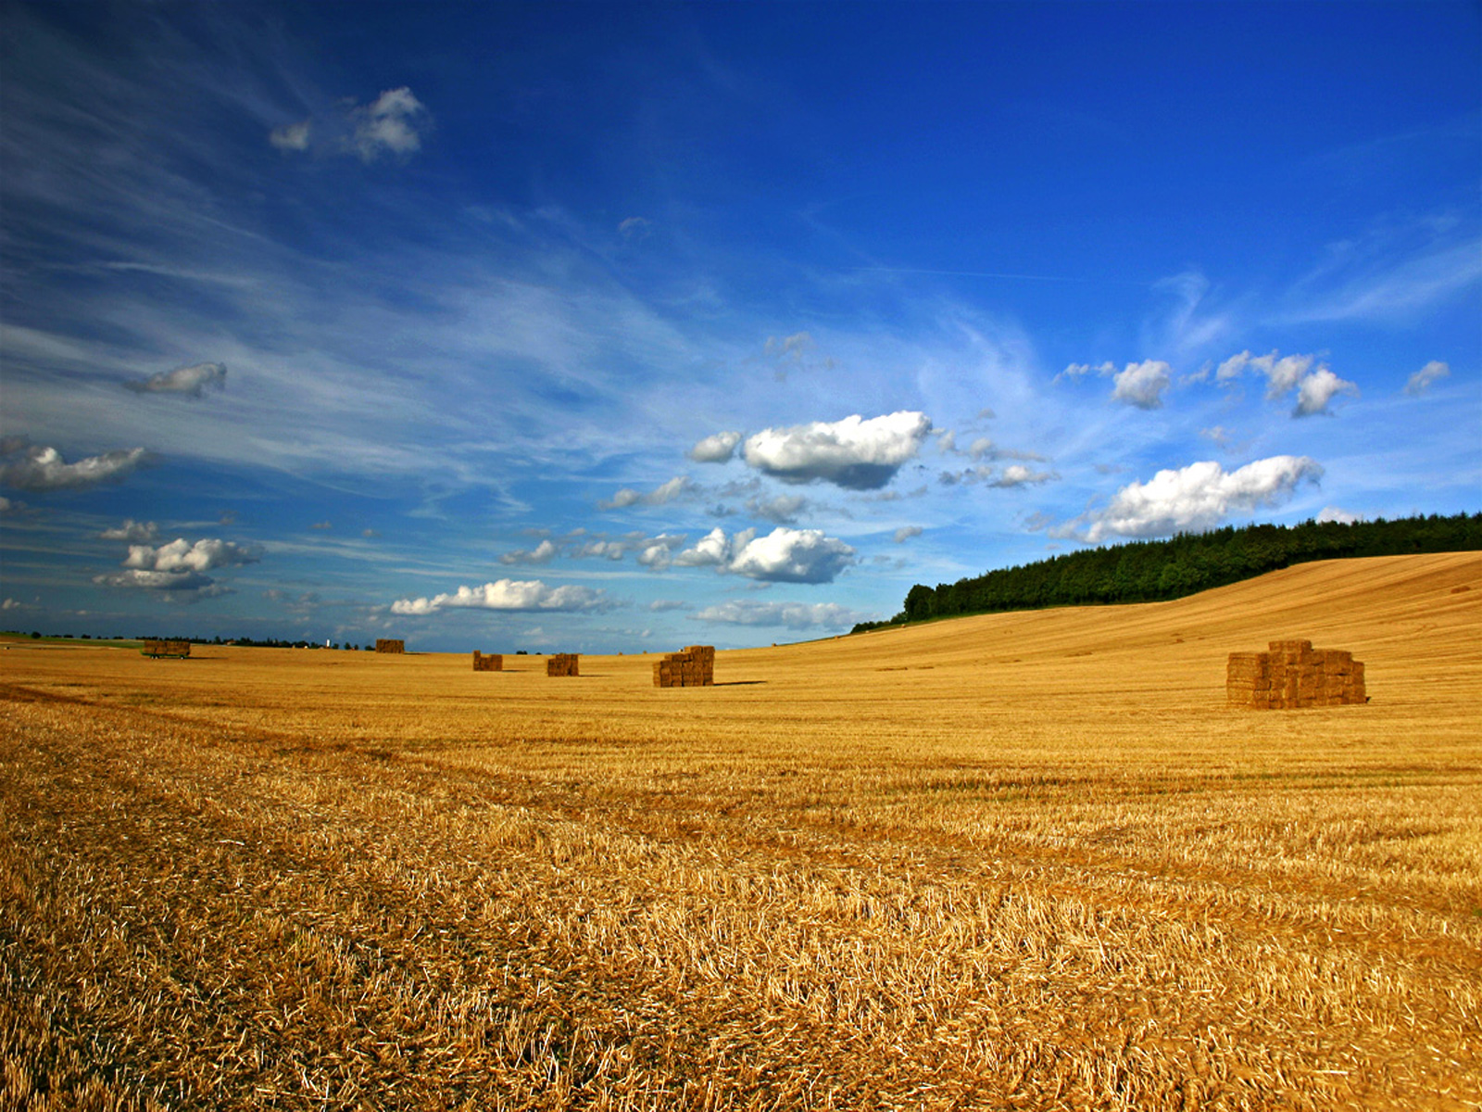
Oklahoma
Nickname : Sooner State
Capital : Oklahoma city
Entrance in the union : 1907 (46th state)
Population : 3,878 million people
Superficie : 181 196 km2
Neighboring states : Texas, Arkansas, Missouri, Kansas, Colorado, New Mexico
Landscape : most diversified of the USA with woods, sand dunes, undulating meadows, cypress marshes

Slide 23
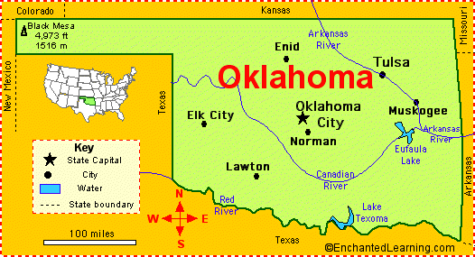
Oklahoma

Slide 24
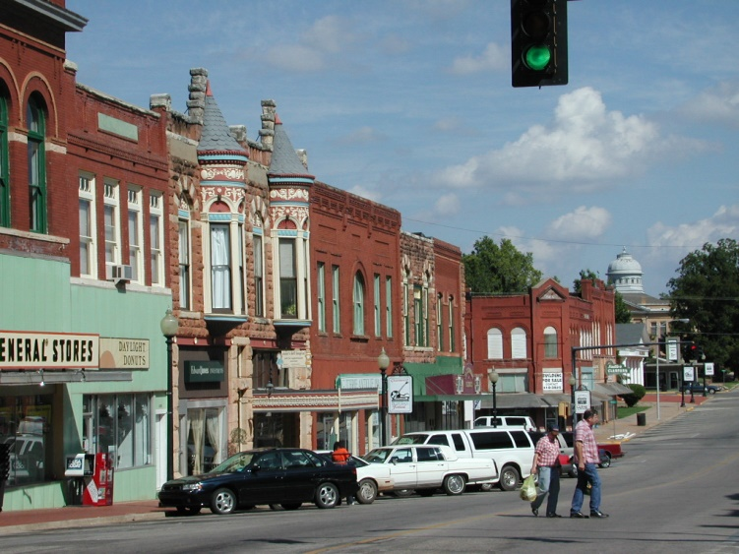
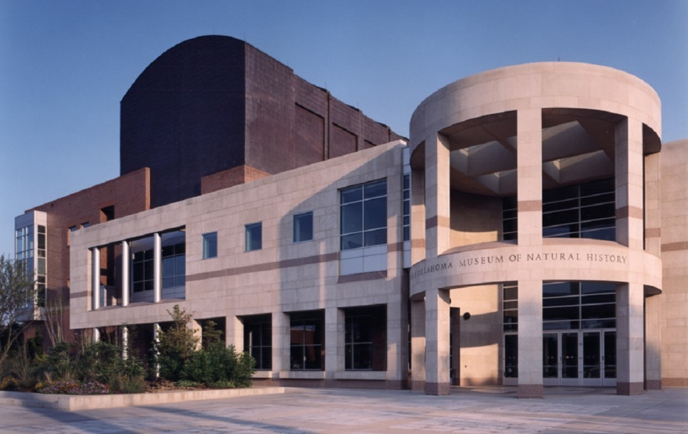
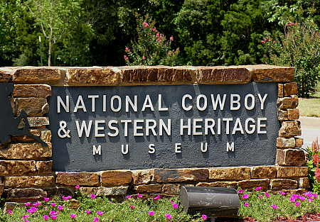
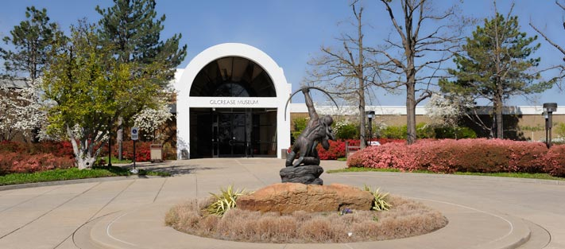
Oklahoma

Slide 25
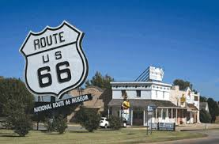
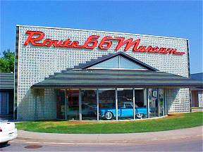
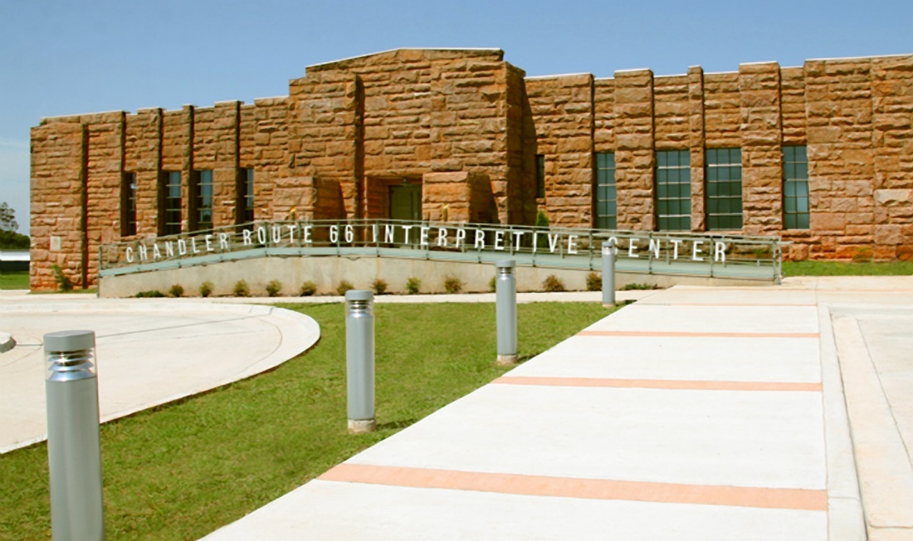
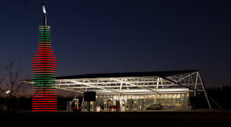
Oklahoma – Route 66

Slide 26
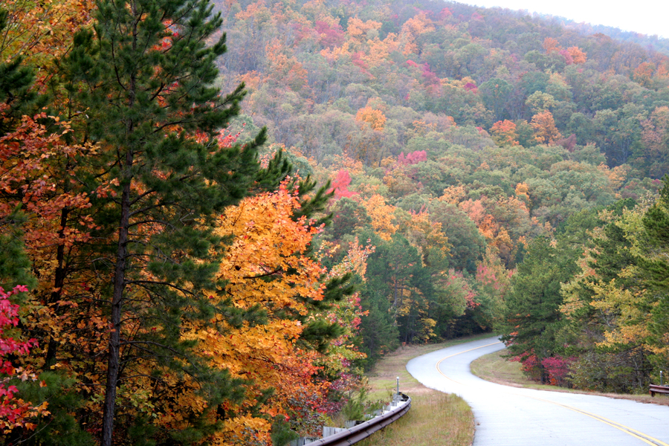
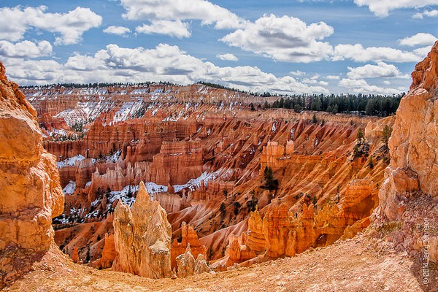
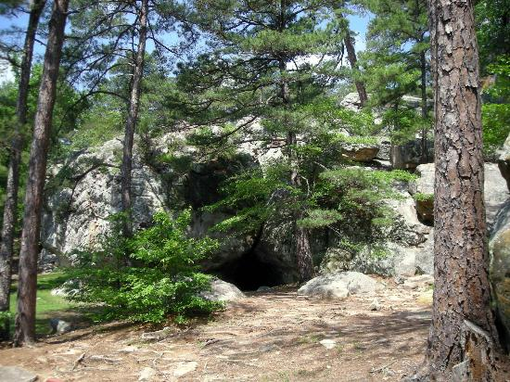

Oklahoma – Nature

Slide 27




Oklahoma - Nature

Slide 28


Oklahoma – Nature

