Slide 1
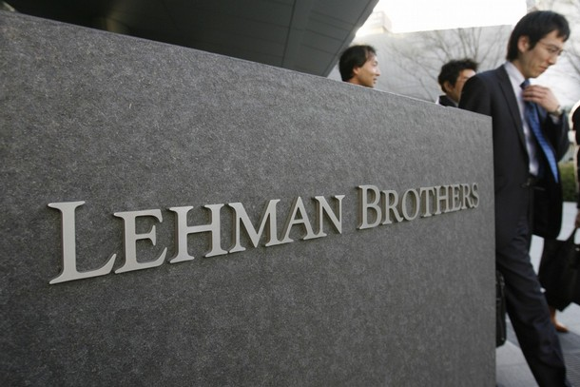

Slide 2
History
1850: Lehman Brothers’ foundation
1858: New office in New-York
1887: Member of the New-York Exchange
1929: Creation of Lehman Corporation
1960’s-1970’s: New offices in Europe and Asia
1980’s: Advisor on several large US companies
1984: Acquisition by American Express
1993: Spin-off of American Express
1994: Public Stock Offering
2000: 150th anniversary
Notes:
http://www.library.hbs.edu/hc/lehman/history.html
https://en.wikipedia.org/wiki/Lehman_Brothers
http://fr.slideshare.net/asadswati1/lehman-brothers-42929059

Slide 3
Core Business & Financial Data
Lehman Brothers
Investment Banking
Asset Management
Trading
Real Estate
Private Banking
Private Equity
Since going public in 1994:
    Net revenues increased over 600%
    Employee headcount increased over 230%
2003-2004: Acquisition of mortgage lenders
Notes:
http://www.investopedia.com/articles/economics/09/lehman-brothers-collapse.asp
https://en.wikipedia.org/wiki/Lehman_Brothers

Slide 4
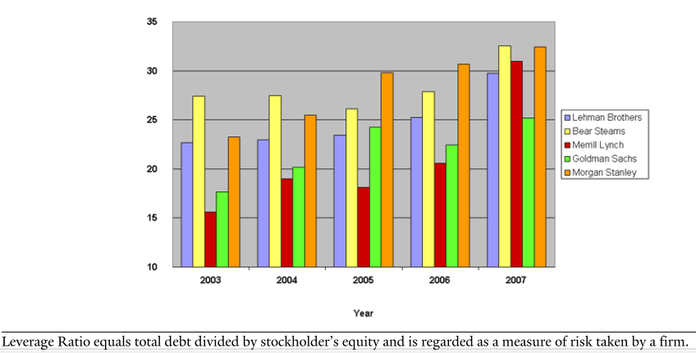
Leverage Ratio for Major Investment Banks
Investments by high leverage: in 2003 leverage of 24 and 31 in 2008
Notes:
http://som.yale.edu/case/2014/lehman-brothers-bankruptcy-overview

Slide 5
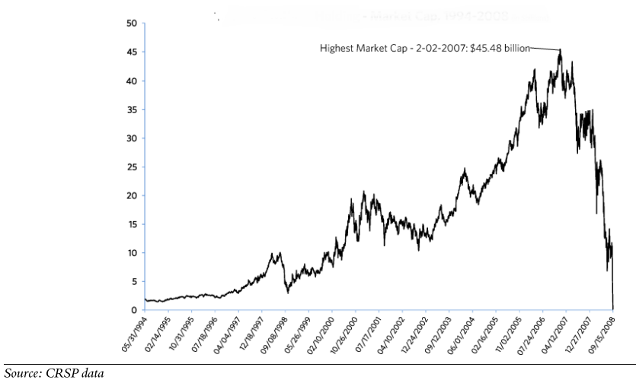
Market Capitalization 1994-2008
September 2007: 55th consecutive profitable quarter
June 9, 2008 : $2.8 billion of loss
September 10, 2008: $3.9 billion of loss and Moody’s deteriorated Lehman
September 15, 2008: Lehman filed Chapter 11 Bankruptcy Protection
September 17, 2008: Lehman Brothers was delisted from the NYSE
Notes:
http://som.yale.edu/case/2014/lehman-brothers-bankruptcy-overview
https://en.wikipedia.org/wiki/Lehman_Brothers
https://en.wikipedia.org/wiki/Report_of_Anton_R._Valukas

Slide 6
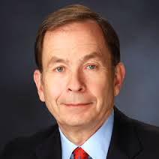
Valukas’ Report
Anton Valukas was appointed by a bankruptcy court in 2009
Lehman used “accounting gimmick”
Manipulation of Liquidity metrics and Leverage ratio
Use of Repurchase agreements market (“Repo”)
“Loophole” in the accounting standard language
Intensive use of Repo 105 and Repo 108 transactions:$50 billion
Violation of accounting principles: no business purpose
No disclosure of information about these Repo transactions
Notes:
https://en.wikipedia.org/wiki/Report_of_Anton_R._Valukas
http://www.dailymail.co.uk/news/article-1257350/Lehman-Brothers-bosses-manipulated-balance-sheet-accounting-tricks-scathing-report-finds.html
http://www.businessinsider.com/report-lehman-brothers-used-accounting-gimmick-to-hide-the-size-of-its-balance-sheet-2010-3?IR=T
http://www.imd.org/research/challenges/TC039-10.cfm
http://www.fraudconferencenews.com/home/2013/6/24/lehman-brothers-accounting-left-to-interpretation
http://www.fraudsharks.com/index.php?option=com_k2&view=item&id=33:repo-105-how-lehman-brothers-manipulated-their-balance-sheet-and-bankrupted-the-company-an-anatomy-of-an-accounting-fraud

Slide 7
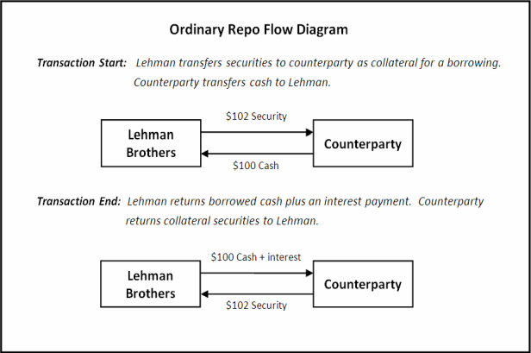
Ordinary Repo
Transaction Start:
Cash (A+) 100
Derivative (A+) 2
to Repo (L+) 102
Transaction End:
Repo (L-) 102 + interest
to Cash (A-) 100 + interest
to Derivative (A-) 2
Notes:
https://jenner.com/lehman
http://som.yale.edu/case/2014/lehman-brothers-bankruptcy-c-managing-balance-sheet-through-use-repo-105
http://www.npr.org/sections/money/2010/03/repo_105_lehmans_accounting_gi.html
http://www.fraudsharks.com/index.php?option=com_k2&view=item&id=33:repo-105-how-lehman-brothers-manipulated-their-balance-sheet-and-bankrupted-the-company-an-anatomy-of-an-accounting-fraud
http://www.imd.org/research/challenges/TC039-10.cfm
https://profalbrecht.wordpress.com/2010/04/24/repo-105-explained-with-numbers-and-detail/
https://en.wikipedia.org/wiki/Lehman_Brothers

Slide 8

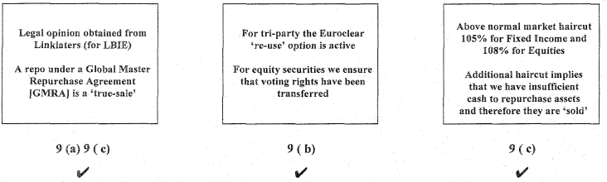
Fulfillment of SFAS 140
Notes:
http://www.jenner.com/lehman/docs/debtors/LBEX-WGM%20748489-748498.pdf.
www.gasb.org/cs/BlobServer?blobcol=urldata&blobtable=MungoBlobs&blobkey=id&blobwhere=1175820919404&blobheader=application%2Fpdf
http://som.yale.edu/case/2014/lehman-brothers-bankruptcy-c-managing-balance-sheet-through-use-repo-105

Slide 9
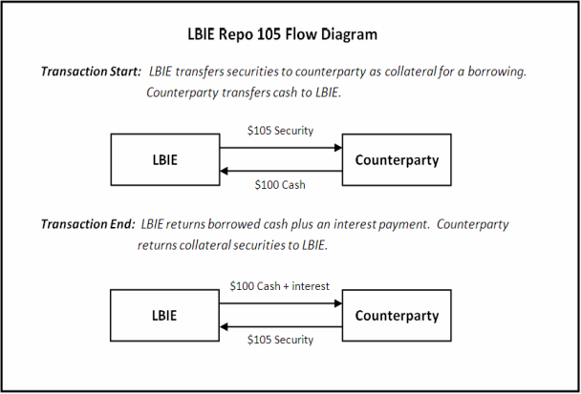
Repo 105/108
Transaction Start:
Cash (A+) 100
Derivative (A+) 5
to Securities (A-) 105
Transaction middle:
Debt (L-) 100
to Cash (A-) 100
Cash (A+) 100
Debt (L+) 100
Transaction End:
Securities (A+) 105 + interest
to Cash (A-) 100 + interest
to Derivative (A-) 5
Notes:
http://web.stanford.edu/~jbulow/Lehmandocs/docs/DEBTORS/LBEX-WGM%20754598-754600.pdf.
https://jenner.com/lehman
http://som.yale.edu/case/2014/lehman-brothers-bankruptcy-c-managing-balance-sheet-through-use-repo-105

Slide 10
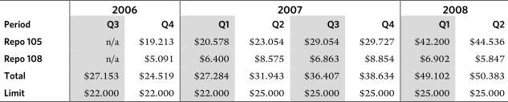
Total Repo 105/108 and The 1x Leverage Rule
Use of Repo 105/108 doubled between 2006 and 2008
Limits were consistently exceeded
Notes:
http://som.yale.edu/case/2014/lehman-brothers-bankruptcy-c-managing-balance-sheet-through-use-repo-105
http://www.imd.org/research/challenges/TC039-10.cfm
https://jenner.com/lehman

Slide 11
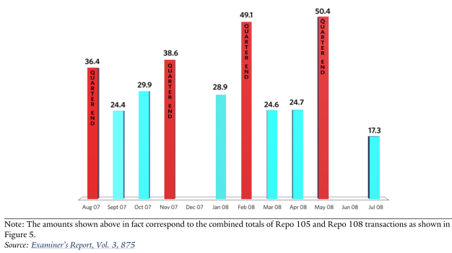
Repo 105/108 by months
Notes:
http://som.yale.edu/case/2014/lehman-brothers-bankruptcy-c-managing-balance-sheet-through-use-repo-105
http://www.fraudsharks.com/index.php?option=com_k2&view=item&id=33:repo-105-how-lehman-brothers-manipulated-their-balance-sheet-and-bankrupted-the-company-an-anatomy-of-an-accounting-fraud
https://en.wikipedia.org/wiki/Lehman_Brothers
https://jenner.com/lehman

Slide 12
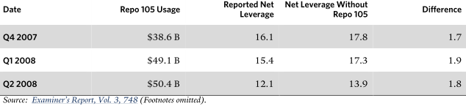
Effect of the Repo 105/108 on Net Leverage
Net leverage: Net assets to equity
Notes:
http://som.yale.edu/case/2014/lehman-brothers-bankruptcy-c-managing-balance-sheet-through-use-repo-105
https://jenner.com/lehman

Slide 13
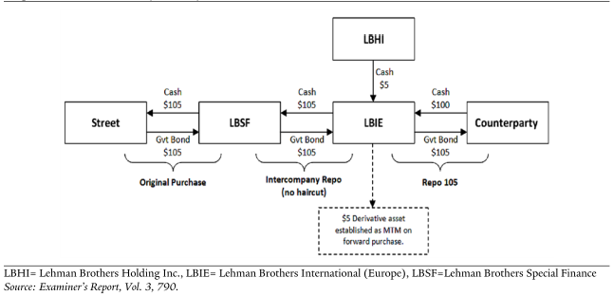
The role of Linklaters
Problem to find American law firms to provide an opinion letter
Linklaters was a law firm in London that provided the opinion letter
Notes:
http://dealbook.nytimes.com/2010/03/12/the-british-origins-of-lehmans-accounting-gimmick/
http://www.dailymail.co.uk/news/article-1257350/Lehman-Brothers-bosses-manipulated-balance-sheet-accounting-tricks-scathing-report-finds.html
https://jenner.com/lehman
http://som.yale.edu/case/2014/lehman-brothers-bankruptcy-c-managing-balance-sheet-through-use-repo-105

Slide 14
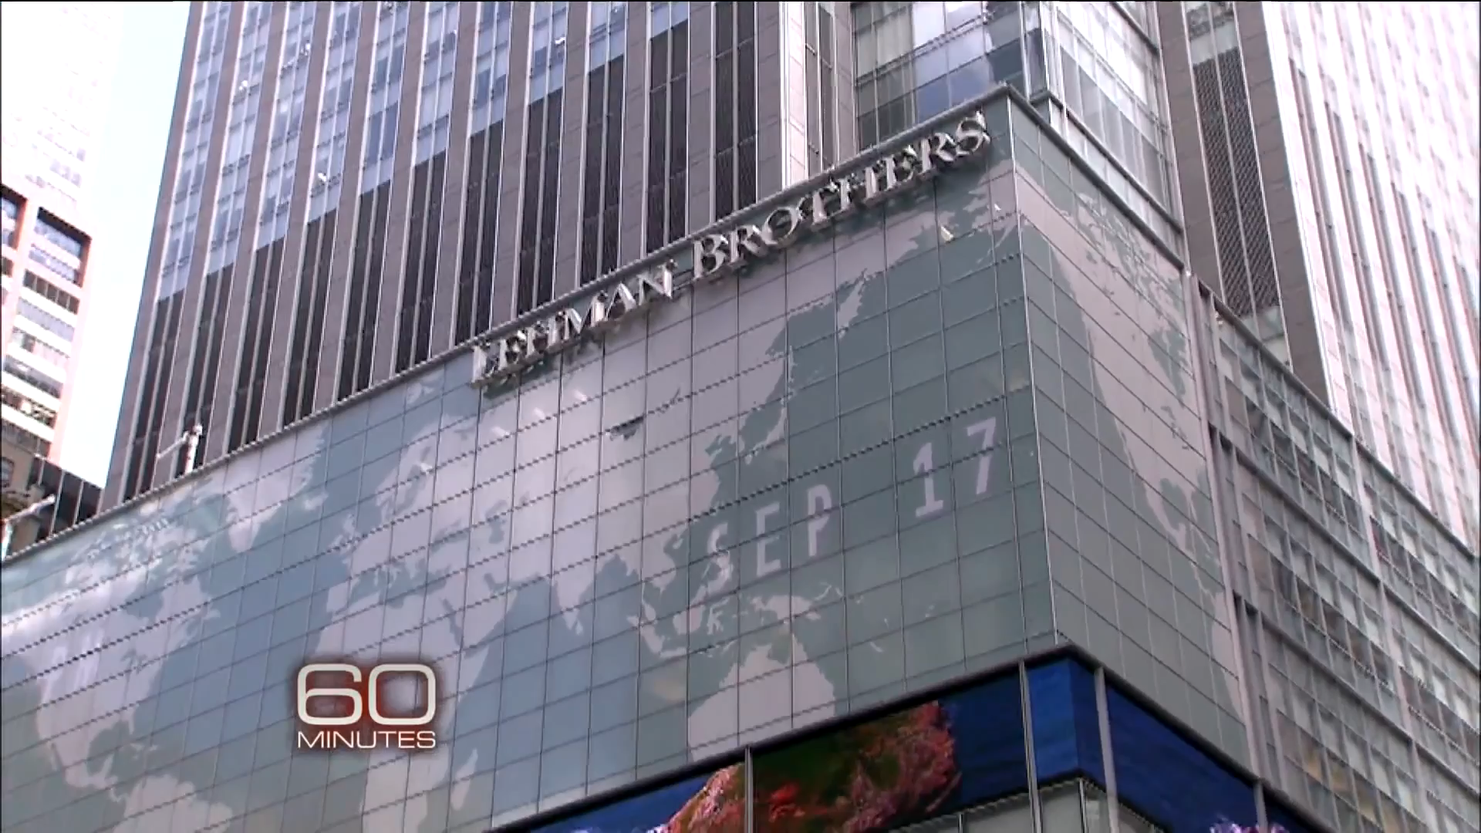
Valukas’ interview
Notes:
https://www.youtube.com/watch?v=3sm-XGVca3c

Slide 15
Mistakes
Internal risk limits and control exceeded
Finance and Risk Committee met only twice in both 2006 and 2007
Risky strategy
Executive pay increased before filling bankruptcy
Plausible legal claims against CEO and CFOs
Whistle-blower: Matthew Lee
Ernst & Young failed to meet professional standards
Notes:
https://jenner.com/lehman
https://www.youtube.com/watch?v=3sm-XGVca3c
https://www.sec.gov/comments/s7-33-10/s73310-119.pdf.
https://en.wikipedia.org/wiki/Bankruptcy_of_Lehman_Brothers
http://www.dailyfinance.com/2010/12/23/fraud-files-is-ernst-and-young-to-blame-in-lehman-bros-fraud/

Slide 16
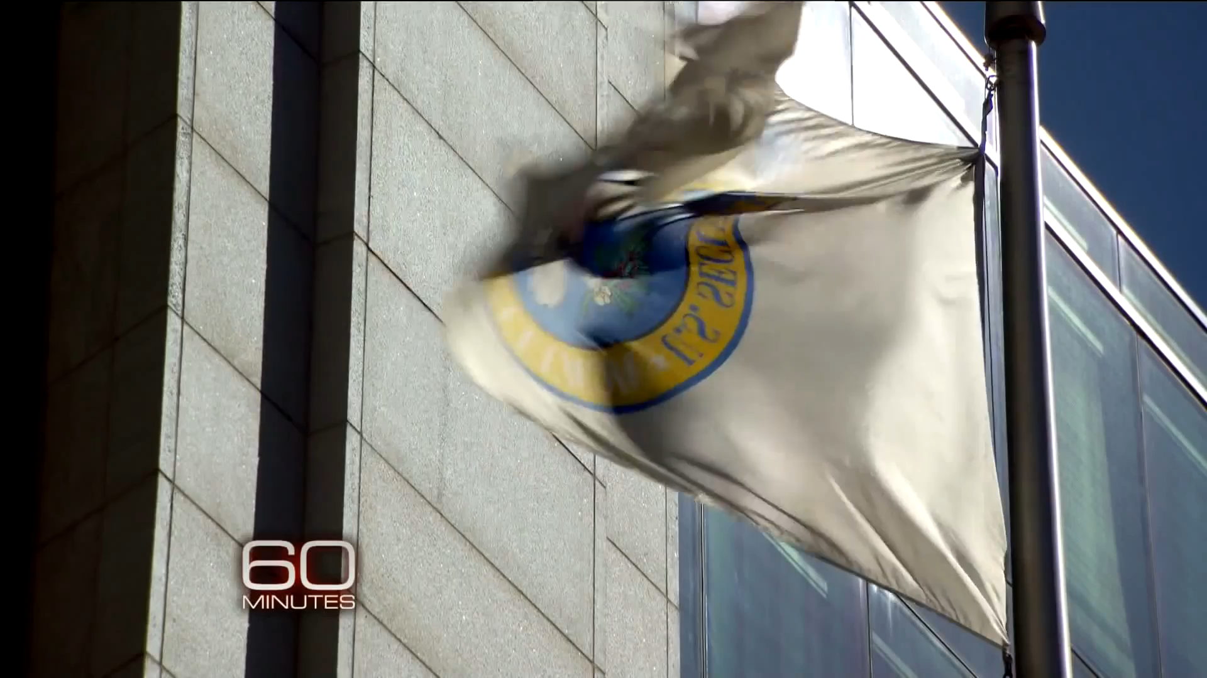
Plausible Explanation
Notes:
https://www.youtube.com/watch?v=3sm-XGVca3c

Slide 17
Actualities & Conclusion
No trial against Richard Fuld or other executive
Investors will receive 14 cents for every dollar Lehman owed them
June 2010: Disciplinary body for the UK accounting profession was investigating Ernst & Young
December 2011: FASB changed Repo accounting rule used by Lehman
May 2015: Richard Fuld admitted that he made number of mistakes as the head of Lehman however the demise wasn’t his fault
Notes:
http://www.theguardian.com/commentisfree/cifamerica/2011/dec/12/lehman-brothers-bankrupt
http://www.cnbc.com/2015/05/28/lehmans-fuld-no-one-thing-caused-the-crisis.html
http://www.wsj.com/articles/SB10001424127887324595704578244043750934904
http://www.accountancyage.com/aa/news/1934026/-sued-lehmans-audit

Slide 18
Reference Page
http://www.theguardian.com/commentisfree/cifamerica/2011/dec/12/lehman-brothers-bankrupt
http://www.cnbc.com/2015/05/28/lehmans-fuld-no-one-thing-caused-the-crisis.html
http://www.wsj.com/articles/SB10001424127887324595704578244043750934904
http://www.accountancyage.com/aa/news/1934026/-sued-lehmans-audit
https://www.youtube.com/watch?v=3sm-XGVca3c
https://jenner.com/lehman
https://www.sec.gov/comments/s7-33-10/s73310-119.pdf.
https://en.wikipedia.org/wiki/Bankruptcy_of_Lehman_Brothers
http://www.dailyfinance.com/2010/12/23/fraud-files-is-ernst-and-young-to-blame-in-lehman-bros-fraud/
http://dealbook.nytimes.com/2010/03/12/the-british-origins-of-lehmans-accounting-gimmick/
http://www.dailymail.co.uk/news/article-1257350/Lehman-Brothers-bosses-manipulated-balance-sheet-accounting-tricks-scathing-report-finds.html
http://som.yale.edu/case/2014/lehman-brothers-bankruptcy-c-managing-balance-sheet-through-use-repo-105
http://www.fraudsharks.com/index.php?option=com_k2&view=item&id=33:repo-105-how-lehman-brothers-manipulated-their-balance-sheet-and-bankrupted-the-company-an-anatomy-of-an-accounting-fraud
https://en.wikipedia.org/wiki/Lehman_Brothers
http://www.jenner.com/lehman/docs/debtors/LBEX-WGM%20748489-748498.pdf.
www.gasb.org/cs/BlobServer?blobcol=urldata&blobtable=MungoBlobs&blobkey=id&blobwhere=1175820919404&blobheader=application%2Fpdf
http://som.yale.edu/case/2014/lehman-brothers-bankruptcy-c-managing-balance-sheet-through-use-repo-105
http://www.npr.org/sections/money/2010/03/repo_105_lehmans_accounting_gi.html
http://www.fraudsharks.com/index.php?option=com_k2&view=item&id=33:repo-105-how-lehman-brothers-manipulated-their-balance-sheet-and-bankrupted-the-company-an-anatomy-of-an-accounting-fraud
http://www.imd.org/research/challenges/TC039-10.cfm
https://profalbrecht.wordpress.com/2010/04/24/repo-105-explained-with-numbers-and-detail/

