Slide 1
Assomption about Challenge mode (Puzzle game style):

Slide 2
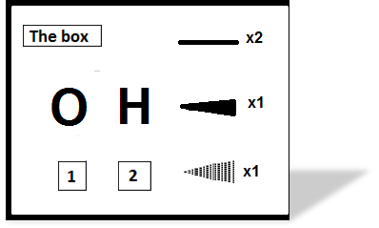

Objective:
Prototype Matlab Version:
Drag and drop function
Next level button locked

Slide 3

Objective:
Prototype Matlab Version:
Next level button locked

Slide 4


Objective:
Prototype Matlab Version:
Next level button locked

Slide 5


Objective:
Prototype Matlab Version:
Next level button Unlocked

Slide 6
Objective:
Prototype Matlab Version:
Next level button locked

Slide 7
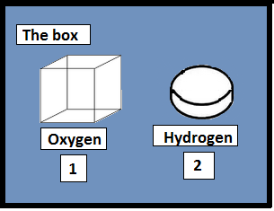
3D Graphical interface version (Like Unity or Blender)
You can put your dices here
Quantities

Slide 8
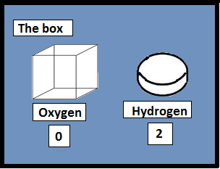
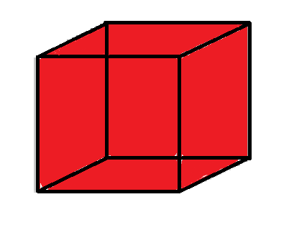
3D Graphical interface version
Covalent links:
Yellow = Free

Slide 9

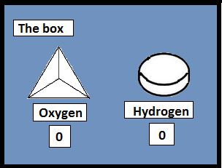
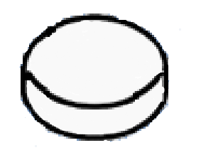
3D Graphical interface version
Covalent links:
Yellow = Free

Slide 10
3D Graphical interface version
+2δ
Covalent links:
Blue = Correctly link
−δ
−δ
Awesome!!!

Slide 11
3D Graphical interface version
+δ
−δ
−δ
Covalent links:
Blue = Correctly link
Red = Wrong link
+δ
Instable!

Slide 12




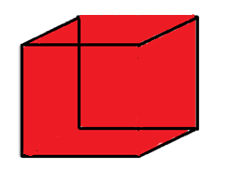
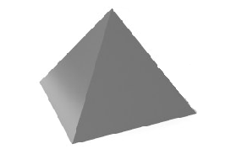
Idea of dices:
One face= one link

Slide 13




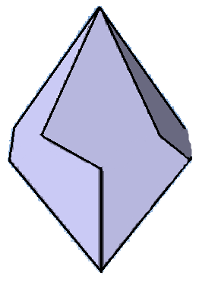
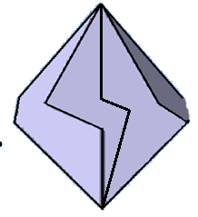
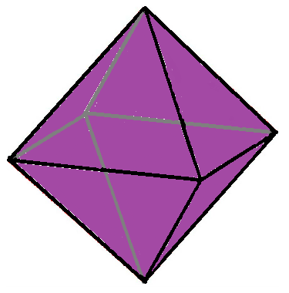
Idea of dices:
One face= one link

Slide 14


Idea of dices:
One size= one line

