Slide 1
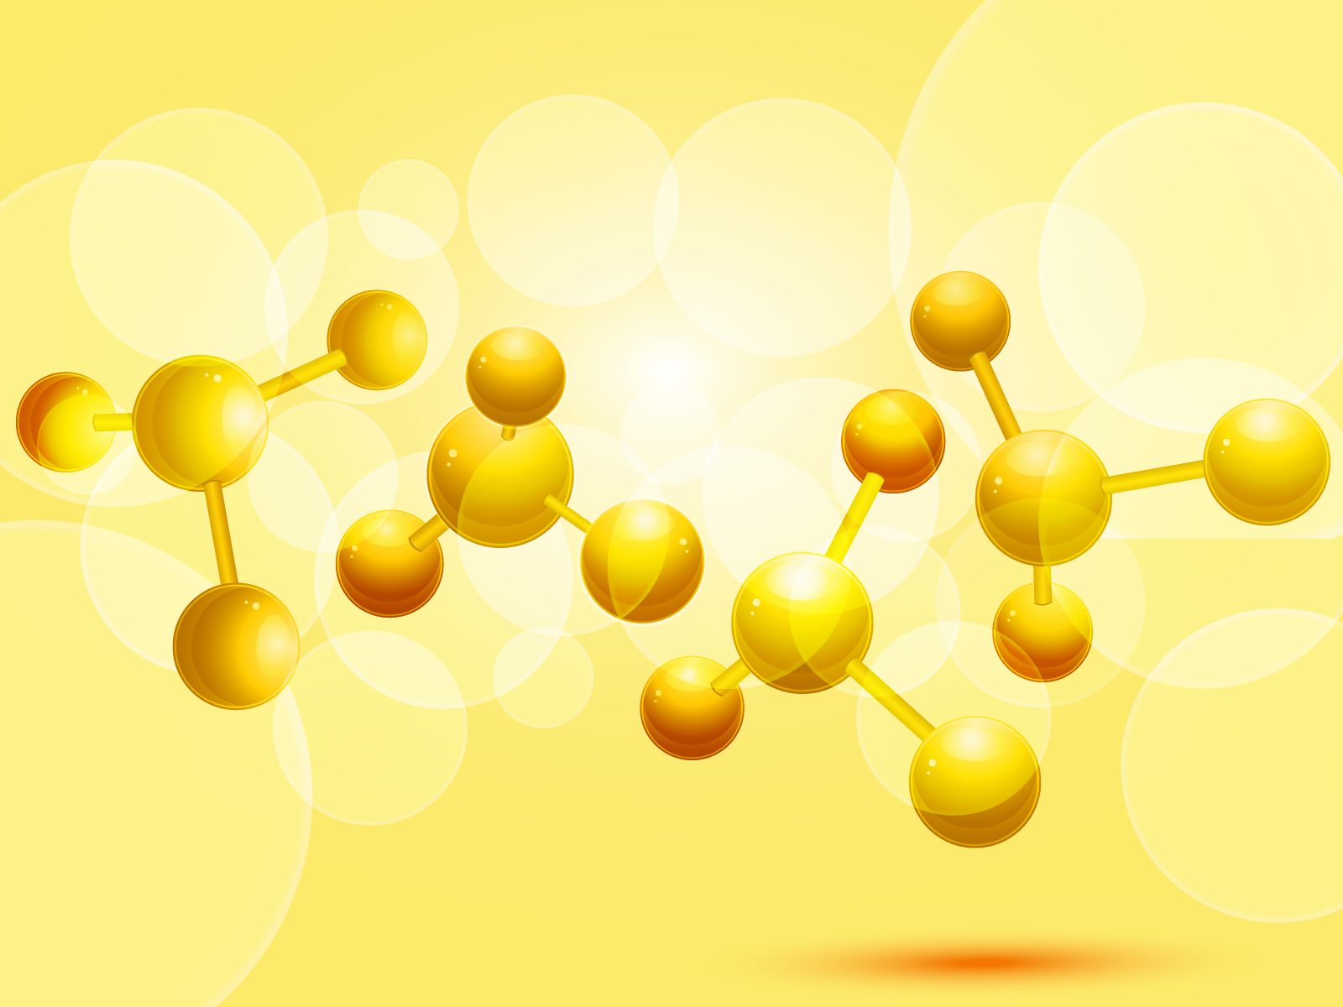
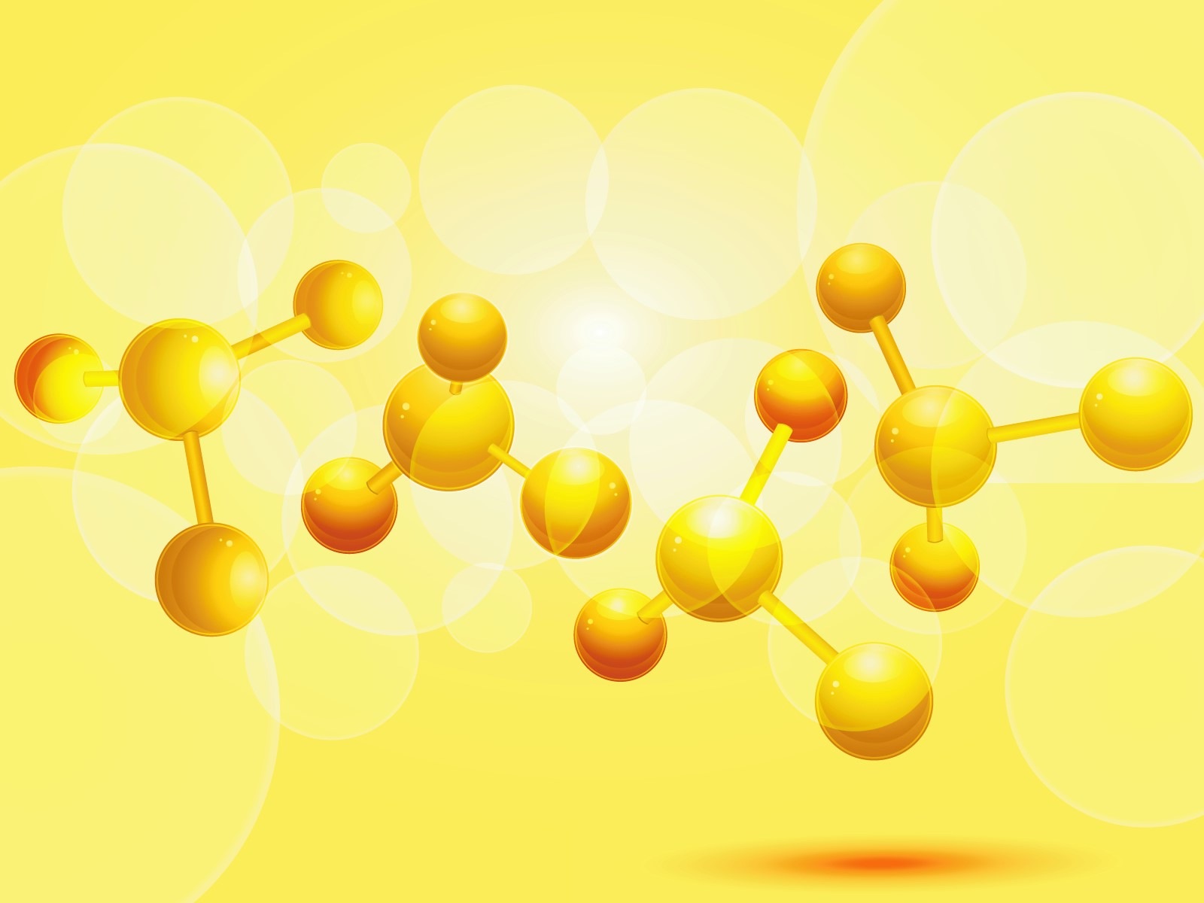
ATOM DICE
TroisDMT Team

Slide 2

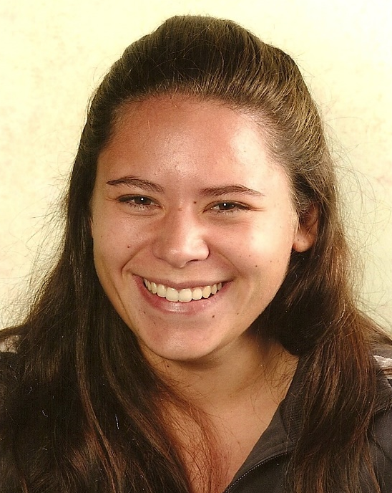

Team
    Producer: Team Manager: Lead Programmer:
    Baptiste Marion Bacary
Notes:
First of all, our presentation:
Baptiste from France the producer
Me, Marion, from France also, the team manager
Bacary, From Senegal, the lead programmer

Slide 3
Presentation of the product
Vision behind the product ;
Why Chemistry App;
Market potential of this product ;
Explanation of the game ;
Envisioned end product

Slide 4
Vision behind the product
Knowledge
Quick learning
Attractive
Chemistry, atomistic, molecules
Simple game, easy to understand
Simple app, challenging, on-line
Creativity
Make your own molecules
Notes:
Marion

Slide 5
Why chemistry?
Many games are succefully associate fun and aknoledgement around some scientist domain like mathematics, physics, astronomy, …
Chemistry is rarely used as a game, it’s only for information (periodic table, properties of the elements, molecule viewer).
Notes:
Marion

Slide 6
Market potential of this product
Notes:
Soumik

Slide 7
Market Sales
    Distribution:
    - Digital (Apple Store, Google Play, Windows Store) ;
    Pricing (four possibilities):
    - Micropayment system (free for the beta version, micropayment for the finish product (2 euros) )
    - Publicity Banner (Rewards generated by clicks)
    - Licence number by Paypal (1,5€ per licence number keys, no demo).
    - Application is free, but in the challenge part when the player is stuck, we can pay for “joker” at 0,89€ (like automatic placement of one atom, …) or to unlock world
Notes:
Baptiste

Slide 8


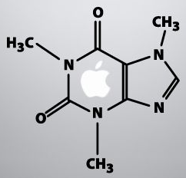
Technology:
    Platform: smartphone are the most popular support for this kind of game (Android, Apple & Windows),
    Experience: no one ;
    Tools: Matlab for prototype version ; Blender for 3D animation (visualization of the interface).
    Controllers: touchscreen for interaction and movement.
Notes:
Soumik

Slide 9



Audience:
    10 – 30 years old casual people ;
    Social setting: alone & on-line (share with friends, challenged them, show score and level advancement) ;
    Social network (Facebook, Google play, kongregate, …).
Notes:
Soumik

Slide 10
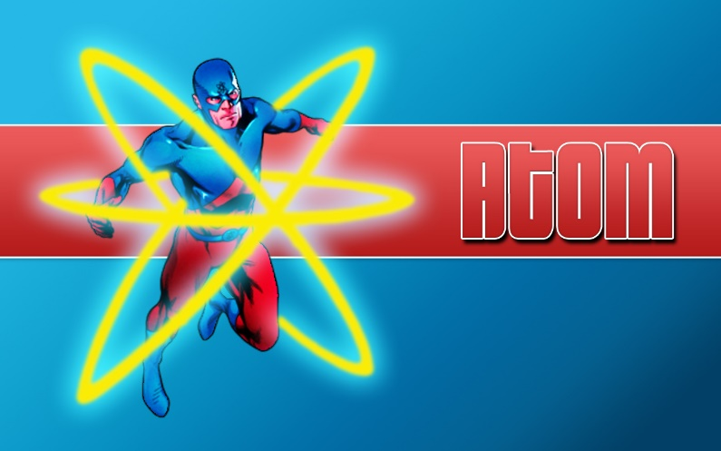
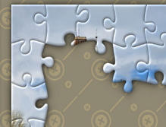
Explanation of the game
  Genre :
    Tradition: puzzle game with learning section;
    Competition: challenge with friends on-line;
    New: association of atoms like a puzzle ;
Notes:
Soumik

Slide 11
Explanation of the game
  Gameplay:
    Experience: you incarn a chemist apprentice ;
    Do: create new molecules with atoms, respecting some realistic condition ;
    Screen: the atom is like a « piece of puzzle » which can be associated with another atom ;
    Awesome: manipulation of atoms and molecule creation.
Notes:
Soumik

Slide 12
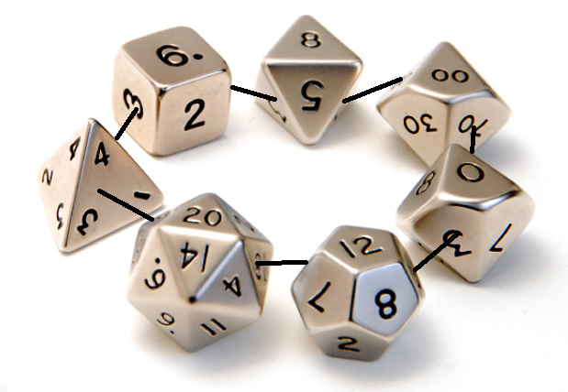
Explanation of the game
  Style:
    Graphical: Atom (Dice) ;
    Mood: relax ;
    Music: relaxing music and different music for challenges ;
    Universe: Challenging a mad scientist around different levels and words (like Candy Crush) ;
Notes:
Baptiste

Slide 13




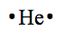

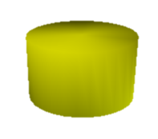
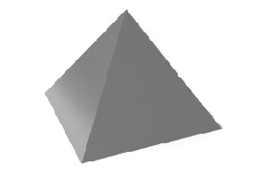
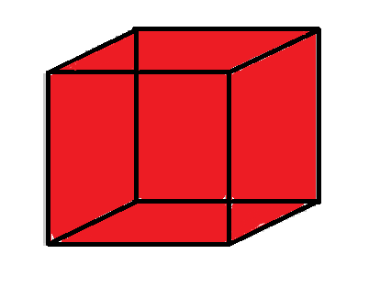
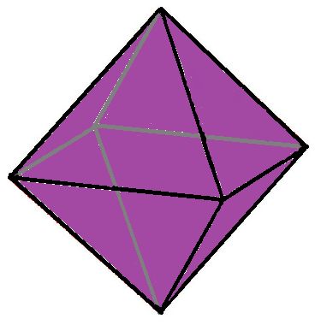
Why the idea of Dices?
Chemistry and atomistic must obey some particular rules, especially rules about electrons and links.
1 links = 1 face, that the idea of dice, but equally, the size of the dice can change in function of atom’s mass.

Slide 14
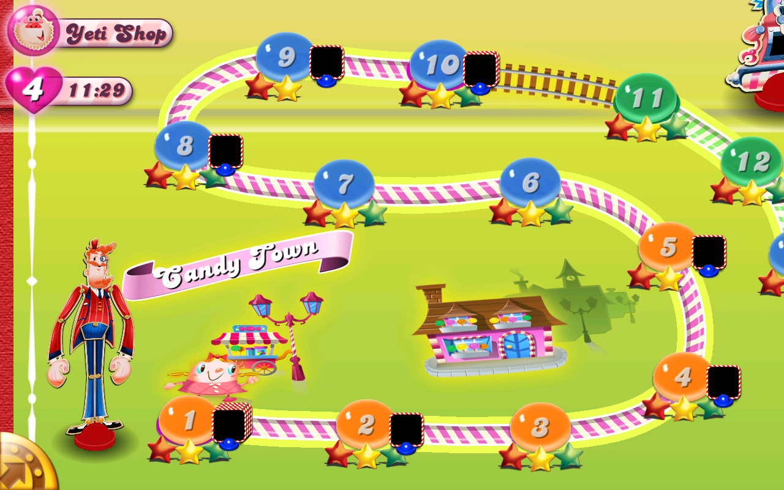
How evolve the player?
Each level is composed of a new challenge, and each word of a new difficulty (Two atoms are given in the first world, 6 atoms in the 5th world, …).
Candy Crush worlds example

Slide 15
How evolve the player?
He can play with facebook or another plateform and unlock the world by asking help to his friends. (It’s same principe than Candy Crush, like almost all the game now).
The score depend on the time spend to find the solution and the optimal one. His best score is saved and he can beat this one.

Slide 16
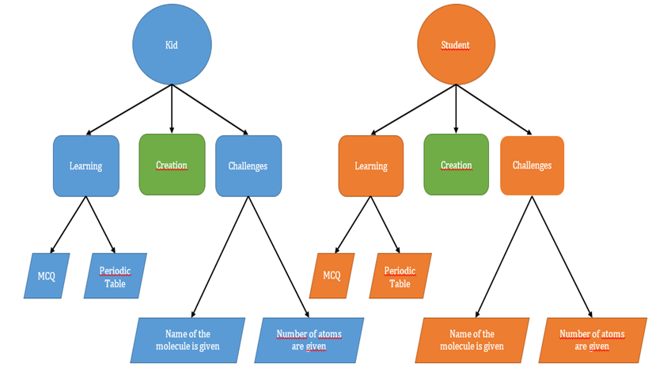
Envisioned end product
Notes:
Baptiste

Slide 17
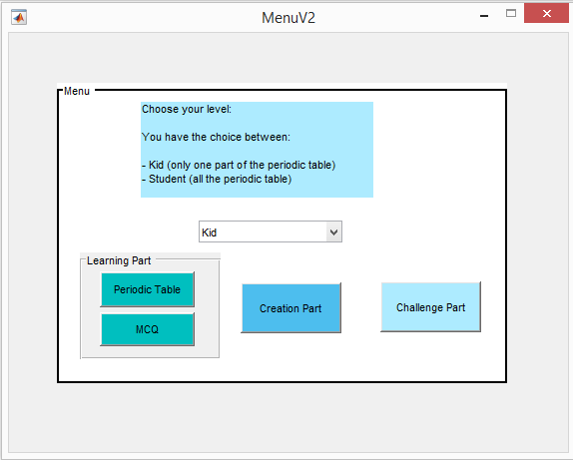
Envisioned end product
Menu (prototype)
Notes:
Baptiste

Slide 18
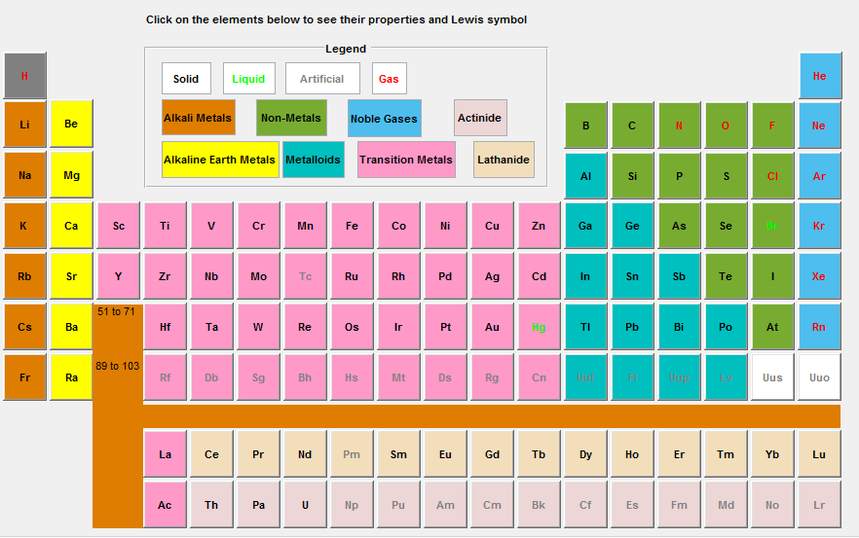
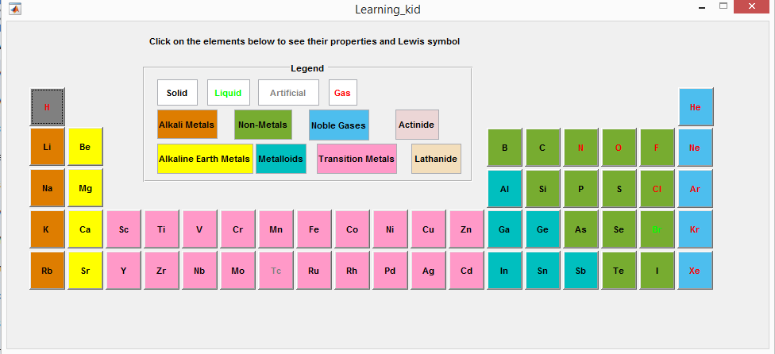
Envisioned end product
Learning part (Periodic table)
Two differents levels: Kid
Two differents levels: Student
Notes:
Baptiste

Slide 19
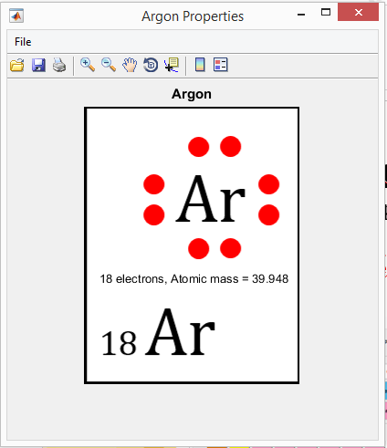
Envisioned end product
Learning part (Periodic table)
You click on an element and you will have:
His properties: atomic number, atomic mass, Lewis Symbol.
Notes:
Baptiste

Slide 20
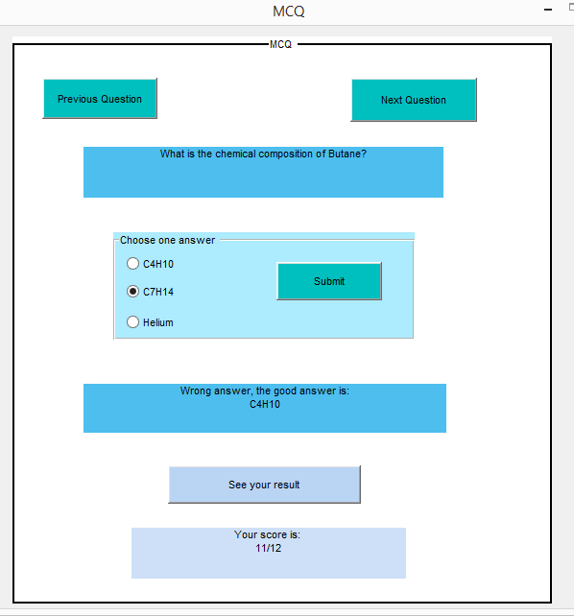
Envisioned end product
Learning part (MCQ)
MCQ is showed in order to increase player’s knowlege AND level.
Like Duolinguo, this MCQ could be have many chemistry/atomistic domain and need reinforcement in function of the frequentation of the player.
Notes:
Baptiste

Slide 21
Envisioned end product
Creation part
You have the choice between link and atom (sphere or dice)
Sphere shape:
C
O
N
Na
Cl
H
Dice shape:
Notes:
Bacary

Slide 22
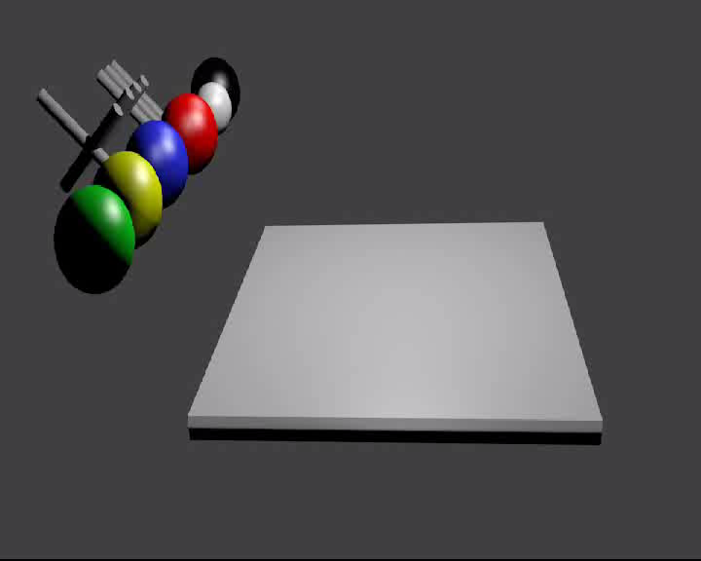
Envisioned end product
Creation part (3D animation – lunch the video)
ToolBox
Draw Area
Notes:
Bacary

Slide 23
Envisioned end product
Challenges part
Two Different games:
1- The app give you atoms, and you must create a specified molecule (do a H2O molecule for example) ;
You have a timer and the time to do that will be your score (world ranking, friends ranking on facebook) ;
In one world all the level had approximatly the same difficutly (same number of atoms but different links numbers), when you change the world (every 20 levels) the difficulty increase (2 atoms in the first world, 6 in the 5th world).
Notes:
Bacary

Slide 24
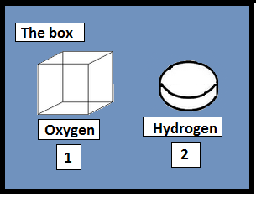
Challenge part:
You can put your dices here
Quantities

Slide 25
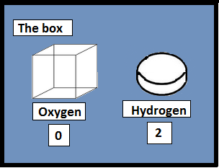
Challenge part:
Covalent links:
Yellow = Free

Slide 26

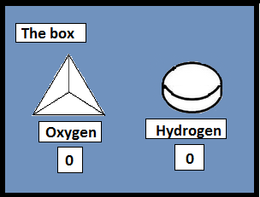
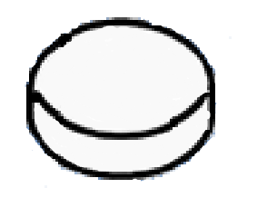
Challenge part:
Covalent links:
Yellow = Free

Slide 27
Challenge part:
+2d
Covalent links:
Blue = Correctly link
-d
-d
Awesome!!!

Slide 28
Challenge part:
+d
-d
-d
Covalent links:
Blue = Correctly link
Red = Wrong link
+d
Instable!

Slide 29
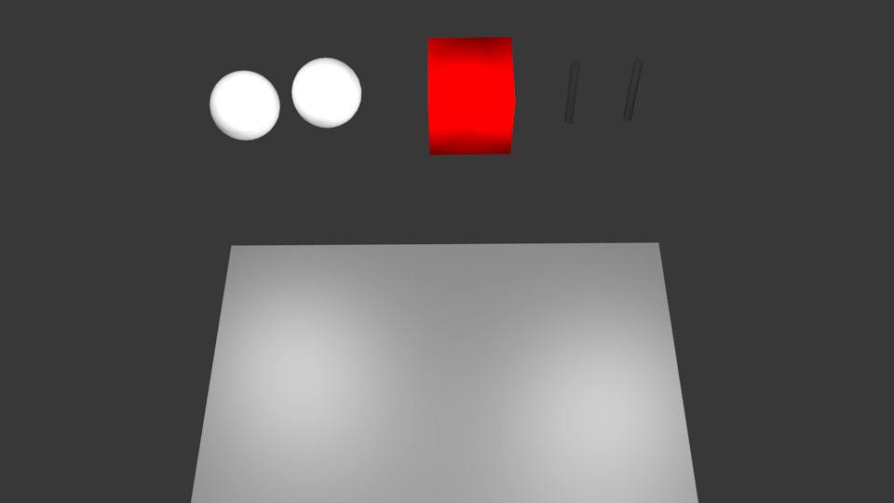
Envisioned end product
Challenge part (3D animation – lunch the video): H2O
Given atoms & links
Notes:
Bacary

Slide 30
Envisioned end product
Challenges part
2- « Panic-challenge section » :
This idea is recent and that why no prototype will be build for this.
The idea is to appear atoms on the screen, the player must form buildable molecules progressively in order to destroy them, and increase score, the game end when there are too much atoms.
The atoms apparition are random and some, usually impossible to use for molecules, could be useful for special abilities. The rhythm of their apparition increase with the time.
Notes:
Bacary

Slide 31
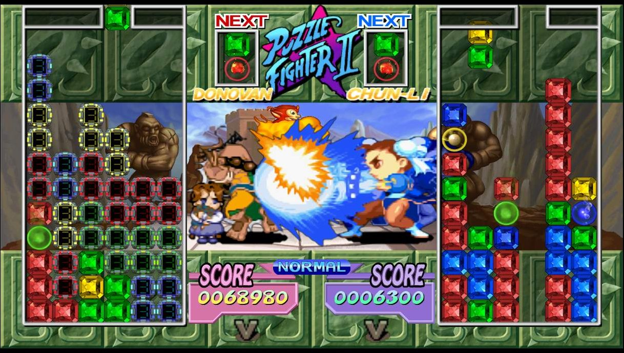
Envisioned end product
Challenges part
Multiplayer mode is possible, and the players can send « attack » during the game when they builds a big molecule.
Puzzle Fighter 2 example

Slide 32
Thank You
TroisDMT Team

