Slide 1
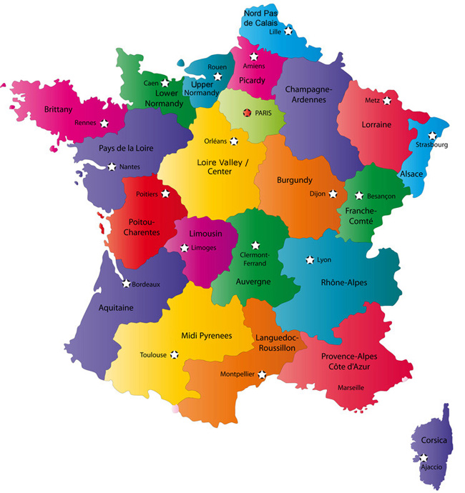
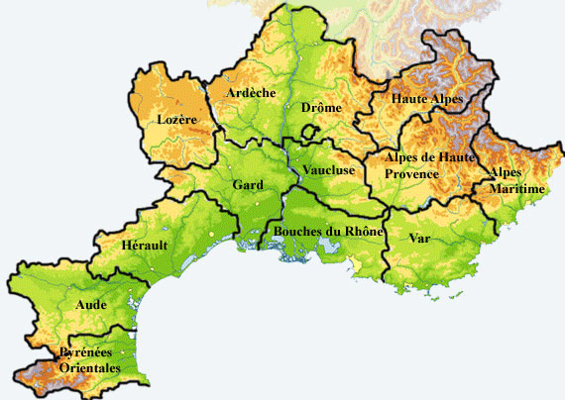
The Roman and Greek remains of Provence
Click on the colored circles

Slide 2
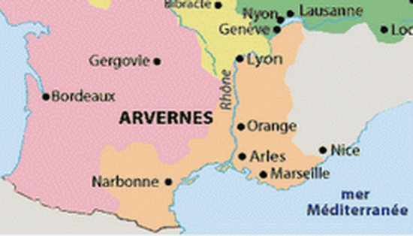
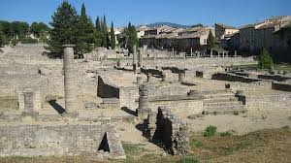
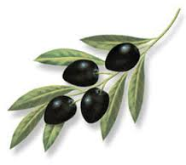
Provence in the Roman Empire: Narbonne
.
La Provincia of the Roman Empire extended beyond the current limits of Provence since called Narbonne, it also incorporated the Languedoc coast. In fact for a long time the capital was Narbo Martius (Narbonne)

Slide 3
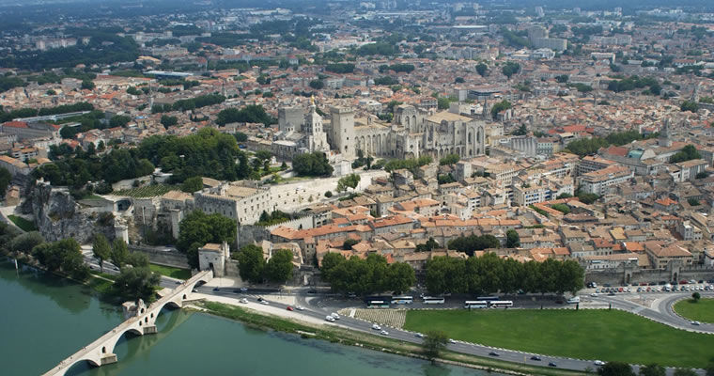
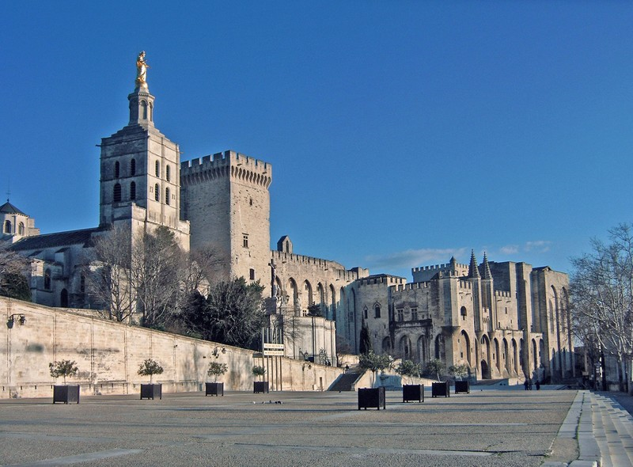
AVIGNON
is a town in the south of France, in the Vaucluse in Provence-Alpes-Côte d'Azur, and installed on the left bank of the Rhone, which marks the limit with the Gard and the Languedoc-Roussillon region. South of Avignon is the Durance between the city of Bouches-du-Rhône. Of the 90 194 inhabitants of the town
Nicknamed the "City of Popes" because of the presence of popes from 1309 to 1423, it is currently the largest city and capital of the department of Vaucluse
here is the Palace of the Popes

Slide 4
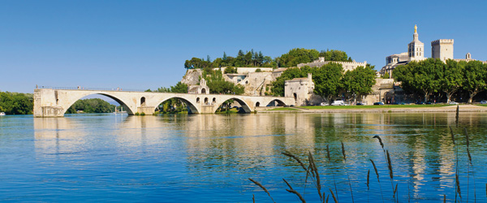
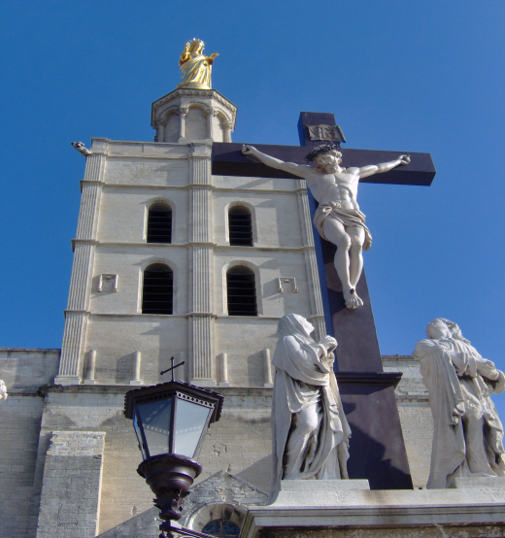
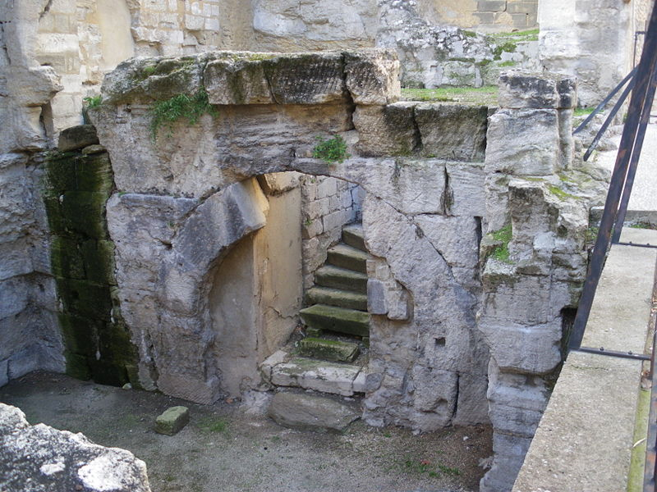
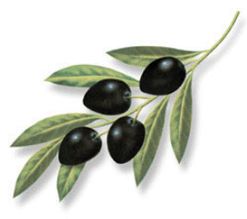
Vestiges romain du Ier siècle, derrière le Palais des papes d'Avignon
Here the bridge of Avignon
Here are the Cathedral of Notre-Dame des Doms
Roman remains of the first century , behind the Palais of the Popes

Slide 5
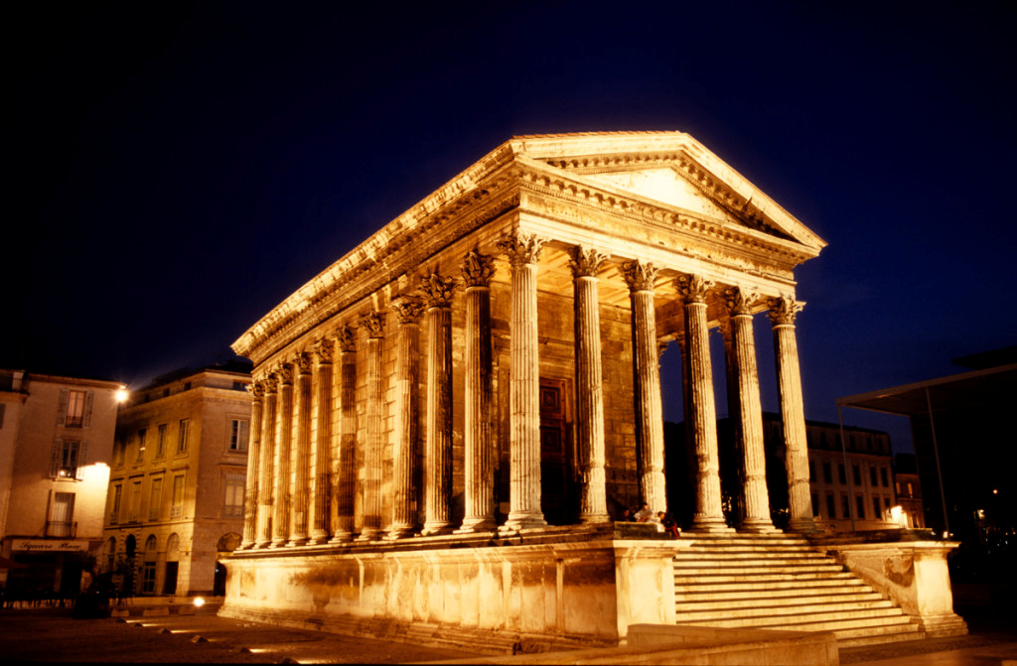
The Square House, Nimes
In Nîmes, still, we find the Square House. Built in the early first century AD. AD, the Square House is now one of the best preserved Roman temples in the world. As the arenas of Nimes, the Square house has known several lives: originally a temple, it later became a consular house, a church and a museum of ancient arts. You'll understand if you try the Gallo-Roman ruins, is in Nîmes as it happens!

Slide 6
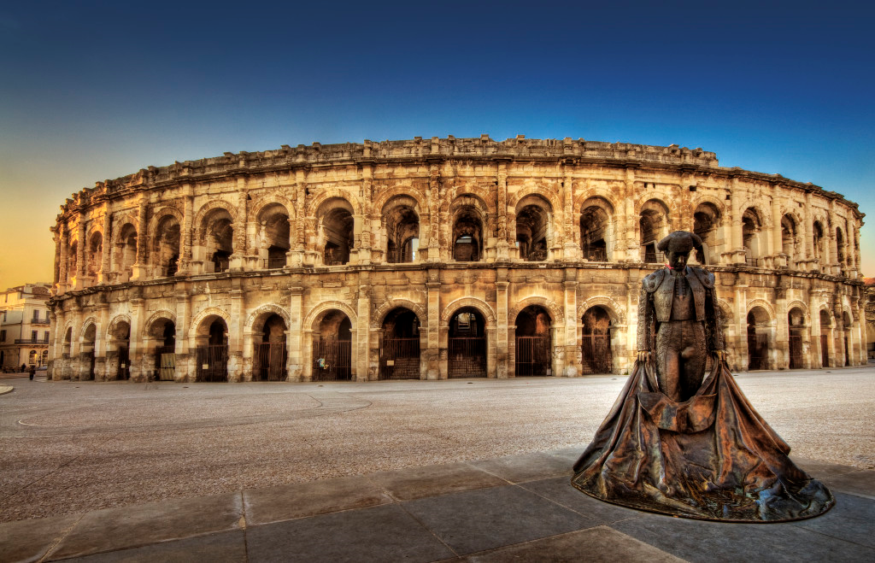
Nimes arena
The 'Nimes Arena ", built between 70 and 80 AD. BC, are actually an amphitheater. This is the best preserved amphitheater of the Roman world. For the record, originally intended for recreational purposes, the amphitheater served successively fortified village shopping area or arenas for bullfights. Today it is one of the most popular entertainment venues in Nîmes.

Slide 7
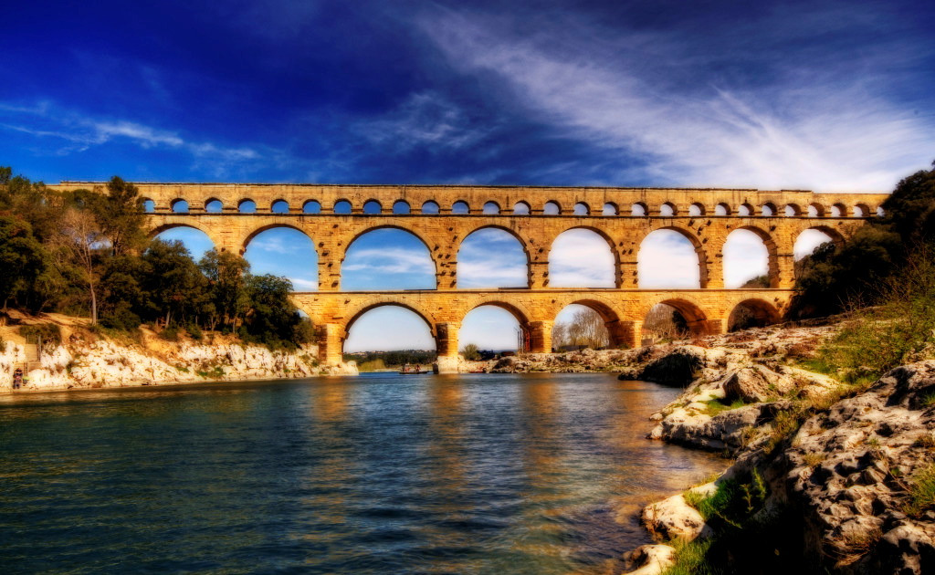
The Bridge of Gard
With the Pont du Gard (built in the first half of the 1st century), it is almost 2000 years of history we contemplate. Majestic and imposing, it is one of the vestiges of the Gallo-Roman era best preserved. With a million visitors each year, the Pont du Gard is one of the most admired monuments in France ...

Slide 8
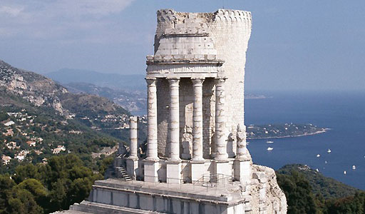
The trophy of the Alps, La Turbie
The trophy of the Alps was built between -7 and -6 BC. AD It is located in the municipality of La Turbie, right next to Monaco. Its name comes from the victory of Emperor Augustus on the 44 tribes that hindered the Alpine passes.

Slide 9
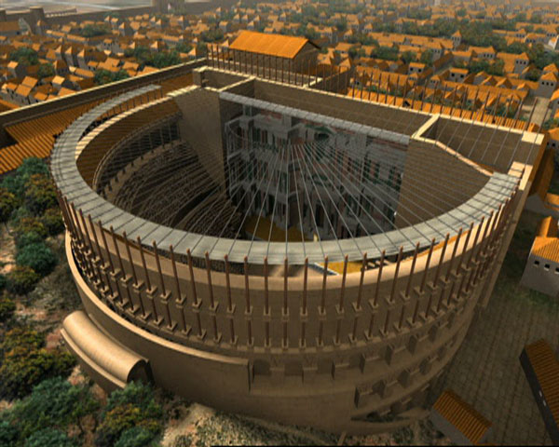
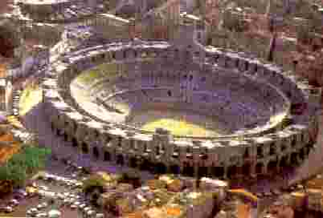
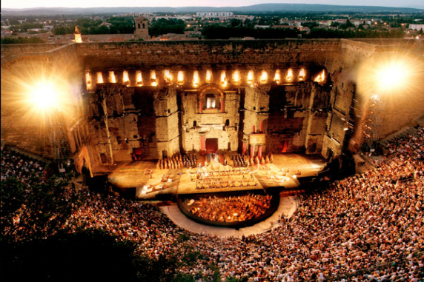
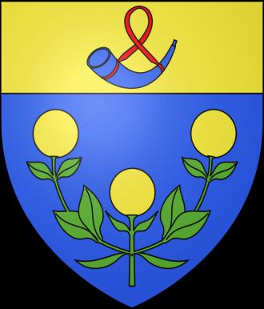
ORANGE
Not until the 19th century to be reborn the ancient theater as a place of entertainment. Auguste Caristie, chief architect of historical monuments, ensures restoration.
    A glass roof for a stone Theatre
    Since June 2006, UNESCO classified Orangeois monument has become a world exclusive: it is not only the unique ancient theater with a stage roof, but also the only ancient theater in the world having preserved its stage wall.

Slide 10
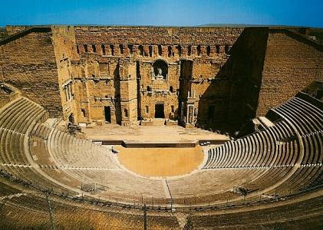
The ancient theater of Orange
The ancient theater of Orange, built in the first century AD. BC, is perhaps one of the best preserved Gallo-Roman theaters in the world. Today the theater is home to the annual "Chorégies d'Orange ', a festival of opera and classical music.

Slide 11
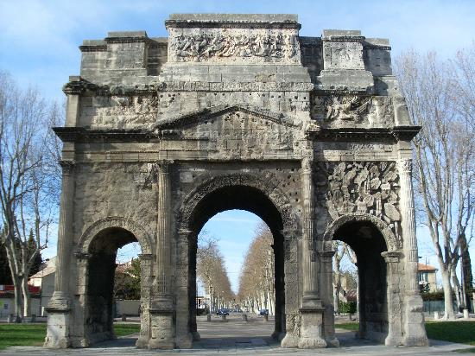
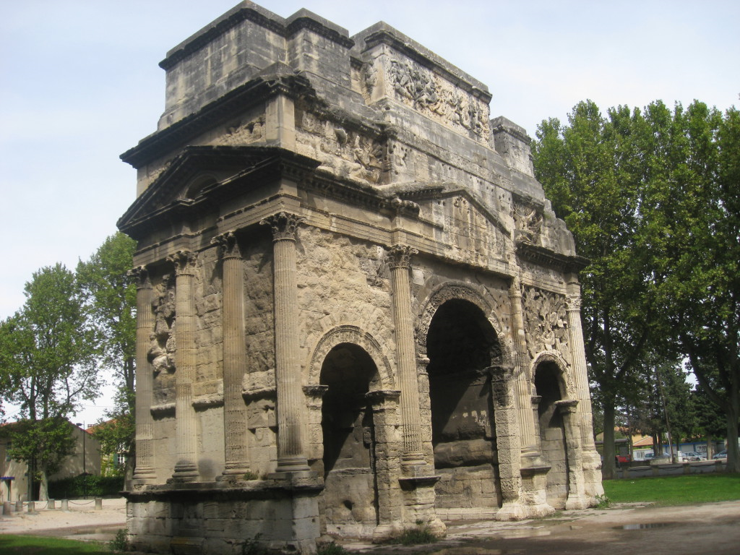
Roman triumphal arch : Orange
Here the Roman triumphal arch in the city of Orange. This building was built in the first century AD. BC to celebrate the entry of Arausio (now Orange) in Via Agrippa (roman roads in Roman Gaul).
Roman Arc de Triomphe in Orange : monument classified

Slide 12
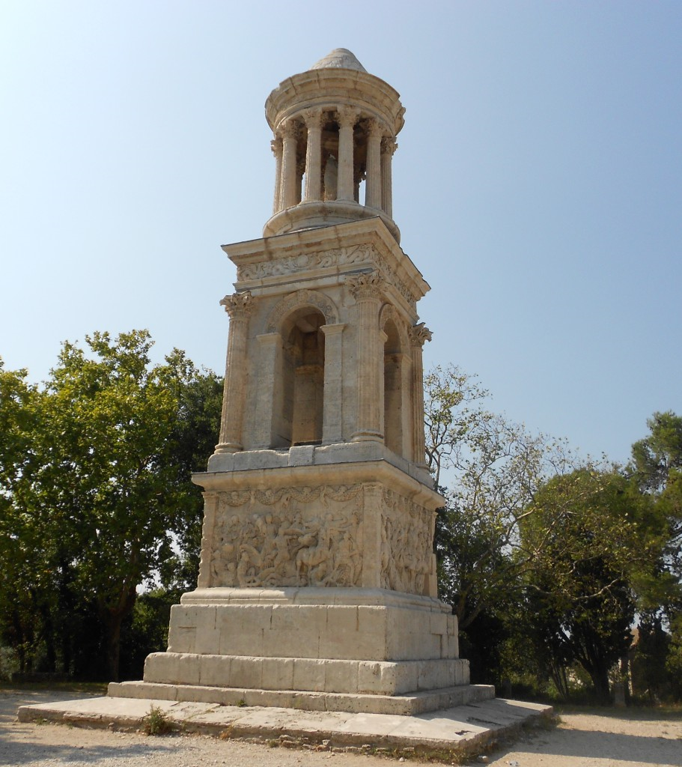
The mausoleum of Glanum,
Saint-Remy de Provence
The mausoleum of Glanum (built between -30 and -20 BC.) Is actually a cenotaph (that is to say, not a tomb housing body but honoring a person) located in Saint-Rémy-de-Provence. Again, its exceptional state of preservation makes it the best preserved Roman mausoleum in the world.

Slide 13
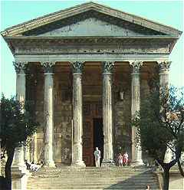
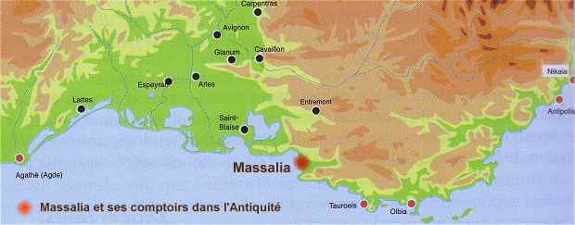
Massalia (Marseille) and the Greeks in Provence
Around 600 BC, the Greek navigators from Phocaea, a Greek city of Ionia in Asia Minor (near modern Izmir on the west coast of Turkey), enter the creek of Lacydon today 'hui occupied by the Old Port. The leader of the expedition, Protis, joins Gyptis, daughter of the head of the local Celtic-Ligurian population and founded Massalia (also called Massilia). This legend was probably a part of historical truth
.

Slide 14
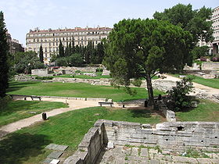
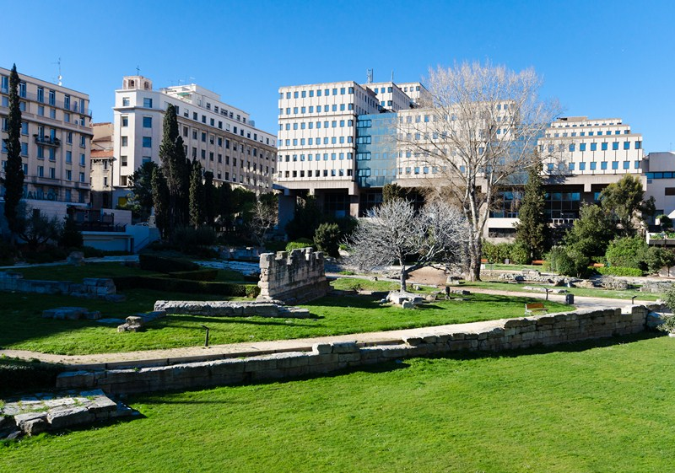
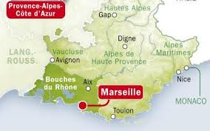
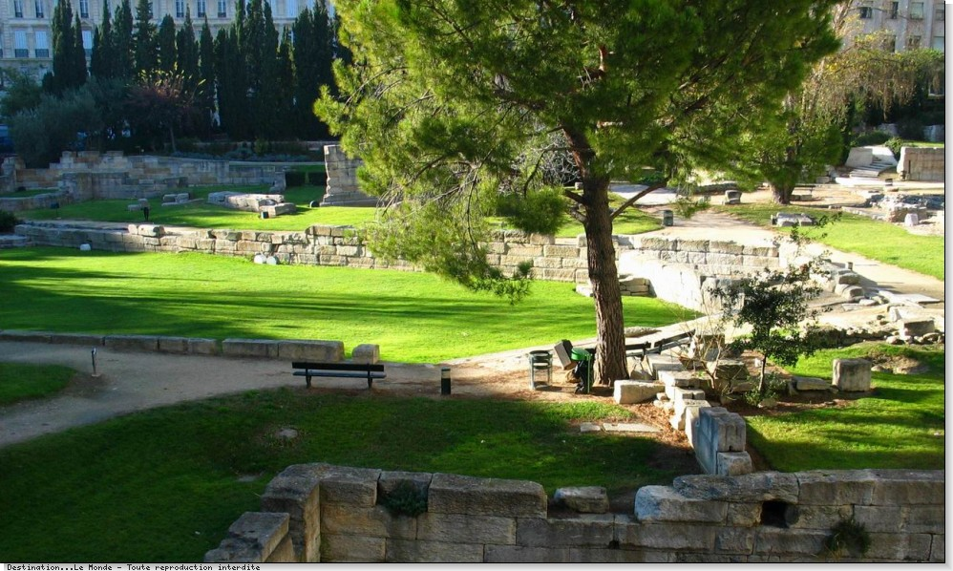
GARDEN OF ANCIENT RUINS HARBOUR OF MARSEILLE
The garden remains is a garden with archaeological remains of the ancient harbour of Marseille.
The site, located behind the Centre Bourse in the 1st district and is the subject of a classification as historic monuments was unearthed in 1967. The garden was created by Joël Louis Martin, landscape architect and it is now part of Marseille history Museum.

Slide 15

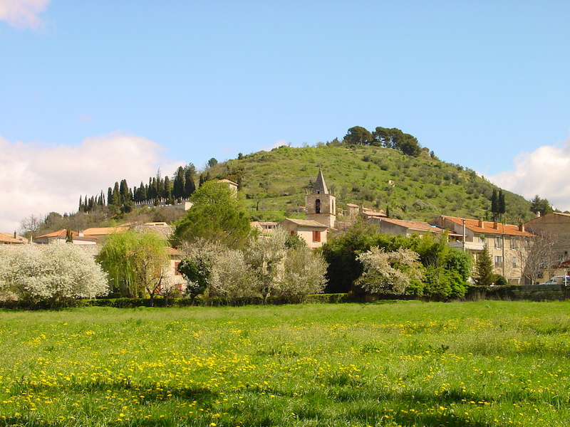
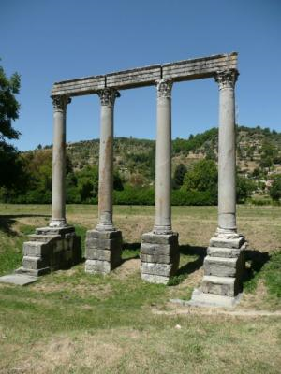
RIEZ THE ROMAN
The remains of a Roman temple dedicated to Apollo are meager when compared to the square house Nimes or Augustan temple in Vienna. But what majesty in the elevation of the columns of gray granite of the Esterel 7 m high and what beauty in sculpture and the architrave
capitals. Not far from an ancient baptistry, these columns allow us dream about what this place there are two thousand years! What story for this small town of Riez which was also the seat of a bishopric in the Middle Ages!
The Saint-Maxime hill overlooking the confluence of three valleys have always borrowed by important communication routes. On this hill, the pre-Roman people of Reii implements an important oppidum (hillfort).
It is in the plain, by cons, that will base the Emperor Augustus, at the very end of the first century BC, the conurbation known as the civitas Julia Augusta Reiorum Apollinaris, it is therefore more former capital city of the current department of Alpes-de-Haute-Provence. The city is growing and is adorned with monuments: public baths, forum, temples ....Four majestic granite columns, memories of a temple tetrastyle evoke the prestigious past.

