Slide 1


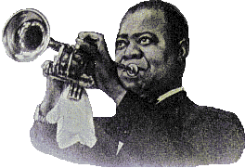


What a wonderful world
Avancement automatique
(la musique commence à la prochaine image)

Slide 2
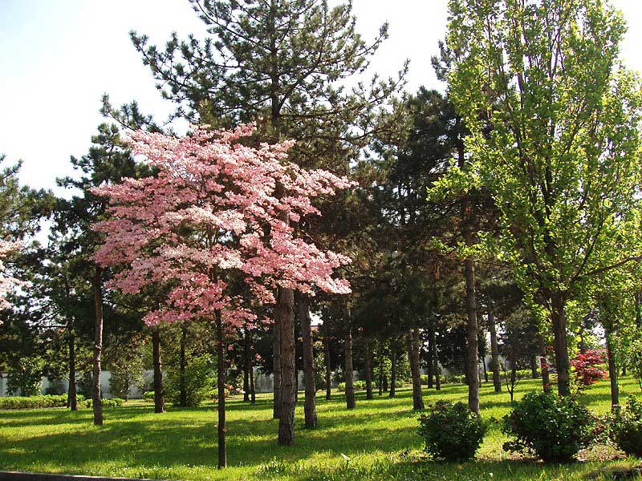
I see trees of green

Slide 3
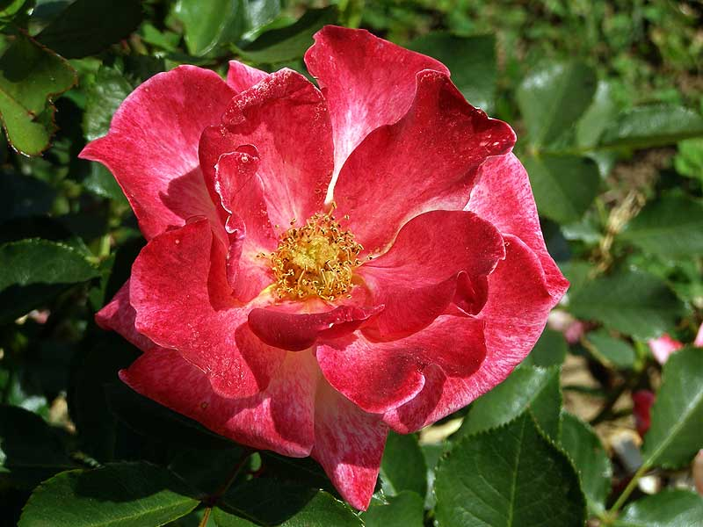
red roses too

Slide 4
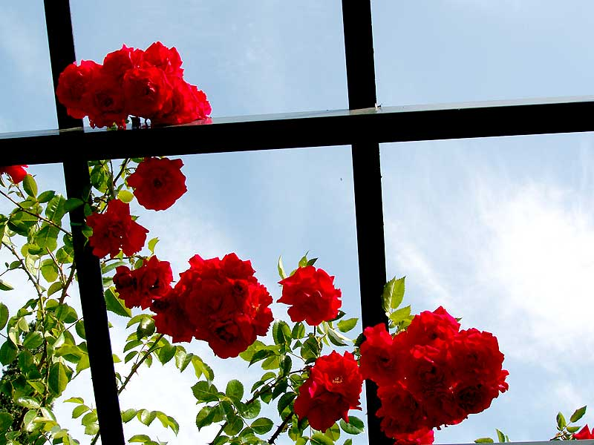
I see them bloom for me and you

Slide 5
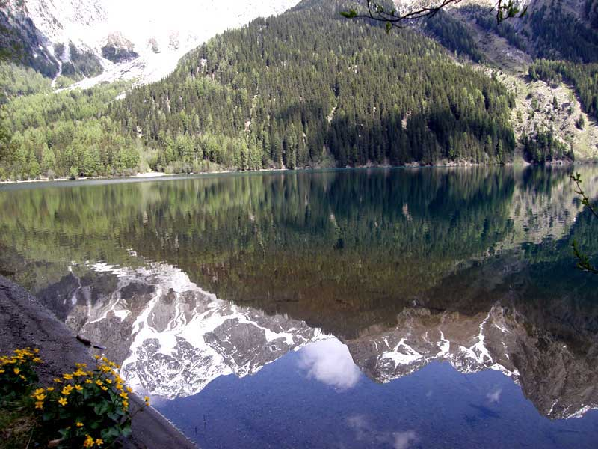
And I think to myself,

Slide 6
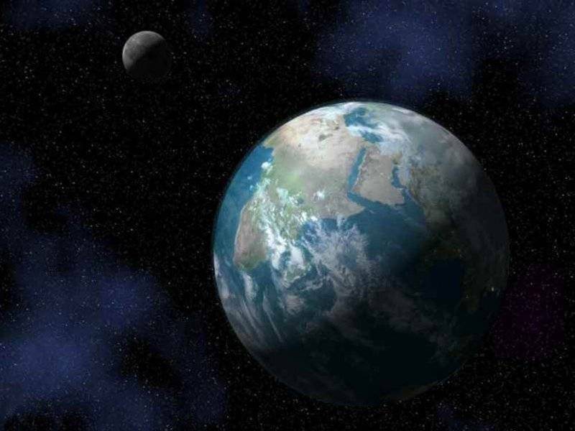

what a wonderful world

Slide 7
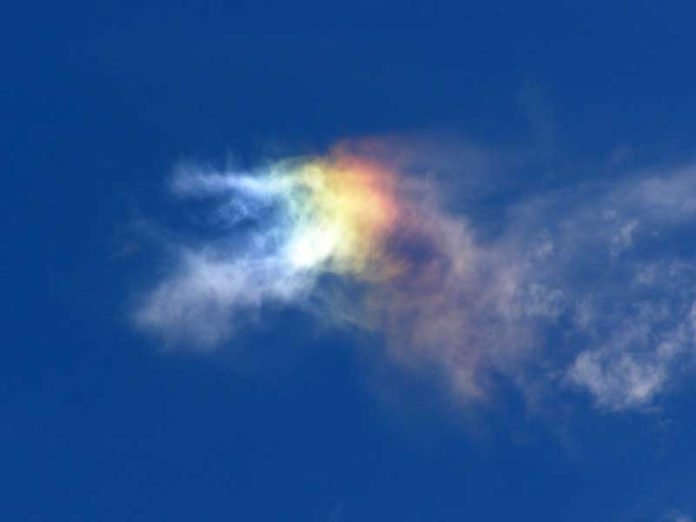
I see skies of blue

Slide 8
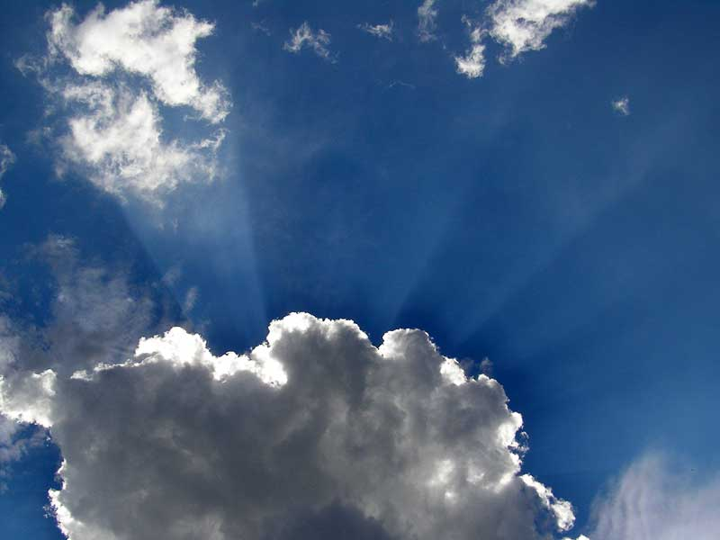
and clouds of white

Slide 9
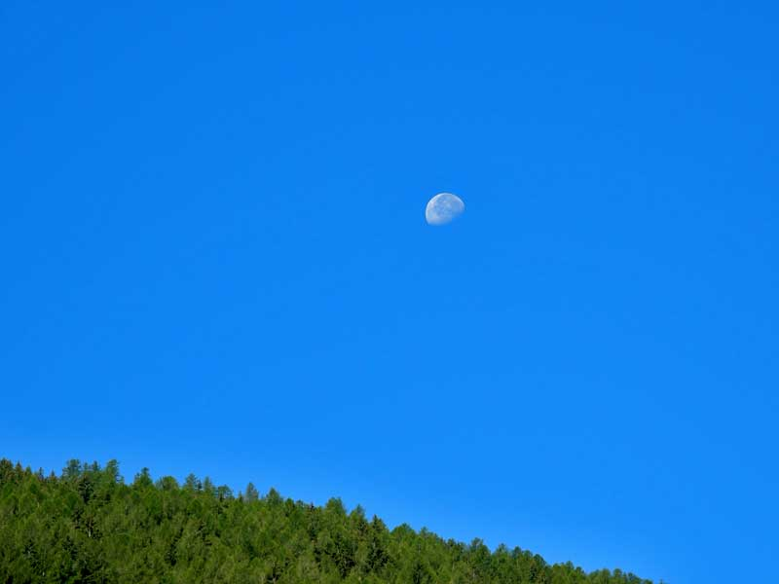

The bright blessed day,,

Slide 10
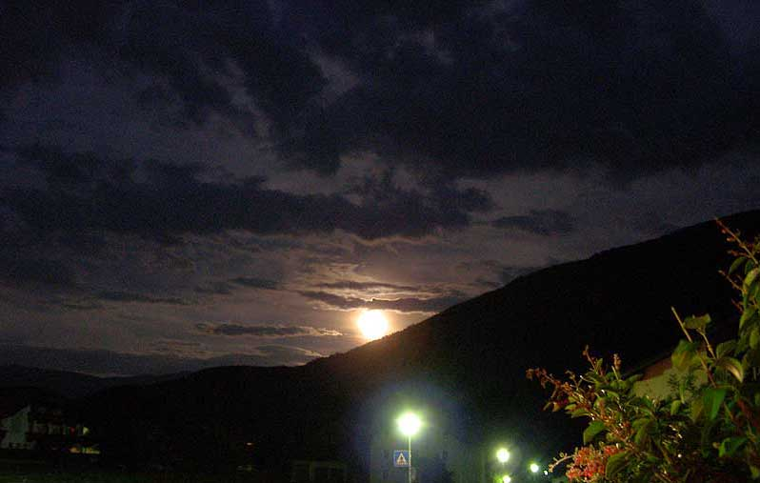
the dark sacred night

Slide 11
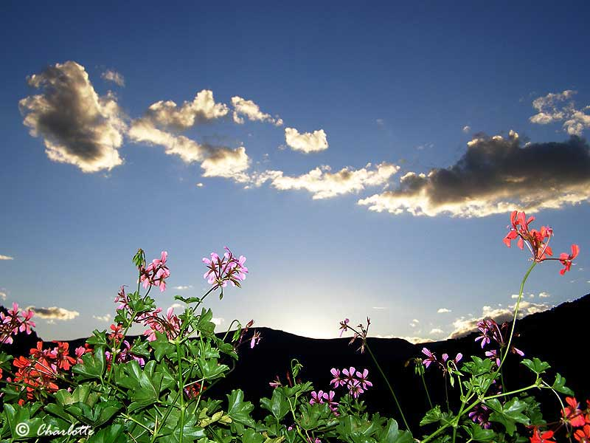
And I think to myself,

Slide 12
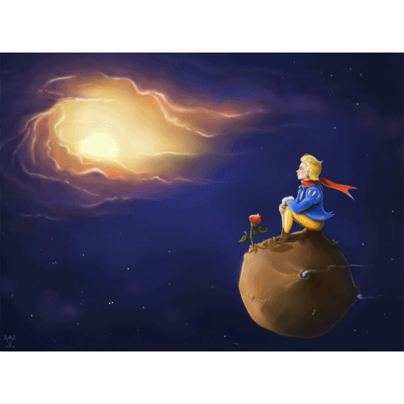
what a wonderful world

Slide 13
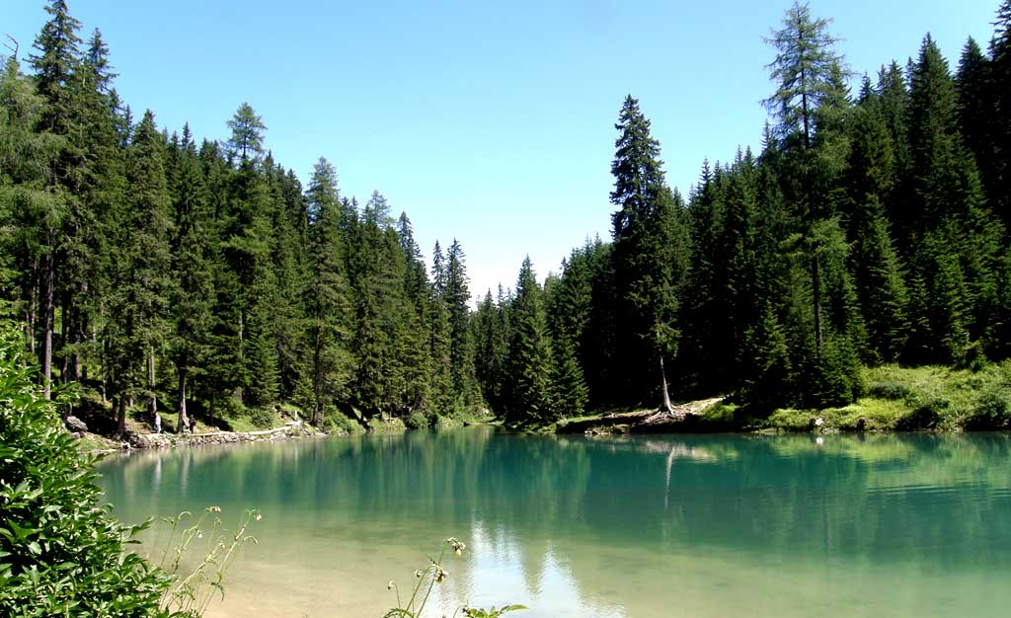

Slide 14
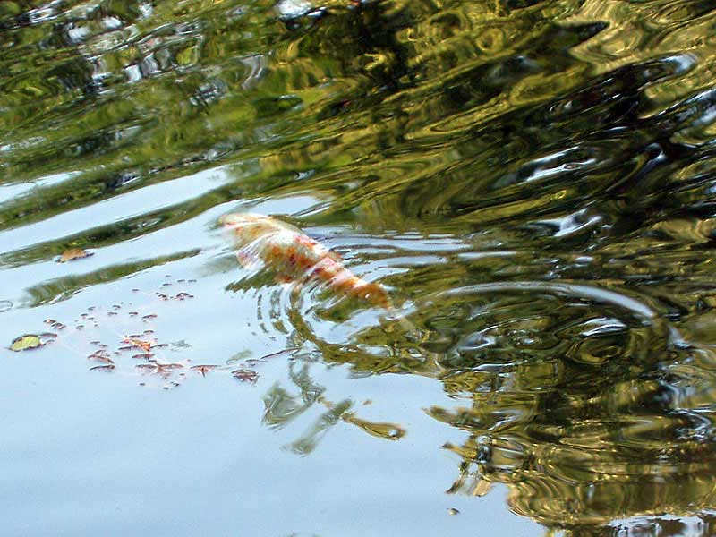

Slide 15
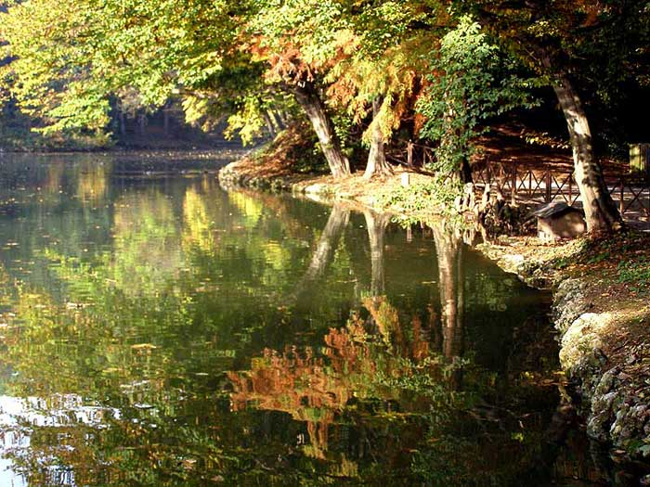

Slide 16
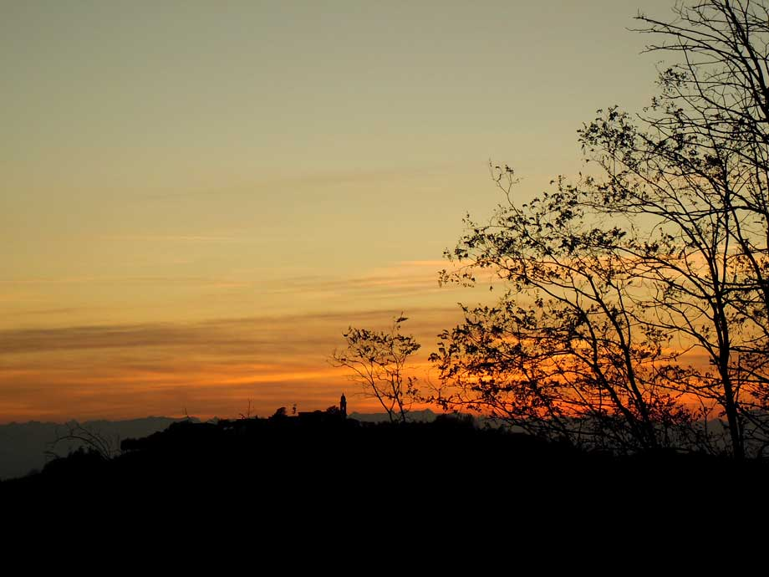

Slide 17
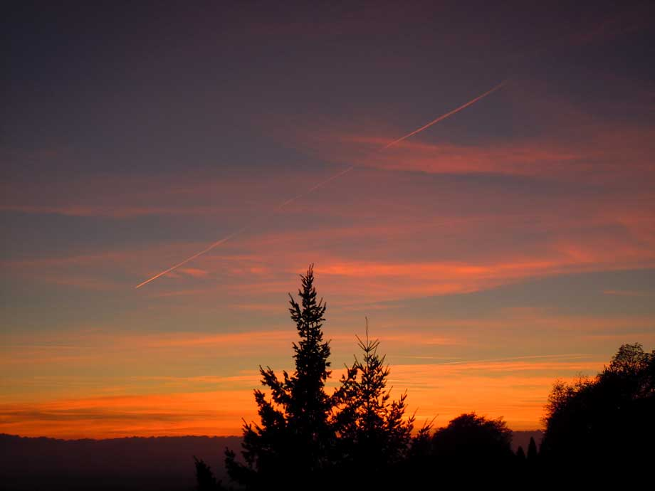

Slide 18
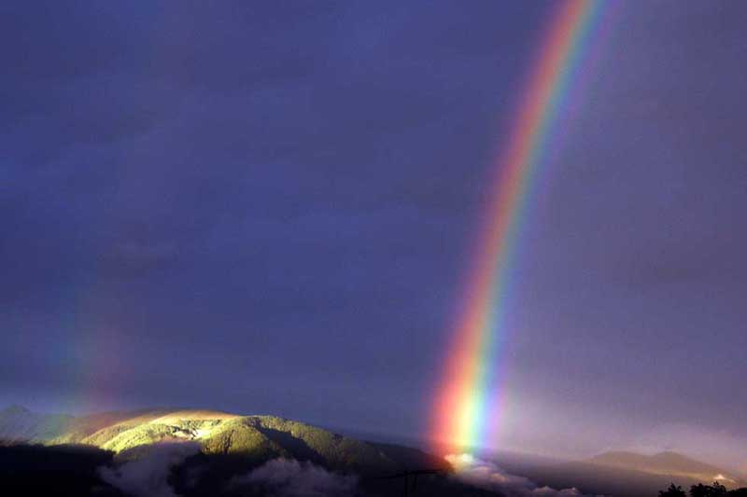
The colors of the rainbow,

Slide 19
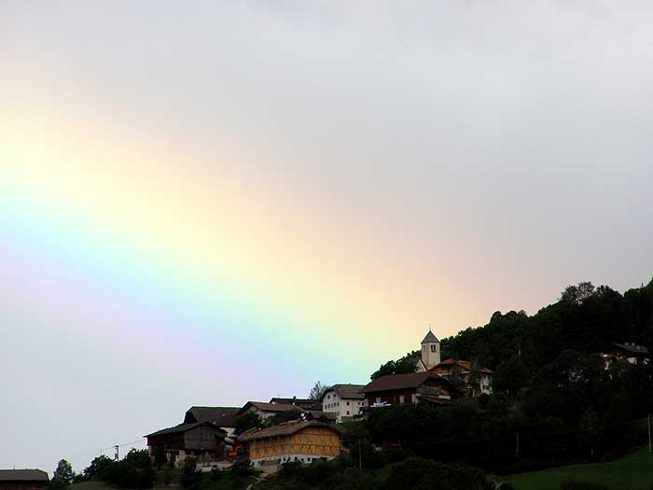
so pretty in the sky

Slide 20
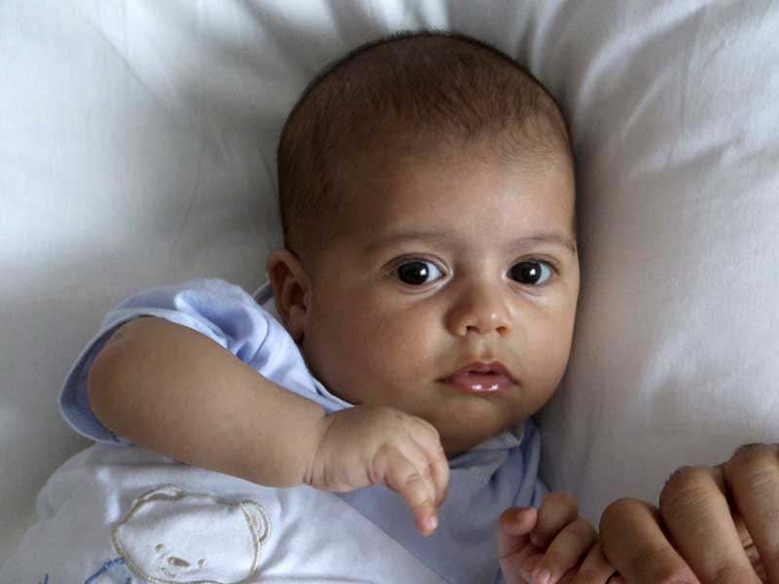
Are also on the faces

Slide 21
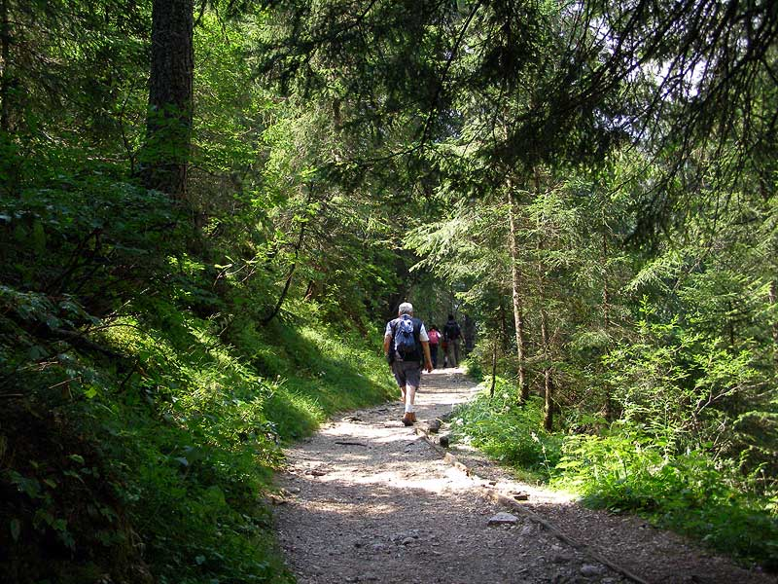
of people going by

Slide 22
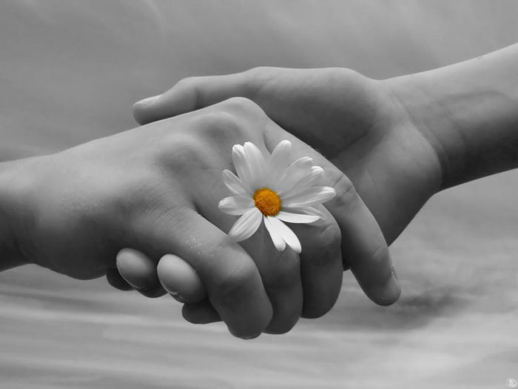
I see friends shakin' hands, ,

Slide 23
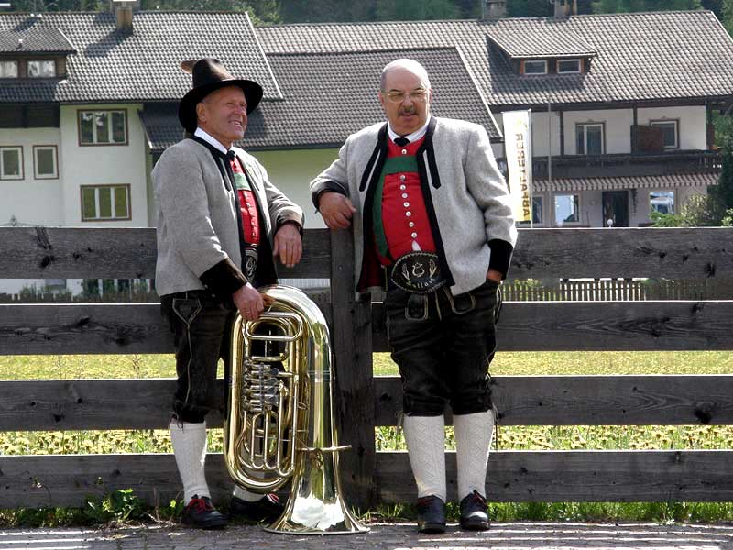
sayin' "How do you do?“

Slide 24
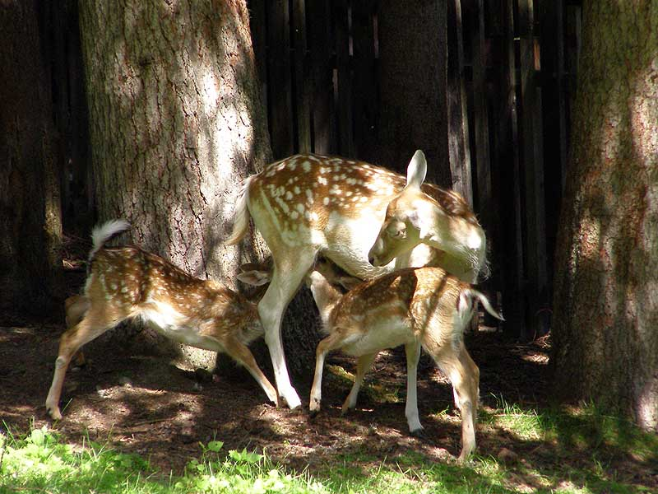
They're really saying "I love you”

Slide 25
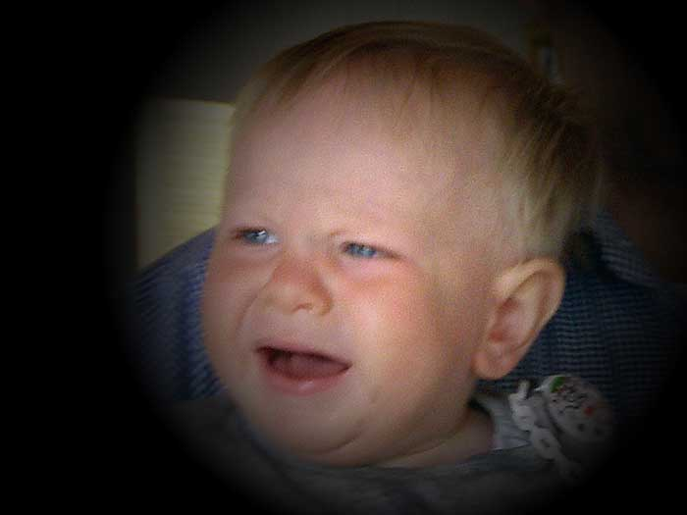
I hear babies cryin',

Slide 26
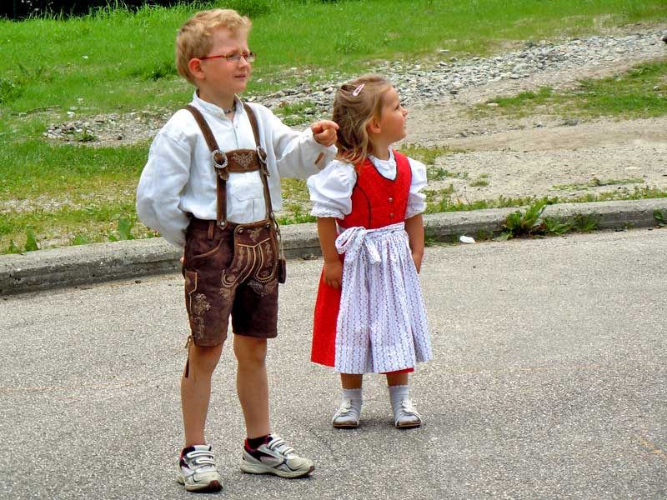
I watch them grow

Slide 27
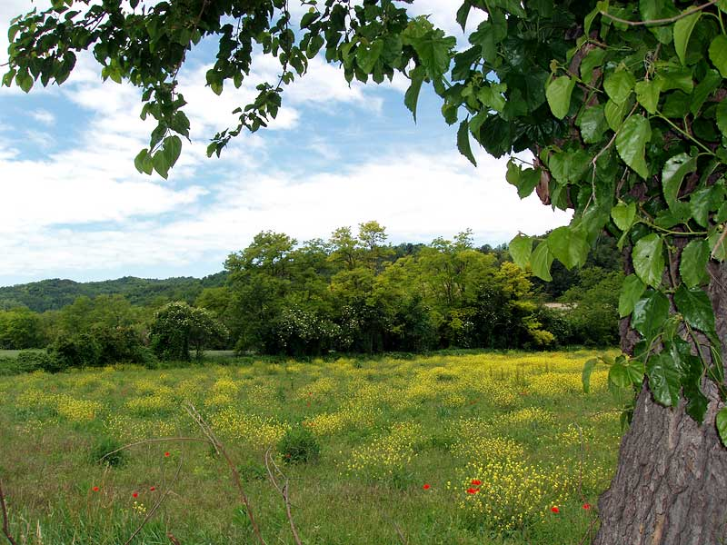

They'll learn much more

Slide 28
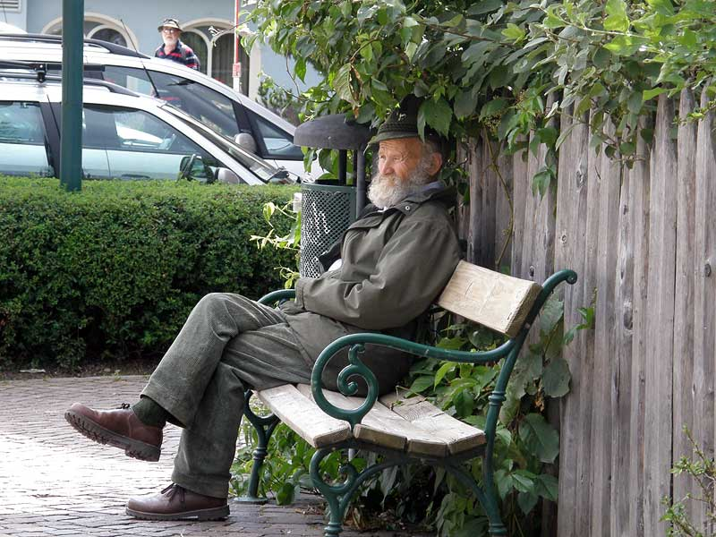
than I'll ever know

Slide 29
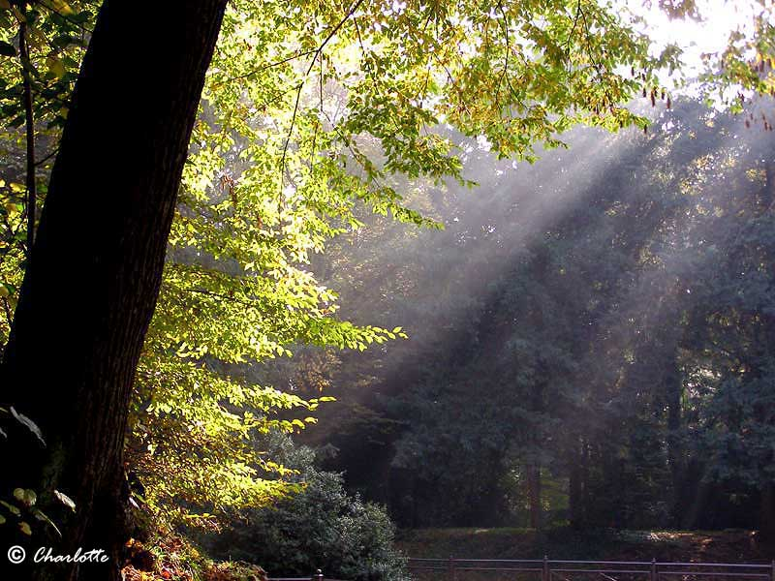
And I think to myself,

Slide 30
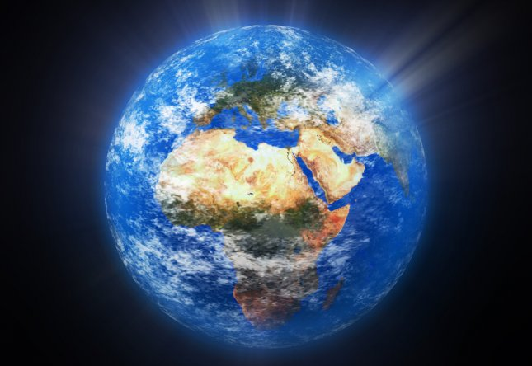
what a wonderful world

Slide 31
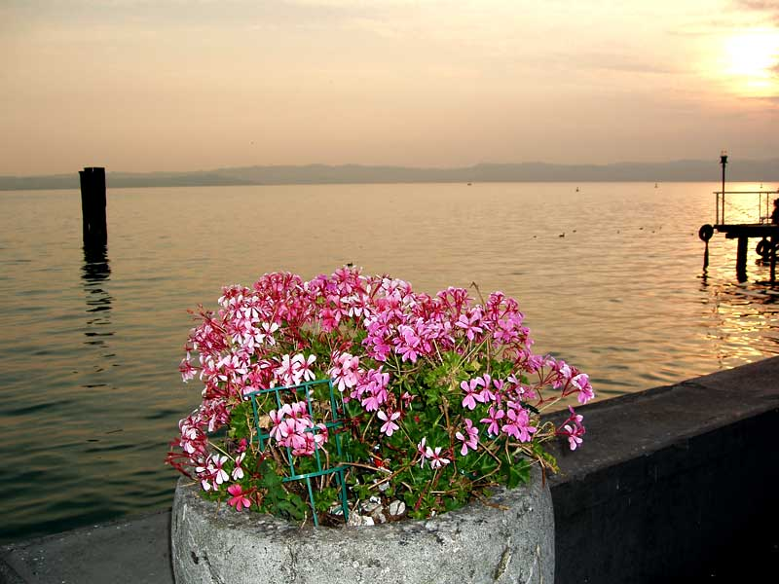
And I think to myself,

Slide 32

what a wonderful world.

Slide 33
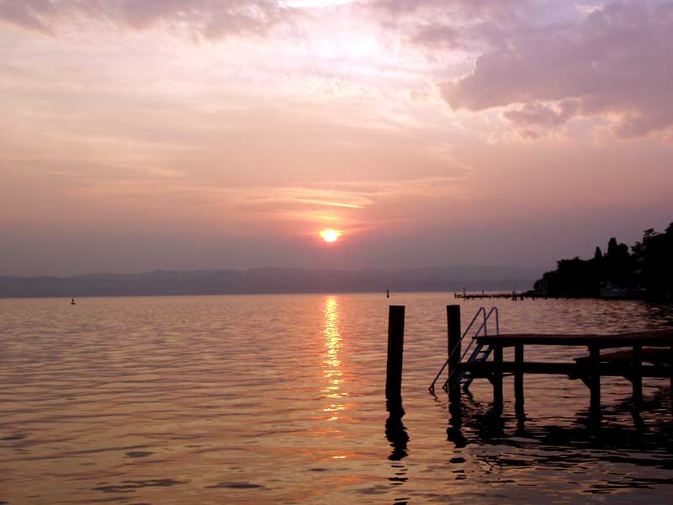

Slide 34
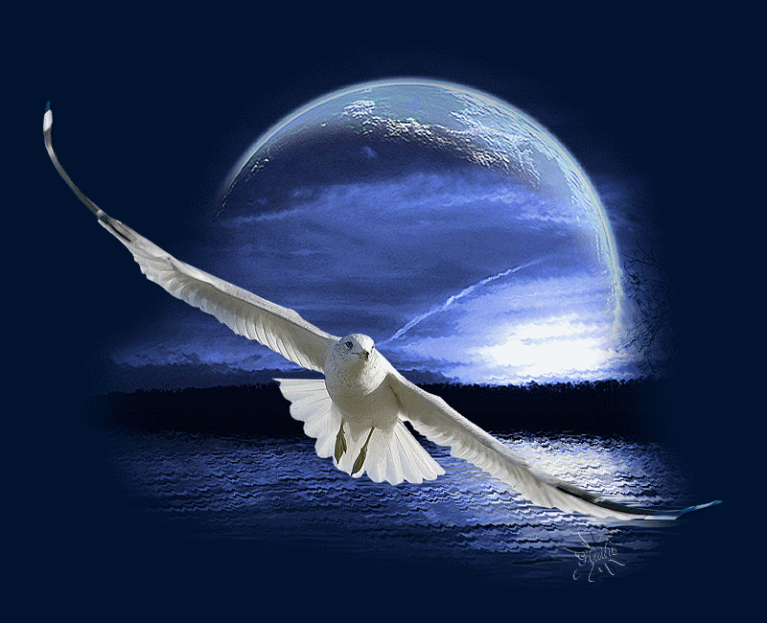



Click ici pour le revoir
Musique: What a wonderful world - Louis Armstrong
(photos 2007)

