Slide 1
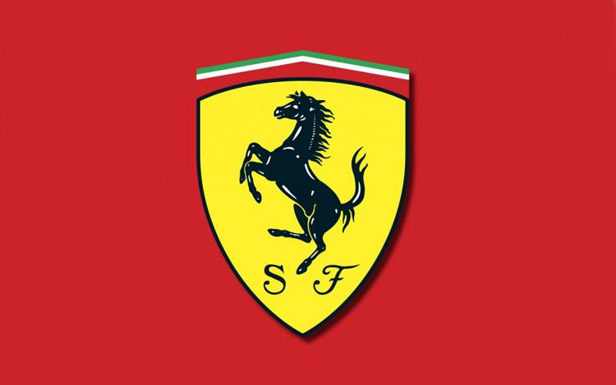
Ferrari February 13th

Slide 2
Summary
Ferrari
History
Period 1980-1990
Ferrari’s revolution
4. New perspectives
5. Evolution VS Revolution
6. Enzo Ferrari’s Legacy
Ferrari February 13th

Slide 3
History
Ferrari
Vidéo : https://www.youtube.com/watch?v=R-2b8m3ro04
Ferrari February 13th

Slide 4
Majors changes 1980 - 1990
Ferrari
INTERNAL ENVIRONMENT
Internationalization
Different perspectives
Poor communication
Ferrari February 13th

Slide 5
Majors changes 1980 - 1990
Ferrari
EXTERNAL ENVIRONMENT
Death of Enzo Ferrari
Fiat’s stake
Alain Prost’s case
Ferrari February 13th

Slide 6
Major revolutionary changes
Ferrari
Fiat’s chairman Gianni Agnelli appointed Luca Di Montezemolo as CEO with a mandate to do whatever was needed to take Ferrari back to the top. Montezemolo had beenn team manager for Ferrari during the successful period in the mid-seventies.
As CEO Luca Di Montezemolo brought about a Revolutionary way of running Ferrari
Ferrari February 13th

Slide 7
Major revolutionary changes - Montezemolos New Approach
Ferrari
To divide Ferrari into three small departments :
Future developments and special projects in the UK under John Barnard.
The engine department in Maranello under Paolo Massai.
The Scuderia Ferrari under Harvey Postlewhaite which is the place where the cars are built and the team managed.
Utilize the relationship betwee the UK facilities and Italy in order to take full advantage of F1 in England for chassis development and specialist sub-contractors while styll harnessing the huge of Maranello.
Introduced a new numbering system based on the year a car woul be racing.
Ferrari February 13th

Slide 8
Major revolutionary changes - Change in Management
Ferrari
Appointment of Jean Todt, to handle the overall management of the team
This opened the way of Ferrari to recruit, not only driver Michael Schumacher, but also a number of the key individuals in the Benetton technical team which had helped him to his world titles in 1994 and 1995. The arrival of Schumacher provided new impetus for the team.
Todt and di Montezemolo also chose not to make a direct replacement for the role of technical suprmo who would both lead the design of the car and the management of the technical activity.
They split in the role between a chief designer, Rory Byrne, who had overall responsibility for designing the car, adn Ross Brawn who managed the entire technical operation, these were roles which both had undertaken in working with Schumacher at Benetton.
Ferrari February 13th

Slide 9
Major revolutionary changes - Evolutionary Changes
Ferrari
Develop Ferrari’s engines, but in line with new technologies and developments theses were now lighter V10s to compete with the Renault and Mercedes engines.
As part of their recruitment of Michael Schumcher in 1996 Ferrari entered into a commercial partnership with tobacco giant Phillip Morris to use theur Marlboro brand on the Ferrari cars.
The blood red Ferrari of old was now replaced by a bright orange red which was more closely matched to the Marlboro colour scheme.
Appointed Paolo Martinelli over the engine design and the other critical areas of aerodynamics and chassis development. A process of fully integrating the engine as part of the car package
Ferrari February 13th

Slide 10
Major revolutionnary changes 1993 - 1995 (Major restructuring)
Ferrari
End of 1992 - Luca Di Montezelomo (CEO) gave the first restructuring
John Bernand come back as technical Director
Gerhar Berger come back too
1993 - Jean Todt come at Ferrari
1994 - Ferrari increase the perfomances of his car
Win 11 podiums
1995 - Ferrari confirms his come back
First win of Jean Alesi in Canada
Ferrari February 13th

Slide 11
Major revolutionnary changes 1996 - 2004 (Schumacher years)
Ferrari
End of 1995 - Schumacher was recruiting by Ferrari
1996 - Schumacher can’t win, because car performances
After Schumacher goes chained wins
But challenged by Benetton and Williams
But world’s champion from 2000 to 2004
Ferrari February 13th

Slide 12
Strategic Change
Ferrari
They have a big restructuring
Change a lot of time his staff
Increase the performances of their cars
Ferrari February 13th

Slide 13
Evolution VS Revolution - Revolution
Ferrari
Acquisition
Acquisition of a UK Team could help Ferrari grow their UK presence while possibly acquiring new technologies, suppliers & specialised technicians.
New Management
New specialised management from key areas can help sustains a competitive advantage
Innovation
Keeping ahead of the competition ventures into new materials. Investment into new continents (like Asia)
Ferrari February 13th

Slide 14
Evolution VS Revolution - Evolution
Ferrari
Advanced Parts
Research & Development of new car parts can increase Ferrari’s competitive edge. New design
models with aerodynamics, tyre technology, fuel technology and advanced engine materials can drive Ferrari ahead of its competitors
Driver Academy
The setup of a driver academy to train drivers from a young age, to become fully acquainted with
the cars
Knowledge
Location and knowledge development is key to enhance their ability to sustain competitive advantage. Architectural and component knowledge is both top level management and at cluster level.
Ferrari February 13th

Slide 15
Enzo Ferrari’s Legacy
Ferrari
The major barrier by Enzo Ferrari was the resistance to change
Psychological resistance to change (uncertaintly/ambiguity), Born in Italy, stay in Italy
Cultural resistance to change (obsolete assumptions) Way of life in Italy, compared to UK
Investment lock-in (fixed investment) Fiat investment
Competence lock-in (building on existing competencies), constantly investing in a “flat 12”
when competitors had newer technology
Stakeholder lock-in (restrictive commitments). Marlboro Investment & contract of Michael
Schumacher
Ferrari February 13th

Slide 16
Enzo Ferrari’s Legacy
Ferrari
Psychological resistance to change:
Enzo wanted to make the best cars the world had seen. To win the championships and outclass the
competition. He didn’t want a driver that thought they were better or higher than the car. “It was an honour to drive for Ferrari”. “The car won, not the driver”.
Cultural resistance to change:
Ferrari initially resisted the trend being pioneered by the British constructors. He defended the engine layout of the Ferrari with the analogy that the ‘horse’ had always pulled, not pushed, the cart. Enzo
initially focused on a powerful engine and thats how they won races. He refused to invest in development of chassis, and new technologies until each time Ferrari became uncompetitive. Reacting
too late to keep up with his competition
Ferrari February 13th

Slide 17
Enzo Ferrari’s Legacy
Ferrari
Investment lock-in:
In the mid-eighties more and more investment was put into the Italian facilities but with no dramatic
effect on performance
Stake Holder Lockin:
Finally, the team began to revolved around Schumacher, Enzo also has famously rejected a number
of top class drivers because they wanted too much money, and this behaviour became another barrier
for Ferrari, because with a top class driver like Schumacher the company grew more than in the past
Ferrari February 13th

Slide 18

Questions ?
Ferrari
Ferrari February 13th

Slide 19
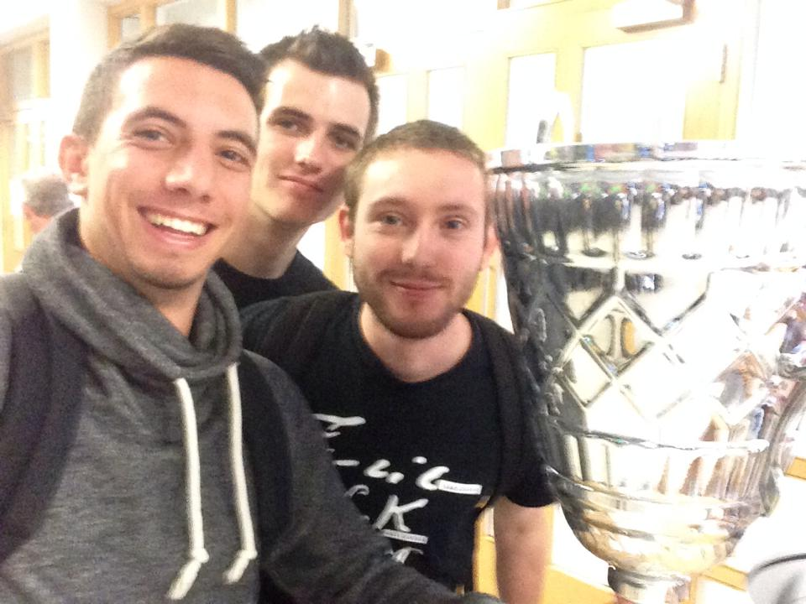
Thank you !
Ferrari
Ferrari February 13th

