Slide 1



Slide 2
Table of contents
0) Introduction
1) Riot Games
2) League of Legends
- A few figures
- The Summoner’s Rift
- Champions and monsters
- Gameplay
- Other gamemodes
- Extra history around the game
3) E-sport & LoL

Slide 3
0) Introduction

Slide 4
1) Riot Games

Slide 5
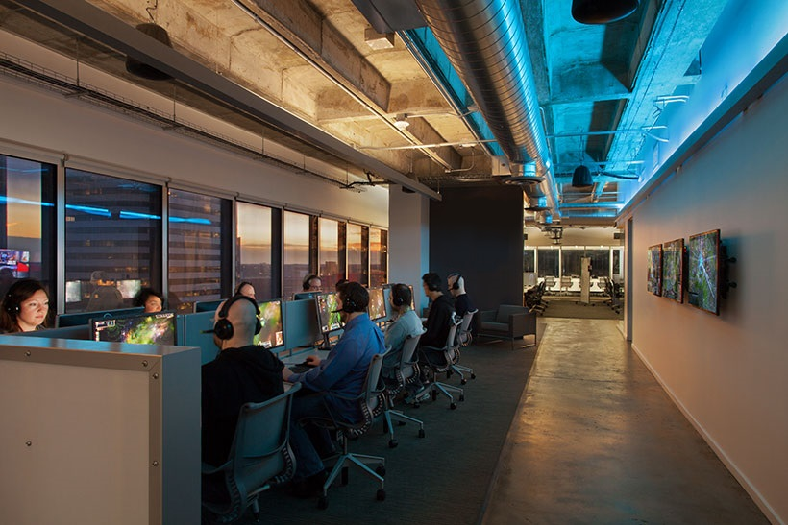


1) Riot Games
Headquarters of Riot Games : Santa Monica
15 another offices around the world
Only one game : League of Legends
Revenue : $624 million (2013)
Key people : Brandon "Ryze" Beck (CEO)
Marc "Tryndamere" Merrill (President)
Number of employee : 1000 (2013)

Slide 6
2) League of Legends

Slide 7

a) What’s League of Legends ?
A few figures :
123 champions
67 millions of players each month (2013)
5 millions of players are connected
simultaneously
4 game mode available without events

Slide 8

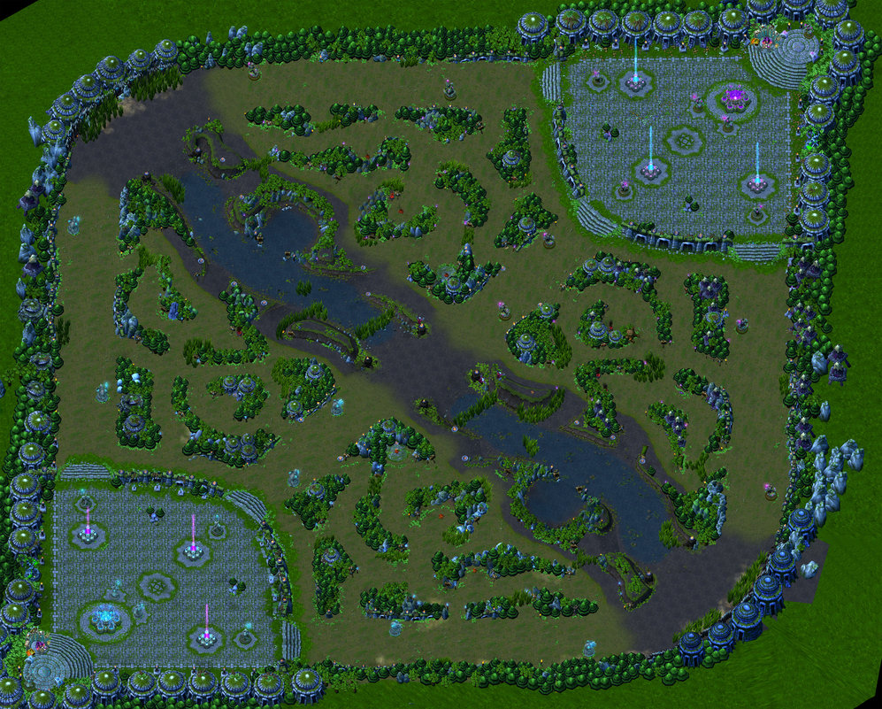
Summoner’s Rift

Slide 9

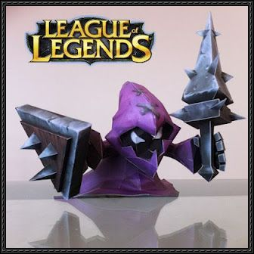
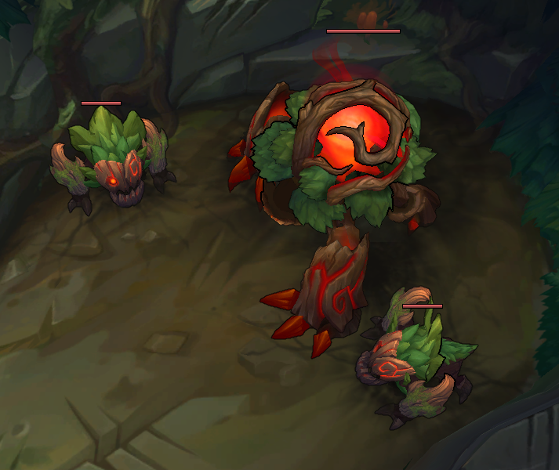
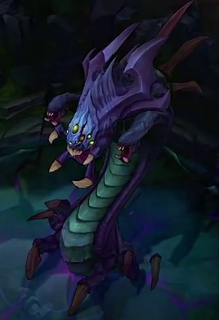
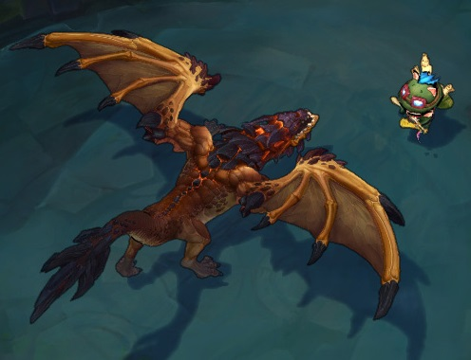

Slide 10
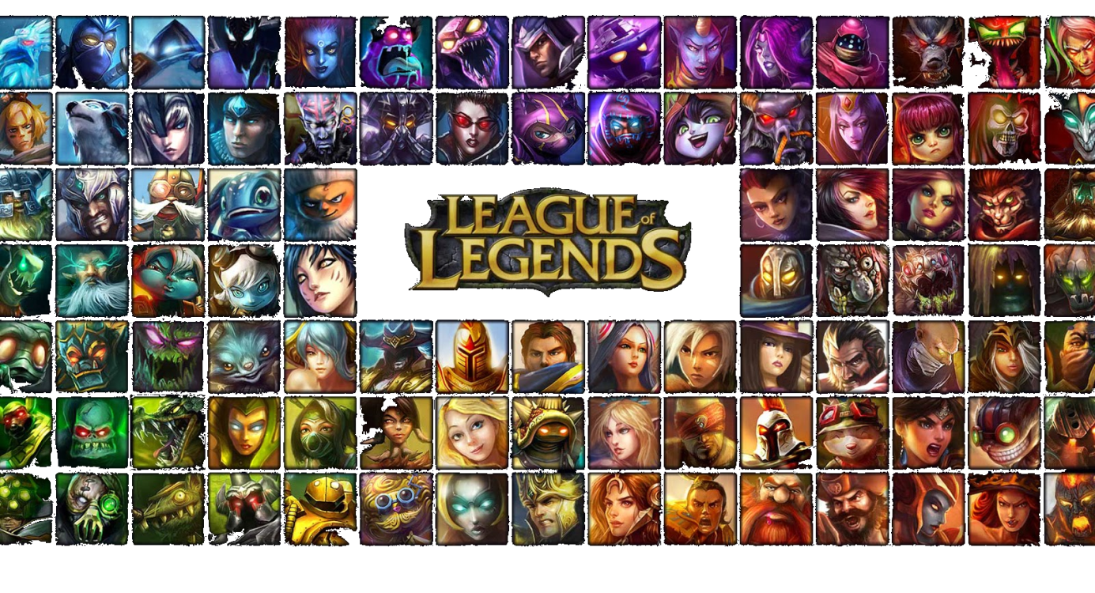
Champions
5 types :
- Fighter (Called bruiser)
- Marksman (Called AD Carry)
- Magician (Called AP Carry)
- Assassin
- Support

Slide 11

