Slide 1

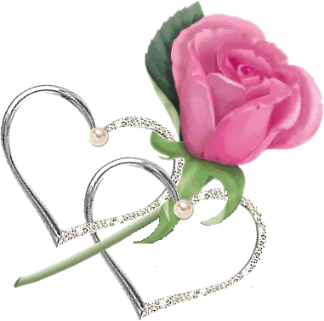

Happy Valentine's day!

Slide 2


Slide 3


Slide 4




Slide 5


Slide 6


Slide 7

by Charlotte

