Slide 1
System x3500 M5 Seller Deck
Announced 6th of January 2015
Notes:
1

Slide 2
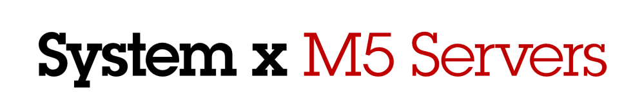

Outline
Market Trends & Portfolio Introduction
x3500 M5
Security
Efficiency
Reliability
Seller Section
2014 LENOVO INTERNAL. ALL RIGHTS RESERVED.

Slide 3
Data center trends
#1
Security concern of IT
decision makers & CIOs¹
Increase in high profile security breaches
Growth in migration of platforms & applications to cloud service providers
Rise in mobility & Bring Your Own Device (BYOD) increasing data growth and risk
Real-time analysis of huge volumes of data
Enterprise customers assessing ODMs
Security
75%
IT spend on new cloud projects by 2017²
Cloud
30B
Connected devices
by 2020³
Mobility
90%
Data on planet created in last 2 years¹
Big Data
¹ Data from IBM Annual Survey of IT and line-of-business leaders for 2013
² Citrix Top Enterprise Mobility Trends, http://blogs.citrix.com/2014/05/06/top-enterprise-mobility-trends/, May 2014
³ IDC Server Virtualization & Cloud, February 2013
2014 LENOVO INTERNAL. ALL RIGHTS RESERVED.
Notes:
3
Edge 2014
Here are some of the major market trends that are influencing the buying patterns and IT purchases of data centers.
First –security is the number one concern of IT decision makers and CIOs. This is due to the rising number of high profile security breaches – such as Target, the New York Times, and NASDAQ, to name a few -- over the past few years. Companies are concerned about the increasing risks to sensitive data, as well as the serious financial implications.
Second – by 2017, over 75% of IT spend will be on new cloud projects – in public, private, and hybrid clouds. We’ve seen a growth in the trend to migrate platforms and applications to cloud service providers. Many businesses believe that it is more efficient and cost effective to outsource some or all of their IT to a highly skilled service provider, while they concentrate on their core competencies.
Third – mobility is on the rise. By 2020 IDC predicts that there will be 30 B connected mobile devices. People want to be able to work or use applications from anywhere, any time. This mobility brings with it a growth of data, as well as security risks that data centers must manage.
Fourth – Along the same lines – there has been an explosion of data: 90% of the world’s data was created in the last two years alone. This drives the need for managing, validating, analyzing, and securing these enormous volumes of data – in real time.
Seven out of 10 senior IT executives recognize IT infrastructure as essential in enabling competitive advantage or optimizing revenue and profit. But fewer than 10 percent of organizations are fully prepared to meet the demands of mobile technology, social media, big data and cloud computing.
Finally, ODMs are posing a new competitive threat to the traditional x86 players.
I’ll discuss a few of these trends in a bit more detail over the next few charts.

Slide 4


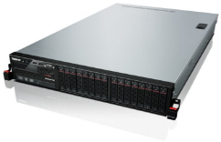
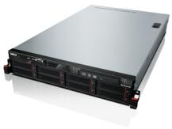

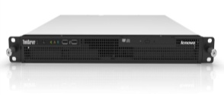
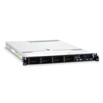
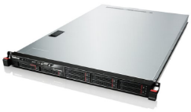
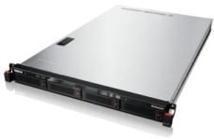
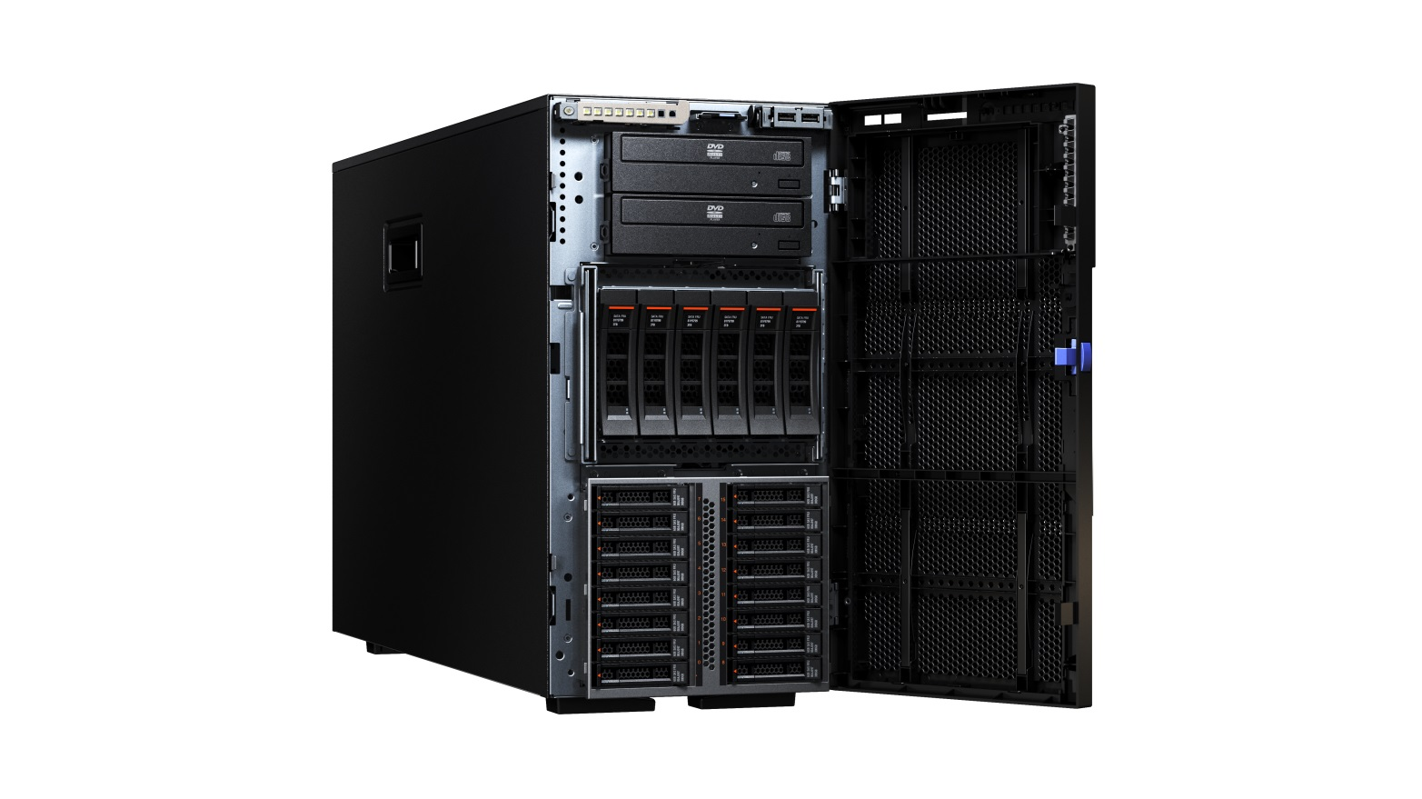
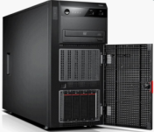

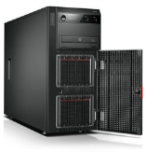
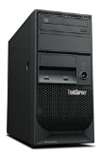
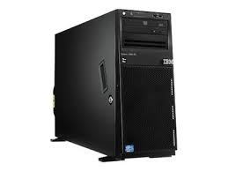

Volume Server Portfolio Overview
Performance
Mainstream
Entry
2 socket, 1U and 2U enterprise-class x86 rack performance, resiliency, security
2 socket, 1U and 2U rack w/open standards, resiliency, & density
1 and 2 socket, 1U and 2U x86 rack optimized for department and SMB performance and value
RD450
x3650
RD650
x3630
Rack
RD350
x3250
RS140
x3550
RD550
x3530
Performance
Mainstream
Entry
2 socket, 4U and 5U enterprise-class x86 tower performance, resiliency, expandability
1 and 2 socket, 5U x86 tower optimized for SMB and distributed enterprise
Tower
x3500 (Jan 2015)
TD340
TD350
TS440
TS140
System x
In blue
x3300
x3100
In red
2014 LENOVO INTERNAL. ALL RIGHTS RESERVED.

Slide 5
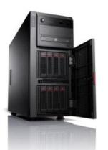
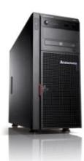
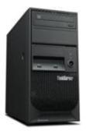
System x and ThinkServer Enhanced Tower Portfolio
First Server, Small /
Branch Office
SMB to Mid-sized Enterprise, Back Office
Infrastructure & Storage Apps, Database, Compute, Virtualization
File/print
Email
Mid- to large-scale business processing
Distributed database
Data collection, analysis
Performance
First server
Point of Sale
File/print
Email
New (1Q15)
Mainstream
x3500 M5
TD350
Business-critical workloads
Cloud Computing, Virtualization
Virtual Desktop
Big Data Hadoop
Analytics, SAP
Database management
Retail Controller/ Point of Sale
x3100 M5
x3300 M4
Entry
TS440
TS140
2014 LENOVO INTERNAL. ALL RIGHTS RESERVED.

Slide 6
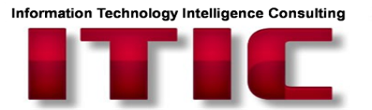

Built-in leadership uptime by design
#1 Reliability x86 Rating¹
Downtime of more than four (4) hours on each server hardware platform (2014)
Dell PowerEdge x86
13%
Dell PowerEdge has
13X
Failure rate⁴
HP ProLiant Servers
10%
ITIC Global Server Hardware, Reliability Report- 2014-2015
Oracle x86
6%
Oracle SPARC
4%
HP ProLiant has
10X
Failure rate³
Fujitsu SPARC
4%
Toshiba Magnia
3%
Fujitsu Primequest
3%
HP Integrity
3%
Cisco UCS
2%
Fujitsu Primergy
2%
IBM Power System i, p
1%
IBM System x
1%
#1 Reliable x86 server
IBM System z
0%
#1 Customer Satisfaction Rating²
#1 Ranking in TBR report in 22 elements across Service, Product and Sales indices:
TBR Satisfaction Indices | Rank
Overall Customer Satisfaction | #1
Service Satisfaction | #1
Product Satisfaction | #1
Sales Responsiveness | #1
¹ ITIC 2014-2015 Reliability Survey, May 2014 -- http://public.dhe.ibm.com/common/ssi/ecm/en/xsl03126usen/XSL03126USEN.PDF
² TBR Customer Satisfaction Survey, August 2014 -- http://public.dhe.ibm.com/common/ssi/ecm/en/xsw03117usen/XSW03117USEN.PDF
³ Based on percentage per install population of System x servers versus percentage per install population of HP ProLIant servers
⁴ Based on percentage per install population of System x servers versus percentage per install population of Dell PowerEdge servers
Notes:
The key take-away from this slide is the impressively high quality and reliability of the System x portfolio.
System x servers ranked #1 in uptime of any x86 server in the past year, according to the 2014-2015 ITIC reliability survey. This is 10X higher reliability than HP ProLiant and 13x higher reliability than Dell PowerEdge.
Additionally, System x servers scored #1 overall in customer satisfaction and vendor support, according to the 1Q14 and 2Q14 TBR customer satisfaction surveys, with the 22 highest indexed scores across the sales, product, and service areas of customer satisfaction. System x servers have consistently scored #1 in TBR customer satisfaction surveys.

Slide 7

Introducing the new System x 3500 M5 (Ann 1/6/15; GA 1/25/15)
All-in-one two socket tower or 5U rack server for business critical enterprise workloads
Outstanding performance with up to two Xeon E5-2600 v3 processors and up to 1.5 TB with 64GB* TruDDR4 Memory
    12Gbps RAID support for enhanced performance & data protection
    Up to two optional GPUs for accelerated graphics
Flexible storage configurations: Up to 32 x 2.5” or 12 x 3.5” or unique intermix of 16 x 2.5” + 6 x 3.5” HDDs/SSDs for tiered storage
  Massive storage capacity for optimized workloads (up to 72 TB)
#1 Reliability built-in for maximized uptime, reduced costs
Built-in, industry-leading System x Trusted Platform Assurance security for superior protection of hardware & firmware
Retail/Point of Sale
Virtual Desktop
Backup & Recovery
Database
Infrastructure
Cloud/Virtualization
 | 50%¹ More Cores & Cache | 2X² Memory Capacity | 39%⁵ Greater Computational Performance | 61%⁶ Greater Virtualization Performance | 50%⁸ Increased Memory Bandwidth | 45%⁹ Memory Power Savings | Approximately 2X¹³ More VMs | #1 SPECcpu Score
2014 LENOVO INTERNAL. ALL RIGHTS RESERVED.
*with 64GB DIMMs - available at a later date
Notes:
The x3500 M5 business critical 5U tower will announce in 1Q15 – and is expected to support the same types of features as the x3650 M5 and x3550 M5 in terms of cores, processor speed, and TruDDR4 memory.

Slide 8
System x3500 M5 Product Overview
Business critical tower or rack server
Data Center Leadership
Enterprise class, secure, all-in-one tower or rack server for remote office, franchise, & small to medium business
Flexible networking options and RAID
Rich remote experience with IMM2
Innovative Energy Efficient design with 80 PLUS Titanium power, extended operating temperature range
Hot swap redundant fans and hot swap power supplies to support business critical applications
Industry-leading hardware and firmware protection with Trusted Platform Assurance
Physical security with lockable bezels
Fits in a rack
Processors | Up to 2 Intel E5-2600 v3 series, up to 36 cores per server
Memory Slots Max Memory | 24x DDR4 (R/LR) DIMM Up to 2DPC@2133MHz (LR) & 1.5 TB of memory with 64 GB** TruDDR4 Memory LRDIMMs; System supports RDIMM/LRDIMM
Disk Drive type | SAS/SATA/SSD
HDD bays | 32x 2.5” HS SAS/SATA HDDs/SSDs 12x 3.5” HS SAS/SATA HDDs or 6x 3.5” SS SATA HDDs (CTO only, PCH or RAID supported) 16x 2.5” + 6x 3.5” HS SAS/SATA HDDs/SSDs (Field upgradable)
RAID | Dedicated RAID slot (12Gbps)/ Support up to 2 RAID adapters
NIC / TPM | 1x IMM & 4x 1Gb Std., optional 10GbE/PCIe card/ Yes
PCIe (x16/x8) | Up to 7 PCIe ports ; support up to 2x 300W GPUs
Power | AC 550W/750W/900W platinum and AC 750W Titanium. All PSU support active/standby mode *
USB ports (model dependent) | Up to 2 front (2.0)/4 back (3.0x 2)/2 internal (3.0) , optional +2 HA SD **
VGA port | 1 front / 1 back
Fan Design | 4x Hot swap redundant fans N+1 design
Light Path | Basic Light Path (Advanced Optional)
System MGMT | IMM2, One IMM dedicated port, FoD upgrade to advanced.
Operating System Support | VMware, Novell SUSE, Red Hat Linux, Windows Server 2012
Operating temp. | Up to 40 ℃
Warranty | 3 years (parts/labor)
Blue Italics represent new features versus x3500 M4 family
* Available at a later date
Notes:
Highlight performance gain on DDR4.

Slide 9
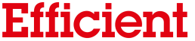
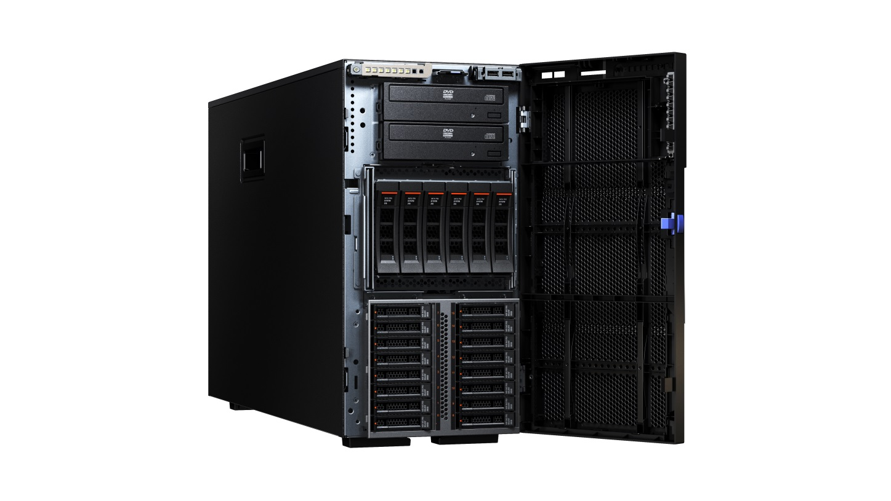
System x3500 M5: Efficiently spanning server requirements in one platform
All-in-one System x3500 M5 server delivers Server and Storage requirements in one platform
Test one system to cover all configurations
  32x 2.5” HS SAS/SATA HDDs/SSDs
  12x 3.5” HS SAS/SATA HDDs or 6x 3.5” SS SATA HDDs (CTO only, PCH or RAID supported)
  16x 2.5” + 6x 3.5” HS SAS/SATA HDDs/SSDs
  (Field upgradable)
72TB storage capacity in single server
Leverage tiered storage with combination of 2.5” SSDs for fast access and 3.5” HDDs for lower cost per terabyte storage for data-at-rest
x3500 M5 Platform
2014 LENOVO INTERNAL. ALL RIGHTS RESERVED.

Slide 10
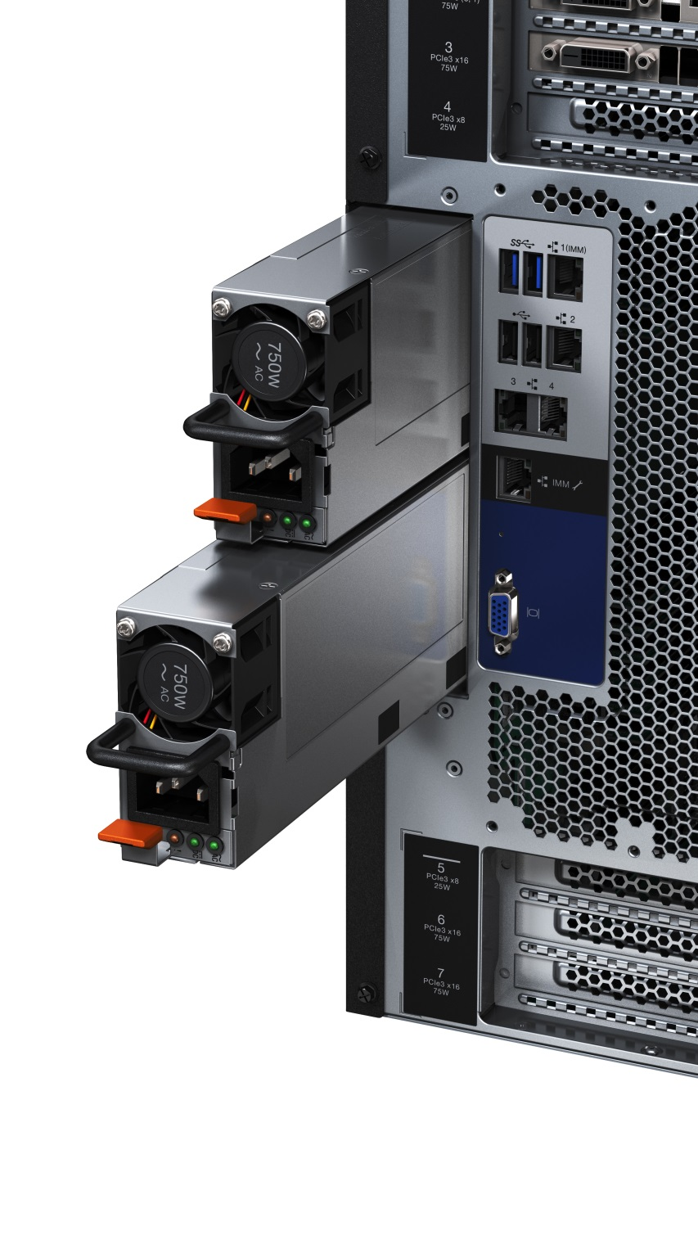
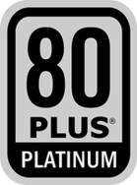

Leadership power and thermal design for energy efficiency
Extended Operating Temperature Support
Support from 5º up to 40ºC for power savings
96% power efficiency with 750W Titanium PSU
Saves energy cost with choice of 3 Platinum and 1 Titanium
Redundant Power supplies with active/standby modes
Low voltage TruDDR4 memory (1.2 V)
with up to 45% power savings
2014 LENOVO INTERNAL. ALL RIGHTS RESERVED.
Notes:
Here are a few of the innovative power and thermal management features built into the x3500 M5 server to minimize data center energy costs. It supports industry-leading extended operating temperature ranges – up to 40 C, while most of the competition can only support up to 35 C. The difference between 35 C and 40 C is around 9 F, which can amount to significant cost savings.
The new Titanium PSUs support up to 96% power efficiency. Improving the server power supply efficiency has a cascading effect up through the data center for both power and cooling. Additionally, System x supports active/standby modes for power supplies so that when the server’s power load is low enough, one of the installed PSUs can be placed into a low power, standby state. This way, the remaining power supplies delivers the entire load, and the efficiency is boosted.

Slide 11
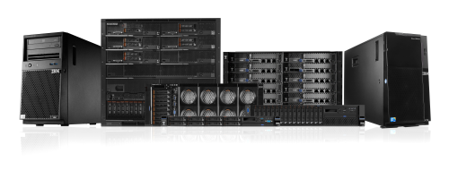

System x3500 M5 Optimized for Performance
Provides clients ability to run more workloads on a single system
Nearly 2X Number of
VMs per Server
Up to 2x Max Memory Possible
1.5TB memory
Increased speed to 2133 MHz
Save 45% power (TruDDR4 Memory vs. DDR3)
Enablement of
20%-70% Faster
Workload Solutions
Up to 131% Increase in Performance¹ over previous generation with New Intel Xeon E5-2600 v3 series processors
  50% more cores (up to 36 total per server)
  Support for 2 x GPUs
12 Gbs RAID doubles
transfer rate for high
density storage
Up to 8x RAID IOPs increase
12Gbps RAID
2x to 8x IOPS performance improvement over 6Gbps solutions
1Gb - 4GB flash backed write cache upgrade
25% Savings on
Industry leading
Networking Solutions
Seamless 10Gb Support
Wide range of industry leading Networking offerings
¹ Intel® Xeon® Processor E5-2600 v3 Product Family Server
Performance Update: Representative Java-based workloads (June 2014)
2014 LENOVO INTERNAL. ALL RIGHTS RESERVED.
Notes:
Here are several key performance advantages of the x3500 M5: Nearly double the number of Virtual Machines per server over the previous generation, due to an increase in memory capacity from 768 GB to 1.5TB. Speed has increased up to 2133 MHz. And TruDDR4 gives a power savings of 50%.
The new server has 50% more cores & cache, and up to 131% performance increase for java workloads. Additionally, the x3500 M5 supports 2 GPUs for additional available processing. Additionally, it supports end-to-end RAID – both devices and infrastructure, which produces up to 8X performance improvement over 6Gbps. And the x3500 M5 supports up to 2 RAID adapters for enhanced data protection and performance. This, combined with the end-to-end 12Gbps storage system, can boost storage performance by utilizing more PCI lanes and dividing the disks into 2 high performance RAID adapters.
Finally, the new server supports 10Gb networking solutions.

Slide 12
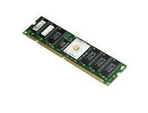
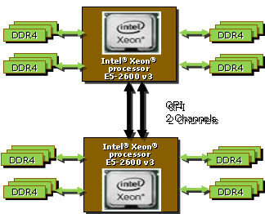


TruDDR4 Compute Node Memory - Driving performance
Significant performance increase: Customers continue to look for ways to increase the return on their IT investments while driving increased system performance. The new line up of System x M5 servers and TruDDR4 Memory provide a full range of offerings to drive the right balance of performance and price for any workload
Up to 24 DIMMs with maximum speed
Up to 2133MHz at 2DPC (RDIMMS, LRDIMMs)
All DIMMs 1.2V
Up to 1.5TB memory capacity with 64GB*
2X²
Memory capacity vs DDR3
Up to 50%⁸
Increased memory bandwidth vs DDR3
Up to 45%⁹
Power savings vs DDR3
RDIMMs
2DPC at 2133MHz – Above Industry POR of 1866MHz
3DPC at 1600MHz
Single voltage = 1.2V
4GB, 8GB, 16GB
LRDIMMs
2DPC at 2133MHz
3DPC at 1866MHz - Above Industry POR of 1600MHz
Single Voltage = 1.2V
32GB, 64GB - Up to 1.5TB with 64GB LRDIMM
2014 LENOVO INTERNAL. ALL RIGHTS RESERVED.
* Available at a later date

Slide 13
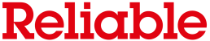
TruDDR4 Memory - Delivering trusted, tested, quality, performance, reliability
  Memory reliability, performance, and quality even more critical as customers utilize greater memory capacities for their Big Data Analytics, Cloud Computing, Virtualization, Database, and High Performance Computing workloads
  TruDDR4 Memory leverages System x Unique DIMM Identifier technology built into the memory DIMMs and System UEFI
    Enable System x to verify whether the memory installed is qualified/supported by Lenovo
    Because the TruDDR4 Memory is authenticated, certain extended memory performance features can be enabled to extend performance over industry standards (Intel POR)
TruDDR4 Memory Key Benefits
  Uses the highest quality components sourced from Tier 1 DRAM suppliers. Only memory that meets our strict requirements are selected for TruDDR4 Memory
  Compatibility tested and tuned on every System x compute nodes to maximize performance and reliability
  TruDDR4 Memory delivers increased reliability, since the memory is authenticated which verifies that qualification has been performed by Lenovo
  Delivers performance above industry standards
  Provides easy service and support worldwide
2014 LENOVO INTERNAL. ALL RIGHTS RESERVED.

Slide 14
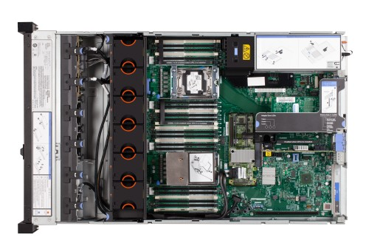
Integrated redundancy: Hot swappable components
Leadership uptime – avoids single point of failure
Tool-less design
Maximized uptime - redundant, hot-swappable high availability design for 99.99% uptime
Easy serviceability without downtime
Enhanced data protection & performance with 12Gbps RAID support (devices + infrastructure) with 2x to 8x IOPS performance improvement over 6Gbps solutions
Memory mirroring
Redundant & hot swap fans
Redundant &
hot swap PSUs
Dual SD modules for hypervisor mirroring*
Robust RAID flexibility
* Available at a later date
2014 LENOVO INTERNAL. ALL RIGHTS RESERVED.
Notes:
The System x3500 M5 incorporates redundant components to avoid single points of failure. This allows it to achieve high levels of uptime.

Slide 15
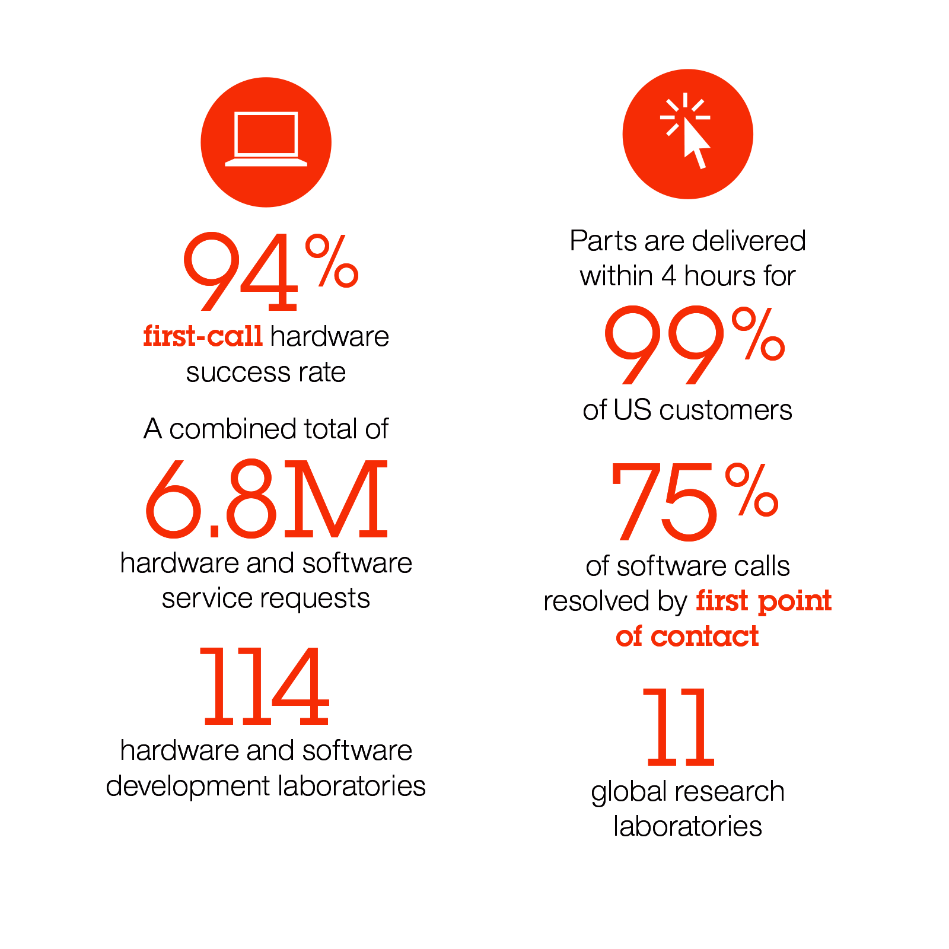
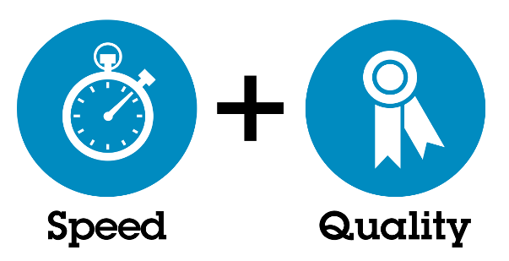
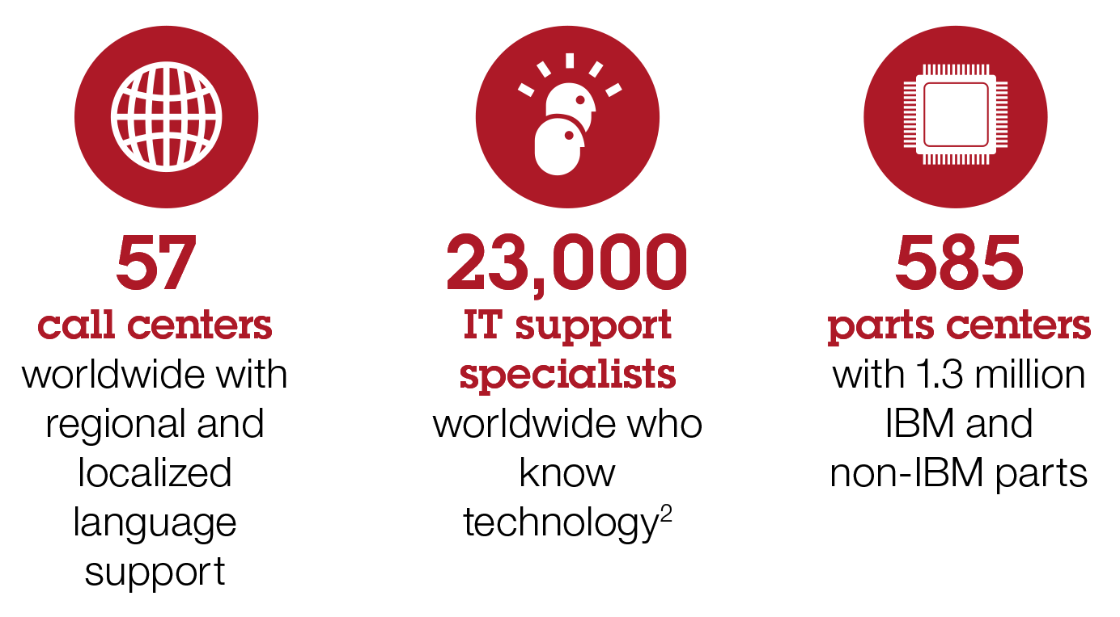
IBM Global Services & Support
IBM is a recognized leader in services & support
Prevent downtime with proactive, first-rate service
Resolve outages faster if they do occur to protect
your brand
Optimize IT and end-user productivity – and revenue
– to enhance business results
Protect your brand reputation and keep your
customer base
Simplify support to save time, resources and costs
Lenovo’s Service Commitment
“After the deal closes, IBM will continue to provide maintenance delivery on Lenovo’s behalf for an extended period pursuant to the terms of a
five-year maintenance service agreement with IBM. Customers who originated contracts with IBM should not see a change in their maintenance support for the duration of the customer’s contract.”
- http://shop.lenovo.com/us/en/news/ibm-server
2014 LENOVO INTERNAL. ALL RIGHTS RESERVED.
Notes:
As an additional advantage, all System x servers – including the new M5 line-up – come backed with world-class IBM global services and support – even as we transition to Lenovo. You can read Lenovo’s service commitment at the bottom of this page.

Slide 16





Industry-leading security innovation built-in
Secured Hardware & Firmware Establish a Solid Foundation for Workloads
System x M5 platform innovation
M5
Innovation
Self Encrypting Drives + IBM Security Key Lifecycle Manager – Enterprise grade data security & key management
TPM 2.0 Chips – Support for new versions of Windows & encryption algorithms
Secure Firmware Rollback – prevents exposing previously fixed vulnerabilities
System x Trusted
Platform Assurance
System x platform innovation
System x Innovation
  Firmware can only execute if digitally verified with public/private keys
  All firmware updates require digital verification with public/private keys
  Rigorous security testing & practices
  2 TPMs standard on all servers
Latest x86 Industry Standards
Industry Standard
Trusted Platform Module (TPM)
  Crypto Assist (Asymmetric, General, Symmetric) *
Intel Xeon E5-2600 V3 CPU
NIST compliance
* Trusted Computing Group (TCG)
http://www.trustedcomputinggroup.org/
*Trusted Platform Assurance should be used in conjunction with industry standard security practices.
Notes:
16
Note: This chart is really meant to be shown/described from the bottom up, as the value is built on top of the industry standard base.
To minimize risk, security requirements should be a central part of any project from the beginning, not something that is tacked on late in the process. System x platforms are designed with premier security built-in from the start – what we call System x Trusted Platform Assurance --, and this enables our customers to minimize cost and risk of their data centers. With Trusted Platform Assurance, System x servers protect the hardware and firmware from low level malware attacks, and therefore establish a solid security foundation for the software and applications that run on top of them.
As you will see, System x Trusted Platform Assurance incorporates innovative System x security features and practices that outstrip the competition.
This page shows how System x delivers industry leading security by starting with x86 industry standards from the Trusted Computing Group (IBM and Lenovo are promoters), NIST compliance and Intel Xeon CPUs. Layered on top of the industry standard components are System x unique innovations. These consist of firmware that is always digitally signed by System x. Firmware may only execute, boot, or be updated if determined to be genuine through verification of its digital signature, using public and private keys. Other unique innovation include 2 Trusted Platform Modules (TPMs) on each server – one for the system and one for the management -- to allow both the server and IMM (Management Engine) to independently verify code and be verified as genuine by third parties. . The TPM is based on the Trusted Computing Group standards and is the anchor of the security subsystem, since it protects the compute nodes & systems management infrastructure. Unlike our competition, System x includes two dedicated TPMs in each system: one for the system overall, and one for the systems management controller. The system and management controller are able to “trust” the set of functions from the TPM. Having this root of trust at the hardware layer helps reduce malware attacks The TPM also has its own hardware locks, which protects it from being physically removed from the system.
System x Trusted Platform Assurance also includes secured and rigorous code development, build and validation practices.
New for the M5 servers– as you can see on the top layer -- is the addition of Self Encrypting drives, along with the IBM Security Key Lifecycle Manager (SKLM), which provides enterprise grade security for key management. SKLM drastically simplifies the task of managing a large fleet of self encrypting drives. Also, new is the inclusion of TPM Chips version 2.0, which support new versions of Windows and encryption algorithms. Secure firmware rollback prevents unauthorized roll back of system firmware that may expose previously fixed vulnerabilities that could be used to compromise a server.

Slide 17

Unique System x Trusted Platform Assurance
Two security processes with rigorous ongoing validation built-in
Ongoing Secure Development & Build
Secure Firmware Development & Build Process
Secure Development Process
Comprehensive Testing Practices
All released Firmware is signed
Ongoing Rigorous Security Testing Practices
Fix & Report Discovered Vulnerabilities
Digitally Signed Firmware
Signed Code can be traced to its source
“You can prove who I say I am”
Secure System Execution (Server in Production)
Core Root of Trust
Boot code is verified at every boot
Only genuine updates can be applied
Secured
Hardware
+
Secured
Firmware
=
Chain
of Trust
Industry-Leading System x Features & Practices for Superior Protection
2014 LENOVO INTERNAL. ALL RIGHTS RESERVED.
Notes:
17
The unique, System x exclusive System x Trusted Platform Assurance security process includes two processes: the development & build process and the secure system execution process – which is how firmware updates are installed in System x servers at live customer sites. Both processes include a rigorous, industry-leading security validation & reporting cycle in which any discovered issues are immediately fixed and rolled back into the firmware, and customers have an option of upgrading to this latest firmware version. The output of the secure development process is digitally signed firmware, which is the input into the live customer site – server in production process.
In the secure system execution process, we do three main things: First we secure the hardware, using locks around the Trusted Platform Module. Then we secure the firmware, by verifying its digital signature every time before it executes. Together, the secured hardware and firmware establishes a chain of trust. In laymen’s terms, this means that just as a chain is only as strong as its weakest link, a system is only as strong as its most vulnerable layer. In order for each layer to be secure and reliable, it must trust the layers beneath it. What this means is that secure hardware and firmware establishes a solid security foundation for upper layer workloads and applications. This protects the system from low level attacks and helps establish integrity for these upper layers. We’ll discuss these two processes in more detail over the next few slides.

Slide 18
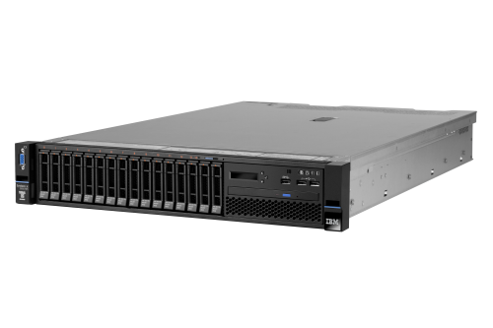


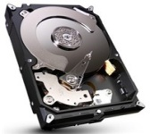
Centralize, automate and simplify encryption key management with SKLM
+
=
System x + Self Encrypting Drives (SEDs)
IBM Security Key Lifecycle Manager (SKLM) or MegaRAID SafeStore Encryption Services
Secured Data
Configurable solutions to meet client specific needs
Advanced RAID with features designed to enhance reliability, availability and performance
Protection of data at rest against loss or theft
Enables secure drive retirement, disposal & repurposing
Efficient, simplified, and transparent key management
Addresses regulatory requirements calling for encryption key protection
Reduces operating costs, speeds implementation and enables interoperability
Supports Key Management Interoperability Protocol (KMIP) standard*
No performance impact
Part of any M5200 Series RAID 5 upgrade**
Centralized authorization key storage
Automated management of local and remote encryption keys
Scalable solution to support large System x environments managing hundreds of thousands of keys
Simple, secure integration with interoperability across solutions including System x
SEDs with SKLM protect enterprise data and simplify key management
*Applies to SKLM ** Applies to MegaRAID SafeStore Encryption
2014 LENOVO INTERNAL. ALL RIGHTS RESERVED.
Notes:
18
For users who need a simple solution for centrally managing the keys for drives in distributed environments, the IBM Security Key Lifecycle Manager – or SKLM – is an ideal solution in combination with the self encrypting drives. This is a scalable means to support large System x deployments, managing hundreds of thousands of keys. SKLM is transparent and does not impact performance. Another option for the x3500 M5 for single store customers is the MegaRAID SafeStore Encryption Services.
Details: It uses Feature on Demand & RAID
RAID controller collects drive info and submits key request to UEFI key management server (KMS) driver
IMM converts IPMI command to KMIP key request, establishes secure connection with SKLM server and sends
SKLM server validates key request and returns encryption key to IMM
IMM returns KMIP results, key and status, to UEFI. UEFI provides to RAID controller
RAID controller uses key to decrypt drive encryption key and unlocks SED for encrypted operation

Slide 19
Use Cases for IBM Security Key Lifecycle Manager & MegaRAID SafeStore
When to use IBM Security Key Lifecycle Manager | When to use MegaRAID SafeStore
Multiple servers – each with SEDs | Single server – under 100 drives
Distributed environment – franchise with multiple stores, offices | Single store or business
Up to Hundreds of thousands of keys | Up to Hundreds of keys
2014 LENOVO INTERNAL. ALL RIGHTS RESERVED.

Slide 20
M5 Seller Section

Slide 21
All-in-one tower or rack server for business critical workloads
NEW
System x3500 M5 (Ann 1/6/15; GA 1/29/15)
Key Features | Customer Benefits
#1 Reliability built | Maximized uptime, easier serviceability, reduced costs
Built-in, industry-leading System x Trusted Platform Assurance | Superior protection of hardware and firmware against low level malware attacks
Flexible storage: Up to 32x 2.5” or 12x 3.5 internal storage bays supporting SAS/SATA HDDs and SSDs, plus intermix of up to 16x 2.5” with 6x 3.5” HDDs | Client choice to meet diverse needs; tiered storage with intermix of 2.5” and 3.5” drives
Up to 40º C operating temperature; Titanium PSUs | Innovative, energy efficient design for extreme savings
Up to two Intel Xeon E5-2600 v3 processors and up to 1.5 TB TruDDR4 Memory | Outstanding performance for running more VMs & workloads: Up to 131% improvement over previous gen; 2x memory; & up to 50% more cores & cache Up to 45% memory power improvement over DDR3 for energy savings
Full 12Gb RAID support on platform with up to 2 RAID adapters | Higher IOPS– up to 2x-8x performance of 6Gbps
Up to two optional GPUs | Accelerated graphics performance
How to Win
Sell advantage of flexible storage configurations, including competitive advantage of intermixing 2.5” with 3.5” drives for tiered storage
Share that Trusted Platform Assurance provides superior protection of hardware and firmware
Highlight the industry-leading reliability with Predictive Failure Analysis & redundant parts
Emphasize the energy savings with 40ºC support & Titanium PSUs
Where to win
  Target Workloads: Point of Sale, Retail Controller, VDI, Cloud, Database, Email, File, Print, Backup & Recovery
  Target Industries: All industries
  Target Customers: Small to Medium Businesses, Distributed Environments, Franchises
Lenovo Confidential
2014 LENOVO INTERNAL. ALL RIGHTS RESERVED.
Notes:
When using with clients, remove “How to Win” on the right side.
21

Slide 22
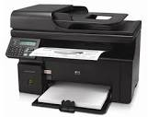





Target Industries: SMB & Distributed Enterprise
Small/Medium Business
Sole Proprietorship/Partnership
High Availability
Backup & Recovery
Storage
Co-located File/Print Servers
Distributed file/print servers
Bought by department
Retail
  Point of Sale for small branch office
Small Remote Locations
Single server presence
Service/Sales Office, Distributed Branch, etc.
Email, virtualization
Franchising
Loosely affiliated
Selective business model
Local Government
  Virtualization
2014 LENOVO INTERNAL. ALL RIGHTS RESERVED.
Notes:
22

Slide 23






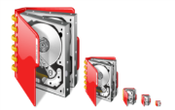
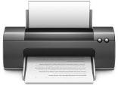

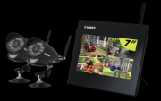
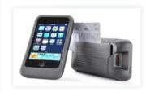
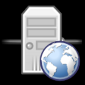
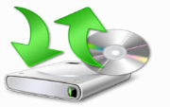

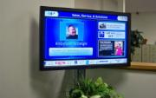
System x3500 M5 Market Segment
Segment
SMB
Education
Medium Retail
Government
Banking
Environment
Home Office
Small Office
Branch Office
Franchise
Rising workload requirements
Limited IT flexibility
Space-constrained IT environment
Server downtime due to low reliability
Lack of IT staff to deploy and manage server solutions
Security and web threats
Regulatory compliance
Pain Point
Workload
File Management
Print Server
Cloud/Virtualization
Virtual Desktop
Mobile POS
Web Server
DATA Backup
CRM
Digital Signage
Enterprise features in all-in-one tower or rack server, balanced with cost
  Flexible storage configurations, including intermix of 2.5” and 3.5” drives on same chassis for tiered storage
  Intel Xeon E5-2600 v3 processors with TruDDR4 Memory
  Titanium PSUs and extended operating temperature ranges for energy savings
  Optional RAID support and GPUs
Industry-leading security and reliability
  Built-in System x Trusted Platform Assurance
  High availability features
Feature
2014 LENOVO INTERNAL. ALL RIGHTS RESERVED.

Slide 24

Top Questions for clients
Do you have servers that are 2-3 years old?
Do you have a distributed environment, remote office, or franchise?
Are you space constrained, and need an all-in-one server for your growing business?
Does security matter to you and your clients? Do you need a solid platform that will safeguard your clients’ data from low level attacks?
Are you concerned about unscheduled server downtime?
Do you need business-class performance for your workloads?
Do you value storage expandability, capacity, and performance?
Do you need to simplify your IT deployment and management?
2014 LENOVO INTERNAL. ALL RIGHTS RESERVED.
Notes:
This is a set of questions you may want to ask clients in order to understand their business needs and dialogue with them prior to introducing the new System x3500 M5 server. It is important to understand clients’ budget, IT skills, and core server requirements.

Slide 25
System x3500 M5 – Answering Client Needs
Client Need | System x3500 M5 Benefits
Protect my business and data | Exclusive, industry-leading System x Trusted Platform Assurance Built-in for secured hardware and firmware platform, plus optional self-encrypting drives with IBM Security Key Lifecycle Management for enterprise data-at-rest protection
Keep my business up & running 24/7 | #1 Reliability Built-in: Industry-leading, proactive diagnostic tools; Redundant, hot-swappable components; & up to 2 RAID adapters for enhanced data protection
Help me save operational costs | Innovative, smart energy efficient features, + more Virtual Machines and workloads
Help me expand my business | All-in-one server that fits desk-side or in a rack. Flexible storage configurations for optimized workload performance with room to grow; performance boost with end-to-end 12Gbps RAID
2014 LENOVO INTERNAL. ALL RIGHTS RESERVED.

Slide 26
System x M5 Servers Give You Flexibility in Ordering
 | M4 Business Critical Servers | M5 Business Critical Servers
Processor Speed | E5-2600 v2, up to 12 cores per CPU | E5-2600 v3, up to 18 cores per CPU
Memory & Memory Speed | Up to 1866 MHz, 768GB | Up to 2133 MHz, 1.5TB
Fans, PSUs, HDDs | Hot swappable fans, PSUs, HDDs | Hot swappable Fans, PSUs, HS HDDs (Optional SS)
Storage Subsystem | HW RAID (no support for HDD/SSD Simple Swap) | No integrated HW RAID (slot avail); direct attached HDD/SSD Simple Swap
Light Path | Optional Advanced LCD Light Path | Optional NextGen Light Path Diagnostic Panel (x3650 M5, x3550 M5)
Slides vs RAIL | Slides (for servicing on rack) | Slides (for servicing on rack)
Cable Management ARM (CMA) | Ship with CMA | Ship with CMA (Optional)
2014 LENOVO INTERNAL. ALL RIGHTS RESERVED.

Slide 27
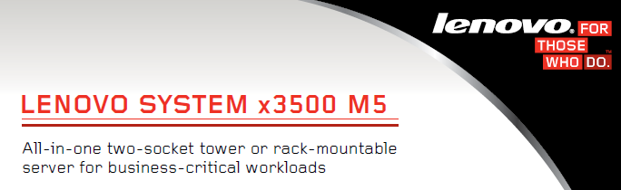
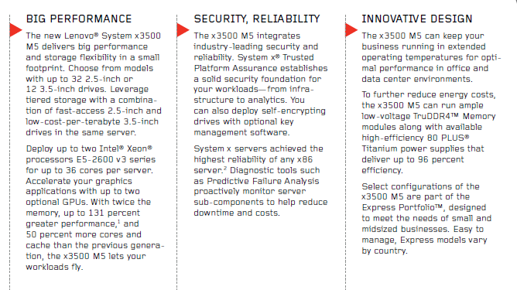
System x3500 M5 Launch Collateral
Data Sheets, Guides, Infographics, Benchmarks
  x3500 M5 Data Sheet Link
  x3500 M5 Product Guide Link
  x3500 M5 Photos (requires MAM access)
  x3500 M5 Blog Post
  x3500 M5 Product Page
  System M5 Servers Infographic Link
  System x3500 M5 Top Benchmark
Education
  System x3500 M5 Sales PW
  M5 Security Overview Link
  M5 Security Deep Dive Link
Product & Solution Presentations
  System x3500 M5 Seller Deck Partnerworld
  System x3500 M5 Client Deck Partnerworld
  System x3500 M5 Proposal Summary PartnerWorld
  M5 Messaging Seller Deck
  M5 Messaging Client Deck Partnerworld
  M5 Overview Client Deck Link
  High Volume Portfolio Overview
  System x 1P & 2P Technical System Overview Deck
  System x M5 Security Overview
  System x M5 Security Seller Deck
  System x M5 VITO Letter Partnerworld
  System x M5 Quick Proposal
  Migrate to System x M5 Sales Play Seller Presentation Partnerworld
Sales Kits & Selling Focus
  x3500 M5 QRG Partnerworld
  x3500 M5 Selling Focus Partnerworld
  x3500 M5 eContact PartnerWorld
2014 LENOVO INTERNAL. ALL RIGHTS RESERVED.
Notes:
I’ve provided you with resources that you can leverage at your leisure for accessing more information on the System x3650 M5 and x3550 M5 servers, including presentations, sales plays, sales kits, videos, white papers, analyst papers, product guides, and web pages.

Slide 28

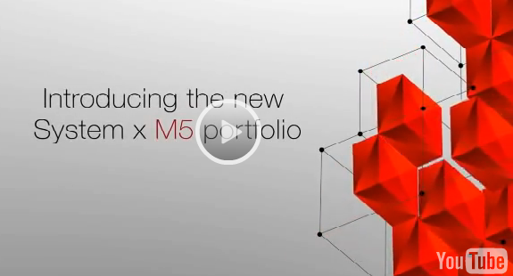
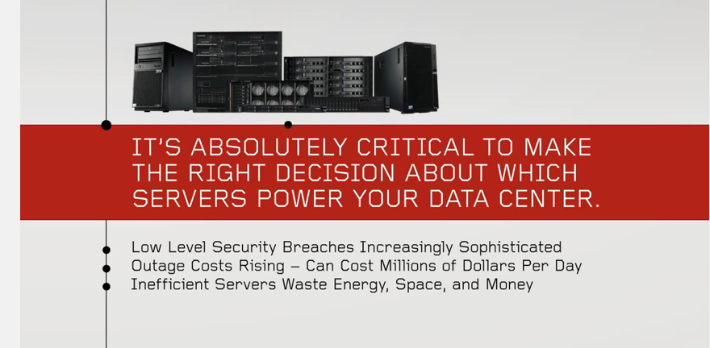
System x3500 M5 Launch Collateral
White Papers & Analyst Papers
  Next Gen Diagnostic Panel
  Why System x 2014
  Energy Efficiency White Paper
  ESG: Big Data & Analytics
  ESG: Cloud
  IDC: Security for System x
Product Pages
  High Volume Landing Page Link
  System x3500 M5 Link
  Videos
  New System x M5 Sparkler Video Link
  Better Future, Faster with System x Link
  System x3500 M5 Product Video
  System x3500 M5 Walkthrough Video
  System x3500 M5 3D Virtual Tour
  System x Beats Cisco Competitive Video Link
  System x Beats HP Competitive Video Link
  System x Beats Dell Competitive Video Link
2014 LENOVO INTERNAL. ALL RIGHTS RESERVED.

Slide 29
Footnotes
¹ Intel Xeon E5-2600 v3 processors support up to 18 cores and 45MB cache, versus 12 cores and 30MB cache on Intel Xeon E5-2600 v2 processors
² Indicates an increase from 768GB with Intel Xeon E5-2600 v2 processors to up to 1.5TB with Intel Xeon E5-2600 v3 processors
³ Internal measurements as of June 2014 for representative Java-based workloads, Intel Xeon E5-2699 v3 (18C, 2.3GHz, 145W) vs Intel Xeon E5-2697 v2 (12C, 2.7GHz, 130W)
⁴ Internal measurements as of June 2014 for representative database workloads, Intel Xeon E5-2699 v3 (18C, 2.3GHz, 145W) vs Intel Xeon E5-2697 v2 (12C, 2.7GHz, 130W)
⁵ Internal measurements as of June 2014 for representative computational workloads, Intel Xeon E5-2699 v3 (18C, 2.3GHz, 145W) vs Intel Xeon E5-2697 v2 (12C, 2.7GHz, 130W)
⁶ Internal measurements as of July 2014 for representative virtualization workloads, Intel Xeon E5-2697 v3 (14C, 2.6GHz, 145W) vs Intel Xeon E5-2697 v2 (12C, 2.7GHz, 130W)
⁷ Internal measurements as of June 2014 on Mayan City CRB with one E5-26xx v3 (14C, 2.3GHz, 145W), 8x4GB DDR4-1600, RHEL kernel 3.10.18, PCPS on 110W, PCPS off 70W on an internal web workload.
⁸ Source as of April 2014: Internal measurements on platform with two E5-2697 v2, 8x8GB DDR3-1866, NUMA, HT enabled, Turbo disabled, RHEL6.3, IC12.0, score: 101.2 GB/s. Platform with two E5-2697v3 (14C, 2.6GHz, 145W), HSW-C0 QGEF, BIOS 27.R01, Prefetchers Enabled, HT enabled, Turbo enabled, NUMA & COD mode, 8x16GB DDR4-2133, IC14.0
⁹ 45% claim based on internal measurements of DIMM energy consumption with 16GB, 2Rx4, 1.5V, DDR3 1866MHz RDIMM at 3 DPC compared with 16GB, 2Rx4, 1.2V, DDR4 2133MHz RDIMM at 3 DPC.
¹⁰ x3650 M5 supports up to 26 x 2.5” drive bays versus 16 x 2.5” drive bays on the x3650 M4
¹¹ Based on internal measurements of NeXtScale M5 Water Cooled system vs. NeXtScale M5 (air cooled) system
¹² LRZ, a client in Germany DC numbers
¹³ Source: Internal measurements as of August 2014. Baseline Configuration on Server Virtualization Benchmark: Intel® Server Board S2600CP with two Intel® Xeon® Processor E5-2697 v2, 16x32GB DDR3-1600 QR LR-DIMM, VMWare ESXi* 5.5 GA, relative performance: 1.0. New configuration: Intel® Server Board S2600GZ with two Intel® Xeon ® Processor E5-2699 v3, 16x32GB DDR4-2133 QR LR-DIMM, VMWare ESXi* 5.5 GA, relative performance: 1.6.
¹⁴ SAP Benchmark Council regulations. System x3650 M5 with two Intel Xeon Processors E5-2699 v3 running at 2.3GHz with 45 MB L3 cache per processor, 256 GB memory, 64-bit DB210, Microsoft Windows Server 2012, and SAP Enhancement Package 5 for SAP ERP 6.0. vs baseline x3650 M4 with 2 processors/24 cores/48 threads, Intel Xeon E5-2697 v2, 2.7- GHz, 64 KB L1 cache & 256 KB L2 cache per core, 30MB L3 cache per processor, 256 GB main memory

Slide 30

Notes:
30

